Slide 1
Engineering Workshop Quick RHIC Intro
Roland Wimmer BNL
May 10, 2023

Slide 2
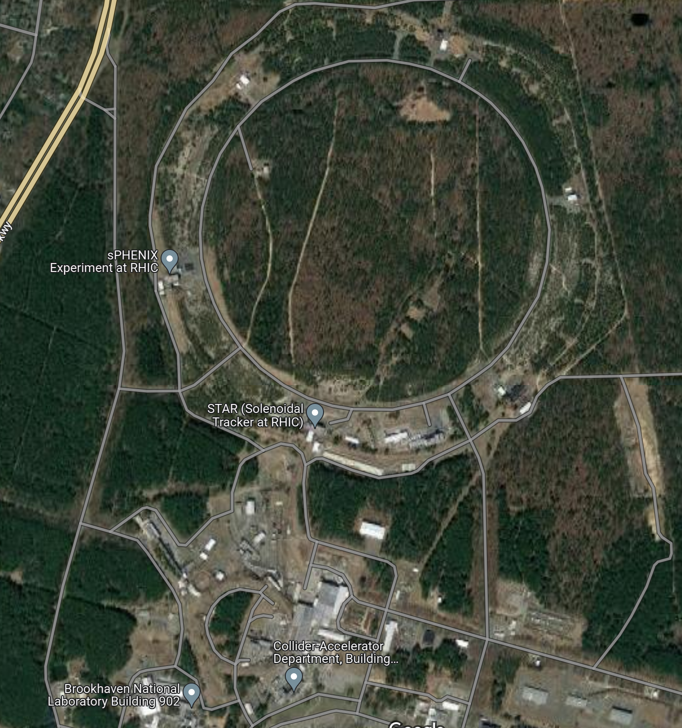
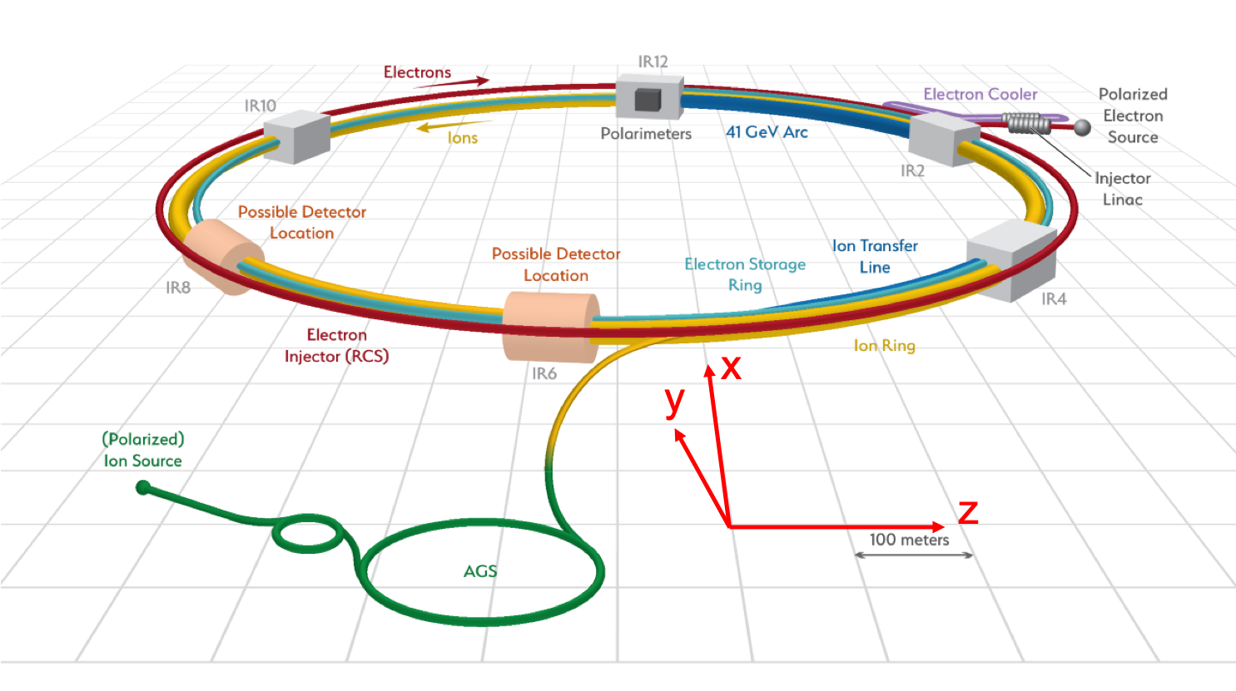
RHIC Overview
IR 12
IR 10
N
6 IRs around the ring at different clock positions
For EIC electrons will travel clockwise and hadrons will travel counterclockwise
At IP6 the Electron going direction is West and the Hadron going direction is East
IR 2
IR 8
IR 4
IR 6

Slide 3
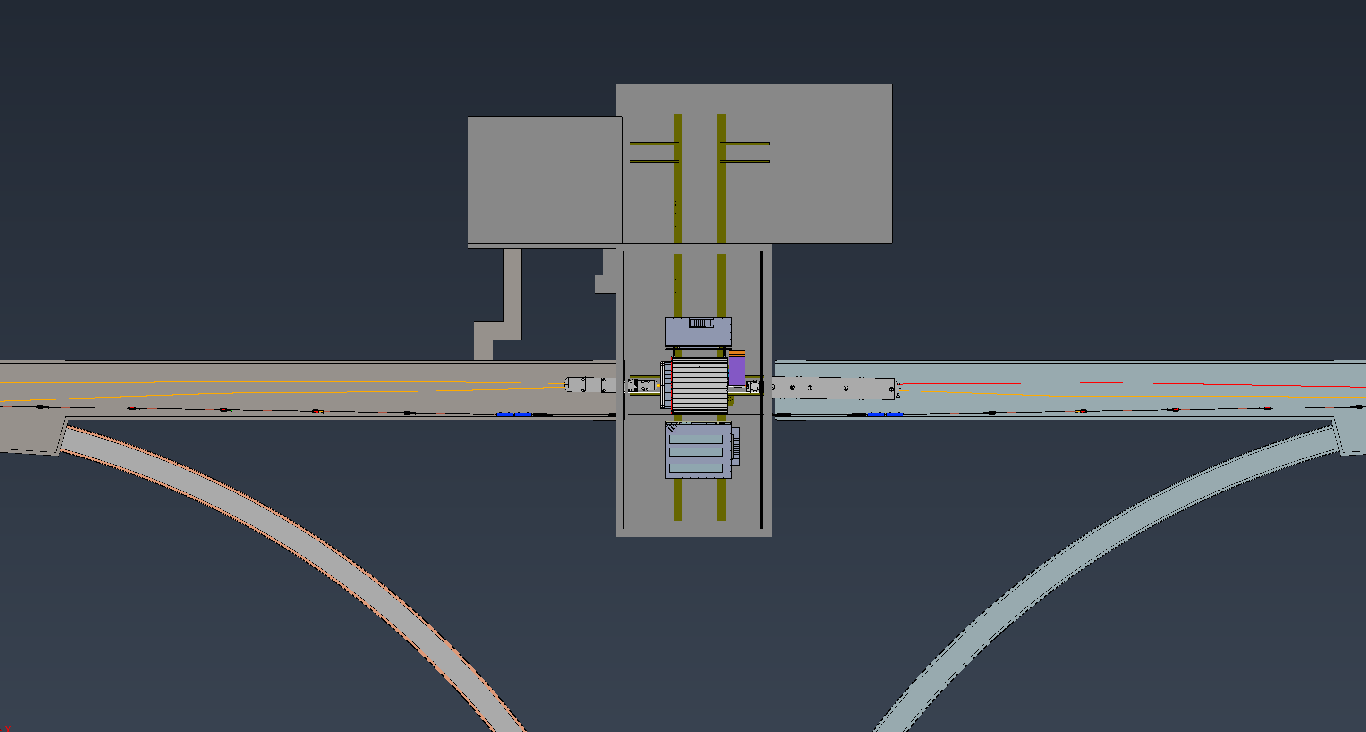
Building 1006 Overview
BLDG 1006
N
Assembly Hall
Interaction Region
Ring Inside
Ring Outside
Electron (Lepton) End
Hadron End

Slide 4
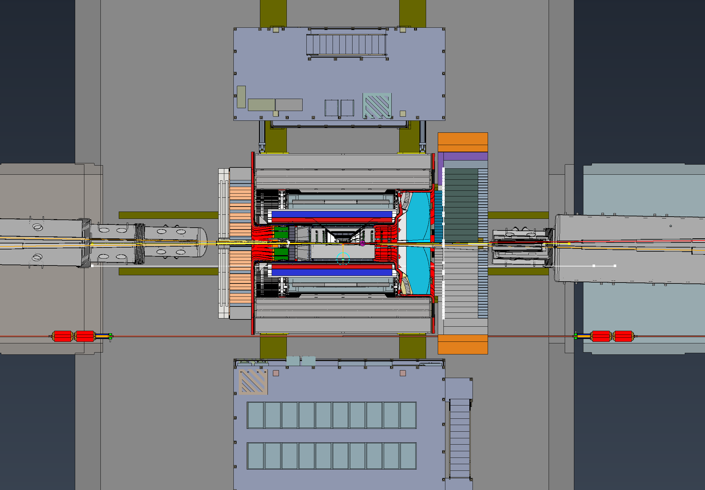
IR Beam Directions
West
East
Red is Electron
Blue is Hadron

Slide 5
IR Coordinates
Blue is Positive Z Axis
West
East
Red is Positive X Axis

Slide 6
Backups

Slide 7
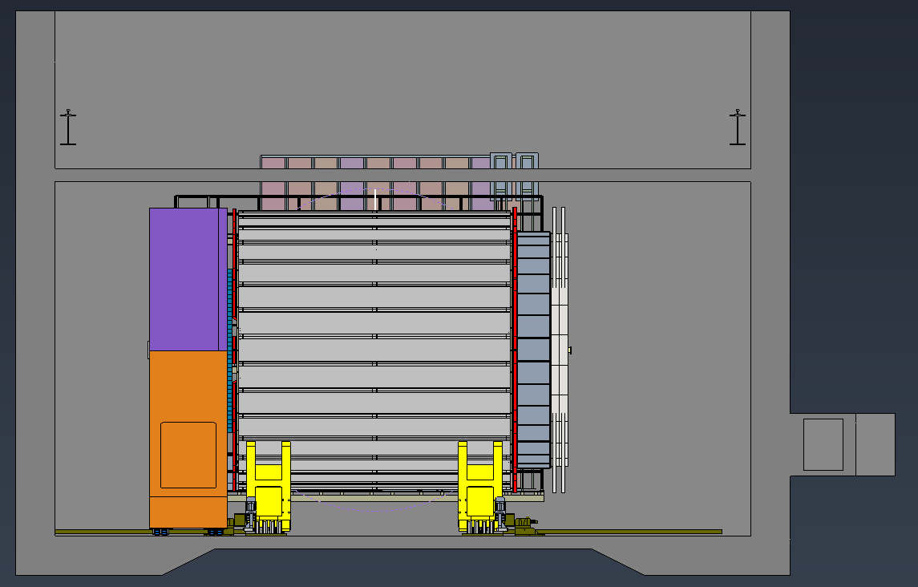
Sideview

Slide 8
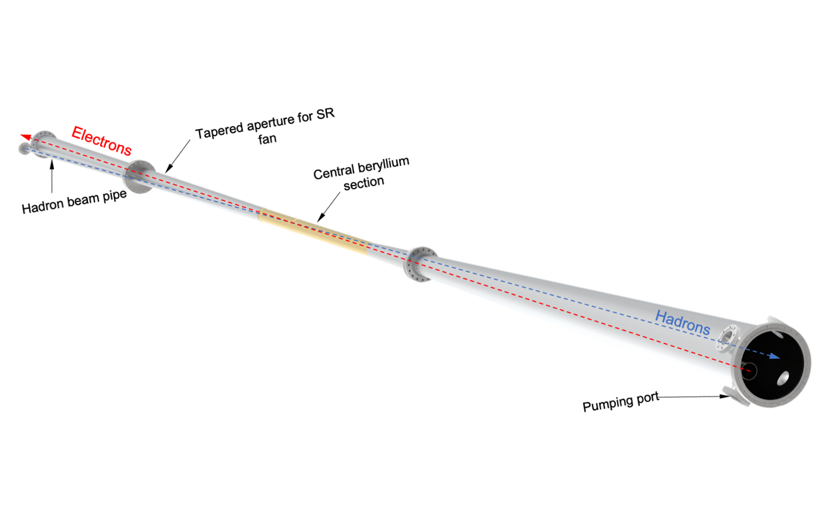
Beampipe

