Slide 1
Detector Integration and Design Engineering Workshop
Rahul Sharma (BNL)
Chief Mechanical Engineer - L3
May 10 – May 12, 2023

Slide 2
Outline
About Me
EPIC Infrastructure and Integration Team
Detector Overview
In Kind/Reused Items - Detector Cradle, Platforms, Barrel HCAL and Flux Return Bars
Status of CAD Models:
Flux Return Bars
HCAL
Superconducting Magnet
Barrel EMCAL
DIRC
Inner Detectors EEEMCAL, pfRICH/mRICH, Silicon Detectors
dRICH
Cable Layout and Management
Long lead time Procurement Items
Next Steps
Questions

Slide 3
About Me
Rahul Sharma
Chief Mechanical Engineer for ePIC
Responsible for WBS 6.10.10 : Infrastructure and Integration for ePIC detector.
Education : MS (Mechanical Engineering) - 2007
15+ years of Experience
Working at BNL since 2009 on following:
DUNE (Deep Underground Neutrino Experiment): Started as Staff Engineer in 2009, worked on Water Cherenkov Detector Design.
Worked as Senior Engineer on TPC (Time projection Chamber) for DUNE detector. Designed and Built Field Cage for TPC for protoDUNE at CERN.
STAR (Solenoid Tracker at RHIC): Worked as Integration Engineer and then Chief Engineer on various major upgrades for STAR detector (Heavy Flavor Tracker, TPC Upgrade, Forward Upgrade). Also managing STAR Technical Support Group.
For ePIC I’m managing Integration and Infrastructure Group. My group is responsible for designing and building new infrastructure, modifying/repurposing existing infrastructure and Integration of various subdetectors for construction of ePIC detector.

Slide 4
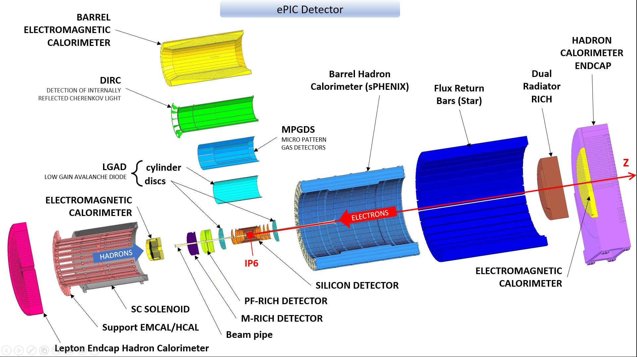
Detector Overview

Slide 5
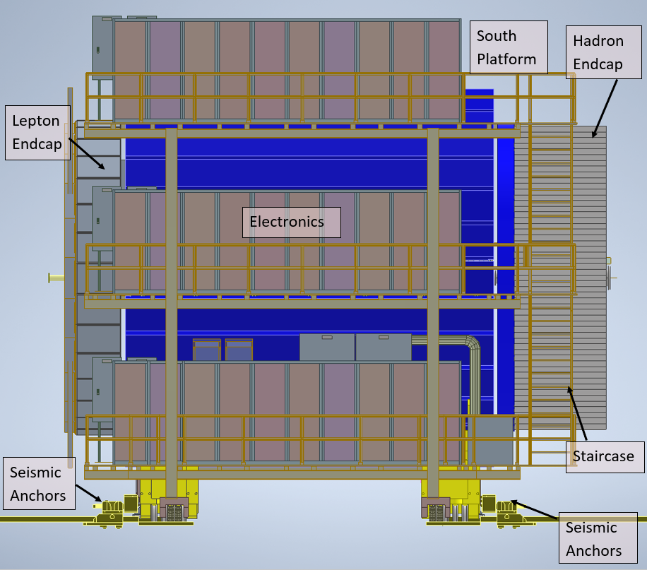
In Kind/Reused Items
We reuse infrastructure from existing detector (STAR) in 1006.
North and South Platform for STAR will be modified and used for EPIC. Modifications needed to clear the path for opening of End Caps.
Barrel HCAL and Flux Return Door on Lepton Endcap will be reused from sPHENIX.
Existing Seismic Anchors will also have to be repositioned
Plan on using same pistons and moving mechanism from STAR.
New Hydraulic Control Units will be needed for moving End Caps and Detector.

Slide 6
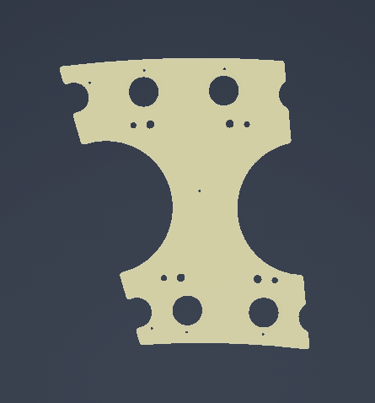
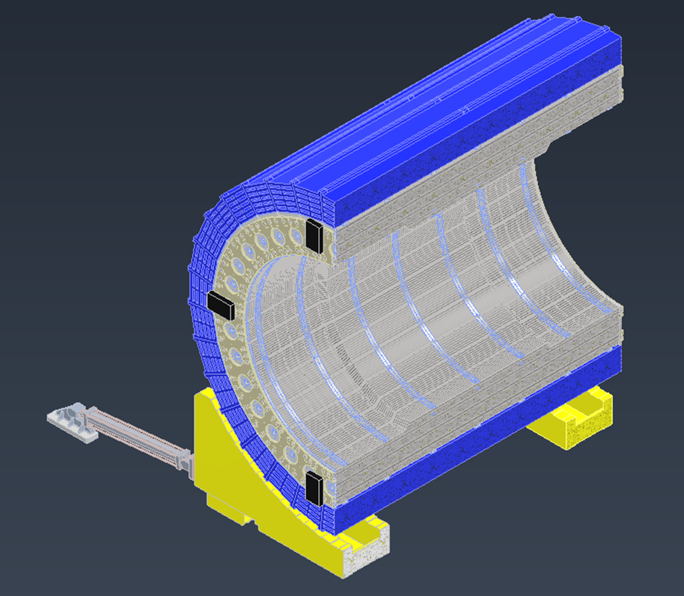
Status of Models (HCAL & Carriage)
Barrel HCAL:
Using the sPHENIX HCAL model
sPHENIX dog-bones are being used as partial supports on the ends
Working on inner support rings, will most likely be combined with the barrel EMCAL support
New Flux Return Bars will be needed as STAR flux return bars are too heavy.
Barrel Carriage:
Using the existing STAR Cradle as a base for ePIC
sPHENIX support web models were trimmed to fit onto the STAR carriage
STAR Flux Return Bars
Dog-Bone
sPHENIX HCAL
STAR Cradle
Support Webs

Slide 7
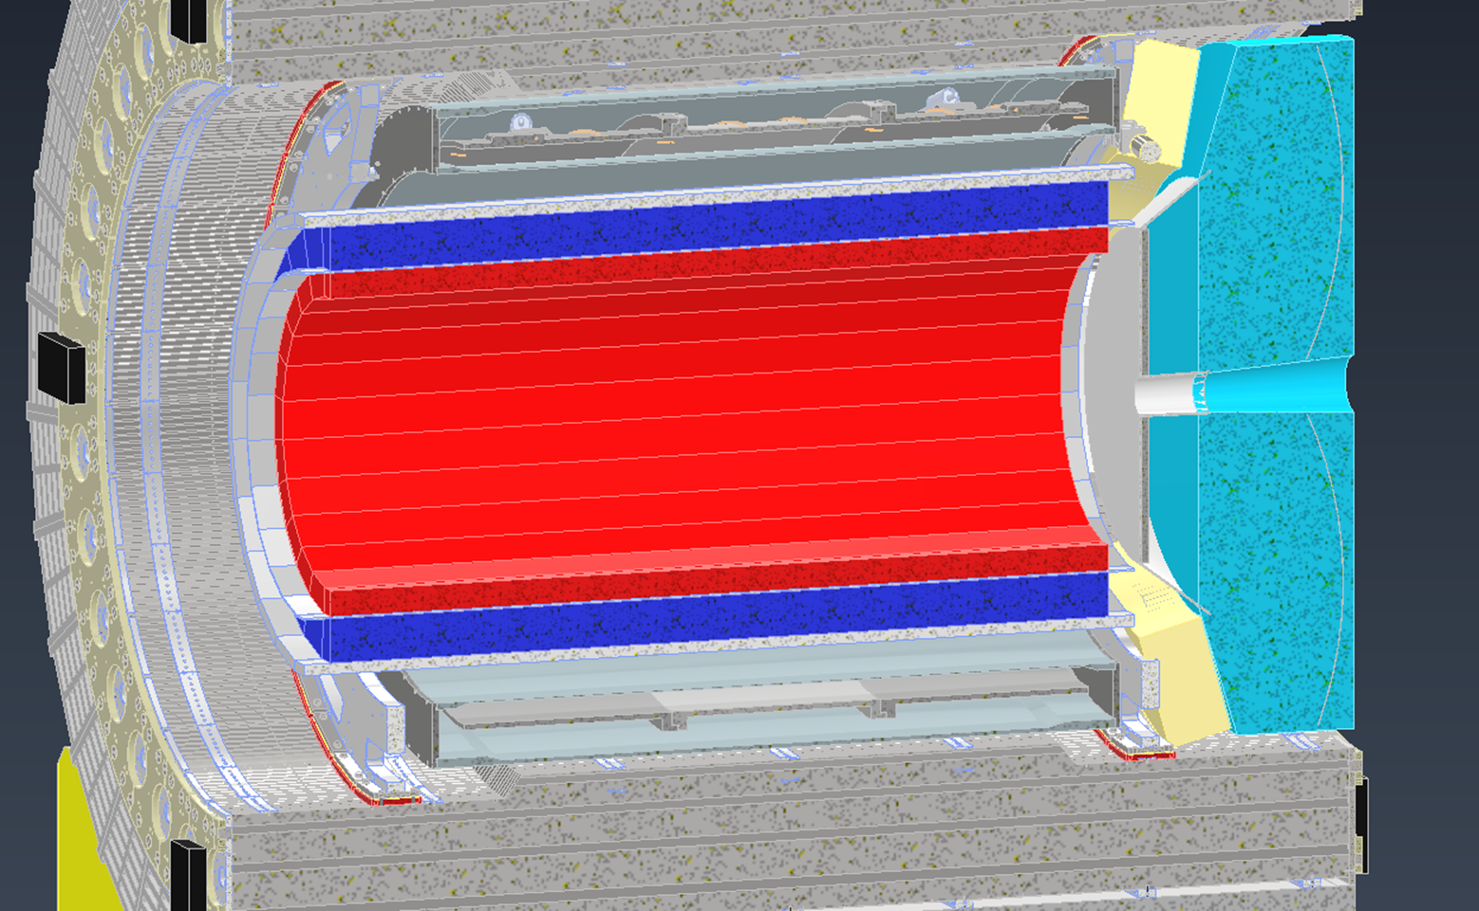
Status of Models (Detectors)
Barrel EMCAL
Solenoid
dRICH
Solenoid – Conceptual Model with right space envelope exists. Waiting for updated preliminary model from Magnet Group.
Sci-Glass/Imaging EMCAL – Conceptual Design Model with significant Details. Waiting for technology decision to work further on Integration and Installation details.
dRICH – Detector Envelope Identified. Working with subgroups on how to support the detector.
Outer MPGDs – Detector Envelope is identified and working on Preliminary Design.
DIRC – Space Envelope is identified and conceptual design for support structure exists as shown. Preliminary design and analysis to follow.
EEEMCAL – Detailed Preliminary Model.
mRICH/pfRICH – Conceptual model exists. Waiting for technology decision to figure out integration and Installation details.
Barrel HCAL
AC-LGAD – Conceptual model exists. Support structure needs to be developed once dimensions are supplied.
Inner MPGDs - Detector Envelope is identified and preliminary design is being worked on.
Silicon Vertex & Sagita Silicon - Detector Envelope is identified and preliminary design is being worked on.
Si Disks - 10 Disks are currently in place, spacing and support needs to be updated
pfRICH
MPGDs
AC-LGAD
EEEMCAL
Silicon Trackers
Beampipe
HP DIRC
Si Disks

Slide 8
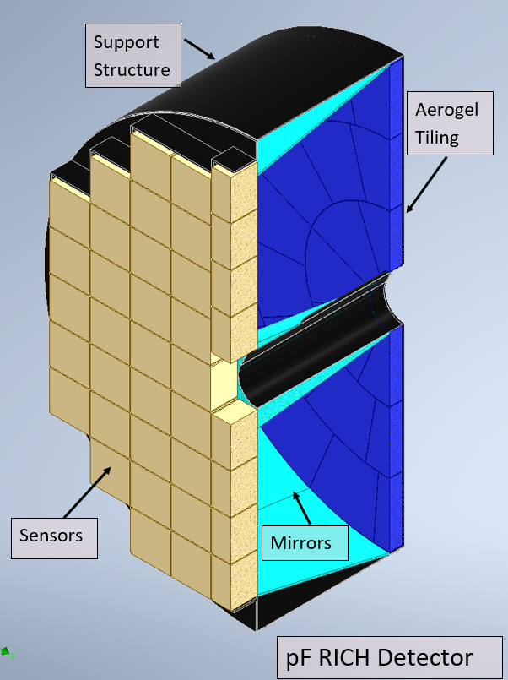
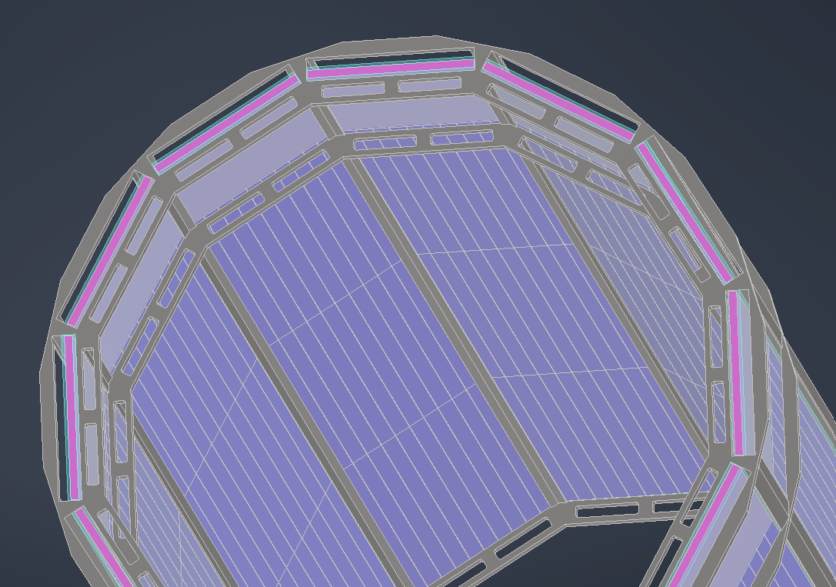
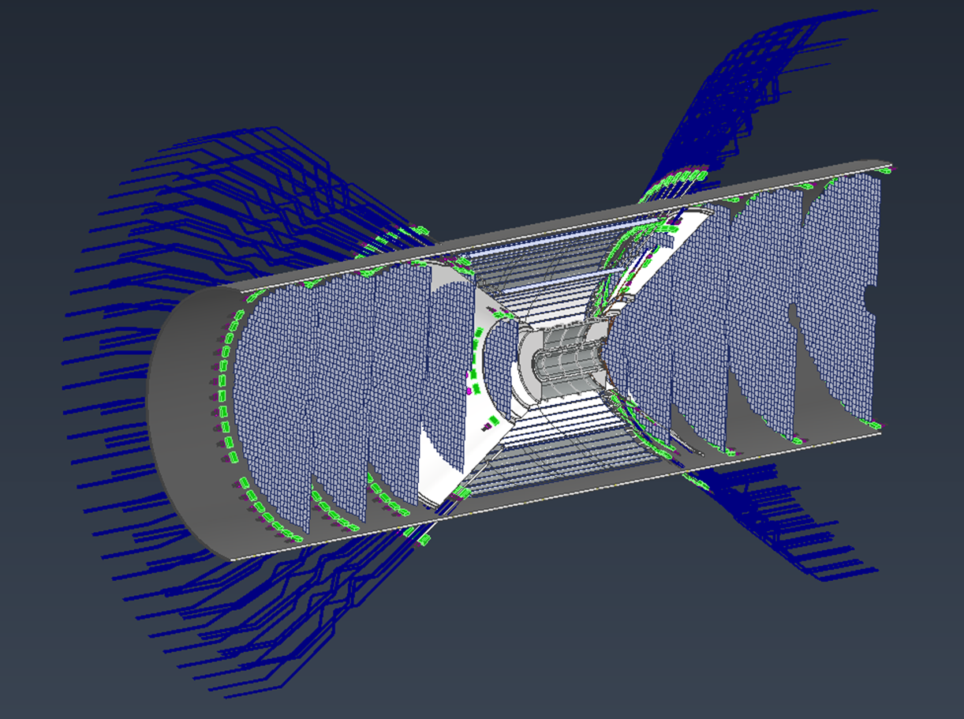
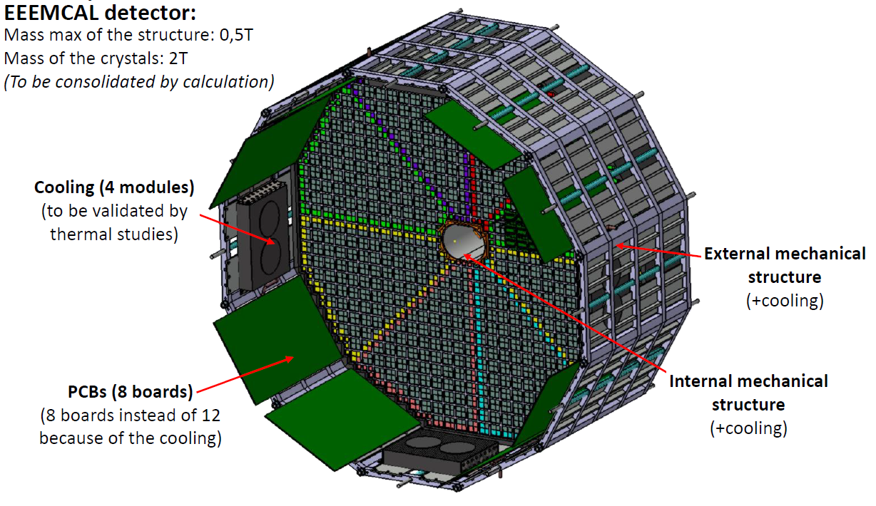
Status of Models Inner Detectors (Details)
Details for DIRC, Si Detectors, pf RICH and EEEMCAL as shown:
DIRC Barboxes
Gap for MPGDs
Cutouts for Cables
Si Disks
Si Trackers
Cables and Services

Slide 9
Barrel EMCAL (Imaging)

Slide 10
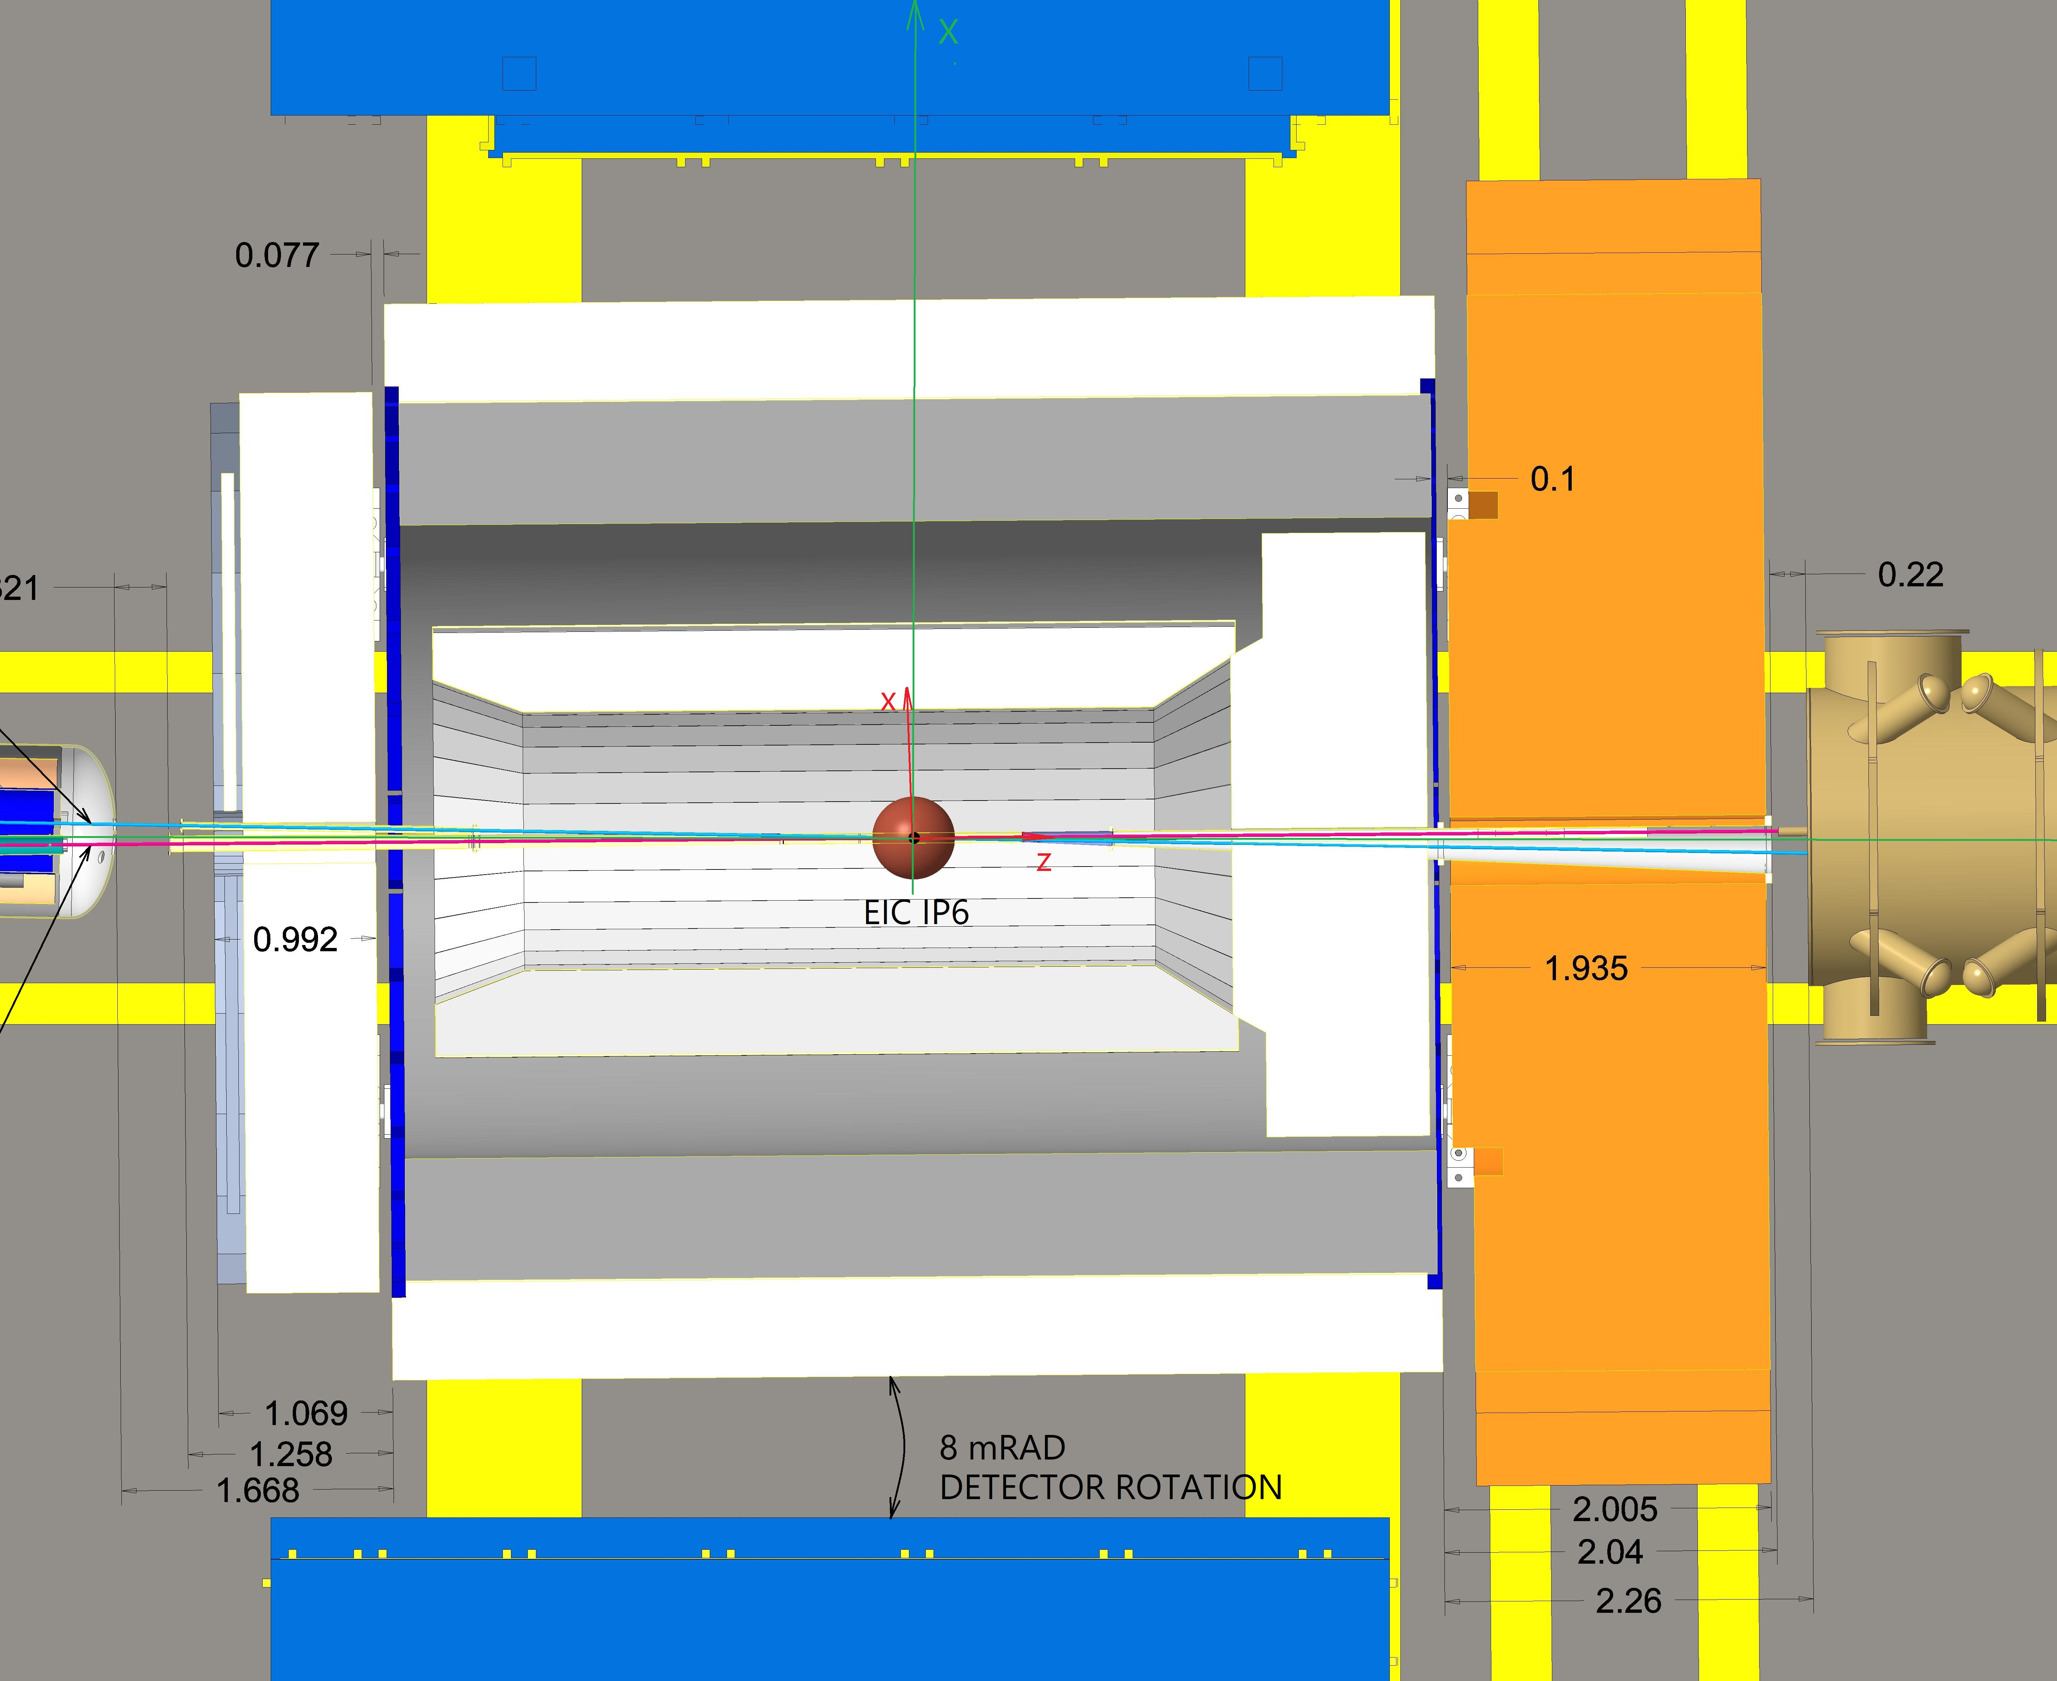
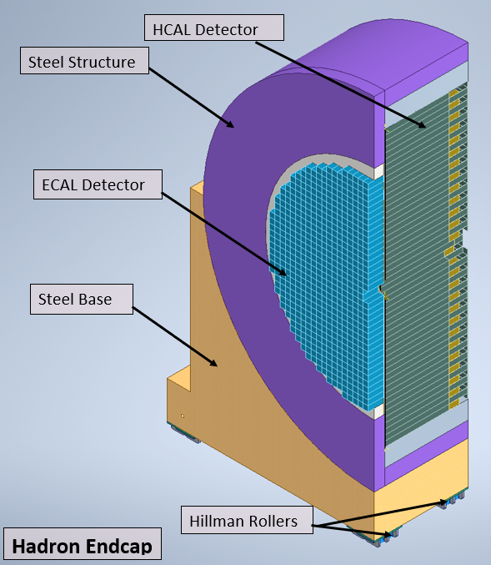
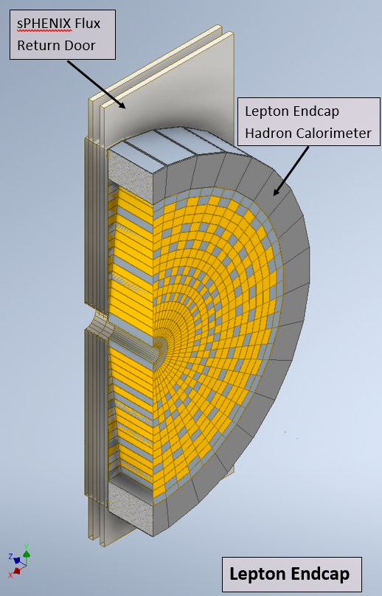
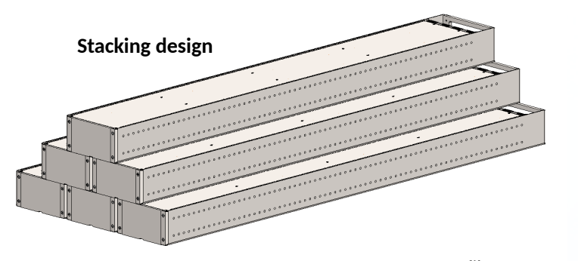
Status of Models (Endcaps)
End Cap Structures accommodate HCAL and EMCAL Detectors
End Caps will be designed as two halves with a vertical split that will allow opening of End Caps for maintenance of detectors in the Barrel
Following Design and Analysis tasks need to be completed as next steps:
Seismic Analysis
Analysis of Magnetic Forces
Pinning/Securing of HCAL/EMCAL detector Blocks
Design of Rails for Endcaps
Design of Guiding Mechanism for Endcaps
North and South Platform Modifications to resolve interference issues
Lepton Endcap – Model is a combo of the sPHENIX flux return endcap and the ePIC HCAL

Slide 11
Long Lead Time Items
Conceptual design of following long lead items given priority:
1) Backward EEEMCAL
2) Forward Endcap HCAL

Slide 12
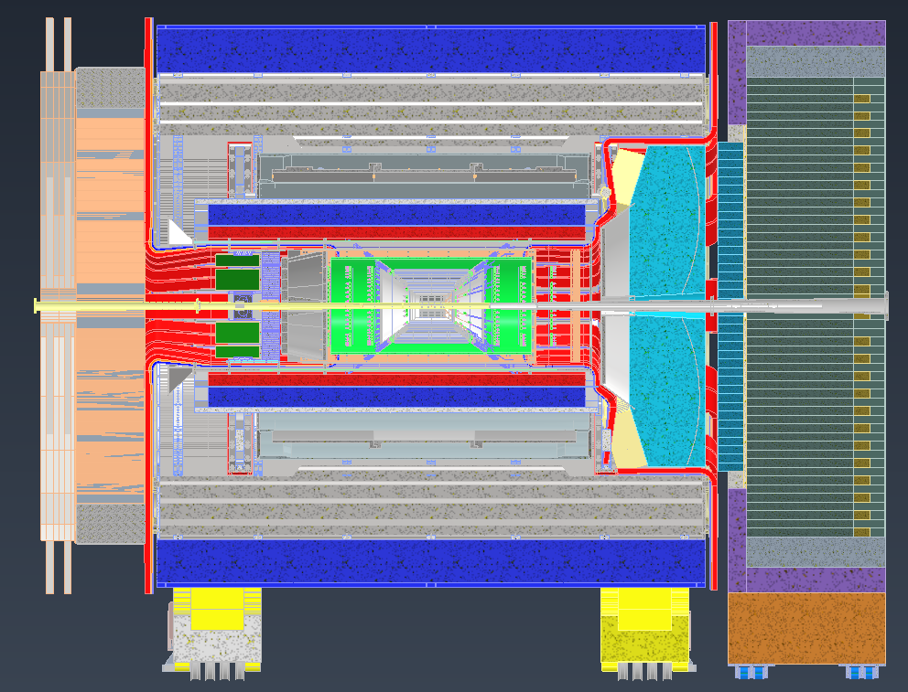
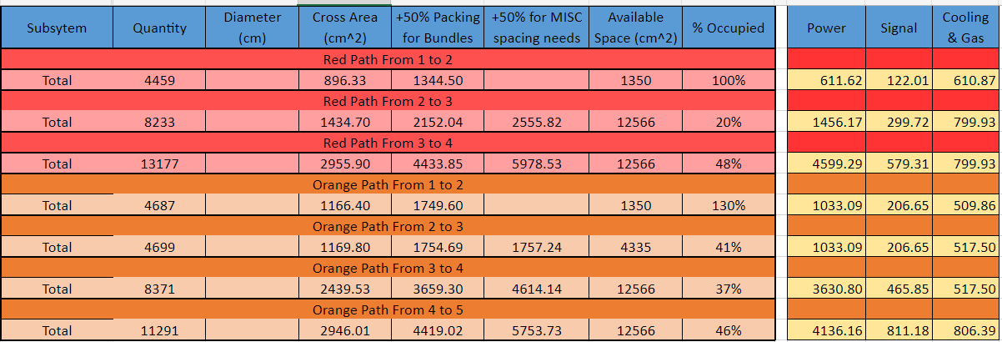
Cable Layout and Management
4
5
3
4
Gathered service estimates from detector groups
Laid out 2 common paths (red and orange) for service routing
Determined locations of bottlenecks
Calculated service bundle volumes at bottleneck locations
Totals for services passing from one point to the next are shown below
Point 1 to 2 on each side needs more space allocated
3
2
1
1
2

Slide 13
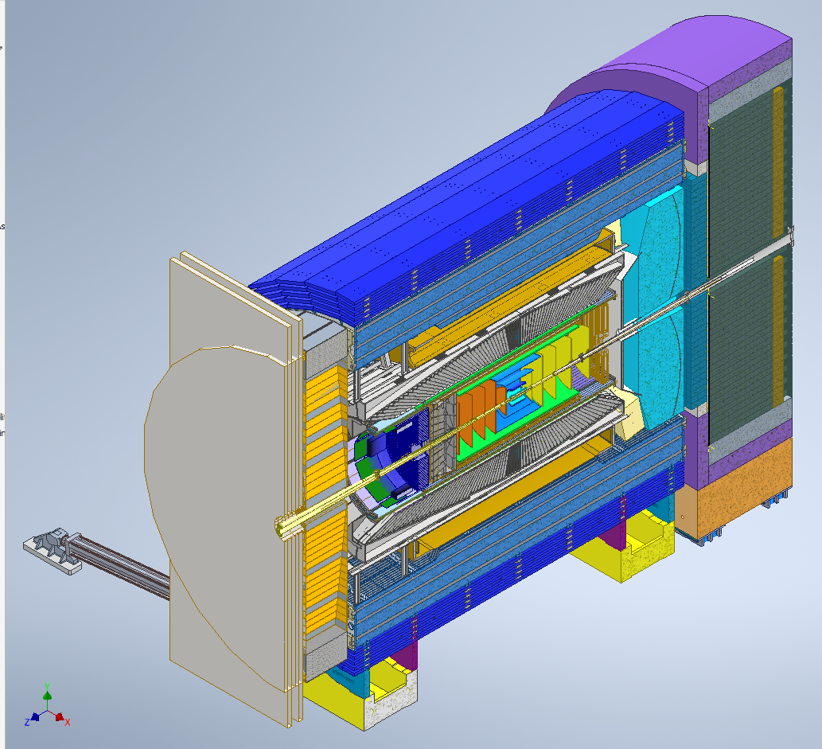
Next Steps
Cable Management Scheme needs to be further developed.
Support Structure models need to be developed further and analyzed.
Long Lead Items will be prioritized in Conceptual and Preliminary design.
Cooling requirements of various detectors need to developed further and need conceptual design of cooling systems/ductwork etc.
As design progresses, Integration documents clearly defining responsibility of each subgroup and interface points will be developed.
Engineering requirements for precision, tolerancing, materials properties etc. will be developed.
Testing Plans for support structures and quality assurance and Inspection plan of the materials used in EPIC detector, subdetectors and their support structures.
Engineering and Material Standards to be identified.
Increase the frequency of Engineering meetings with various subgroups.

