Slide 1
Systems Engineering for the EIC Detector
ENGINEERING SCOPE, REQUIREMENTS, & INTERFACES
Walt Akers, Systems Engineer
Thomas Jefferson National Accelerator Facility

Slide 2
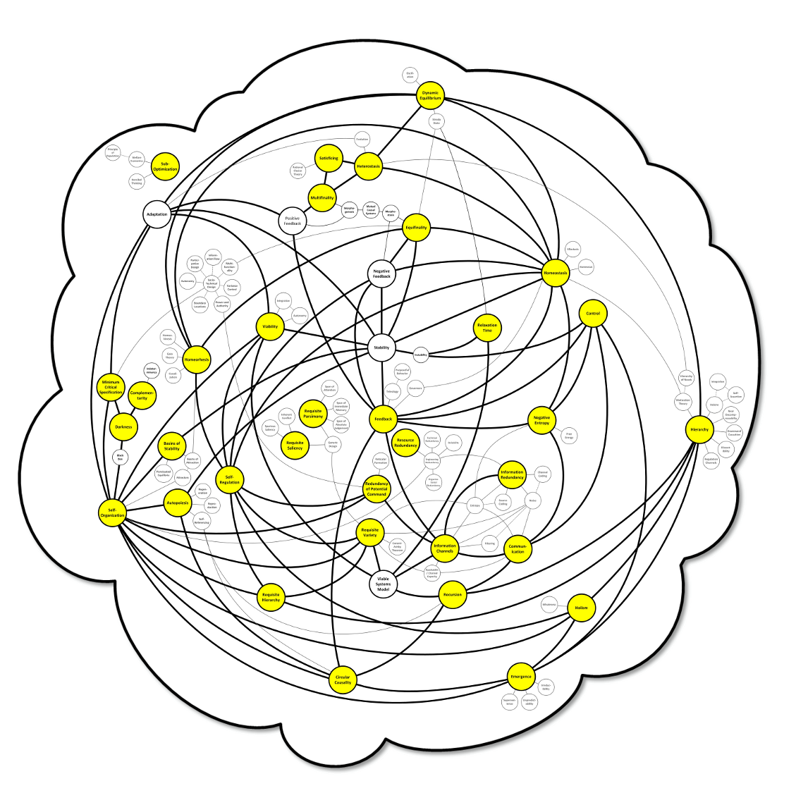
General Systems Engineering
Systems Engineering
In general, Systems Engineering is a branch of General Systems Theory and it is made up of many, many disciplines.
Systems Engineering provides the foundation for many of the approaches that we use today, including:
Project Management,
Quality Engineering,
Risk Management,
Process Engineering,
Change Management, etc.
At this stage in the EIC project, our most important considerations will be:
Scope Definition
Defining what our system is, what it will do, and what will be part of it.
Requirements Definition
Defining the general, function and performance requirements for our system and sub-systems.
Interface Development
Specifying how our systems will interconnect with one another and the external environment.

Slide 3
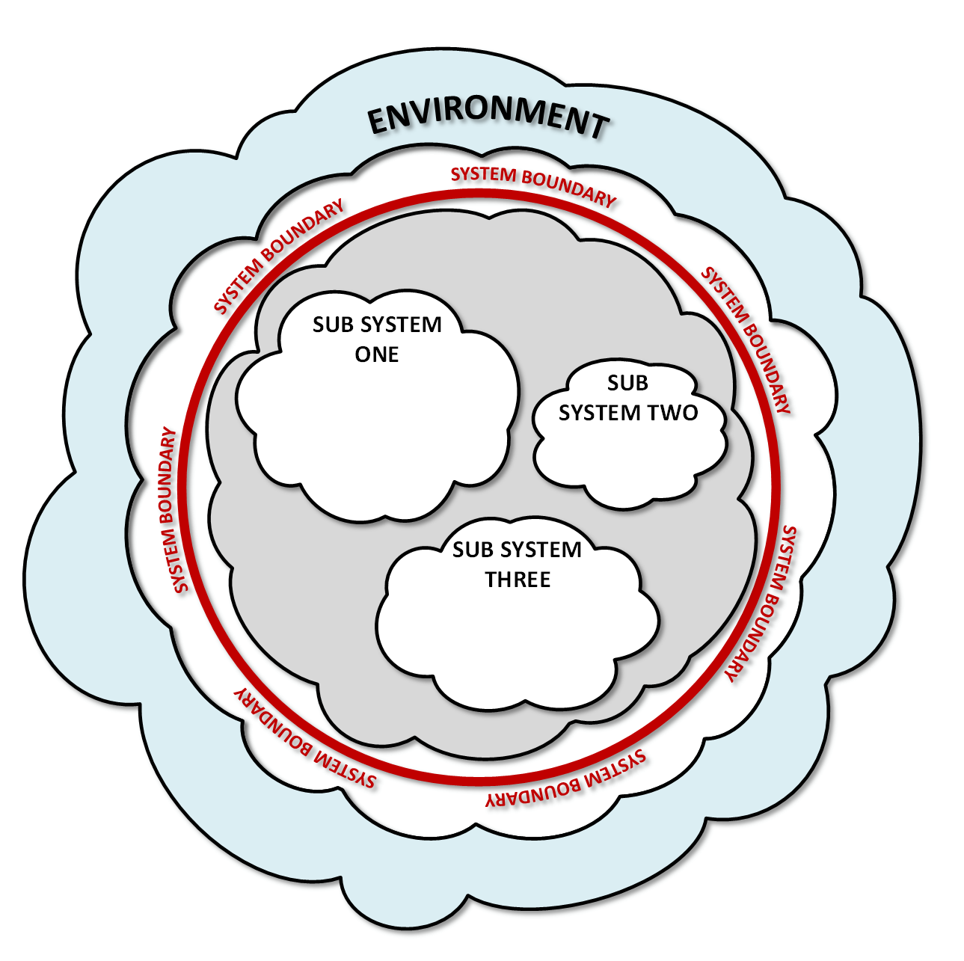
General Systems Engineering
Scope Definition
In Systems Engineering terms, scope definition is framing your system to determine the boundary between what is part of the system… and what is not.
The Environment
Everything outside of your system’s boundary is in the environment. You cannot necessarily control the environment, but you must accommodate it and coordinate with it to share resources.
The System
Everything inside your system’s boundary is part of your system – a collection of related entities that work together to achieve a function or purpose.
Systems Are Recursive
The complete Electron Ion Collider can be considered a single large system that consists of the detector, the electron storage ring, and other sub-systems.
Likewise, the detector can be considered a single system consisting of hadron calorimeters, electron calorimeters, trackers, and particle identifiers.
The way you bound your system depends on the problem you’re trying to solve.

Slide 4
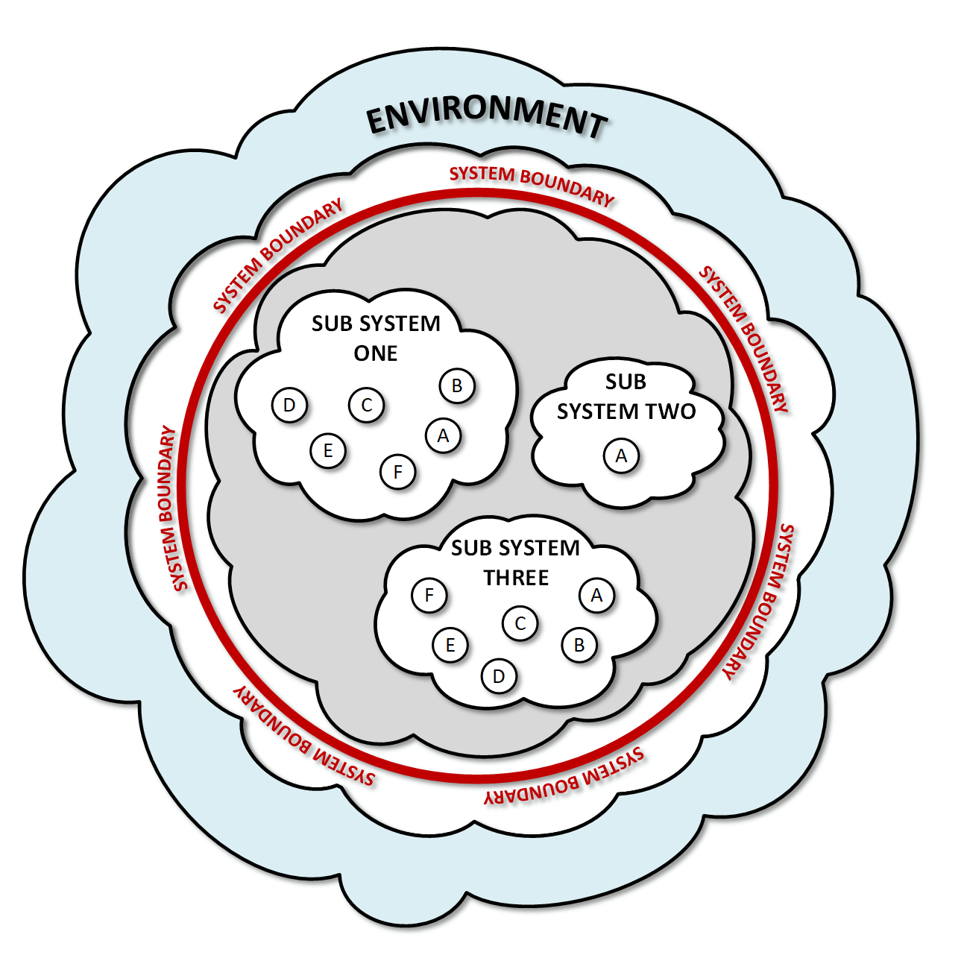
Requirements Development
Requirements Definition
As part of our requirements gathering process, a hierarchy of requirement categories has been established.
General Requirements What is it?
These are the highest level requirements that define the function or purpose of the sub-system with respect to the overall system.
Functional Requirements What does it do?
These requirements identify the features and capabilities that the sub-system must have in order to satisfy its general requirements AND what features it requires from other systems.
Performance Requirements How well does it do it?
These requirements quantify the performance levels that must be met by the sub-system AND from the systems that support it. These requirements provide the minimal critical specification¹ that the engineering staff will use to design the system.
¹ The minimum set of core requirements with which an operable unit can produce a satisfactory result without external control of its internal functions. (Herbst, Socio-Technical Design, 1974)

Slide 5
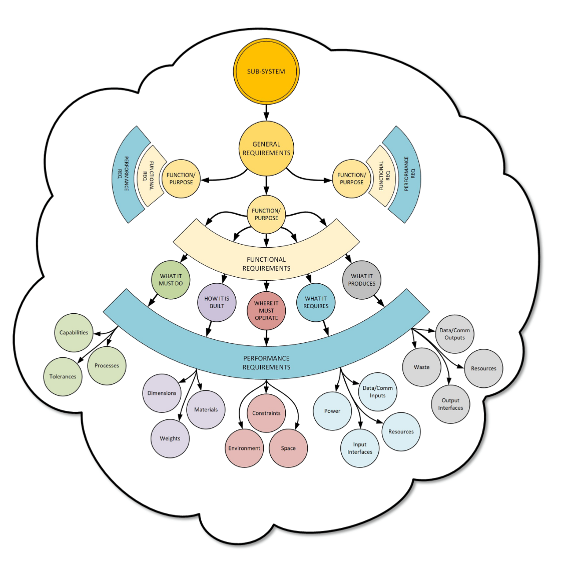
Requirements Development
Requirements Hierarchy
All requirements exist within a hierarchy and should have traceability from top to bottom; i.e. no orphaned requirements.
Requirements become more specific as they proceed from General to Performance, but they should not include specifications, implementation details or design decisions that are in the domain of the system implementers.
The requirements should be concise, and definitions should be limited to a single concept.
The complete set of requirements should identify all of the conditions that must be met for the system to operate… and as long as the implementers satisfy all of those conditions, regardless of their approach, the final system should work.

Slide 6
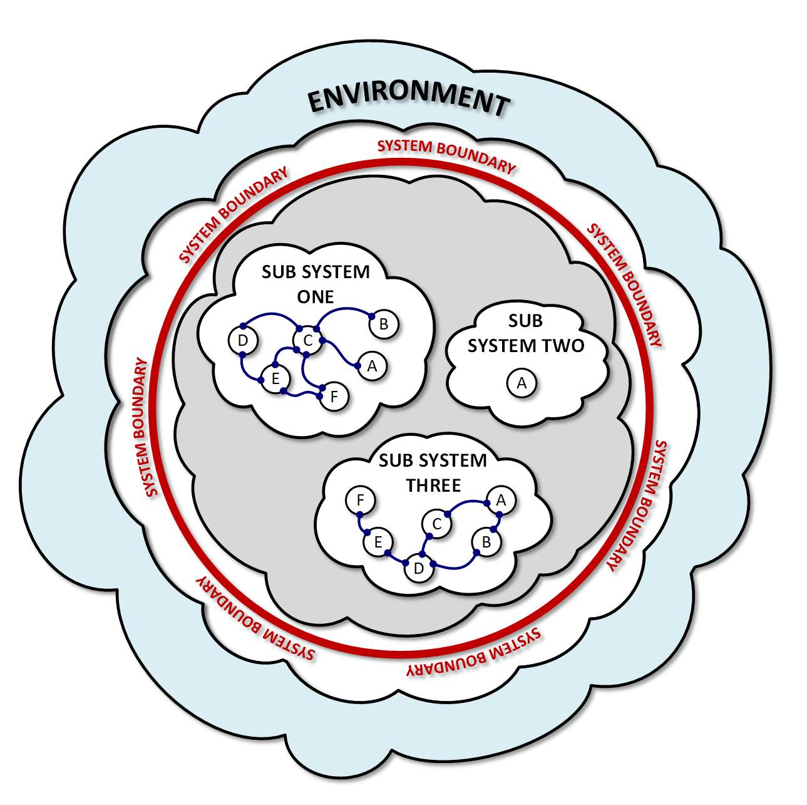
Systems Integration
Systems Integration
Systems integration is the process of coordinating the interfaces, interferences, and interactions between sub-systems and their environment to achieve operability.
Interfaces:
the connections and conduits (input/output) between a sub-system and other entities.
Interferences:
the limiting factors within the assembled system (and its environment) that constrain the sub-systems.
Interactions:
emergent conditions that arise from the operation (or coexistence) of multiple sub-systems in the operating environment.

Slide 7
Systems Integration
Inward Facing Interfaces
Inward facing interfaces are the connections that exist entirely within a sub-system and are used to exchange material, energy, information or support internally. They have the following characteristics:
Encapsulated:
Internal interfaces connect devices and components that exist entirely within a single sub-system.
Independent:
Internal interfaces function independently from external entities. As long as they continue to satisfy their requirements, any changes to these interfaces should not impact the higher system.
Private:
The design and implementation of internal interfaces are private to the sub-system. The higher level system does not need to know about the configuration or existence of these interfaces.

Slide 8
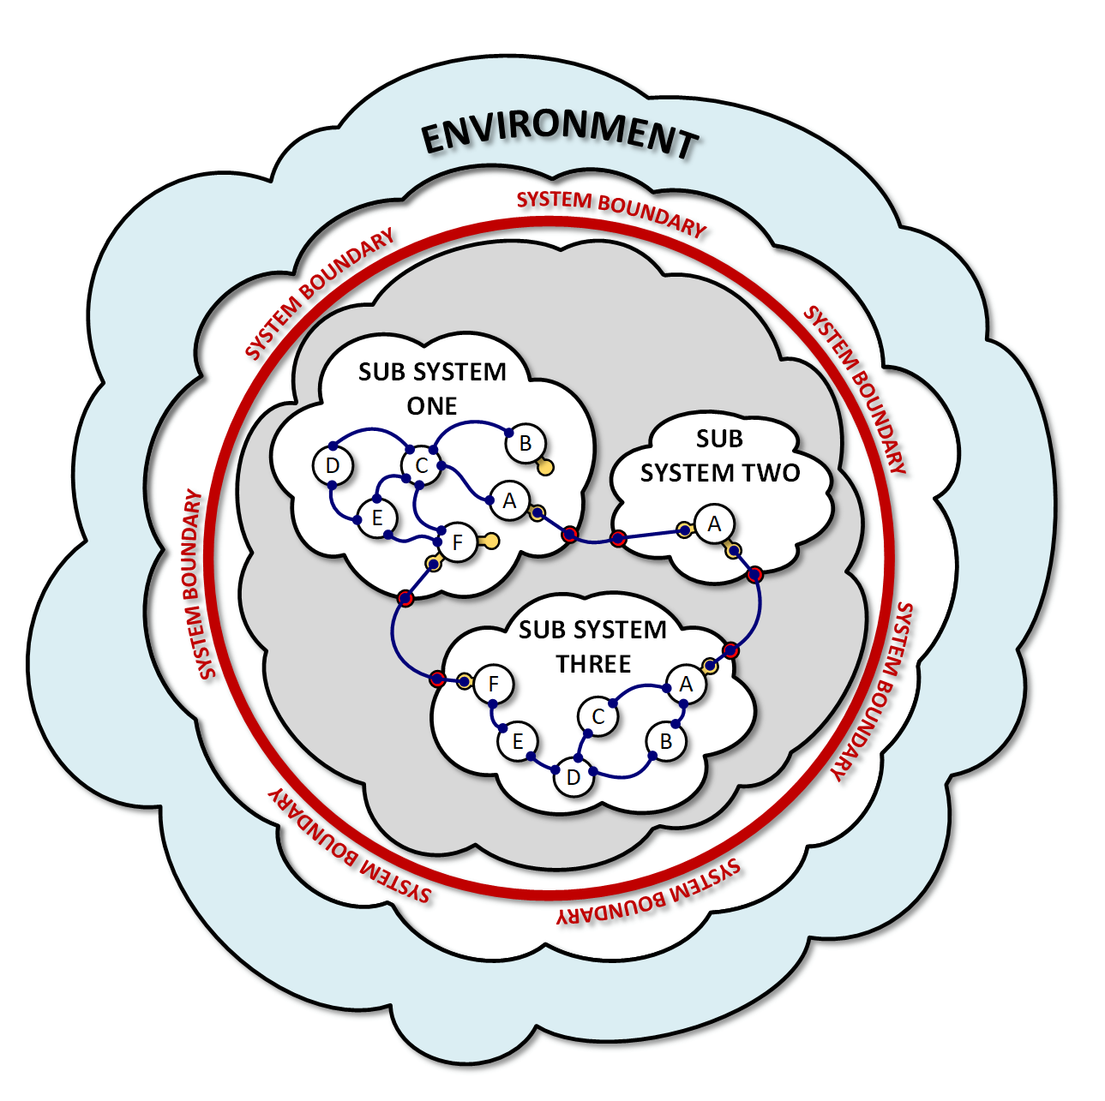
Systems Integration
Outward Facing Interfaces
Outward facing interfaces are connections that are used to join sub-systems within the larger system. They have the following characteristics:
Externally Coordinated:
Because these interfaces must connect to external entities, the specification for the interface and its capacities must be well defined and coordinated with associated sub-systems.
Internally Abstract:
Although the interface itself is well defined, the implementation details behind the interface remain private. This prevents external entities from becoming dependent on the internal implementation details of the sub-system.

Slide 9
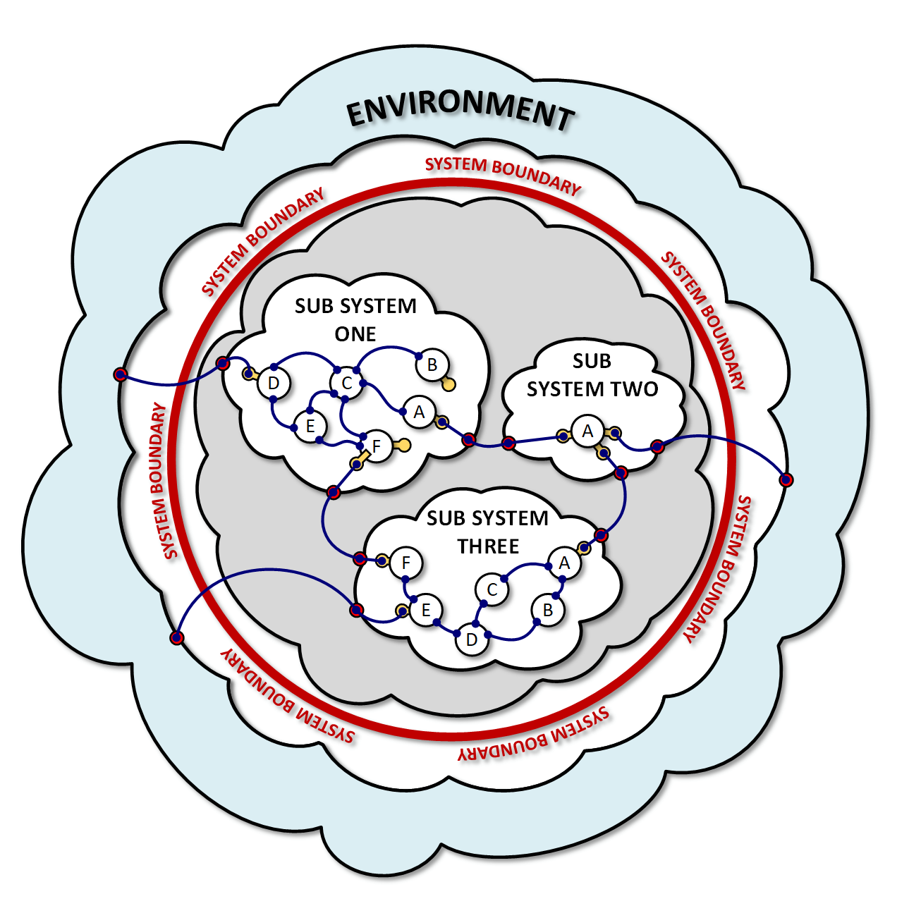
Systems Integration
External Interfaces
External interfaces are connections that join the system or sub-systems to resources and services outside of the system.
In addition to all of the features of outward facing interfaces, they must:
a) be developed in coordination with resource providers that exist outside of the system, and
b) be designed to accommodate conditions within the system AND in the external environment.

Slide 10
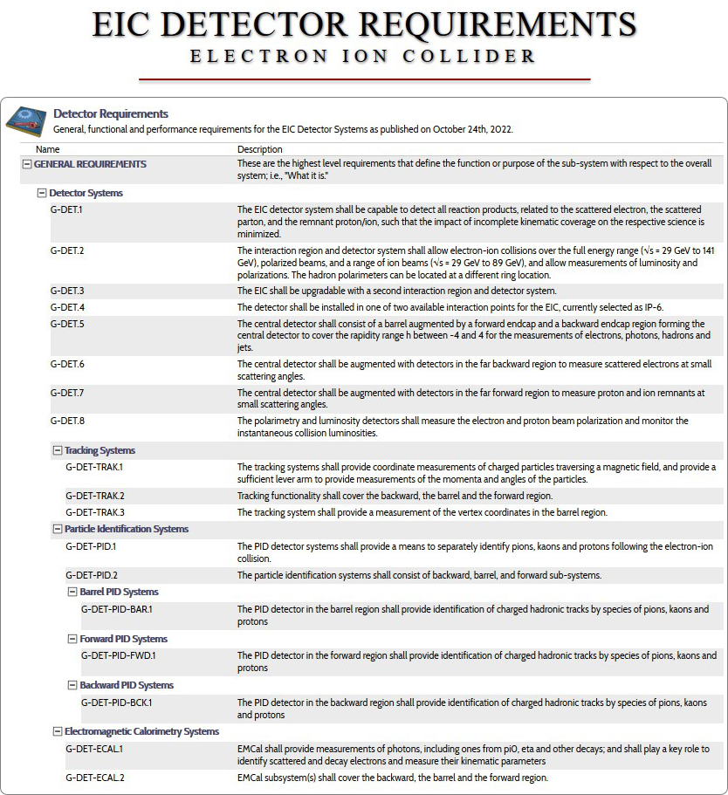
Where Are We Now?
Requirements Development
We have collected our first round of requirements from the science staff and they have been approved and published.
We are currently making a second round of revisions, linking the requirements into a hierarchy, and loading them into Visure – our requirements management tool.
Once validated and approved, EIC detector requirements are placed on a reference page where they can be accessed by the researchers, engineers and user community.
In addition to the current requirements, older versions will be maintained in an archive to allow researchers to see changes that were introduced over time.
A comment log will be included to document what updates were made and the rationale for the decision.
Visit https://eic.jlab.org/Requirements for more details.
10

Slide 11
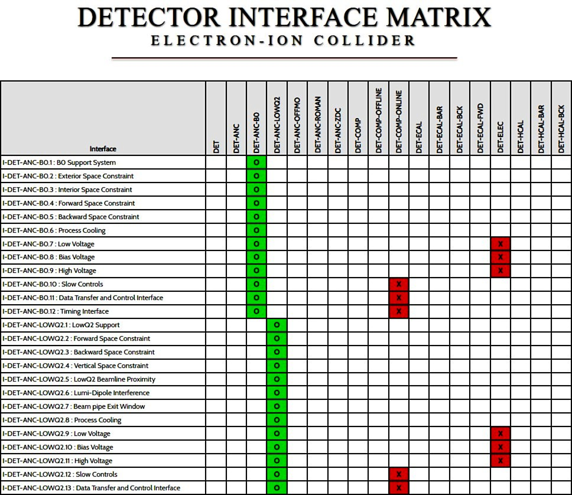
Where Are We Now?
Interface Definitions
We are currently collecting interface definitions now.
Interface definitions do not provide a specification for the interfaces, but rather define the connected systems and what is being exchanged.
This provides the minimal critical specification for the interface, and the final specification will be developed by the designers and engineers.
At the request of Rahul Sharma, we’ve also developed an interface matrix that visually illustrates the name of the interface and the sub-systems that it connects.
Like the requirements, the interface information will be incorporated into the Visure database managed by Joel Watkins.
Visit https://eic.jlab.org/Interfaces/InterfaceMatrix.html for more details.
11

Slide 12
Where Are We Going?
What Is Next? That’s Up To You!
The goal of the Systems Engineering Group is to create tools that improve communications and efficiency.
We need to know…
How we can adapt the information that we’re collecting to make it most valuable to you?
What new (or improved) information do you need to produce better designs?
How can we package (and communicate) the designs and specifications that you’re producing to ensure that we generate a cohesive, functional system.
12

