Slide 1
EPIC Barrel Installation
Rahul Sharma
and Roland Wimmer
May 10 – May 12, 2023

Slide 2
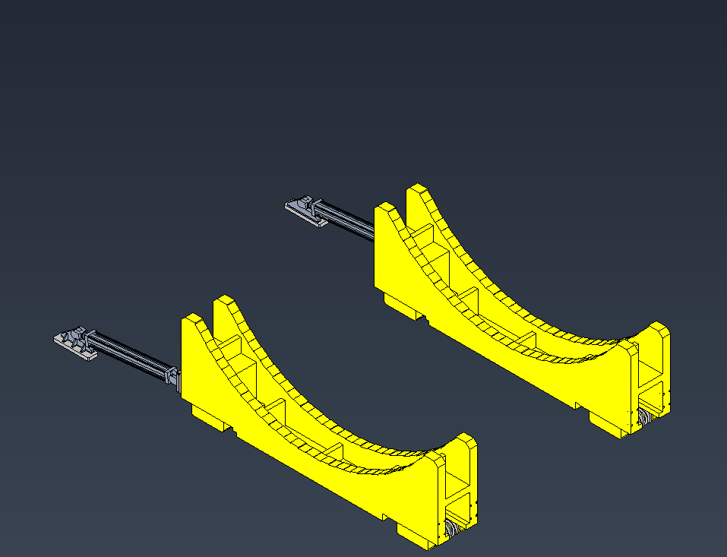
STAR Cradles

Slide 3
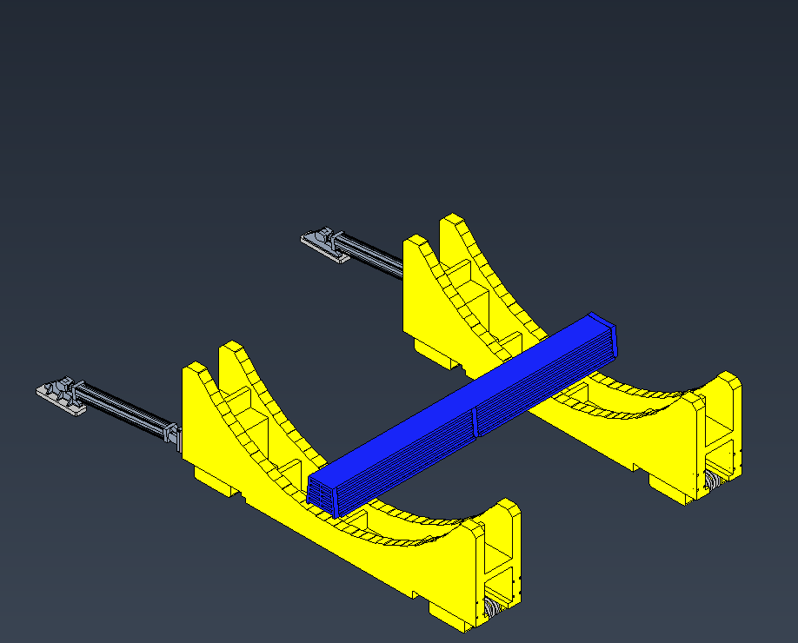
Lay in Flux Return Bars

Slide 4
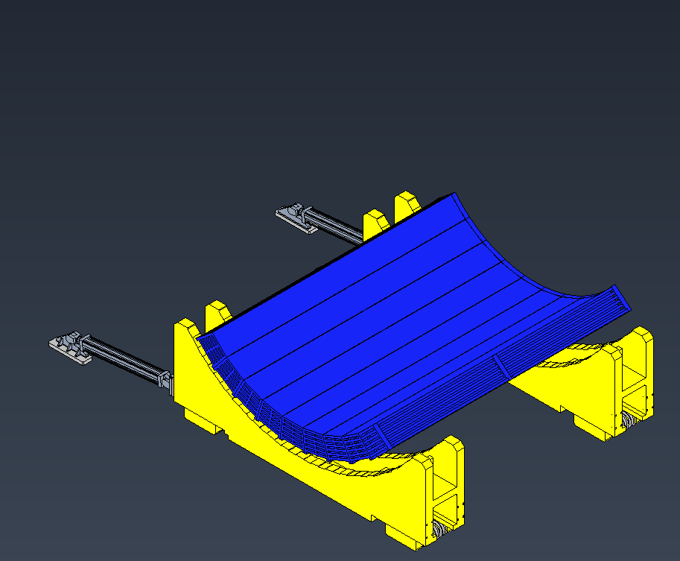
Install Bottom Sectors of Flux Return Bars

Slide 5
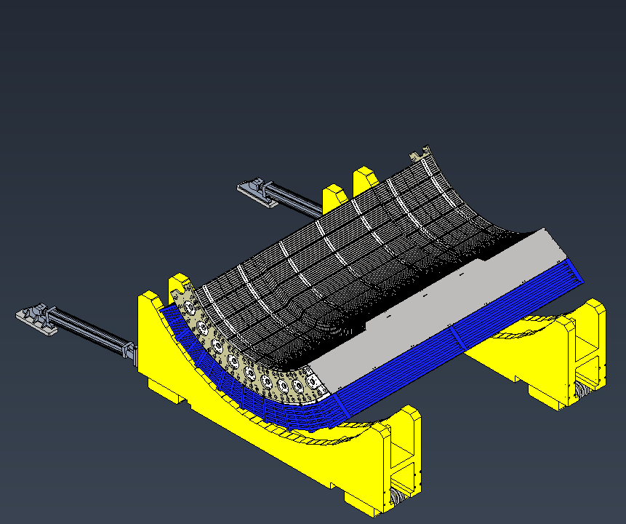
Install HCAL Sectors

Slide 6
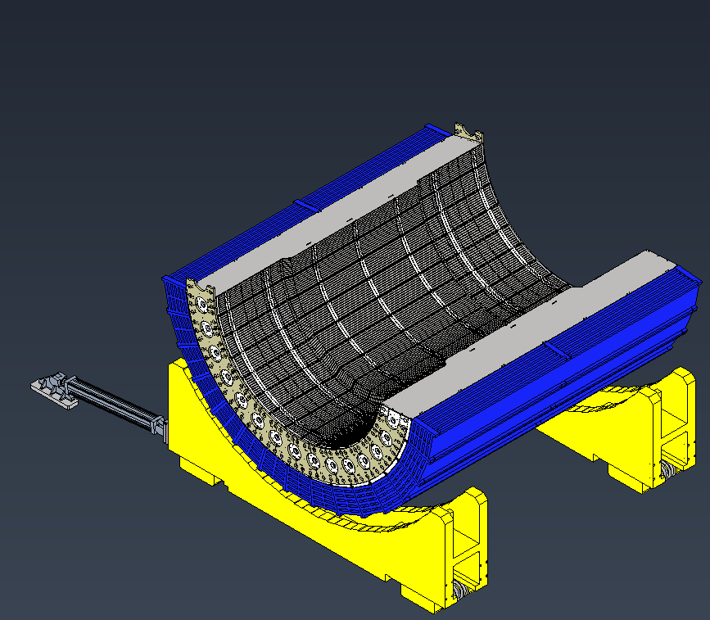
Install Bottom Half of HCAL and Flux Return Bars

Slide 7
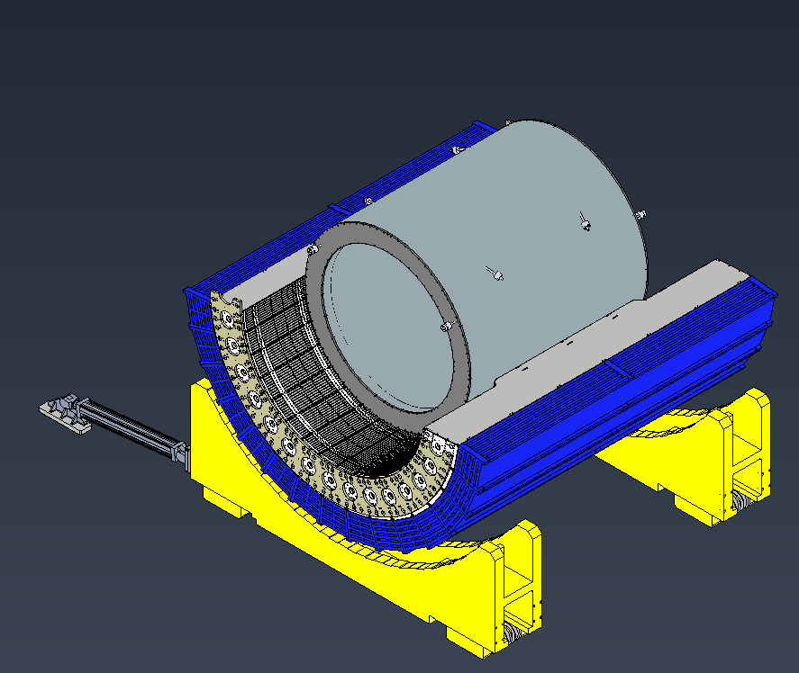
Install Magnet

Slide 8
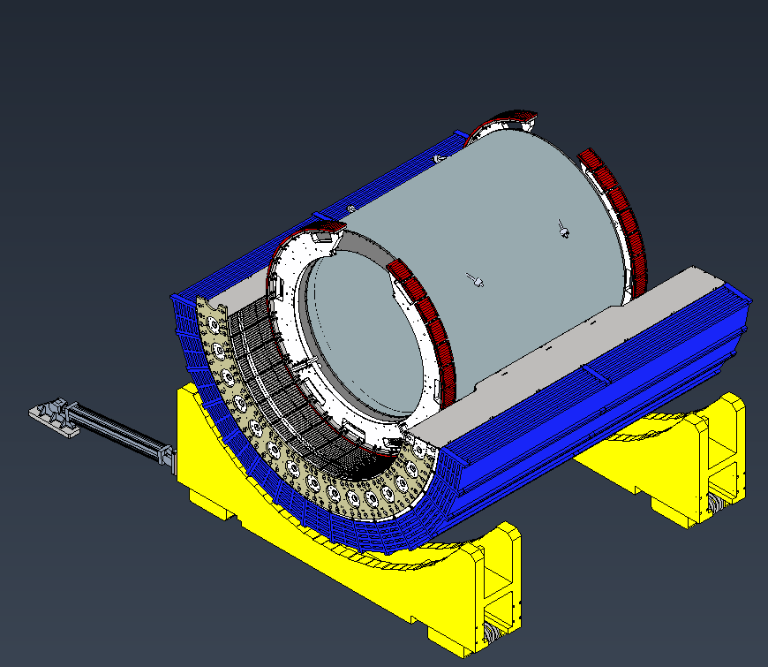
Install Inner Support Rings

Slide 9
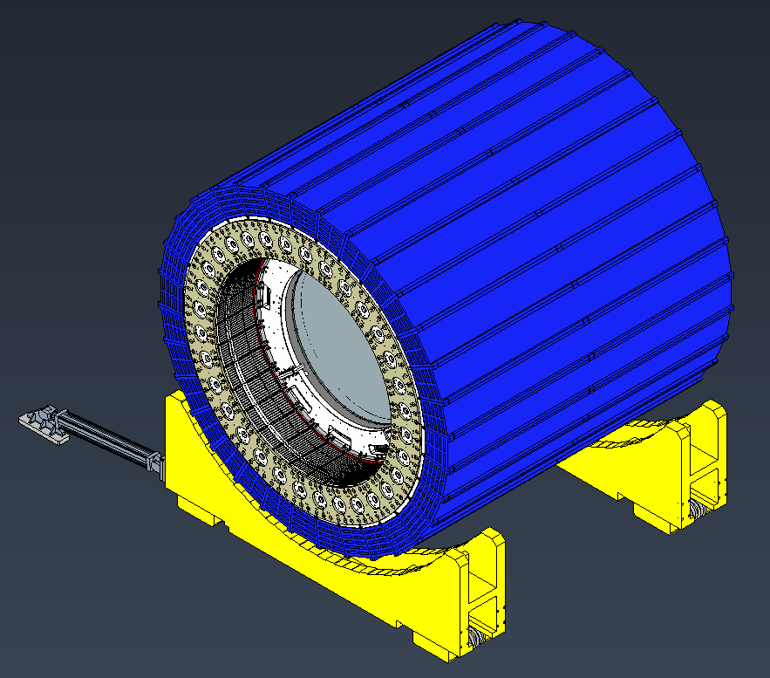
Install top half of HCAL and Flux Return Bars

Slide 10
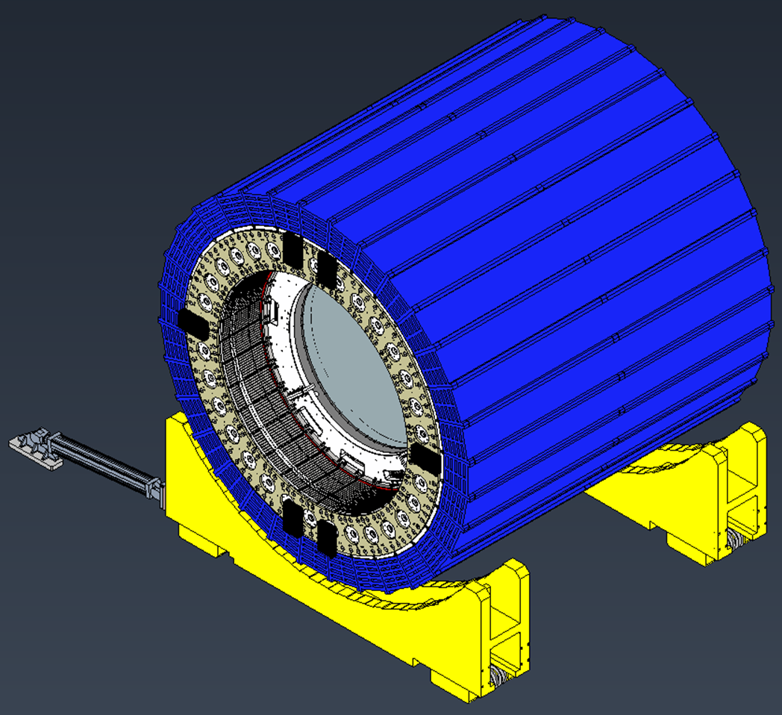
Install Endcap Spacers

Slide 11
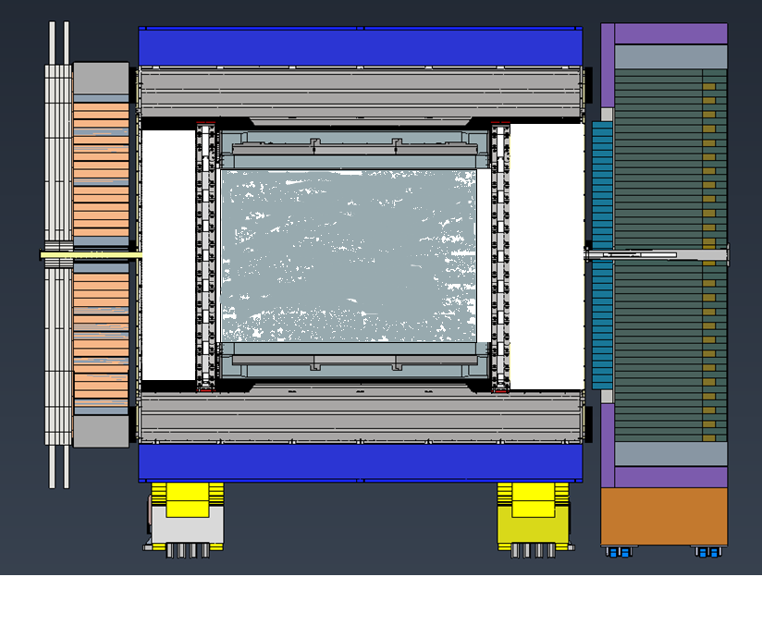
Roll Into the IR and Magnet Mapping

Slide 12
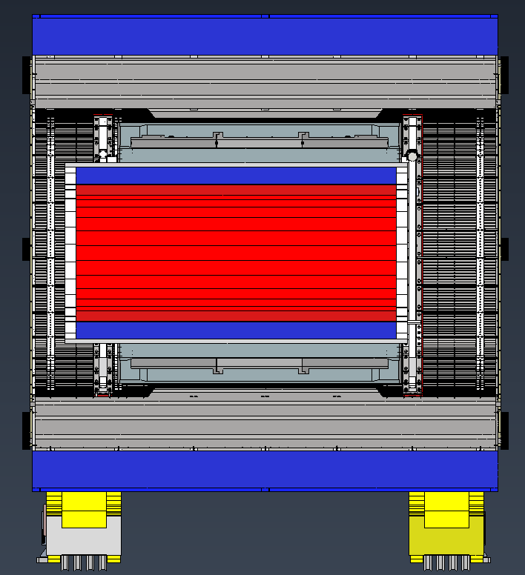
Install Barrel EMCAL

Slide 13
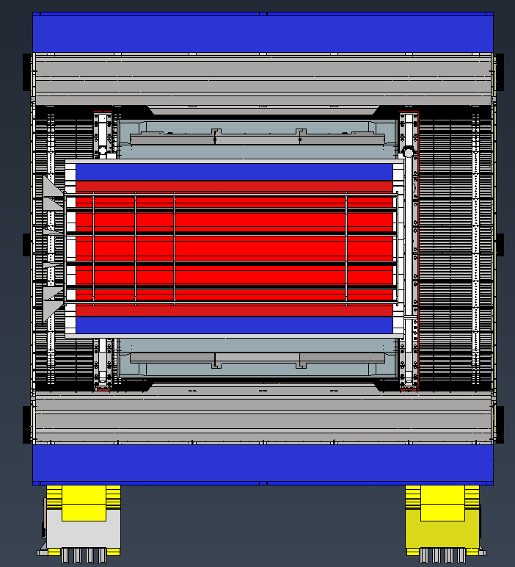
Install DIRC Support Frame

Slide 14
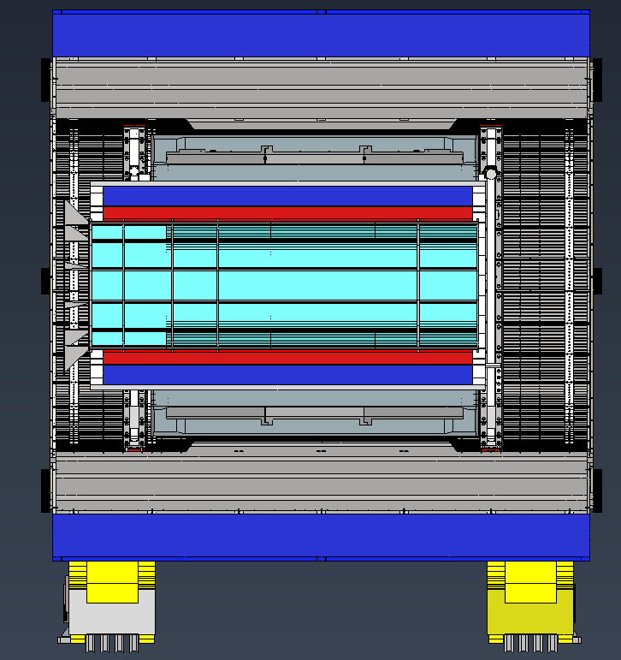
Install DIRC Bar Boxes

Slide 15
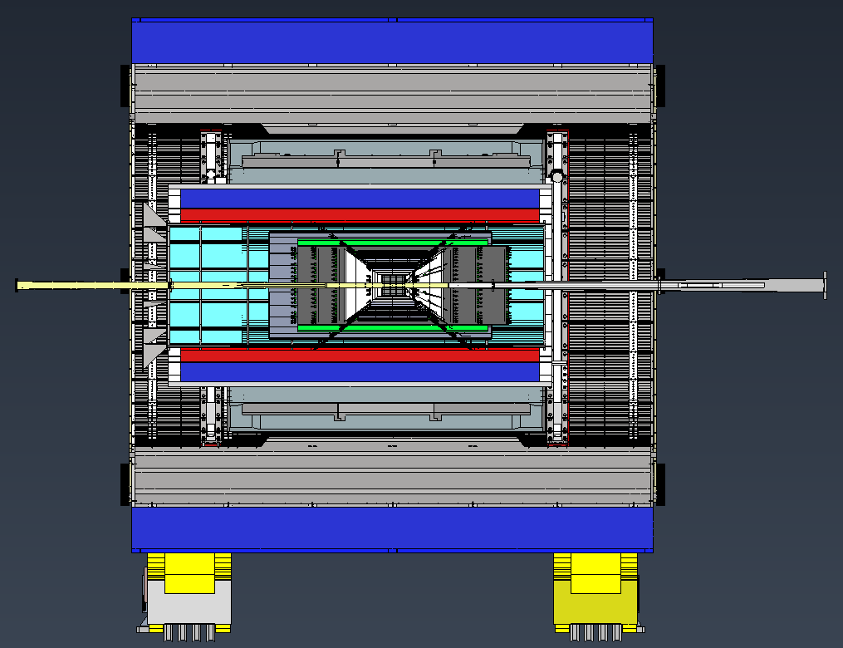
Install ACLGAD Barrel, MPGDs and Si Detectors

Slide 16
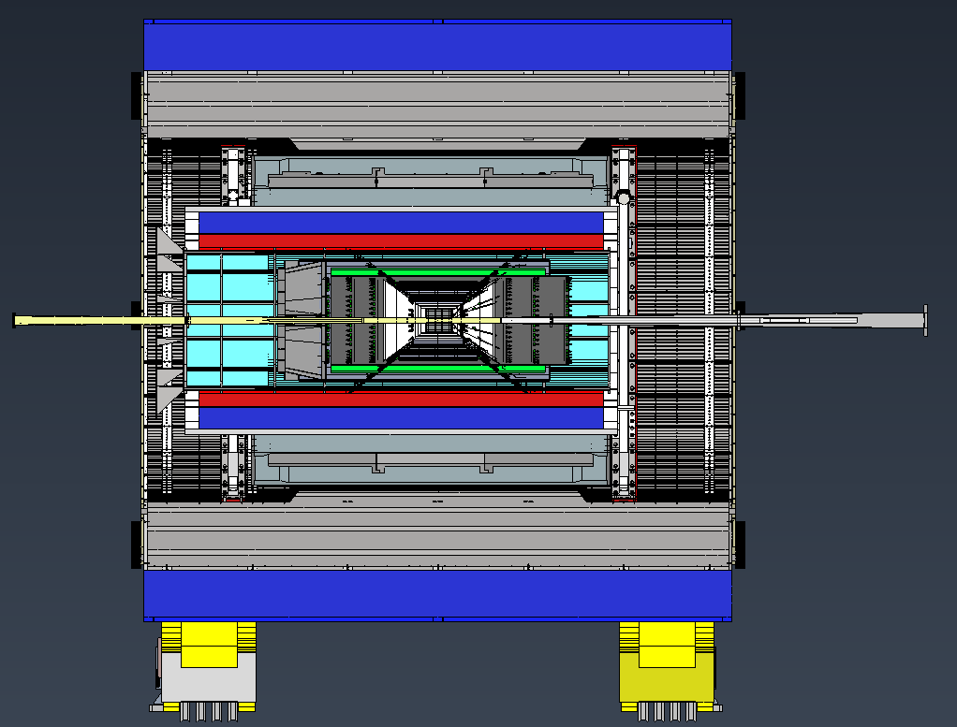
Install pfRICH

Slide 17
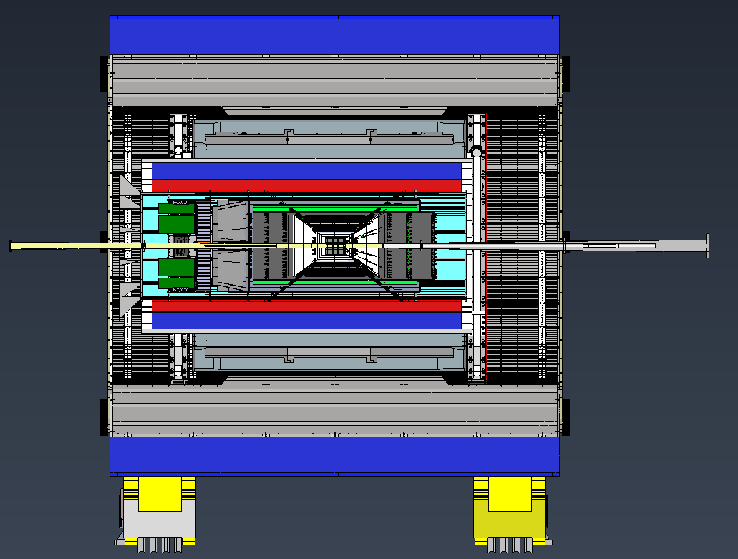
Install EEEMCAL

Slide 18
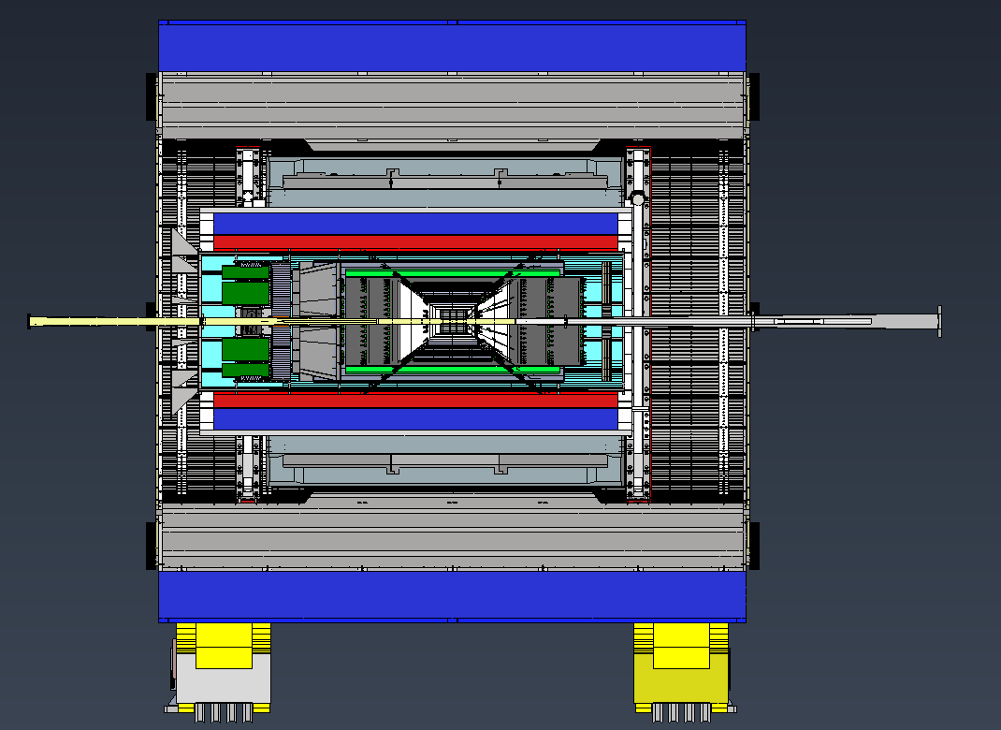
Install FE AC LGAD Disk

Slide 19
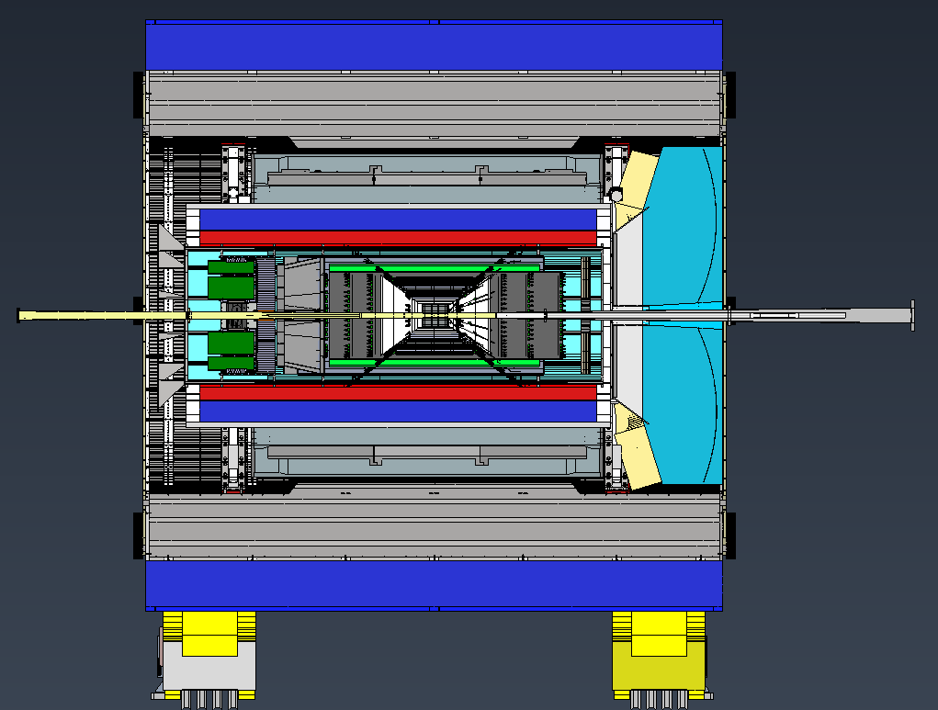
Install dRICH

Slide 20
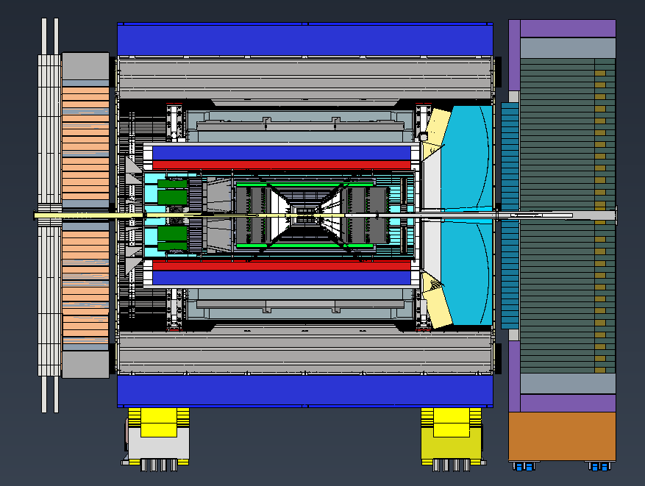
Roll Back into the IR in final position

