Slide 1
CERN ALICE – EIC meeting eRD113
EIC-SC
May 08, 2023

Slide 2
ALICE ITS3 – EIC meeting at CERN

Slide 3
ALICE ITS3 – EIC meeting at CERN
ePIC SVT detector and collaboration with ITS3 - covered areas (04/24-25/2023):
Agreements
  use of ITS3 sensor for EIC and design database for ePIC specific developments
Plans for ITS3 developments
  ER2 submission: end Q1 CT2024 (towards final ITS3 sensor architecture)
Options for EIC Sensors (stitching options)
  Reduced stitching variants possible (total: 2-3 options)
  Handling ePIC fabrication orders (through CERN – communication with foundry)
  Powering variants (double sided powering in ITS3 sensors)
Contributions to ITS3
  Sending designers (2) to CERN to integrate in ITS3 and liaisons to EIC efforts
  Continue with contributions in EIC-SC institutions

Slide 4
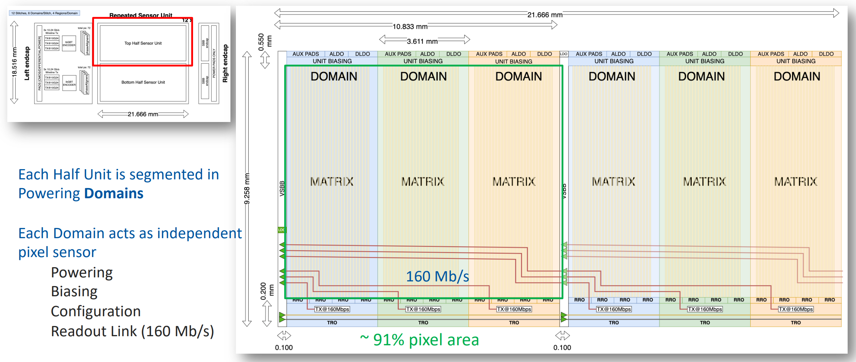
ALICE ITS3 – plans for ER2
Inter-reticle spacing, top and bottom peripheral circuit area
ALICE Upgrade Week at CERN: 8 to 12 May 2023

Slide 5
Options for EIC – stitching plans (ER2)
ALICE Upgrade Week at CERN: 8 to 12 May 2023

Slide 6
Options for EIC – stitching plans
Stitching options considerations:
Number of stitching options
  It will be limited to 2÷3 options, including the baseline 12x stitching upon decision of the foundry;
Non-sensitive area consideration
  Maximization of sensitive area (9X%); final assessment expected when all peripheral blocks are designed;
Powering options
  Sagging (IR) of power supply is major concern (routing of power line – RDL? – to opposite side)

Slide 7
ALICE ITS3 – ePIC MAPS development
Areas highlighted as desired contributions to the ALICE-ITS3 MAPS (04/25/2023):
(SRAM) Development of dual-port Static Random Access Memory (SRAM), either as a compiler code or at least as full custom block (TPSCo 65nm contains single port SRAM compiler and it does not use DFM recommended rules) for buffering data for data transmission at the Repeated Sensor Unit (RSU) peripheries.
(LP_StCells) Development of standard cells library (take care of the subset of cells) oriented on Low-Power (non-minimum Lengths of FETs) and respecting recommended rules, target 9T version, including timing characterization with Liberate (BNL/RAL interested).
(HV_StCells) Development of standard cells, minimal subset, suitable for operation at HV (required for power management, i.e., operation when no core power is ON).
(VFM_ADC) Development of small footprint ADC for Vital Functions Monitoring (VFM) with interfacing circuitries suited for connecting signals to be monitored and interfacing to slow control and fetching data to output through slow control of data stream interface (BNL started).
(LDoC_ULVS) Development of Long-Distance on-Chip (LDoC) Ultra-Low-Voltage Signaling (ULVS) data transmission for sending data from stitched Repeated Sensor Units (RSU) to the peripheral area, where Time Division Multiple Access (TDMA) interrace connects to the lpGBT IP for data aggregation of high-speed links for data transfer off MAPS sensors (BNL interested).
(F_D/R) Development of fast driver/receiver blocks (RAL already involved).

Slide 8
ALICE ITS3 – ePIC MAPS development
Areas discussed as desired contributions to the ALICE-ITS3 MAPS (2022):
(UVM_Det_Model) formal verification, building model including congregation od data flow, and integration with event builder.
(PWR_Scheme) powering of stitched RSUs, to handle IR drops, including development of LDOs and having strategies of handling IR drops and selection between two method of sensors biasing practiced in MOSS and MOST circuits.
(Diff_IO) differential IO libraries of pads and standard cells (HV) HV_StCells, standard cells have bee mentioned in the CEN meeting, no pads.
(Data_TX) PLL, serializer, line driver parallel development, use of lpGBT IP in the most conceptual development.
Contibutions under discussion with ITS3 team and to be shared among EIC-SC institutions
+ EIC specific development areas, e.g. adaptation to serial powering, voltage regulation for RSUs. considerations for double sided powering, etc.

Slide 9
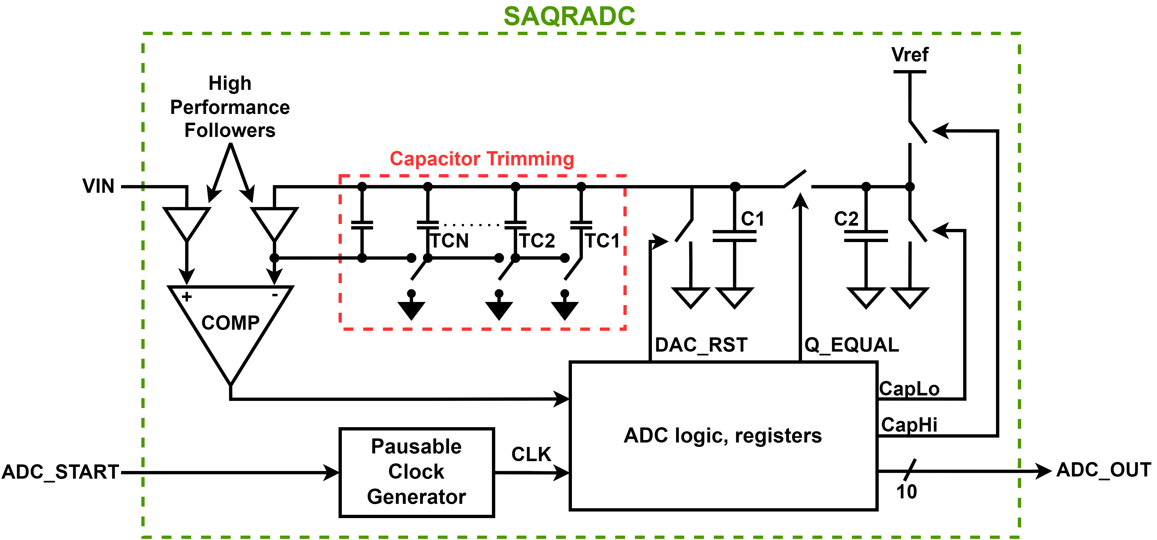
Contribution idea1: VFM_ADC
Monitoring of essential signals and levels within an ASIC (temperature, bias voltage/current values, etc.) requires some kind of processing on analog,
Standard ADC architectures are large, power-hungry, and suited for running continuously which is not necessary as the signals to be monitored need to only be checked on occasion,
Therefore a compact, low-power ADC that can run on command while shutting itself down while not in use is pursued.
A compact Succesive Approximation Charge (Q) Redistribution (SAQRADC) ADC running off of a pausable clock generator
Key Features:
10-bit resolution
Pausable clock generator
DAC with 2 sampling capacitors of ~220fF
Capacitor trimming to tens of attofarads
High gain comparator with \high performance source followers with gain > 0.999 and Cin < 0.1fF
IEEE Journal of Solid-State Circuits, 10(6), 379–385

Slide 10
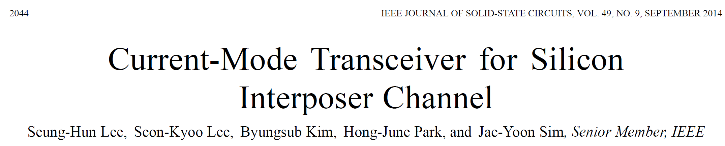
Contribution idea2: LDoC_ULVS
Several inspirational developments reported, e.g.:
On-chip global interconnects and silicon interposer channels (tested up to 20 mm).
Nominal data rate: 3 Gb/s (ALICE ITS3 needs 160Mbps but ×10 longer distance).
Highly power-efficient: 9.5 fJ/bit/mm (280 μW for a 10 mm link at 3 Gb/s).
Transmitter: Open drain, one-tap pre-emphasis.
Receiver: I sense amplifier, active L for bandwidthä.
Replacement with fully digital feedback loop for offset cancellation
IEEE Journal of Solid-State Circuits, 49(9), 2044–2048
Challenge: resistivity of long
(across stitched sensor) traces

