Slide 1
TIC MEETING COMMUNICATIONS
Klaus Dehmelt
Technical and Integration Council Meeting
June-05-2023

Slide 2
Need to get DSC efforts into WBS structure

Slide 4
Simulation Campaign

Slide 5
Simulation Campaign
Updates will be requested on a monthly basis
Shared google docs will be provided
Brief update on the first Monday of simulation campaign

Slide 6
Today/Future TIC Meetings
Tracking → Today
DAQ → Week 24 - June 12
Barrel Em/HCal → Week 25 - June 19
FBKWD/FFWD → Week 26 - June 26

Slide 7
Today’s Agenda
Integration status Tracker DSC
Status of design and layout
Si tracker
Gaseous tracker
Advancement between now to August?
Does present technical design and implementation fulfill the YR requirements?

Slide 8
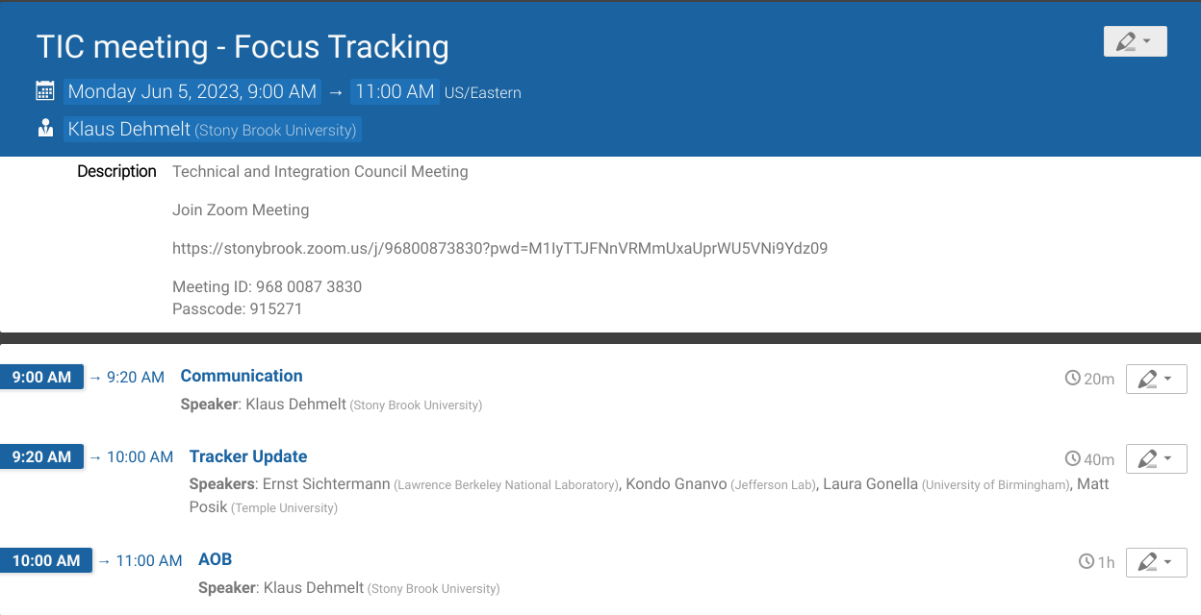
Today’s Agenda

