Slide 1
ePIC TIC Meeting Electronics - Status
Fernando Barbosa (JLab)
12 June 2023

Slide 2
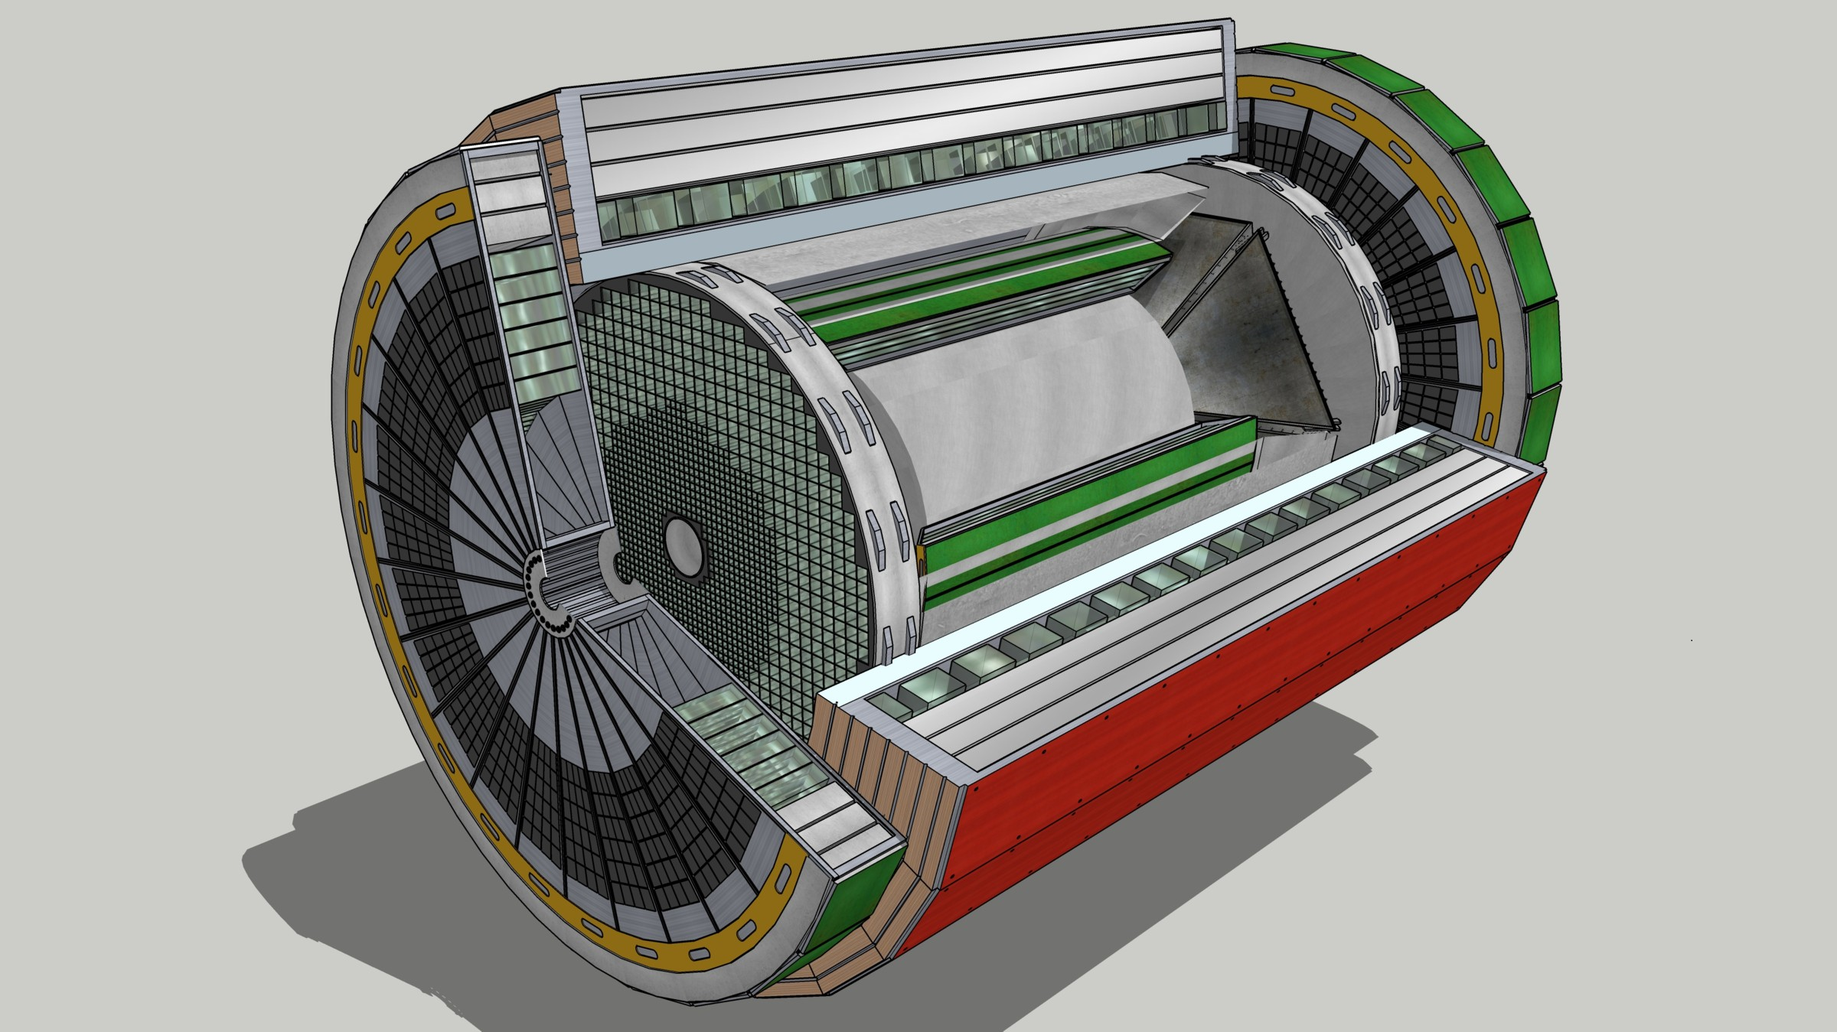
EIC Streaming Readout Architecture
Front-End Electronics
DAQ
Detector
FEB
(Front End Board)
RDO
(Readout Board)
DAM + Computing (Data Aggregation Module)
Total
BW: O(100 Tbps)
BW: O(10 Tbps)
GTU
(Global Timing Unit)
Bunch Crossing ~ 10.2 ns/98.5 MHz
Event Rate ~ 2 us/500 kHz
Low occupancy.
L ~ 100 m
fiber
Jitter ~ 5 ps
ASIC
Goal: O(100 Gbps)
Fiber
Switch / Server / Link-Exchange: Readout
Switch / Server: Processing
Switch / Server: Buffer
FEB
Storage
FPGA
Fiber
Monitoring
RDO
FEB
LVDS ~ 20-30 m*
Analog ~ 20m
Power Supply System
(HV, LV, Bias)
Cooling Systems
Data
Configuration & Control
Power
*LVDS – ANSI/TIA/EIA-644A standard. Maximum cable length dependent on data rate.
w/ Jin and Kai

Slide 3
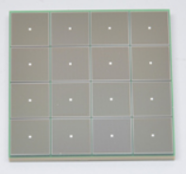
EIC Readout Chain
Global Timing Unit (GTU)
-Interfaces to Collider, Run Control & DAM
-Config & Control
-Clock & Timing
On Detector
SMT BGA
Name
Design
Function
Attributes
Sensor
Detector Specific
-Multi-Channel Sensor
-MAPS
-AC-LGAD
-MPGD
-MCP-PMT
-SiPM
-LAPPD
Adapter
Detector Specific
-HV/Bias Distribution
-HV divider
-Interconnect Routing
-Sensor Specific
-Passive
Front End Board
(FEB)
Detector Specific
-Amplification
-Shaping
-Digitization
-Zero Suppression
-Bias Control & Monitoring
-ASIC/ADC
-Discrete
-Serial Link
Readout Board
(RDO)
Few Variants
-Communication
-Aggregation
-Formatting
-Data Readout
-Config & Control
-Clock & Timing
-FPGA
-Fiber Link
Data Aggregation Module (DAM)
Common
-Computing Interface
-Aggregation
-Software Trigger
-Config & Control
-Clock & Timing
-Large FPGA
-PCIe
-Ethernet
Computing
Common
-Data Buffering and Sinking
-Calibration Support
-QA/Scalers
-Collider Feedback
-Event ID/Building
-Software Trigger
-Monitoring
-COTS
-Ethernet

Slide 4
ePIC Readout Channels
Detector System | Channels | Nominal Readout Technology | eRD109 Initiatives
Si Tracking: 3 vertex layers, 3 sagitta layers, 4 backward disks, 5 forward disks | 7 m^2 32 B pixels 5,200 MAPS sensors | MAPS – ITS-3
MPGD tracking: 3 layers | 100k | Strips | SALSA
Calorimeters: (in P6) Forward: LFHCAL pECAL Barrel: HCAL ECAL Backward: ECAL nHCAL | 31640 19000 1536 8160 3256 3240 | SiPM | Discrete/HGCROC
Far Forward: B0: 3 MAPS layers 1 or 2 AC-LGAD layer 2 Roman Pots 2 Off Momentum ZDC: Crystal Calorimeter 32 Silicon pad layer 4 silicon pixel layers 2 boxes scintillator | 3x20cmx20cm (300M pixel) 300k or 600k 1M (4 x 135k layers each) 650k (4 x 80k layers each) 400 11520 160k 72 | MAPS – ITS-3 AC-LGAG AC-LGAD AC-LGAD APD Si PMT/SiPM | EICROC EICROC EICROC Discrete/HGCROC HGCROC Discrete/HGCROC
Far Backward: Low Q Tagger 1 Low Q Tagger 2 2 Calorimeters | 1.3M 480k 700 | AC-LGAD AC-LGAD PMT/SiPM | EICROC EICROC Discrete/HGCROC
PID-TOF | 3M-50M | AC-LGAD | EICROC
PID-Cherenkov: dRICH pfRICH (if selected) DIRC | 300k 70k (225k) 74k | SiPM LAPPD/HRPPD MC-PMT/LAPPD/HRPPD | ALCOR EICROC EICROC

Slide 5
Readout Channels & eRD109 proposals
Detector Group | Channels | AC-LGAD | SiPM/PMT | MPGD
 | MAPS | AC/DC-LGAD | SiPM/PMT | MPGD
Tracking | 32 B |  |  | 100k
Calorimeters | 50M |  | 67k
Far Forward | 300M | 2.3M | 500
Far Backward |  | 1.8M | 700
PID |  | 3M-50M + 70k | 300k
TOTAL | 32 B | 7.1M-54M | 370k | 100k
ASIC | ITS-3 | EICROC FCFD HPsOC ASROC FAST | Discrete/COTS HGCROC3 ALCOR-EIC | SALSA
HRPPD
eRD109
Readout implementations with discrete/COTS and ASICs are leading candidates for the EIC. The large number of channels, density, granularity and geometry favor high circuit density solutions.
We continue to assess ASIC developments from other sources.

Slide 6
FY23 eRD109 Status
Contract awards have taken much longer than expected.
Contract terms and norms are subject to negotiations between JLab’s procurement department and institutions – multiple cycles and very laborious.
 | Detector/Technology | Discrete/ASIC | Group | Awarded
A | Calorimeter | Discrete | IUCF | April 2023
B | Calorimeter | HGCROC | ORNL | April 2023
C | dRICH | ALCOR | INFN | April 2023
D | AC-LGAD | EICROC | Omega/IN2P3 | See below
 |  | FCFD | FNAL | Est. June 2023
 |  | Barrel L-M Serv. Hybrid | ORNL | April 2023
 |  | 3rd Party Evaluation | UCSC | Est. June 2023
E | MPGD/µRWell | SALSA | CEA | May 2023
 |  |  | USP | May 2023
Five (5) eRD109 proposals with nine (9) contracts to be awarded.
Remaining ones are in the final stages of negotiations.
IN2P3 and OMEGA have committed considerable resources to the design of the ROC ASICs to meet the EIC streaming readout needs.

Slide 7
FY24 eRD109 Proposals
Call for proposals has been announced.
Continuation and new proposals are due by 7 July 2023.
Reviews and documentation ready by late August 2023.
This will help better align projects with funds and will allow projects to continue uninterrupted.

Slide 8
Summary
Progress in awarding and development of the eRD109 projects.
FY24 eRD109 proposal submission – 7 July 2023.
We will have to decide if the VTRX+ transceivers will be employed in the high radiation areas of ePIC, and if so commit to join the CERN fab run by the end of 2023.
OMEGA and in2p3 have now committed considerable resources dedicated specifically to EIC ROC ASIC development. This is great news!
This week, we will have a combined meeting with the readout experts from the ASTROPIX collaboration.

