Slide 1
TIC Meeting EICROC for AC-LGAD
Fernando Barbosa (JLab)
7 August 2023

Slide 2
Agenda
Objective:
Collect AC-LGAD detector requirements and identify any needed input for further development of the EICROC ASIC.
The ROC Family of ASICs.
EICROC Nominal Design Parameters.
AC-LGAD Specifications & Requirements.
Does the EICROC meet the ePIC AC-LGAD detector requirements?
Next Steps.

Slide 3
The ROC family of ASICs – Omega/IN2P3
We have had a number of meetings with the OMEGA/IN2P3 designers recently at the Electronics & DAQ WG and TIC:
Similar Interfaces, different frontends.
HGCROC - Si or PMT 72 Ch -Name? - HRPPDs
Cd = 5-50 pF
Q = 1-10 pC
Tj = 25 ps
P = 10-15 mW/Ch
H2GCROC- SiPM 72 Ch -ePIROC? - SiPMs
Cd = 5-50 pF
Q = 1-10 pC
Tj = 100-120 ps
P = 15 - 20 mW/Ch
EICROC- AC-LGAD 32x32 Ch (pixel)
Cd = 1-5 pF
Q = 1-50 fC
Tj = 15-20 ps
P = <1 mW/Ch

Slide 4
ePIC Readout Channels (w/ Project P6 updates)
Detector System | Channels | Nominal Readout Technology | eRD109 Initiatives
Si Tracking: 3 vertex layers, 3 sagitta layers, 4 backward disks, 5 forward disks | 7 m^2 32 B pixels 5,200 MAPS sensors | MAPS – ITS-3
MPGD tracking: 3 layers | 100 k | Strips | SALSA
Calorimeters: (in P6) Forward: LFHCAL pECAL Barrel: HCAL ECAL SciFi/Pb Imaging Si Backward: ECAL nHCAL | 31640 19000 1536 5760 88 M 3256 3240 | SiPM SiPM SiPM SiPM Astropix SiPM SiPM | Discrete/H2GCROC Discrete/H2GCROC Discrete/H2GCROC Discrete/H2GCROC ASTROPIX V4 Discrete/H2GCROC Discrete/H2GCROC
Far Forward: B0: 4 AC-LGAD layers 2 Roman Pots 2 Off Momentum ZDC: Crystal Calorimeter 32 Silicon pad layer 4 silicon pixel layers 2 boxes scintillator | 1 M 560 k 320 k 400 11520 160 k 72 | AC-LGAD AC-LGAG AC-LGAD APD Si AC-LGAD PMT/SiPM | EICROC EICROC EICROC Discrete/HGCROC/H2GCROC HGCROC EICROC Discrete/HGCROC/H2GCROC
Far Backward: Low Q Tagger 1 Low Q Tagger 2 2 Calorimeters | 1.3 M 480 k 700 | Si Si PMT/SiPM | Timepix4 Timepix4 Discrete/HGCROC/H2GCROC
PID-TOF Barrel TOF CTTL Hadron Endcap TOF FTTL | 2.2 M 5.6 M | AC-LGAD AC-LGAD | EICROC EICROC
PID-Cherenkov: dRICH pfRICH hpDIRC | 5376 69632 69362 | SiPM HRPPD MCP-PMT/HRPPD | ALCOR HGCROC HGCROC
HGCROC – Si/PMTs
H2GCROC – SiPMs
EICROC – AC-LGAD
TBD

Slide 5
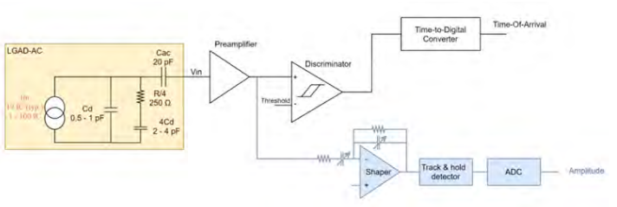
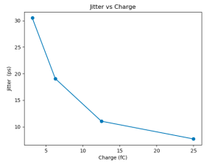
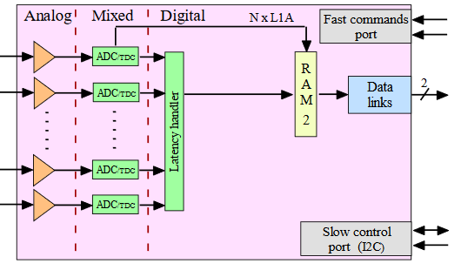
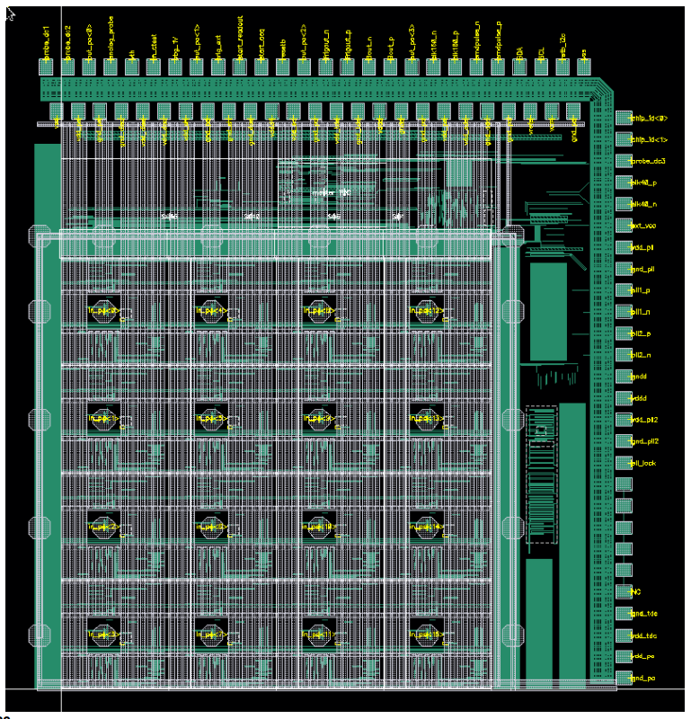
EICROC – Nominal Design Parameters
Collaboration by OMEGA/IN2P3/IJCLab/CEA-Irfu/AGH
One pixel – EICROC0
Sensor
Plus backend of ePIROC
2D, 32x32 pixel readout
Preamp, discriminator, TOA, ADC
Cd: 1 – 5 pF
Q range: 1 – 50 fC
TOA TDC – Timing Jitter: 15 – 20 ps
ADC: 8b
Link: 1.28 Gbps @ 40 MHz
Power: <1 mW/Ch
Packaging: Bump+Wire Bonds
Proposed ePIROC (based on H2GCROC3)
Wire
Wire
Bump
4x4 500 um pixels

Slide 6
AC-LGAD &HRPPD Specifications & Requirements – Input to ASIC Design
Detector System | Channels | Sensor Technology | Type, Size, Ch Sensor Layout | Sensor-ASIC Packaging | Cd (pF) | Qin (fC) Min - Max | Timing resolution (ps) | Channel Rates (kHz/Ch)
Far Forward
B0: 4 AC-LGAD layers | 1 M | AC-LGAD | Pixel, 500x500 um, 1024 | 32x32, 1024 | 0.5 | ? | 50 | ?
2 Roman Pots | 560 k | AC-LGAD | Pixel, 500x500 um, 1024 | 32x32, 1024 | 0.5 | ? | 30 - 40 | ?
2 Off Momentum | 320 k | AC-LGAD | Pixel, 500x500 um, 1024 | 32x32, 1024 | 0.5 | ? | 30 - 40 | ?
PID TOF
Barrel TOF | 2.2 M | AC-LGAD | Strip, 0.5x10 mm, 64x2 array | ?, 128 | ? | 2 - ? | 35 | ?
Hadron Endcap TOF | 5.6 M | AC-LGAD | Pixel, 500x500 um, 1024 | 32x32, 1024 | 0.5 | 1 - ? | 25 | ?
PID-Cherenkov
pfRICH | 69632 | HRPPD | Pixel, 120x120 mm, 1024 | 64, 256 | <10 | ? | 20 | ?
hpDIRC | 69362 | MCP-PMT, HRPPD | Pixel, 120x120 mm, 1024 | 64, 256 | <10 | ? | 50 | ?
Above specifications need to be confirmed.
Missing parameters (indicated in orange):
Barrel TOF: Cd, Packaging.
Qin (fC) Min-Max: minimum charge sensitivity and dynamic range.
Maximum signal rate per channel.

Slide 7
Setting aside the missing parameters, does the nominally planned EICROC meet the ePIC AC-LGAD detector requirements?
B0, RP, OMD, Hadron Endcap TOF – Yes.
Barrel TOF – Needs further study.
Capacitance for strips is likely much higher (>10 pF?) than for pixels leading to jitter degradation. EICROC0 tests and circuit simulations may still show jitter to be within 35 ps requirement.
Strip configuration and preferred ASIC footprint for 128 ch is much different from the 32x32 pixel arrangement. An EICROC variant with less number of channels and/or in combination with an interposer/IC package may be possible.
An EICROC variant requires additional resources from Omega/IN2P3.

Slide 8
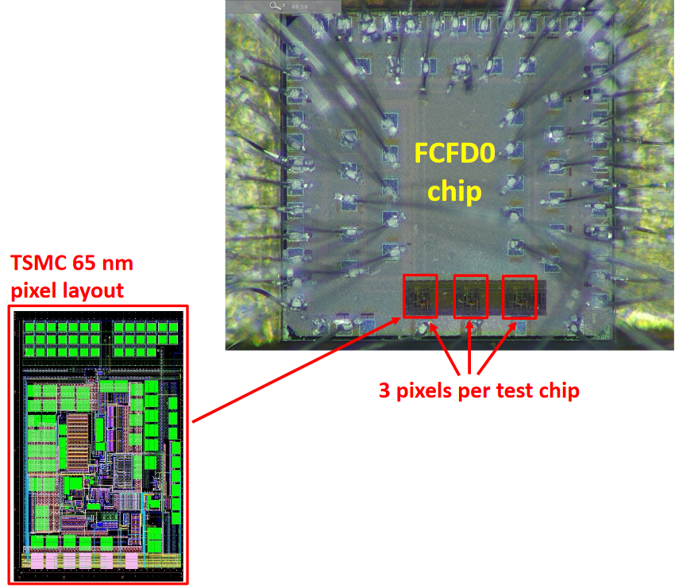
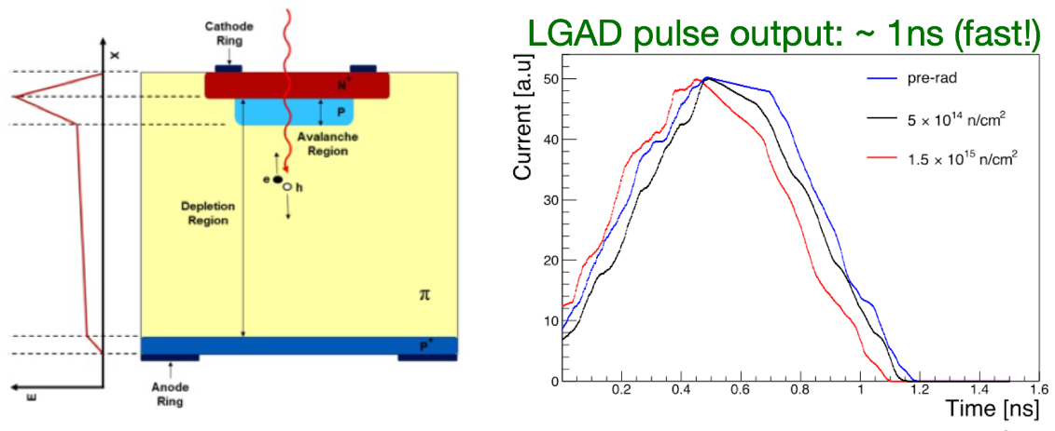
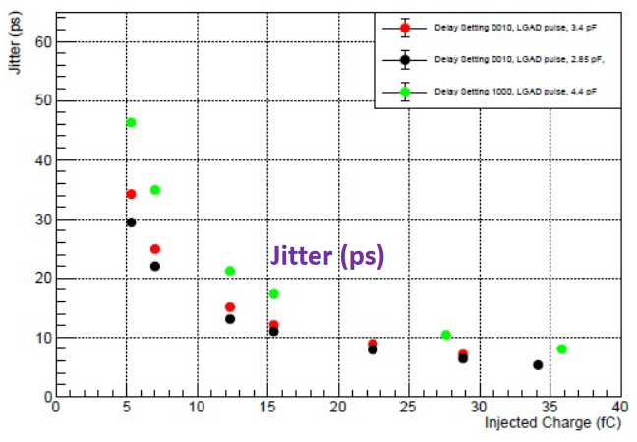
Barrel TOF – How to mitigate the risks?
eRD109 already addresses this: FCFD
Develop the FCFDv2 based on existing FCFDv0:
FCFDv1: 2023
FCFCv2: 2024 - 2025
TSMC 65 nm.
Timing precision: ~30 ps @ 5 fC; <10 ps @ 30 fC.
Development specifically targets strips and Barrel TOF requirements: Cd, packaging.
Considerable in-kind FNAL commitment.

Slide 9
Next Steps
Verify and collect missing parameters.
Why? Some considerations on specific parameters:
Qin Min-Max: The minimum charge sensitivity requirement is bound by the ENC from the combination of the sensor technology, the design of the ASIC input structure and their integration, e.g. parasitics.
Cd: the sensor capacitance plus parasitics impact timing precision and drive the fine-tuning of the ASIC shaping parameters.
Rates: the maximum rate per channel requirement impacts the design of the ASIC shaping parameters, memory depth and output link speed and/or number of links.

Slide 10
Next Steps - continued
ePIC specifications and requirements will be proposed and discussed with the Omega/IN2P3 groups to finalize the specifications of the EICROC and its variants.
The Omega/IN2P3 will then propose design and development plans.
Summary of ASIC developments (OMEGA/IN2P3, FNAL):
AC-LGAD
B0, RP, OMD, Hadron Endcap TOF – EICROC
Barrel TOF – EICROCx or FCFD.
MCP-PMT, HRPPD:
Revise HGCROC – Name?
SiPM:
Revise H2GCROC – ePIROC?

