Slide 1
Technical and Integration Council Meeting: August 21, 2023
J. Lajoie, S. Dalla Torre

Slide 2
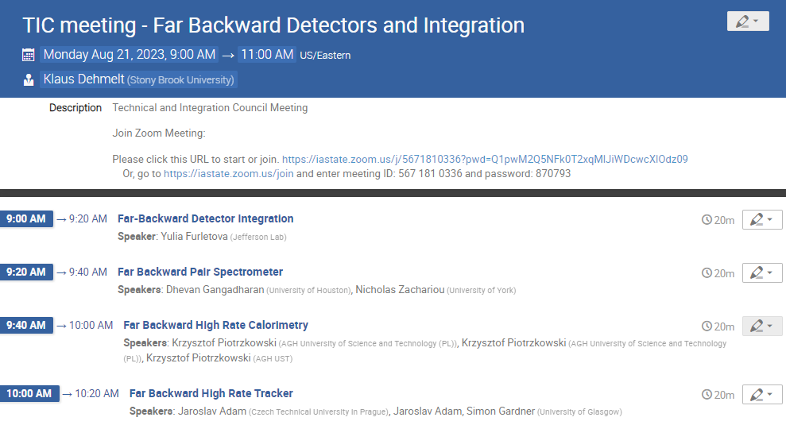
Announcements
Today:
Far-Backward Detectors and Integration
Silvia is on vacation this week so you are stuck with me today
August 28th:
SKIP
DAC R&D and ePIC Review this week
September 7^{th @} 12PM ET
Labor Day Holiday Sept. 4th, Alternate Day
Background MC developments, thresholds, (possibly tracking?)
September 11th:
FEE (others than HGCROC/EICROC), coupling sensors with ASIC
Global overview/approach to cooling
September 18th:
Update on MPGD’s?

Slide 3
Detector Naming Convention
OK, we get it – we botched the rollout of this, failed to communicate clearly, and generated a lot of confusion
The SP office believes it would be helpful to have properly descriptive standardized names to used in official/technical documentation as well as software. The Coordinators and TC were asked for a proposal.
We have some comments already, we would like to hear from as many of you as possible:
This is NOT INTENDED AS A VOTE! It is a genuine request for input.
The multiple choice response is not required to submit input
https://forms.gle/7ouTUMij9x4nR9vL7
We’ll take this feedback and decide how to go forward with involvement of the DSC’s and the rest of the collaboration.

