Slide 1
Impedance Modeling And Collective Effects in ESR
Alexei Blednykh
EIC Accelerator Design Weekly Meeting
Jun 7, 2023
A. Blednykh Accel Phys EIC Accelerator Design Weekly Meeting, 7 June 2023, BNL

Slide 2
Overview
Electron Storage Ring (HSR)
  Impedance Budget
Summary
A. Blednykh Accel Phys EIC Accelerator Design Weekly Meeting, 7 June 2023, BNL

Slide 3
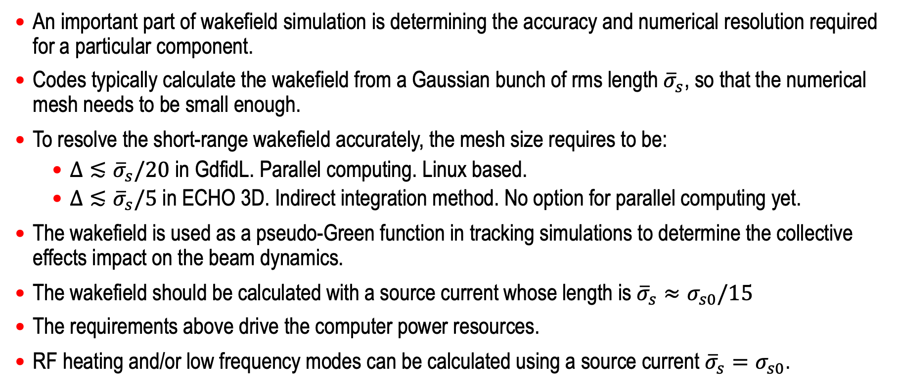
Calculation of the Pseudo-Green Function
An important part of wakefield simulation is determining the accuracy and numerical resolution required for a particular component.
Codes typically calculate the wakefield from a Gaussian bunch of rms length ${\overline{σ}}_{s}$, so that the numerical mesh needs to be small enough.
To resolve the short-range wakefield accurately, the mesh size requires to be:
  $Δ≲{\overline{σ}}_{s}/20$ in GdfidL. Parallel computing. Linux based.
  $Δ≲{\overline{σ}}_{s}/5$in ECHO 3D. Indirect integration method. No option for parallel computing yet.
The wakefield is used as a pseudo-Green function in tracking simulations to determine the collective effects impact on the beam dynamics.
The wakefield should be calculated with a source current whose length is ${\overline{σ}}_{s}≈σ_{s0}/15$
The requirements above drive the computer power resources.
RF heating and/or low frequency modes can be calculated using a source current ${\overline{σ}}_{s}=σ_{s0}$.
Review Article, A. Blednykh, G. Bassi, V. Smaluk, and R. Lindberg, “Impedance modeling and its application to the analysis of the collective effects”, Phys. Rev. Accel. Beams 24, 104801 (2021).
A. Blednykh Accel Phys EIC Accelerator Design Weekly Meeting, 7 June 2023, BNL

Slide 4
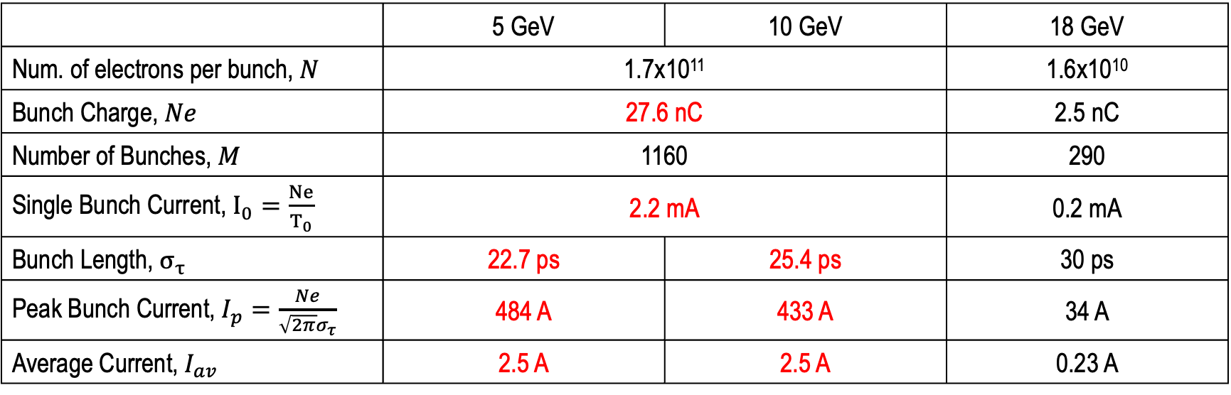
ESR Beam Intensity
 | 5 GeV | 10 GeV | 18 GeV
Num. of electrons per bunch, $N$ | 1.7x10¹¹ |  | 1.6x10¹⁰
Bunch Charge, $Ne$ | 27.6 nC |  | 2.5 nC
Number of Bunches, $M$ | 1160 | 1160 | 290
Single Bunch Current, $I_{0}=\frac{Ne}{T_{0}}$ | 2.2 mA |  | 0.2 mA
Bunch Length, $σ_{τ}$ | 22.7 ps | 25.4 ps | 30 ps
Peak Bunch Current, $I_{p}=\frac{Ne}{\sqrt{2π}σ_{τ}}$ | 484 A | 433 A | 34 A
Average Current, $I_{av}$ | 2.5 A | 2.5 A | 0.23 A
A. Blednykh Accel Phys EIC Accelerator Design Weekly Meeting, 7 June 2023, BNL

Slide 5
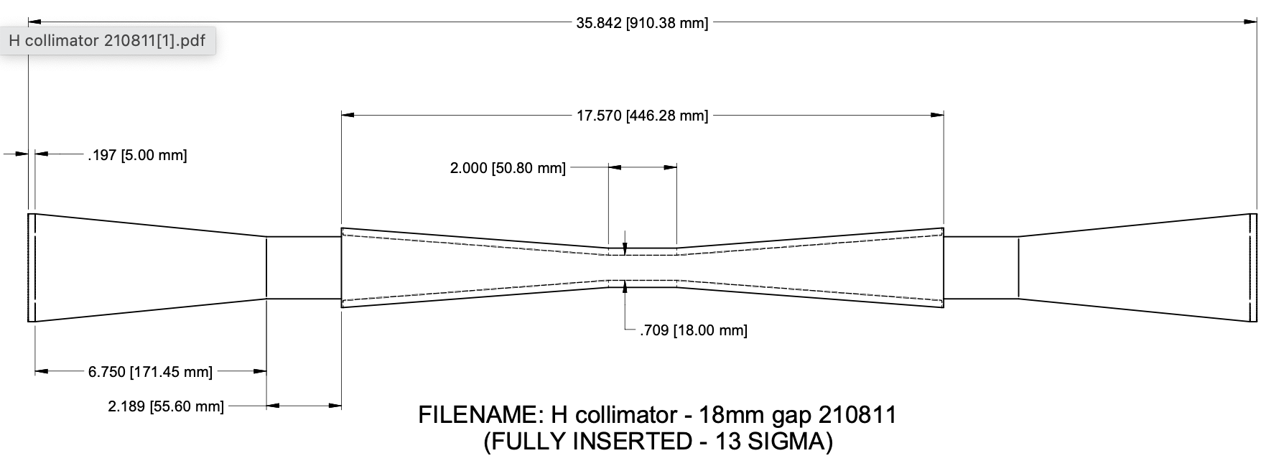
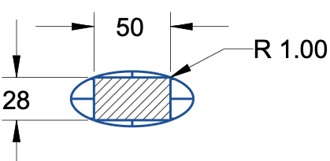
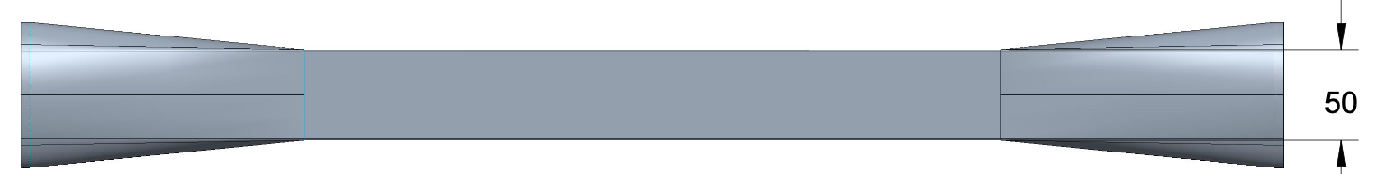

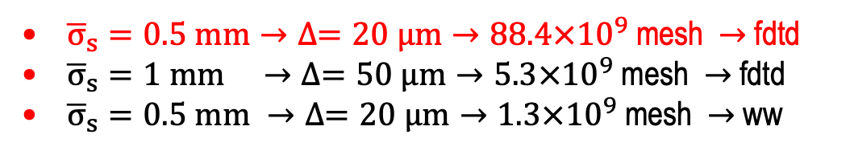
ESR Horizontal In-Vacuum Collimator
The total length is 910mm, with a ~370mm taper length.
The middle section has a rectangular profile
Available NSLS-II Computer Resources
23 x 24 CPU’s & 23 x 750 GB RAM
Detailed conceptual design in C. Hetzel’s talk
Computer Resources Usage
D. Hidas
G. Wang
20 $μm$
Collimator
GdfidL Algorithms
  Finite Difference Time Domain (-fdtd)
  Moving Window (-windowwake)
${\overline{σ}}_{s}=0.5 mm→∆=20 μm→88.4×{10}^{9}$ mesh $→$fdtd
${\overline{σ}}_{s}=1 mm →∆=50 μm→5.3×{10}^{9}$ mesh $→$fdtd
${\overline{σ}}_{s}=0.5 mm →∆=20 μm→1.3×{10}^{9}$ mesh $→$ ww
Transition
Longitudinal short-range wakefield W(s)
Codes benchmarking: G. Wang, M. Blaskiewicz, A. Blednykh and M. Sangroula, IPAC2021 Proceeding, WEPAB032
Top View of the Tapered Transition
A. Blednykh Accel Phys EIC Accelerator Design Weekly Meeting, 7 June 2023, BNL

Slide 6
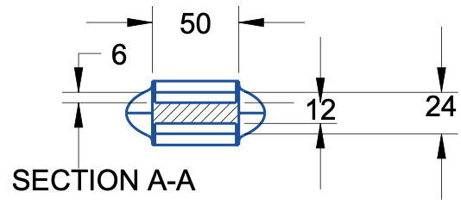
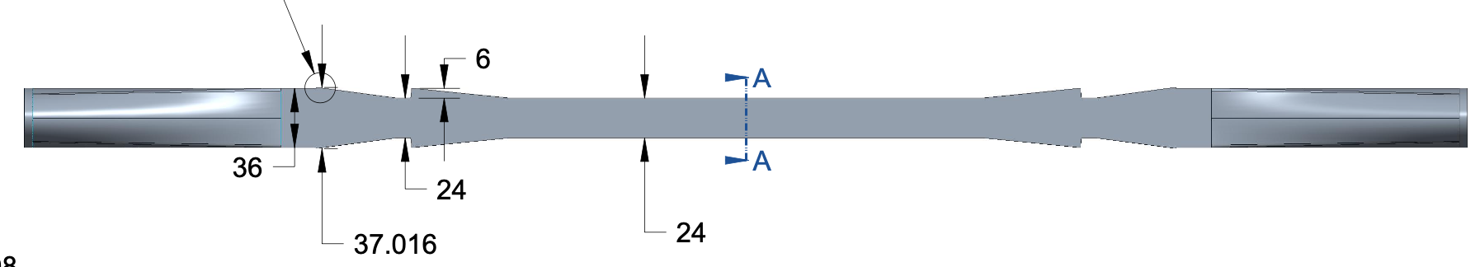
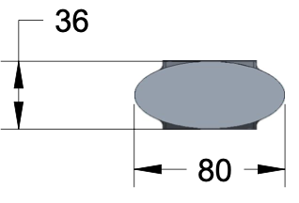
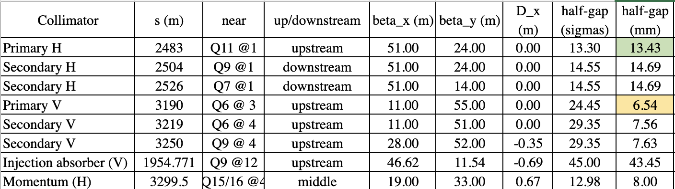

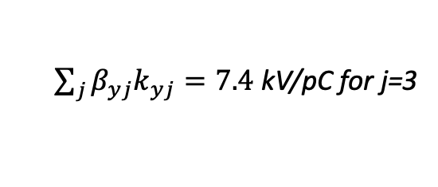
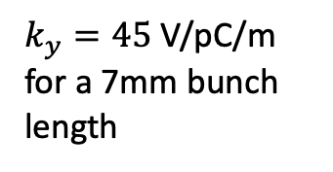
ESR Vertical Collimator (W_{yD})
At open position
M. Valette, A. Drees, C. Hetzel, J. Belong, G. Wang, M. Blaskiewicz
20um STEPSIZE - GdfidL
$k_{y}=45$ V/pC/m for a 7mm bunch length
$\sum_{j}{β_{yj}k_{yj}=7.4}$ kV/pC for j=3
Contribution of three VCLMs is ~30% of the present total vertical impedance budget.
If the minimum gap will be smaller as designed (12 mm).
Damage of jaws. The material choice is work in progress
A. Blednykh Accel Phys EIC Accelerator Design Weekly Meeting, 7 June 2023, BNL

Slide 7
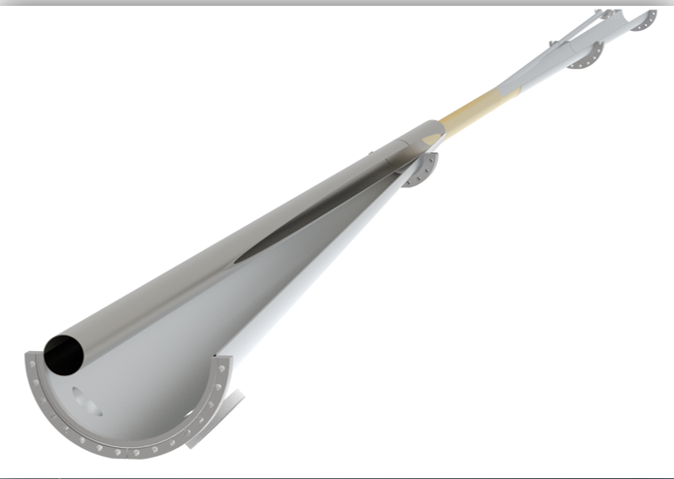
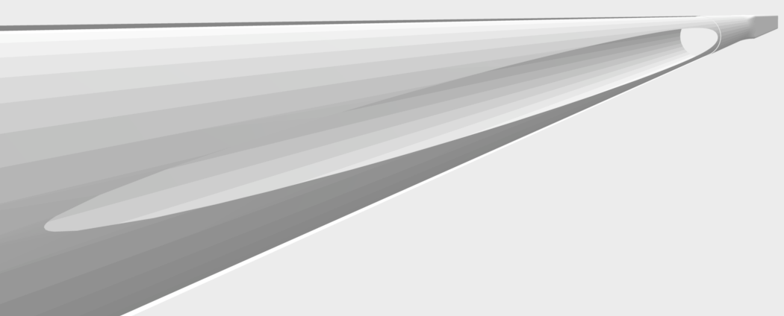
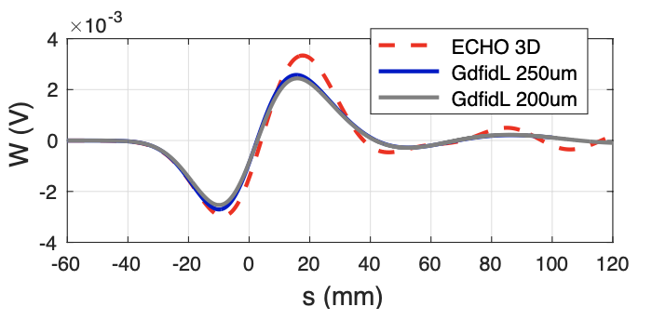
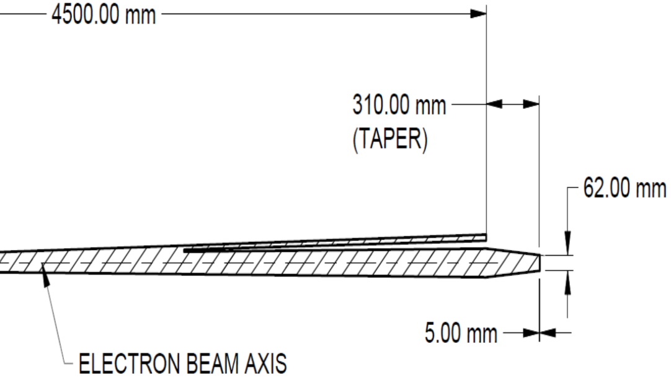
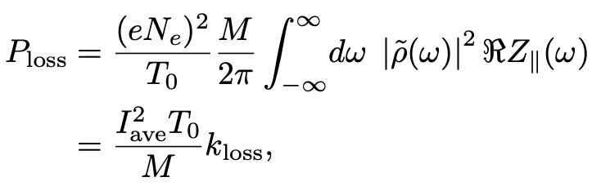




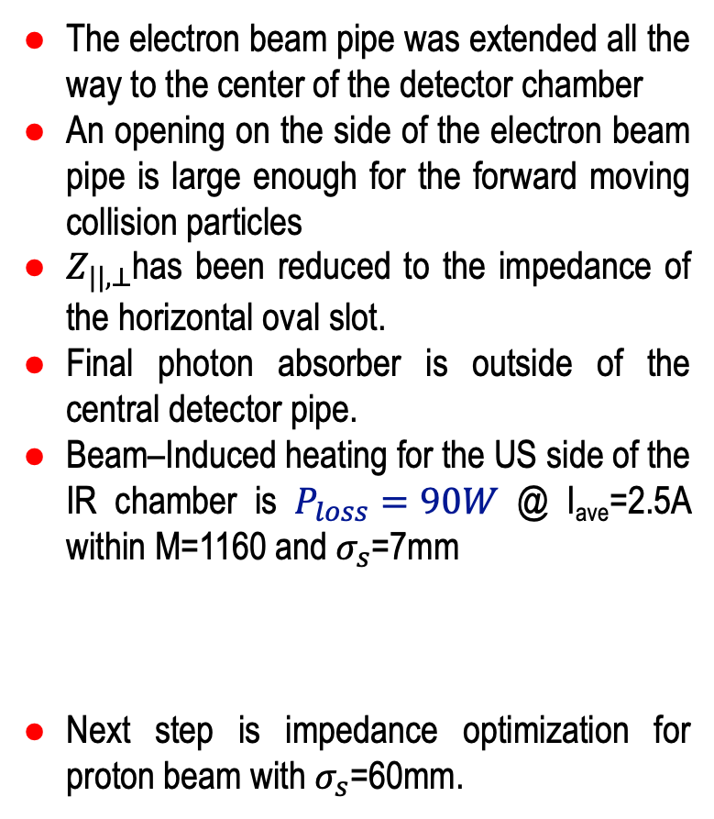
IR Chamber Design
- A. Blednykh, E. C. Aschenauer, M. Blaskiewicz, C. Hetzel, M. Sangroula, G. Wang, H. Witte, IPAC2021 Proceeding, WEPAB032
- H. Witte et al., These PAC2021 Proceedings, WEPAB002
Horizontal Oval Slot (US)
The electron beam pipe was extended all the way to the center of the detector chamber
An opening on the side of the electron beam pipe is large enough for the forward moving collision particles
$Z_{||,⊥}$has been reduced to the impedance of the horizontal oval slot.
Final photon absorber is outside of the central detector pipe.
Beam–Induced heating for the US side of the IR chamber is $P_{loss}=90W$ @ I_{ave}=2.5A within M=1160 and $σ_{s}$=7mm
Next step is impedance optimization for proton beam with $σ_{s}$=60mm.
$$e^{−}$$
40mm
1.4m long Beryllium section
$∅$60mm
$$e^{−}$$
Tapered Transition (DS)
$∅$60mm
C. Hetzel
A. Blednykh Accel Phys EIC Accelerator Design Weekly Meeting, 7 June 2023, BNL

Slide 8
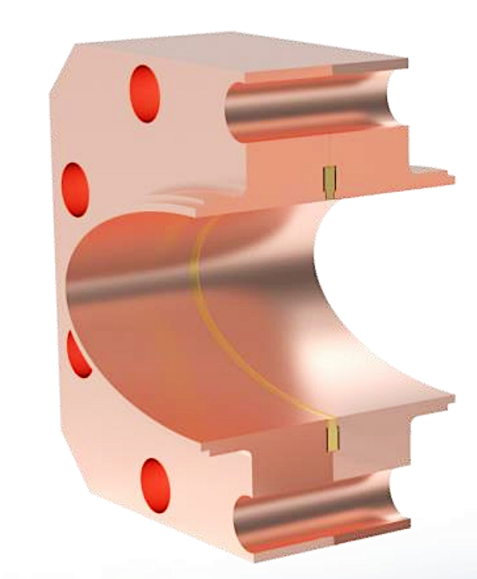
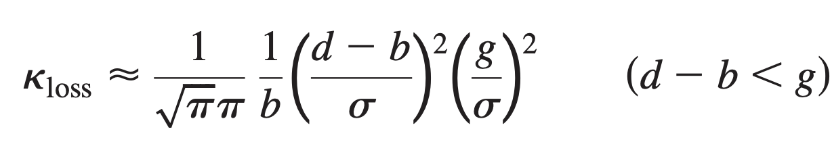




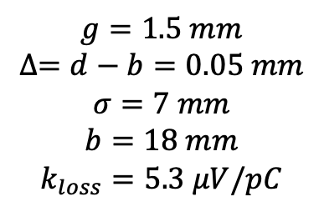



Flange Joints
Option A
Option B
$$g=1.5 mm$$
1.5mm
$$∆=0.05 mm$$
0.25mm
$${\overline{σ}}_{s}=0.5 mm$$
$${\overline{σ}}_{s}=0.5 mm$$
Factor of 10!
Total: ~2000
$k_{loss}=5.9 μV/pC$ ($σ=7mm$)
$k_{loss}=12 μV/pC$ ($σ=7mm$)
$$g=1.5 mm$$
$$∆=d−b=0.05 mm$$
$$σ=7 mm$$
$$b=18 mm$$
$$k_{loss}=5.3 μV/pC$$
Longitudinal wakefield
Slot regime $g<σ$
Option A is a reasonable choice
A. Blednykh Accel Phys EIC Accelerator Design Weekly Meeting, 7 June 2023, BNL

Slide 9
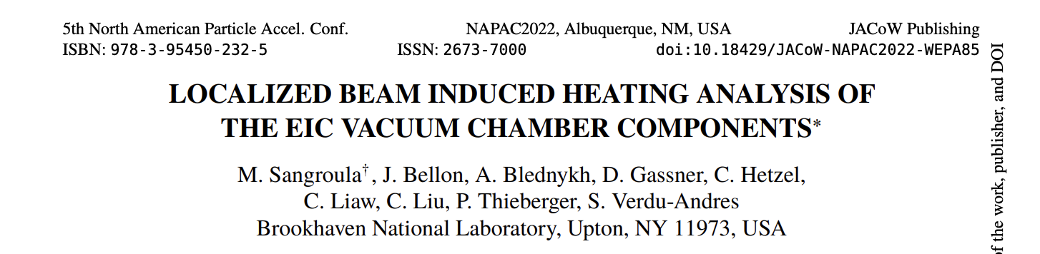
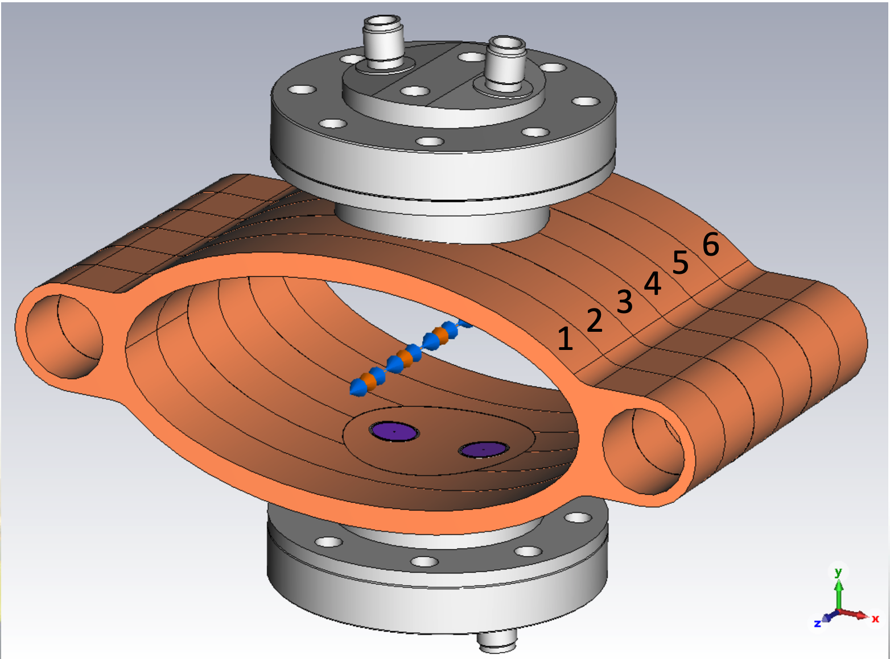
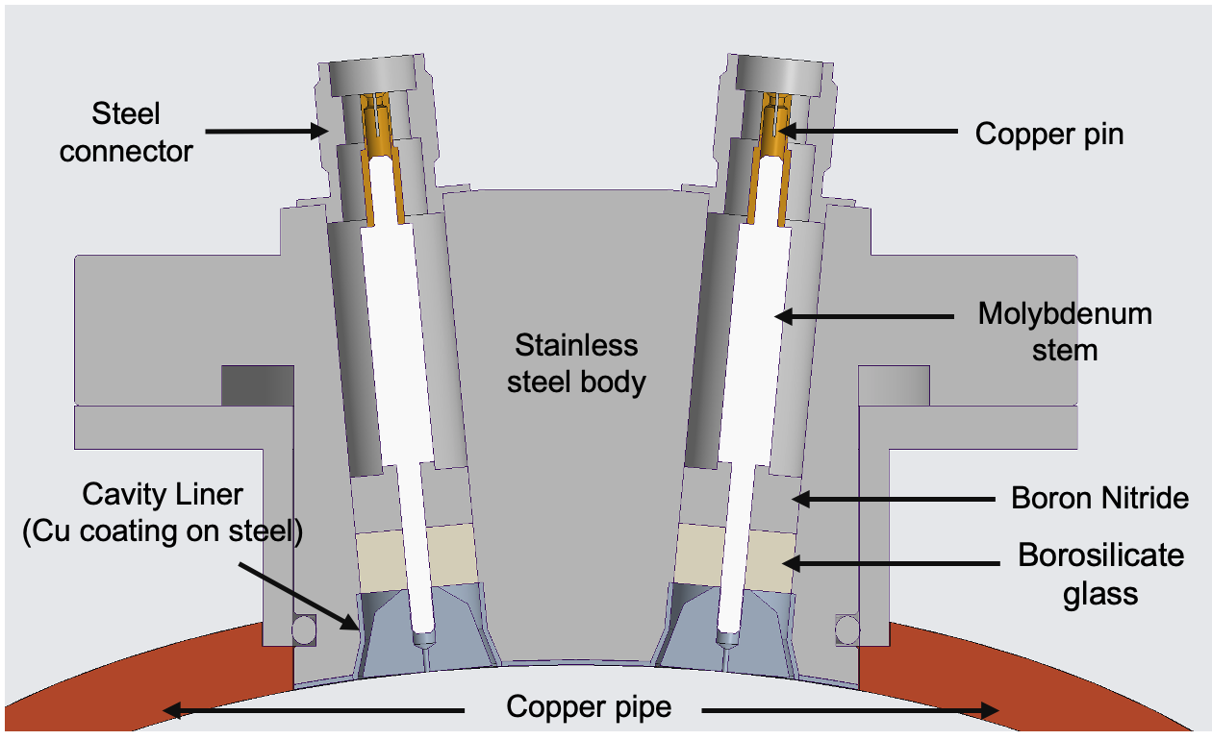
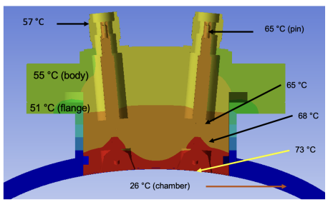
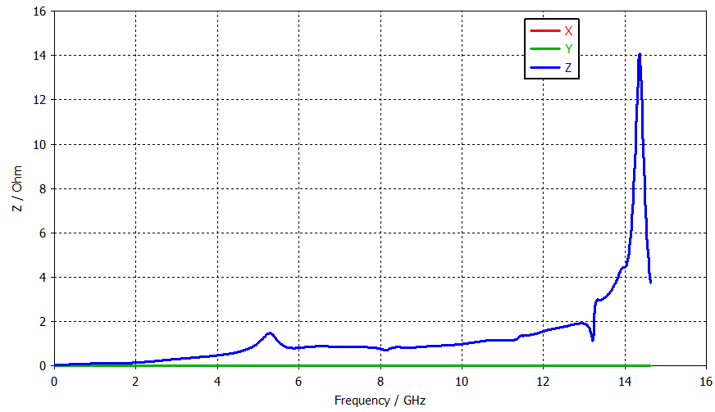
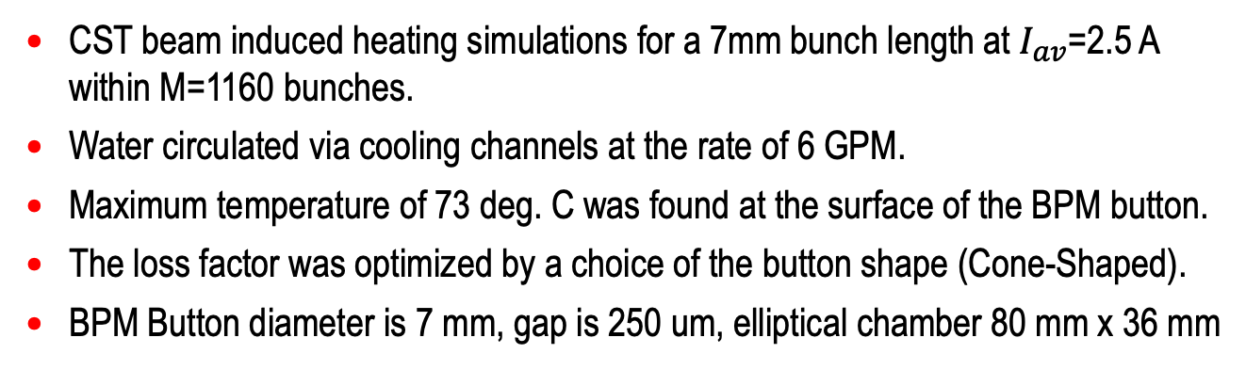
ESR BPM Button (Normal Conducting)
M. Sangroula
ESR BPM Button Assembly
CST beam induced heating simulations for a 7mm bunch length at $I_{av}$=2.5 A within M=1160 bunches.
Water circulated via cooling channels at the rate of 6 GPM.
Maximum temperature of 73 deg. C was found at the surface of the BPM button.
The loss factor was optimized by a choice of the button shape (Cone-Shaped).
BPM Button diameter is 7 mm, gap is 250 um, elliptical chamber 80 mm x 36 mm
Real Part of the long. impedance
A. Blednykh Accel Phys EIC Accelerator Design Weekly Meeting, 7 June 2023, BNL

Slide 10
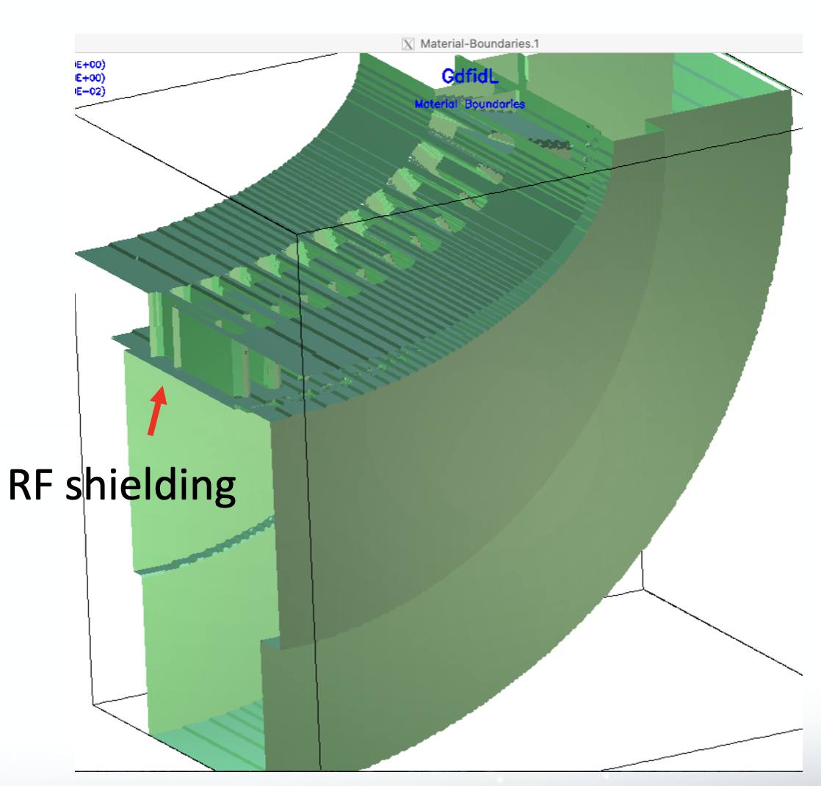
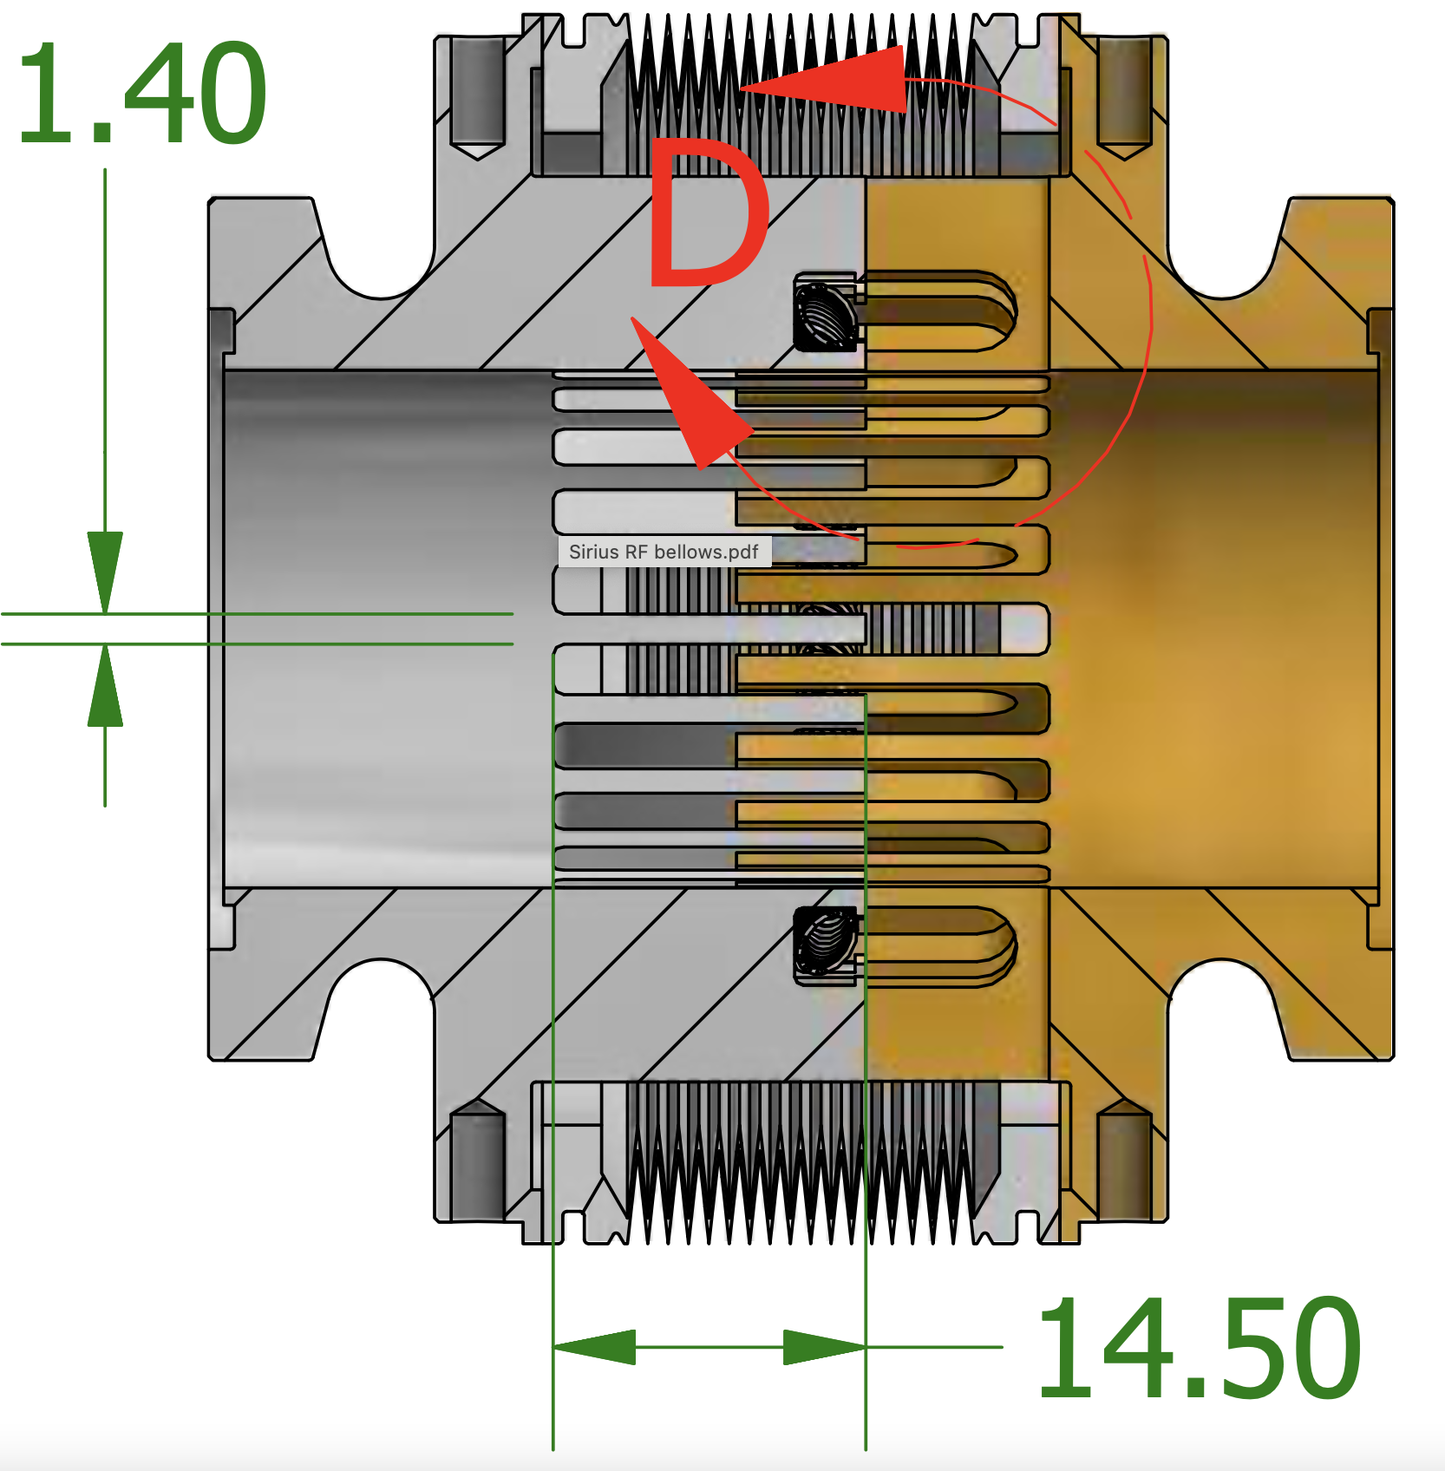
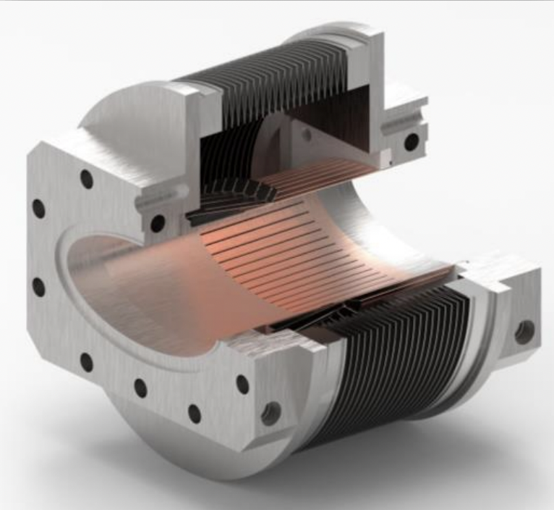
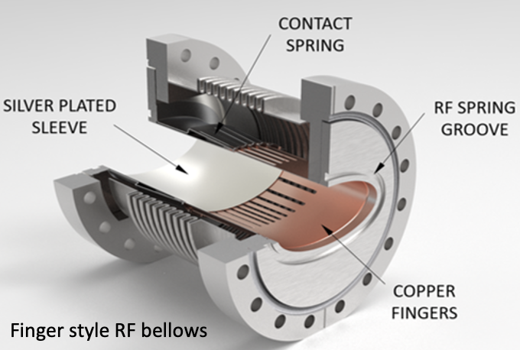
Bellows Design Adapted for ESR CHM Profile
SKEKB Comb Type
NSLS-II Conventional
Sirius Comb Type
ESR Bellows
C. Hetzel
ESR bellows is based on the NSLS-II conventional design
Water cooling channels are integrated to mitigate beam-induced heating
A. Blednykh Accel Phys EIC Accelerator Design Weekly Meeting, 7 June 2023, BNL

Slide 11
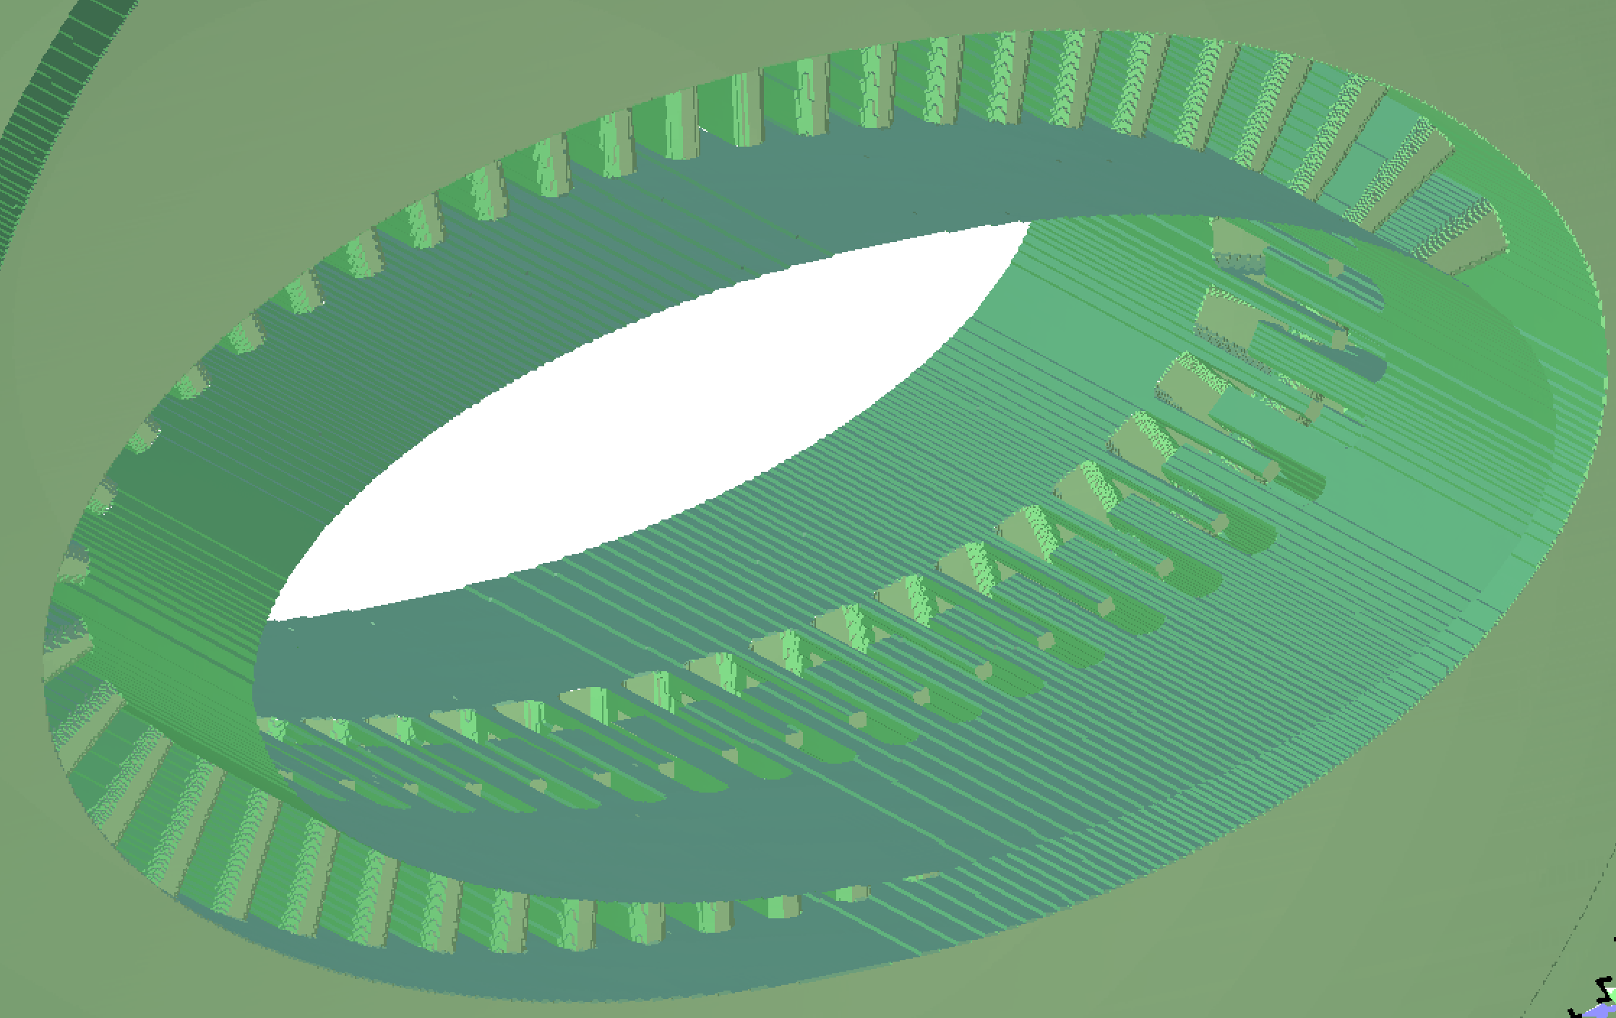


Sirius Comb Type Bellows Adapted for ESR
$k_{loss}=0.55mV/pC$ for a 7mm bunch length
Beam Induced Heating - OK
y
$$P_{loss}=38W @ 2.5A$$
x
$k_{loss}$ is smaller for longer bunches. Enough room for the water cooling channels.
x & y motion is limited by the space between the RF fingers.
RF flexible spring and small finger height eliminate capacitance effect at low-frequency (LF)
Significant Contribution at HF
A. Blednykh Accel Phys EIC Accelerator Design Weekly Meeting, 7 June 2023, BNL

Slide 12
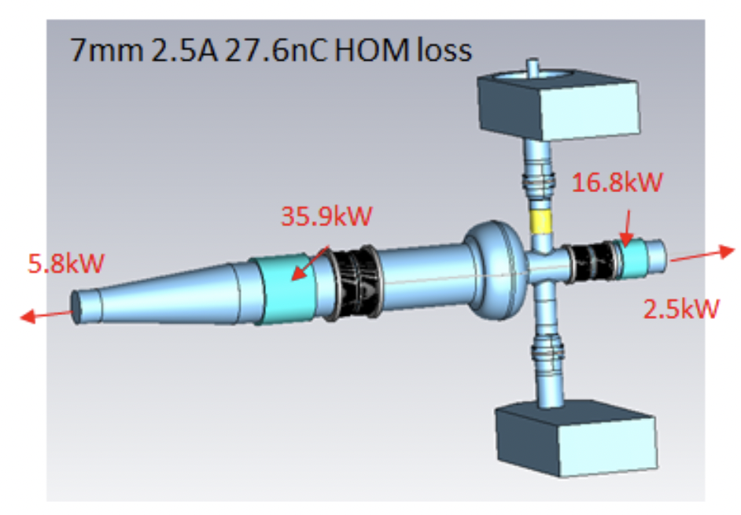
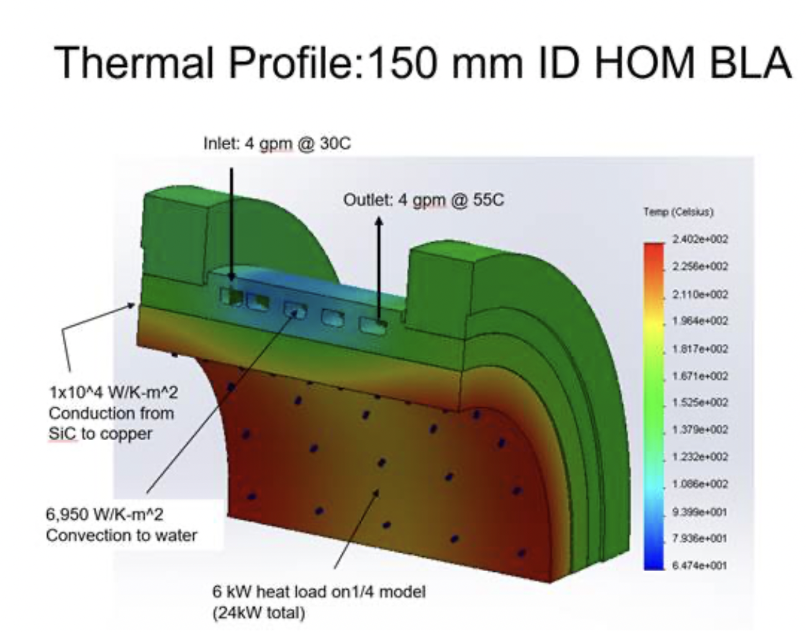
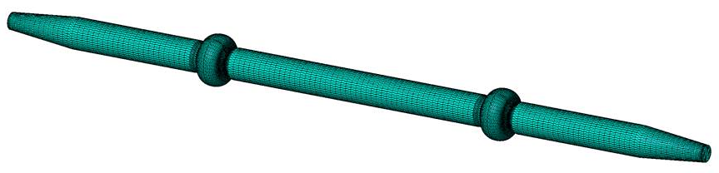
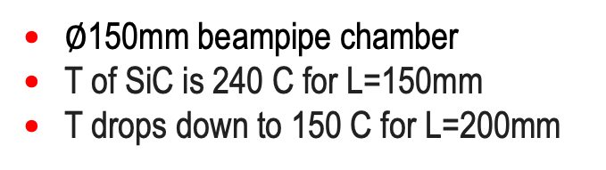
ESR Asymmetric 591 MHz RF Cavity
Installation of the RF cavities and number of tapered transitions
Protection from Synch. Rad.
Beam pipe between the cavities needs to be reduced from 150mm to 70mm to accommodate APS magnets
$∅$150mm beampipe chamber
T of SiC is 240 C for L=150mm
T drops down to 150 C for L=200mm
J. Guo
D. Holmes
G. Wang
W. Xu
C. Hetzel
C. Montag
R. Rimmer
E. Daly
A. Zaltsman
  ESR 591 MHz Cavities (HOM).
    Limiting space in IP10 for 17 cavities, tapered transitions, quadrupoles, correctors, BPMs, … .
    Asymmetric design with a 150 mm beam pipe diameter with integrated HOM
    Beam induced heating of HOM absorber.
Two Back-To-Back Cavities
x 9
x 9
Two Back-To Back Cavities & Tapered Transition
A. Blednykh Accel Phys EIC Accelerator Design Weekly Meeting, 7 June 2023, BNL

Slide 13


ESR – Impedance Budget
FFT of the total longitudinal wakefield at 5GeV
Components | Abbreviation | Number | Status
Bellows | BLW | 350 | ✓ x2 (NEG)
Collimator Ramp¹ | CLM | 16 | ✓
Horizontal In-Vacuum Collimator | HIVC | 3 | TBD
Vertical In-Vacuum Collimator | VIVC | 3 | TBD
Crab Cavity | CRBCVT | 2 | ✓
Beam Position Monitor² | BPM | 494 | ✓
Gate Valve² | GV | 30 | ✓
Stripline Kicker² | SK | 18 | ✓
Main RF Cavity² | CVT | 23 | ✓
Tapered Transition in RF Section | TPRD | 9? | TBD
Multipole Chamber Absorber | MPABS | 292 | ✓
Dipole Chamber Absorber | DPABS | 250 | ✓
Flange Joints | FLNG | 1500 | TBD
Resistive Wall | RW | - | ✓
Coherent Synchrotron Radiation | CSR | - | ✓
$$\overline{σ_{s}}=0.3mm$$
$$\overline{σ_{s}}=2mm$$
The strong resonance peak at 14GHz corresponds to 494 BPM.
1 - SKEKB design
2 - NSLS-II design
✓ - Included into the total W(s)
A. Blednykh Accel Phys EIC Accelerator Design Weekly Meeting, 7 June 2023, BNL

Slide 14


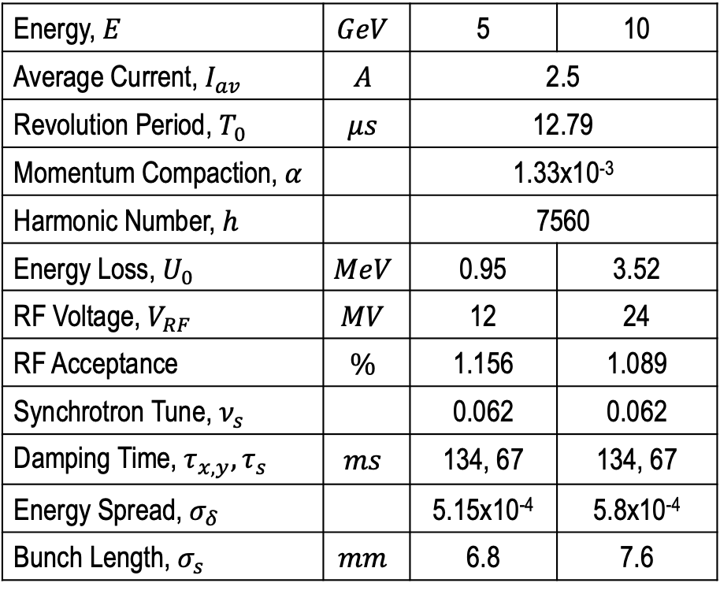
Microwave Instability Threshold at 5GeV
Energy, $E$ | $$GeV$$ | 5 | 10
Average Current, $I_{av}$ | $$A$$ | 2.5
Revolution Period, $T_{0}$ | $$μs$$ | 12.79
Momentum Compaction, $α$ |  | 1.33x10⁻³
Harmonic Number, $h$ |  | 7560
Energy Loss, $U_{0}$ | $$MeV$$ | 0.95 | 3.52
RF Voltage, $V_{RF}$ | $$MV$$ | 12 | 24
RF Acceptance | $$\%$$ | 1.156 | 1.089
Synchrotron Tune, $ν_{s}$ |  | 0.062 | 0.062
Damping Time, $τ_{x,y},τ_{s}$ | $$ms$$ | 134, 67 | 134, 67
Energy Spread, $σ_{δ}$ |  | 5.15x10⁻⁴ | 5.8x10⁻⁴
Bunch Length, $σ_{s}$ | $$mm$$ | 6.8 | 7.6
$$I_{th,μw}$$
Energy spread $σ_{δ}$ and bunch length $σ_{τ}$ as a function of single-bunch current
Microwave instability threshold is $I_{th,μw}=15 mA$
NSLS-II, APS, … need less than 1M macroparticles & 1 kick per turn for numerical simulations.
EIC requires, at least, 8M macroparticles and 8 wakefield elements per turn, C>3times longer, momentum compaction 5 times larger, … .
A. Blednykh Accel Phys EIC Accelerator Design Weekly Meeting, 7 June 2023, BNL

Slide 15



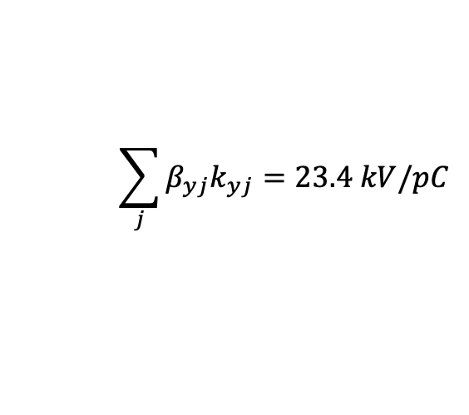
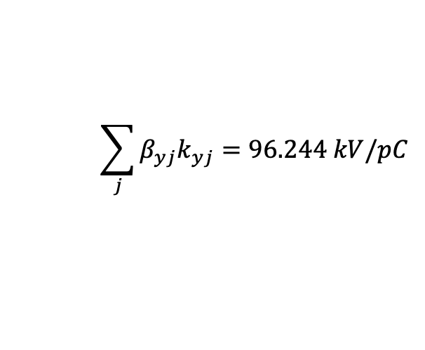

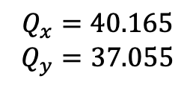
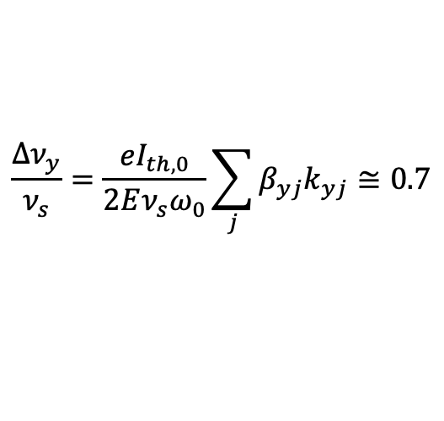
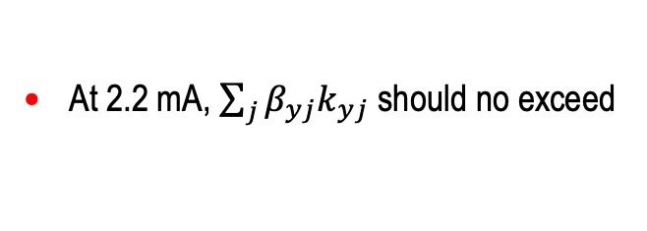



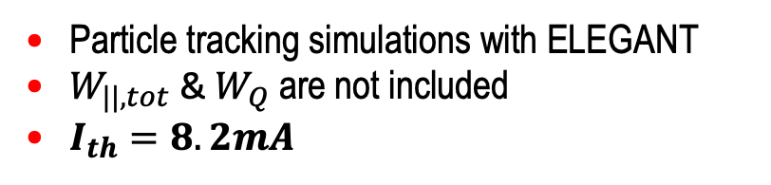
Transverse Mode Coupling Instability at 5GeV Lattice
Total Dipole Vertical Wakefield
Chromaticity 0/0
$$σ_{s}=7mm$$
$$Q_{x}=40.165$$
$$Q_{y}=37.055$$
$k_{yD}=876$ V/pC/m
The TMCI at zero chromaticity
$$E=5GeV$$
$$\frac{∆ν_{y}}{ν_{s}}=\frac{eI_{th,0}}{2Eν_{s}ω_{0}}\sum_{j}{β_{yj}k_{yj}≅0.7}$$
$$ν_{s}=0.06157$$
$$β_{y,av}=26.72$$
At 2.2 mA, $\sum_{j}{β_{yj}k_{yj}}$ should no exceed
$$ω_{0}=2π × 78.195kHz$$
Particle tracking simulations with ELEGANT
$W_{||,tot}$ & $W_{Q}$ are not included
$I_{th}=8.2mA$
$$\sum_{j}{β_{yj}k_{yj}=23.4 kV/pC}$$
$$\sum_{j}{β_{yj}k_{yj}=96.244 kV/pC}$$
$$I_{th}=9mA$$
A. Blednykh Accel Phys EIC Accelerator Design Weekly Meeting, 7 June 2023, BNL

Slide 16
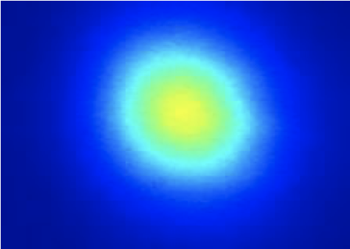
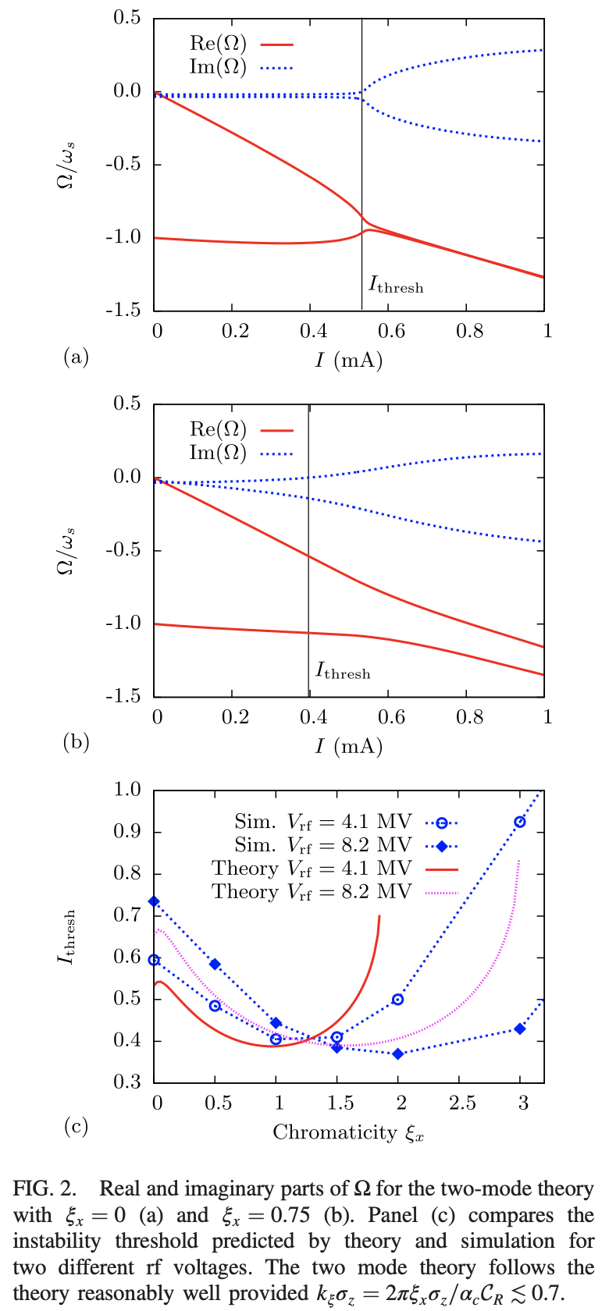
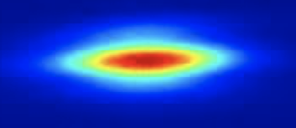
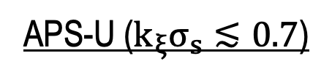

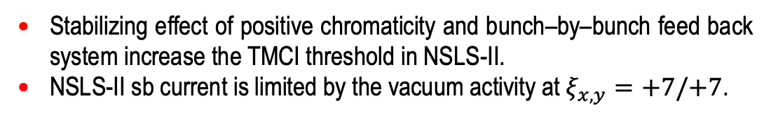
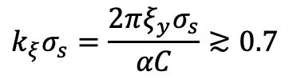
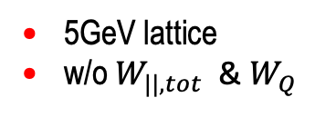




TMCI Threshold vs. Chromaticity
NSLS-II ($k_{ξ}σ_{s}≳0.7$)
APS-U ($k_{ξ}σ_{s}≲0.7$)
EIC ($k_{ξ}σ_{s}≲0.7$)
$$C=792 m \& α=3.7×{10}^{−4}$$
$C=1100 m \&$ $α=5.66×{10}^{−5}$
$C=3833.93 m \&$ $α=1.33×{10}^{−3}$
5GeV lattice
w/o $W_{||,tot}$ & $W_{Q}$
Experimental data
Two-Mode approximation valid when
$$k_{ξ}σ_{s}=\frac{2πξ_{y}σ_{s}}{αC}≳0.7$$
Stabilizing effect of positive chromaticity and bunch–by–bunch feed back system increase the TMCI threshold in NSLS-II.
NSLS-II sb current is limited by the vacuum activity at $ξ_{x,y}=+7/+7$.
R. Lindberg, Phys. Rev. Accel. Beams 19, 124402
A. Blednykh Accel Phys EIC Accelerator Design Weekly Meeting, 7 June 2023, BNL

Slide 17
Summary
Work on Impedance Budget for ESR and HSR is continued. RCS is next.
The Collective Effects Simulations have been performed for ESR w/ up-to-date Impedance Budget. The instability thresholds are above the required single-bunch current of 2.2 mA. HSR is next.
The crab cavities in the ESR and HSR can lead to very strong transverse coupled-bunch instabilities.
Transverse Bunch-by Bunch Feedback is required during injection and ramping in the HSR to suppress the instabilities.
The proton beam is stable during store due to large synchrotron tune and beam-beam tune spread.
Beam – Beam Simulation w/ the total longitudinal Wakefield is work in progress.
A. Blednykh Accel Phys EIC Accelerator Design Weekly Meeting, 7 June 2023, BNL

Slide 18

ESR Individual Component Contribution to the Total Longitudinal Wakefield (${\overline{σ}}_{s}$=0.3mm)
Bellows, Ramp Collimators and Gate Valves are the first few largest sources
A. Blednykh Accel Phys EIC Accelerator Design Weekly Meeting, 7 June 2023, BNL

Slide 19

ESR Individual Component Contribution to the Total Vertical Dipole Wakefield (${\overline{σ}}_{s}$=2mm)
Bellows, BPM and Gate Valves are the first few largest sources.
A. Blednykh Accel Phys EIC Accelerator Design Weekly Meeting, 7 June 2023, BNL

