Slide 1
SR control in the Polarimeter Region Update
Polarimeter Meeting
M. Sullivan
June 7, 2023

Slide 2
Outline
Recap of the issues
18 GeV
Various W thicknesses
10 GeV
W thickness
Summary

Slide 3
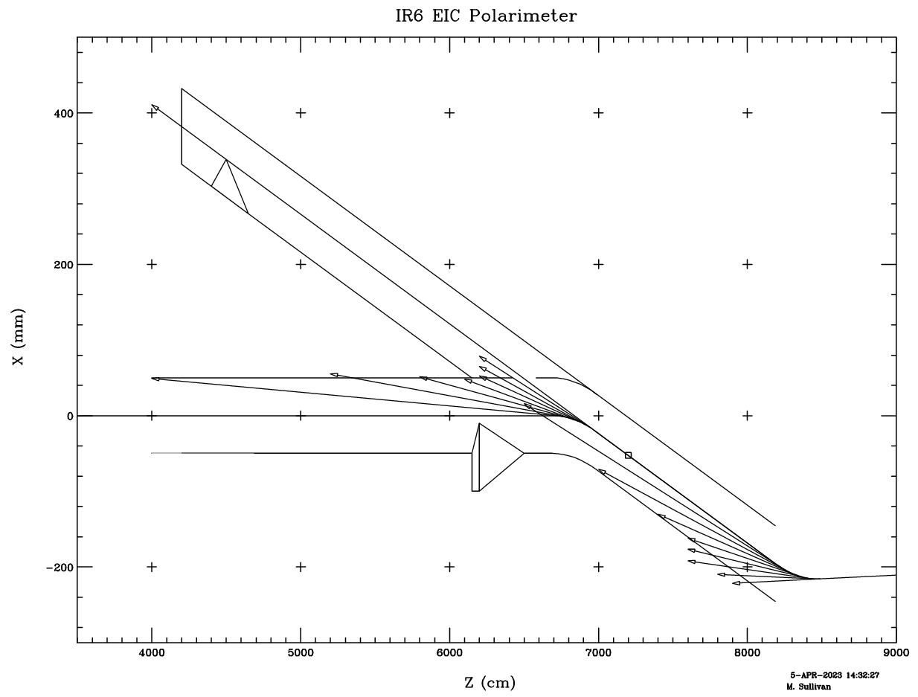
Drawing of polarimeter region
Each 1/8 fan slice has:
4090 W for B3 and
3566 W for B2
Total SR power from these 2 bend magnets is 32.86 kW
Some notes:
Power density at a photon window near the electron detector is 22.4 kW over 5 cm = 450 W/mm
Will melt all materials
Long vacuum tube to move the window away from the sources
With a mask positioned as shown the photon window sees mostly quadrupole radiation
Water cooling
B2
B3

Slide 4
Photon window for the polarimeter
Previous presentations had these power numbers on the window
10 W/mm² is about the usual engineering maximum
18 GeV
W fan ht (mm) W/mm² Kc (keV) E/bun (keV) #γ/bun #γ>20 keV
From B3 2752 4.5 12.2 67 1.7e12 8.3e10 2.3e10
From B2 7703 2.8 55.0 63 4.8e12 2.5e11 6.7e10
10 GeV
W fan ht (mm) W/mm² Kc (keV) E/bun (keV) #γ/bun #γ>20 keV
From B3 2366 4.5 10.5 12 6.9e7 1.9e7 8.2e5
From B2 6158 2.8 44.0 11 4.8e12 2.5e11 6.7e10

Slide 5
Photon window (2)
The fan height from the far magnet (D3) is 4.5 mm (round up to 5 mm)
The fan height from the near magnet (D2) is 2.8 mm (round up to 3 mm)
Suggest we put a horizontal mask into the photon beam pipe down near the window that is high enough to absorb the bend fan radiation about halfway between the laser IP and the photon window
Needs to be at least 8mm high in order to get water cooling into the mask (±4 mm in Y)
At the suggested location (44 m – 2 m upstream of the window), the mask would occlude a horizontal slice of the photon window approx. ± 5 mm by 5 cm
Can be sloped so that the power density is manageable
Cartoon (next slide) has a sloped surface that is 5 cm by 150 cm (could be more)

Slide 6
Drawing of polarimeter region
Each 1/8 fan slice has:
4090 W for B3 and
3566 W for B2
Total SR power from these 2 bend magnets is 32.86 kW
Some details:
Hole in beam pipe for the photons is a long oval about 1.6 m in X by 6 cm in Y
Propose adding a smaller horizontal slit (3.7 m in X and 1.5 cm in Y) to the above to let the first 3 slices of the B2 fan hit the mask
Engineering needed for the crotch area
Photon window sees mostly quad radiation
Water cooling
B2
B3

Slide 7
Some numbers
Studied the power density as a function of the mask size
If the mask is +/- 4 mm (8 mm in Y) and 55 mm in X (from the beam pipe wall to 5 mm past the center of the beam pipe) then
The photon window receives almost only quadrupole radiation
The total power on the window is now 116 W
This is 3.96×10⁹ photons per beam bunch incident on the window >1 keV
The mask at this location (2 m upstream of the photon window) intercepts 6152 W
If we slope the mask over 1.5 m, then the linear power density is 4.1 W/mm which should be OK
There is a lot of SR power spraying down this beam pipe so we will need to water cool this entire pipe

Slide 8
Photons incident on the photon window
The program SYNC_BKG gives me the number of photons incident on the photon window as well as an estimate of the energy spectrum
I can use this information as input to my 2nd program MASKING to get an estimate of the number of incident photons that get through the window

Slide 9
Photons incident on and through the window
I simulated a 2 mm Al window with 100 million incident photons with perpendicular incidence
I found that 1848153 (1.8%) go through with most of the soft photons being absorbed
Normalizing this number, we get 39.6 x 1848153 = 7.32×10⁷ photons getting through per beam bunch
I also simulated a window with 2 mm Al then 2 mm H₂O and then 2 mm Pb
I found that 6676 (6.7×10⁻⁵) got through which (normalized) equals 2.64×10⁵ photons per bunch and this is equal to 23.8 GeV per beam bunch
Also did the same as previous but with 2 mm of W instead of Pb
I found that 461 (4.6×10⁻⁶) got through which (normalized) equals 1.83×10⁴ photons per bunch and this is equal to 2.48 GeV per beam bunch

Slide 10
Discussion and next runs
I noticed that the photon energy spectrum is cut off in the Pb and W plots (in the backup slides)
I didn’t generate photons out to a high enough energy (my default is 150 keV)
Even though there are very few photons above 150 keV – most of them get through
The default is easy to change
So I ran with an energy range of 1-300 keV
Also some runs from 1-500 keV
Also checked 10 GeV beam
1.06x10⁹ photons > 1keV incident on the photon window
Also get 99.9 W of quadrupole power on the window
Notes:
Total photons and power from masks 26-32. 26,27,28 are vertical masks (horizontal slit) and 29, 30, 31 and 32 are horizontal masks (vertical slit)

Slide 11
Numbers for 1-300 and 1-500 keV runs (18 GeV)
We still have 3.96×10⁹ photons per beam bunch incident on the window >1 keV
For 2 mm Al, 2 mm H₂O and 2 mm W with range 1-300 keV we get:
29739 photons out of 100M incident getting through
We normalize this by multiplying by 39.6 to get 1.178x10⁶ photons per beam bunch
This corresponds to 258 GeV/bunch
For 2 mm Al, 2 mm H₂O and 5 mm W with range of 1-500 keV we get:
3.85x10⁵ photons/bunch and 117 GeV/bunch

Slide 12
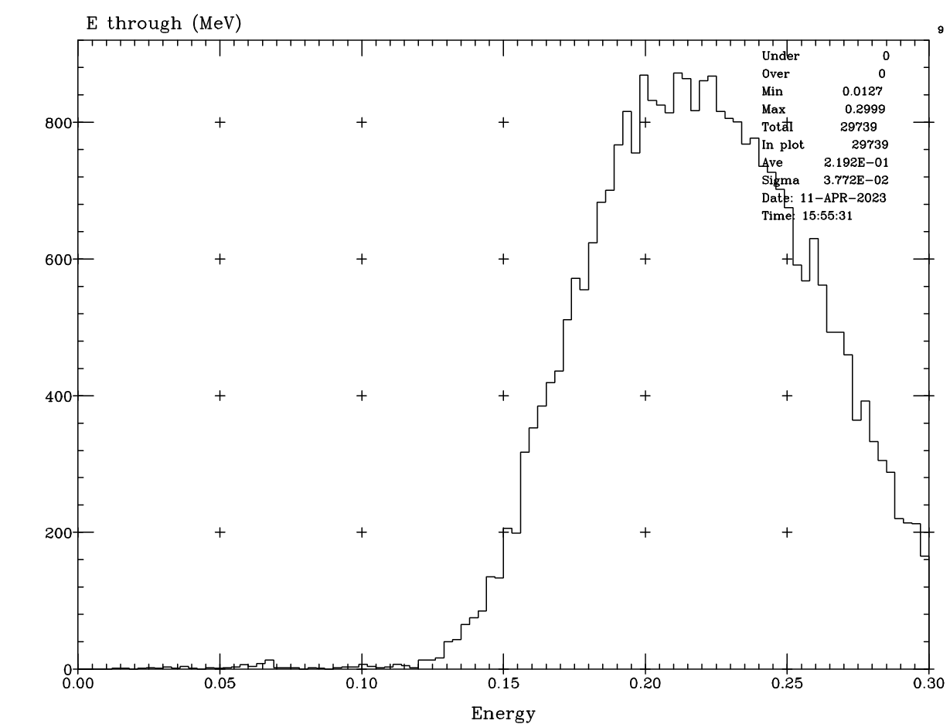
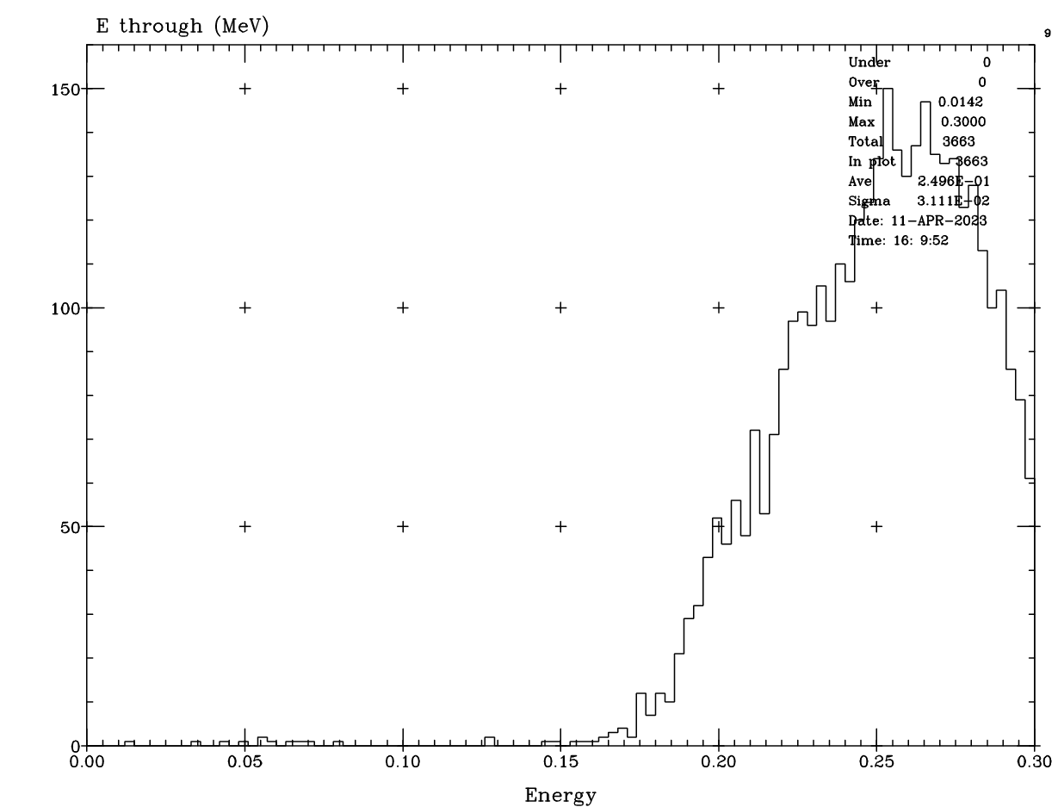
Some plots
2 mm W incident energy range 1-300 keV
5 mm W incident energy range 1-300 keV

Slide 13
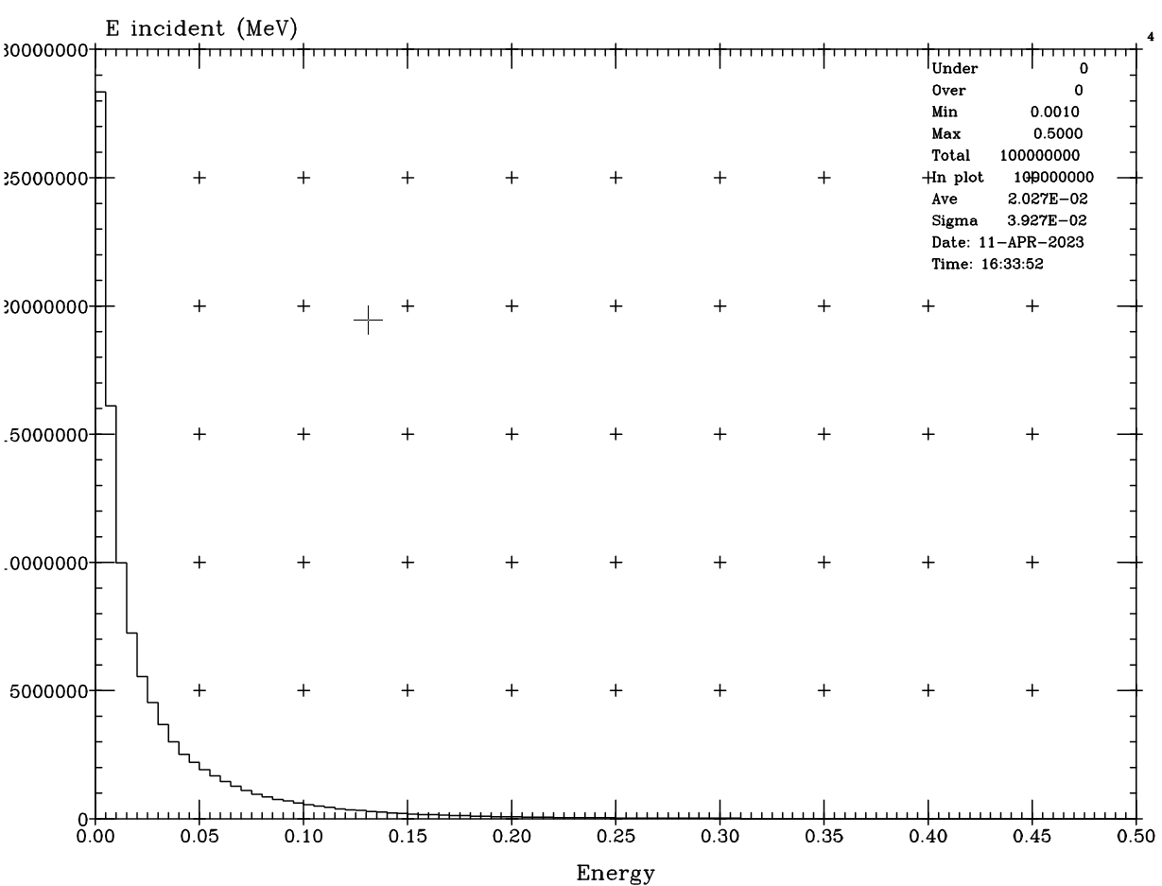
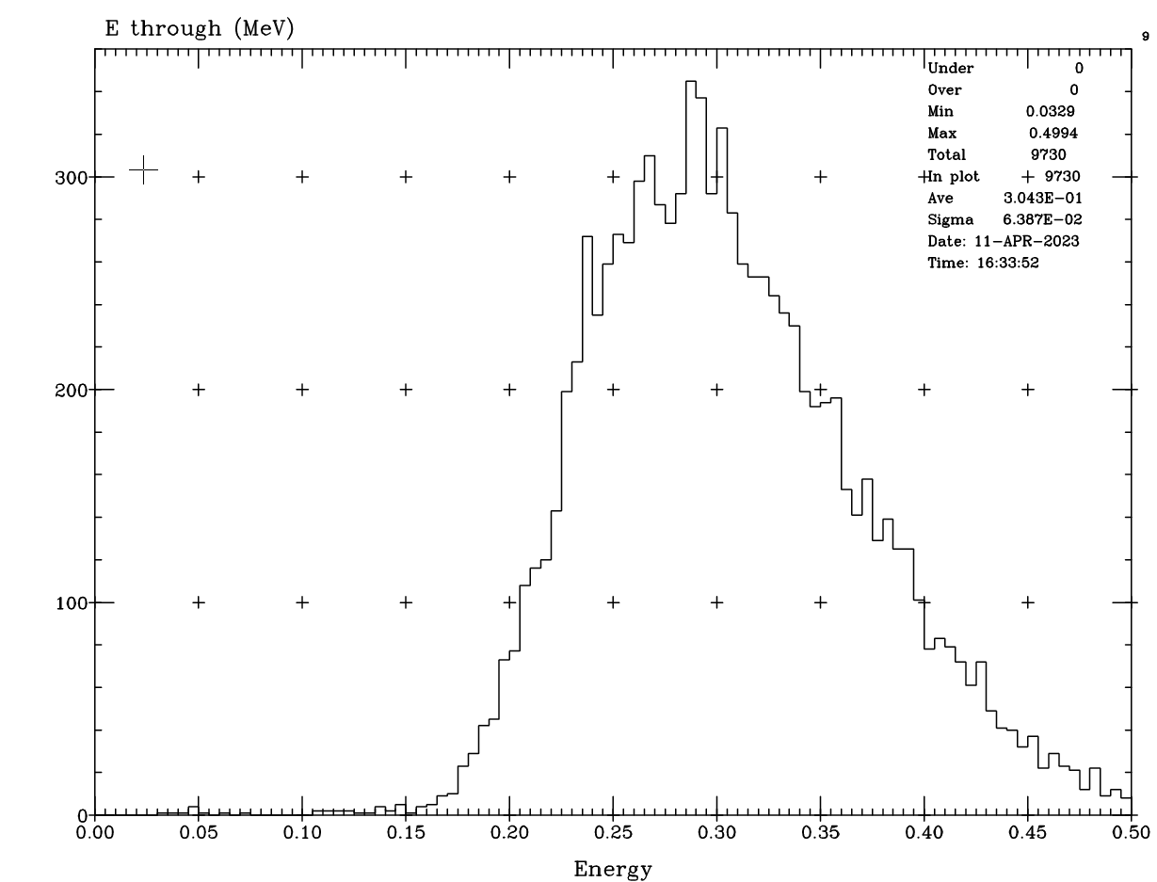
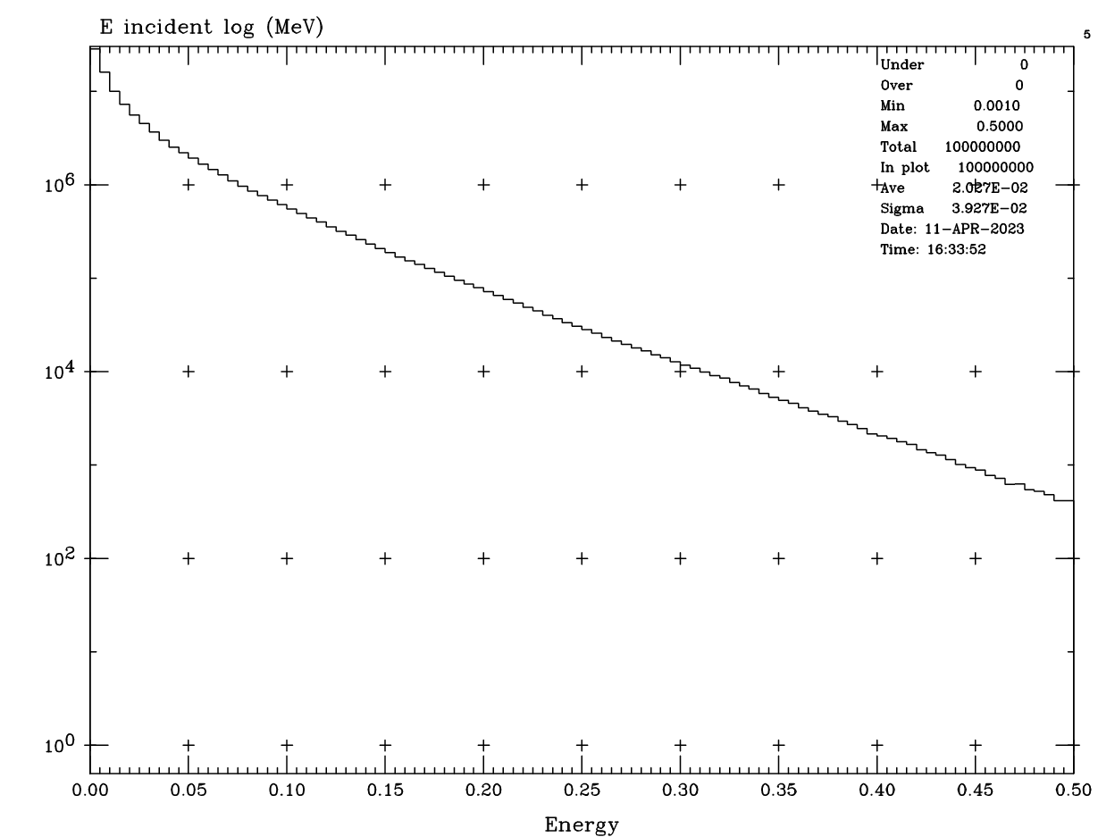
1-500 keV incident energy range
Incident energy distribution on photon window
Energy plot of photons that go through 5 mm W

Slide 14
W was then increased to 1 cm then to 2 cm
For 2 mm Al, 2 mm H₂O and 1 cm W with a range of 1-500 KeV
6.52x10⁴ photons getting through/bunch
Energy getting through is 22.9 GeV/beam bunch
For 2 mm Al, 2 mm H2O and 2 cm W with a range 1-500 keV
3600 photons getting through with a total of 1.39 GeV energy/ bunch
These numbers are starting to seem acceptable

Slide 15
Beam tails
I thought that these high energy photons which are getting through even 2 cm of W were coming from the beam tail distribution and the beam particle density out at these high beam sigmas is not well known
I tried a more favorable beam tail distribution (fewer particles out at high sigmas) and discovered that I got very little difference
Closer inspection of my output file from SYNC_BKG revealed that some of the bend radiation is still getting around the proposed mask
The output information indicates which sources are contributing to a particular surface

Slide 16
10 GeV
As expected, the 10 GeV SR energy spectrum is much softer
We now have 1.06×10⁹ photons per beam bunch incident on the window >1 keV (4 times less than 18 GeV)
For 2 mm Al, 2 mm H₂O and 2 mm W with range 1-150 keV we get:
4 photons out of 1B incident getting through
We normalize this by multiplying by 1.06 to get 4 photons per beam bunch
This corresponds to 269 keV/bunch
2 mm of W is more than adequate to shield the photon detector from the SR

Slide 17
Summary
The SR on the photon window can be managed if we can insert a mask a couple of meters upstream of the window that is designed to absorb almost all of the bend radiation
We are then left with mostly quadrupole radiation and some leftover bend radiation which comes to about 120 W
Fairly broad peak at the center of the window
We may need a fairly thick W shield (≥ 2 cm) for the 18 GeV beam
The 10 GeV beam has a softer photon energy spectrum and we have found that 2 mm of W looks to be quite effective in blocking all of the SR photons at this beam energy

Slide 18
Next steps
Zhengquiao has asked if the quadrupole just upstream of the electron detector might not have SR that hits the electron detector
I have come up with a plan to put that quad in my model but have not yet done so. Hope to do that soon.
With the quad so close to the electron detector I do not think that it is capable of putting much background into the detector but it does need to be checked
His excellent point is that the detector is quite close to the beam envelope

Slide 19
Thanks

Slide 20
Backup plots

Slide 21
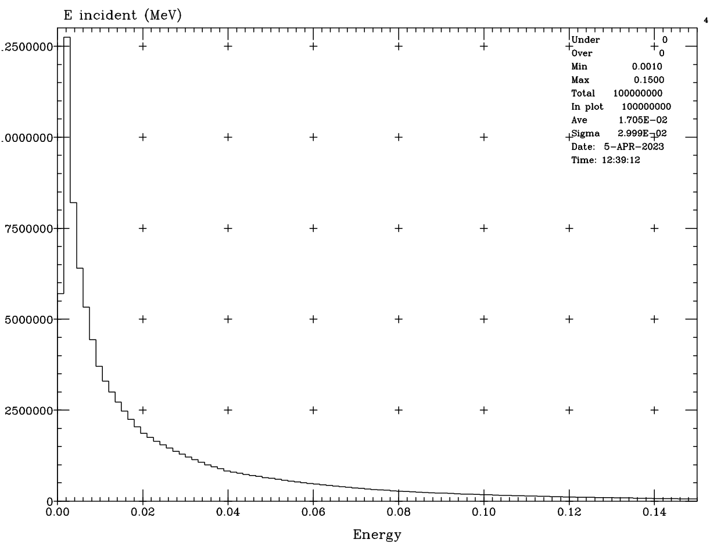
Incident energy spectrum
Quadrupole radiation incident on the polarimeter photon window
Meant to show these plots last time

Slide 22
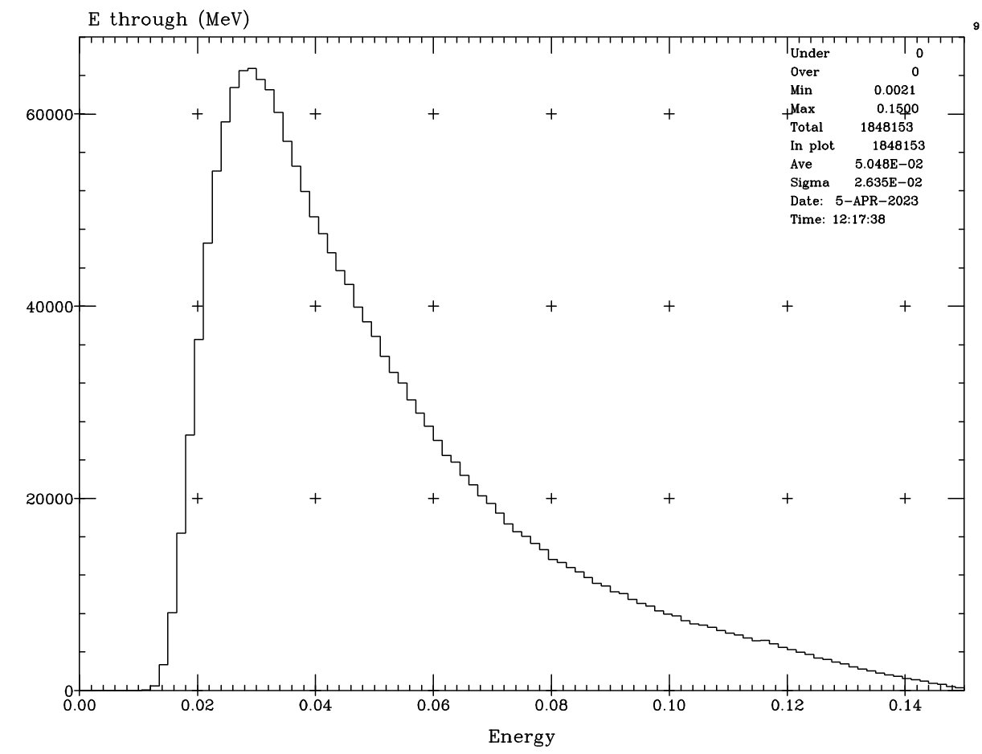
Through photons
Energy spectrum of photons that go through 2 mm of Al

Slide 23
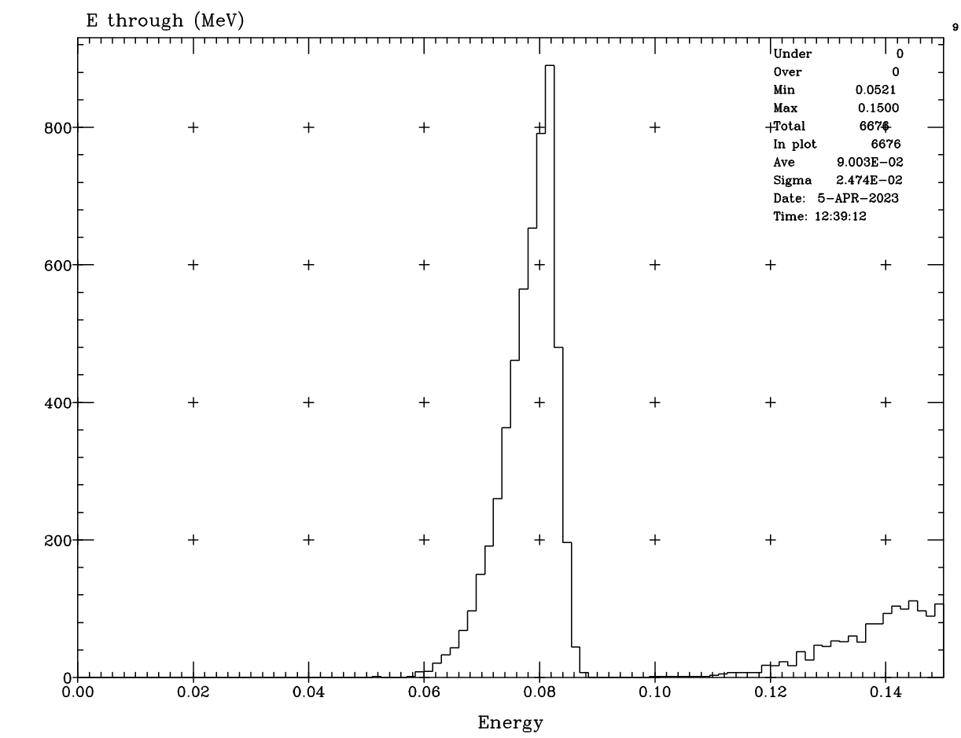
Through photons
Energy spectrum of photons that go through:
2mm of Al +
2 mm H2O +
2 mm Pb
Note the K shell peak at 82 keV

Slide 24
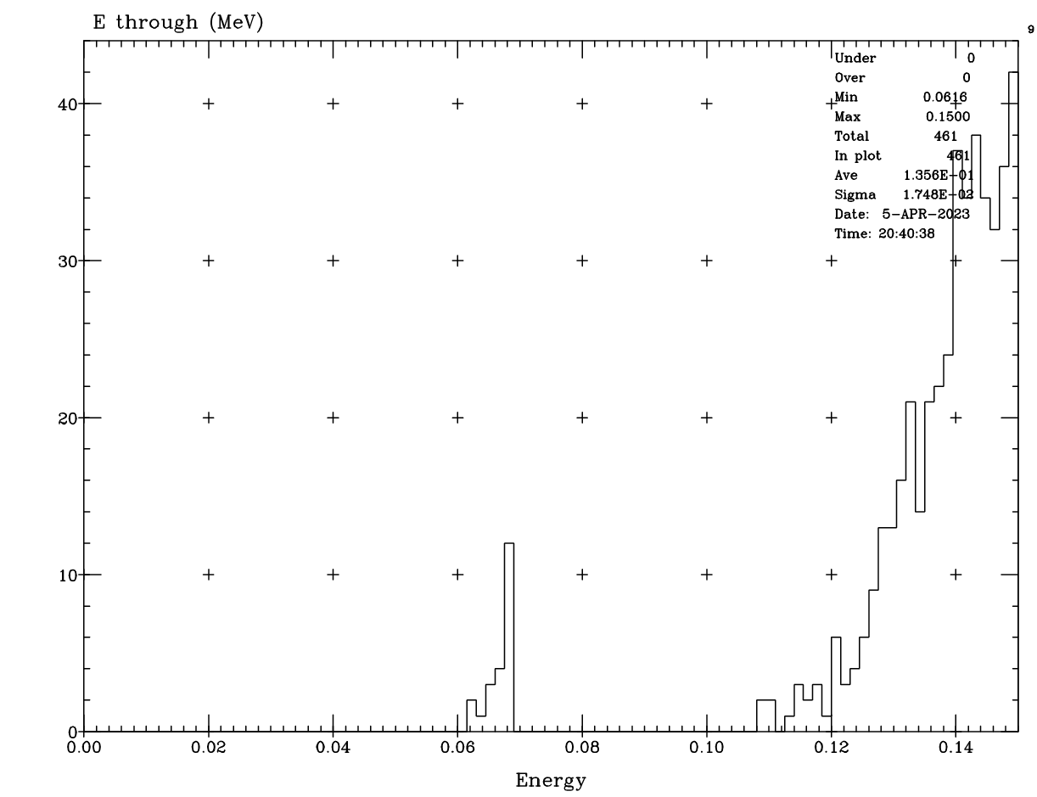
Through photons
Energy spectrum of photons that go through:
2mm of Al +
2 mm H2O +
2 mm W
Most are at the high end

Slide 25
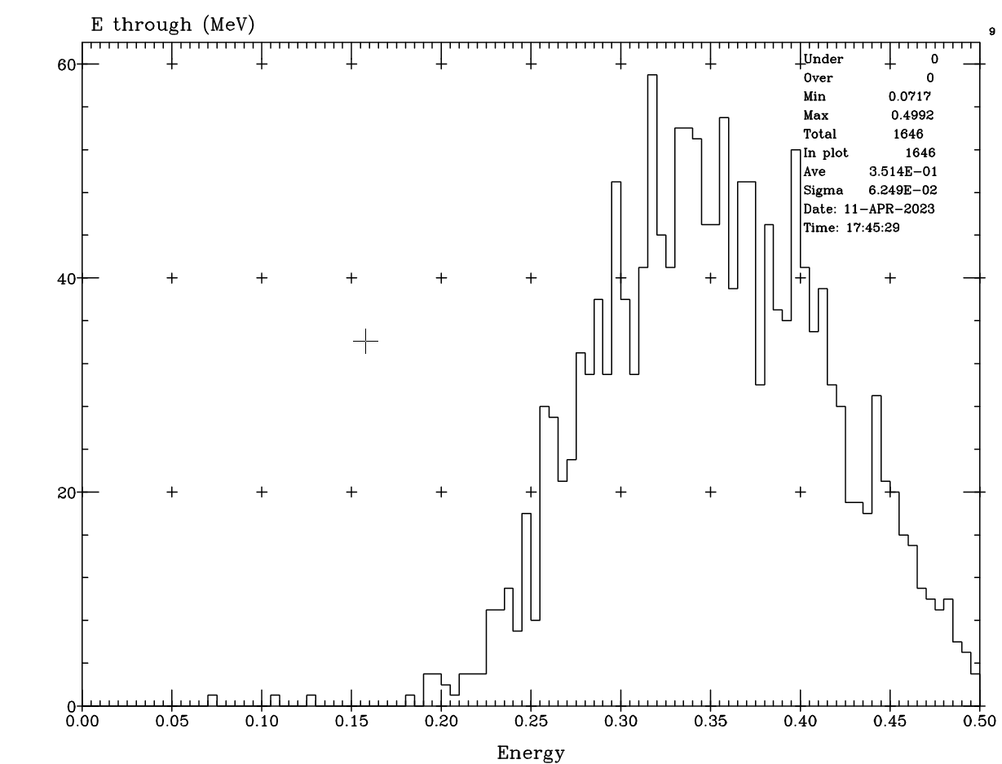
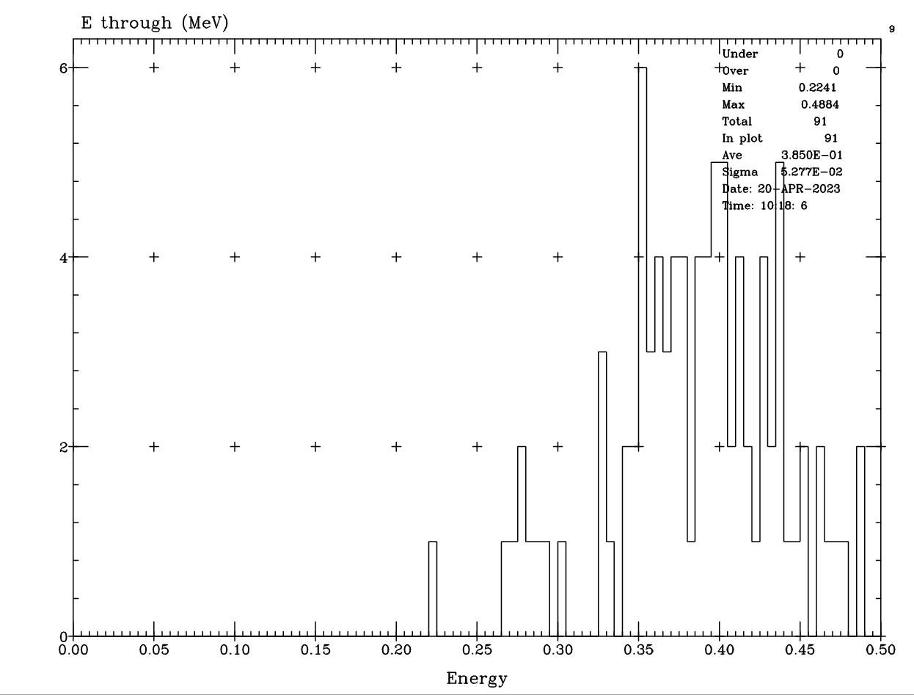
18 GeV plots with 1 cm and 2 cm of W
2 mm Al, 2 mm H₂O and 1 cm W
2 mm Al, 2 mm H₂O and 2 cm W

Slide 26
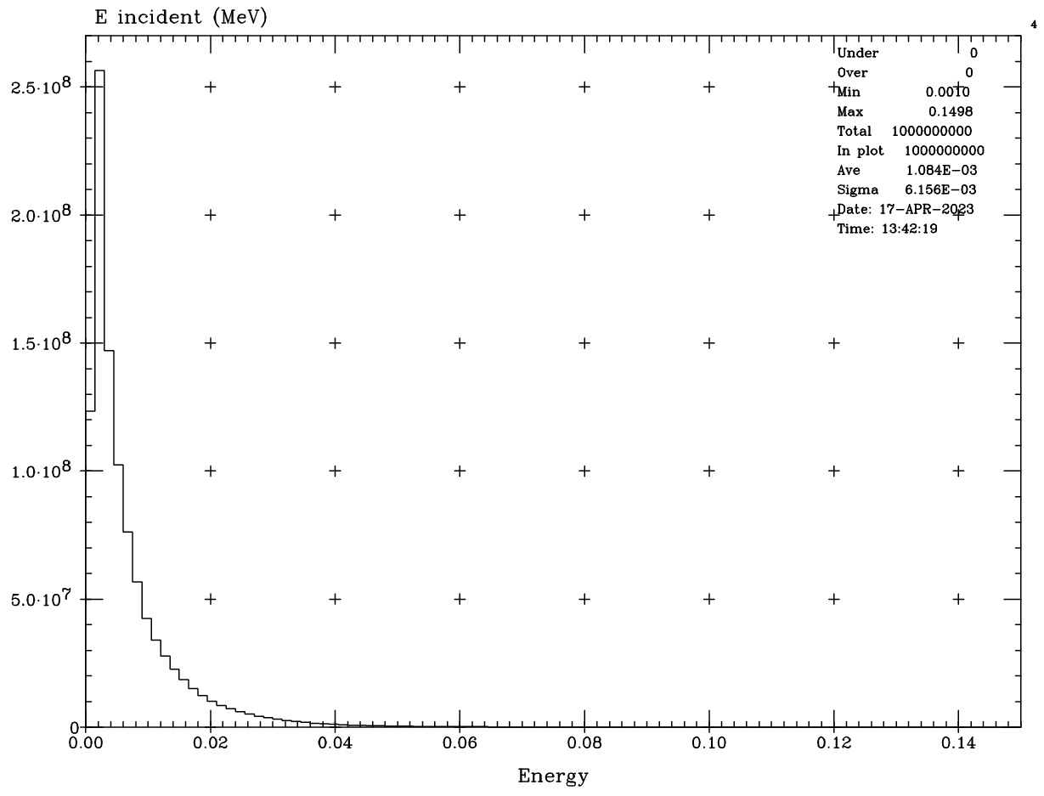
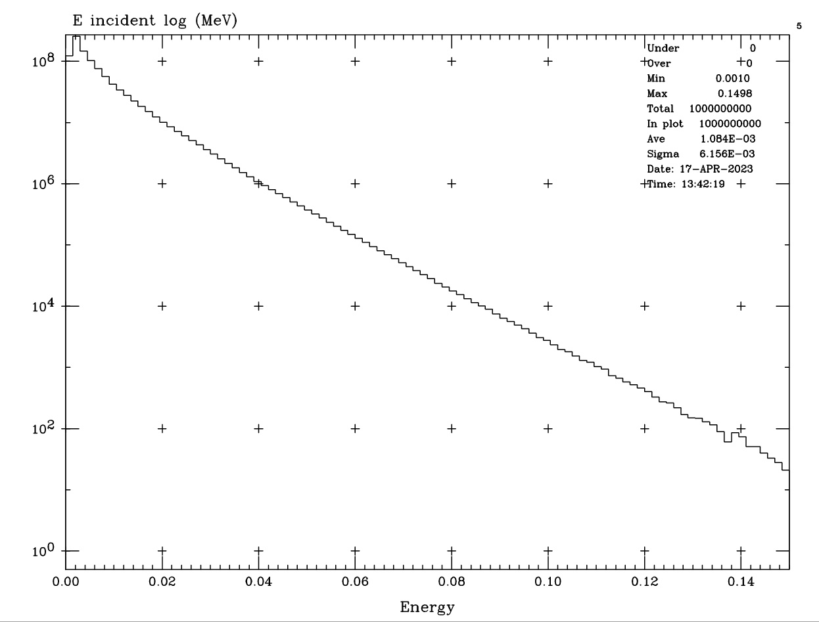
10 GeV SR plots
Note: The range is out to only 150 keV
This is a much softer energy distribution as expected
Incident photon energy distribution (1 billion events)

