Slide 1
The Anomalous Magnetic Moment of the Muon
W. Morse - BNL

Slide 2
Physics
I’m not trying to “teach physics” in this talk.
You have many great professors who will do that.
I’m just trying to convince you that physics is interesting.
If you have a question right away.
Don’t wait until the end of the talk!

Slide 3
Where does all this come from
I love physics.
I love math.
I asked my professor “Where does all this come from”.
He said “We don’t know!”
We still don’t know, but I will give some insights I have found since then.

Slide 4
Matter Particles circa 1930s
Particle | Mass (MeV) | Charge | Force | Size | Spin (h)
Proton p | 938.3 | + | S, E, W, G | 10⁻¹⁵ m | 1/2
Neutron n | 939.6 | 0 | S, W, G | 10⁻¹⁵ m | 1/2
Electron e | 0.511 | - | E, W, G | < 10⁻²⁰ m | 1/2
Neutrino ν | ≈ 10⁻⁷ | 0 | W, G | < 10⁻²⁰ m | 1/2

Slide 5
Spin = h/2
In 1920s, two young physicists could understand their data if the electron was spinning.
Wrote a paper.
Then the big boss came back from sabbatical.
They tried to pull the paper, but it was already published.
The reason the electron has spin 1/2 is so that we could be here to discover …….

Slide 6
Gauge Symmetries circa 1970s
SM = SU(3) × SU(2) × U(1)
Force | Carrier | Spin
Strong | Gluon | 1
Electro-Magnetic | Photon | 1
Weak | W | 1
Gravity | Graviton | 2
Mass | H | 0

Slide 7
Weak Force
Free neutron decay half-life ~ 10 minutes.
If earth to sun filled with Pb, most neutrinos would still get through.
Strong N* → p π 10⁻²² sec
Electromagnetic π → γ γ 10⁻¹⁸ sec
Hydrogen p e → n ν
Without the weak interaction, there would be no energy from the sun, no elements but Big Bang H, He.
The strength of the weak force determines the lifetime of the sun.
Why don’t neutrons in nucleus decay?

Slide 8
Physics
Binding energy of the deuteron = 2.2 MeV.
If neutron were 0.1% heavier, deuteron would be radioactive!
If proton were heavier than the neutron, hydrogen would be radioactive!
Physics is exactly what it has to be in order for us to be here to discover the laws of physics.

Slide 9
Quantum Mechanics
Developed 1910 – 1950 by:
Niels Bohr – “Anyone who thinks they understand QM, and is not deeply disturbed by it, doesn’t understand QM.”
Albert Einstein – “It’s spooky action at a distance”
Erwin Schrödinger – “I wish I never discovered these damn wave functions.”
I love QM! It is not trivial!
Without QM we wouldn’t be here to discover QM.

Slide 10
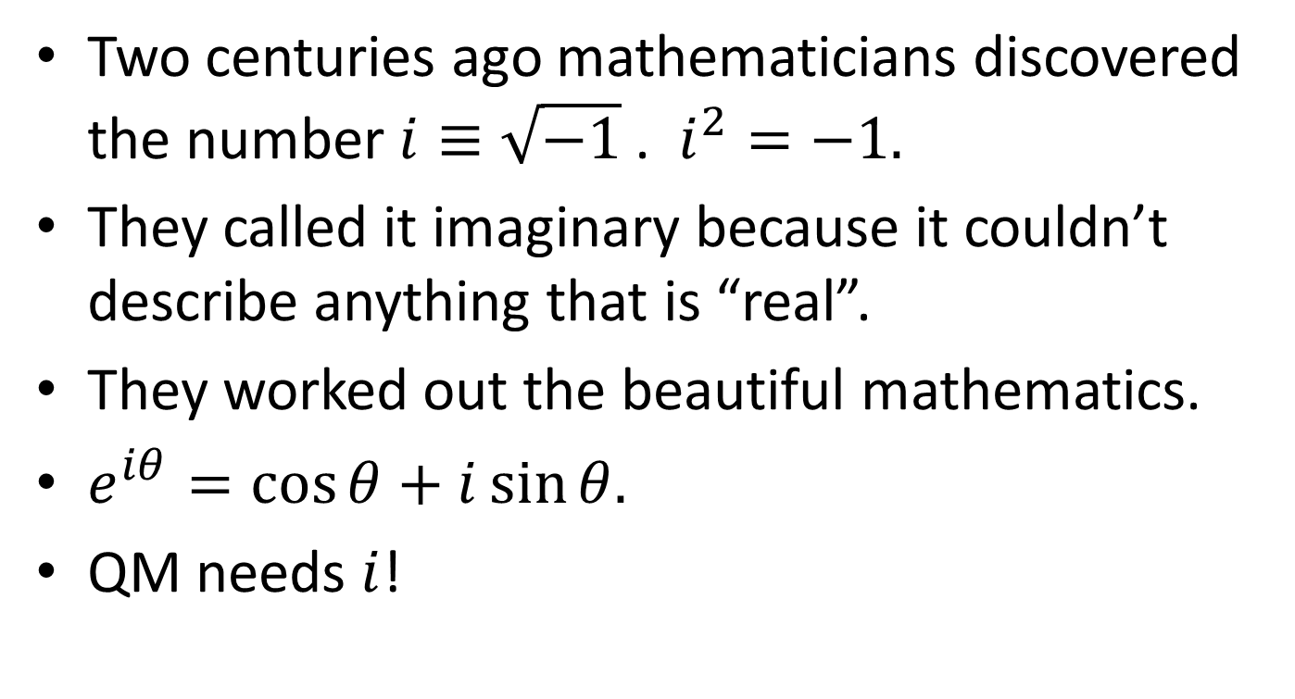
Imaginary Numbers
Two centuries ago mathematicians discovered the number $i≡\sqrt{−1}$ . $i^{2}=−1.$
They called it imaginary because it couldn’t describe anything that is “real”.
They worked out the beautiful mathematics.
$e^{iθ}=\cos{θ}+i\sin{θ.}$
QM needs $i$!

Slide 11
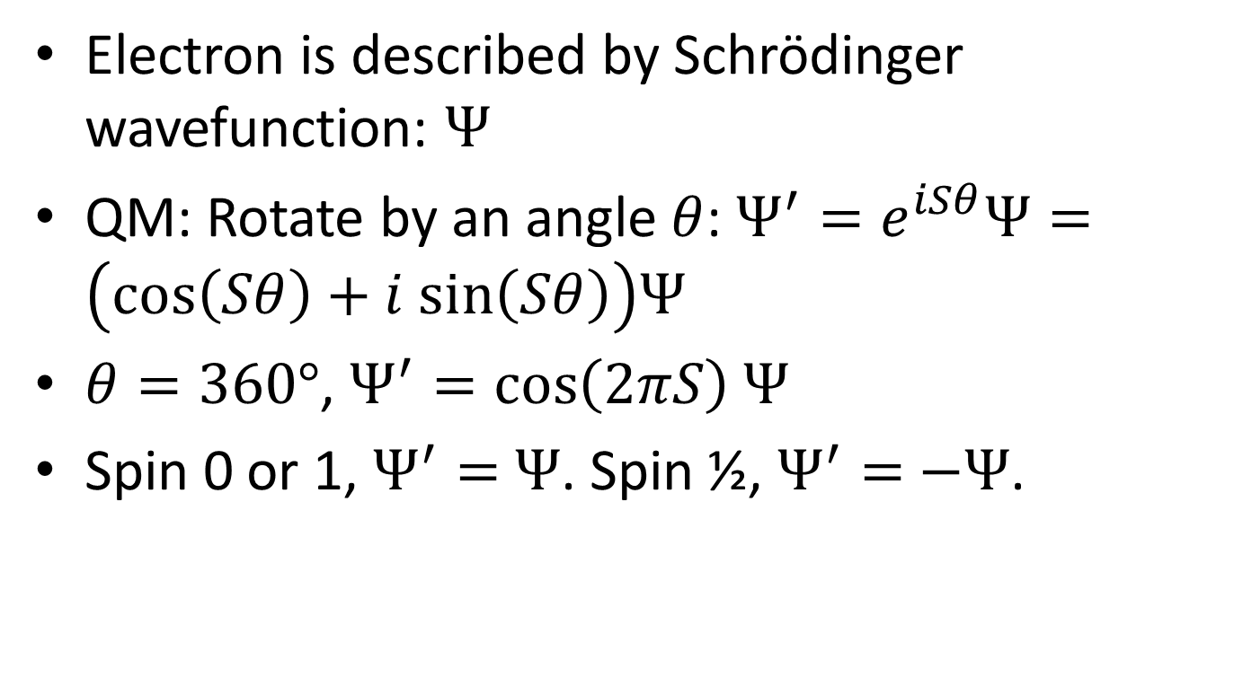
Quantum Mechanics
Electron is described by Schrödinger wavefunction: $Ψ$
QM: Rotate by an angle $θ$: $Ψ^{′}=e^{iSθ}Ψ=\left(cos\left(Sθ\right)+i sin\left(Sθ\right)\right)Ψ$
$θ=360°$, $Ψ^{′}=\cos\left(2πS\right)$ $Ψ$
Spin 0 or 1, $Ψ^{′}=$ $Ψ$. Spin ½, $Ψ^{′}=$ $−Ψ$.

Slide 12
QM
Can’t put two electrons in the same place at the same time.
Spin-statistics symmetry, Chemistry, ….
Spin ½ are matter particles!
Spin 0, 1, 2 are force particles!
Very simple, but profound.

Slide 13
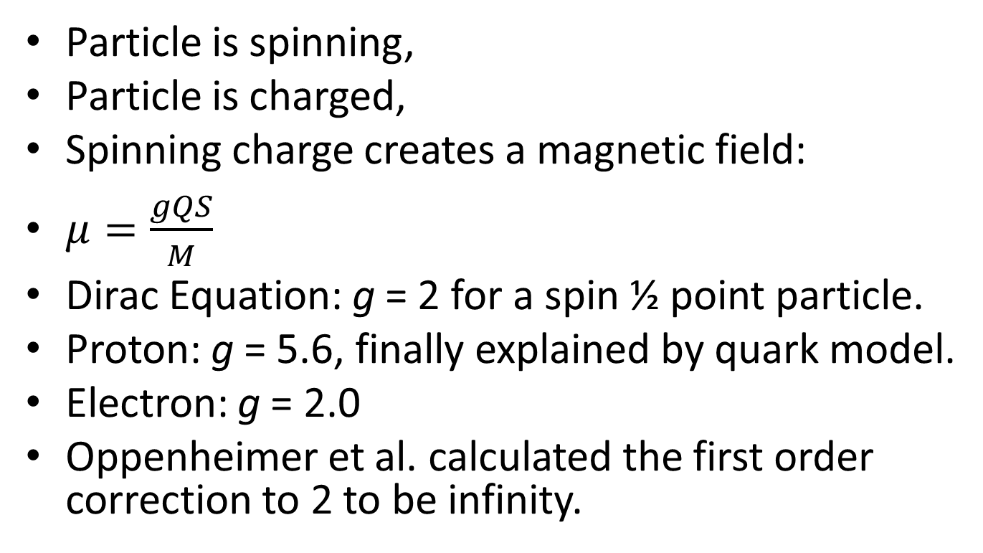
Magnetic Moment 1930s
Particle is spinning,
Particle is charged,
Spinning charge creates a magnetic field:
$μ=\frac{gQS}{M}$
Dirac Equation: g = 2 for a spin ½ point particle.
Proton: g = 5.6, finally explained by quark model.
Electron: g = 2.0
Oppenheimer et al. calculated the first order correction to 2 to be infinity.

Slide 14
Spin ½ Particles 1940s – 1980s
Three Generations!
Particle | Mass (MeV) | Particle | Mass (MeV) | Particle | Mass (MeV)
u | 312 | c | 1750 | t | 171200
d | 313 | s | 490 | b | 5620
e | 0.5 |  | 105 | τ | 1777
ν_{e} | ~10⁻⁷ | ν_{µ} | ~10⁻⁷ | ν_{τ} | ~10⁻⁷

Slide 15
More Symmetries
C symmetry – changes particle to anti-particle.
P symmetry – changes x to –x.
T symmetry – changes t to –t.
Good symmetries for strong, EM, gravity.
Discovered in 1950 – 60s: P, T, C are broken symmetries in the weak interaction.
Without weak interaction broken symmetries, we wouldn’t be here.

Slide 16
Theory 1970s
In SM we can only get this if there are three, or more, ways for a given reaction to go, and get QM interference with the three amplitudes, with at least one imaginary amplitude.
Need at least three generations.
In the big bang all the non-neutrino particles/anti-particles should have finally annihilated to photons.
Due to symmetry breaking, p/photon ≈ 10⁻⁹.

Slide 17
Theory 1980s - 2023
Not enough symmetry violation in the Big Bang SM for us to be here.
Maybe more symmetry violation in neutrino sector?
Maybe super-symmetry? SUSY.
Symmetry between spin ½ and spin 1.
Selectron is a force particle! Sphoton is a matter particle! Different SM/SUSY masses, so symmetry is broken.

Slide 18

Electron a = $\frac{g−2}{2}$ = 0.0011
1948 I.I. Rabi, Conference at Shelter Island.
Schwinger et al.,
Quantum Electrodynamics (QED).
“Renormalization” gets rid of the infinities.
For any new theory, the first question: “Is it renormalizable”.

Slide 19
QED Renormalization
Renormalization is a collection of techniques in quantum field theory, the statistical mechanics of fields, and the theory of self-similar geometric structures, that are used to treat infinities arising in calculated quantities by altering values of these quantities to compensate for effects of their self-interactions.
For example, an electron theory may begin by postulating an electron with an initial mass and charge. In quantum field theory a cloud of virtual particles, such as photons, positrons, and others surrounds and interacts with the initial electron. Accounting for the interactions of the surrounding particles (e.g. collisions at different energies) shows that the electron-system behaves as if it had a different mass and charge than initially postulated. Renormalization, in this example, mathematically replaces the initially postulated mass and charge of an electron with the experimentally observed mass and charge.

Slide 20
Quantum Mechanics
Anomalous magnetic moment is due to QM.
The energy of the vacuum classically is zero.
QM: dE x dt = h
The problem with zero is that it has no uncertainty.

Slide 21
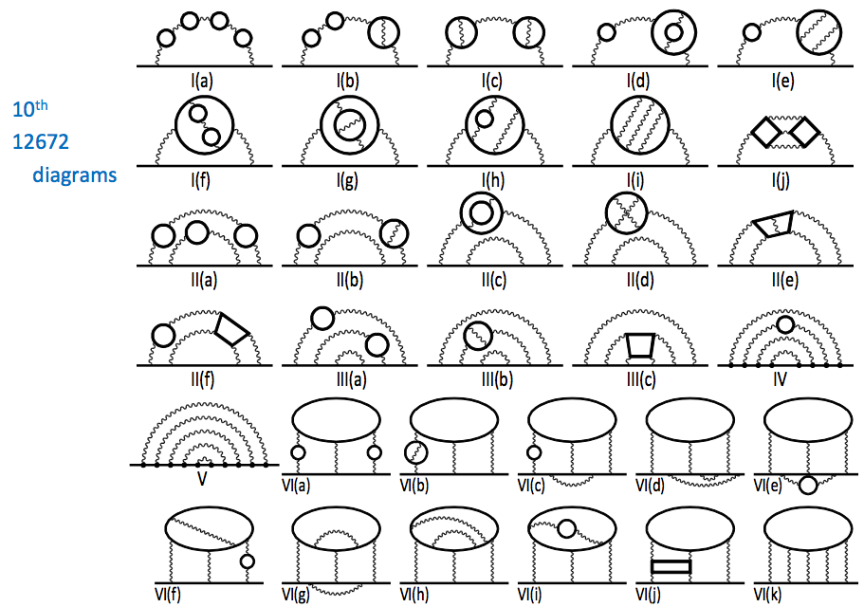
Quantum Electrodynamics
Not Boring!
What about
Einstein’s
General
Theory
Relativity
dE x dt = h

Slide 22
History of the universe
Big bang (birth of our space-time) 14B years ago.
I was born.
We figured out that the big bang happened 14B years ago.
Georges Lemaître, (1894-1966), Belgian cosmologist, Catholic priest, and father of the Big Bang theory.
That the entire observable universe of galaxies began with a bang seemed preposterous.

Slide 23
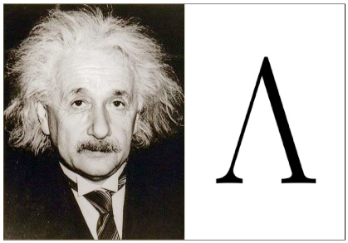
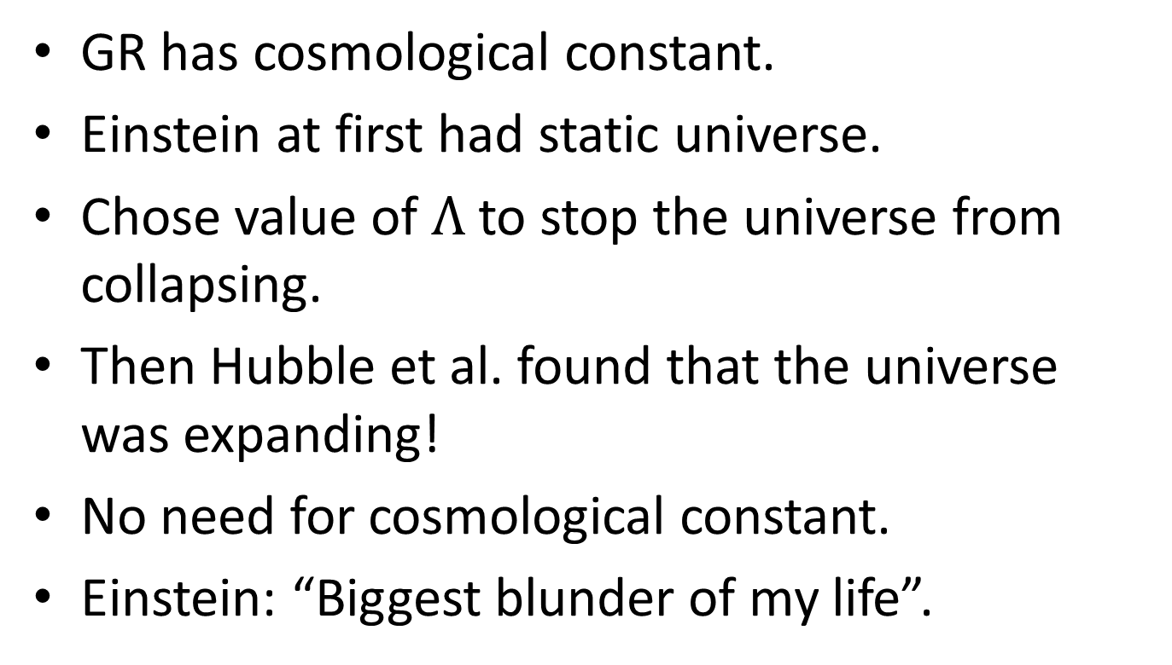
Einsteins’ Cosmological Constant
GR has cosmological constant.
Einstein at first had static universe.
Chose value of $Λ$ to stop the universe from collapsing.
Then Hubble et al. found that the universe was expanding!
No need for cosmological constant.
Einstein: “Biggest blunder of my life”.

Slide 24
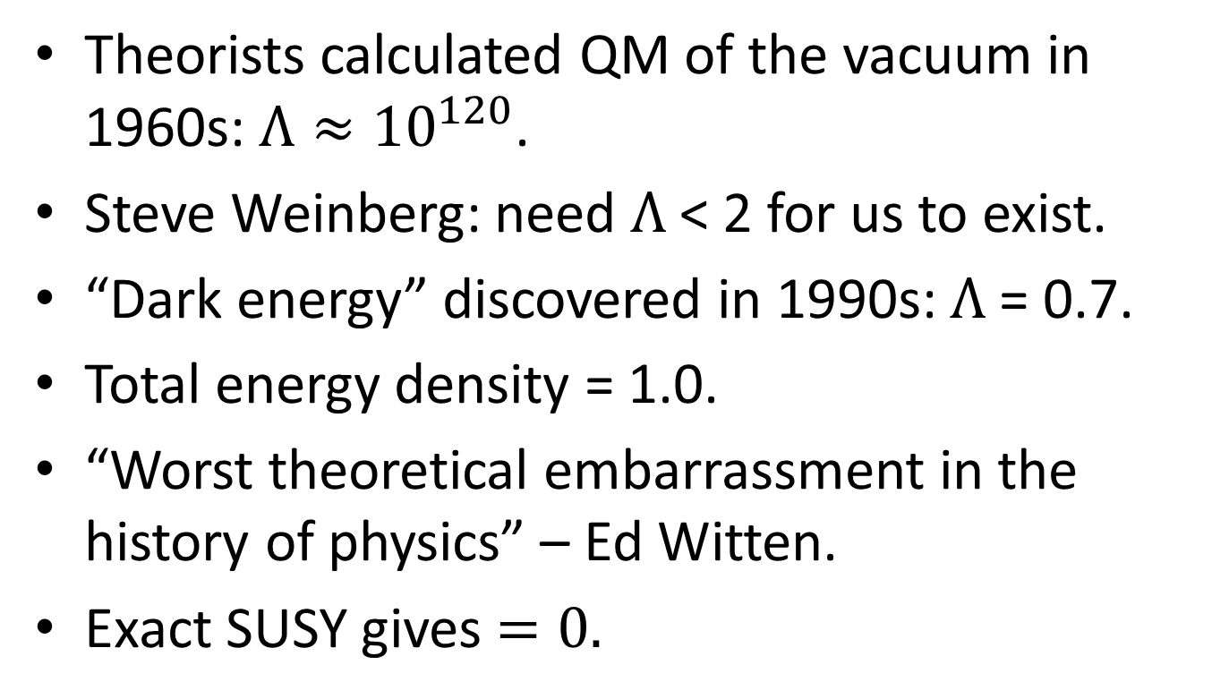
“Dark Energy” aka cosmological constant.
Theorists calculated QM of the vacuum in 1960s: ${Λ≈10}^{120}$.
Steve Weinberg: need $Λ$< 2 for us to exist.
“Dark energy” discovered in 1990s: $Λ$= 0.7.
Total energy density = 1.0.
“Worst theoretical embarrassment in the history of physics” – Ed Witten.
Exact SUSY gives $=0.$

Slide 25
Future of our universe
For a matter dominated universe, the pull of gravity slows the expansion rate vs. time.
For a dark energy dominated universe, the expansion rate increases with time.
We now live in a dark energy dominated universe.
Big bang was the creation of space-time.
Faster than the speed of light? Yes.

Slide 26
Meta-stable? Quantum tunneling?

Slide 27
Quantum Mechanics
All particles exist in the vacuum.
All particles contribute to the anomalous magnetic moment.
Are there new particles beyond the SM?
Are there new symmetries?
E821 measure anomalous magnetic moment to 0.5 parts per million (ppm).
Theorists: calculate to 0.5ppm. Compare.

Slide 28
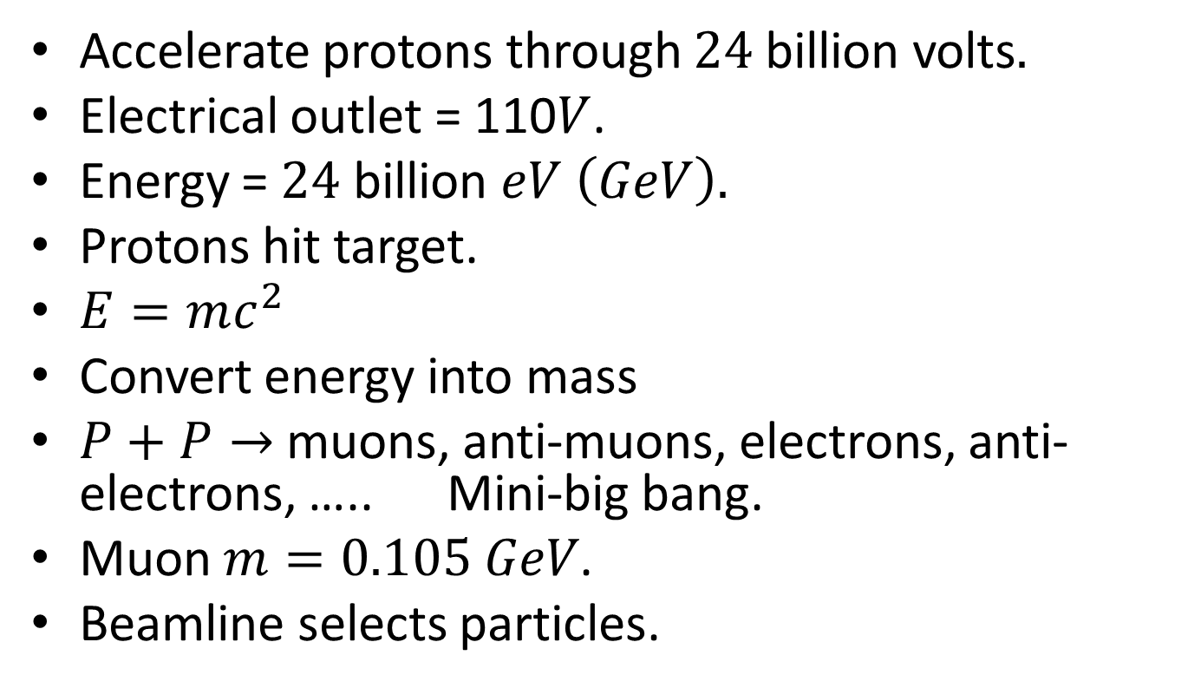
BNL E821 Experiment
Accelerate protons through $24$billion volts$.$
Electrical outlet = 110$V$.
Energy = $24$ billion $eV \left(GeV\right).$
Protons hit target.
$E=mc^{2}$
Convert energy into mass
$P+P→$ muons, anti-muons, electrons, anti-electrons, ….. Mini-big bang.
Muon $m=0.105 GeV$.
Beamline selects particles.

Slide 29
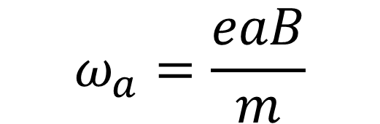

Spin Precession
spinning top $μ$ magnetic moment
G B
$$ω_{a}=\frac{eaB}{m}$$

Slide 30
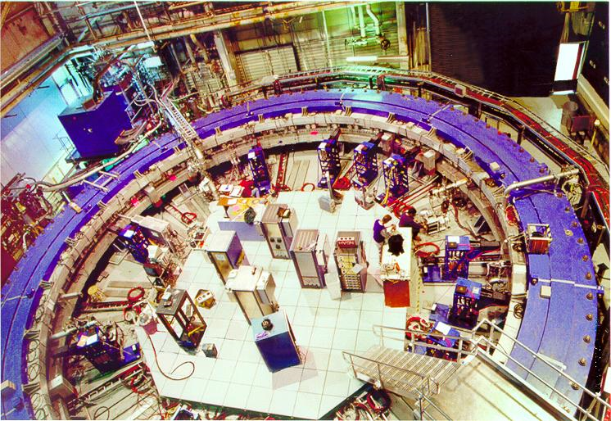
Storage Ring Magnet at BNL
24 detectors

Slide 31

$$μ^{+}→e^{+}v\overline{v}$$
Weak decay.
The high energy positrons go preferentially in the direction of the muon spin (parity violation).
Measure the time of the high energy positrons.

Slide 32
High Energy Positrons vs. Decay Time

Slide 33
BNL E821 Final Result 2004
E821 = black points
SM theory estimate = white points

Slide 34
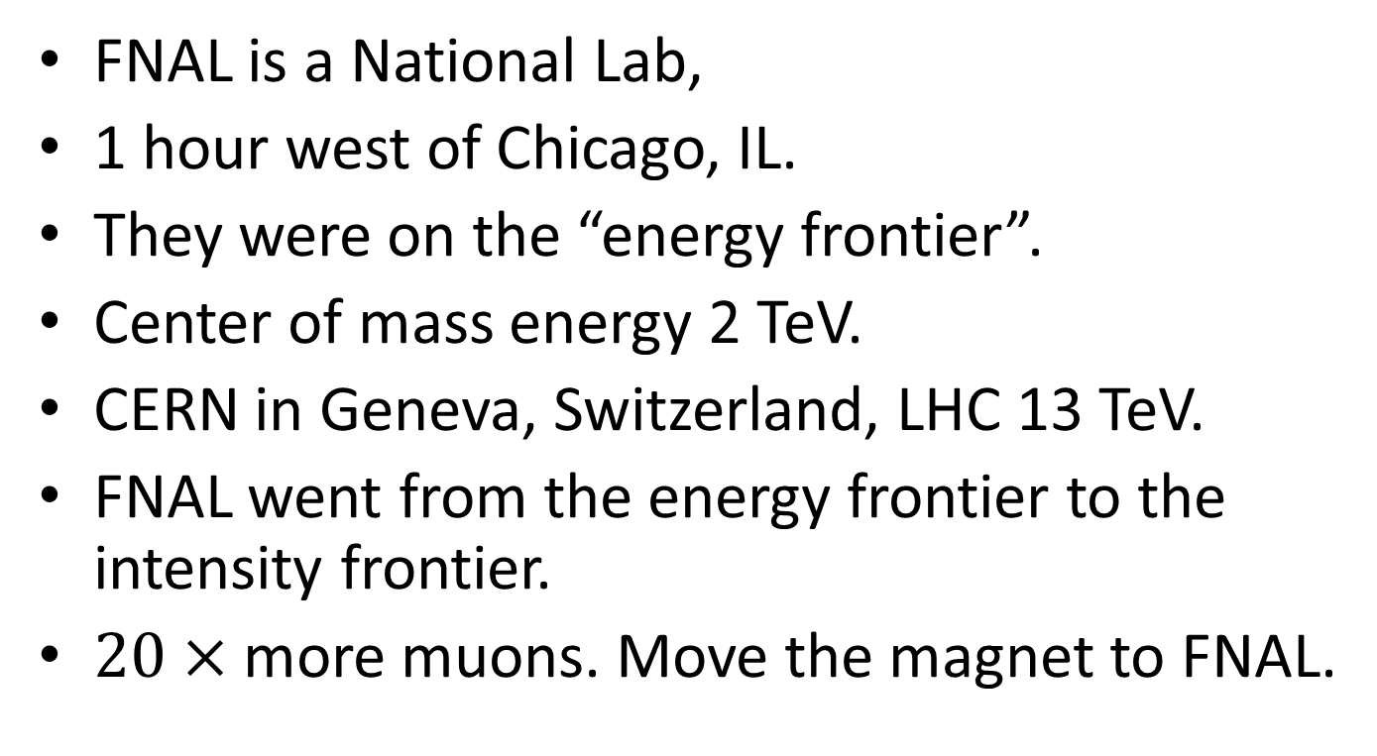
FNAL
FNAL is a National Lab,
1 hour west of Chicago, IL.
They were on the “energy frontier”.
Center of mass energy 2 TeV.
CERN in Geneva, Switzerland, LHC 13 TeV.
FNAL went from the energy frontier to the intensity frontier.
$20×$ more muons. Move the magnet to FNAL.

Slide 35
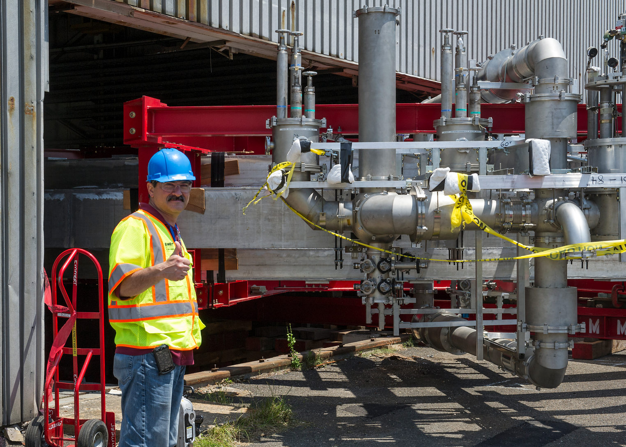
Move from BNL to FNAL

Slide 36
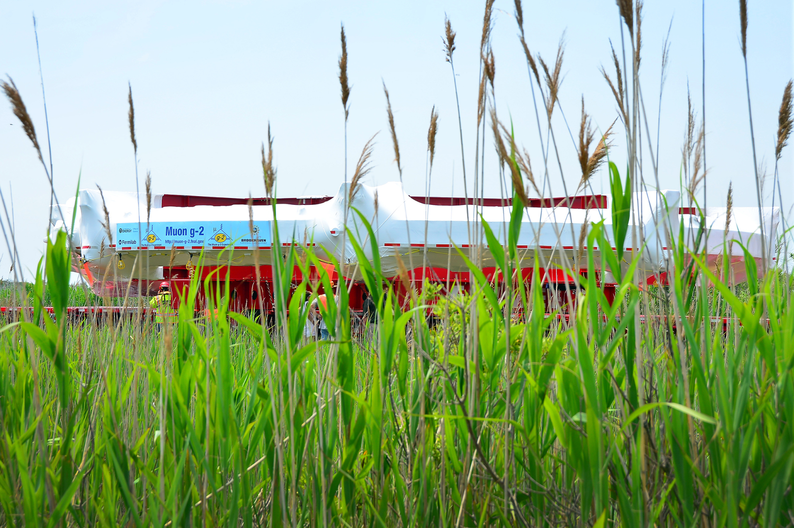
Smith Point Marina

Slide 37
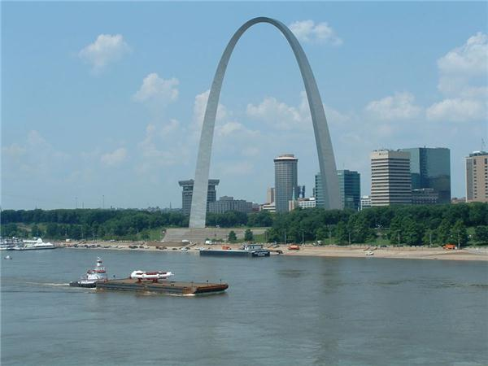
Around FL, and up Miss. River

Slide 38
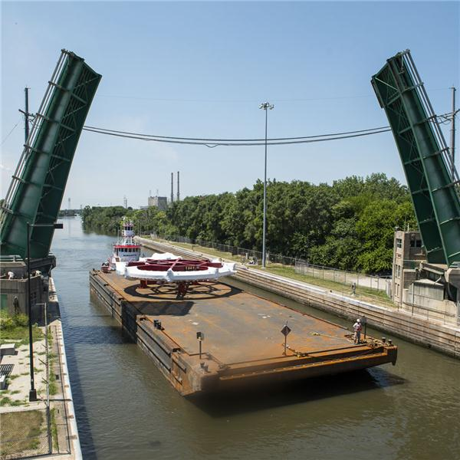
Up Illinois River

Slide 39
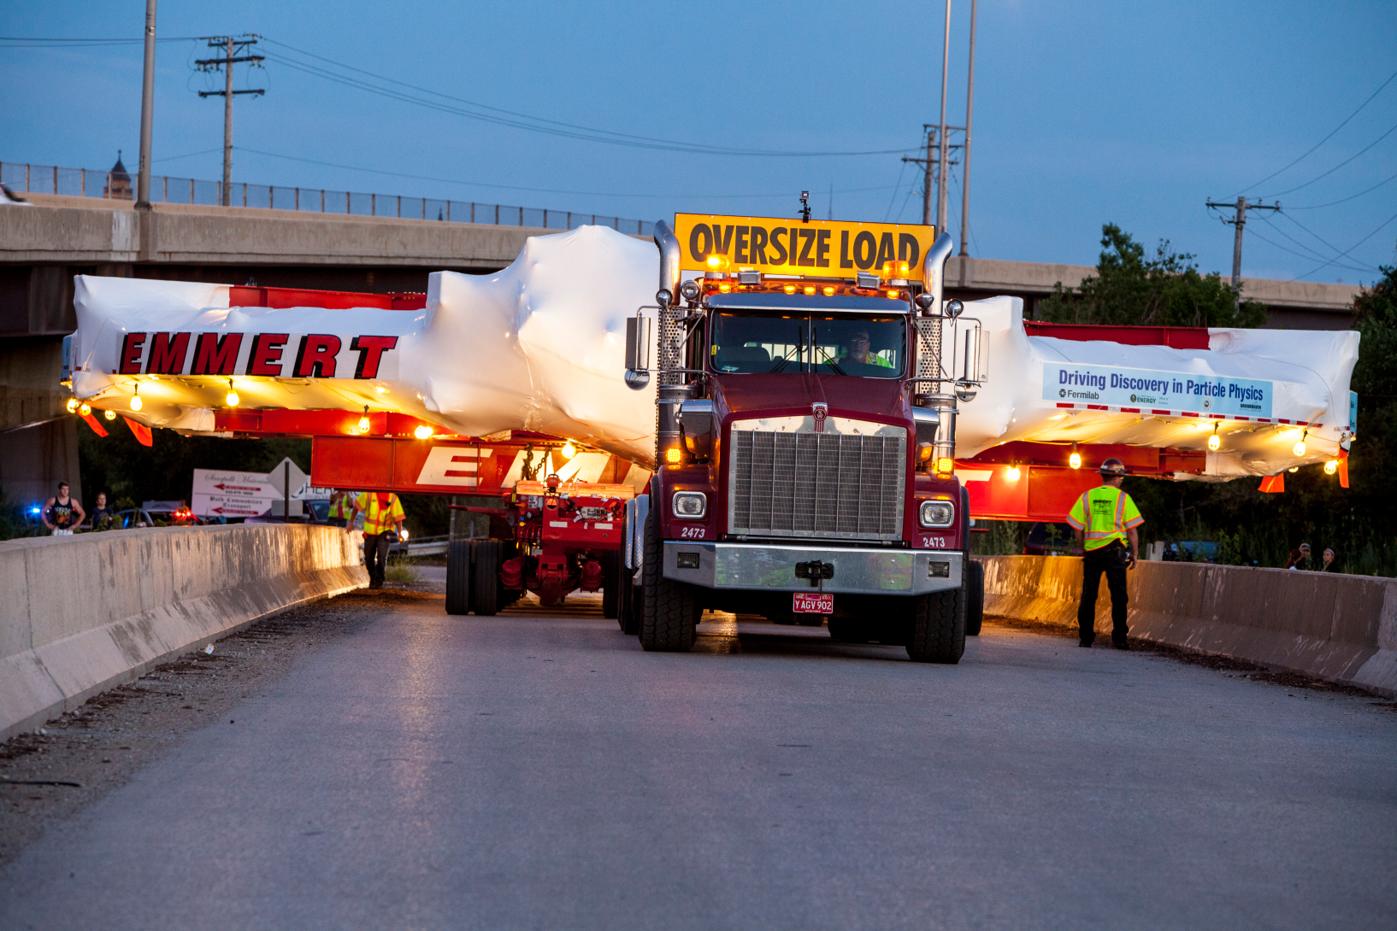
Entrance Ramp to Interstate 88

Slide 40
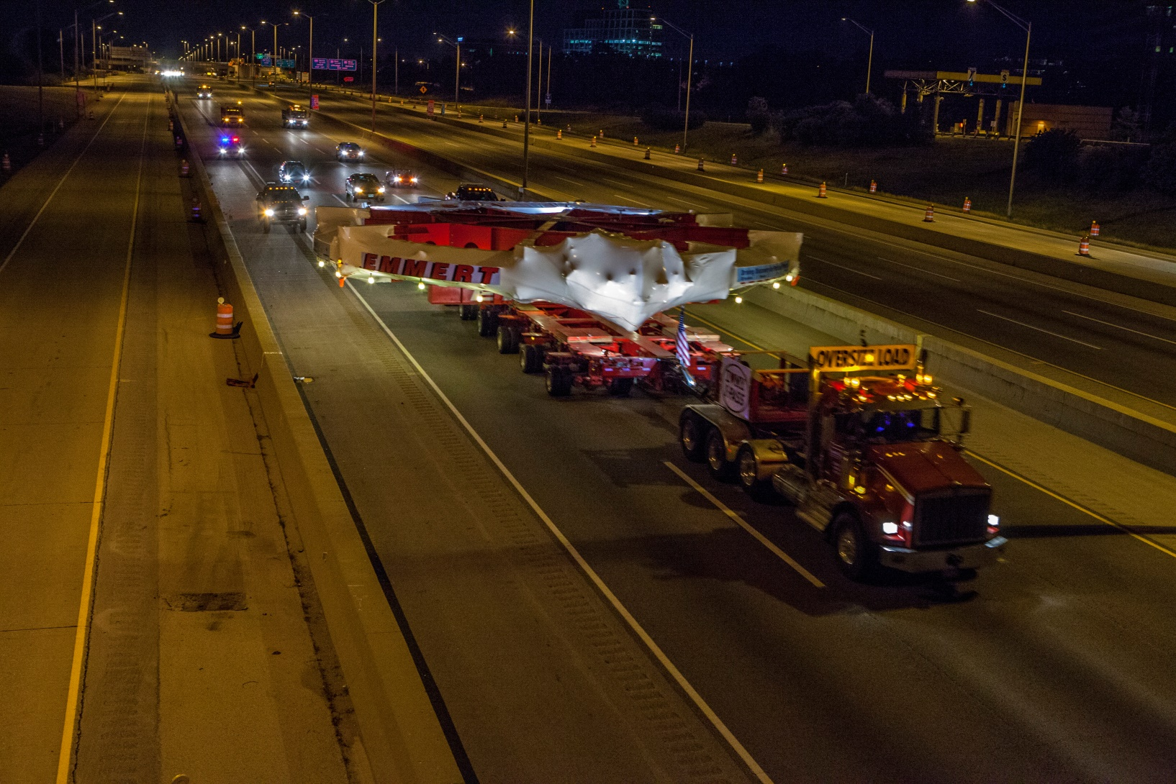
Interstate 88

Slide 41
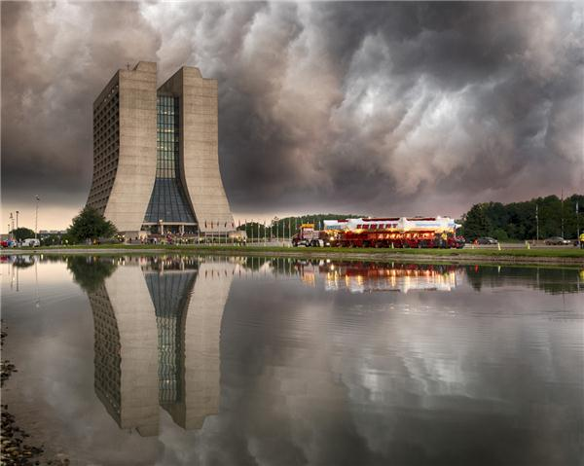
Arriving at FNAL 2013

Slide 43
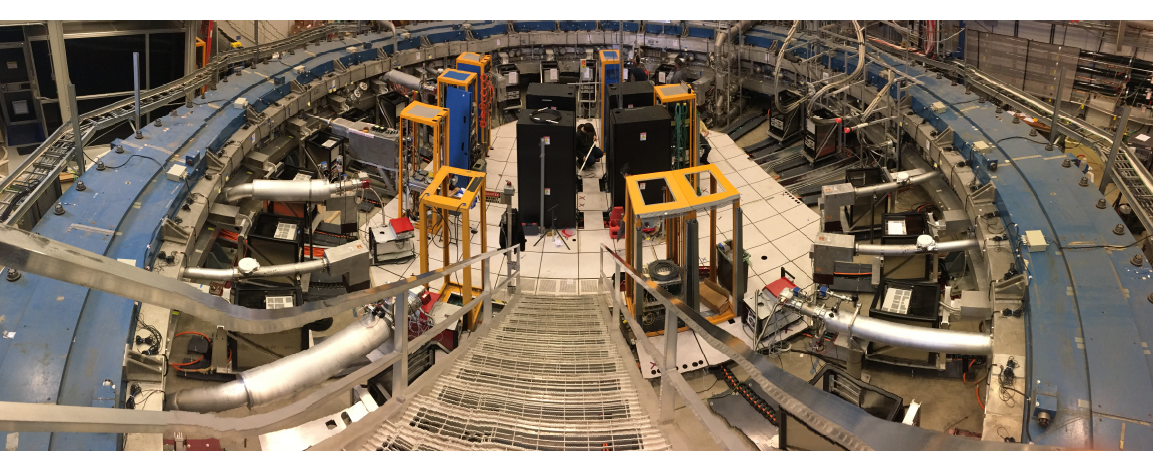
FNAL 2017

Slide 44
To Be Continued
Took data 2018 – 2023 at FNAL.
Result from run 1 agrees well with BNL E821
FNAL E989 confirms the E821 result with slightly smaller errors.
Final E989 will have 20x more muons than BNL E821.
New theory efforts do not confirm the 2004 theory efforts.
They are smoking the super computers.
Need more time to sort things out – stay tuned.

Slide 45
BNL E821 Final Result 2004
E821 final result

