Slide 1
ePIC Electronics & DAQ WG Meeting
Agenda
Introduction
Status of eRD109
HRPPD Update
AOB

Slide 2
Introduction
WG meetings will balance presentations with topics from Electronics, DAQ and Streaming Readout.
For the electronics, we will schedule updates from the various eRD109 projects soon. Follow-up meetings of specific interest may also be scheduled with ASIC/design experts, and as needed, to finalize specifications and requirements.
With the recent re-organization, we will also update the list of contacts with the various detector groups, specifically related to readout, and for regular updates from the latest detector implementations.

Slide 3
FY23 eRD109 Status
Contract awards have taken longer than expected.
Contract terms and norms are subject to negotiations between JLab’s procurement department and institutions – multiple cycles and very laborious.
 | Detector/Technology | Discrete/ASIC | Group | Awarded
A | Calorimeter | Discrete | IUCF | April 2023
B | Calorimeter | HGCROC | ORNL | April 2023
C | dRICH | ALCOR | INFN | April 2023
D | AC-LGAD | EICROC | Omega
 |  | FCFD | FNAL
 |  | Barrel L-M Serv. Hybrid | ORNL | April 2023
 |  | 3rd Party Evaluation | UCSC
E | MPGD/µRWell | SALSA | CEA
 |  |  | USP
Five (5) eRD109 proposals with nine (9) contracts to be awarded.
Some contracts have been awarded recently.
Remaining ones are in the final stages of negotiations.

Slide 4
FY24 eRD109
Call for proposals has just been announced.
Continuation and new proposals are due by 7 July 2023.
Reviews and documentation ready by late August 2023.
This will help better align the projects with funds and will allow projects to continue uninterrupted.

Slide 5
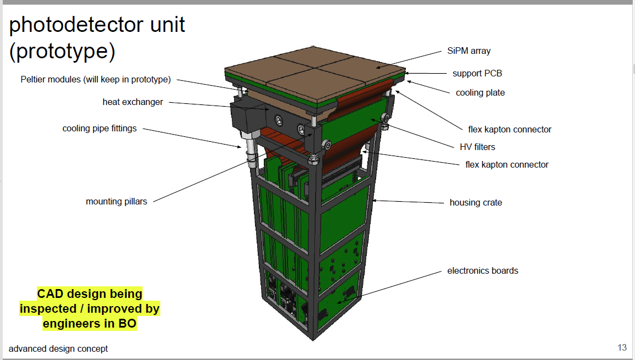
dRICH/ALCOR update
Recent dRICH meeting on readout.
Photodetector unit shown below, from Roberto Preghenella.
FEBs + RDO - plan

Slide 6
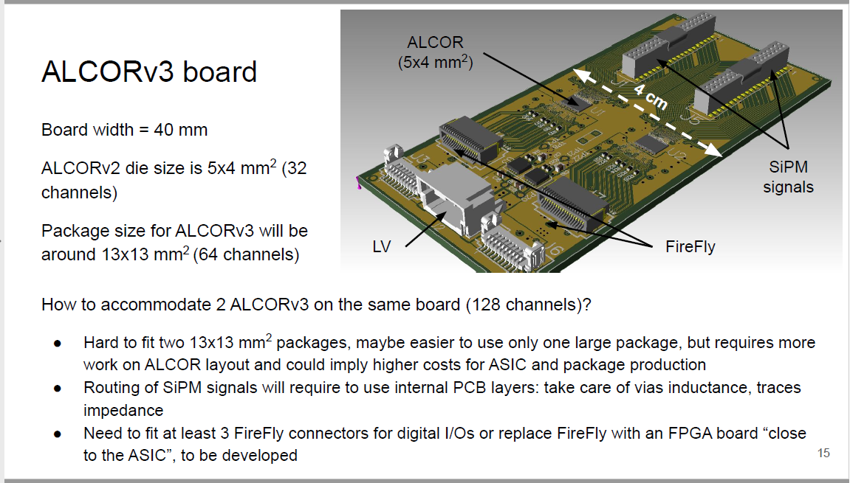
dRICH/ALCOR update
ALCOR v2.0 – 12/2022, expected soon.
ALCOR v2.1 – 3/2023, expected this Summer.
Towards ALCOR V3, from Fabio Cossio.

