Slide 1
EIC Project Update
Elke Aschenauer and Rolf Ent
Co-Associate Directors for the Experimental Program
ePIC General Meeting
May 23rd 2023

Slide 2
What we are doing this Summer
REVIEWS REVIEWS REVIEWS REVIEWS
EIC Project ePIC Engineering Workshop May 10-12, 2023, at BNL/Zoom
EIC Cost Review-June 26-29, 2023
EIC AB Meeting- June 29, 2023, virtual
Preliminary Design Status Review ePIC PID detectors 5&6 → see next slide
PAC Meeting- TBD- Summer 2023
MAC Meeting- TBD Summer/Fall 2023
Final Design Reviews for LLPs of Detector Summer
DAC Meeting(s)-TBD Late Summer/Fall 2023 → detector R&D (2 days) and technical design review of entire ePIC detector (2 days)
90% Design Review Solenoid October 5&6
EIC CD-3A Director’s Review- October 10-12, 2023, at BNL
Independent Cost Review (ICR)
EIC CD-3A OPA Review- November 14-16, 2023, at BNL
RRB Meetings
December 7-8, 2023, at SURA
April 2024 tentative for Europe/Italy
Final Design Reviews for all ePIC subsystems April – October 2024
DOE CD 2/3 OPA Review and ICR January 2025 (TBC)
DOE CD 2/3 ESAAB Approval April 2025
RHIC Operations Concludes June 2025

Slide 3
Preliminary Timeline-Preparation for Director/OPA Reviews
Schedule Updates/Installation Workshop complete May 31
Cost Estimate Updates/Justification Form for LLP items complete June 16
LLP Cost Review by June 26-29
Start practicing EVMS and Formal Change Control July 1
to include all Design, R&D and LLP activities
Cost/Schedule Revisions incorporated by July 14
Management Review by August 4
Incorporate final changes and freeze data August 25
Prepare PM documentation for Management Review August 30
Revisions to BOE backup documentation finalized by Sept. 6
Page Turn week of (CAMs have numbers) Sept 11
Run reports for posting by Sept 11
Dry Run week of Sept 18
Post documentation including backup by Sept 26
Post Presentations by October 3
Director’s Review starts October 10
Posting for OPA Review October 31
Independent Cost Review (ICR) TBD
CD-3A OPA Review starts November 14
To succeed in all of this we need some support from ePIC

Slide 4
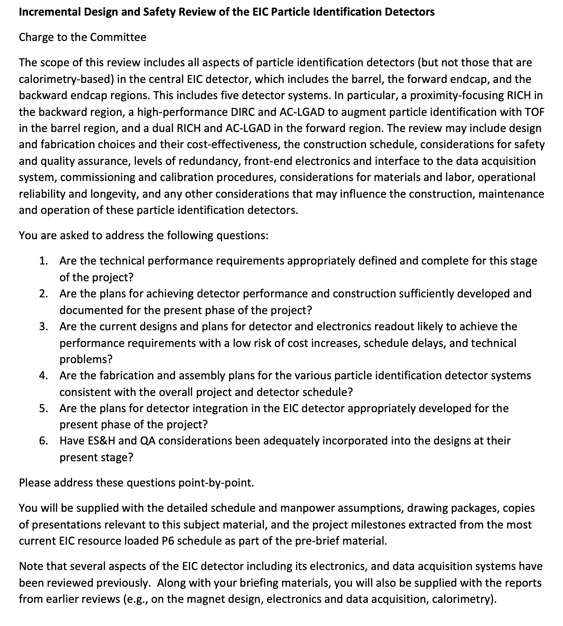
PID Review
Date: 5&6th of July 8:00 am to 2:00 pm EDT both days
Reviewers:
Peter Krizan (U Ljubljana), Chair Floris Keizer (CERN), Ana Amelia Machado (UniCamp)
Koji Nakamura (KEK), Justin Stevens (W&M)
Draft Charge:
Will work on the agenda and ask for name of
speakers in the next week

Slide 5
CERN Visit
CERN visit April 24-25:
Visit with Joachim Mnich CERN Science Director
→ very positive feedback on making ePIC recognized experiment (now in the hands of John and Silvia) and cooperation on EIC overall
Meeting on photo-sensors and RICH detectors with LHC-b and ALICE
https://agenda.infn.it/event/35393/
Meeting with ALICE ITS-3 team on collaboration with EIC Si Consortium

Slide 6
Summary on ITS-3 ALICE –EIC SiC
Overall a very positive and successful meeting → clear goal to cooperate as much as possible in boundary conditions.
Main lessons learned and next steps
ITS3 open to sharing their sensor design with EIC → necessary agreements will need to be put in place in the next month.
ITS3 development made significant progress → received a lot of critical technical information to guide the next steps in R&D for both sensor and system design/integration of the ePIC SVT
but there remains still some risk in the ITS development → ALICE team will need to remain focused on their requirements and timeline challenges
→ ITS3 welcomes/seeks partnership in development with EIC designers contributing to ITS3
→ Received extremely valuable input to overall schedule and workforce needs for EIC SVT
Example: relation between schedule for ITS3 ER2/ER3 submission and evaluation and the
EIC/LAS development schedule → adjust our schedule to give more time for the sensor
modifications and the schedule and integrate lessons learnt from ITS3
→ ITS3 suggests we put in place a backup plan as our workforce is still growing, and the
overall EIC SVT schedule is aggressive
All the inputs are currently folded in an updated plan by the EIC SVT team
Updates will be presented in the respective ePIC meetings (TIC & TWG) by the SVT team

Slide 7
EIC Project Detector R&D Program
https://wiki.bnl.gov/conferences/index.php/ProjectRandDFY23
Call for FY24 sent to R&D-Contacts May 8th
Dear current and future R&D participants, it is time to discuss the next steps in our path, i.e., the FY24 projects. We are trying to get the R&D program fully in sync with the FY boundaries. Proposals 1. Please submit your proposals and progress reports (where applicable) to us by July 7, 2023. We aspire to have a DAC meeting well in time to prepare for contracts at the beginning of FY24. 2. We expect progress report from all ongoing projects eRD101 to eRD113. What milestones were achieved. How did our understanding improve. What is left to do? 3. eRD102, eRD103, eRD104, eRD106, eRD107, eRD108, eRD109, eRD110, eRD111, eRD112, and eRD113 may submit continuation proposals if and only if technical risk milestones remain. These new proposals should be relatively straightforward to write. Keep them short and concise. List whatever technical risks remain, the milestones, deliverables, and two money matrices showing cost/item and funding/institution to close those remaining risks. Also list the representatives for each institution. List all participating members and institutions on the front page. Please also give, if applicable, an outlook for the years past FY24. Be aware that R&D should not be mixed with PED. If you are not sure, talk to us. The proposals should concentrate on detector R&D tasks that mitigate project detector technical, risk. DAC Review Meeting With the project detector R&D expected to dwindle down at CD-2, we will limit the meeting to a two-day review meeting in the July-August period. The FY24 proposal goals of all continuation projects should be presented as well as a short status report of all FY22/FY23 proposals. More details on this meeting will be announced soon. Best regards, Elke, Rolf, and Thomas

Slide 8
A lot is going on in parallel – Examples
Close to all contracts related to EIC project detector R&D with BNL and JLab procurements being awarded, some are still waiting for responses at the Universities and Labs. Some contracts for PED are also ongoing.
Magnet “mid-project” review (~75% design completion) completed April 17th – 19th
Started work on specifications for LLPs (SiPMs & PbWO₄) → critical input for LLPs FDR.
Detailing installation schedule for the EIC experimental equipment
→ see https://www.dropbox.com/s/w9oz0asvtb66hfh/Installation%20Schedule%20for%20the%20EIC%20052023.docx?dl=0
→ determining currently all constrains from accelerator installation and commissioning
Prepare for the TCC of the backward RICH and Barrel Ecal
Engineering workshop 10 – 12th of May @ BNL
identified many action items and solutions to integration challenges
→ will meet with all the different sub-detector groups in the next weeks to discuss
integration issues
technical design questions and possible solutions
need to identify synergies, i.e. common cooling
to define & integrate the DSCs work package structures in project structure
define the details of readout chains and update cables & services information
→ update sketchup model and geometry data base
→ Will provide updates on ePIC pictures from CAD and sketchup
Started work defining a concept for all the controls of the experiment

Slide 9
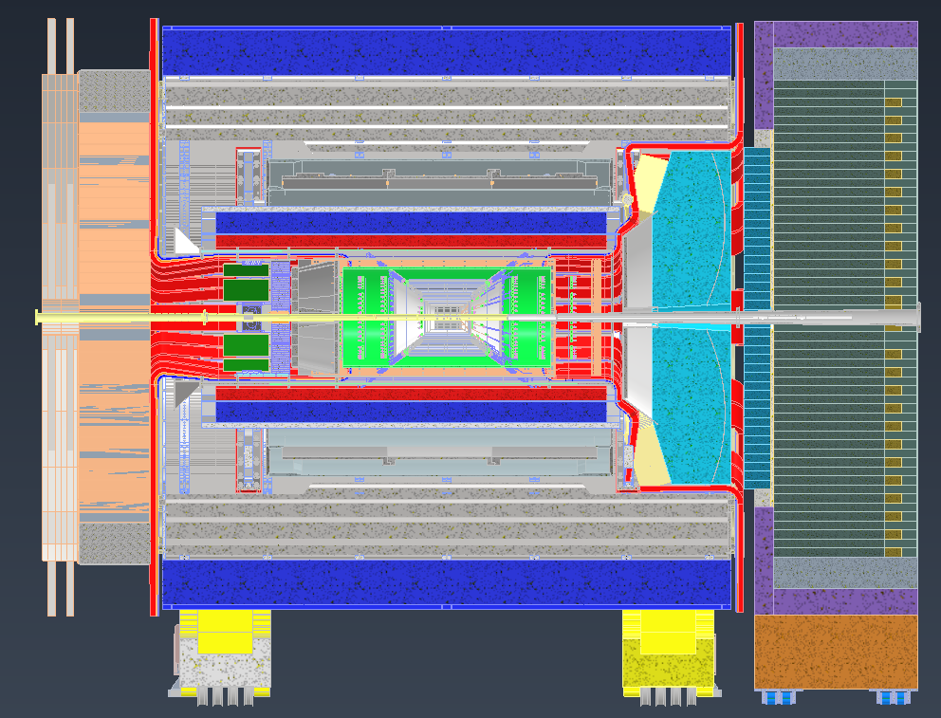
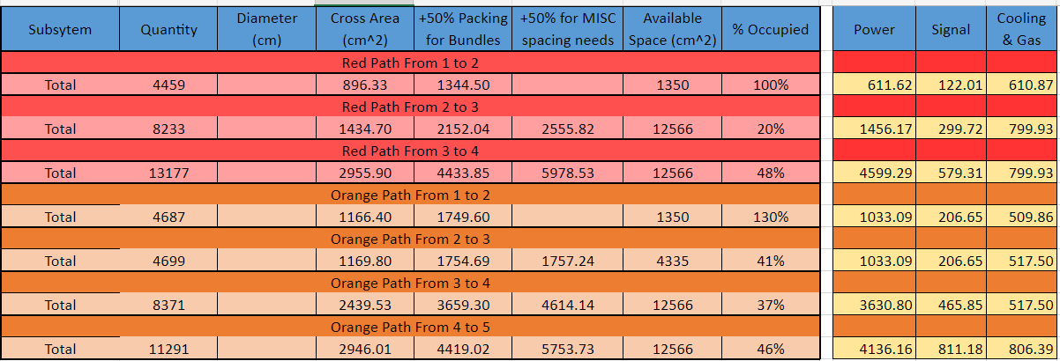
Services Layout and Management
4
5
3
4
Gathered service estimates from detector groups
Laid out 2 common paths (red and orange) for service routing
Determined locations of bottlenecks
Calculated service bundle volumes at bottleneck locations
Totals for services passing from one point to the next are shown below
Point 1 to 2 on each side needs more space allocated
3
2
1
1
2
We need an update from all sub-detectors by the end of May PLEASE !!!!
The information should be updated here
https://wiki.bnl.gov/EPIC/index.php?title=Project_Information
both for central and ancillary subdetectors
→ the same for readout chain definition

Slide 10
System Engineering
for more details see talk by Walt Akers
https://indico.bnl.gov/event/19202/contributions/75979/attachments/47422/80408/Akers-20230510.pptx

Slide 11
System Engineering

Slide 14
Follow up on recent technology choices
The path to integrate the recent technology changes, Barrel Ecal and backward RICH,
by ePIC into the EIC Project baseline
Remember: five-step change control process
The detector collaboration initiates a possible change in baseline scope
The collaboration technical board or equivalent ensures the change is consistent
with the NAS science requirements and initiates the change request
→ prepare input for the TCCB
detailed changes in cost, schedule and risk → implement in P6
science and technical justification for the change ← input from ePIC
first backward RICH as it is a less complex case
The detector TCCB collects wide input, discusses, and gives advise
The Project Technical Director gives approval
The EIC Management Team needs to approve the formal baseline change control
→ process for both detectors needs to be compete by the DAC technical design review

Slide 15
Collaboration – Project Integration
6.10.04 Particle
Identification
Level-3
Rolf & Elke
Level-2
6.10.04.01 Backward RICH
Level-4
6.10.04.02 Barrel DIRC
Level-4
6.10.04.03 dRICH
Level-4
6.10.04.04 Time-of-Flight
Level-4
DIRC-Photon-sensors
Level-5
DIRC-Quartz-bars
Level-5
6.10.04.04.01
bToF
Level-5
6.10.04.04.02
fToF
Level-5
Integrating Collaborators:
L3: CAM from the project
Fold in users/collaborators as
on L4: CAM + technical contact == DSTC
bRICH
DIRC
dRICH
ToF
on L5 Work Package leaders
as defined in the DSS - structure
Photon-Sensors
Quartz-Bars
………..
We need a control account manager (CAM) at each WBS level. WBS levels go down to where it is meaningful to accumulate cost and schedule variance. There can be many Work Packages below.

Slide 16
Collaboration – Project integration
6.10.04 Particle
Identification
Level-3
CAM from Project
6.10.04.01 Backward RICH
Level-4
6.10.04.02 Barrel DIRC
Level-4
CAM from Project
+
DSTC from
6.10.04.03 dRICH
Level-4
6.10.04.04 Time-of-Flight
Level-4
Photonsensors
Level-5
can be
the same
→ one WP
Photonsensors
Level-5
Work Package lead
from
Photonsensors
Level-5
6.10.04.04.01
bToF
Level-5
6.10.04.04.02
fToF
Level-5
Cooling
Level-5
DIRC-Quartz-bars
Level-5
Cooling
Level-5
Cooling
Level-6
Work Package lead
from
Readout
Level-5
merge
if PS are the same
→ one WP
Readout
Level-5
Work Package lead
from
Gas system
Level-5
Readout
Level-6
Vessel / Boxes
Level-5
and more
Vessel
Level-5
Sensor
Level-6
Sensor
Level-6
Mirror /F-Lens
Level-5
Mirror
Level-5
Support
Structure
Level-6
Support
Structure
Level-6
Support
Structure
Level-5
Aerogel
Level-5
Readout
Level-5
and more
and more
and more

