Slide 1
Input
Hidden Layers
Dense Neural Network
Output
w₁
w₂
b₁
b₂
Loss Function
b₃
⁞
⁞
⁞
⁞
⁞
Optimizer

Slide 2

RP
1k Epochs
IP
6
200
400
100
6
x
w₁
w₂
b₁
x
“For when you care about outliers a little bit”
θ_{x}
b₂
θ_{x}
y
Huber Loss
b₃
y
θ_{y}
⁞
θ_{y}
⁞
⁞
⁞
⁞
Adam Optimizer

Slide 3
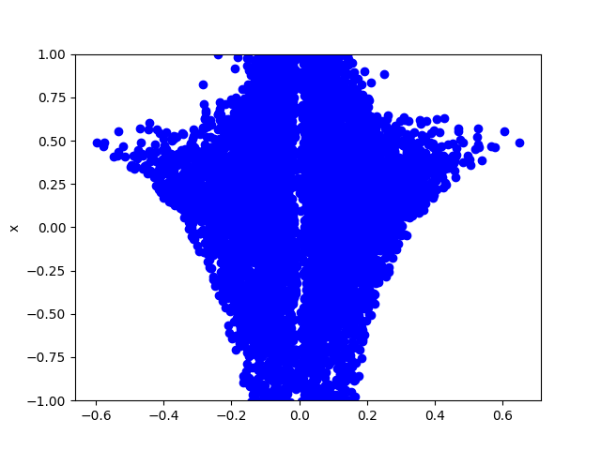
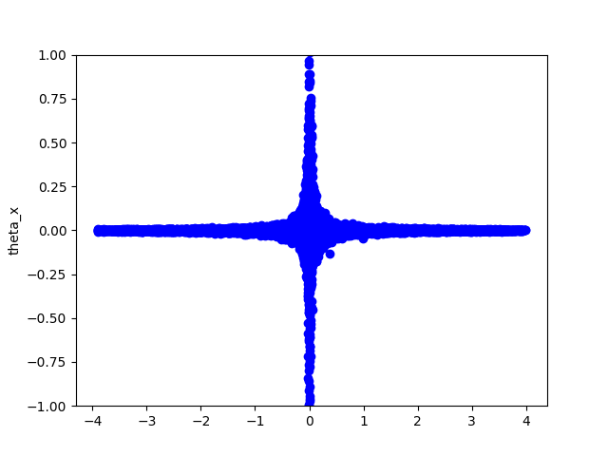
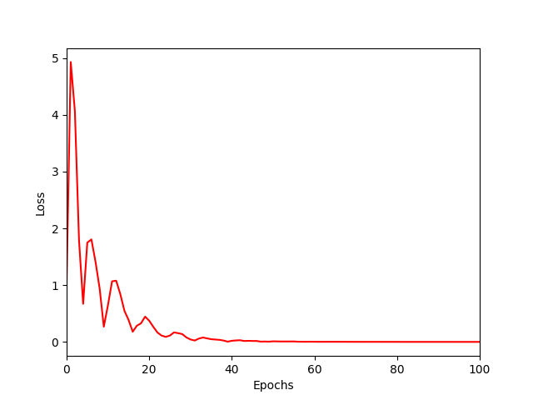
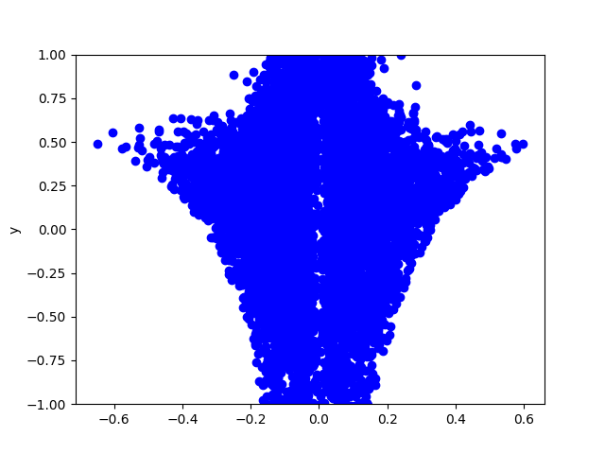
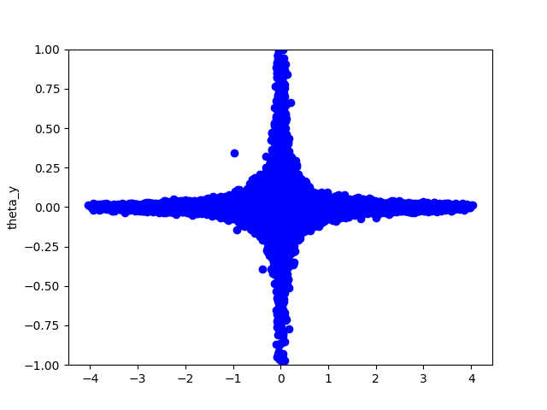
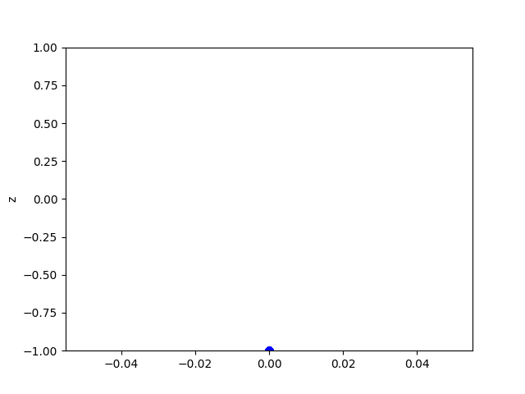
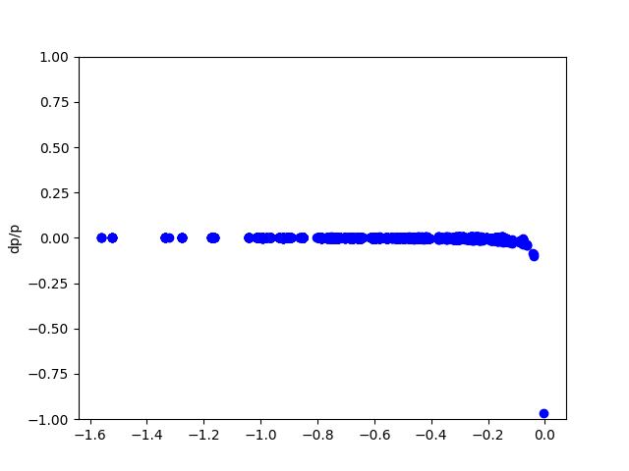
Performance

Slide 4
Outstanding Issues and next steps
Do we need a better optimizer / loss function?
Do we need a different number of hidden layers or nodes?
Does it work better if we change the output layer to 3 nodes and try to directly train to the momentum vector?
Does more training data help or have we hit the floor (make plot of data used vs minimum loss function)
Z is producing a constant, nonzero value

