Slide 1
Information regarding SiPM specs and ordering for ePIC Discussion 05/17/2023 O.Tsai
SiPM for EIC detectors 02/04/22 recap
Questions:
where we are? – we are using SiPMs for STAR detector (R&Ds and real detectors) for past 10 years or so (HPK)
where the technology has to improve? - current sensors can be used for EIC calorimetry applications as is* (HPK)
what the prospects are? – we don’t expect breakthrough development, incremental improvements probably possible
where we can benefit from synergies? - little overlap with PID due to different requirements
what we need to focus on? – better define requirements/justifications, continue R&D (eRD105, eRD106, eRD107,eRD110)
Main concern is increase in noise with radiation <- Mitigation (replacing, may be cooling)
Minor to No degradation of response due to rad damages. (backup slides)

Slide 2
December 2022, Calorimetry review for ePIC
Calorimetry SiPM meeting on Apr 19, 2023 https://indico.bnl.gov/event/19172
Long term issues with SiPMs? looks like I got confused with statement ‘SiPMs are dying in GLUEX’
Contacted GLUEX colleagues (Eugene, Zisis) quickly responded – essentially 0 issues
Contacted CMS colleagues (Yuri Musienko) CMS HCAL Phase 1 upgrade – no issues
STAR FCS limited experience – no problem so far.
EIC R&D - I have not seen bad SiPMs
Conclusion:
Long Term issues under typical operation conditions (apart from rad damages) not a concern.

Slide 3
What we still need to do to ‘write a PO’ for ePIC calorimeters SiPMs?
Is it require to do ‘open market survey’? If so, then it will be required to come up with a formal requirements document, and long process of selecting a vendor (at least ~ one year ).
Much easier is to proceed with a sole source, which may be justified by all generic R&Ds we did for EIC calorimetry SiPMs to date. That will include testing new HPK 6x6, 15 um SiPMs.
Better define specs. But which one? - Active area and pixel size for different detectors? Sasha’s talk last meeting :
Backward ECal - area size 6x6 or 3x3? – 6x6 seems obvious choice for practical reasons…
Barrel ECal - pixel size 50 um? – need to verify with MC
N.B. Orders for ePIC calorimeters are small (except forward Hcal). For such quantities it will be difficult to engage companies even to adjust a pixel size (change it from 15um to 20 um, HPK did for CMS barrel TOF recently ~330k channels).

Slide 4
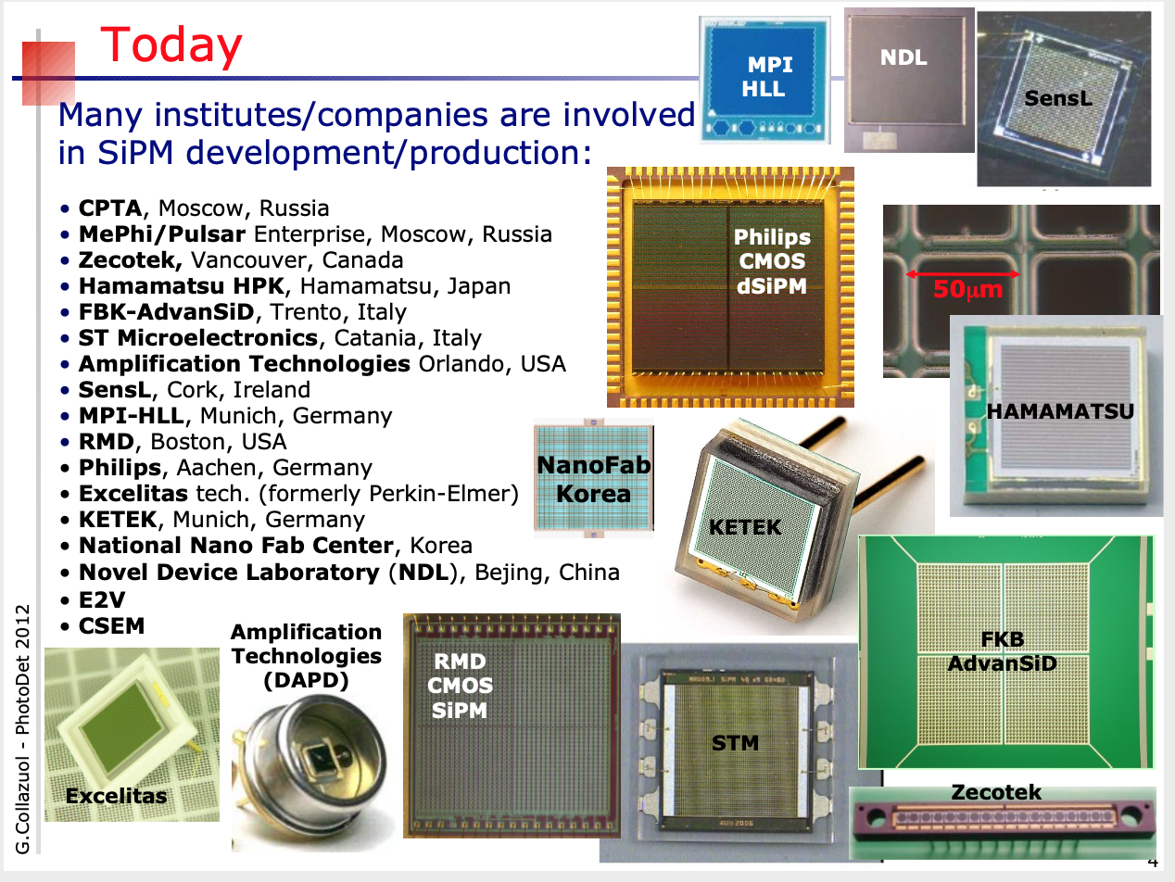
SiPMs Cambrian explosion ~10 years ago…
Yesterday
Any tweaks of parameters (if company will agree to do it at all) is a process ~ 1 year, $80-100K, + efforts to test… I don’t see what we want to tweak for existing HPK sensors.
FY23 eRD110, DAC think we don’t need to do any R&D/tests for SiPMs for calorimeters
At the end most calorimeters in our field end up with, we know what company it is…
Summary:
If for ePIC calorimetry proceed with a ‘sole source’ approach then we are almost ready.

