Slide 1
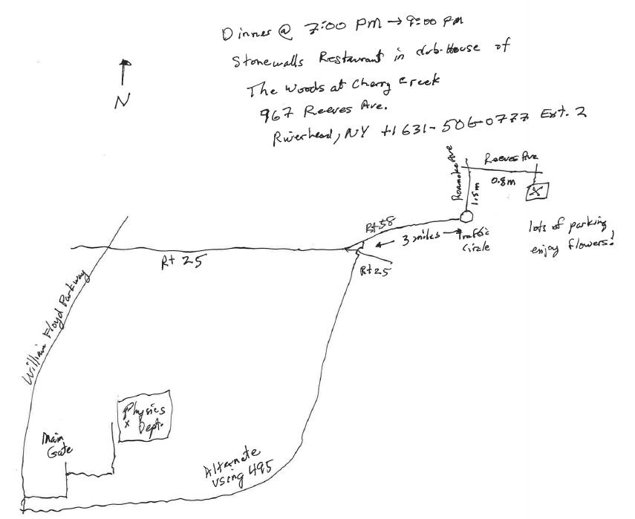
Exit 73 from 495

