Slide 1
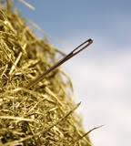
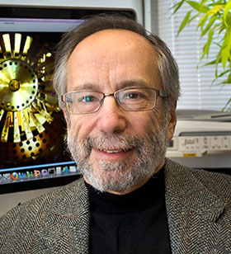
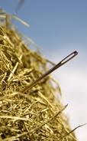

-
K⁺ → π⁺νν at the AGS
Needles in a Haystack!
Stewart Smith
Princeton University
F
Littenberg Symposium
BNL, June 24 2016

Slide 2
Acknowledgements
wvvv
p
The US, Canadian and Japanese funding agencies provided generous, long-term support and understanding through their national laboratories and university programs.
The fabulous support of lab directors Nick Samios, Erich Vogt, Alan Astbury, Bob Palmer and Larry Trueman was critical.
Sadly, we have already lost too many of our colleagues and friends along the way, including Frank Shoemaker, Howard Edwards, Ted Kycia, John McDonald, Adit Sambamurti, Shojiro Sugimoto, Seiji Kabe, Leonid Landsberg, and just this week I-Hung Chiang. It is an honour to pay tribute to them today.

Slide 3
The first golden age of kaon physics
1958 V–A theory (Lee, Yang, Feynman, Gell-Mann, Marshak and Sudarshan): P,T violation, but preserves CP symmetry.
1963 Nicola Cabibbo resolved the systematics of strange-particle decays (except for absence of strangeness-changing neutral currents). Massive experimental program to confirm.
“Cabibbo’s paper has become the most cited of the more than 350,000 physics papers published since 1893.” Franklin medal citation in 2011.
1964. Only a year later Fitch and Cronin discovered CP violation in neutral K decays at Brookhaven.
  1970: Glashow, Iliopolous and Maiani explain suppression of strangeness-changing neutral currents, predict charm.
  1972: Nygren, Christenson, Carithers measure K⁰_{L}→μμ ∼10⁻⁸, consistent with GIM calculation, almost at unitarity lower limit.

Slide 4
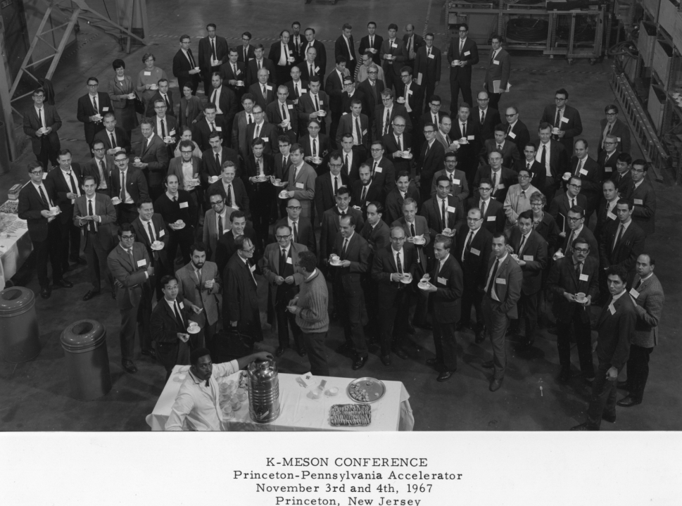
Does K^{O}_{L}→π⁺π⁻
= K^{O}_{L}→π⁰π⁰ ???

Slide 5
“Benign neglect” in the 1970’s set the stage for the rebirth of Kaon physics in the 80’s
Kobayashi/Maskawa proposed standard-model picture of CP violation requiring 6 quarks (only 3 had been observed).
Charm, beauty, and τ discovered – 3 generations!
QCD and EW theories form a Standard Model whose predictions can be tested experimentally.
Huge advances in beam intensities, detector technology, electronics, computing, etc.
By 1981 it was possible to imagine a new generation of kaon experiments with 10³ to 10⁴ higher sensitivity.
  Direct CP violation (FNAL and CERN)
  K decays violating lepton flavour conservation (Brookhaven)
  K→πνν -- unique opportunities for spotting new physics and testing the Standard Model.

Slide 6
The formation of the E-787 collaboration
I982 BNL and Princeton groups agreed to spend the summer evaluating possible rare K experiments with the goal of collaborating together.
  I spent the summer at TRIUMF working on K_{L}→μ e, along with Bill Louis and John Greenhalgh in Princeton. The Kycia group at BNL worked on K⁺→π⁺νν, led by Laurie.
  In the Fall we chose K⁺→π⁺νν because:
    BR precisely predicted by the Standard Model (~10⁻⁹ at that time!)
    Experimental limit was ~ 2x10⁻⁷.
    → An exciting journey to reach the SM level, with a great window for new physics on the way.
LOI to the AGS in fall 1982; Doug Bryman’s TRIUMF group joined, as well as Maged Atiya from Columbia and Dan Marlow, then at Carnegie Mellon.
Proposal in Sept 1983, a few weeks following the demise of fair Isabelle. (Labor Day weekend at Nevis ….)

Slide 7
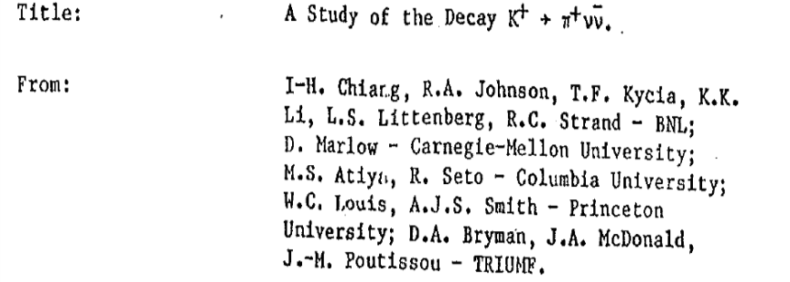

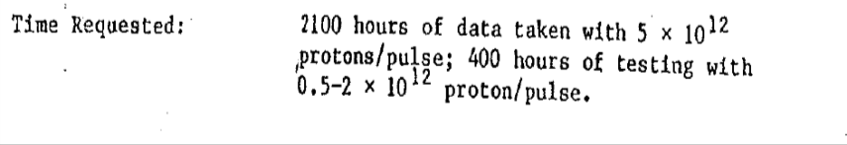


Slide 8
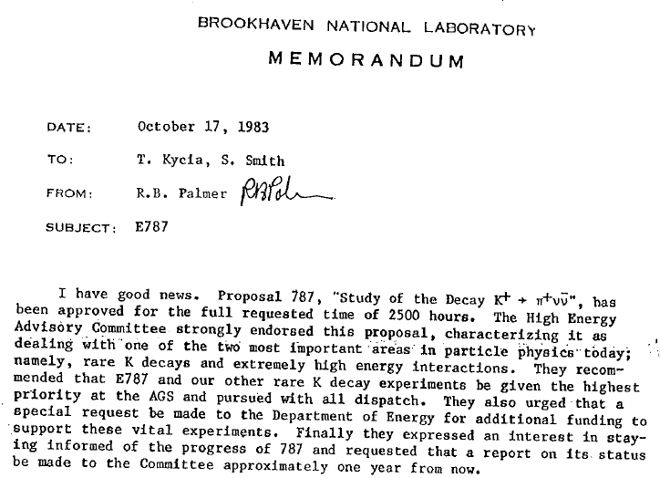

Slide 9
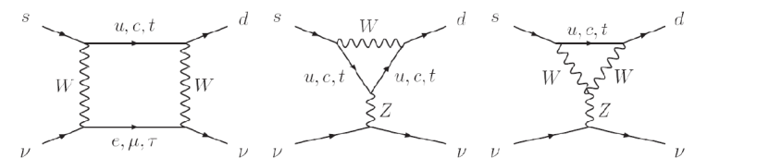
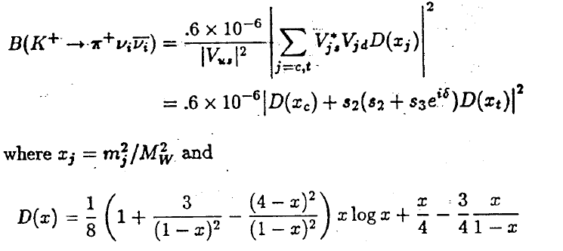
K⁺→π⁺νν in the Standard Model
_
⋅
u
⋅
π
K
⋅
⋅
No long-range couplings
GIM cancellation is spoiled by quark-mass effects, so that
Inami and
Lim, 1981

Slide 10
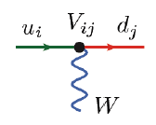
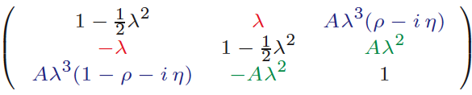
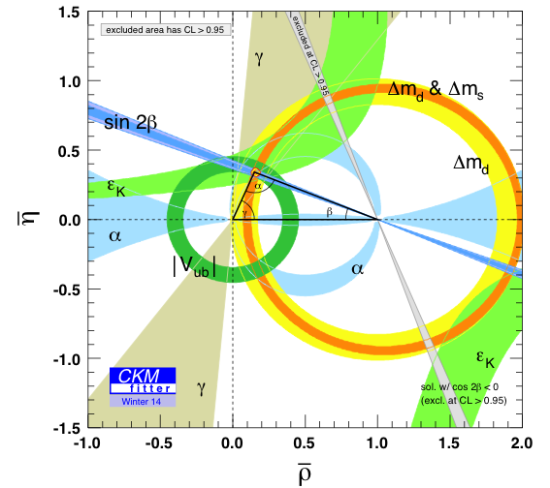
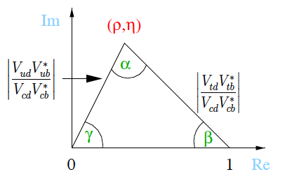
CP Violation vs Standard Model
(2015)
V_{ud}V*_{ub}+ V_{cd} V*_{cb}+ V_{td}V*_{tb} = 0
  All CPV effects governed by η
The CKM picture able to account for all observed CPV effects & flavor interactions

Slide 11
K→πνν and the Unitarity Triangle
-
Product of 1st and 3rd columns
(There are other such relations
but they are almost straight lines!)
V_{ud}V*_{ub}+ V_{cd} V*_{cb}+ V_{td}V*_{tb} = 0
Im
K⁰_{L}→π⁰νν
B_{d}, B_{S} Mixing
K⁺→π⁺νν
Re

Slide 12
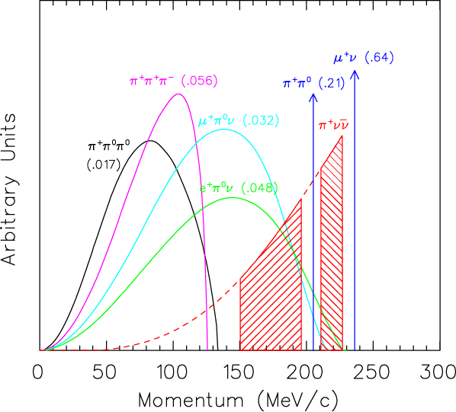
Experimental considerations for K⁺→π⁺νν
_
momentum spectra of charged particles in signal and
background K decays
We’re dealing with pions, muons,
electrons and photons
For every K decay, only the neutrinos should escape detection
Working in the CM (stopped-K) has many advantages
  Can exploit a kinematic peculiarity - signal has poor signature, but backgrounds have excellent signatures [CM = Lab]
  Many powerful low energy particle identification techniques can be used
Measure everything possible about the K⁺ and π⁺ with high resolution
Fine segmentation, deadtimeless electronics to handle rates.
pnn1
pnn2
CM

Slide 13
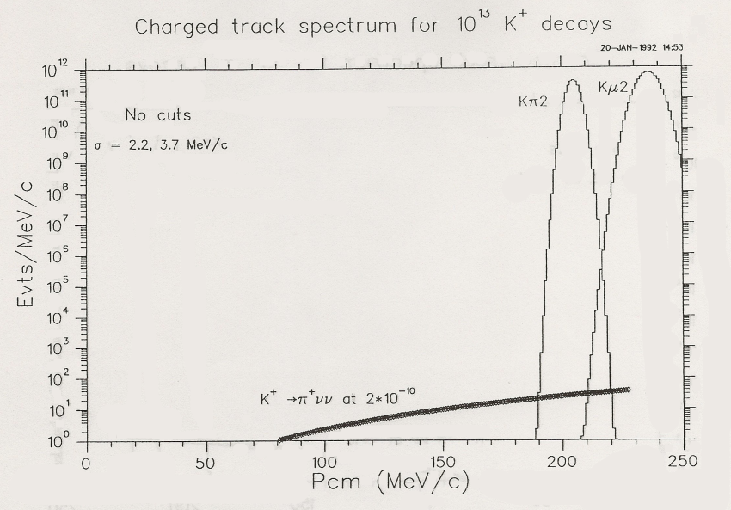
Reality
Kinematics
Particle ID
Hermetic veto system

Slide 14
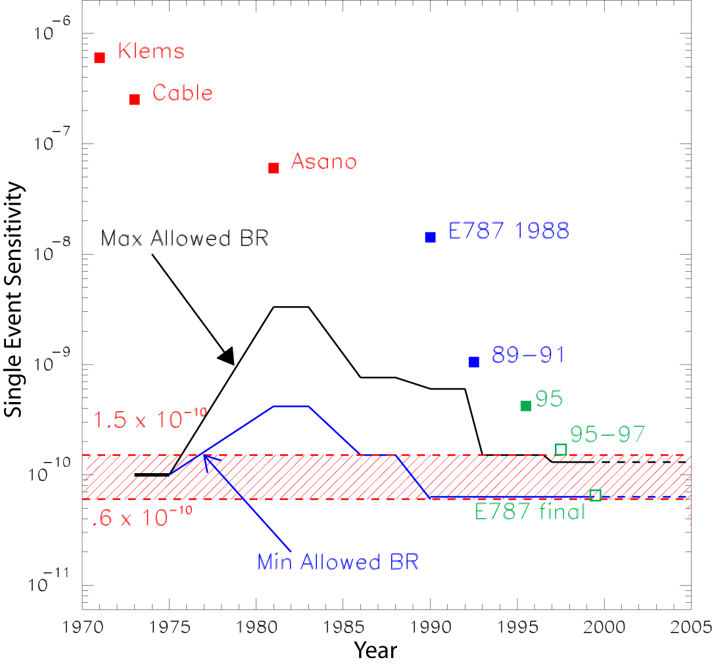
A moving target ….

Slide 15
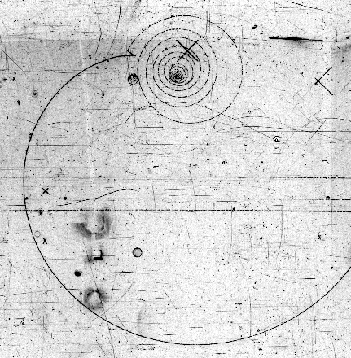
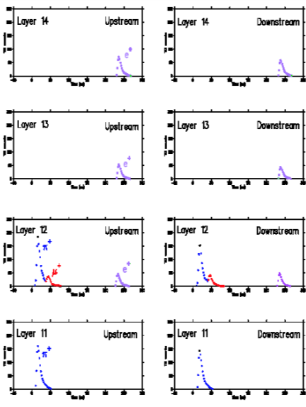
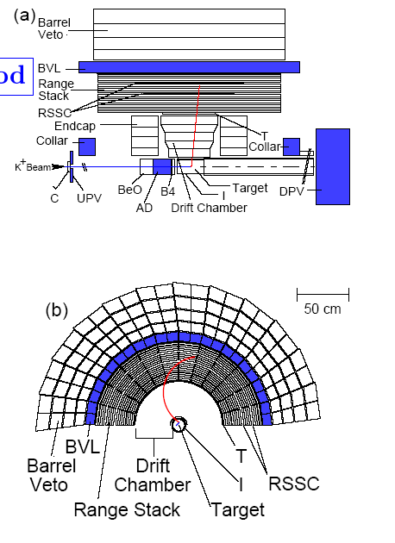
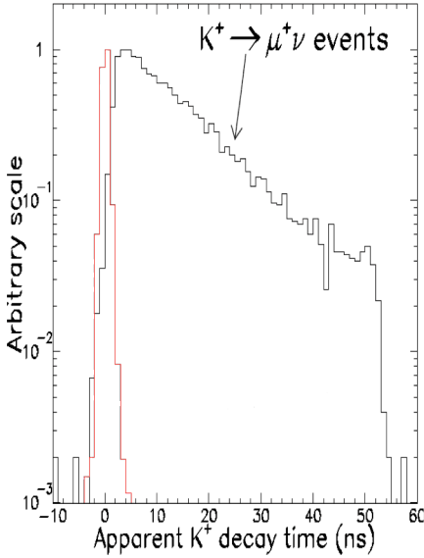
E787/949 – A “zero-energy” 4π collider detector
e⁺
Incoming 700MeV/c K⁺: identified & tracked by beam instrumentation. Slowed by energy loss in a BeO “degrader”
μ⁺
π⁺
K⁺ stops & decays at rest in scintillating fiber target – wait 2ns to make sure
Outgoing π⁺: verified by counters. Momentum measured in cylindrical drift chamber, energy & range in target & RS (1T magnetic field parallel to beam)
π⁺ beam events
π⁺ stops & decays in RS – detect π⁺→μ⁺ →e⁺ chain with transient digitizers
Photons registered by all systems so events can be eliminated
July 2005
Notes:
15

Slide 16
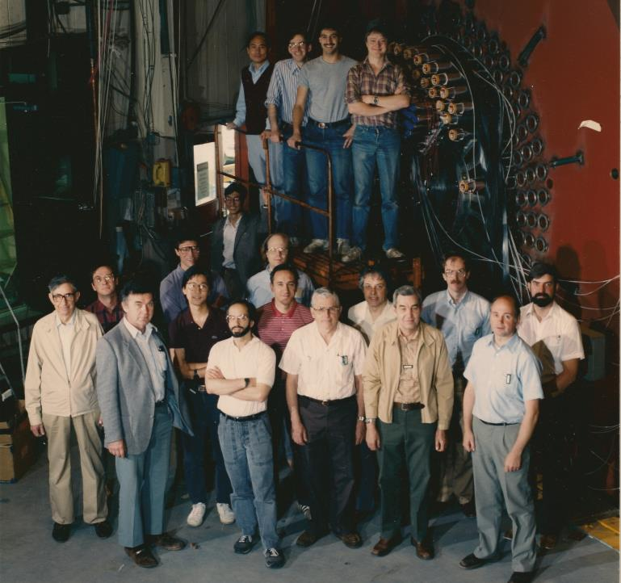

E 787
team in
1988
as the
detector
nears
completion

Slide 17
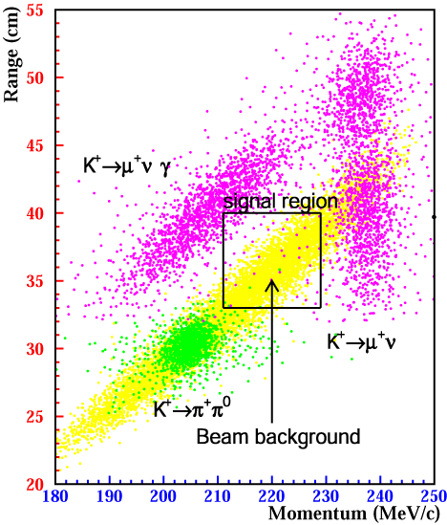
E787 Analysis “Philosophy”
Signal region “the BOX”
p_{π} > p(K⁺→π⁺π⁰) = 205MeV/c
similar regions for Range, Energy
K⁺→π⁰μ⁺ν
Background sources
pions (K⁺→π⁺π⁰ )
muons (K⁺→μ+ν(γ),..)
beam background, etc.
Background rejection
Kinematics (p, R, E)
Particle ID (μ, π, e)
Photon rejection
17
Notes:
17

Slide 18
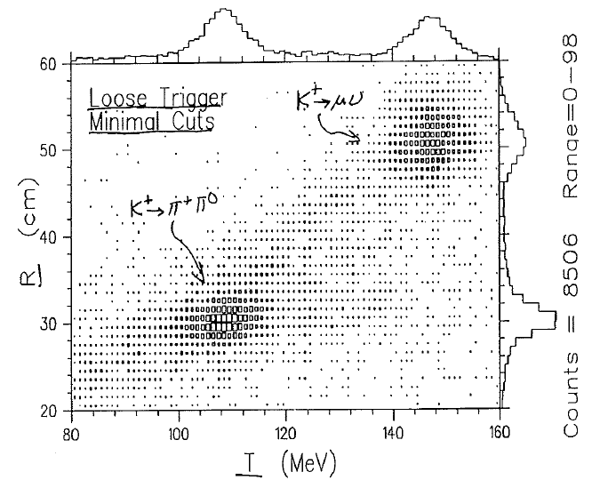
Plot of Range vs Energy for the 2 weeks
of data in 1988 Test Run

Slide 19
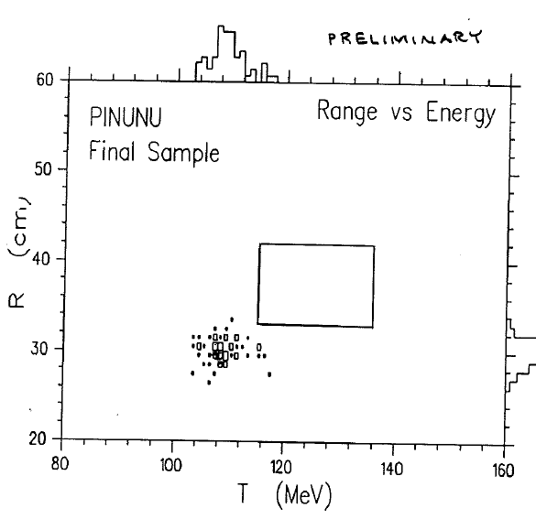
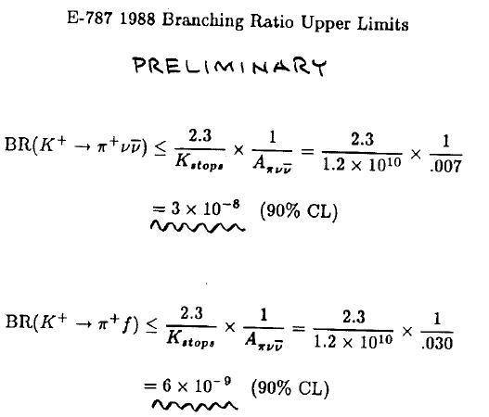
First E-787 measurement; from– 2 week test run

Slide 20
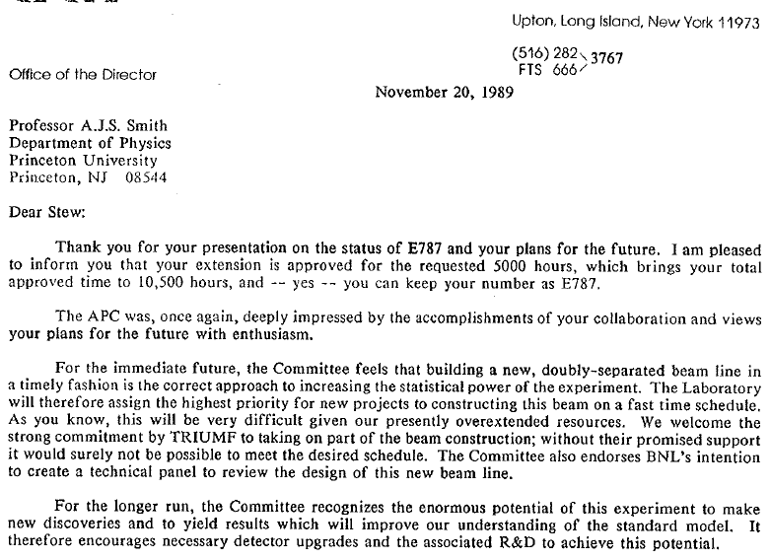
Test run was so successful that a new proposal for E-787 Phase II was approved a year later.

Slide 21
E787 Phase II
1988 test run and Phase I running during 1989-1991 pointed the way to major upgrade of the beamline and detector.
Group was expanded, most significantly when a Japanese group led by Shojiro Sugimoto joined us.
The upgrade R&D and construction took place between 1991 and 1994
An engineering run was taken in 1994
The first data run with a complete detector was taken in 1995.
Notes:
21

Slide 22
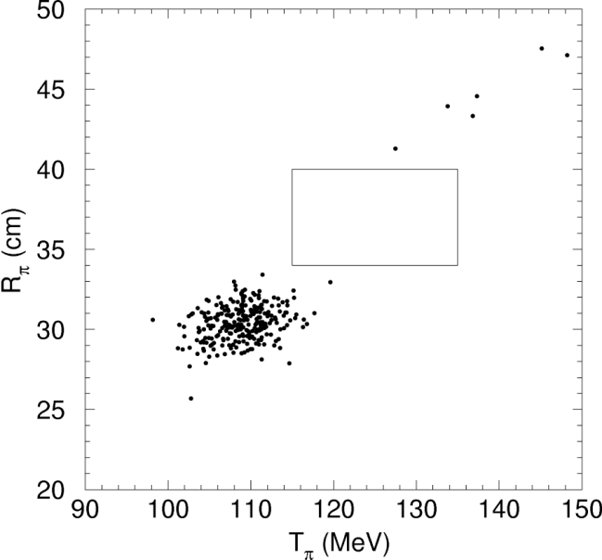
By the end of Phase I , E787 had reached:
1989-91 result:
B(K⁺→π⁺νν)<2.4×10⁻⁹
estimated background ~ 0.5 evt
Plot shows pion range in the stopping target vs pion energy after all other cuts

Slide 23
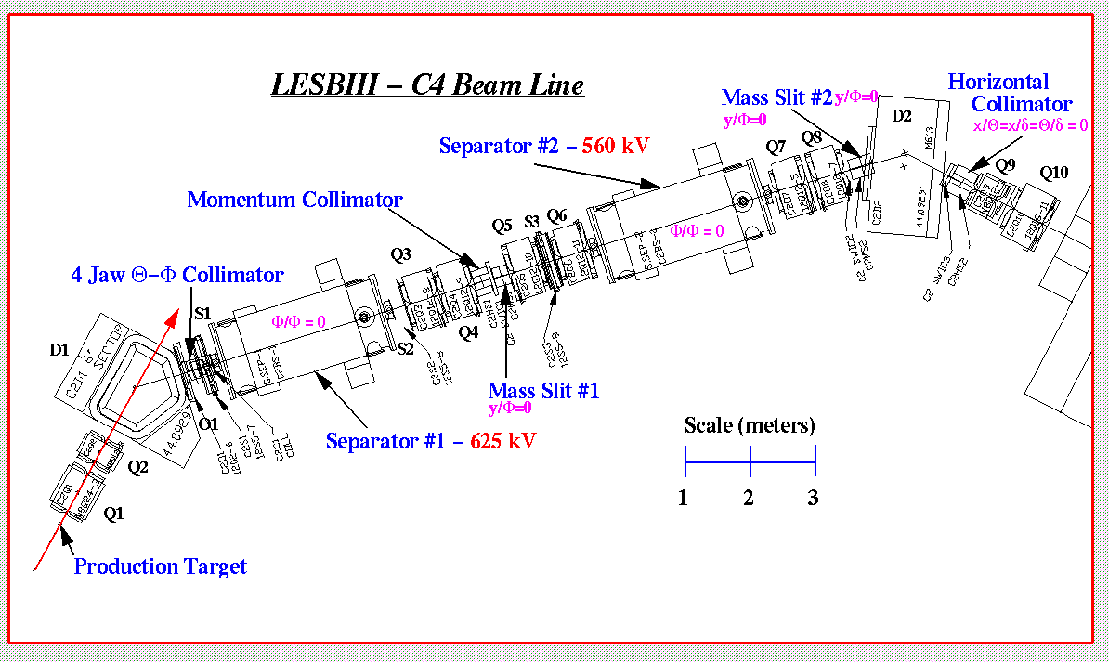
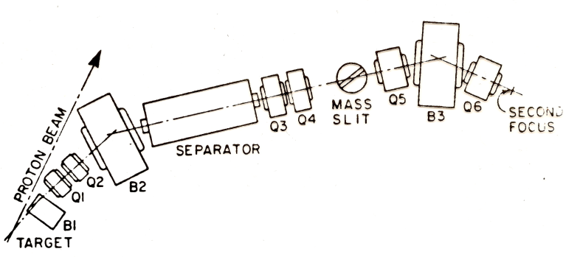
Phase II: Vastly improved beamline
Doubly separated → pion rejection improved tenfold
  ¾ K’s, instead of ¾ pions
Acceptance quadrupled, but longer. Overall, 2.5 increase in K’s on E-787 target / Primary beam proton
Original beam

Slide 24
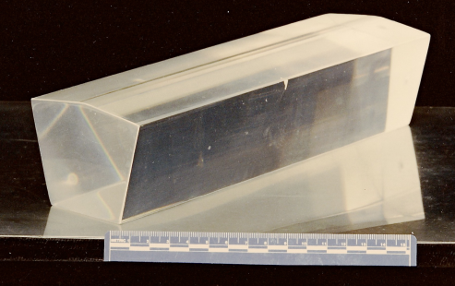
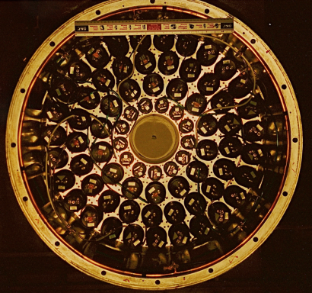
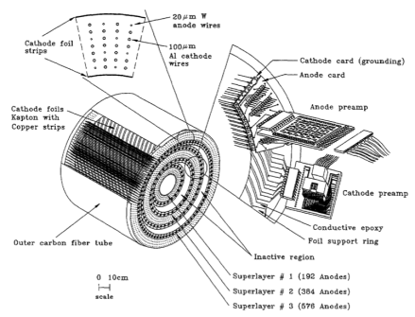
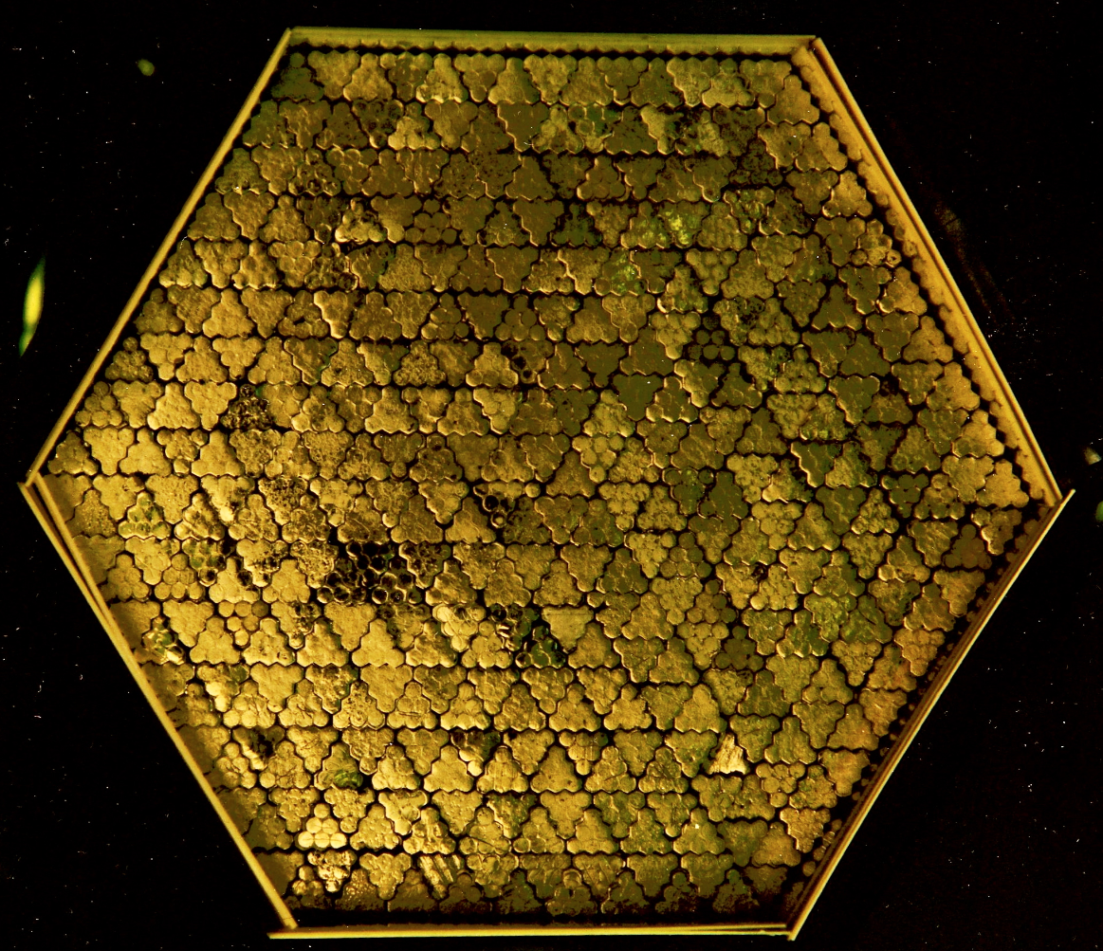
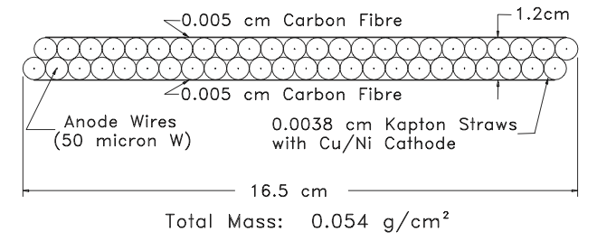
Phase II: Reduced dead material “everywhere”
Endcap photon vetoes: 30% live Pb-scintillator sandwich counters replaced by 100% live pure CsI, read out via B field-tolerant PMTs
New Drift Chamber
  ~2% momentum resolution→ 1%
Straw chambers in range stack
  Material reduced from 0.3 to 0.05 gm/cm2
New stopping-K scintillator target
  90% live vs 75%
  3 X brighter
  More uniform geometry

Slide 25
Phase II: Trigger, Electronics & DAQ
Expansion of 8-bit 500-Mhz sample transient recorder system (with on-the-fly sparsification, etc.)
Similar devices executed in gallium arsenide for target, photon vetoes
New, more intelligent multilevel trigger
Unix-based DAQ built from scratch in about 6 months
John Haggerty Chris Witzig Steve Adler

Slide 26
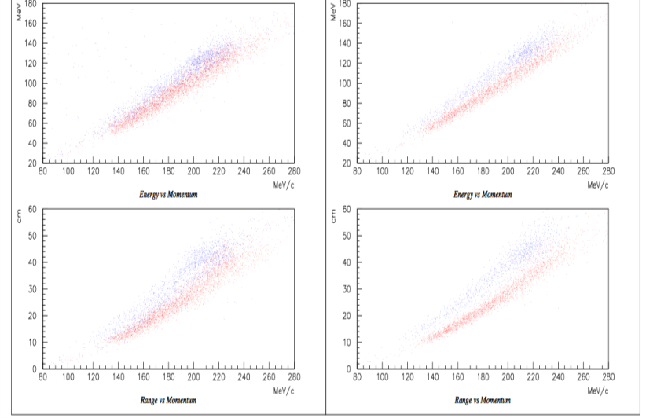
Particle ID improvement
muons
pions
Energy → Energy →
Momentum → Momentum →

Slide 27
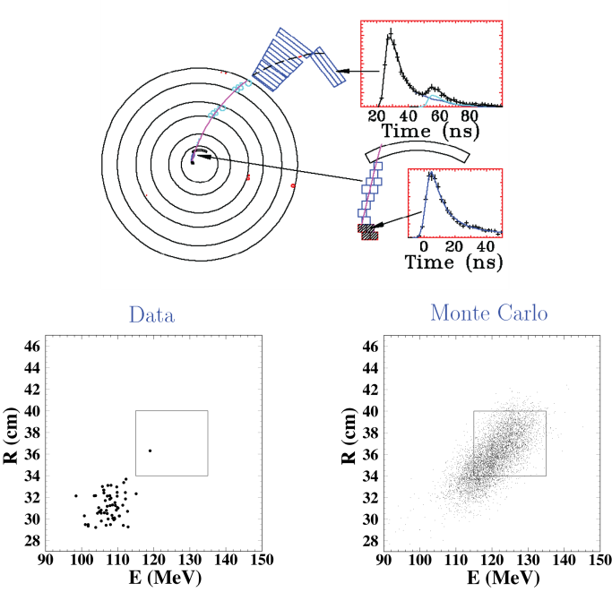
The First Event !
Implied branching ratio ~5 × SM prediction….
2.4× all previous sample was collected in 1995 including the 1st event.
Data Simulation

Slide 29
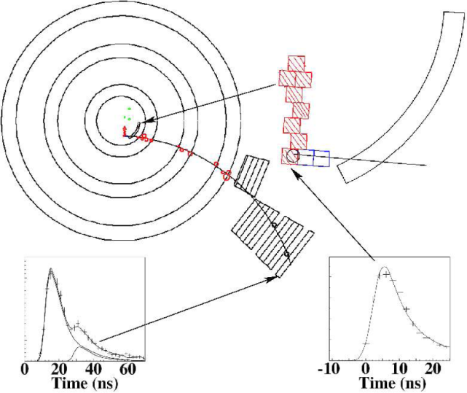
Three more years of data
By end of run in 1998 we reached <10⁻¹⁰/event sensitivity and found a second event.
BR now ~ 2 x SM
attention!
tetwic that predicted by the SM (but statistically individual basis.

Slide 30
Phase III E – 949:
Miracle followed by tragedy
The AGS could produce > 6 10¹³ protons/pulse with 40% duty factor, but the experiment was rate limited to 2 10¹³.
  Improving the duty factor translates directly into up to 2.5 times higher average beam flux without increasing the instantaneous rates in the detector:
Fortuitously an idea for KOPIO allowed the AGS spill to be lengthened almost without limit
  and with further detector improvements E 949 could accept 6.5 10¹³/sec
But the AGS program terminated in 1997, after only one year of E 949 running

Slide 31
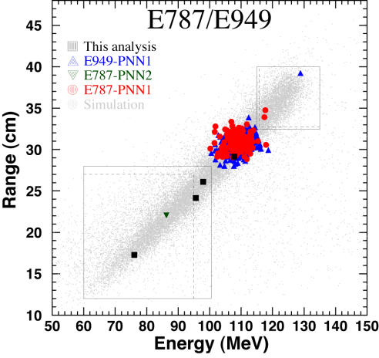
Final Combined E787/949 Result
E949-PNN2
7 events
1.73
+1.15
-1.05
(68% CL interval)
c.f. SM prediction: (0.78±0.08) x 10⁻¹⁰

Slide 32
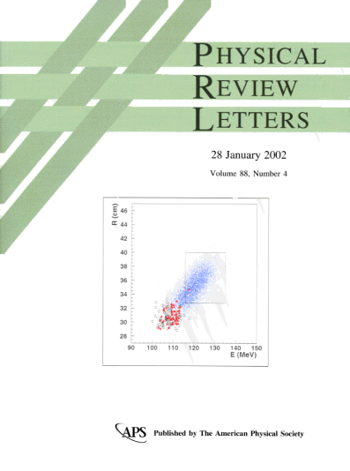
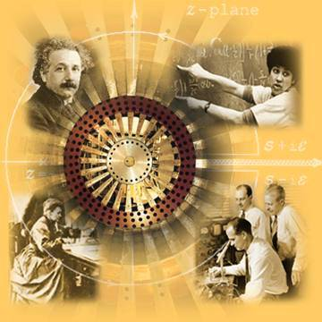
APS Loves E 787

Slide 33
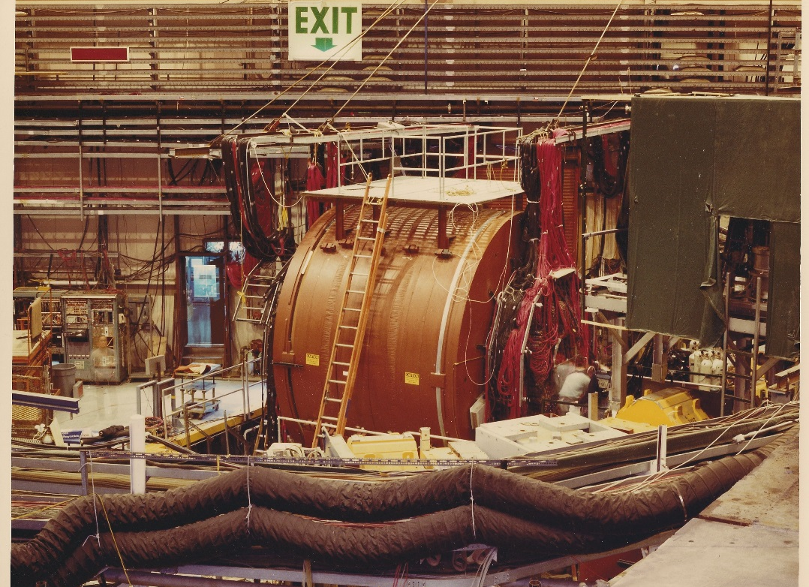
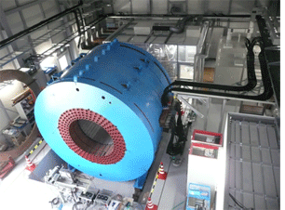
But at least our magnet’s OK, and working on its 3rd life!
SURA Cyclotron
E 787-949
The core of LEPS, the Laser Electron Photon Experiment at the SPring-8 synchrotron radiation facility in Japan

Slide 34
Conclusion: The E 787/949 program:
Improved the sensitivity to K⁺→ π⁺νν by > 1000, and could have gone another order of magnitude
  First observation of a very important process.
  It could have achieved another order of magnitude
  We’d know whether the BR was anything like 2×SM
Transformed many students and postdocs into prominent scientists –they were able to “do their thing.”
Would have been almost impossible today.
  It was an evolving program rather than a project. We couldn’t get there in one step.
  Required large amounts of advanced funding!
  Step n+1 required lots of R&D and new technology (accelerator, beam and detector) based on experience in step n.
_

Slide 35
BACKUPS

Slide 36
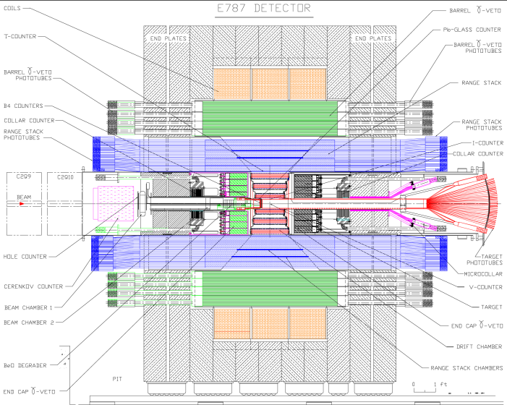
E787 K⁺→π⁺νν
Stopped K⁺ ~10M/spill, purity ~75% ~1/4 stop in target
CM device looks like collider detector
Measure π⁺ p,T,R, lifecycle
Hermetic veto (extra particles cannot avoid being detected)
Notes:
36

Slide 37
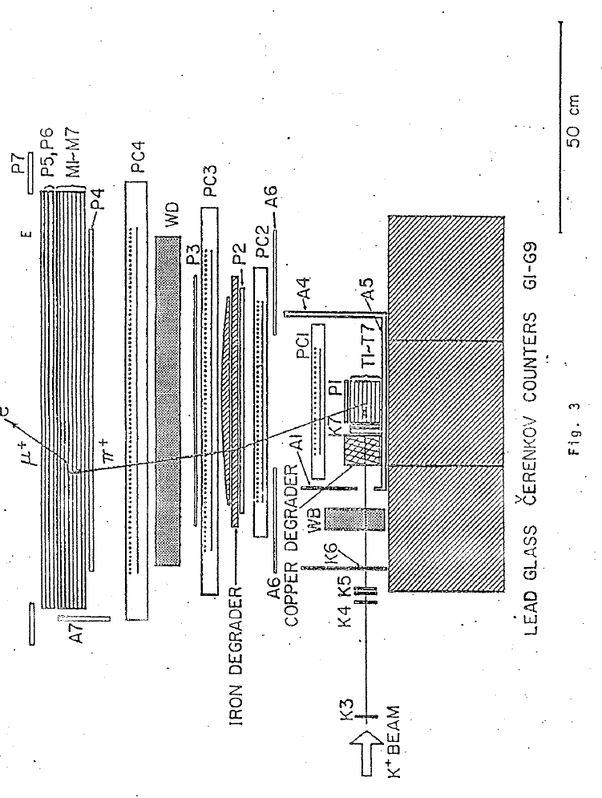
“Previous art:” Detector of Asano et al.
BR < 2 10⁻⁷
K⁺→π⁺π⁰

Slide 38
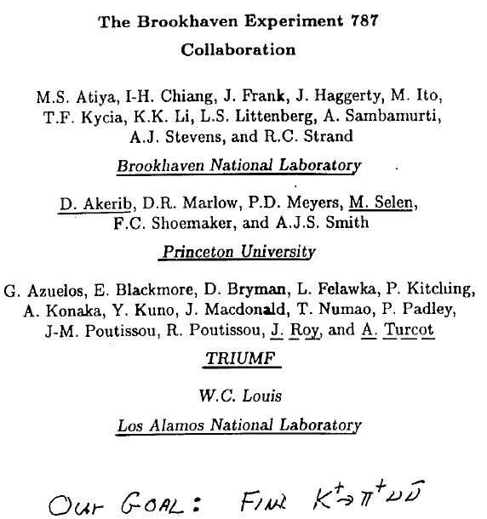
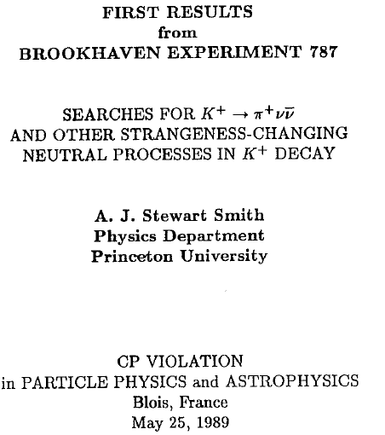
A 2-week test run was a complete success,
with interesting results as icing on the cake
25th anniversary of the discovery
of CP Violation

Slide 39
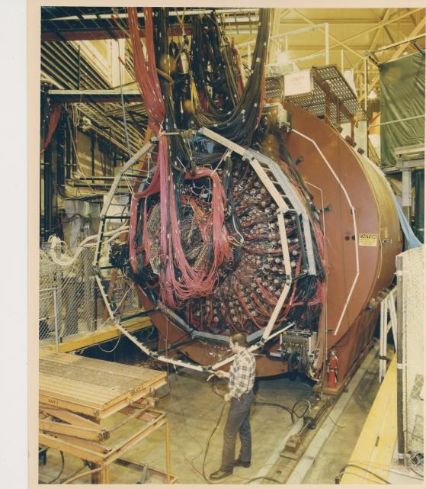
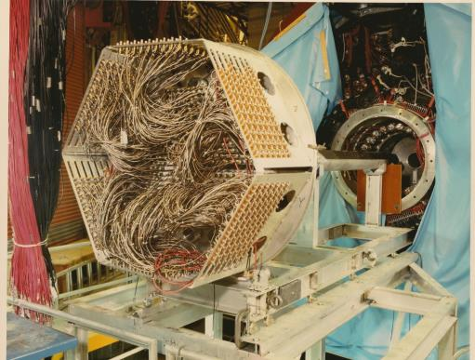
Detector construction
1988: The detector is
ready for action
Target installation.

Slide 40
Princeton faculty and PhD students
Faculty
  Frank Shoemaker, Bill Louis, Dan Marlow, Peter Meyers, Mark Ito and Andrew Bazarko
Graduate Students
  Dan Akerib -- faculty, Stanford/SLAC
  Mehran Ardebili -- finance
  Mark Convery -- senior staff scientist at SLAC
  Rob McPherson -- faculty, U Victoria; Head, ATLAS-Canada,
  Deputy Spokesperson, ATLAS
  Mats Selen -- faculty, U. Illinois Urbana
  Robert J Stone finance and would-be rock star

