Slide 1
Personal Reminiscence about the Daya Bay Reactor Neutrino Experiment
Randy Johnson
University of Cincinnati
LittenbergFest – June 25, 2016

Slide 2
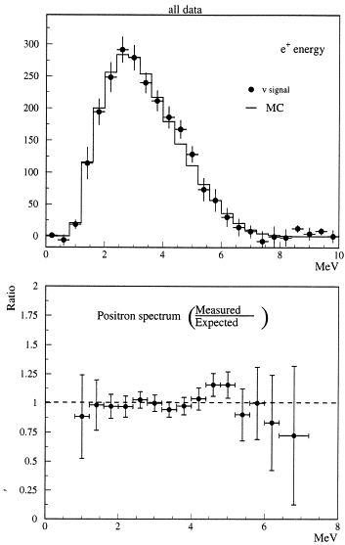
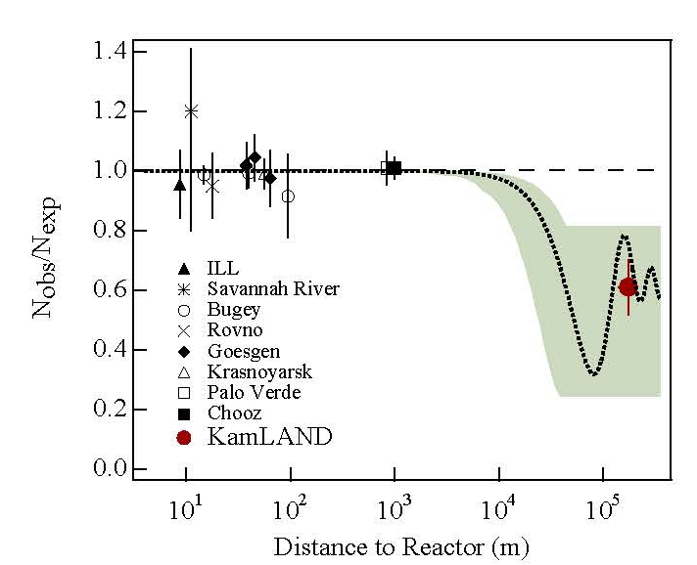
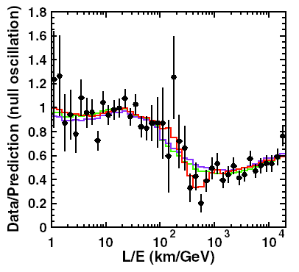
Neutrino Mixing Matrix Landscape - ICHEP 2004 Beijing
  Kamland has confirmed solar LMA solution of sin² 2θ₁₂ ~ 0.83.
  SuperK measured sin² 2θ₂₃ > 0.9 from atmospheric oscillations
  SNO confirmed total solar flux was consistent with the SSM.
  CHOOZ limited the value of sin² 2θ₁₃ < 0.15 (0.13).

Slide 3
Holy Grail of Neutrino Physics:
Measure CP Violation
Next Step: Measure sin² 2θ₁₃
Why?
  CP violating terms proportional to sin θ₁₃
How?
  Short baseline reactor neutrino experiment
  Must improve (by an order of magnitude) on Chooz and Palo Verde
    Increased number of events
    Reduce systematic errors
Goal: δsin² 2θ₁₃ < 0.01 (NuSAG recommendation)

Slide 4
Physics Goals of Experiment
1%

Slide 5
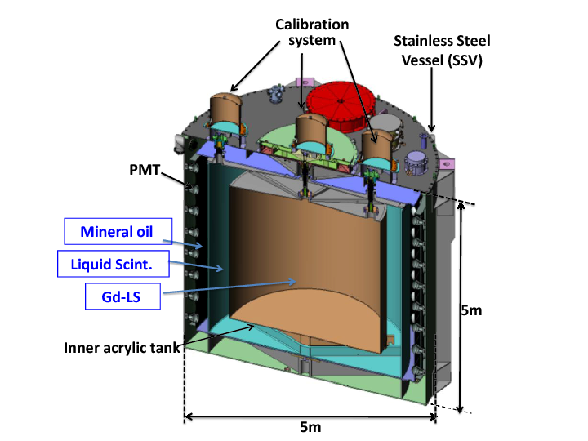
How Do You Meet These Goals?
First, make multi-layer detectors
Method:
Delayed Coincidence

Slide 6
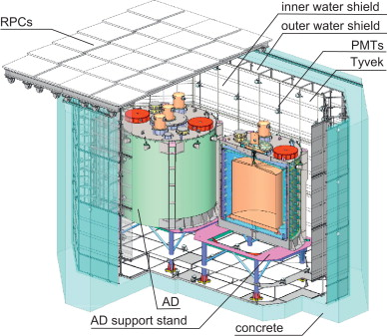
How Do You Meet These Goals?
Second, shield detector with an active water veto

Slide 7
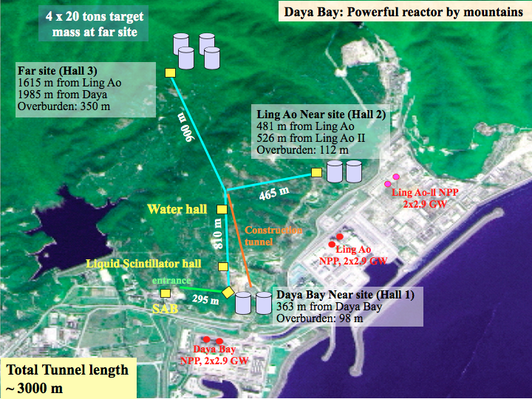
How Do You Meet These Goals?
Third, make near and far detectors
and shield them with an overburden

Slide 8
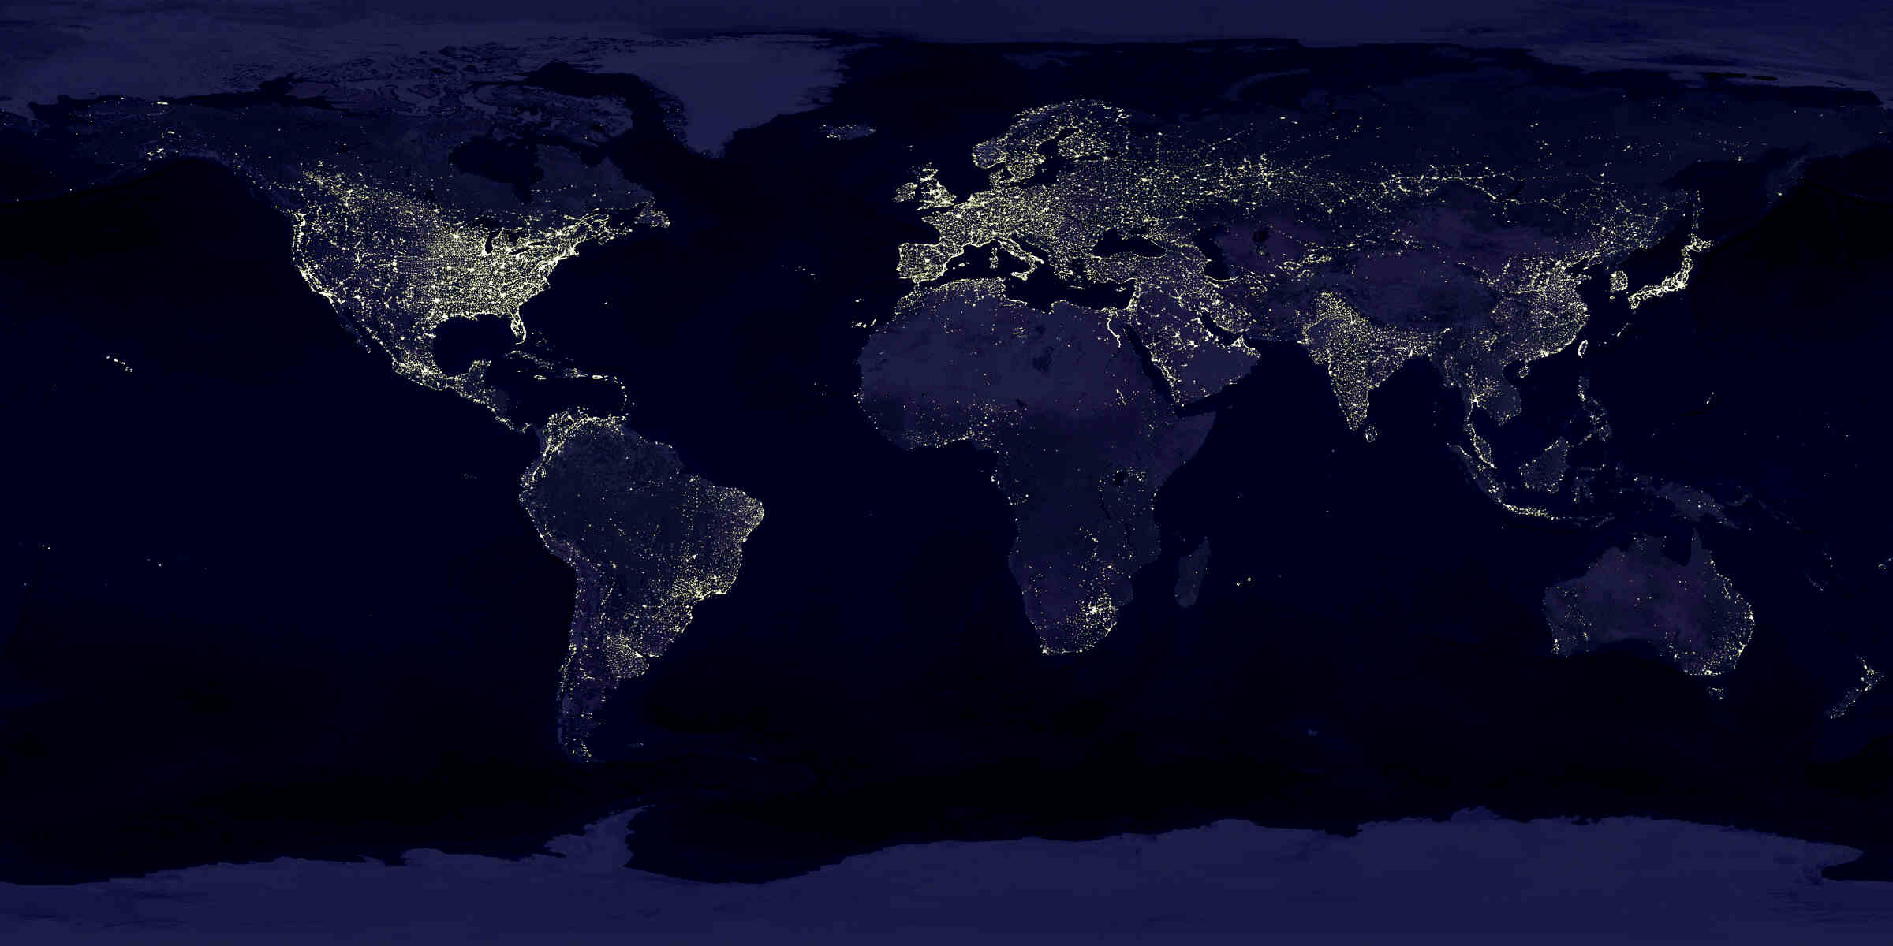
Proposed θ₁₃ experiments
Chooz, France
Krasnoyasrk, Russia
Braidwood, USA
Kashiwazaki, Japan
Diablo Canyon, USA
Daya Bay, China
Angra, Brazil

Slide 9
Why was DOE interested in
Daya Bay?
Agencies are always looking to do good physics
NuSAG report recommends a reactor neutrino experiment
Something for the Labs to do
Needed international cooperation for the NLC

Slide 10
Daya Bay Collaboration Forms
2006
USA:
BNL/Physics
BNL/Chemistry
Cal Tech
LBNL
Houston
UIUC
Asia:
Beijing Normal
CIAE
CUHK
HKU
IHEP
National Taiwan
Tsinghua
Europe:
JINR

Slide 11
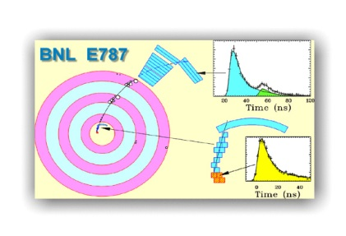
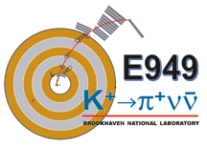
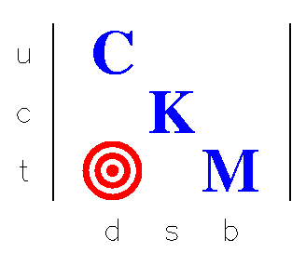


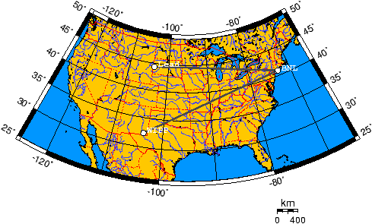

BNL Physics
Electronic Detector Group
Steve Kettell , BNL
February 15th, 2006
Daya Bay Collaboration Meeting
E734
Brookhaven leads group making water veto
M. Bishai, M. Diwan, D. Jaffe, S. Kettell,
L. Littenberg and
B. Viren
…others are interested
MINOS
VLBN

Slide 12
Landscape – Neutrino 2006
Chooz, France
Krasnoyasrk, Russia
Braidwood, USA
Kashiwazaki, Japan
RENO, South Korea
Diablo Canyon, USA
Daya Bay, China
Angra, Brazil

Slide 13
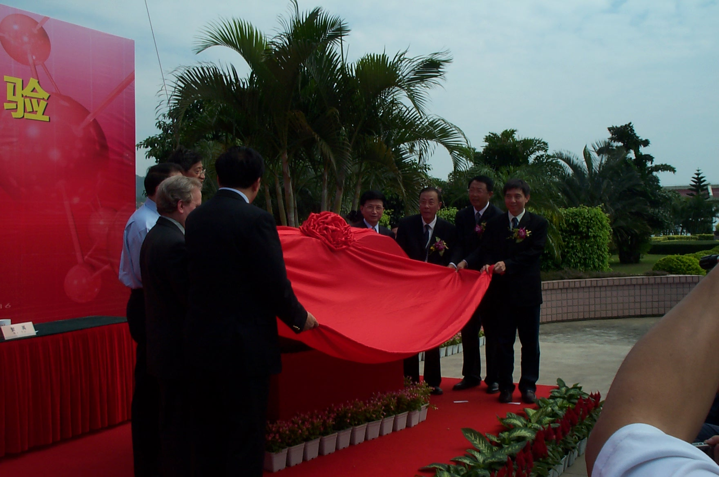
Site Dedication – Nov. 2007

Slide 14
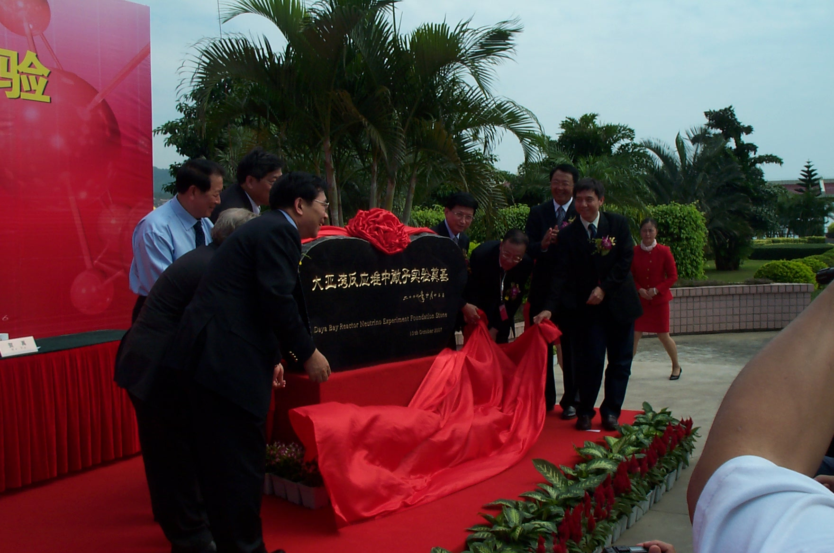
Site Dedication – Nov. 2007

Slide 15
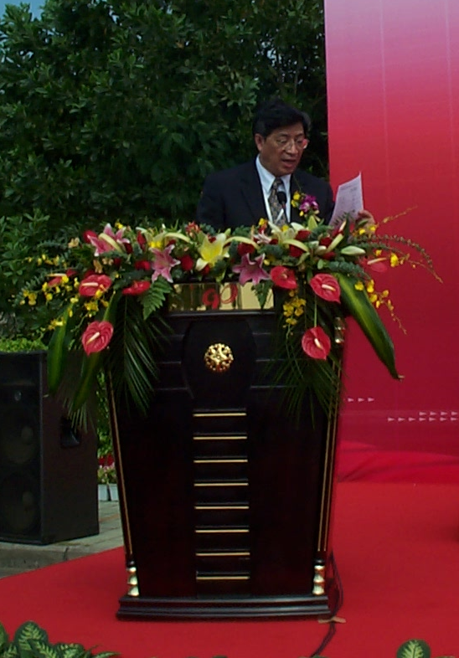
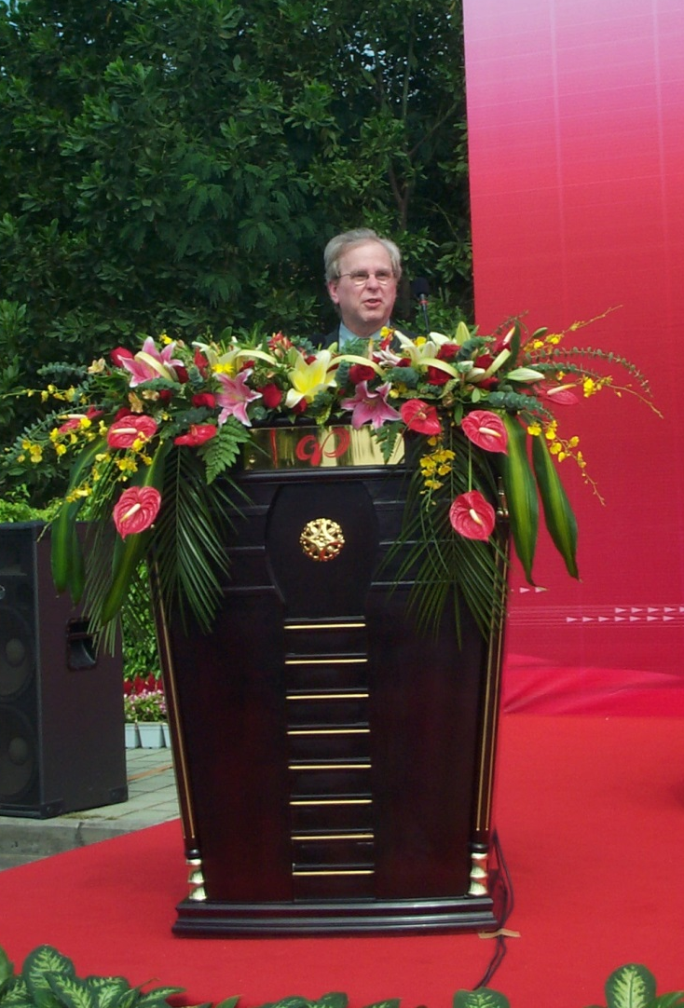
Major Players
Hesheng Chen
Director, IHEP
Robin Staffin
Associate Director for HEP, DOE

Slide 16
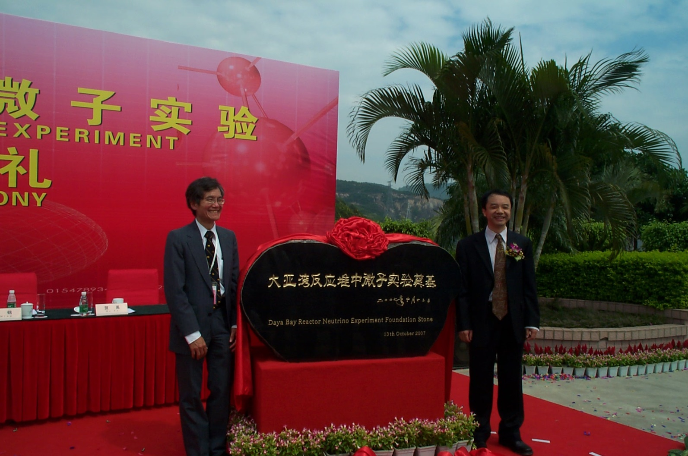
Major Players
Spokespersons
Kam-Biu Luk
LBNL
Yifang Wang
IHEP

Slide 17
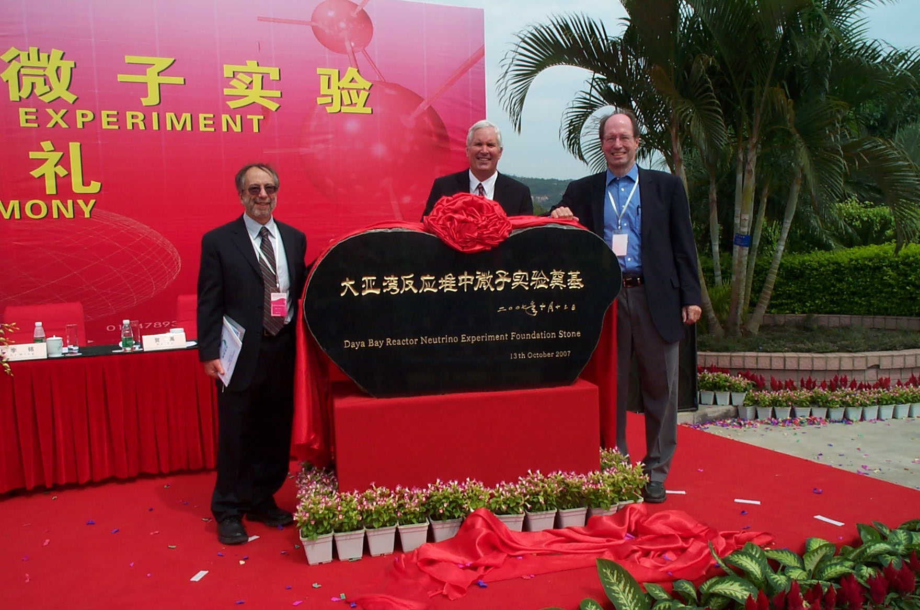
Major Players
Guess who?
BNL Physics
Jim Siegrist
LBNL Physics
Guess who II?
Program Manager, DOE

Slide 18
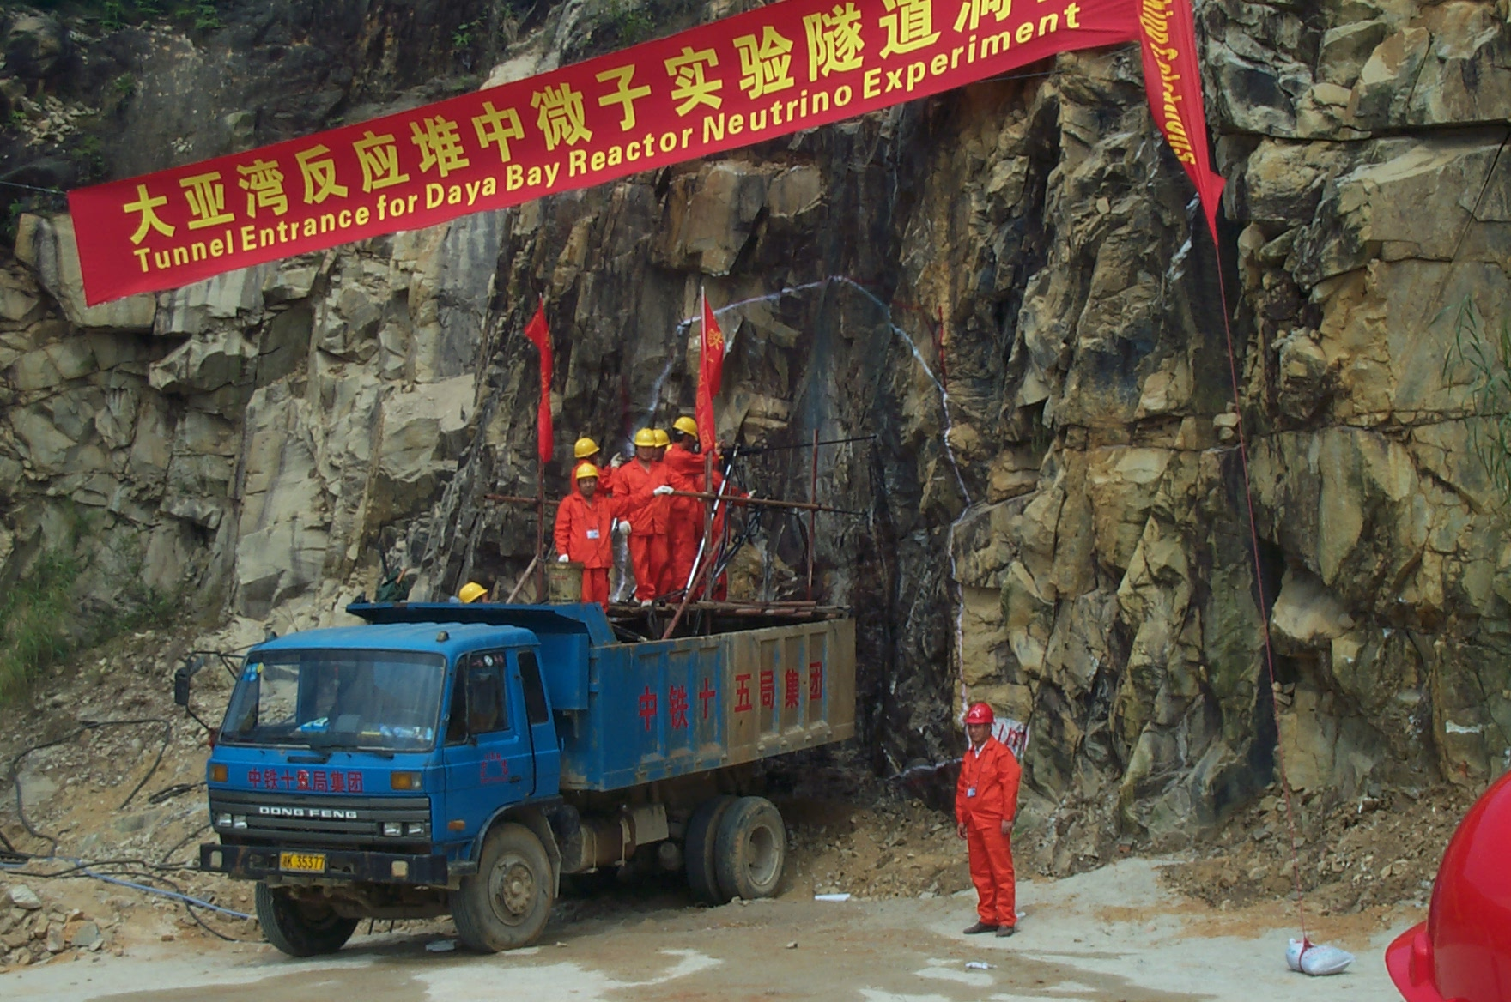
“Start of Construction”

Slide 19
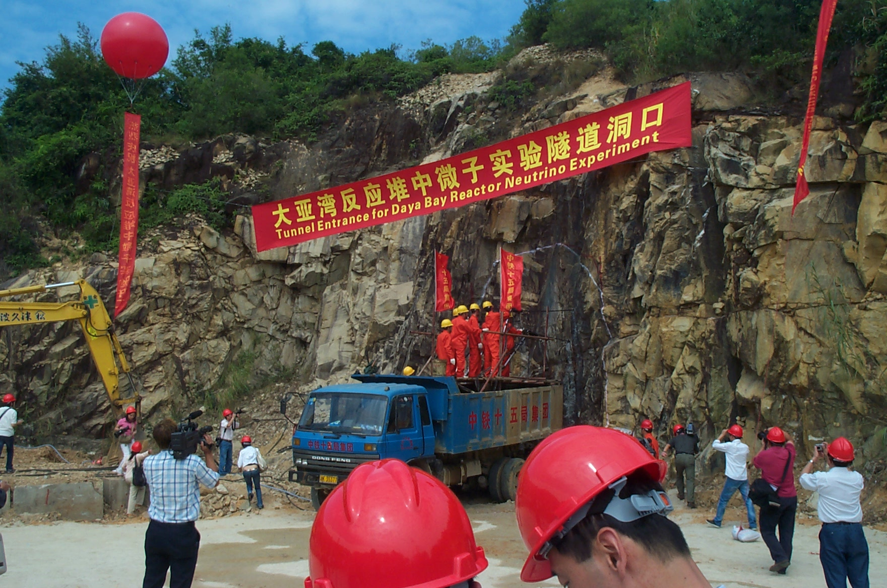
“Start of Construction”

Slide 20
Landscape – Neutrino 2008
Chooz, France
Braidwood, USA
RENO, South Korea
Daya Bay, China

Slide 21
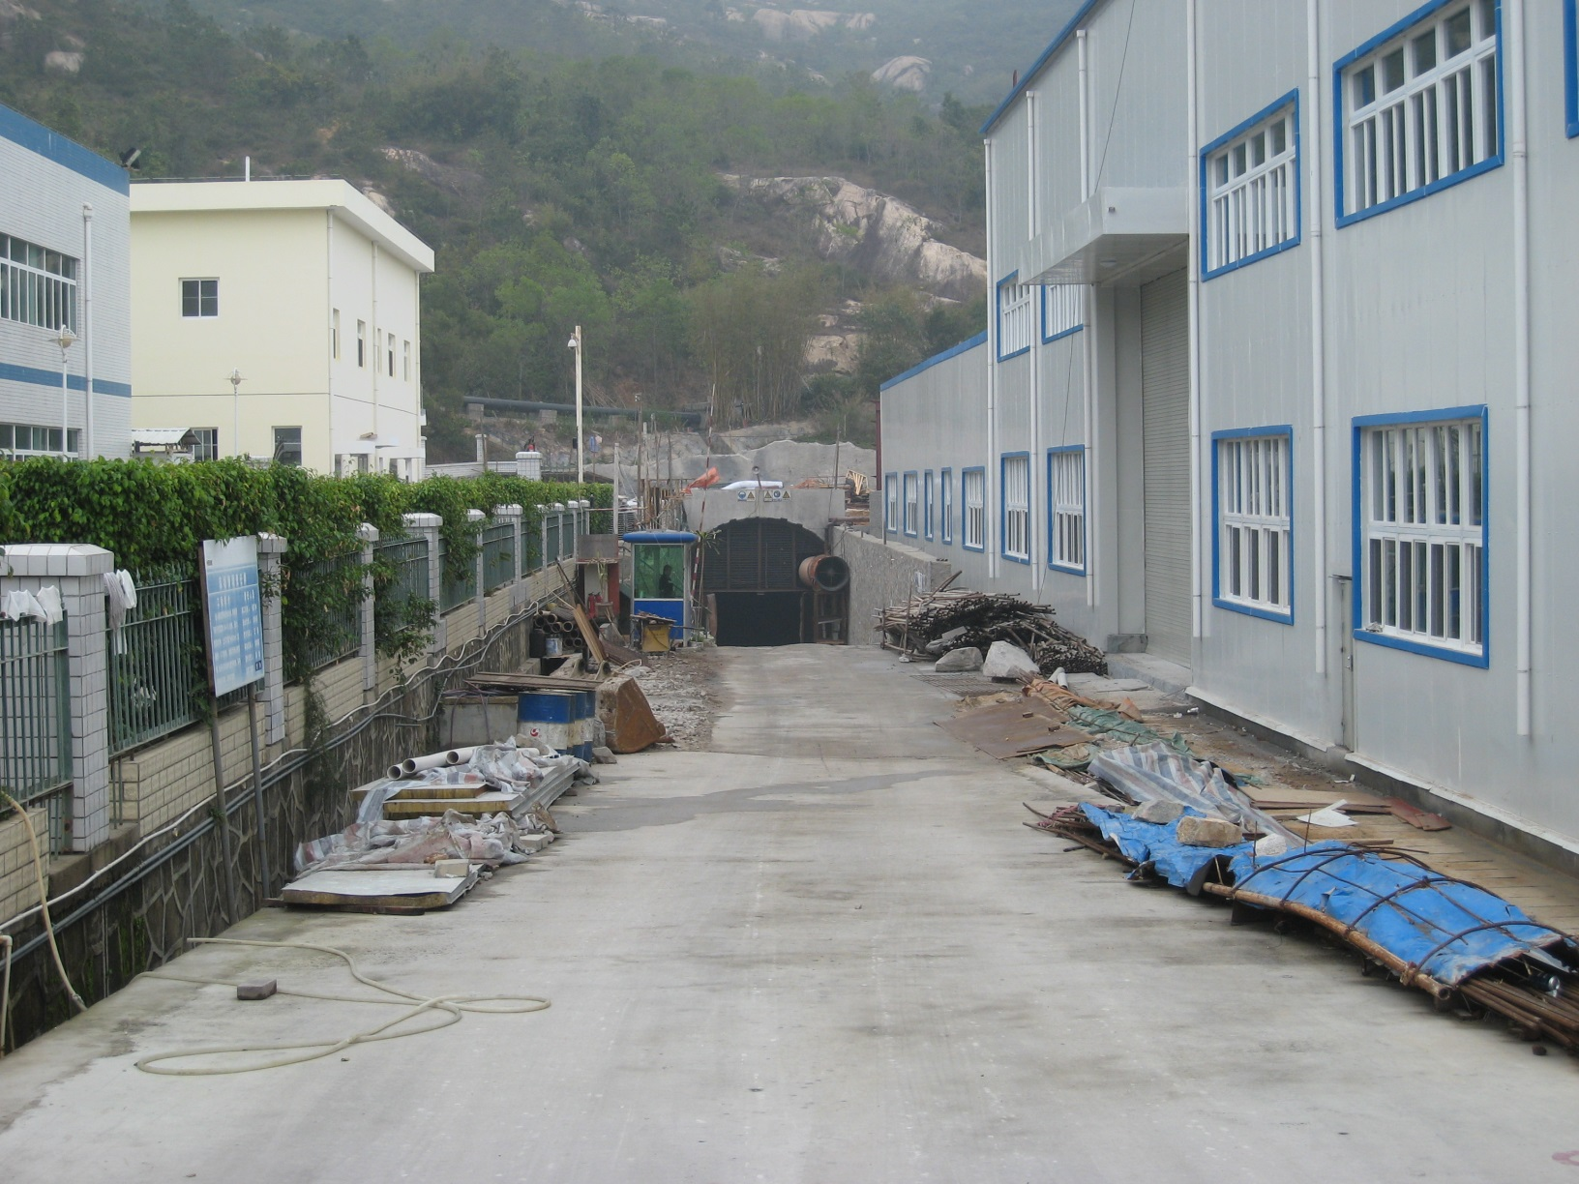
Construction Progress 2009
Counting House
Detector Assembly
Building
Tunnel

Slide 22
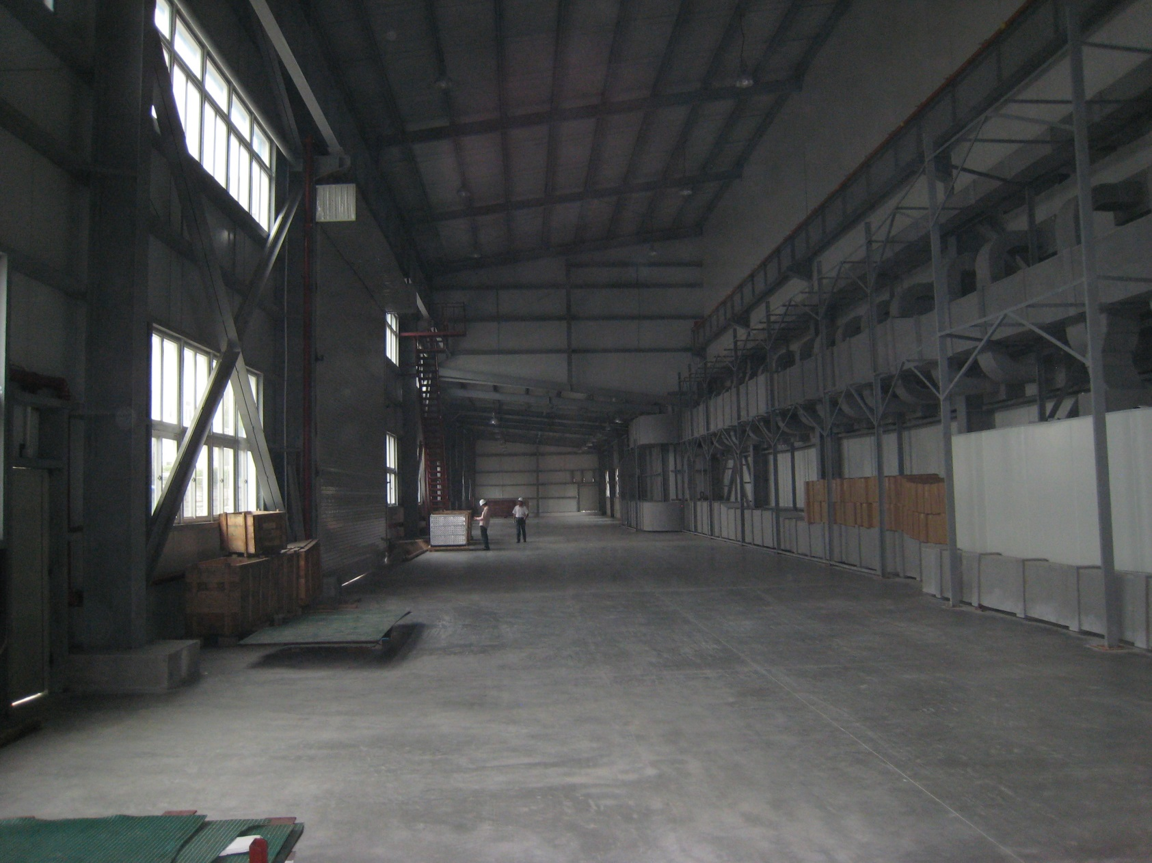
Construction Progress 2009
Detector Assembly
Building

Slide 23
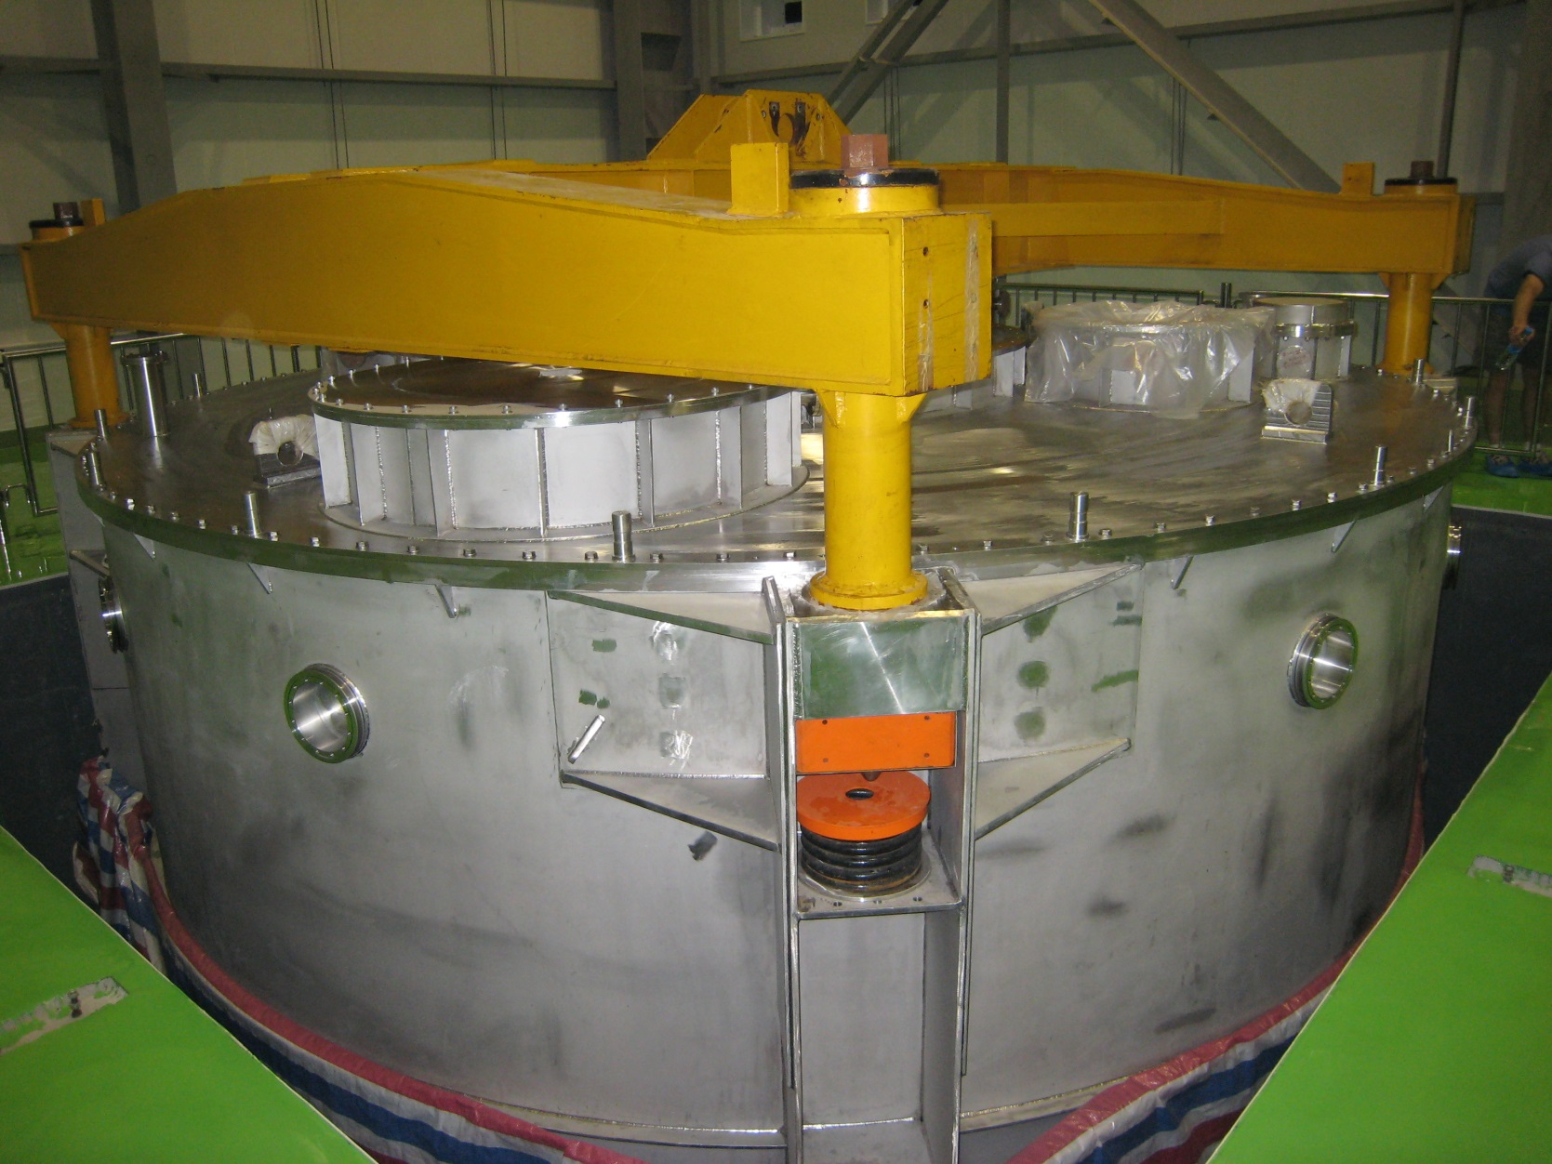
Construction Progress 2009
Clean Room with Assembly Pit

Slide 24
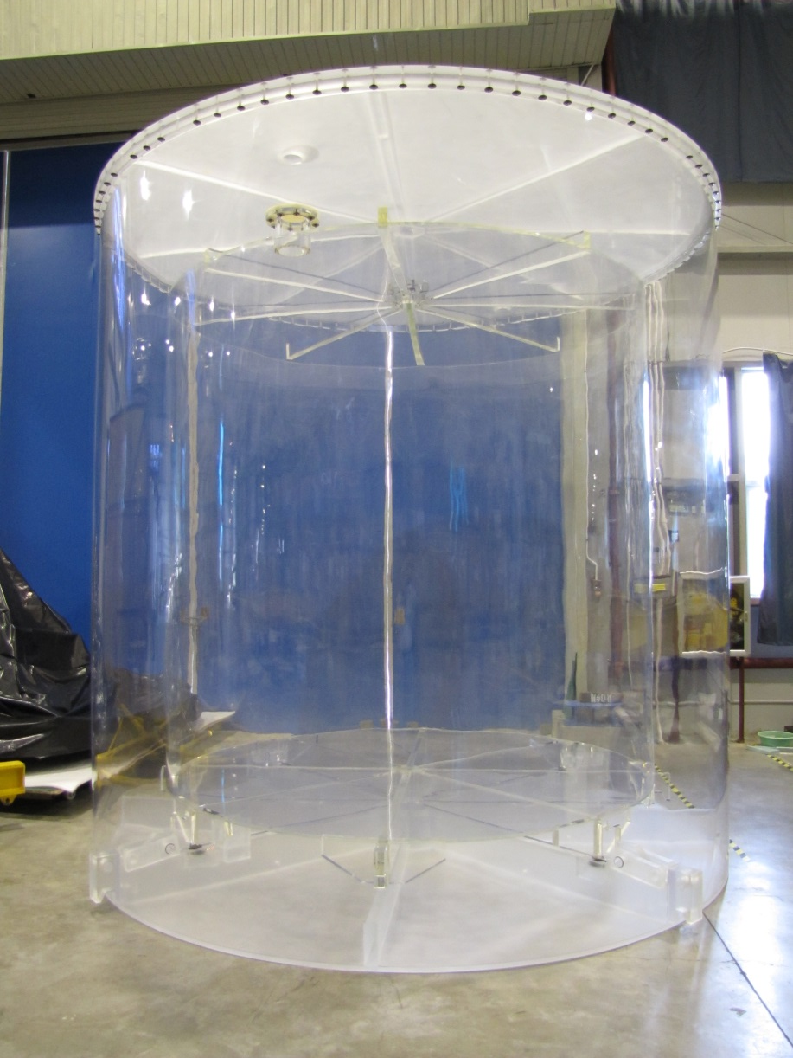
Installation Start - 2010

Slide 25
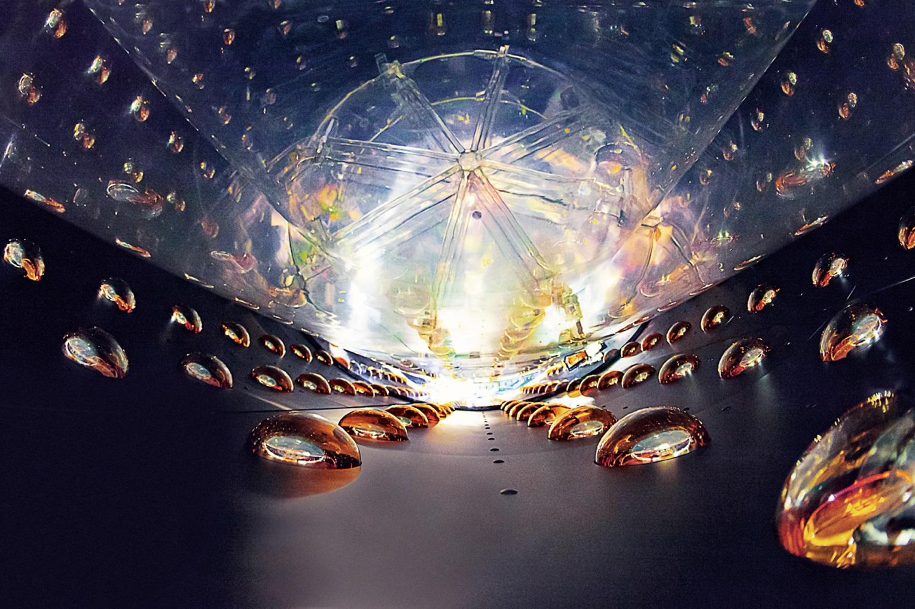
Installation Start - 2010

Slide 26
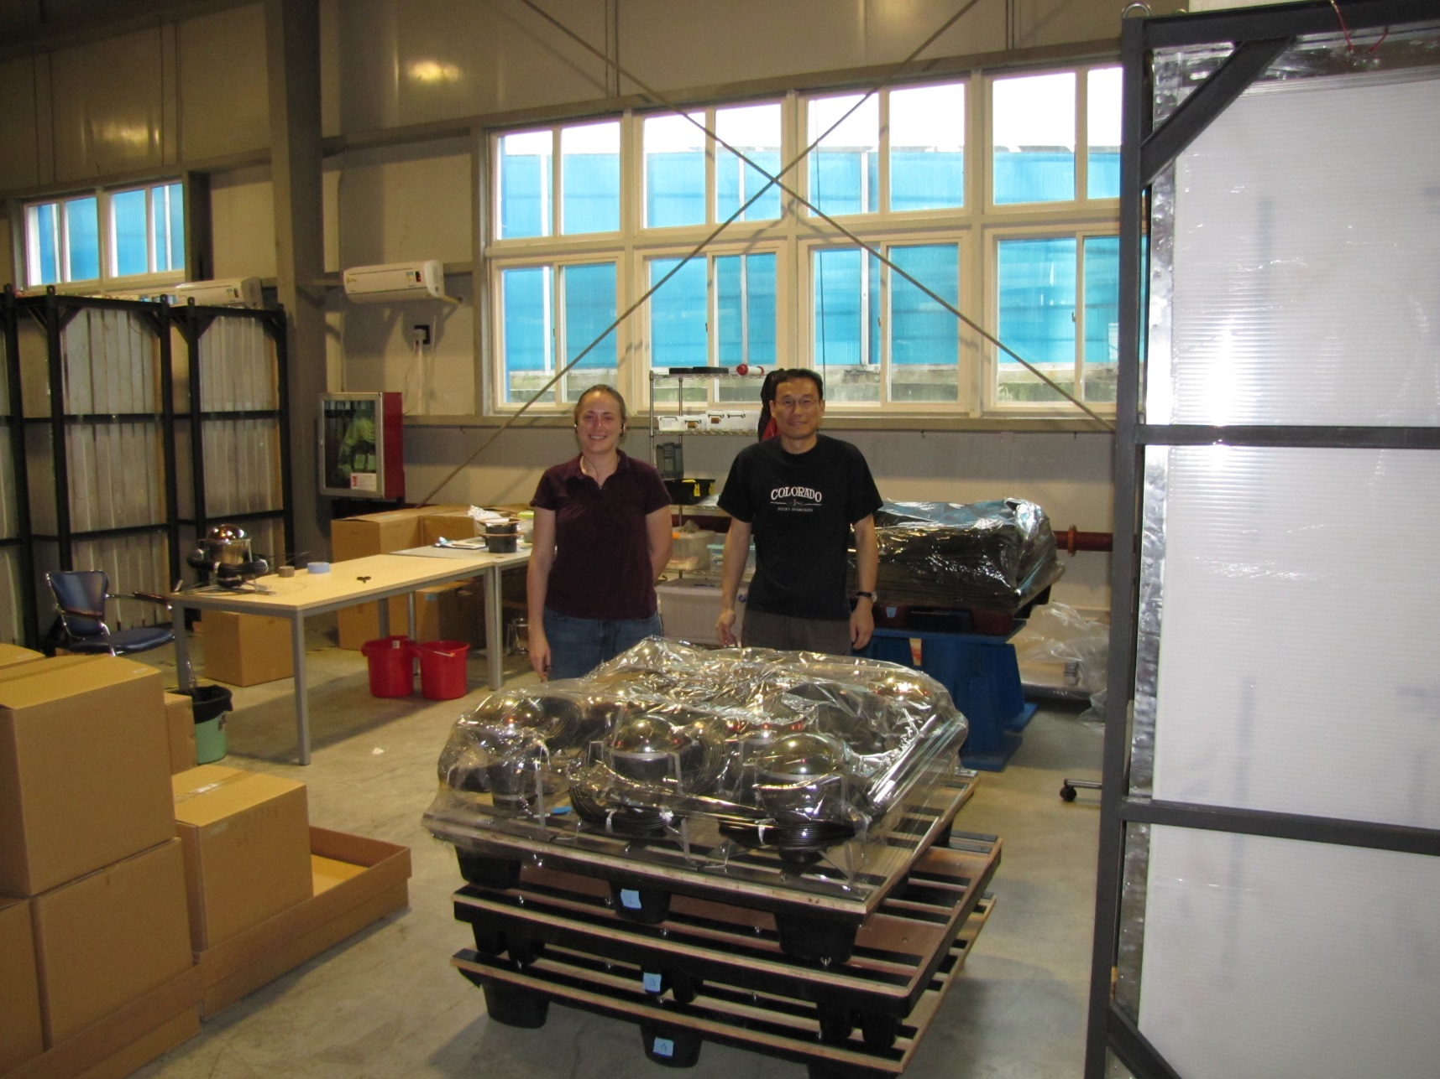
Installation Start - 2010

Slide 27
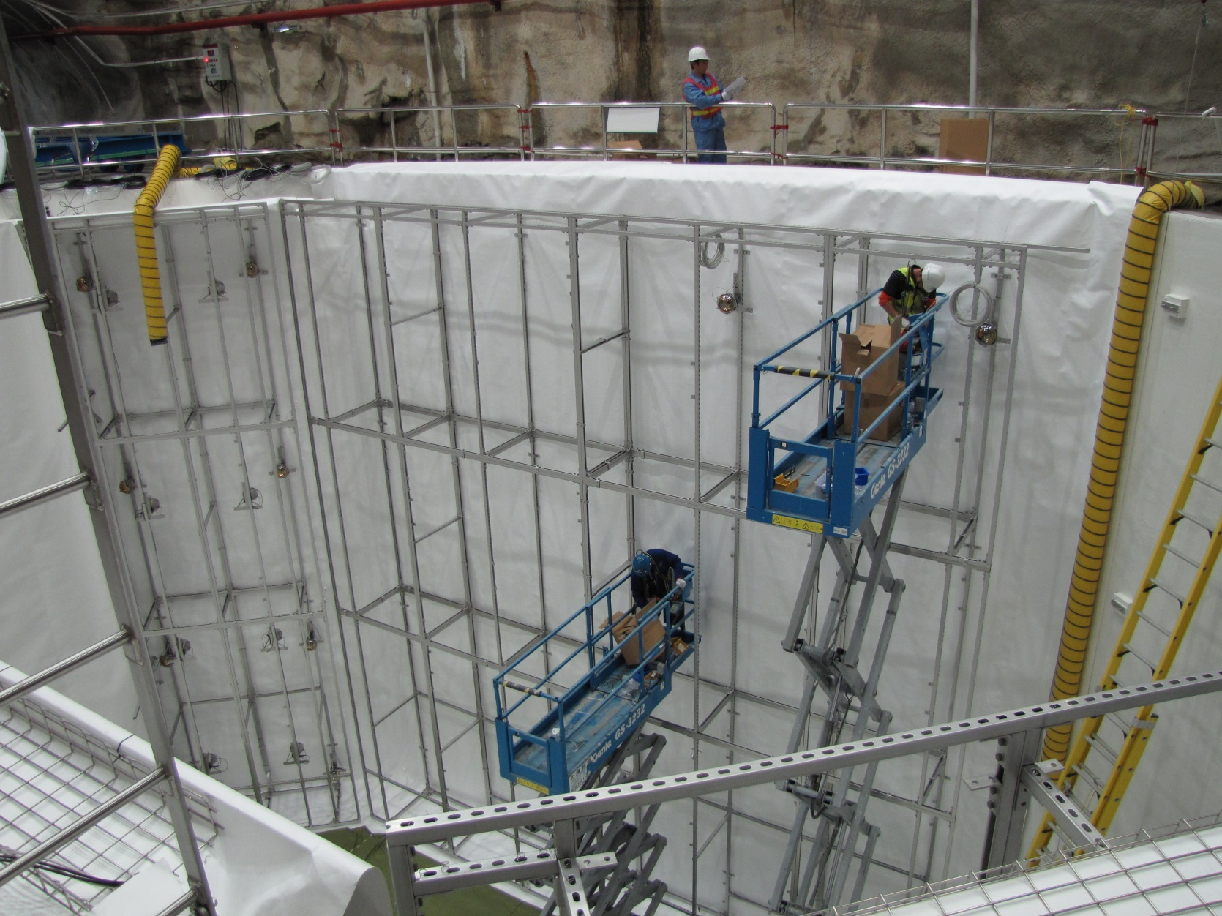
Installation Start - 2010

Slide 28
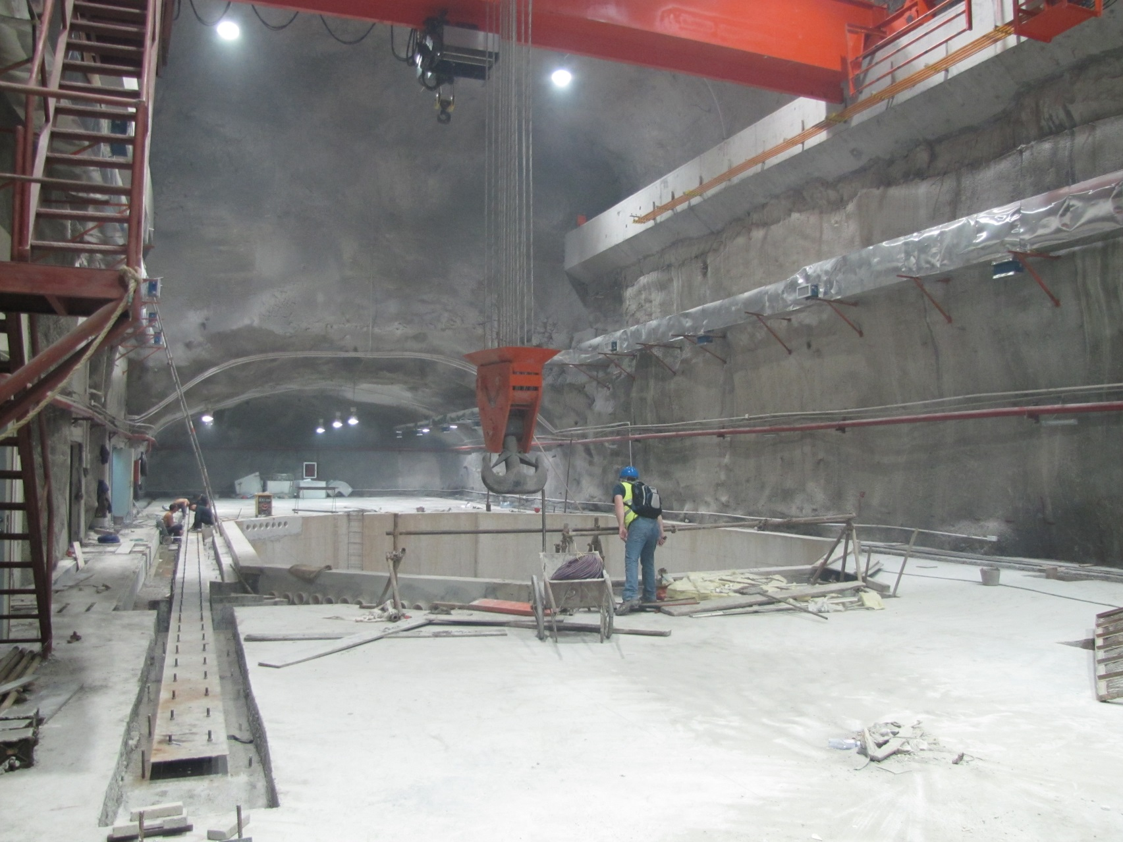
Construction Continues 2010
Far Hall

Slide 29
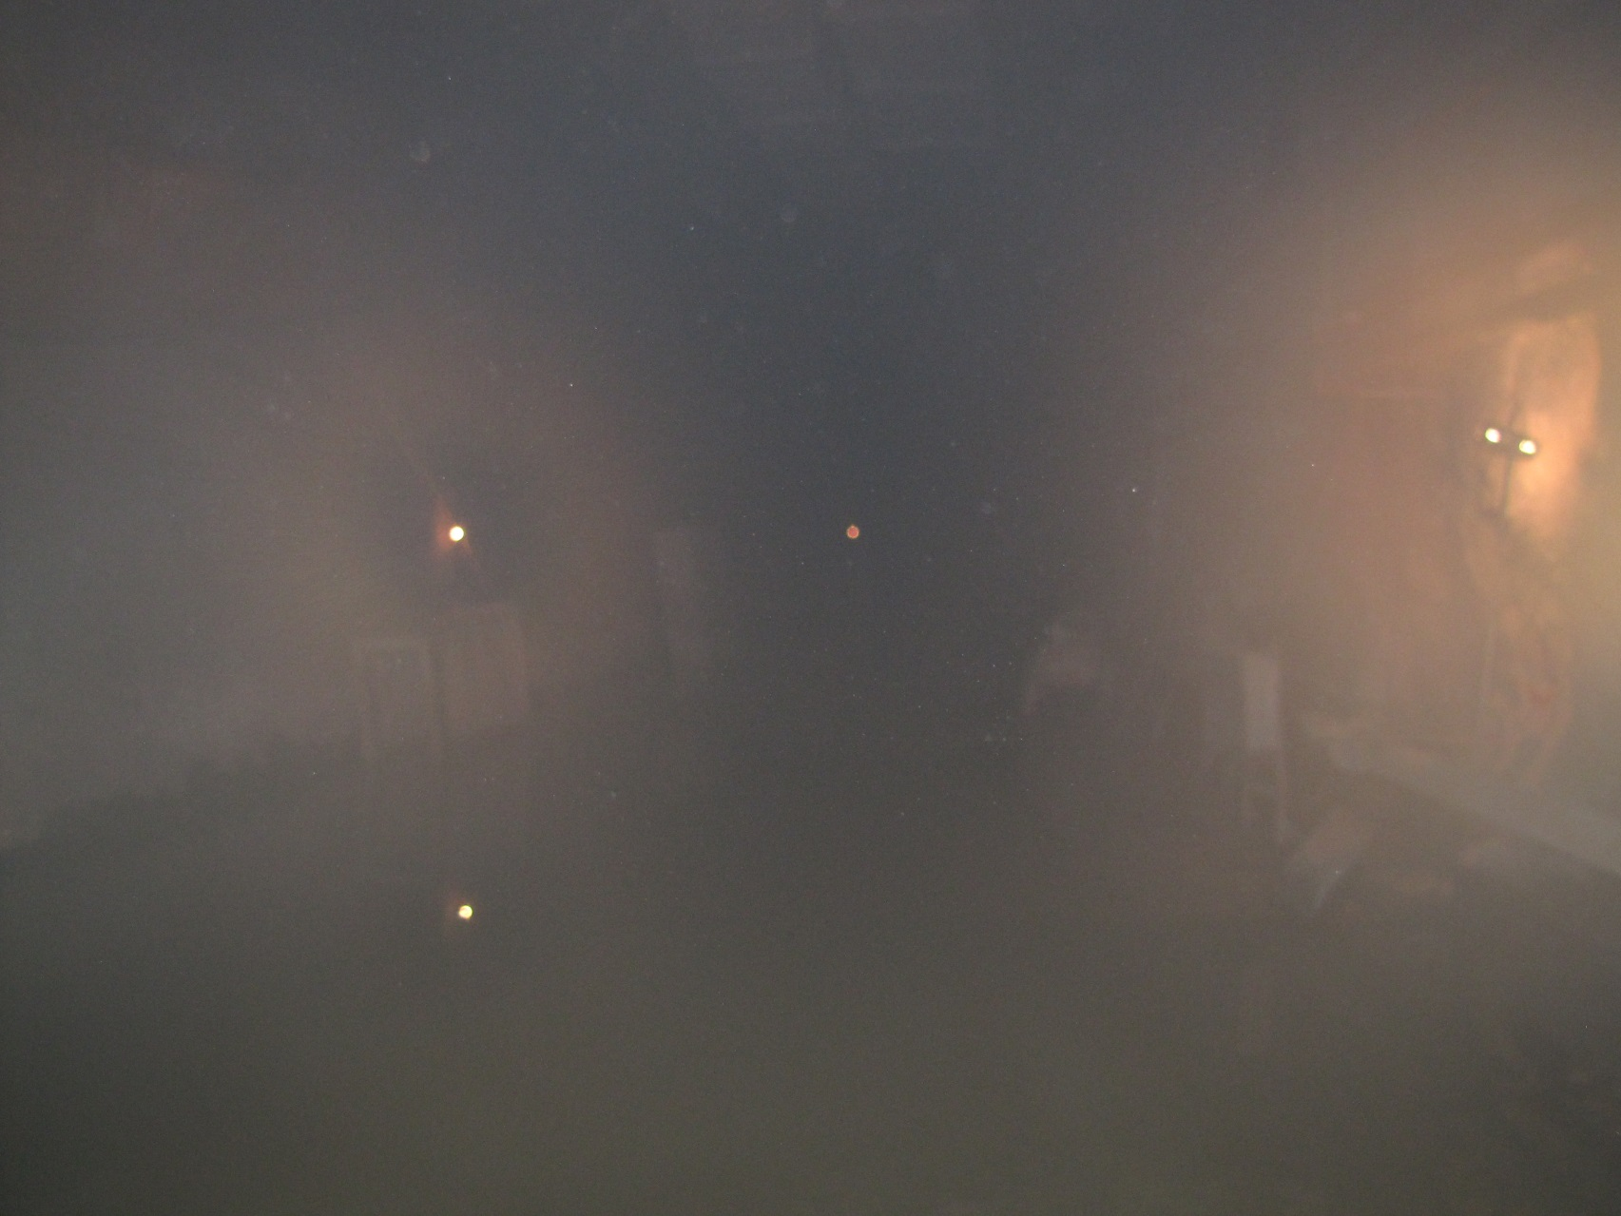
Construction Continues 2010
Far Hall

Slide 30
First Data
Two Detectors Operational
X
X
X
X
X
X

Slide 31
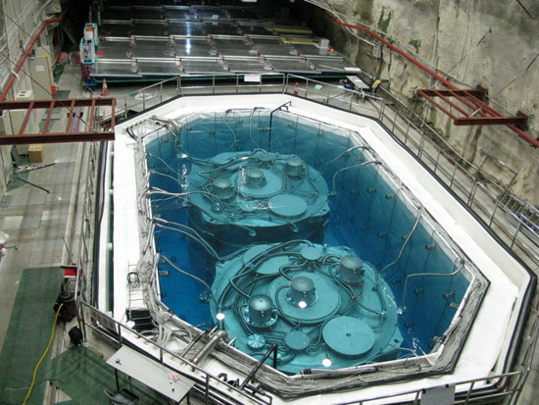
First Results
Detector Simularities
NIM 685, 78 (2012)
Δ response = 0.6 ± 0.8(stat) ± 0.3(sys) %

Slide 32
First Physics Data
Six Detectors Operational
X
X

Slide 33
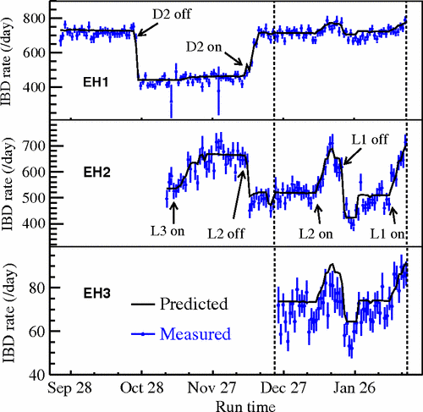
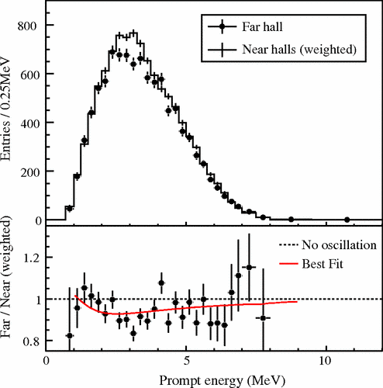
First Physics Results
55 Days of Running

Slide 34
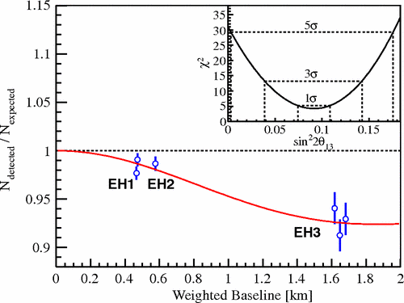
First Physics Results
55 Days of Running
PRL 108, 171803 (2012)
sin² 2θ₁₃ = 0.092±0.016(stat.)±0.005(syst.)

Slide 35
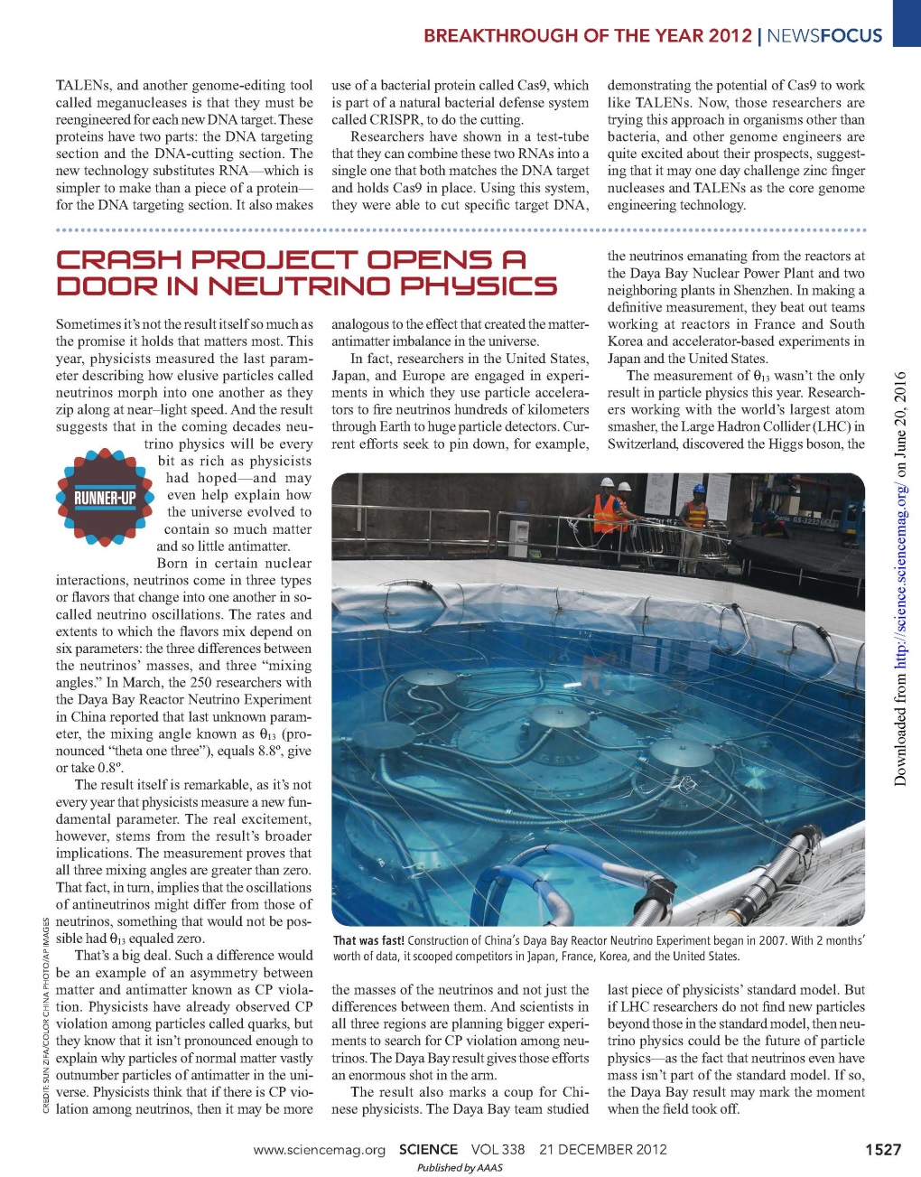
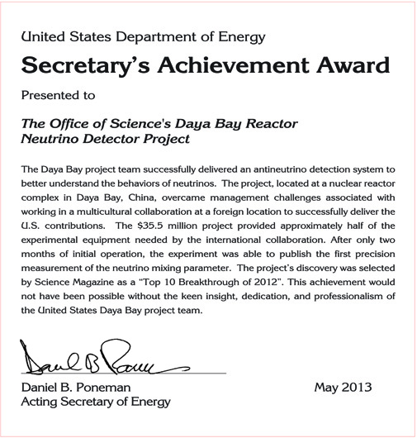
Recognition

Slide 36
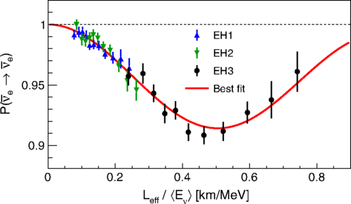
Best Result to Date
6 + 8 Detector Runs
PRL 115, 111802 (2015)
sin² 2θ₁₃ = 0.084 ± 0.005
|Δ(m_{ee})²| = (2.42 ± 0.22)x10⁻³ eV²

Slide 37
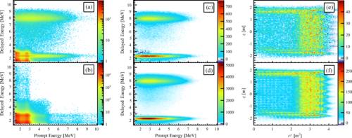
Getting Results from Proton Capture
PRD 93, 072011 (2016)

Slide 38
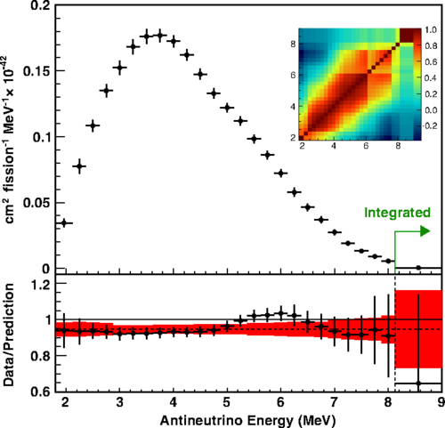
Turning the Tables
Reactor Flux from Near Detectors
PRL 116, 061801 (2016)

Slide 39
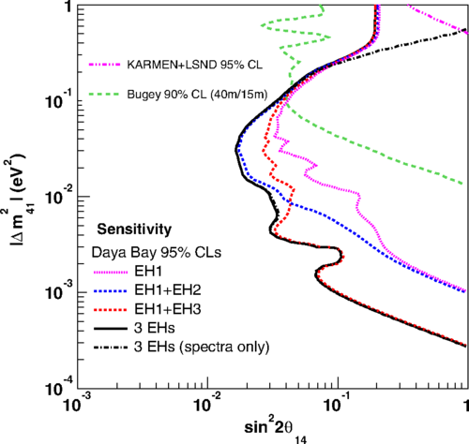
More Oscillations?
Sterile Neutrino Search
PRL 113, 141802 (2014)
6 Detector Running
Better now – shown at confs.
Combined paper with MINOS
in the works

Slide 40
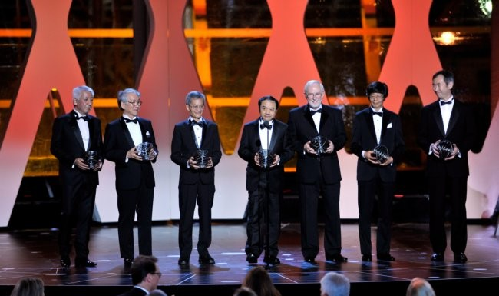
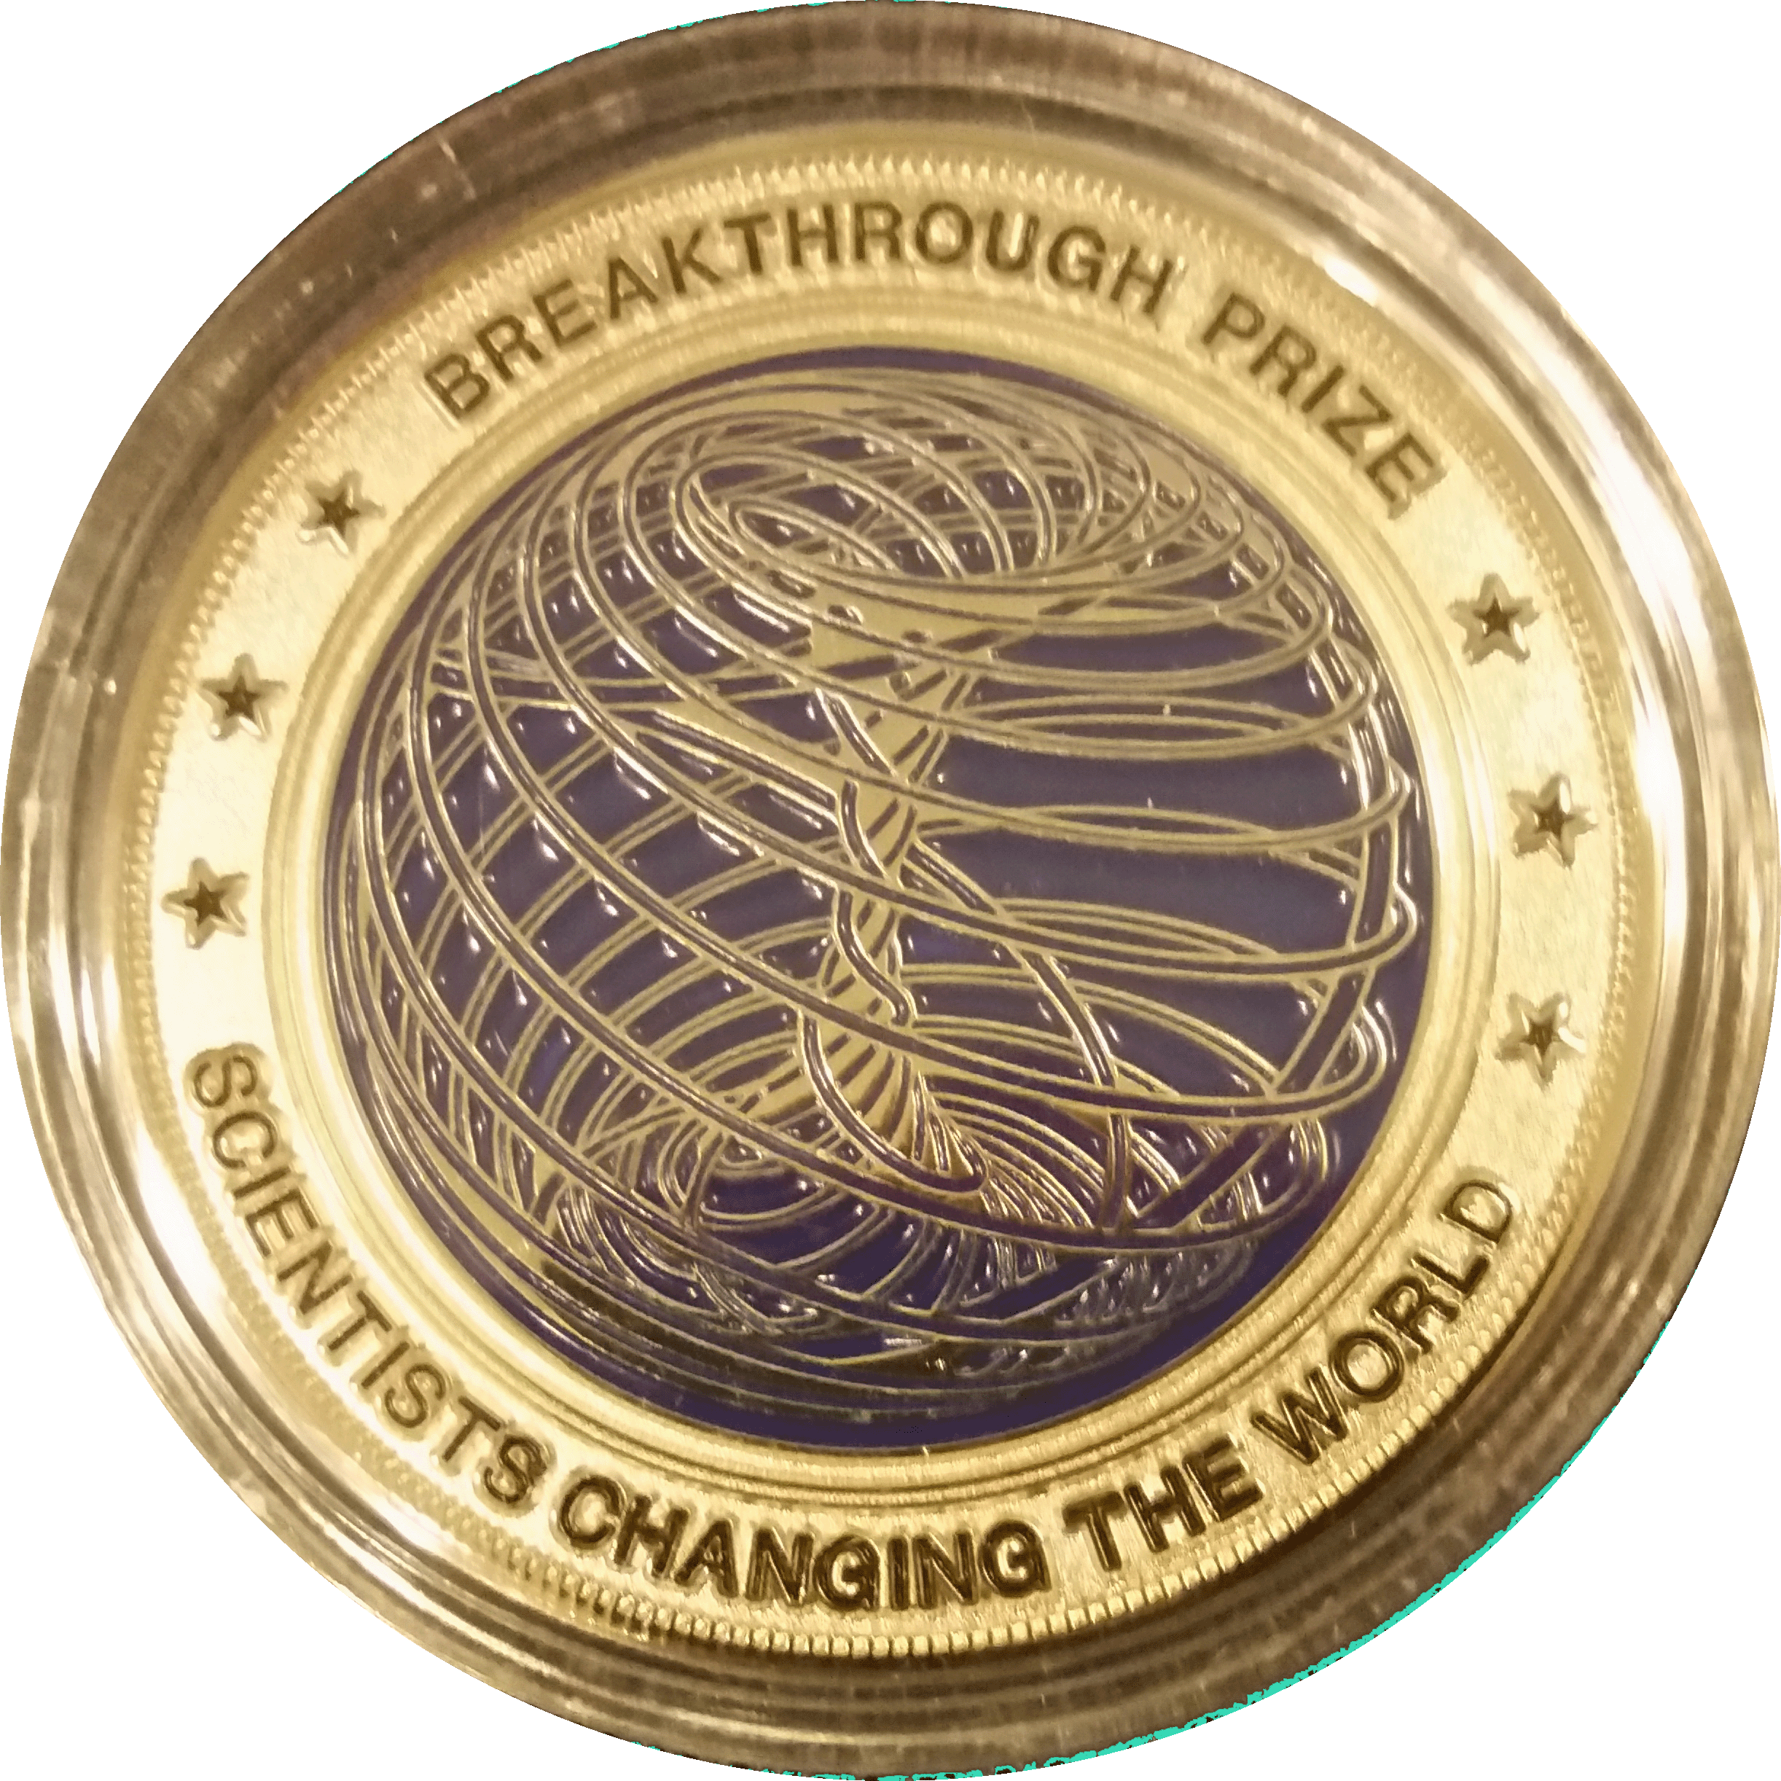
Breakthrough Prize in Fundamental Physics – 2016
Shared with Kamland, K2K/T2K,
SNO, and SuperK

Slide 41
Landscape – Neutrino 2016
Chooz, France
RENO, South Korea
Daya Bay, China

Slide 42
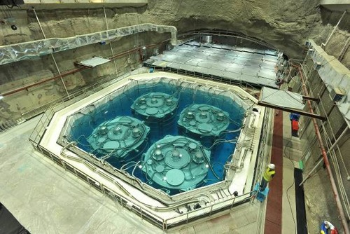
Where Are They Now?
Daya Bay: Approved to run through 2017 completing its five year run

Slide 43
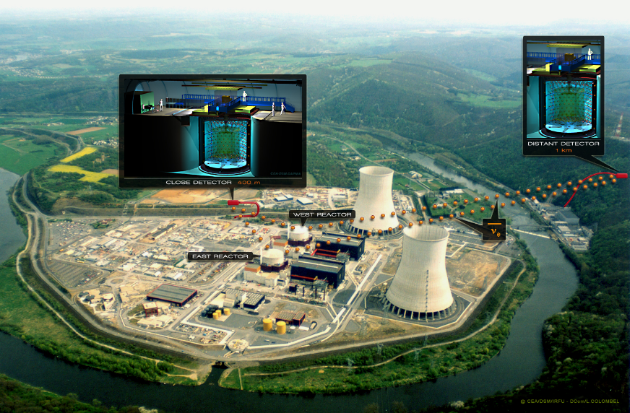
Where Are They Now?
Double Chooz: Initially ran with only far detector. Completed near detector in Jan. 2015 and has published two detector result. They continue to run.

Slide 44
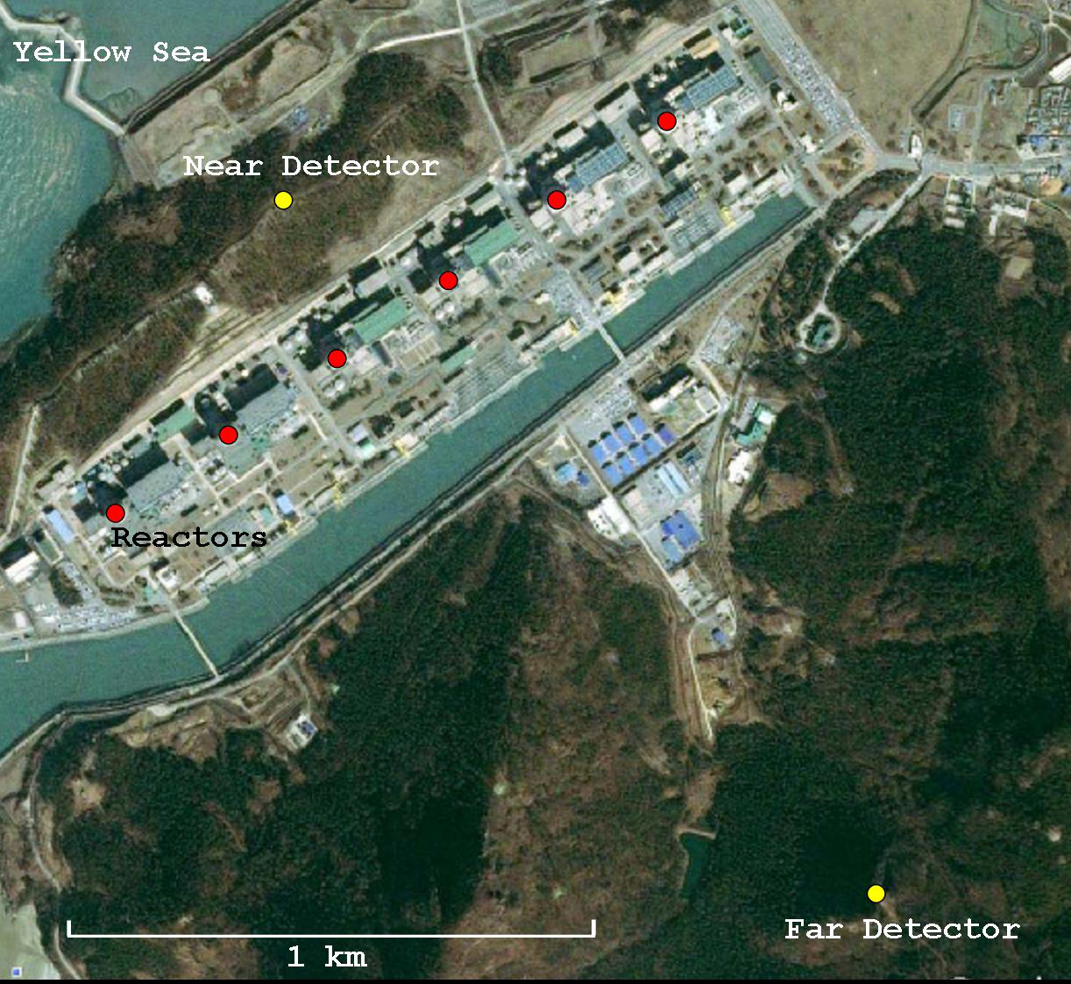
Where Are They Now?
RENO: Took 3 years of two detector data until accident sidelined them.

Slide 45
Where Are They Now?
Hesheng Chen
Director, CAS
Robin Staffin
Out of HEP

Slide 46
Where Are They Now?
Spokespersons
Kam-Biu Luk
LBNL
Yifang Wang
Director of IHEP

Slide 47
Where Are They Now?
Honoree Today
Jim Siegrist
Associate Director HEP, DOE
Me
Professor Emeritus, UC

