Slide 1
Deep Underground Neutrino Experiment at the Sanford Underground Research Facility.
Milind Diwan Littenberg Fest
6/24/2016
Notes:
It is a great pleasure for me to speak today. And I thank Laurie and the organizers to allow me to do so.
This is the last talk of the day and so it will wander a bit and I hope you enjoy it as much as I have enjoyed coming up with it.

Slide 3
Long Baseline Neutrino Facility/Deep Underground Neutrino Experiment
BNL scientists and collaborators were responsible for recognizing the scientific opportunity, demonstrating the feasibility, and initiating and promoting the project to the scientific community.
The scientific environment created at BNL by leaders such as Laurie Littenberg made it possible to take the needed intellectual risks. Our team continues to be central because of it.
Notes:
We have a truly powerful team and it is recognized internationally. They are thriving in our
environment. I will mention a few names as I go through, but please forgive me if I cannot be comprehensive.

Slide 4
Notes:
Many of us have attended the secret littenberg university. And today I will unveil the secret report from this university which happens to be free. There are some rules that take years to master. And so I will now explain these rules to you and how they have impacted the makings of this new project.

Slide 5
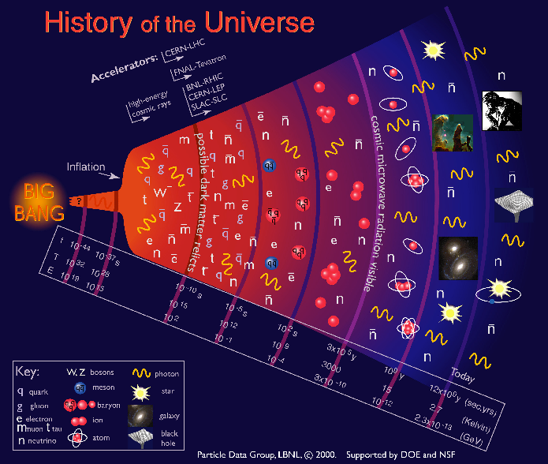
Lesson 1: Thinking is expensive, choose wisely
(start with the universe !)
Something happened here to make the universe more matter and less anti-matter
Neutrinos become free
Known from nuclear physics measurements of the abundance of light elements. But the number should be ~0 ! The current standard model does not have the ingredients to make this happen.
Notes:
First rule is… And therefore we might as well think about the biggest questions.
The known universe is made of matter. We know this very well from a number of observations. The baryon asymmetry is known to better than 10% to be less than a part in a billion because we know nuclear physics very well and we can then track back the measurements of light nuclei abundances.
This number should be 0. And in fact by simple calculations we can show that the number of baryons in the universe should be 9 orders of magnitude smaller if there was no asymmetry in the beginning.
And so something happened at the beginning at a temperature of 10^12-10^14 GeV. Remember this number. This is one of the grandest problems in physics.
We know that to make this asymmetry take place, we need matter and antimatter to behave differently or have CP violation for this effect to take place.
What is CP violation ?
Why did we think neutrinos could violate CP and why is it important?
How did we arrive at the conclusion that such a measurement was feasible ?
What was the difficulty in demonstrating the feasibility ?

Slide 6
Neutrino Oscillations!
?
What is δ ?
Solar, Atmospheric, Accelerator, Reactor experiments have resulted in a picture of neutrinos with mass ~ 0.1 eV.
Small mass →Singlet heavy partner at ~10¹² GeV (with lepton number and CP violation in its decay → natural explanation for leptogenesis →Baryogenesis.
Must establish if neutrinos and antineutrinos behave differently or measure δ!
Notes:
An emerging explanation for the matter abundance in the universe is emerging through an
amazing set of observations in the past two decades. Starting with Ray Davis’s observation of disappearance of solar neutrinos to our most recent observation of reactor neutrino disappearance in Daya Bay (which you just heard about) this picture has been assembled. We do not yet know the absolute neutrino mass, but we know the differences from these oscillation experiments. We also do not know if they are arranged this way or that.
If you take the squareroot of the largest mass squared difference then you find that the scale of mass is ~0.1 eV. This is totally amazing because it means it has a heavy partner (a sterile right handed neutrino ) at 10^12-10^14 GeV. The decay of this neutrino would violate lepton number and charge parity.
Let me spend a little more time on this plot. This is the mixing matrix for neutrinos. So for example, the third mass state is almost evenly divided between muon and tau neutrinos. And so mixing angle is pi/4. The second mass state is very close to 1/3, 1/3, 1/3 and first one is 2/3 electron neutrinos. The big question is whether this system has CP violation or a phase. The phase of course makes no sense unless each of the states is mix of all three eigenstates. Or in terms of angles, this theta_13 angle is non-zero. But how non-zero does it need to be.
Lastly, the oscillation phenomena is hugely affected by neutrino motion through matter. Matter
will enhance or suppress oscillations because it adds an additional potential that act as an index of refraction.
No matter the neutrino oscillations laboratory is rich with phenomenological consequences. And it could give us the means to check if charge parity is violated.

Slide 7
ACP~30%
@500km
This is worthwhile because it could lead to other fundamental observations.
The complete disappearance of muon neutrinos after 500 km/GeV is a real physical effect ! A small fraction would convert to electron type and have a large neutrino/antineutrino asymmetry.
Notes:
This is now a calculation that uses the latest parameters. And the effects are still so stunningly large that I think the wider physics community has not quite grasped it yet. This shows a evolution of a 1 GeV muon type neutrino (this would be typical from an accelerator).

Slide 8
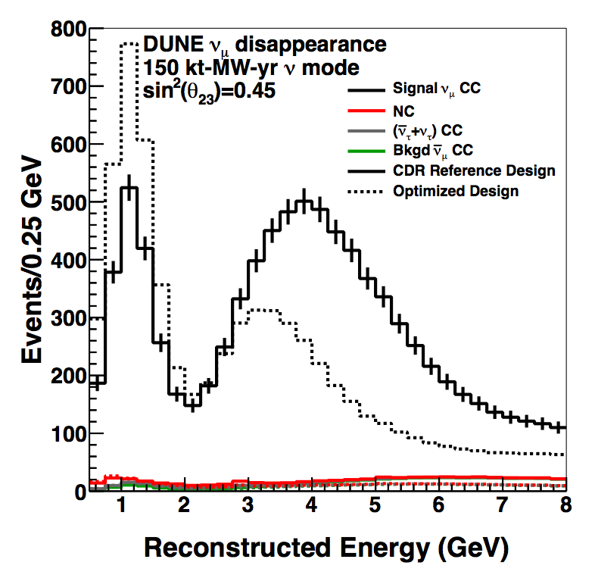
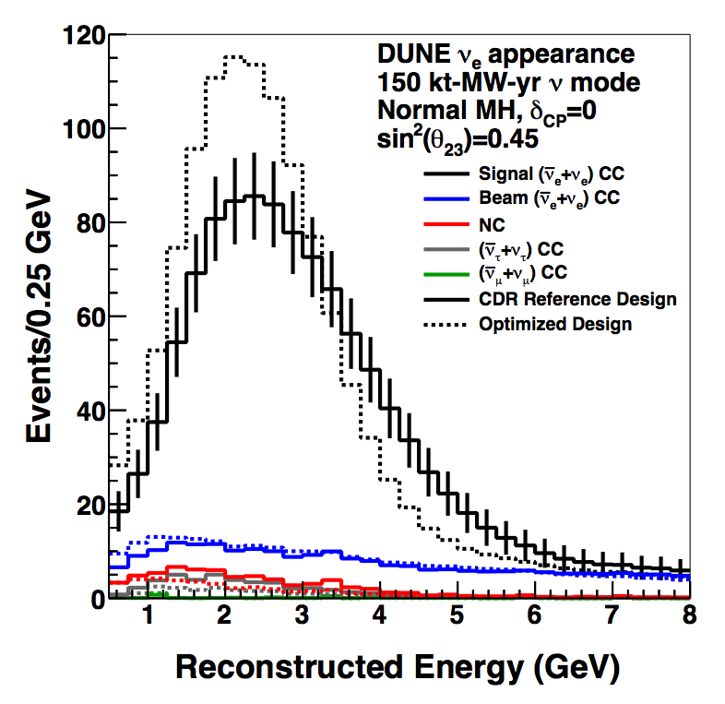
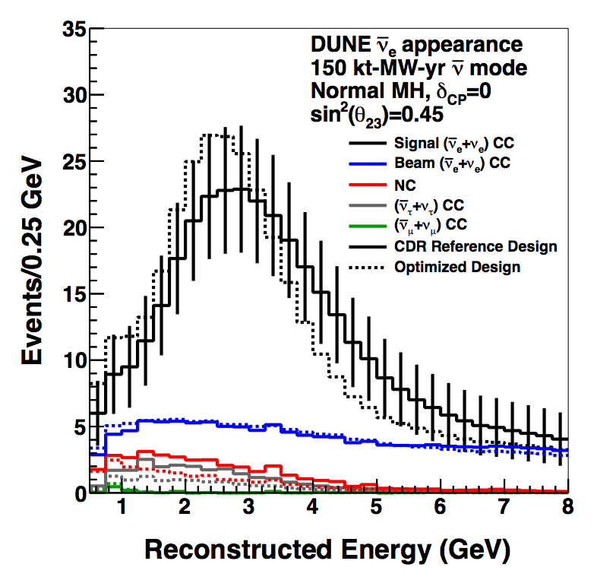
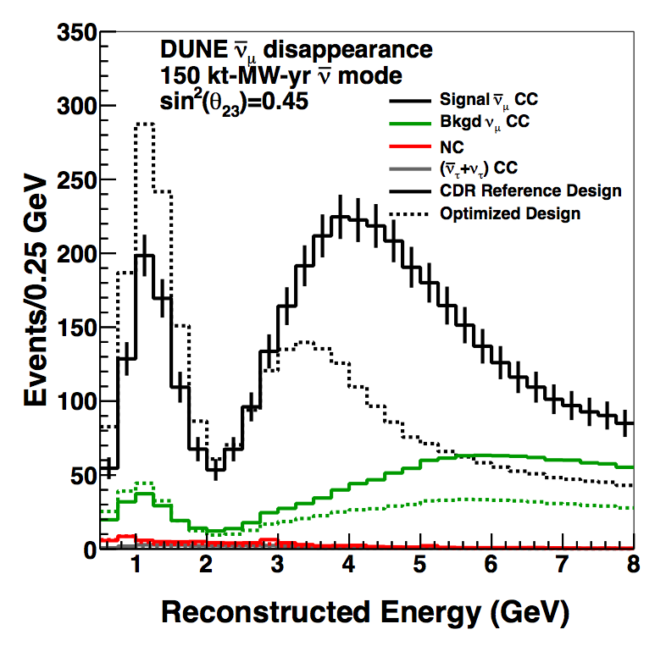
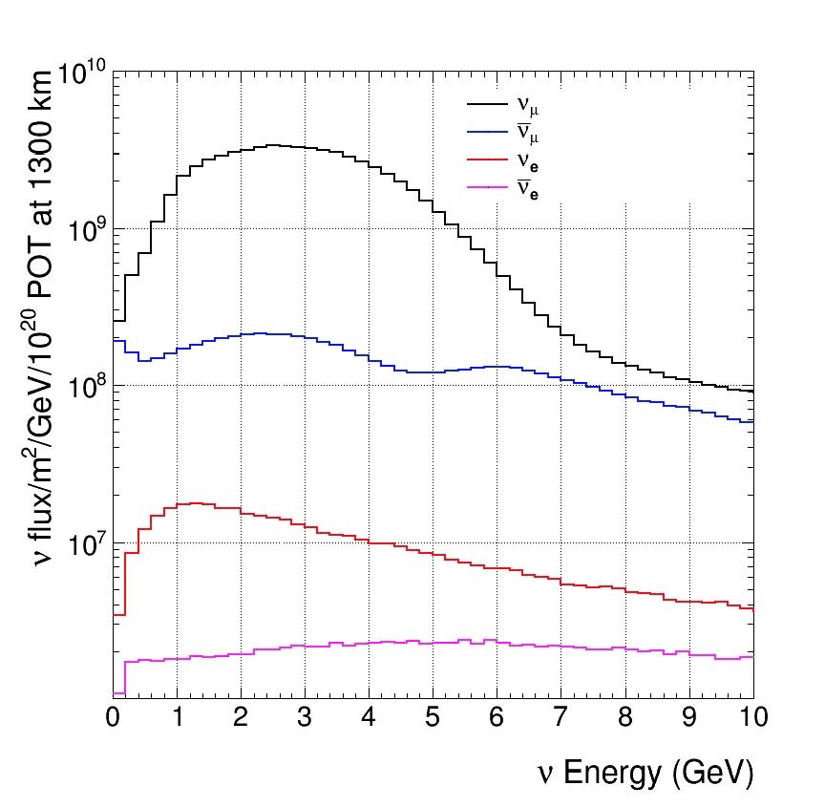
Event Spectra
With a few years of running for 10 kt of liquid argon.
1300 km with a wide band beam from FNAL.
ν_{μ} / ν_{μ} disappearance
ν_{e} / ν_{e} appearance
Pre-oscillation
Notes:
Disappearance minimum is delta m squared
Amplitude is theta 23
Appearance amplitude theta 23 theta 13 and delta cp
Dip is both delta m squared and cp

Slide 9
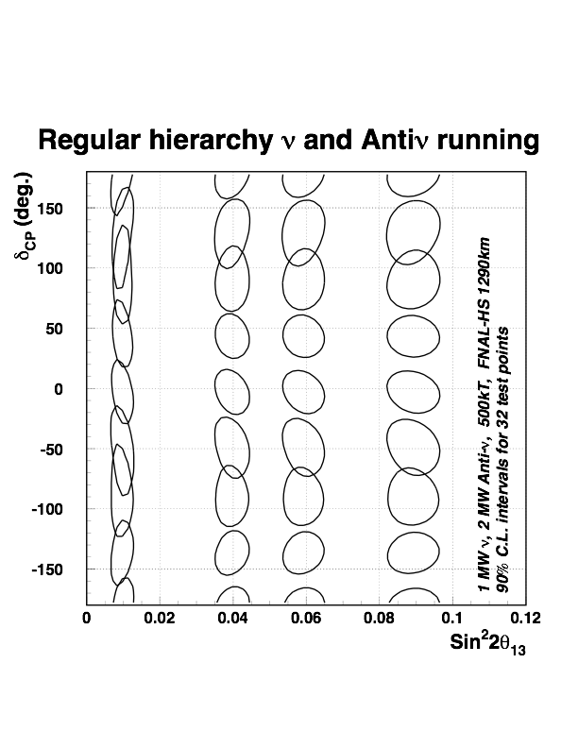
Lesson 2: Explain the most important concepts in plain language.
To a very good approx., our statistical ability to determine δ
or Acp is independent of sin²2θ13 (down to~0.003) and the detector distance (for long distance) - Bill Marciano.
There is no need to fine-tune the experiment for these parameters.
arXiv: 0407047
Normal
±10º
We demonstrated that the experiment was entirely feasible including matter effects, detector resolution, backgrounds, systematics and practical accelerator upgrades.
Daya Bay result
Needs: ~1 MW wide band beam, ~300 kt water (20% efficiency) or ~50 kt (90% efficiency) liquid argon detector,
Notes:
After the definitive discovery of neutrino oscillations, discussion started on the next steps. There was a great deal of confusion on how to approach the CP measurements. We had a working group here which was started by Tom Kirk. Bill Marciano realized that in fact the CP asymmetry measurement is not highly dependent on the value of theta_13 nor on the distance as long as it is reasonably long. We needed to demonstrate that it was in fact practical. This is a very early calculation in which I made some very conservative assumptions on detector and beam performance. Everything is included in this calculation, matter effect, resolutions, backgrounds, systematics, and obviously there were a lot of arguments over this. This assumes that we start the beam at FNAL and the detector is in Homestake at 1300 km. It explicitly demonstrates that that we could do this experiment to about +-10 deg. What it needs is a 1 MW wide band beam. Wide band because that allows elimination of many degeneracies in this plot. And a minimum 300 kt water of 50 kt liquid argon detector. An this is what we are going to do. We are most likely going to do better than this but the picture roughly remains the same.
The most important considerations
Length of baseline
Size of detector => numbers of events needed
depth of overburden: detector
detector technology ?

Slide 10
Baseline optimization
>1200 km is needed to break the degeneracy between CP and matter effects.
Statistics at both nodes needed. Total of ~1000 events needed => 1MW*40kt*many years.
At >2000 km suppression of events in one polarity is very high: nu/anu asymmetry measurement a challenge.
On these general grounds we can state that 1000 - 2000 km is optimum.
Max oscillation asymmetry with no matter
The site of the former Homestake mine was picked for many reasons, but it also happens to be just right for this physics.

Slide 11
Lesson 3. Protect the time and intellectual output of your coworkers and colleagues
An astonishing amount of work is in progress.
Event reconstruction in LAR TPC (Xin Qian/Chao Zhang/Brett Viren)
Optimization of the wide band beam (M. Bishai)
Precision of parameter extraction/fitting (E. Worcester)
R&D on TPC and electronics (Bo Yu, M. Worcester, Hucheng Chen, Instrumentation …)
Planning for prototypes at CERN (J. Stewart, S. Kettell, …)
Design/planning for underground facilities (Dolph, Stewart…)
Cryogenics, detector properties (Craig Thorn, Yichen Li )
Computing (Potekhin, Adams)
We have a huge team working on this with many visitors and collaborators.
Notes:
Our team is engaged in making this project a reality on almost all fronts. To make this project successful will require a lot of creative energy and risk taking. This is what we are good at.
I am going to go very quickly through some of the items and explain where we are. I cannot go through each one.

Slide 12
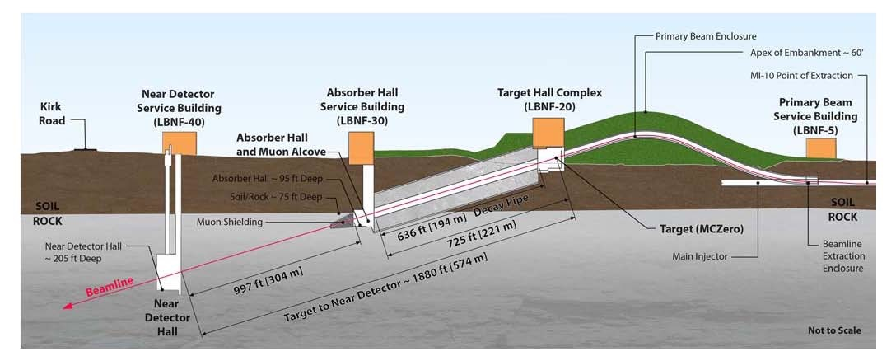
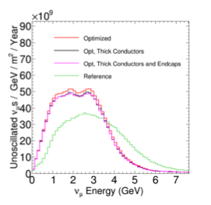
LBNF/DUNE Neutrino Beam
muon range out ~113 m
60 – 120 GeV Proton beam energy
Initial power 1.2 MW upgradable to 2.4 MW
PIP II complete before start of data taking
10²¹ protons on target per year
Large ν flux 1 to 5 GeV
Optimization of the beam => 3-horn system improves the flux by a large factor
Muon kern will shorten the muon range-out

Slide 13
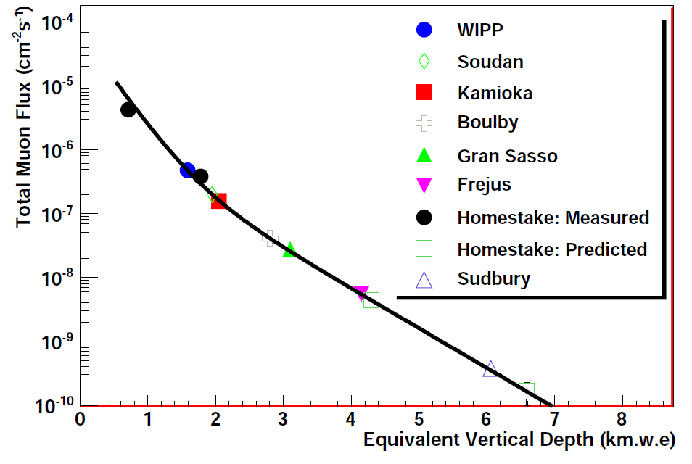
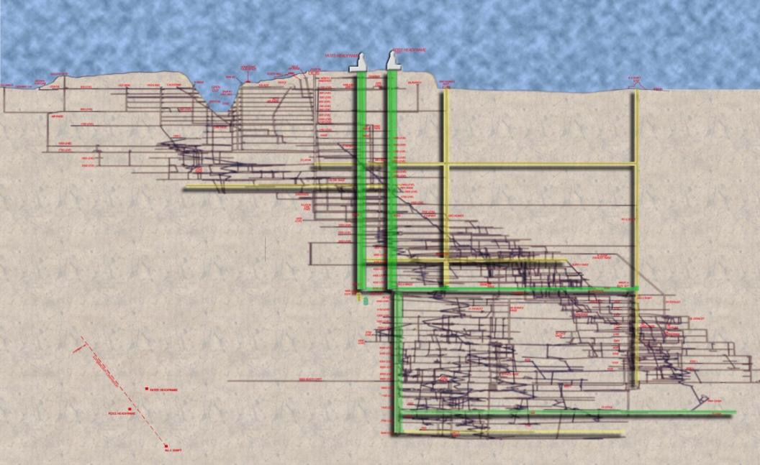
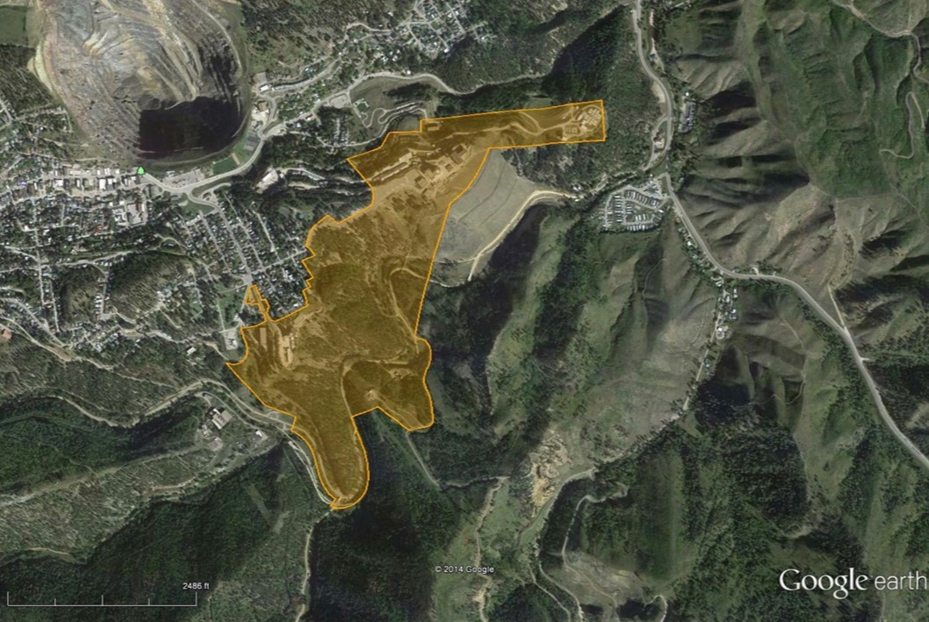
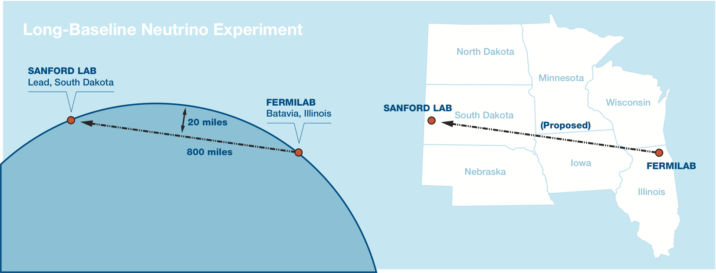
The Sanford Underground Research Facility (Far Detector Home)
4850’

Slide 14
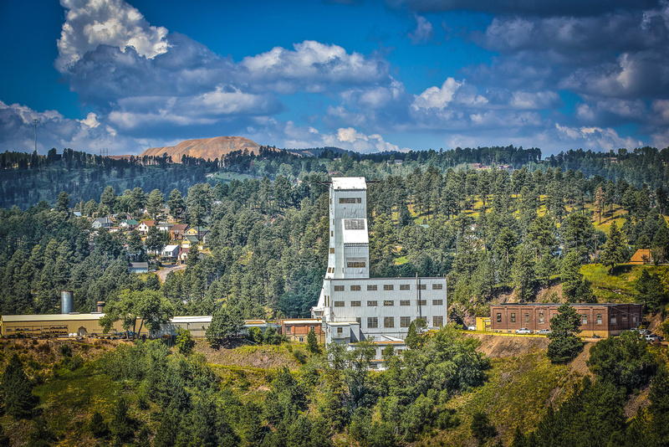
Underground Modernization
Facility donated to the State of South Dakota for science in perpetuity
Experimental Facilities at 4850 ft level
Two vertical access shafts
Ross shaft refurbishment is ~60% complete
Over $100M invested from private and state funds
Working two 12 hour shifts/day in order to be done by June 2017
Will allow large excavations at SURF in 2017!

Slide 15
Traversing Up the Ross Shaft Video From old steel into new

Slide 16
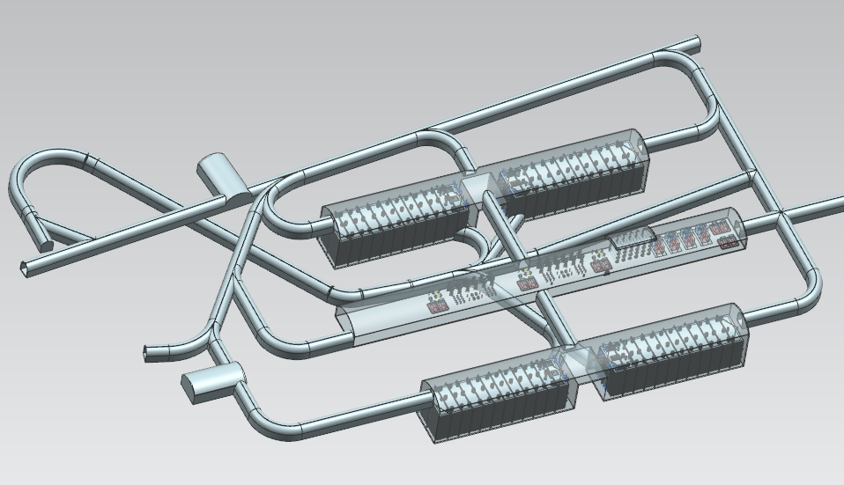
Far Detector – Cryostat / Cryogenic Systems Layout
Each Cryostat holds 17.1kt LAr
Free standing steel supported membrane cryostat design
CERN-FNAL design team
Cryostat 2
Cryostat 1
Central utility cavern
Cryostat 4
Cryostat 3
Central Utility Cavern holds Cold boxes,
LN2 dewars, booster compressors, LAr/GAr filters
Notes:
Full 40 kt is the scope. CF will deliver all the underground space early.
Planning for 40kt from the first day

Slide 17
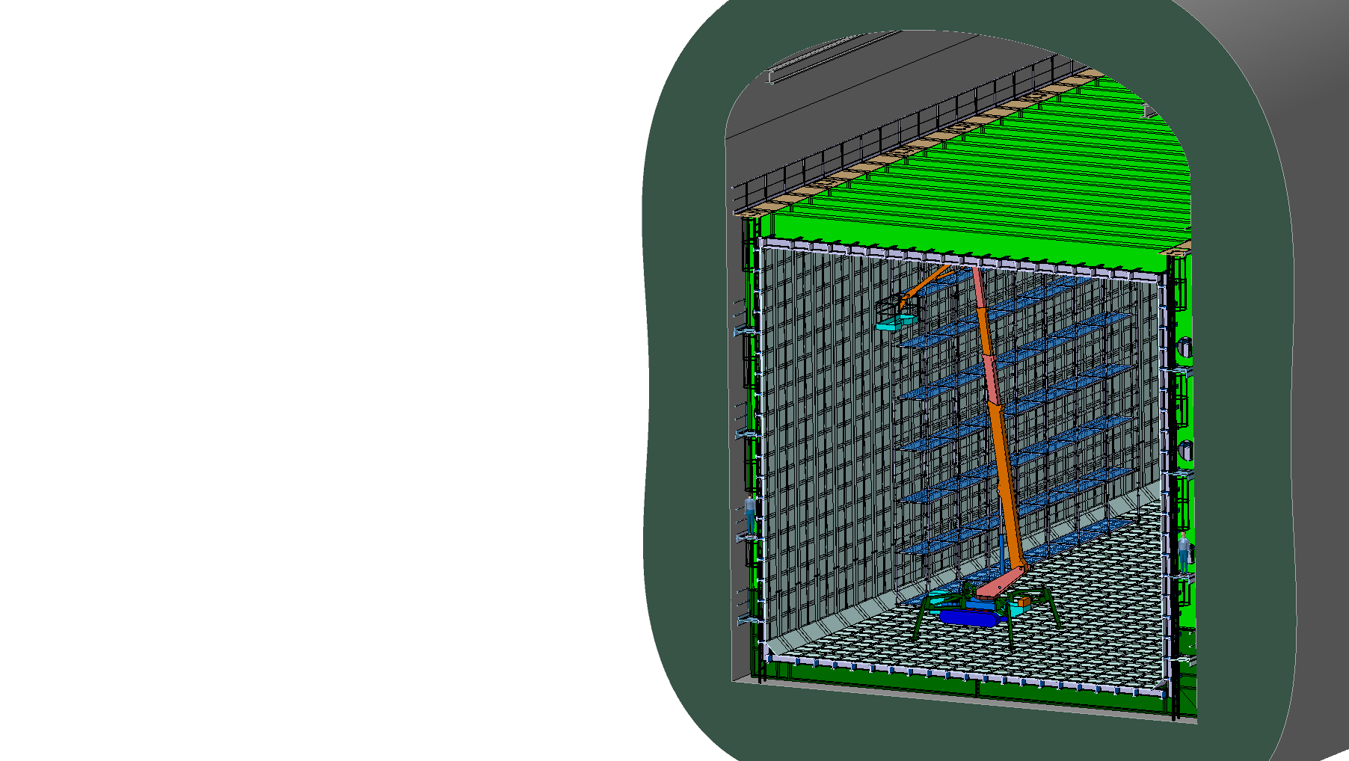
Free-Standing Steel Cryostat Design
People for Scale
External (Internal) Dimensions
19.1m (16.9m) W x 18.0m (15.8m) H x 66.0m (63.8m) L

Slide 18
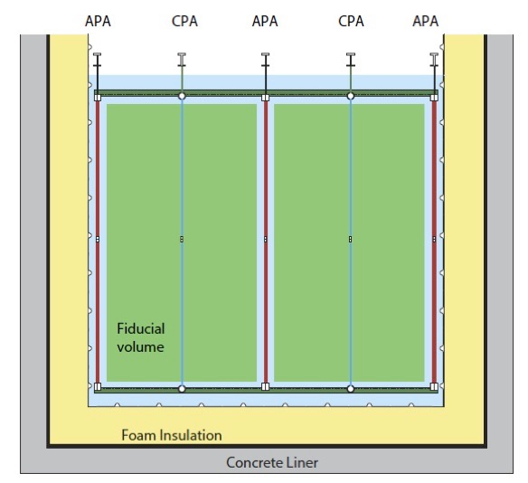
Nominal 10 kt Detector Configuration – Single phase readout
Liquid Argon Time projection chamber with both charge and optical readout.
First 10kt detector will be single phase
58 m
62 m
LAr Detector Module Characteristics
17.1/13.8/11.6 Total/Active/Fiducial mass
3 Anode Plane Assemblies (APA) wide (wire planes)
Cold electronics 384,000 channels
Cathode planes (CPA) at 180kV
3.6 m max drift length
Photon detection for event interaction time determination for underground physics
14.4 m
12 m
3.6 m
Steel Cryostat

Slide 19
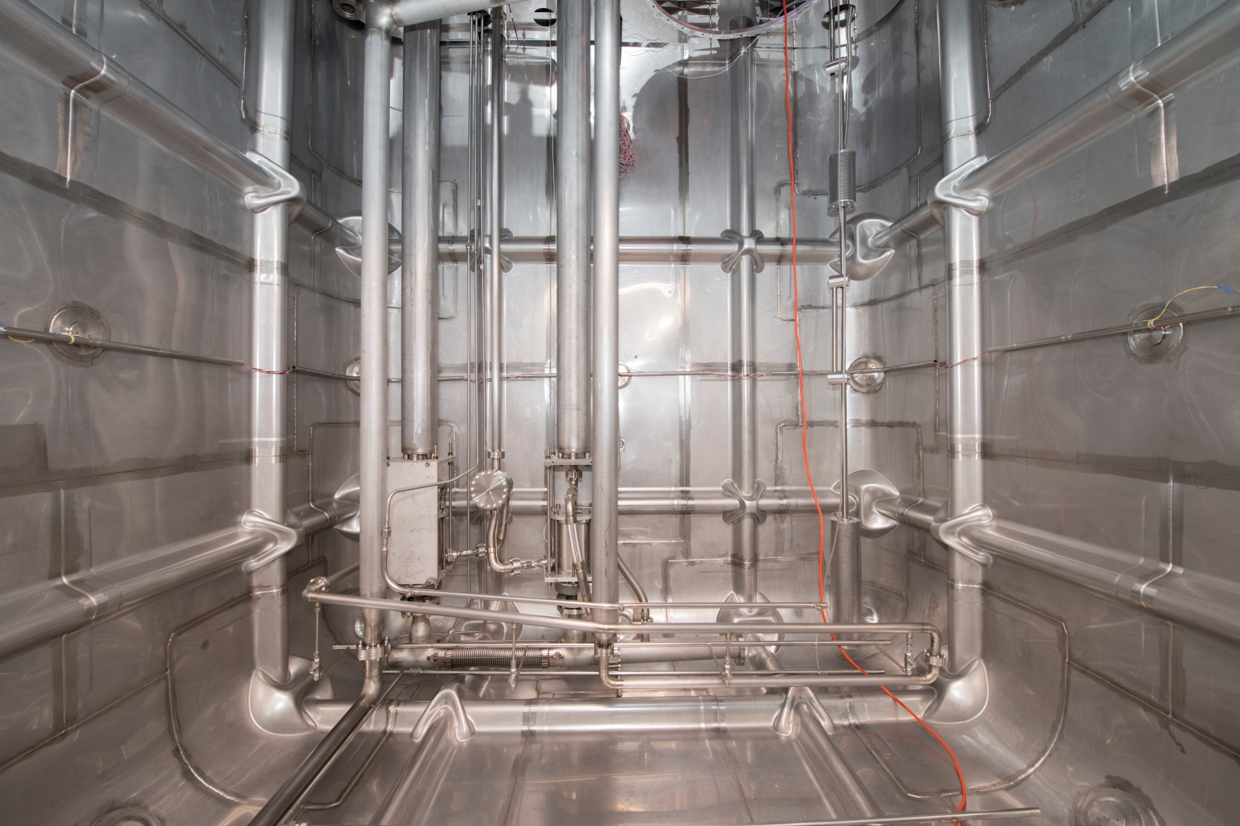
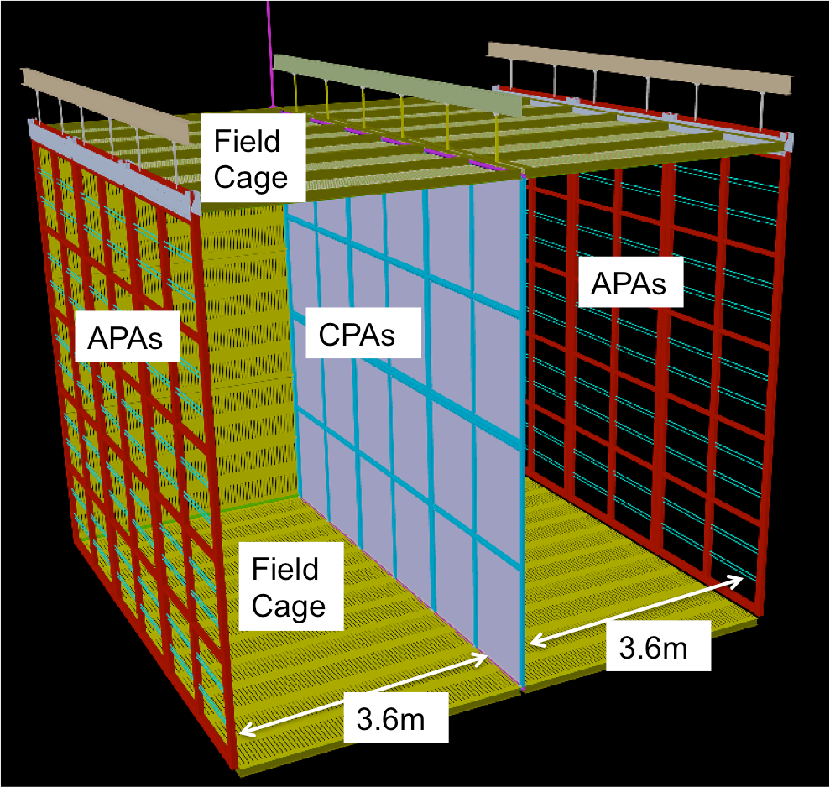
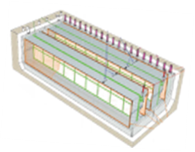
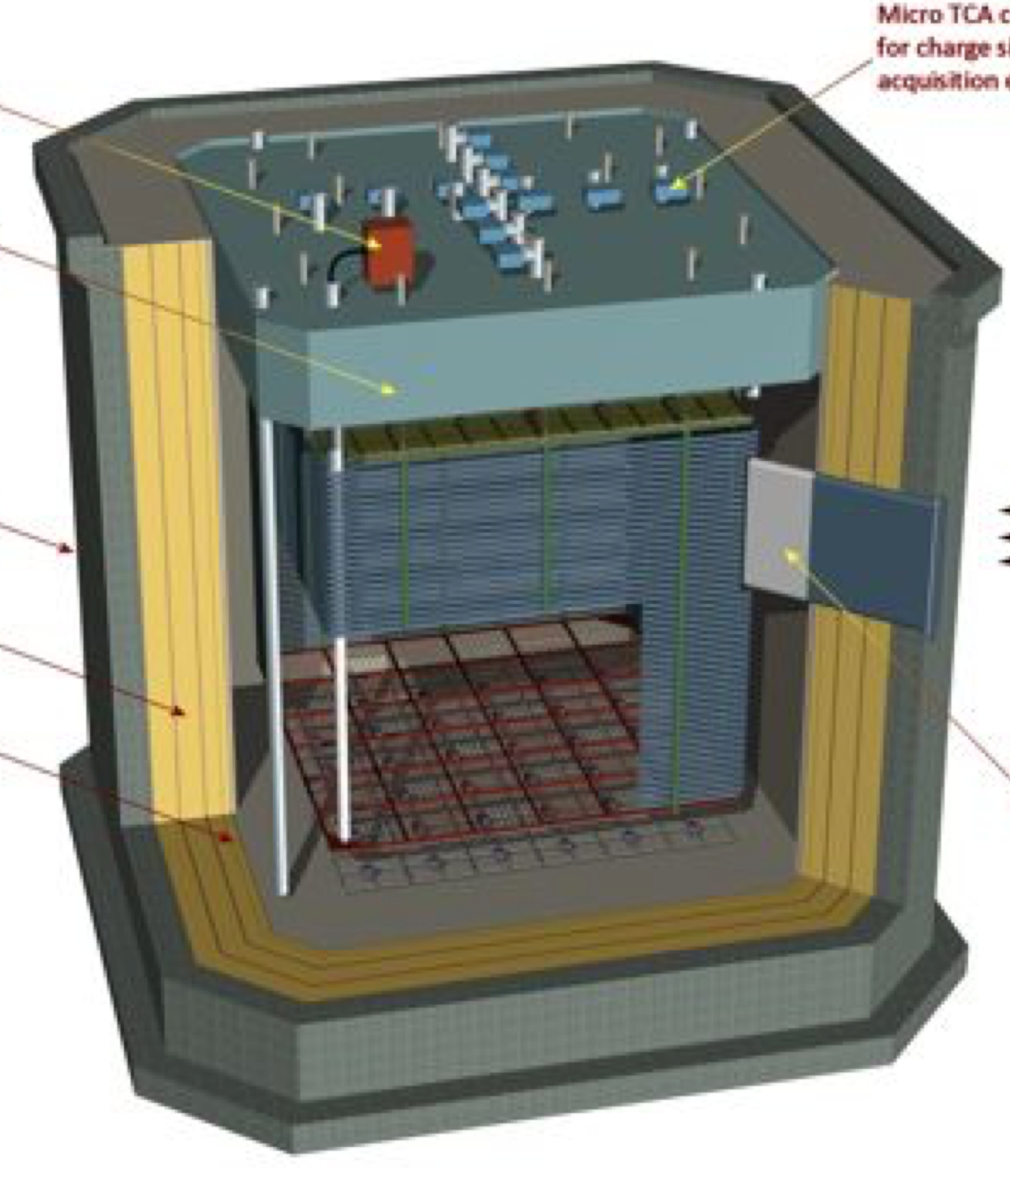
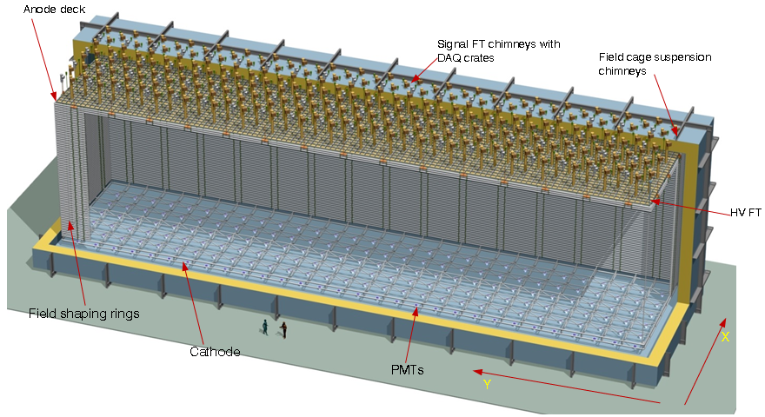
LArTPC Development Path
Fermilab SBN and CERN neutrino platform provide a strong LArTPC development and prototyping program
Single-Phase
35-t prototype
DUNE SP PT @ CERN
DUNE Reference Design
ICARUS
LBL
2015
2018
SBL
ArgoNueT
LarIAT
MicroBooNE
SBND
Dual-Phase
2016
2018
DUNE Alternative Design
WA105: 1x1x3 m³
WA105

Slide 20
Many issues here
Architecture
Low level testing
Power management
Decision tree
Risk analysis (30year lifetime)
Interfaces and redesign of ADC.
Crucial contribution from BNL Instrumentation
QA is a very big issue and will require large well integrated collaboration of institutions.

Slide 21
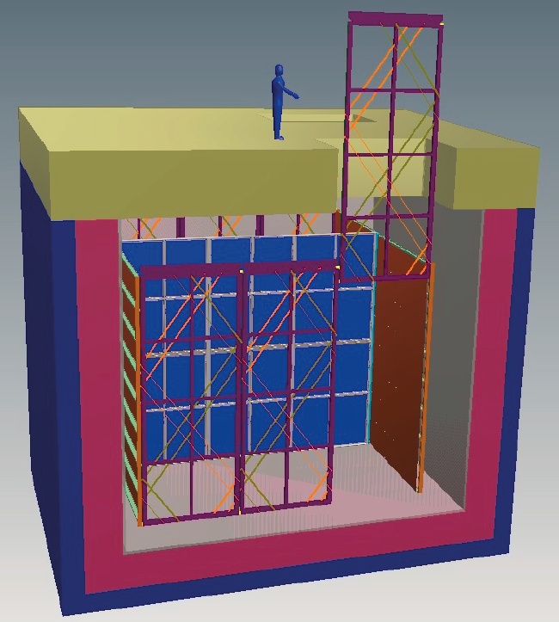
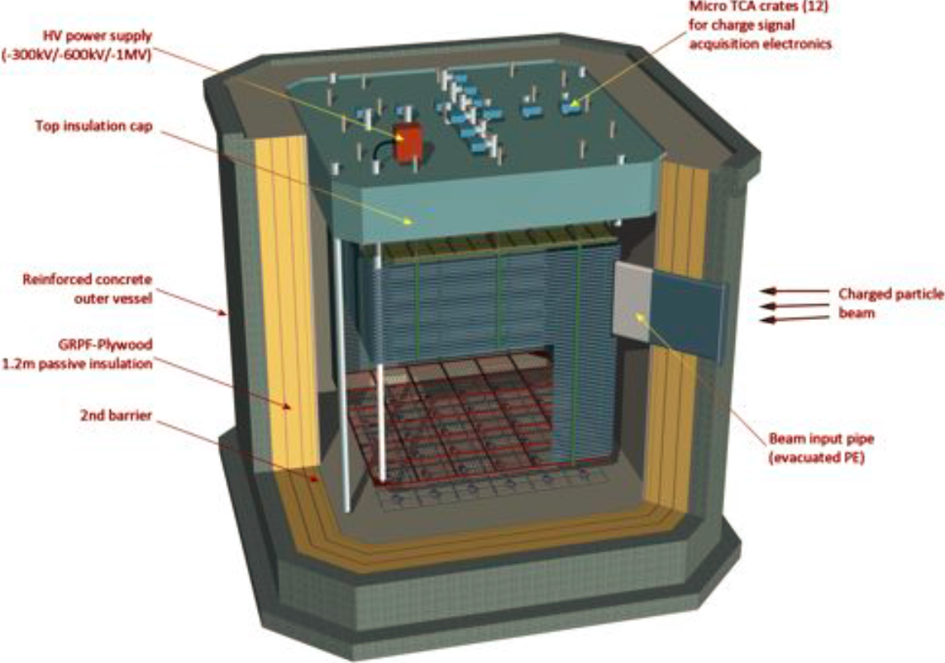
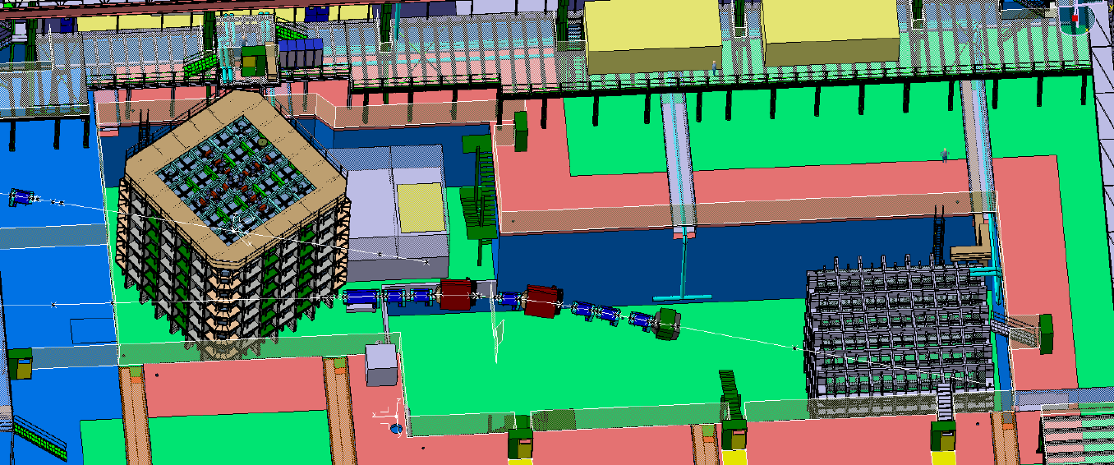
Far Detector Prototypes
Operational by 2018
protoDUNE: single-phase prototype (6 full-scale APAs) at CERN
WA105: 6 x 6 x 6 m³ dual-phase prototype at CERN
Test Beam (EHN1) at CERN

Slide 22
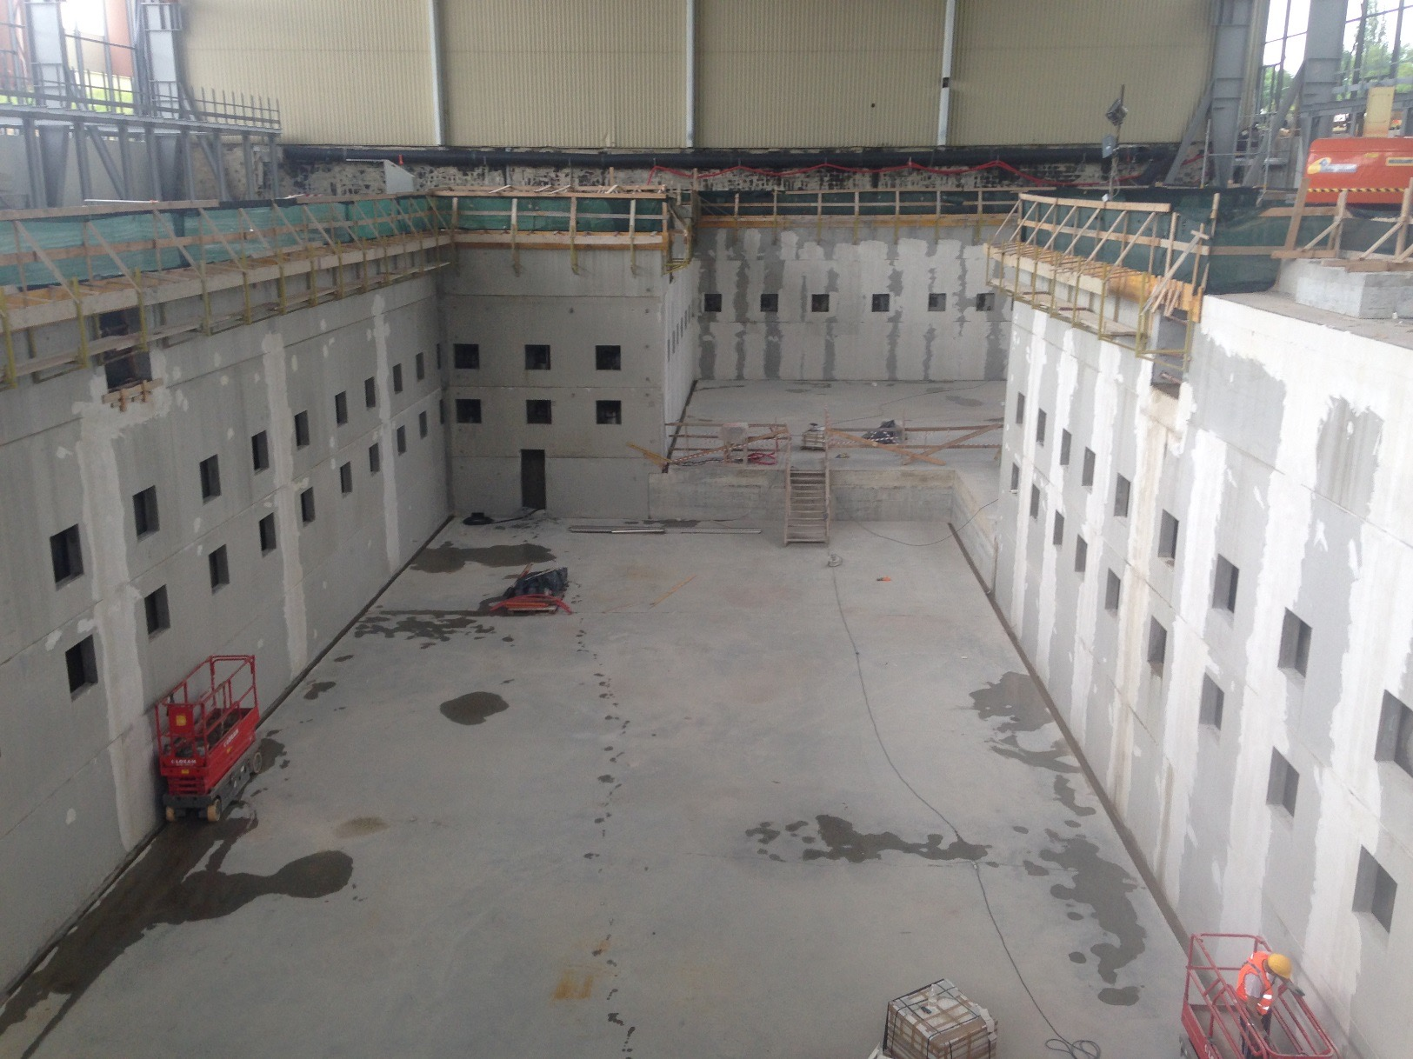
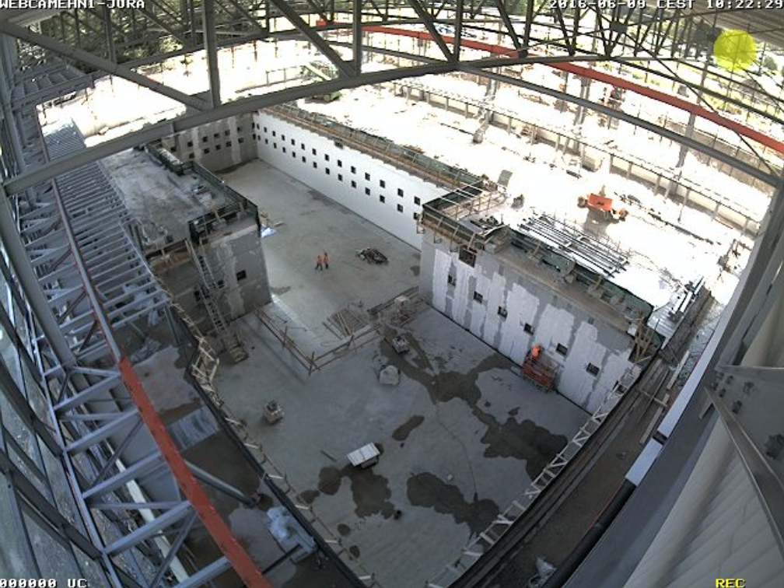
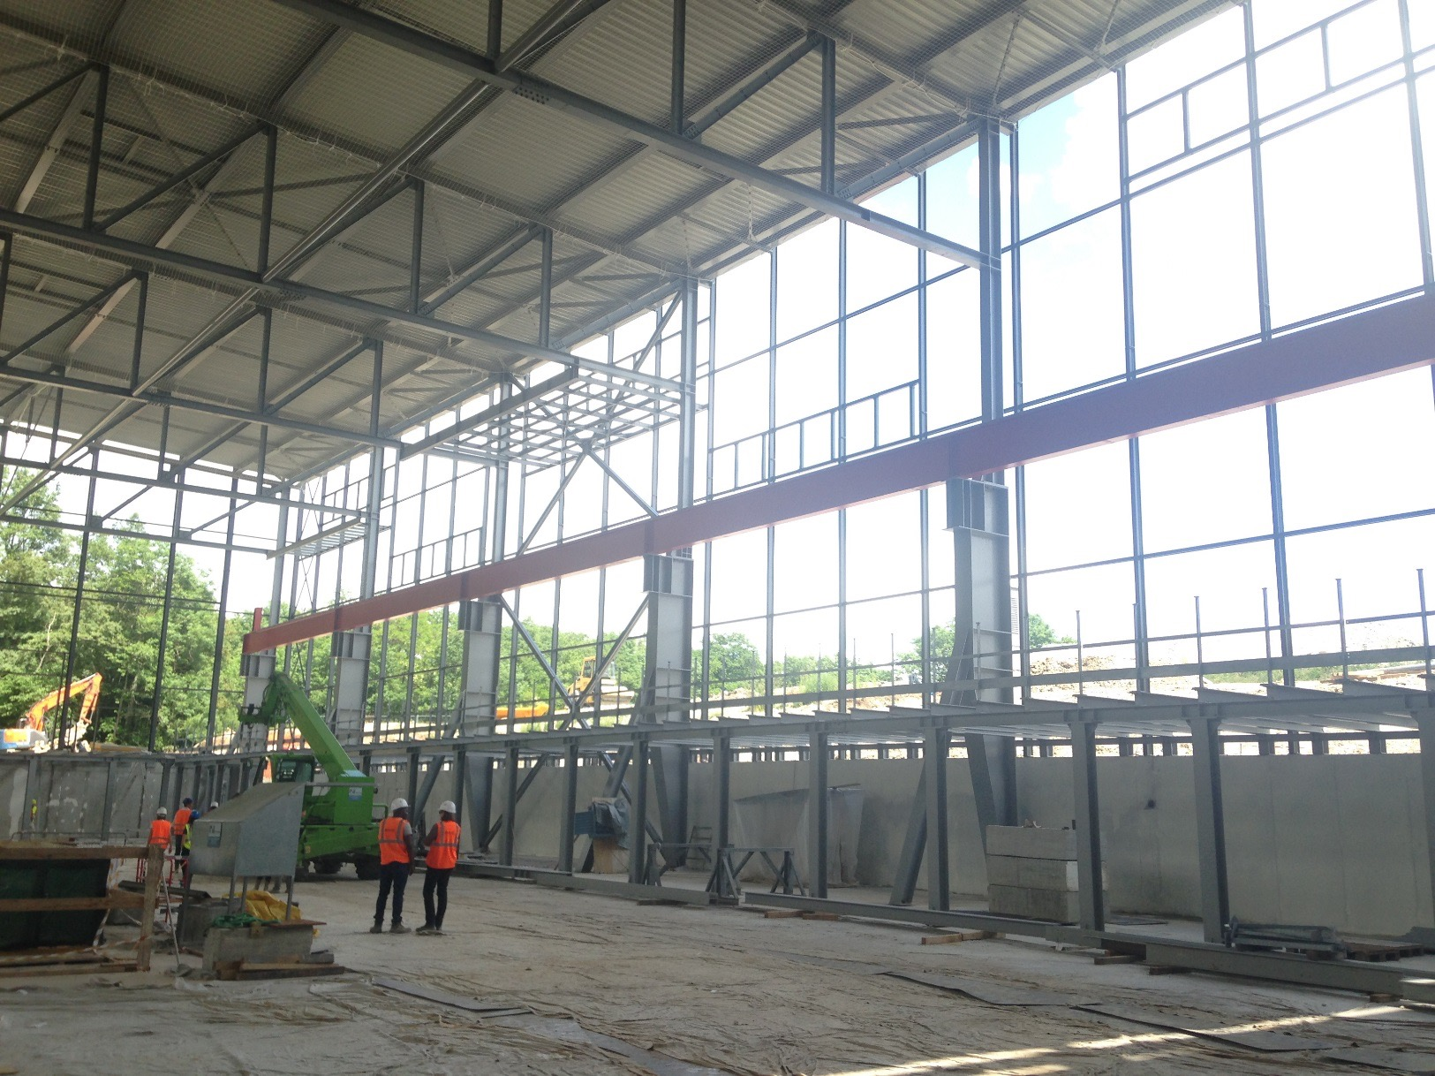
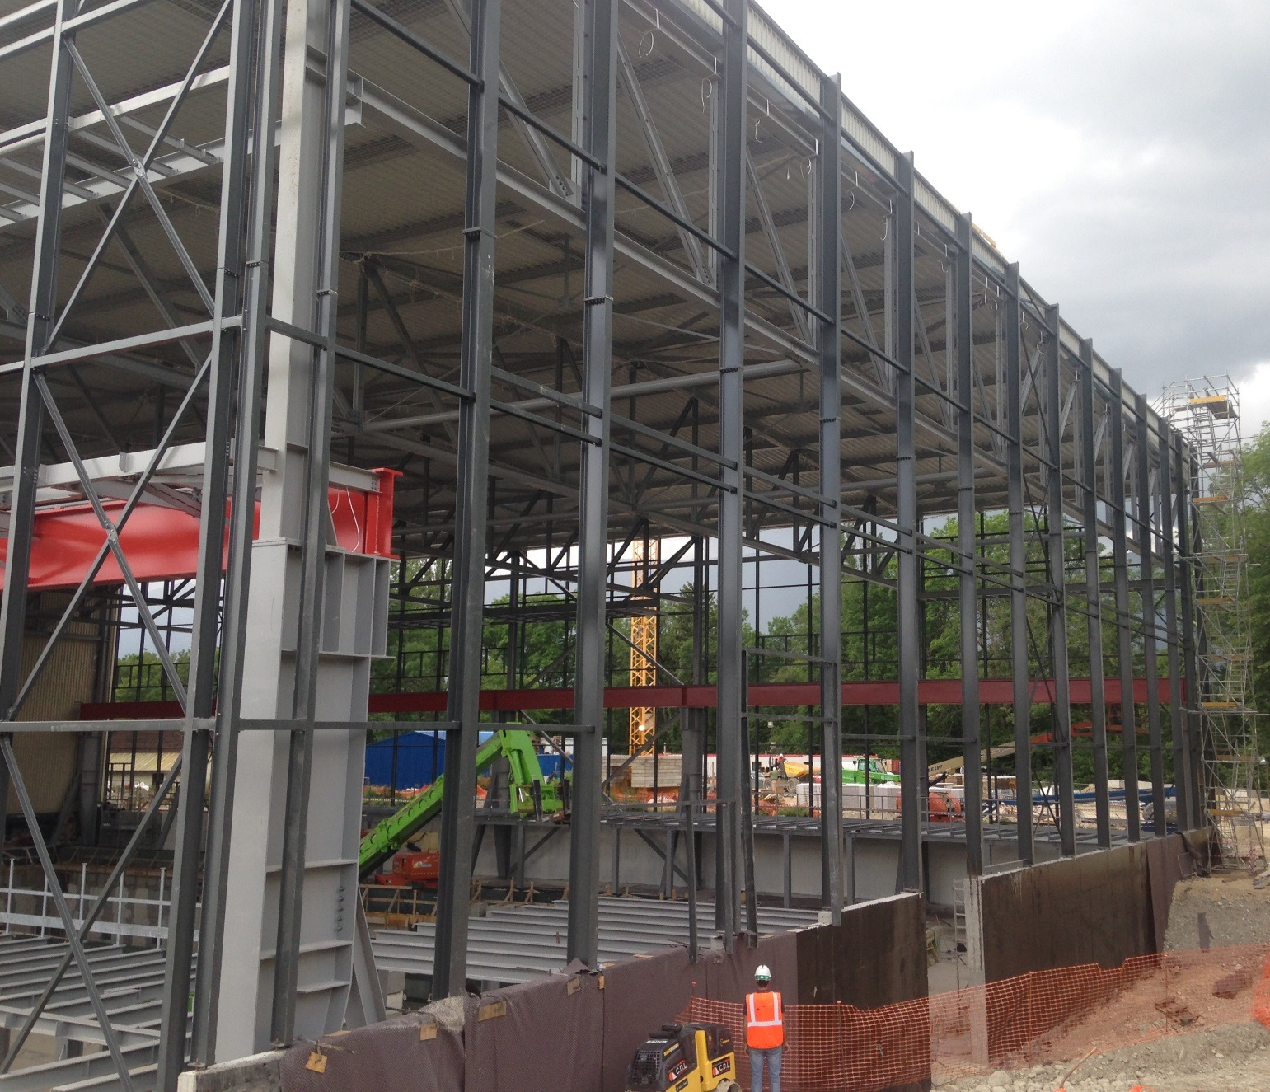
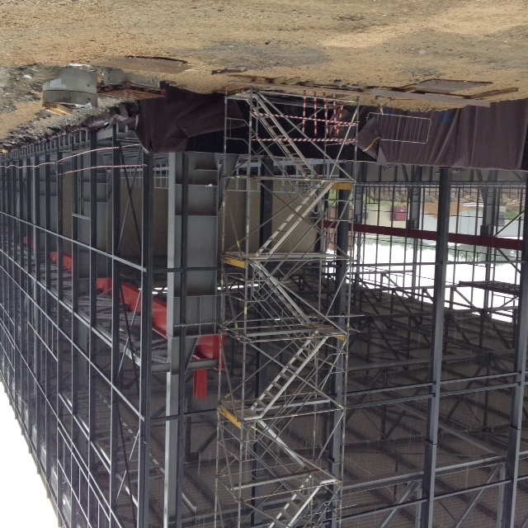
CERN-EXN1 extension, ν Experimental Area
12/06/16

Slide 23
Schedule
LBNF/DUNE is considered the first mega-science project on US soil. Governance model is based on LHC experiments.
The DOE, FNAL, CERN support to making this happen is extraordinary.
LBNE collaboration formation 2008.
2010 CD0 for LBNF/DUNE
2014-15 Greatly expanded international DUNE collaboration formation
July 2015 “CD-1 Refresh” review. Conceptual design review.
Dec. 2015 CD-3a CF Far Site. Initiate far site excavation and outfitting.
2017 Ongoing shaft renovation at SURF complete
2017 Start of far site excavation.
2018 Testing of “full-scale” far detector elements at CERN
2019 Technical Design review (Start Detector Construction)
2021 Ready for start of installation of the first far detector module
2024 start of physics with one detector module
2026 Beam and near detector available
2028 DUNE construction finished
Notes:
The schedule obviously will depend on congress. But here it is. There is a lot of construction in the next 10 years. Data could start in 8 years.
Through our thoughts and our actions we started a very large endevour.

Slide 24
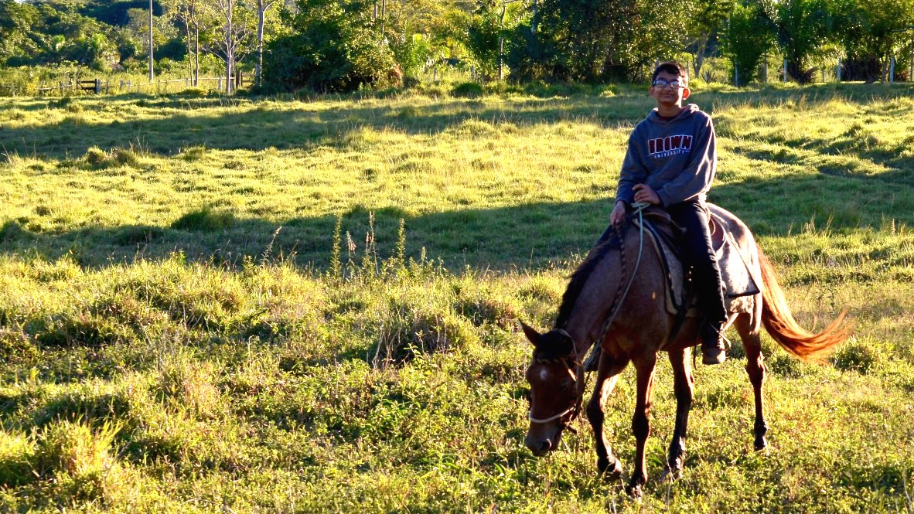
Conclusion
I was a victim of a series of accidents, as are we all. -Vonnegut
Thanks to Laurie for many years of mentorship and friendship.
Notes:
To conclude, first I want to thank Laurie for the many years of mentorship and friendship.
And I think he will appreciate my sentiment (since neither of us are religious) that we have all
come to this special place to do special things through a series of accidents. This is certainly true in my case. But I think we can be proud and grateful that we made sure of being “present”
and participating.

