Slide 1
Status for planned SiPM irradiation campaign at the Berkeley 88'' cyclotron
JiaJun Huang

Slide 2
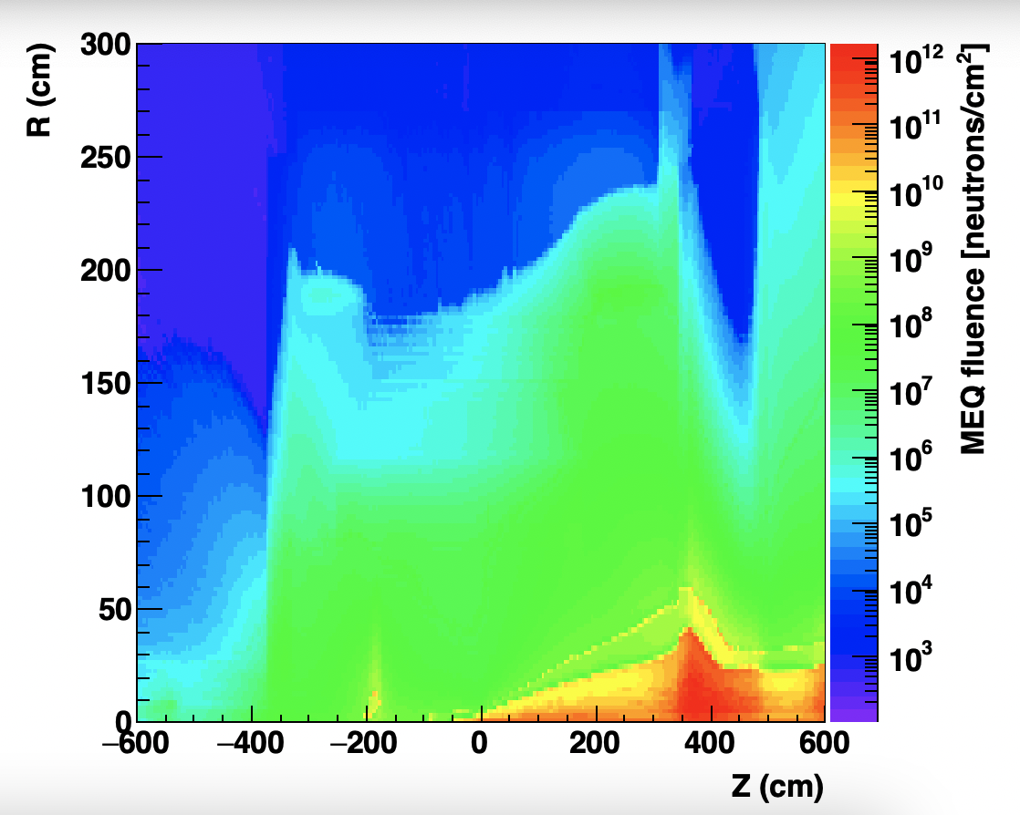
Expected 1 MeV equivalent flux pear year running at top lumi
Insert region will receive order 10e12, which is expected to cause trouble
Plot by Alex

Slide 3
Neutron flux consideration for SiPM-on-tile usage
Up to 5e13 1 MeV neutrons / cm2 over lifetime of experiment (TDR) | Up to 1e12 1 MeV neutrons / cm2 Per year at top luminosity.
Operating temperature: -30C (TDR) | Operating temperature: room temperature (Dark current at RT at 2V is ~30 higher than at -30C)
Dark current scales with fluence and is T dependent. -> Given the temperature difference the max neutron fluence in 1 year of EIC is similar to the maximum tolerable in CMS HGCAL design over lifetime

Slide 4
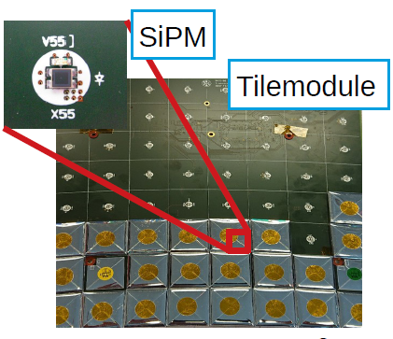
Some more details
SiPM used: 1.3 mm and 2 mm, 15 microns | SiPM used: 1.3 mm (or 3 mm?), 15 microns
Dedicated irradiation campaign and beamtest 2022-2023 | Dedicated irradiation campaign : Summer 2023 at Berkeley
Signal-to-noise ratio: S/N > 10 for 1 MIP (as per TDR) S/N ~2.5 for 1 MIP at highest dose (as per latest public result) | Signal-to-noise ratio: S/N > 5 at 1 MIP to be able to keep a 0.5 MIP threshold with 2.5 sigma suppression of noise
Mitigation measures (for higher dose region) - Larger SiPM (2 mm instead of 1.3 mm) - Casted scintillator, not injected molded scintillator - … | Mitigation measures: - Design to keep SiPM accessible for annealing after each run. - …

Slide 5
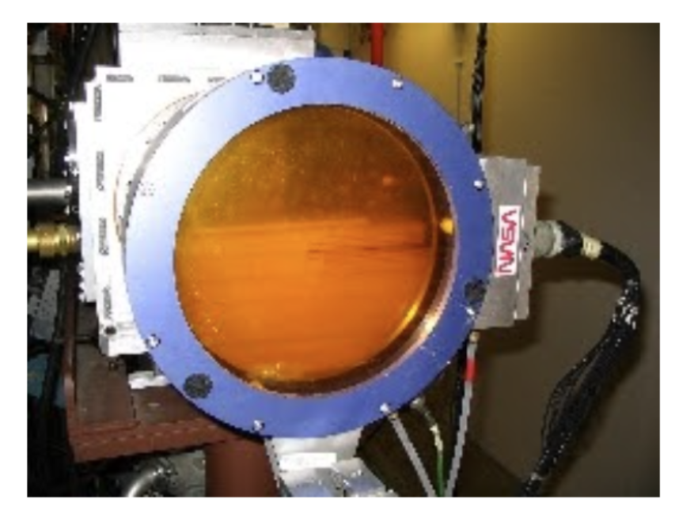
88’’ Cyclotron Irradiation (most likely August 2023)
Radiation test with SiPMs on different positions from the beam for the future EIC
Berkeley Lab 4 inch diameter collimator
50 MeV proton beam
Aim to get 10E12 1 MeV neutron damage (1 year running at EIC)
Equivalent 4 hours of 10E8 50 MeV proton per cm2 per second
Maximum 10cm diameter SiPM arrays within the effective area

Slide 6
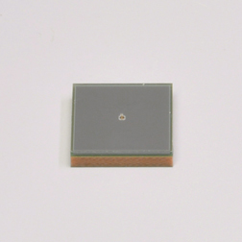
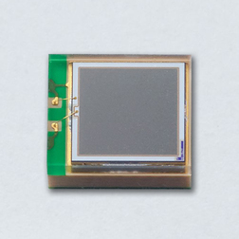
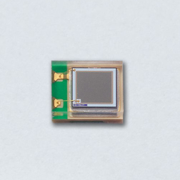
SiPMs to be Used for Testing
We are using the latest generation of Hamamatsu 6x6, 3x3, and 1.3x1.3 mm SiPM for irradiation testing
Before Irradiation:
Obtain gain
Characterize SiPM dark rate
Breakdown voltage
Signal-to-noise ratio (with LED)
Characterize MIP value for SiPM-on-tile
*We will irradiate any other model if we receive them (on time)

Slide 7
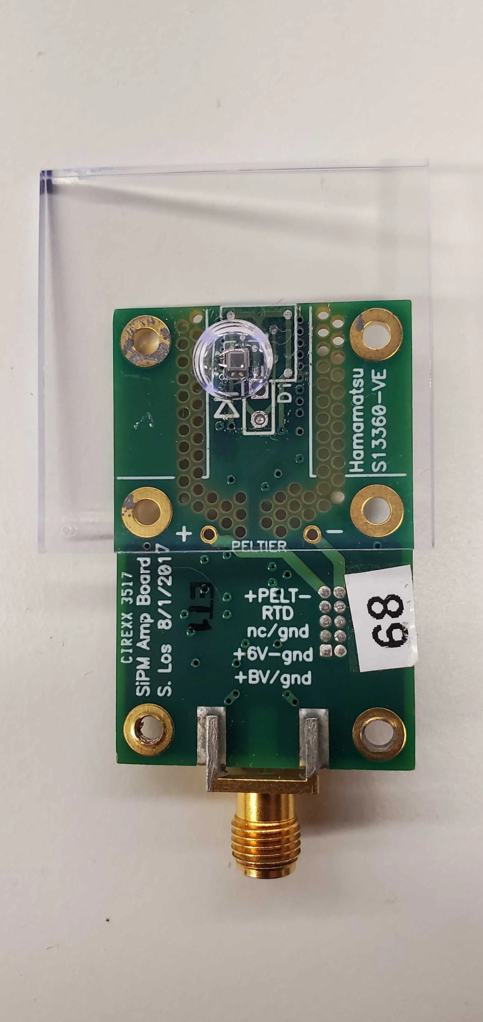
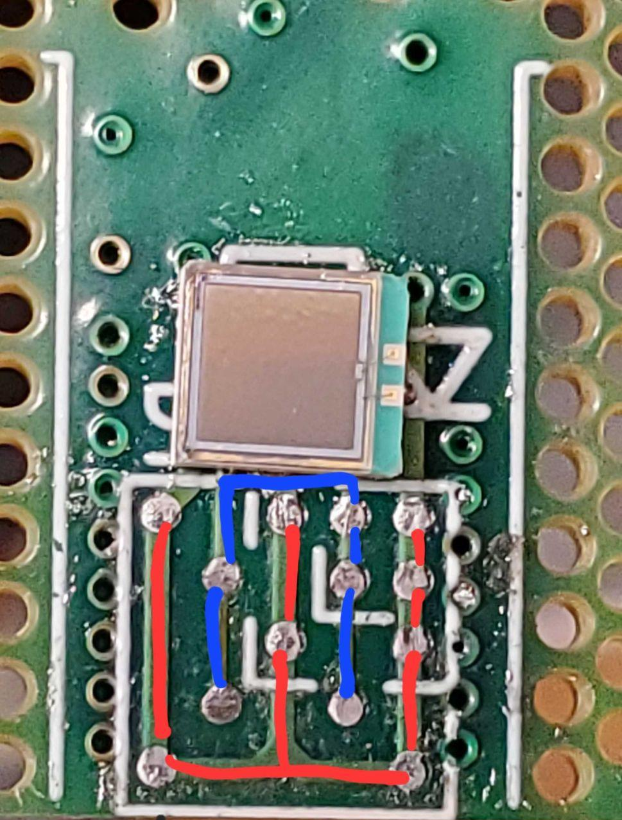
FermiLab Board Readout
Built in circuit board ready to be use
Optimizer preamplifier near SiPM
Replaceable SiPM section for different models of SiPM
Reverse amplification waveform
Setup:
Reverse amplifier attached to the readout for further amplification
Readout directed to DRS4 (full-waveform digitizer) for data collection and analytics in Python

Slide 8
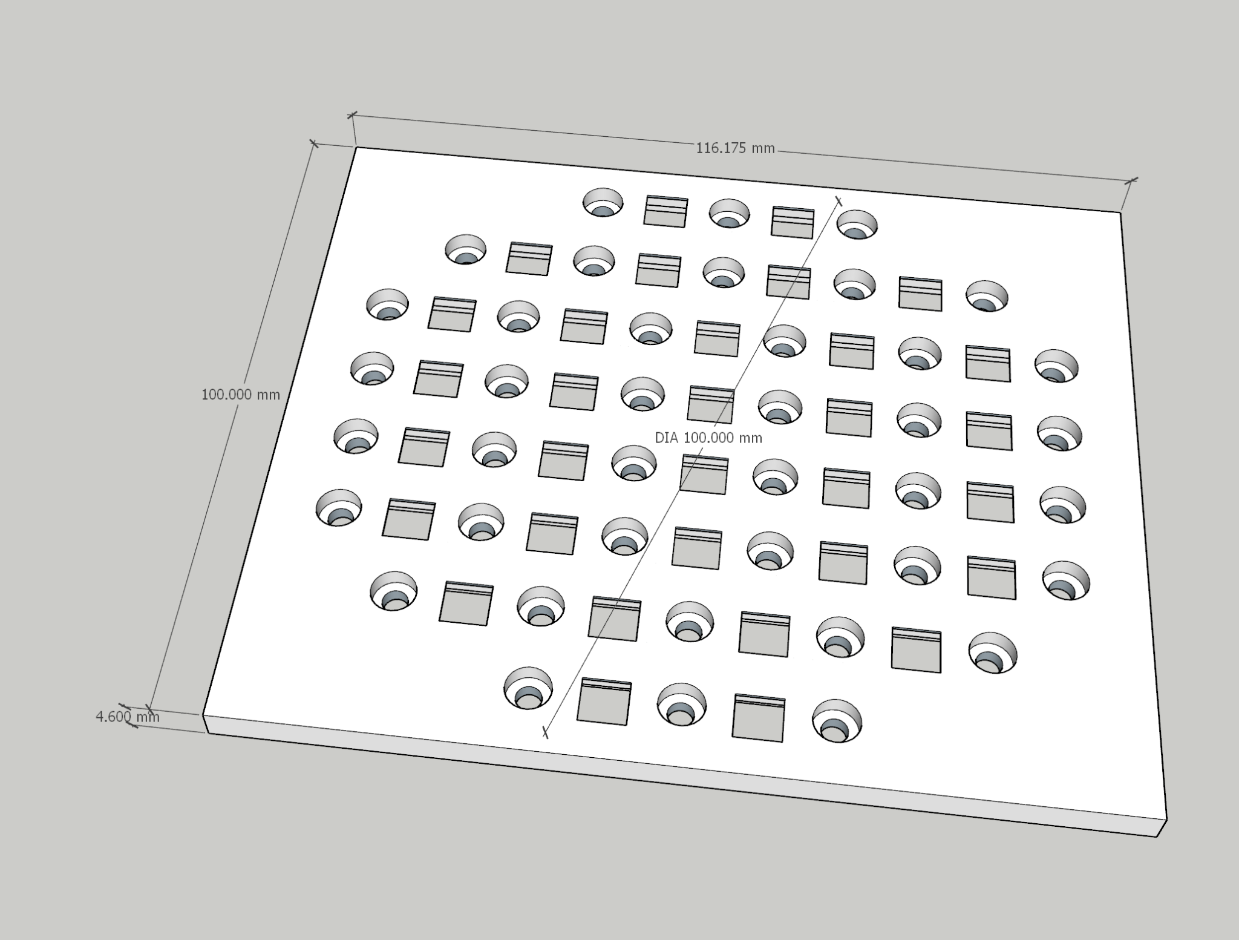
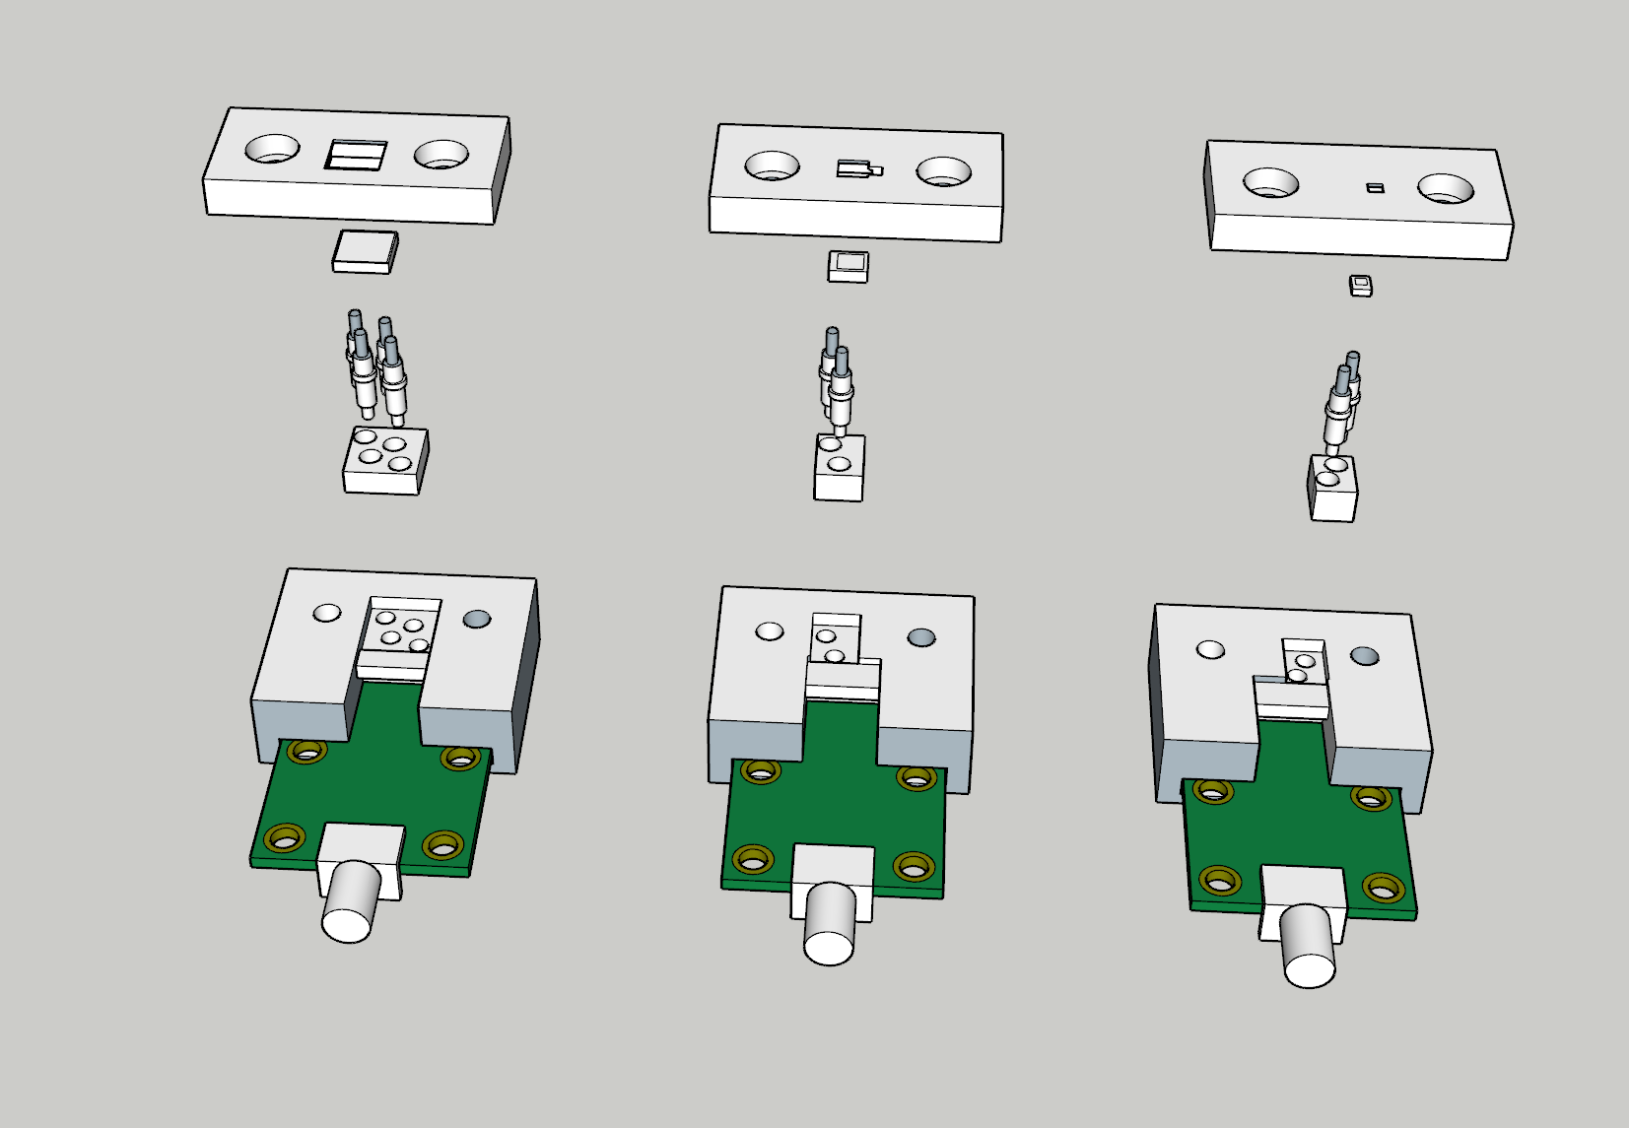
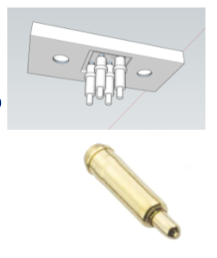
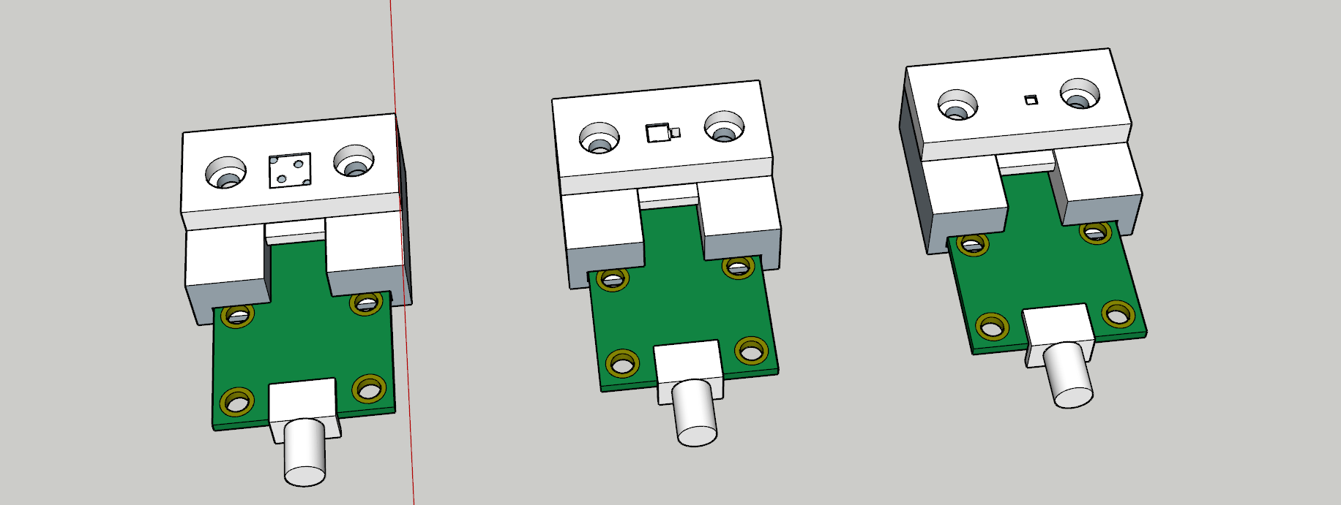
3D Model for SiPM and Fermilab Board
Mostly aiming at “non-destructive” test, in which we will use pogo pins to measure before and after irradiation, i.e not soldering. -> SiPMs could be used afterwards in other dedicated setups or detector systems

Slide 9
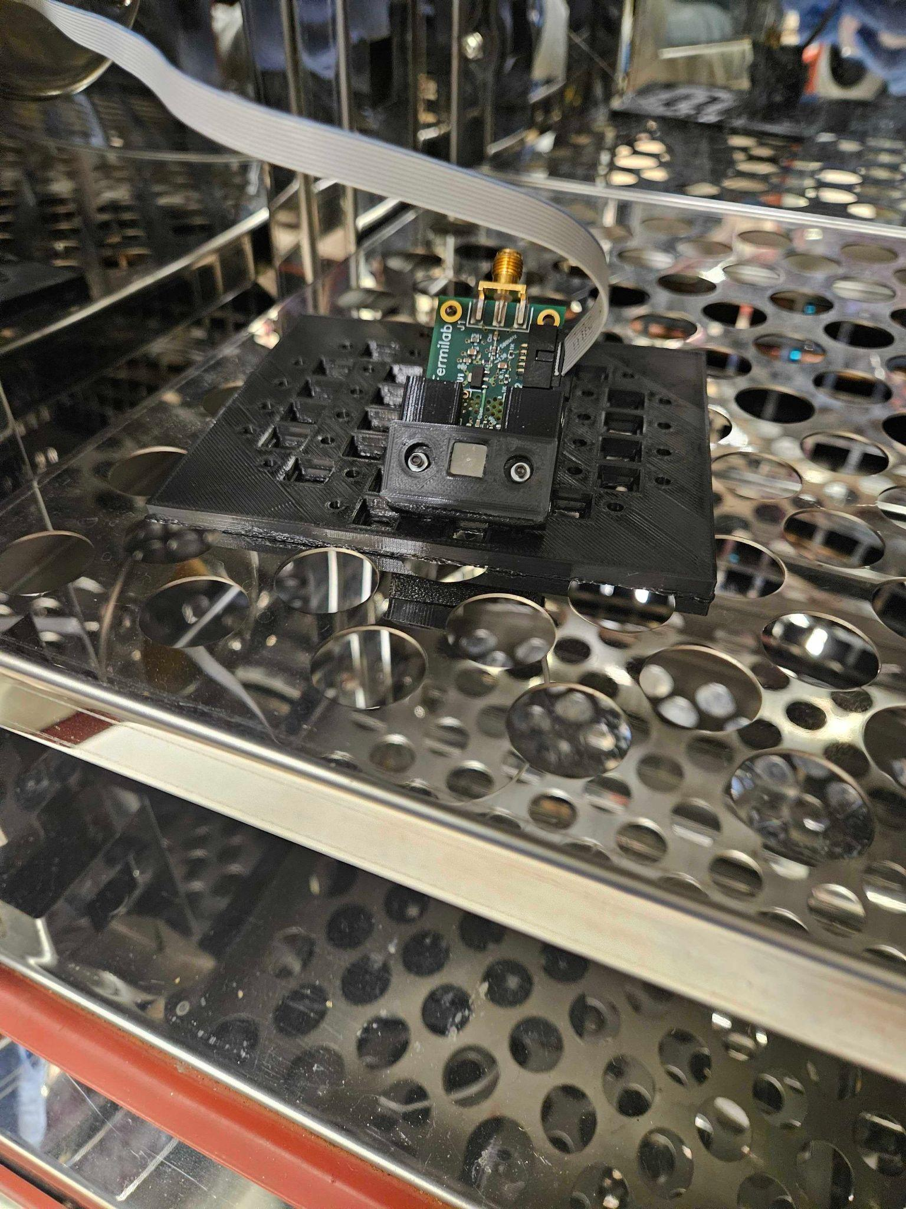
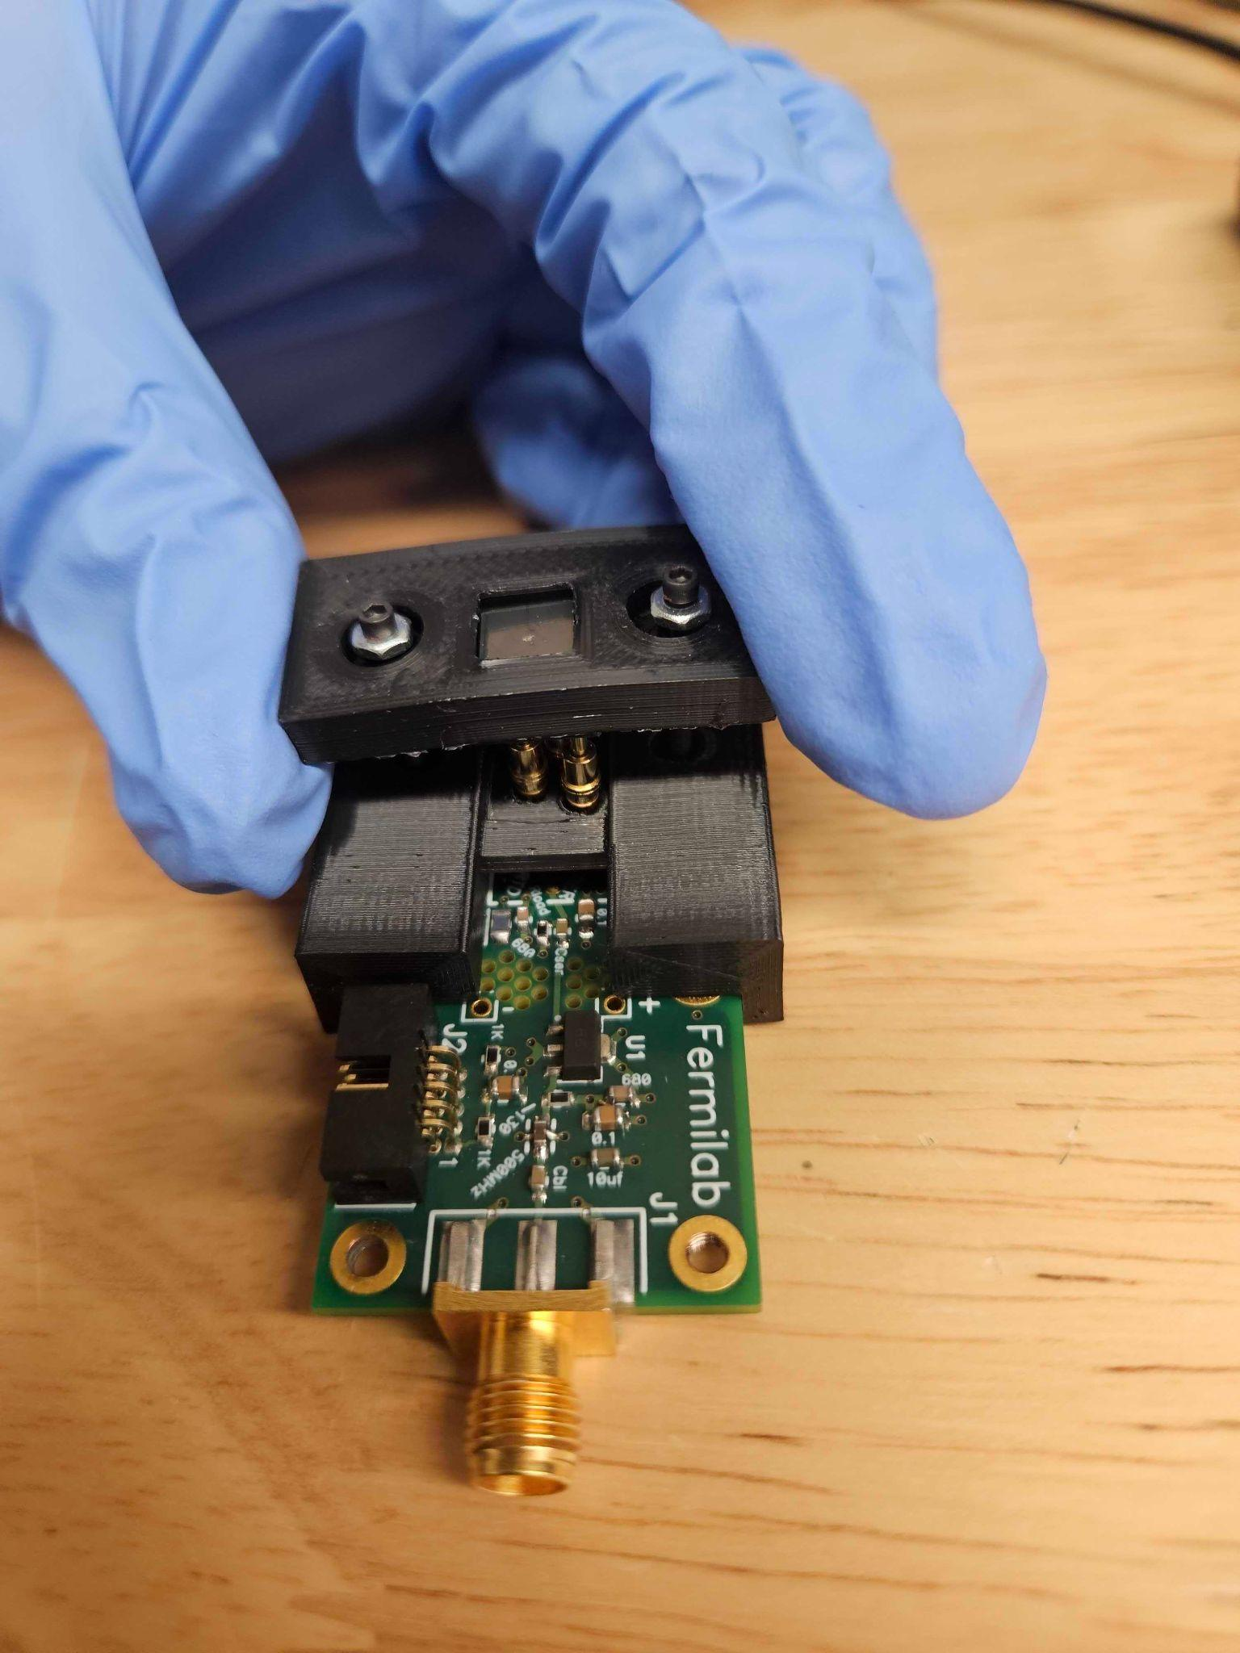
3D Model for SiPM and Fermilab Board
-10cm radius SiPM array that fits about 20 SiPMs per tray with the different sizes
- FNAL board holder will attach to the backside of the SiPM using screws to tighten

Slide 10
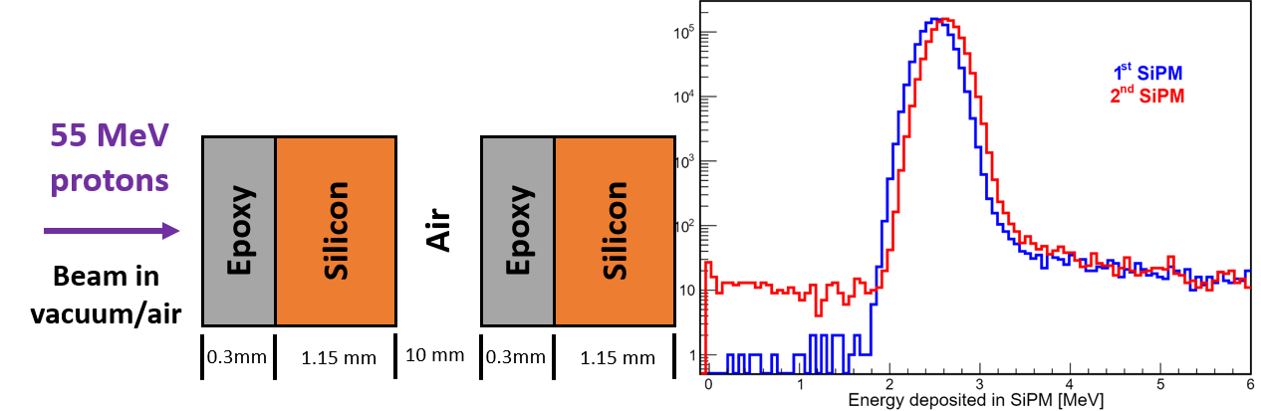
Berkeley Setup
We will use 2 or 3 trays of SIPMs one after the other. Plan to remove some after certain time to measure different fluences
Geant4 simulation

Slide 11
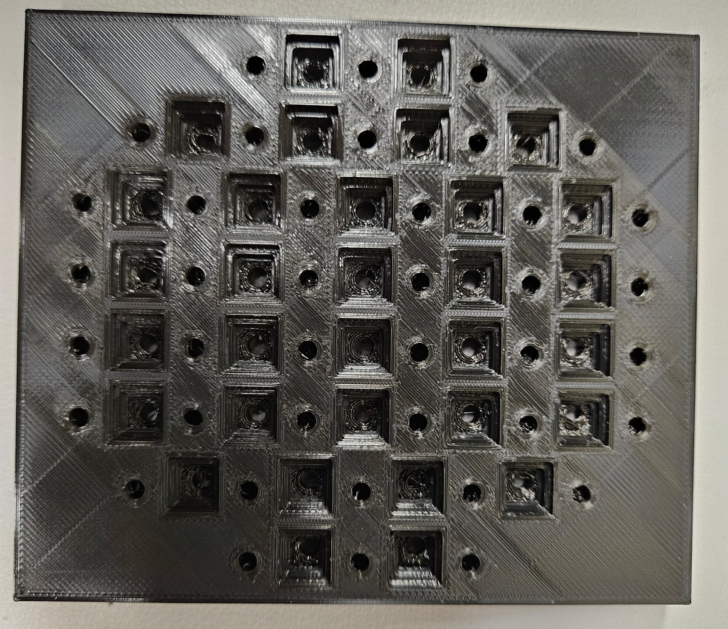
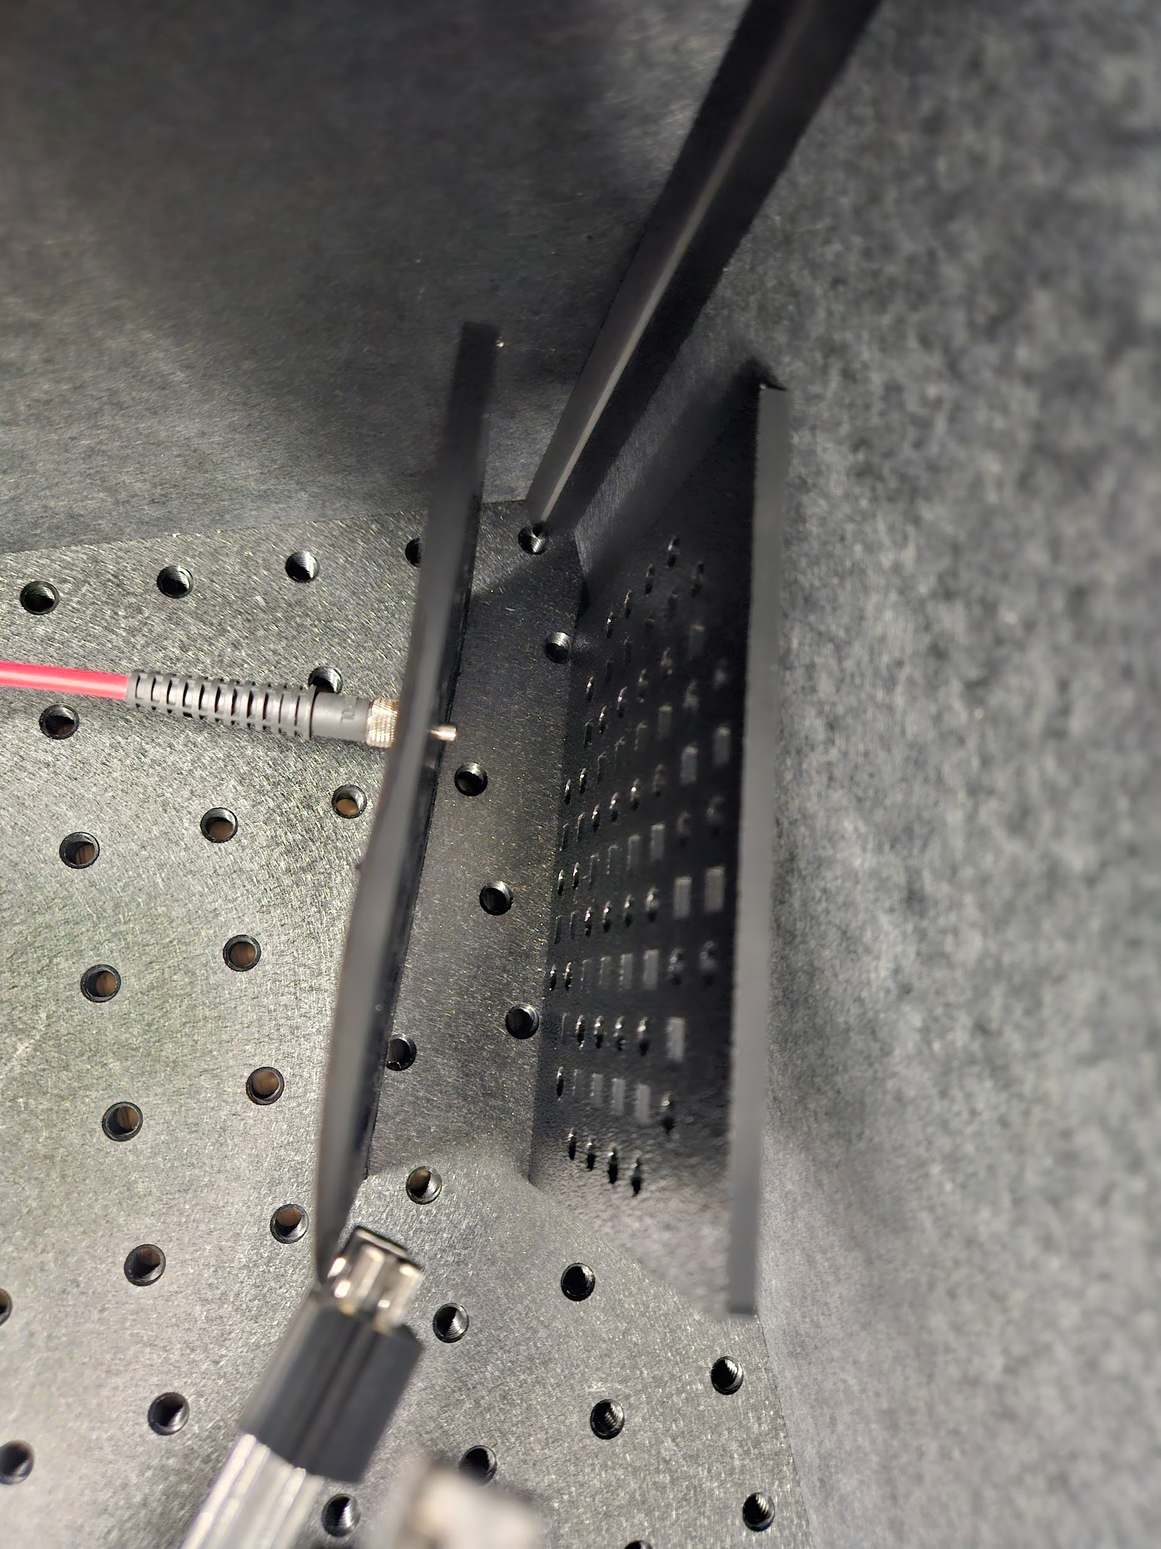
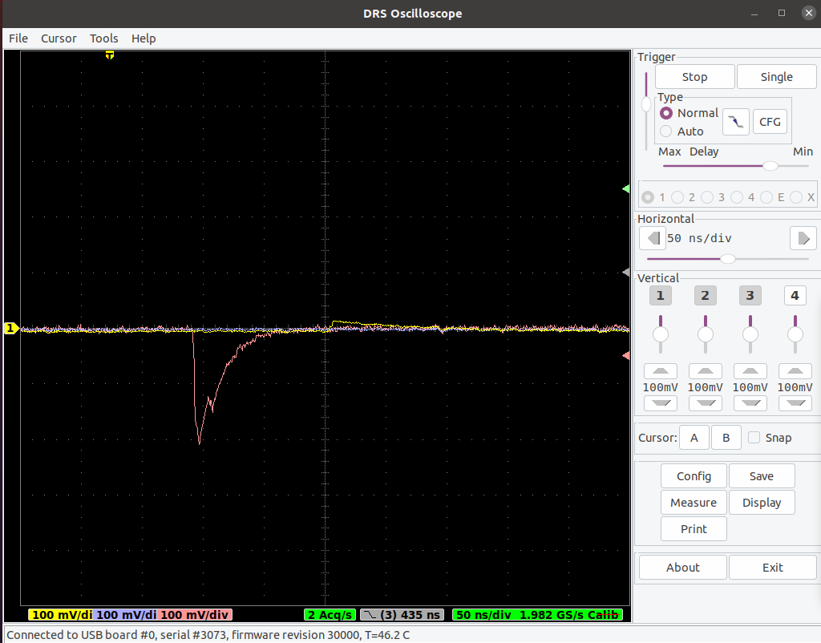
SiPM testing Readout Setup
6V Amp Bias
Testing Source
FNAL Board
SiPM Volt Bias
Keithley 2450 Bias
UV LED
Readout
ZFL-1000LN+ Amp
SiPM Array
DRS4 Digitizer
Computer
#1
Computer
#2

Slide 12
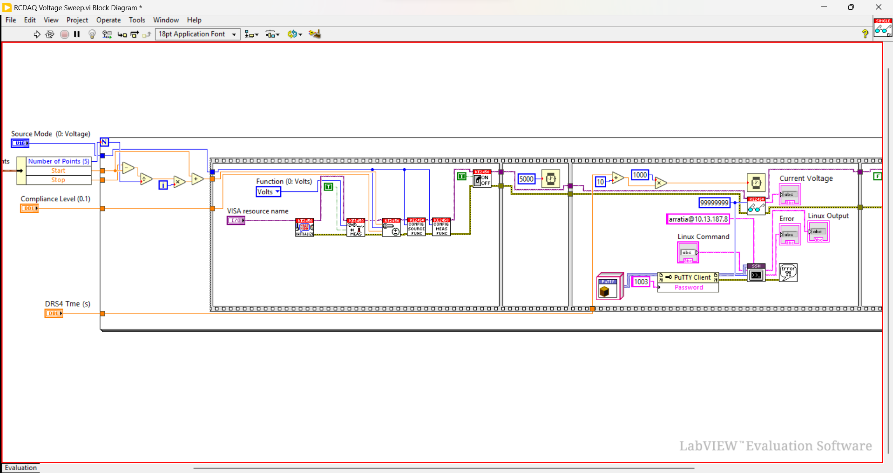
Voltage Sweep Automation Using LabView
Automated setup that changes voltage and records waveform using DRS4

Slide 13
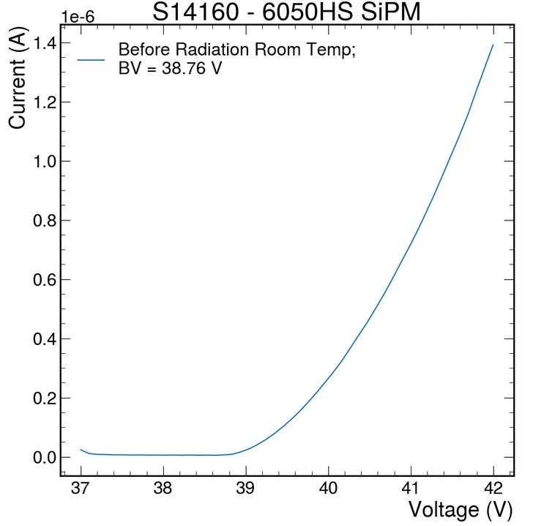
IV Characteristics
To determine breakdown voltage and dark current

Slide 14
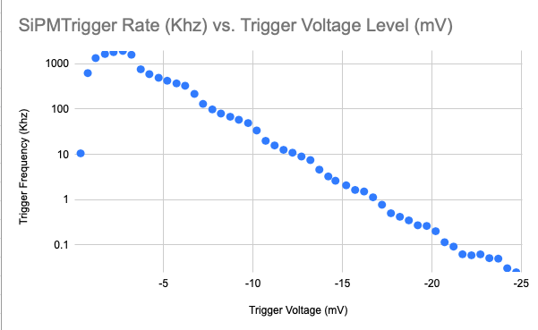
Dark Rate Scan with Frequency Counter
To determine the triggering threshold for cosmic runs

Slide 15
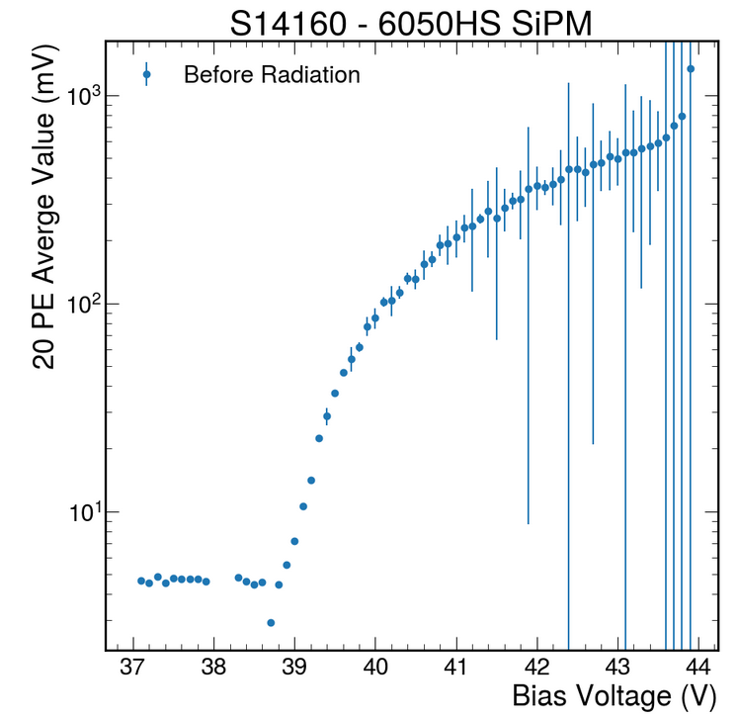
Signal-to-noise ratio vs voltage study with LED
Fixed intensity LED at a fixed location from the SiPM tray
Simulation for the number of photon produced by a MIP
LED intensity that yields ~20 pe at +2 OV
UV LED
Average Signal Intensity (mV)

Slide 16
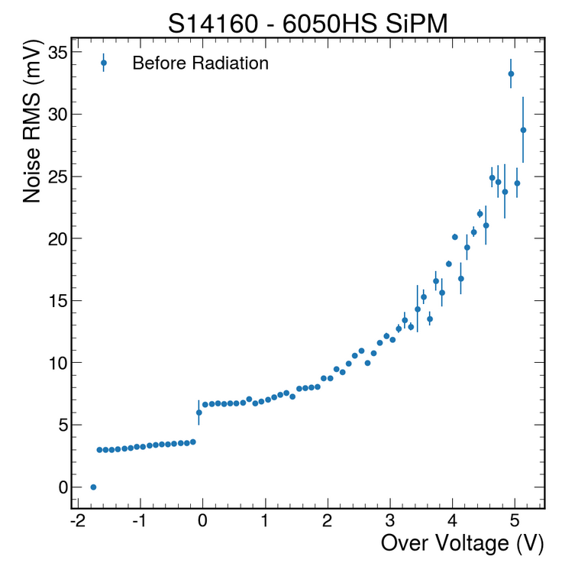
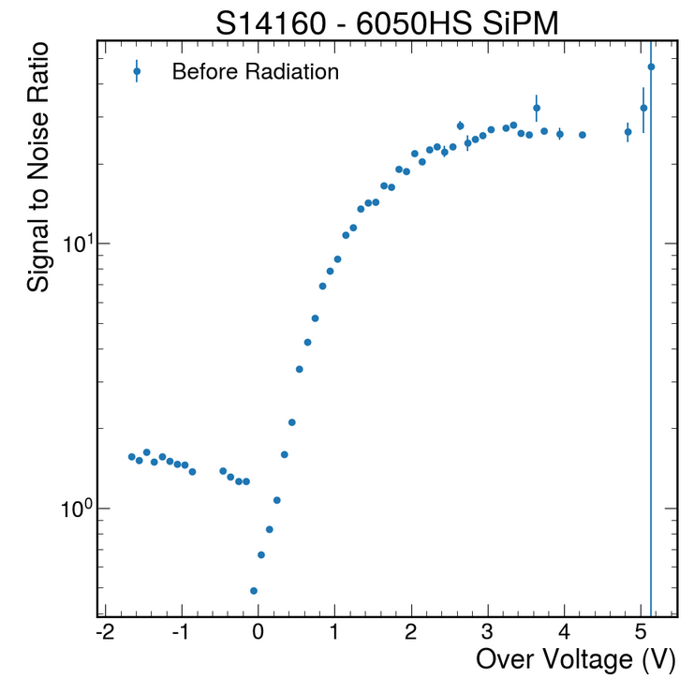
Signal to Noise Ratio
Noise

Slide 17
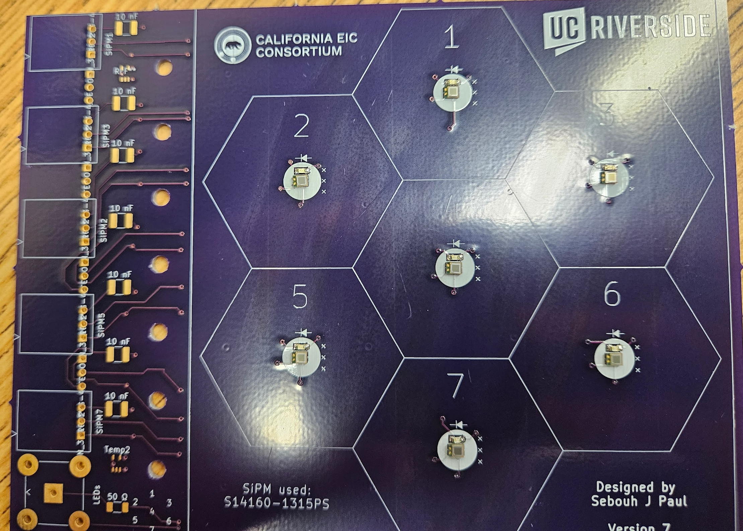
Irradiation of Flower SiPM Board with Tiles
Also plan to irradiate SiPM on board with tiles for more realistic comparison of cosmic rays and S/N ratio before and after test.
Using CAEN DAQ (CITIROC 1A ASIC) for readout, using 1 m cables to mimic transport of analogue signal like in real detector. CITIROC 1A shaper time to be set to 10-20 ns, similar to HGROC that we will use in the real experiment

Slide 18
Summary Planned Measurements
IV,
Dark rate,
S/N with LED,
S/N with cosmics using CITIROC 1A (10-20 ns shaper), for all SiPM models before and after irradiation.

Slide 19
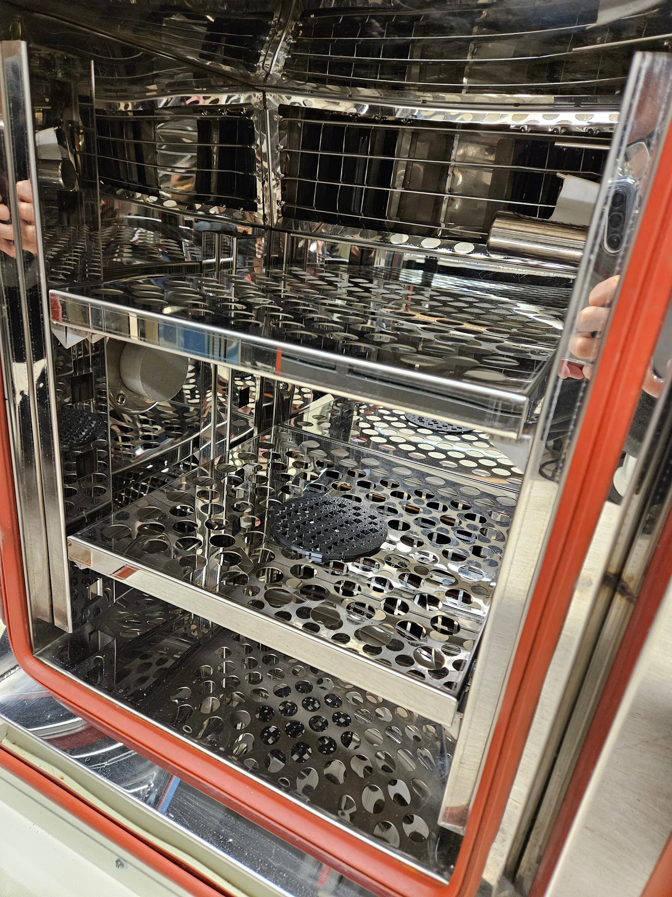
Annealing
-SiPM property comparison with pre-irradiation
-Heat chamber SiPM annealing test
-Quantify signal-to-noise ratio after irradiation and after annealing

Slide 20
Summary and conclusions
Setup for the Berkeley test beam is ready.
Setups for testing at UCR are ready
SiPMs are at hand.
Environmental chamber ready for annealing studies
Performance metrics are identified and have been performed with unirradiated samples

Slide 21
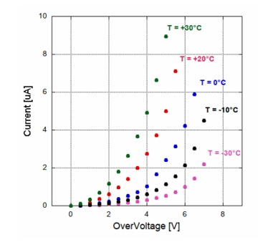
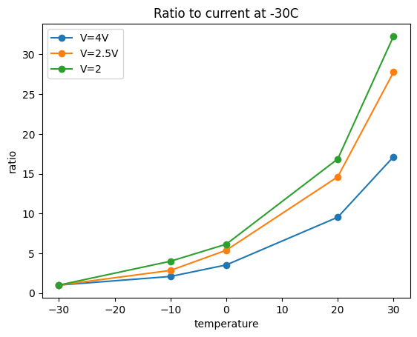
Backup
14160 3050HS
Ref: arXiv:2006.06258v2

Slide 22
