Slide 1
Machine Learning applications for collider luminosity maximization
Xiaofeng Gu
Collaborators:
MSU: Yue Hao, Will Fung
LBNL: Ji Qiang, Sherry Li, Yi-Kai Kan
BNL: Xiaofeng Gu
Nov 29, 2022
Abstract
The luminosity of a collider can be affected by many parameters at the same time. It is not easy to distinguish the effects of one parameter from all other parameters separately. Therefore, optimizing the performance of a collider such as RHIC, EIC becomes a multi-objective optimization problem with possible noisy signals and involves many parameters. Therefore, machine learning (Bayesian and Gaussian Process) could be a good tool for the luminosity optimization. Here, we talk about a Bayesian optimization method which is developed at LBNL GPTune and its planned application to RHIC luminosity optimization, as well as its possible application to EIC collider.

Slide 2
Outline:
Machine Learning applications for EIC Machine
Introduction to EIC Machine
LEReC Cooling performance
RHIC luminosity
EBIS intensity
Machine Learning Opportunities in EIC Beam Dynamics
Introduction
Dynamic Aperture

Slide 3
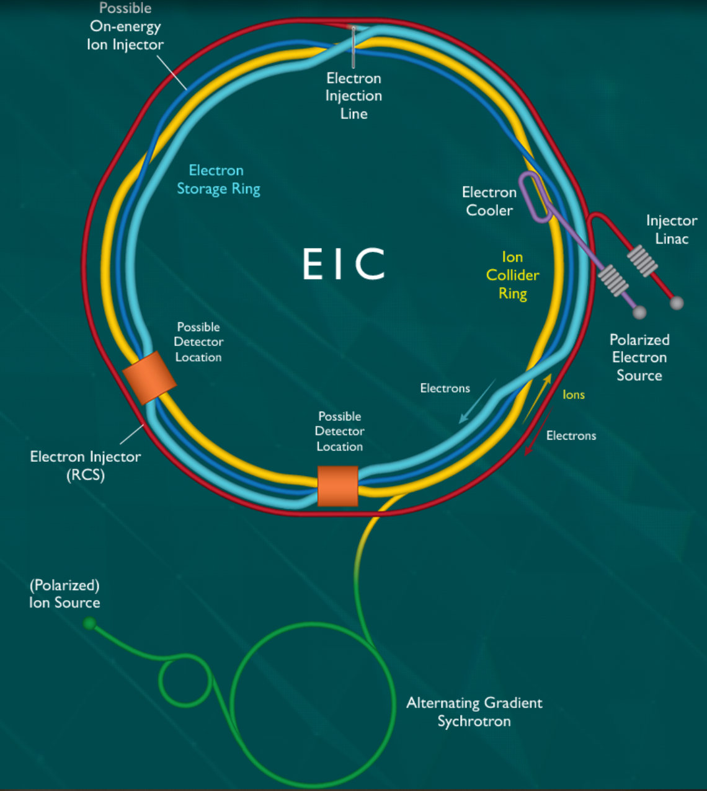
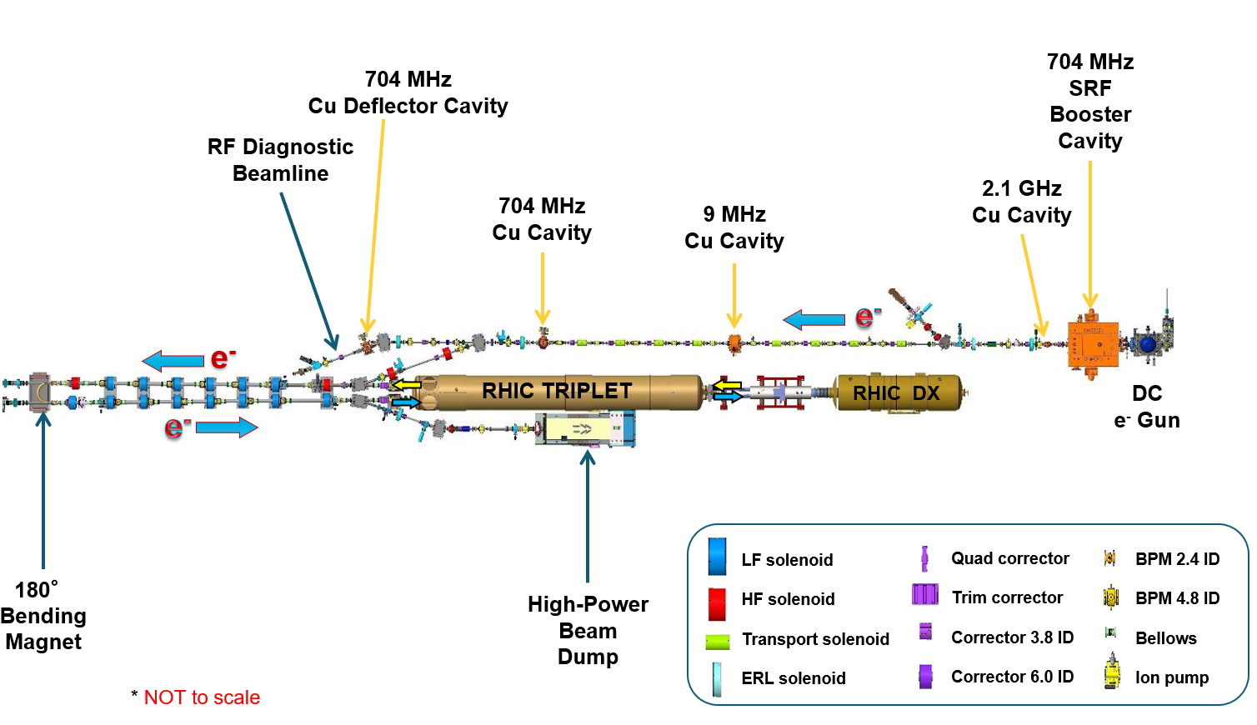
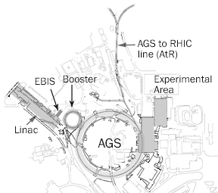
The EIC Machine
Laser Ion Source-EBIS
Polarized Proton Source-Linac
Booster-AGS-HSR
Electron Injector Linac
Polarized Electron Source
RCS-ESR
Electron Cooler (pre-cooler, hardon cooler)
Interaction Region

Slide 4
ML Opportunities in EIC Machine
Intensity optimization (EBIS-ongoing)
Emittance optimization
Polarization optimization (AGS-ongoing)
Beam alignment (cooling-tested, luminosity region-ongoing)
$$L=\frac{N_{1}N_{2}fH}{2π\sqrt{σ_{x1}^{2}+σ_{x2}^{2}}\sqrt{σ_{y2}^{2}+σ_{y2}^{2}}}$$
Machine learning for digital twin development and polarization optimization at BNL hadron injectors Lucy Lin

Slide 5
Outline:
Machine Learning applications for EIC Machine
Introduction to EIC Machine
LEReC Cooling performance
RHIC luminosity
EBIS intensity
Opportunities in EIC Beam Dynamics
Introduction
Beam-Beam
Dynamic Aperture

Slide 6
Gaussian Process for cooling beam alignment
Courtesy of Y. Gao
LEReC is fully operational electron cooler which:
utilizes RF-accelerated bunched electron beams
uses non-magnetized electron beam
stable 24/7 running of high-current electron accelerator and stable cooling of ion bunches was provided over many months of collider operation in 2020 and 2021.
Contributed a significant luminosity improvement for RHIC operation at low energies
provided electron beam for some studies which required by the EIC project, such as the cooling studies and high current beam in 2022.
LEReC beam alignment with Gaussian Process for a better cooling
Yuan Gao, etc.
https://github.com/SheffieldML/GPy
https://journals.aps.org/prab/abstract/10.1103/PhysRevAccelBeams.25.014601

Slide 7
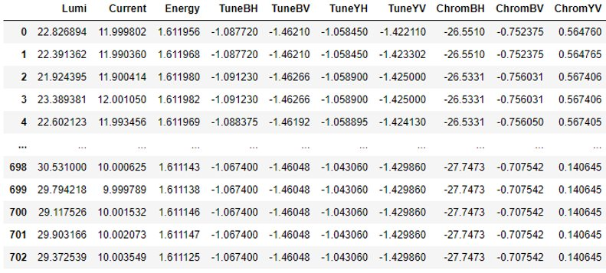
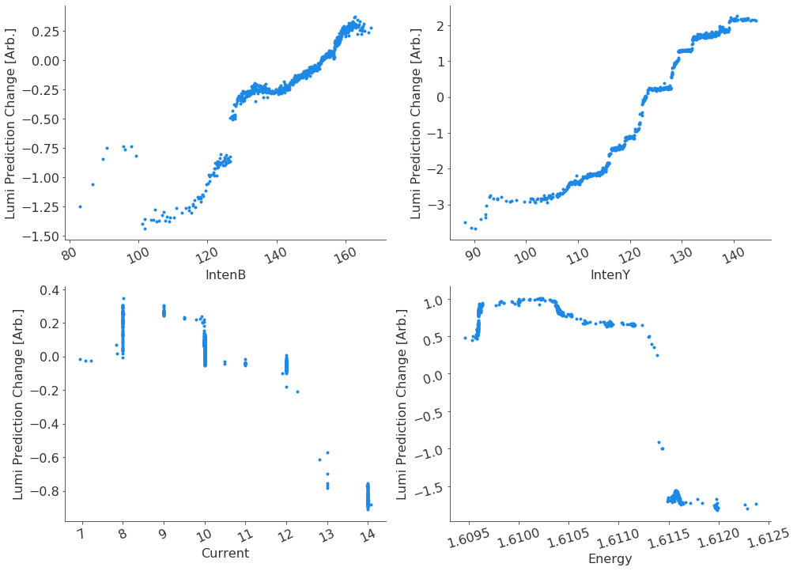
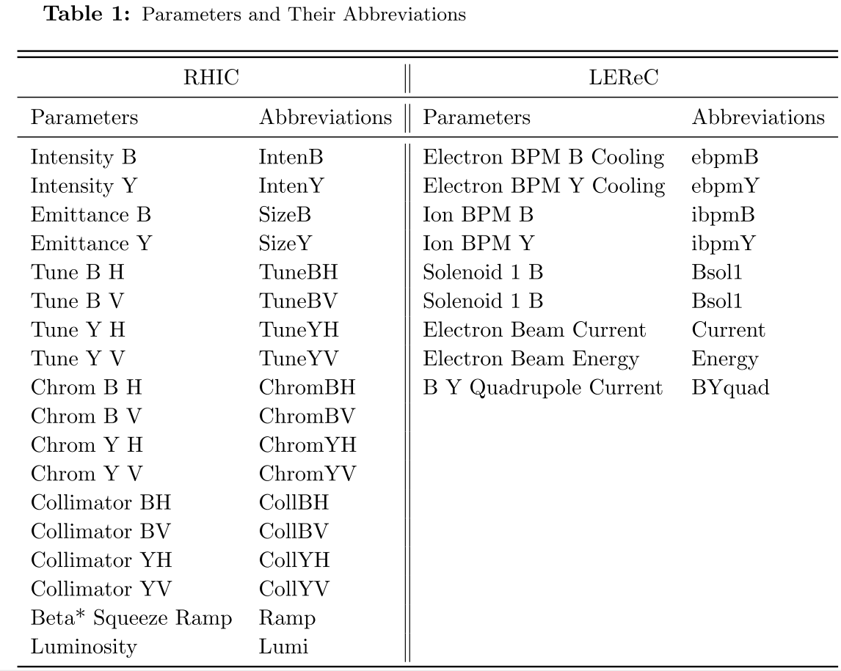
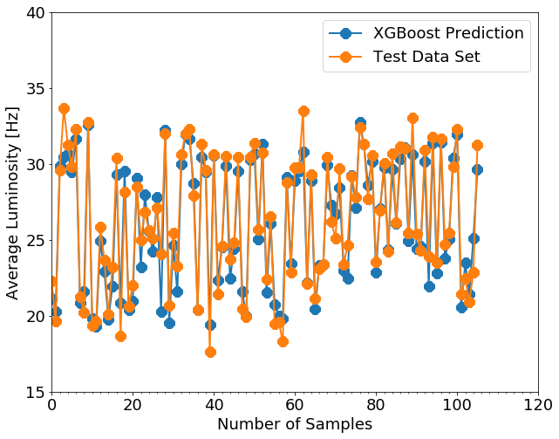
XGBoost for Cooling Optimization (offline)
XGBoost :
Multi-dimensions nonlinear regression algorithm: good for f(x1,x2,x3, … , x26) with n>3 or 4. (Higgs Machine Learning Challenge)
The black-box model: 80% data for training, 20% data for test and comparison
Model R_2 score: 0.90, predicts the luminosity very well.
703 useful stores
E-beam current was moved from 10 mA to 8 mA after XGBoost Analysis.
Found the blue ion intensity contributes more than the yellow to the luminosity because of its less loss rate maybe.
Most operation parameters are very closed to their optimum value, several parameters could be improved.

Slide 8
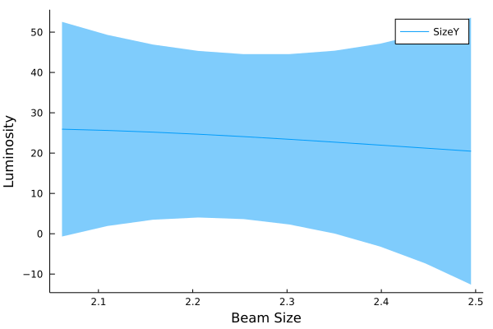
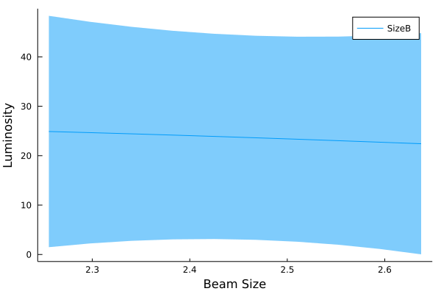
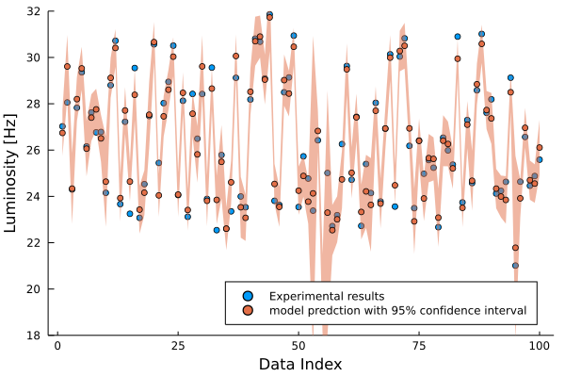
Gaussian Process for Cooling Optimization (offline)
Gaussian Process with Matérn kernel 3/2:
Correct trend is obtained when evaluating the luminosity as function of beam size. However, the error bar is large which indicates more data point is needed.

Slide 9
Outline:
Machine Learning applications for EIC Machine
Introduction to EIC Machine
LEReC Cooling performance
RHIC luminosity
EBIS intensity
Opportunities in EIC Beam Dynamics
Introduction
Beam-Beam
Dynamic Aperture

Slide 10
ML in EIC Interaction/Luminosity
Machine learning is useful for EIC interaction optimization: beam alignment, local lattice control.
A surrogate model will be trained with simulation and guide luminosity optimization and possibly the long-term degradation study. The study is on-going.
This surrogate model with high dimension parameter space. A simplest case is to replace the charge particle distribution with the Gaussian distribution’s second order moments:

Slide 11
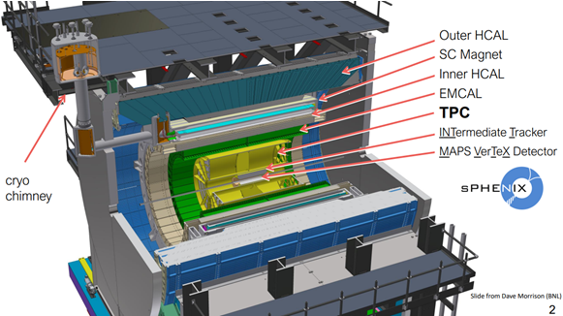
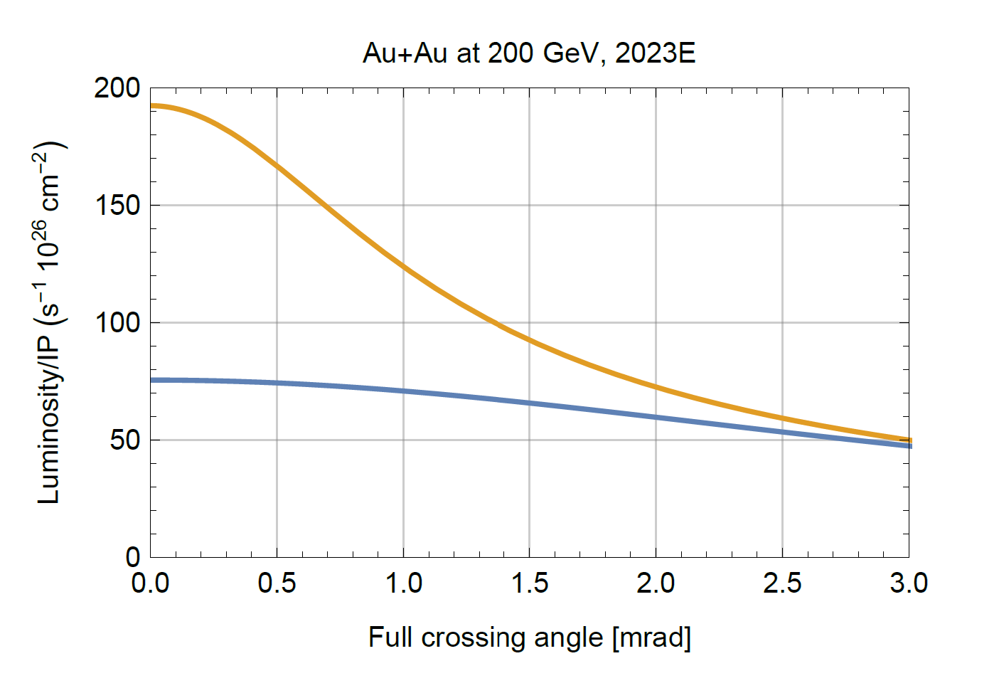
Example-RHIC luminosity Optimization
$$L=\frac{N_{1}N_{2}fH}{2π\sqrt{σ_{x1}^{2}+σ_{x2}^{2}}\sqrt{σ_{y2}^{2}+σ_{y2}^{2}}}$$
sPHENIX:
VTX (+/-10 cm)
Crossing angle (2mrad)
S/N - Background
Global Parameters:
Orbit (Dipole)
Tune (Quadrupole),
Chromaticity (Sextuple)
Octupole
Local (IR8) Parameters:
Beta*
S* (more sensitive than head on)
Transverse offset
Other Parameters:
RF Voltage
Collimator Position
ALL
VTX
Courtesy of W. Fischer

Slide 12
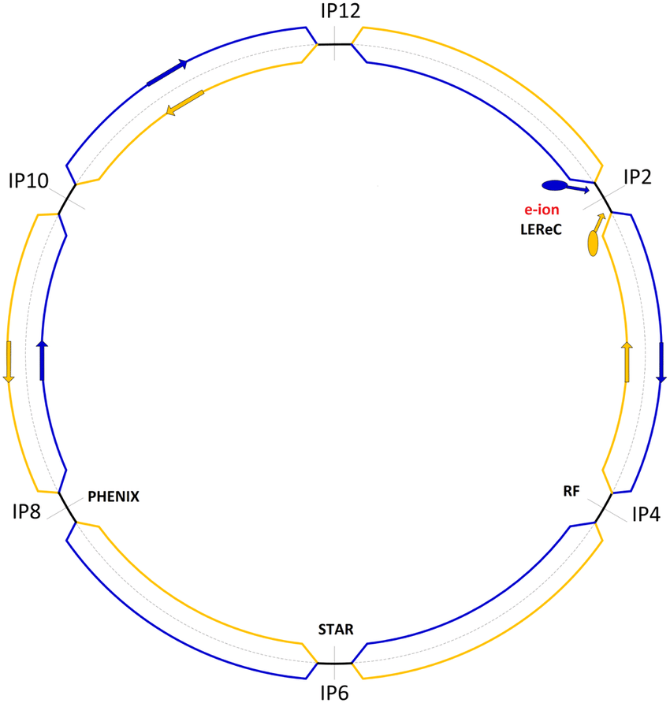
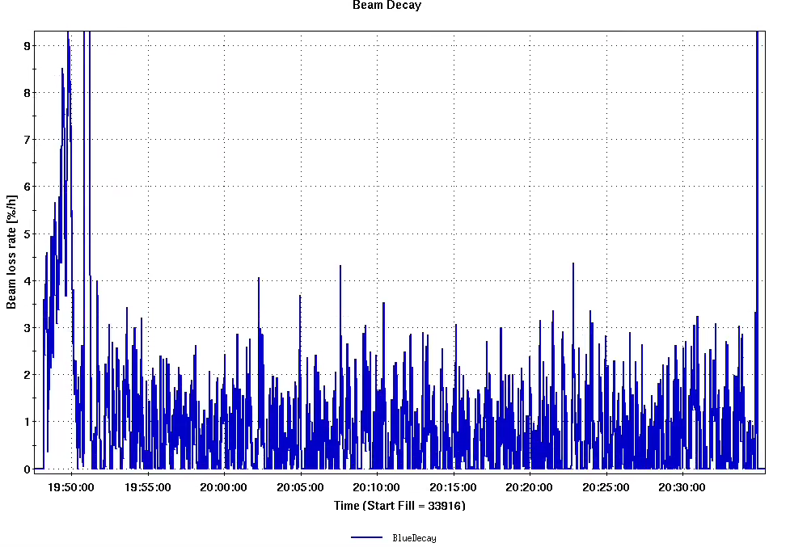
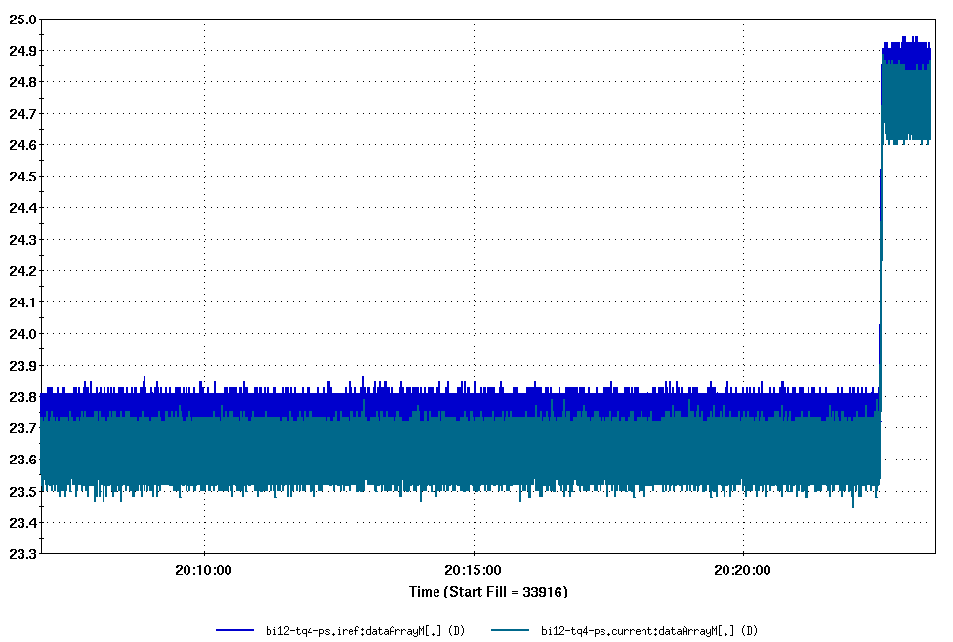
Online Luminosity Optimization APEX Test
Successfully test the s* script at store (IR12).
No additional significant beam loss during +/- 0.5 m s* change.
Will explore a large safety range next time at IR12 without separation bump.
MADX (Online) model vs Machine
Offline Data Analysis

Slide 13
Outline:
Machine Learning applications for EIC Machine
Introduction to EIC Machine
LEReC Cooling performance
RHIC luminosity
EBIS intensity
Opportunities in EIC Beam Dynamics
Introduction
Beam-Beam
Dynamic Aperture

Slide 14
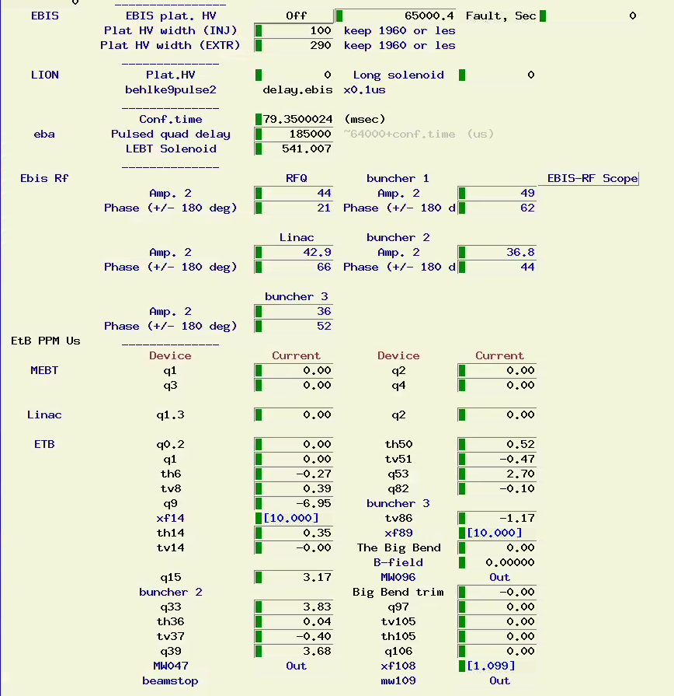
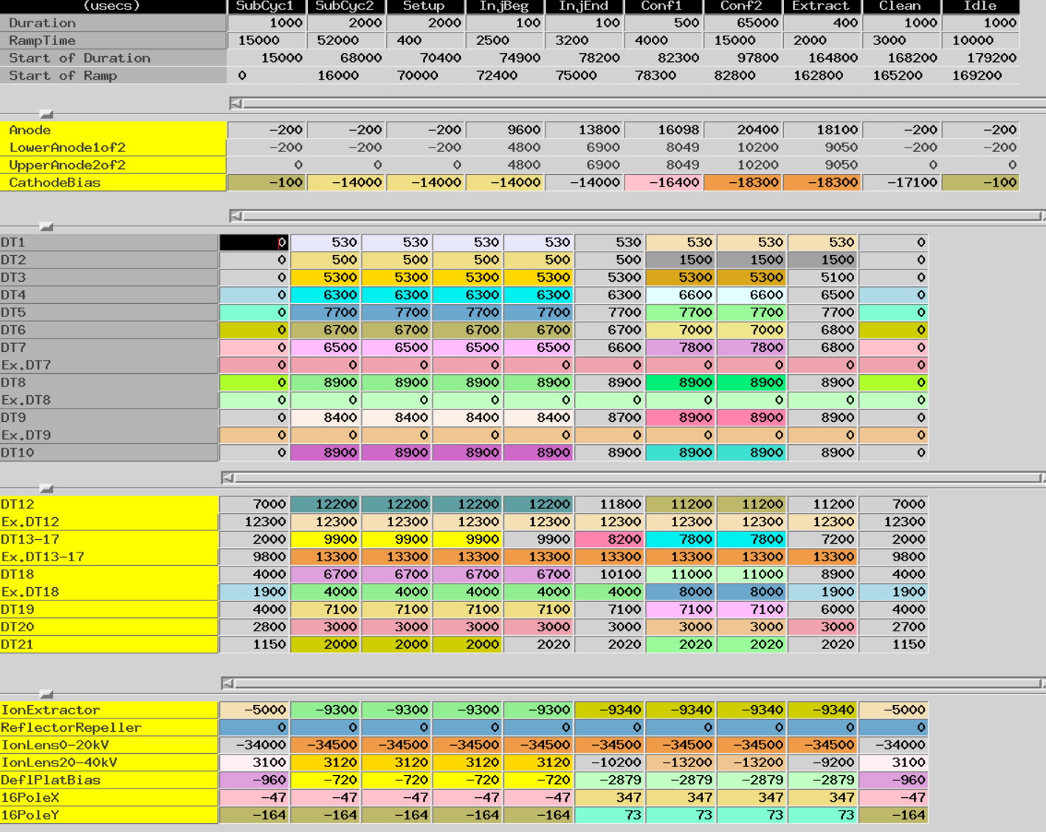
EBIS Intensity Optimization
LION
Injection Line
EBIS
Extraction line + LEBT
RFQ (10)
MEBT (4)
Linac (2)
HEBT (23)

Slide 15
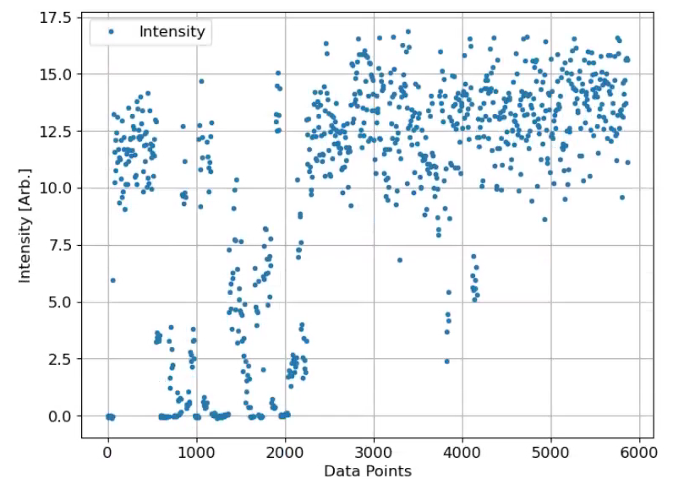
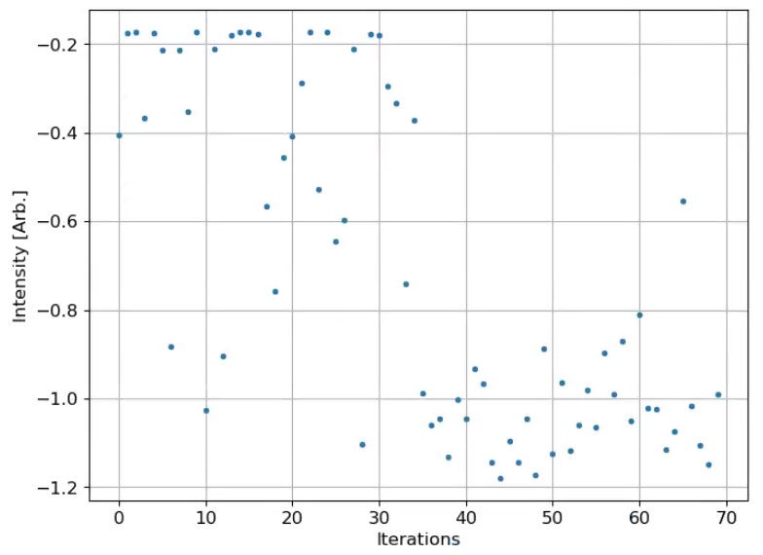
LBNL GPTune and EBIS Injection Line
~14.0
11.5
~22%
Injection optimization
script was running from 12:33 to 13:36 (~63 min)
1 cycle with 800 ms period was used for injection optimization (to be gentle when injecting beam is less during optimization
fc96 was used for injection optimization
70 iterations (44, signals are too noisy.)
9 parameters

Slide 16
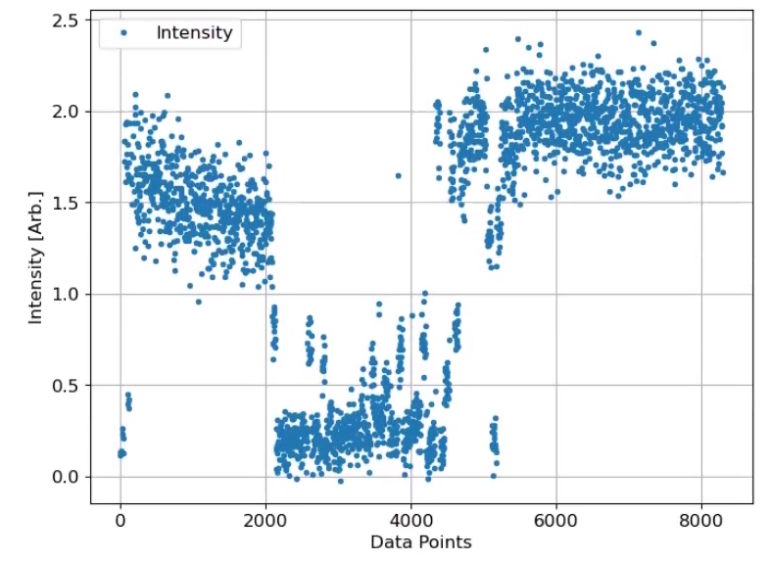
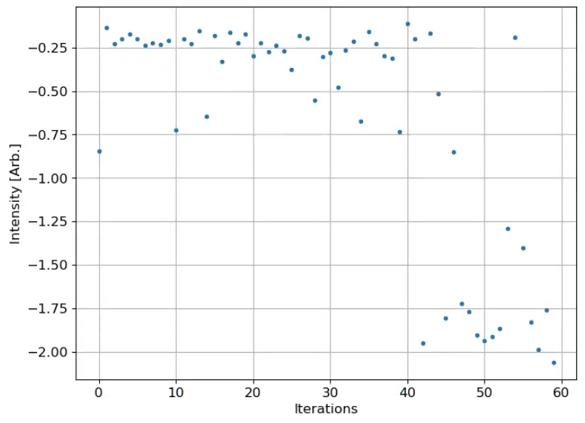
LBNL GPTune and EBIS Extraction Line
~2.0
1.4
~42.8%
Extraction optimization
script was running from 10:18 to 11:15 (~57 min)
2 cycles with 800 ms period was used for extraction.
xf14 was used for extraction optimization.
60 iterations (60, need more iterations?)
10 parameters

Slide 17
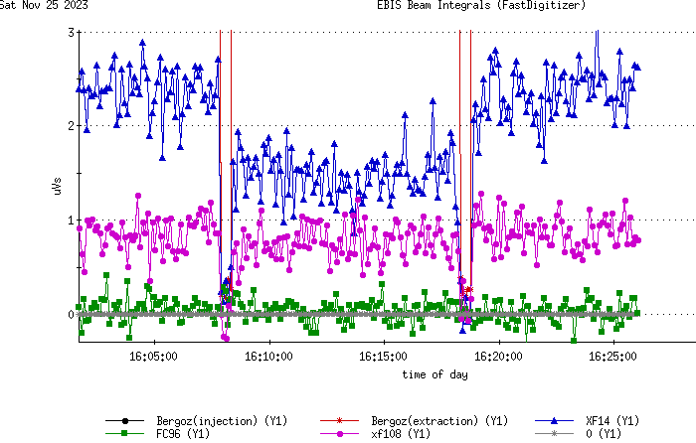
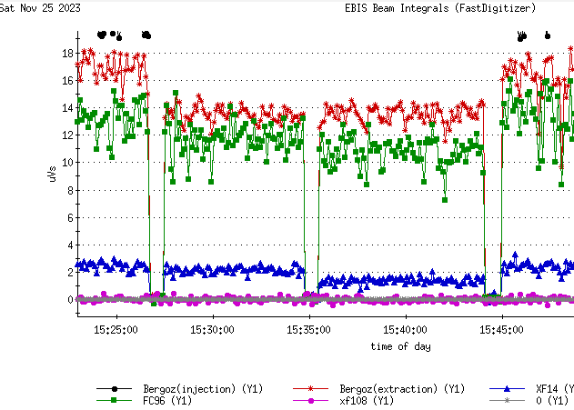
LBNL GPTune and EBIS Total Gain
2.4
GPTune works with
these noisy signals!
14
1.5
11
Intensity detector | Orignal | Ext. optimized with xf14 | Gain |  | + Inj. Optimized with FC96 | Gain from Inj. optimization |  | Total Gain
Bergoz (extraction) (uVs) | 13.7 | 13.7 | - |  | 16.3 | 19% |  | 19%
xf14 (uVs) | 1.5 | 2.2 | 47% (42%) |  | 2.4 | 9% |  | 60%
fc96 (uVs) | 11 | 12 | 9% |  | 14 | 17% (22%) |  | 27%

Slide 18
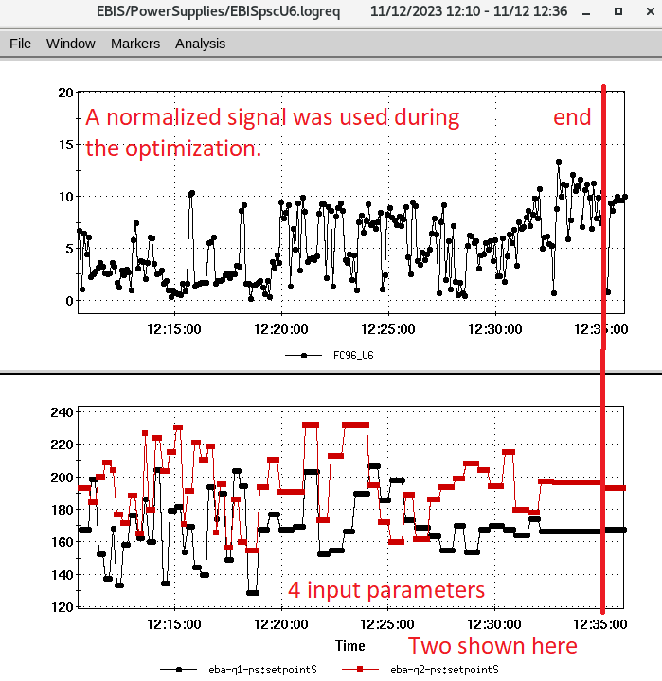
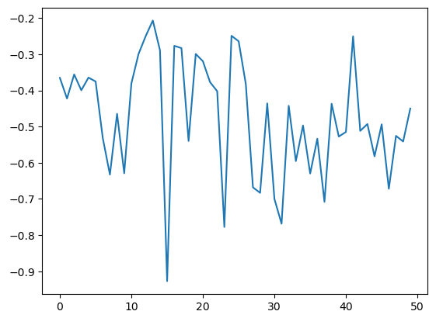
LBNL GPTune and EBIS MEBT Line
Iteration
The objective function is minimized and hence the total intensity is maximized.

Slide 19
Outline:
Machine Learning applications for EIC Machine
Introduction to EIC Machine
LEReC Cooling performance
RHIC luminosity
EBIS intensity
Opportunities in EIC Beam Dynamics
Introduction
Beam-Beam
Dynamic Aperture

Slide 20
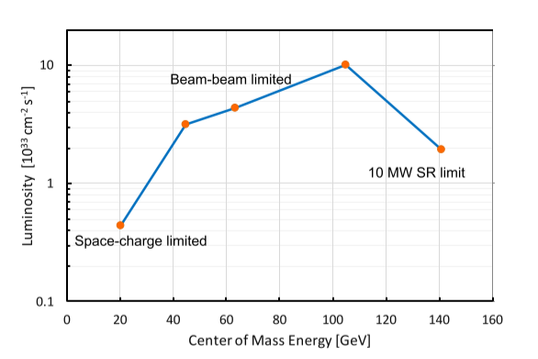
Beam Dynamics Challenges in EIC
EIC promises up to $1×{10}^{34}$ ${cm}^{−2}s^{−2}$ luminosity
Beam-Beam effect
Dynamic Aperture
Hadron cooling
Space charge
Beam instabilities
Spin preservation
…

Slide 21
ML Opportunities in EIC Beam Dynamics
Available data for now:
Physics simulation results
Experimental data from similar setup (e.g. RHIC)
What ML algorithm can help:
Replace lengthy simulation with surrogate models
Optimization in larger parameter space
Determine the ‘principal components’ in complex dynamical or control problems

Slide 22
Outline:
Machine Learning applications for EIC Machine
Introduction to EIC Machine
LEReC Cooling performance
RHIC luminosity
EBIS intensity
Opportunities in EIC Beam Dynamics
Introduction
Beam-Beam
Dynamic Aperture

Slide 23
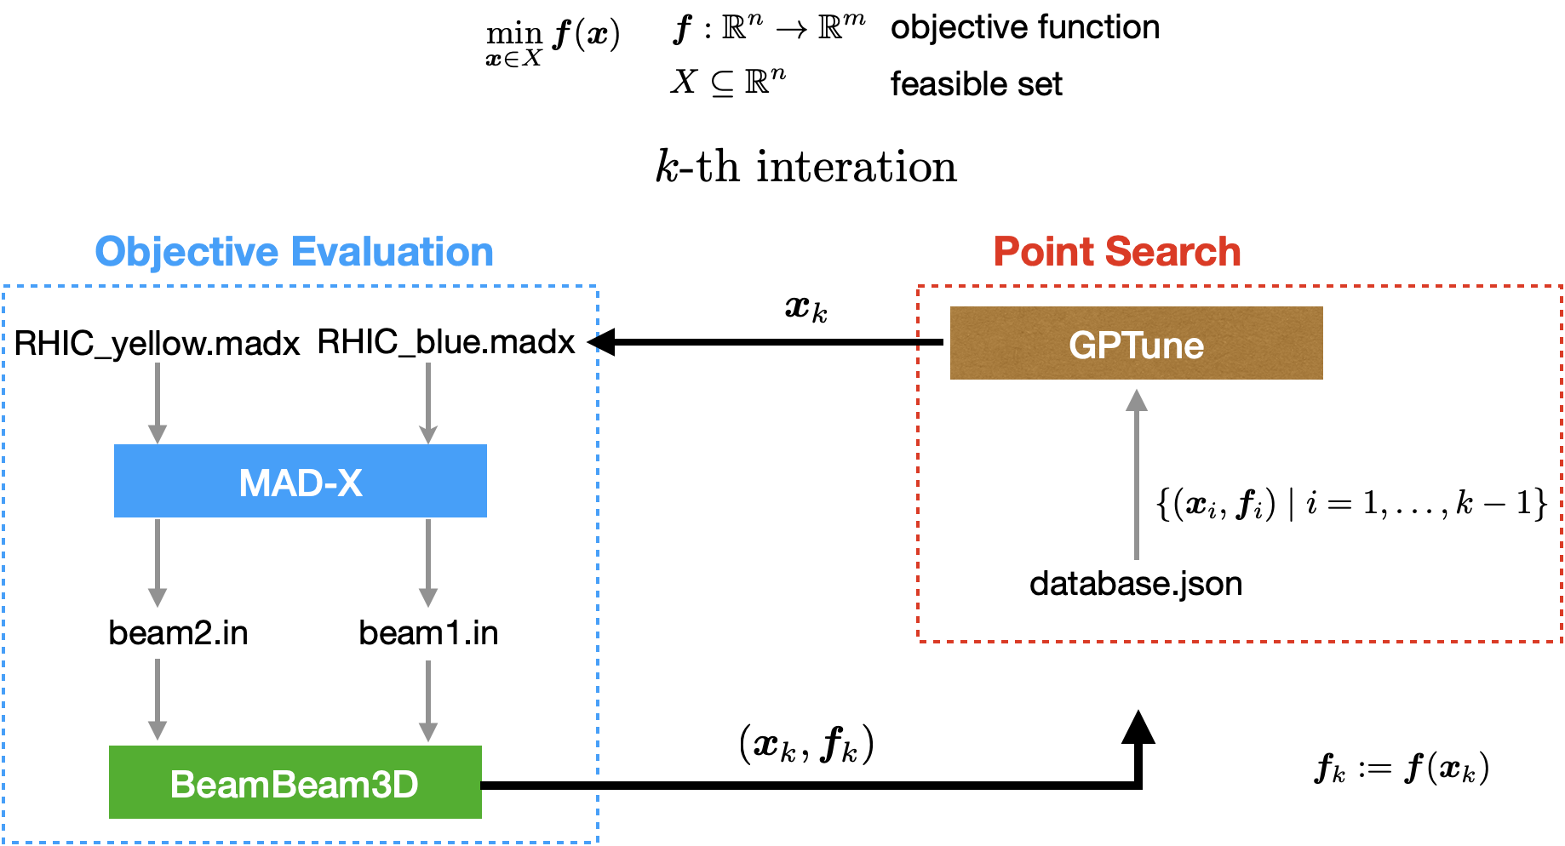
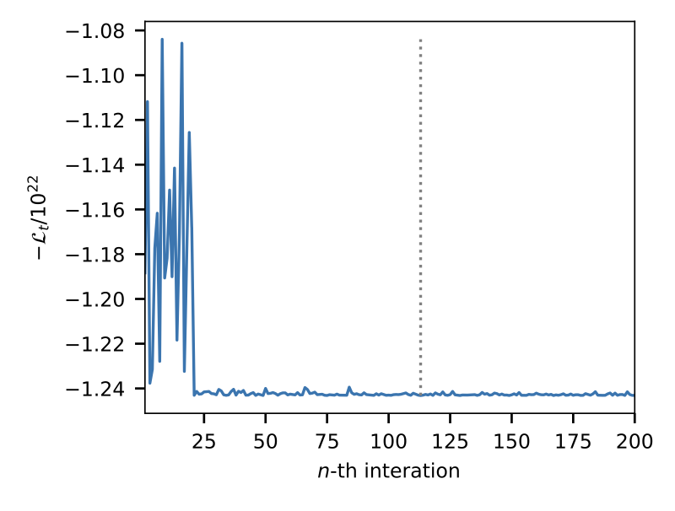
Bayesian optimization for RHIC Luminosity
The optimization of the lattice setting with respect to the luminosity is performed for the head-on collision of two Au-Au beams in the Relativistic Heavy Ion Collider (RHIC). The parameters of the lattice setting with only two variables $ΔS_{x}$ and $ΔS_{y}$.
The result of the optimization is shown in Figure 3. The value of the objective function converges when more optimization steps are executed. This implies the value of the objective function is minimized and hence the total luminosity $L_{t}$is maximized.

Slide 24
Outline:
Machine Learning applications for EIC Machine
Introduction to EIC Machine
LEReC Cooling performance
RHIC luminosity
EBIS intensity
Opportunities in EIC Beam Dynamics
Introduction
Beam-Beam
Dynamic Aperture

Slide 25
ML in EIC Dynamic Aperture
Both rings need careful optimization of DA
Bare lattice, from the design nonlinearities + Beam-Beam interaction
Impact of errors, IR magnets, HOMs of crab cavities ~ 50 free parameters
Build a surrogate model to predict DA.
Train the AI model using results from DA indicators, then refine with tracking results → GP + BO
Deal with 50+ parameter → high dimensionality
Replace with Sparse GP and reduce the KL divergence
To have satisfactory results, large number of sample needed, O(N^3) complexity in inverting the kernel matrix
Off-diagonal low-rank approximation
With advanced tool GPTune¹ (https://github.com/gptune/GPTune).
See: Using Machine Learning to Improve Dynamic Aperture Estimates Frederik Van der Veken

Slide 26
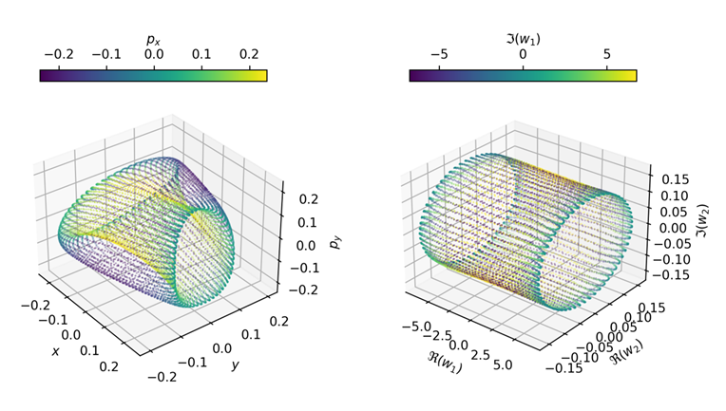
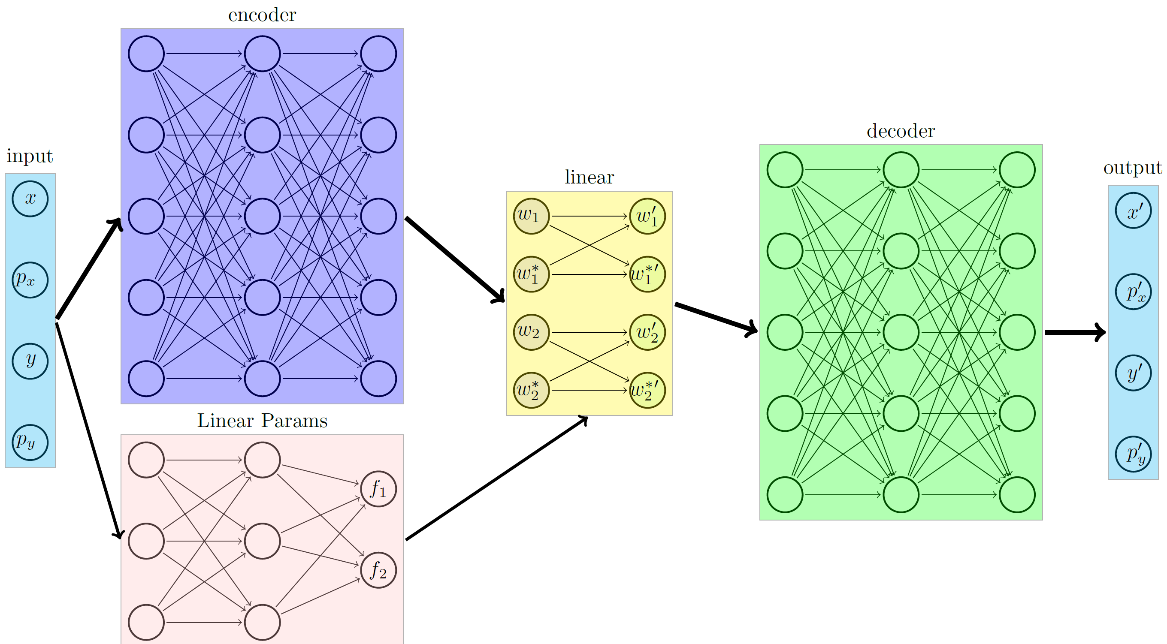
ML based DA indicator (Preliminary)
Many DA indicators exist with well-known advantages and limitations:
Normal Form approach
Frequency Map Analysis
The underline physics knowledge helps build a ML model.
The goal is to find a ML based transformation for particle within the DA a rigid rotation.
A Koopman Operator Approach
Similar to the normal form approach, we may use special Neural network (SympNets [1])
maintains the symplecticity of the transformation.
Symplectic condition determines the decoder automatically.
[1]P. Jin, Z. Zhang, A. Zhu, Y. Tang, & G. Em Karniadakis. (2020). SympNets: Intrinsic structure-preserving symplectic networks for identifying Hamiltonian systems.
The Koopman operator is represented by the encoder that transform a nonlinear map to a linear map, with its frequency retrieved by another NN predictor.

Slide 27
Summary
We plan to use some ML algorithms to:
Optimize the EIC machine (individually) performance;
Aid understanding of EIC beam dynamics, to enhance the design of EIC and prepare for the smooth commissioning/ operation.
Some preliminary works have been done or are ongoing now:
EBIS
AGS
RHIC Luminosity
LEReC
Software/packages are used or will be used:
Gaussian Process
XGBoost
GPTune
MG-GPO
…

