Slide 1
Anomaly Detection for an X-ray Free-Electon Laser
Nov 29, 2023
D. Ratner
SLAC National Accelerator Laboratory

Slide 2
Outline
Introduction and motivation for X-ray Free-Electron Lasers
RF station faults / Coincident anomaly detection
Cathode quantum efficiency degradation / Ghost imaging
Teaser on collider application (beam shape reconstruction)

Slide 3
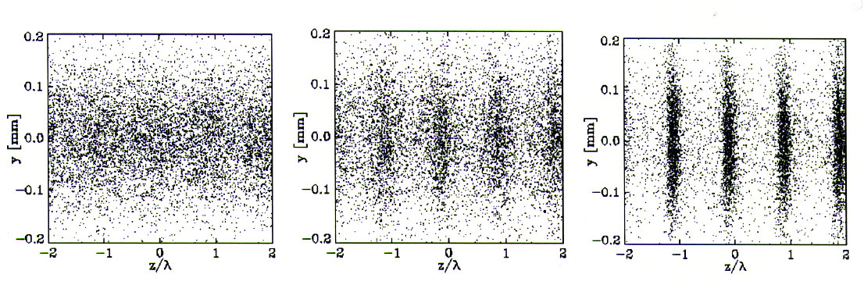
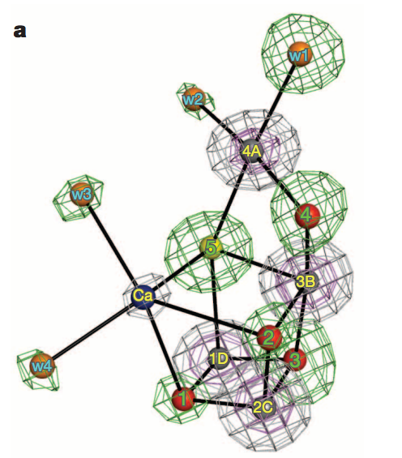
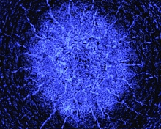
Introduction to XFELs
Linac Coherent Light Source (LCLS)
X-ray free-electron lasers: Accelerator driven x-ray sources to study ultrafast, ultrasmall scale phenomena
Single particle imaging (Mimivirus)
Ekeberg et al.,
Shock waves in extreme conditions
Photosystem II
Suga et al.
Si
Milathianaki et al.

Slide 4
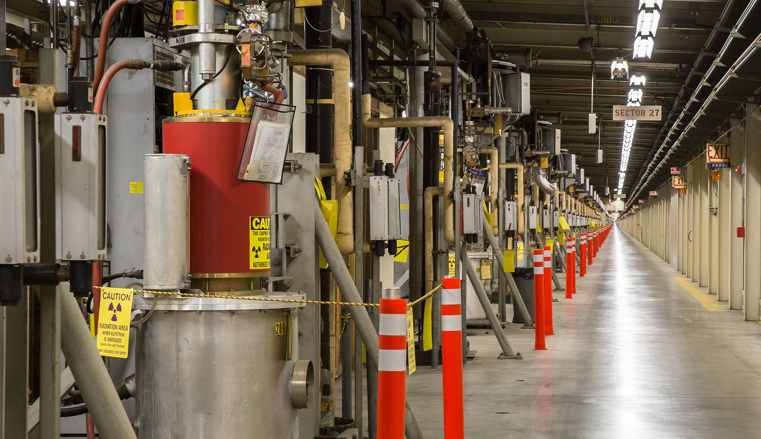
Motivation
Failure prediction at accelerators:
Failures cause downtime, degrade performance
1000s of subsystems → frequent failures
200k variables to monitor at LCLS → impossible to do manually
Big data, but nearly none of it labeled
SLAC Linear Accelerator and 280 Overpass
SLAC RF Stations

Slide 5
Case Study 1: RF Station Faults
Case study: RF station faults
RF stations provide power for acceleration
Most common fault at LCLS (1000s/year)
Degrades performance even if no downtime
Years of data, only dozens labeled
SLAC Linear Accelerator and 280 Overpass
SLAC RF Stations

Slide 6
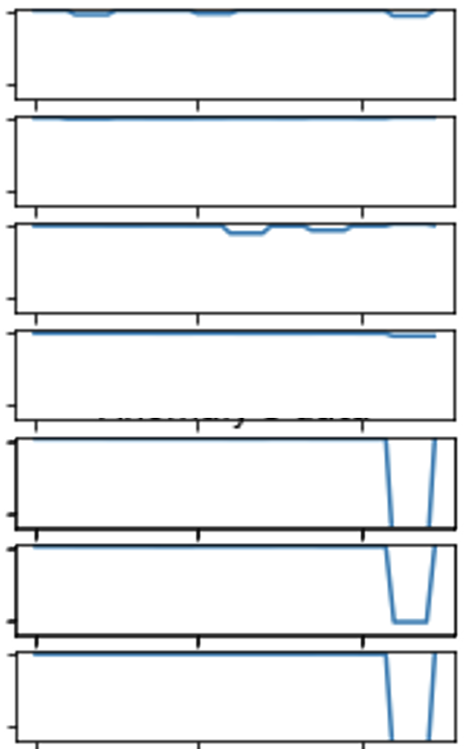
Case Study 1: RF Station Faults
Existing solution #1: Thresholding on subsystem amplitudes
Readbacks of station power condensed to “status bit” for each of 80 stations
Status bit ‘0’ if healthy, and flips to ‘1’ if RF amplitude changes more than 2%
RF station amplitude for 1 station
RF station diagram
Status bit has multiple problems:
Too simplistic (only looks for sudden drops)
Too permissive (misses subtle faults)
Too noisy (lots of false positives)
7 example measurements
70% of alarms are false
(i.e. poor precision)
0
Time (min)
5
Recall = TP/(TP+FN) Precision = TP/(TP+FP)
TP = true positive, FP = false positive, FN = false negative

Slide 7
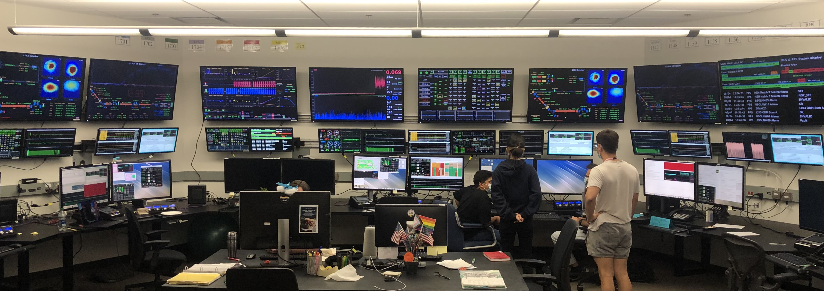
Case Study 1: RF Station Faults
Existing solution #2: Manual, beam-based anomaly detection
After observing a drop, search for RF stations with warning/fail status
Operators watch for a drop in X-ray power here
Many missed events
(recall ~ 1%)

Slide 8
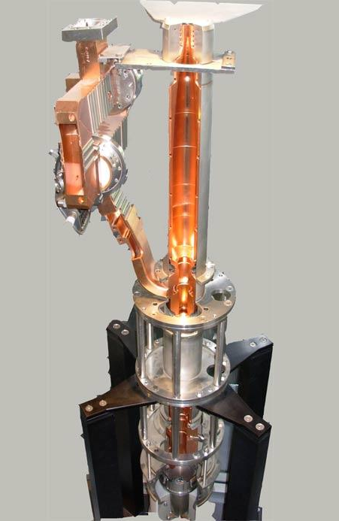
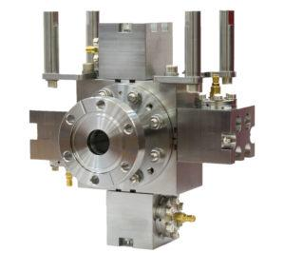
Case Study 1: RF Station Faults
New approach: Beam-based algorithm inspired by operators
Highway 280
RF stations
Beam position monitors
Question: How do we train these algorithms with no labels?
Algorithm #1 looks for subsystem anomalies
Algorithm #2 looks at final beam quality
Key insight: A ‘good’ pair of algorithms will be self-consistent
Simultaneous anomalies trigger alarm

Slide 9
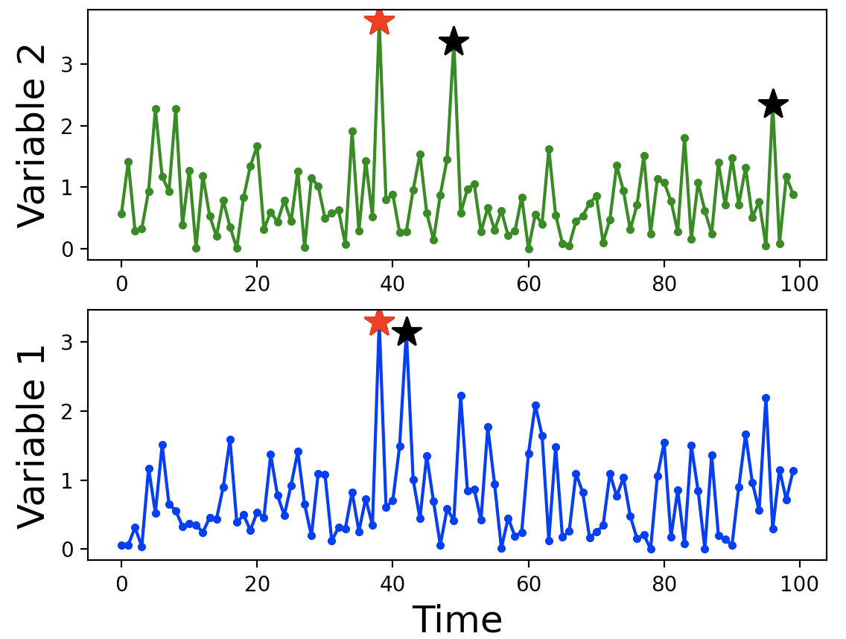
Coincident Anomaly Detection (CoAD)
Consider two algorithms making predictions on two streams of data
Subsystem
Algorithm 1
Prediction
Self-Consistency
metric
Unknown
machine state
Beam quality
Algorithm 2
Prediction
Subsystem (s)
Red stars = consistent
black stars = inconsistent
More red = higher recall;
less black = higher precision
Anomaly
confidence
Quality (q)
FP rate = product of black star rates
Anomaly
confidence
TP rate = red star rate – FP rate
➔ Unsupervised precision/recall

Slide 10
Coincident Anomaly Detection (CoAD)
Consider two algorithms making predictions on two streams of data
We estimate unlabeled version of recall/precision from coincidence
Estimates can be differentiable ➔ can train neural networks!
i.e. a loss function, not just a metric
Formally the loss function is defined for NN outputs :
: red star rate
: estimated FP rate
: Estimated anomaly rate
: Weighting factor (recall vs. precision)

Slide 11
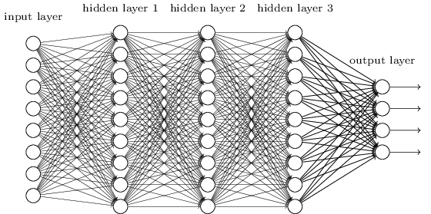
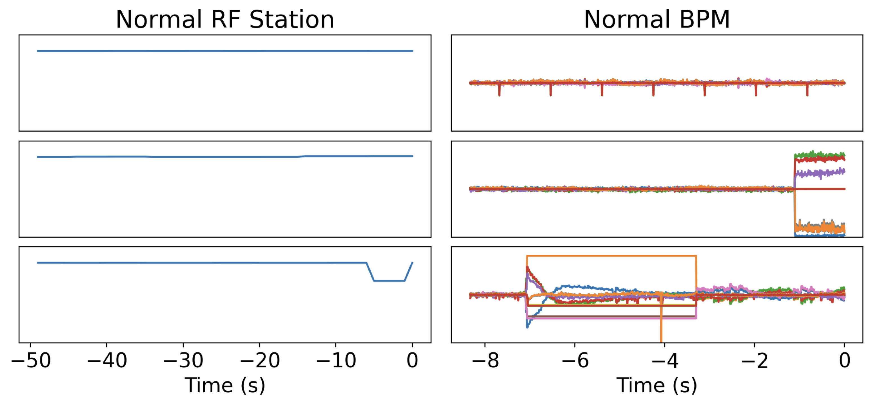
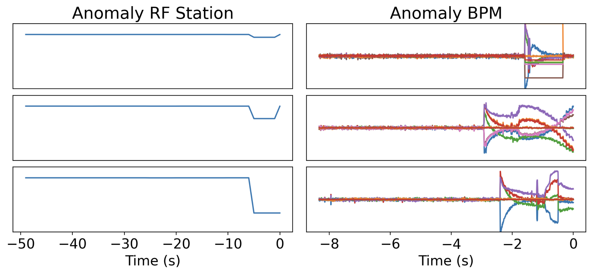
CoAD for RF Station Faults
Implementation for RF station task:
Network 1
Unsupervised loss function
RF Station data
Anomaly confidence
Estimated precision/recall
Network 2
Beam Data
Anomaly confidence

Slide 12
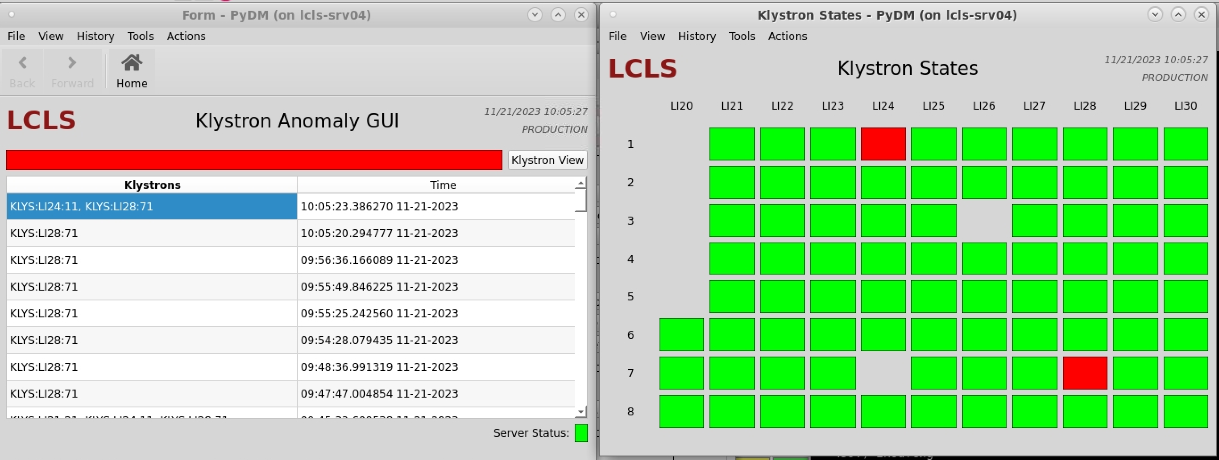
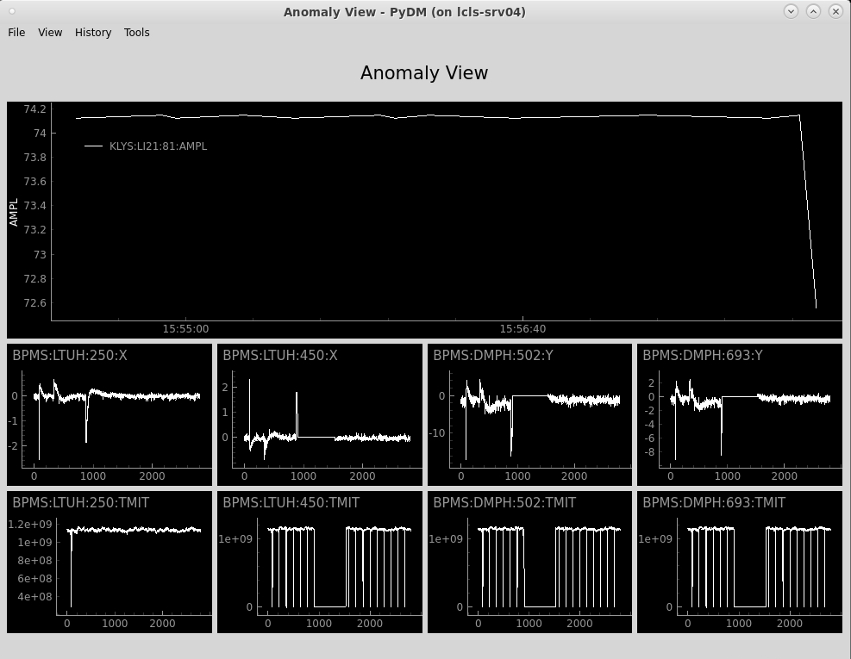
Case Study 1: Performance in the control room
Summary of predictions on 4 months of data
 | Precision | Recall (events)
Manual recording by operator | NA | 6
Status bit | 0.31 | 385
Coincident Detection | 0.88 | 504
100x more anomalies vs. manual recording
30% more anomalies vs. status bit
6x fewer false positives vs. status bit
Live deployment in LCLS control room!
RF
Amplitude
BPMs
Ryan Humble, Finn O’Shea, Zhe Zhang

Slide 13
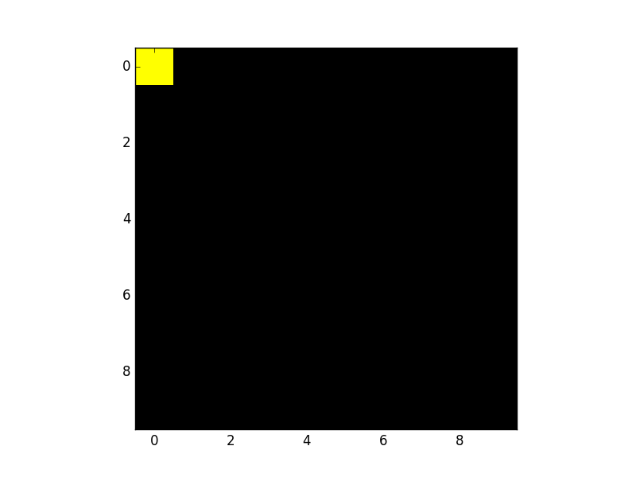
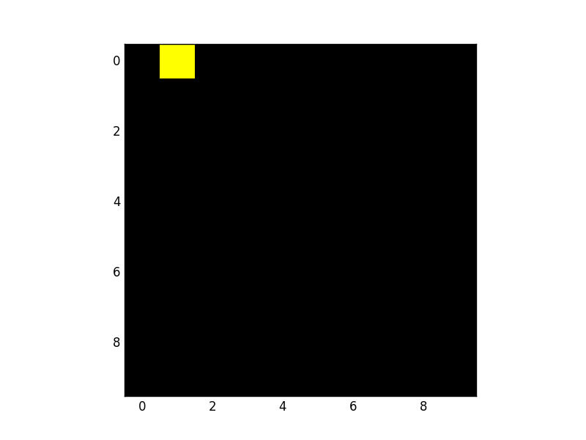
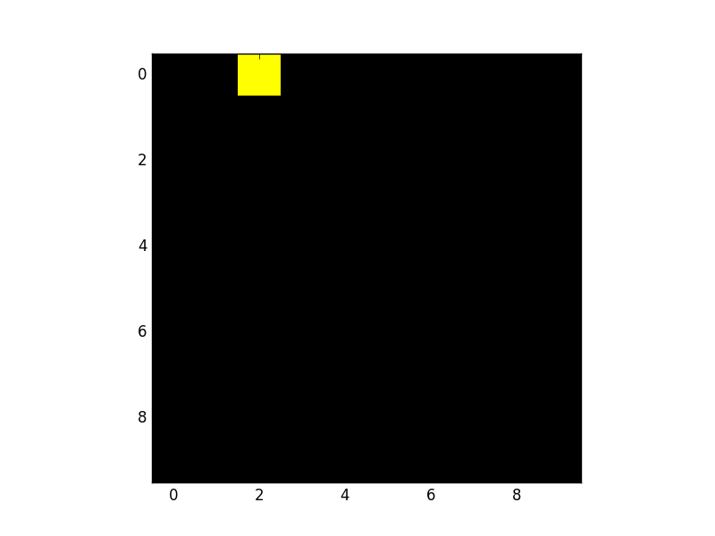
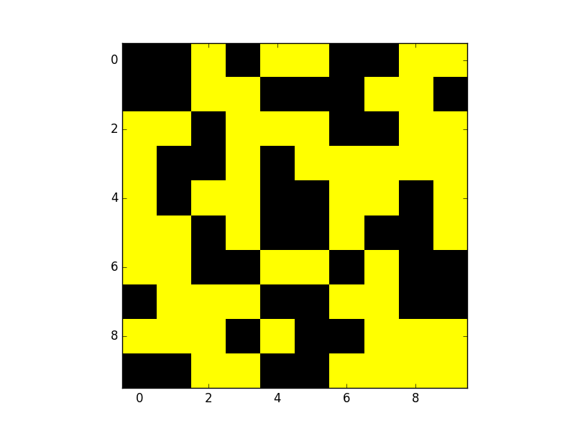
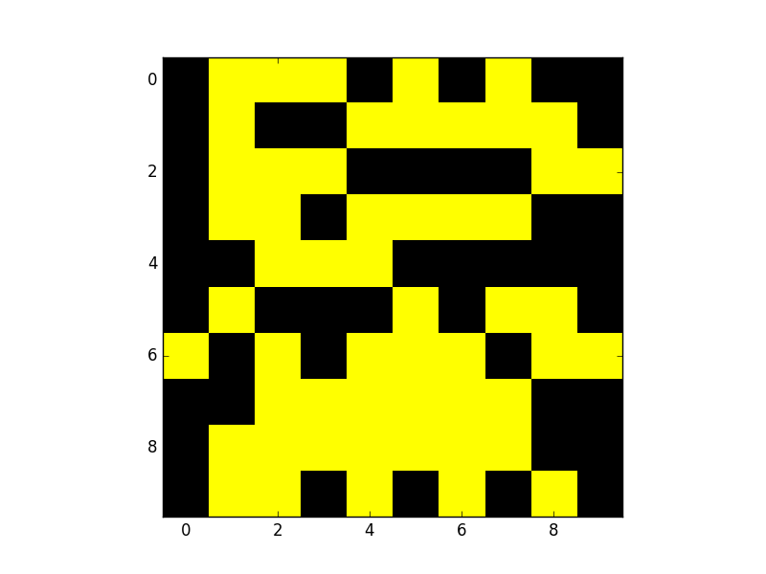
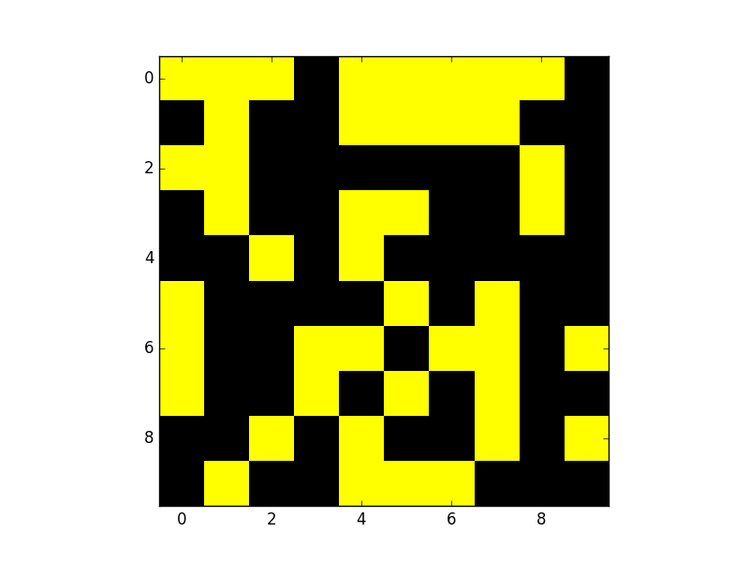
Case Study 2: Ghost imaging
What is ghost imaging?
Raster scan
Ghost imaging
Exploit natural (passive) variation in beam!
b
=
a
x
Reconstructed Target, x*
Radiation, a
b = [ 5037,
4783,
4891, … ]
Bucket measures total transmission
Target, x

Slide 14
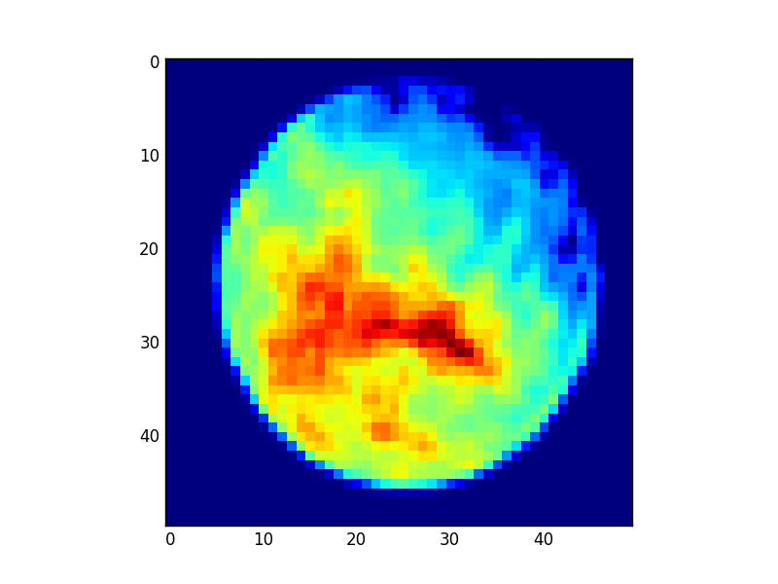
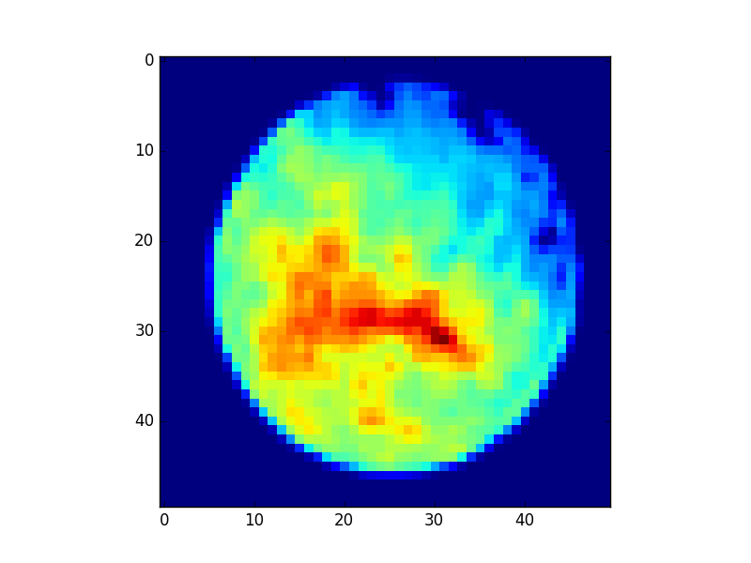
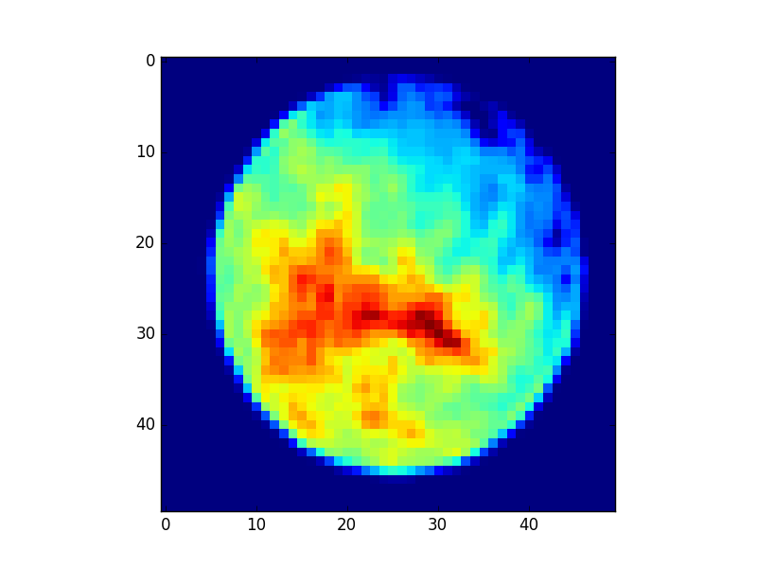
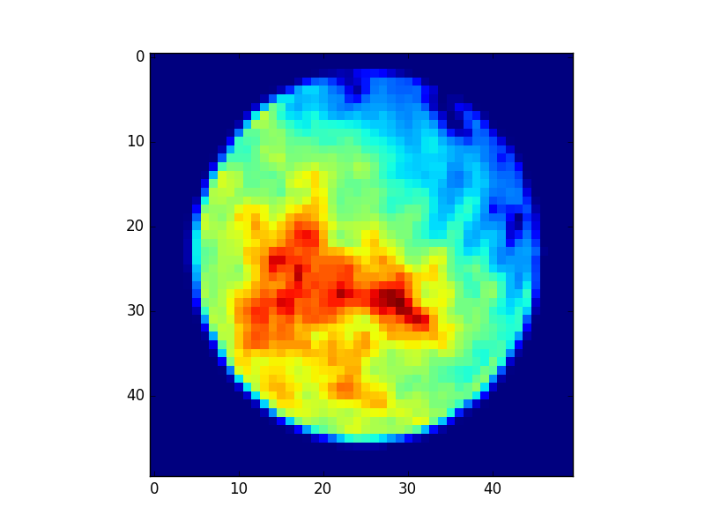
Case Study 2: GI for Quantum Efficiency Map
photocathode quantum efficiency
Laser photon hits cathode to produce electron beam
Quantum efficiency (QE): probability of a photon producing an electron
QE map directly impacts electron beam emittance (“quality”)
Current mapping are both low resolution and invasive
4 years later finally in progress… camera controls are not synchronous!
target
Cathode QE reconstruction at LCLS
Cathode laser
Electron charge
Day 1
Day 3
Cathode
K. Kabra, et al., Phys. Rev. Accel. Beams 23, 022803 (2020)

Slide 15
Ghost imaging: Collider example
Can GI resolve transverse beam shapes at an interaction point from offset and luminosity jitter?
LHC Motivation:
Improve focusing at the IP
Provide experiments with probability distributions for every crossing
Possibly of interest to EIC?
Infer beam shape from luminosity and beam offset jitter
I₁
I₂
=
δ
L
As function of offset, δ
D. Ratner, A. Chao, K. Li, IPAC2021, WEXA05

Slide 16
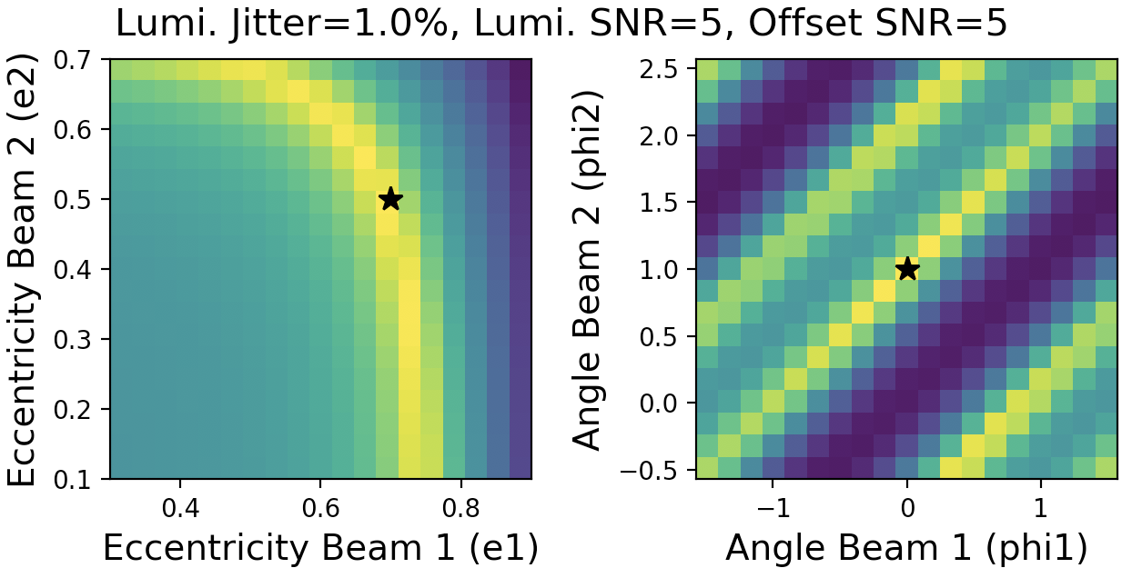
Ghost imaging: Collider example
Can GI resolve transverse beam shapes at an interaction point from offset and luminosity jitter?
LHC Motivation:
Improve focusing at the IP
Provide experiments with probability distributions for every crossing
Possibly of interest to EIC?
Simulation example works…
…but synchronous BPM/Lumi data not available at LHC
➔ Synchronous acquisition critical
D. Ratner, A. Chao, K. Li, IPAC2021, WEXA05

Slide 17
Conclusion
Summary:
Turning the corner on deployment of AI methods (anomaly detection, tuning, etc.)
Several examples of AI methods outperforming classical methods (SLAC and elsewhere)
But…
Implementing AI methods for online controls puts new stresses on control systems ➔ the earlier you establish AI-ready systems the better
Synchronous acquisition, high data rates, easy access to GPUs for deployment
Thanks for listening!
And thanks to everyone who worked on these projects!
Alex Chao, William Colocho, Eric Darve, Matt Gibbs, Ryan Humble, Michael Kagan, Kevin Li, Jason Liang, Finn O’Shea, Jake Rudolph, Eloise Yang, Zhe Zhang

Slide 18
Backup
Notes:
Histogram of the events based on the change in RF amplitude. Orange were labeled anomalous by our algorithm. A simple threshold at ~5 would have significant differences (about 20%) from our NN prediction. Based on visual inspection and correlation efficiency, we believe the NN is mostly correct (~10% errors).

Slide 19
Coincident Anomaly Detection (CoAD)
Consider two algorithms making predictions on two streams of data
Key insight #1: We estimate unlabeled version of recall/precision from coincidence
Key insight #2: Estimates can be differentiable ➔ can train neural networks!
i.e. a loss function, not just a metric
Formally the loss function is defined for NN outputs :
: red star rate
: estimated FP rate
: Estimated anomaly rate
: Weighting factor (recall vs. precision)

Slide 20
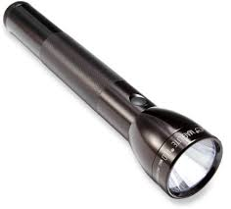
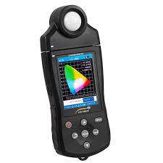
Ghost Imaging Concept
Ghost imaging / Single pixel camera / Compressive Sensing
Riddle: How can I take a picture with a spectrometer?
Answer: Have a friend with a flashlight

Slide 21
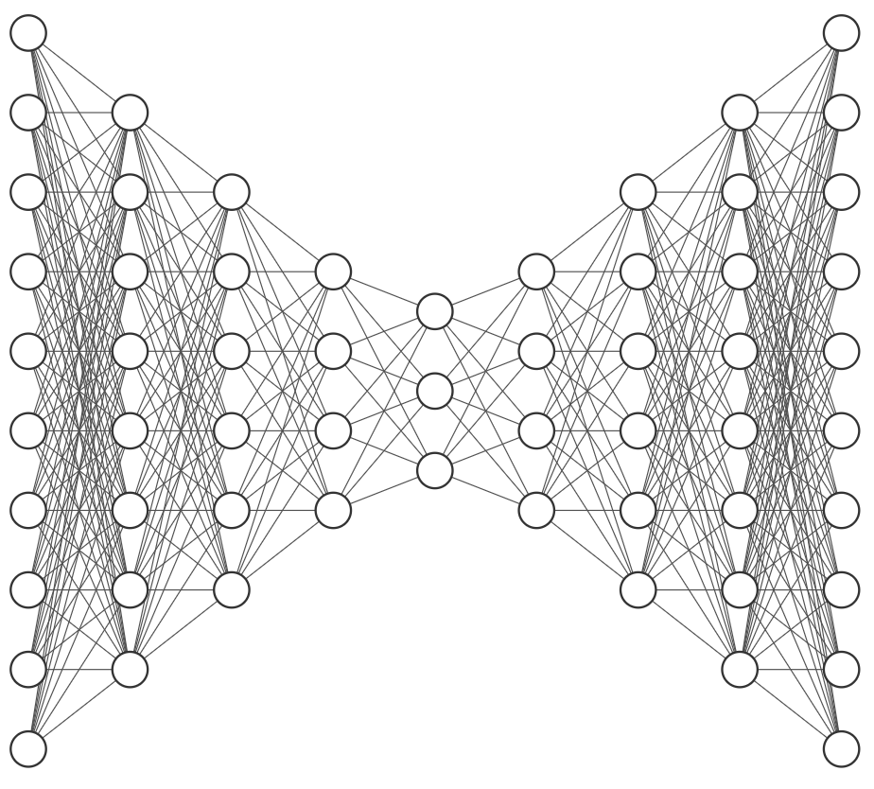
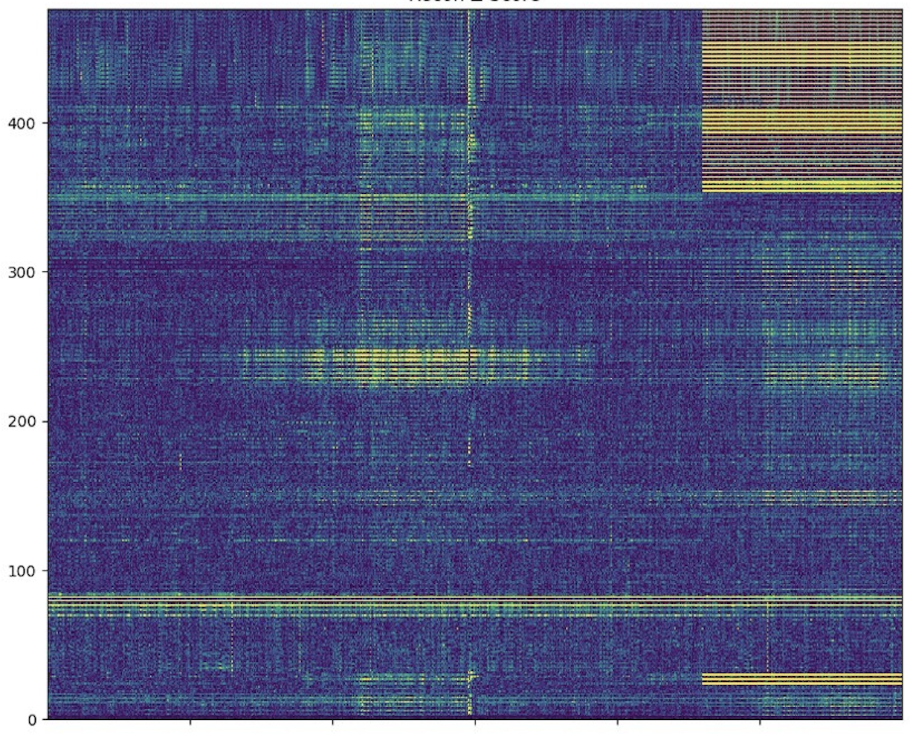
Case Study 2: Resilient VAE for general fault detection
Auto-encoder for unsupervised anomaly detection
Input
Output
Latent space
Accelerator diagnostics
Accelerator diagnostics
Reconstruction error
|Output – Input|
Diagnostics
Time (~1 minute)
Ryan Humble

Slide 22
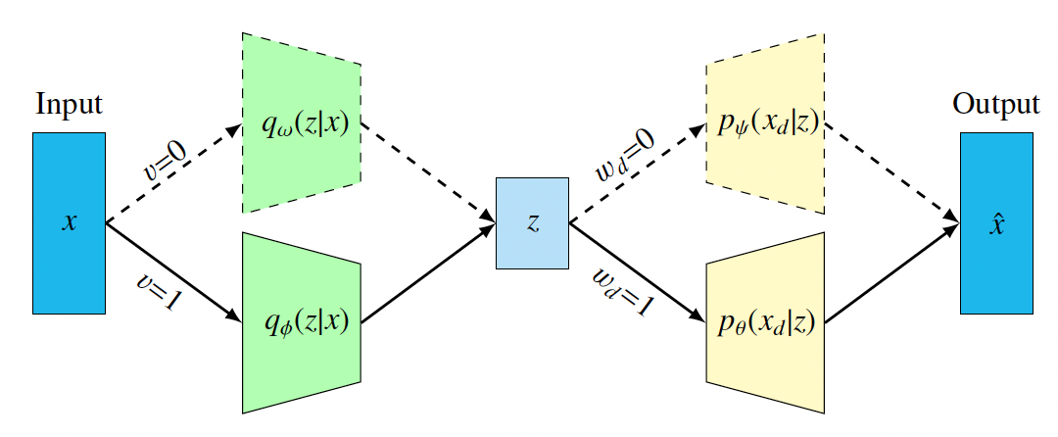
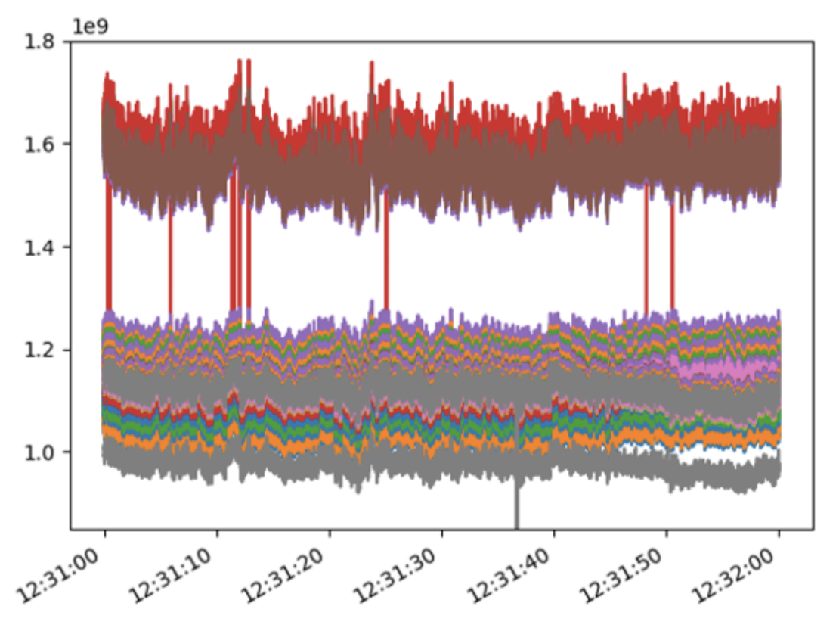
Case Study 2: Resilient VAE for general fault detection
Auto-encoder for unsupervised anomaly detection
“Resilient VAE” avoids need for a normal training set
Work in progress…
Beam scraping
Reconstruction error
|Output – Input|
BPM Charge
Diagnostics
Time (~1 minute)
Klystron fault
Ryan Humble

