Slide 1
Machine Learning for Columnar High Energy Physics Analysis
Elliott Kauffman - Princeton University
Alexander Held - University of Wisconsin-Madison
Oksana Shadura - University of Nebraska-Lincoln
This work was supported by the U.S. National Science Foundation (NSF) Cooperative Agreement OAC-1836650 (IRIS-HEP)

Slide 2
Outline
1. Analysis Grand Challenge Overview
2. Strategy for Integrating Machine Learning
3. Training Pipeline
4. Inference Pipeline

Slide 3
Analysis Grand Challenge
Demonstrate realistic analysis workflow in anticipation of HL-LHC requirements
Task: ttbar cross-section measurement using 2015 CMS Open Data
Interactive and accessible user interface
Open Data - everyone can participate!
Include all aspects of typical LHC analysis
Data access
Event selection
Histogramming
Statistical model building / fitting
Analysis preservation

Slide 4
Machine Learning in HEP Analysis
What is needed for HL-LHC?
Improvement in algorithm performance
Better utilization of computational resources
Machine learning (especially deep learning) can help with this!
Add ML task to AGC pipeline to reflect developments in HEP analysis

Slide 5
Analysis Grand Challenge + ML

Slide 6
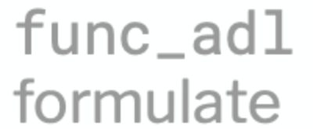
Analysis Grand Challenge + ML

Slide 7
Machine Learning Task
b_{top-lep}
l⁺
ν_{l}
b
W⁺
t
Assign jets to their parent partons
Allows us to approximate observables such as
Mass of top quark (combined mass of b_{top-had} and two W jets)
Angle between top_{lepton} jet and lepton (Δɸ)
t
W⁻
b
q
q
b_{top-had}
W
W

Slide 8
Approach to ML Task
1. Consider leading N jets in each event
2. Find all possible permutations of parton assignments of these N jets (two W, one b_{top-had}, one b_{top-lep})
3. Calculate features for each set of permutations and feed into BDT
4. Select permutation with highest BDT score
5. Use selection to label jets
6. Calculate ML observables
JETS
PERMUTATIONS
BDT
ML OBSERVABLES
BDT SCORES
LABELED JETS
?
?
W
top
_{lepton}
?
?
?
✖
✖
✖
?
?
?
✖
✖
✓
?
?
?
?
?
✖
✖
✖
top
_{hadron}
W
?
?
?
✖
✖
✖

Slide 9
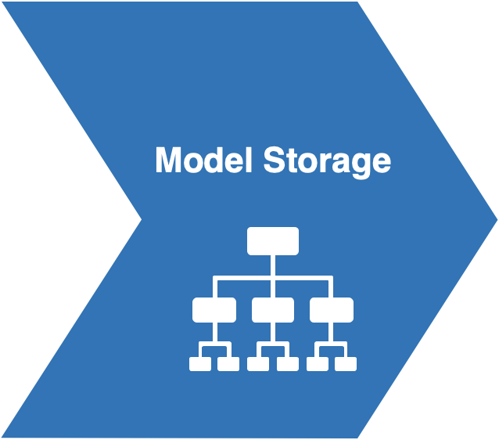
Training

Slide 10
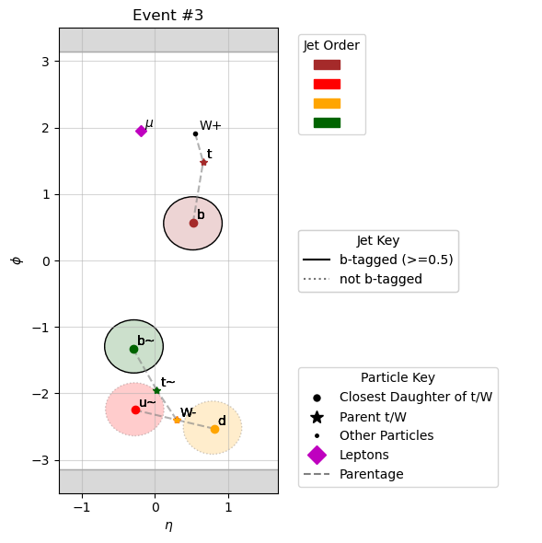
Training: Event Selection
Example Event
Only look at ttbar MC events
Match jets to particles using ∆R matching
Find parent particle (either W or top quark)
Keep events which are 100% reconstructable
nearest_genpart = jets.nearest(genparts, threshold=0.4)
nearest_parent = nearest_genpart.distinctParent # parent of matched particle
parent_pdgid = nearest_parent.pdgId # pdgId of parent particle

Slide 11
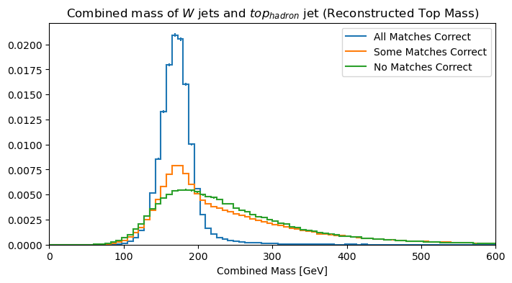
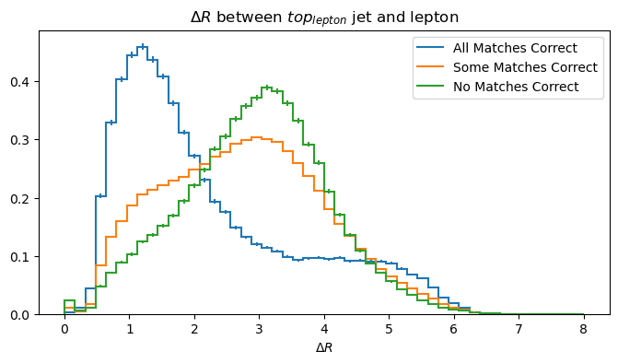
Training: Obtaining Training Features
Python HEP libraries utilized:
uproot
coffea
awkward
coffea processor with coffea.nanoevents.NanoAODSchema
EXAMPLE FEATURES
use awkward to calculate features
coffea.processor.column_accumulator objects

Slide 12
Training: Hyperparameter Optimization
Set up mlflow on dask workers
client = utils.get_client()
client.run(initialize_mlflow)
futures = client.map(fit_model,
samples_even,
features=features_even,
labels=labels_even,
evaluation_matrix=evaluation_matrix,
n_folds=N_FOLD,
mlflowclient=mlflowclient,
use_mlflow=USE_MLFLOW,
log_models=MODEL_LOGGING)
res = client.gather(futures)
Map jobs to workers (each job trains models for each hyperparameter selection)
Number of times to split dataset for cross-validation
Track input hyperparameters
mlflowclient.log_param(run_id, param, np.average(value))
Track training scores
mlflowclient.log_metric(run_id, metric, np.average(value))
For each trial
Log resulting model
with mlflow.start_run(run_id=run_id, nested=True) as run:
mlflow.xgboost.log_model(result["model"], "model", signature=signature)

Slide 13
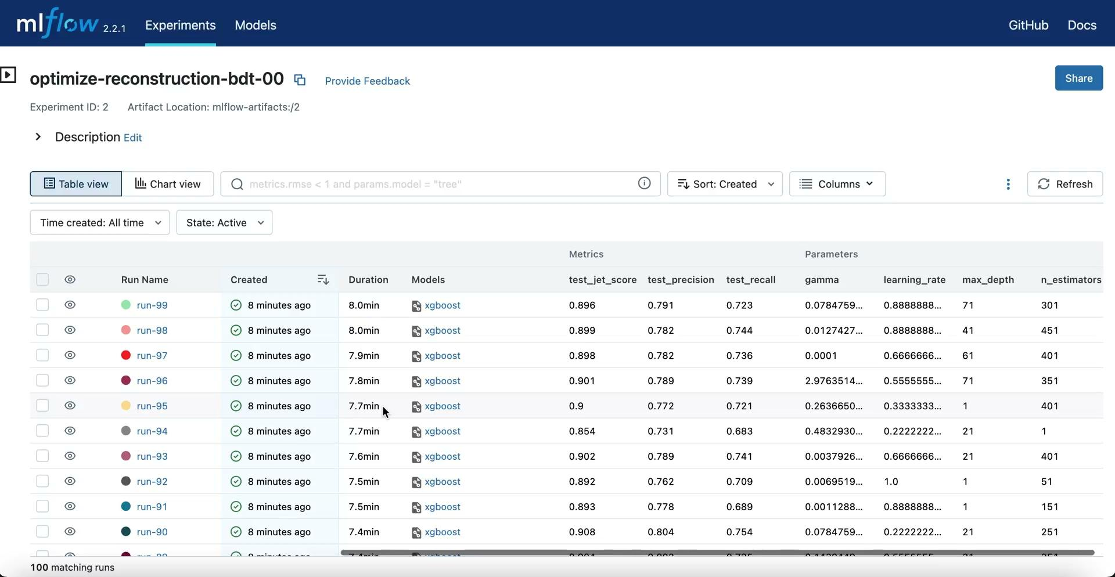
Training: Hyperparameter Optimization

Slide 14
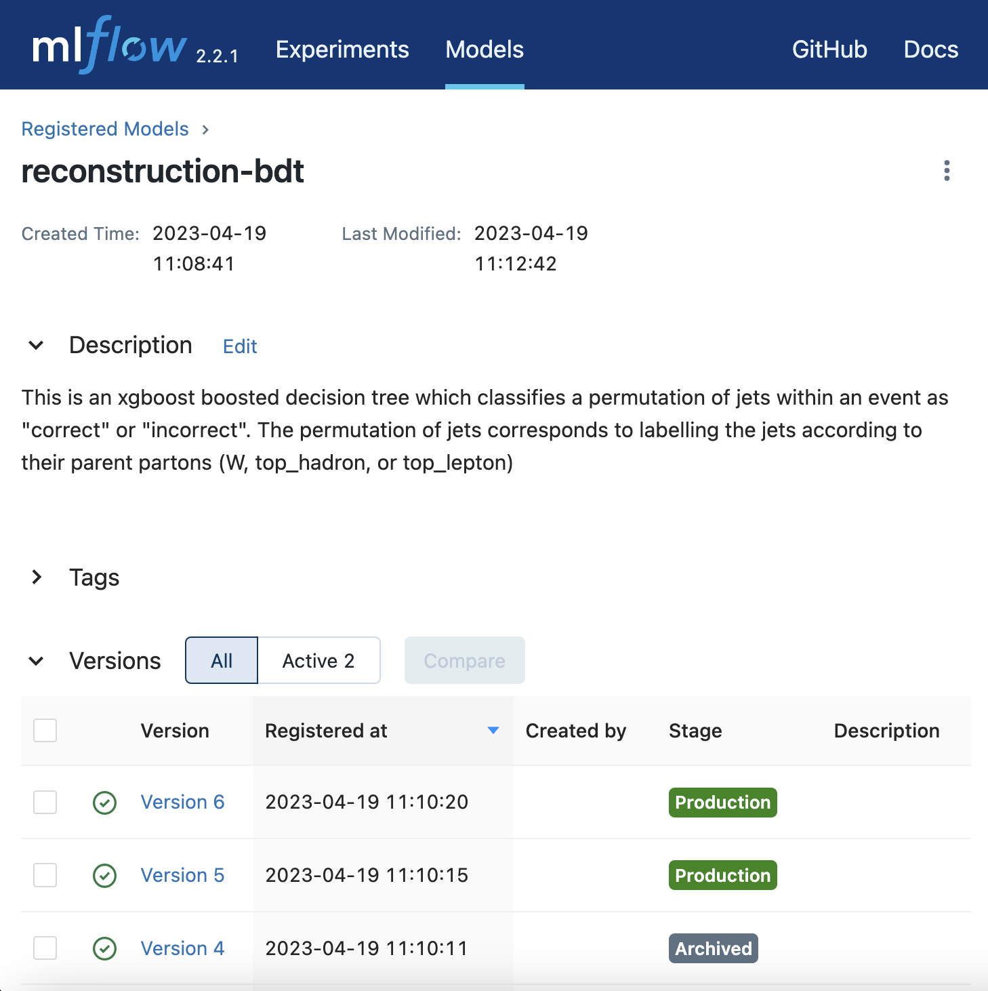
Training: Model Storage
best_model_path = f'runs:/{best_run_id}/model'
best_model = mlflow.xgboost.load_model(best_model_path) # load model locally
result = mlflow.register_model(best_model_path, "reconstruction-bdt") # register best model in mlflow model repository

Slide 15
Training: Model Storage
name: "reconstruction_bdt_xgb"
backend: "fil"
max_batch_size: 50000000
input [
{
name: "input__0"
data_type: TYPE_FP32
dims: [ 20 ]
}
]
output [
{
name: "output__0"
data_type: TYPE_FP32
dims: [ 2 ]
}
]
instance_group [{ kind: KIND_GPU }]
parameters [
{
key: "model_type"
value: { string_value: "xgboost" }
},
{
key: "predict_proba"
value: { string_value: "true" }
},
]
version_policy: { all { }}
dynamic_batching { }
model_name
1
xgboost.model
config.pbtxt

Slide 16
Inference

Slide 17
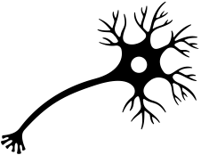
Inference: Machine Learning Inference
Features
Result
1. Set up Triton gRPC client
Entries
Entries
2. Perform inference request:
output = grpcclient.InferRequestedOutput(output_name)
inpt = [grpcclient.InferInput(input_name, features.shape, dtype)]
inpt[0].set_data_from_numpy(features)
results[even_perm]=triton_client.infer(
model_name=self.model_name,
model_version=self.model_vers_odd,
inputs=inpt,
outputs=[output]
).as_numpy(output_name)[:, 1]
gRPC client
GPU

Slide 18
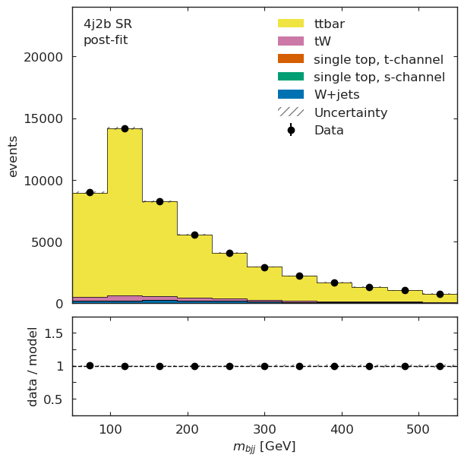
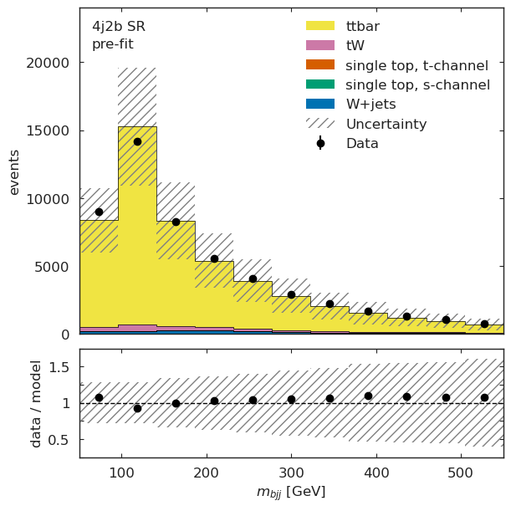
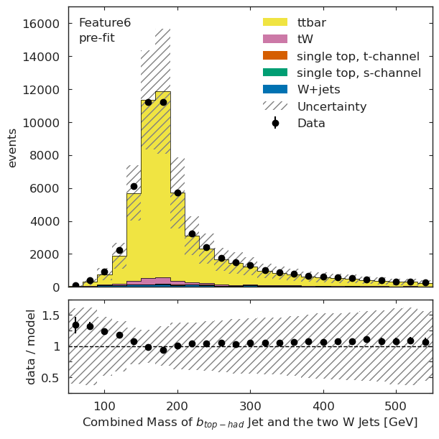
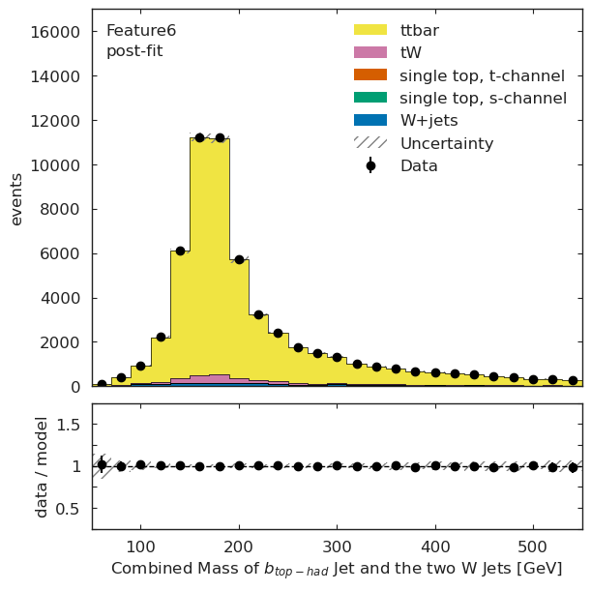
Inference: Result, diagnostics
Statistical model fit from non-ML approach
Apply fit results to model with ML observables
Python HEP libraries utilized:
cabinetry
hist
model_prediction = cabinetry.model_utils.prediction(model_ml)
fit_results_mod = cabinetry.model_utils.match_fit_results(model_ml, fit_results)
model_prediction_postfit = cabinetry.model_utils.prediction(model_ml, fit_results=fit_results_mod)

Slide 19
Future Goals
Explore more complex ML models
Now that we have the infrastructure in place, we can extend to deep learning approaches
Triton inference server will help a lot here!
Benchmarking

Slide 20
Learn more about AGC!
AGC Documentation
Try it yourself!
Coffea-casa @ UNL
Elastic Analysis Facility @ Fermilab
Local Setup

