Slide 1
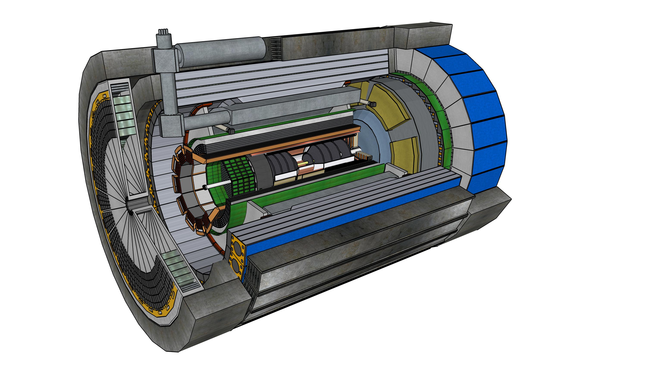



ePIC Overview
John Lajoie
Oak Ridge National Laboratory

Slide 2
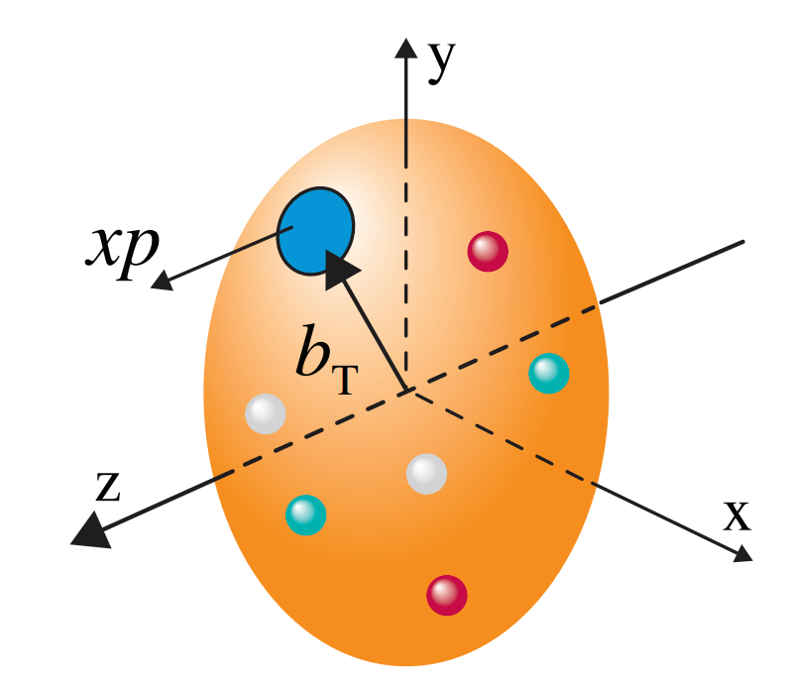
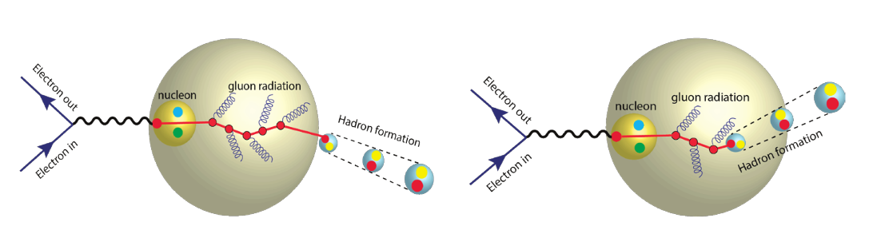
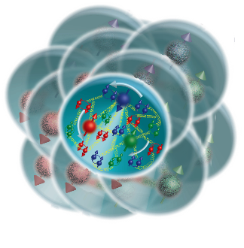
The EIC Science Mission
How do the nucleon properties like mass and spin emerge from quarks and their interactions?
How are the sea quarks and gluons, and their spins, distributed in space and momentum inside the nucleon?
What is the mechanism through which quark-gluon interactions give rise to nuclear binding?
Is there a saturation point for the density of gluons in nuclei at high energies, and does this lead to the formation of gluonic matter with universal properties across all nuclei, including the proton?
In what manner do color-charged quarks and gluons, along with colorless jets, interact with the nuclear medium? And how do the confined hadronic states emerge from these quarks and gluons?
What impact does a high-density nuclear environment have on the interactions, correlations, and behaviors of quarks and gluons?
2

Slide 3
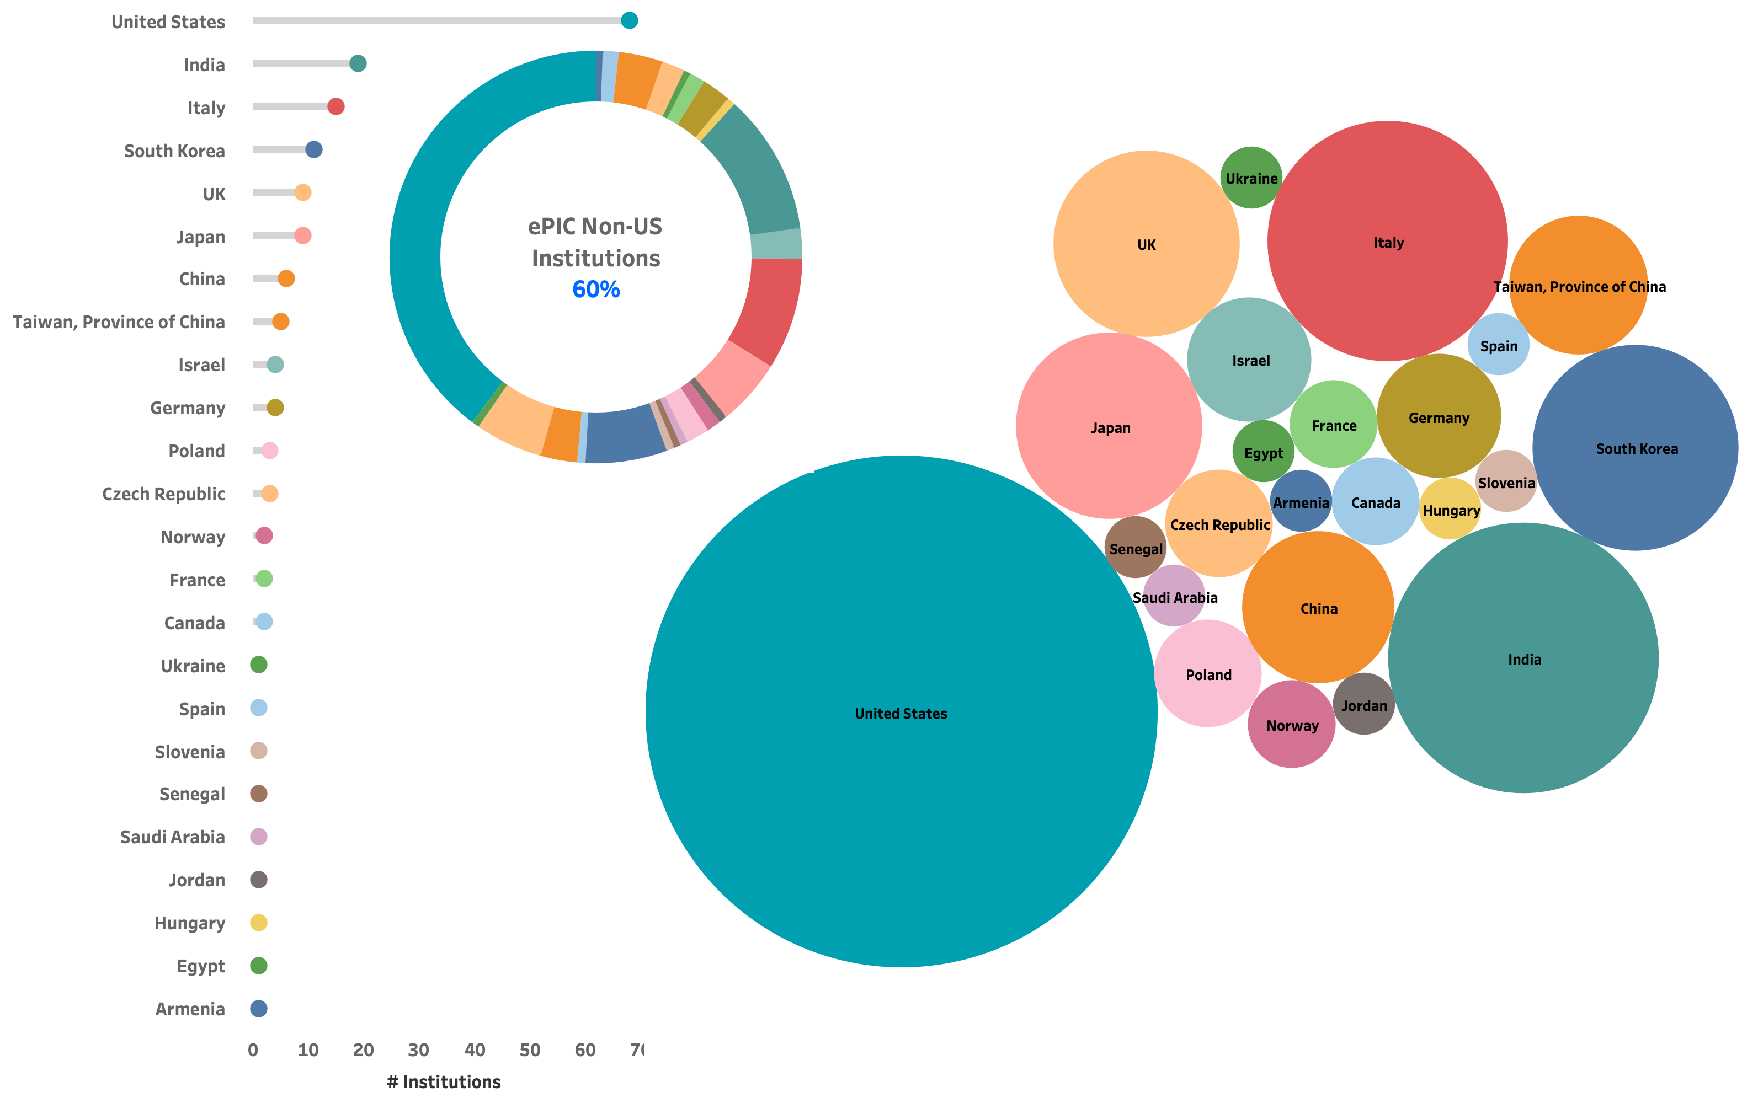
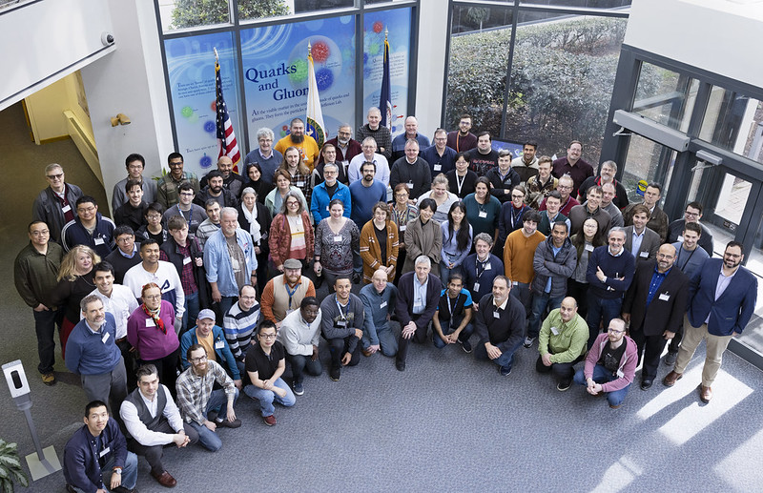
The ePIC Collaboration
171 institutions
24 countries
500+ participants
A truly global pursuit for the first experiment at the EIC!
Notes:
24 countries total

Slide 4
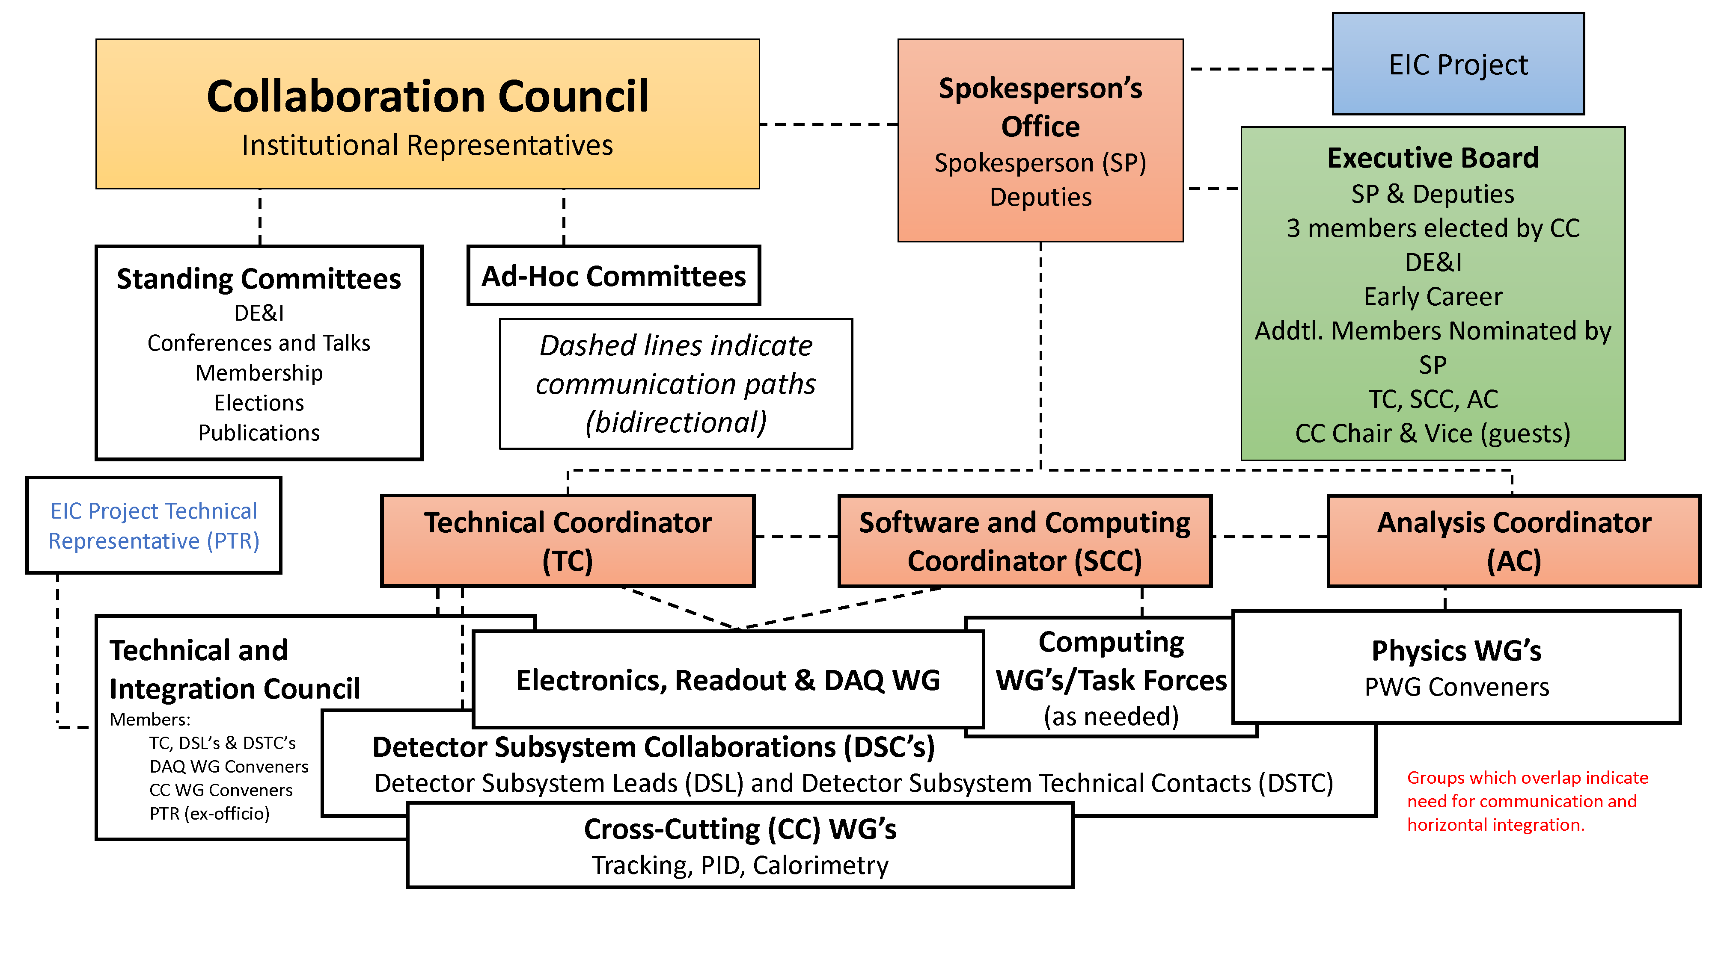


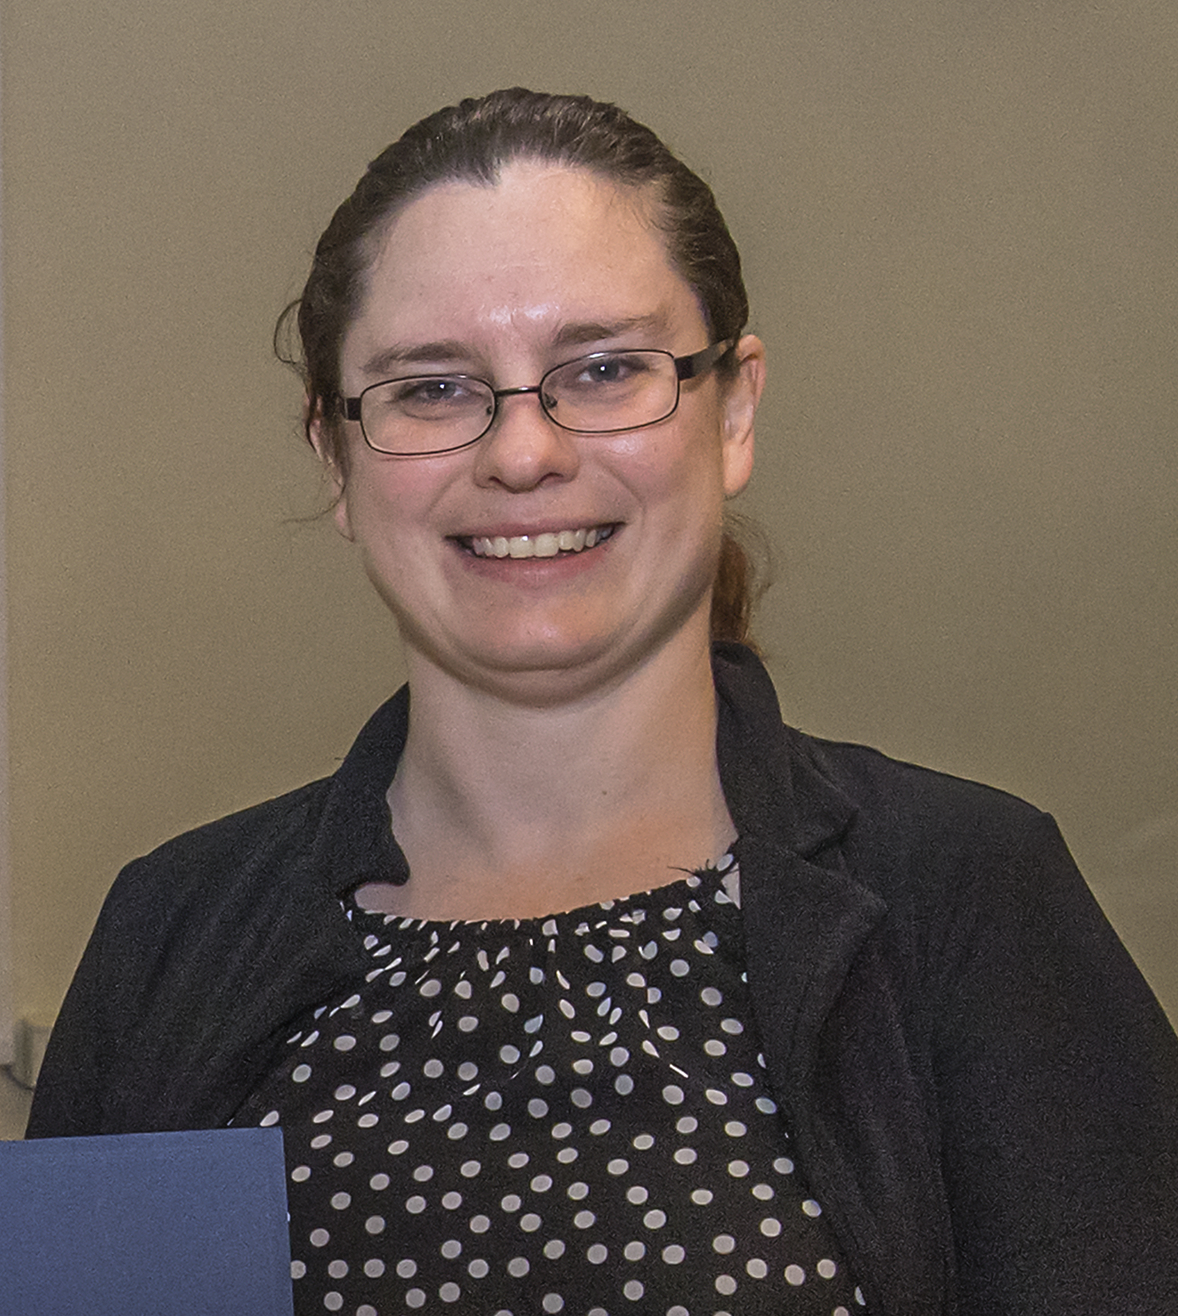
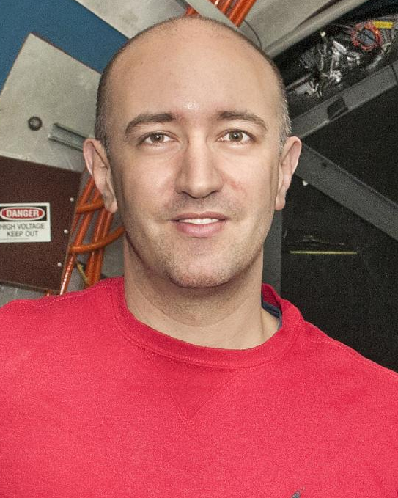
ePIC Collaboration Structure
Technical Coordinator (Acting)
• Silvia Dalla Torre (INFN)
Deputy TC’s
SCC Coordinator
• Markus Diefenthaler (JLab)
• Wouter Deconinck
(U. of Manitoba,
Deputy SCC for Operations)
• Sylvester Joosten
(ANL, Deputy SCC for Development)
• Torre Wenaus
(BNL, Deputy SCC for Infrastructure)
Analysis Co-Coordinators
• Rosi Reed (Lehigh Univ.)
• Salvatore Fazio (Univ. Calabria)

Slide 5
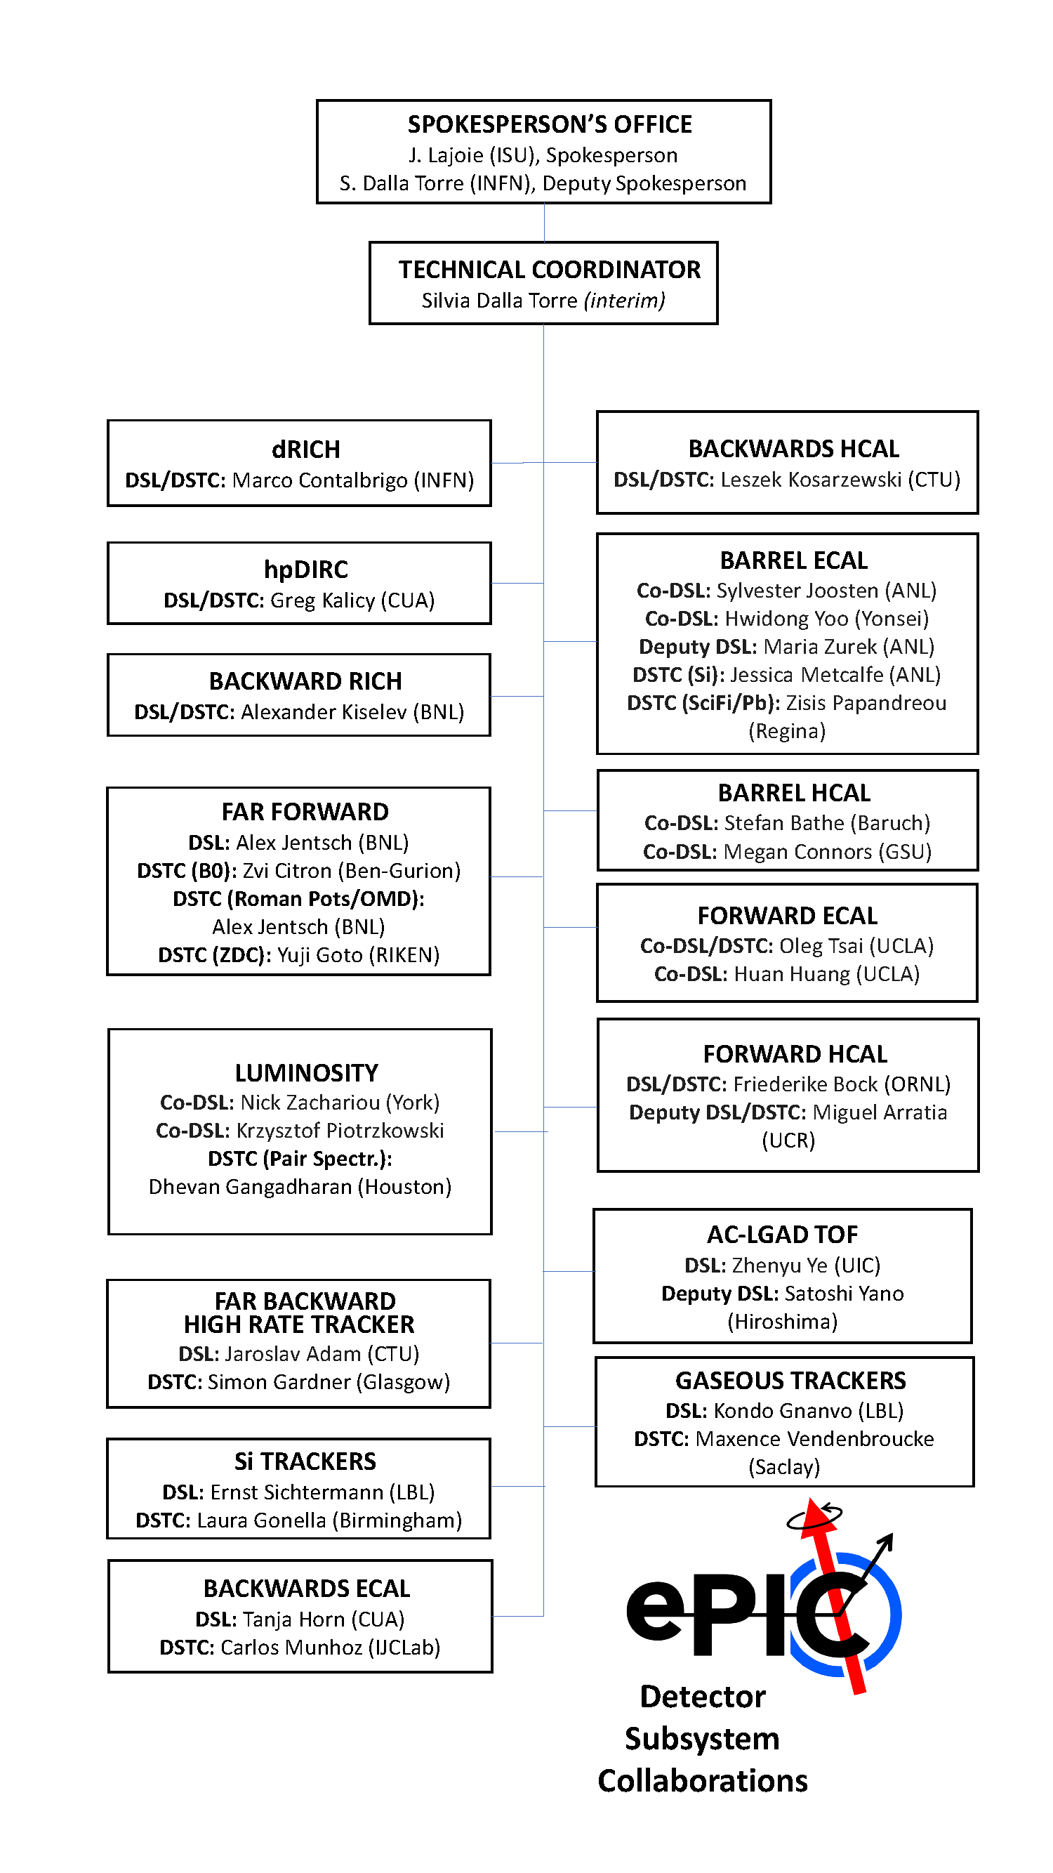
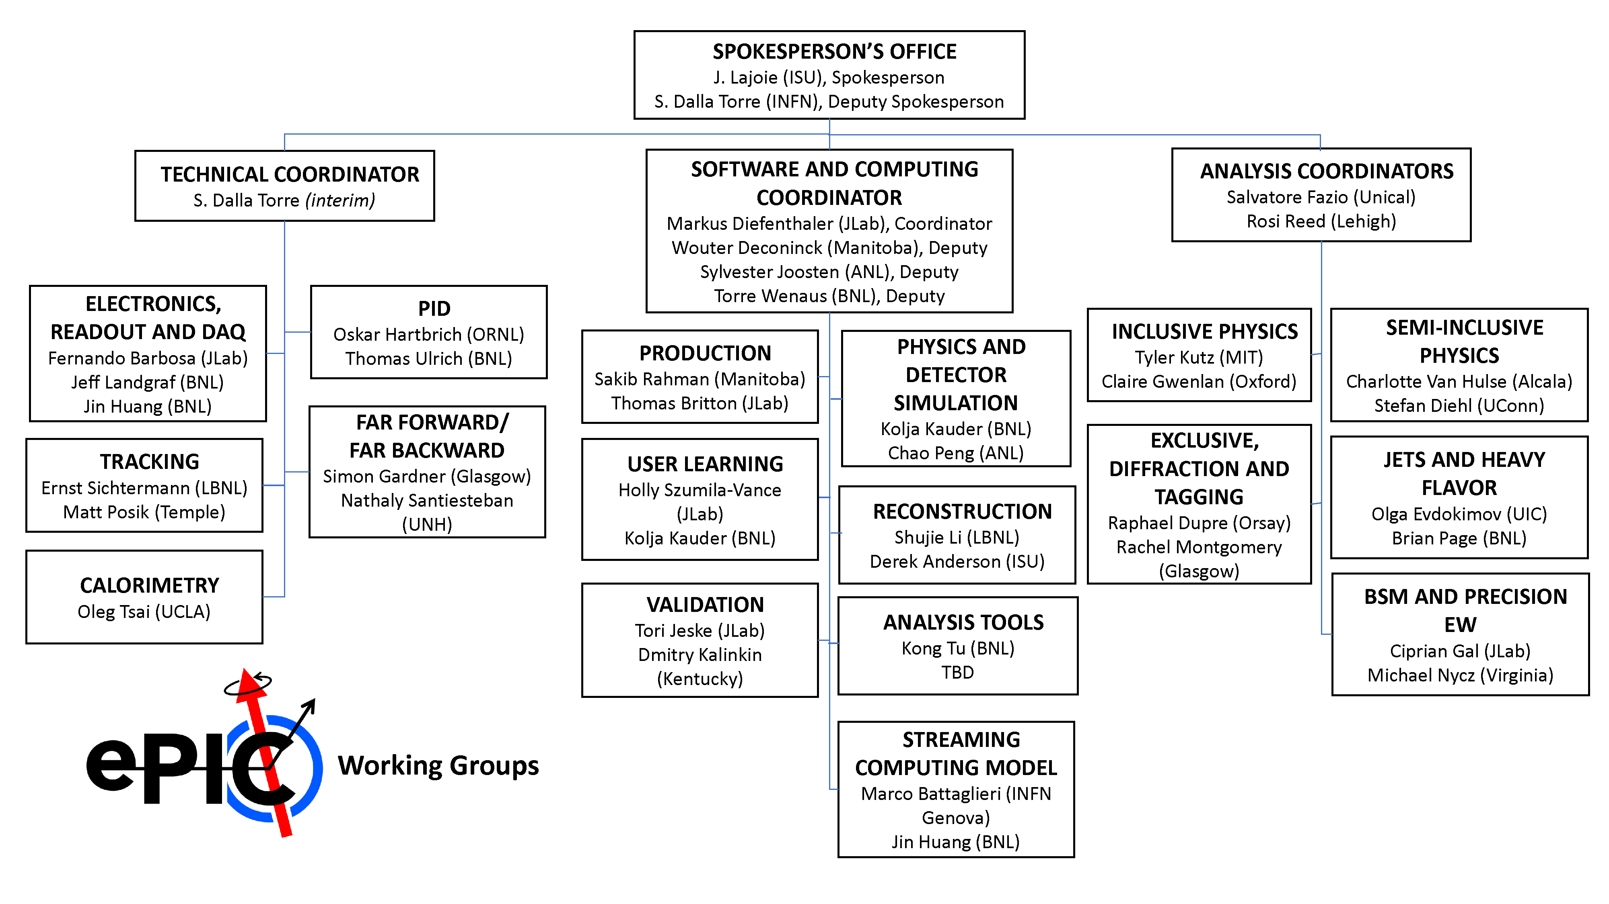
ePIC Collaboration Structure

Slide 6
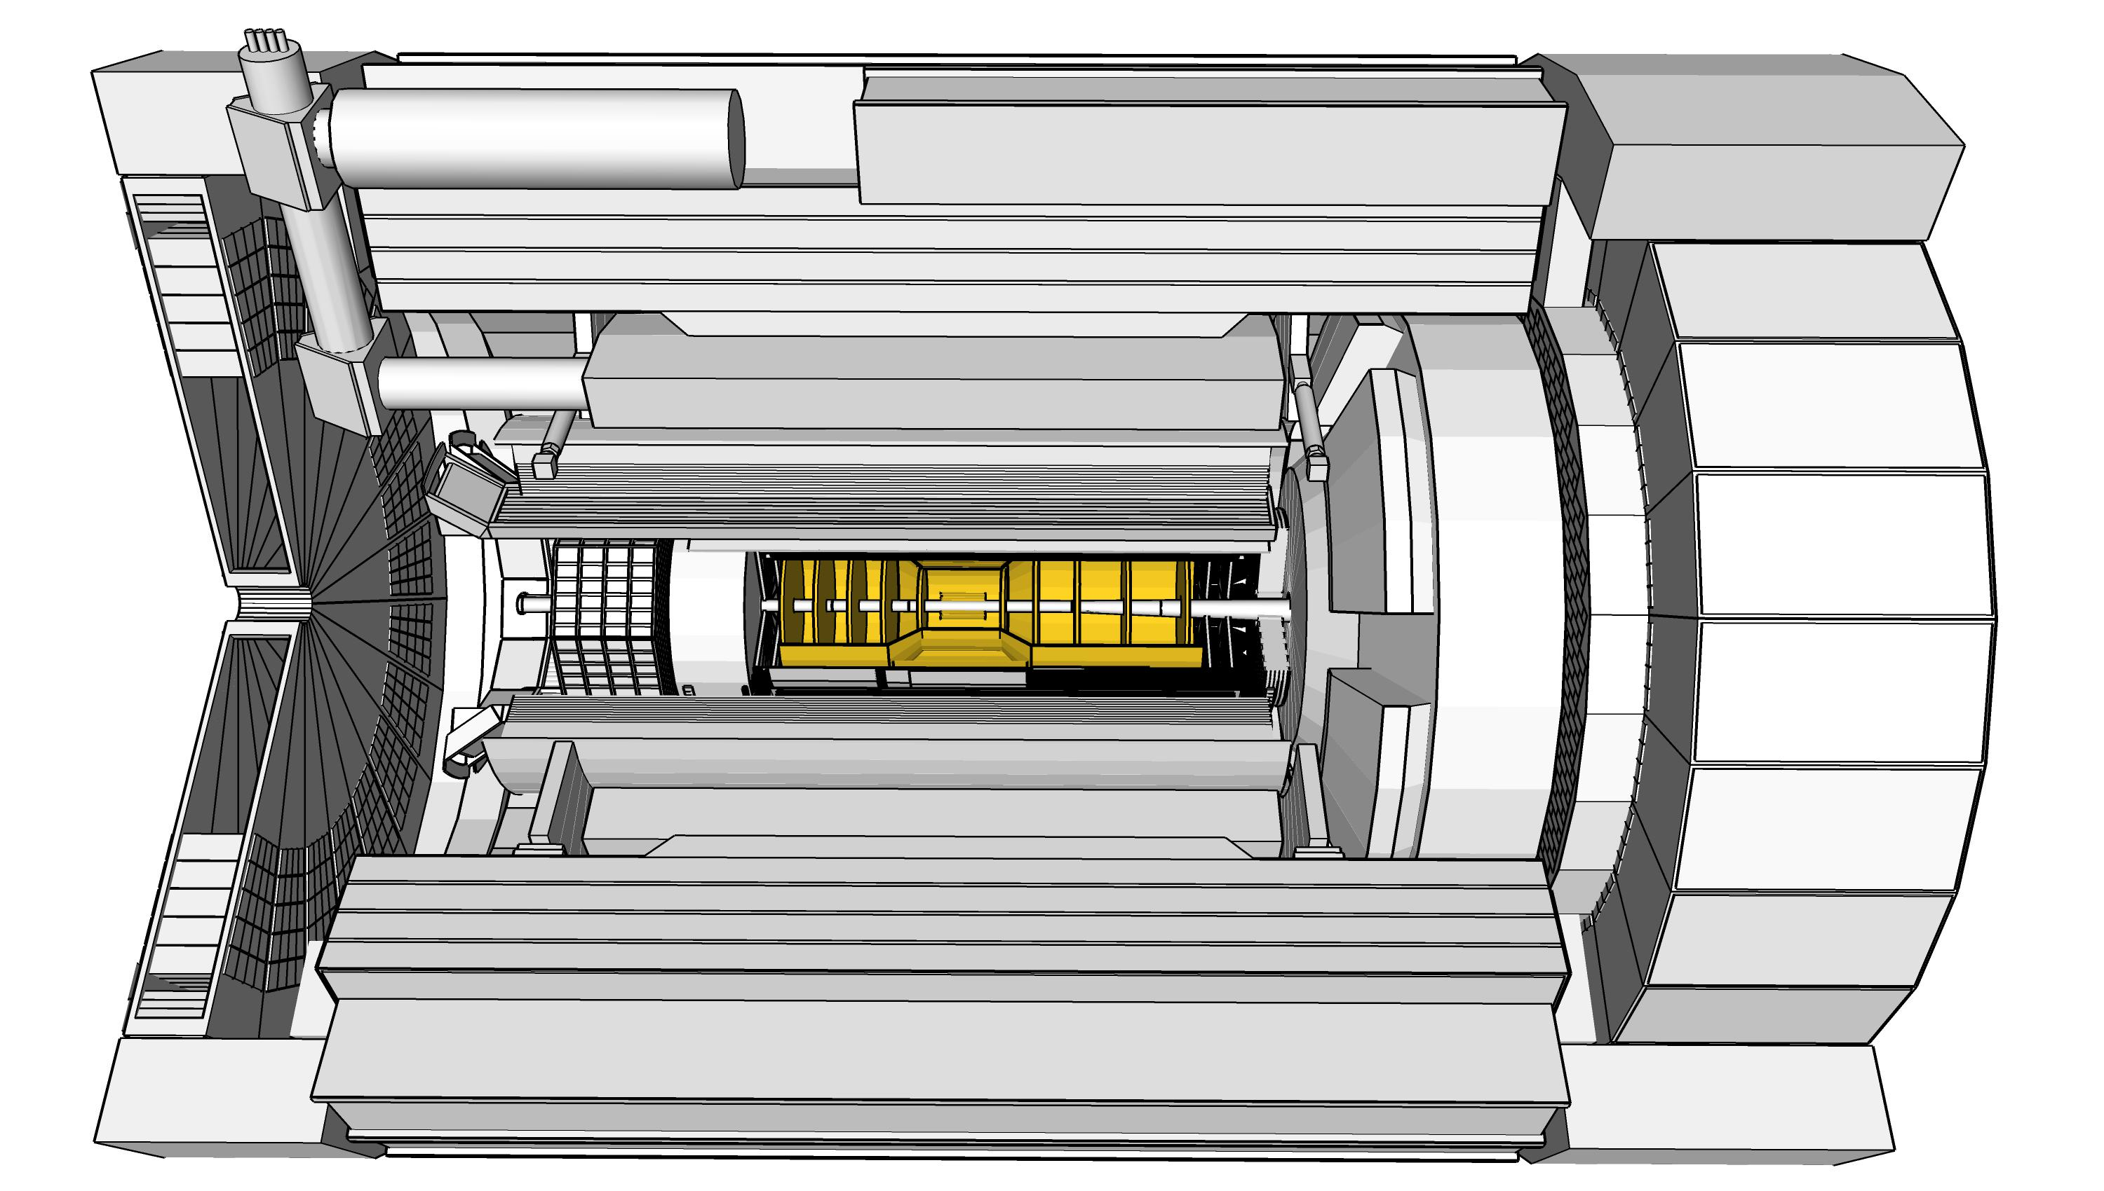
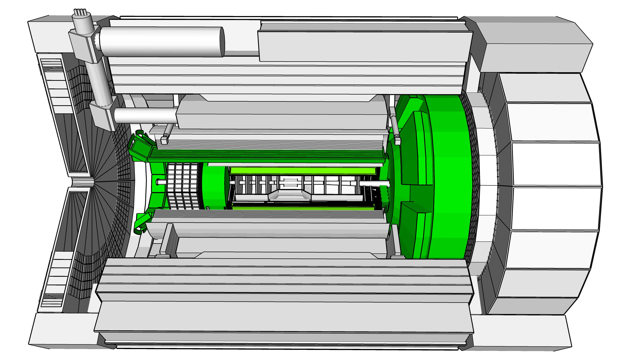
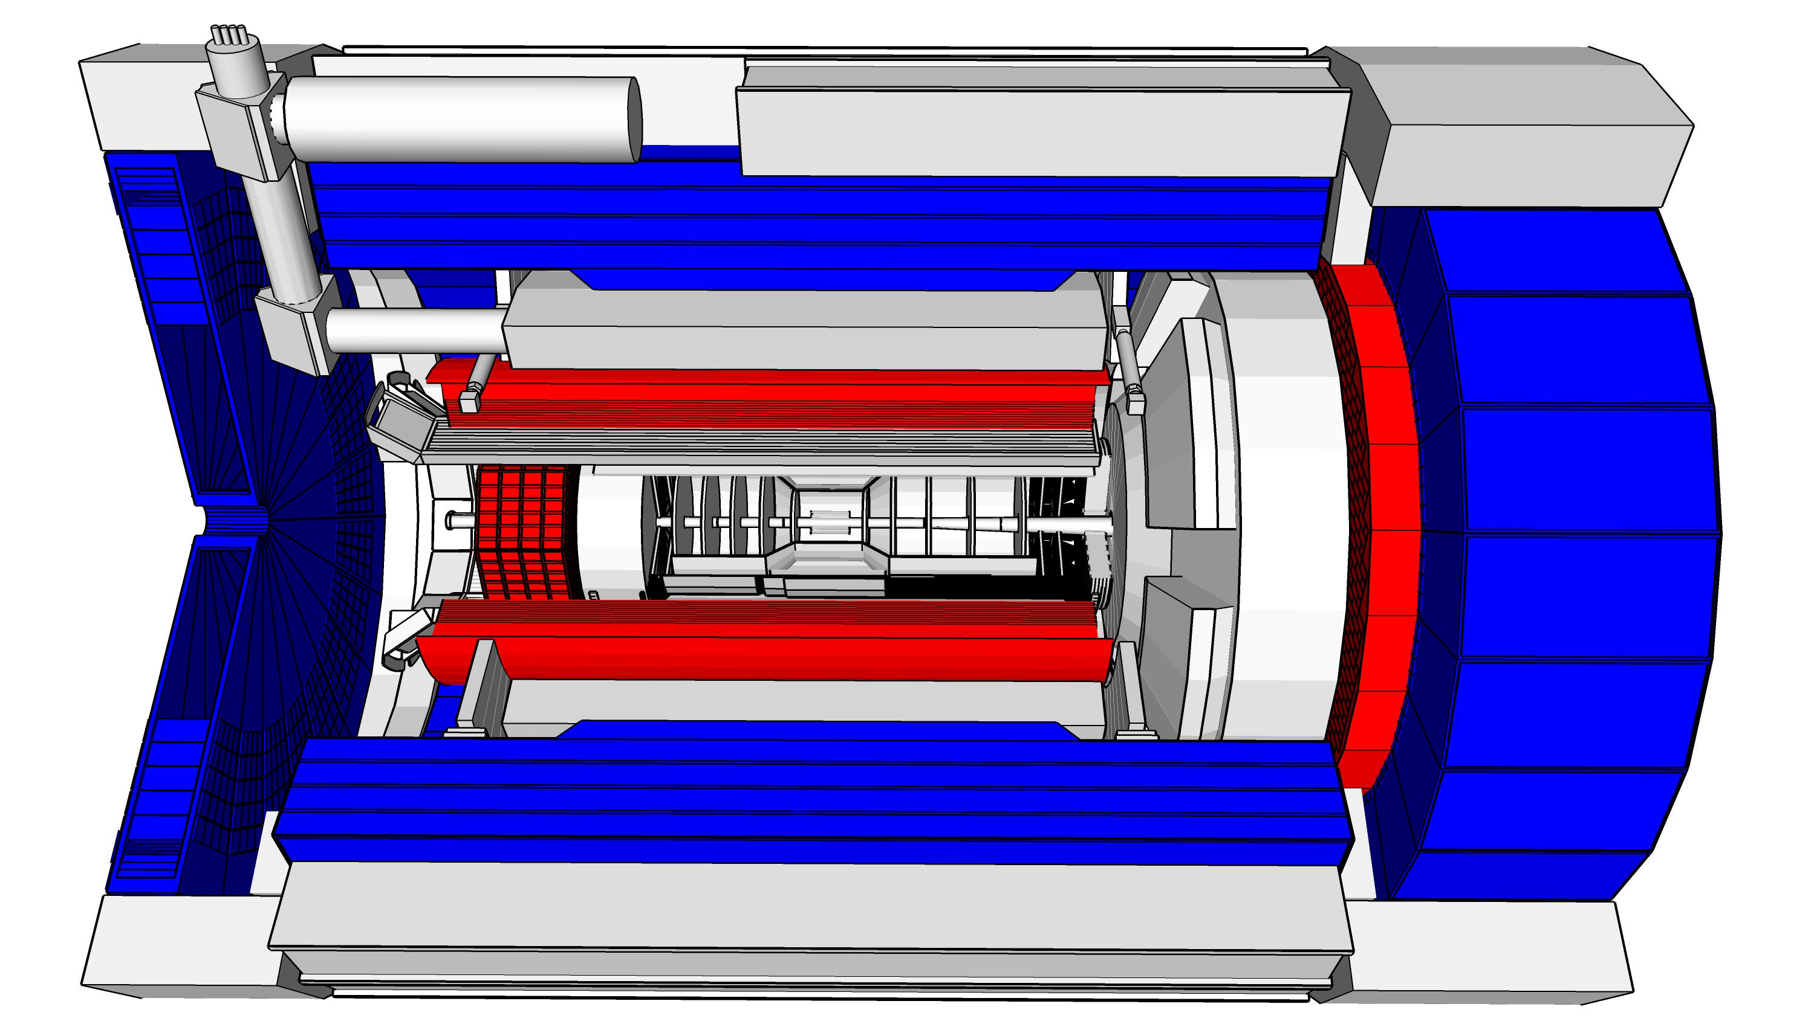
ePIC Detector Design
3.5m
η=0
5.0m
3.2m
Tracking:
  New 1.7T solenoid
  Si MAPS Tracker
  MPGDs (μRWELL/μMegas)
PID:
  hpDIRC
  pfRICH
  dRICH
  AC-LGAD (~30ps TOF)
Calorimetry:
  Imaging Barrel EMCal
  PbWO4 EMCal in backward
  direction
  Finely segmented EMCal +HCal
  in forward direction
  Outer HCal (sPHENIX re-use)
  Backwards HCal (tail-catcher)
5.34m
hadrons
electrons

Slide 7
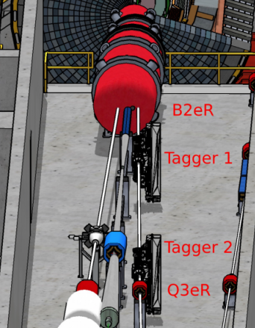
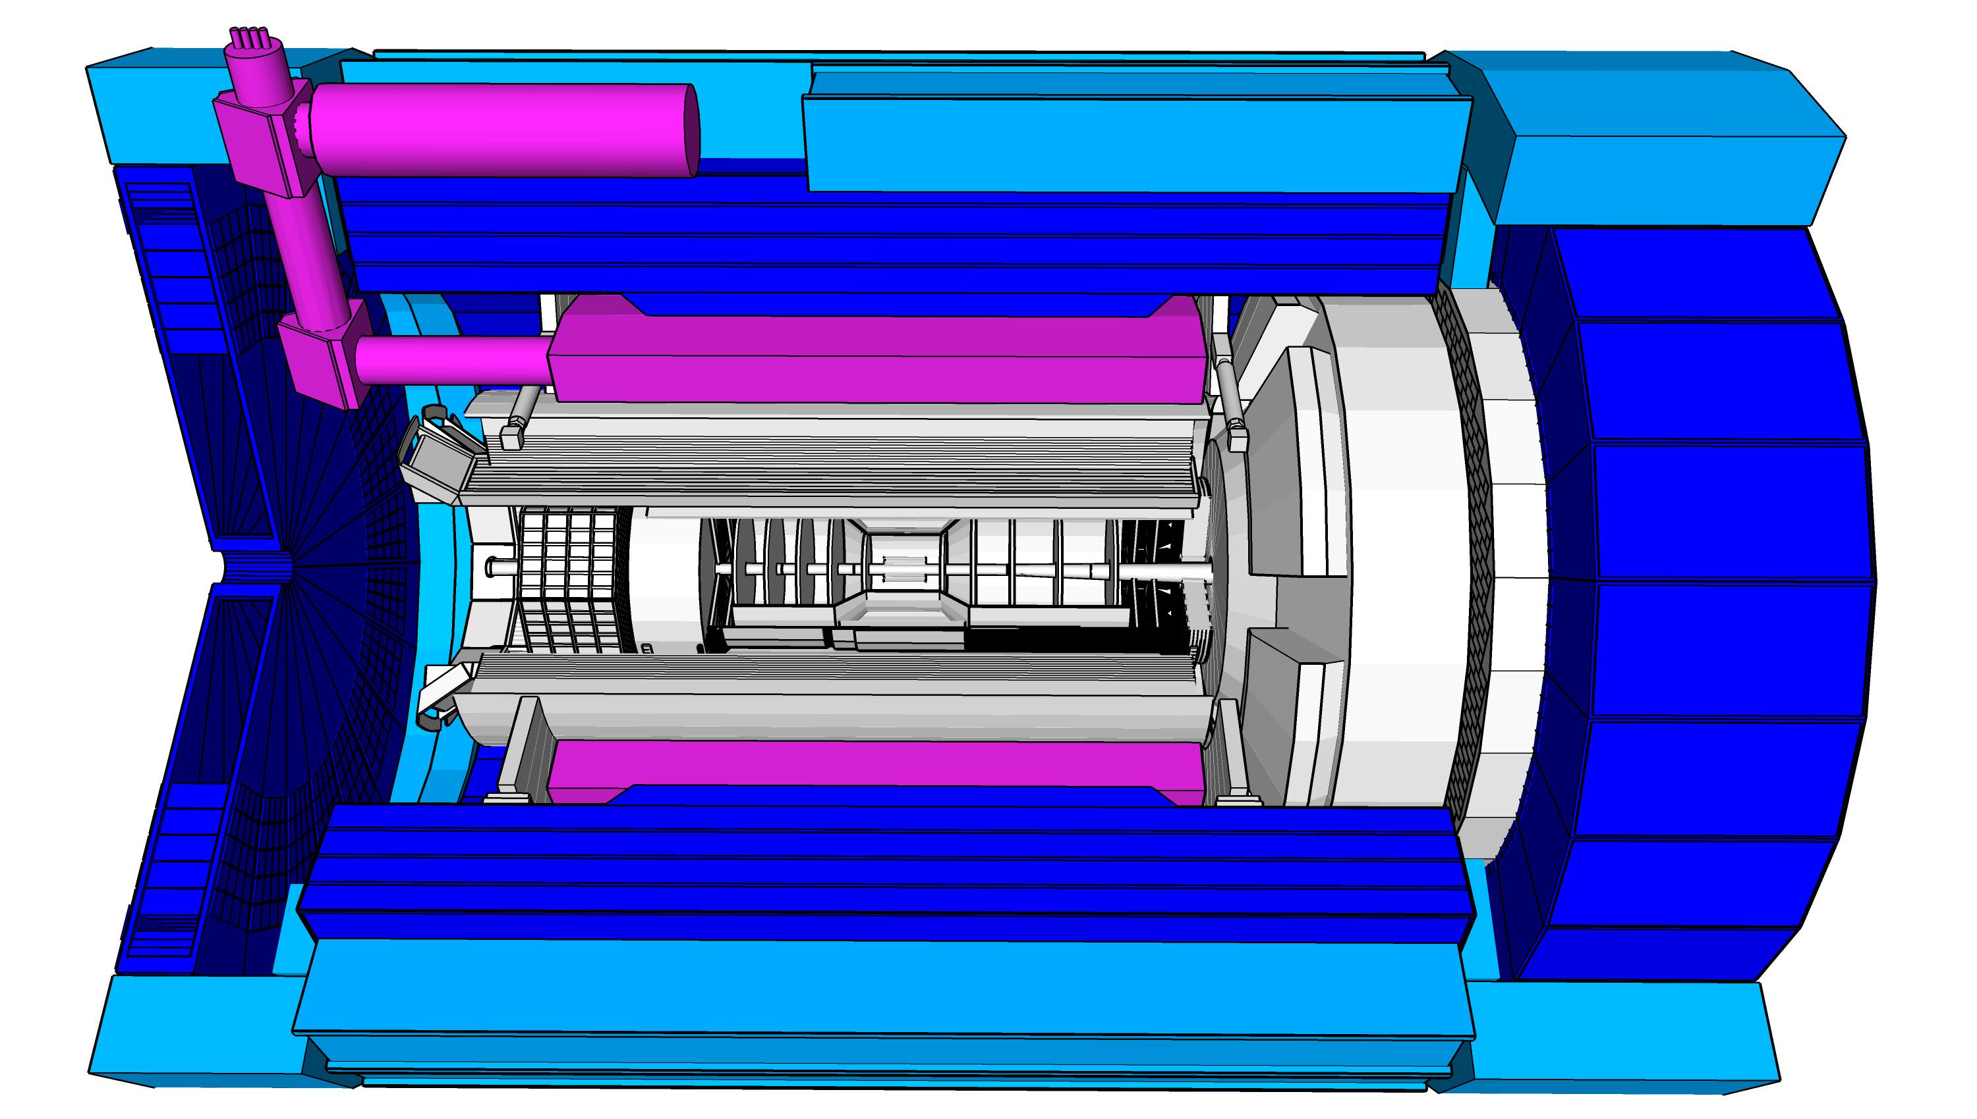
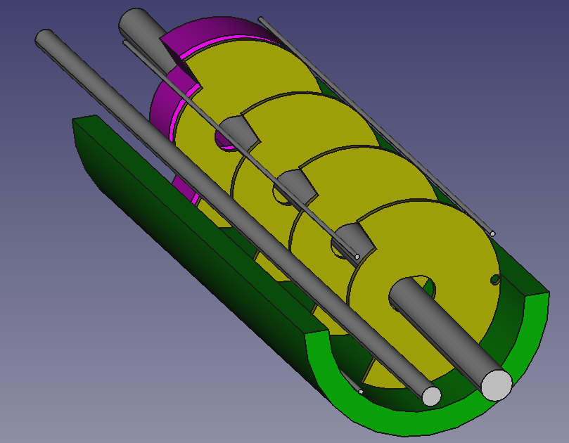
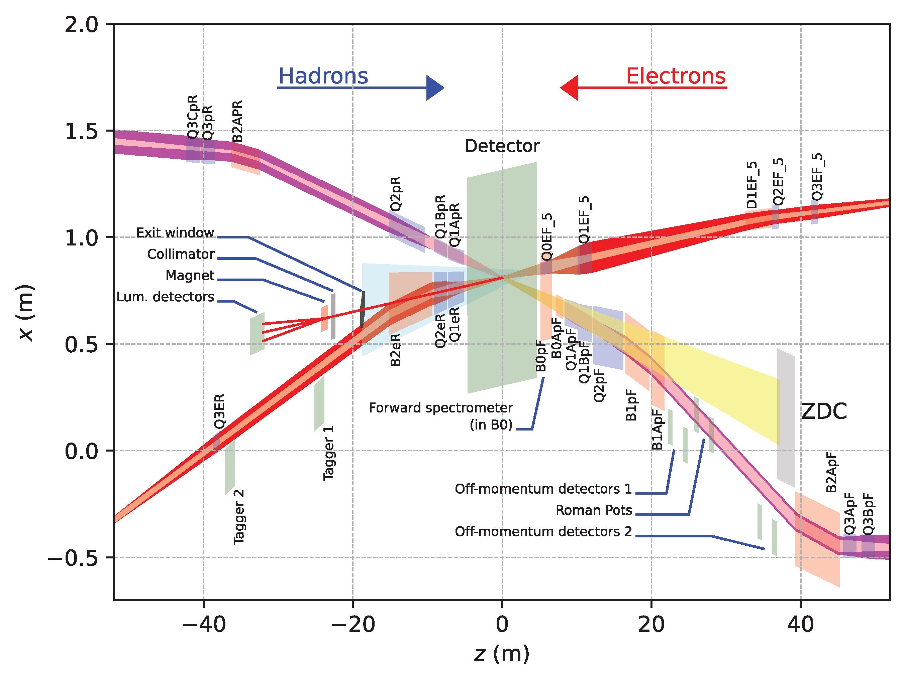
Far-Forward and Far-Backward Detectors
8.5m
PbW04 EMCAL
Si Tracking
Far-Backward Detectors
Luminosity monitor
Low-Q² Tagging Detectors
Far-Forward Detectors
B0 Tracking and Photon Detection
Roman Pots and Off-Momentum Detectors
Zero-Degree Calorimeter

Slide 8
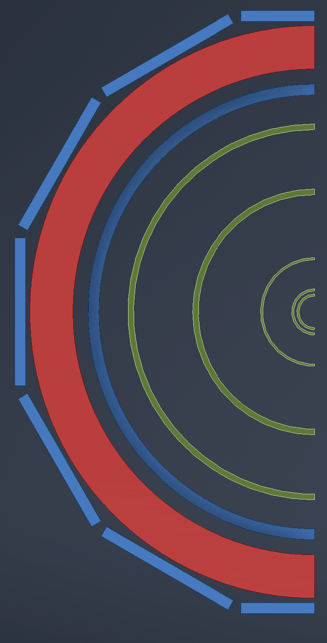

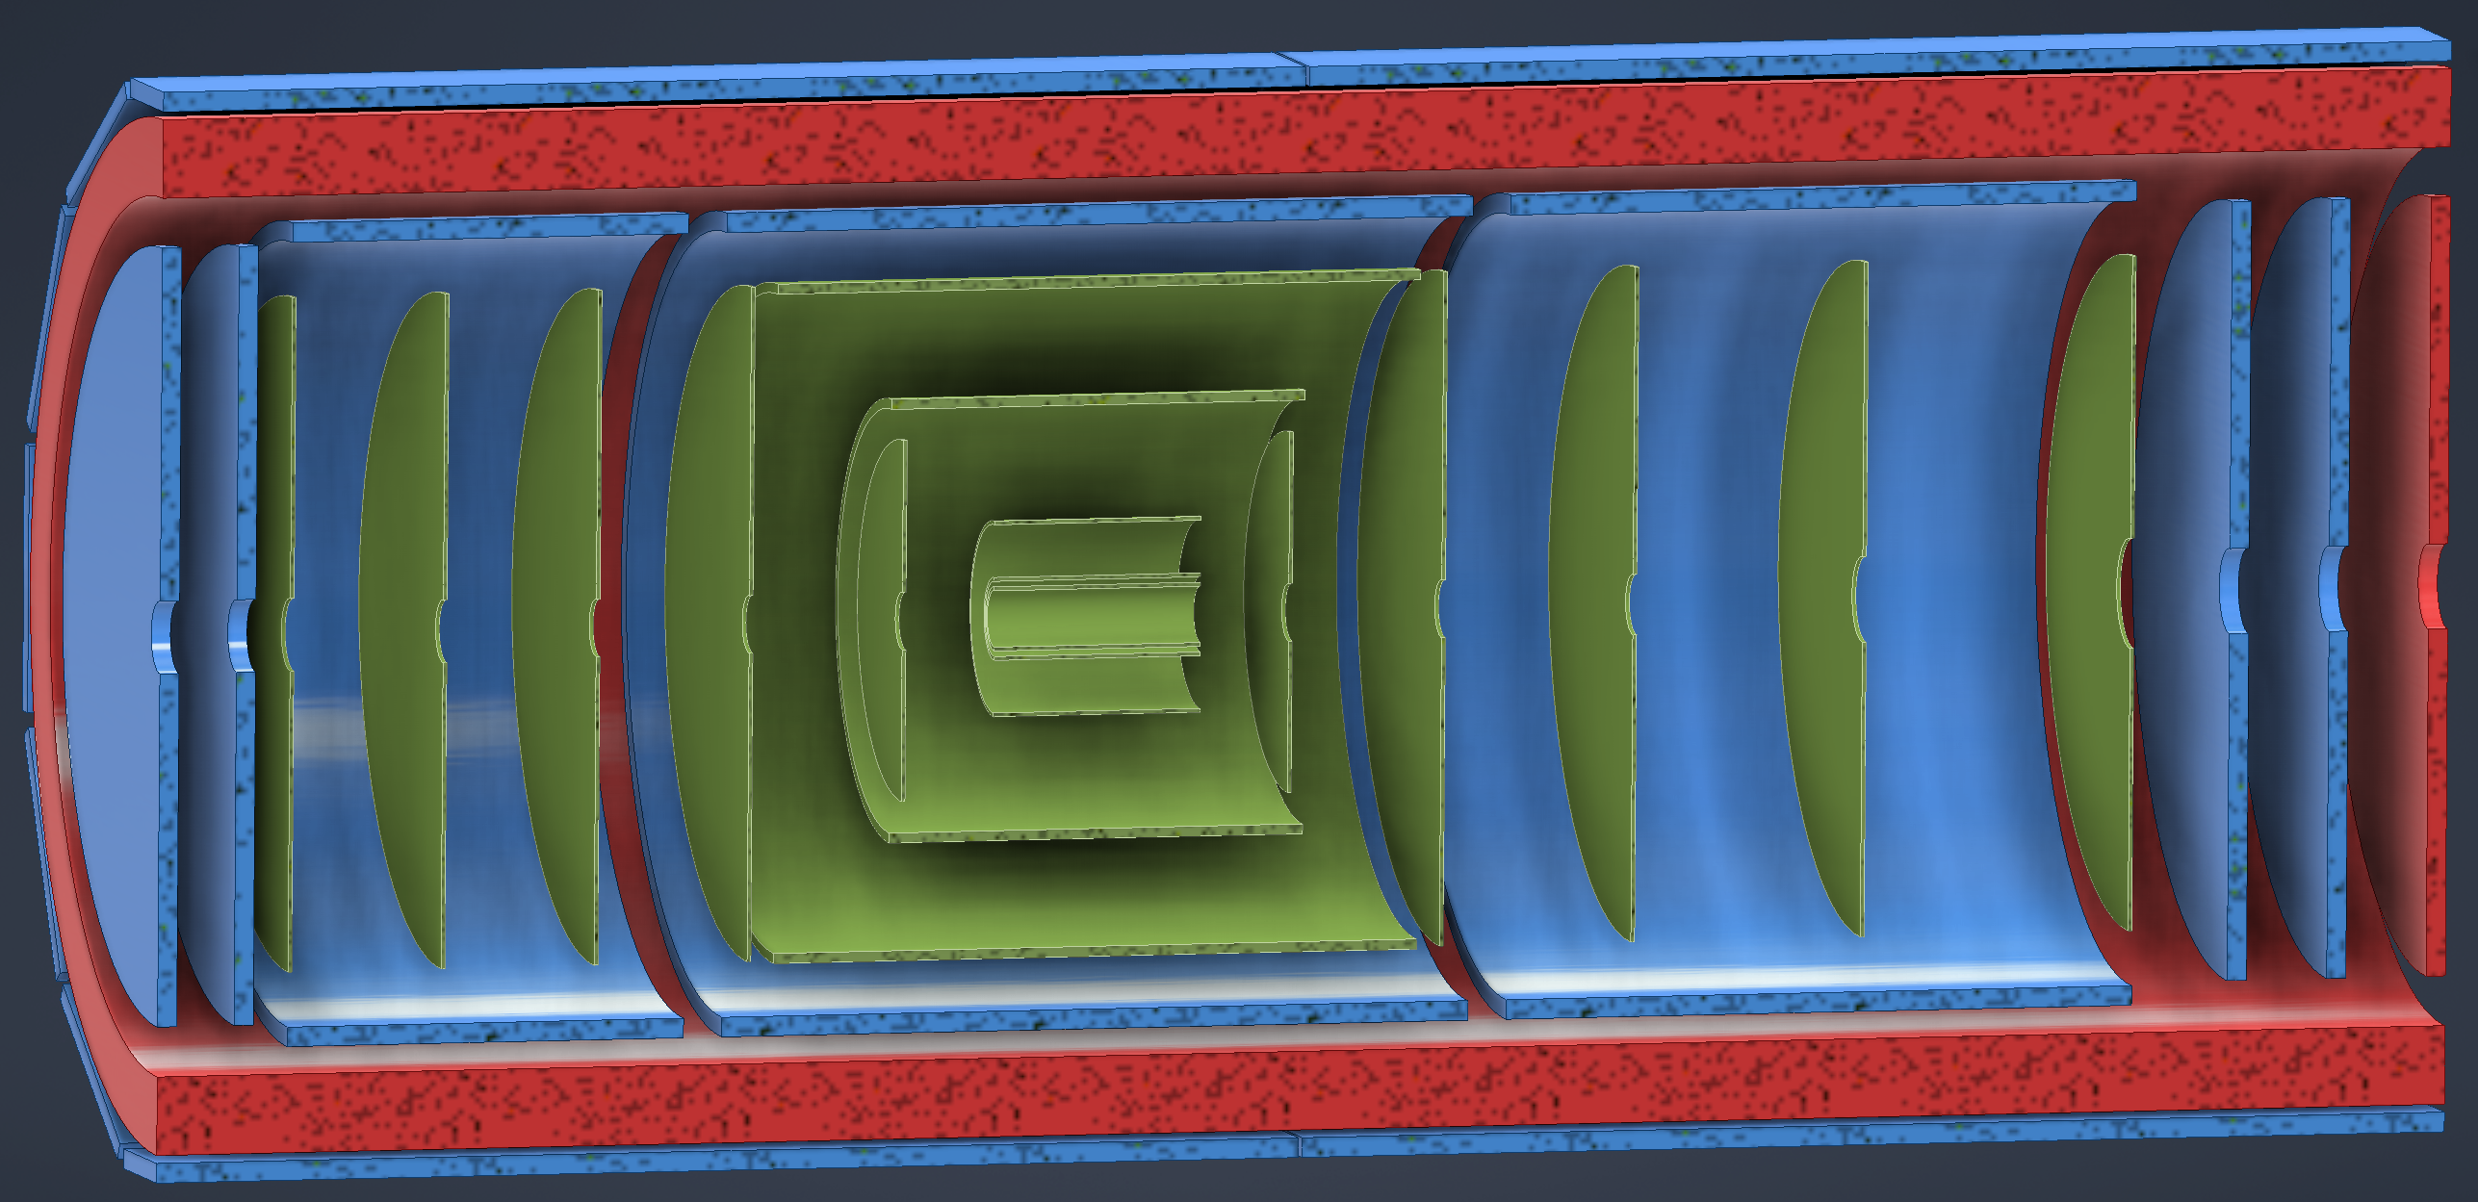
ePIC Tracking Detectors
MAPS Tracker:
  Small pixels (20 μm), low power consumption (<20 mW/cm²) and material budget (0.05% to 0.55% X/X₀) per layer
  Based on ALICE ITS3 development
  Vertex layers optimized for beam pipe bakeout and ITS-3 sensor size
  Barrel layers based on EIC LAS development
  Forward and backwards disks
MPGD Layers:
  Provide timing and pattern recognition redundancy
  Cylindrical μMEGAs
  Planar μRWell’s before hpDIRC
    Impact point and direction for ring seeding
AC-LGAD TOF and AstroPix (BECAL)
  Additional space point for pattern recognition / redundancy
world’s first
at
world’s first
at
MAPS Barrel + Disks
MPGD Barrels + Disks
AC-LGAD based ToF

Slide 9
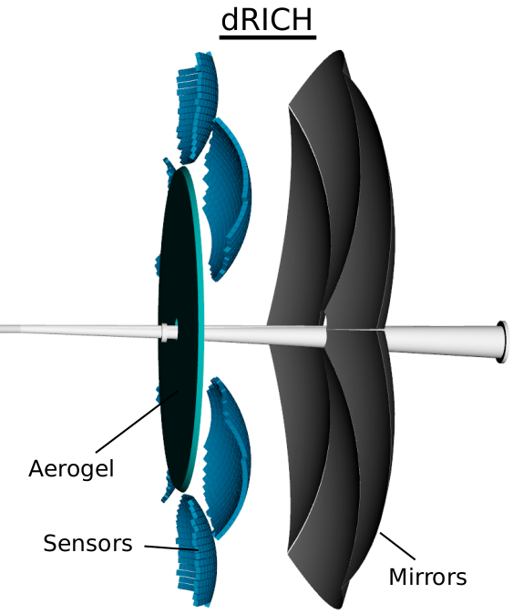
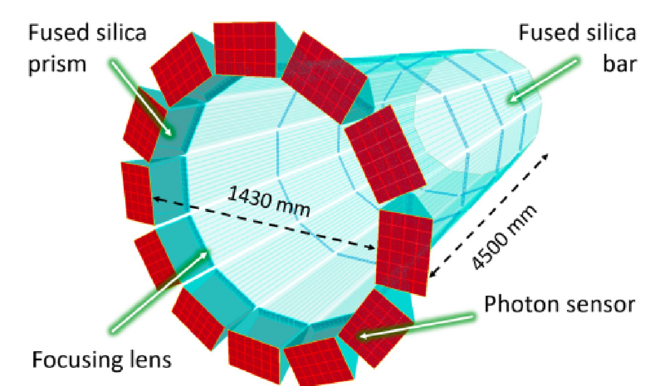
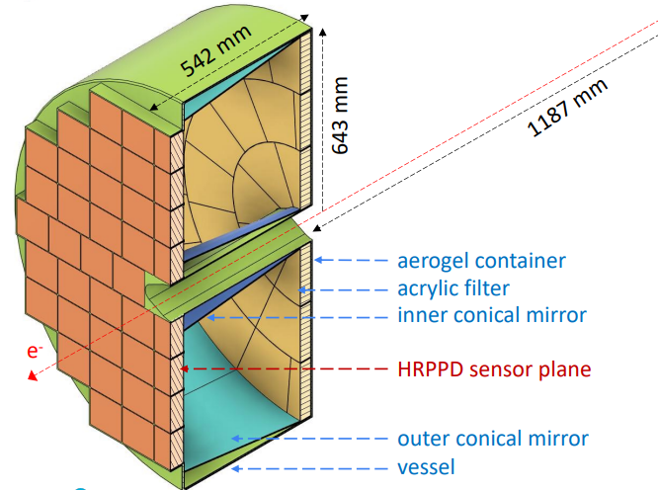
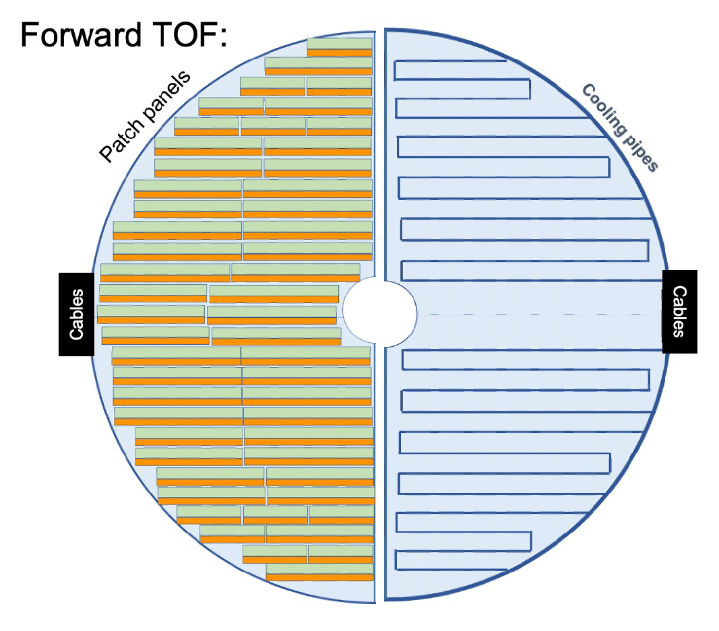
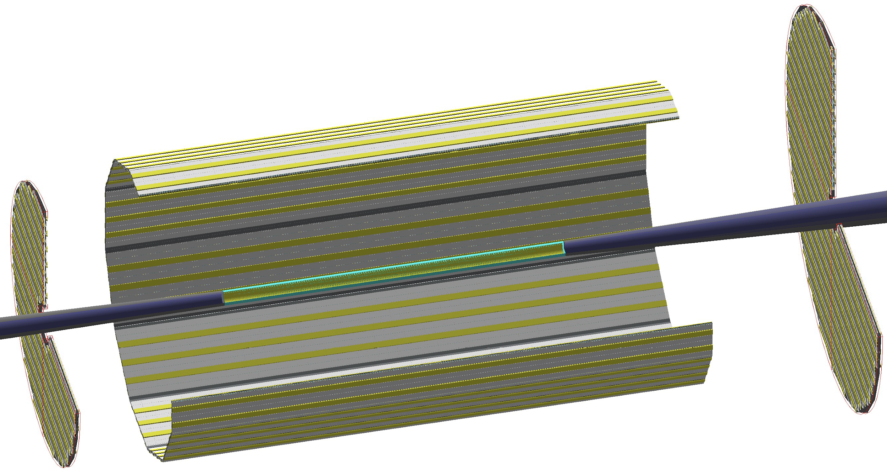
Particle ID
Dual-Radiator RICH(dRICH)
High-Performance DIRC
Quartz bar radiator (BaBAR bars)
light detection with MCP-PMTs
Fully focused
π/K 3σ separation at 6 GeV/c
Proximity Focused (pfRICH)
Long proximity gap (~40 cm)
Sensor: HRPPDs
up to 9 GeV/c 3σ π/K sep.
world’s first
at
C₂F₆ Gas Volume and Aerogel
Sensors tiled on spheres (SiPMs)
π/K 3σ sep. at 50 GeV/c
AC-LGAD
TOF (~30ps)
world’s first
at
world’s first
at
hadrons
electrons
Accurate space point for tracking
forward disk and central barrel

Slide 10
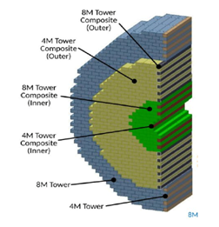
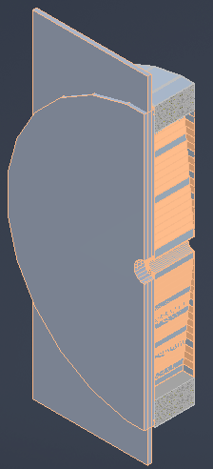
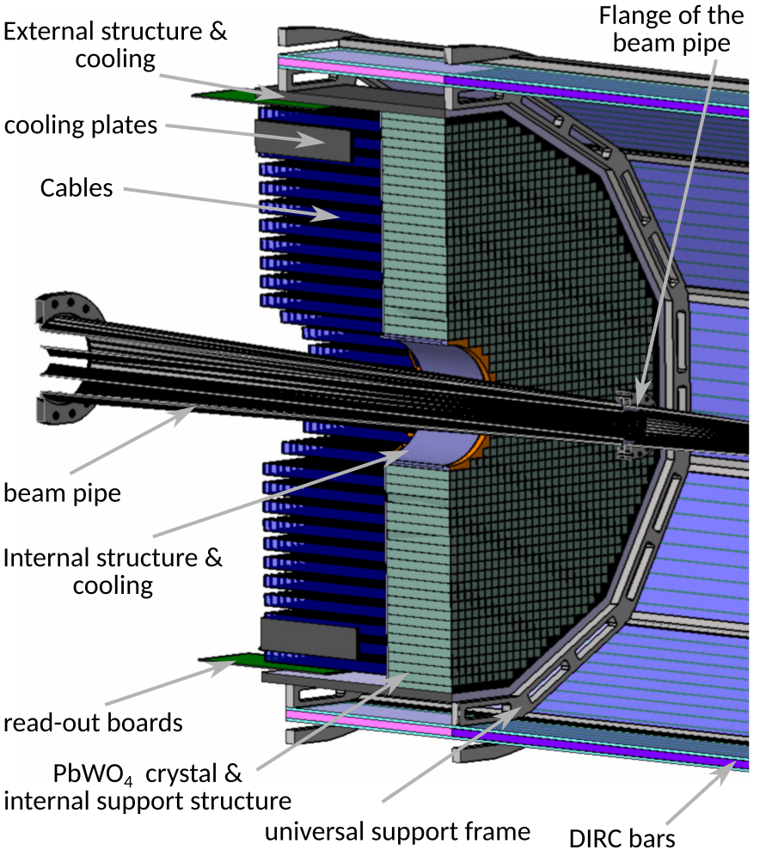
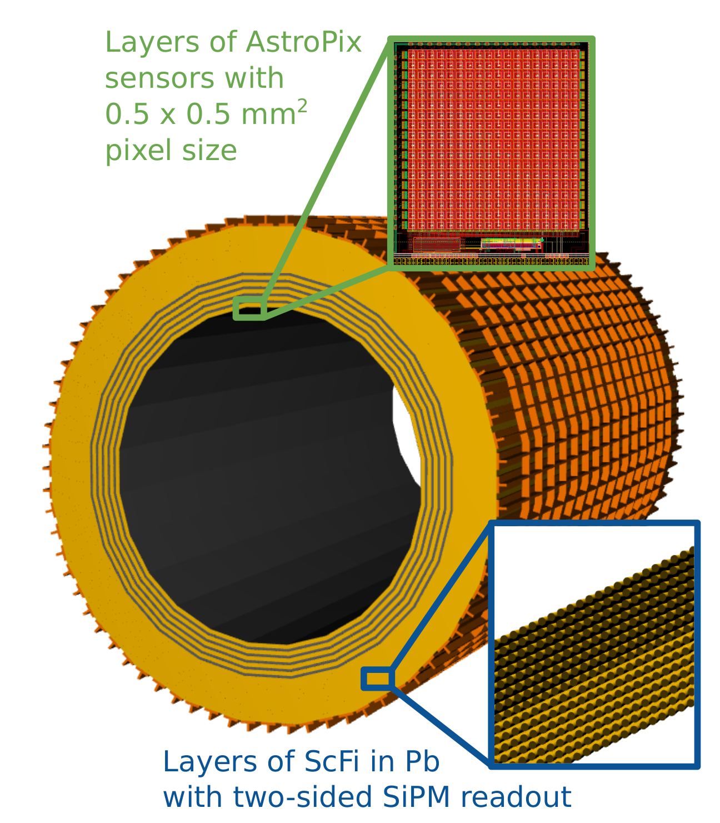
Calorimetry
hadrons
electrons
Backwards HCal
Steel/Sc Sandwich
tail catcher
world’s first
at
High granularity
W/SciFi EMCal
Longitudinally separated HCAL with high-η insert
world’s first
at
Backwards EMCal
PbW04 crystals, SiPM photosensor
Barrel HCAL
(sPHENIX re-use)
world’s first
at

Slide 11
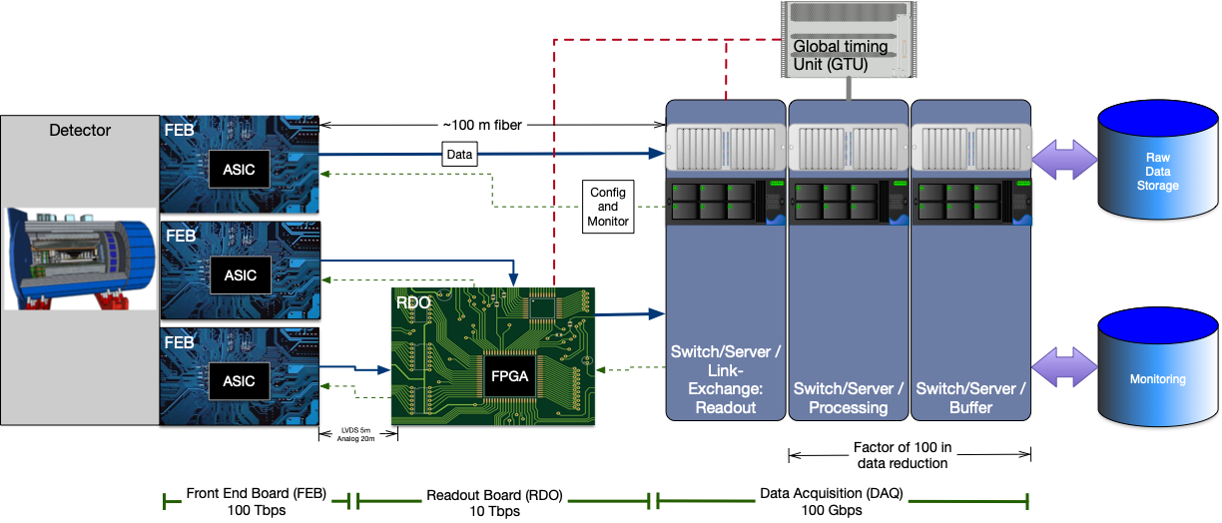
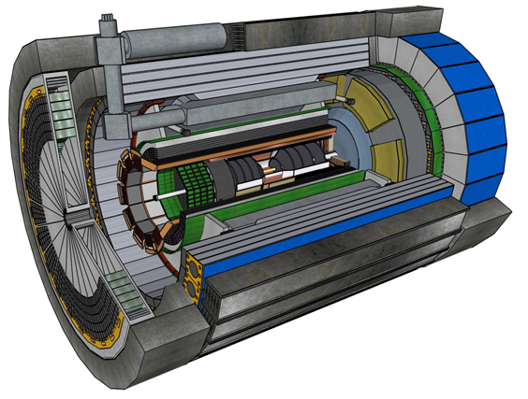
ePIC Streaming DAQ
Bunch Crossing ~ 10.2 ns/98.5 MHz
Interaction Rate ~ 2 us/500 kHz
Low occupancy
No External trigger
All collision data digitized but aggressively zero suppressed at FEB
Low / zero deadtime
Event selection can be based upon full data from all detectors (in real time, or later)
Collision data flow is independent and unidirectional-> no global latency requirements
Avoiding hardware trigger avoids complex custom hardware and firmware
Data volume is reduced as much as possible at each stage ensuring that biases are controlled

Slide 12


Software for the Realization of the Experiment
Our software design is based on lessons learned in the worldwide NP and HEP community and a decision-making process involving the whole community. We will continue to work with the worldwide NP and HEP community.
Modular Simulation, Reconstruction, and Analysis Toolkit using tools from the NP-HEP community
EDM4eic data model based on EDM4hep and podio.
Geometry Description and Detector Interface using DD4hep.
MC Event Generators
Detector Simulations in Geant4
Readout Simulation (Digitization)
Reconstruction
in JANA2
Physics
Analyses
Continuous Integration for Detector and Physics Benchmarks and Reproducibility
We are providing a production-ready software stack throughout the development:
Milestone: Software enabled first large-scale simulation campaign for ePIC.
We have a good foundation to meet the near-term and long-term software needs for ePIC.

Slide 13
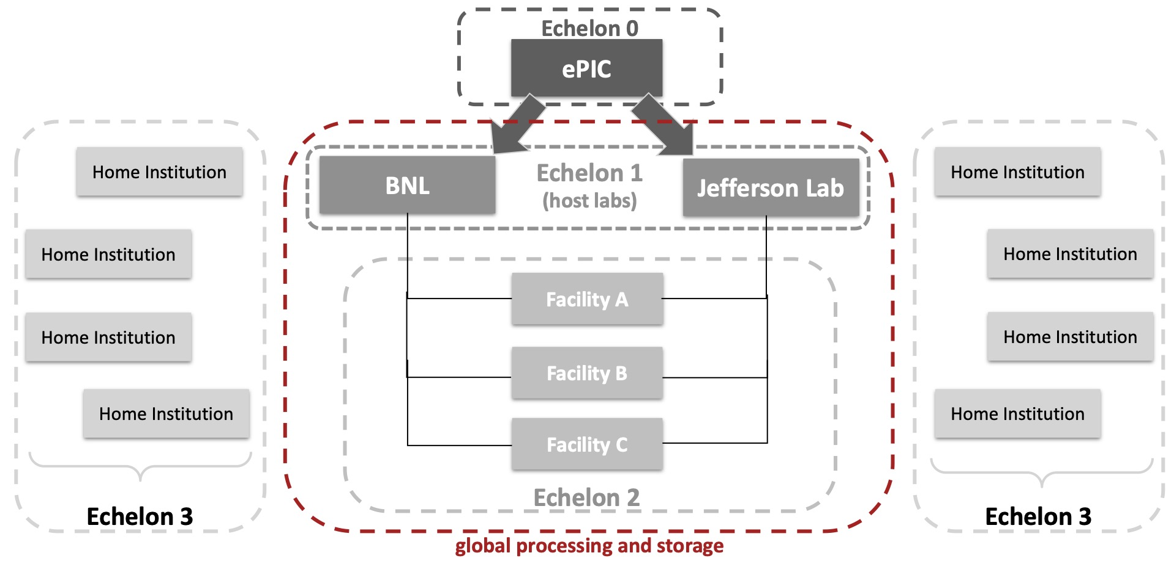
Streaming Computing Model
Streaming Readout of the ePIC Detector to maximize and accelerate science:
  ePIC aims for rapid turnaround of 2-3 weeks for data for physics analyses.
  Timeline driven by calibrations.
Four tiers of the ePIC Streaming Computing Model computing fabric:
  Echelon 0: ePIC experiment and its streaming readout.
  Echelon 1: Crucial and innovative partnership between host labs.
  Echelon 2: Essential global contributions.
  Echelon 3: Full support of the analysis community.
High level milestones ensures that the agile development process is continuously confronted with real world exercising of the software and the developing realization of the computing model:
  Priority always given to meeting near-term needs.
  Longer range timeline progressively exercising the streaming computing model to deliver for the needs of the CD process, for specific applications, e.g. test beams, for scaling and capability challenges, and ultimately for the phases of data taking.
Exciting opportunities to get involved in ePIC Software & Computing!

Slide 14
AI Strategy
AI is key part of all Software & Computing WGs in ePIC:
Focus on AI Development as Part of Simulation Campaigns:
Software and computing plan and integration with NHEP community developments successfully reviewed by EIC Computing and Software Advisory Committee.
Integration of AI methods in monthly simulation campaigns as measure of AI progress.
Ongoing work on centralization of training, management of model parameters, and workflow integration.
Strategic Development: Emphasis on algorithms for fast calibrations for streaming computing workflows and PID.
Collaborative Efforts:
Knowledge transfer with NHEP experiments on AI integration in production workflows.
Introduction of an AI challenge at the forthcoming collaboration meeting
  Results will be showcased at CERN meeting in April 2024.
Future Directions:
Data and analysis preservation for AI approaches.
Distributed learning for the distributed streaming computing model of ePIC.
Work with the theory community in NHEP on ways to advance data analysis and interpretation using AI.

Slide 15
Take-Away Messages
The EIC is a new QCD laboratory designed to elucidate:
  Origin of Nucleon Mass & Spin
  Nucleon / Nuclear Femtography
  Dense Gluon States
  BSM physics
The ePIC Collaboration is strong, active and growing!
The ePIC detector is maturing into a detailed technical design tuned to pursue the EIC science program
Software, Computing and AI are active efforts within ePIC and critical to its success!

Slide 16
Obligatory Shameless Plug
Mailing Lists – https://lists.bnl.gov/mailman/listinfo
Indico Agenda - https://indico.bnl.gov/category/402/
  ePIC Software and Computing: https://indico.bnl.gov/category/435/
Wiki - https://wiki.bnl.gov/EPIC
ePIC Software Training:
https://eic.github.io/tutorial-setting-up-environment/
https://eic.github.io/tutorial-geometry-development-using-dd4hep/
https://eic.github.io/tutorial-simulations-using-ddsim-and-geant4/
https://eic.github.io/tutorial-jana2/
Recordings: https://www.youtube.com/@eicusergroup1532
Mattermost: https://chat.epic-eic.org

Slide 17


Slide 18
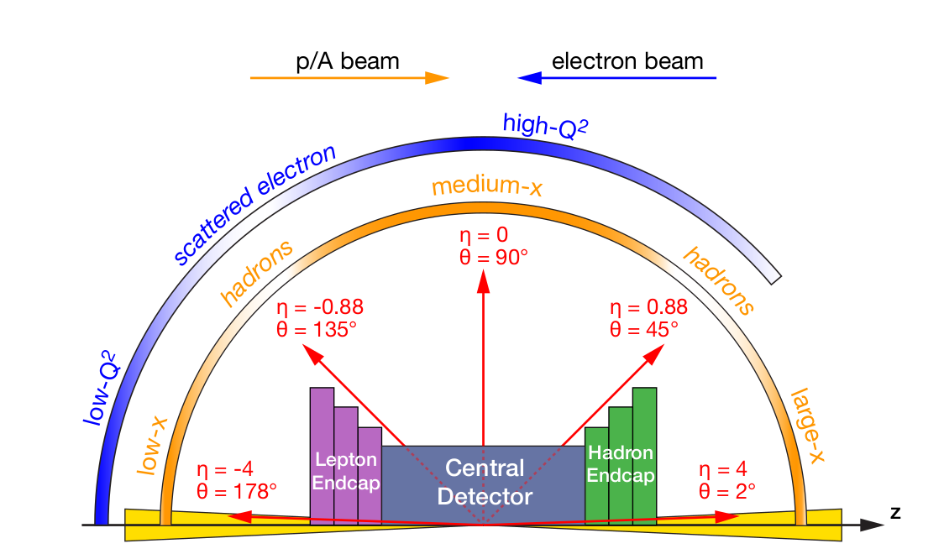
EIC Detector Requirements
Vertex detector → Identify primary and secondary vertices,
Low material budget: 0.05% X/X₀ per layer
High spatial resolution: 20 μm pitch CMOS Monolithic Active Pixel Sensor
Central and Endcap tracker → High precision low mass tracking
MAPS – tracking layers in combination with micro pattern gas detectors
Particle Identification → High performance single track PID for π, K, p separation
RICH detectors (RICH, DIRC)
Time-of-Flight high resolution timing detectors (HRPPDs, LGAD)
Novel photon sensors: MCP-PMT / HRPPD
Electromagnetic calorimetry → Measure photons (E, angle), identify electrons
PbWO₄ Crystals (backward), W/ScFi (forward)
Barrel Imaging Calorimeter (Si + Pb/ScFi)
Hadron calorimetry → Measure charged hadrons, neutrons and K_{L}⁰
Achieve ~70%/√E + 10% for low E hadrons (~ 20 GeV)
Fe/Sc sandwich with longitudinal segmentation
Very forward and backward detectors → Large acceptance for diffraction, tagging, neutrons from nuclear breakup
Silicon tracking layers in lepton and hadron beam vacuum
Zero-degree high resolution electromagnetic and hadronic calorimeters
DAQ & Readout Electronics → trigger-less / streaming DAQ, Integrate AI into DAQ
Radius/Distance from IP

Slide 19
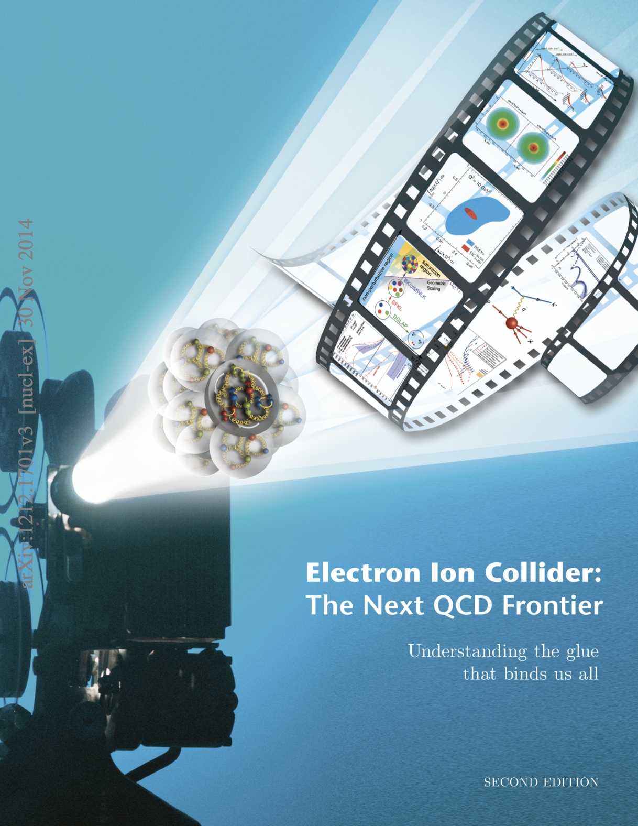

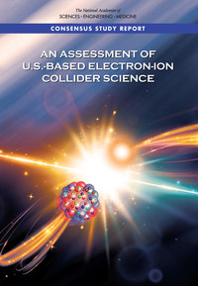


Detector Design Process Timeline
Detector and machine design parameters driven by physics objectives
2012
2015
2018
2020
2023
Call for proposals issued jointly by BNL and JLab in March 2021 (Due Dec 2021)
  ATHENA, CORE and ECCE proposals submitted
DPAP review Dec 2021 – Jan 2022, closeout March 2022
  ECCE proposal chosen as basis for first EIC detector reference design
Spring/Summer 2022 – ATHENA and ECCE form joint leadership team
  Joint WG’s formed and consolidation process undertaken
  Coordination with EIC project on development of technical design
Collaboration formation process started July 2022
Charter ratified & elected ePIC Leadership Team February 2023
EIC/ePIC endorsed as highest priority for new facility construction in 2023 LRP.
Working towards TDR and CD-3A (review Nov. 2023) and CD-2/3 (2025)

Slide 20
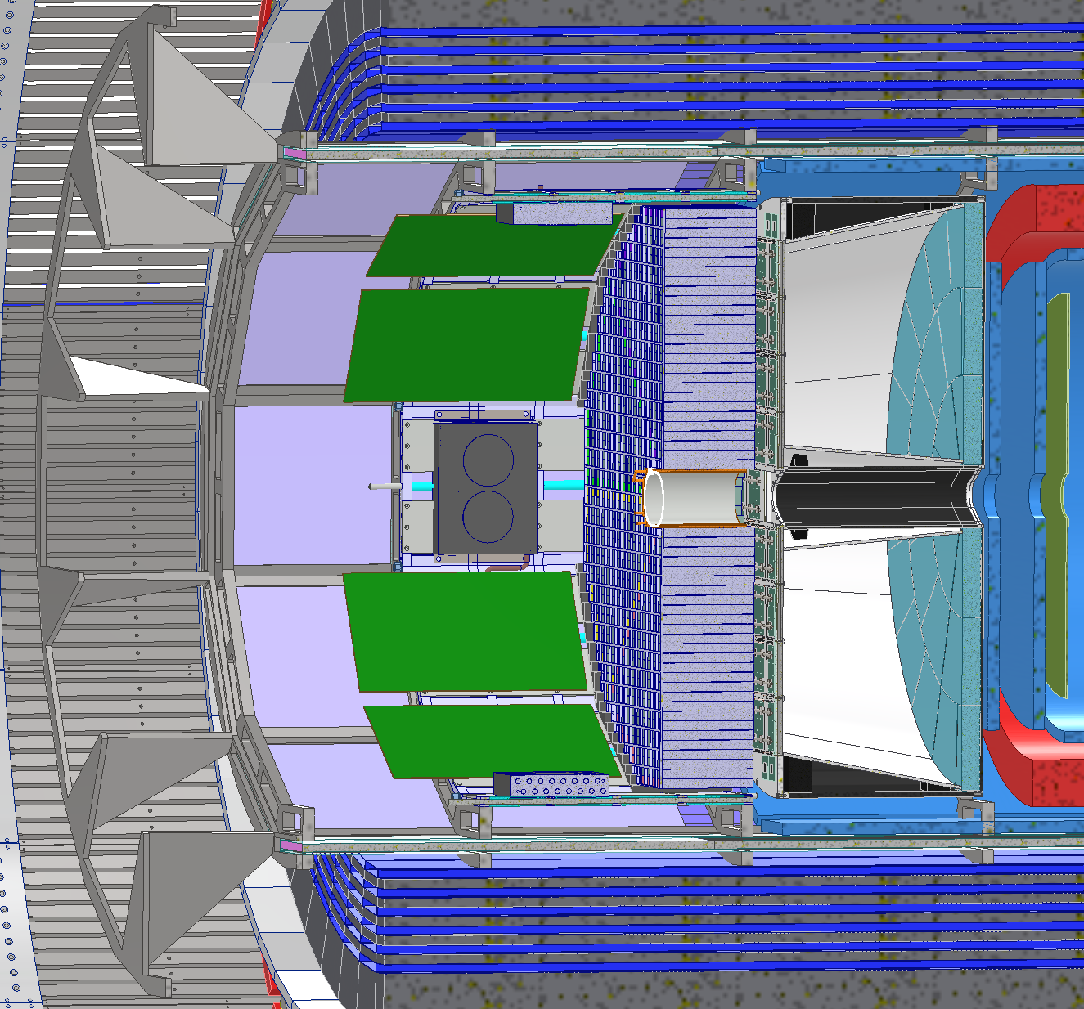
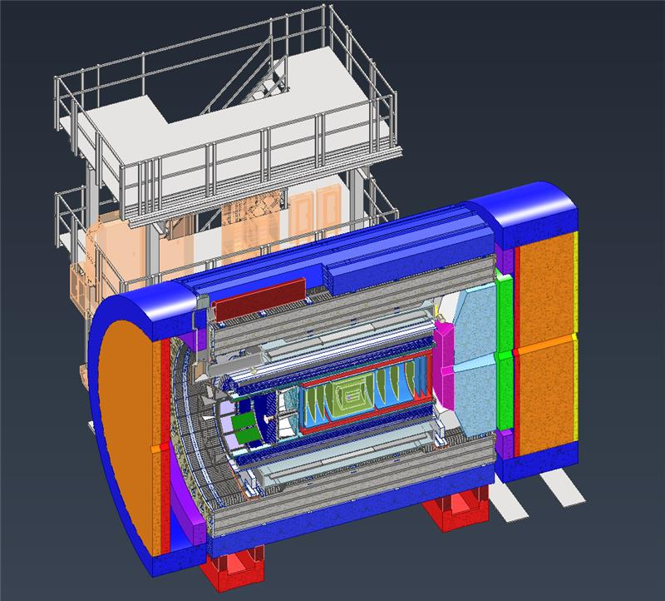
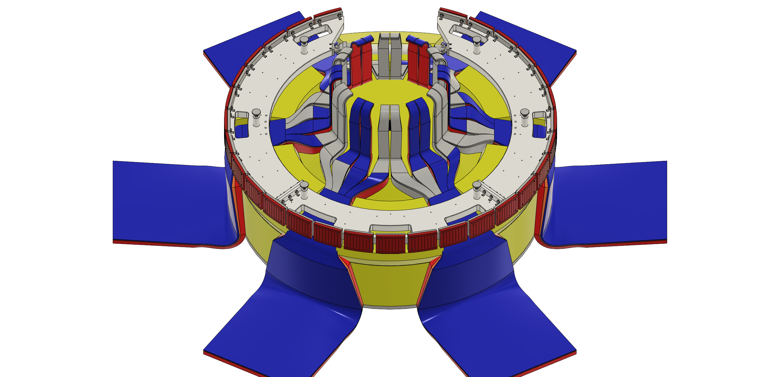
Integration
Backwards detector optimization
dRICH vessel, end rings, and services paths
Services and
cable routing

Slide 21
Hot/Cold QCD Town Hall Recommendation
We recommend the expeditious completion of the EIC as the highest priority for facility construction
The Electron-Ion Collider (EIC) is a powerful and versatile new accelerator facility, capable of colliding high-energy beams ranging from heavy ions to polarized light ions and protons with high-energy polarized electron beams. In the 2015 Long Range Plan the EIC was put forward as the highest priority for new facility construction and the expeditious completion remains a top priority for the nuclear physics community. The EIC, accompanied by the general-purpose large-acceptance detector, ePIC, will be a discovery machine that addresses fundamental questions such as the origin of mass and spin of the proton as well as probing dense gluon systems in nuclei. It will allow for the exploration of new landscapes in QCD, permitting the “tomography”, or high-resolution multidimensional mapping of the quark and gluon components inside of nucleons and nuclei. Realizing the EIC will keep the U.S. on the frontiers of nuclear physics and accelerator science and technology.
  (with two sub-bullets related to support for the ePIC detector and workforce, and EIC Theory)
There is consistent and overwhelming support for EIC
EIC must continue to be a HIGH recommendation for the field

Slide 22
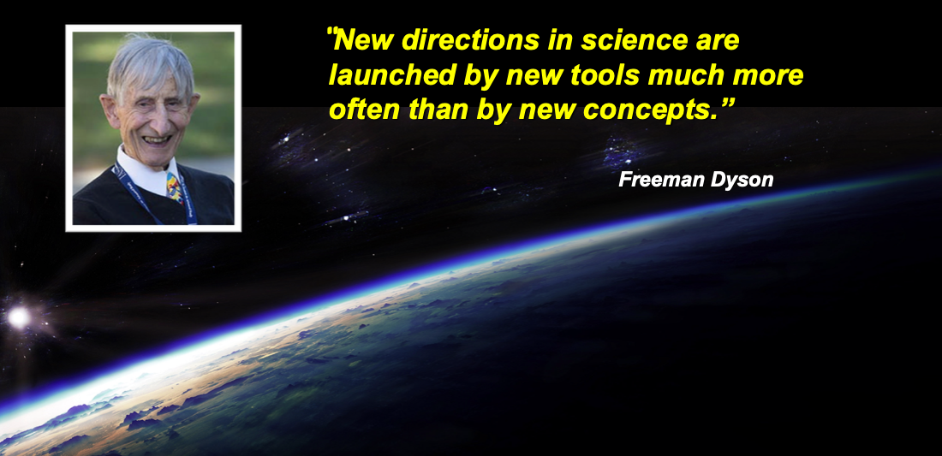

Slide 23
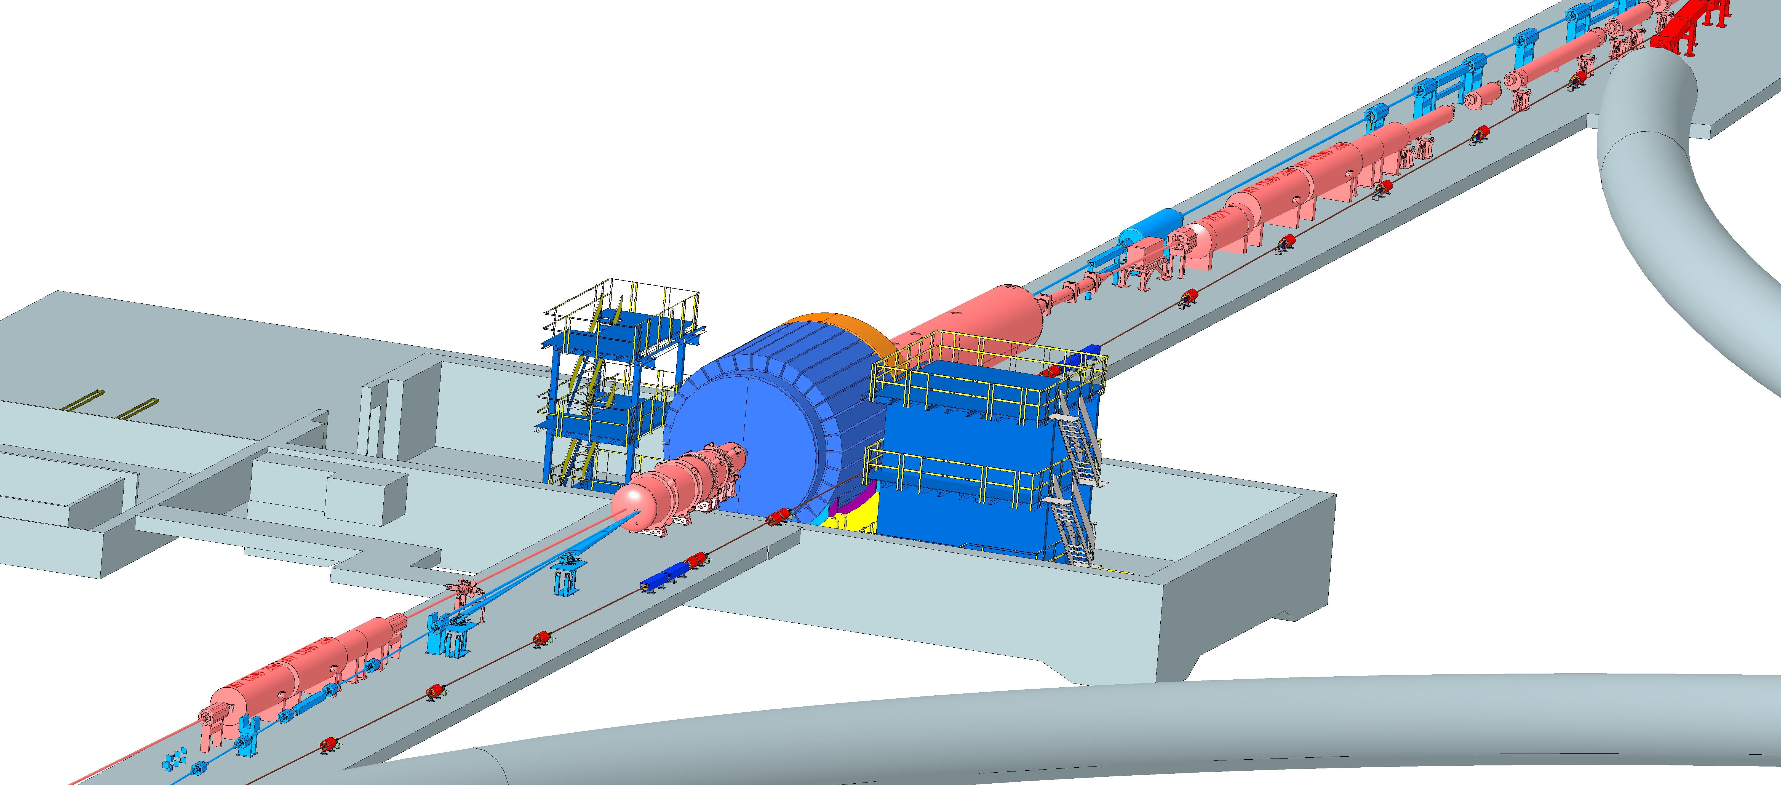
Interaction Region Integration
ESR Forward side
Forward Side
SC Magnet Cryostat
HSR Injection Line
Central Detector
Rear Side
SC Magnet Cryostat
HSR Forward Side
HSR: Hadron Storage Ring
ESR: Electron Storage Ring
RCS: Rapid Cycling Synchrotron
SC: Superconducting
HSR
Rear Side
RCS
With Detector Bypass
ESR Rear side

Slide 24
Beam Backgrounds
proton beam:
Low beam lifetime during injection and ramping
Beam gas interactions, large hadronic cross section
  Secondary interactions with aperture limitations, i.e. with magnets, beam pipe, masks
electron beam:
Synchrotron radiation
  Backscattering
  Photo desorption
  → degradation of vacuum
Beam gas interactions
  Off momentum electrons
Higher order mode losses
  Local heating at injection and ramp (short bunches)
  Degradation of vacuum
Background due to de-excitation of beam if bunches are replaced
Requirements:
Keep beam backgrounds as low as possible
→ Careful design of interaction region, beam-pipe masks and photon beam dump
→ Excellent vacuum system
Important to note:
Low multiplicity per event: < 10 tracks
No pileup from collisions 500 kHz @10³⁴ cm⁻²s⁻¹ → DIS event every 200 bunches
Radiation environment much less harsh than LHC → factor 100 less

Slide 25
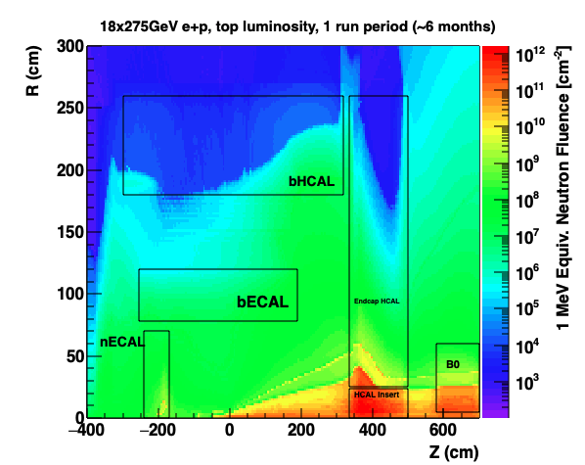
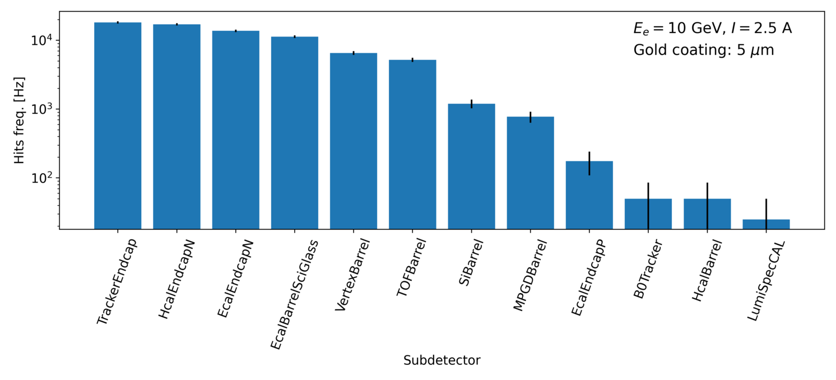
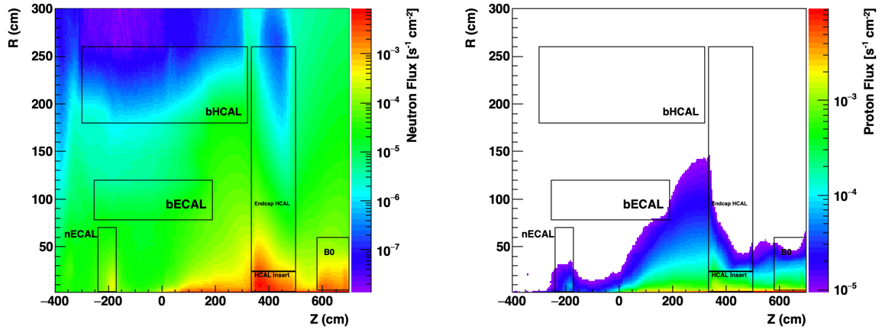
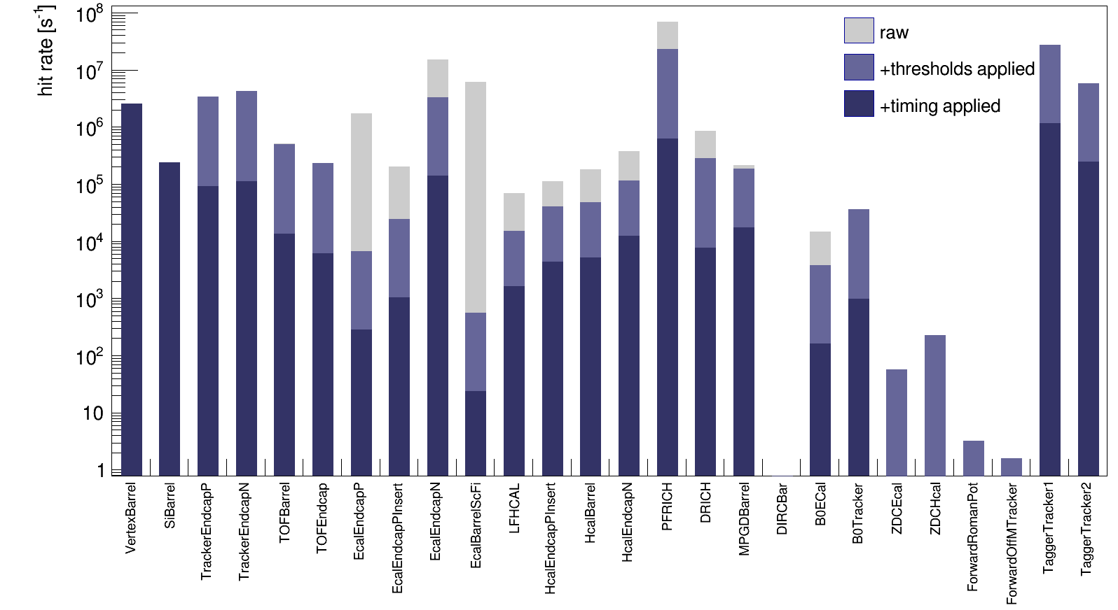
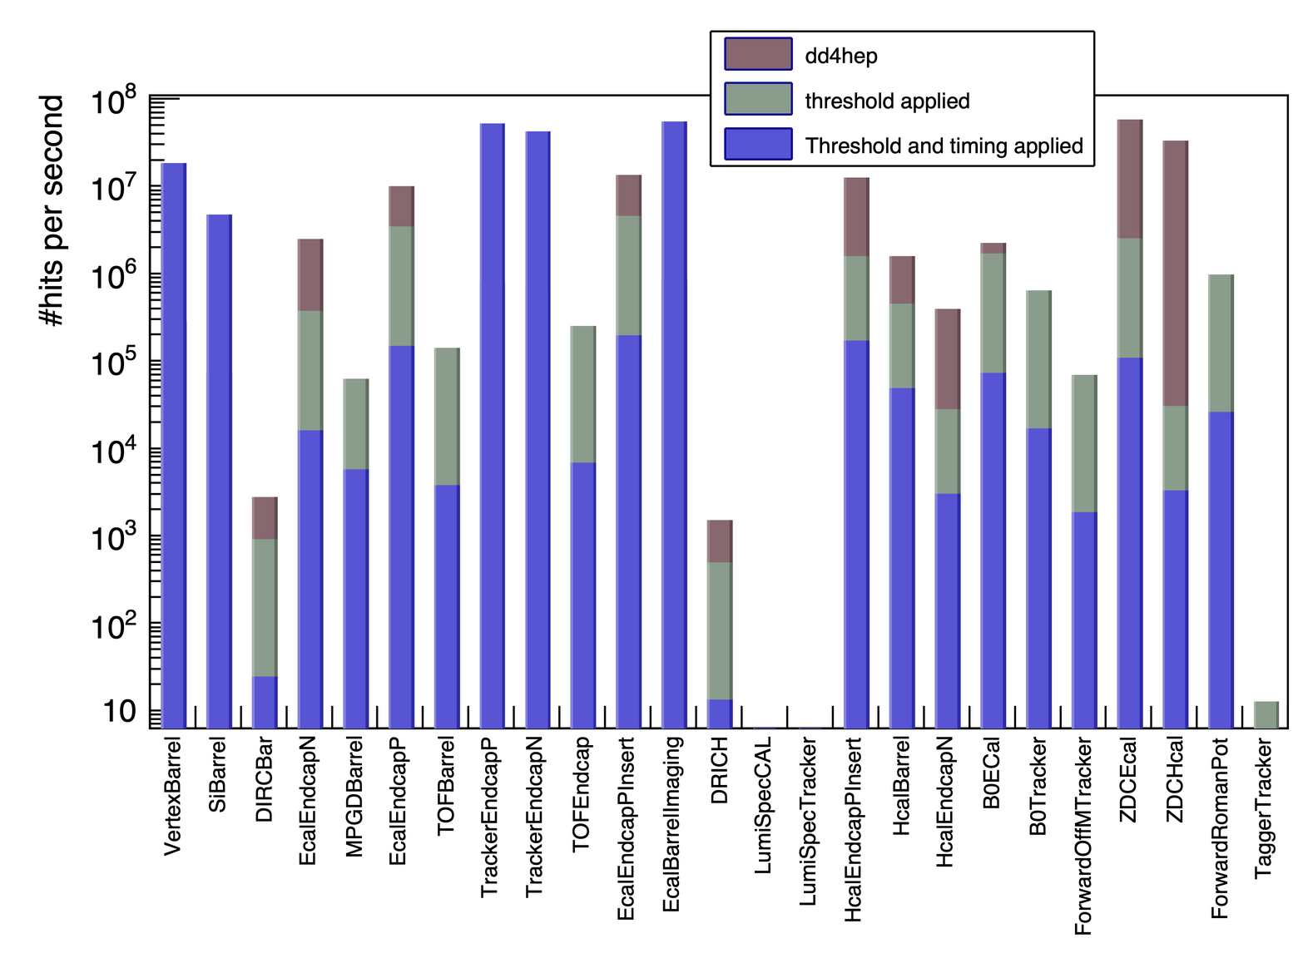
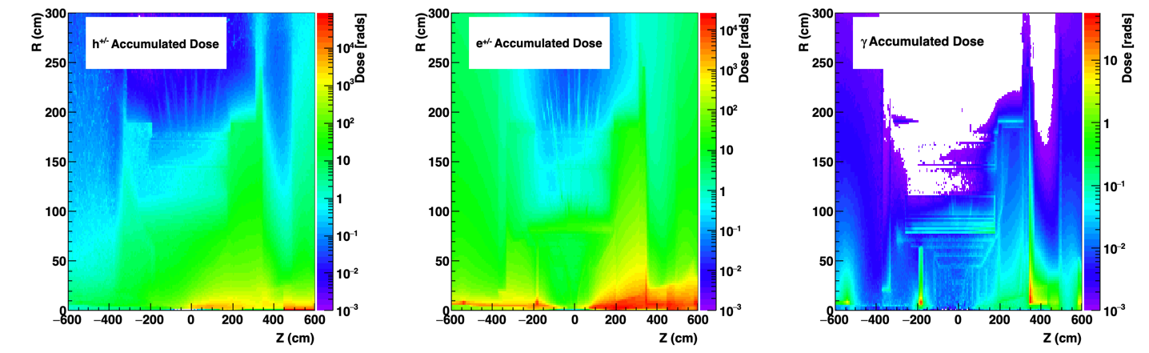
Background and Radiation Simulations
Synchrotron Radiation
1 MeV Neutron fluence at top luminosity (500 kHz) for
18 GeV x 275 GeV
Neutron & proton flux E_{kin}>250 MeV to determine single event upsets
top luminosity & 18 GeV x 275 GeV
Electron Beam Gas
Radiation dose at 18 GeV x 275 GeV for top luminosity 500 kHz
Hadron Beam Gas
25

Slide 26
High-Level Installation Schedule
Oct 2028
Jan 2029
early
CD-4A
04/2031
early CD-4
CD-4A
04/2032
CD-3
04/2025
April 2029
Dec 2029
CD-4
04/2034
June 2030
Oct 2030
Jan 2031
Construction
IR-6 ready
for installation
Transition into
Operations
Start of
Operations
&
Science
lower half
barrel Hcal
installed
Solenoid
delivered
Endcap HCals
completed
Solenoid
Field mapping
done in beam position
Hadron Endcap
Detectors
installed
Trackers, dRICH
ECal
done in IP-6 Assembly Hall
Barrel Ecal
ready
for installation
Solenoid and Barrel HCal need to be ready by Jan 2029
All other subdetectors need to be ready between 06/29 to 06/30 depending on their location in the detector
Barrel Hcal
& Solenoid
installed
followed by low
power test
Lepton Endcap
Detectors
installed
Trackers, bRICH
ECal
Barrel Detectors
installed
ECal, DIRC,
ToF, Trackers

Slide 27
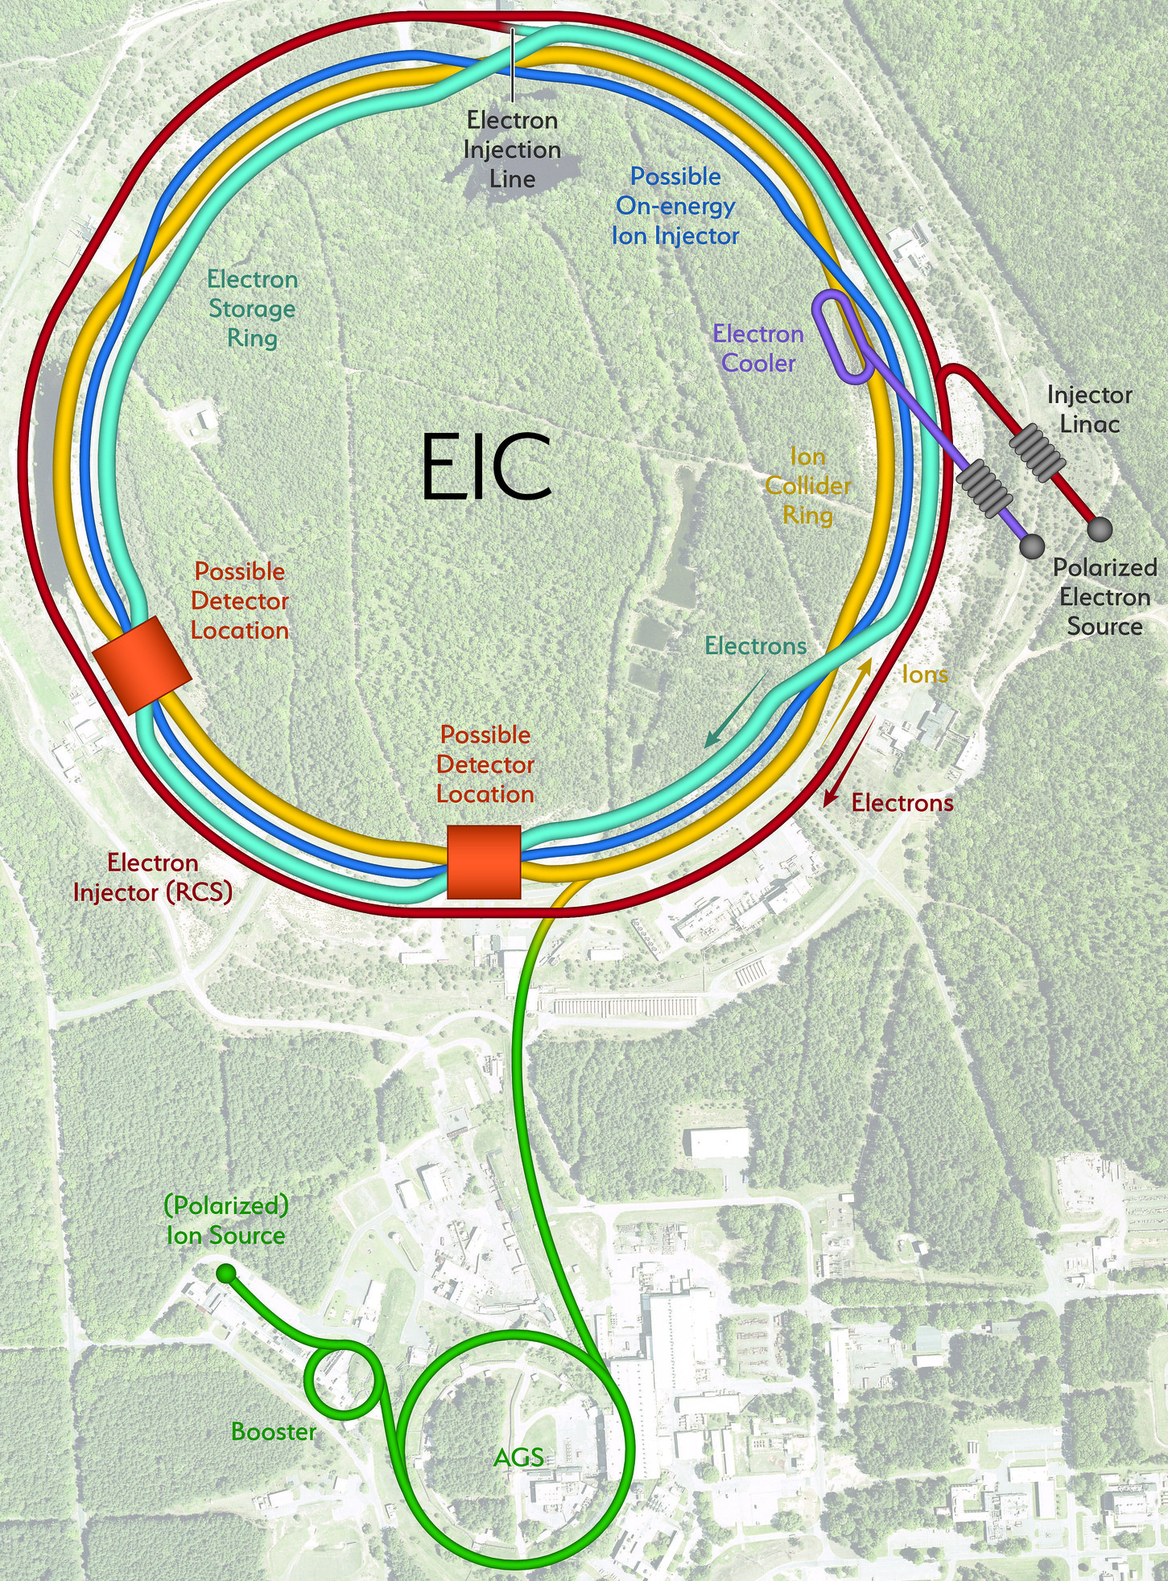


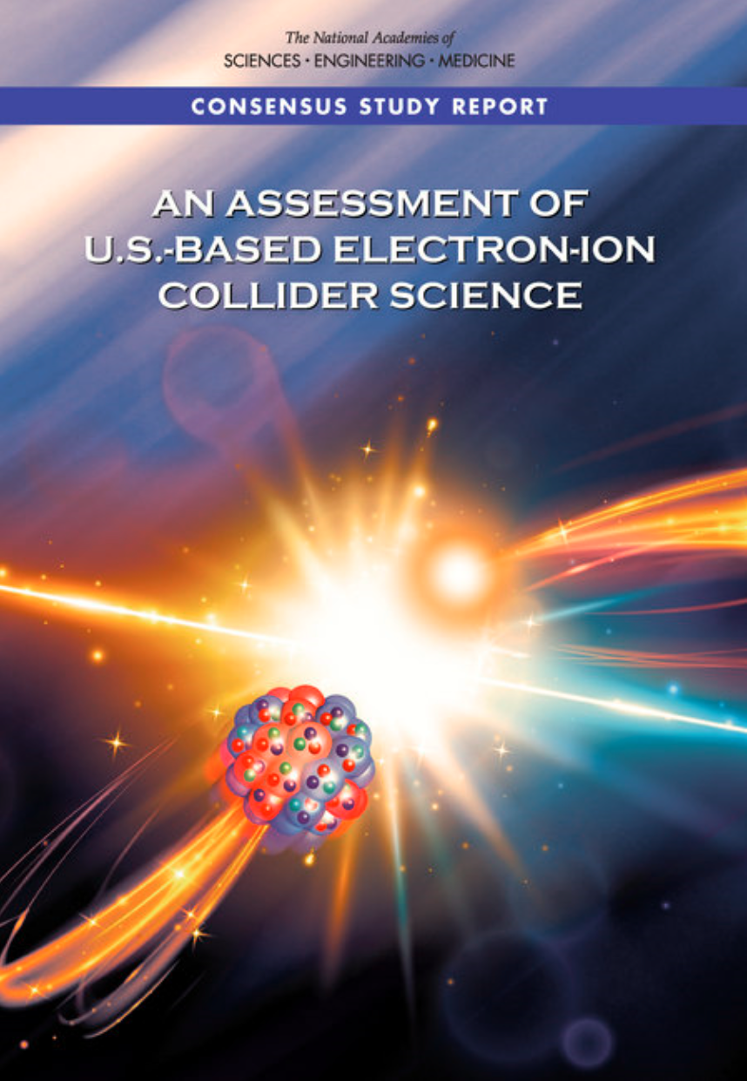
The Electron-Ion Collider (EIC)
Joint project between Brookhaven National Lab and Jefferson Lab
$1.7-2.8B investment
  CD-1 (2021), CD-3A (2024), CD-2/3 (2025)
Explore the structure of matter via QCD:
Operations as soon as 2032
  Origin of Nucleon Mass & Spin
  Confinement
  Nucleon / Nuclear Femtography
  Dense Gluon States
  BSM

Slide 28
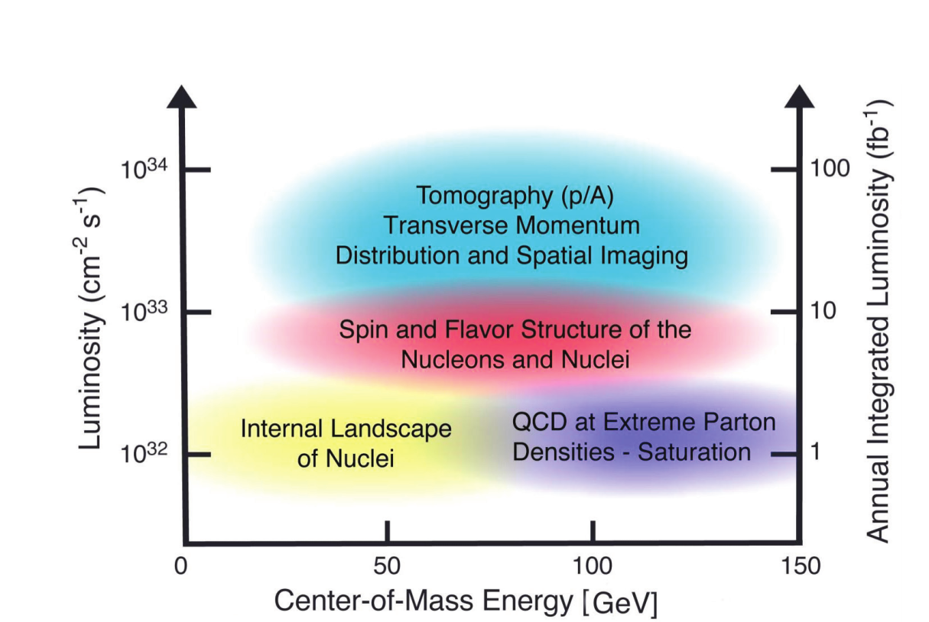
EIC Machine Parameters
Center of mass energy: 20 – 140 GeV
  Electrons: 2.5 – 18 GeV
  Protons: 40 – 275 GeV (ions: Z/A x E_{proton})
Luminosity: 10³⁴ /cm²/sec
Polarization: <70% (both electron and ion)
Ion Species: proton - Uranium
Detectors: up to 2 interaction regions
with (almost) complete coverage

Slide 29
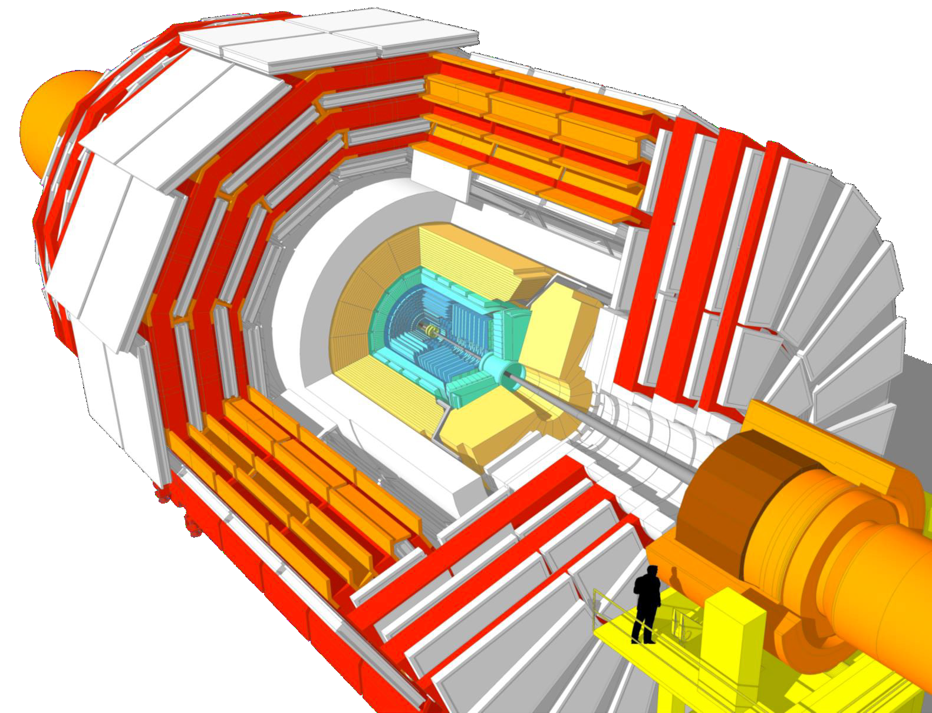

AC-LGAD TOF
CMS ETL (LGAD)
AC-LGAD detectors add an AC-coupled readout to provide both
fast timing response and excellent spatial resolution (4D).
Roman pot arrays

Slide 30
Backward Calorimetry
Backward EMCAL
Non-projective PbWO₄ calorimeter (EEEMC-Consortium)
  2 × 2 × 20 cm³ crystals
  Length ~20X/X₀, transverse size ~Molière radius
  Located inside the inner DIRC frame
  Preferred readout: SiPMs of pixel size 10μm or 15μm
  Cooling to keep temperature stable within ± 0.1 ◦C
Ongoing efforts advancing the design to increase coverage in η (−3.7 < η < −1.5) with inlay around beampipe

Slide 31
Barrel EM Calorimetry
Hybrid concept
  Imaging calorimetry based on monolithic silicon sensors AstroPix (NASA’s AMEGO-X mission) - 500 μm x 500 μm pixels Nuclear Inst. and Methods in Physics Research, A 1019 (2021) 165795
  Scintillating fibers in Pb (Similar to GlueX Barrel ECal, 2-side readout w/ SiPMs) Nuclear Inst. and Methods in Physics Research, A 896 (2018) 24-42
6 layers of imaging Si sensors interleaved with 5 Pb/ScFi layers and followed by a large chunk of Pb/ScFi section (can be extended to inner HCAL)
Total radiation thickness for EMCAL of ~20 X₀
Detector coverage: -1.7 < η < 1.3 which overlaps with “electron-going” side endcap
Energy resolution - SciFi/Pb Layers: 𝟓.𝟑% /√𝑬 ⨁ 𝟏.𝟎%
Position resolution - Imaging Layers (+ 2-side SciFi readout): with 1st layer hit information ~ pixel size

Slide 32





Barrel Hadronic Calorimetry
Reuse of sPHENIX outer (outside of the Solenoid) HCal ≈ 3.5λ_{l}
Steel and scintillating tiles with wavelength shifting fiber
Δη x Δφ ≈ 0.1 x 0.1
(1,536 readout channels, SiPMs)

Slide 33


Forward Hadronic Calorimetry
Design based on longitudinally separated steel and scintillator tiles (ORNL)
Inspired by Projectile Spectator Detector (CBM)
  60 layers of steel-sci plates + 10 layers of W-Sci plates (5 x 5 cm towers)
  7 signals per tower (from 10 plates)
  λ/λ₀ = 6.9 (HCAL only, larger shower containment)
Ongoing efforts to explore granular inlay around beampipe

Slide 34




Tracking Performance
Simulated performance
F. Bock, Hard Probes 2023
Technology
ITS3 MAPS based Si-detectors:
O(20µm) pitch, X/X⁰ ∼ 0.05 − 0.55%/ layer
Gaseous tracker:
σ = 55 µm, X/X₀ ∼ 0.2%/layer
AstroPix outer tracker layer:
500µm pixel pitch (σ = 144 µm)
F. Bock, Hard Probes 2023
First “μITS3” assembly at CERN
Cylindrical μMega
Meets EICUG Yellow Report design requirements
Backward momentum resolution complemented by calorimetric resolution

Slide 35




Calorimetry Performance
plots by N. Schmidt
F. Bock, Hard Probes 2023
Performance on energy resolution and matching
Technologies fulfill YR requirements on energy resolution
Ongoing simulation studies related to overlaps between different η regions for calorimetry and reconstruction algorithms
Ongoing work on Monte-Carlo validation
Validation for high Z absorbers

Slide 36



Particle ID
Particle IDentification needs
Electrons from photons ⟶ 4π coverage in tracking
Electrons from charged hadrons ⟶ mostly provided by calorimetry and tracking
Charged pions, kaons and protons from each other on track level ⟶ Cherenkov detectors
  Cherenkov detectors, complemented by ToF
HRPPD
Need more than one technology to cover the entire momentum ranges at different rapidities

Slide 37

Electronics
Global Timing Unit (GTU)
-Interfaces to
Collider Run Control & DAM
-Config & Control
-Clock & Timing
Electronics Readout Chain
We have 23 different detector technologies in the ePIC detector
It would be intractable if all have different readout electronics
The goal is to minimize the number of different ASICs and use common readout solutions
On Detector
SMT BGA
Sensor
Adapter
Front End Board (FEB)
Readout Board (RDO)
Data Aggregation Module (DAM)
Computing
Detector Group | Channels | AC-LGAD | SiPM/PMT | MPGD
 | MAPS | AC-LGAD | SiPM/PMT | MPGD
TOTAL | 32 B | 7.1M-54M | 370k | 100k
ASIC | ITS-3 | EICROC FCFD HPsOC ASROC FAST | Discrete/COTS HGCROC3 ALCOR-EIC | SALSA
We expect to need
ITS-3, Astropix, Timepix, and 4 different ASICs
Based on existing ASICs → reduce cost & time
Much synergy with international efforts

Slide 38





Far-Forward Detectors
B0 Silicon Tracker and EM Calorimeter
Roman Pots integration
B0 system: Measures charged particles in the forward direction and tags neutral particles
Off-momentum detectors: Measure charged particles resulting from, e.g., decays and fission
Roman pot detectors: Measure charged particles near the beam
Zero-degree calorimeter: Measures neutral particles at small angles
Detector | Acceptance
Zero-Degree Calorimeter (ZDC) | 𝜽 < 5.5 mrad (𝜂 > 6)
Roman Pots (2 stations) | 0.0 < 𝜽 < 5.0 mrad (𝜂 > 6)
Off-Momentum Detectors (2 stations) | 𝜽 < 5.0 mrad (𝜂 > 6)
B0 Detector | 5.5 < 𝜽 < 20.0 mrad (4.6 < 𝜂 < 5.9)

Slide 39


Far Backwards Detectors
Luminosity Spectrometer
Low-Q² tagger
~1% measure of luminosity
relative luminosity to 10⁻⁴
e+p → e γ p
e+Au → e γ Au
Clean photoproduction signal for
10⁻³ < Q² < 10⁻¹

Slide 40



Marco Magnet Design
Conductor is based on CEA-Saclay experience as used for previous magnets.
Contract for conductor test samples in place with viable vendor.
Steel
Mechanical analysis undergoing final checks
Coil is divided in 3 modules with 557 Turns each. This is done mainly to accommodate possible conductor length.
Flux return steel layout fully defined to minimize forces and fringe fields (~10G)
Conductor exits
The two most important design parameters are conservative: large temperature margin and large critical current margin
Joint CEA-Saclay-JLab-BNL effort

Slide 41
ePIC Collaboration Structure

