Slide 1
chATLAS
An AI Assistant for the ATLAS Collaboration
Daniel Murnane, Gabriel Facini, Runze Li & Cary Randazzo
AI4EIC Workshop
November 30, 2023
Notes:
Add Fermilab

Slide 2
Motivation
Motivated to have a tool that could be a front-door for…
Quickly parsing documentation and twiki
Semantic search and availability of heterogeneous sources of ATLAS information
Summarizing research
Connecting the dots between different groups
Debugging software
Searching and summarizing JIRA and Glance information

Slide 3
History
In April 2023, initial ATLAS ML Forum meeting to discuss usage of ChatGPT and Github Copilot within ATLAS
In June 2023, presentations on several ongoing works to use LLMs within ATLAS
ATLAS-GPT: Daniel Murnane
ChATLAS: Gabriel Facini
Google Bard + ATLAS: Kaushik De
Analysis Description Language + GPT: Gokhan Unel
Decision made to converge ATLAS-GPT and ChATLAS and create an official prototype
Fortnightly developer meetings kicked off in August 2023
Currently approx. seven part-time contributors
Launched ATLAS-public demo November 16 https://chatlas-flask-chatlas.app.cern.ch/

Slide 4
Current Status: Demo

Slide 5
Current Status: Infrastructure
(PP) = (Possibly Processed)
CERN Openshift
CERN OAuth SSO
Query
Flask Server
User
Query
OpenAI
LangChain
Embedding Vector
GPT 3.5 / GPT 4
Chroma DB
H.F.S.T Embedding
Conversational RetrievalChain
CERN EOS

Slide 6
Current Status: Infrastructure
(PP) = (Possibly Processed)
CERN Openshift
CERN OAuth SSO
Flask Server
Response $⊕$ KNN docs w/ similarity scores
User
(PP) Response
OpenAI
LangChain
Response
GPT 3.5 / GPT 4
Chroma DB
H.F.S.T Embedding
Conversational RetrievalChain
(PP) Query $$⊕$$ (PP) KNN docs
KNN documents
CERN EOS

Slide 7
Current Status: Infrastructure
(PP) = (Possibly Processed)
CERN Openshift
Currently takes ~3 seconds to respond (mostly waiting on OpenAI)
CERN OAuth SSO
Query
Flask Server
Response $⊕$ KNN docs w/ similarity scores
User
Query
(PP) Response
OpenAI
LangChain
Embedding Vector
Response
GPT 3.5 / GPT 4
Chroma DB
H.F.S.T Embedding
Conversational RetrievalChain
(PP) Query $$⊕$$ (PP) KNN docs
KNN documents
CERN EOS

Slide 8
Current Status: Datasets
Diagram of all the possible ATLAS datasets and how many we have in the DB
Add a box around those that are almost in the DB
Stage the progress of each (solid/dashed in-progress/complete, scraped, converted, chunked+embedded)
Twiki
ATLAS Software Docs
E-group Archive
Indico Meetings PDF Text
CDS Papers & Notes PDF Text
- - - In-progress
----- Complete
Not yet started
Scraping
Converting
Chunking/Embedding
JIRA
ATLAS Codebases
Group-level Documentation
Mattermost
PDF Plots

Slide 9
Details: Scraping
ATLAS Twiki
CDS
Indico
Start with set of “Starting URLs”
Recursively visit included links
Find all headers, and visit content below
Append metadata of twiki (parent structure, date revised, etc.)
Discover whether the CDS paper has a Gitlab latex repo
If latex exists, pull from repo and (planned) convert to markdown
(Planned) Use unstructured library to parse markdown
If latex does not exist, use nougat library to read PDF (including equations) into markdown
Load event list
Scrape timetable contents (date, title, speaker, etc.)
(Planned) Pull PDF slide decks and minutes
(Planned) Parse in the same way as in CDS

Slide 10
Details: Chunking
(Current) Loop through HTML and Markdown heading sections
If section exceeds 510 tokens, split with SentenceTransformersTokenTextSplitter
Pass chunk through HuggingFace’s sentence-transformers/all-MiniLM-L6-v2 model
(Planned) Use built-in unstructured library to identify chunks
Insert chunk into Chroma database, with metadata of file URL, twiki name
Original Query
K documents
Previous chat
Details: Retrieval
All handled internally by qa = ConversationalRetrievalChain.from_llm( llm=model, retriever=db.as_retriever(), memory=memory, verbose=False,)
LLM Model is GPT-3.5 from OpenAI API, retriever is default Chroma which contains the embedding model, memory is a buffer that retains all previous chat information
Implicit is that the model aggregates all K-documents with a prompt to produce a new question based on the original question and the K-documents
Conversational RetrievalChain
K documents + processed new query

Slide 11
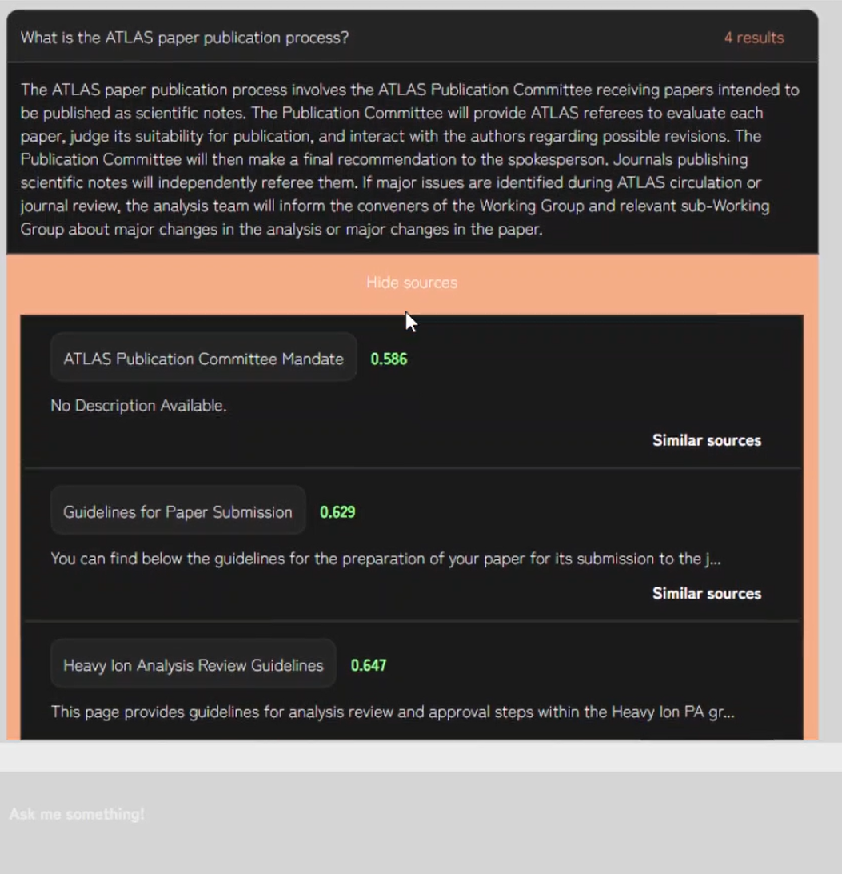
Details: Chat interface

Slide 12
Details: Chat interface
Version 1.0 contains everything needed to answer a query
Can cite the top sources used in the response
Has a quick search for similar sources
Input query
LLM response
Source title
Similarity score
Instant similarity search
Next query entry

Slide 13
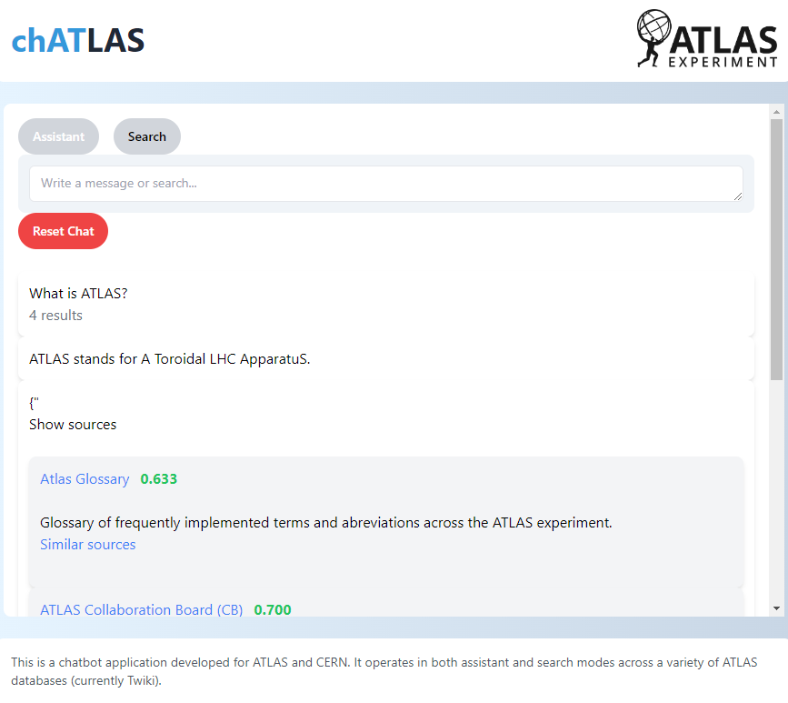
Details: Chat interface
Version 1.0 contains everything needed to answer a query
Can cite the top sources used in the response
Has a quick search for similar sources
Experimenting with a V2.0 appearance that is lighter, and has a dedicated Assistant mode and Search mode

Slide 14
Shortcomings and Hurdles
Getting the data! Highly heterogeneous file types, many behind authorisation walls, many stale or inaccurate, many requiring high levels of post-processing
Community solutions could go a long way: Ensure that any experiment/collaboration databases are easily accessible and exportable. All websites should live in a git repo. All publications should be submitted and saved as latex, and compiled separately. All discussion forums should have anonymisation options. This would have saved O(1 year) of data wrangling
Hallucination is still a very real problem [https://www.arxiv-vanity.com/papers/2311.04348/]
A high quality AI assistant probably requires fine tuning, which is an expensive task (less in gpu-hours, more in expert-hours)
Open-source solutions for UI are not particularly flexible. A tool built by+for the scientific community would be very useful! Open-source solutions for backend (retrieval, document aggregation) are perfectly fine.
Codebase integration: experiment codebases are huge, not so well-commented, and non-obvious how to chunk. Perhaps an automated commenting algorithm as a pre-process step?

Slide 15
Roadmap
Twiki
ATLAS Software Docs
CDS Papers & Notes PDF Text
ATLAS Codebases
JIRA
Datasets
E-group Archive
Indico Meetings PDF Text
Mattermost
Group-level Documentation
PDF Plots
Vision model for plots and diagrams
HuggingFace & OpenAI API
HuggingFace both Embedding & Completion
More sophisticated document aggregation
Fine-tuned Completion Model
Infrastructure & Models
Single-query Assistant & Simple search
Filtered search & Continued- conversation Assistant
Integration with Gitlab and IDEs
Integration with other CERN AI Assistants
Agentic – categorize, review papers, monitor Glance and Jira
Interface & Features
Today Jan ’24 March ’24 July ‘24

Slide 16
Open questions & Conclusion
How to avoid hallucinations? Probably “GPT-5 / Q* / AGI” will make this hurdle irrelevant
How to best “censor” politically incorrect responses (e.g. which analysis team is the best?)
How to measure the quality of responses – LangSmith AI-assisted evaluators?
What is the best dataset to gather for fine-tuning?
How to anonymize email threads and discussion forums?
We are having a lot of fun building this thing from scratch, but if there was an open-source scientific community framework for AI Assistants, it would be even more fun!

Slide 17
BACKUP

Slide 18
Retrieval-Augmented Generation

Slide 19
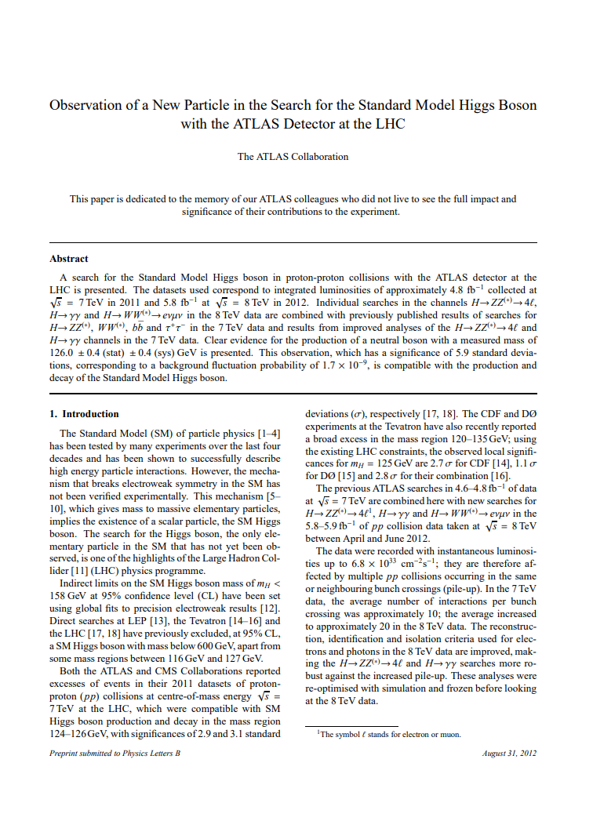
Retrieval-augmented generation (RAG)
Convert document to txt
arXiv:1207.7214v2 [hep-ex] 31 Aug 2012EUROPEANORGANISATION FOR NUCLEARRESEARCH(CERN) CERN-PH-EP-2012-218 Acceptedby: PhysicsLettersB Observation ofa NewParticleinthe Searchfor the Standard Model HiggsBoson withthe ATLAS Detector atthe LHC TheATLAS Collaboration This paper is dedicated tothe memory of our ATLAS colleagues whodid not livetosee the full impact and signicance of their contributions totheex periment. Abstract A search for the Standard Model Higgs boson in proton-proton collisions with the ATLAS detector at the LHC is presented. The datasets used correspond to inte grated luminosities of approximately 4.8fb1collectedats=7TeVin2011and5.8fb1ats=8TeVin2012. Individualsearchesinthe …

Slide 20
Retrieval-augmented generation (RAG)
higgs_discovery.txt
arXiv:1207.7214v2 [hep-ex] 31 Aug 2012EUROPEANORGANISATION FOR NUCLEARRESEARCH(CERN) CERN-PH-EP-2012-218 Acceptedby: PhysicsLettersB Observation ofa NewParticleinthe Searchfor the Standard Model HiggsBoson withthe ATLAS Detector atthe LHC TheATLAS Collaboration This paper is dedicated tothe memory of our ATLAS colleagues whodid not livetosee the full impact and signicance of their contributions totheex periment. Abstract A search for the Standard Model Higgs boson in proton-proton collisions with the ATLAS detector at the LHC is presented. The datasets used correspond to inte grated luminosities of approximately 4.8fb1collectedats=7TeVin2011and5.8fb1ats=8TeVin2012. Individualsearchesinthe …
Convert document to txt
Split into K-word chunks
higgs_discovery_0.txt
higgs_discovery_1.txt
arXiv:1207.7214v2 [hep-ex] 31 Aug 2012EUROPEANORGANISATION FOR NUCLEARRESEARCH(CERN) CERN-PH-EP-2012-218 Acceptedby: PhysicsLettersB Observation ofa NewParticleinthe Searchfor the Standard Model HiggsBoson withthe ATLAS Detector atthe LHC TheATLAS Collaboration This paper is dedicated …
This paper is dedicated tothe memory of our ATLAS colleagues whodid not livetosee the full impact and signicance of their contributions totheex periment. Abstract A search for the Standard Model Higgs boson in proton-proton collisions with the ATLAS detector at the LHC is presented. …

Slide 21
Retrieval-augmented generation (RAG)
higgs_discovery.txt
arXiv:1207.7214v2 [hep-ex] 31 Aug 2012EUROPEANORGANISATION FOR NUCLEARRESEARCH(CERN) CERN-PH-EP-2012-218 Acceptedby: PhysicsLettersB Observation ofa NewParticleinthe Searchfor the Standard Model HiggsBoson withthe ATLAS Detector atthe LHC TheATLAS Collaboration This paper is dedicated tothe memory of our ATLAS colleagues whodid not livetosee the full impact and signicance of their contributions totheex periment. Abstract A search for the Standard Model Higgs boson in proton-proton collisions with the ATLAS detector at the LHC is presented. The datasets used correspond to inte grated luminosities of approximately 4.8fb1collectedats=7TeVin2011and5.8fb1ats=8TeVin2012. Individualsearchesinthe …
Convert document to txt
Split into K-word chunks
Embed each chunk with HuggingFace SentenceTransformer model into 1536-dimensional vector space
higgs_discovery_0.txt
higgs_discovery_1.txt
arXiv:1207.7214v2 [hep-ex] 31 Aug 2012EUROPEANORGANISATION FOR NUCLEARRESEARCH(CERN) CERN-PH-EP-2012-218 Acceptedby: PhysicsLettersB Observation ofa NewParticleinthe Searchfor the Standard Model HiggsBoson withthe ATLAS Detector atthe LHC TheATLAS Collaboration This paper is dedicated …
This paper is dedicated tothe memory of our ATLAS colleagues whodid not livetosee the full impact and signicance of their contributions totheex periment. Abstract A search for the Standard Model Higgs boson in proton-proton collisions with the ATLAS detector at the LHC is presented. …
…
0
1
…
$$ℝ^{1536}$$

Slide 22
How it works
Convert document to txt
Split into K-word chunks
Embed each chunk with HuggingFace SentenceTransformer model into 1536-dimensional vector space
Embed prompt $P$in this space
0
$$P$$
1
$$d_{i}$$
$$ℝ^{1536}$$

Slide 23
How it works
Convert document to txt
Split into K-word chunks
Embed each chunk with HuggingFace SentenceTransformer model into 1536-dimensional vector space
Embed prompt $P$in this space
Nearest neighbour search (KNN, $K≤10$, $P⋅d_{i}≤0.5$)
0
$$P$$
1
$$d_{i}$$
$$ℝ^{1536}$$

Slide 24
How it works
arXiv:1207.7214v2 [hep-ex] 31 Aug 2012EUROPEANORGANISATION FOR NUCLEARRESEARCH(CERN) CERN-PH-EP-2012-218 Acceptedby: PhysicsLettersB Observation ofa NewParticleinthe Searchfor the Standard Model HiggsBoson withthe ATLAS Detector atthe LHC TheATLAS Collaboration This paper is dedicated …
$$⊕$$
Convert document to txt
Split into K chunks
Embed each chunk with HuggingFace SentenceTransformer model into 1536-dimensional vector space
Embed prompt $P$in this space
Nearest neighbour search (KNN, $K≤10$, $P⋅d_{i}≤0.5$)
Append all matching sections to prompt and query GPT-4
This paper is dedicated tothe memory of our ATLAS colleagues whodid not livetosee the full impact and signicance of their contributions totheex periment. Abstract A search for the Standard Model Higgs boson in proton-proton collisions with the ATLAS detector at the LHC is presented. …
$$⊕$$
0
$$P$$
1
$$d_{i}$$
$$ℝ^{1536}$$

Slide 25
Knowledge Graphs

Slide 26
https://arxiv.org/pdf/2311.07914.pdf

Slide 27
Document aggregation techniques

