Slide 1
Adversarial Methods for Interpreting Generative Models Application to Synthetic SNS Data
Eric Yeats
PhD Candidate (ECE) Duke University (Advised by Prof. Hai Li)
DOE-SCGSR Award Recipient ORNL (Collab. with Prof. Frank Liu, ODU)

Slide 2
Background
Starting from a known noise distribution, score-based models learn an iterative denoising process to generate data
Score-based models are SOTA for generating continuous (e.g., images) and graphical data (e.g., molecules)
Potentially very useful for EIC
What’s the one thing that these people have in common?
[Ho et al., 2020, Song et al., 2021]
Notes:
- SOTA status of diffusion models – desirable to leverage these capabilities at EIC.
- Interesting to be talking about how AI can help physics: much of our theoretical understanding of generative models and especially score-based models comes from statistical mechanics

Slide 3
Motivation
We would like to leverage the power of deep generative models in the design, management, and experiments of the EIC.
DEEP GENERATIVE MODEL
(e.g., surrogate for Monte Carlo; latent space for data exploration, data compression)
Important Decisions
(e.g., data interpretation, detector design)
High Dimensional Data
Real or Synthetic
Problem: Deep generative models are black boxes! We need to be able to interpret what they’ve learned to trust them for high-stakes decisions.
Notes:
- Leverage power of
- Then, we will use our generative model to make important decisions
- Key issue with generative models is that they are black boxes
- My research aims to open the black box that is a deep generative model such that we can better understand the concepts it captures

Slide 4
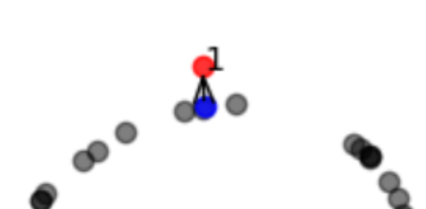
Adversarial Methods for Interpreting Generative Models
“Adversarial Estimation of Topological Dimension with Harmonic Score Maps”
NeurIPS Diffusion WS 2023
“NashAE: Disentangling Representations with Adversarial Covariance Minimization”
European Conf. on Computer Vision 2022
Standard latent spaces are redundant and entangled
Disentangled latents: minimal and modular representation
Learn latents with statistically independent elements
Score-based Model
Topological dimension: local, lower-dim structure of data
Dimension reduct.
Classification & clustering tasks
Generative model validation
0
1
3
2
Latent space without disentanglement
Latent space with disentanglement
Notes:
- The two works I’ll present today employ adversarial techniques to help explain the concepts learned by generative models
- The first uses adversarial input perturbations to score-based models to estimate the topological dimension of data they capture
- While in our experiments the number of inputs is typically high-dimensional, the data typically lives in a lower dimensional space and the topological dimension serves as a local measure of data dimensionality

Slide 5
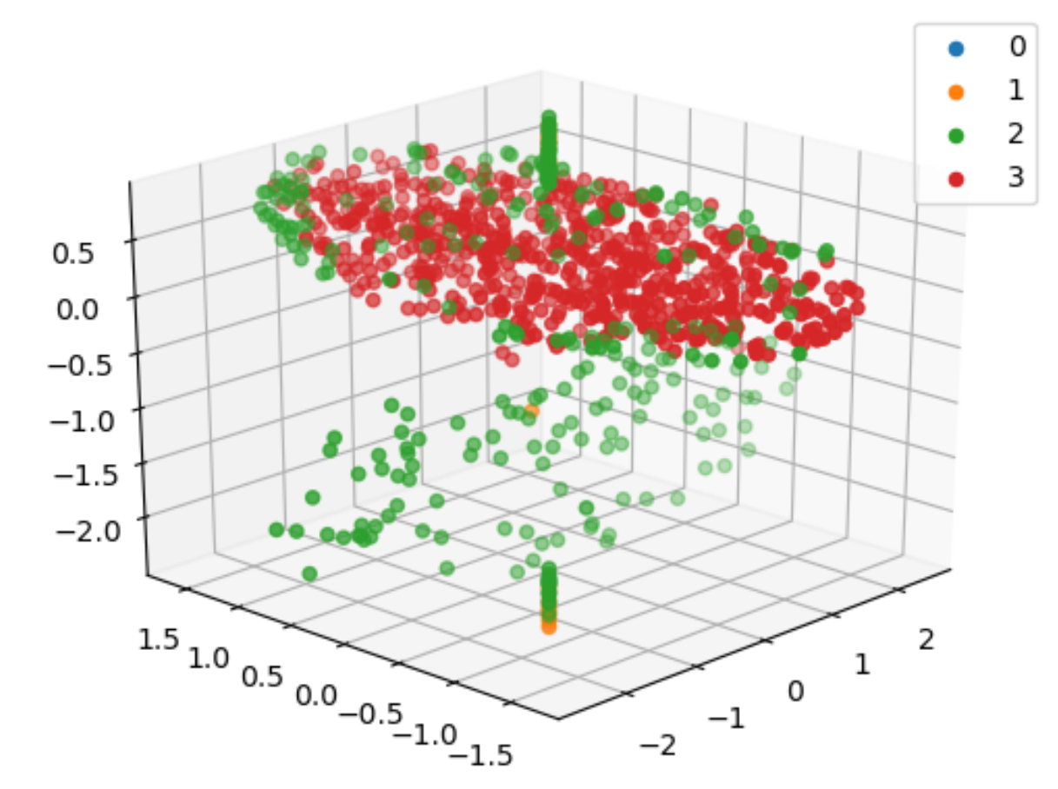
TD Estimation of Score Models Overview
Method
Training with Dirichlet energy to implicitly learn topological dimension
Inference with adversarial attacks to retrieve learned topological dimension
TD estimation results on manifold datasets
TD Predictions from a Score-based model on the LineDiskBall manifold

Slide 6
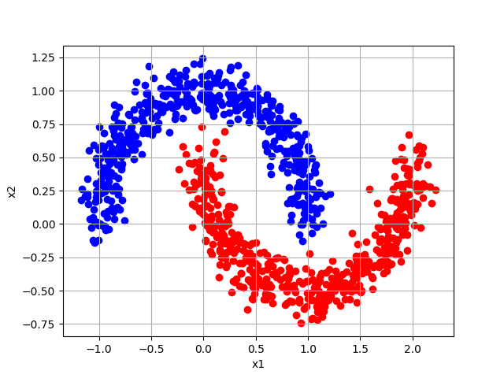
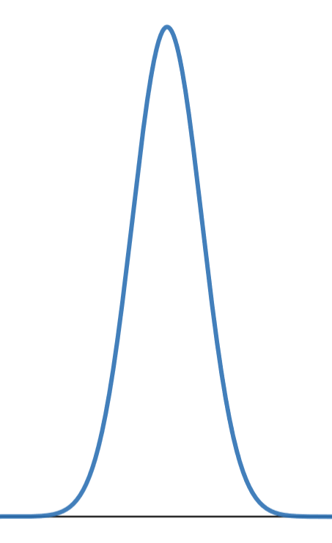
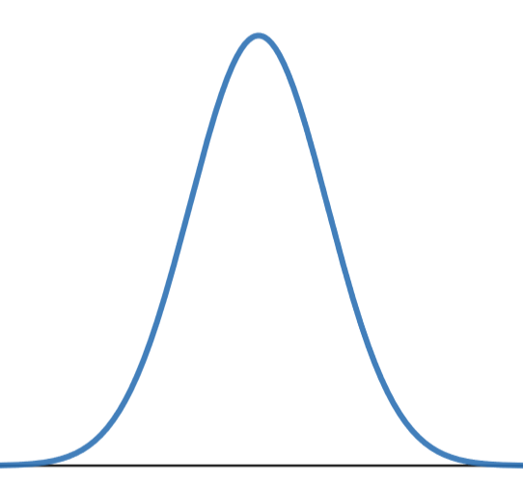
Topological Dimension Estimation Training: Dirichlet Energy Regularization
Learned Data Manifolds
Original Cross-Section
Dirichlet Energy Regularized Cross-Section
$γ$ Dirichlet Energy Regularization
$$σ^{2}$$
$$σ^{2}+γ\frac{\dim_{AD}}{\dim_{TD}}$$
Notes:
- Score-based models learn a distribution, and initially cross-sections of the distribution are sharp
- We introduce Dirichlet Energy regularization during training, which widens cross-sections in a way that reveals topological dimension

Slide 7
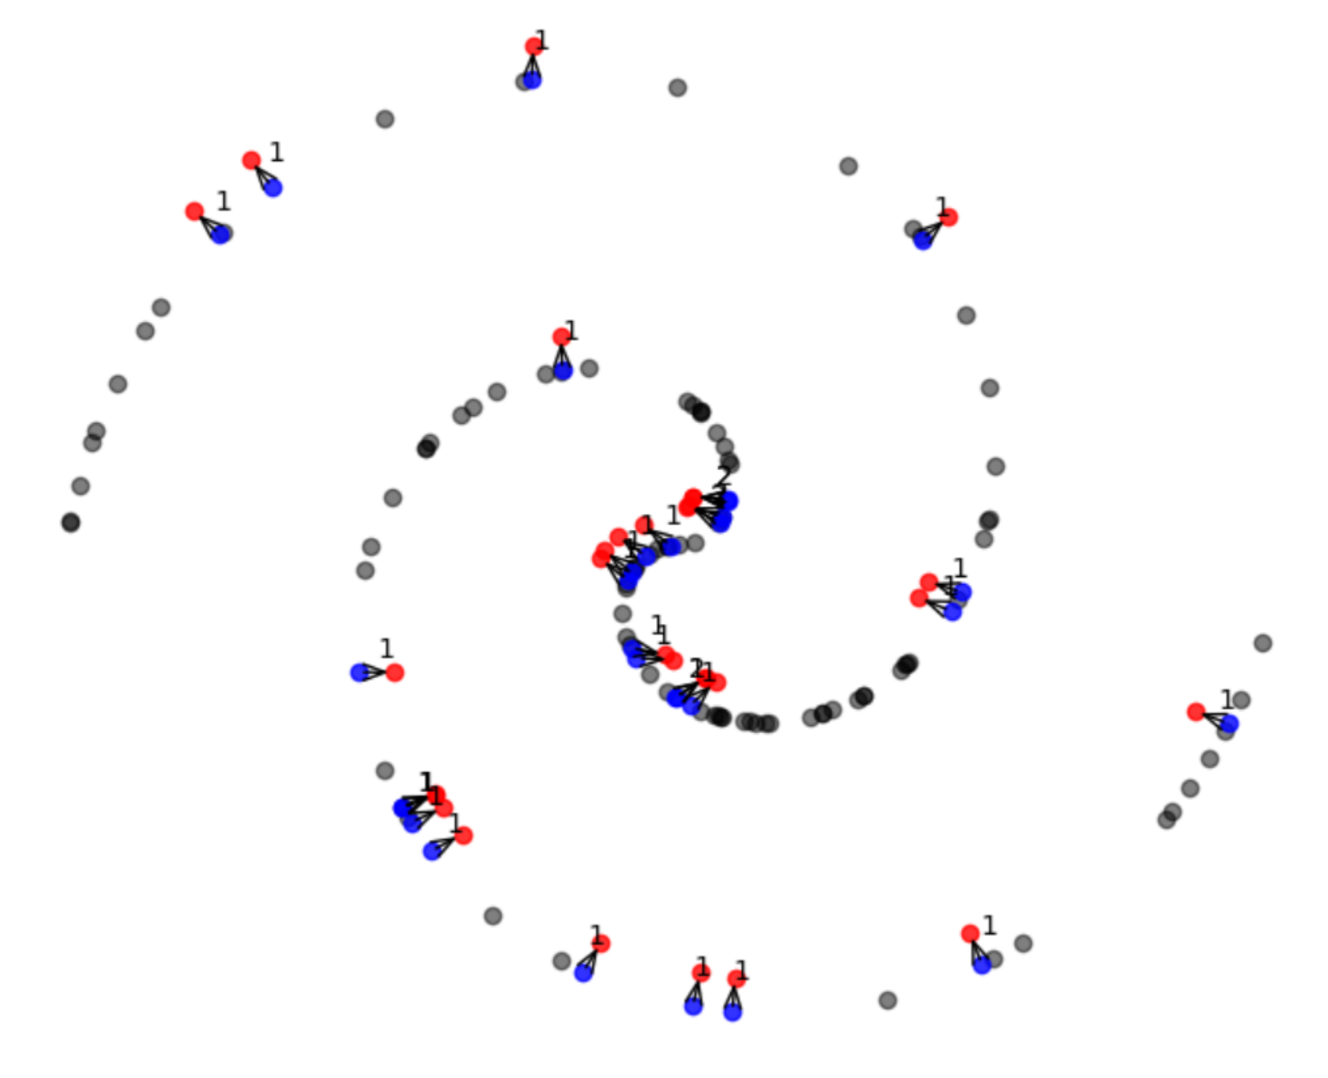
Topological Dimension Estimation Inference: Adversarial Attack
1) Adversarial attack: perturb input to descend log-likelihood
2) Measure learned log-likelihood curvature (variance) to retrieve topological dimension
$$Δ\log{p(x)}$$
$$Δx$$
[Yeats et al., 2023]

Slide 8
Topological Dimension Prediction Results
Statistical estimators require well-picked hyperparameters and lots of data
Our method is competitive with statistical estimators on simple manifolds
Our method is more robust to noise and scales much better to curved, high-dimensional manifolds
(noise added)
Manifold Datasets
Statistical Estimators
Our Method

Slide 9
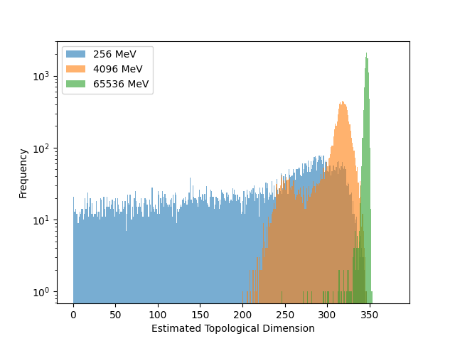
Unsupervised Calorimeter shower clustering demo
Employed TD estimation technique to cluster calorimeter shower data
100k Single photon shower samples from 384 voxel ATLAS GEANT4 dataset (Fast Calorimeter Simulation Challenge ‘22)
Clustering result shows some separability based on TD at these photon energies
High TD of higher-energy particles reflects challenge for generative modeling

Slide 10
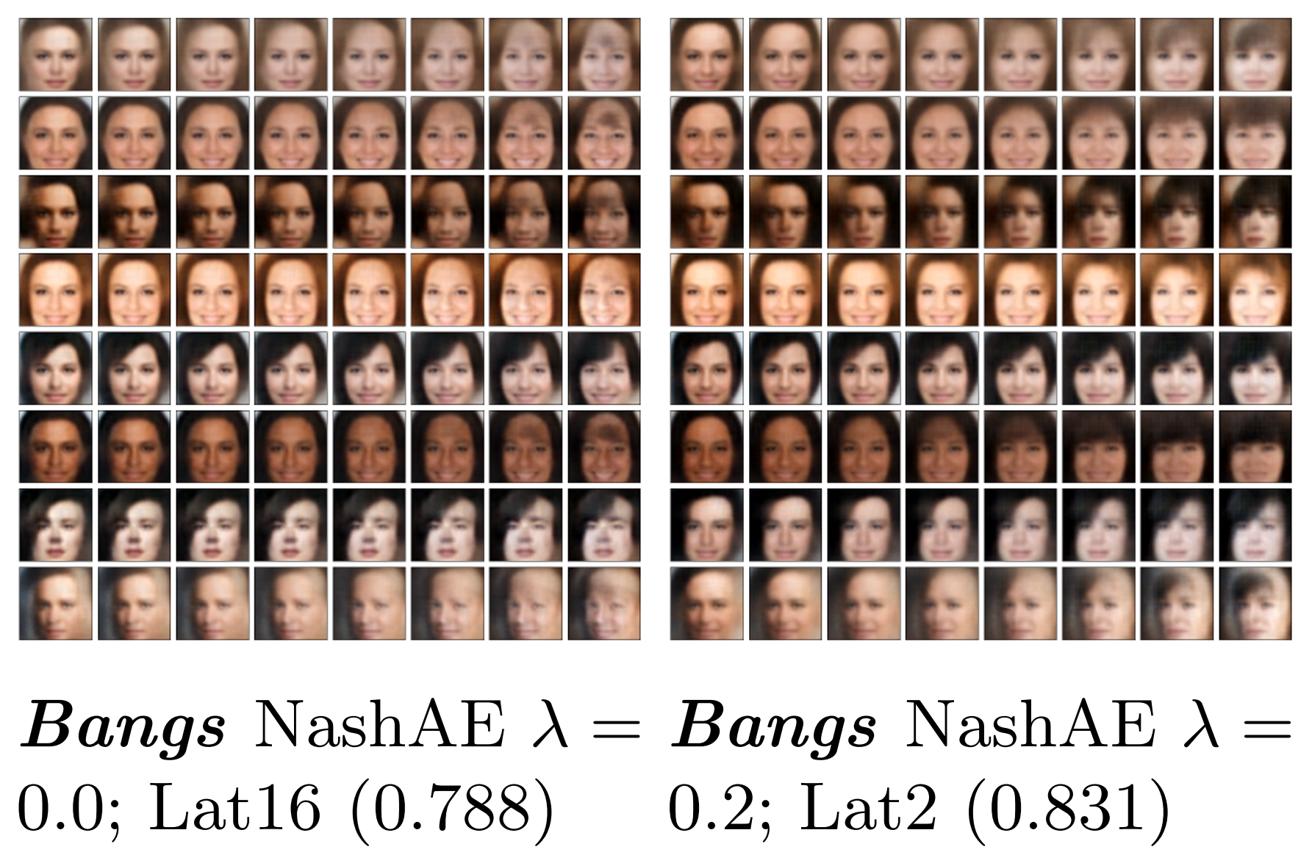
NashAE Overview
Goal: Seek a simplified, nonredundant latent space via disentanglement
NashAE method
Disentangling SNS beamline data
Quantifying the number of factors of variation in SNS data
Z
Most predictive latent entry for Bangs
CelebA Experiment: latent space traversals of disentangled variables clearly reflect the attribute they encode for
Without disentanglement
With disentanglement

Slide 11
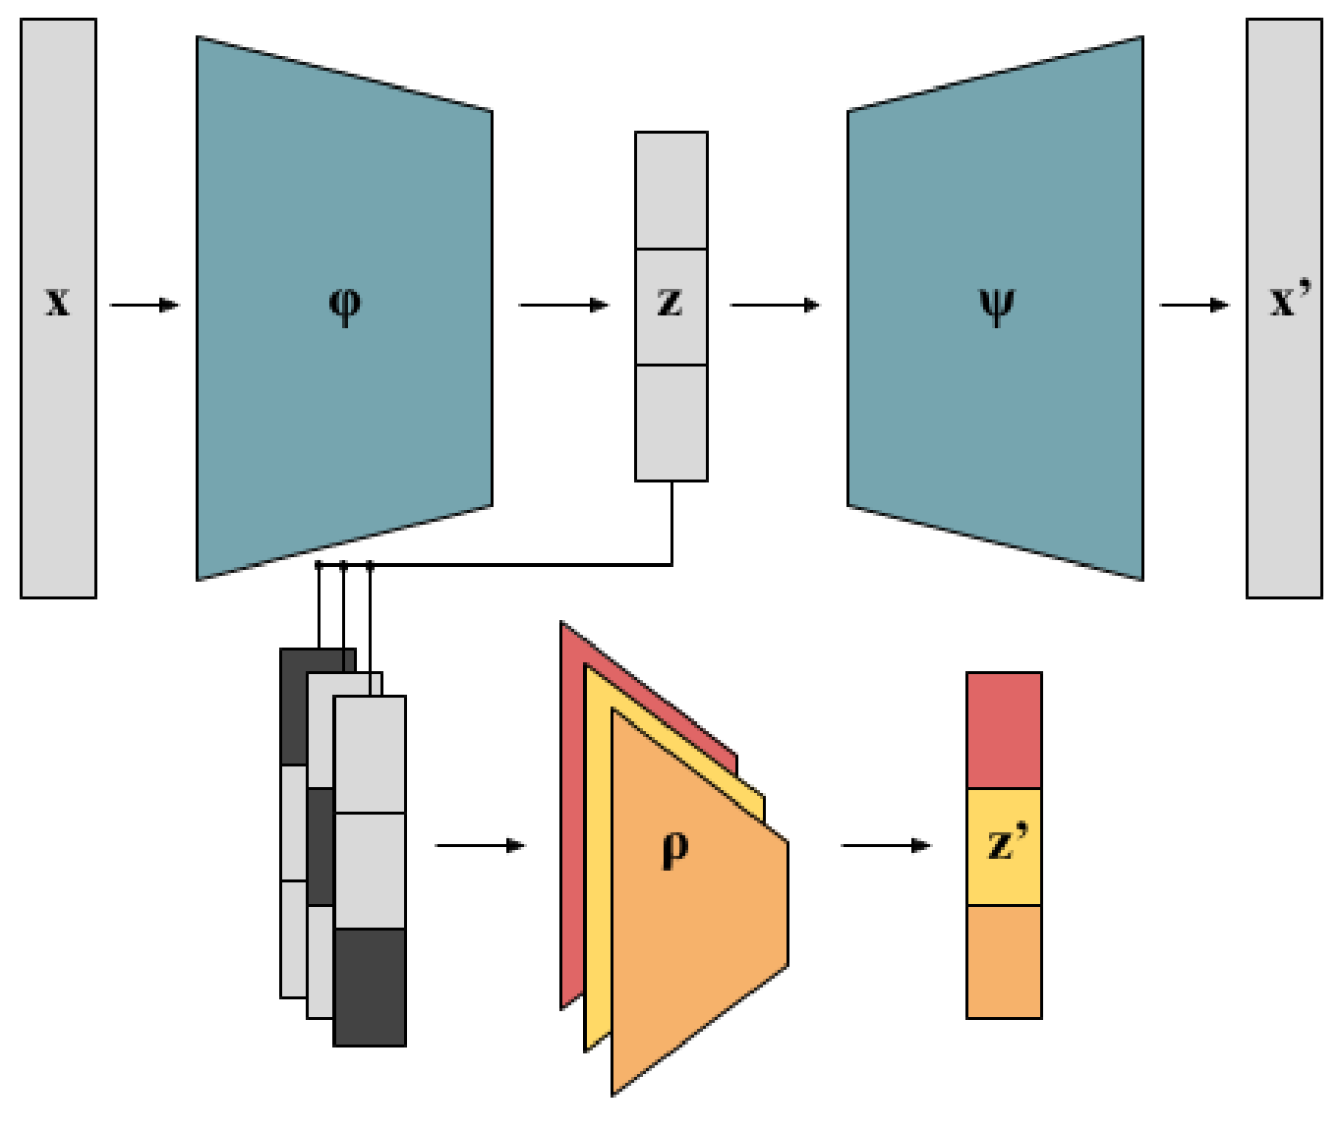
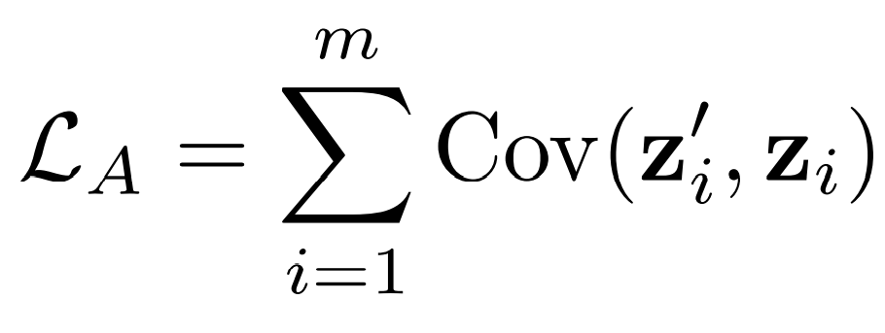
NashAE Method: Adversarial Covariance Min.
1) NashAE MSE Loss
3) Enc. Adversarial Loss
2) Predictor MSE Loss
Modify z to reduce info shared between elements
Predict missing element given all others
NashAE Training Objective

Slide 12
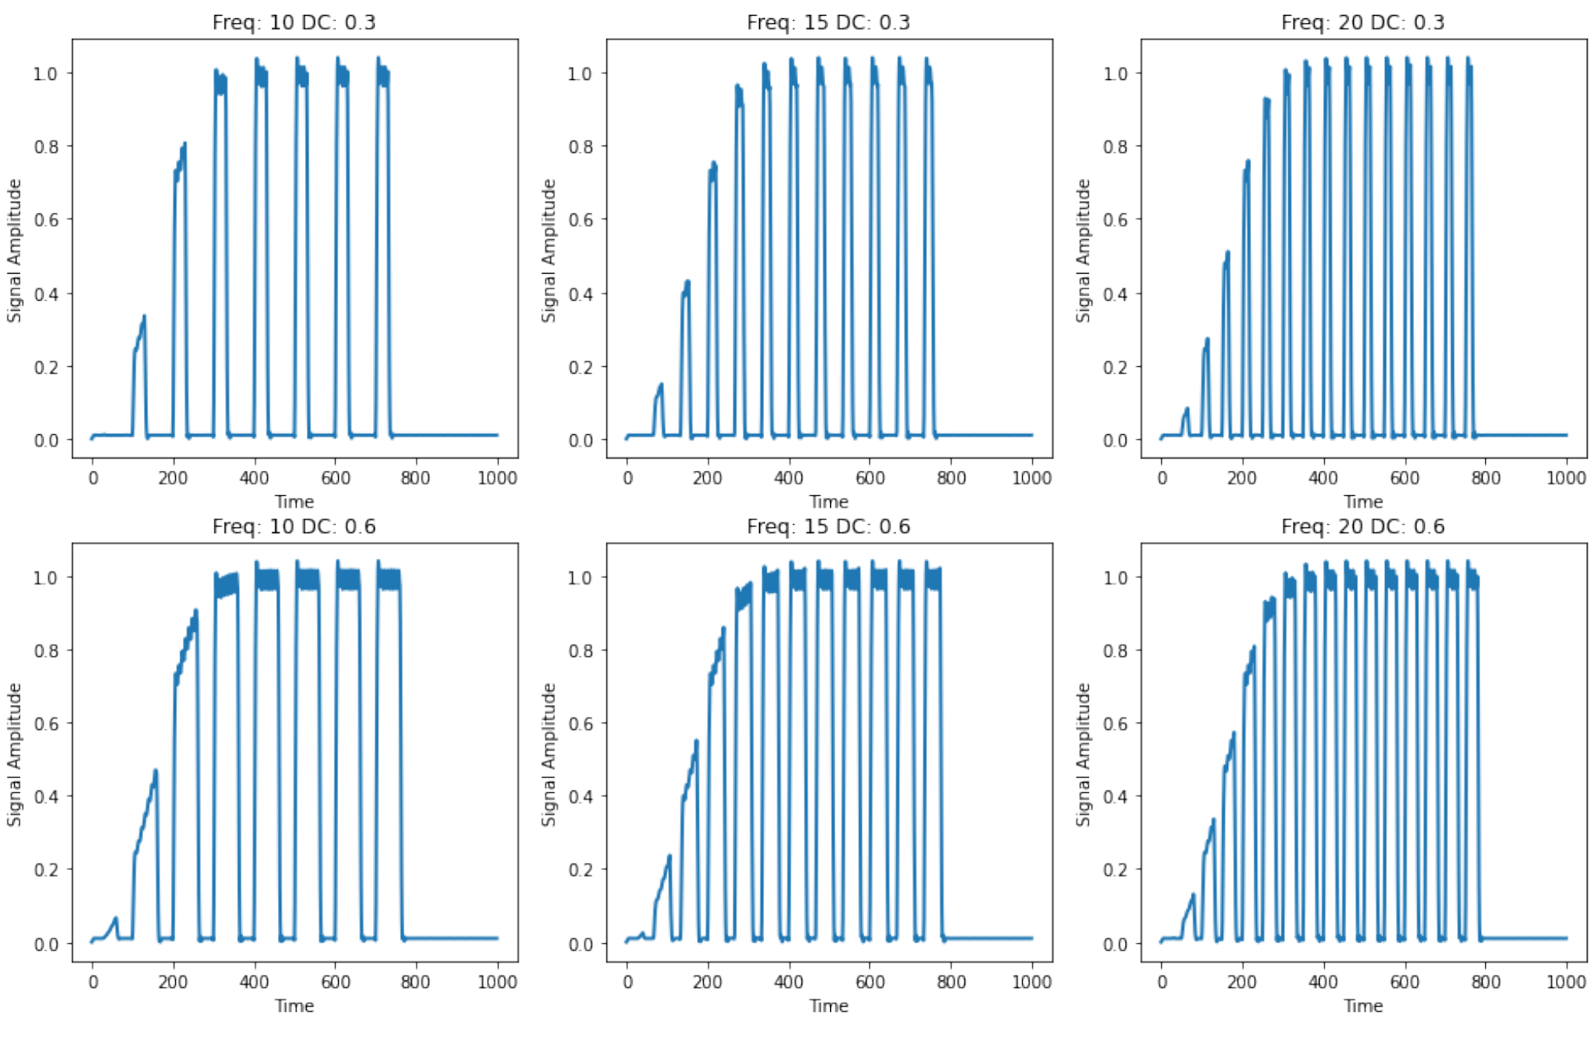
Application to SNS Beamline Data: Visualization
Synthetic Beamline: models generation, acceleration, and tuning of ion beams in the LINAC portion of the SNS system.
3 components: ion injection, chopper, RF acc.
Dataset formed by samples of the ramp-up phase of beamline as we vary the duty cycle and frequency of the chopper
Duty Cycle (continuous)
Latent Response vs True Data Parameters
Frequency (categorical)
Standard
latent space
Disentangled
latent space

Slide 13
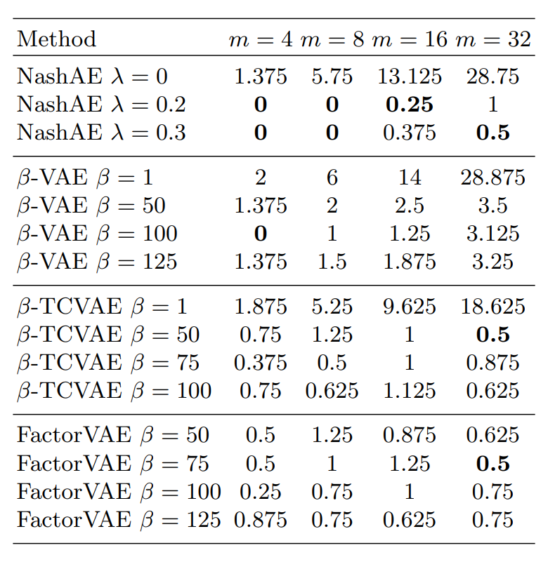
Application to SNS Data: Factor Quantification
Ambient Latent Dimension m
Average absolute error of the number of factors of variation predicted by disentanglement methods
NashAE is the most reliable in identifying the true number of factors of variation
⬅ Disentanglement Methods ➔

Slide 14
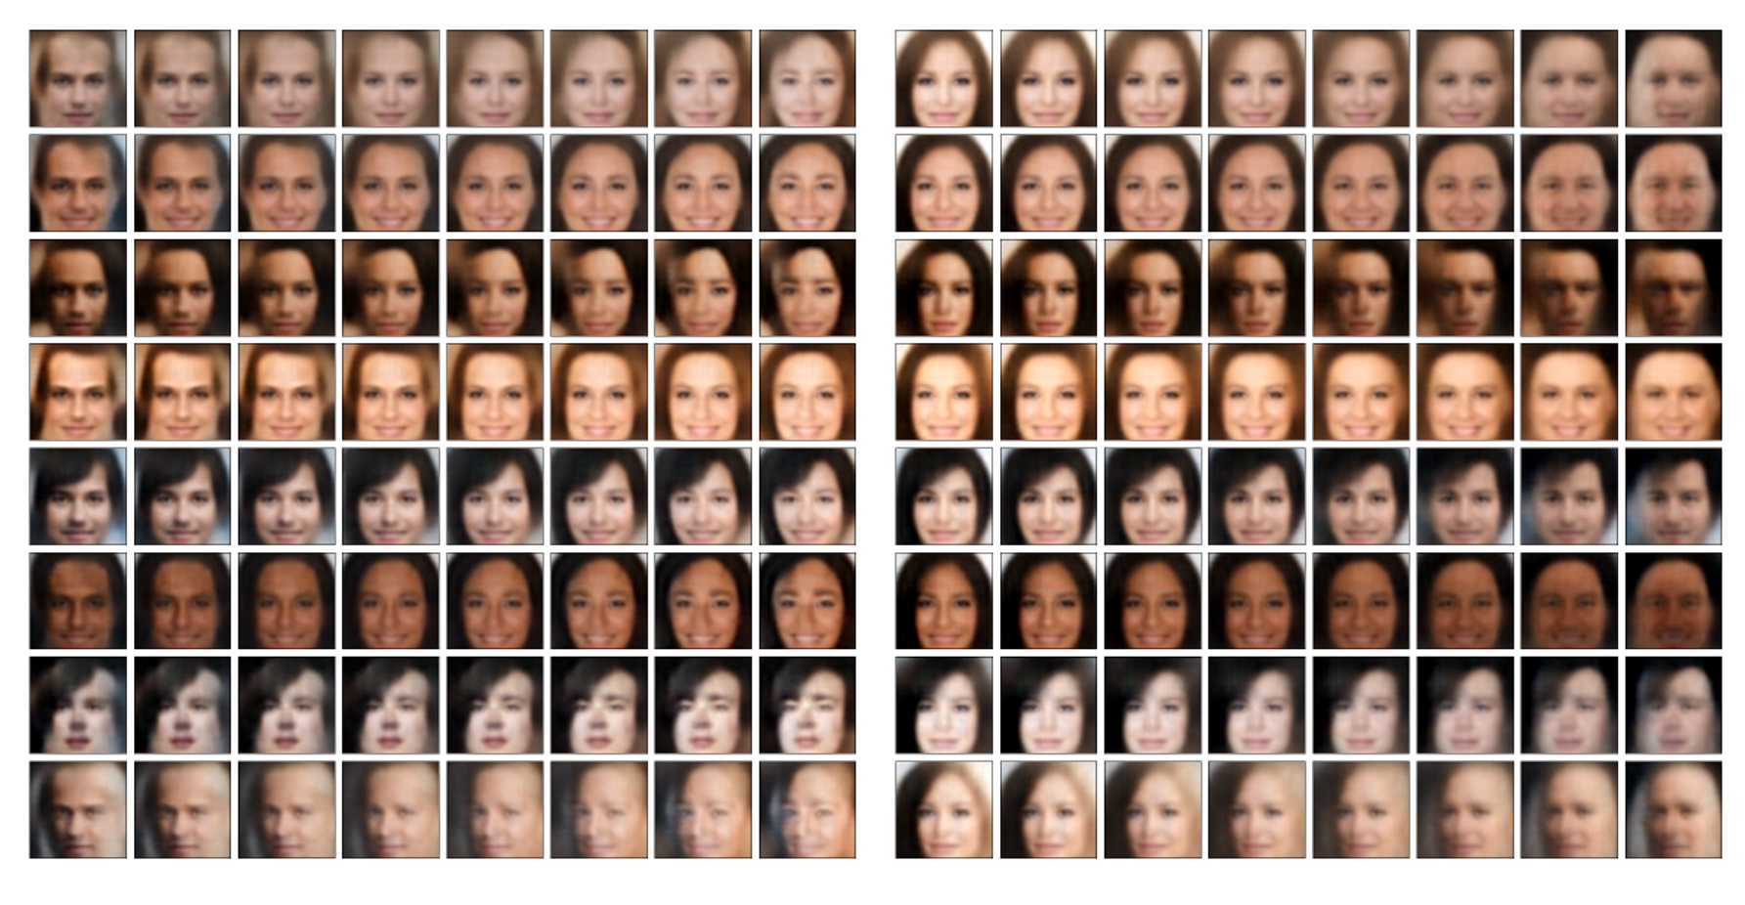
Application to CelebA Dataset: Latent Traversals
Most predictive latent entry for Bangs
Most predictive latent entry for Male
Without disentanglement
With disentanglement
Without disentanglement
With disentanglement
Notes:
-

Slide 15
Summary
Adversarial Estimation of Topological Dimension with Harmonic Score Maps – NeurIPS Diffusion WS 2023
NashAE: Disentangling Representations with Adversarial Covariance Minimization – European Conference on Computer Vision 2022
Standard
latent space
Disentangled
latent space

Slide 16
Thank you!
References
Ho et al., “Denoising Diffusion Probabilistic Models” NeurIPS 2020
Song et al., “Score-based Generative Modeling through Stochastic Differential Equations” ICLR 2021
Yeats et al., “Adversarial Estimation of Topological Dimension with Harmonic Score Maps” NeurIPS Diffusion Workshop 2023
Yeats et al., “NashAE: Disentangling Representations with Adversarial Covariance Minimization” ECCV 2022

