Slide 1
Fast 2D Bicephalous Convolutional Autoencoder for Compressing 3D Time Projection Chamber Data
By Yi Huang, Yihui Ren, Shinjae Yoo, Jin Huang
Speaker: Yi Huang
Nov. 28, 2023 AI4EIC

Slide 2
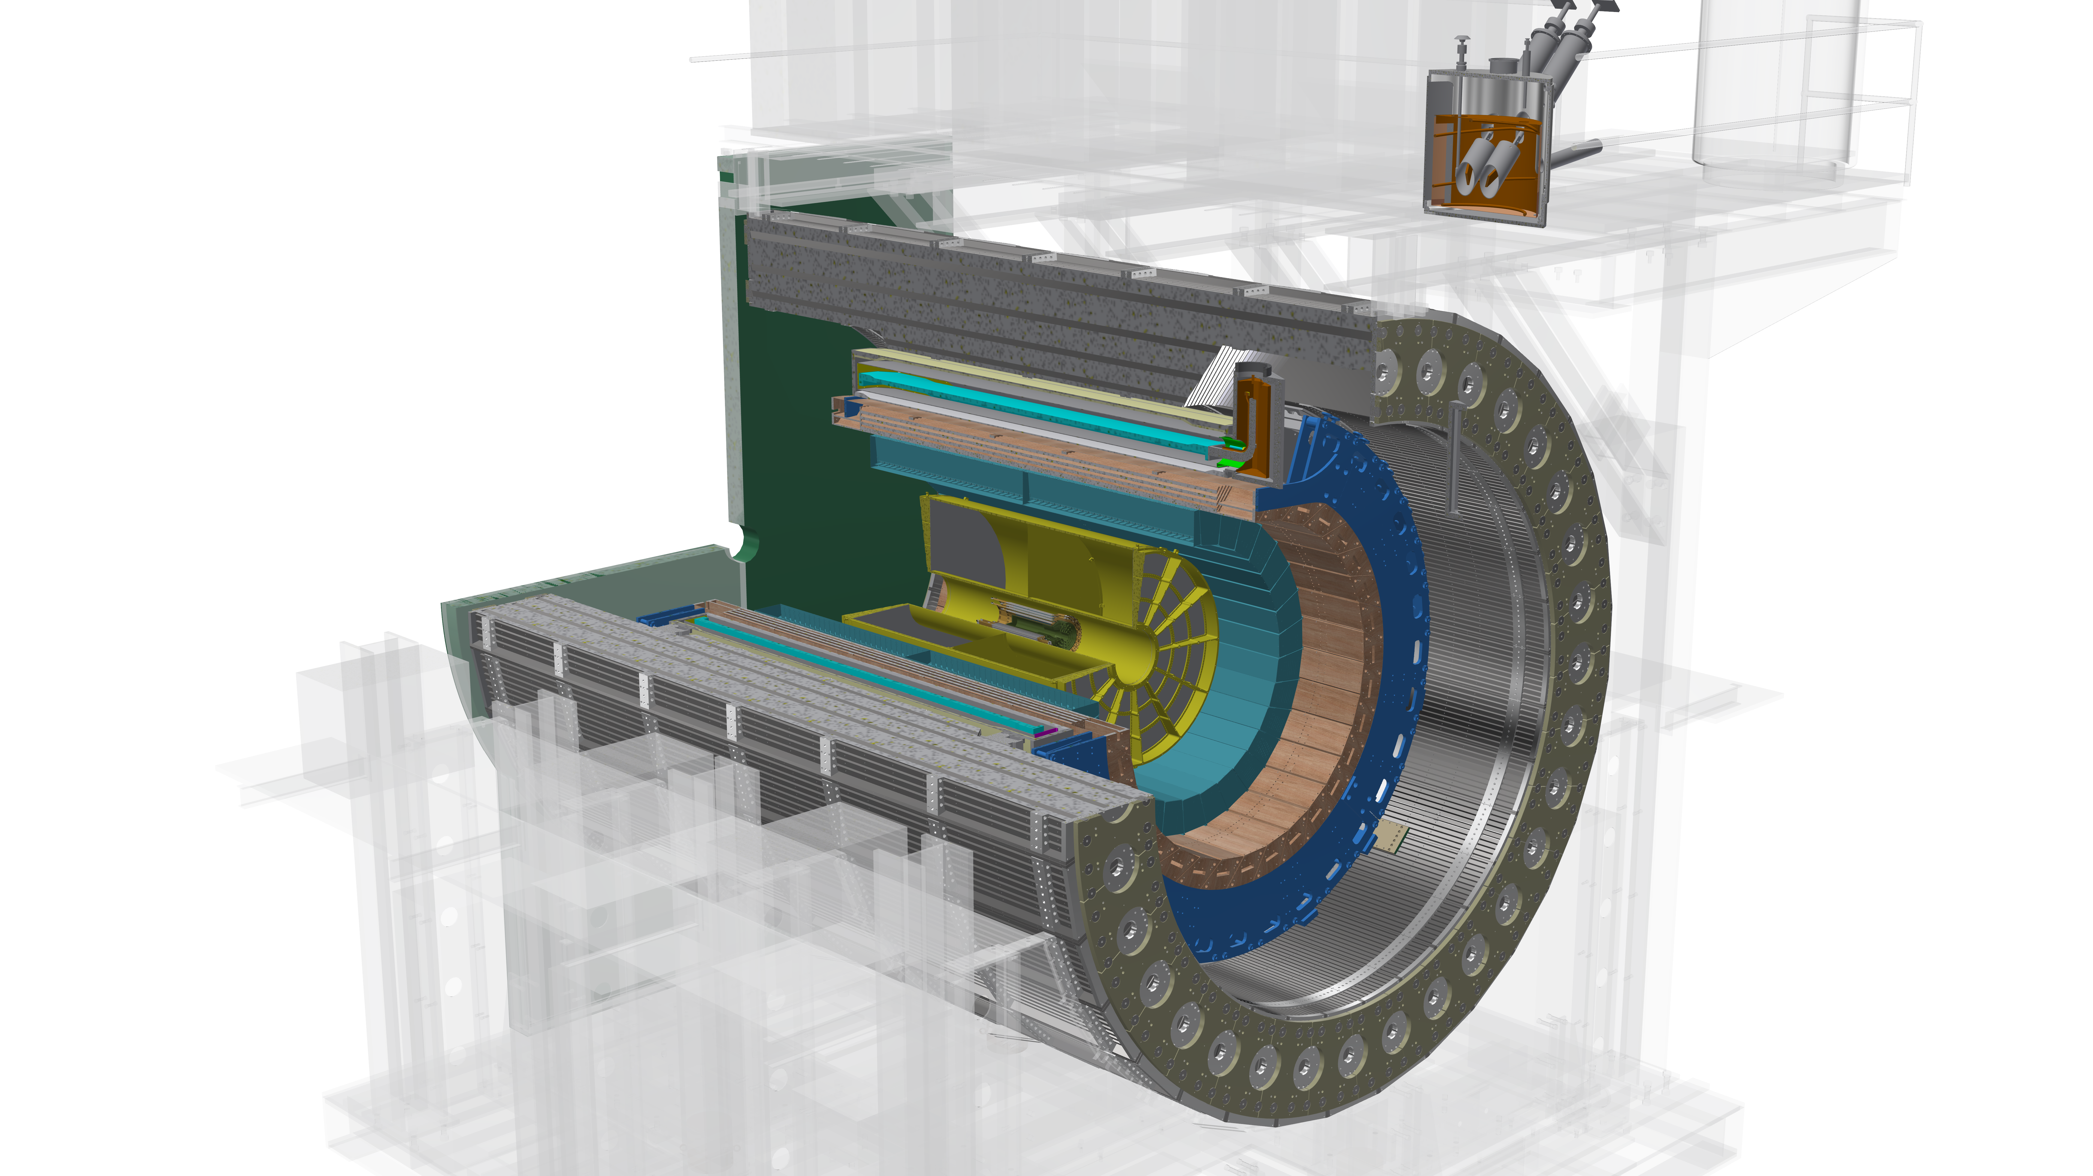
Detector model at sPHENIX
Electromagnetic calorimeter
Silicon Tracker
Time-projection Chamber

Slide 3
Time projection Chamber (TPC)
A TPC is composed of 48 layers of rectangular grid of sensor nodes. It acts as a camera capturing 3D particle trajectories.
3 layer groups: inner, middle, and outer. Each layer group has 16 layers
2 sides, divided by the transverse plane passing the collision point
12 sectors, $30$ degree each

Slide 4
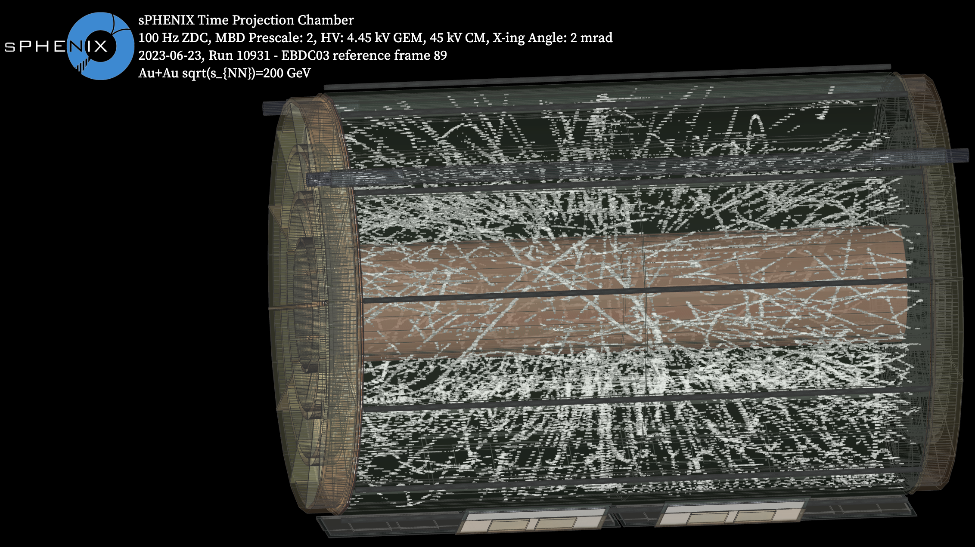

Slide 5
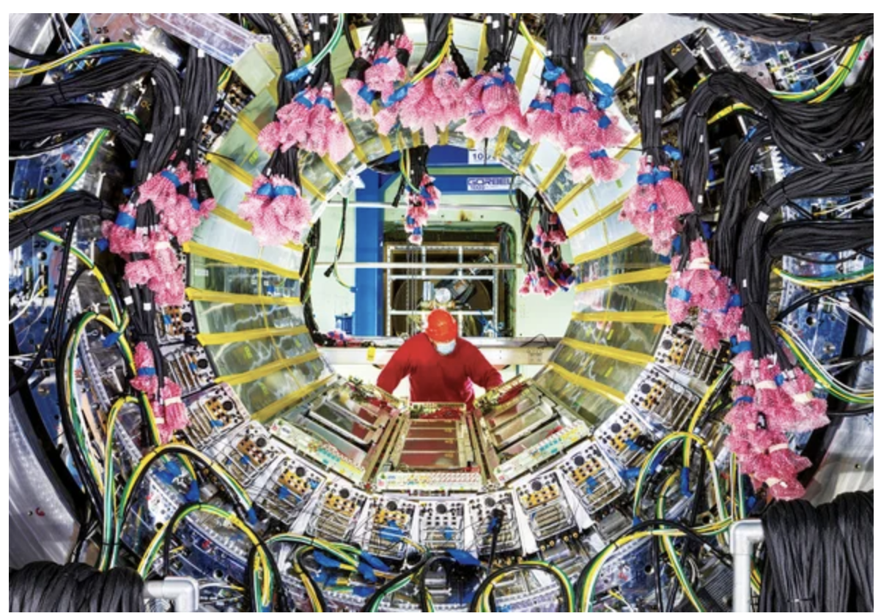
“Tiny Bubbles of Primordial Soup Re-create Early Universe” March 1, 2023, Scientific American

Slide 6
Motivation
Trigger Approach
10% of data are saved to permanent storage while others are lost forever
data

Slide 7
Motivation
Lossy compression Approach
Compress the data online, save the compression, and use reconstructed data for downstream analysis
Compressed data

Slide 8
Data
In this study, we are going to focus on the outer layer group:
16 layers along the radial direction
2304 columns of sensor nodes along the azimuth direction
498 rows along the beam direction
Subdivided into 24 TPC wedges of shape (16, 192, 249)

Slide 9
Data
TPC wedges of shape (16, 192, 249)
Input to the neural compression algorithm
Each sensor node output an analog-to-digit converter (ADC) value as an integer in [0, 1023].
All ADC values below 64 are suppressed to 0 to increase sparsity.
In this study, we use log scale ADC value, i.e. $\log_{2}\left(\text{ADC} + 1\right)$. A log scale ADC value is in [0, 10]. There is no value less 6 because of the zero suppression.
Fig. Log scale ADC value in a TPC wedge

Slide 10
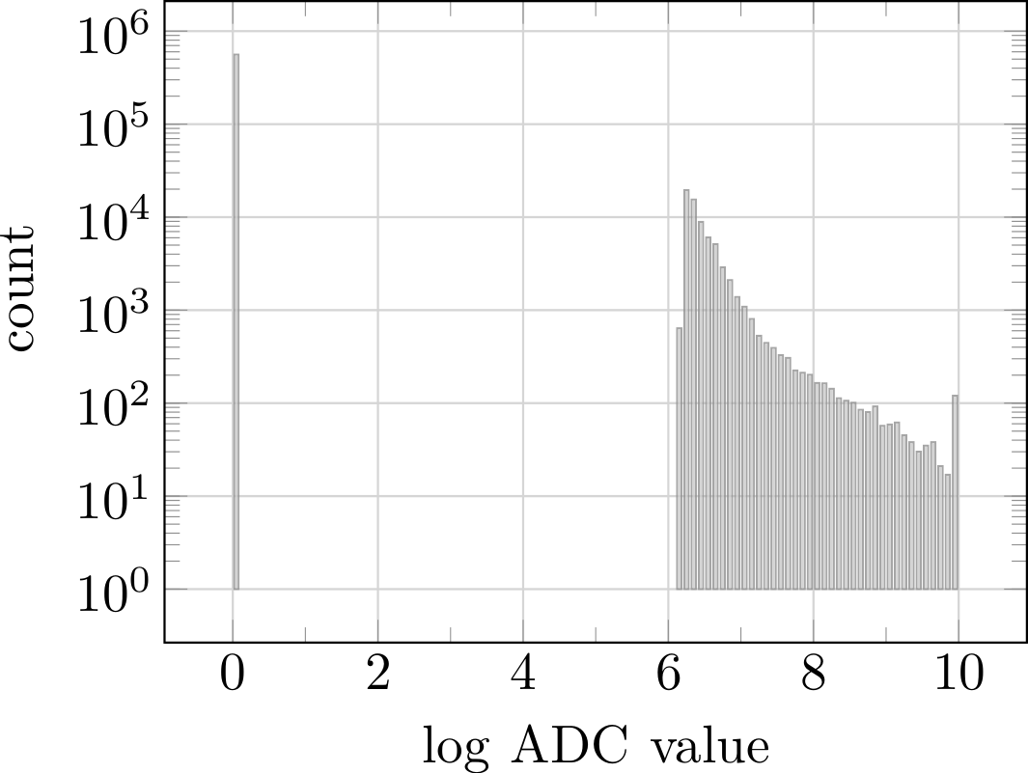
Data
Acrophobia neural network
CTRL click for interactive plot

Slide 11
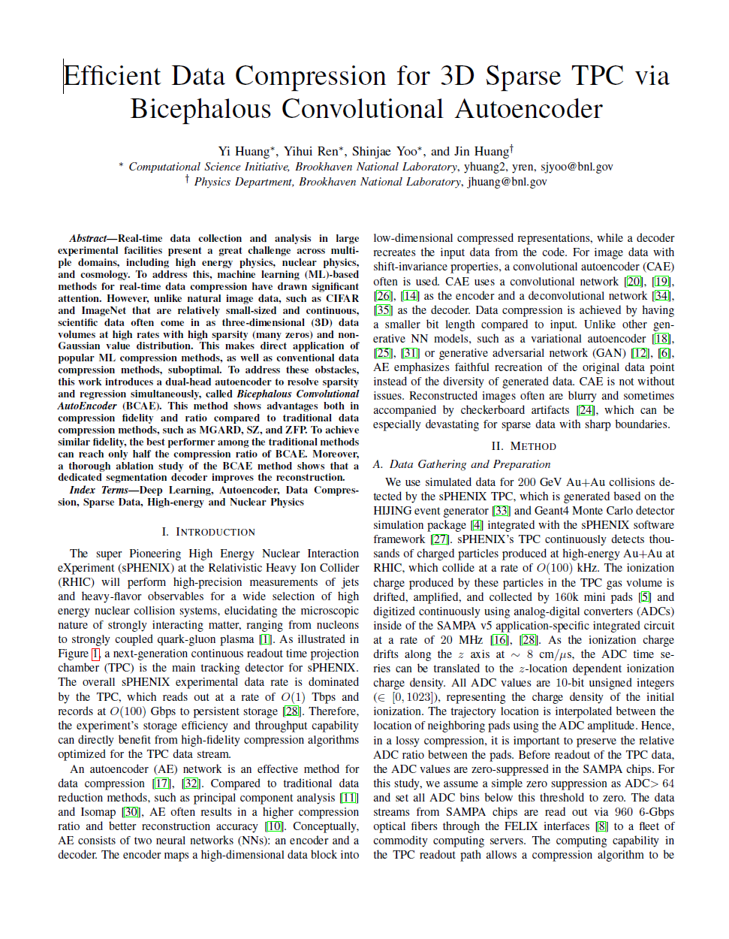
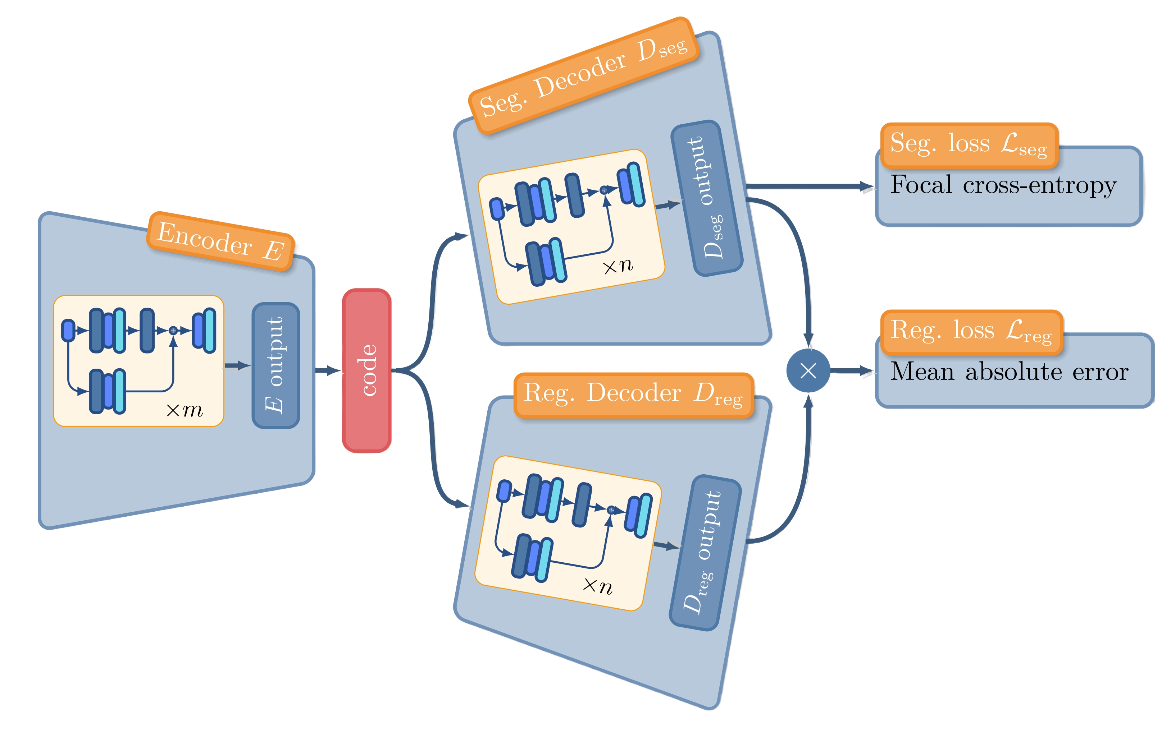
Model
https://arxiv.org/pdf/2111.05423.pdf

Slide 12
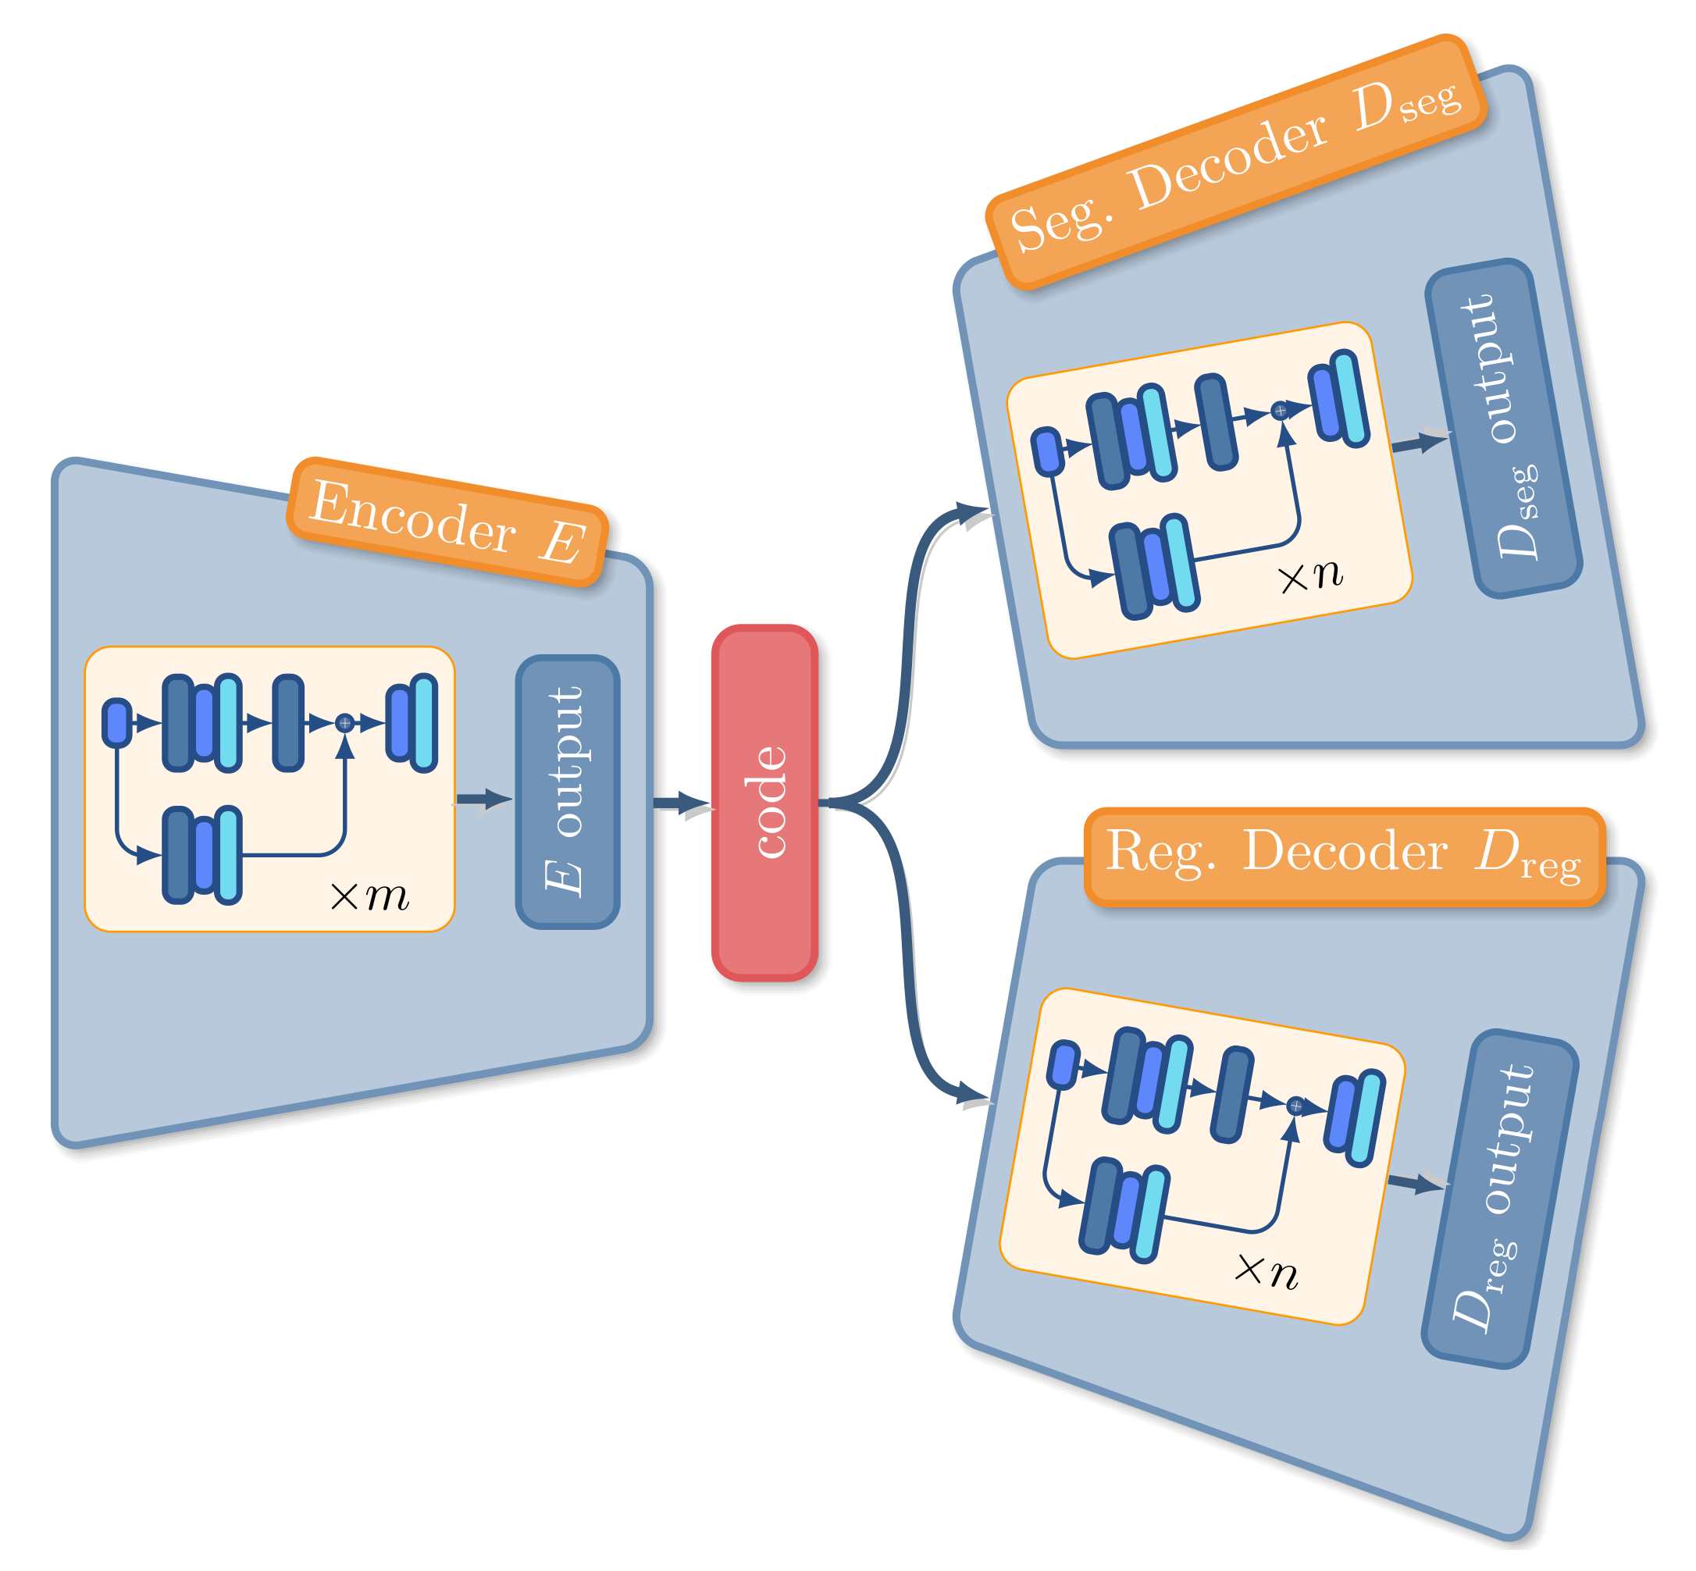
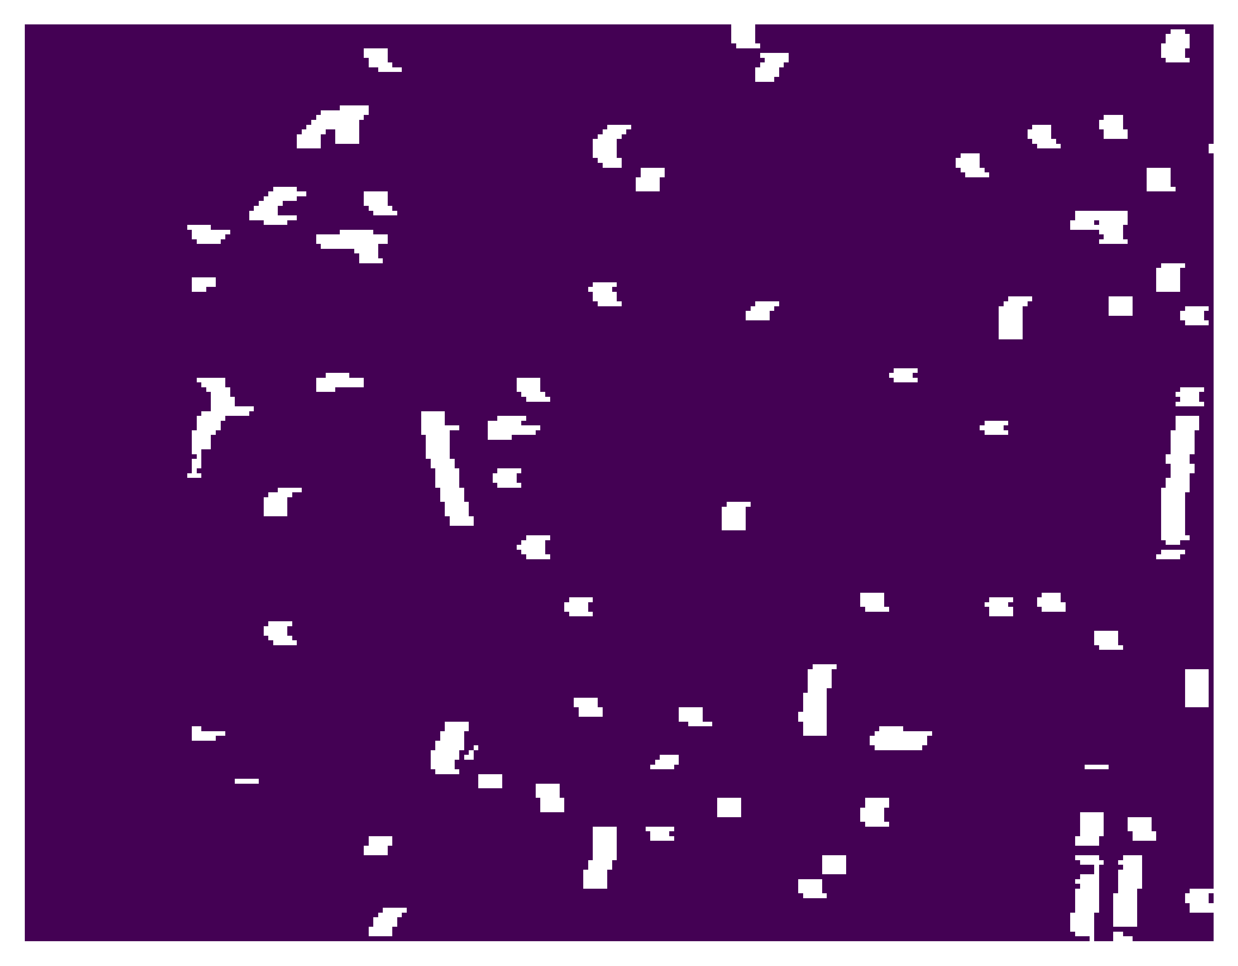
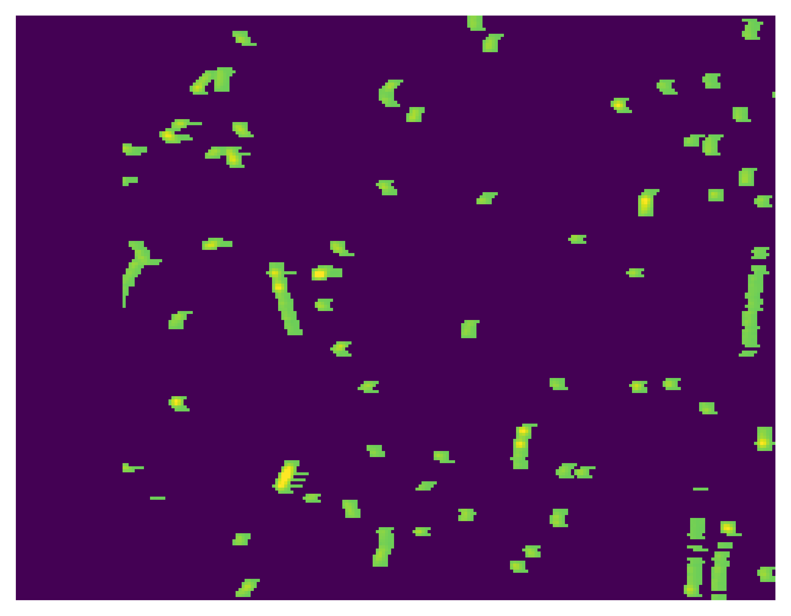
Model
Segmentation output (mask)
input
Regression output
Permanent storage

Slide 13
Model
Segmentation output (mask)
input
Regression output
Permanent storage

Slide 14
Model
Regression output $×$ mask
input
Regression loss

Slide 15
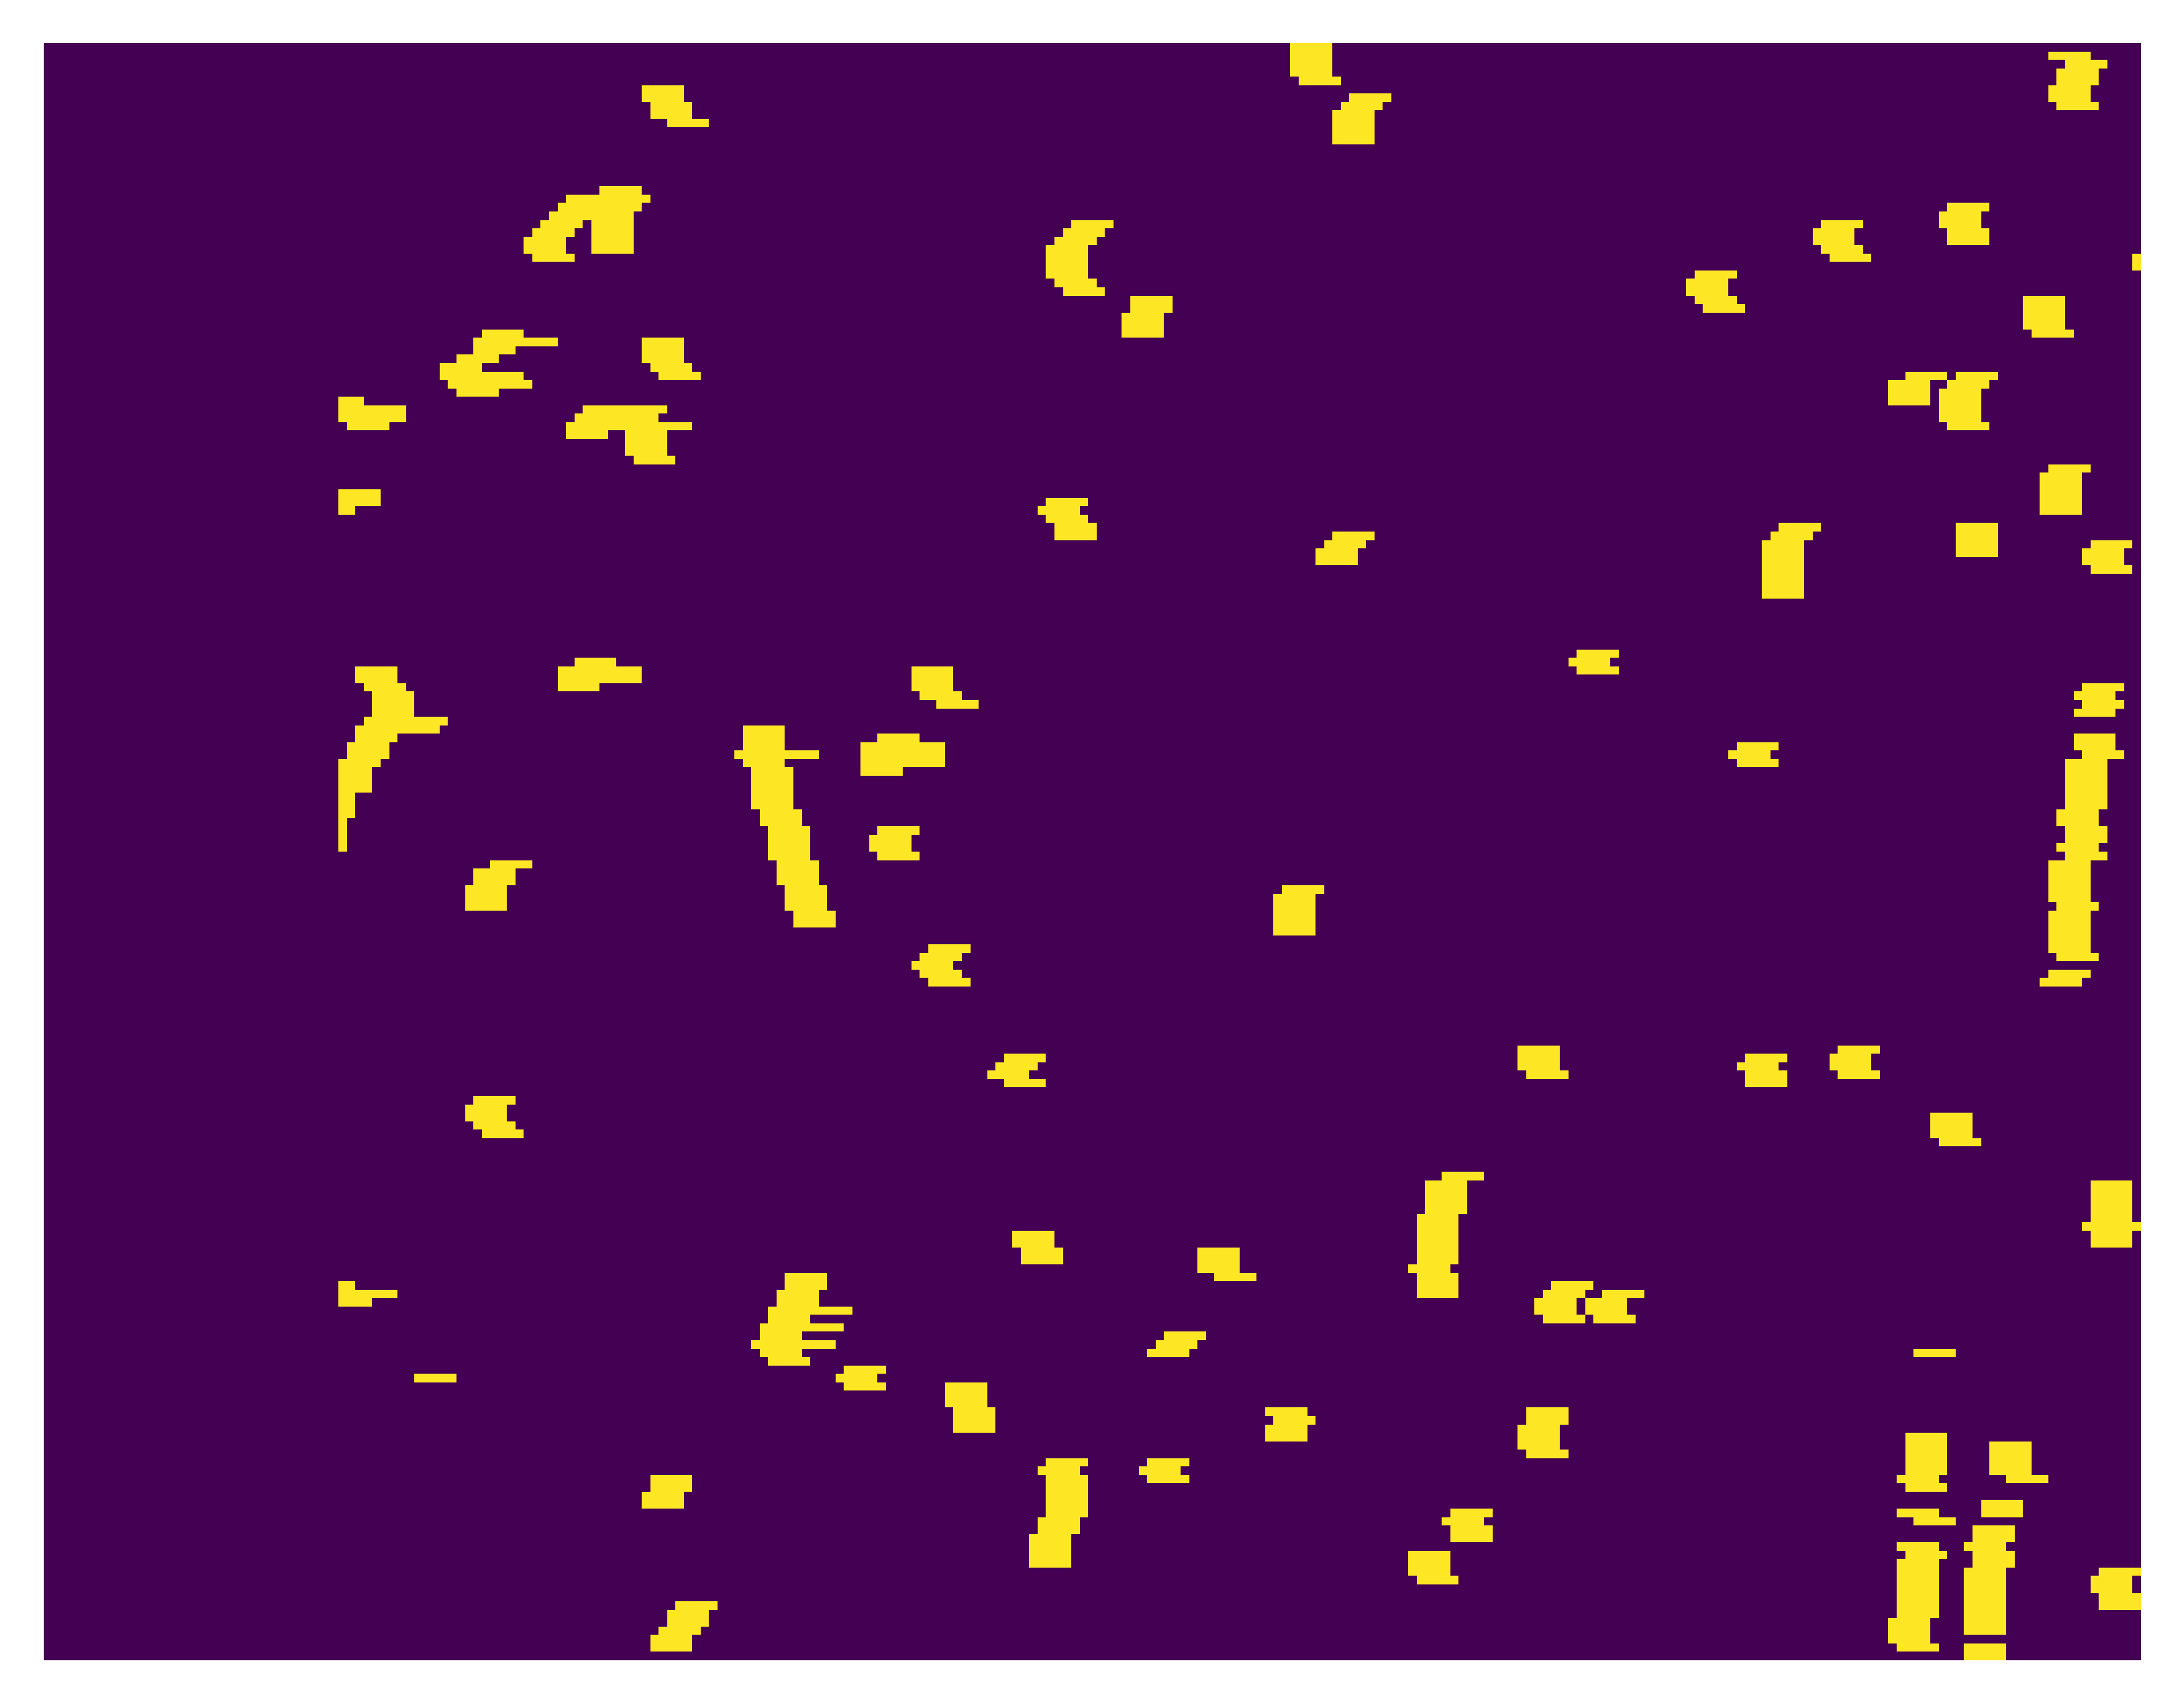
Model
mask
Classification ground truth (input $>0$)
Classification loss

Slide 16
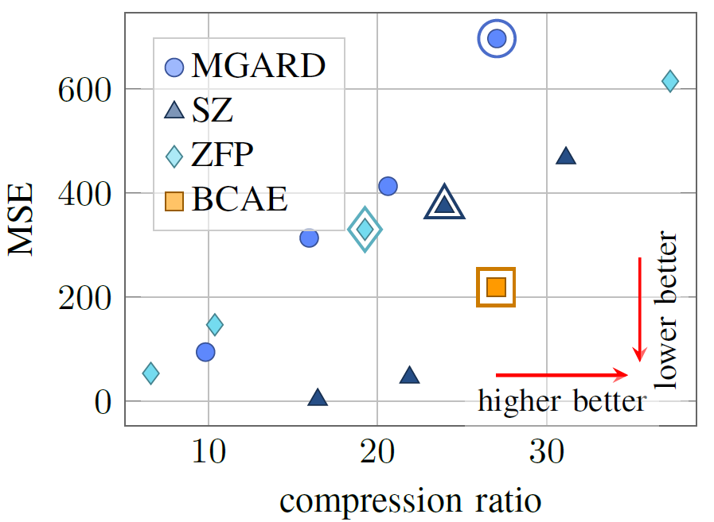
Performance of BCAE comparing to
off-the-shelf lossy compression algorithms

Slide 17
Model
Performance of BCAE comparing to
off-the-shelf lossy compression algorithms
What we are NOT happy with BCAE
It was trained with the raw ADC values, but log ADC values is more useful.
We want better reconstruction accuracy.
It is too slow.

Slide 18
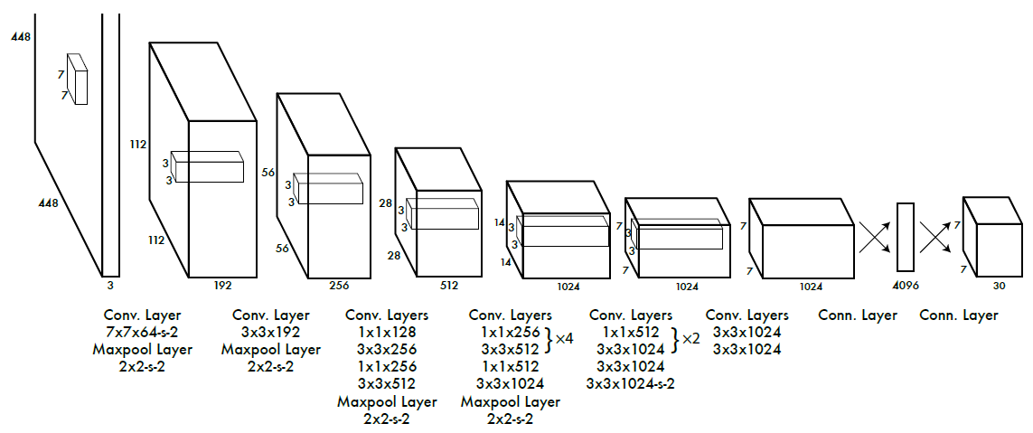
Use 2D Convolution to make BCAE Faster
Yolo v1
Deep but fast

Slide 19
Use 2D Convolution to make BCAE Faster
The TPC wedge data has shape (16, 192, 249).
Comparing to the azimuth and horizontal direction, the radial dimension is thin.
We can treat the radial dimension as the feature dimension and use 2D convolutions
Yes, to my eyes, that is an image with 16 channels.
16 layers
And translational invariance is not satisfied along the radial direction

Slide 20
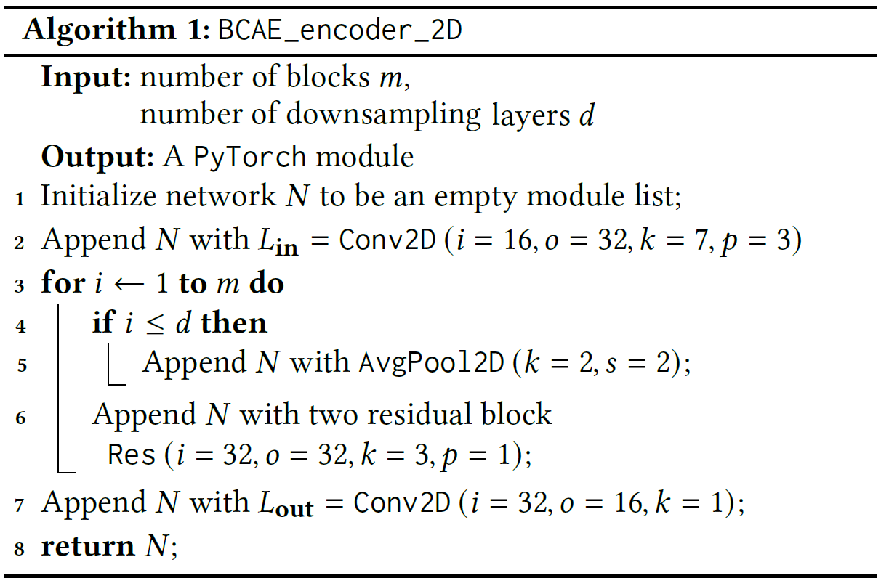
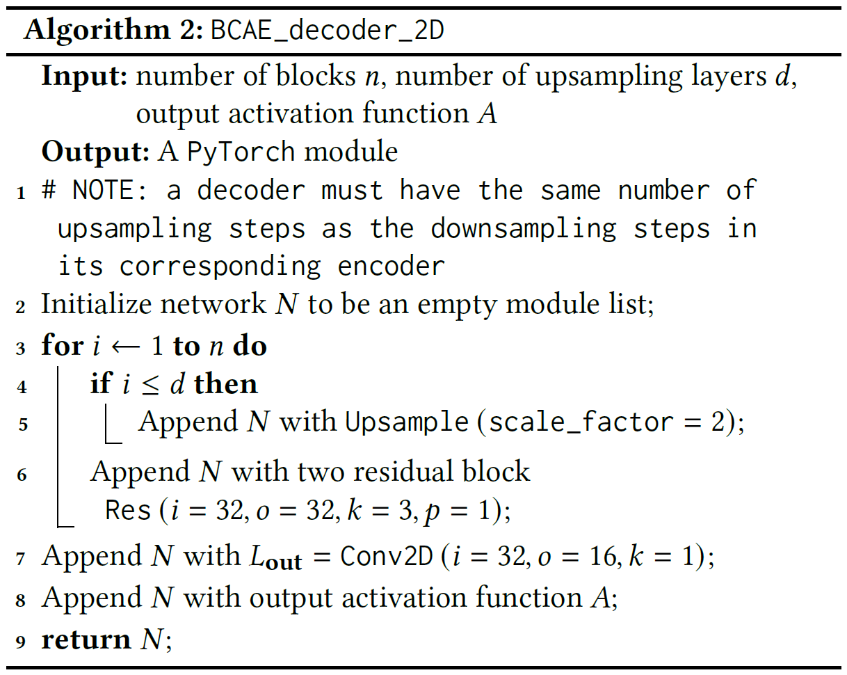
2D Encoder and Decoder
4 convolutions per block

Slide 21
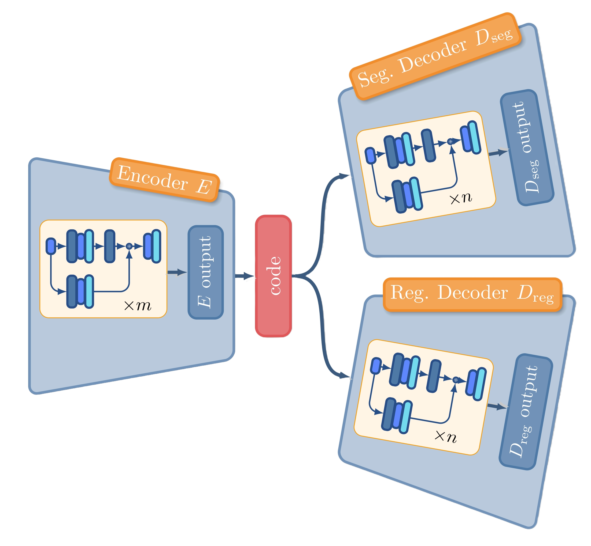
2D Encoder and Decoder tunable encoder decoder sizes
Time Sensitive
Not Time Sensitive
Smaller, faster encoder
Bulkier, slower decoder
Can stronger decoder compensate for a weaker encoder?

Slide 22
2D Encoder and Decoder tunable encoder decoder sizes
Luck on our side

Slide 23
Performance comparison old BCAE versus BCAE-2D

Slide 24
Performance comparison better 3D BCAE
From BCAE to BCAE++
3D convolution
Pad (16, 192, 249) to (16, 192, 256) for easy halving and an increased compression ratio
Remove normalization
Much better reconstruction performance
Still slow

Slide 25
Performance comparison better 3D BCAE
From BCAE to BCAE-HT
3D convolution
Pad (16, 192, 249) to (16, 192, 256) for easy halving and an increased compression ratio
Remove normalization
Much smaller intermediate output channels for higher throughput
Slightly better reconstruction performance
Super small model size
Higher throughput

Slide 26
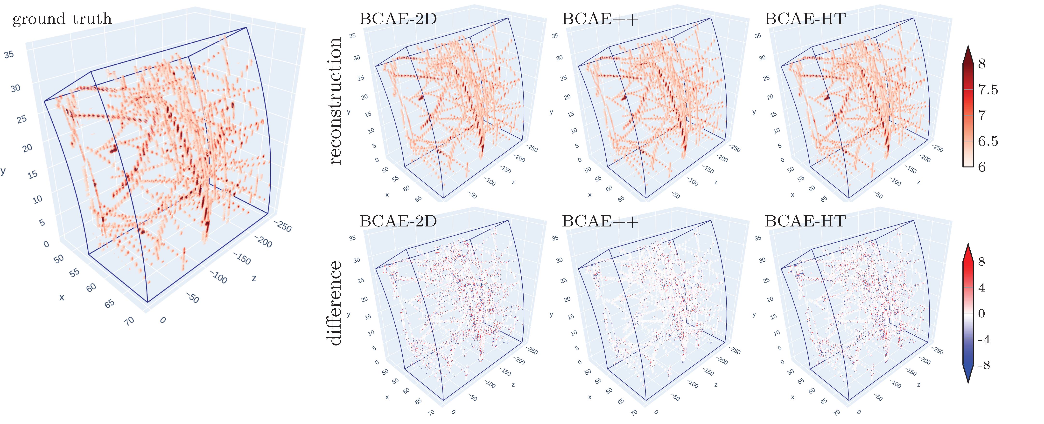
Performance comparison

Slide 27
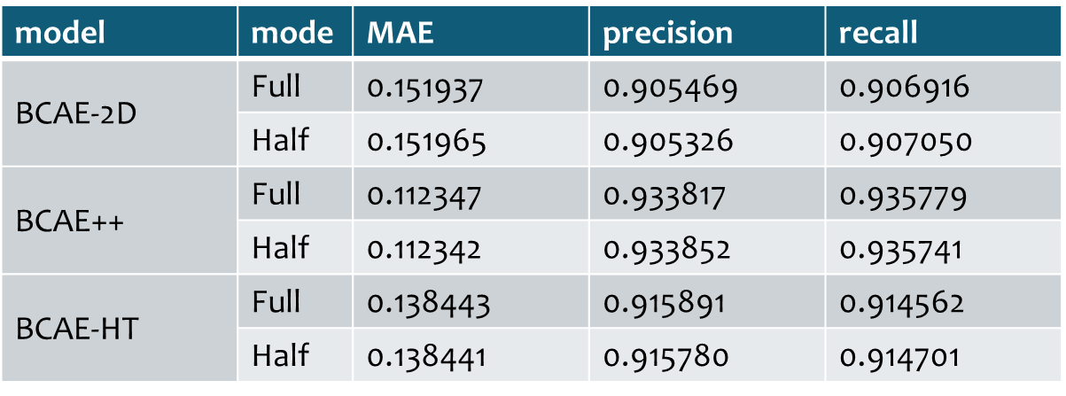
Throughput comparison two computing modes
Full: encode with float 32, save code as float 16, decode with float 32
Half: encode with float 16, save code as float 16, decode with float 32

Slide 28
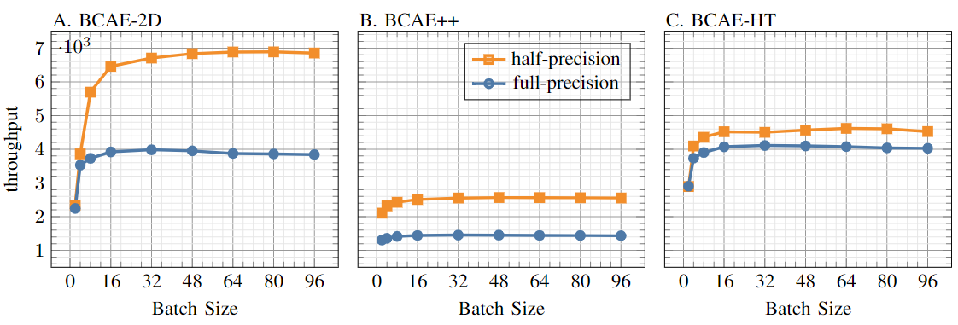
Throughput comparison two computing modes
Why don’t we have the same speedup here?

Slide 29
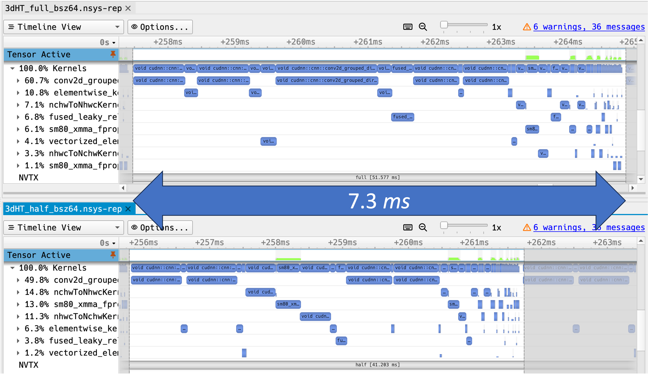
Why the Lack of Speedup
Nsight System Profiling
Full precision
Half precision

Slide 30
Alternative
Computing
Architecture
Core
Core
Core
CPU
Core
Core
Core
Core
Core
Core
Small number of cores
Super powerful cores
Multi-level of memory to reduce latency
L1
L1
L1
L1
L1
L1
L1
L1
L1
L2

Slide 31
Alternative
Computing
Architecture
GPU
Large number of cores
Less powerful cores
Cores operate in lock step (single instruction multi data, or SIMD)
Core
Core
Core
Core
Core
Core
Core
Core
Core
L1
L1
L1
L1
L1
L1
L1
L1
L1
L2

Slide 32
Alternative
Computing
Architecture
IPU
From GraphCore
Absolutely no shared memory!
Only local on-chip memory.
Even simpler cores
Cores executing their own job (multi instruction multi data, or MIMD)
Local memory
Core
Local memory
Core
Local memory
Core

Slide 33
Alternative
Computing
Architecture
IPU
From GraphCore
Absolutely no shared memory!
Only local on-chip memory.
Even simpler cores
Cores executing their own job (multi instruction multi data, or MIMD)
A crazily large number of cores

Slide 34
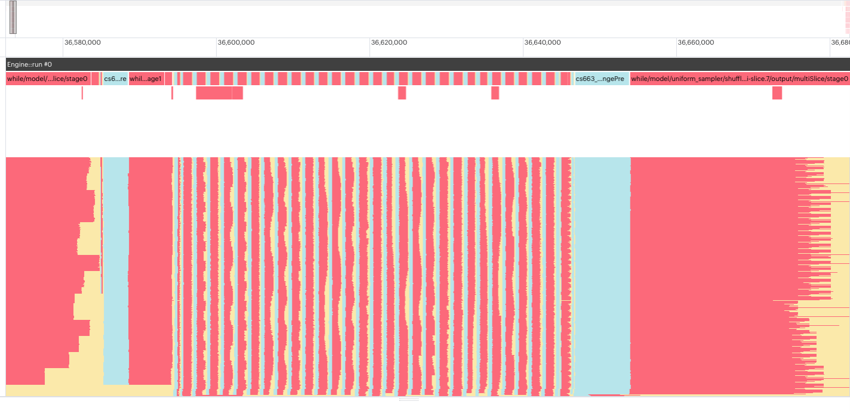
Alternative
Computing
Architecture
CPU
GPU
IPU
To slow
Expansive
?
IPU need serious tuning to achieve peak performance.
GraphCore provides comprehensive profiling tools for the tuning
We are in the process of finding the peak throughput on GraphCore.

Slide 35
Conclusion
Sparse TPC data present a unique challenge for data compression community.
We introduced three variants of compression BCAE-2D, BCAE++, and BCAE-HT.
Future Work
Incorporate network pruning, quantization, and sparse CNN techniques.
Extend our throughput comparison to include results of GPU-accelerated conventional lossy compression methods, as MGARD-GPU and cuSZ.
Test the algorithms on alternative computing architecture (IPU, etc.)

