Slide 1
ePIC Barrel ECal Meeting
May 23, 2023
Tom O’Connor

Slide 2
Engineering Update
Engineering Workshop at BNL
ePIC/BNL information
ePIC issues
EMCal specific issues
Recent developments since workshop

Slide 3
Engineering Workshop at BNL
May 10 – May 12, 2023
Discuss design and overall integration of subdetectors
The installation sequence, schedule, resources and budget for installation activities
Accelerate the design of some detectors that are lagging behind as compared to others
Gain a better understanding of the space envelopes, interfaces, and constraints for each subdetector
Tour experimental hall

Slide 4
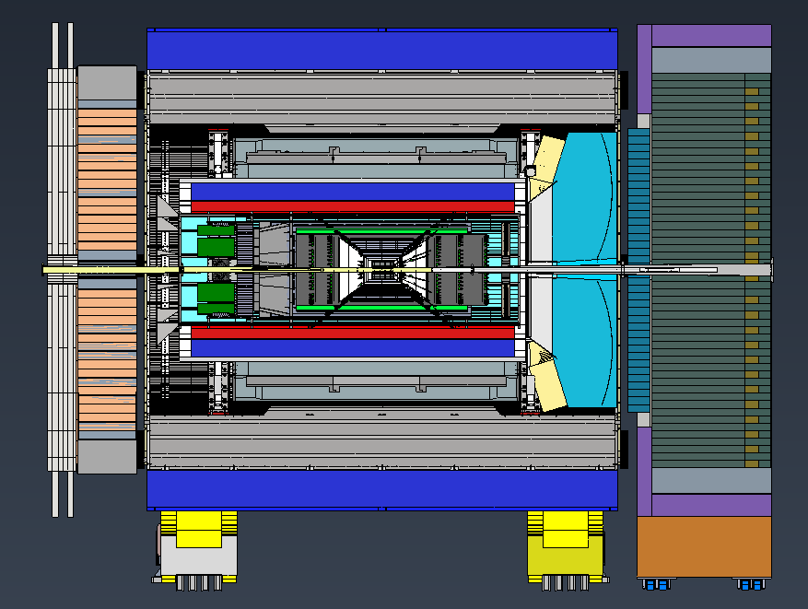
Reference CAD Model
sPHENIX Support Rings

Slide 5
ePIC Background Information:
HCal and magnet are from sPHENIX
Cradle is from STAR
Detector is rotated 8mrad on cradle (this complicates separating/removing endcaps)
EMCal must be loaded on DRich side due to assembly area constraints
Astropix installation/removal/maintenance in experimental hall is not possible
ePIC will use two support rings from sPHENIX to support HCal and constrain magnet
Barrel EMCal should be supported from the same rings (no rails/space frame and this means an end supported EMCal)
DIRC and other internal detectors need to be supported by EMCal (and sPHENIX support rings)
Magnet test in the hall with HCal and magnet only. Then return to assembly area to finish assembly starting with EMCal.
It takes 3 months to extract and reinstall STAR

Slide 6
ePIC Issues:
Interferences are everywhere (EMCal/DRich, EMCal/DIRC, Support Rings, Internal detectors, etc)
Beampipe must be baked with sensitive internal detectors in place
Magnet must be kept cool when ePIC is removed for maintenance
Cable routing/management and cooling is a challenge and there is a lot of work to be done. Some cables must be connected prior to installation.
Adjustment and alignment requirements for each subdetector need to be developed.
General assembly plan exists
Crane in assembly hall is rated for 40 tons (more on this later)
Integration/assembly schedule must account for long lead items

Slide 7
EMCal specific issues:
Verify the actual dimensions of EMCAL. There has been talk of making it shorter overall or perhaps having different lengths for imaging and non-imaging sections? This has a direct impact on the support and must be resolved. EMCal design is less refined than that of other detectors.
EMCal cannot be slid in on rails. It must be supported by pre-existing rings and loading becomes end-supported.
EMCal has smaller OD than baseline design. This may mean more room for cables but it complicates tie-in with support rings.
Support ring location is not well aligned with the ends of the EMCal.
EMCal will be built for 6 astropix layers but only use 4 at first?
There are questions about our FEA and thermal analysis (more on this later)
FEA should be repeated with final design for end supported barrel. Thermal analysis should be repeated too.
Reference EMCal is 55 tons….too heavy for crane.
Use same assembly procedure and installation device from sPHENIX

Slide 8
EMCal (continued):
Install wedges and rotate fixture
Permanent, geared endplate ties in to support HCal rings
End supported Barrel
Internal Detectors tie into EMCal Endplate
Outer aluminum plate probably should be made longer to move endplate away from SciFi Readout
sPHENIX Assembly Fixture
(Dan Cacace, BNL)

Slide 9
EMCal (continued):
sPHENIX Installation Fixture
(Dan Cacace, BNL)
sPHENIX Calorimeter
(Dan Cacace, BNL)

Slide 10
EMCal (continued):
End of ECAL
sPHENIX Support Rings location

Slide 11
Recent developments:
Reduced the thickness of the non-imaging layer by roughly 9cm. Wedge now weighs 3050#. Total ECal weight is 36.5 tons. Crane limit is 40 tons with unknown safety factor requirements
Existing tooling for lead may not be wide enough for 24 wedges
BNL has performed an independent stress analysis. Their results on a single wedge predict more deflection but only 0.007” total
They also did a FEA on an end supported barrel (old design) which predicts a deflection of 0.03” in the center
Our reduced wedge still has 2cm gaps for Astropix

Slide 12
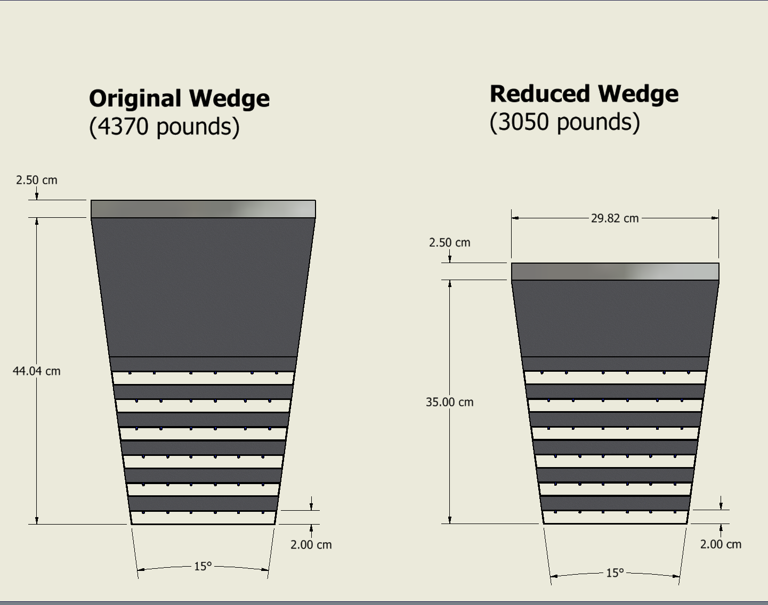
Recent developments (continued):
Inner surface is 78.3cm from beam
Space is limited between inner surface and inner detectors
Is it possible to move outward by 3cm to create space for inner services?

