Slide 1


Report of INTT Sensor Testing
NCU
Kai-Yu Cheng, Chia-Ming Kuo

Slide 2
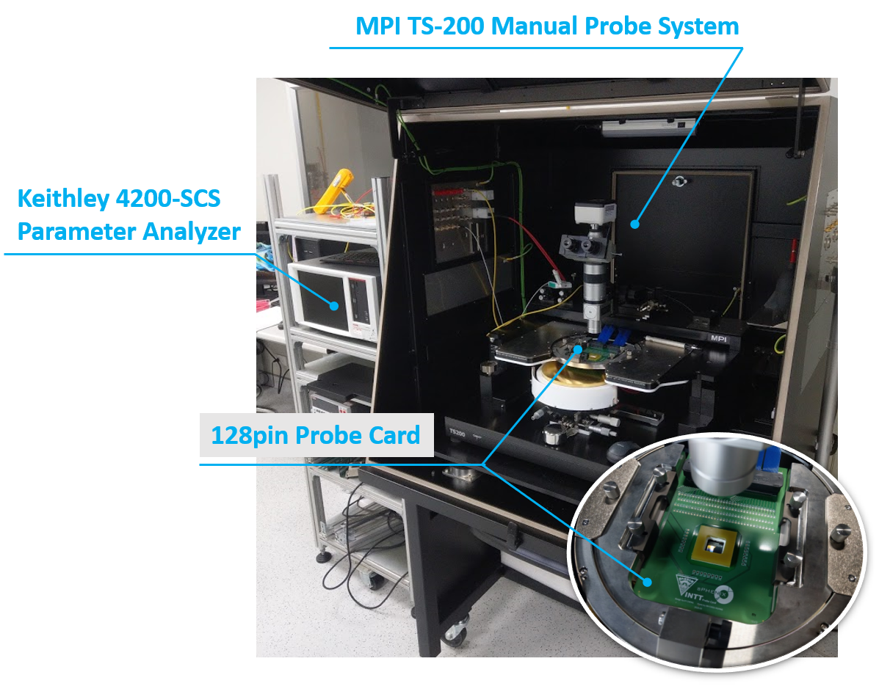
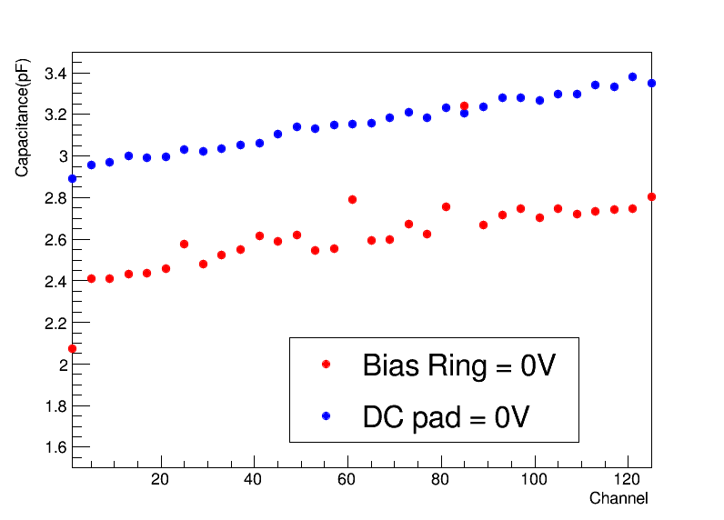
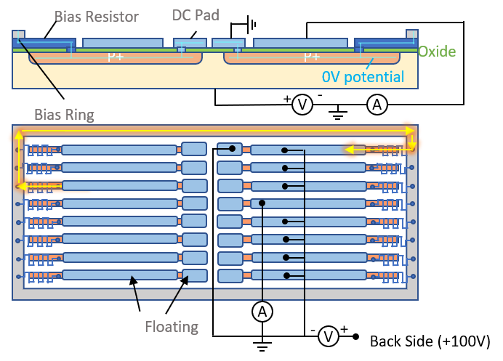
The CV Measurement Circuit of INTT Sensor Testing
Measure the capacitance of single channel from AC readout pad to check the status of each channels.
Supply bias voltage to the backside of sensor. The AC signal also send to backside and measure current variety form AC pad on front side. To sure we only measure the single channel capacitance, relay matrix will ground all channels except target channel. The system and circuit are showed in right plots.
Ground the DC pad to sure the sensors are full depletion, because grounding bias ring are difficult during all chips measurement. The bottom left plot shows the difference between grounding bias ring and DC pads. The value of DC pad situation is little higher, but the trend are the same, so ground some DC pads to supply same voltage is expedient method.
AC readout
AC readout
AC readout
…
A
+
Backside
-

Slide 3
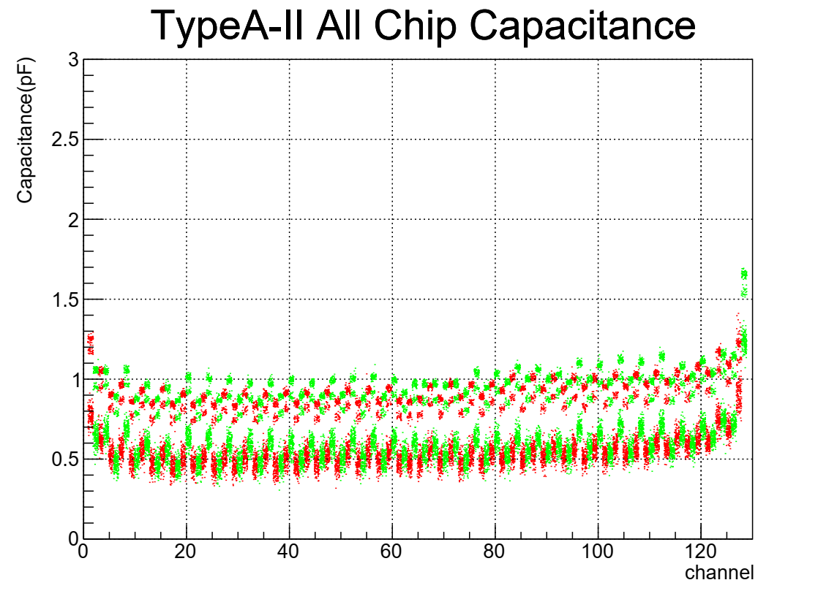
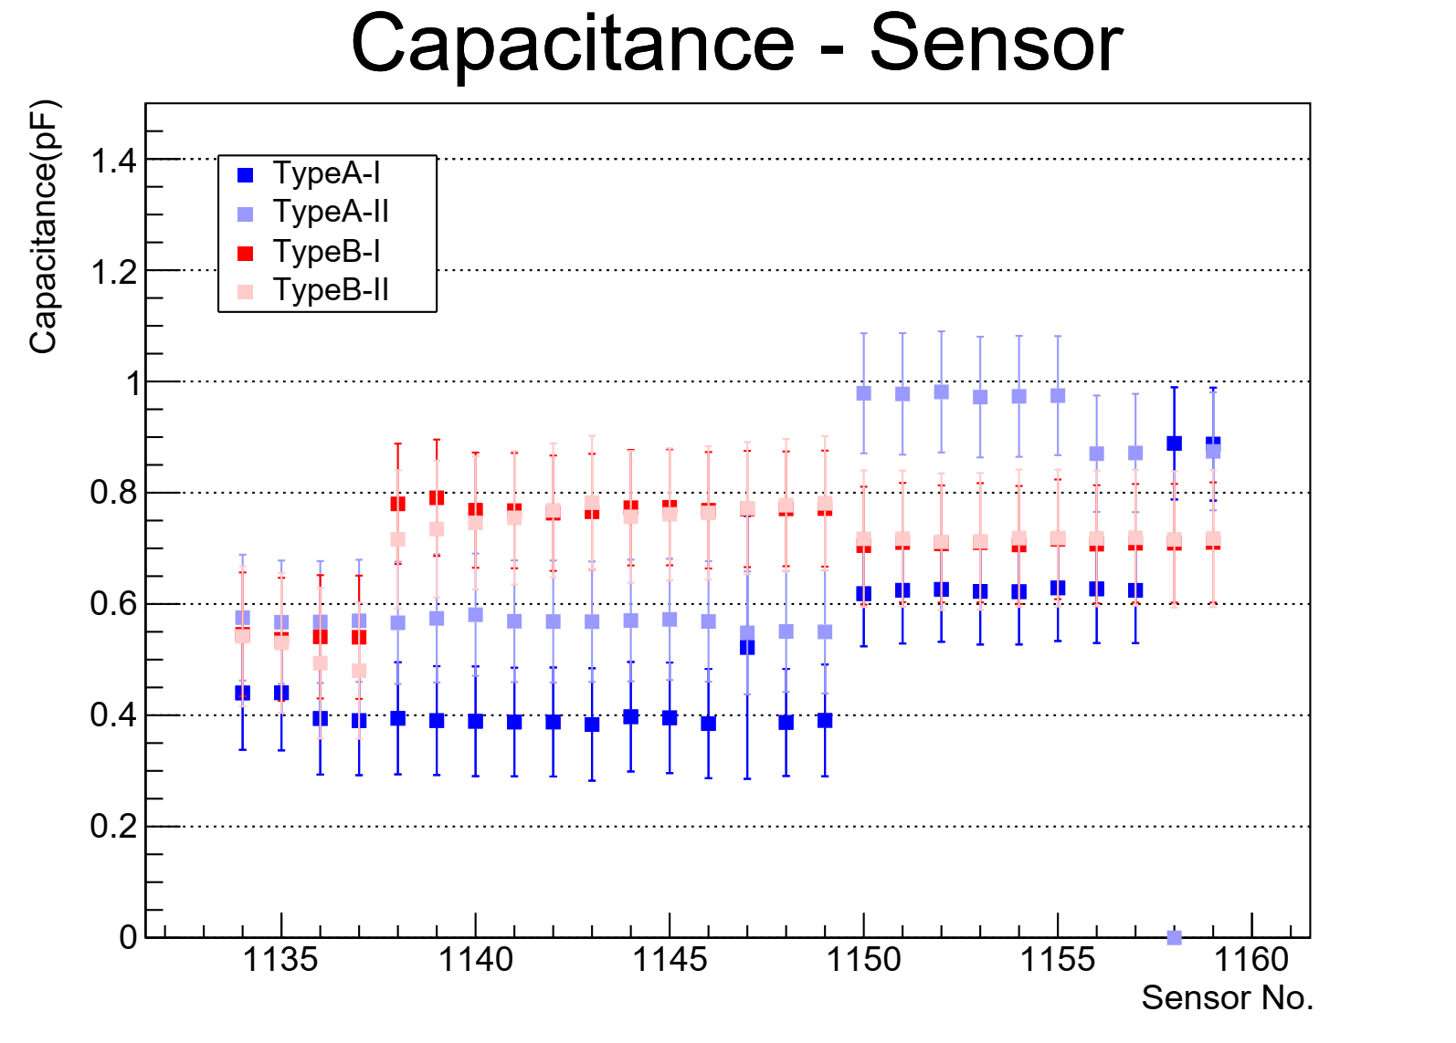
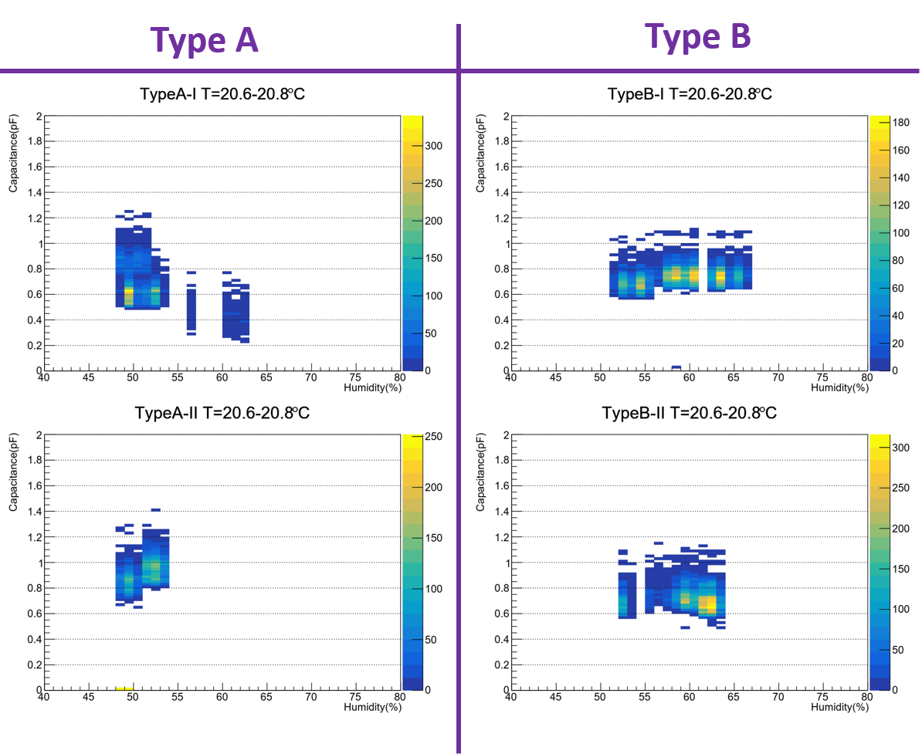
The Measurement Result of INTT Sensor Testing
Because the layout of sensor, each module is divided into four parts in the measurement. The left plot show one part result of sensor 1133-1159. All capacitance of channels are gaussian distribution, so we can identify the broken and functional channels from measurement. The left plot obviously show there are two different distributions. These differences could match to measuring period that be showed in middle plot.
The capacitance of signal channel showed in left plots is about 0.5pF, so total capacitance is about 1000pF. Compared with total sensor from HAMAMATSU’s inspection only has 7% difference. Therefore, this method could measure the capacitance of single channel.
To check why capacitances are different in periods, we analyze the relation between environment and measurement. The right plots shows the variety of capacitance with humidity at same temperature. The result shows the measurement is not obviously affected by humidity, so maybe this effect come from the status of sensor or measure system.
Period I
Period II
Two chips are remeasured in period II
Broken

Slide 4
Summary
Even if can’t ground bias ring during whole measurement, grounding from the DC pads also could get single channel capacitance to check status od each channels.
However, the capacitance of single channel is too fine (<1.5pF), so the value could be affected by environment. From humidity study, the humidity didn’t has obvious effect, so maybe this effect come from the status of sensor or measure system.
If the capacitance are measured in short period, the values is stable. The RMS of gaussian distribution in same channel is about 0.05. Therefore, we still can use data that come from same measurement period to identify character of channels.
In first branch, all channels in sensor 1131-1159 are good. We don’t see any channel has very strange value.
The secondary branch check had started.
4

