Slide 1


Report of INTT Sensor Testing
NCU
Kai-Yu Cheng, Chia-Ming Kuo

Slide 2
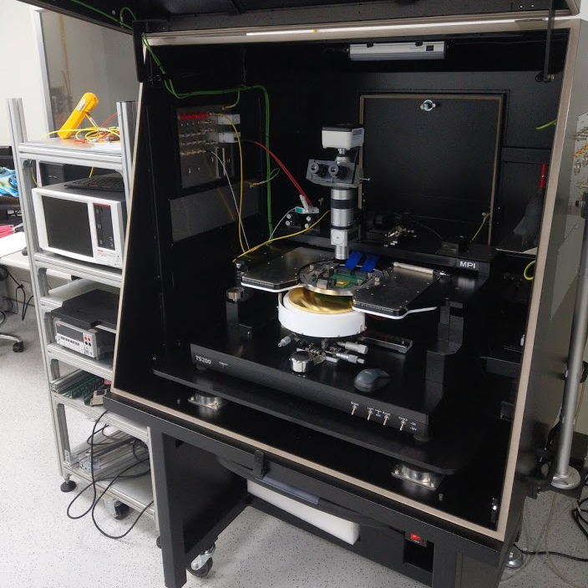
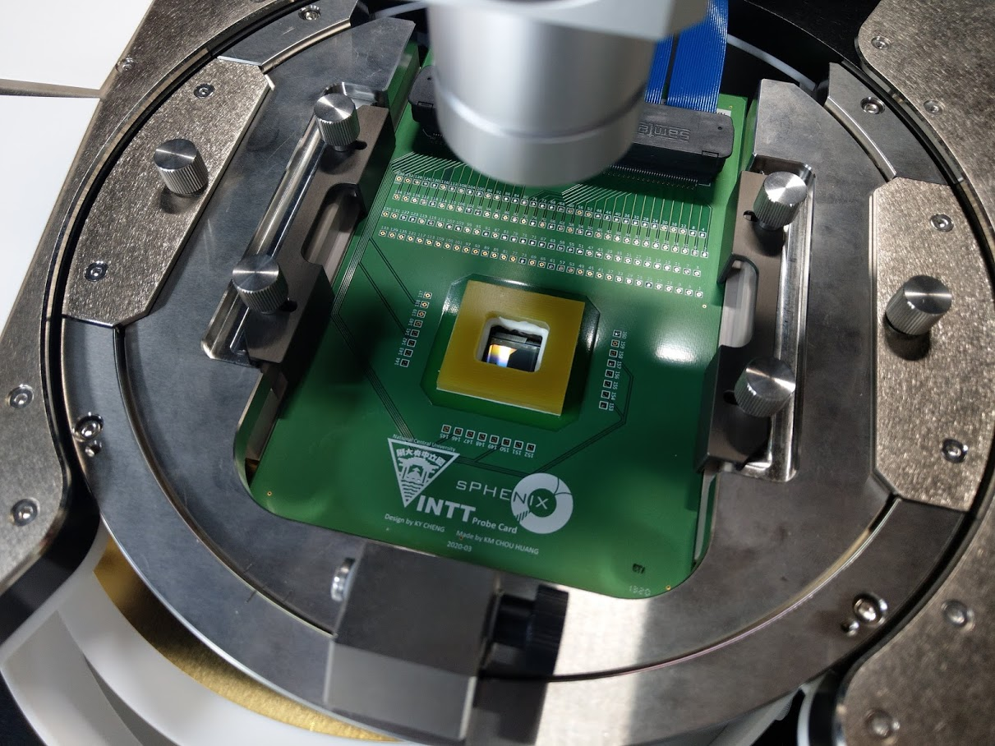
The System of INTT Sensor Testing
Goal
MPI TS-200 Manual Probe System
Measure the capacitance of single channel from AC readout pad to check the status of each channels.
For AC couple sensor, it is hard to get leakage current of single channel, so IV curve of each will not be measured.
Keithley 4200-SCS
Parameter Analyzer
Whole sensor testing are operated in clear room of class 10000.
MPI TS200 has highly repeatable platen lift design to sure the contact force and stroke are stable. Therefore, the traces of probe can be controlled easily.
The 4200-SCS parameter analyzer could measure the pF level capacitance from -200V to 200V.
The probe card is connected to relay switch to scan all channels automatically.
128pin Probe Card

Slide 3
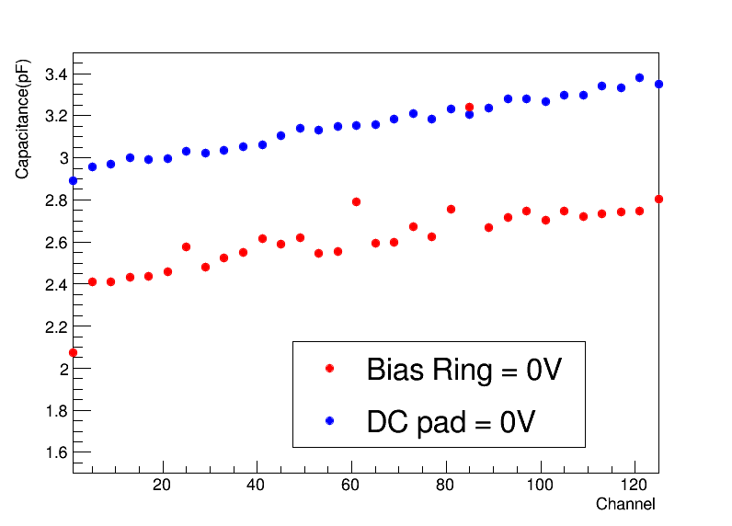
The CV Measurement Circuit of INTT Sensor Testing
Supply bias voltage to the backside of sensor. The AC signal also send to backside and measure current variety form AC pad on front side.
To sure we only measure the single channel capacitance, relay matrix will ground all channels except target channel.
The DC pads are connected to ground to sure the sensor is full depletion. In standard set up, the bias ring should be grounded, but in INTT sensor layout grounding bias ring are difficult during all chips measurement. Therefore, ground some DC pads to supply same voltage is expedient method.
The left plot shows the difference between grounding bias ring and DC pads. The value of DC pad situation is little higher, but the trend are the same.
Bias Resistor
DC Pad
P+
P+
Oxide
0V potential
+
-
Bias Ring
V
A
Floating
A
-
+
V
Back Side (+100V)
AC readout
AC readout
AC readout
…
A
+
Backside
-

Slide 4
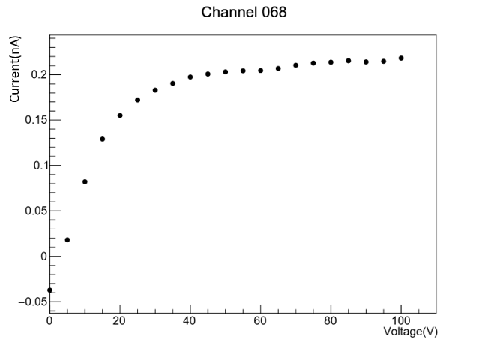
The IV Measurement Circuit of INTT Sensor Testing
Also supply bias voltage to the backside of sensor, but the current are measured on DC pads.
During the measurement other channels in the same chip also be grounded, but this set up can only block the current from the same chip. The leakage current from other chips couldn't be shielded.
The left plot shows the one channel result of IV measurement. The current at 100V is about 0.22nA. If this current is leakage current of single channel, the leakage current of total sensor is about 450nA. This value is 7 times larger than HAMAMATSU inspection. Therefore, this method can’t get the current of single channel.
Bias Resistor
DC Pad
P+
P+
Oxide
0V potential
Bias Ring
+
-
V
A
?
Floating
A
-
+
V
Back Side (+100V)
DC readout
BR
BR
BR
…
A
Backside

Slide 5
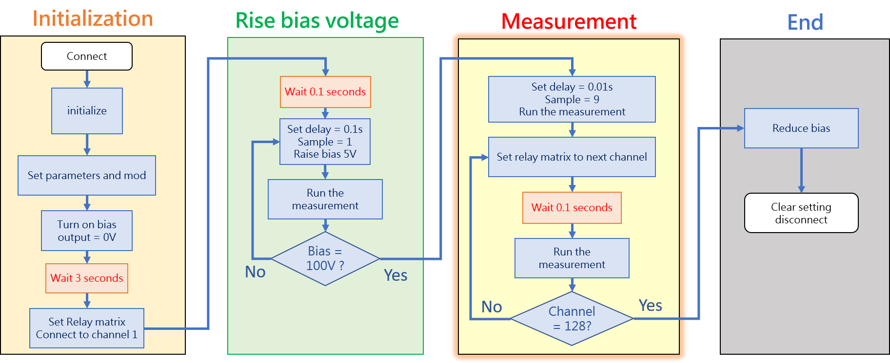
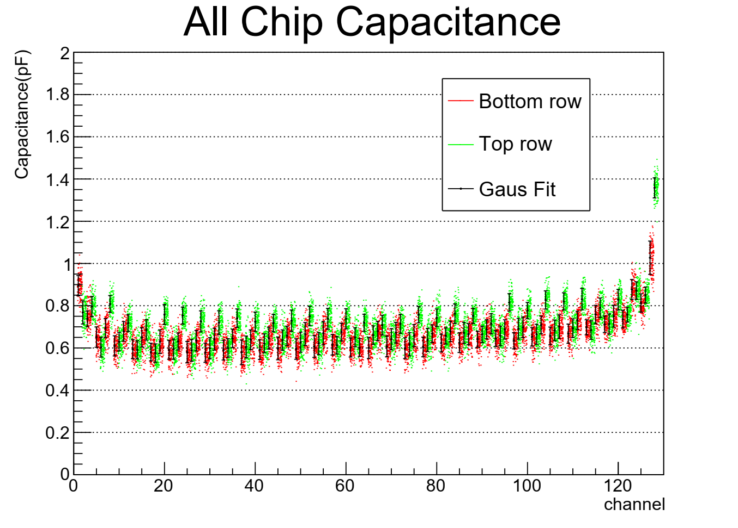
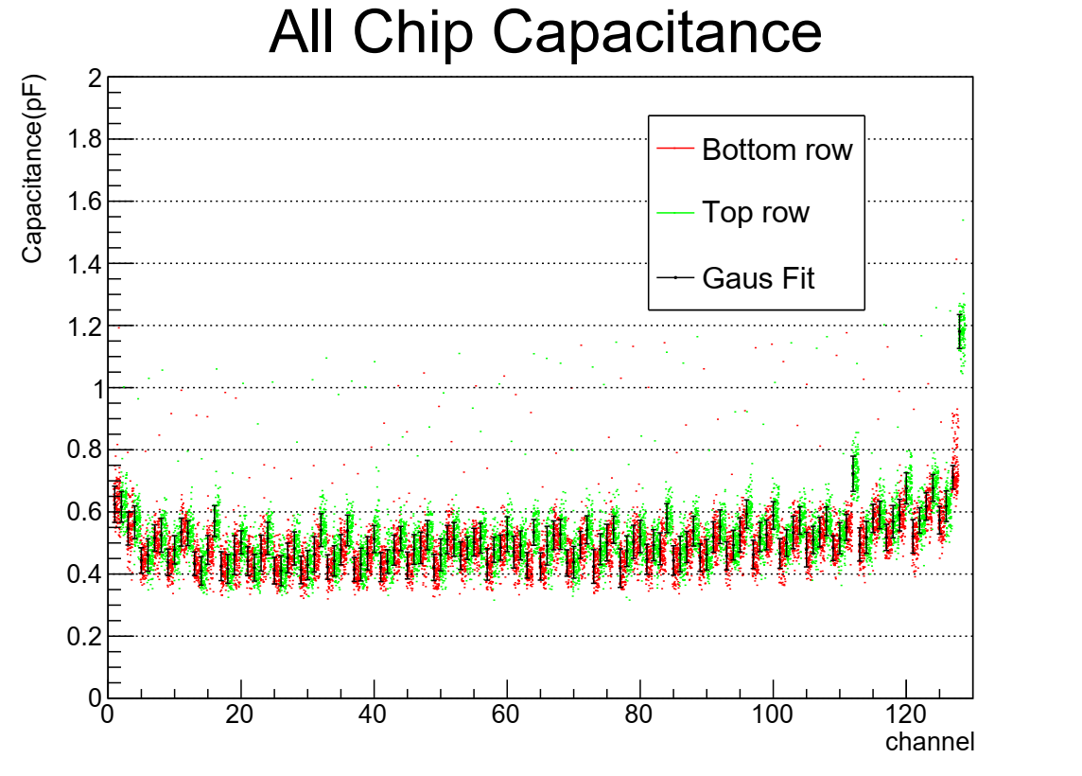
The Process of INTT Sensor Testing
Top picture shows the measuring process :
The voltage will be raised to 100V with speed 50V/s.
The voltage of backside keep 100V. Using the relay matrix to scan all channels.
Bottom plots show the capacitance histogram of type-A sensor 1134-1149. The left plot shows the capacitance of even chips and right shows the odd chips.
The readout of INTT sensor is two rows design. The different colors in plots show the different rows.
From bottom plots, the mean and fluctuation values of each channels can be defined to identify the broken and functional channels. However, the capacitance of single channel is too fine, so the values will be affected by system and environment substantially. (In bottom right plot)
Bottom plots show the capacitance of signal channel is about 0.5pF, so total capacitance is about 1000pF. Compared with total sensor from HAMAMATSU’s inspection only has 7% difference.
All even Chips Capacitance
All odd Chips Capacitance

Slide 6
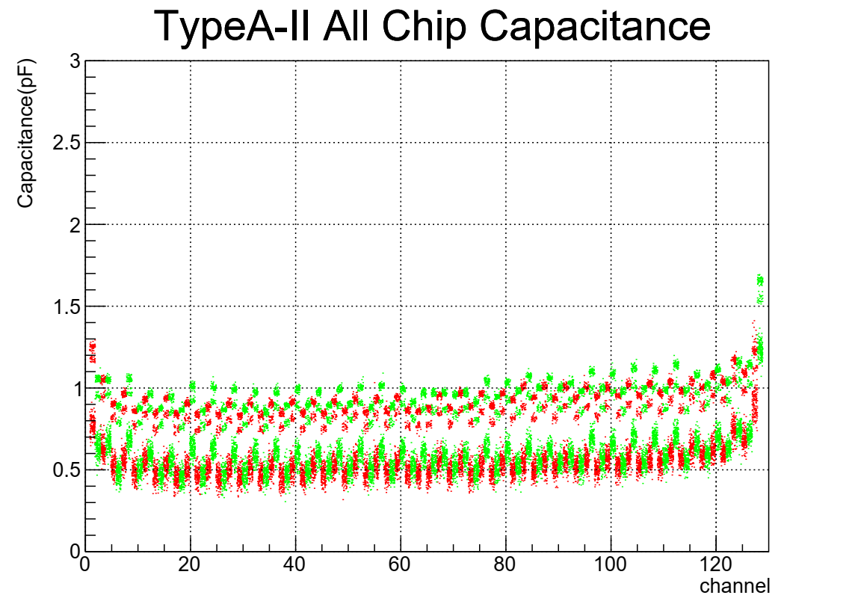
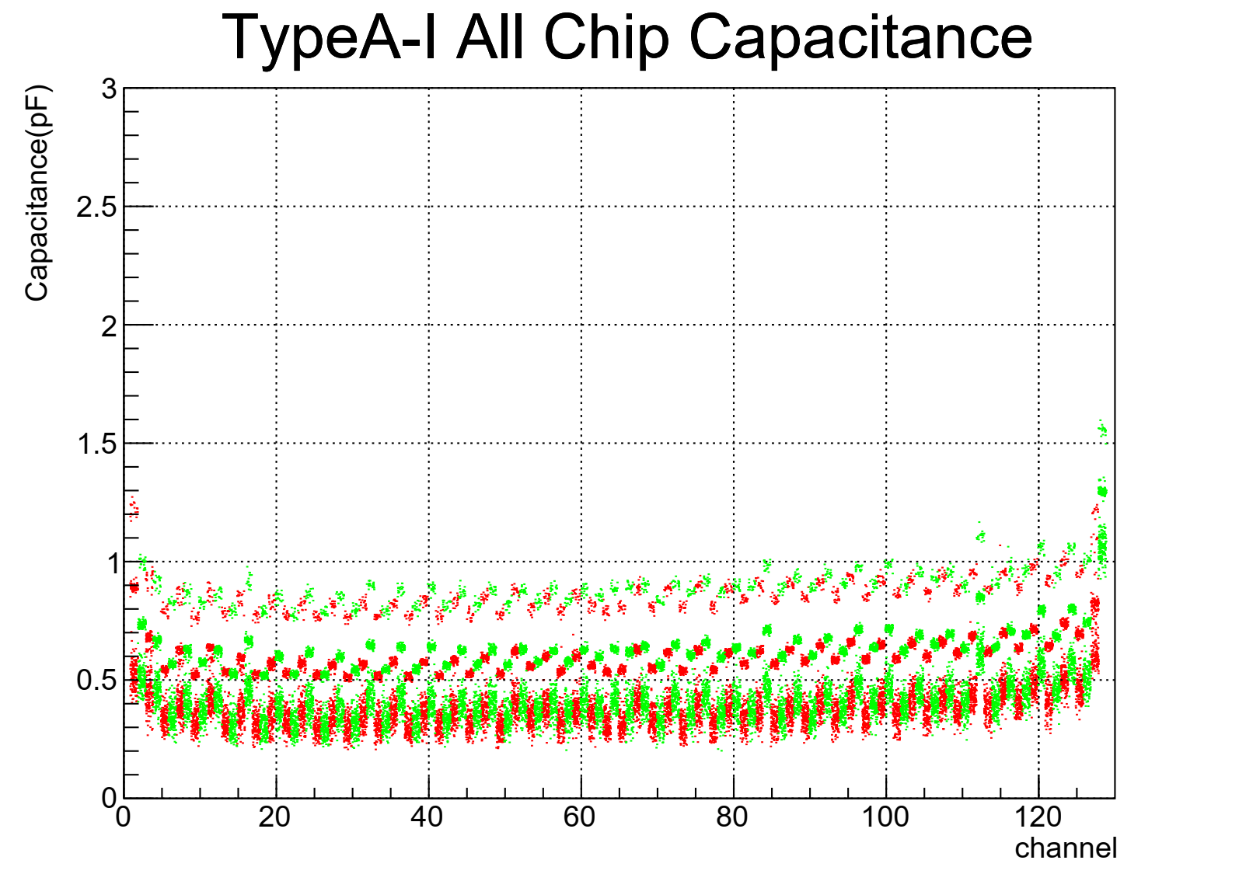
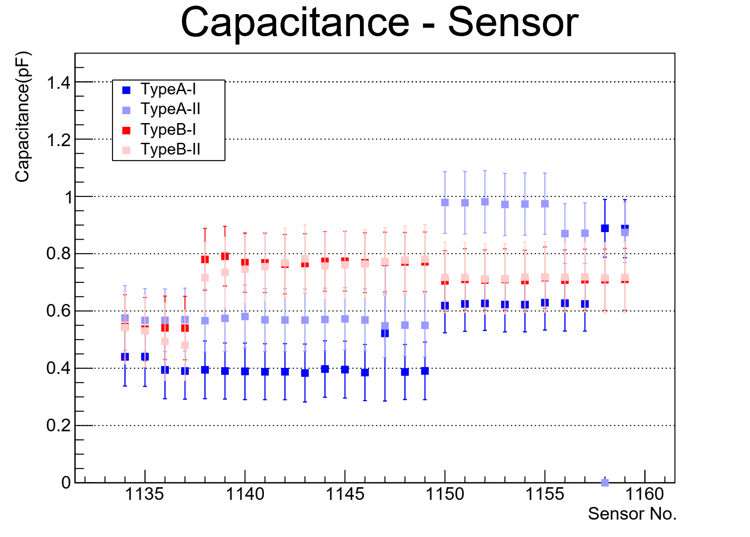
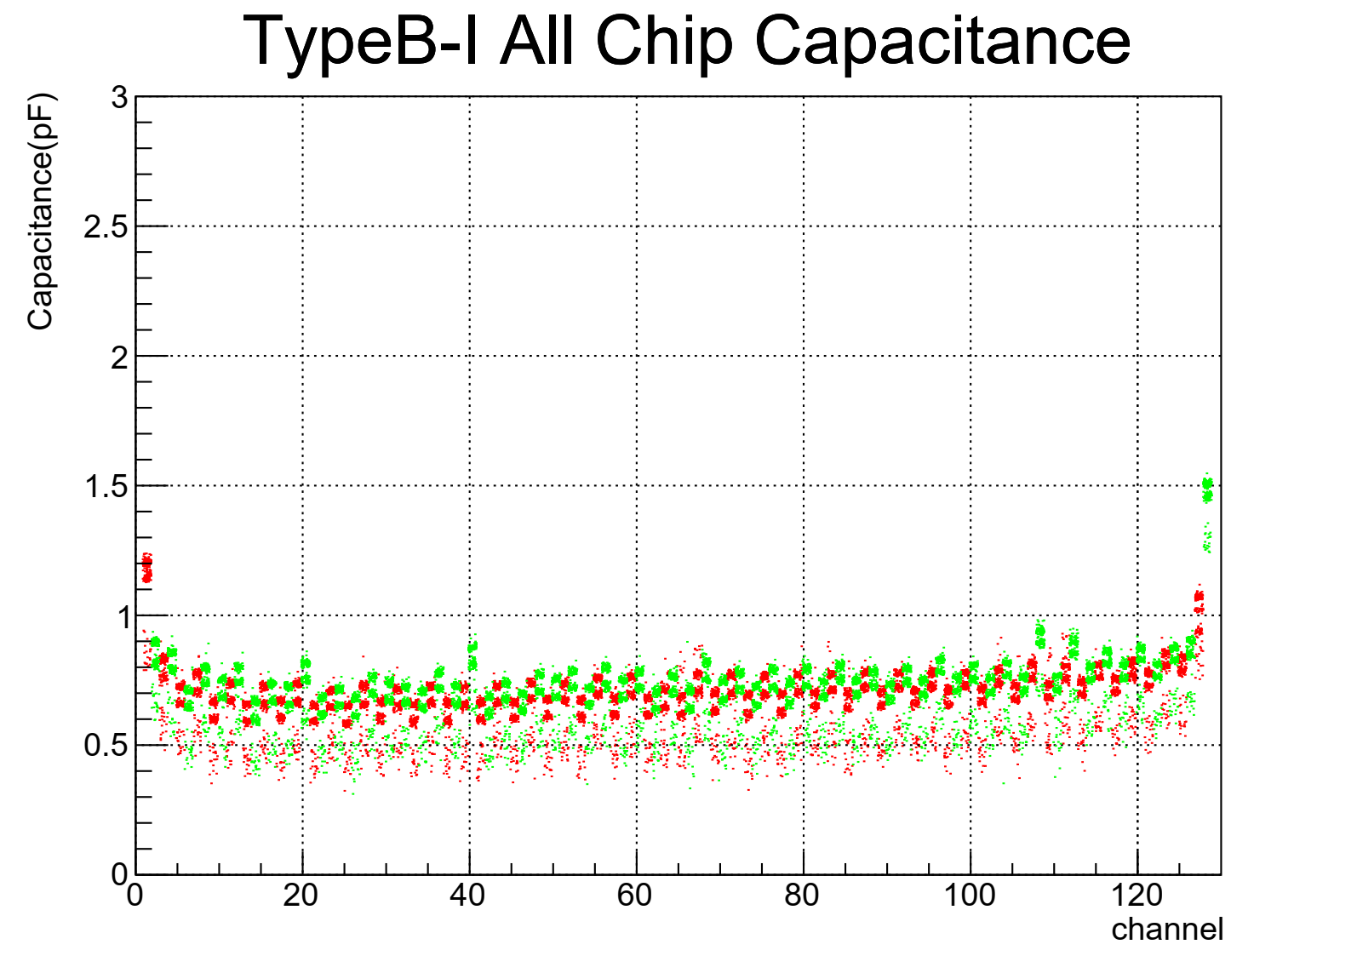
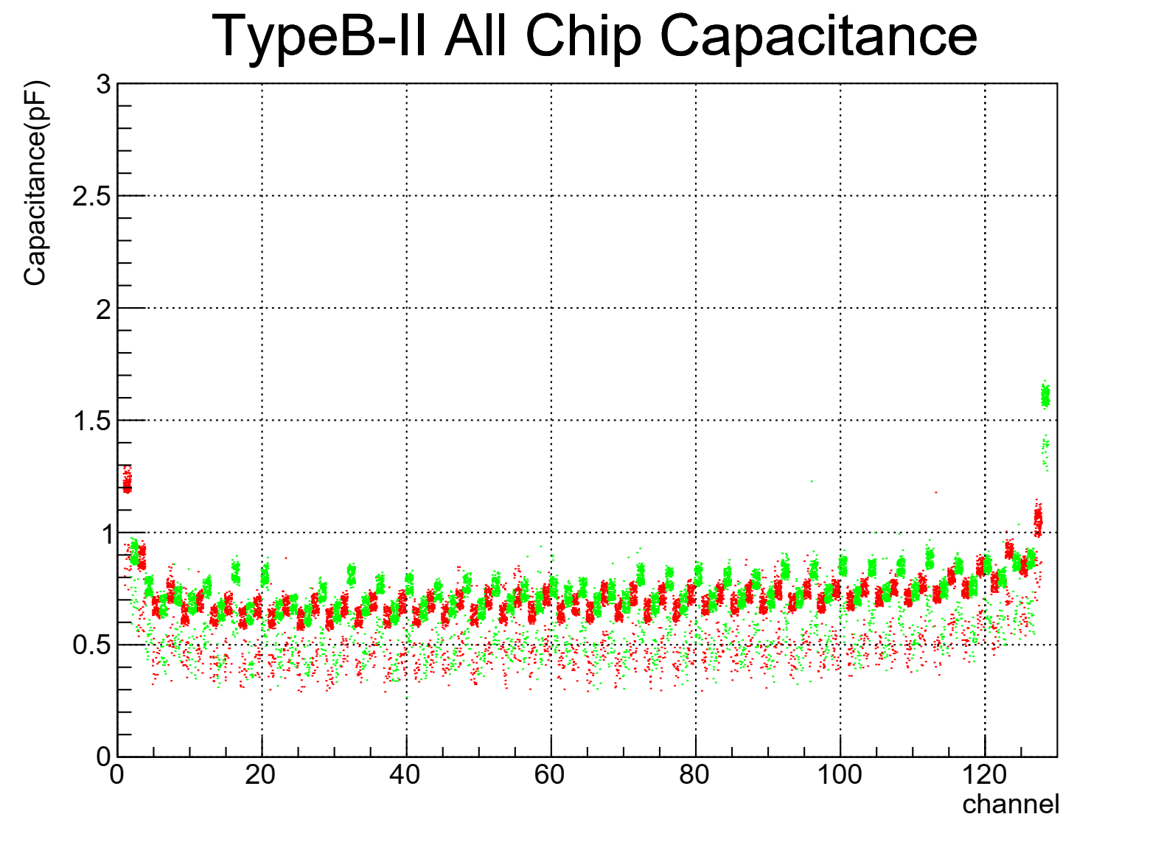
The Measurement Result of INTT Sensor Testing
One set of sensor need use four probe cards to measure all chips. All sensor data shows in right four plots. These plots obviously show there are few different capacitance distributions. These differences could match to measuring period.
The measurement was paused in the middle, so whole testing could be divided into two period. The bottom plot shows the values are different in these two periods.
Period I
Period II
Two chips are remeasured in period II
Broken

Slide 7
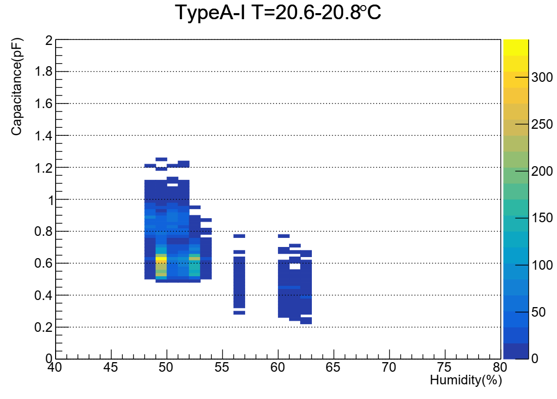
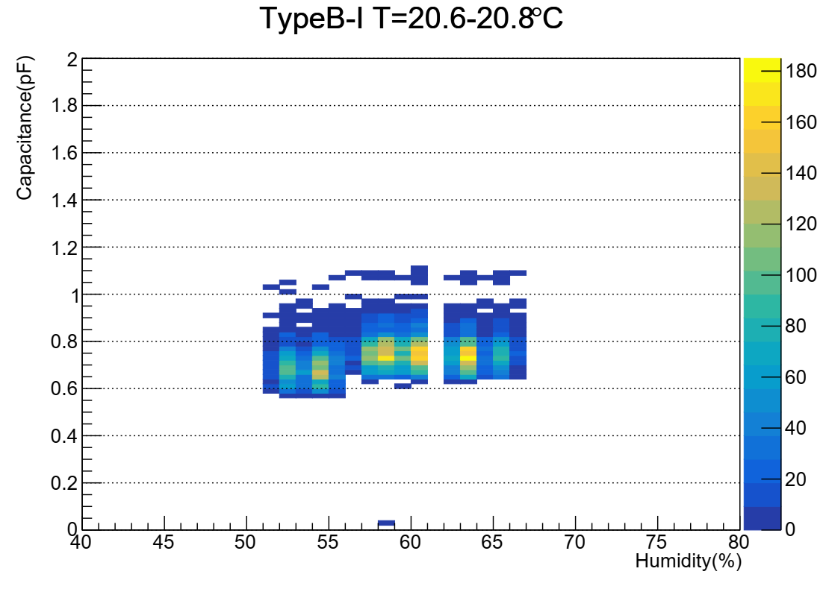
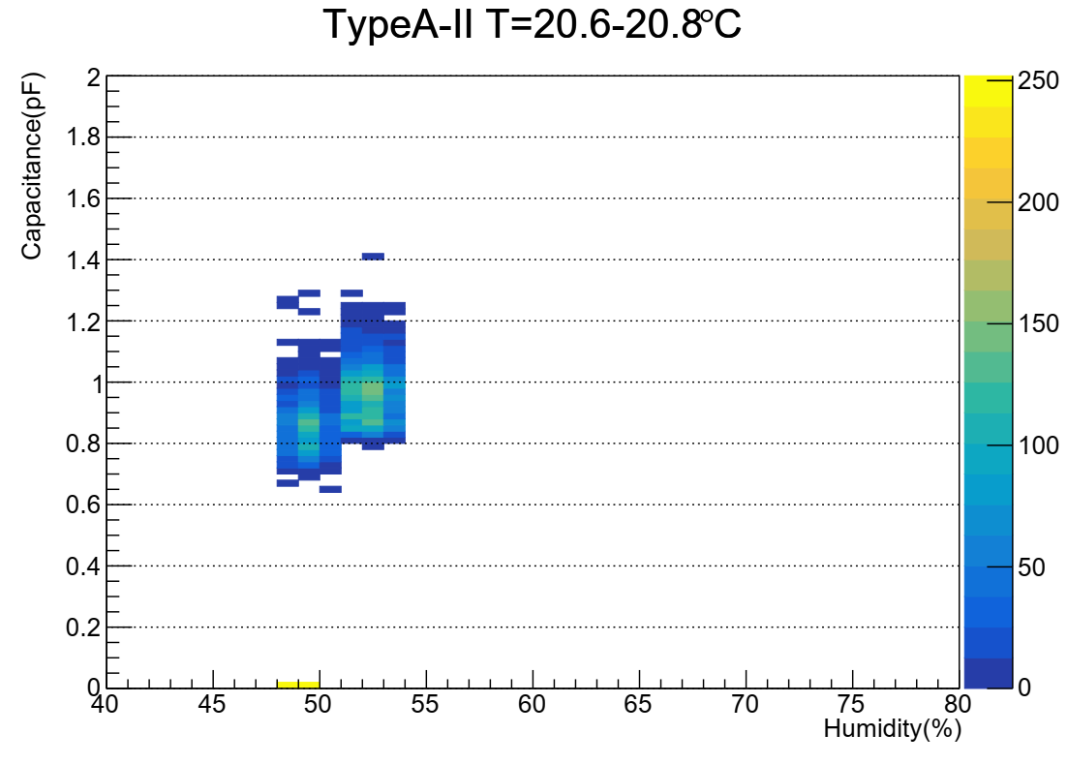
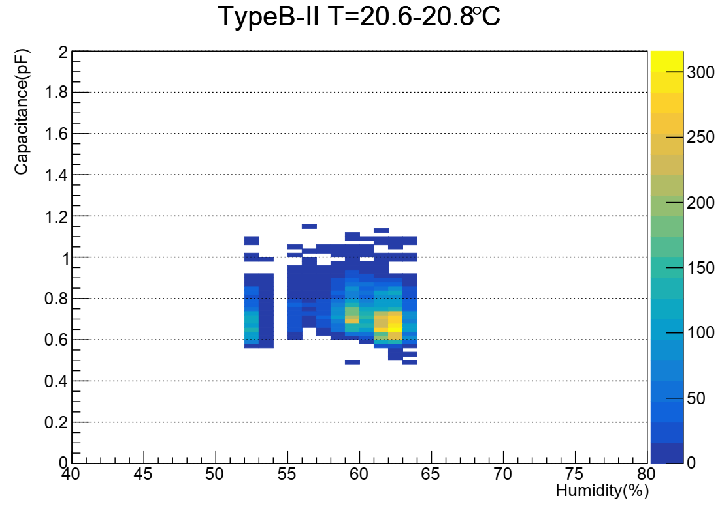
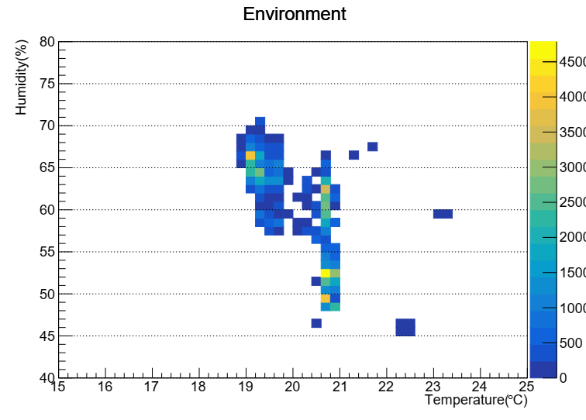
The Relation between Humidity and Capacitance
Type A
Type B
To check why capacitances are different in periods, we analyze the relation between environment and measurement.
Bottom plots shows the temperature and humidity distribution in whole testing. The right plots show the effect of humidity at constant temperature.
In right plots, the measurement is not obviously affected by humidity.
The temperature data in same humidity is too low, so can’t know the effect of temperature.

Slide 8
Summary
Even if can’t ground bias ring during whole measurement, grounding from the DC pads also could get single channel capacitance to check status od each channels.
However, the capacitance of single channel is too fine (<1.5pF), so the value could be affected by environment. From humidity study, the humidity didn’t has obvious effect, so maybe this effect come from the status of sensor or measure system.
If the capacitance are measured in short period, the values is stable. The RMS of gaussian distribution in same channel is about 0.05. Therefore, we still can use data that come from same measurement period to identify character of channels.
In first branch, all channels in sensor 1131-1159 are good. We don’t see any channel has very strange value.
The secondary branch check had started.

