Slide 1
Santa Cruz Institute of Particle Physics (SCIPP) at UCSC
Tony Affolder & Vitaliy Fadeyev
On Behalf of the Team

Slide 2
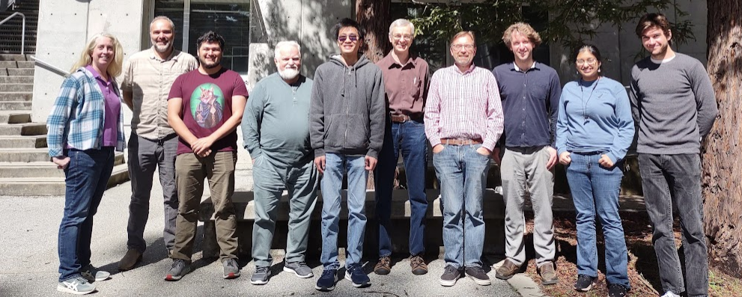
Who are we?
Team of 2 Academics (Mike Hance, Jason Nielson) and 2 Scientists (Tony Affolder, Vitaliy Fadeyev) with a team of experienced technicians (Kirsten Affolder, Forest Martinez-M….), junior technicians (rotating) & undergraduates (rotating)
Post-docs, graduate students possible with funding
Current team producing ATLAS Strip modules

Slide 3
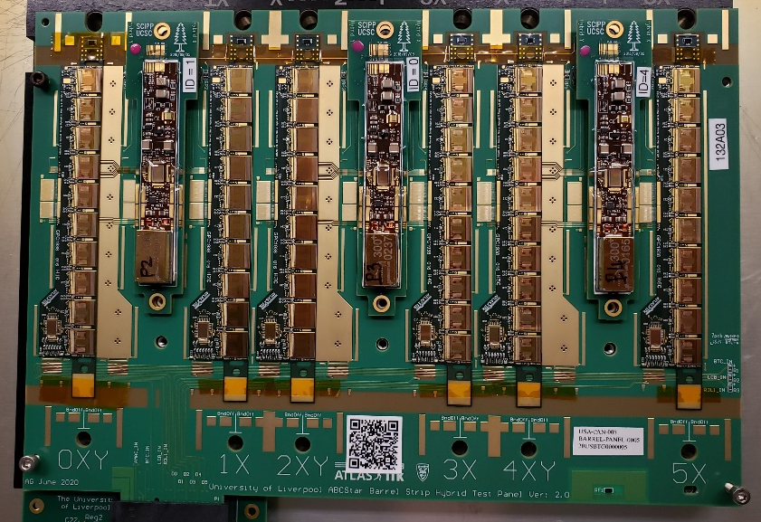
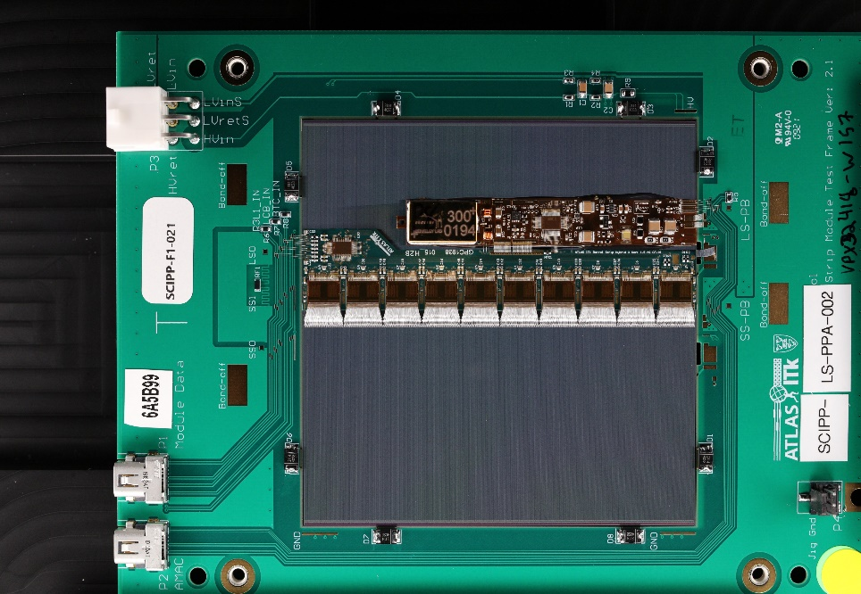
What is are experience/interests?
Extensive expertise (25+ years) in the design, manufacture, assembly and testing for sensors, hybrids and modules for tracking devices
CLEO, CDF, HPS, CMS, LHCb, ATLAS
Currently, starting 3 year production for ATLAS ITk Strip upgrade
3000 hybrids and 2000 modules
Interested in gaining experience with MAPS based devices and their packaging for large scale detectors and stretching it into calorimetry
It is the present and the future ☺
ATLAS Hybrid Panel
ATLAS LS Module

Slide 4
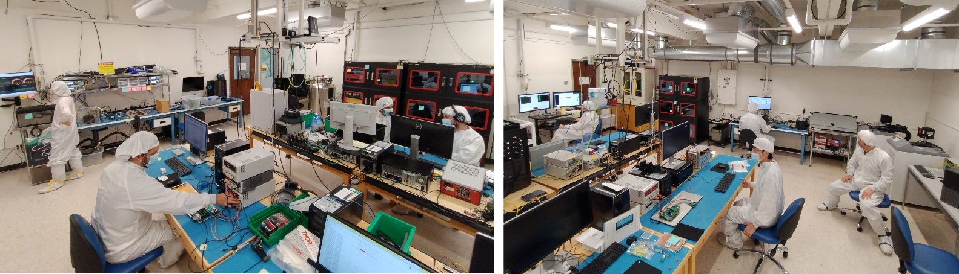
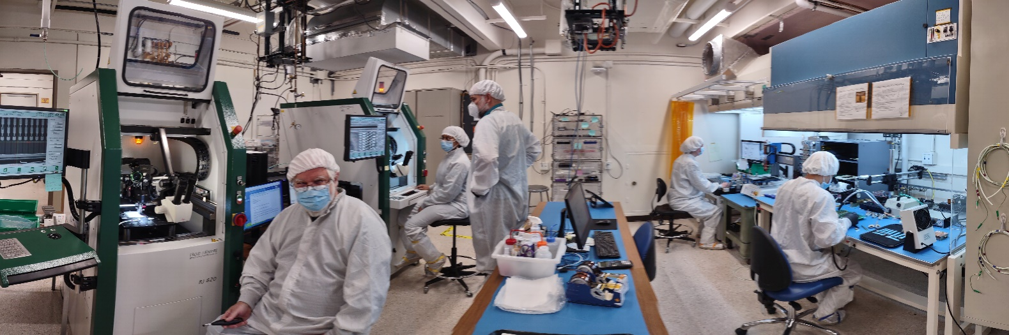
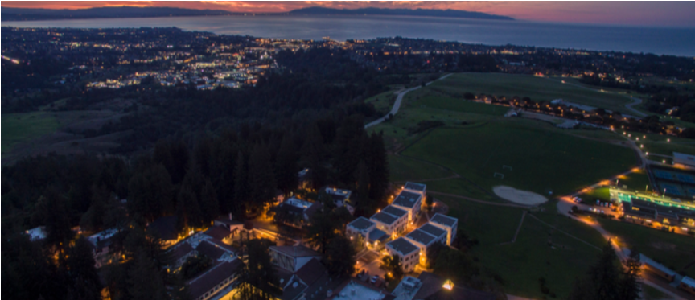
Where are we? What do we have?
SCIPP at the UCSC campus
For ATLAS assembly/testing, two large class ISO-7 cleanrooms (total 170 m²)
Equipped with wire bonders, pull testers, glue robots, chillers, metrology systems, dry storage, vacuum, FPGA electrical test systems, …..
ATLAS space occupied until production completion (3-4 years)
In near term, lab space with clean hood available
Large enough for development of assembly and testing infrastructure and methods
Metrology and Wire bonding in the ATLAS space/

Slide 5
Plans for EPIC Barrel Imaging Calorimeter
Near term
Learn how to operate ASTROPIX systems (1 and multi-chip)
Working toward a module-0 and Electrical QC systems (robotic?)
Beginning mockups of mechanical assembly
Working toward a module-0 and Assembly systems (robotic?)
Long term
Taking on the assembly and testing of a reasonable fraction of the staves
Size depends on scope of work, funding and timing of pre-production and production phases
We hope to learn more to understand what is possible this week!!

