Slide 1
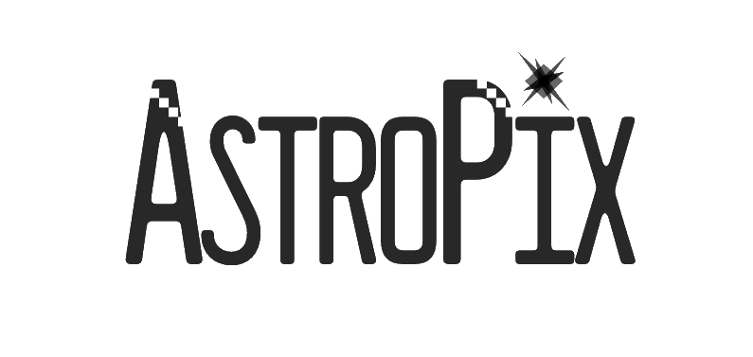
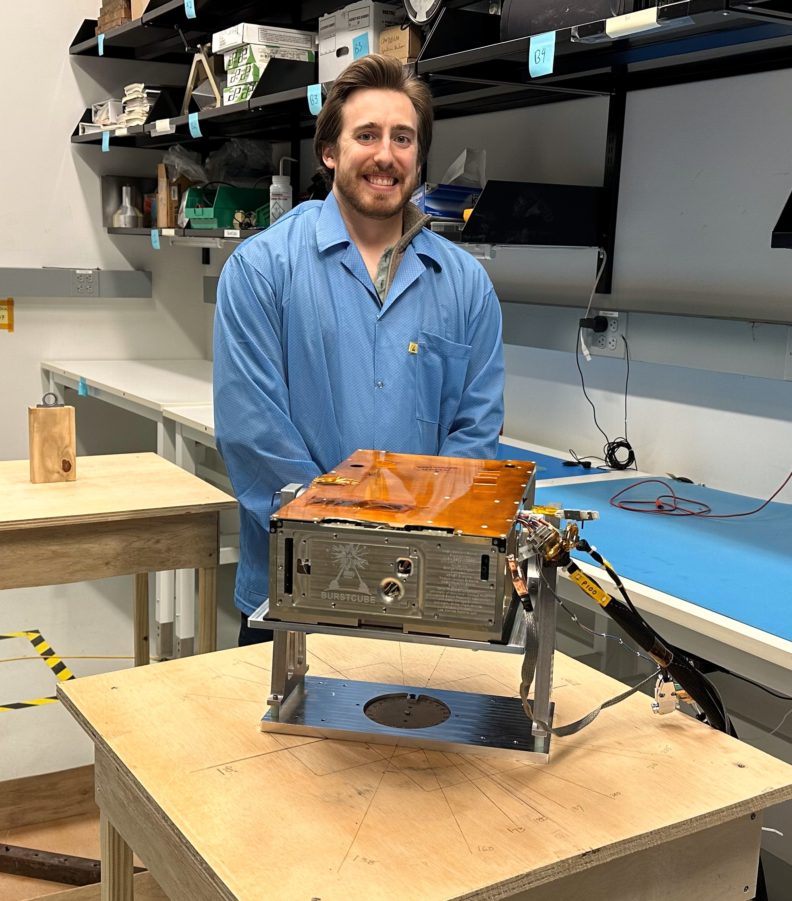
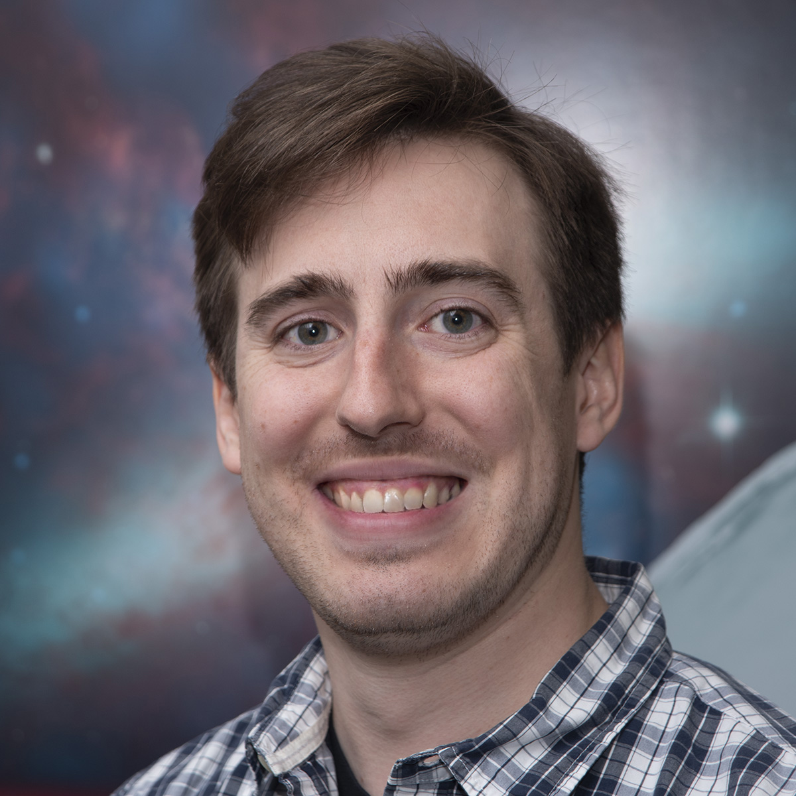
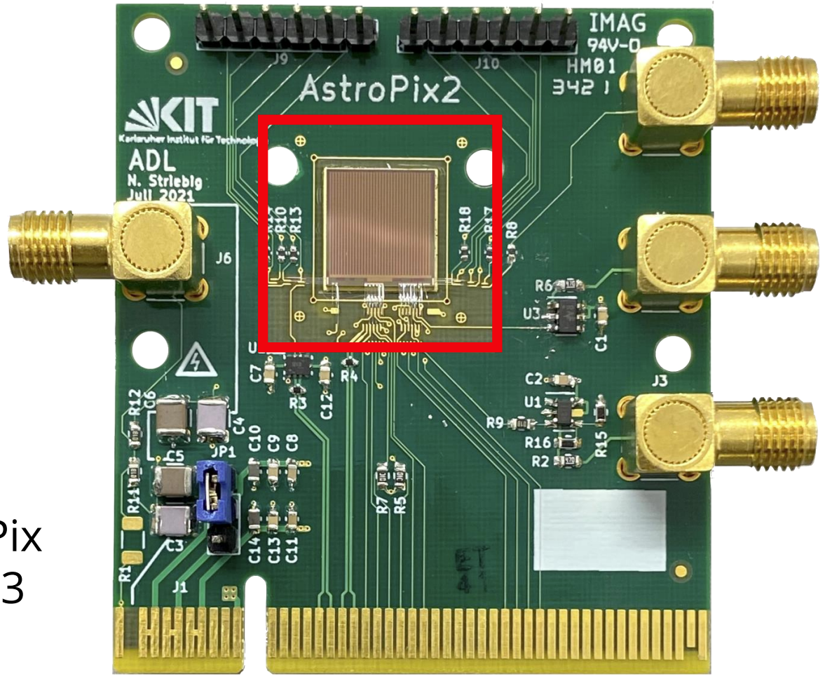
Dan Violette
Goddard Space Flight Program
NASA Postdoctoral Program
Interests include High Energy Astrophysics, primarily focused on wide-field instrumentation for transient detection, but also extending to sub-threshold transient detection searches, simulation, etc.
At GSFC I am working on AstroPix and the AstroPix Sounding Rocket Technology Demonstration Payload, A-STEP.
I also work with BurstCube (Full Unocculted Sky 50keV-1MeV Transient Monitor) on pre-flight I&T and pipeline development.

