Slide 1
ePIC Barrel ECal Meeting
June 15, 2023
Integration and Engineering Priorities

Slide 2
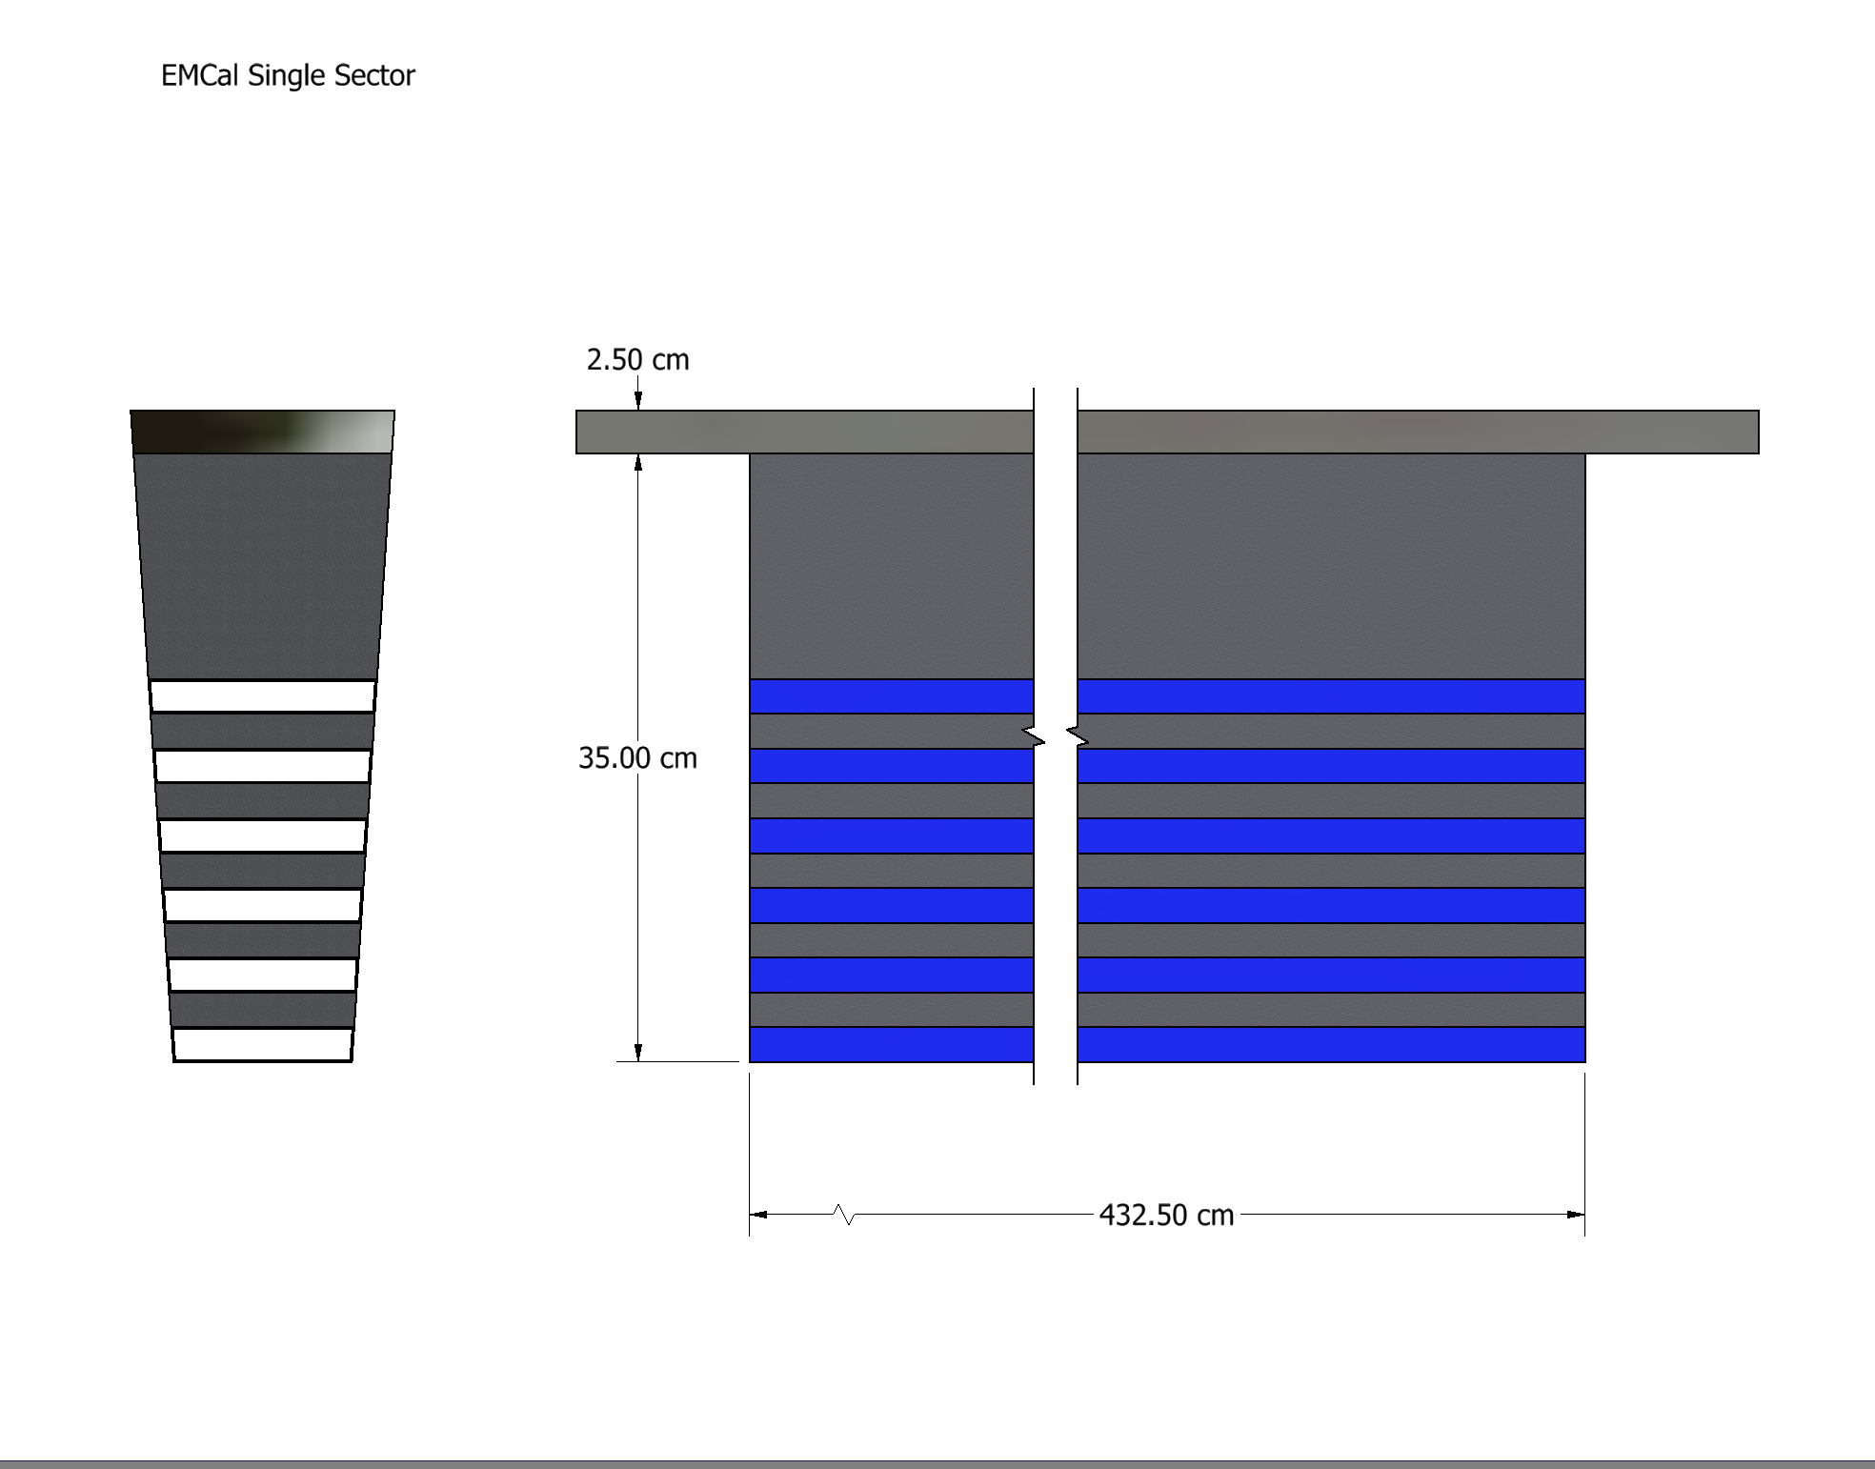
EM Cal Single Sector

Slide 3
ECal Individual Sector Assembly Highlights/Priorities:
Finalize dimensions of imaging and non-imaging regions; barrel expected to grow outward by ~3cm for DIRC
Increase space for electronics, etc. on each end
Additional aluminum sheets needed for each Pb/SciFi layer will increase thickness
Design carbon fiber shelves
Follow GlueX procedures and practices as much as possible (ie. Documentation)
Sector assembly will combine finished layers and shelves in a “trench”
Perform tests on spare GlueX sector to determine mechanical properties.
FEA with measured mechanical properties (possible impact on plate thicknesses)
Design fixtures to test BabyBCal at Fermilab
Carbon fiber parts must be strong enough for non-self-supported sector.
2 two-meter long astropix per shelf, install from each end
Unprotected inner Imaging Layer with no gaps

Slide 4
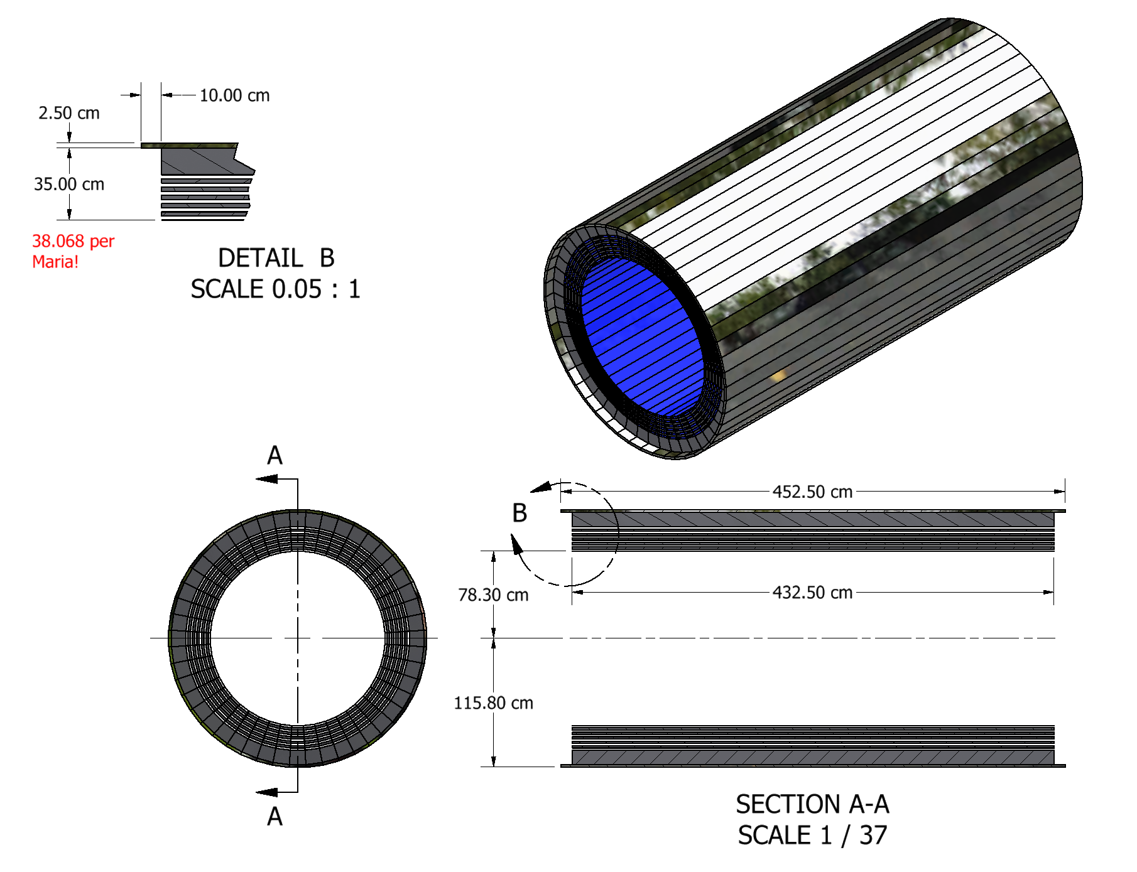
48 Sector Barrel EMCal

Slide 5
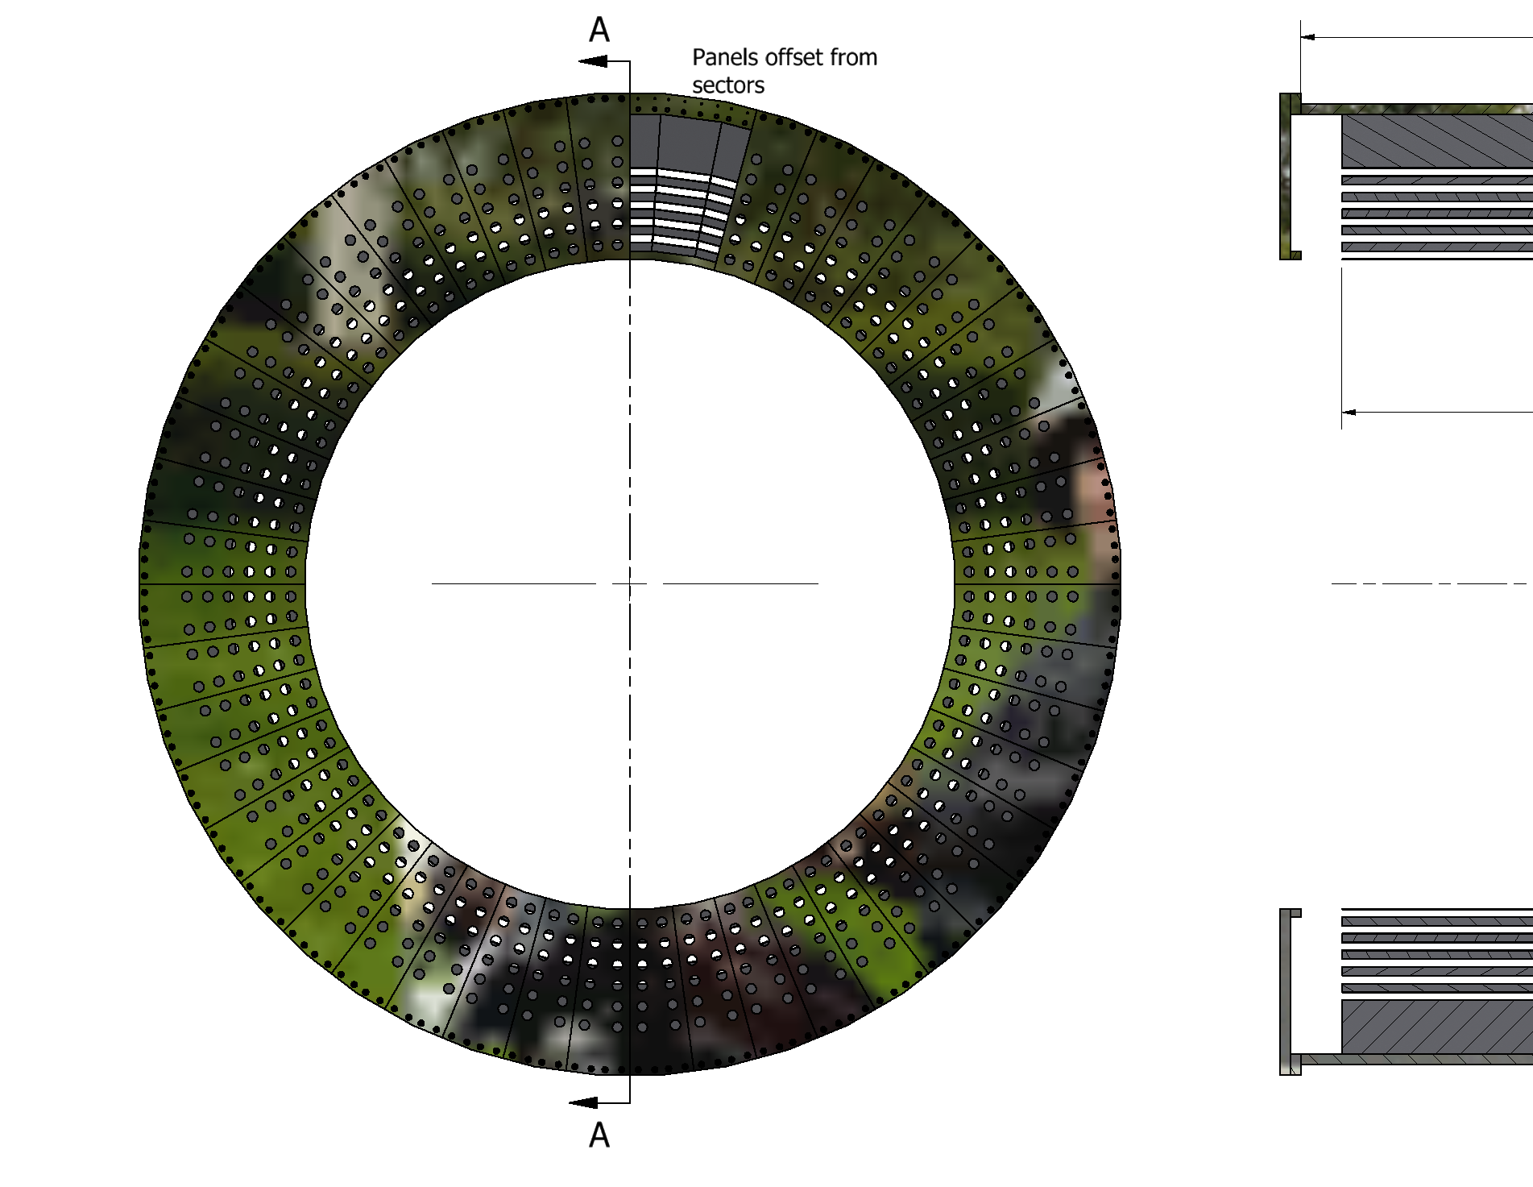
Mounting Rings

Slide 6
Barrel EMCal Assembly Highlights/Priorities:
Mounting ring design compatible with sPHENIX assembly fixture (rollers)
Ring dimensions must be adjusted to allow for complete access (inner layer)
Rings on the ends may over-constrain the self-supporting idea
Develop plan for lifting/manipulating individual sectors (lifting eyes in outer plate?)
Pockets on outer plate or longitudinal straps
Total EMCal weight will probably exceed 40 tons (additional crane or build at height)
Add DIRC interface to ring design on west end

Slide 7
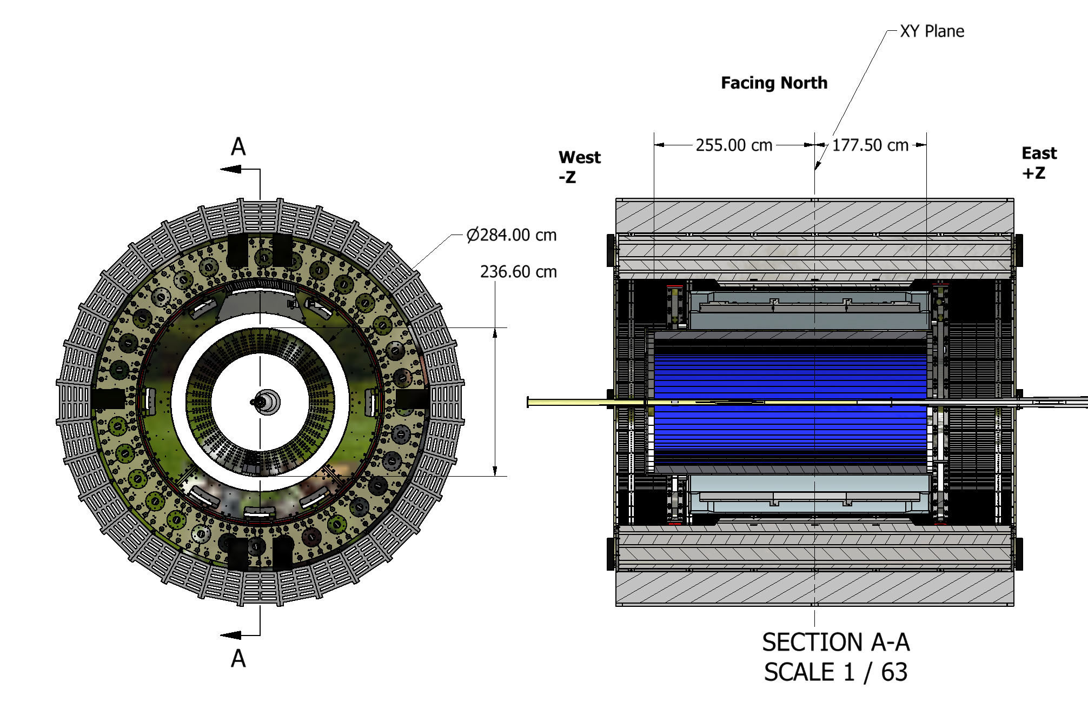
Placement in EPIC

Slide 8
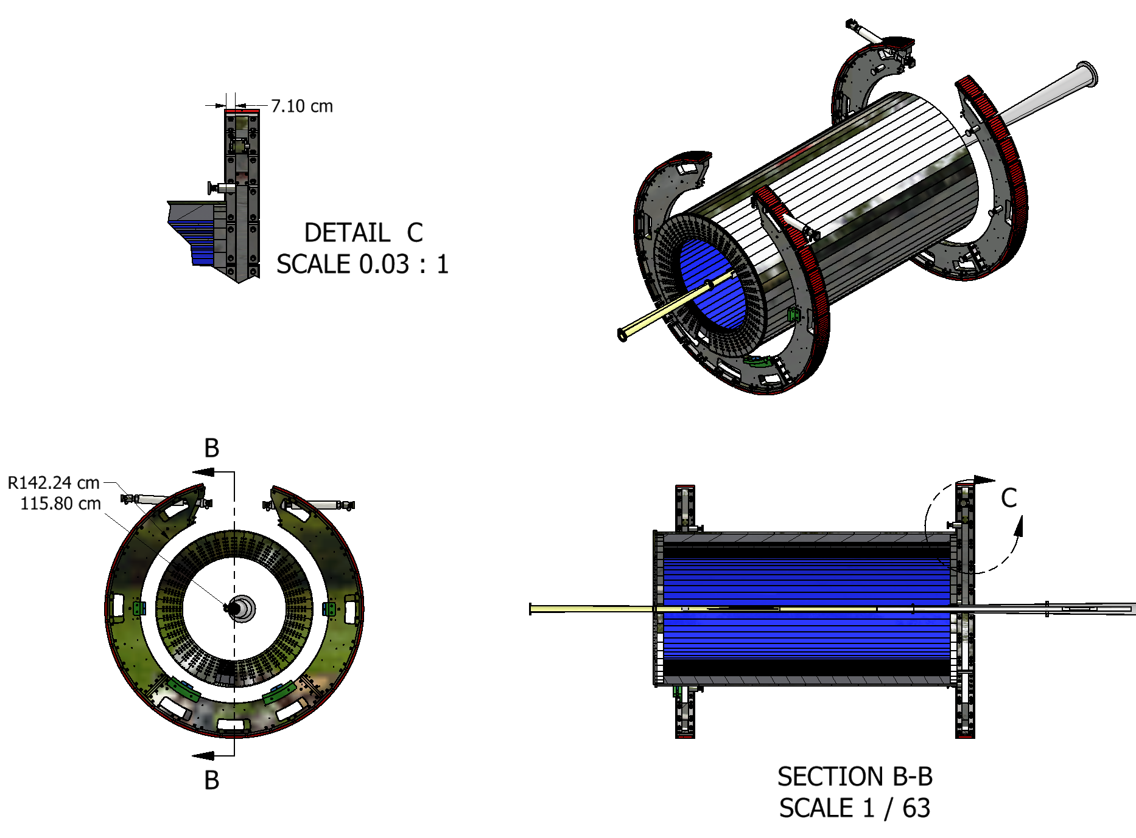
EMCal and Support Rings

Slide 9
Barrel Installation Priorities:
Increase length of outer plate on east end to overlap support ring
Add outer band or blocks to close the gap between outer plate and support rings
Finalize design installation of inner imaging layer
Cable and services

