Slide 1
EMCal Barrel Assembly and Installation
Dan Cacace

Slide 2
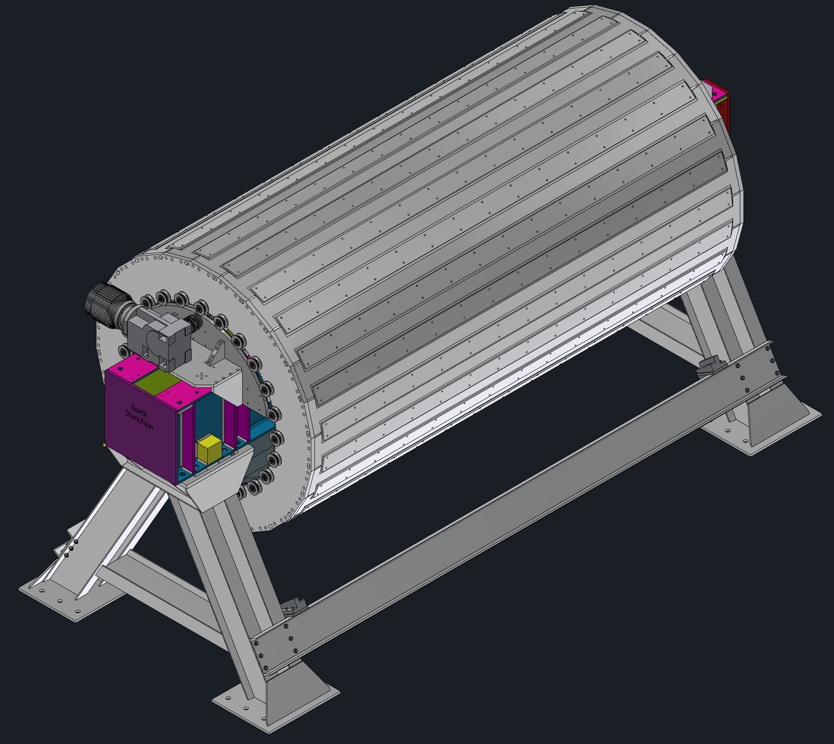
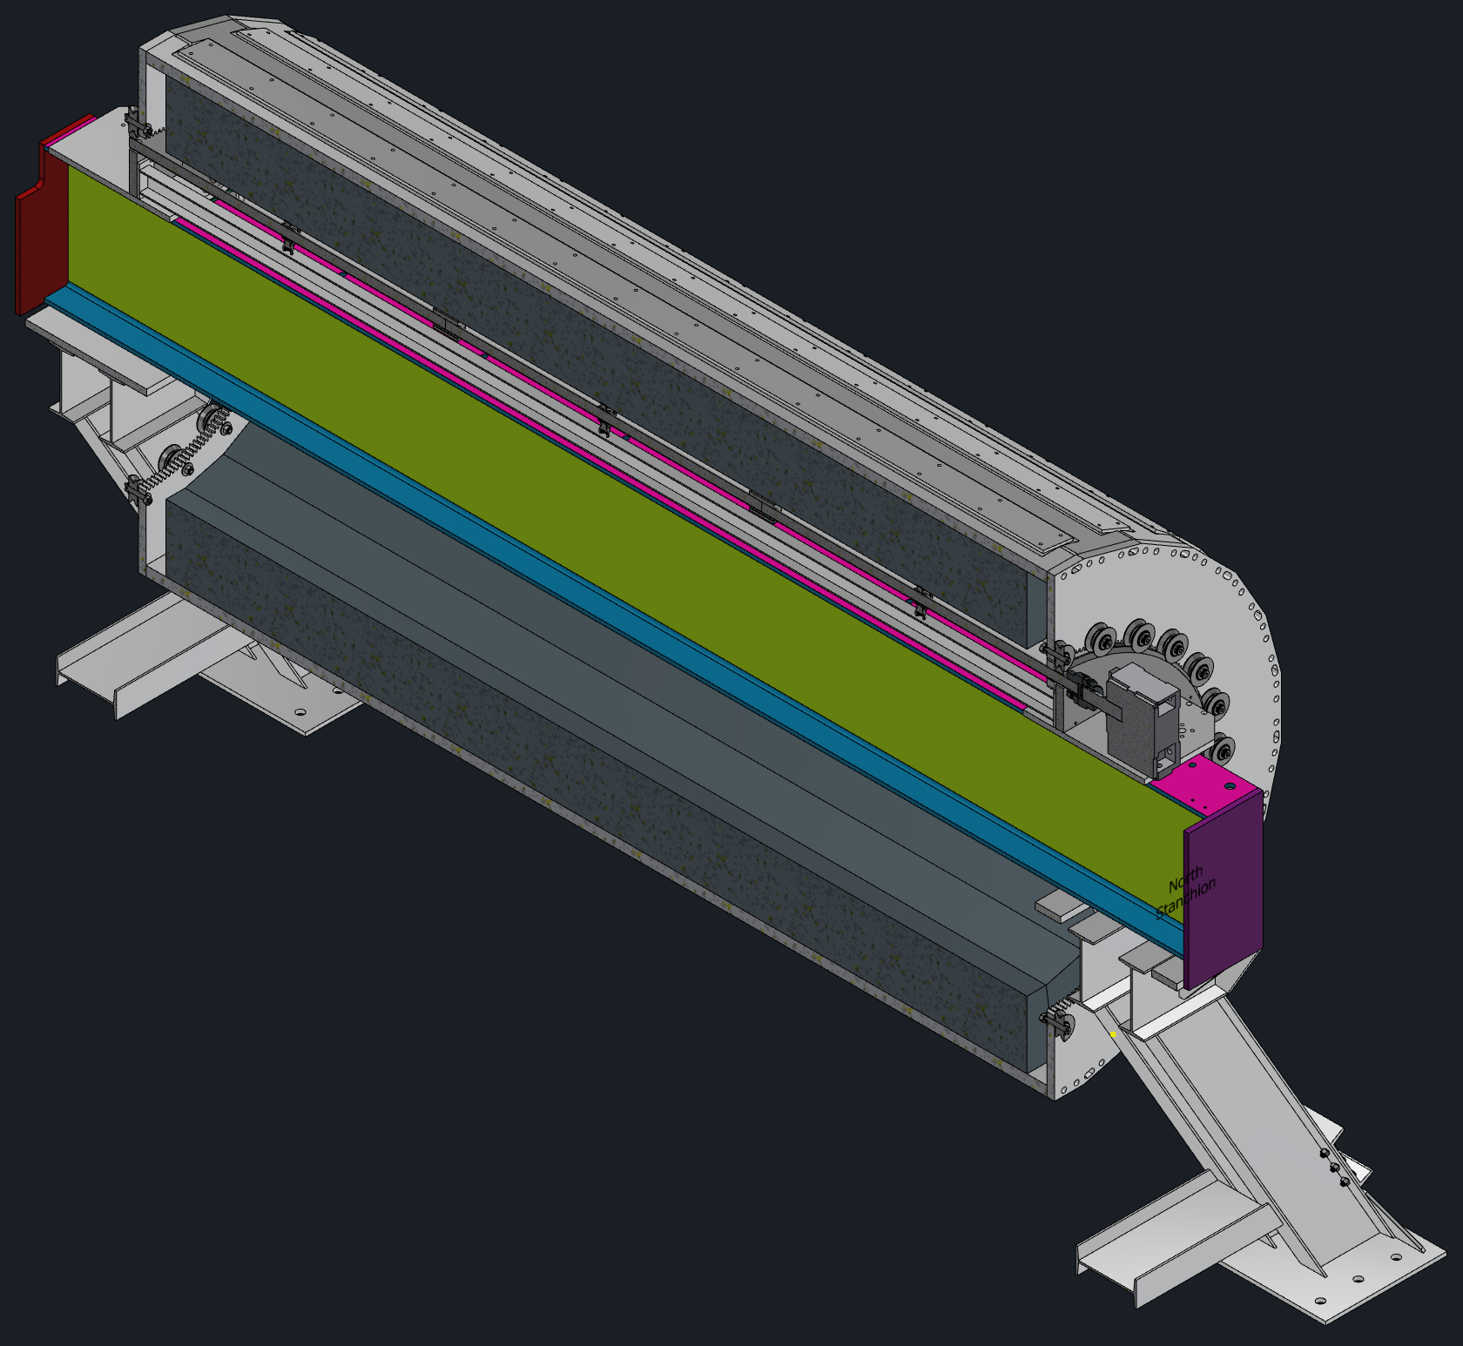
Assembly Fixtures
EMCal
Sled
Rotation Motor
Roller Rings
A-Frame Stands
Slider Beam

Slide 3
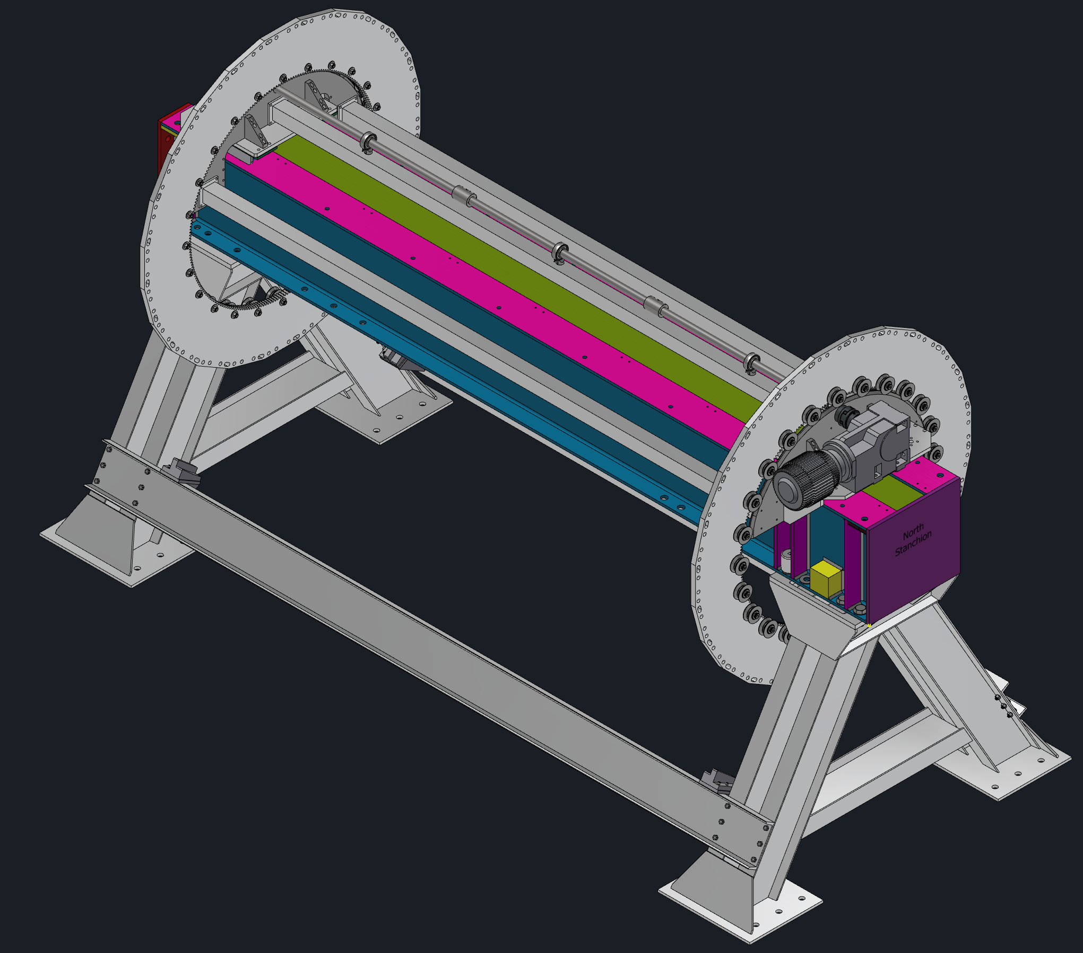
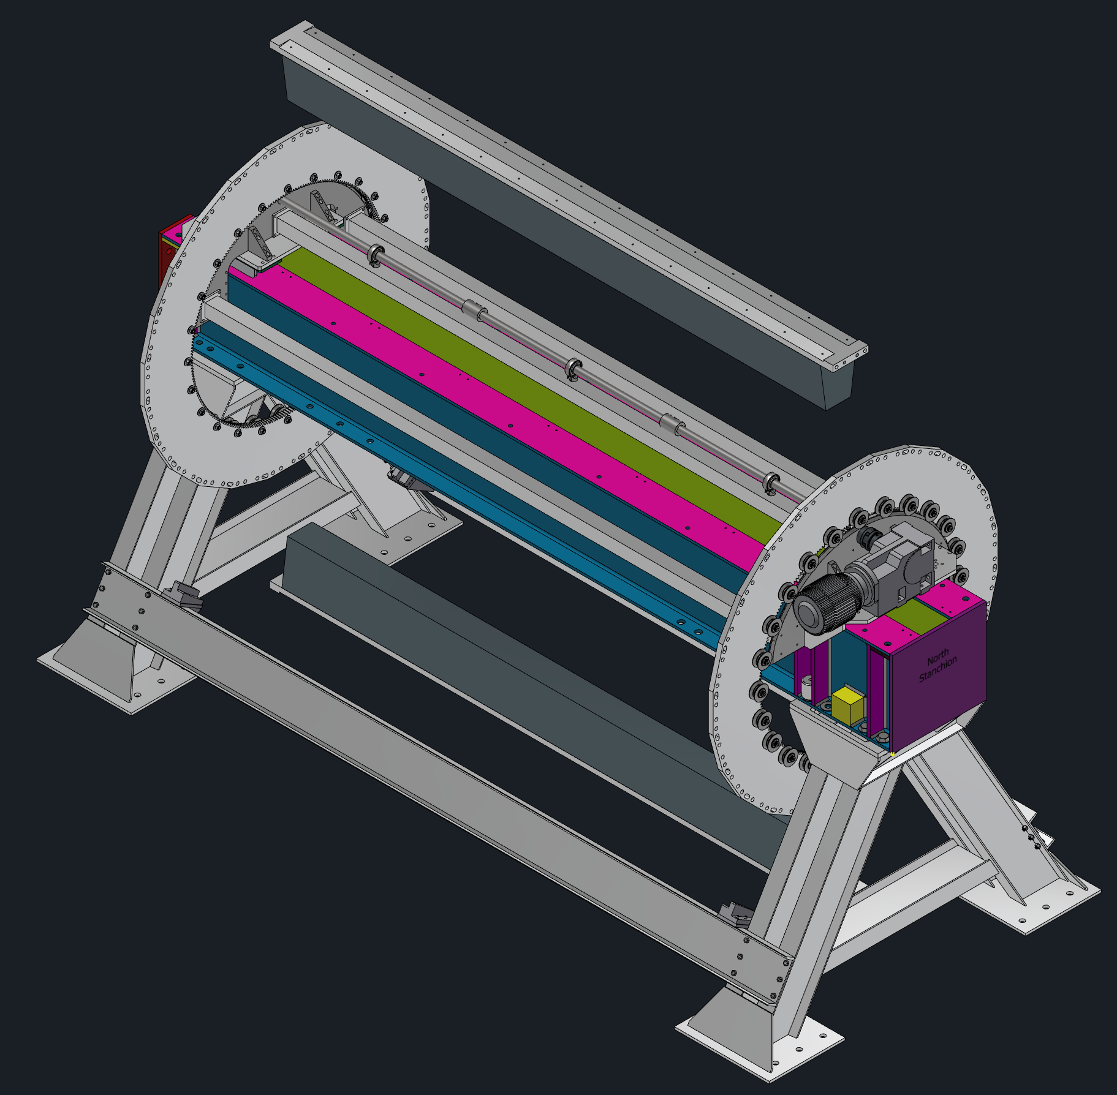
Assembly
End Rings in Place, No Sectors
Install Top and Bottom Sectors

Slide 4
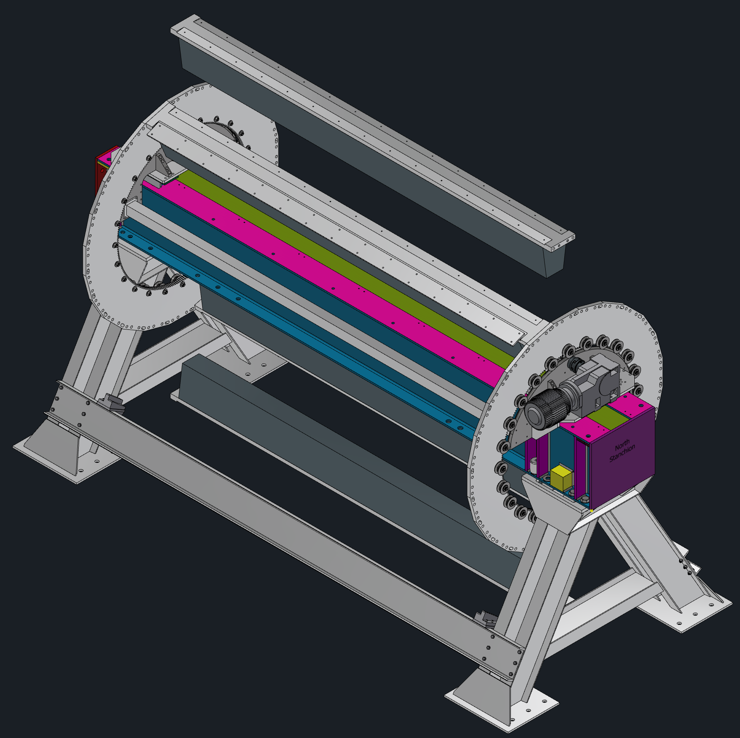
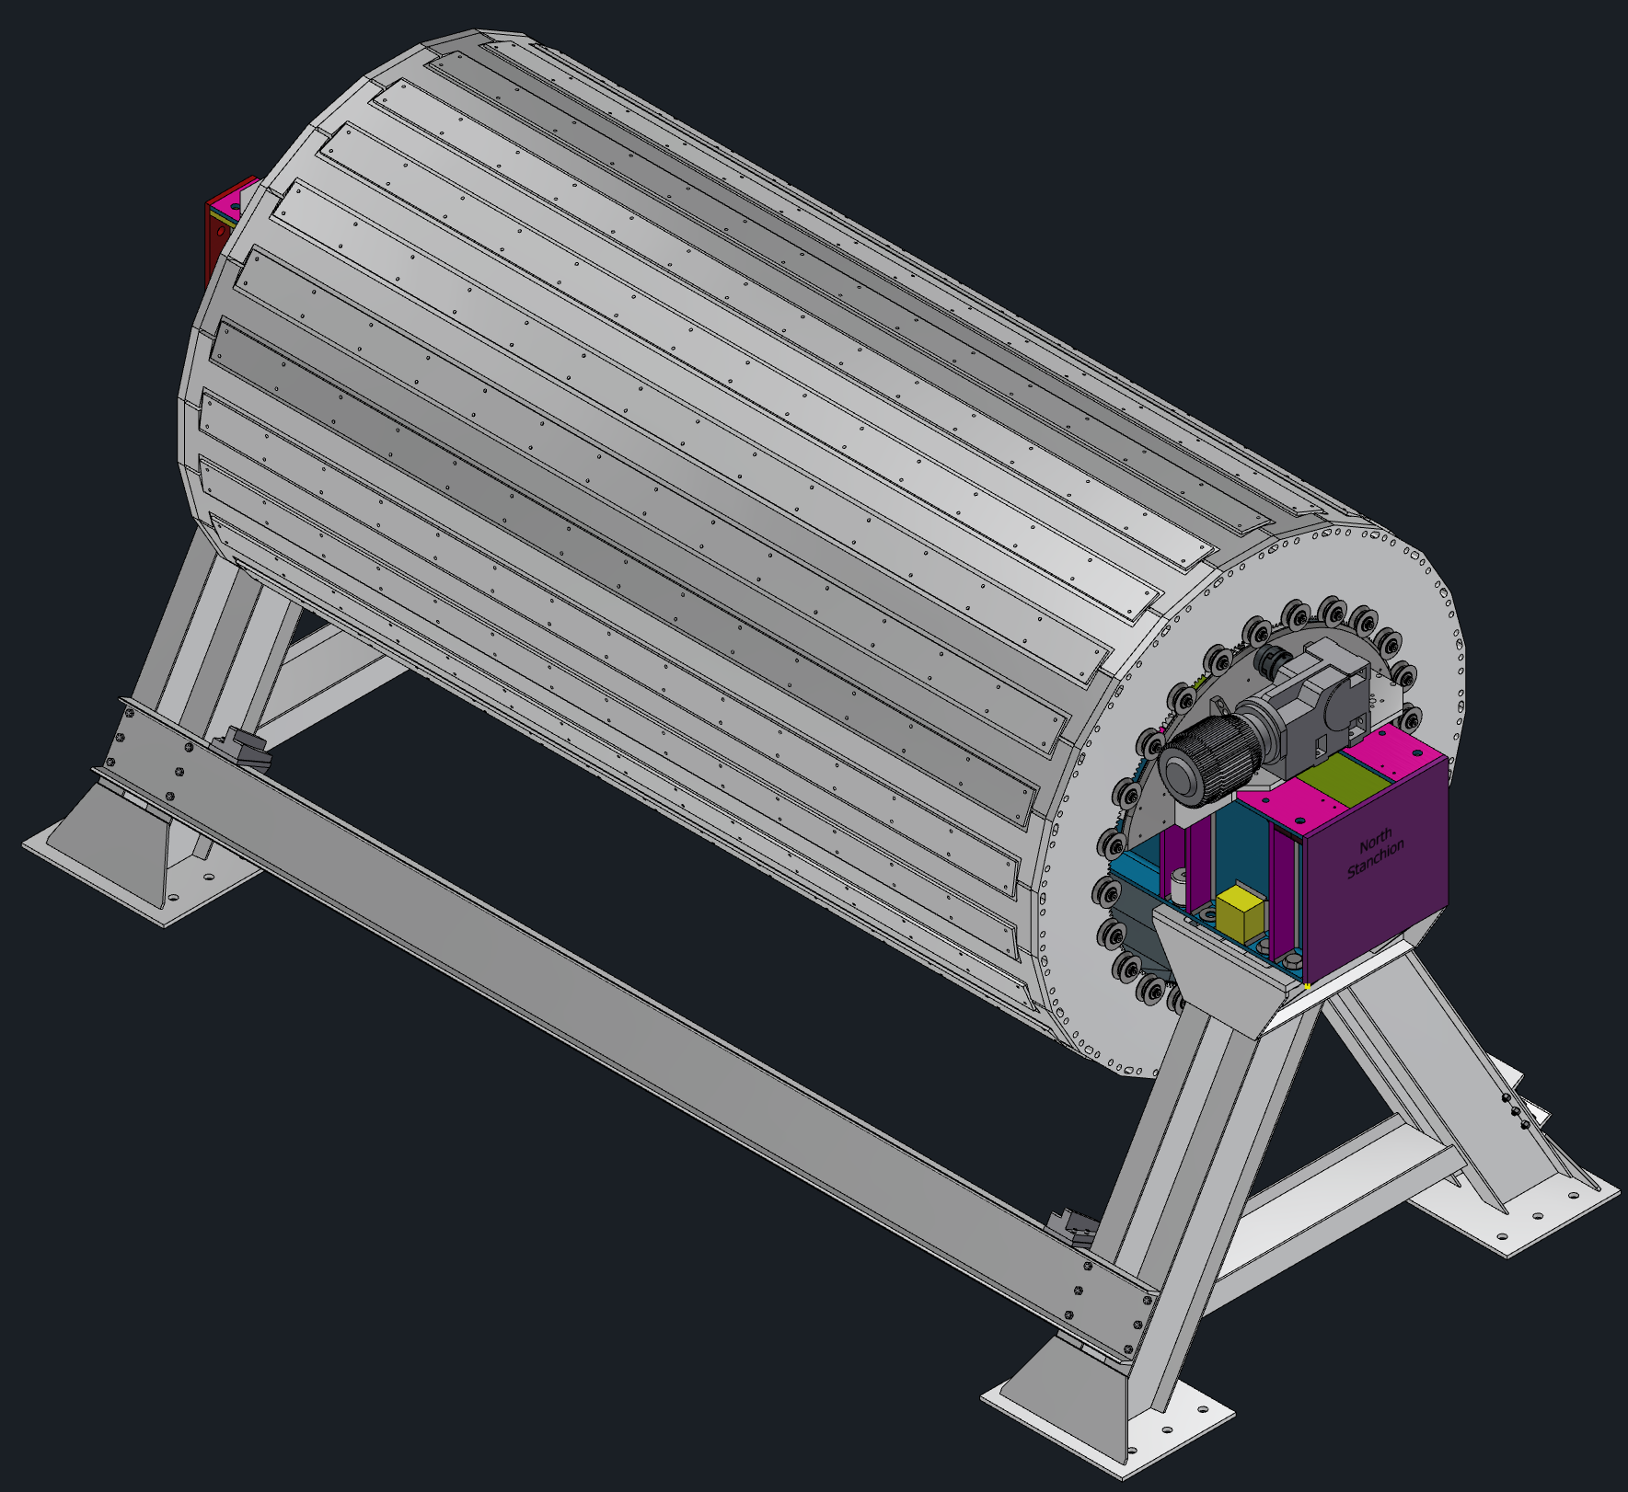
Assembly
Attach Sector, Rotate and Repeat
All Sectors Installed

Slide 5
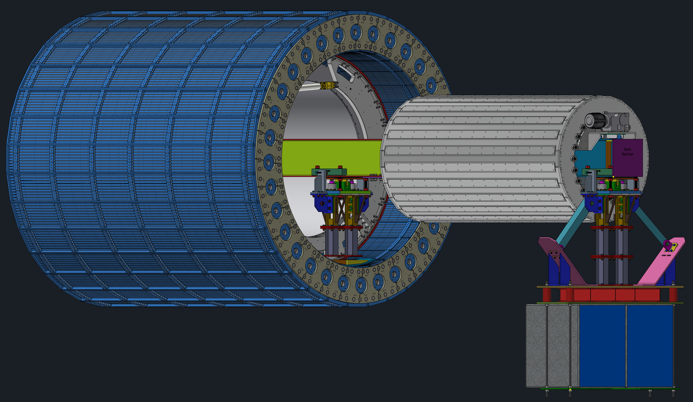
Installation Fixtures
Support Ring
HCal
EMCal
Sled
Magnet
Slider Beam
Stanchions

Slide 6
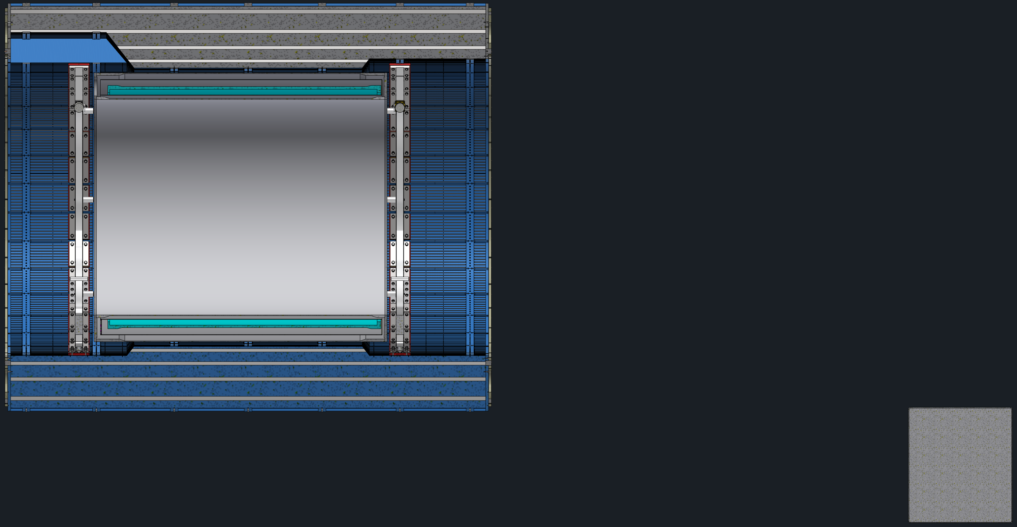
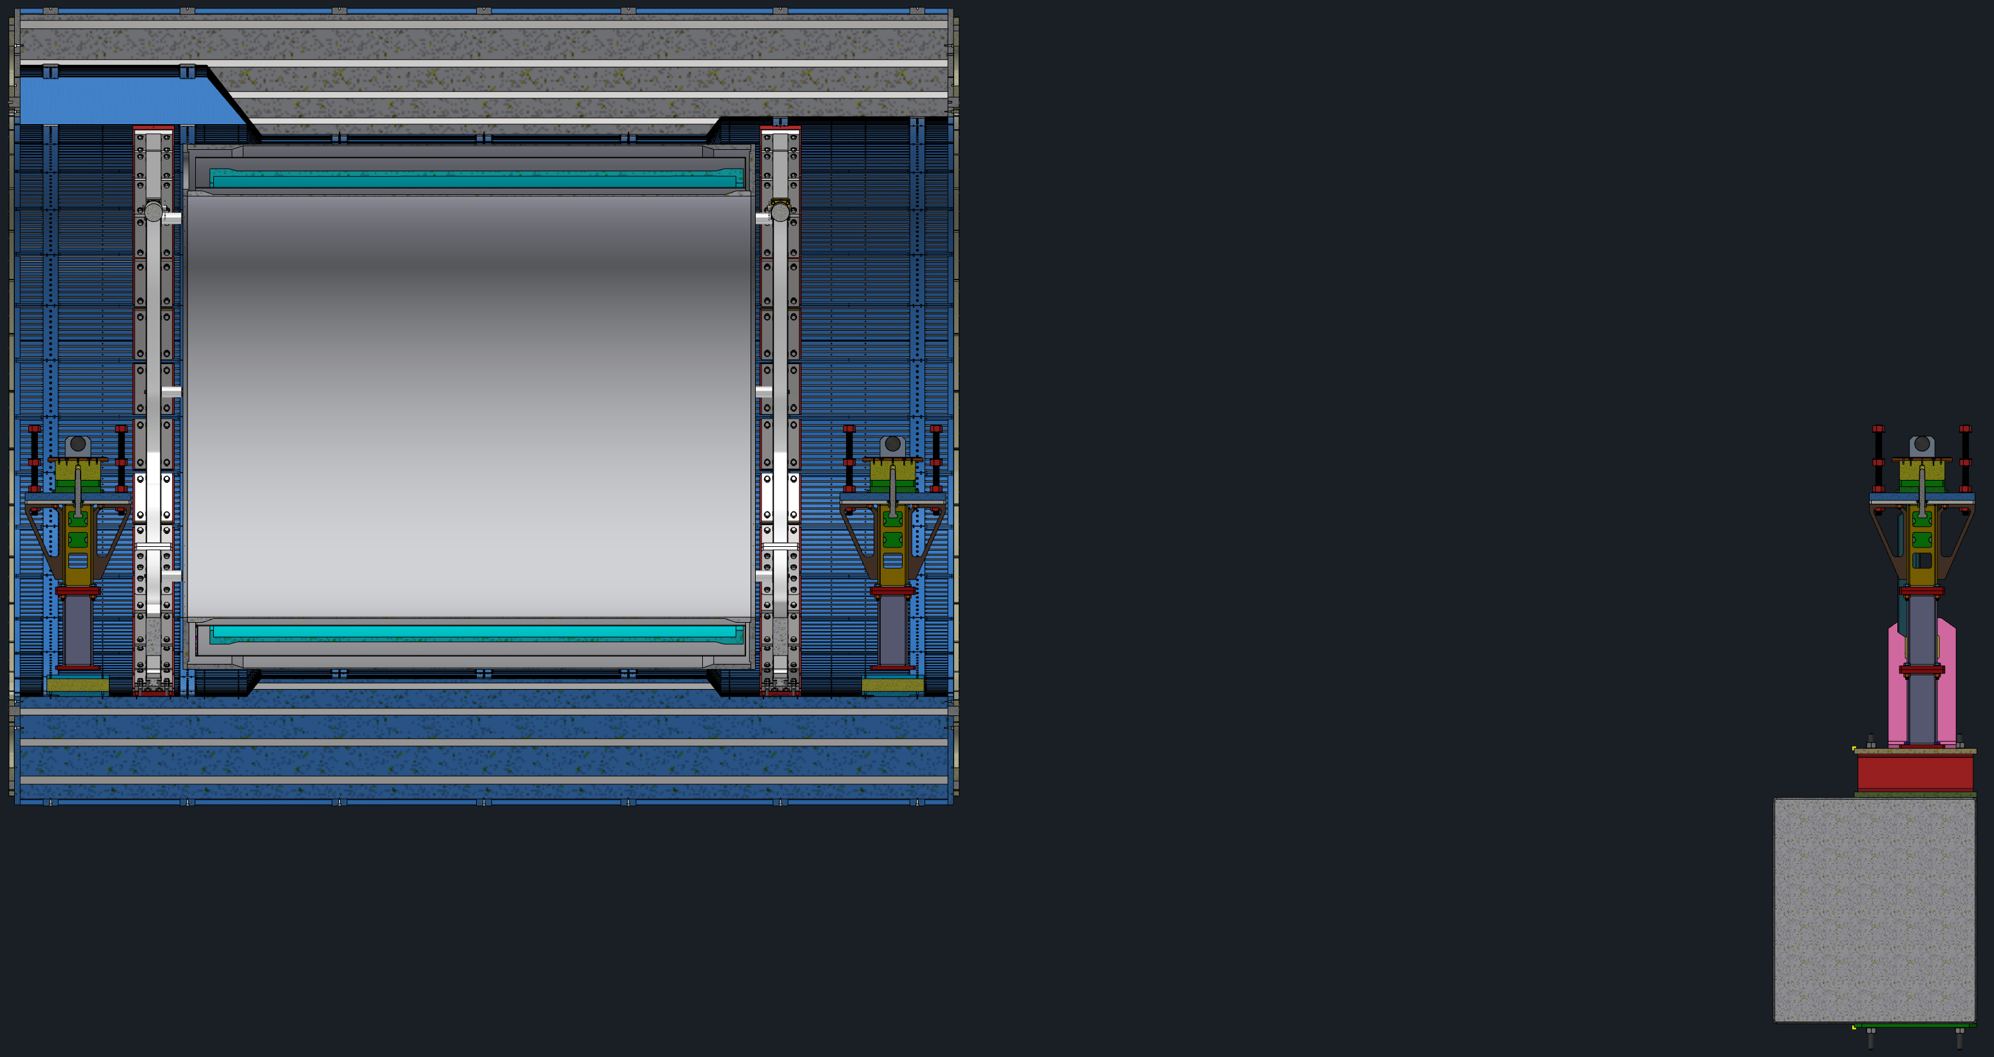
Installation
Prepare Area
Install Stanchions

Slide 7
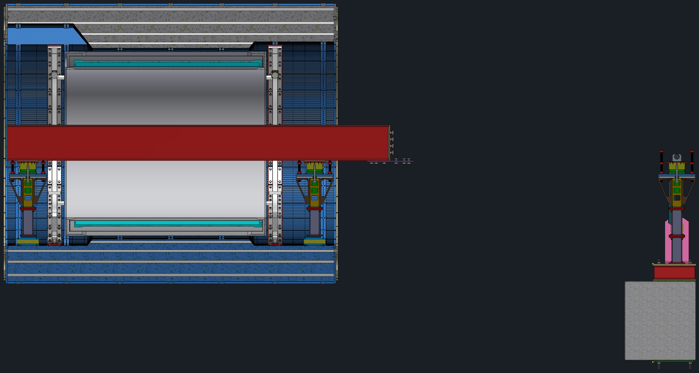
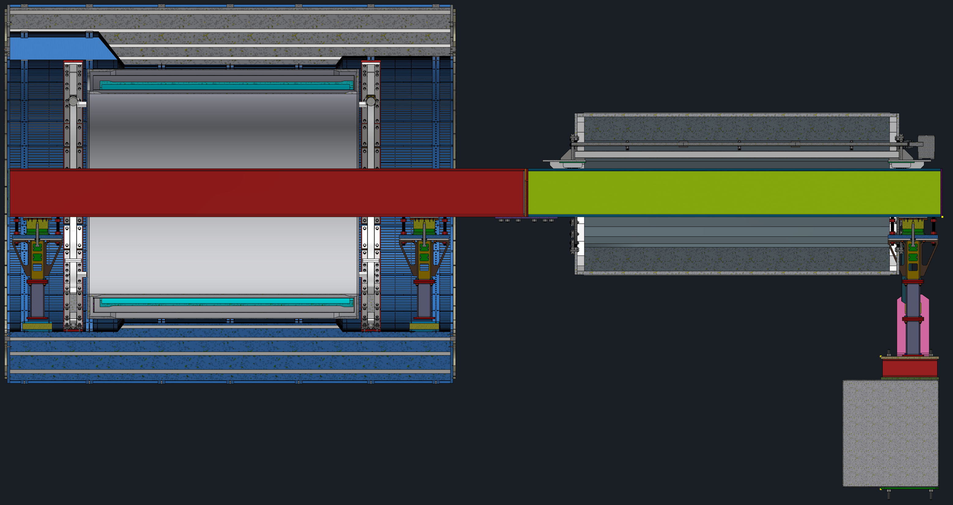
Installation
Install Long Slider Beam
Attach Short Slider Beam with EMCal/Sled

Slide 8
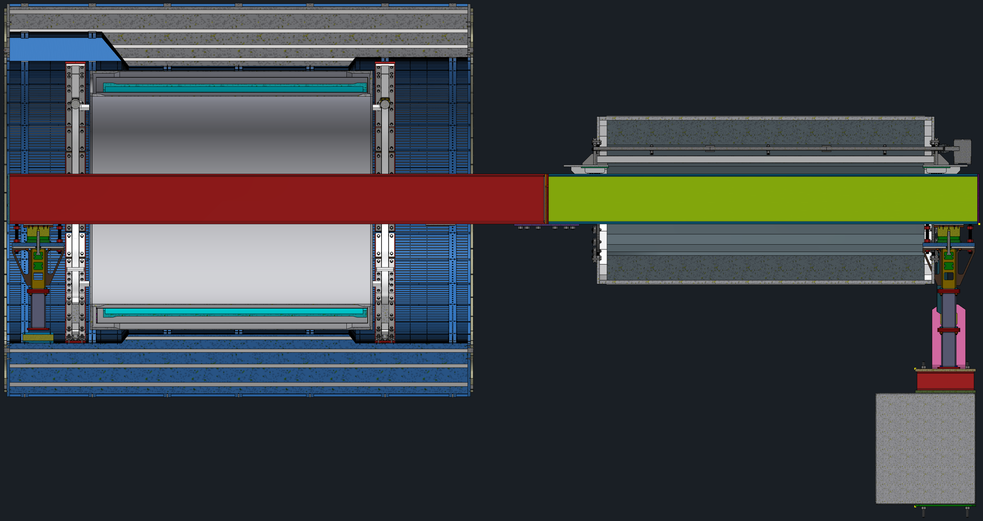
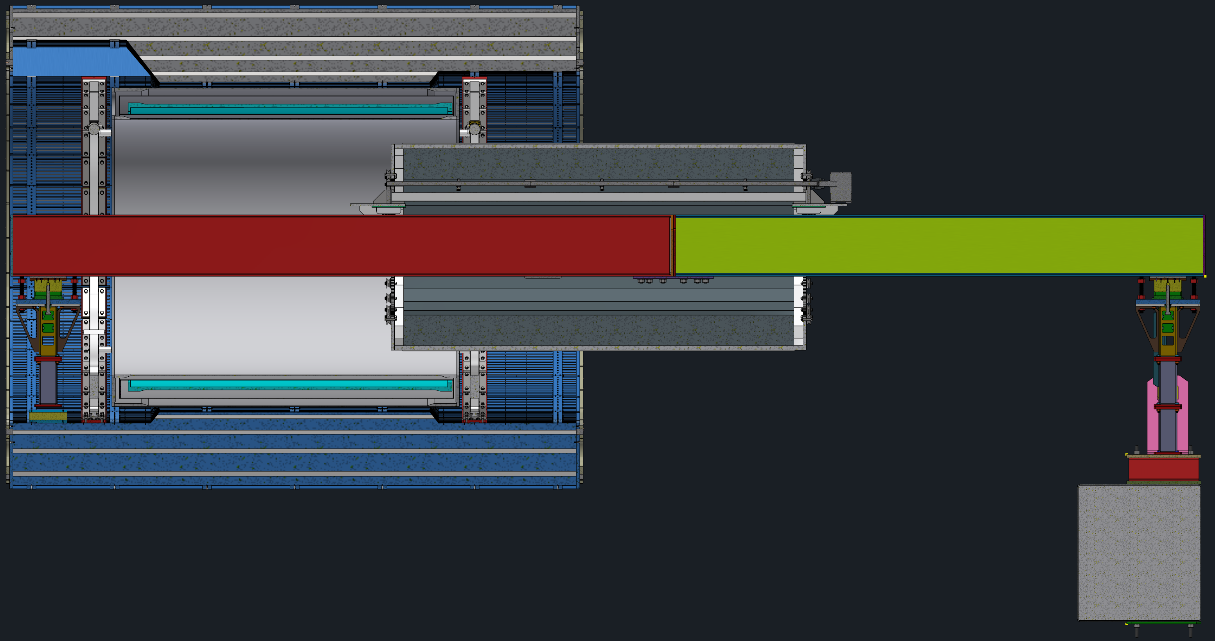
Installation
Remove Center Stanchion
Install EMCal

Slide 9
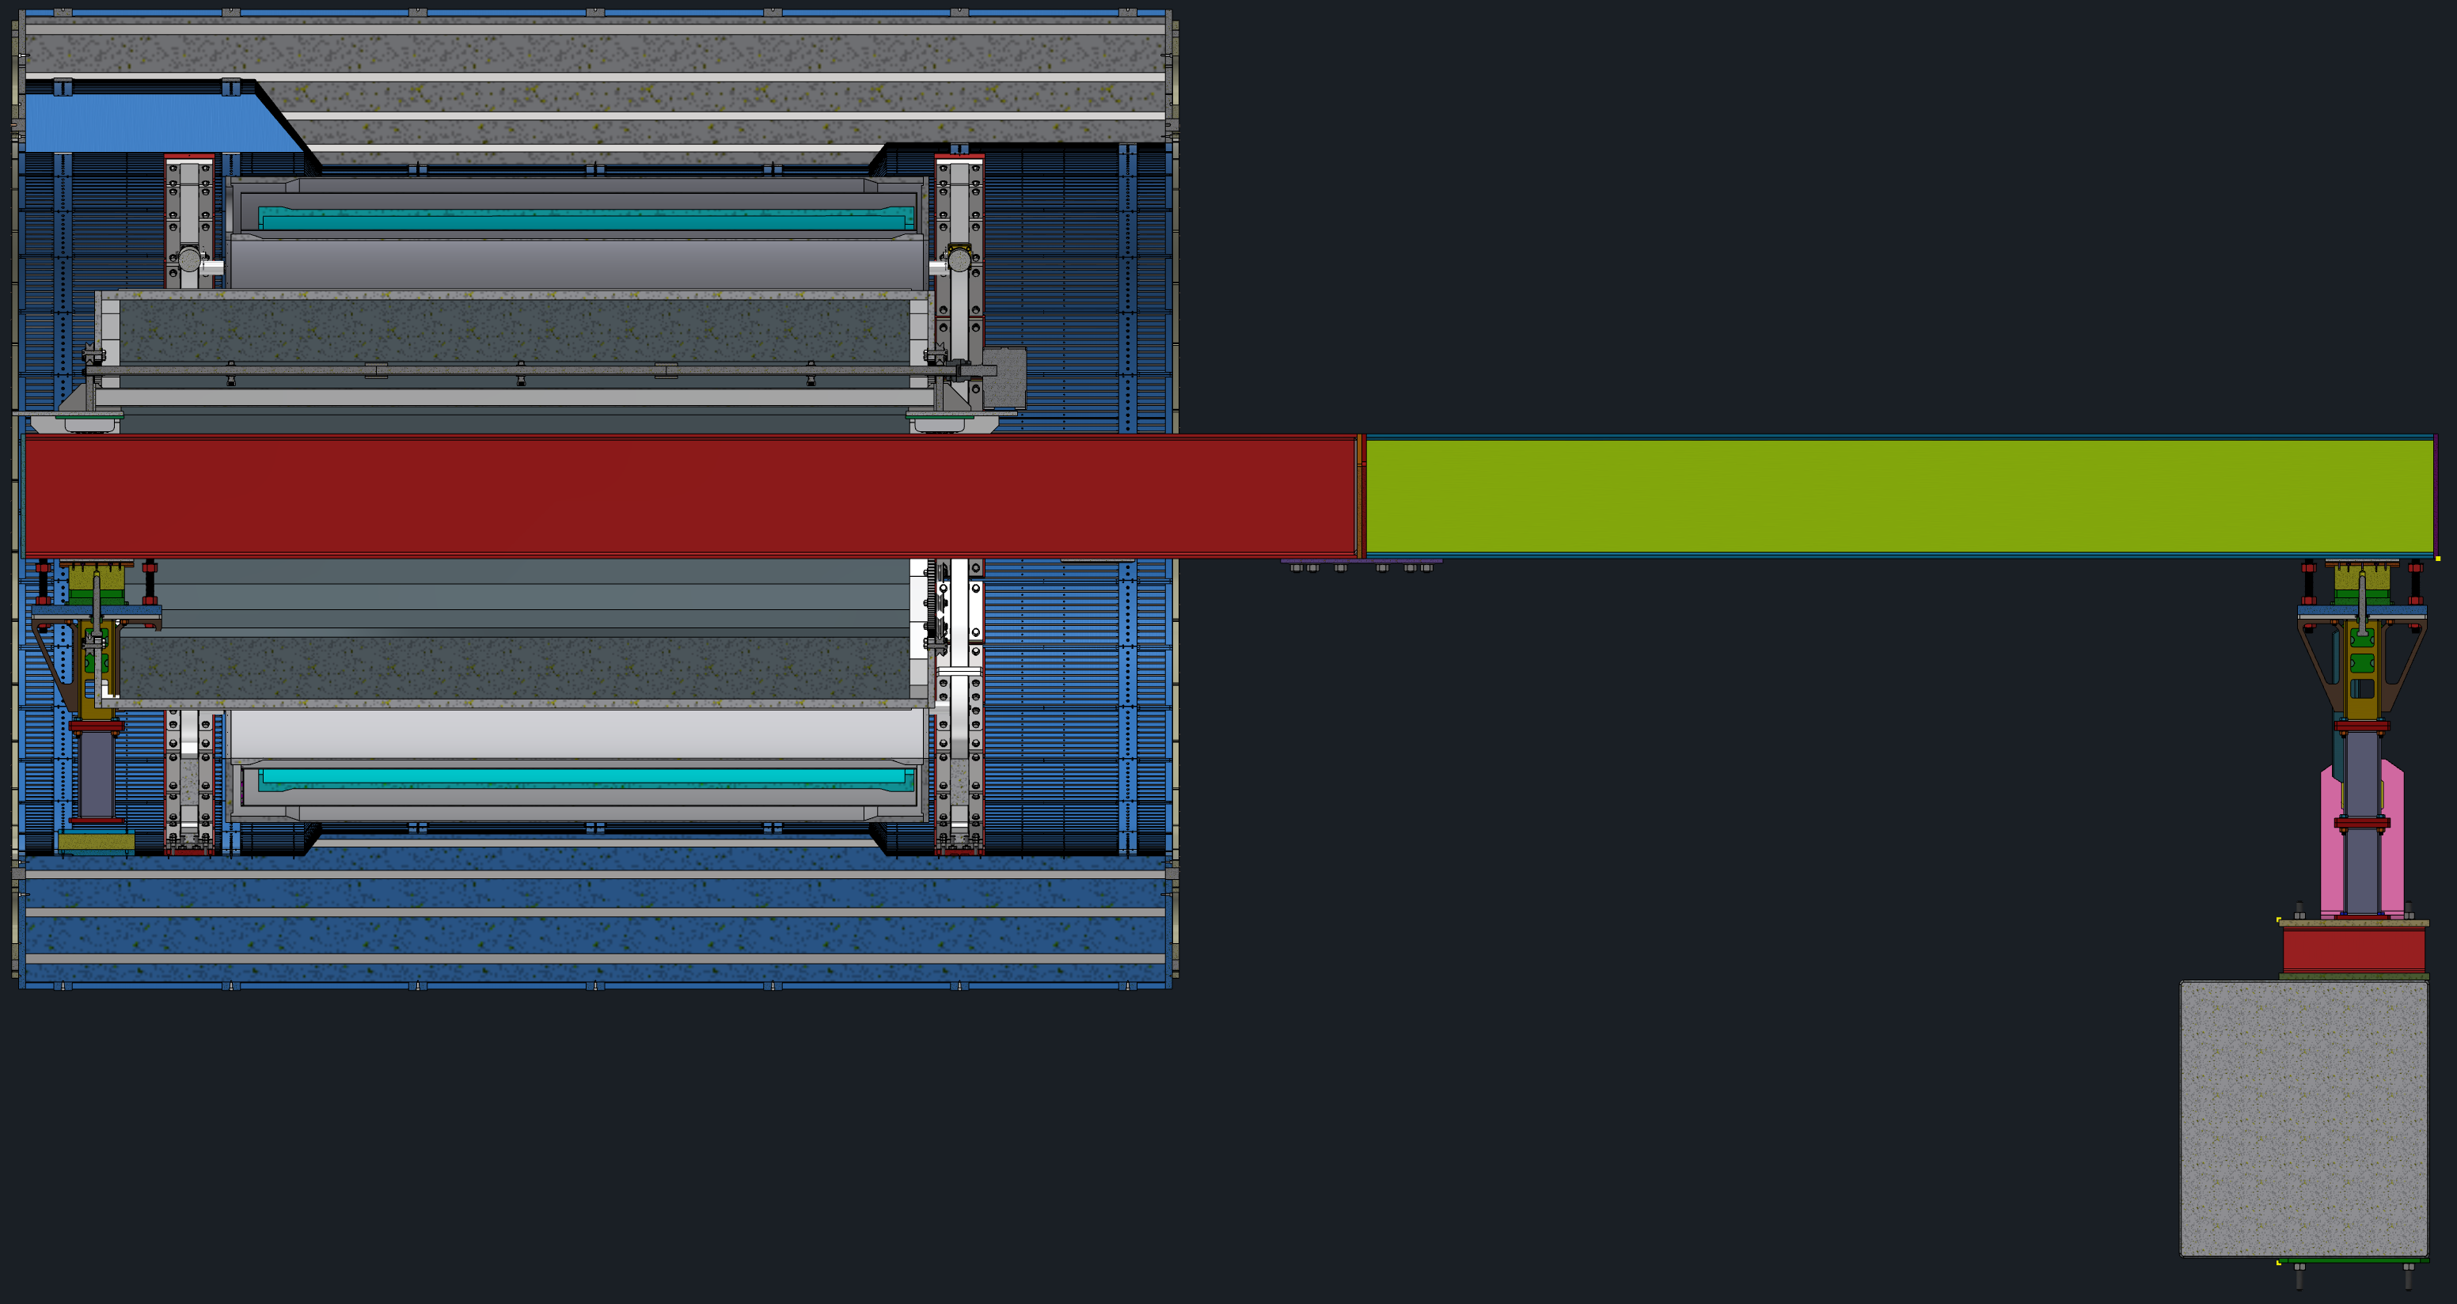
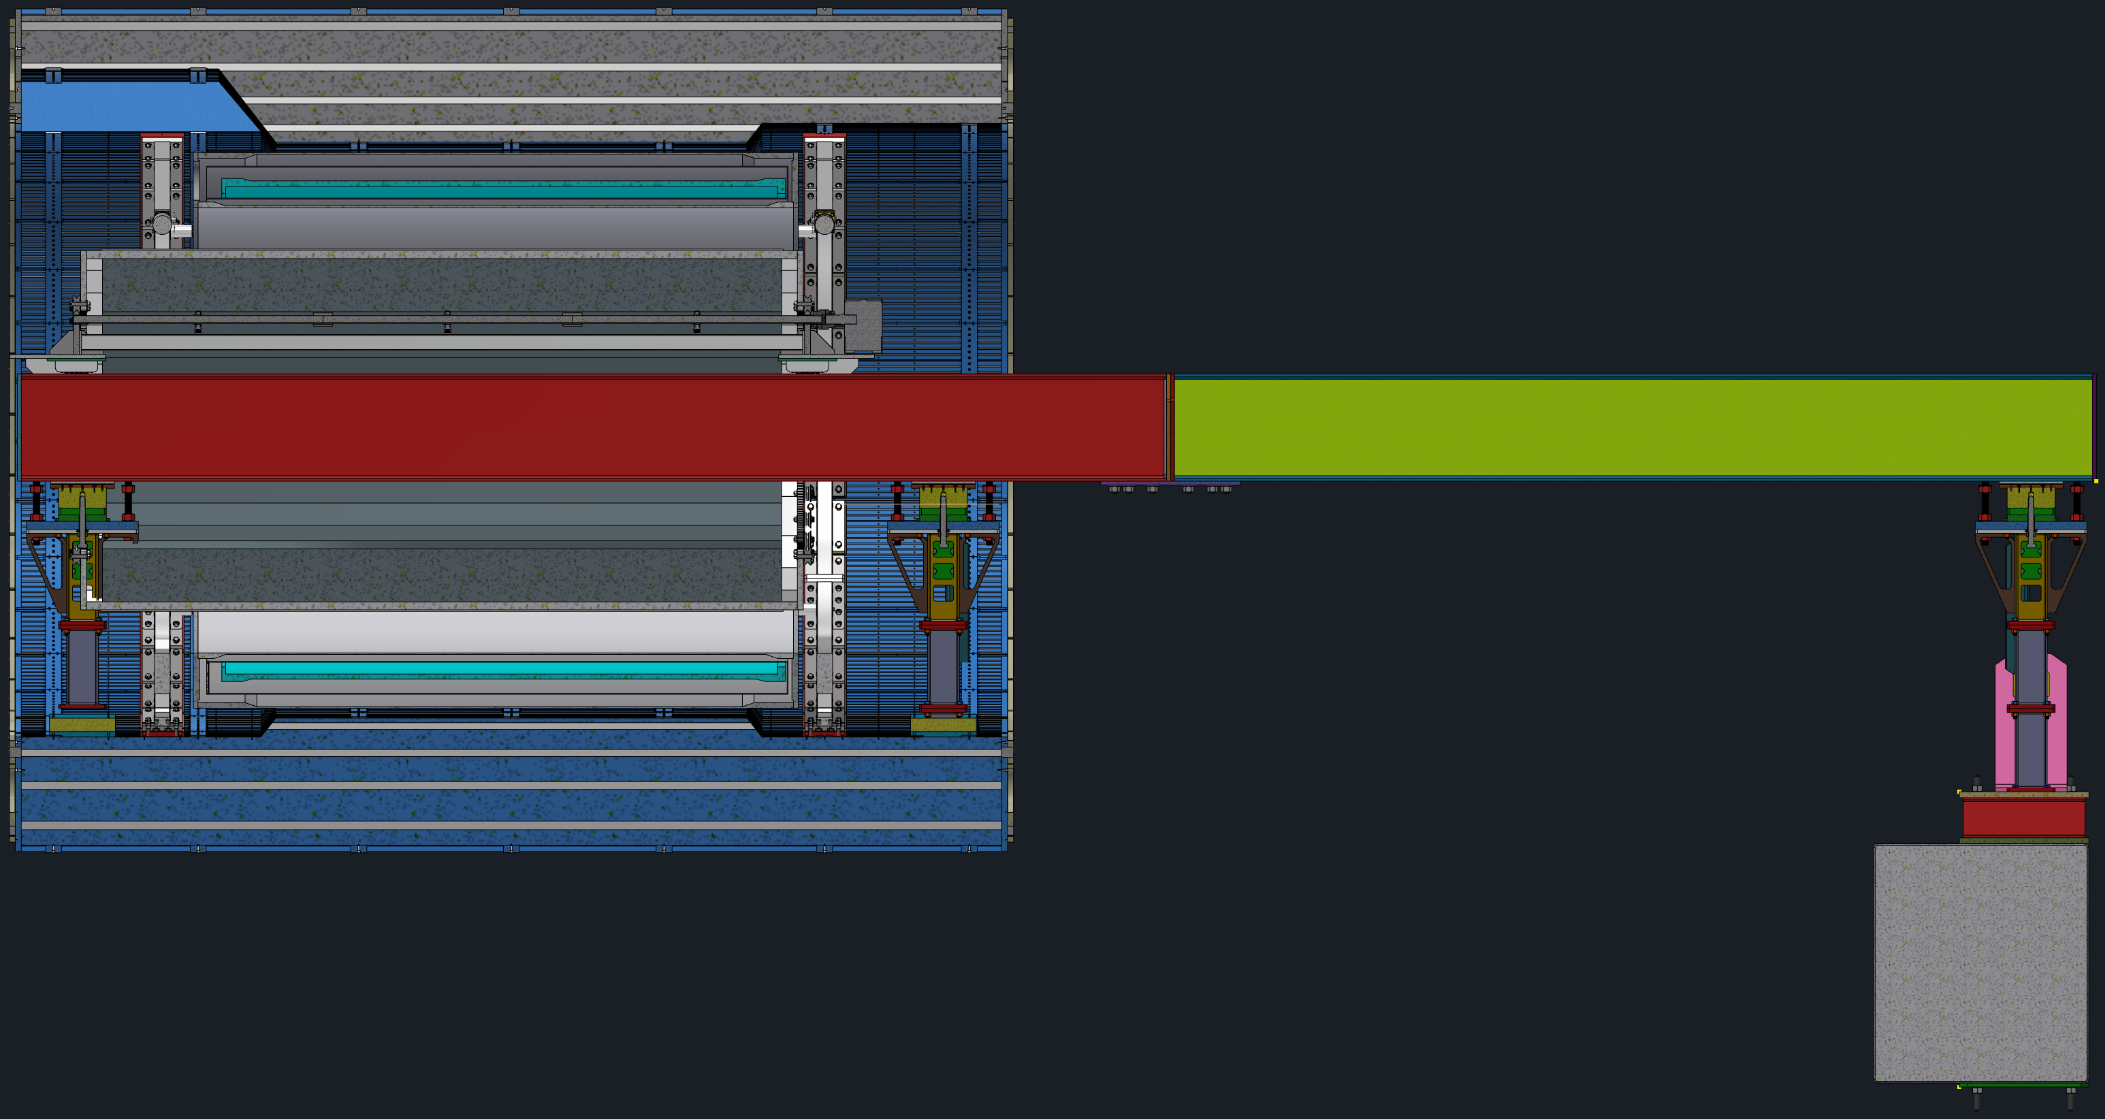
Installation
Attach EMCal to Support Rings
Reinstall Center Stanchion

Slide 10
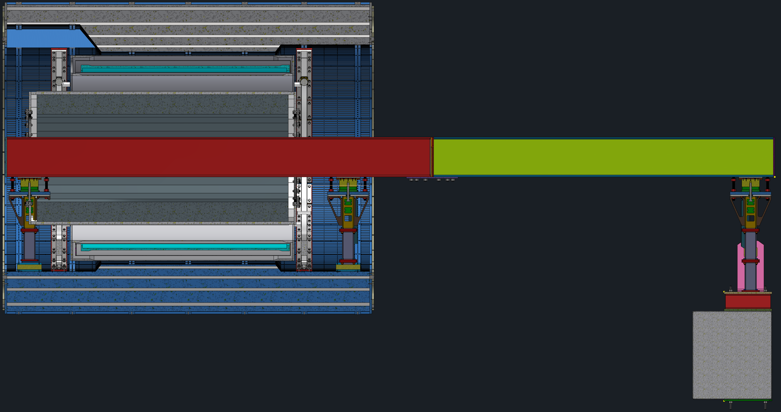
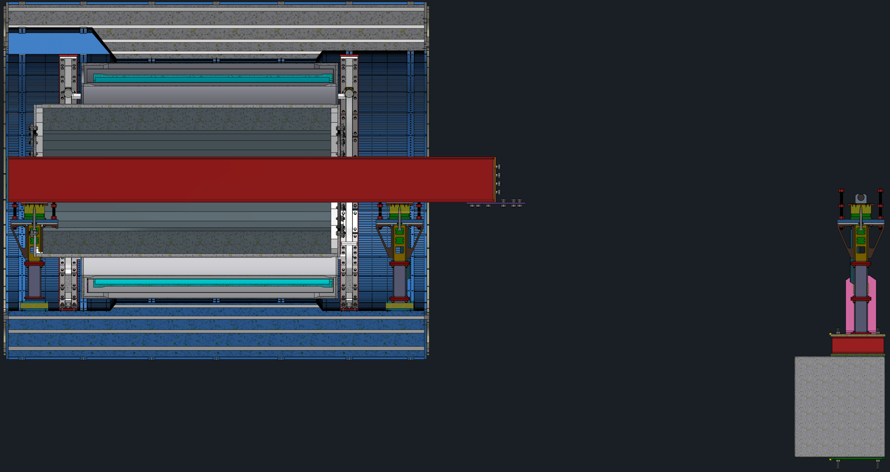
Installation
Remove Slead
Remove Short Slider Beam

Slide 11
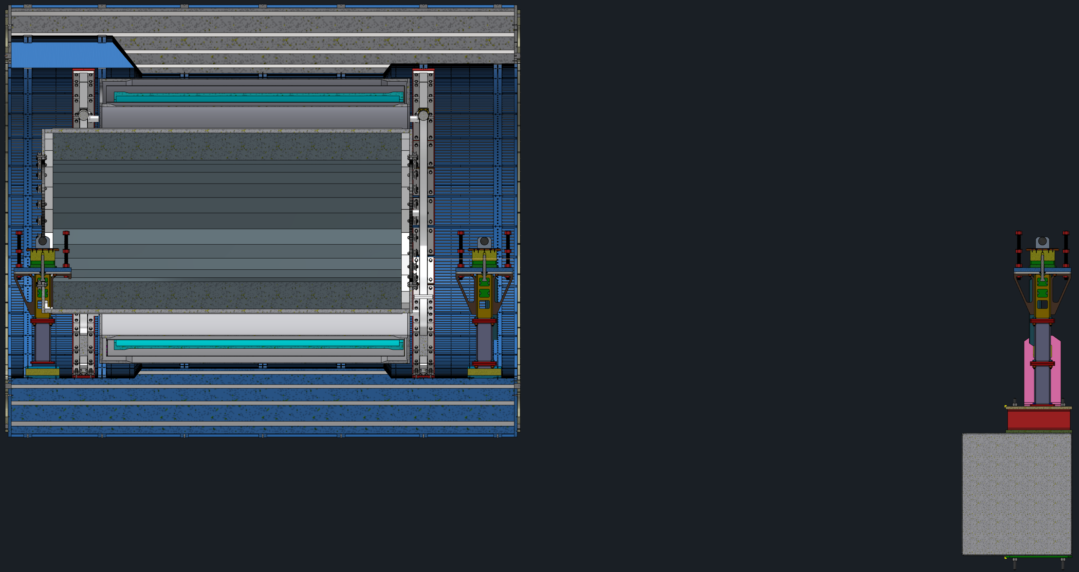
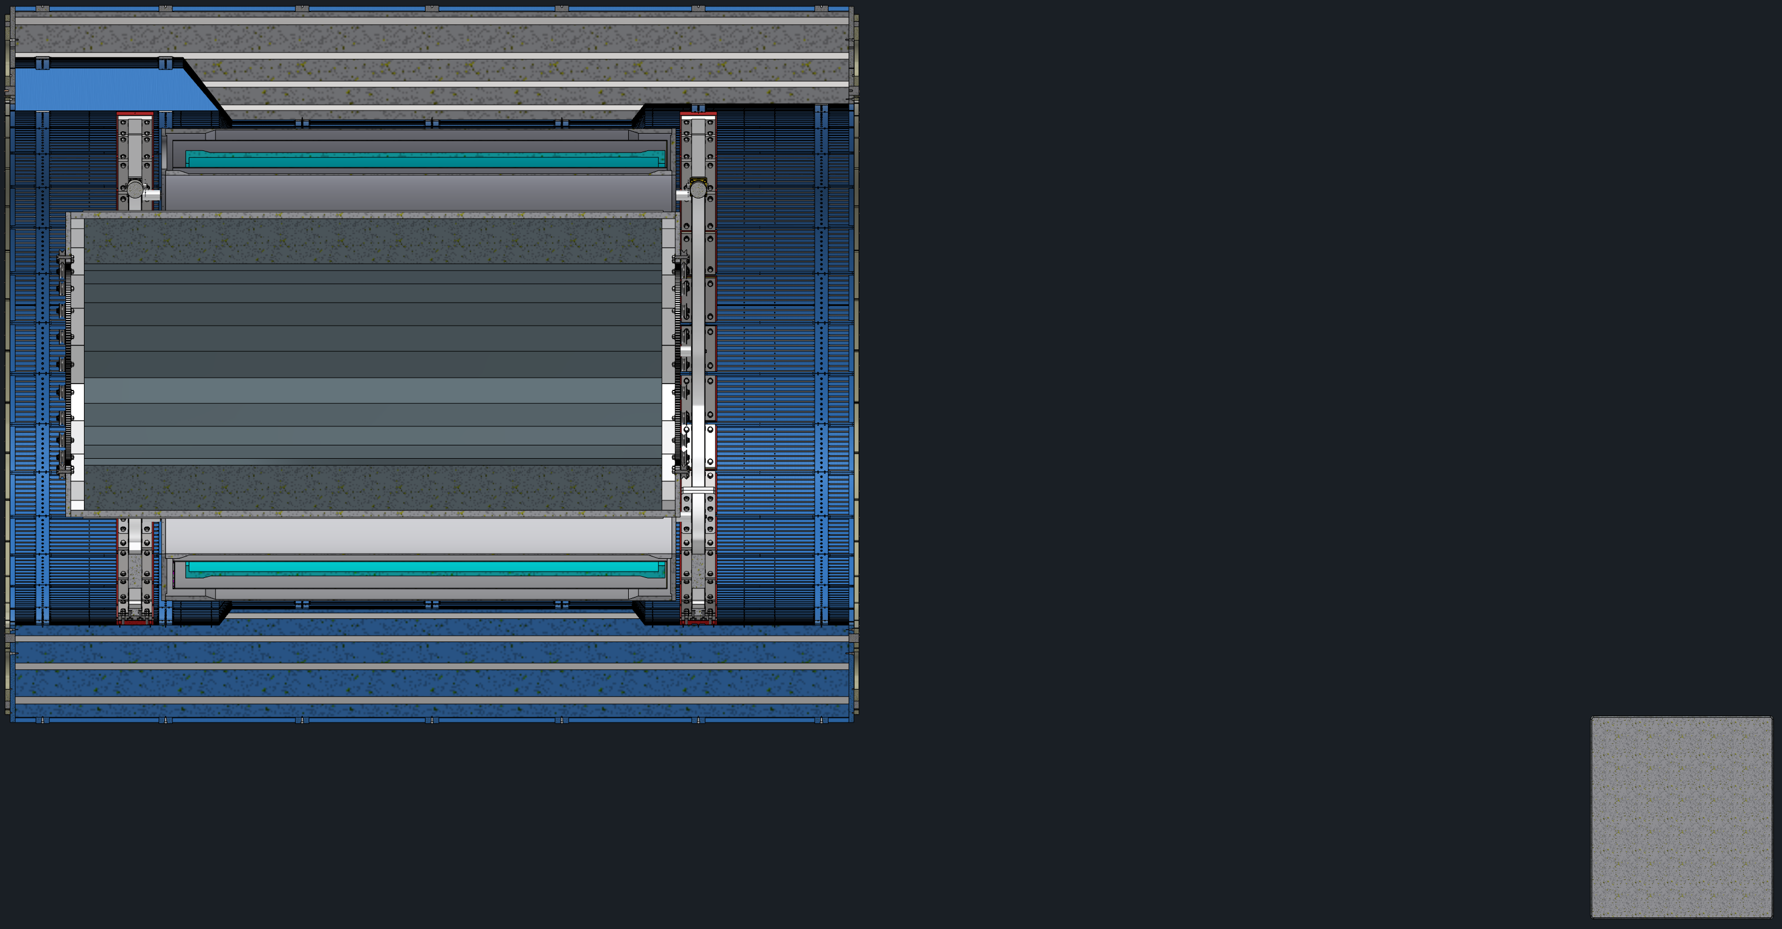
Installation
Remove Long Slider Beam
Remove Stanchions

