Slide 1
Welcome to the 7th edition of the “Photocathode Physics for Photoinjector” workshop L. Cultrera
Oct 3-5, 2023
Photocathode Physics for Photoinjectors Workshop
Stony Brook University
1

Slide 2
And welcome to Long Island and New York area

Slide 3
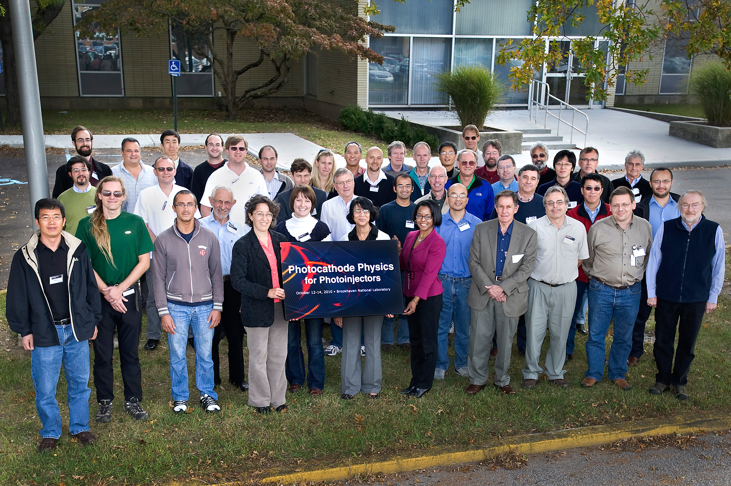
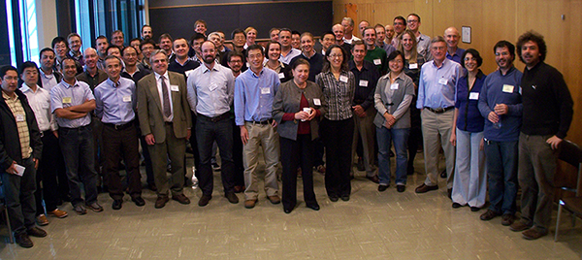
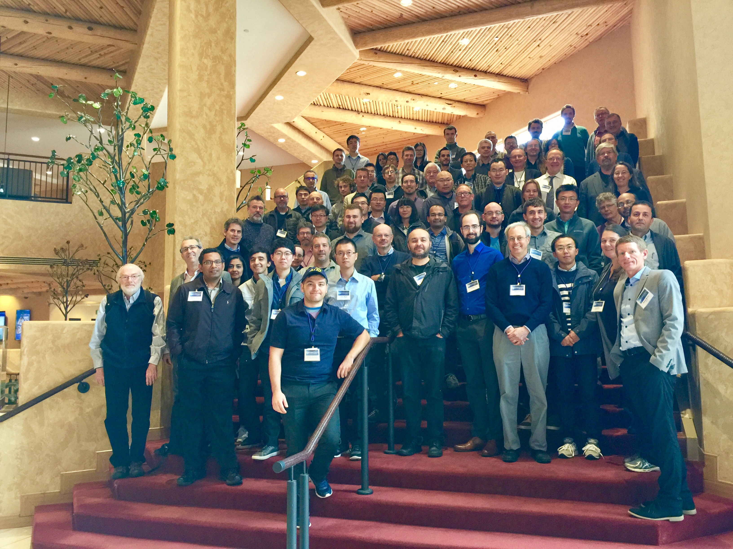
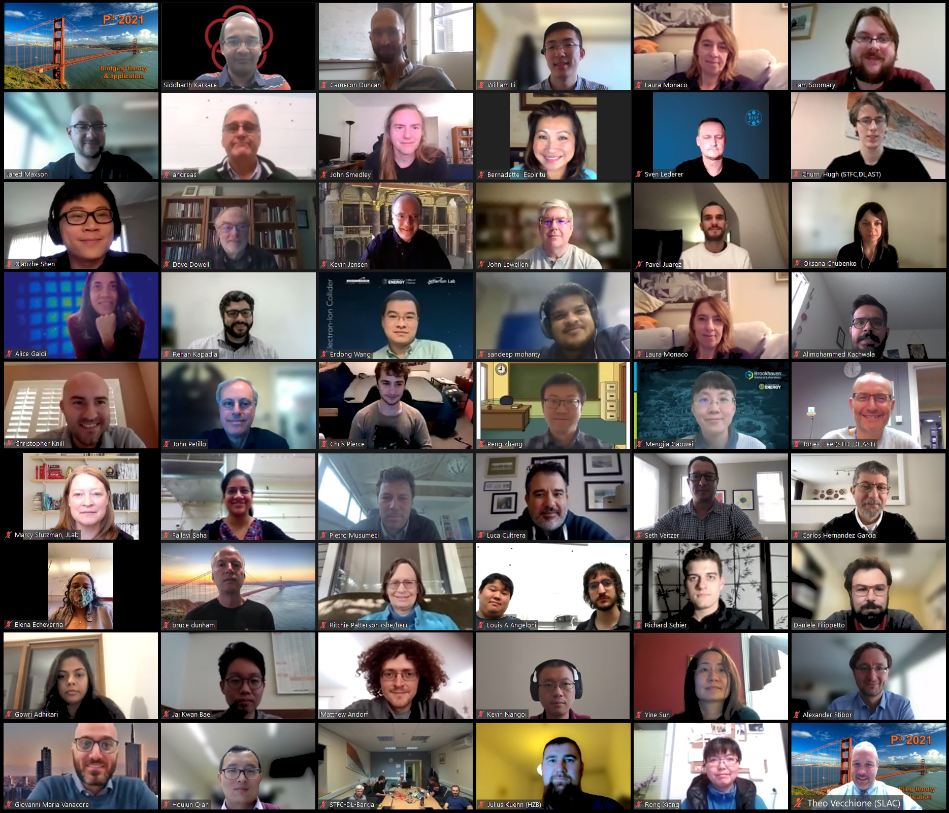
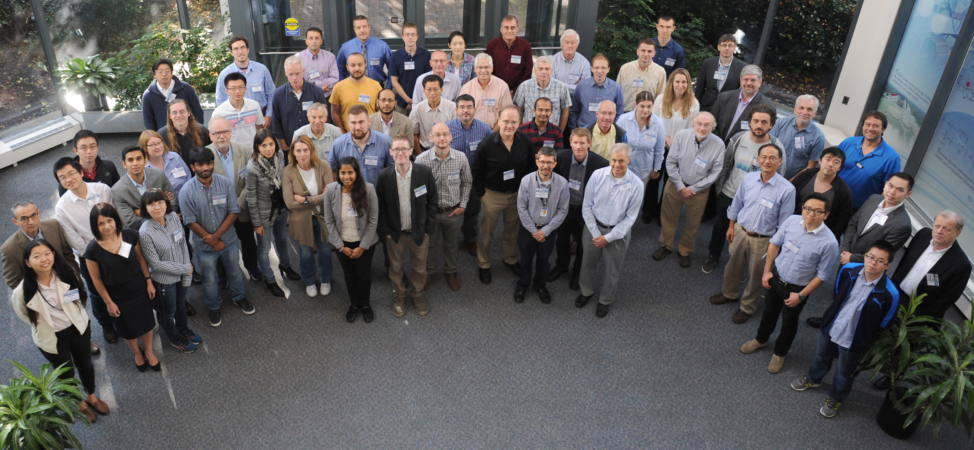
Back to the origins…
2010 – Brookhaven National Laboratory
2012 – Cornell University
2014 – Lawrence Berkeley National Laboratory
2016 – Thomas Jefferson National Accelerator Facility
2018 – Los Alamos National Laboratory
2021 – SLAC National Accelerator Laboratory

Slide 4
Special Thanks
Local Organizing Committee
L. Cultrera (co-Chair)
M. Gaowei (co-Chair)
S. Capp
Support staff
C. Weaver
D. Basozmen
Scientific Committee
Luca Cultrera
Oksana Chubenko
Dimitre Dimitrov
Mengjia Gaowei
Carlos Hernandez-Garcia
Kevin Jensen
Siddharth Karkare
Jared Maxson
Nathan Moody
Pietro Musumeci
John Smedley
Marcy Stutzman
Theodore Vecchione

Slide 5
Logistics
Food
We’ll provide breakfast, coffee breaks, lunches and dinners
WiFi
WolfieNet-Guest (need to register with your email)
Eduroam (for .edu)
Photoshoot
Wednesday at 12:30 at the entrance of Wang Center
Tour of photocathode lab in Instrumentation Division
On Thursday after the last session (about 2:00pm)
Need to be approved guest - Bring your photo ID – There will be a bus

Slide 6
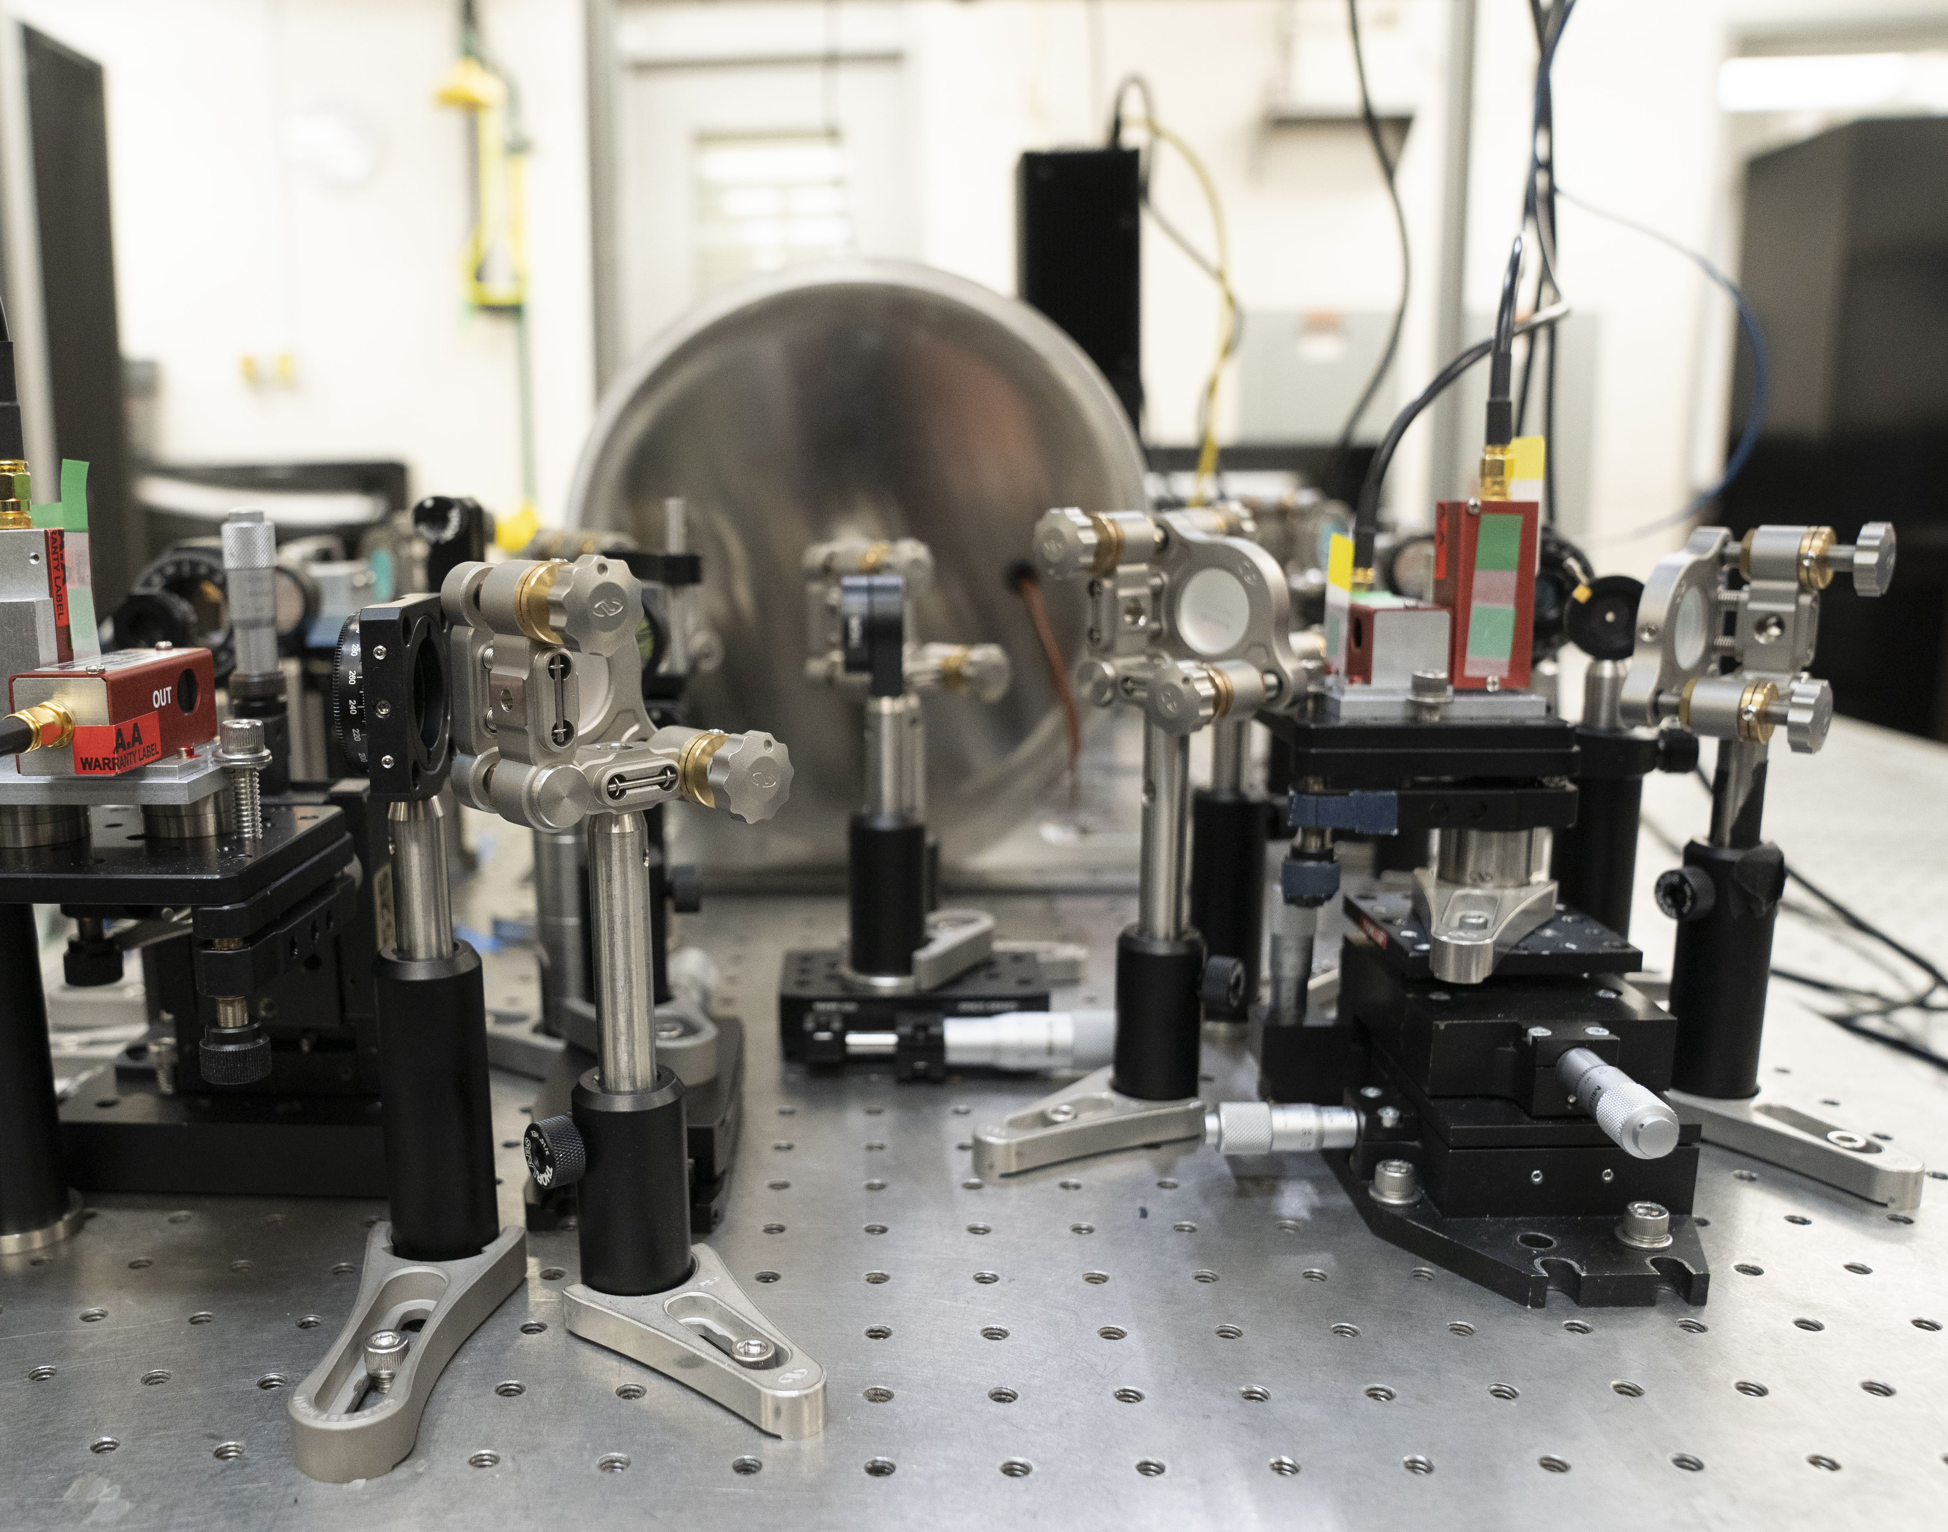
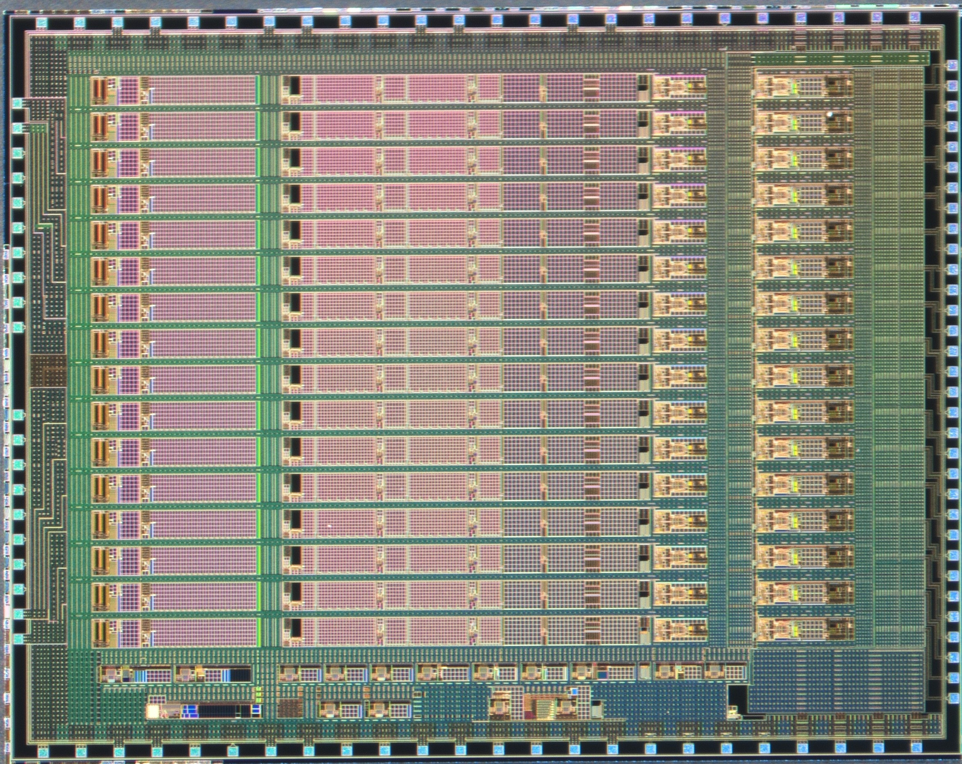
QIST Lab
ASIC Development Facility

Slide 7
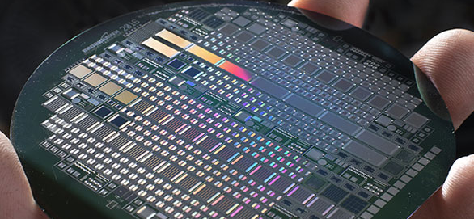
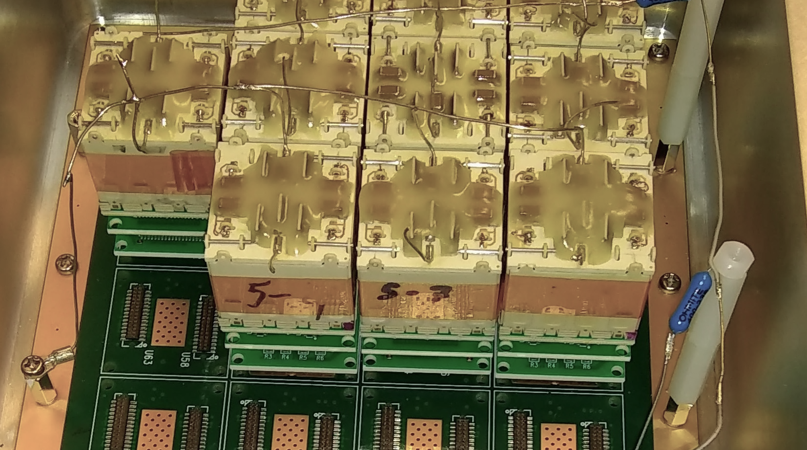
Semiconductors and Sensors
We work on all aspects associated with sensor R&D and operate labs for the custom fabrication and testing of semiconductor sensors for:
Photon science (X-ray detection)
High-energy and nuclear physics (fast charged particles)
Gamma-ray astronomy, medical imaging
Nuclear nonproliferation, nuclear security, and safeguards (alpha particles, gamma-ray, and neutron detection)
Instrument integration, ASIC, data acquisition, and system development
Sponsoring agencies include the Department of Energy, National Nuclear Security Administration, NASA, Defense Threat Reduction Agency, National Science Foundation
4” silicon wafer of
High-Voltage JFETs
CdZnTe array of 6x6x20 mm3 bars for NASA

Slide 8
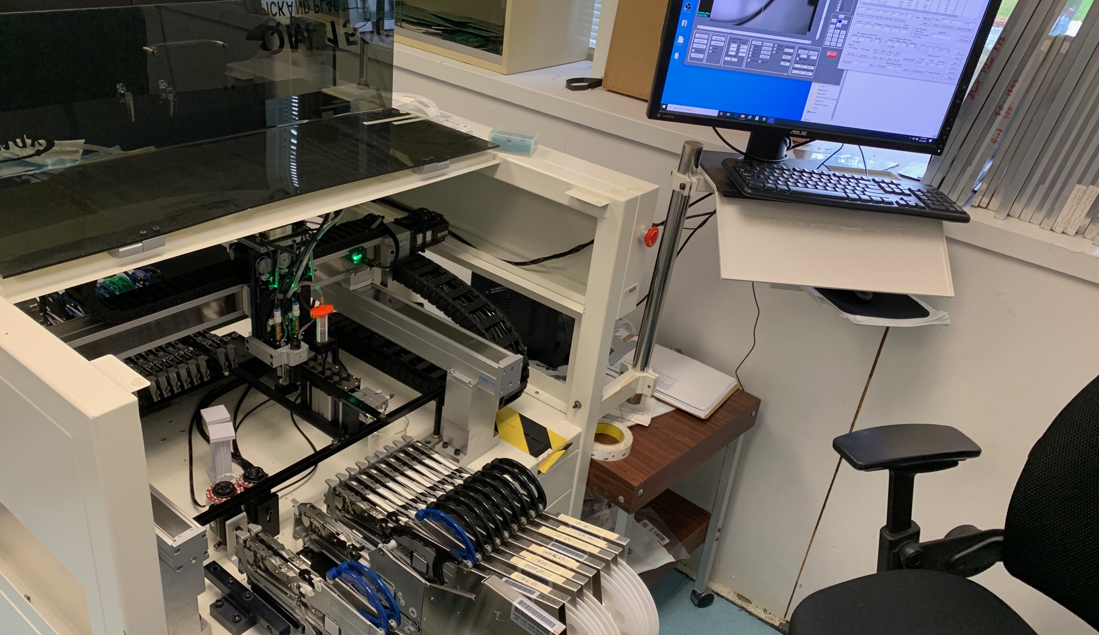
High-Density Interconnects
We have tools to design and fabricate interconnections for large international experiments. We develop prototypes and processes for projects in the conceptual stage. Some projects lead to commercial applications.
Our capabilities include:
Wire bonding, gold stud and solder bumping, flip-chip bonding, precision die bonding
Protecting wire bonds with encapsulation, underfill, and epoxy
Evaluating strength, integrity of wire-bonded interconnects
Inspecting interconnects through x-ray imaging
Determining surface roughness, deposition thickness, and size of detectors, substrates, and bumps via 3-D profilometry
Attaching surface-mount components to printed circuit boards
Removing fluxes, residues, and contaminants
Assembling wires for signal and power cables
High-Density Interconnect Lab
Electronics assembly area

Slide 9
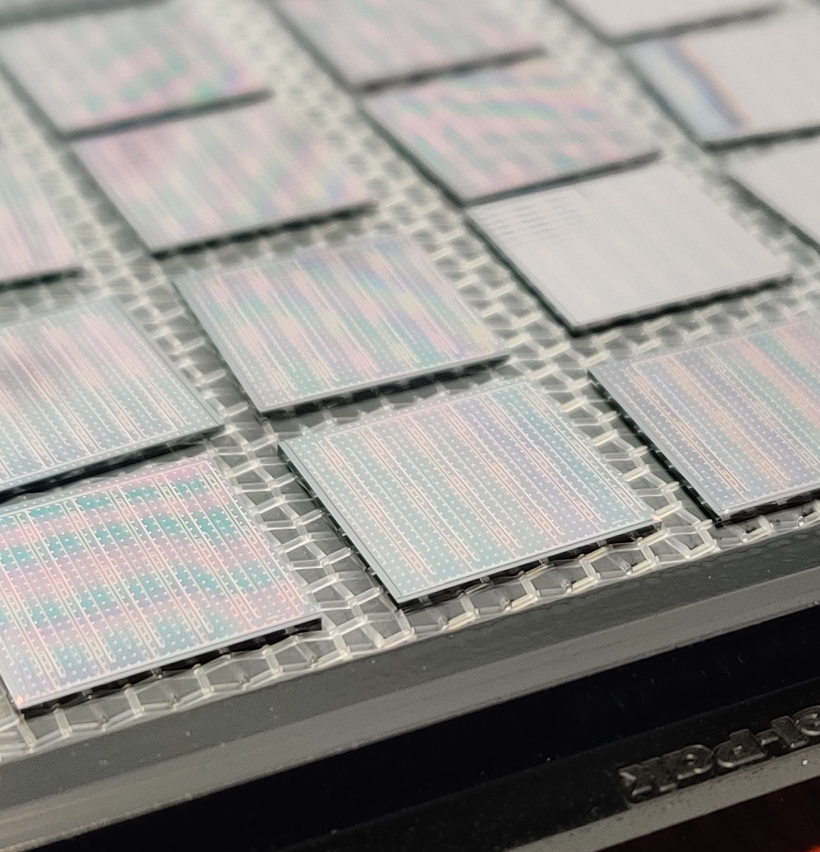
Application-Specific Integrated Circuits (ASICs)
Application-specific integrated circuits (ASICs) enable technology for many complex detector systems.
Our capabilities include:
Design of low-noise and low-power front-end circuits
Specialization of ASICs for cryogenic operation
Advancement of techniques for radiation-hardened microelectronics
Development of hybrid- and monolithic active-pixel detectors
Extension of functionalities of highly granular pixel detectors
Enablement of scalable quantum systems with integrated readout and control (radio frequency and cryogenic)
Implementation of AI, machine learning, and neuromorphic platforms
Generation and maintenance of libraries and models
Application of industry-standard electronic computer-aided design (ECAD)
VIPIC-L 3D-integrated
pixel ROICs with 65μm pitch

Slide 10
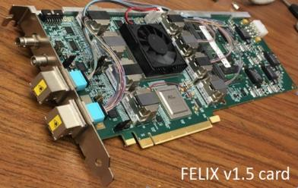
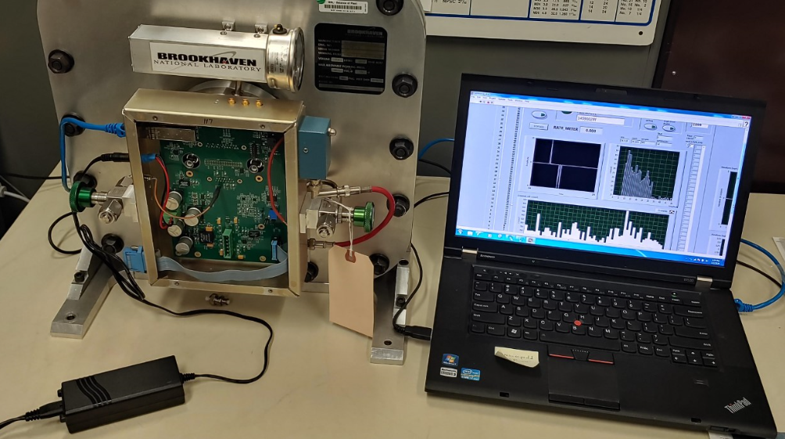
Data Acquisition and Control Systems
We develop unique hardware- and software-based solutions for when standard off-the-shelf isn't sufficient.
Our capabilities include:
Utilizing the latest technologies to develop next-generation solutions
Application specific integrated circuits (ASICs)
Field programmable gate arrays (FPGAs)
System-on-a-chip and radio frequency system-on-a-chip
Power and data cabling solutions
Software applications for data acquisition (DAQ), control, and diagnostics
Designing DAQ systems for harsh environments
Cryogenics, high radiation, high magnetic fields, space, and radio pure
High Throughput
Data Acquisition
24cm Neutron Detector

Slide 11
Printed Circuit Boards
We design complex, multilayer printed circuit boards, moving preliminary designs to mature production-ready packages.
Our capabilities include:
Progression of analog or digital designs from conception through fabrication
Delivery of innovative, creative and custom solutions
Establishment of tailored design standards and configurations
Collaboration with fabrication facilities
Design of advanced and low-noise signal processing systems
Verification of completed design elements on CAD and computer-aided manufacturing (CAM) software
Inspection and optimization of previously created designs for fabrication and assembly by PCB manufacturers
Routing for Data Acquisition and Controller Board with DDR 4 Memory

Slide 12
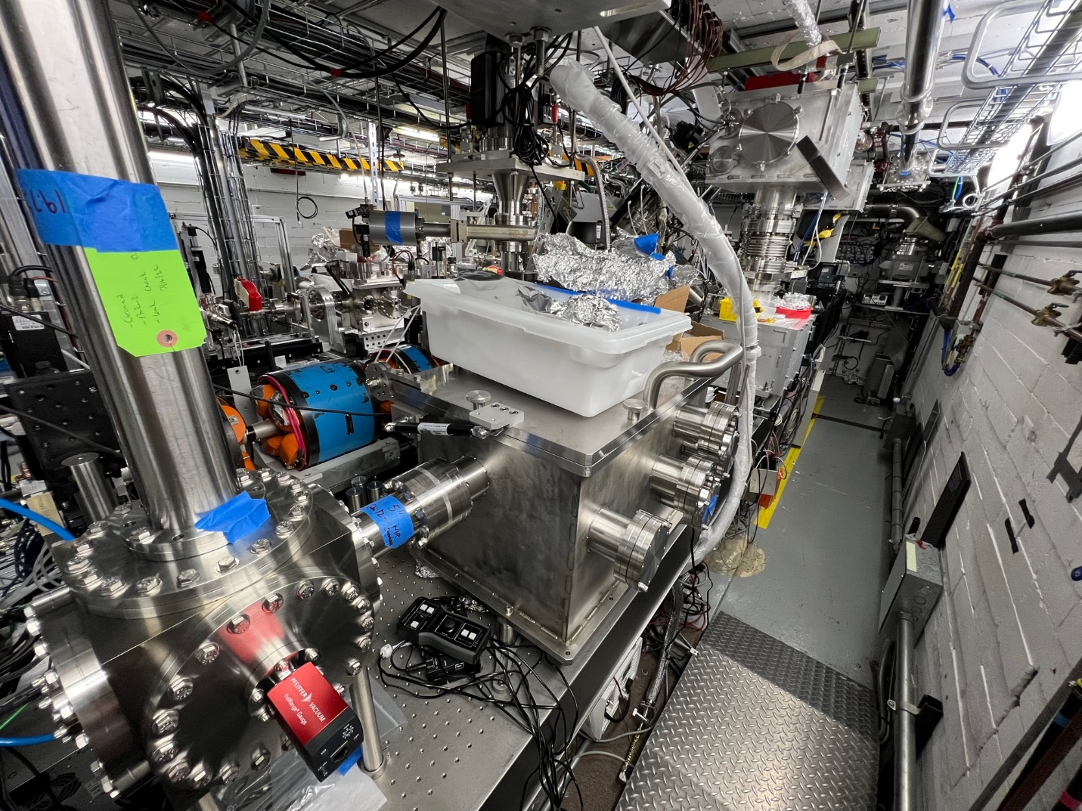
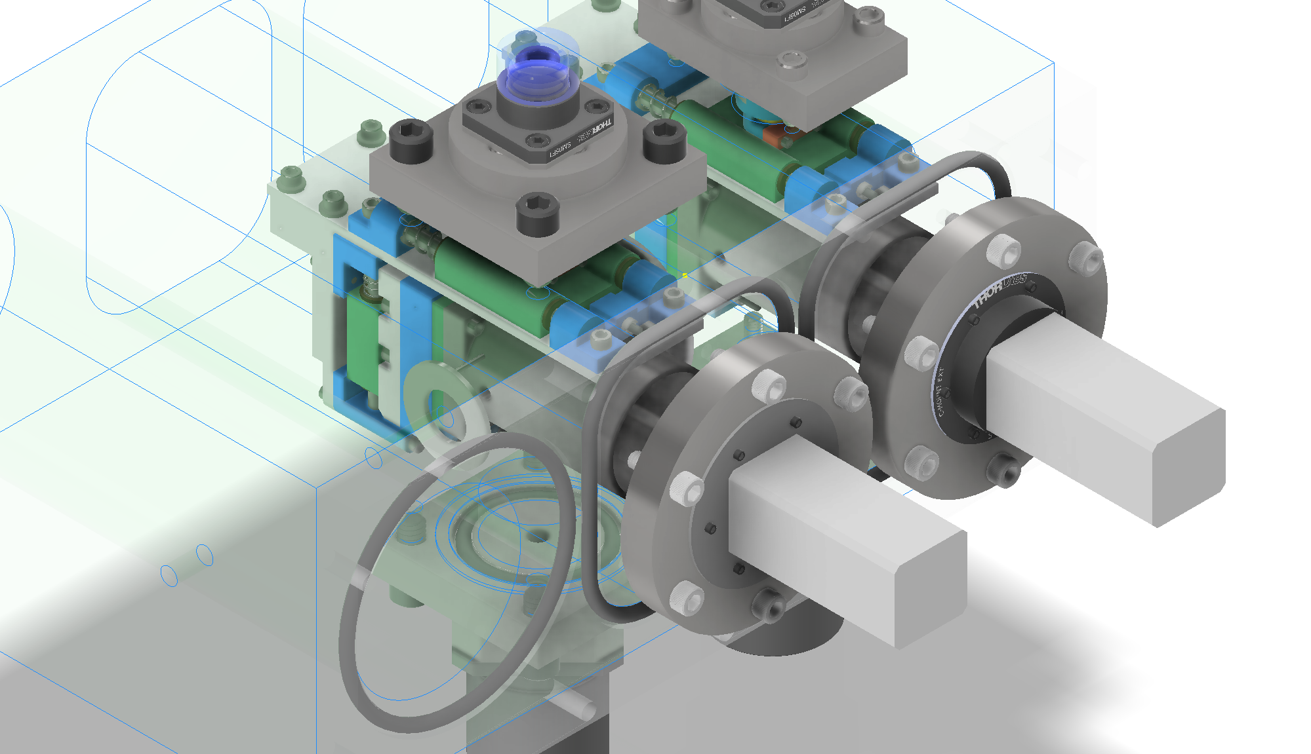
Mechanical Engineering, Fabrication, and Integration
We transform conceptual designs into functional components and complete systems. With in-house expertise and fabrication capabilities—including a fully equipped machine shop—we contribute to large collaborative experiments, prototype development efforts, and commercial applications.
Our capabilities include:
Computer aided design: 3D modeling and engineering drawings
Analysis through Ansys
Fabrication and device assembly
Vacuum systems and components
Optical systems and components
Clean room assembly
Metrology: OGP Interferometric laser, optical measurement unit
Experiment utilities/services: pipe and cable routing design
Near Infrared Laser Chamber
Aerosol Mass Spectrometer

Slide 13
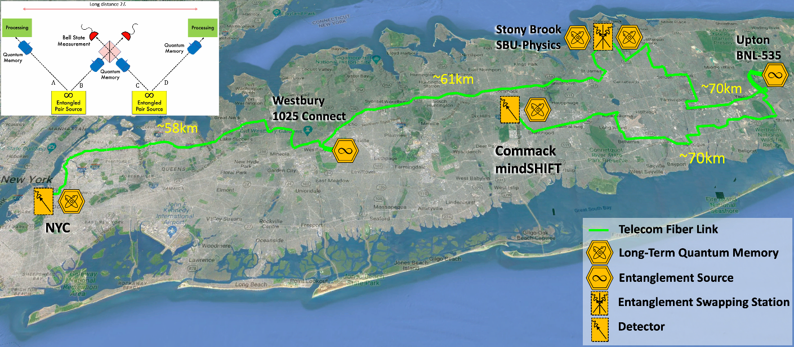
Quantum Information Science and Technology
Building the first prototype of the quantum internet: distributing quantum entanglement over Long Island for applications in quantum communication, quantum computing, and quantum sensing (in collaboration with Stony Brook University). Advancing quantum technologies and techniques (e.g., quantum LIDAR and astrometry).
Our capabilities include:
(Superconductive Nanowire) Single photon detection in the NIR and Telecom bands.
Quantum interference of single-photon wave-packets travelling tens of kilometers.
Atomic-based quantum memories compatible with polarization photonic qubits.
Telecon-band entangled photon sources.
Classical control and management layers to enable quantum technologies.
20 km free-space optical link in the NIR band.
Open as a Quantum Network User Facility: Quantum technologies and the fabric of the quantum economy will be enriched as users test, benchmark, validate, and develop new devices, concepts, and ideas.

Slide 14
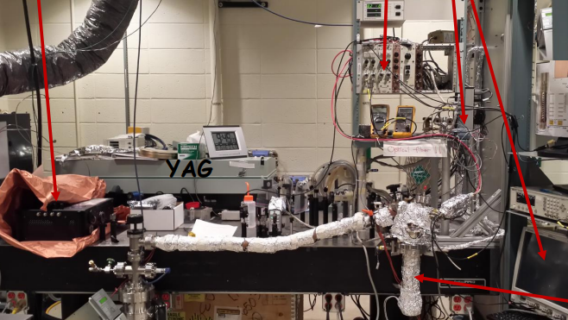
Photocathodes and Lasers
The Photocathode and Lasers group excels in the design, synthesis, and characterization of advanced materials and structures for single photon detection and intense electron beams production. We develop our custom vacuum system for the growth of thin films. Laser-matter interaction—from deep UV to IR—is our specialty and we use a wide range of lasers to characterize and modify the properties of materials.
Our capabilities include:
Growing thin films in ultra-high vacuum (UHV):
Alkali antimonides, alkali tellurides, negative electron affinity layers
Measuring electron spin polarization and spin relaxation times
Characterizing electron photo-emissive properties
Designing, building, testing custom solution for UHV experiments
Deposition systems, UHV transport systems, electron beam sources
Testing solid state photon detectors in a wide range of photon energies and conditions
Processing materials
Laser ablation, laser annealing, micro-machining
Mott polarimeter
Cryogenic detector test stand

Slide 15
Photocathodes and Photoinjectors at BNL
Long tradition of photoemission studies
X-ray in-operando growth and characterization
2D Protective coatings
Photocathodes for spin polarized electron beams
RF photoinjectors (ATF and LEAF facility)
High Voltage DC (LEReC DC gun)
SRF DC gun (112 MHz RF gun for CeC)
EIC electron sources
Development of spin polarized electron source
Development of the high average current for the hadron cooling

Slide 16
Enjoy the workshop!!

