Slide 1
EWPAA 2022 Highlights
D. Sertore INFN Milan – LASA
Lee Jones (STFC, DL), On behalf of the EWPAA Organizing Committee

Slide 2
EWPAA
The European Workshop on Photocathodes for Particle Accelerator Applications is convened every other year and it brings together the European Photocathode Community with the goal to improve collaborations and to exchange know-how.
The Workshop is also an opportunity for young researchers to present their work in the field and to be updated on the latest research result in the field
Previous Workshops held:
2016 in Daresbury at STFC
2017 in Berlin at HZB
2019 in Villingen at PSI
The 2022 event, originally scheduled for 2021 to celebrate 15 years since the WSHQE, still suffered from the long tail of the COVID pandemic.
It was held in-person but with several presentations given remotely

Slide 4
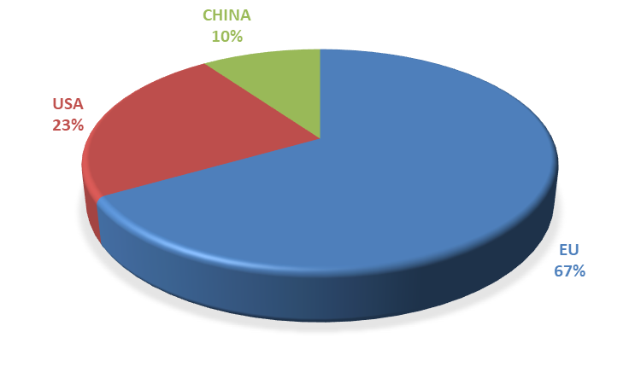
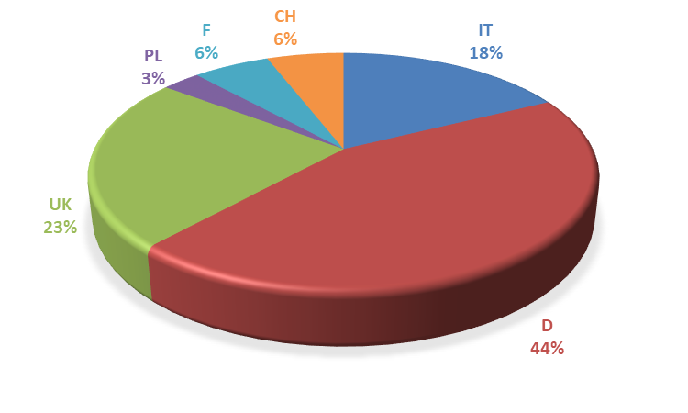
Participation
We have in total 51 registrants, including 10 remote presenters.
Overall Participation
European Participation

Slide 5
Workshop Structure – 7 WGs
Overview of Photocathode Research
Photocathode Performance in Accelerator Applications
New Photocathode Ideas
Advanced Photocathode Characterization
Metallic Photocathodes
Semiconductor Photocathodes
Photocathode Theory

Slide 6
WG 1 – Overview of Photocathode Research
Working Group 1 was focused on general overviews of key areas of photocathode R&D.
High Brightness Beams
Recent Advancements in Photocathodes
Experience on Polarized Photocathodes
Alberto Bacci – INFN Milano
Laura Monaco – INFN Milano
Kurt Aulenbacher – University of Mainz

Slide 7
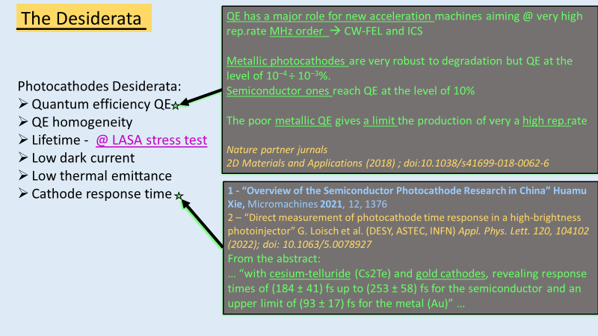
WG 1 - Highlights
Alberto presented photocathode requirements from a beam dynamics point of view with particular attention to generation of high brightness beams. He presented different applications such as the MariX project, BriXSinO ERL and Eupraxia. The role played by the GIOTTO algorithm to achieve optimize parameters was presented.
Laura’s ‘recent advances’ summary contained a lot of important updates and progress from all around the world, with notable content in relation to the use of Cs₂Te at DESY, and progress with the SRF gun at HZDR. This is complemented to some extent by the work at HZB on bi-alkali cathodes for use in their SRF gun.
Kurt shared state of the art and the development paths for “polarized” photocathodes. He presented some interesting information on the use of Cs:F:Li to both activate and protect the surface of his polarized electron sources, coupled to their mounting on a boron nitride puck to cope with the high laser powers (and heat loads therein) required to extract high levels of polarized beam current.

Slide 8
WG 2 – Photocathode Performance in Accelerator Applications
JLAB DC Gun Developments
CsK₂Sb Photocathodes for Application in an Industrial Accelerator
Status of Precise Measurements of Electron Beam Polarization Changes During Long Term Operation
Carlos Garcia - JLAB
Verena Kuemper - RI
Jennifer Groth - Johannes Gutenberg-Uni
Photocathode Activities at DESY
Performance of Bialkali Photocathode in DC–SRF Photoinjector
Photocathode Performance at LCLS–II
Pavel Lopez - DESY
Haumu Xie - PKU
Theo Vecchione - SLAC
Working Group 2 was focused on photocathode performance in accelerators. It remains a goal in Photocathode R&D to improve the cathode performance in accelerator applications

Slide 9
WG 2 - Highlights
Verena presented some interesting results on the performance of the RI Lighthouse Lab Gun, including their preparation of a bi-alkali cathode with automated transport. She highlighted the promising application of two 350 kV DC guns with K₂CsSb preparation system with the goal of producing 40 mA in CW operation 23 h/7 days a week
Jennifer’s presentation was focused on improving the stability of the electron spin polarization over time on GaAs. The actual cesium and oxygen preparation suffers from a polarization change. The presented NF₃ activation allows more activation cycles with more stable results.
Pavel made an interesting summary of the extended know-how developed at DESY on the preparation of Cs₂Te photocathodes and their operation in the accelerator complex. Extremely long life times were shown up to 1,452 days. Ion back bombardment is under investigation as a possible cause of photocathode damage. Setting up ‘Blue Lab’.

Slide 10
WG 3 – New Photocathodes Ideas
Ultra–thin MgO Films on Metal Photocathodes to Enhance QE
Plasma Photocathode
CERN Photocathode Activities
Chris Benjamin – Uni Warwwick and ASTeC
Carlo Benedetti - LBNL
Miguel Calderon - CERN
Protective Layers on Bi–alkali Cathodes
AI/ML–selection of Air–stable
Nathan Moody - LANL
Evan Antoniuk - LLNL
Working Group 3 was focused on new ideas and concepts within the field of photocathode technology.

Slide 11
WG 3 - Highlights
Chris’s work is on the application of ultra-thin oxide film on metal to reduce work function. An ultra-thin MgO film was deposited on Ag(100) and Cu(100). Both structures were characterized by XPS, LEED and QE measurement confirming the increase QE and robustness. MTE measurement with TESS system confirm a good approximation of energy spread with Dowell-Schmerge approximation.
Miguel presented the activities on photocathodes on-going at CERN for CLEAR and AWAKE experiment. Cs₂Te photocathodes by co-evaporation deposition has been introduced with good results. CERN is exploring metallic photocathodes with surface nano-structuring as well as surface-plasmon assisted photoemission.
Carlo introduced the novel concept of plasma photocathodes. In a plasma photocathode the production and acceleration of the electron bunch are decoupled. The driver is responsible for the plasma creation while a short-wavelength, low intensity, trailing ionization pulse create tunnel-ionized electron directly into the plasma waves.

Slide 12
WG 4 – Metallic Photocathodes
Studies on the Evolution of MTE for Photocathodes Subjected to Controlled Degradation by Gas Exposure
Copper Photocathodes for CLARA
Copper photocathode experience at FERMI
Liam Soomary – Liverpool Uni and The Cockcroft Institute
Tim Noakes – UKRI STFC Daresbuty
Mauro Trovò - ELETTRA
Technology Aspects in Preparation at NCBJ of Nb–Pb Superconducting Photocathodes for XFEL–Type RF Electron Guns
Jerzy Lorkiewicz – Nuclear Center for Nuclear Research
Working Group 4 looked at the performance of metal photocathodes in the accelerator environment, and also at work to improve their performance.

Slide 13
WG 4 - Highlights
Liam presented work on degradation of polycrystalline copper photocathodes, and the performance of cesium implanted copper photocathodes. The latter is an attractive option to lower work function with possibly tune the QE. Implanted photocathodes were also studied w.r.t degradation by gas exposure.
Tim reviewed the current status of the CLARA accelerator. In particular, he reported on the history of the solid copper backplate and the transition to a new INFN-style Mo plug. A copper thin film was deposited on the plug, but lifetime was very poor. A hybrid plug with a copper tip insert was investigated and operated successfully for 6 months.
Mauro shared the FERMI gun experience on operation of RF gun without a photocathode exchange mechanism. The general QE trend during operation is a decrease probably due to increasing base pressure. Emphasis was placed on dark current from the gun and its impact on machine operation
Jerzy’s presentation was focused on Nb-Pb photocathode for SRF guns. After a review of the materials choice for the photocathodes, the Pb deposition process was presented describing two main techniques used: Filtered Arc (generated high protrusions) and Two-Step Coating (better crystallinity).

Slide 14
WG 5 – Semiconductor Photocathodes
Multi–alkali Antimonide Photocathodes for Highly Brilliant Electron Beams
Characterisation at Daresbury Laboratory of CsTe Photocathodes Grown at CERN
Cs₂Te\KCsSb in Gun Operation at PITZ
Chen Wang - HZB
Lee Jones – STFC Daresbury
Sandeep Mohanty - DESY
Operation of Cs₂Te in SRF gun for THz User Shifts
Rong Xiang - HZDR
Working Group 5 focused on the development and application of alkali-antimonide photocathodes and their use in accelerators.

Slide 15
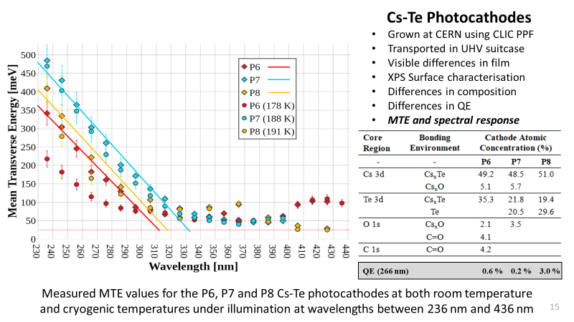
WG 5 - Highlights
Chen’s work was focused on multialkali antimonide photocathodes developed at HZB for high brightness beams. NaKSb were deposited on Mo substrate in UHV conditions and studied by XPS and QE measurement. Correlations between chemical composition and QE were discussed. A hybrid deposition (combination of sequential and co-evap) proved to give best results.
Lee presented the performance characterization at Daresbury of Cs₂Te photocathodes deposited at CERN. Different techniques (XPS, STM and TESS spectrometer) available at Daresbury Lab were used. Multiple chemical species were detected, and correlations between surface properties, MTE values and spectral response were discussed.
Sandeep reported on the deposition experience of KCsSb photocathodes at INFN LASA, and their performance during operation at PITZ. Despite good QE, fast response time and low thermal emittance, these photocathodes showed high dark current and low operational lifetime w.r.t. Cs₂Te. NaKSb(Cs) photocathodes were found to have multi-year lifetime, stable up to 120 °C.
Rong shared her experience on operation of Cs₂Te photocathodes in the ELBE SRF gun. Cs₂Te on Cu performed well in SRF gun in terms of QE and charge lifetime, with acceptable level of dark current. XPS analysis showed influence of contamination on photocathode properties. A dedicated startup procedure is needed to limit multipacting.

Slide 16
WG 6 – Photocathode Theory
Monte Carlo Transverse Emittance and Quantum Efficiency Study on Cs₂Te
Monte Carlo Simulations of Electron Photoemission from Plasmon–enhanced Bialkali Photocathode
Exploring Cesium—Tellurium Phase Space via High–throughput Calculations beyond Semi–local Density–functional Theory
Gowri Adhikari - DESY
Zenggong Jiang - SARI
Holger Dietrich Sassnick - UniOldenbug
Ultrafast Sub–threshold One-photon Photoemission
Andrea Schroeder – University of Illinois at Chicago
Working Group 6 focused on the construction, development and testing of theoretical models supporting photoemission from photocathodes.

Slide 17
WG 6 - Theory
Gowri applied the Monte Carlo techniques to Cs₂Te. She presented DFT calculation of the orthorhombic crystal structure that she used in a three-step model. Different scattering mechanisms in the transport were considered . Good match with experimental results assuming 0.25 electron effective mass. The response time was estimated in 200 fs.
Holger-Dietrich’s presentation focused on DFT of binary Cs-based photocathodes (Cs₃Sb and Cs₂Te) using high-throughput methods. This approach gave the possibility to explore different structures for both compounds and select the most stable. For Cs-Te system they start to take into account the surface effects and examine the stability of different terminations w.r.t. the electronic properties.
Zenggong reported on Monte Carlo simulation of photoemission from plasmon-enhanced bi-alkali photocathodes. The goal is to increase light absorption on the surface, improving QE and response time. Three-step model was applied to structures properly designed for plasmon excitation. Factor 2-3 of QE enhancement was achieved while preserving emittance (with caveat). Next step is the production of such a structures.

Slide 18
WG 7 – Advanced Photocathode Characterization
The ASU photocathode research lab
Photocathode Response Time Measurement
Resolving Surface Chemical States of p-GaN:Cs Photocathodes by XPS Analysis
Siddartha Karkare - ASU
Gregor Loisch - DESY
Jana Schaber - HZDR
High Crystalline Cesium Telluride Photocathode on Atomically–thin Graphene with Co–deposition
Menjia Gaowei – BNL
Molecular Beam Epitaxy of Cs–Sb Thin Films: Structure–oriented Growth of High Efficiency Photocathodes
Stoichiometry Control and Automated Growth of Alkali Antimonide Photocathode Films by Molecular Beam Deposition
Alice Galdi – Uni Salerno
Vitaly Pavlenko - LANL
Working Group 7 was dedicated to advanced photocathode characterization.

Slide 19
WG 7 - Highlights
Gregor presented direct response time measurement on semiconductor (and metal) photocathodes by measuring the bunch lengthening during the photoemission process. The set-up at PITZ allows bunch length measurement of low charge and short bunch with a high-resolution TDS. Extended simulation and experimental work done to compensate for errors. Shortest Cs₂Te response was 184 ± 42 fs, with 183 ± 10 fs for Au.
Jana shared her studies to use p-GaN:Cs as photocathodes by in-situ photoelectron spectroscopy. She found by XPS that C and O are embedded in the materials and that Ar sputtering induces surface damage. XPS was also used to study the Cs activation. Research is on-going to use this in the HZDR SRF Gun.
Alice reported on molecular beam epitaxy of Cs-Sb thin films to grow structure-oriented high efficiency photocathodes. Epitaxy of Cs₃Sb achieved by monitoring sample structure with RHEED during growth. Identified CsSb as an interesting structure, atomically smooth, easily achievable by co-deposition and robust against oxidation.

Slide 20
ERL in European Strategy for Particle Accelerator
Accelerator R&D Roadmap and it's impact on photocathode research
New accelerator roadmap emphasise interest to further development of Energy Recovery Linacs (ERL) as high efficiency sustainable accelerator facilities.
High average current, in 100 mA range, electron injectors are one of the most critical components of ERLs and additional efforts should be concentrated on further development of the injectors.
Major efforts should be concentrated on the following:
Optimisation technology of existing photocathode materials
Development new photocathode materials which could operate with existing laser system
Design photocathode plug which may be compatible with different types of the guns
Development of laser systems which would allow for delivery required current with UV photocathodes
Development of gun technologies which would allow for providing beams compatible with existing accelerator structures without excessive bunching schemes. Potential to reach this goal have.
High field QWR SRF gun
High field QWR NCRF gun
Elliptical cavity SRF gun
There is no operational injector which can demonstrate 100 mA of polarised current: Limited by photocathode lifetime
Potential to deliver this current (if GaAs lifetime by activation with Cs-alkali metal layer is successful),
DC photocathode guns
SRF photocathode guns
https://doi.org/10.23731/CYRM-2022-001
Boris Militsyn
STFC Daresbury Laboratory, UK

Slide 21
ERL in European Strategy for Particle Accelerator
https://doi.org/10.23731/CYRM-2022-001

Slide 22
European Networking
One of the scope of EWPAA is to foster the creation of collaborations among different labs.
We have historical collaborations such as:
INFN-DESY on Cs₂Te and recently alkali antimonide photocathodes
HZB-HZRD on photocathodes for SRF guns
HZDR-University of Mainz on general collaboration
We have seen in this workshop new collaborations:
CERN and STFC with sample exchange. Besides the scientific case, this motivates also a technological effort to preserve photocathode during long journey
HZB and STFC with sample exchange is planned in the near future
A further outcome is the possibility to have a “common” center for photocathode analysis like STFC, able to accept different samples from different laboratories.

Slide 23
Conclusions
Theoretical simulation is becoming a more mature/popular area of photocathode research
Models are becoming more realistic – no longer acceptable to just use ground state and bulk band structure for calculations (need to take into account surface effects, non-zero temperature for electrons)
Modelling of telluride and antimonide photocathodes becoming increasingly popular which are more complex to simulate than metals (different phases, more complicated electron transport)
The SLAC group have managed to extract response time from their simulations, which is new.
Operations
Successful application of photocathodes has been approved in DC guns, NC RF guns and SRF guns. It will be applied also in the industry accelerator (Research instruments).
Mature semiconductor cathode options ready for various applications include Cs₂Te ( DESY XFEL ), Cs₂KSb (ERL), GaAs (polarised).
Operational experience
Extremely high vacuum environment is the key for long operation life time.
It is clear that the ion bombardment is responsible for the cathode surface damaging during DC gun operation.
Cryogenic temperature has influence to the QE of Cs₂KSb.
Outlook for the next step:
The analysis of cathode without explosion to air will help us to understand the cathode surface changing or QE distribution changing during gun operation.
Low MTE is desired for special user (hard X-ray FEL and microscope).

Slide 24
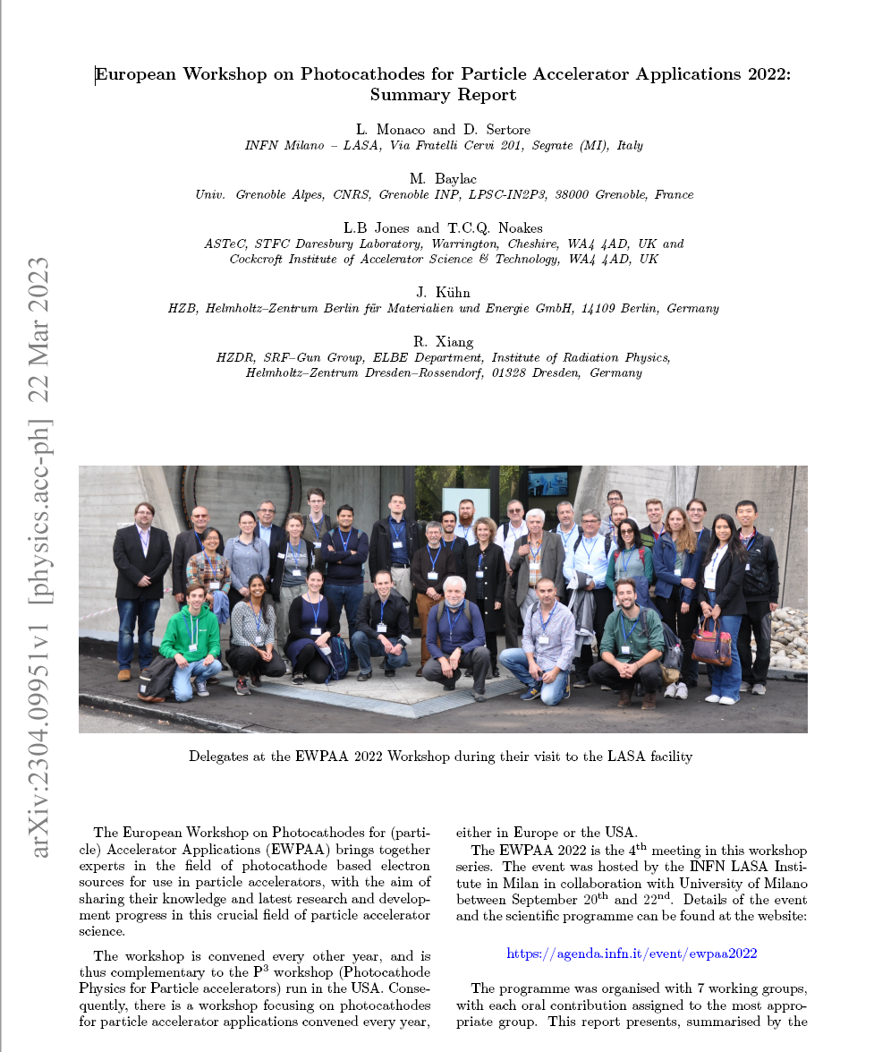
Conference Summary
The EWPAA Summary Report has been published on arXiv.
https://arxiv.org/abs/2304.09951

Slide 26
