Slide 1
Epitaxial growth of the cesium antimonide photocathode
Chad Pennington
Cornell University , Department of Physics + CLASSE
P3 Workshop, October 3rd-5th , 2023

Slide 2
Acknowledgements
Thank you to everyone for their contributions to this work:
Cornell University: Elena Echeverria, Matt Gordon, Michael Kaemingk, Tomas Arias, Jared Maxson.
Arizona State University: Pallavi Saha, Priyadarshini Bhattacharya, Siddharth Karkare.
Brookhaven National Laboratory: Kali Mondal, Mengjia Gaowei.
SLAC: John Smedley.
University of Salerno, Italy: Alice Galdi.

Slide 3
Outline
Motivation for the epitaxial growth of Cs₃Sb.
Growth of ordered photocathodes using pulsed laser deposition (PLD) and in-operando x-ray characterization.
Measuring quantum efficiency with optical interference in the photocathode-substrate system.
Cs₁Sb₁: a highly oxygen resistant, visible photocathode.
Summary and Conclusions.

Slide 4
Epitaxial Growth
Cs₃Sb photocathodes are conventionally grown polycrystalline with disordered surfaces.
Reducing the intrinsic emittance may be limited by the surface disorder in the form of defects, grain boundaries, and roughness.
Material ordering eliminates defects (roughness, grain boundaries) that contribute to electron momentum spread.
Epitaxy opens the door to band structure engineering.
We lattice-match Cs₃Sb films with the crystal substrate (e. 3C-SiC(100)) via Molecular Beam Epitaxy (MBE)

Slide 5
Epitaxial Growth
Cs₃Sb photocathodes are conventionally grown polycrystalline with disordered surfaces.
Reducing the intrinsic emittance may be limited by the surface disorder in the form of defects, grain boundaries, and roughness.
Epitaxy is the alignment of crystal layers with respect to an underlying crystal seed layer.

Slide 6
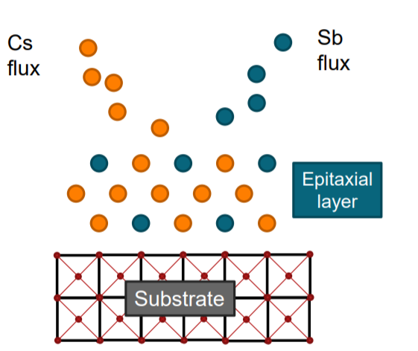
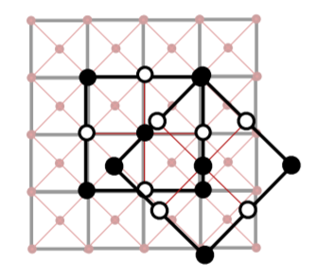
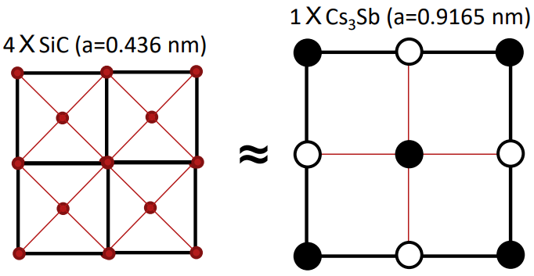
Epitaxial Growth
Cs₃Sb photocathodes are conventionally grown polycrystalline with disordered surfaces.
Reducing the intrinsic emittance may be limited by the surface disorder in the form of defects, grain boundaries, and roughness.
Epitaxy is the alignment of crystal layers with respect to an underlying crystal seed layer.
Cs₃Sb is grown on lattice matched, 3C-SiC substrates.
Notes:
MTE may be limited by epitaxy. Explain two diff orientations

Slide 7
Why epitaxy?
Towards higher brightness: a figure for the quality of the electron beam.
Material ordering eliminates defects (roughness, grain boundaries) that contribute to electron momentum spread (MTE).
Epitaxy opens the door to band structure and/or QE engineering – similar to work on single crystal GaAs and GaN.
-. W. Liu, et. , Appl. Phys. Lett. 109, 252104 (2016).
- J. Marini,, Polarization engineered N-polar Cs-free GaN photocathodes, J. Appl. Phys. 124, 113101 (2018).
Notes:
Reference polarized session. Mention NEA w/o Cs

Slide 8
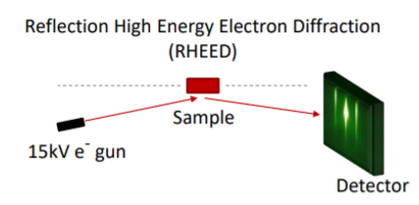
RHEED: one tool for determining epitaxy
RHEED identifies the surface structure through grazing incidence over the first few atomic layers of the sample.

Slide 9
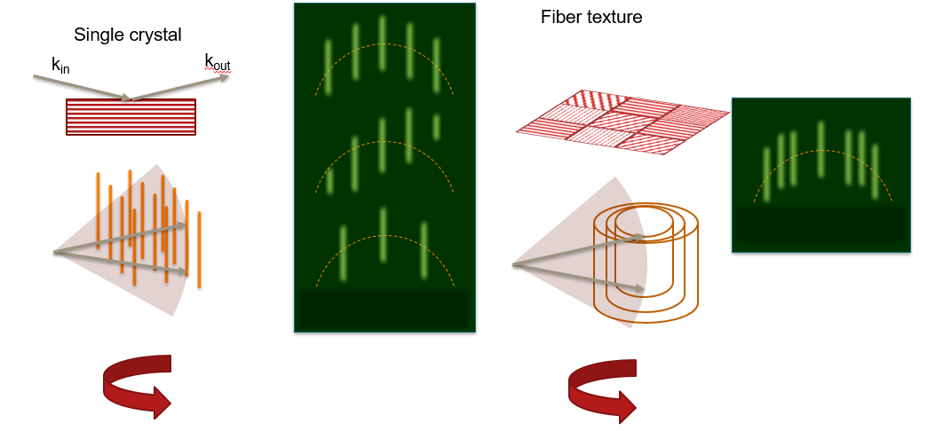
RHEED: one tool for determining epitaxy
RHEED identifies the surface structure through grazing incidence over the first few atomic layers of the sample.

Slide 10
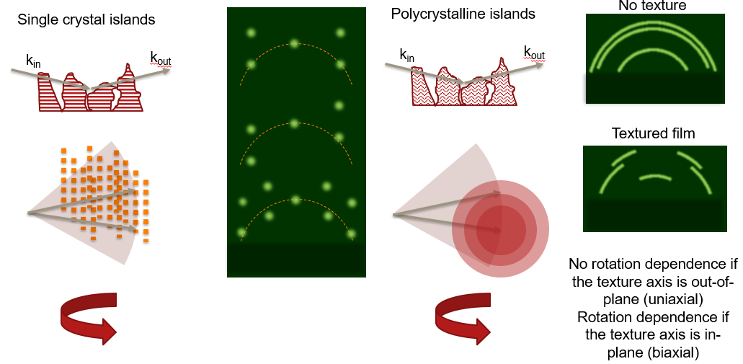
RHEED: one tool for determining epitaxy
RHEED identifies the surface structure through grazing incidence over the first few atomic layers of the sample.
X-ray diffraction (XRD) is another tool that can determine epitaxy.
See Kali Mondal’s talk in this session!

Slide 11
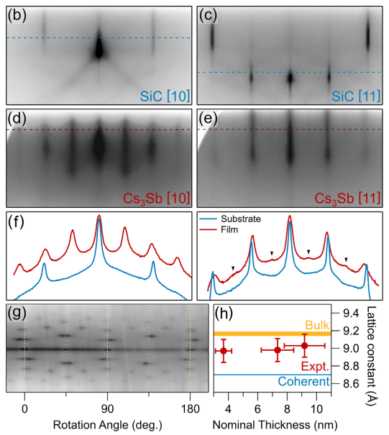
Results on Cs₃Sb grown with MBE
Cs₃Sb grown via molecular beam epitaxy (MBE) on the lattice-matched 3C-SiC(100) substrate facilitates epitaxial growth.
See John Smedley’s talk in the Novel Concepts Session on Oct. 5!
- C. T. Parzyck, A. Galdi, et. Al. Phys. Rev. Lett. 128, 114801 – Published 18 March 2022

Slide 12
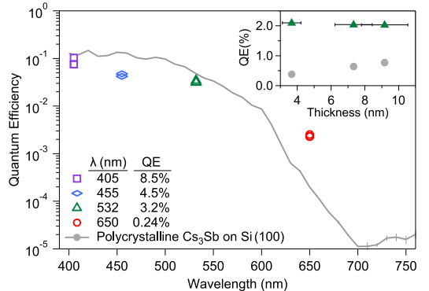
Results on Cs₃Sb grown with MBE
Cs₃Sb grown via molecular beam epitaxy (MBE) on the lattice-matched 3C-SiC(100) substrate facilitates epitaxial growth.
Highly efficient in the ultra-thin limit (sub-10 nm). QE near 2% at 532 nm for ~2 nm thick film.
See John Smedley’s talk in the Novel Concepts Session on Oct. 5!
- C. T. Parzyck, A. Galdi, et. Al. Phys. Rev. Lett. 128, 114801 – Published 18 March 2022

Slide 13
Outline
Motivation for the epitaxial growth of Cs₃Sb.
Growth of ordered photocathodes using pulsed laser deposition (PLD) and in-operando x-ray characterization.
Measuring quantum efficiency with optical interference in the photocathode-substrate system.
Cs₁Sb₁: a highly oxygen resistant visible photocathode.
Summary and Conclusions.

Slide 14
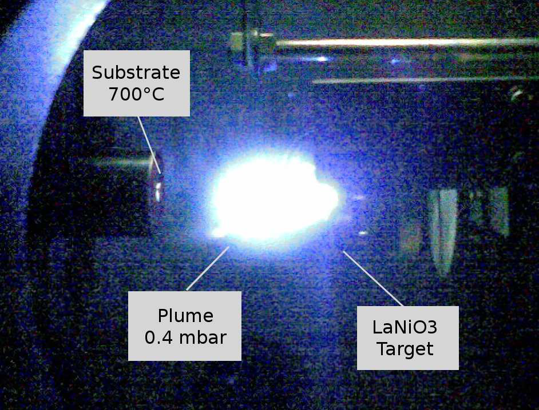
Photocathodes at NSLS-II
Beamline 4-ID at the National Synchrotron Light Source (NSLS-II):
Option for growing with PLD or conventional thermal evaporation.
Pulsed Laser Deposition (PLD)
248 nm pulsed excimer laser vaporizes Sb target, condensing on substrate.
Consistent rep rate and laser fluence leads to extremely stable and controlled deposition rates.
Plumes of Sb or Sb₄?
Substrate
+ heater
Plume
(Sb)
Sb target
Example PLD setup

Slide 15
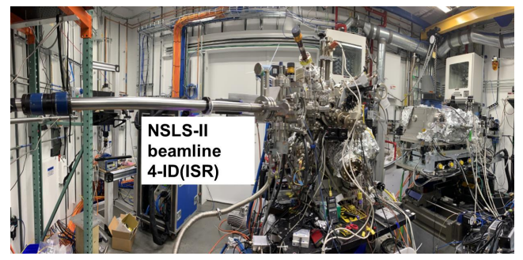
Photocathodes at NSLS-II
Beamline 4-ID at the National Synchrotron Light Source (NSLS-II):
Option for growing with PLD or conventional thermal evaporation.
Pulsed Laser Deposition (PLD)
248 nm pulsed excimer laser vaporizes Sb target, condensing on substrate.
Consistent rep rate and laser fluence leads to extremely stable and controlled deposition rates.
Plumes of Sb or Sb₄?
Substrate
+ heater
Plume
(Sb)
Sb target
Characterization:
X-ray diffraction (XRD) – bulk structure
X-ray reflectivity (XRR) – thickness and rms roughness.
X-ray fluorescence (XRF) – stoichiometry
RHEED – surface structure
Quantum efficiency
Example PLD setup

Slide 16
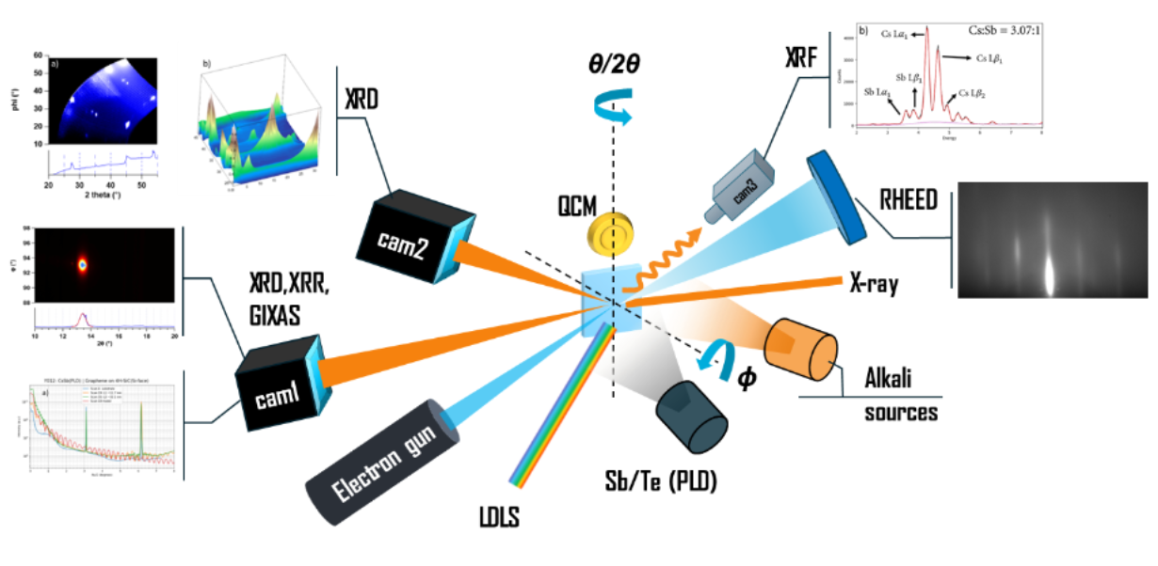
The experiment
Our growth method:
Real-time thickness, stoichiometry, XRD measurements.
Notes:
Mention companion talk to John and Kali. Mention RHEED, co-location of x-rays and electrons. Animate diff growth methods

Slide 17
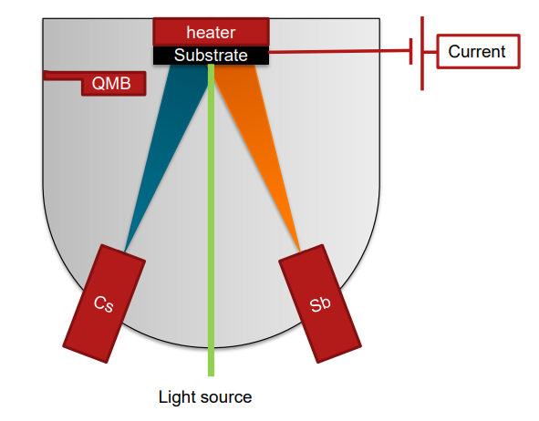
The experiment
Our growth method:
Real-time thickness, stoichiometry, XRD measurements.
Conventional photocathode growth:
Photocurrent oriented.
Maximize quantum efficiency.

Slide 18
Flat, ordered Cs₃Sb on 3C-SiC(001)
RHEED patterns indicate flat and fiber-textured films.
Deposition temperature: 90 C.
Grown using PLD.
Fiber textured film.
Thickness ~8 nm.
Deposition temperature: 80 C.
Grown using PLD.
Ordered film with 3D islands.
Thickness = 5.6 nm.
Flat, thin, and ordered films with near percent level QE at 530 nm are easily grown with PLD.
A Cs:Sb stoichiometry ratio of 3:1 is derived from XRF for ordered Cs₃Sb films.
Deposition temperature: 85 C.
Grown using thermal evaporation. Fiber textured film.
Thickness = 8.3 nm.
Notes:
Emphasize not difficult to grow flat fiber textured films with right diagnostics. Simplify fiber texture figure, spend more time here

Slide 19
Outline
Motivation for the epitaxial growth of Cs₃Sb.
Growth of ordered photocathodes using pulsed laser deposition (PLD) and in-operando x-ray characterization.
Measuring quantum efficiency with optical interference in the photocathode-substrate system.
Cs₁Sb₁: a highly oxygen resistant visible photocathode.
Summary and Conclusions.
Notes:
Transition from growing films to measuring QE, something interesting happens…

Slide 20
Optical interference in the cathode substrate
Cs₃Sb: 10-30 nm thick
3C-SiC(100)
1.3 um
Si(100)
~0.5 mm
Notes:
Animate in the QE – start with optical properties of layers, transparency of SiC – emphasize cathode smoothness to see this effect. Use arrows for light rays

Slide 21
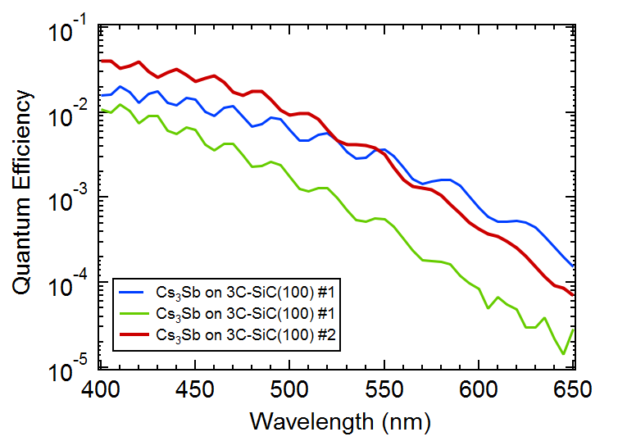
Optical interference in the cathode substrate
Cs₃Sb: 10-30 nm thick
3C-SiC(100)
1.3 um
Si(100)
~0.5 mm
Photocathode films are smooth and thin enough to measure effects from interference.
A. Alexander et. al. Enhanced photocathode performance through optimization of film thickness and substrate
Journal of Vacuum Science & Technology B 35, 022202 (2017); https://doi.org/10.1116/1.4976527

Slide 22
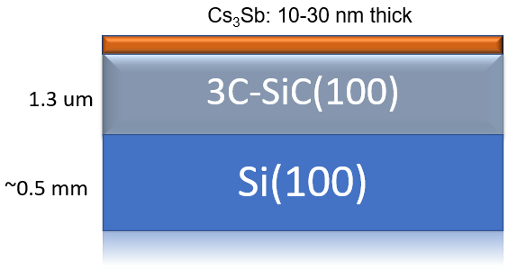
Optical interference in the cathode substrate
a.) 1.3 um SiC layer
Electric field inside the cathode film
z`
$$E_{y}=E_{0}e^{iωt}(c_{f}e^{in_{PC}kz}+c_{b}e^{−i{\tilde{n}}_{Pc }kz})$$

Slide 23
Optical interference in the cathode substrate
a.) 1.3 um SiC layer
Electric field inside the cathode film
Laser power absorbed in film
z`
$$E_{y}=E_{0}e^{iωt}(c_{f}e^{in_{PC}kz}+c_{b}e^{−i{\tilde{n}}_{Pc }kz})$$
$$P_{abs}\left(z\right)=\frac{{d(Re(S}_{z}))}{dz}$$
Calculate the Poynting vector
$$a\left(z,λ\right)=\frac{P_{abs}\left(z,λ\right)}{P_{in}\left(λ\right)}$$
$$S_{z}=\frac{1}{2}E_{y}∙{\tilde{H}}_{x}$$

Slide 24
Optical interference in the cathode substrate
a.) 1.3 um SiC layer
Electric field inside the cathode film
Laser power absorbed in film
z`
$$E_{y}=E_{0}e^{iωt}(c_{f}e^{in_{PC}kz}+c_{b}e^{−i{\tilde{n}}_{Pc }kz})$$
$$P_{abs}\left(z\right)=\frac{{d(Re(S}_{z}))}{dz}$$
Calculate the Poynting vector
$$a\left(z,λ\right)=\frac{P_{abs}\left(z,λ\right)}{P_{in}(λ)}$$
$$S_{z}=\frac{1}{2}E_{y}∙{\tilde{H}}_{x}$$
Consider photoelectrons with energy greater than the workfunction. [2]
Profile of photon absorption into material.
$$QE=N∙{\left(\frac{hc}{λ}−E_{vac}\right)}^{2}\int_{0}^{h}{e^{−\frac{z}{λ_{esc}}} a(z,λ)dz}$$
Probability of a photoexcited electron escaping material.
Where N is a pre-factor, $h$ is the cathode thickness, $E_{vac}$ is the vacuum energy, and $λ_{esc}$ is the escape depth of the electron.
A. Alexander et. al. Enhanced photocathode performance through optimization of film thickness and substrate
Journal of Vacuum Science & Technology B 35, 022202 (2017); https://doi.org/10.1116/1.4976527
- David H. Dowell and John F. Schmerge
Phys. Rev. ST Accel. Beams 12, 074201 – Published 27 July 2009; Erratum Phys. Rev. ST Accel. Beams 12, 119901 (2009)
Notes:
Mention three fitting parameters in model. Explain the Dowell 3 step model (simplicest scaling). Lambda dependence for a(z). Box references – make easier to see

Slide 25
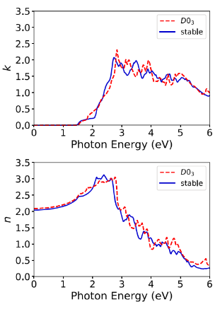
Optical interference in the cathode substrate
a.) 1.3 um SiC layer
Consider photoelectrons with energy greater than the workfunction. [2]
z`
Profile of photon absorption into material.
$$QE=N∙{\left(\frac{hc}{λ}−E_{vac}\right)}^{2}\int_{0}^{h}{e^{−\frac{z}{λ_{esc}}} a(z)dz}$$
Probability of a photoexcited electron escaping material.
Where N is a pre-factor, $h$ is the cathode thickness, $E_{vac}$ is the vacuum energy, and $λ_{esc}$ is the escape depth of the electron.
- Index of refraction data for Cs₃Sb obtained from DFT calculations.
- Optical constants data for Si and SiC obtained from literature sources at https://refractiveindex.info/.
Model could be improved with DFT density of states and detailed quantum mechanical descriptions.
See Dimitre Dimitrov talk in Theory session today!
Notes:
Reference DFT paper for Cs3Sb

Slide 26
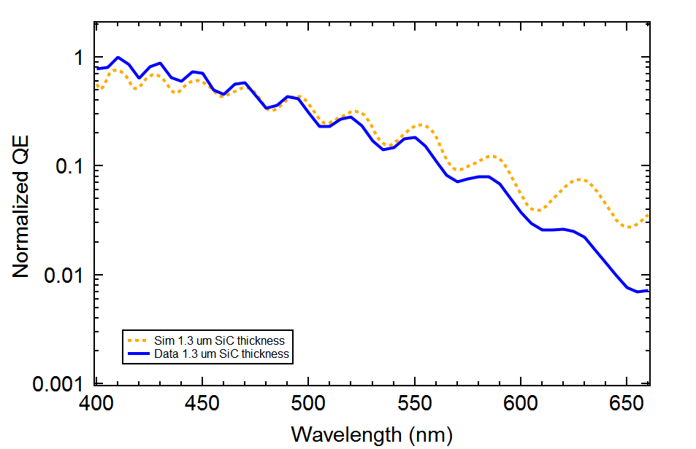
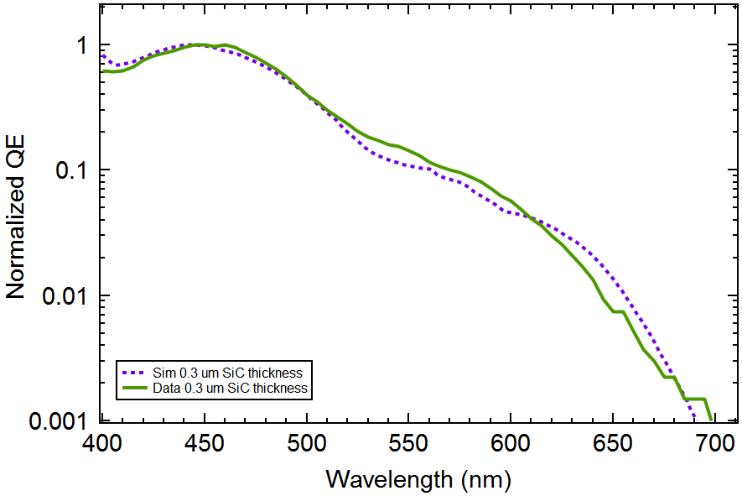
Optical interference in the cathode substrate
a.) 1.3 um SiC layer
a)
z`
Fit results:
SiC thickess: 1.58 um.
Cs3Sb thickness: 35 nm.
e⁻ Escape depth: 60 nm.
Vacuum energy: 1.9 eV
b.) 0.3 um SiC layer
b)
Fit results:
SiC thickess: 0.29 um.
Cs3Sb thickness: 23 nm.
e⁻ Escape depth: 100 nm.
Vacuum energy: 1.9 eV
0.3 um
Notes:
Change dimensions in cartoons. By changing layer thickness – periodicity changes. Take away – we can model this very well

Slide 27
Outline
Motivation for the epitaxial growth of Cs₃Sb.
Growth of ordered photocathodes using pulsed laser deposition (PLD) and in-operando x-ray characterization.
Measuring quantum efficiency with optical interference in the photocathode-substrate system.
Cs₁Sb₁: a highly oxygen resistant, visible photocathode.
Summary and Conclusions.
Notes:
Transition – in the process of growing epitaxial cathodes, things went wrong in the right way

Slide 28
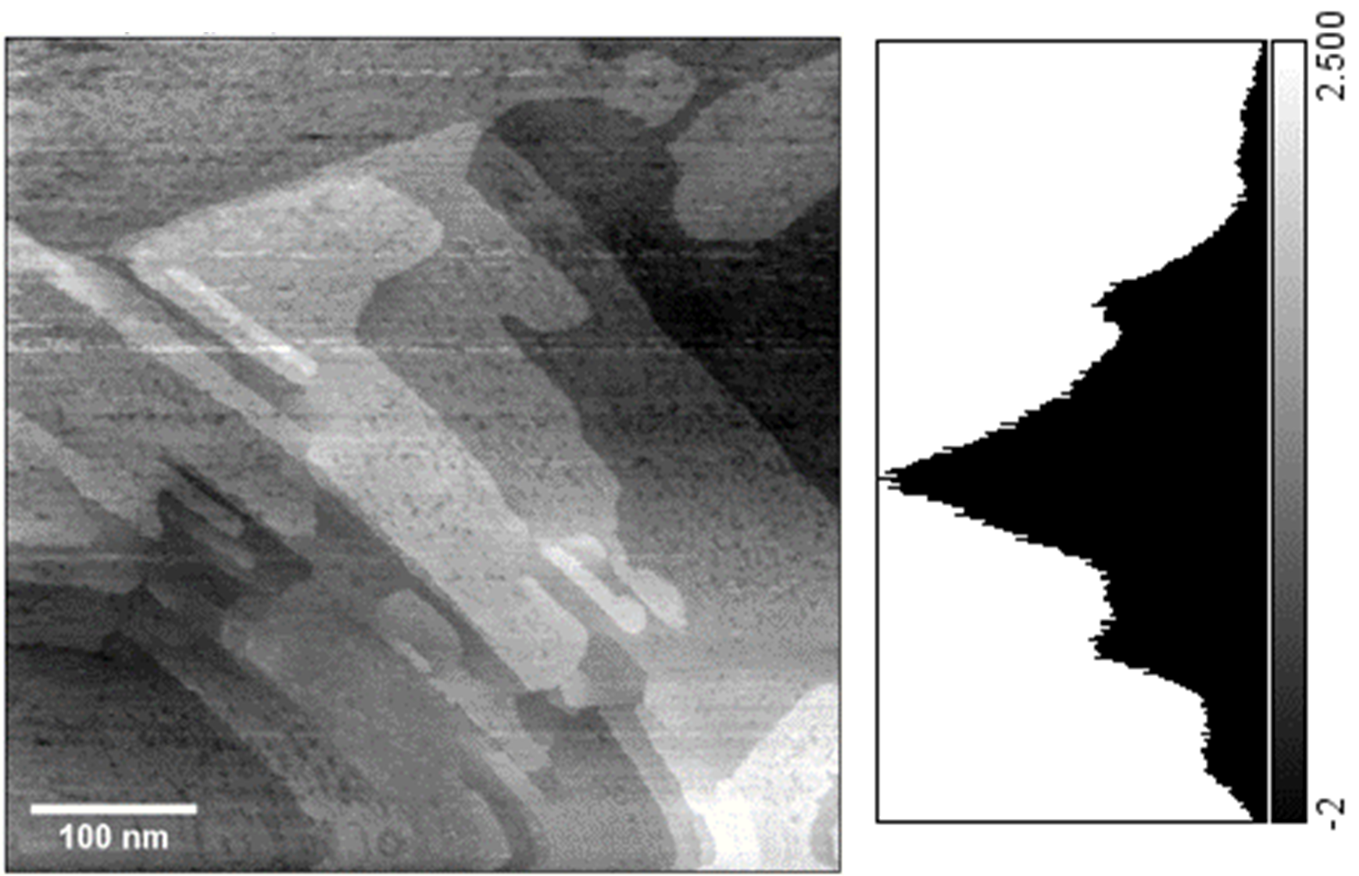
An alternate stoichiometry: Cs₁Sb₁
While Cs₁Sb₁ is not epitaxial with the 3C-SiC substrate, smooth, fiber textured films are readily grown in wide range of substrate temperatures and deposition rates.
Azimuthally independent streaks in RHEED
fiber-textured surface
Sample grown at:
Substrate temp: 160 C.
Thickness ~18 nm.
CsSb samples were grown with both MBE and PLD.
Scanning Tunneling Microscopy (STM)
- Surface roughness ~0.6 nm.
-Multimodal histogram indicates flat steps along surface.
STM results courtesy of Hines Lab at Cornell.
Image band pass filtered for contrast

Slide 29
An alternate stoichiometry: Cs₁Sb₁
A visible photocathode with threshold near 570 nm and percent level QE at 400 nm.
Notes:
Initially thought these were dead cathodes when measuring in green – realize different work function than what we are used to

Slide 30
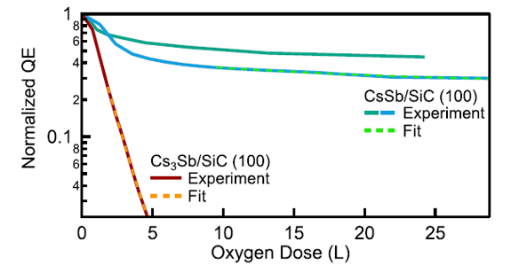
An alternate stoichiometry: Cs₁Sb₁
A visible photocathode with threshold near 570 nm and percent level QE at 400 nm.
Highly resistant to oxidation.
Survives over an order of magnitude times longer than Cs₃Sb at an $O_{2}$ partial pressure of 5$×$10⁻⁸ Torr.
Photoemission threshold lies between Cs₂Te and other alkali antimonides.
- C.T. Parzyck, C.A. Pennington et al, “Atomically smooth films of CsSb: a chemically robust visible light
photocathode” arXiv:2305.19553
Notes:
Response between Cs2Te and alkali antimonides. Interesting from MS perspective – also for PC application. Mention lifetime – why we should be impressed

Slide 31
Outline
Motivation for the epitaxial growth of Cs₃Sb.
Growth of ordered photocathodes using pulsed laser deposition (PLD) and in-operando x-ray characterization.
Measuring quantum efficiency with optical interference in the photocathode-substrate system.
Cs₁Sb₁: a highly oxygen resistant visible photocathode.
Summary and Conclusions.

Slide 32
Summary and Conclusions
Flat, ordered, Cs₃Sb films with high quantum efficiency can be readily grown on commercially available, single crystal substrates (3C-SiC).
Engineering quantum efficiency by exploiting optical interference effects in the cathode-substrate multilayer.
Cs₁Sb₁ is a flat, oxygen-resistant photocathode with photoemission response at key laser wavelengths of 400 nm and 570 nm.
Future Directions:
Investigate the relationship between epitaxy and intrinsic emittance.
Explore epitaxial growth with bi-alkali antimonides (NaK₂Sb, K₂CsSb, etc.).
Epitaxy opens the door to engineering photocathodes at the level of atomic layers to enhance brightness.

Slide 33
Thank you for listening!
Thanks to all the collaborators!
Any questions?

Slide 34
Bonus Slides

Slide 35
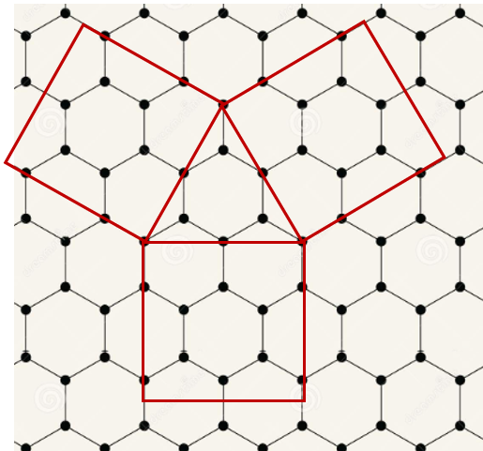
Epitaxial K₂CsSb on new substrate
Growth conditions
Substrate temp: 85-90 C.
Sb deposition by PLD.
New substrate.
Ternary evaporation of K, Cs, Sb.
RHEED e-beam
0 Rotation angle (deg) 17
K₂CsSb lattice constant: ~8.61 Angs
K₂CsSb grows with epitaxial domains on new substrate.

Slide 36
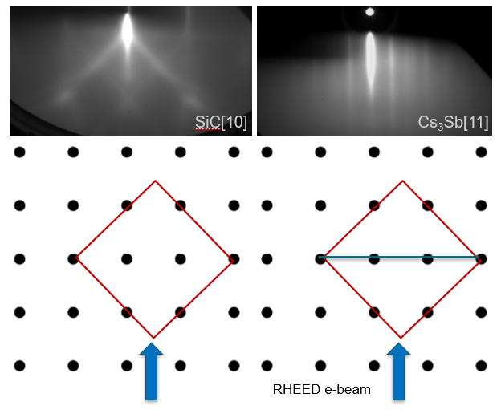
Representative Cs₃Sb on 3C-SiC(100) grown with PLD. Substrate temperature held at 90 degrees.

