Slide 1

Demonstration of Thermal Limit to Mean Transverse Energy from Cesium Antimonide Photocathode
Alimohammed Kachwala
Arizona State University

Slide 2
Outline
Introduction
High QE Cs₃Sb Photocathode
Measurements Using Photoemission Electron Microscope
Photoemission Electron Energy Spectra (PEES)
Mean Transverse Energy (MTE)
Quantum Efficiency (QE)
Conclusion
Future Work

Slide 3
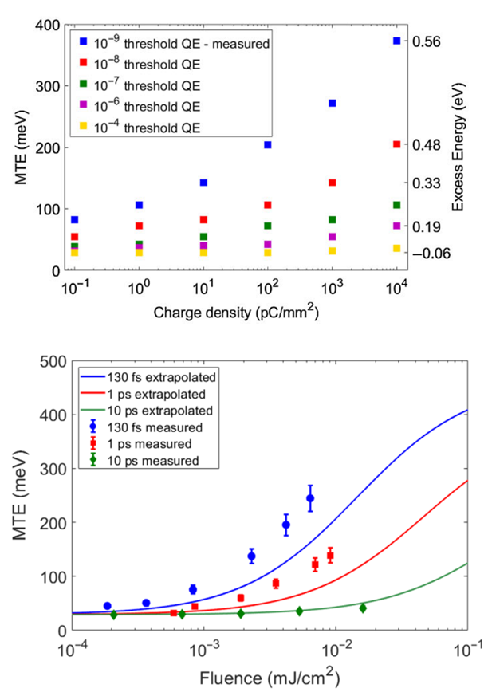
Introduction
Metal Photocathodes
ℏω > Φ_{effective}
Fast Response Time
(<1 ps)
ℏω ~ Φ_{effective}
Vacuum Level
Energy
Long Operational Lifetime
Φ_{effective}
E_{f}
Low Emittance/MTE
Non Linear Photoemission
Cu
Need High QE cathodes to beat Non-Linear Photoemission
Position
LOW QE
At Threshold, MTE ~ k_{b}T, ~25 meV at 300 K
Physical Review Accelerators and Beams 26.9 (2023): 093401
Physical review letters 125.5 (2020): 054801

Slide 4
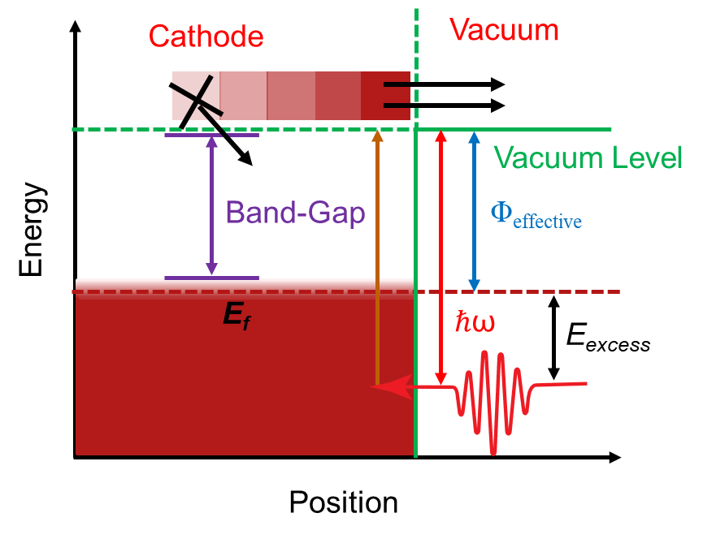
High QE Photocathodes
Low Electron Affinity Semiconductors
Alkali Antimonide Photocathodes
K₂CsSb
Na₂KSb
Cs₃Sb

Slide 5
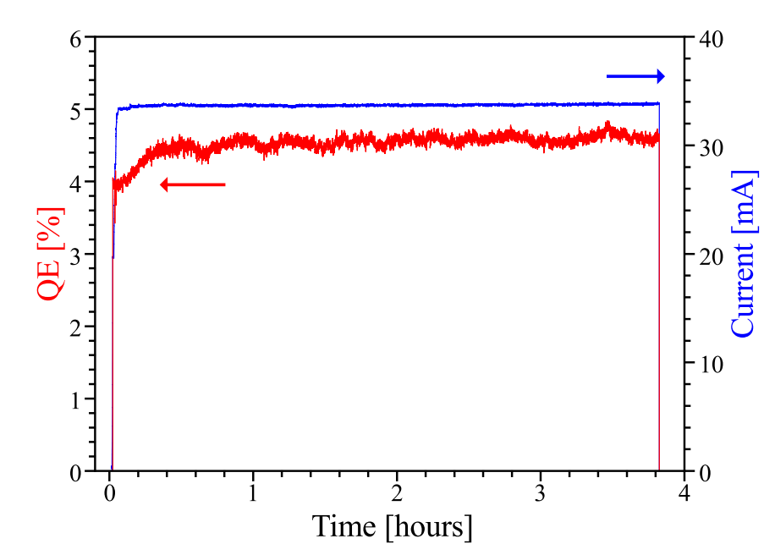
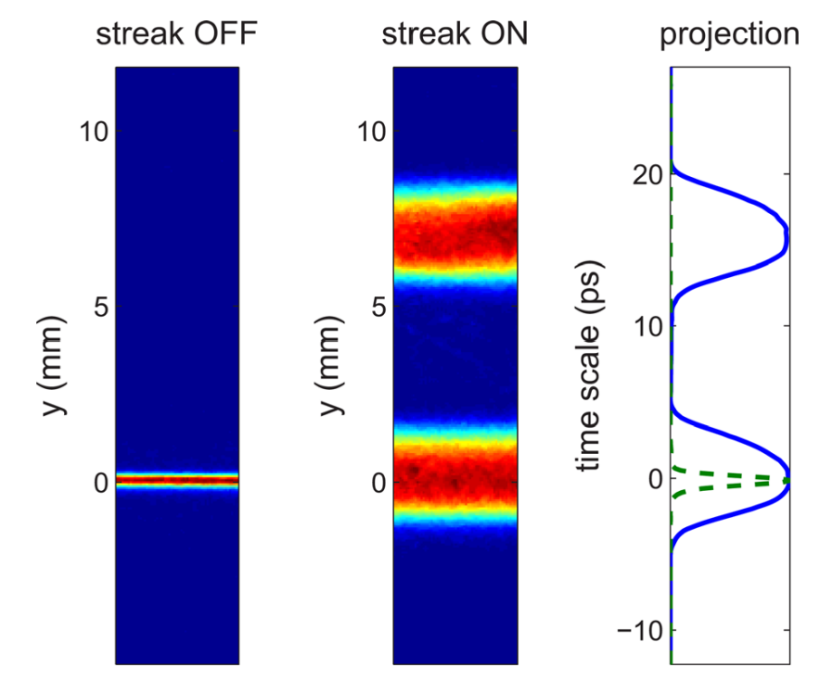
Cs₃Sb for High Brightness Applications
Operational
Lifetime
Response Time
Sub pico-second response time with λ = 520 nm
Applied Physics Letters 102.3 (2013).
Applied Physics Letters 99.15 (2011).

Slide 6
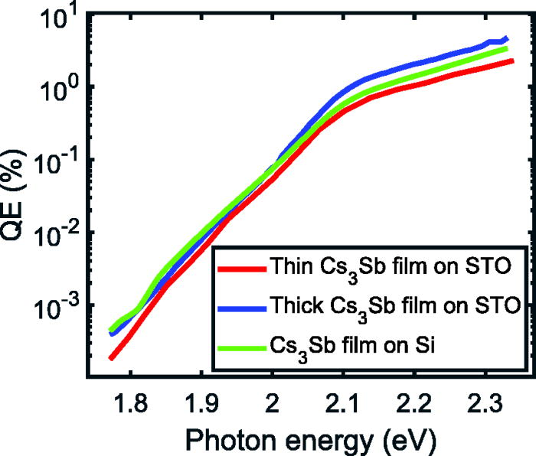
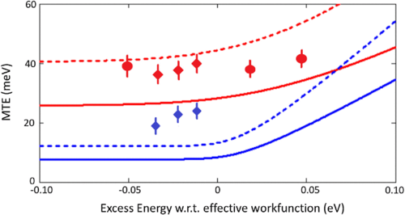
Cs₃Sb for High Brightness Applications
High QE
Low MTE
MTE of ~40 meV (> 25 meV at 300 K)
Physical Surface Roughness
Work Function Variation (“Chemical Roughness”)
Knee at
ℏω = 2.1 eV
At λ=690 nm, QE=0.7E-4
40 meV at 300K
(Expected 25 meV)
22 meV at 90K
(Expected 8 meV)
Orders of Magitude Higher than Metal Photocathode
Applied Physics Letters 120.19 (2022): 194102.
Physical Review Special Topics-Accelerators and Beams 18.11 (2015): 113401.

Slide 7
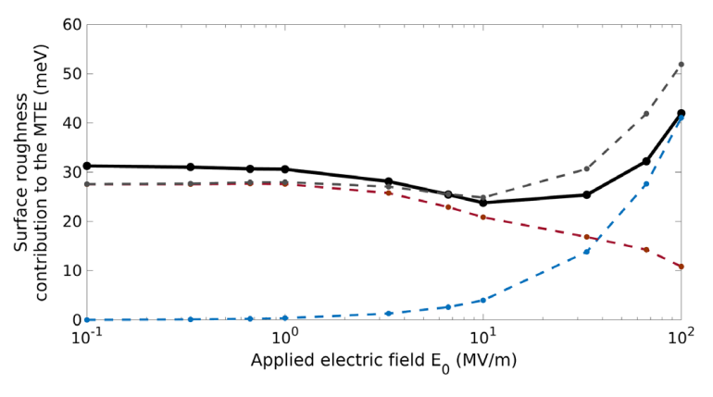
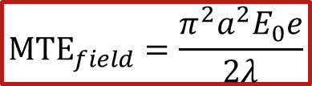




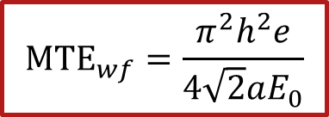

MTE: Photocathode Roughness
Surface Morphology
(Physical + chemical) roughness
Physical Roughness
Chemical Roughness
$$MTE_{wf}=\frac{π^{2}h^{2}e}{4\sqrt{2}aE_{0}}$$
$$a$$
Phys. Rev Applied, 4, 024015 (2015).
$$λ$$
${MTE}_{wf}$
$${MTE}_{field}=\frac{π^{2}a^{2}E_{0}e}{2λ}$$
$$E_{0}$$
J. Appl. Phys. 121, 044904 (2017).
${MTE}_{field}$
$$E_{0}=Applied Electric Field$$
$$E_{0}$$
Phys. Rev. ST- Accel and Beams, 21, 093401 (2018)

Slide 8
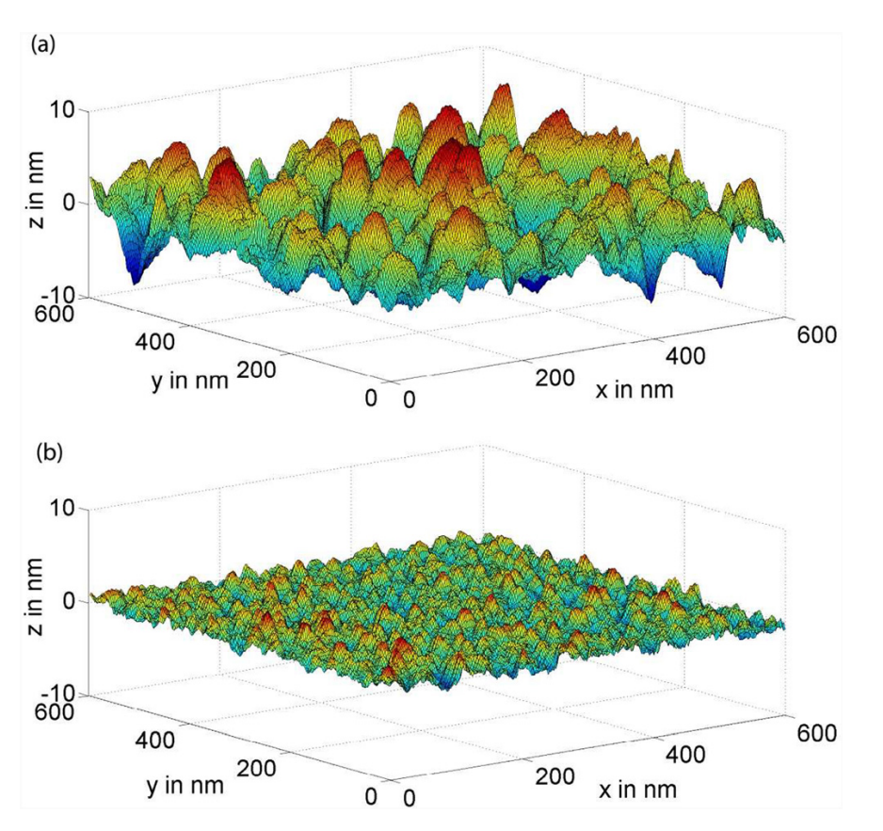
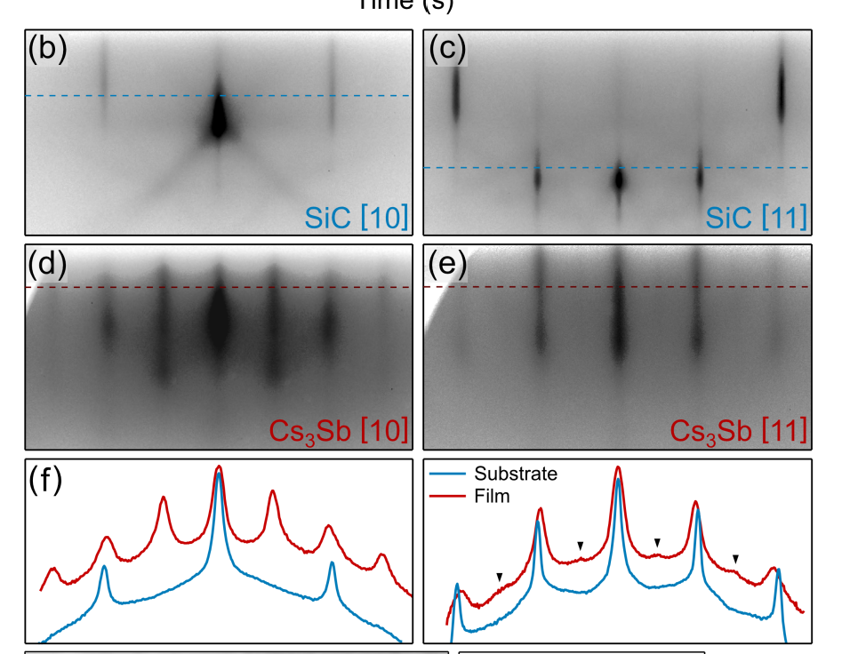
Cs₃Sb: Efforts to Grow Smooth Films
Epitaxial Growth
Sequential Deposition
Co-Deposition
Sequential: RMS surface roughness = 2.5 nm
Average spacing b/w peaks = 100 nm.
Co-Deposition: RMS surface roughness = 0.6 nm
Average spacing b/w peaks = 40 nm
Journal of Applied Physics 121.4 (2017).
Physical Review Letters 128.11 (2022): 114801.

Slide 9
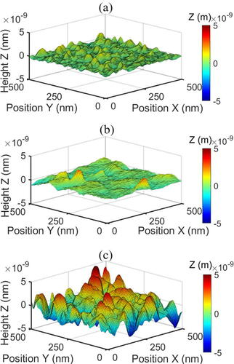
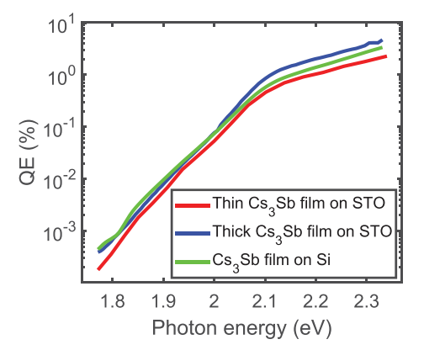
Cs₃Sb: Efforts to Grow Smooth Films
Co-Deposition on Lattice Matched Substrate
Thin (6.3 nm): STO
Thick (40 nm): STO
40 nm thick on Si
Thin STO: RMS surface roughness = 0.3 nm
Average spacing b/w peaks = 60 nm.
Thick STO: RMS surface roughness = 0.6 nm
Average spacing b/w peaks = 100 nm.
On Si: RMS surface roughness = 1.4 nm
Average spacing b/w peaks = 100 nm.
Observe Knee at
ℏω = 2.1 eV (λ = 620 nm)
Applied Physics Letters 120.19 (2022): 194102.

Slide 10
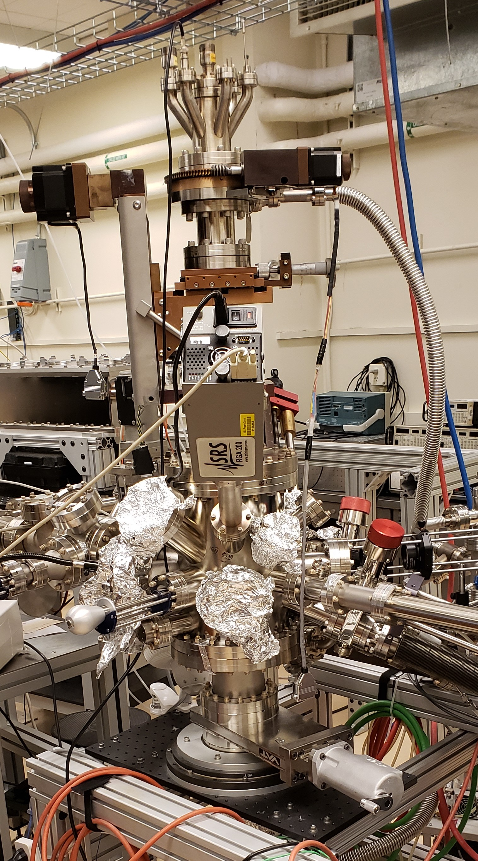
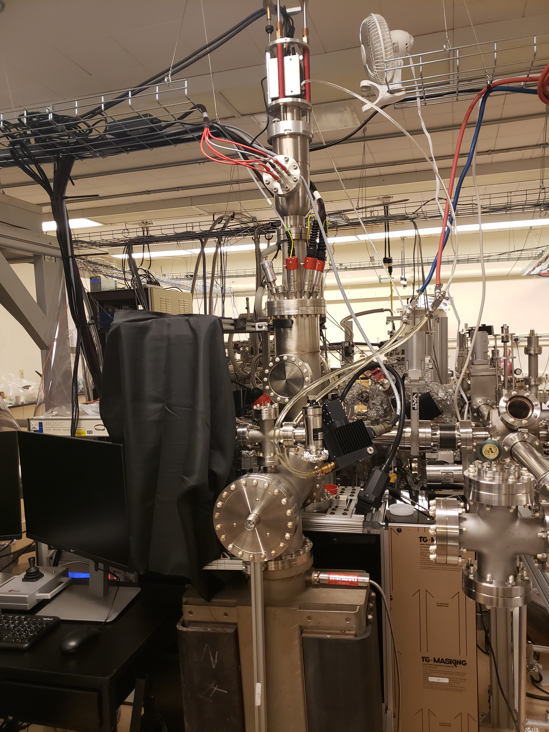
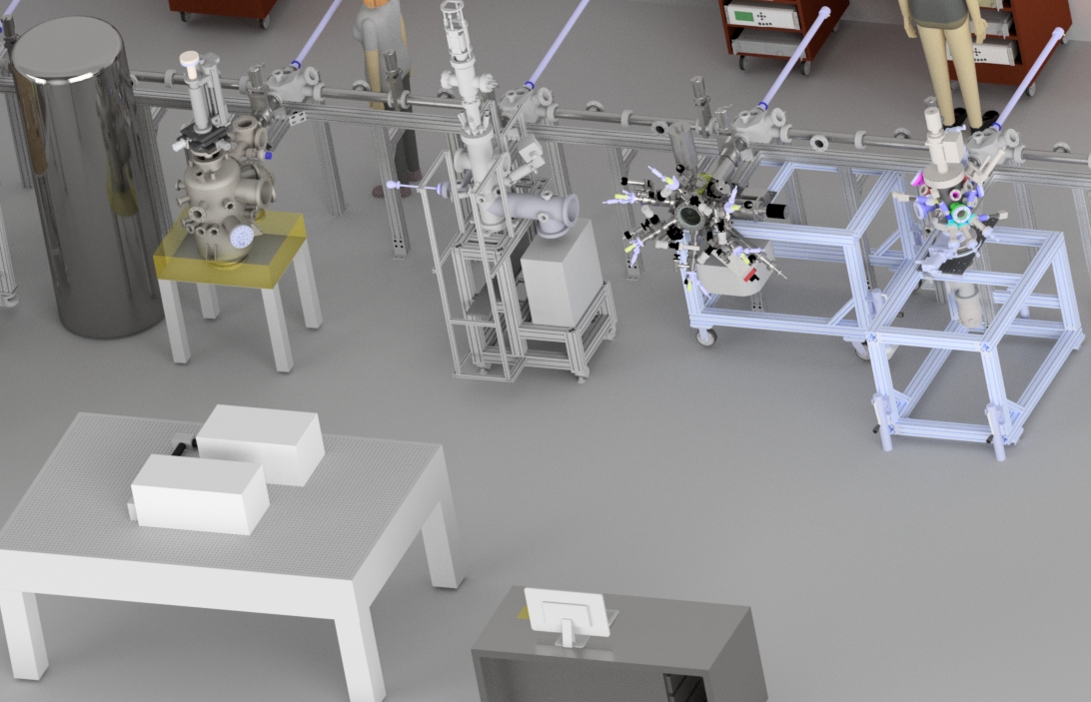
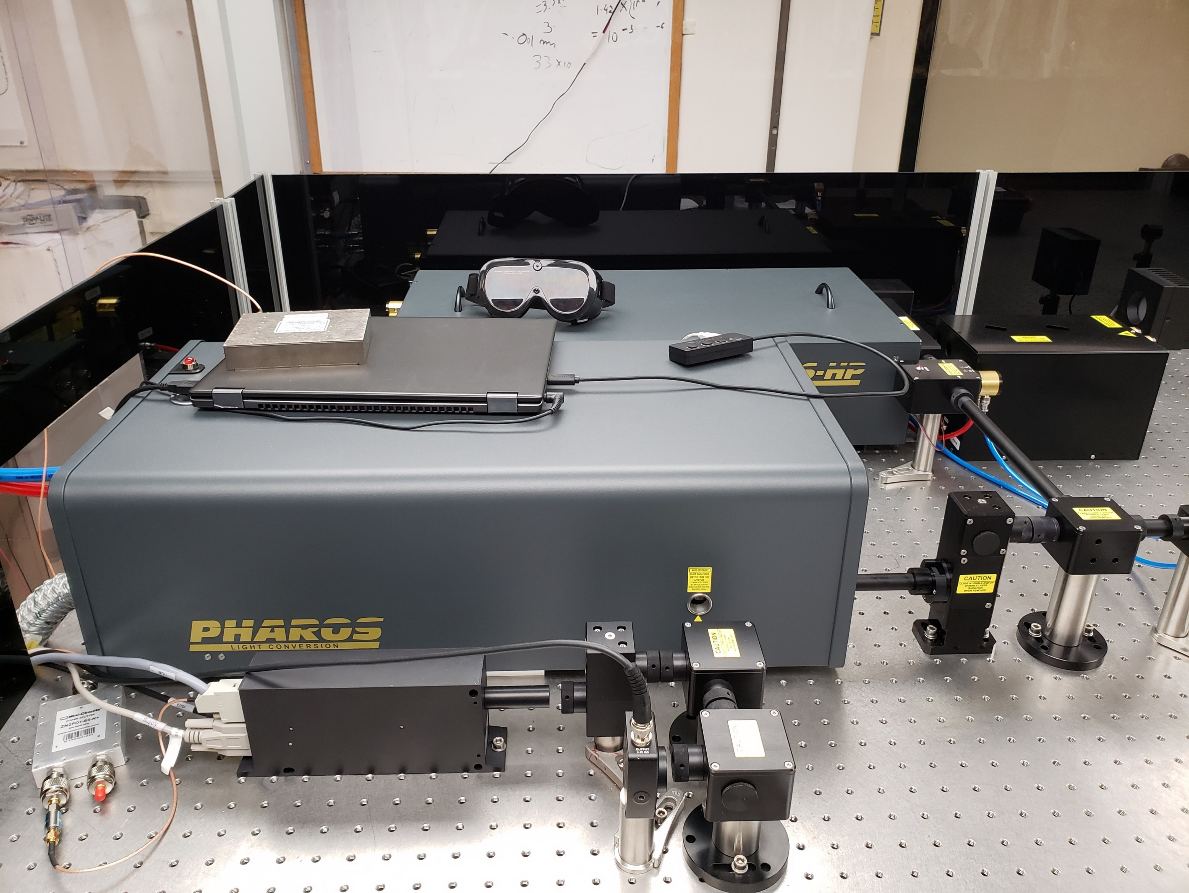
Experiment
Growth
Thickness: ~40 nm
Substrates: Si and Nb doped STO
Measurements
ℏω: 1.45 – 2.33 eV
Repetition rate: 500 kHz
Pulse length: 150 fs
PEEM
Growth Chamber
QE
3% - 4%
λ = 530 nm
Transfer
Via UHV transfer line in PEEM
Measured: PEES, MTE & QE
OPA Laser

Slide 11
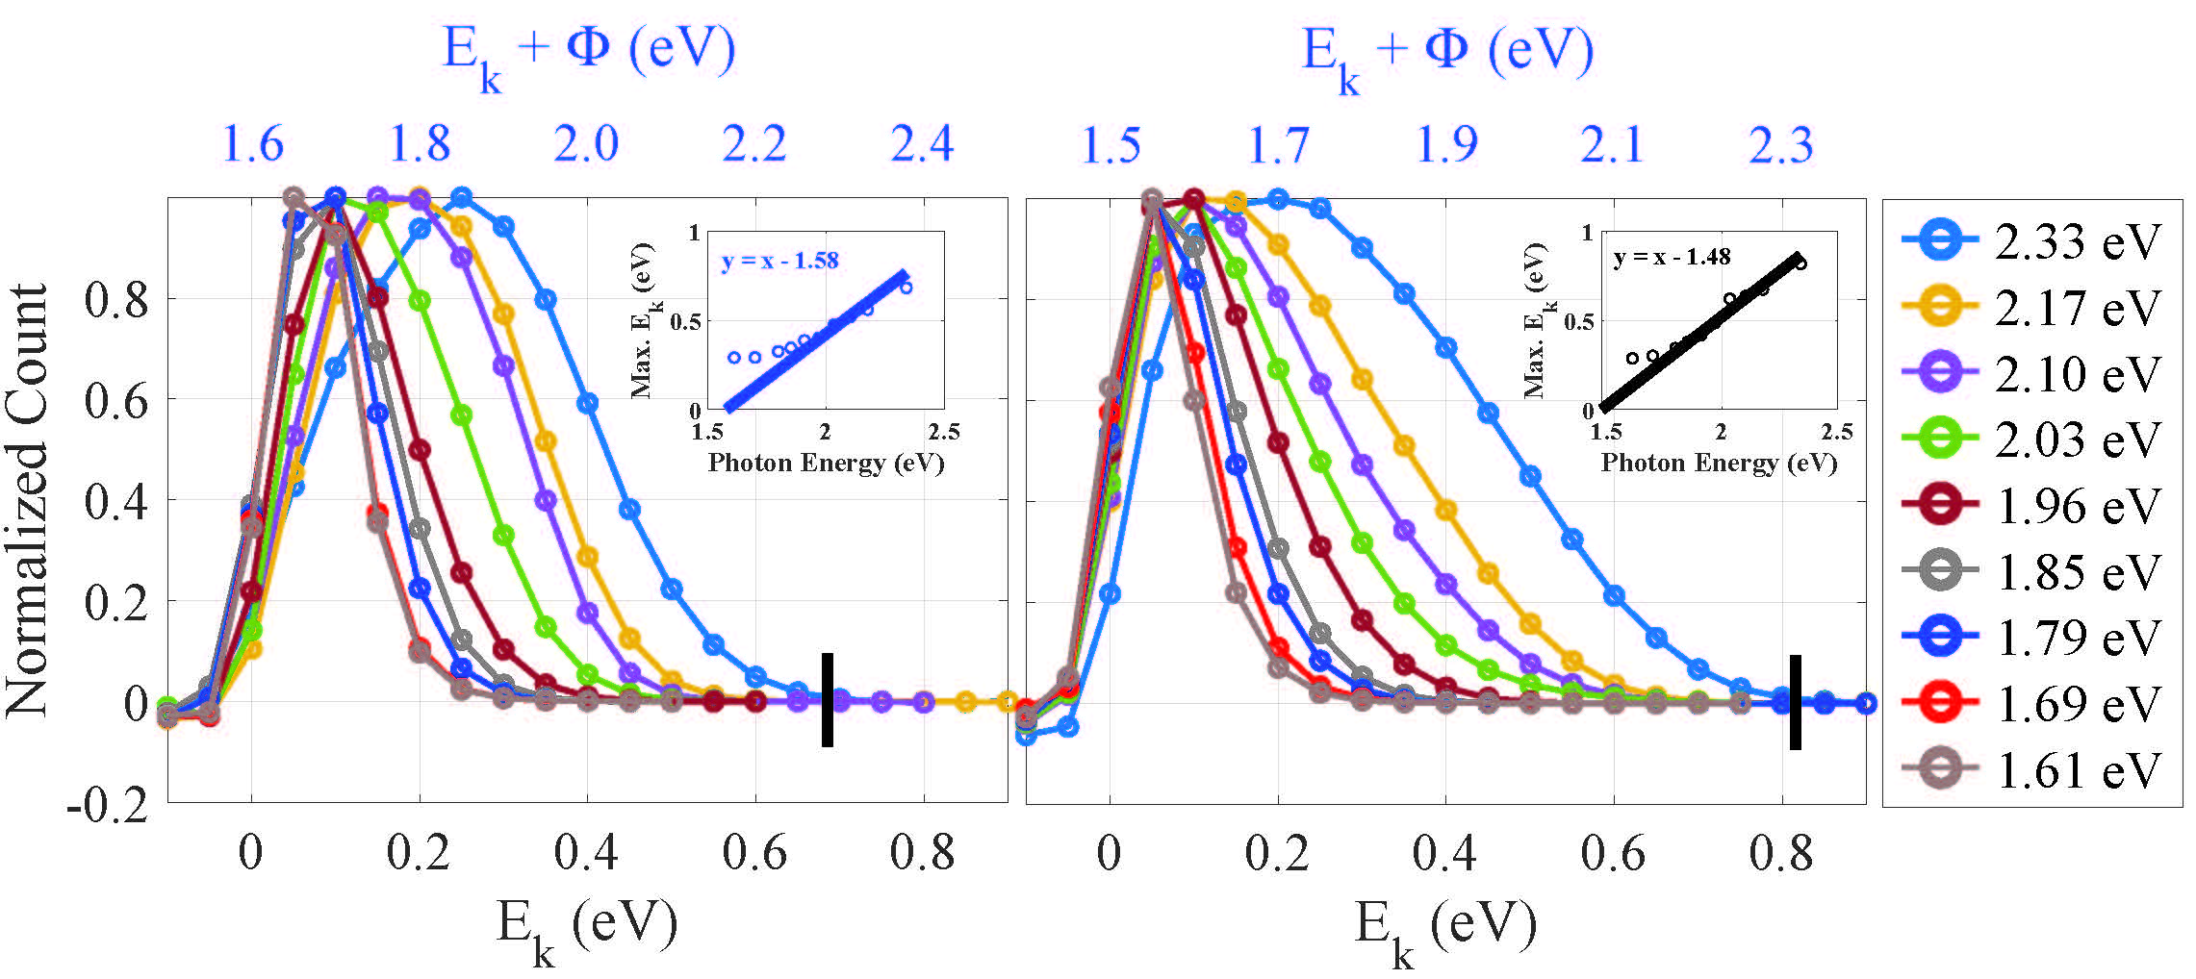
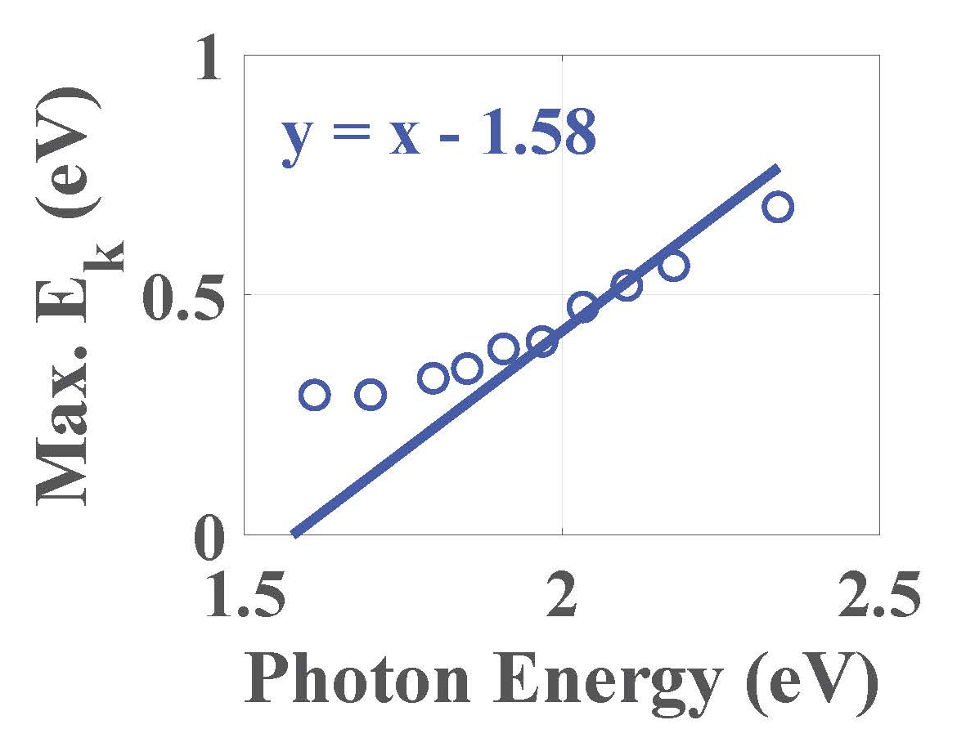
Photoemission Electron Energy Spectra
Substrate: Doped Si
Maximum E_{k} = 1% of the maxima of the energy distribution curve
Φ
~0.75 eV

Slide 12
Photoemission Electron Energy Spectra
Φ = 1.6 eV
Electron Scattering during transport
Φ = 4.4 eV
NO Electron Scattering during transport
Doped Si
Metal Cathode
Platinum

Slide 13
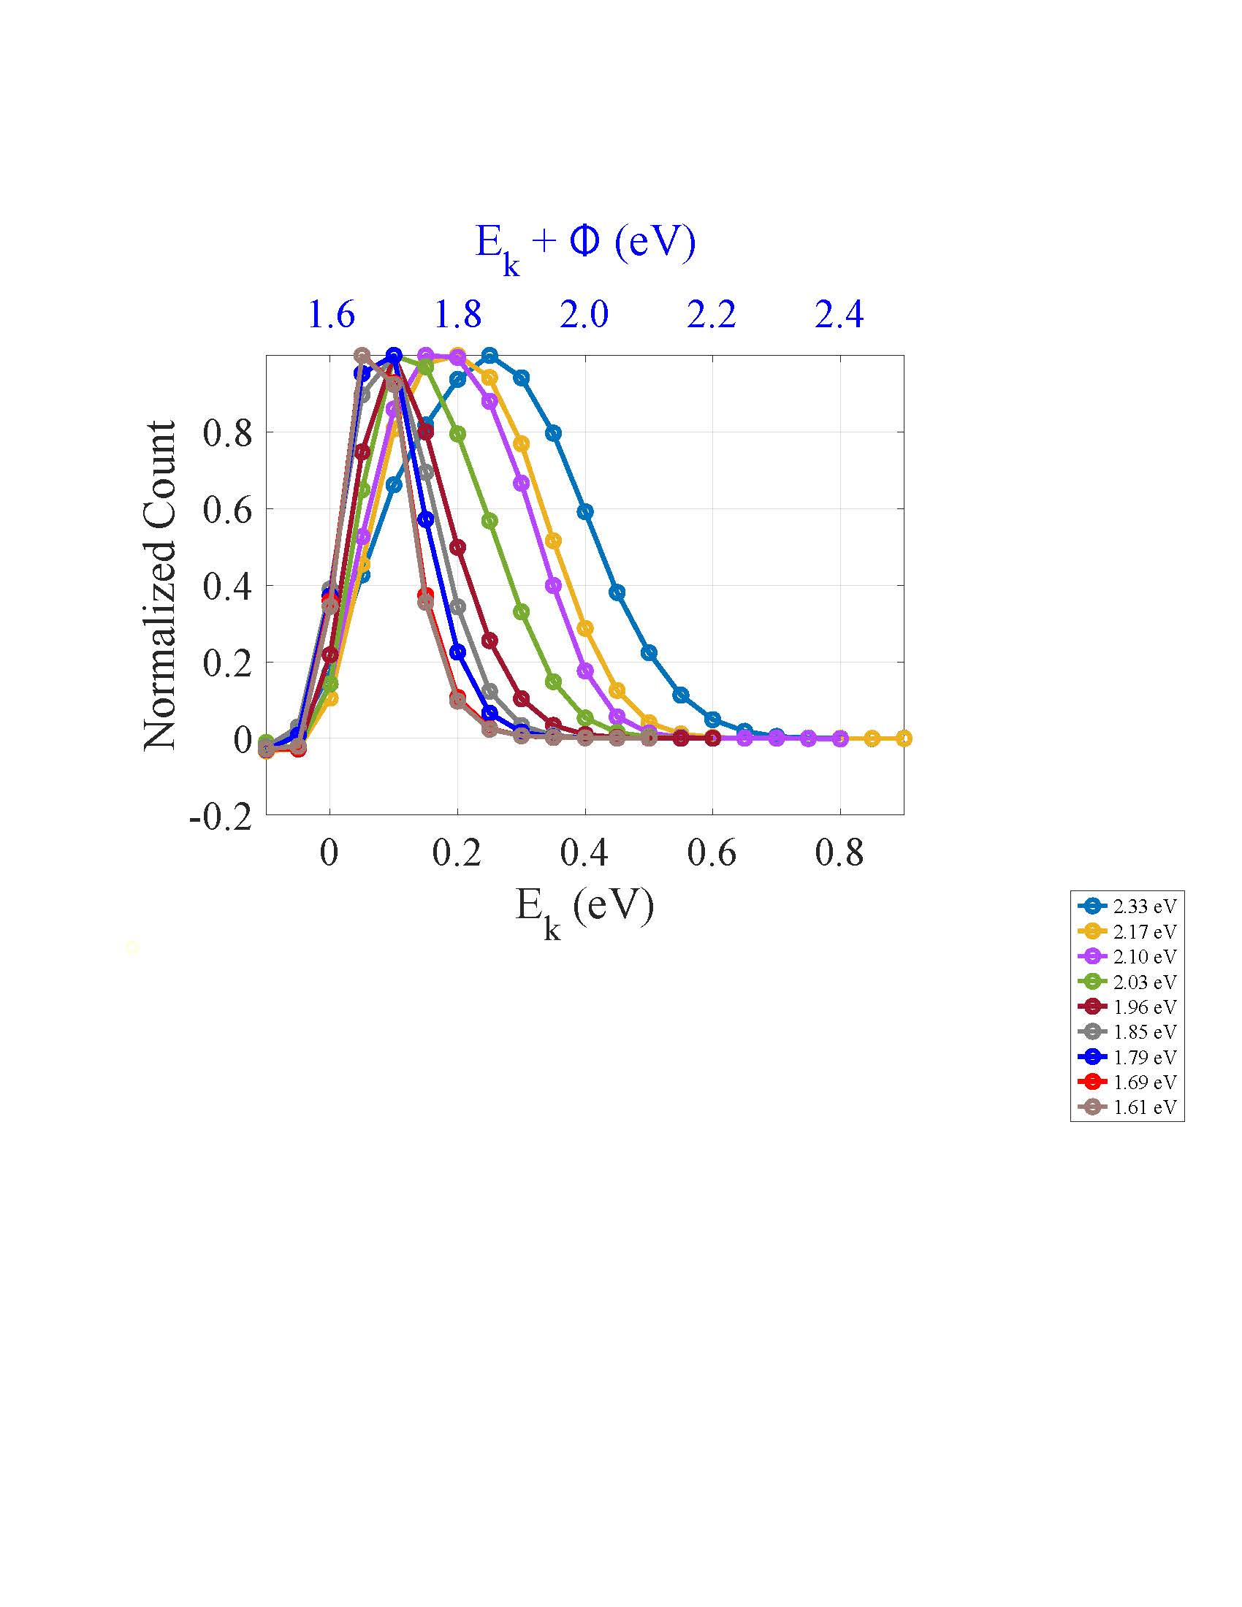
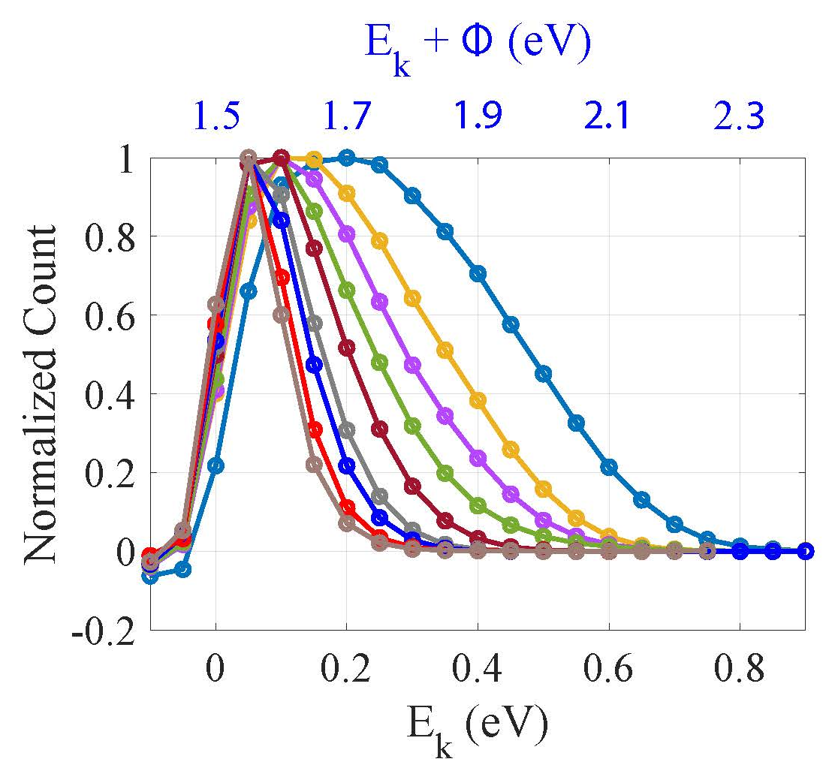
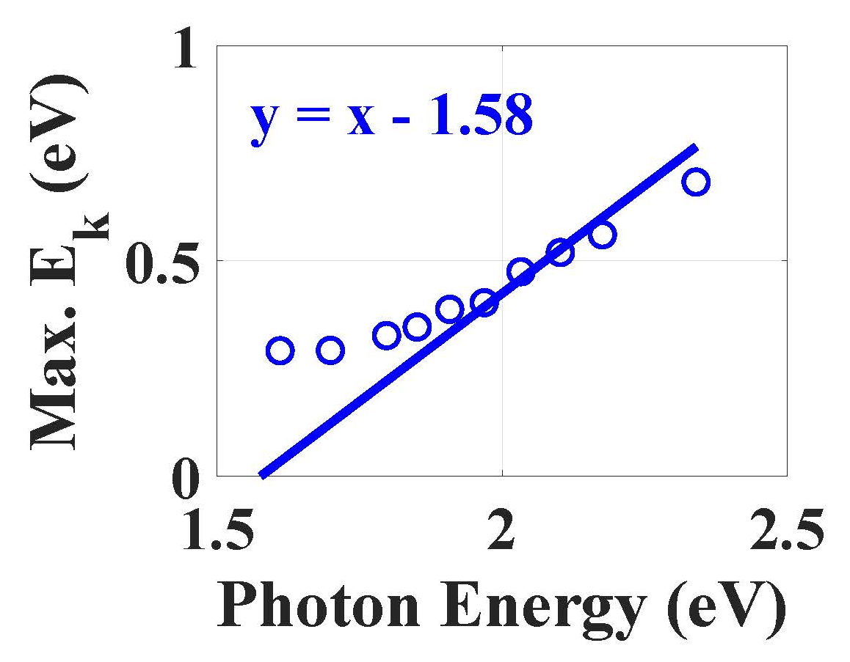
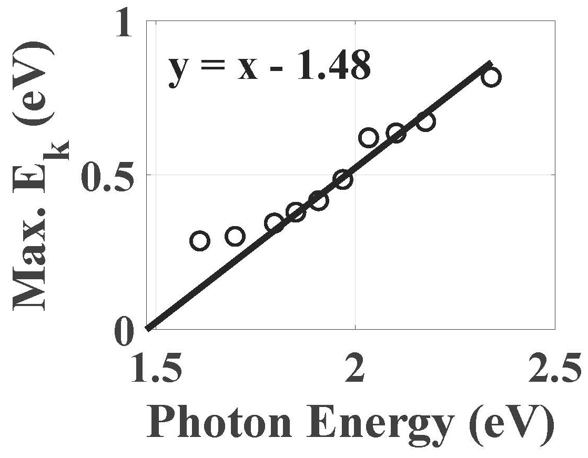
Photoemission Electron Energy Spectra
Substrate: Doped Si
Substrate: Nb Doped STO

Slide 14
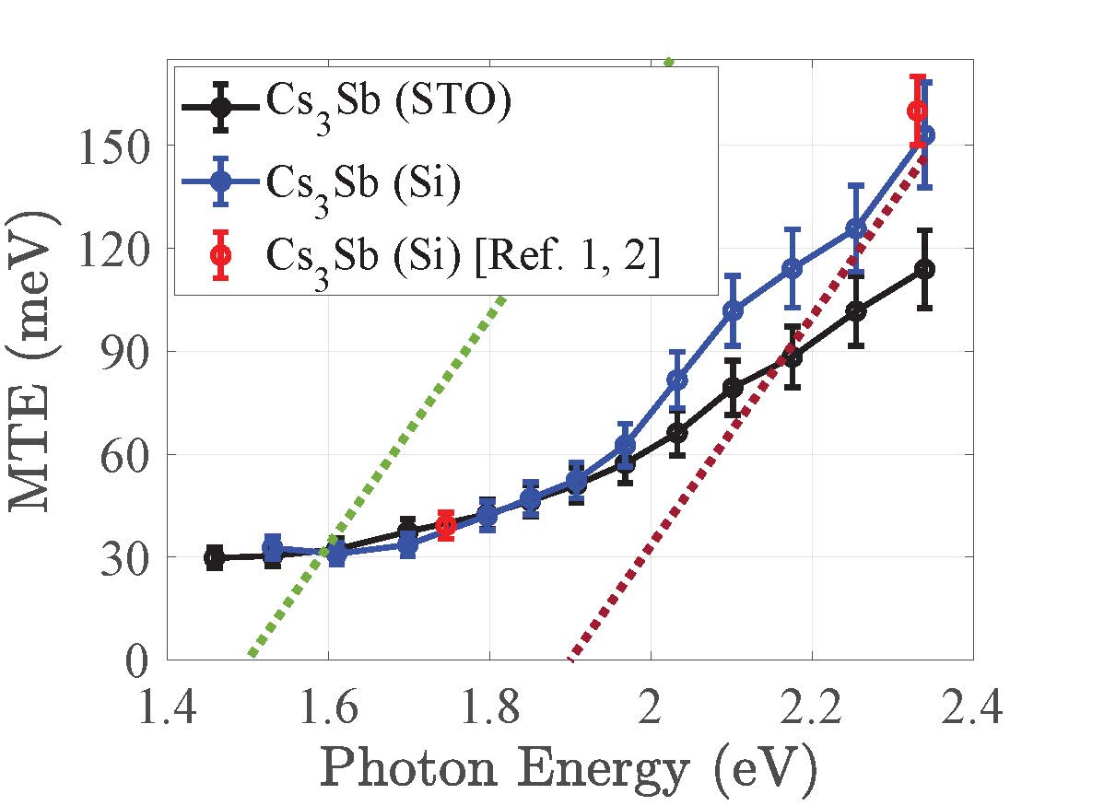
Mean Transverse Energy
At ℏω = 1.5 eV, MTE = 30 meV (~25 meV at 300 K)
At ℏω = 1.8 eV, MTE = 40 meV and at ℏω = 2.3 eV, MTE = 150 meV (comparable to previously reported values)
The dotted line is the plot for (excess energy)/3 considering Φ = 1.5 eV (green) and Φ = 1.9 eV (brown)
MTE doesn’t scale as 1/3rd of excess energy (Scattering before emission)
Physical Review Special Topics-Accelerators and Beams 18.11 (2015): 113401.
Applied Physics Letters 99.15 (2011).
GT

Slide 15
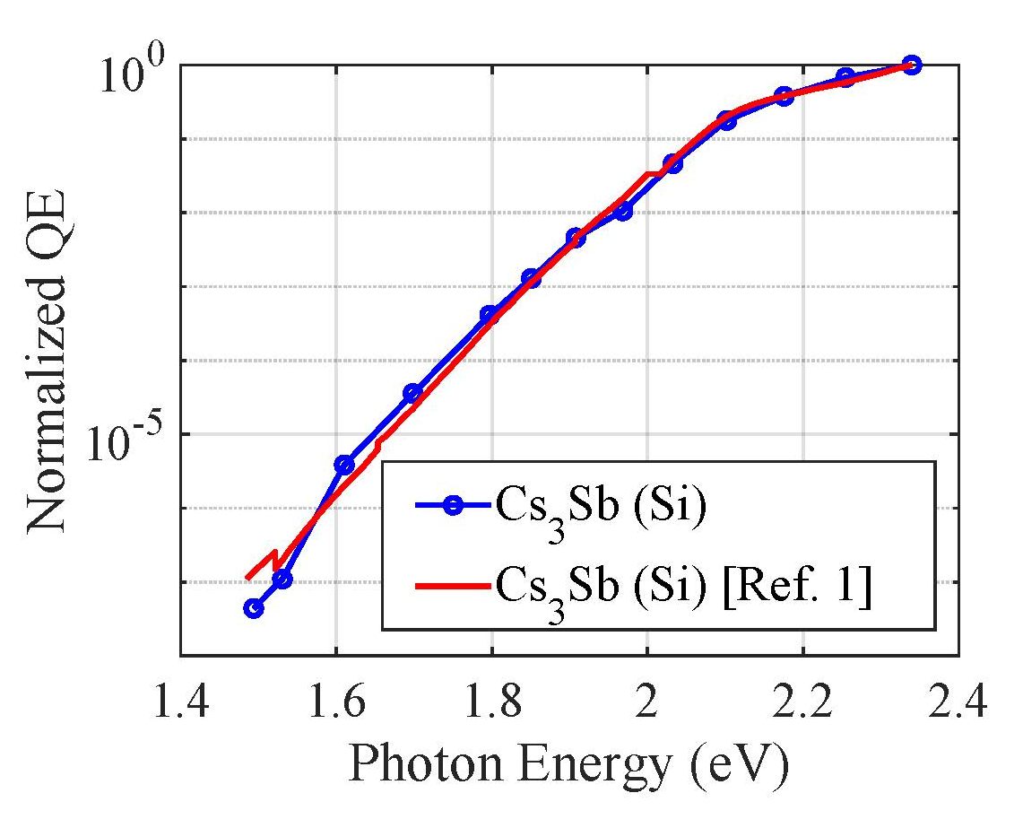
Quantum Efficiency
QE at ℏω =1.5 eV is 7 orders of magnitude lower when compared with that at ℏω = 2.3 eV
A knee-like feature is also observed in the QE spectral response at ℏω = 2.1 eV
Unstable D0₃ cubic structure
1) Applied Physics Letters 120.19 (2022): 194102.
Nangoi, J. K., et al. arXiv preprint arXiv:2205.14322 (2022)

Slide 16
Conclusion
Measured Photoemission electron energy spectra (PEES), MTE, and QE of Cs₃Sb photocathodes in the photon energy range of 1.45–2.33 eV
The PEES indicate that for Cs₃Sb cathodes is Φ = 1.5 ± 0.1 eV, significantly lower than the 2.1 eV value that was previously reported based on the QE spectral response
The value of MTE at this work function of 1.5 eV was observed to be ~30 meV—very close to the 25 meV (thermal limit) at 300 K within instrumental error
QE of the order of 10⁻⁷ at threshold (comparable to metal cathodes).
At ℏω = ~1.9 eV , QE of the order of 10⁻³ and MTE ~40 meV (better than metal cathodes)

Slide 17
Future Work
PEES and MTE measurements on epitaxial Cs₃Sb/CsSb photocathodes
Photoemission studies of other alkali antimonide photocathodes such as K₂CsSb and Na₂KSb
Growth and photoemission studies of epitaxial alkali antimonide photocathodes such as K₂CsSb and Na₂KSb
Study the performance of Cs₃Sb and other alkali antimonide photocathodes at cryogenic temperatures

Slide 18



Acknowledgement
Arizona State University
Pallavi Saha
Priyadarshini Bhattacharyya
Siddharth Karkare (PI)
Northern Illinois University
Oksana Chubenko
Euclid Beamlabs
Eric Montgomery

Slide 19
Thank You!
Questions? Comments?

Slide 20
Back Up Slides

Slide 21
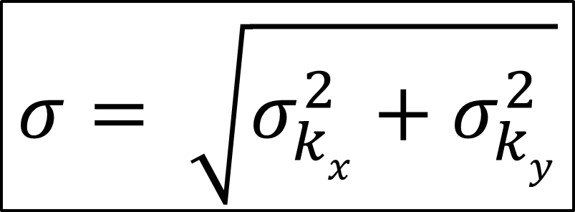
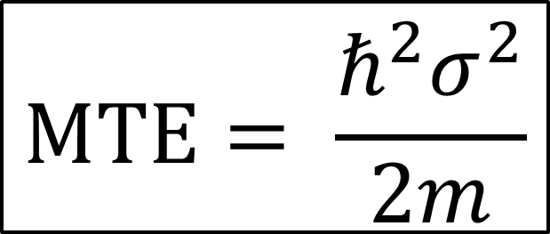
MTE Measurement
$$MTE= \frac{ℏ^{2}σ^{2}}{2m}$$
$$σ= \sqrt{σ_{kx}^{2}+σ_{ky}^{2}}$$
GB

Slide 22
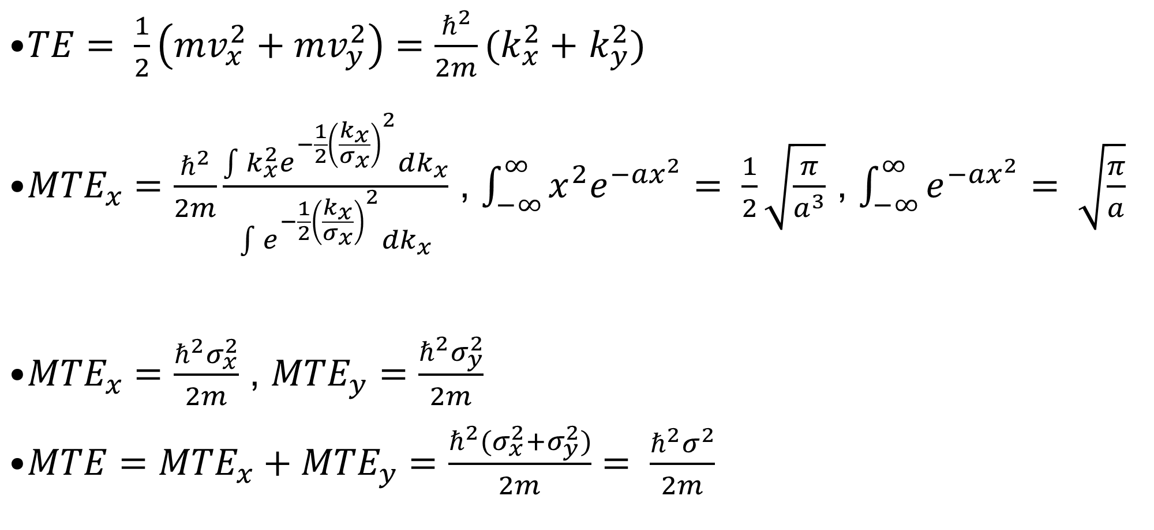
MTE
$TE= \frac{1}{2}\left(mv_{x}^{2}+mv_{y}^{2}\right)=\frac{ℏ^{2}}{2m}(k_{x}^{2}+$ $k_{y}^{2})$
${MTE}_{x}=\frac{ℏ^{2}}{2m}\frac{\int{k_{x}^{2}e^{−\frac{1}{2}{\left(\frac{k_{x}}{σ_{x}}\right)}^{2}}dk_{x}}}{\int{e^{−\frac{1}{2}{\left(\frac{k_{x}}{σ_{x}}\right)}^{2}}}dk_{x}}$ , $\int_{−∞}^{∞}{x^{2}e^{−ax^{2}}= \frac{1}{2}\sqrt{\frac{π}{a^{3}}}}$ , $\int_{−∞}^{∞}{e^{−ax^{2}}= \sqrt{\frac{π}{a}}}$
${MTE}_{x}=\frac{ℏ^{2}σ_{x}^{2}}{2m}$ , ${MTE}_{y}=\frac{ℏ^{2}σ_{y}^{2}}{2m}$
$MTE={MTE}_{x}+{MTE}_{y}=\frac{ℏ^{2}{(σ}_{x}^{2}+σ_{y}^{2})}{2m}= \frac{ℏ^{2}σ^{2}}{2m}$

Slide 23
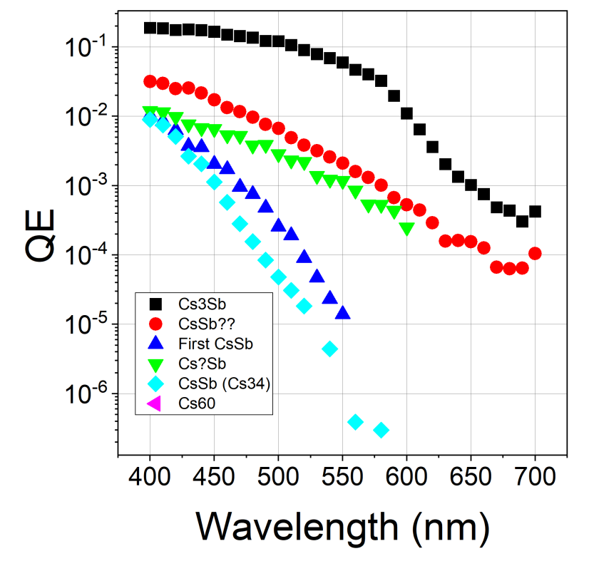
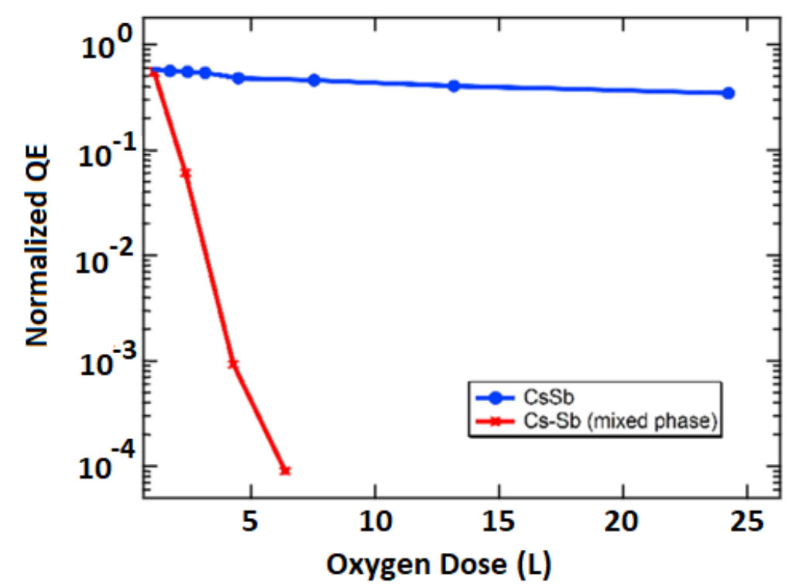
Cs₃Sb/CsSb
QE spectral response profile comparison between Cs₃Sb and CsSb photocathodes
Growth Procedure: Co-Deposition
Oxidation Response
Acknowledgement: Elena Echeverria, Cornell University

