Slide 1
Na-K-Sb photocathode development at Helmholtz-Zentrum Berlin
Dr. Julius Kühn
Department High Brightness Beams
J. Kühn | Photocathode Physics for Photoinjectors workshop, BNL / Stony Brook, NY, USA

Slide 2
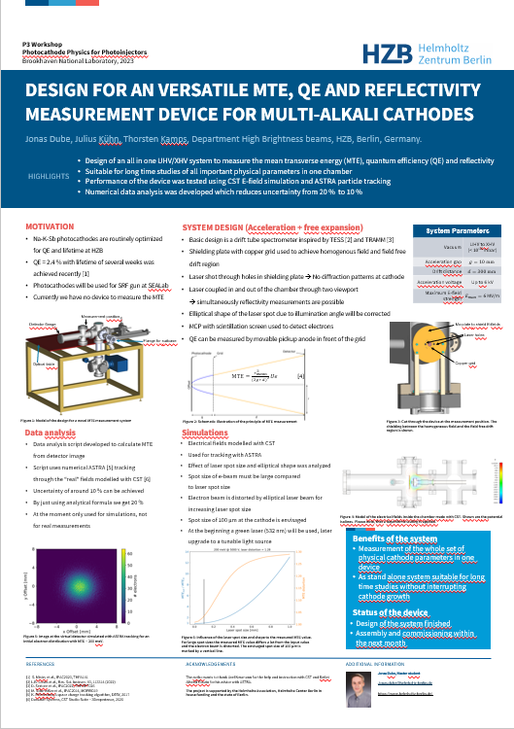
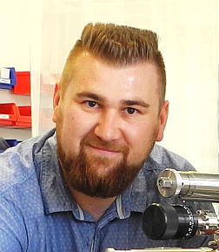
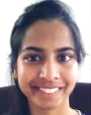
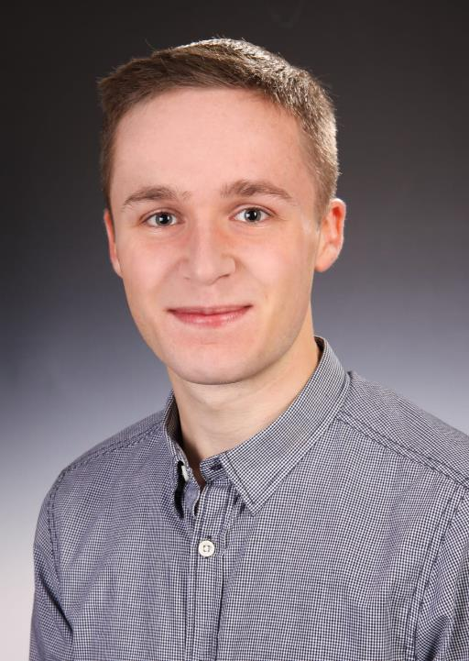
Working group & outline
Accelerator Division
Department high brightness beams
Group Leader: Prof. Kamps HU Berlin
Photocathode R&D
Drive Laser and Laser Beam Transport
Beam dynamics and instrumentation
Beam Applications
Prof. Dr. Thorsten Kamps
OUTLINE
SEAlab – SRF electron accelerator laboratory
Status photocathode lab
Recipe development for Na-K-Sb photocathodes
Lifetime investigations
Summary & Outlook
Dr. Julius Kühn
Dr. Sonal Mistry
Chen Wang
Jonas Dube

Slide 3
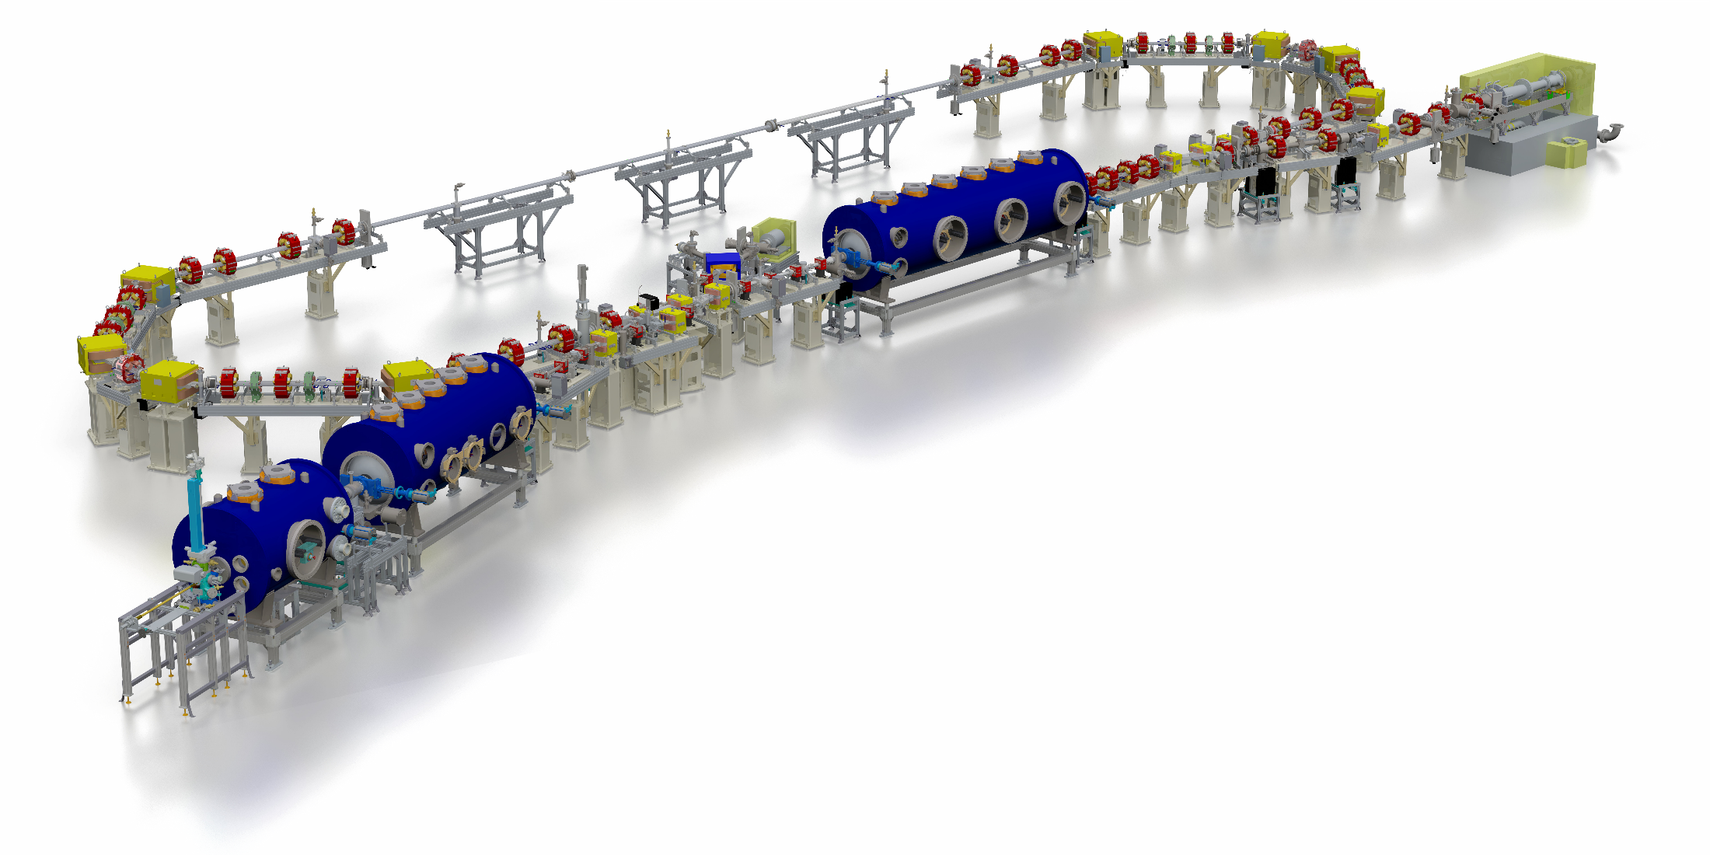
SEALab – sRF electron accelerator laboratory at hzb
berlin Energy Recovery Linac Prototype
transition into
SEAlab
Superconducting RF Electron Accelerator laboratory
(since 2021)
Sealab is an sustainable accelerator science and applications laboratory
CW operation with SRF photo-injector and SRF accelerating systems
broad range of beam parameters: Hz to GHz, fC to nC, fs to ps, up to 6.5 MeV (50 MeV with linac)
three main themes: R&D on CW SRF accelerating systems, Accelerator R&D research topics, pilot experiments (e.g. UED)
industrial collaboration hub (e.g. Research Instruments)
„1st meter“
SRF-photoinjector:
1.5 … 2.3 MeV
Photocathode
Transfersystem
Commissioning in
2023 in progress

Slide 4
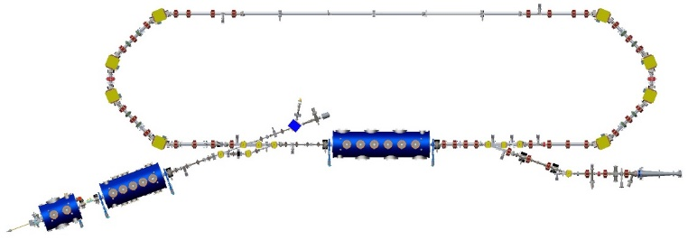
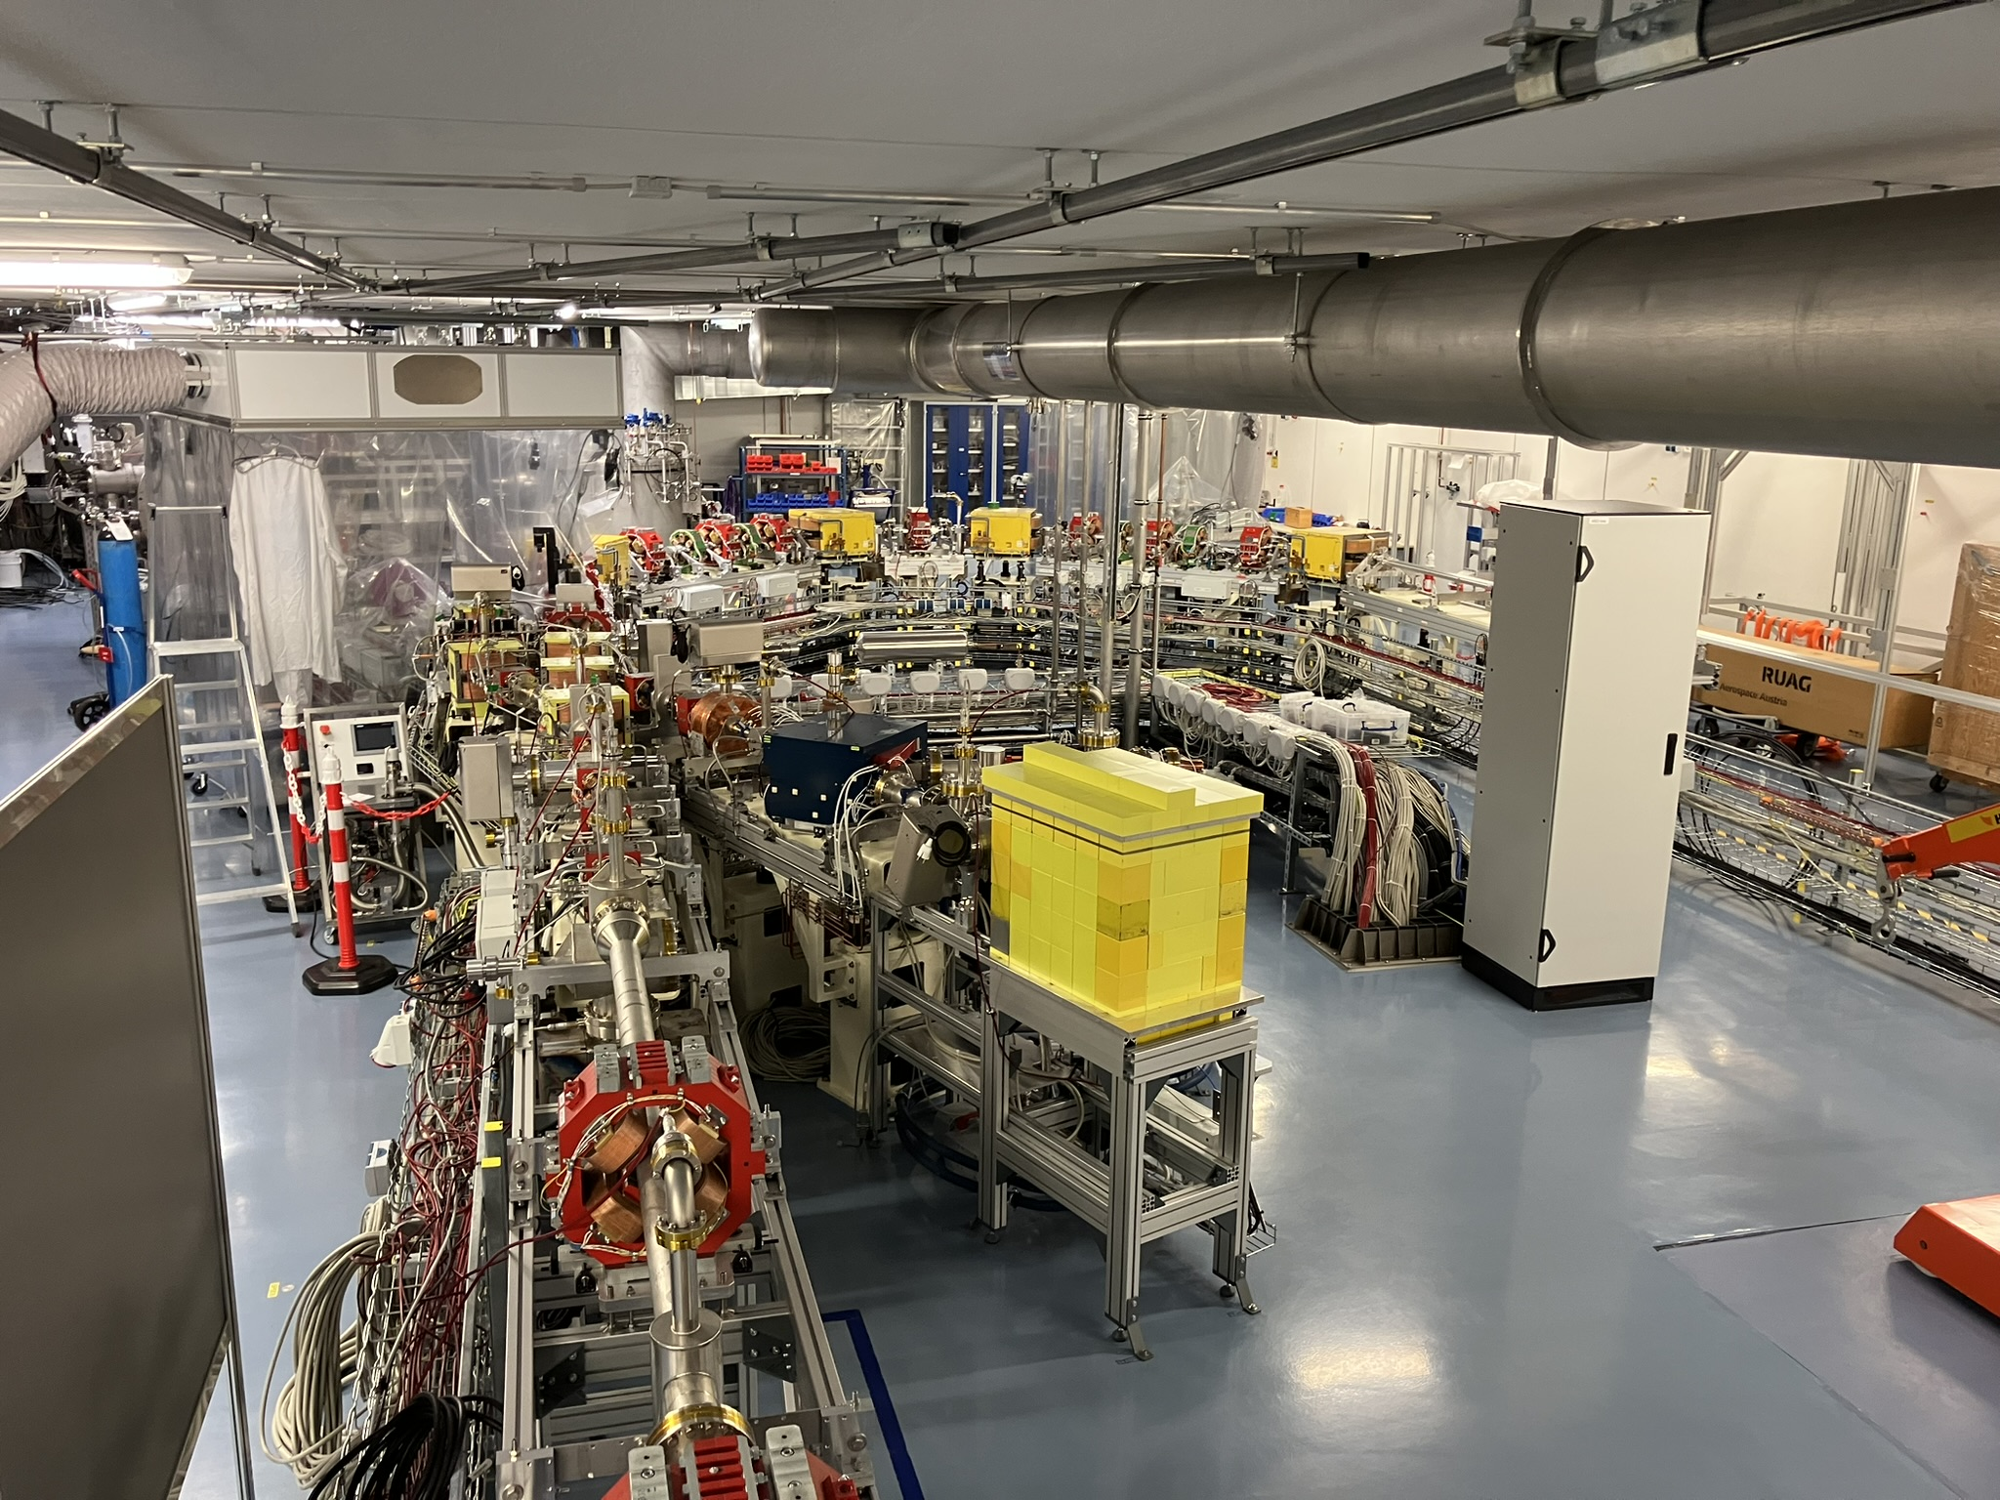
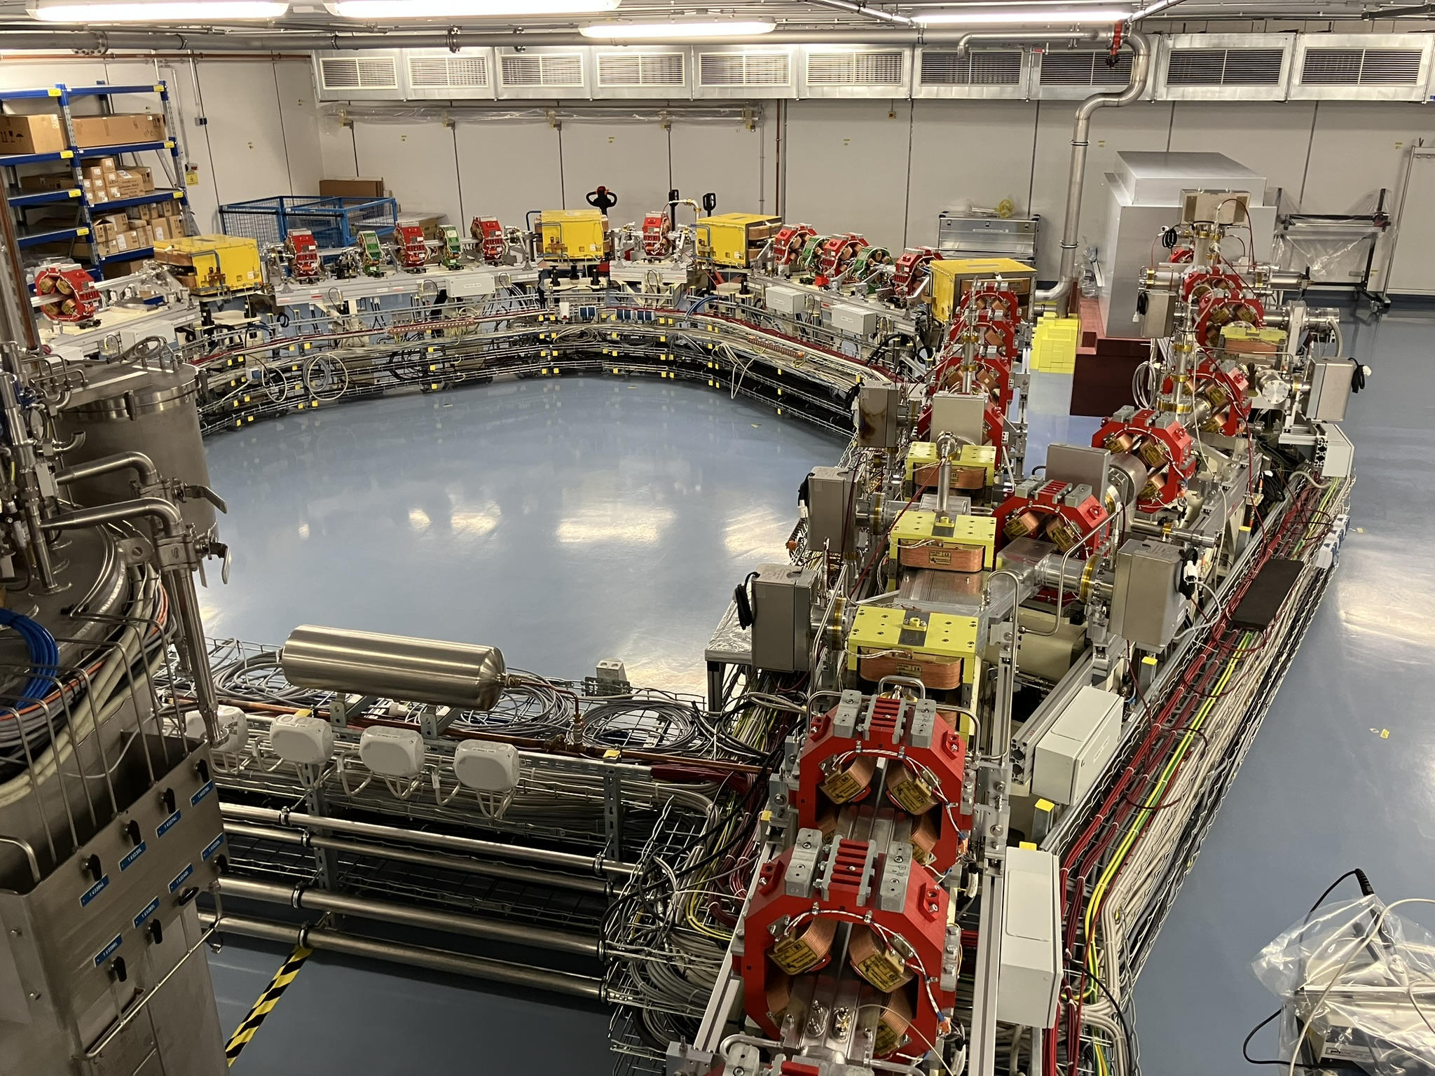
SEALab – sRF electron accelerator laboratory at hzb (september 2023)
SEALAB
(bERLinPro)
Superconducting RF Electron Accelerator Laboratory

Slide 5
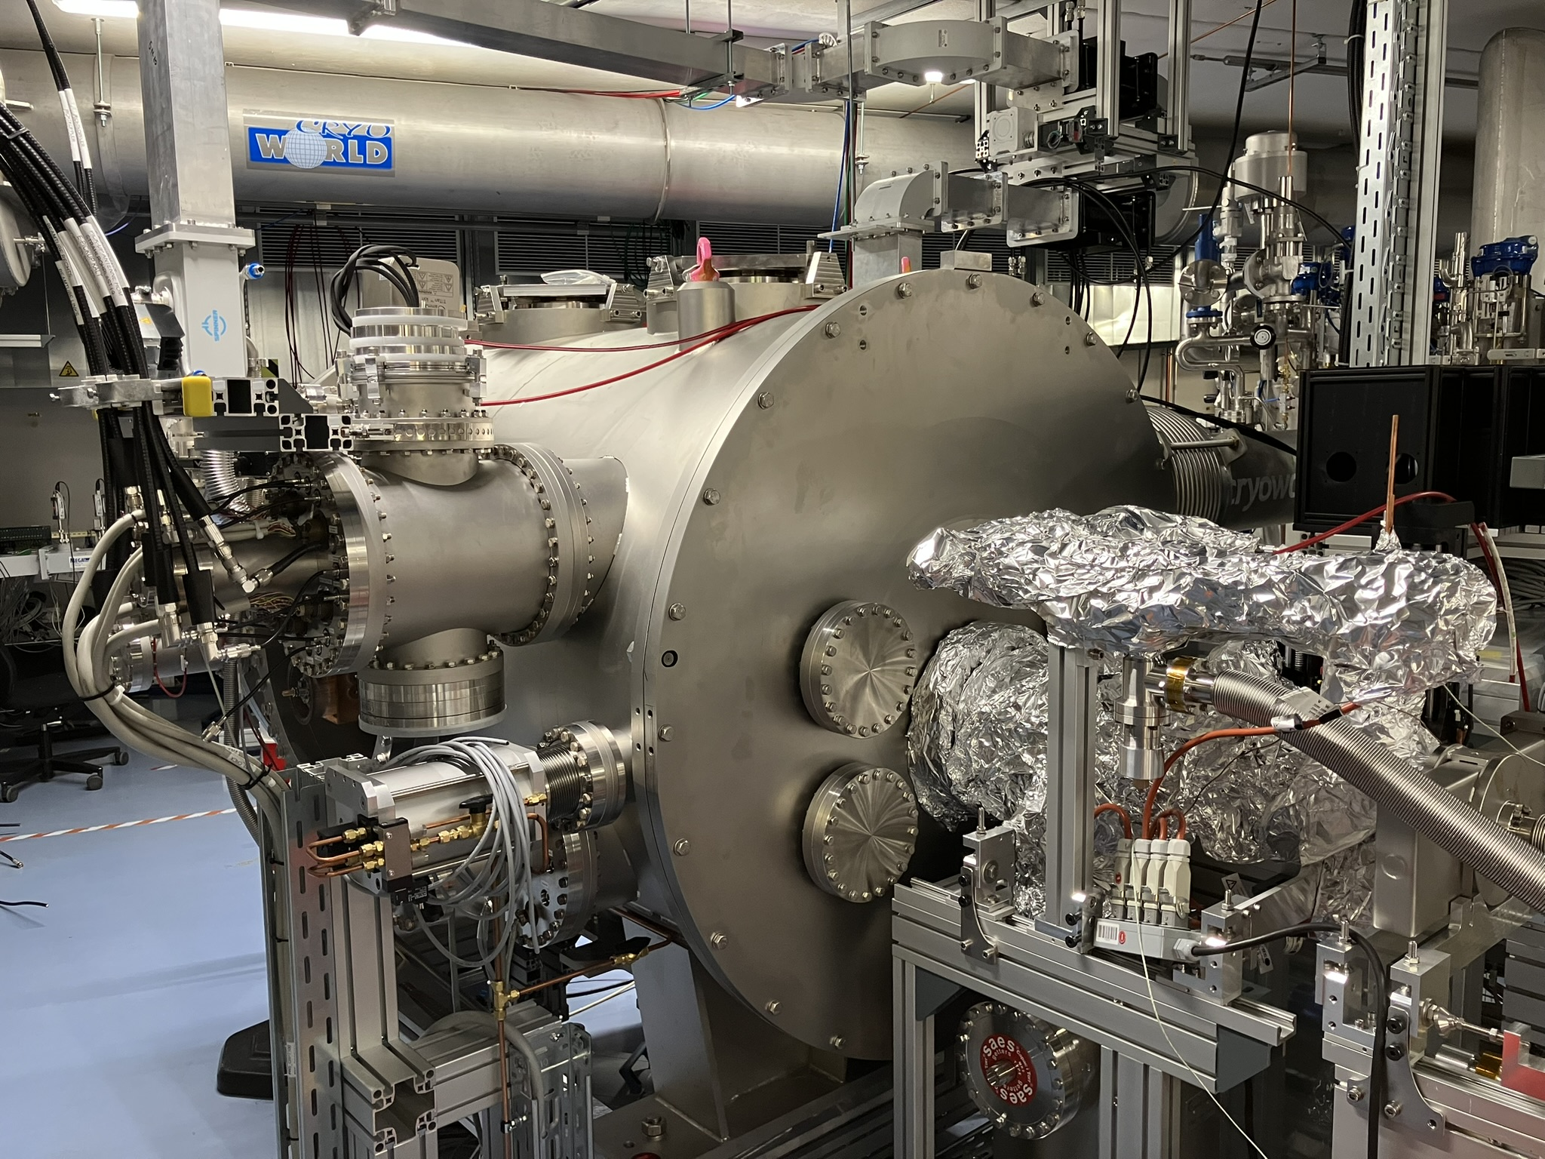
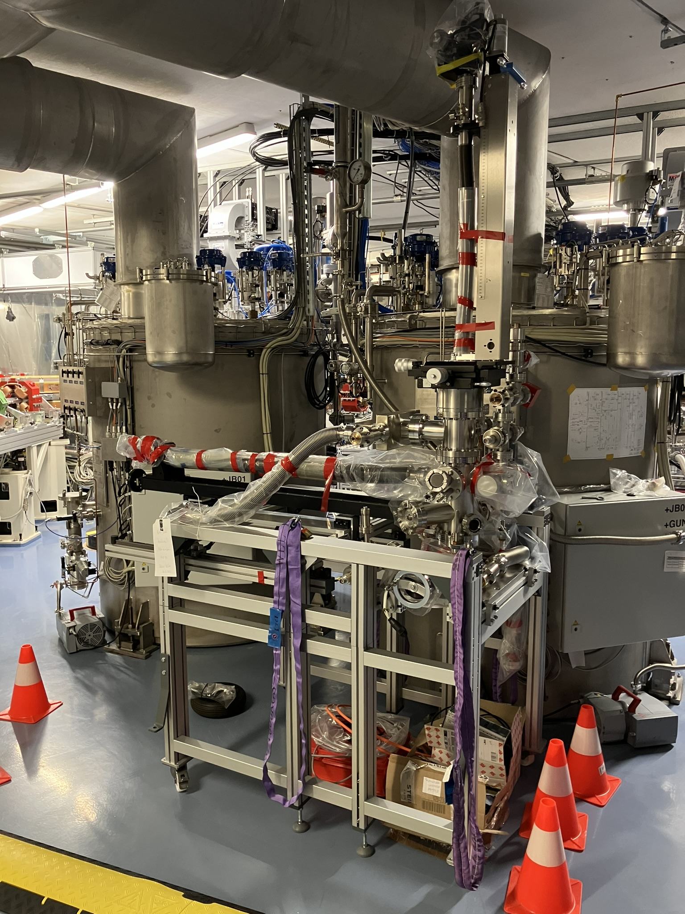
SEALab – sRF electron accelerator laboratory at hzb (SEPtember 2023)
SRF photoinjector module + “1st meter”
Photocathode transfer system (parking)

Slide 6
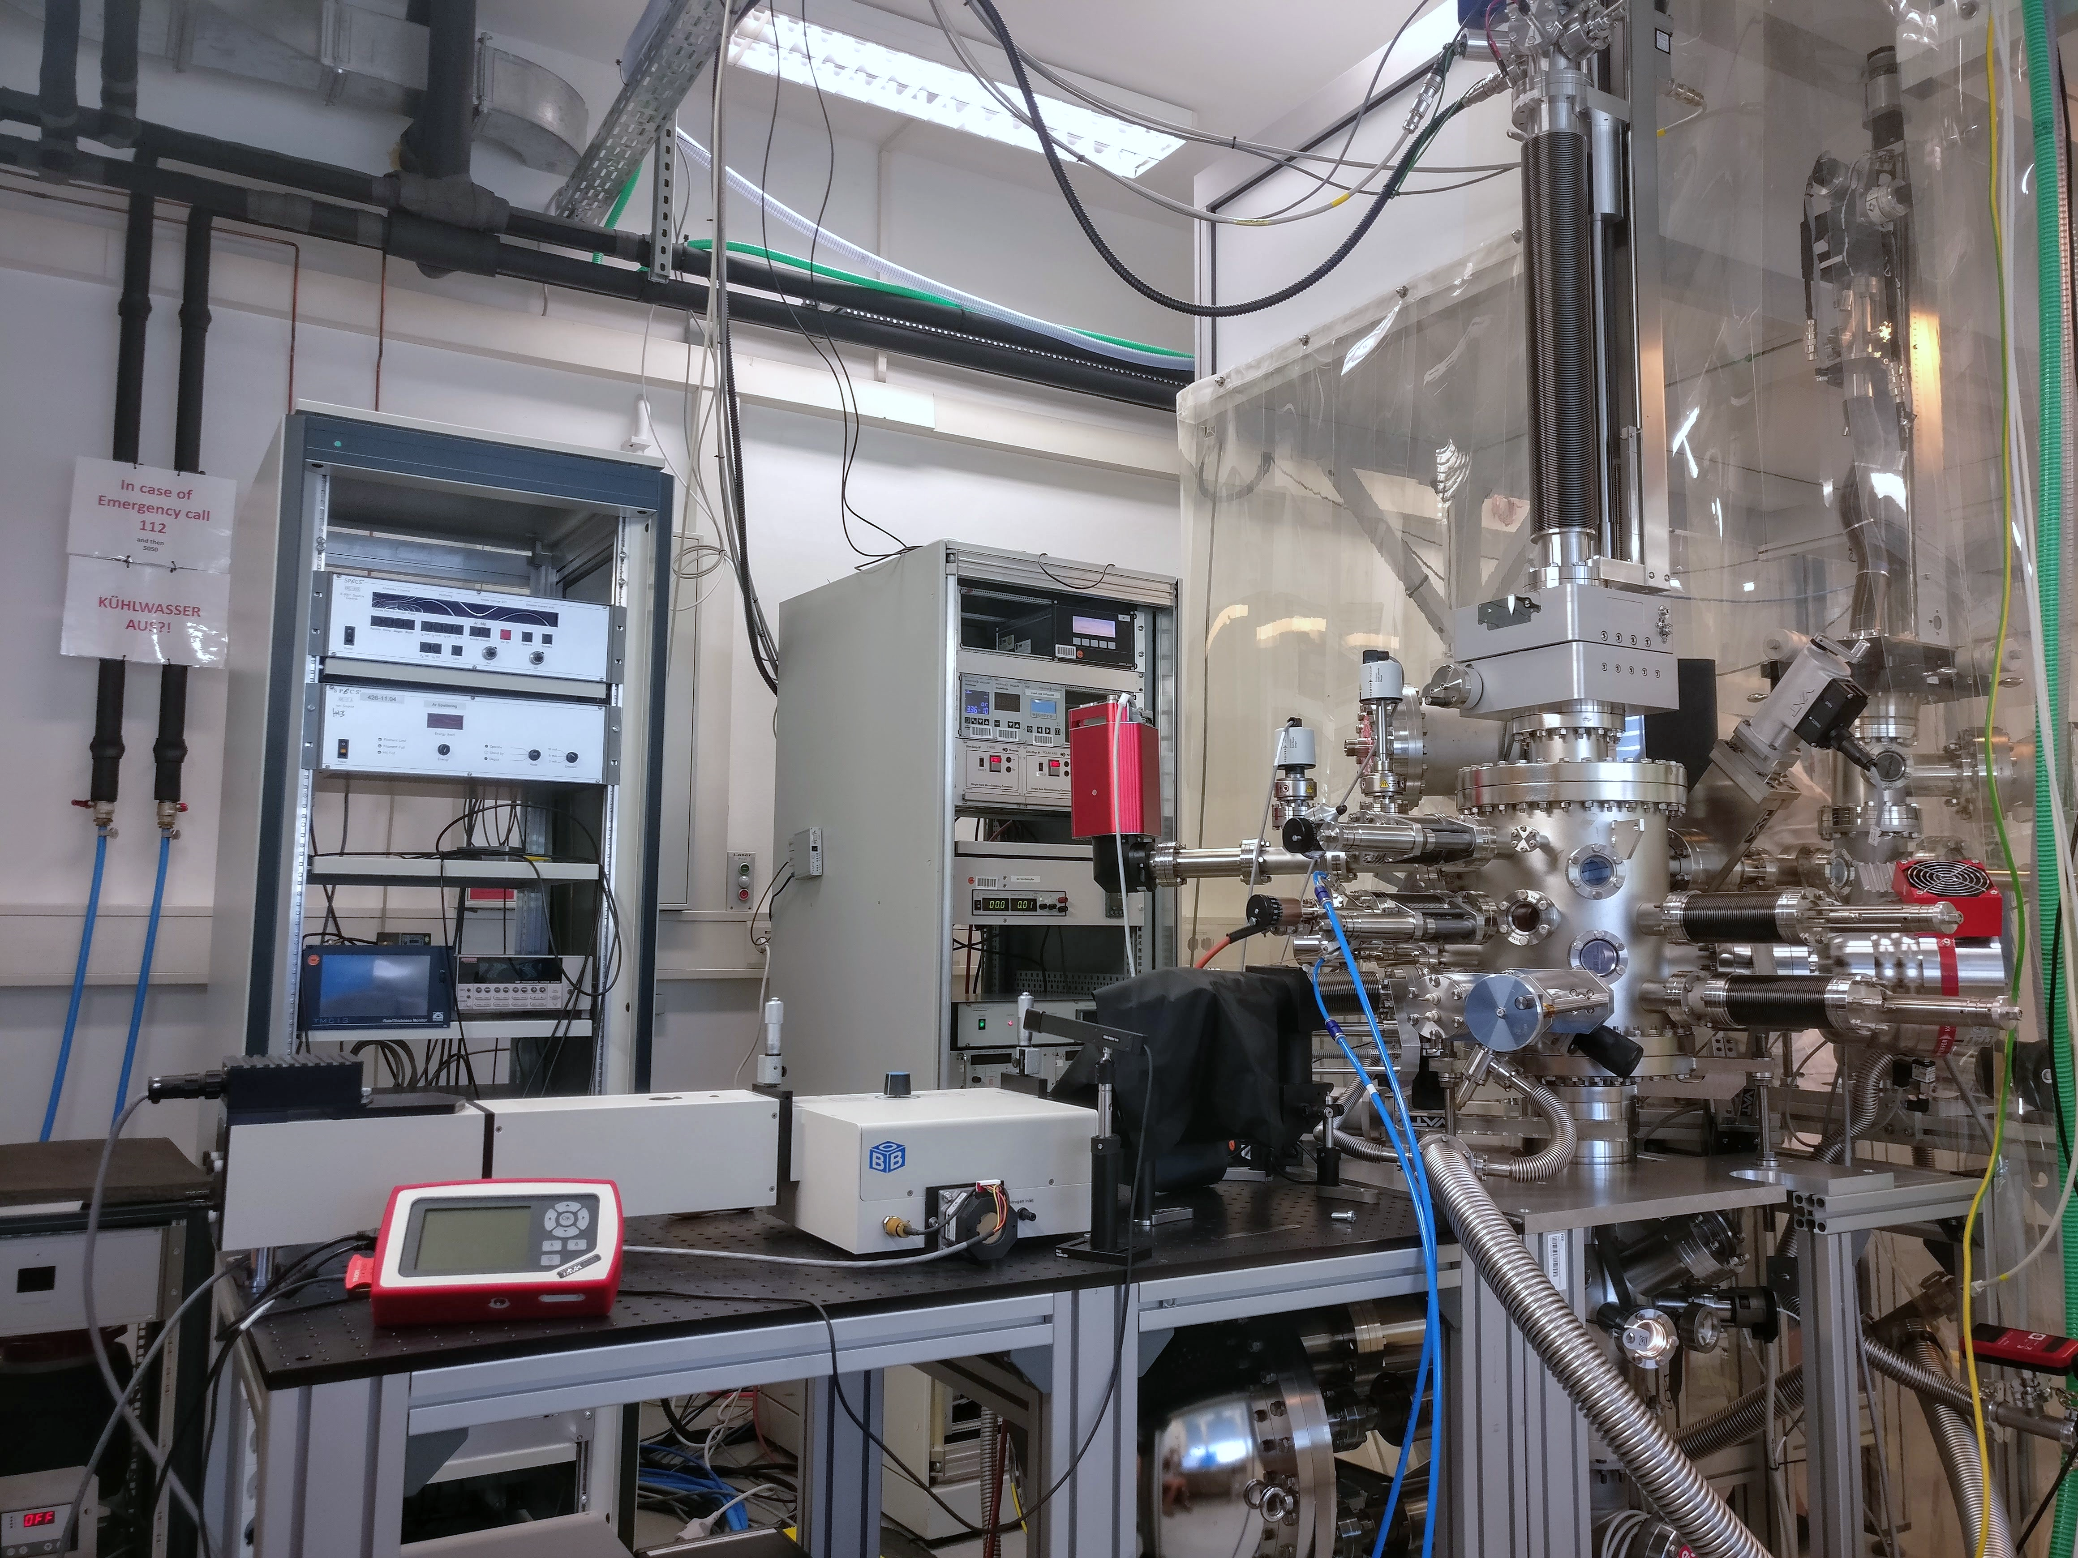
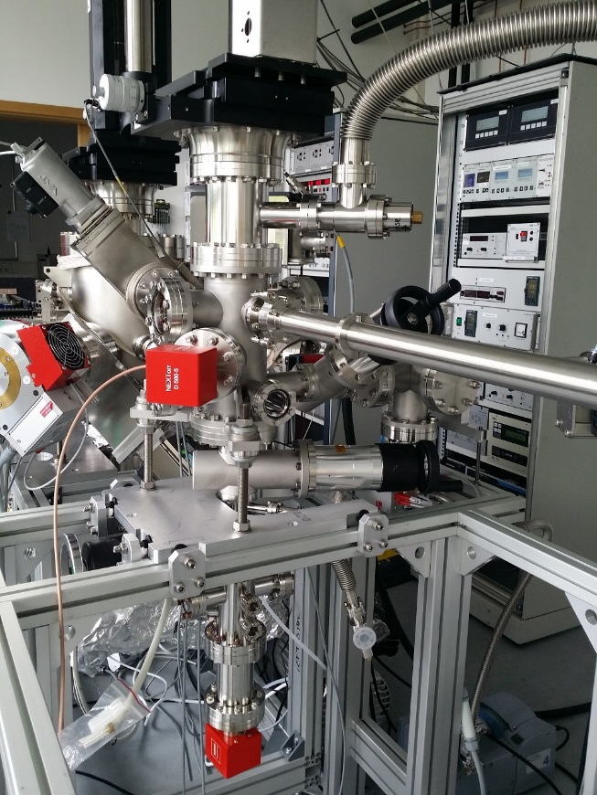
photocathode lab
Preparation & Analysis System
Transfer system w/ vacuum suitcase
Transfer System #1
~3·10⁻¹⁰ mbar
Preparation Chamber
~1·10⁻¹⁰ mbar
Load Lock
~3·10⁻⁸ mbar
Spectral Response Setup
Vacuum Suitcase #1
< 1·10⁻¹⁰ mbar
Analysis Chamber
~1·10⁻¹⁰ mbar

Slide 7
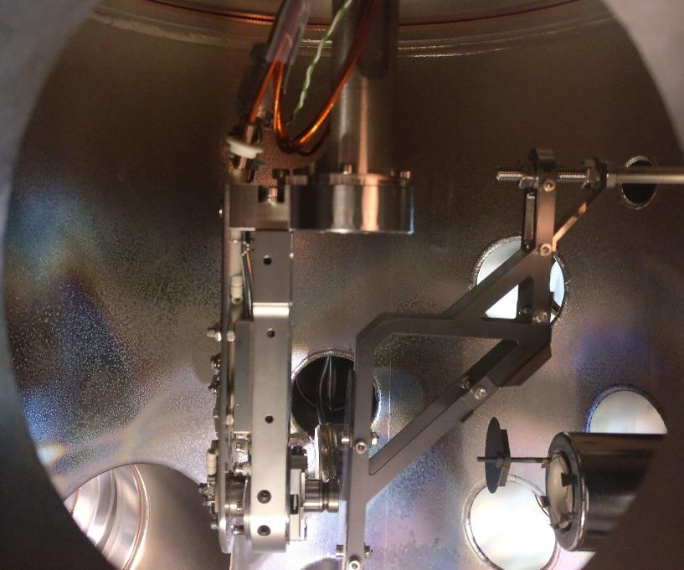
Recipe development for Na-K-Sb photocathodes
manipulator
Sample stage on XYZ,φ manipulator
Aperture
QCM
Mo
Sb
source
Aperture
Sb source
Sample plug
alkali dispensers
Anode
Na + K sources

Slide 8
Recipe development for Na-K-Sb photocathodes
Sequential deposition
Hybrid deposition
Co-deposition
Deposition of Sb
Deposition parameters:
Sample temperature
Deposition duration – controlled by photocurrent measurement
Deposition rate of alkalis – dispenser current
Other influencing factors: partial pressure of O₂,H₂O…
Deposition of K
Deposition of K
Co-deposition of K and Na
Deposition Na
Deposition of Na and K

Slide 9
Overview Na-K-Sb photocathodes grown in 2022-2023
Sample | QE | Composition by XPS |  |  | Method | Remark
 | 515 nm | Na | K | Sb
WH04 | - | 1.5 | 0.6 | 1 | Sequential deposition | low alkali content
WH05 | - | 2.2 | 0.8 | 1 | Co-deposition | high Na content
WH06 | 0.5 % | 2.4 | 0.4 | 1 | Co-deposition | high Na content,
WH06+K | 0.4 % | 2.7 | 0.5 | 1 |  | Additional K deposition after WH06
WH07 | - | 2 | 0.7 | 1 | Sequential deposition | temperature too high for K deposition
WH08 | 0.2 % | 0.8 | 2.3 | 1 | Hybrid-deposition | High K content (Hybrid without heating up to 150C)
WH09 | 2.6 % | 1.4 | 1.5 | 1 | Hybrid-deposition | Sample position y=5 closer to alkali metal sources
WH10 | 0.5 % | 1.1 | 1.5 | 1 | Hybrid-deposition | repetition of WH09, Sample position y=0, low alkali content
WH11 | 0.5 % | 1.9 | 0.7 | 1 | Hybrid-deposition | repetition of WH09, Sample position y= 10, high Na content
WH12 | 0.3% | 2.3 | 0.4 | 1 | Hybrid-deposition | repetition of WH09, Sample position y= 5, high Na content
WH13 | 1.3 % | 2 | 0.9 | 1 | Hybrid-deposition | Sample position y=5, high Na content
WH14 | 2.4 % | 1.8 | 1.6 | 1 | Co-deposition | different temperatures
WH15 | - | 1.1 | 2.3 | 1 | Hybrid deposition | different temperatures, single Na-dispenser
WH16 | - | 2.4 | 0.6 | 1 | Co-deposition | Repetition of WH14, long co-deposition time 6h, high Na content
WH17 | 1.9 % | 1.5 | 1.9 | 1 | Co-deposition | different temperatures

Slide 10
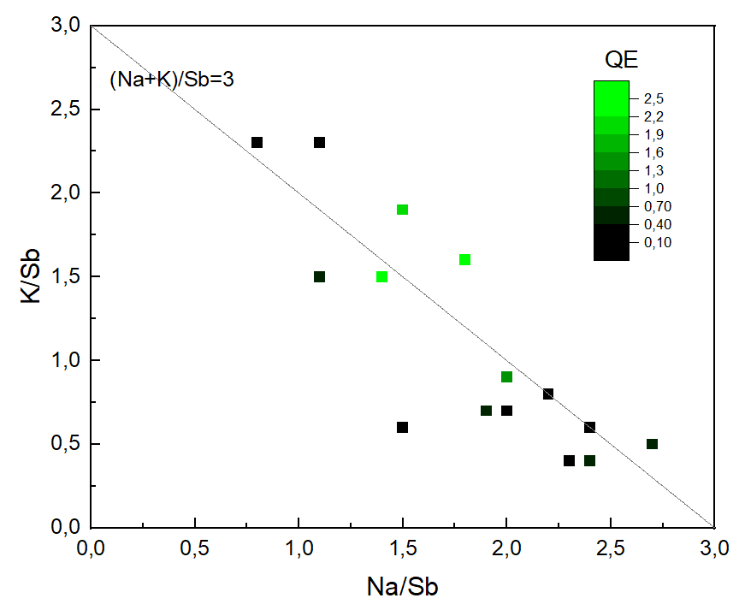
Na-K-Sb composition related to qe
Group 1:
far away from the line (Na+K)/Sb=3
alkali deficiency samples
short deposition time or long distance
Group 2: Bottom right
Na saturated and K deficient samples
high sample temperature (loss K), too long deposition time/ high Na dispenser current
Group 3:Top left
Na deficiency samples (uncommon)
low Na deposition time/current,
Unstable Na dispensers
Group 4: Green point
QE higher then 1%

Slide 11
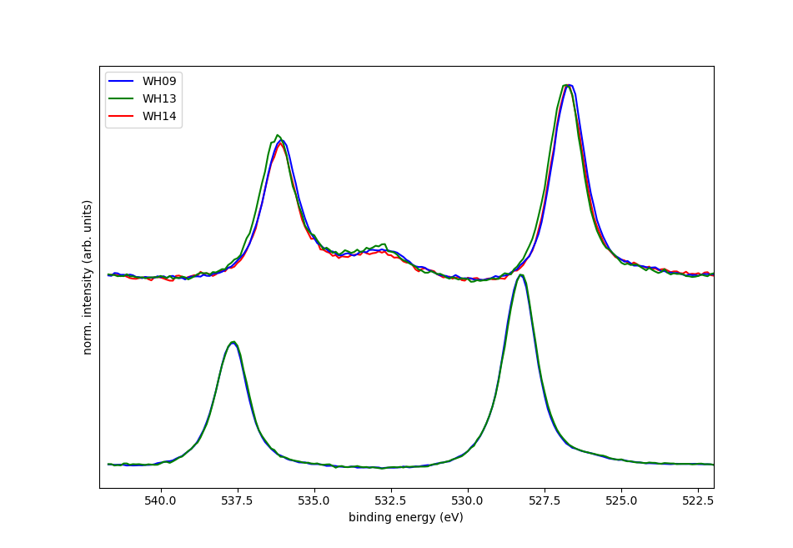
Na-K-Sb composition related to qe > 1%
 | QE at 515 nm | XPS stoichiometry content
 | QE | Na | K | Sb | (Na+K)/Sb | Na/K
WH17 | 1.9% | 1.5 | 1.9 | 1.0 | 3.4 | 0.8
WH14 | 2.4% | 1.8 | 1.6 | 1.0 | 3.4 | 1.1
WH09 | 2.6% | 1.4 | 1.5 | 1.0 | 2.9 | 0.9
WH13 | 1.3% | 2.0 | 0.9 | 1.0 | 2.9 | 2.2
Sb 3d 5/2
Sb 3d 3/2
O 1s
Na-K-Sb
QE and stoichiometry of Na-K-Sb films
Sb
Sb fully reacted
Avoid K deficiency and Na saturation
higher QE with K≈1.5 up 2.4%
Peak position of Sb 3d for Sb and Na-K-Sb films:
Sb (0) 3d 5/2 at 528.3 eV
Sb (3-) 5/2 shift to lower energy to 526.8 eV
S. Mistry, T. Kamps, J. Kühn, and C. Wang, “Multi-Alkali Antimonide Photocathode Development for High Brightness Beams”, in Proc. IPAC'22, Bangkok, Thailand, Jun. 2022, pp. 2610-2613. doi:10.18429/JACoW-IPAC2022-THPOPT019

Slide 12
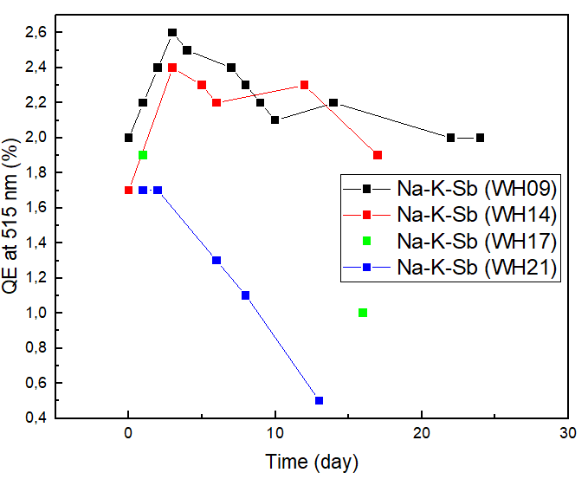
Robustness investigations on Na-K-Sb photocathodes
Chemical composition of Na-K-Sb photocathodes and their lifetime
 | QE (max) at 515 nm | XPS stoichiometry content |  |  |  |  | Days >1.0%
 | QE | Na | K | Sb | (Na+K)/Sb | Na/K | >1.0%
WH09 | 2.6% | 1.4 | 1.5 | 1.0 | 2.9 | 0.9 | ++
WH14 | 2.4% | 1.8 | 1.6 | 1.0 | 3.4 | 1.1 | ++
WH17 | 1.9% | 1.5 | 1.9 | 1.0 | 3.4 | 0.8 | 16
WH21 | 1.7% | - | - | - | - | - | 9
Increase of QE within the first days
chemical stability is possibly related to stoichiometry – in a certain range, lower K content – longer lifetime

Slide 13
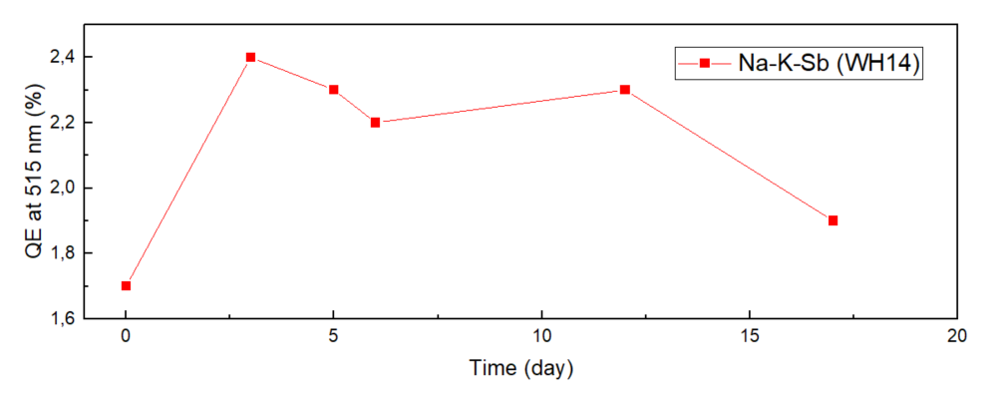
Robustness investigations on Na-K-Sb photocathodes
Change of chemical composition, the chemical composition change during this lifetime
Increase of QE in the first days
Composition almost remains the same over two weeks
Slight shift of Sb 3d peak to lower energy
WH14 | QE at 515 nm | XPS stoichiometry content |  |  |  | Peak position for Sb 3d 5/2
 | QE | Na | K | Sb | (Na+K)/Sb
Day1 | 1.8% | 1.8 | 1.6 | 1.0 | 3.4 | 526.8
Day13 | 2.3% | 1.9 | 1.6 | 1.0 | 3.5 | 526.6

Slide 14
Robustness investigations on Na-K-Sb photocathodes
Thermal stability study of Na-K-Sb: 4 heating cycles up to 130°C, XPS data taken at RT after 24h heating
Photocurrent decreases with higher sample temperature
Decrease of photocurrent may due to the loss of K content
X-ray also contribute to the loss of photocurrent
Chemical composition change after heating
 | Day | XPS stoichiometry content |  |  |  | QE (%)
 |  | Na | K | Sb | (Na+K)/Sb | 515 nm
WH17 | 18 | 1.6 | 1.9 | 1.0 | 3.5 | 1.1
WH17 | 70°C 24h | 1.5 | 1.9 | 1.0 | 3.4 | 1.1
WH17 | 90°C 24h | 1.6 | 1.8 | 1.0 | 3.4 | 1.1
WH17 | 110°C 24h | 1.8 | 1.7 | 1.0 | 3.5 | 0.8
WH17 | 130°C 24h | 1.7 | 1.4 | 1.0 | 3.1 | 0.5

Slide 15
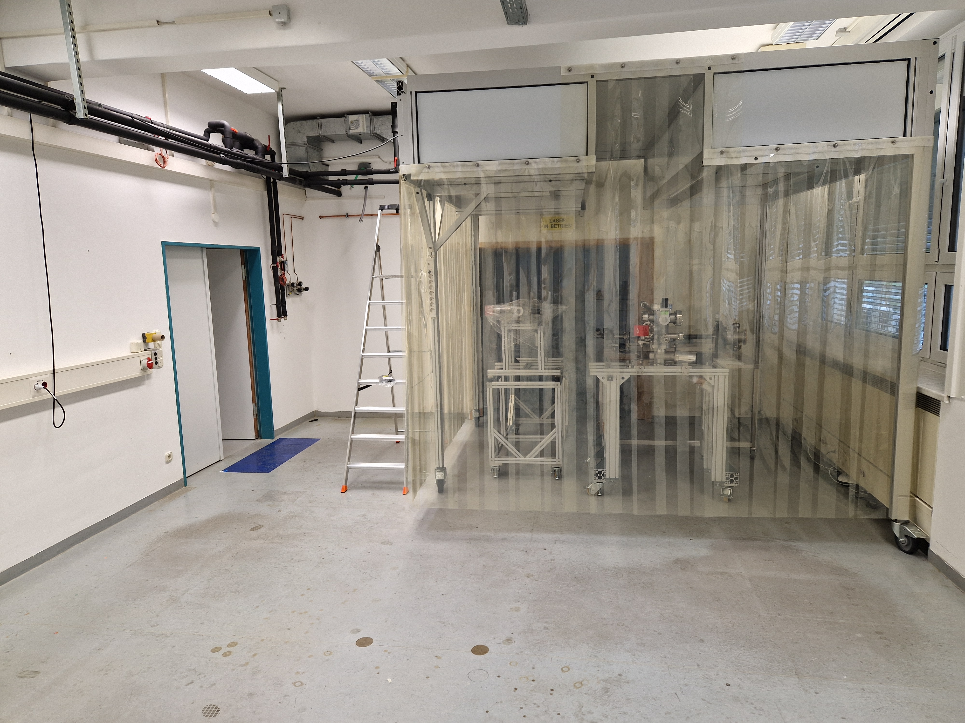
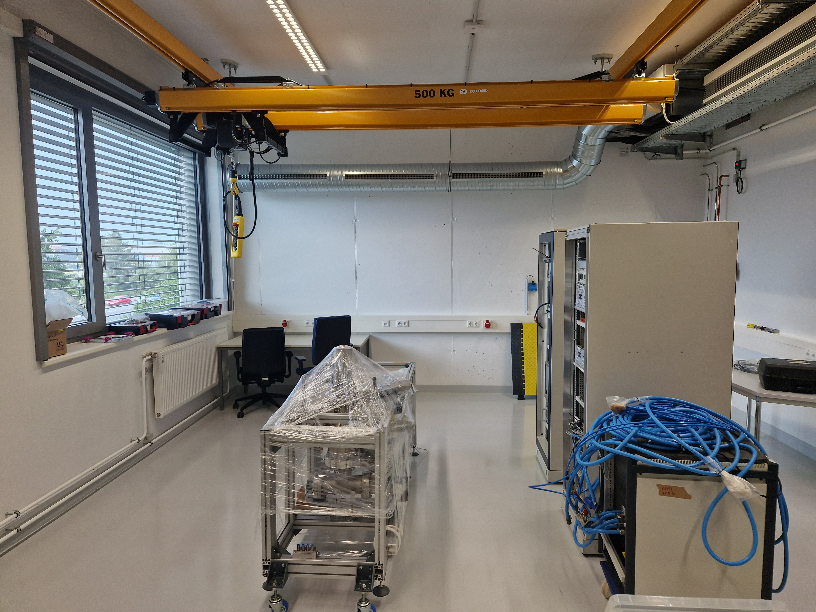
Summary & outlook
Several Na-K-Sb photocathodes have been grown with QE > 2% at 515 nm
SRF-gun commissioning started at SEAlab (cool down tests)
Vacuum suitcase ready to transport sample to BESSY and other systems
Setup of system to measure MTE, QE and reflectivity (ongoing)
Setup of new lab with triple evaporation chamber (ongoing)
Changing from SAES dispensers to SAES pills in effusion cells (planned)
Old lab (2014-2023)
New lab (2023)
Triple evaporation chamber
Thank you for your attention!

