Slide 1
Development of Multialkali antimonides photocathodes for high-brightness photoinjectors
Event: P3 Photocathode Workshop, October 3rd – 5th, 2023, New York, USA
Speaker:
Sandeep Kumar Mohanty
Contents:
Multi-alkali antimonides photocathodes development
Why the Optical properties are important?
Experimental results (Cathode 1 & 2)
Density Function Theory (DFT) study (K3Sb, K2CsSb)
Comparison with experimental results
Summary & Future plan
Co-authors:
M. Krasilnikov, A. Oppelt, F. Stephan
DESY, Zeuthen, Germany
D. Sertore, L. Monaco, G. Guerini Rocco
INFN LASA, Segrate, Italy and Università degli Studi di Milano
P3 Photocathode Workshop 2023 , October 3rd – 5th, 2023

Slide 2
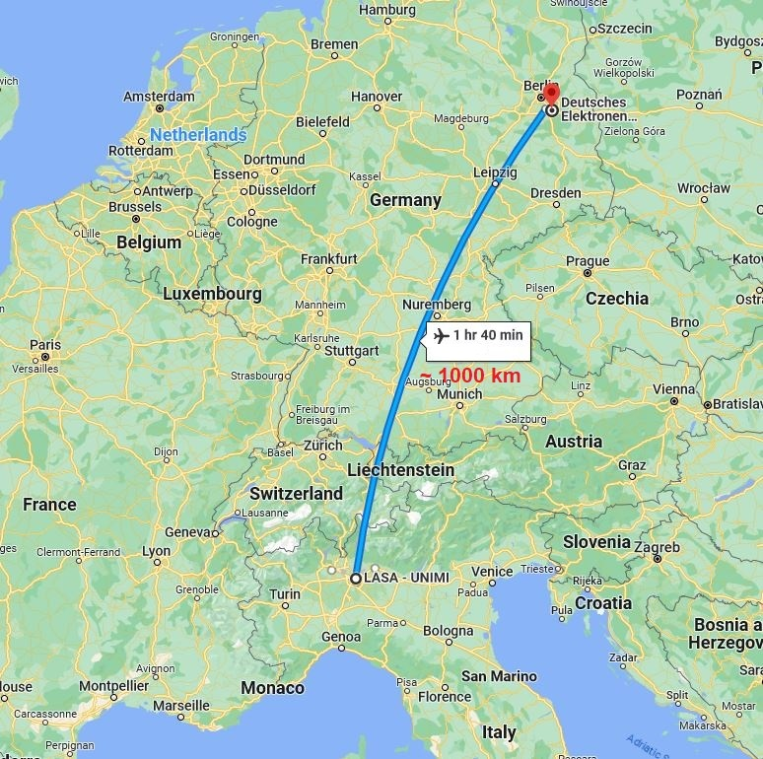
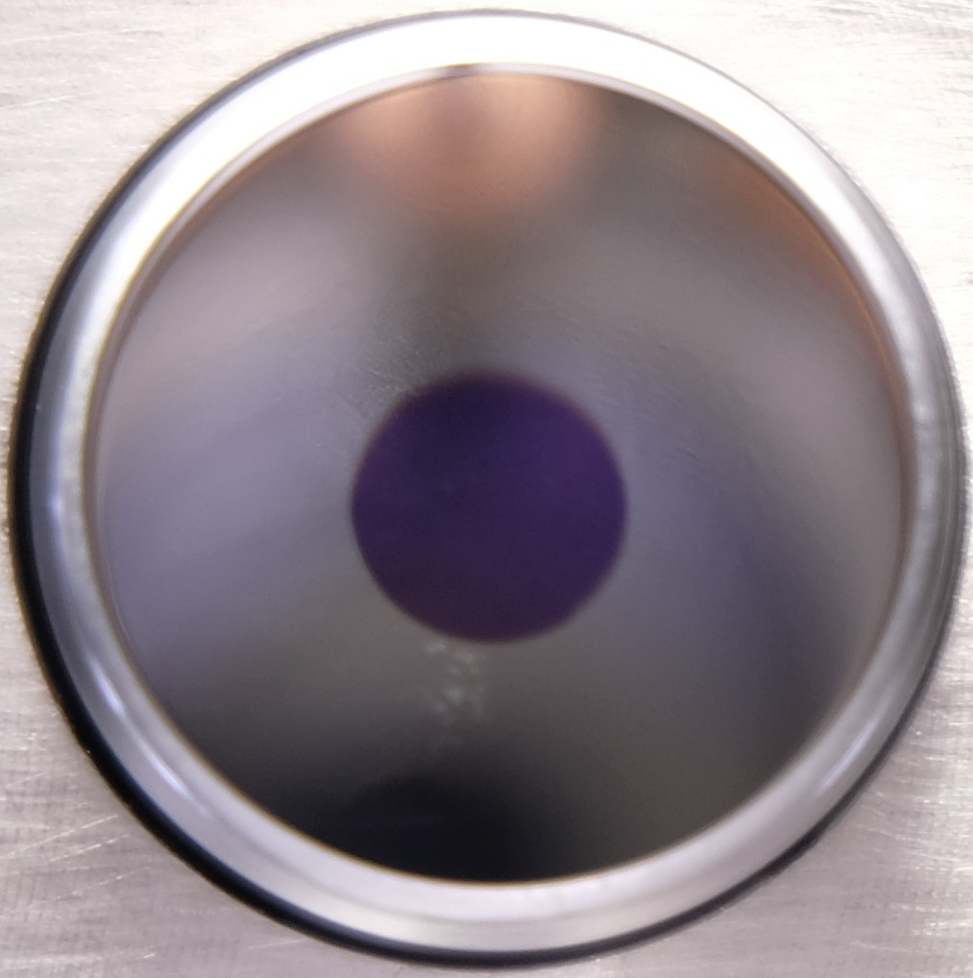
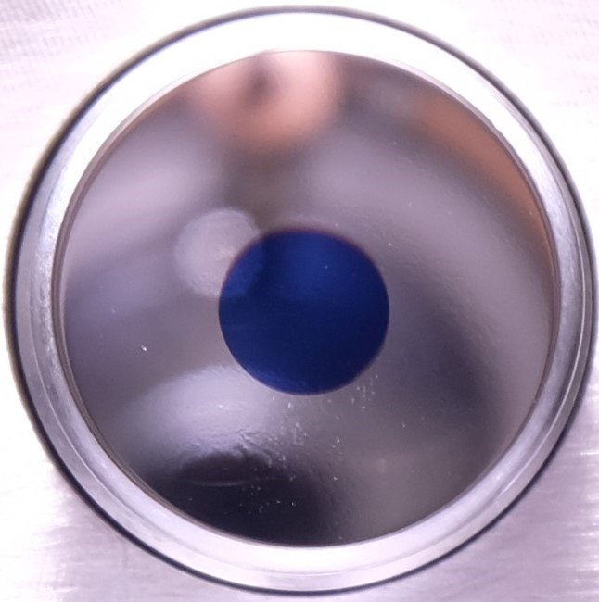
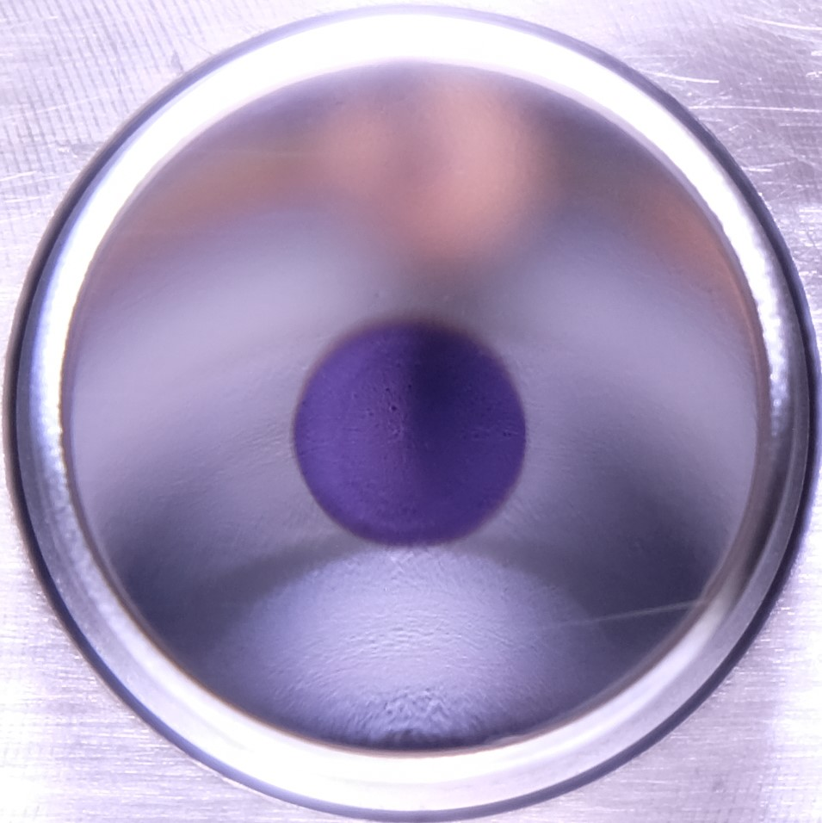
Multi-alkali antimonides photocathodes development
Alkali based Photocathodes (K₂CsSb, Na₂KSb, Cs₃Sb,….) have shown great potential in low gradient guns (<20 MV/m)
Cornell DC gun, BNL SRF gun
>1 % QE at green wavelengths, 0.5 - 0.6 mm.mrad/mm thermal emittance
High average current
Improves cathode laser efficiency and shaping
DESY collaborates with INFN LASA to explore multi-alkali photocathode performance in high-gradient guns
INFN LASA, Italy, develops cathode recipe and production
Photoinjector test facility at DESY Zeuthen site (PITZ) tests cathodes in a high-gradient RF gun.
In the R&D stage (produced a total of 8 cathodes), a reproducible recipe has been achieved for the KCsSb compound with a maximum QE of ~ 9% @ 515 nm [1].
3 KCsSb photocathodes were prepared at INFN LASA in July 2021 and successfully tested at PITZ RF gun [2].
High QE ( 4-8 % at 515 nm)
Thermal emittance (0.6 mm.mrad/mm) (lower than Cs₂Te)
Response time (preliminary results show < 100 fs )
Higher dark current than Cs₂Te
Short operational lifetime (~48 hours)
Produced cathodes
[1] Mohanty SK, Krasilnikov M, Oppelt A, Stephan F, Sertore D, Monaco L, Pagani C, Hillert W. Development and Characterization of Multi-Alkali Antimonide Photocathodes for High-Brightness RF Photoinjectors. Micromachines. 2023; 14(6):1182. https://doi.org/10.3390/mi14061182 .
[2] S. Mohanty, "Development and Test Results of Multi-Alkali Antimonide Photocathodes in the High Gradient RF Gun at PITZ", in Proc. FEL2022, Trieste. doi:10.18429/jacow-fel2022-tup04
KCsSb film
Mo
Thin cathodes: Sb 5 nm
Thick cathodes: Sb 10 nm
112.1 (thin)
147.1 (thick)
123.1 (thin)

Slide 3
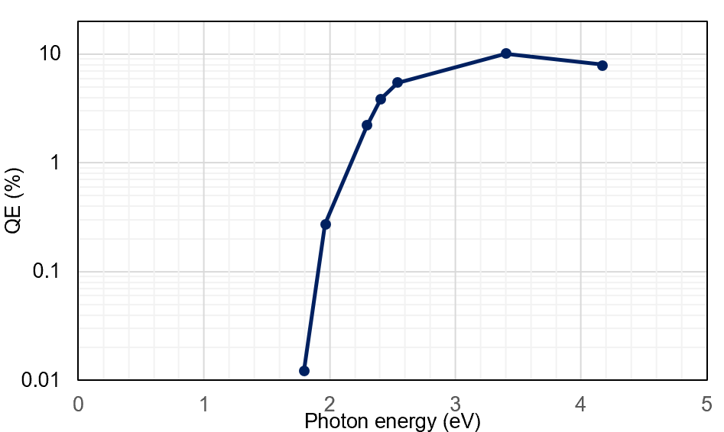
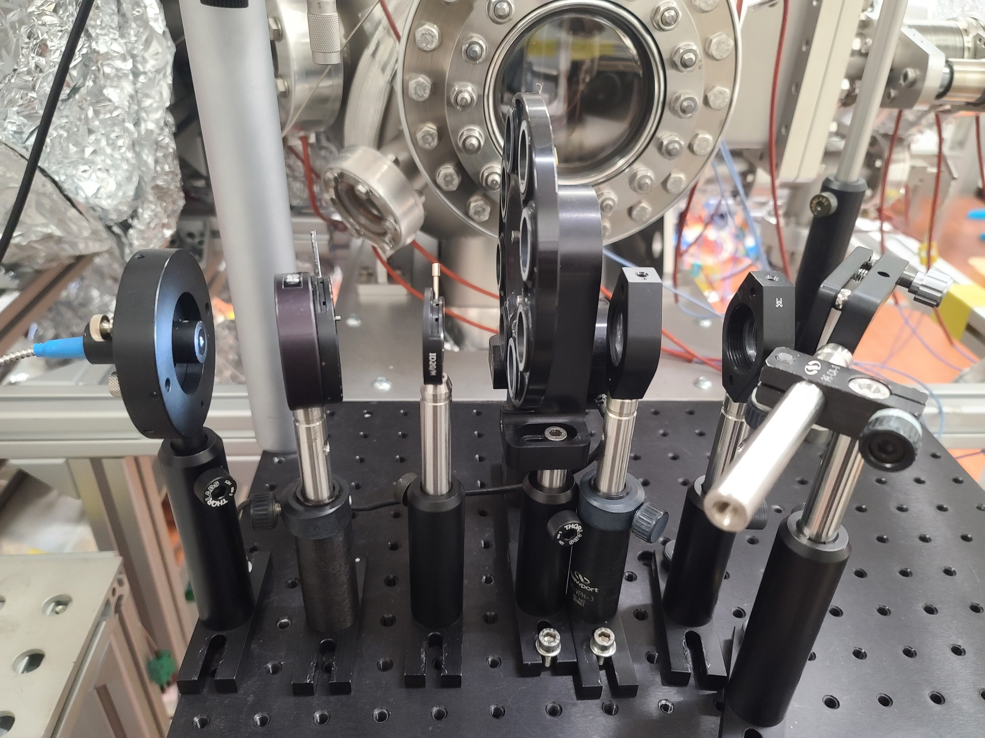
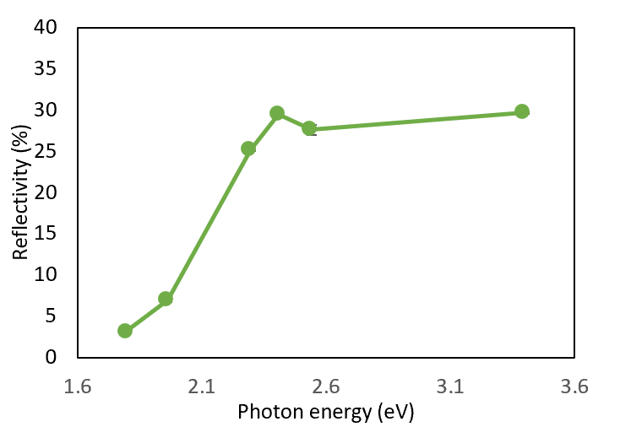
Multi-alkali antimonides photocathodes development
To improve + optimize cathode recipe :
Two new cathodes grown in the new “production” system.
One thick (Sb = 10 nm) (#137.2)
One thin (Sb = 5 nm) (#137.3)
To understand the evolving photocathode structure during and after deposition, a "multi-wavelength" diagnostic setup is utilized.
Sb
K
KSb
Cs
KCsSb
5 or 10 nm
Sequential deposition method
Thickness
Deposition rate
“Multi-wavelength” Optical Diagnostics
used during cathode deposition
Real-time spectral response
Real-time QE at 8 different wavelengths
Continuous tracking of the Eg+Ea value in real time.
Identify the formation of new compounds
(transition from Sb to KSb and then to KCsSb)
Reaction Kinetics
revealing reaction rates and intermediate stages.
Optical filters
Eg+Ea
Eg = band gap
Ea = electron affinity
Real-time spectral reflectivity
LDLS laser
Peaks due to electronic transitions
Real-time reflectivity at 8 different wavelengths
Optical Characterization
provide insights into the energy band structure
and electronic transitions within the compound
Motorized filter wheel
(housing 8 optical filters with different wavelengths)

Slide 4
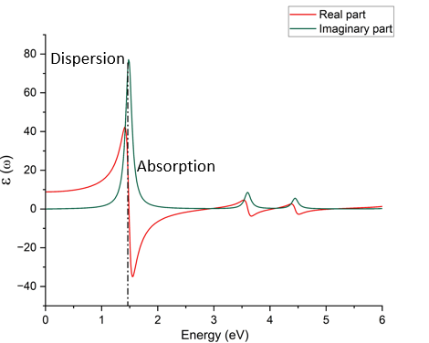
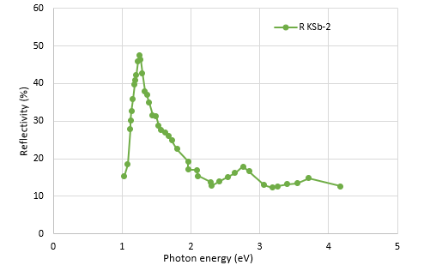
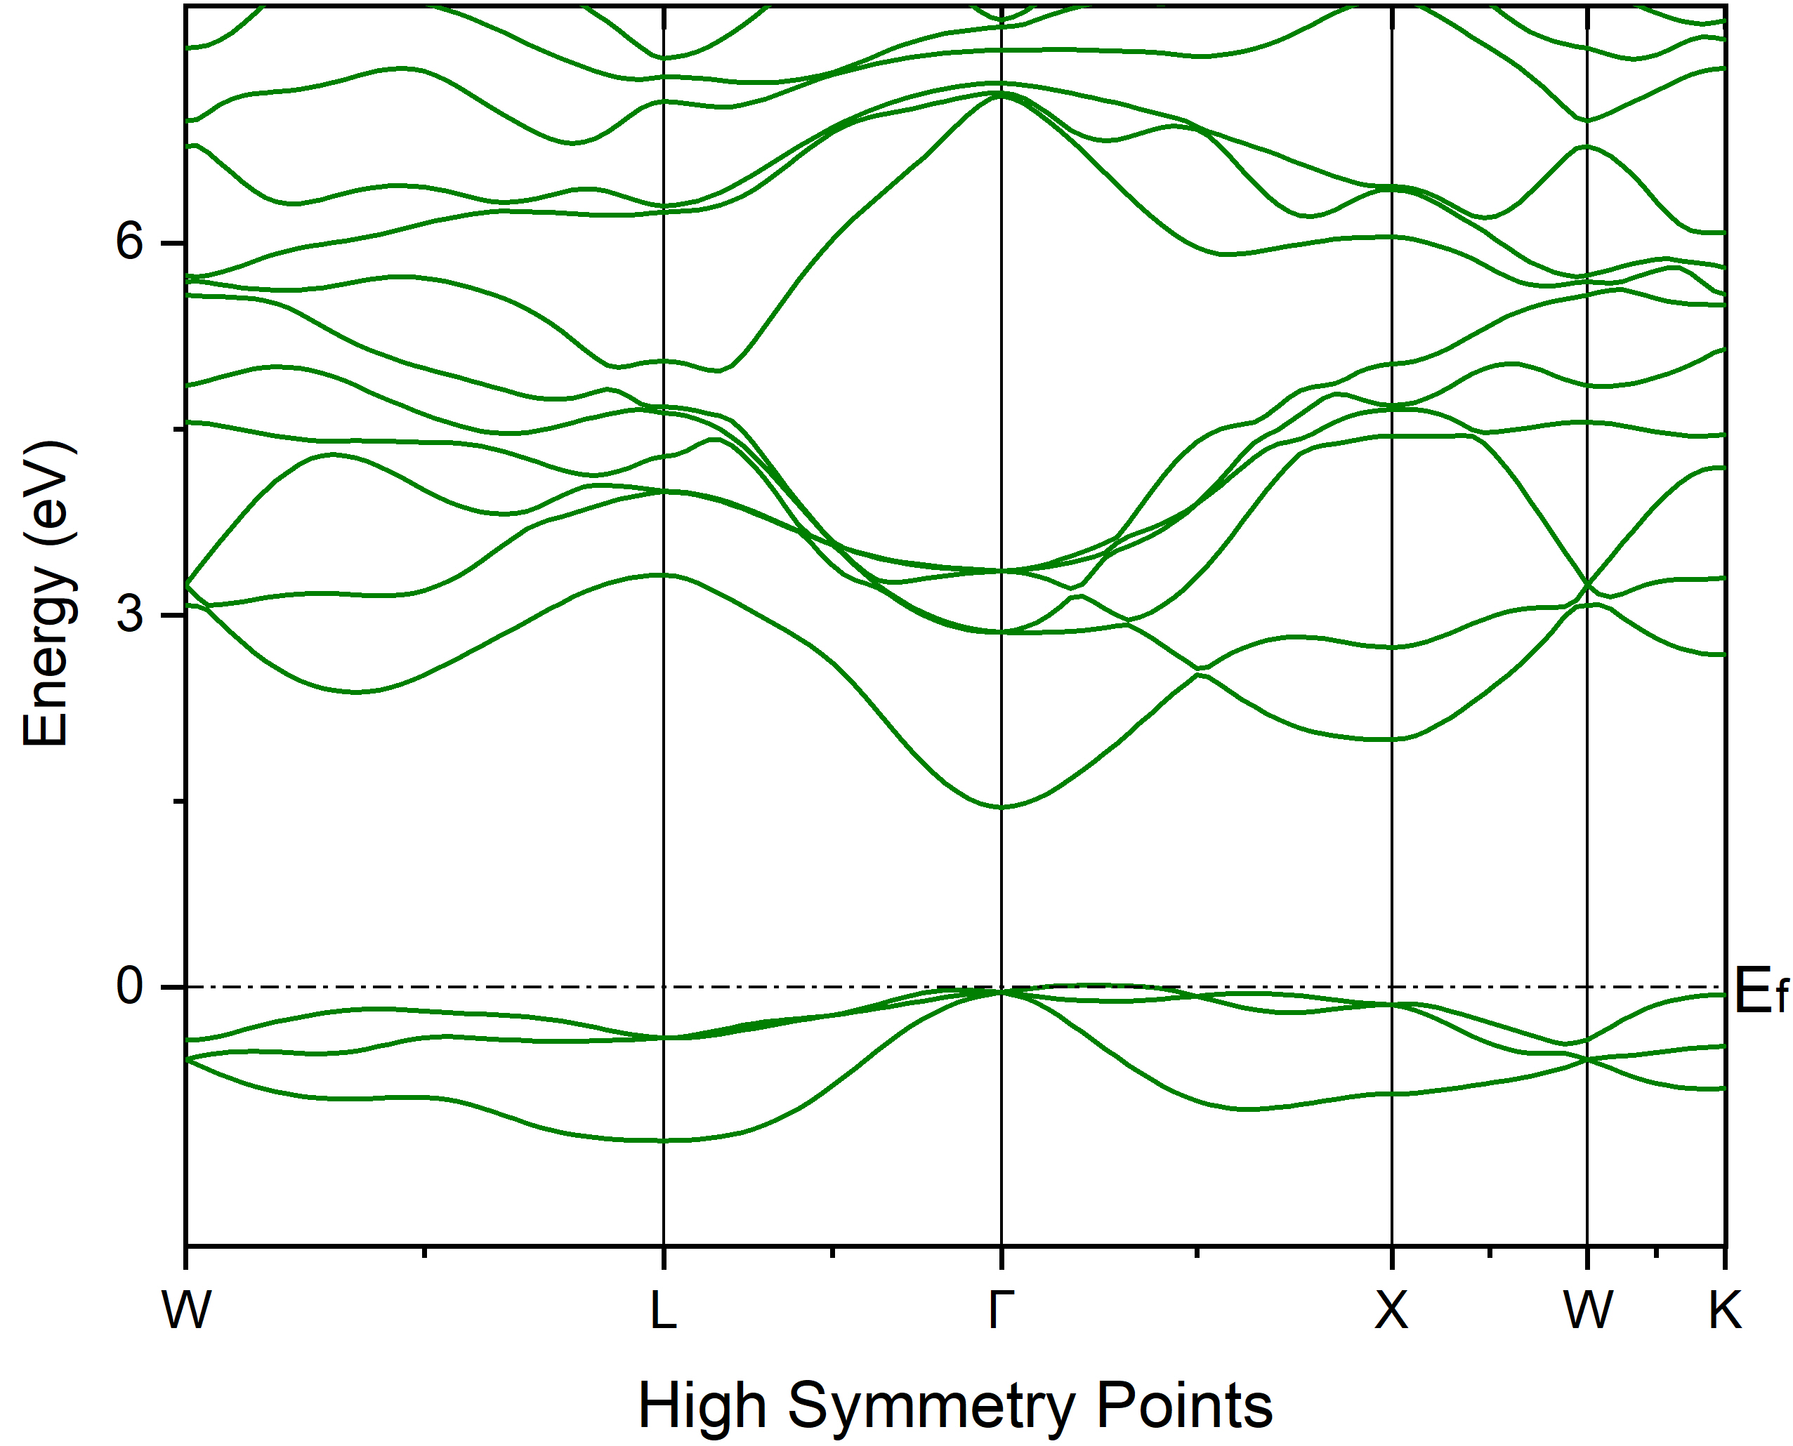
Why the Optical properties are important?
Analyzing a material's electronic structure using optical measurements like spectral reflectivity and spectral response is an indirect approach, relying on interpretations and correlations rather than direct electronic state measurement.
Optical Properties
Spectral reflectivity
Maxwell model [1]
E
Refractive index n(ω) = ${\left[\frac{\sqrt{{ɛ₁}^{2}\left(ω\right)+{ɛ₂}^{2}\left(ω\right)}−ɛ₁(ω)}{2}\right]}^{0.5}$
Extinction coefficient k(ω) = ${\left[\frac{\sqrt{{ɛ₁}^{2}\left(ω\right)+{ɛ₂}^{2}\left(ω\right)}+ɛ₁(ω)}{2}\right]}^{0.5}$
Reflectivity R(ω) = $\frac{{\left(1−n\right)}^{2}+k^{2}}{{\left(1+n\right)}^{2}+k^{2}}$
Polarisation: P(ω) = ϵ0 χ̃(ω) E(ω)
Complex dielectric function: ϵ̃(ω) = 1+ χ̃(ω)
Real part: ϵ’(ω) = ϵ1 = 1+ χ̃’(ω)
Imaginary part: ϵ”(ω) = ϵ2 = χ̃"(ω) Absorption
Evac
Conduction Band (C.B)
Ea
Eg
Et
$$hυ$$
e⁻
Valance Band (V.B)
[1] F. Wooten, “Chapter 1 - introduction,” in Optical Properties of Solids,F. Wooten, Ed. Academic Press, 1972, pp. 1–14.
Z
Spectral reflectivity
Eg = Band gap
Ea = Electron affinity
Et = Photoemission threshold
C.B
Peaks due to electronic transitions
V.B
Dielectric function
Band structure

Slide 5
Why the Optical properties are important?
Analyzing a material's electronic structure using optical measurements like spectral reflectivity and spectral response is an indirect approach, relying on interpretations and correlations rather than direct electronic state measurement.
Optical Properties
Spectral reflectivity
E
Evac
Conduction band
Ea
Eg
Et
Peaks due to electronic transitions
$$hυ$$
Not simplified
to interpret directly
e⁻
Film thickness
Film
Valance band
Mo (substrate)
Z
Interference effects due to thickness or the presence of multiple layers (such as thin films and substrates)
Also, surface roughness, etc. can influence.
Our Model
Interpretation of optical measurements requires theoretical models and assumptions about the underlying electronic structure.
The dielectric function (Kramer’s-Kronig equation) is used to calculate the optical properties of the material.
Refractive index n(ω) = ${\left[\frac{\sqrt{{ɛ₁}^{2}\left(ω\right)+{ɛ₂}^{2}\left(ω\right)}−ɛ₁(ω)}{2}\right]}^{0.5}$
Extinction coefficient k(ω) = ${\left[\frac{\sqrt{{ɛ₁}^{2}\left(ω\right)+{ɛ₂}^{2}\left(ω\right)}+ɛ₁(ω)}{2}\right]}^{0.5}$
Reflectivity R(ω) = $\frac{{\left(1−n\right)}^{2}+k^{2}}{{\left(1+n\right)}^{2}+k^{2}}$
Quantum Espresso software package and its postprocessing code epsilon.x
Optical properties like reflectivity etc.
Experimental reflectivity
Comparison

Slide 6
Experimental results
Cathode - 1
Cathode 137.2 (K+Sb+Cs), Sb = 10 nm (Thick)
I
II
Sb
K
KSb
Cs
KCsSb
10 nm
0.4-0.6 nm/min
0.6-0.8 nm/min
Power is used for 120 °C
Power is used for 140 °C
Power is used for 120 °C

Slide 7
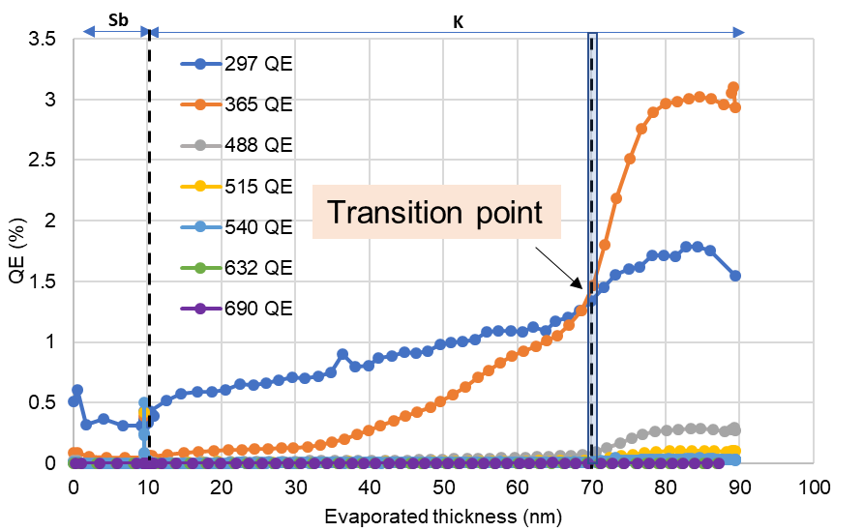
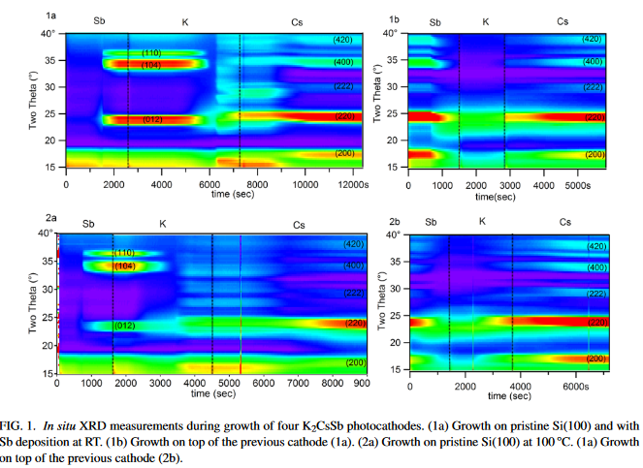
“Real-time” QE & Reflectivity curve 137.2 (KSb – Thick, Cathode-1)
“Real-time” QE vs. evaporated thickness during Sb & K deposition
“Real-time” Reflectivity vs. evaporated thickness during Sb & K deposition
Sb
K
Transition point
During Sb deposition, the reflectivity was increased (at 2 nm).
After 70 nm of K evaporation (transition point) [1,2], there is a change in slope in real-time QE (at all the wavelengths).
After 70 nm of K evaporation (transition point) [1,2], the reflectivity patterns at 365nm, 488 nm, 540 nm, and 515 nm differ from that observed at
632 nm and 690 nm.
The rate of QE increase at 365 nm was higher compared to 297 nm only after 70 nm of K evaporation (e-e scattering!, if hv ≥ 2Eg).
Previous XRD studies [2]
[1] Mohanty SK, Krasilnikov M, Oppelt A, Stephan F, Sertore D, Monaco L, Pagani C, Hillert W. Development and Characterization of Multi-Alkali Antimonide Photocathodes for High-Brightness RF Photoinjectors. Micromachines. 2023; 14(6):1182. https://doi.org/10.3390/mi14061182 .
[2] Ruiz-Osés, M.; Schubert, S.; Attenkofer, K.; Ben-Zvi, I.; Liang, X.; Muller, E.; Padmore, H.; Rao, T.; Vecchione, T.; Wong, J.; et al. Direct observation of bi-alkali antimonide photocathodes growth via in operando x-ray diffraction studies. APL Mater. 2014,2, 121101.

Slide 8
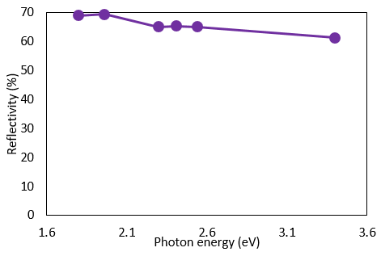
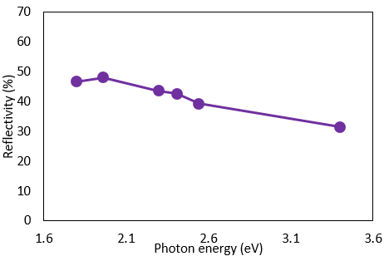
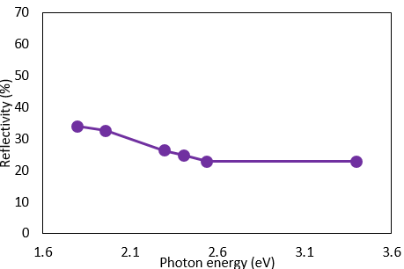
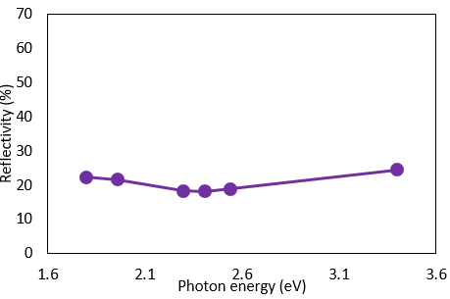
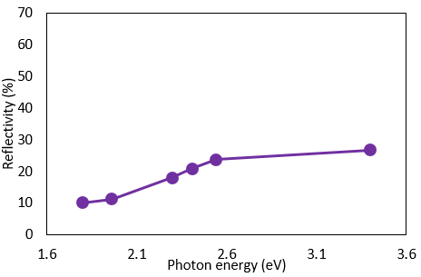
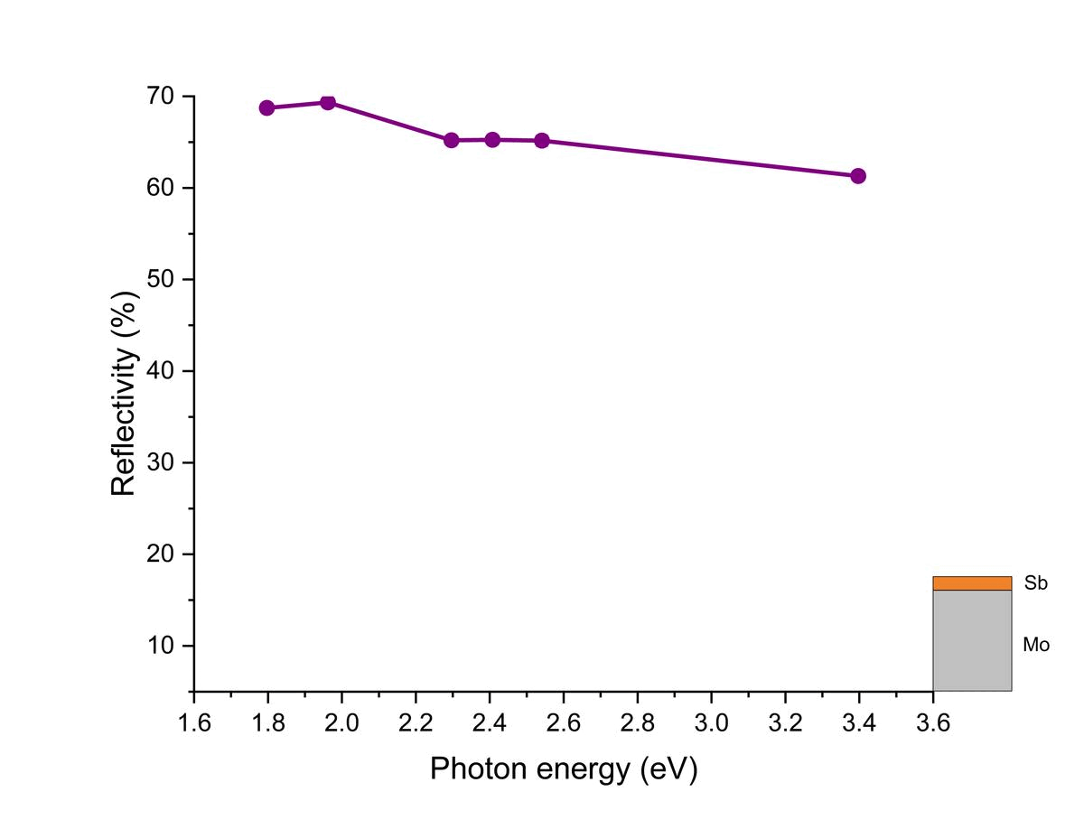
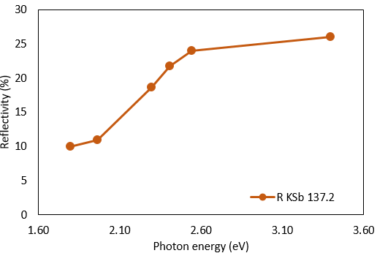
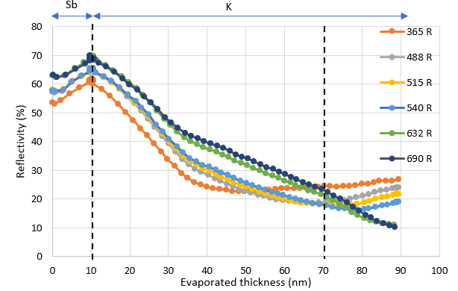
Real-time Reflectivity history during Sb+K deposition (137.2 KSb-Thick,Cathode-1)
“Real-time” Spectral reflectivity vs. Photon energy
@30 nm of K
@50 nm of K
@70 nm of K
@88 nm of K
R(%) history during Sb+K deposition (137.2 KSb-Thick) (Cathode-1)
Sb deposition
K deposition
“Real-time” Reflectivity vs. Thickness
Final Reflectivity
Up to 30 nm of K evaporation, there was a marginal change in the shape of the spectral reflectivity curve (but decreased at all λ).
From 30 to 50 nm of K evaporation, in the “Reflectivity vs. Thickness” Fig., there is a change in slope in the reflectivity observed at all λ, and
the shape of the spectral reflectivity (upper plot) curve has also changed.
At 70 nm of K evaporation (transition point), a small curve has appeared (between 2.1 eV to 2.6 eV) in the spectral reflectivity Fig. (upper plot).

Slide 9
Cathode - 1
Cathode 137.2 (K+Sb+Cs), Sb = 10 nm (Thick)
I
II
Sb
K
KSb
Cs
KCsSb
10 nm
0.4-0.6 nm/min
0.6-0.8 nm/min
Power is used for 120 °C
Power is used for 140 °C
Power is used for 120 °C

Slide 10
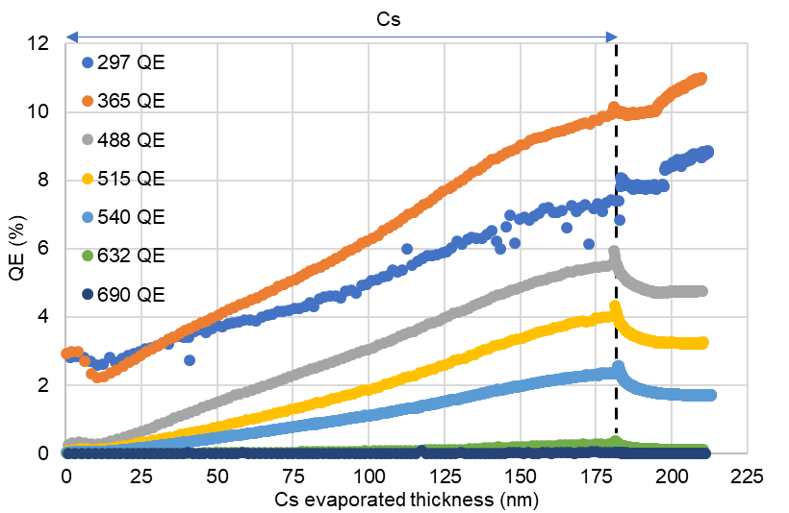
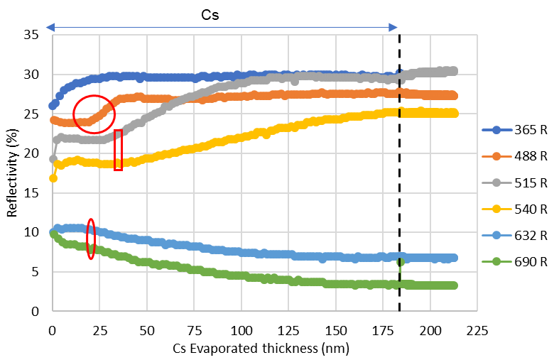
“Real-time” QE & Reflectivity curve 137.2 (KSb+Cs – Thick, Cathode-1)
“Real-time” QE vs. evaporated thickness during Cs deposition
“Real-time” Reflectivity vs. evaporated thickness during Cs deposition
After 23 nm of Cs evaporation, a change in slope in the reflectivity curve for 488 nm has been noticed. At this point, the
reflectivity of red wavelengths (632 & 690 nm) starts to decrease.
After 30 nm of Cs evaporation, the reflectivity for green wavelengths (515 & 540 nm) starts to increase.
At the end of Cs evaporation, the QE of UV wavelengths (297 & 365 nm) stabilize initially and then start to increase, whereas
for the rest of the wavelengths, it starts to decrease (excess Cs evaporation!)

Slide 11
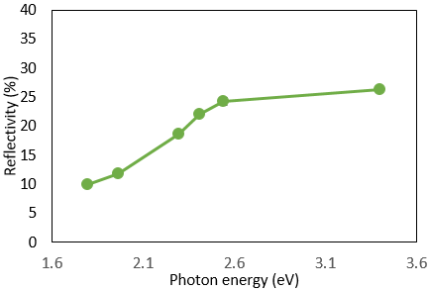
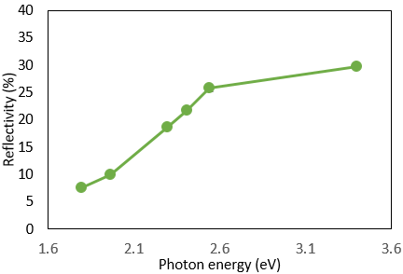
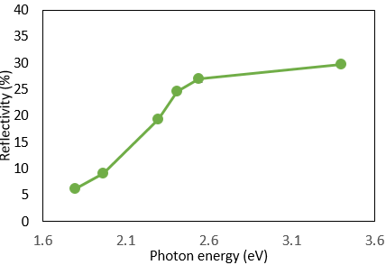
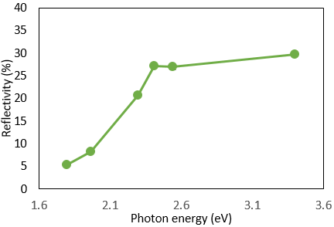
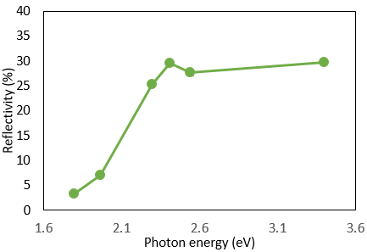
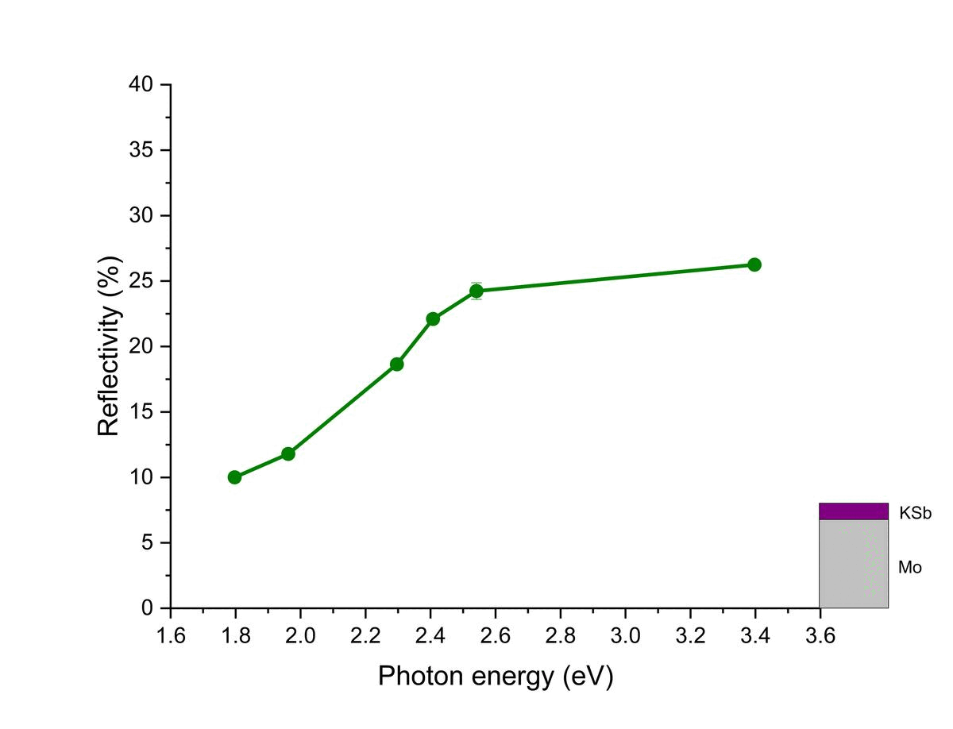
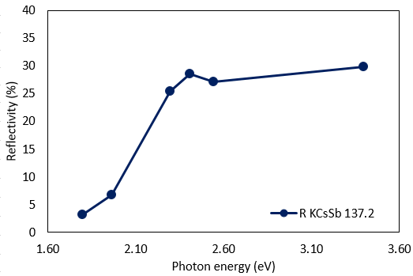
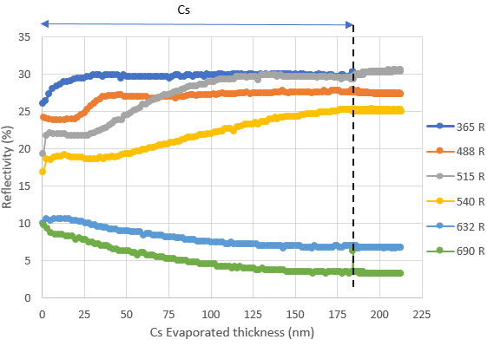
Real-time Reflectivity history during KSb+Cs deposition (137.2 KCsSb-Thick, Cathode-1)
“Real-time” Spectral reflectivity vs. Photon energy
@30 nm of Cs
@52 nm of Cs
@76 nm of Cs
@183 nm of Cs
R(%) history during KSb+Cs deposition (137.2 KCsSb-Thick) (Cathode-1)
Sb + K deposition
Cs deposition
“Real-time” Reflectivity vs. Thickness
Final Reflectivity
Up to 30 nm of Cs evaporation, the reflectivity was increased at the 365 nm (3.39 eV) wavelength of light.
Up to 76 nm of Cs evaporation, in the “Reflectivity vs. Thickness” Fig., the reflectivity was increased in the green wavelengths
{515 (2.40 eV), 540 nm (2.29 eV)}, also a peak appeared in the spectral reflectivity curve at 2.40 eV (515 nm).

Slide 12
Cathode - 2
Cathode 137.3 (K+Sb+Cs), Sb = 5 nm (Thin)
I
II
Sb
K
KSb
Cs
KCsSb
5 nm
0.4-0.6 nm/min
0.6-0.8 nm/min
Decrease the power
compared to the previous K
deposition (137.2)
Decrease the power
compared to the previous Cs
deposition (137.2)

Slide 13
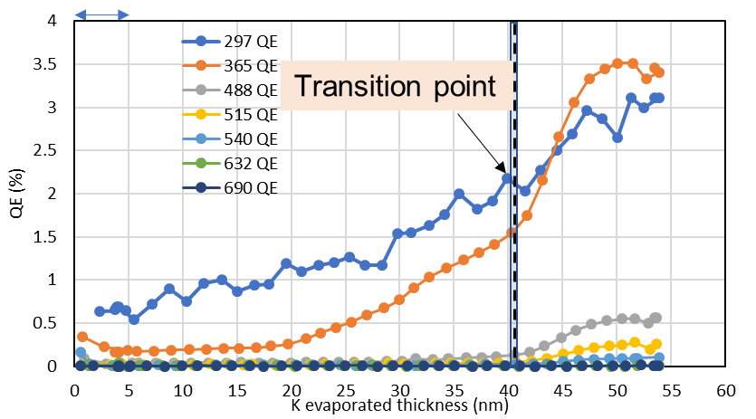
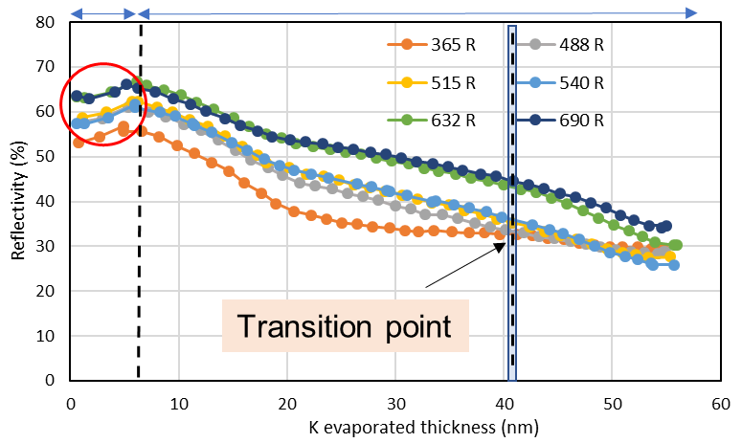
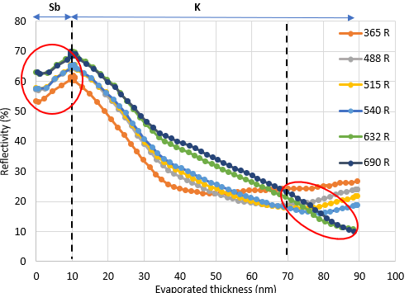
“Real-time” QE & Reflectivity curve 137.3 (KSb – Thin, Cathode-2)
“Real-time” QE vs. evaporated thickness during Sb & K deposition
“Real-time” Reflectivity vs. evaporated thickness during Sb & K deposition
Sb
K
Sb
K
KSb- 137.3 (Thin)
Cathode-2
During Sb deposition, the reflectivity was increased (at 1.5 nm).
There is a change in slope in real-time QE (at all the wavelengths) that has been observed after 41 nm of
K evaporation (transition point).
The rate of QE increase at 365 was higher compared to 297 nm, appeared only after 41 nm of K evaporation
(e-e scattering, if hv ≥ 2Eg).
Transition point
KSb- 137.2 (Thick)
Cathode-1

Slide 14
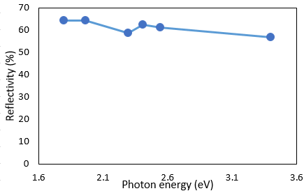
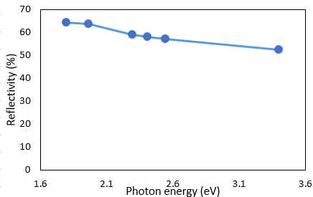
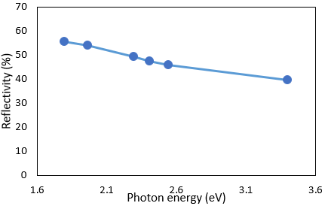
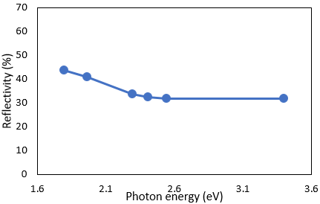
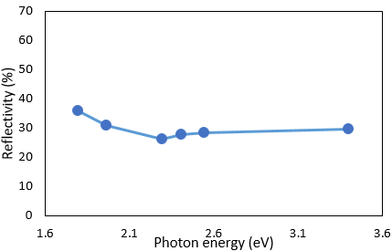
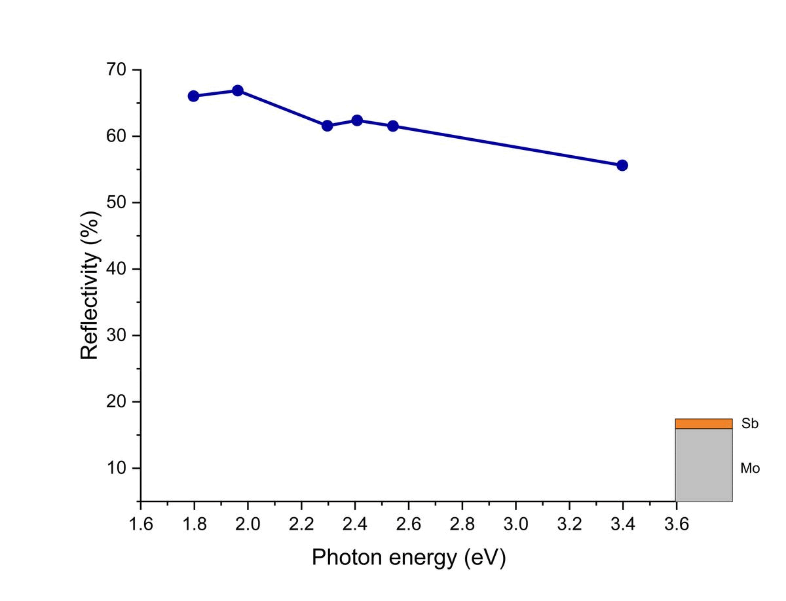
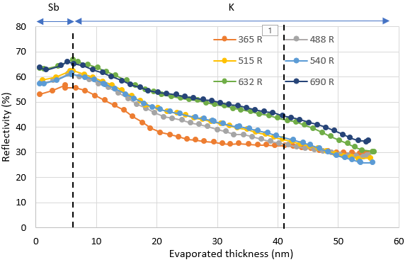
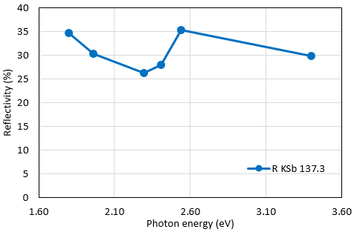
Real-time Reflectivity history during Sb+K deposition (137.3 KSb-Thin, Cathode-2)
“Real-time” Spectral reflectivity vs. Photon energy
R(%) history during Sb+K deposition (137.3 KSb-Thin)
Cathode-2
R(%) history during Sb+K deposition (137.2 KSb-Thick)
Cathode-1
@10 nm of K
@20 nm of K
@44 nm of K
@54 nm of K
Sb deposition
K deposition
“Real-time” Reflectivity vs. Thickness
Final Reflectivity
Up to 10 nm of K evaporation, the shape of spectral reflectivity was marginally changed (shows slow reaction due to comparative low temperature).
Up to 20 nm of K evaporation, the spectral reflectivity was decreased at all the wavelengths.
Up to 54 nm of K evaporation, the shape of the reflectivity curve has changed, and a small curve formed between 1.95 eV and 2.54 eV.

Slide 15
Cathode - 2
Cathode 137.3 (K+Sb+Cs), Sb = 5 nm (Thin)
I
II
Sb
K
KSb
Cs
KCsSb
5 nm
0.4-0.6 nm/min
0.6-0.8 nm/min
Decrease the power
compared to the previous K
deposition (137.2)
Decrease the power
compared to the previous Cs
deposition (137.2)

Slide 16
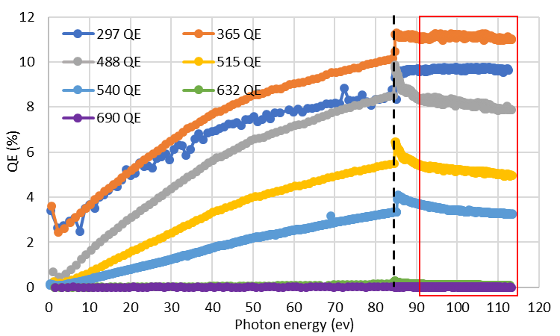
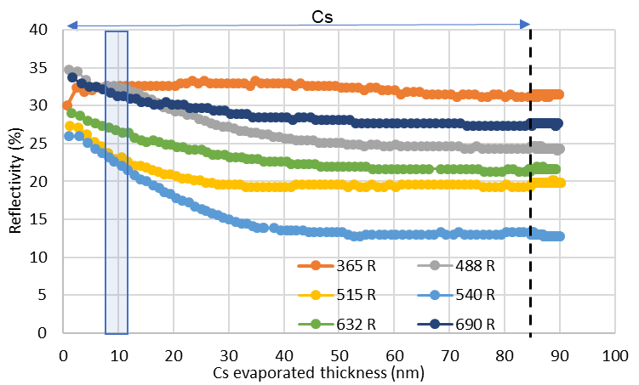
“Real-time” QE & Reflectivity curve 137.3 (KSb+Cs – Thin, Cathode-2)
“Real-time” QE vs. evaporated thickness during Cs deposition
“Real-time” Reflectivity vs. evaporated thickness during Cs deposition
Cs
Cs evaporated thickness (nm)
After 10 nm of Cs evaporation, there is a change in slope in the reflectivity curve for all the wavelengths (except 365 nm).
At the end of Cs evaporation, a small jump appeared at the QE (at all the wavelengths), but afterward, the QE was getting
decreased except UV wavelengths (297 & 365 nm) (temperature-sensitive surface layer! [1]).
[1] Mohanty SK, Krasilnikov M, Oppelt A, Stephan F, Sertore D, Monaco L, Pagani C, Hillert W. Development and Characterization of Multi-Alkali Antimonide Photocathodes for High-Brightness RF Photoinjectors. Micromachines. 2023; 14(6):1182. https://doi.org/10.3390/mi14061182 .

Slide 17
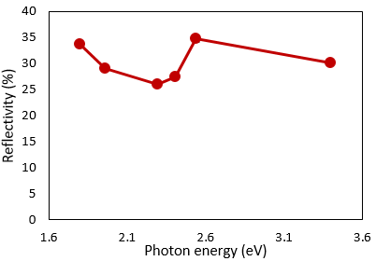
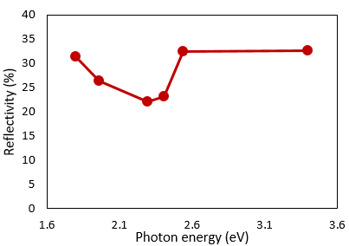
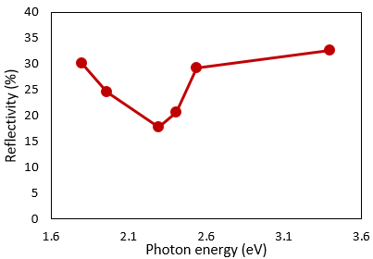
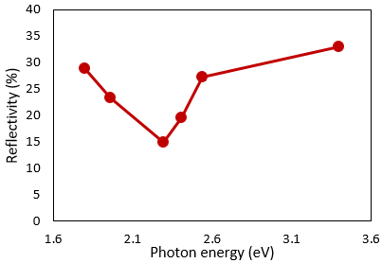
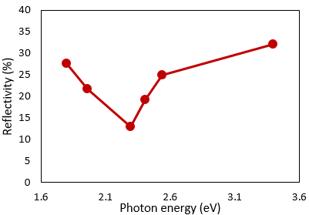
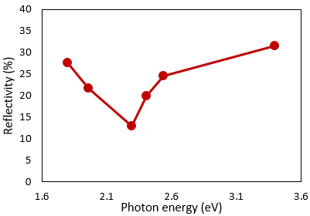
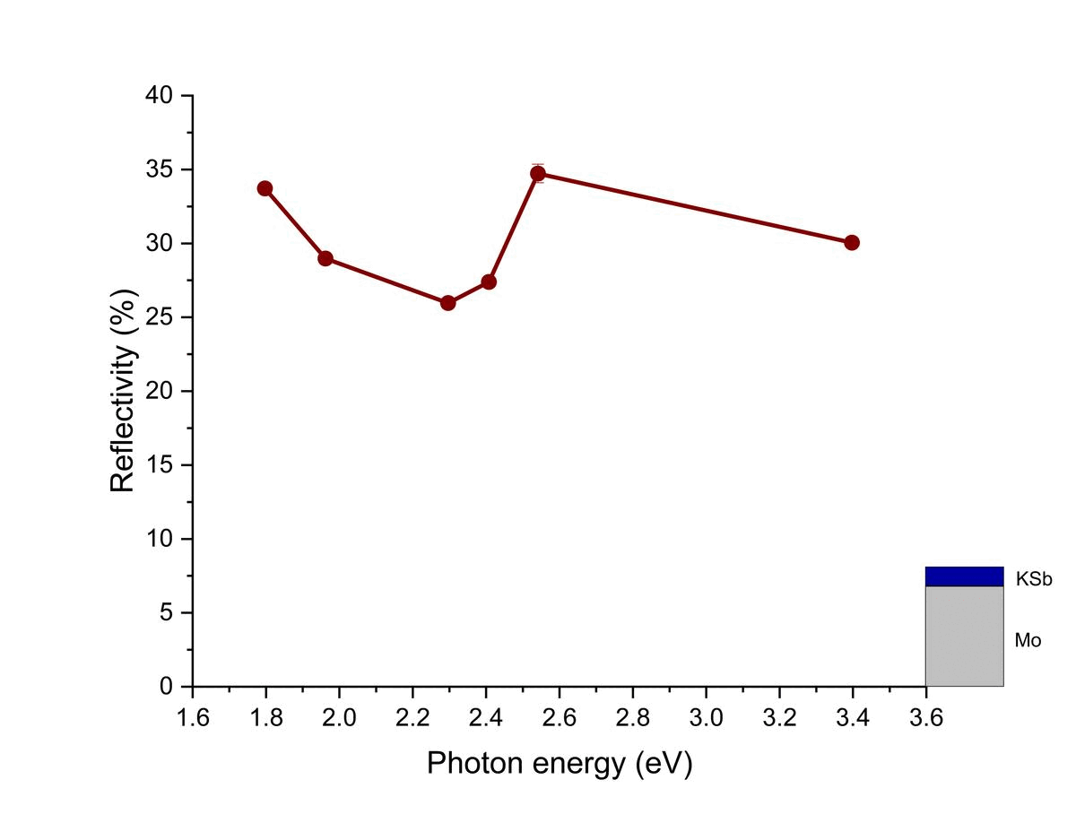
Real-time Reflectivity history during KSb+Cs deposition (137.3 KCsSb-Thin, Cathode-2)
“Real-time” Spectral reflectivity vs. Photon energy
R(%) history during KSb+Cs deposition (137.3 KCsSb-Thin)
Cathode-2
R(%) history during KSb+Cs deposition (137.2 KCsSb-Thick)
Cathode-1
@10 nm of Cs
@20 nm of Cs
@30 nm of Cs
@60 nm of Cs
@85 nm of Cs
Sb + K deposition
Cs deposition
“Real-time” Reflectivity vs. Thickness
Final Reflectivity
From 0-10 nm of Cs evaporation, in “real-time reflectivity vs. thickness” Fig., the rate of change in (slope) of reflectivity (decreasing) at green wavelengths (515 &
540 nm) was higher compared to other wavelengths.
Up to 20 nm of Cs evaporation, in “real-time reflectivity vs. Photon energy” Fig., the curve was observed to be deeper, but the shape was getting narrower.
Up to 30 nm of Cs evaporation, in “real-time reflectivity vs. Thickness” Fig., the “rate of decrease” of reflectivity was stabilized for all the wavelengths.

Slide 18
Comparison of R (%) between KCsSb Thick (137.2) and Thin (137.3) cathodes
KCsSb Thick (137.2) Cathode-1
Summary
KCsSb Thin (137.3) Cathode-2
Spectral Reflectivity
Spectral Reflectivity
After Sb
After Sb
After K
After K
After Cs
After Cs
18

Slide 19
Comparison between KCsSb Thick (137.2) and Thin (137.3) cathodes
KCsSb Thick (137.2)
KCsSb Thin (137.3)
1.05 eV
Thick
1.22 eV
Thin
1.44 eV
1.87 eV
2.29 eV
Colour of the cathode
Colour of the cathode

Slide 20
Simulation results
Density Function Theory (DFT) study

Slide 21
Electronic structure (DFT study)
Band structure calculation by HSE method
K₃Sb
(Cubic)
K₃Sb
(Hexagonal)
K₂CsSb
(Cubic)
[1] A. H. Sommer and W. H. McCarroll, “A New Modification of the Semiconducting
Compound K3Sb,” Journal of Applied Physics, vol. 37, no. 1, pp. 174–179, 062004.
[2] A. H. Sommer and W. H. McCarroll, “A New Modification of the Semiconducting
Compound K3Sb,” Journal of Applied Physics, vol. 37, no. 1, pp. 174–179, 06 2004.
[3] C. Ghosh and B. P. Varma, “Preparation and study of properties of a few alkali antimonide photocathodes,”
Journal of Applied Physics, vol. 49, no. 8, pp. 4549–4553, 08 2008
a = 8.493 angstrom
a = 6.025 angstrom
C = 10.690 angstrom

Slide 22
K2CsSb (Cubic) Optical Properties
n(ω) = ${\left[\frac{\sqrt{{ɛ₁}^{2}\left(ω\right)+{ɛ₂}^{2}\left(ω\right)}−ɛ₁(ω)}{2}\right]}^{0.5}$
k(ω) = ${\left[\frac{\sqrt{{ɛ₁}^{2}\left(ω\right)+{ɛ₂}^{2}\left(ω\right)}+ɛ₁(ω)}{2}\right]}^{0.5}$
R(ω) = $\frac{{\left(1−n\right)}^{2}+k^{2}}{{\left(1+n\right)}^{2}+k^{2}}$
α (ω) = 4πk/λ
Real
Imaginary
Refractive index n(ω)
Real & imaginary part of dielectric function
Extinction coefficient k(ω)
Reflectivity R(ω)
Absorption coefficient I(ω)
Ground-state calculations, are implemented in Quantum Espresso and the dielectric function is calculated in epsilon.x post-processing utility.

Slide 23
Comparison of simulation with experimental results

Slide 24
Comparison between the DFT Simulation and Experimental Data for K₃Sb
K₃Sb
(Cubic)
K₃Sb
(Hexagonal)
Experimental [1]
Simulation
Simulation
Experimental [1]
Comparison between the reference experimental [1] and simulated imaginary part of the dielectric function
Comparison between the reference experimental [1] and simulated imaginary part of the dielectric function
KSb-thin
However, the observed two major peaks in our KSb-thick cathodes do not match those of the K₃Sb hexagonal or cubic compounds.
Potentially thin KSb exhibits a cubic crystal orientation!
Comparison of the peaks between reference experimental [1] and our lab-grown KSb (thin) cathodes.
[1] A. Ebina and T. Takahashi, “Transmittance spectra and optical constants of alkali-antimony compounds k3sb, na3sb, and na2ksb,” Phys. Rev. B, vol. 7, pp. 4712–4719, May 1973.

Slide 25
Reflectivity comparison of KCsSb compound
Simulation Spectral Reflectivity K₂CsSb (cubic)
Experimental Spectral Reflectivity KCsSb
2.93
4.39
1.05 eV
1.22 eV
3.67
Thick
Sb =10 nm
Thin
Sb = 5 nm
2.40
3.06
1.49
1.44 eV
2.13
1.49
Band structure
K₃Sb
K₃Sb
To arrive at a definitive conclusion, verification with photoemission spectroscopy results is necessary!!
1.54 eV
Simulation Reflectivity K₃Sb

Slide 26
Summary & Future plan
Two cathodes have been produced with sequential deposition with QE @514 nm recorded 4-6 %.
A new “multi-wavelength” Optical Diagnostics setup has been used during the cathode deposition
It gives information about real-time spectral response and reflectivity during cathode growth.
The optical spectra of these semiconductors provide a rich source of information on their electronic properties.
Comparing the spectral reflectivity between two cathodes (having different thicknesses) shows that the intermediate phase, i.e., K+Sb (KSb compound), and the final phase, i.e., KCsSb compound, potentially contain different crystal structures for thick (Sb = 10nm) and thin (Sb = 5 nm) cathodes. (Further verification through photoemission spectroscopy results is required!)
By comparing with DFT simulation data, it has been found that, potentially, both the cathodes (i.e., thin and thick) have a different band gap.
By analyzing optical spectra, particularly spectral reflectivity, and comparing them with theoretical models (DFT results) offers a valuable method to predict the electronic structure of the grown compound.
Having knowledge of these real-time optical properties can further help to develop the automated growth procedure.
Future Plans:
The next batch of green cathodes is planned to be tested at PITZ at the end of this year.
TRAnsverse Momentum Measurement (TRAMM) device is currently being developed and planned to be integrated into the production system to measure thermal emittance.
Photoemission spectroscopy study.
Thank You for your attention!

Slide 27
Backup Slides

Slide 28
R(%) history (137.2 KSb-Thick)
R(%) history (137.3 KSb-Thin)

Slide 29
Comparison between the DFT Simulation and Experimental Data for K₃Sb
K₃Sb
(Cubic)
K₃Sb
(Hexagonal)
Not exactly match
Experimental [1]
KSb-thick
Simulation
Simulation
KSb-thin
Experimental [1]
Comparison between the reference experimental [1] and simulated imaginary part of the dielectric function
Comparison between the reference experimental [1] and simulated imaginary part of the dielectric function
KSb-thin
Comparing the transmittance data from reference experiments [1] for the cubic and hexagonal structures of K₃Sb.
Potentially thin KSb exhibits a cubic crystal orientation!
Comparison of the peaks between reference experimental [1] and our lab-grown KSb (thin) cathodes.
[1] A. Ebina and T. Takahashi, “Transmittance spectra and optical constants of alkali-antimony compounds k3sb, na3sb, and na2ksb,” Phys. Rev. B, vol. 7, pp. 4712–4719, May 1973.

Slide 30
“New” KCsSb #8 cathode
KCsSb #8 has grown in the R&D preparation chamber
through sequential deposition method.
90 °C
130 °C
120 °C
Sb
K
KSb
Cs
KSbCs
0.2-0.4 nm/min
0.3-0.6 nm/min
5nm
Deposition rate has been changed compared to previous
methods (i.e., 1 nm/min) during K and Cs deposition.
Due to little elevated temp. 130 °C (before 120 °C) and
slow deposition rate (0.2-0.4 nm/min), which helped to
improve the QE (record high ~ 1.2 % at 543 nm) for KSb film.
Unfortunately, the Cs source was completely empty during the
Cs deposition, so we observe a disturbance in the QE curve.
The final QE of KCsSb #8 is
5.1 % @543 nm (compare to 3.07 % for thin cathodes )
8.84 %@ 515 nm (compare to 6.88 % for thin cathodes
(the QEs are estimated by including the transmittance of the viewport)
Photocurrent and reflectivity history (not include transmittance of the viewport)
* Here the transmittance value of viewport is not included in QE data

Slide 31
K3Sb Cubic Optical Properties
n(ω) = ${\left[\frac{\sqrt{{ɛ₁}^{2}\left(ω\right)+{ɛ₂}^{2}\left(ω\right)}−ɛ₁(ω)}{2}\right]}^{0.5}$
k(ω) = ${\left[\frac{\sqrt{{ɛ₁}^{2}\left(ω\right)+{ɛ₂}^{2}\left(ω\right)}+ɛ₁(ω)}{2}\right]}^{0.5}$
R(ω) = $\frac{{\left(1−n\right)}^{2}+k^{2}}{{\left(1+n\right)}^{2}+k^{2}}$
α (ω) = 4πk/λ
Real
Imaginary
Refractive index n(ω)
Real & imaginary part of dielectric function
Extinction coefficient k(ω)
Reflectivity R(ω)
Absorption coefficient I(ω)
Ground-state calculations, are implemented in Quantum Espresso and the dielectric function is calculated in epsilon.x post-processing utility.

Slide 32
K3Sb Hexagonal Optical Properties
n(ω) = ${\left[\frac{\sqrt{{ɛ₁}^{2}\left(ω\right)+{ɛ₂}^{2}\left(ω\right)}−ɛ₁(ω)}{2}\right]}^{0.5}$
k(ω) = ${\left[\frac{\sqrt{{ɛ₁}^{2}\left(ω\right)+{ɛ₂}^{2}\left(ω\right)}+ɛ₁(ω)}{2}\right]}^{0.5}$
R(ω) = $\frac{{\left(1−n\right)}^{2}+k^{2}}{{\left(1+n\right)}^{2}+k^{2}}$
α (ω) = 4πk/λ
1.04
2.18
3.32
1.54
4.15
2.46
4.62
2.85
Real
Imaginary
Real & imaginary part of dielectric function
Refractive index n(ω)
Extinction coefficient k(ω)
Reflectivity R(ω)
Absorption coefficient I(ω)
Ground-state calculations, are implemented in Quantum Espresso and the dielectric function is calculated in epsilon.x post-processing utility.

Slide 33
Reflectivity comparison of KSb compound
3.90 eV
R &D
Thin KSb
2.70 eV
4.50 eV
3.06 eV
1.42 eV
3.37 eV
1.032 eV
3.71eV
1.54 eV
2.75 eV
Thick KSb
Simulation Reflectivity KSb
Experimental Reflectivity KSb
Experimental Optical density for K3Sb cubic & hexagonal
findings by A. H. SOMMER
Journal of Applied Physics 37, 174 (1966); https://doi.org/10.1063/1.1707801

Slide 34
Reaction of Cs with different bulk agent
KCsSb Photocathodes
Cathode | Temperature (°C) during Cs deposition | Δ QE (elevation)
KCsSb-3 | 60* | 1.87
KCsSb-4 | 90 | 0.86
KCsSb-5 | 90 | 0.87
KCsSb-6 | 90 | 0.86
KCsSb-7 | 110 | 0.64
Incoming Cs
Evaporation
K + Sb
Bulk
Diffusion
jump at the end
Rate of diffusion α Substrate Temperature
A very temperature-sensitive surface layer
that make an equilibrium point between
inward cesium (being distributed, diffused) and
evaporated cesium.
Sudden decrease in evaporation rate
would immediately upset this balance or equilibrium
point and would impact the emission barrier via the electron
affinity.

