Slide 1

R&D of Very High Frequency (VHF) gun for SHINE project at Tsinghua University
Yingchao Du
Department of Engineering Physics，Tsinghua University
Beijing, China,100084
dych@tsinghua.edu.cn

Slide 2
outline
Introduction
Gun design
Commissioning and beam testing
Summary and outlook

Slide 3
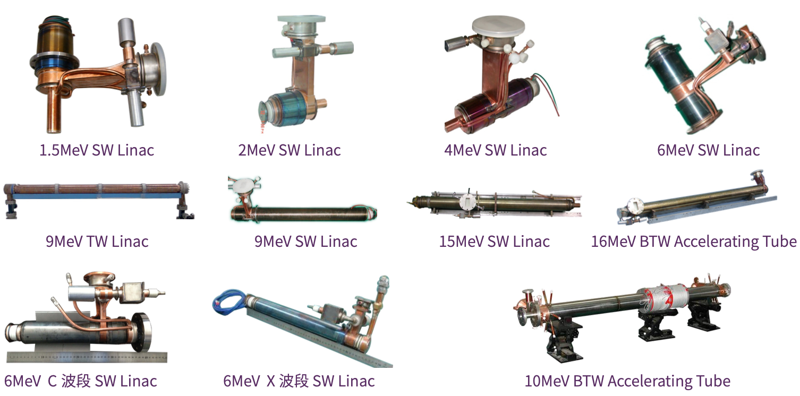
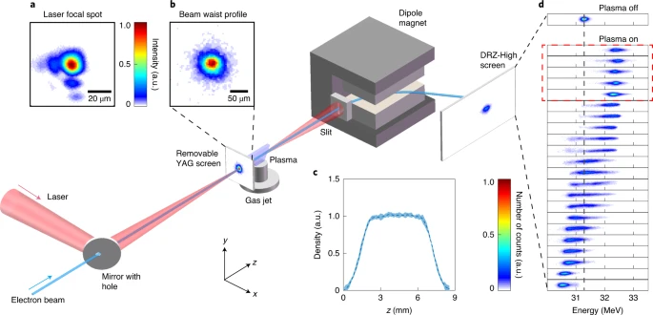
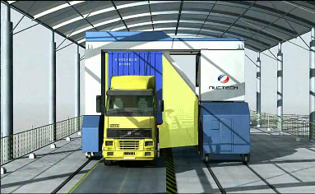
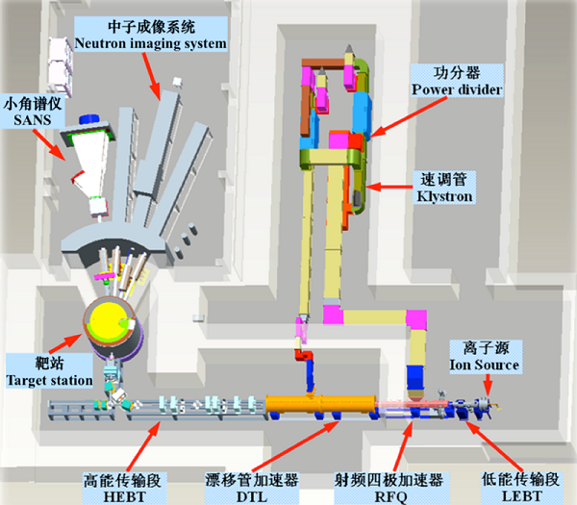
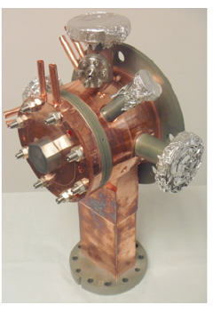
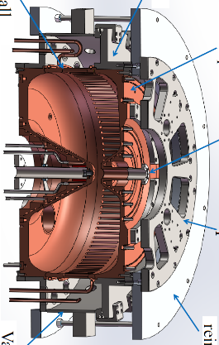
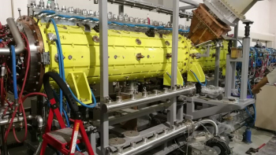
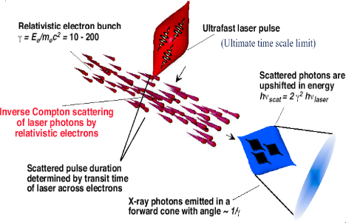
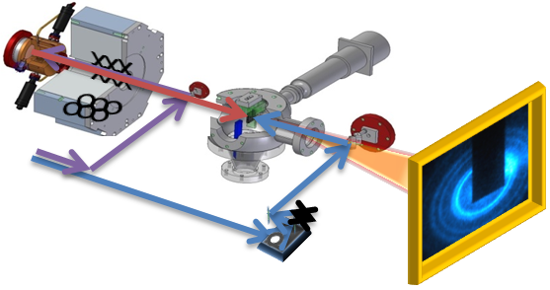
Accelerator Lab at Tsinghua University
Low energy Linac for industry and medical
Plasma wake-field accelerator and applications
Accelerator physics and applications
Compact Pulsed Hadron Source and applications
High brightness electron source and applications

Slide 4
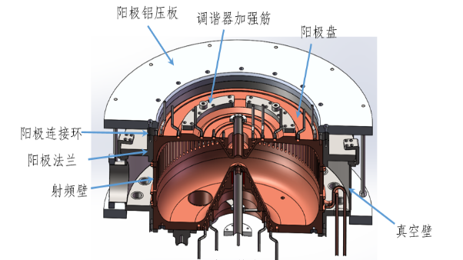
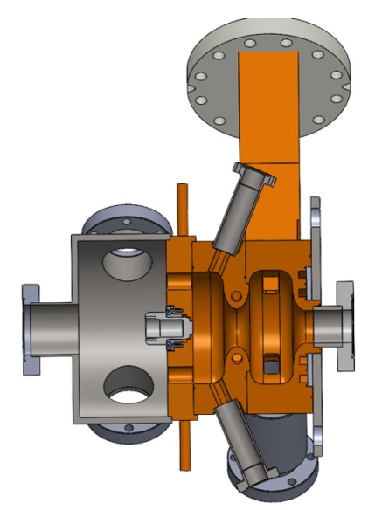
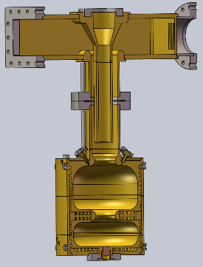
R&D of the photocathode RF gun at Tsinghua
More than 30 photocathode RF guns were made at THU
Tsinghua Thomson scattering source
BNL
Shanghai Deep Ultraviolet FEL
USTC
2000-2006
2006-2009
2009-2018
2019-
Modifications of BNL-type gun
New gun with semiconductor cathode for middle or high repetition-rate beam
Low dark current, Max. cathode filed: 80-110MV/m
Low dark current and BDR, Max. cathode filed: 100-120MV/m, successfully applied at TTX, DCLS,SXFEL, etc. al

Slide 5
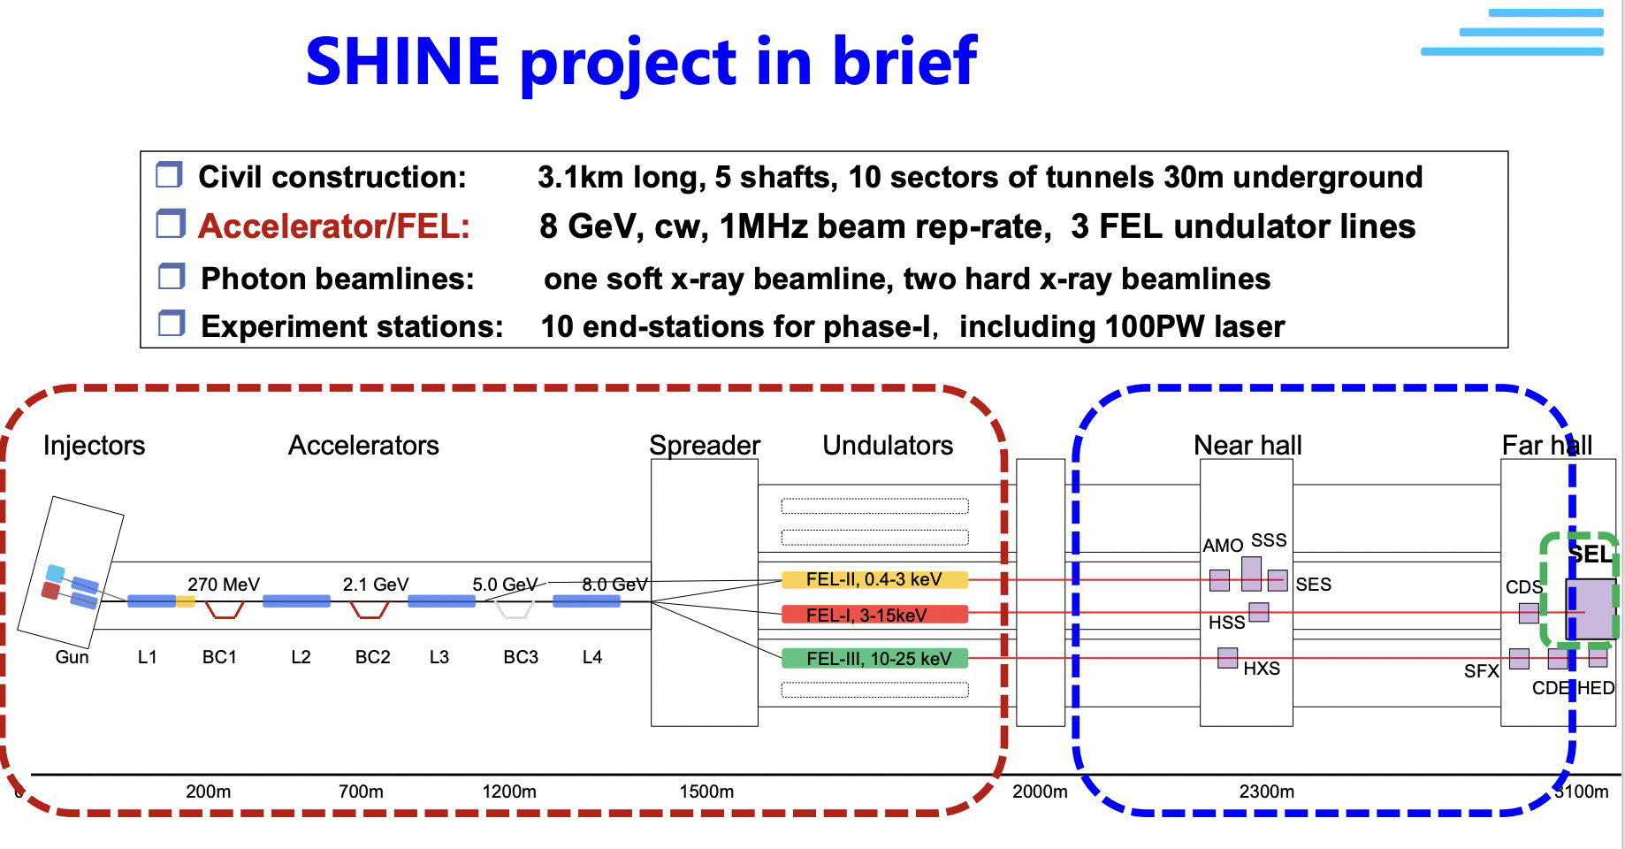
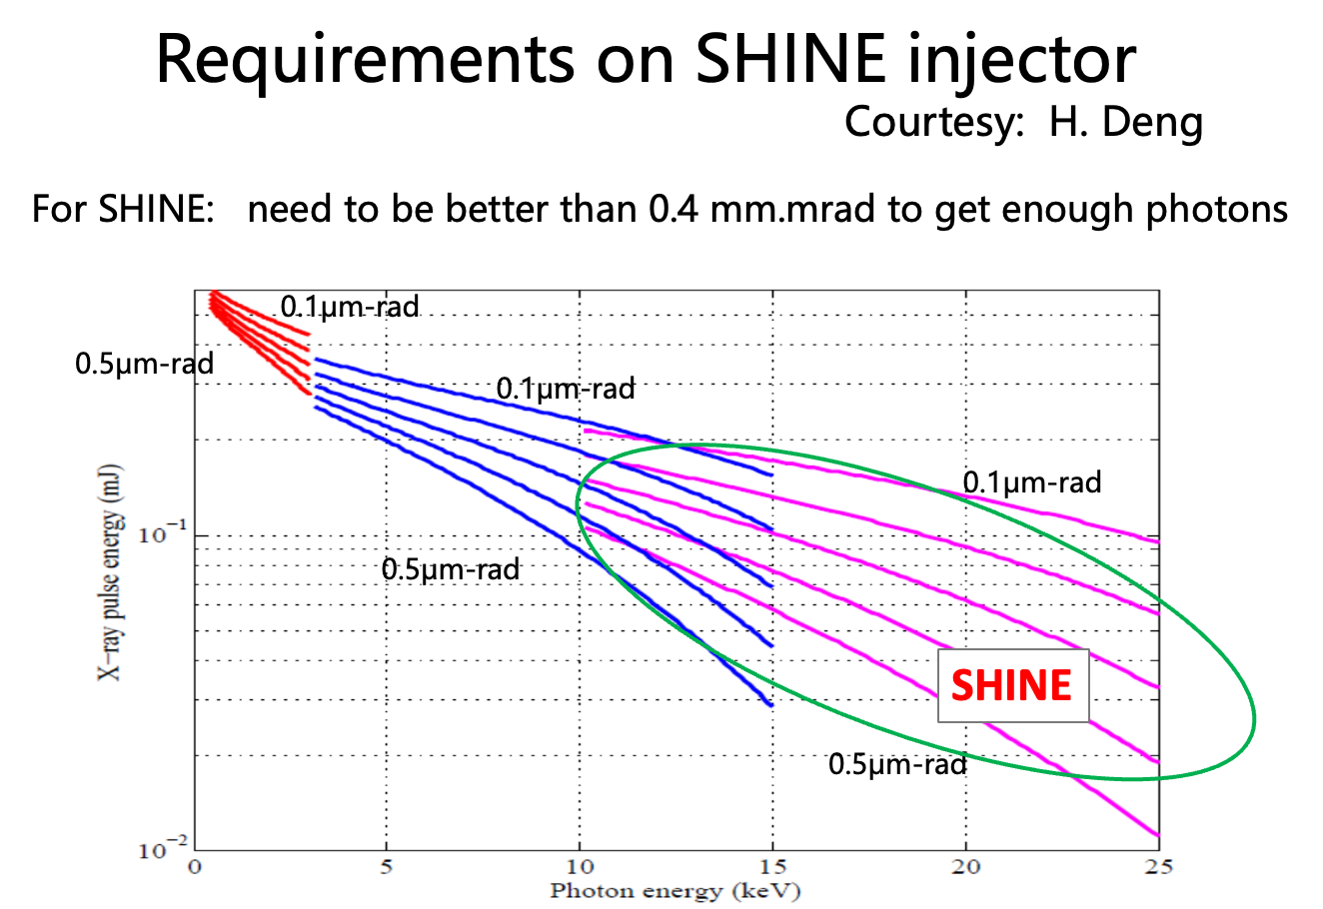
Gun's requirements of SHINE project
CW operation
1 MHz repetition
High charge, 20-300pC
Low emittance, 0.4um@100pC

Slide 6
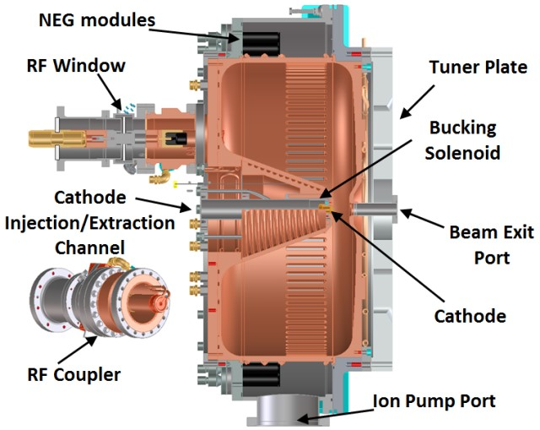
Gun's requirements for SHINE project
VHF photocathode gun: Baseline for SHINE project
Advantages:
  Normal conducting
  Long wavelength, big size, low temperature increase
  High cathode gradient and cavity voltage
  Good vacuum performance, successfully operated with semiconductor cathode
  Demonstrated for stable CW operation and MHz repetition rate beam at LBNL and SLAC
APEX-gun@LBNL

Slide 7
R&D timeline of SHINE VHF gun
2019.3 MOU signed between Tsinghua and SHINE project
2019.12 Finish gun design，start manufacturing
2021.1 Finish the manufacturing of the prototype gun
2021.12 Achieve 30 kW CW operation of the prototype gun
2022.4 Finish the manufacturing of the second gun
2022.8 Achieve 70 kW CW operation of the second gun
2022.8 Generate the first photoelectron beam
2023.1 beam emittance optimized and achieved good beam performance
2023.4 Delivered to SHINE and installed in tunnel
2023.9 Vacuum ready for beam commissioning

Slide 8
outline
Introduction
Gun design
Commissioning and beam testing
Summary and outlook

Slide 9
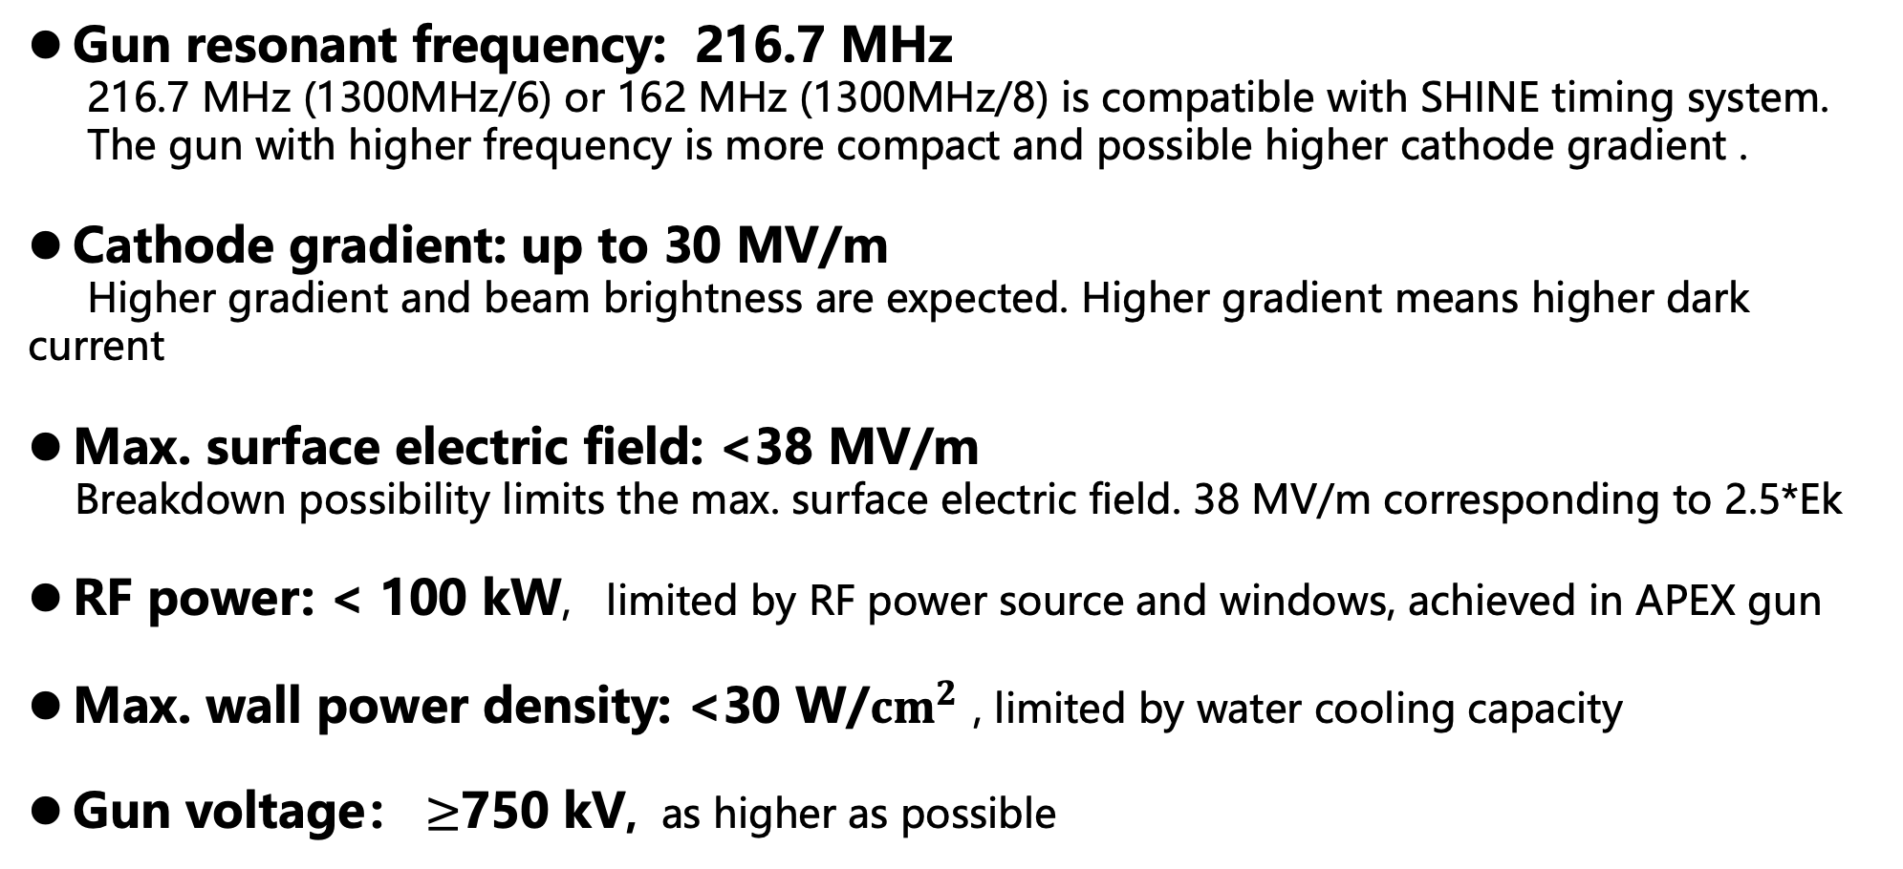
Basic considerations on VHF gun design
Gun resonant frequency: 216.7 MHz
216.7 MHz (1300MHz/6) or 162 MHz (1300MHz/8) is compatible with SHINE timing system.
The gun with higher frequency is more compact and possible higher cathode gradient .
Cathode gradient: up to 30 MV/m
Higher gradient and beam brightness are expected. Higher gradient means higher dark current
Max. surface electric field: <38 MV/m
Breakdown possibility limits the max. surface electric field. 38 MV/m corresponding to 2.5*Ek
RF power: < 100 kW, limited by RF power source and windows, achieved in APEX gun
Max. wall power density: <30 W/${cm}^{2}$ , limited by water cooling capacity
Gun voltage： $≥$750 kV, as higher as possible

Slide 10
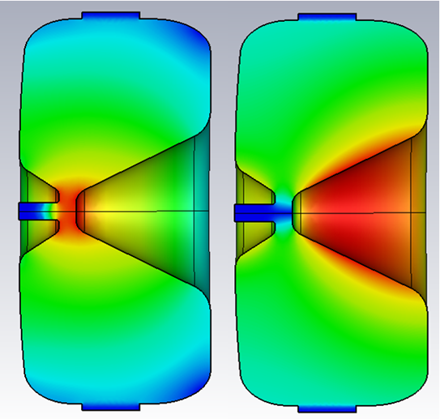
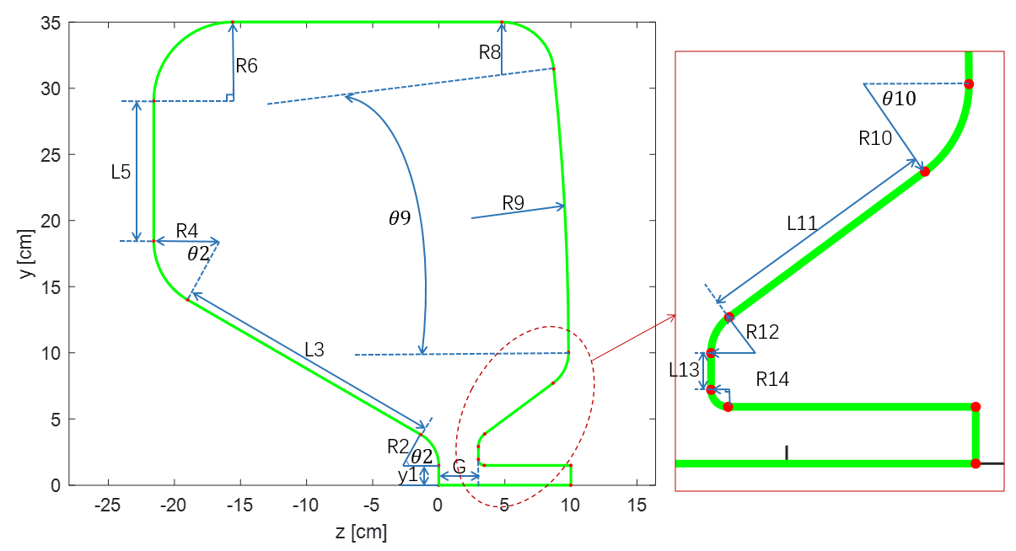
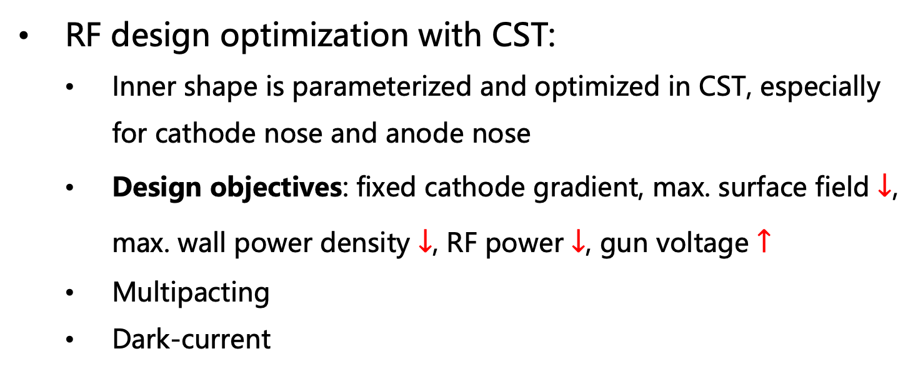
VHF gun design
RF design optimization with CST:
  Inner shape is parameterized and optimized in CST, especially for cathode nose and anode nose
  Design objectives: fixed cathode gradient, max. surface field $↓$, max. wall power density $↓$, RF power $↓$, gun voltage $↑$
  Multipacting
  Dark-current
E field
H field
RF parameters | VHF Gun@THU
Frequency | 216.67 MHz
Cathode gradient | 30 MV/m
Input RF power | 90.4 kW
Max. E field | 36.99 MV/m (<2.5kilp)
Max. P density | 28.45 W/cm²
Voltage | 868 kV

Slide 11
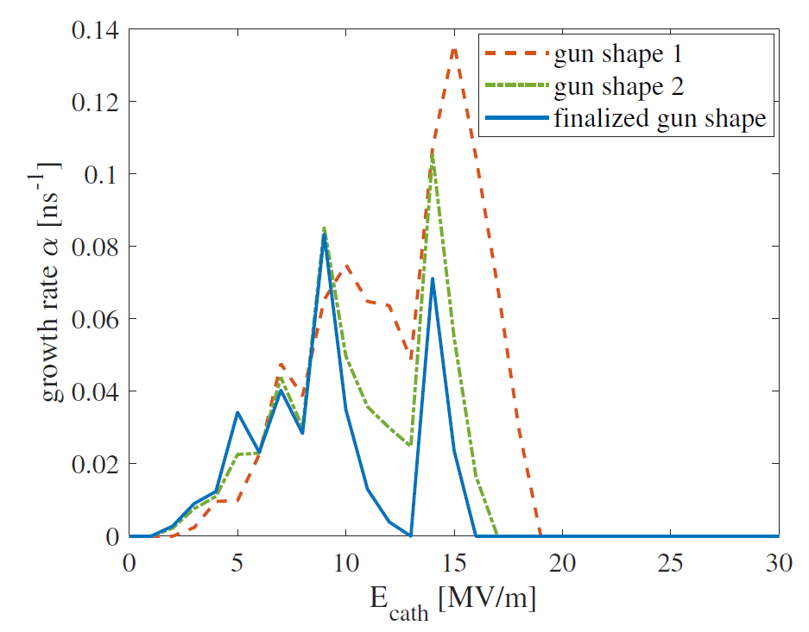
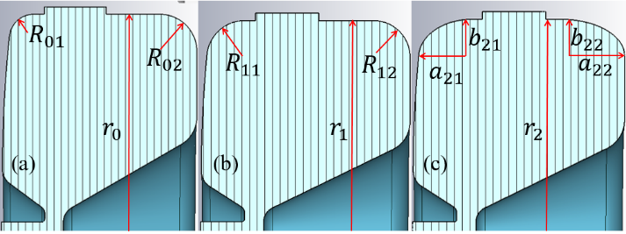
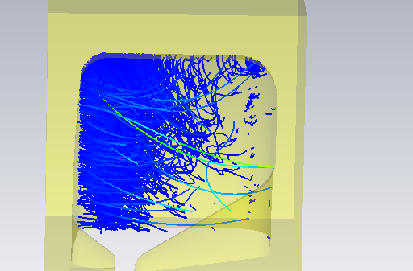
VHF gun design and optimization
Multipacting simulation
(a) gun shape 1. (b) gun shape 2. (c) finalized gun shape.
Change rounded corners to elliptical
Reduce the radius
MP locates at the upper corner of the anode plate
multipacting location
The designed cathode gradient：30 MV/m
No multipacting for gradient higher than 16 MV/m

Slide 12
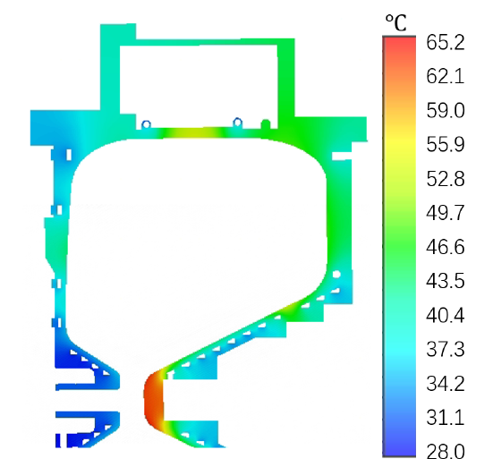
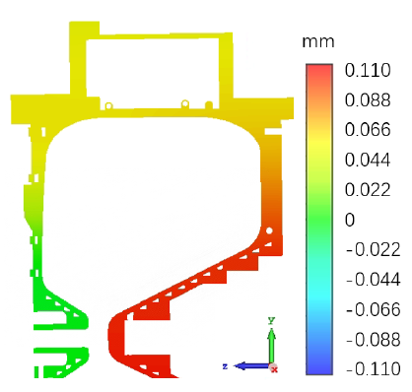
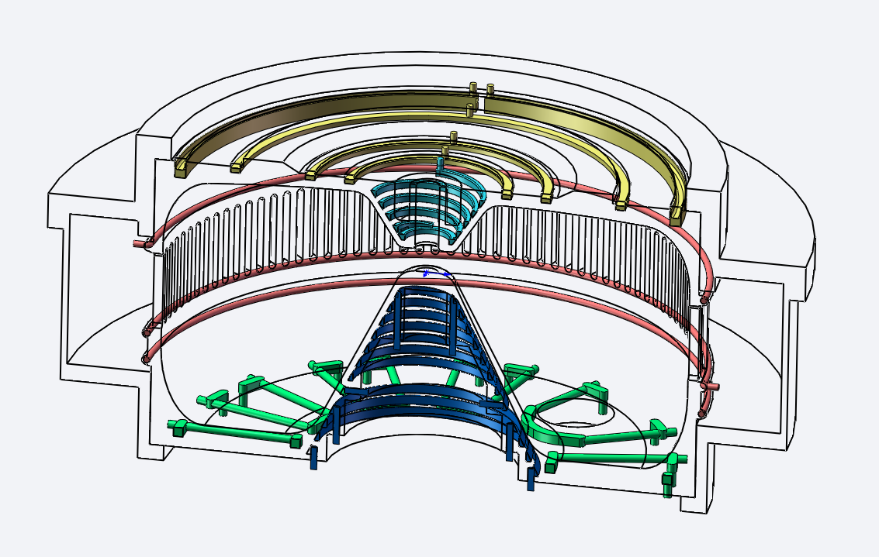
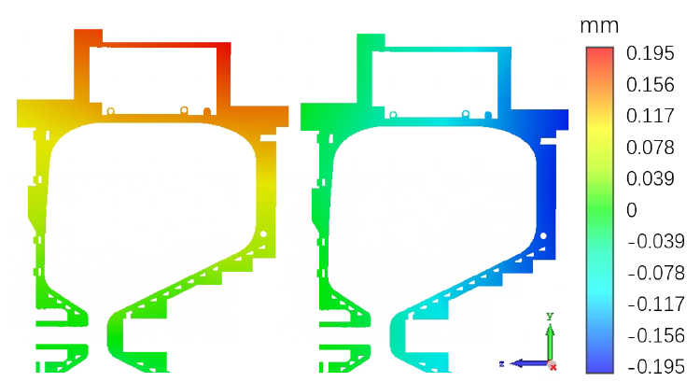
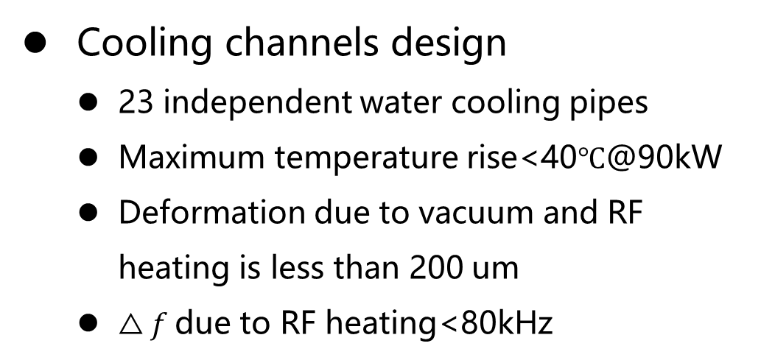
VHF gun RF design and optimization
Cooling channels design
  23 independent water cooling pipes
  Maximum temperature rise<40$℃$@90kW
  Deformation due to vacuum and RF heating is less than 200 um
  $△f$due to RF heating<80kHz
54℃
Axial deformation
due to pressure
65.2℃
Radial and axial deformation
due to thermal expansion

Slide 13
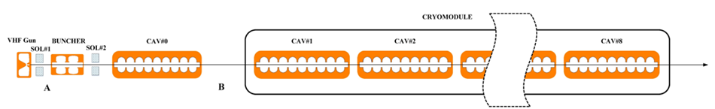
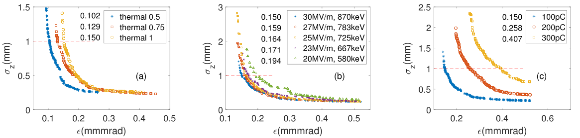
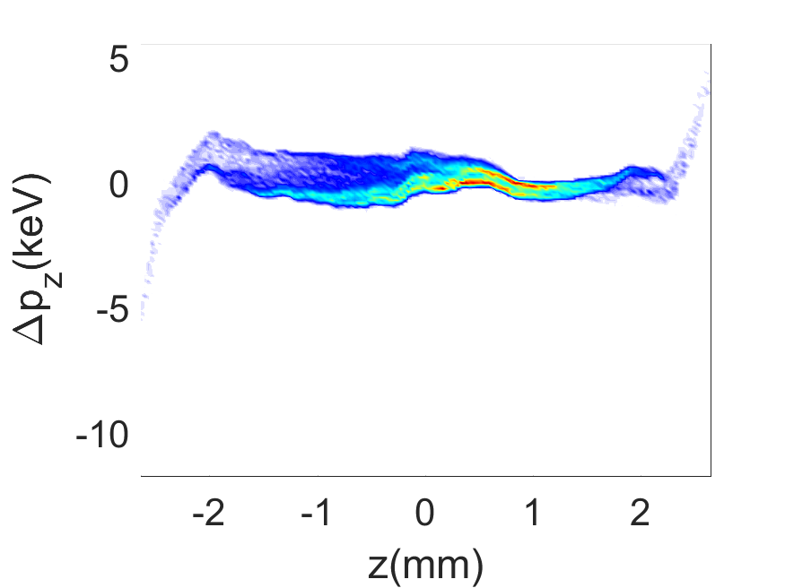

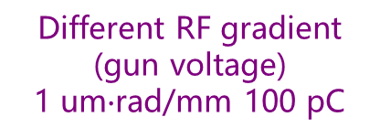
VHF gun RF design and optimization
Beam dynamics simulation and optimization
MOGA with Astra, fourteen parameters
Objectives: Low beam emittance and high order energy spread with 1mm rms bunch length
Different thermal emittance
30 MV/m 100 pC
Different RF gradient (gun voltage)
1 um$∙$rad/mm 100 pC
Different beam charge
1 um$∙$rad/mm 30 MV/m
High order energy spread:
<0.6keV rms

Slide 14
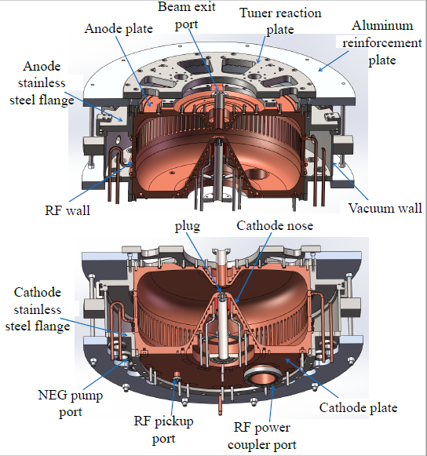
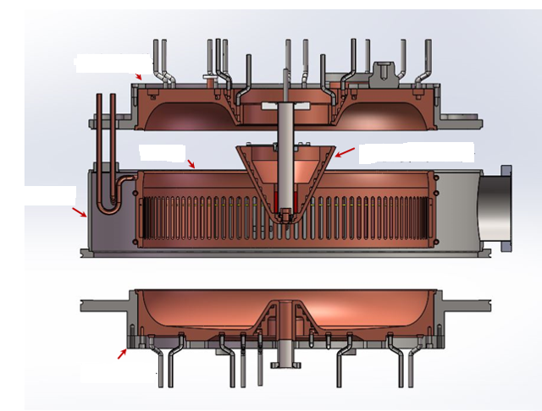
VHF gun RF design and optimization
Mechanical design
Cathode plate
RF wall
Nose
Vacuum wall
Anode plate

Slide 15
outline
Introduction
Gun design
Commissioning and beam testing
Summary and outlook

Slide 16
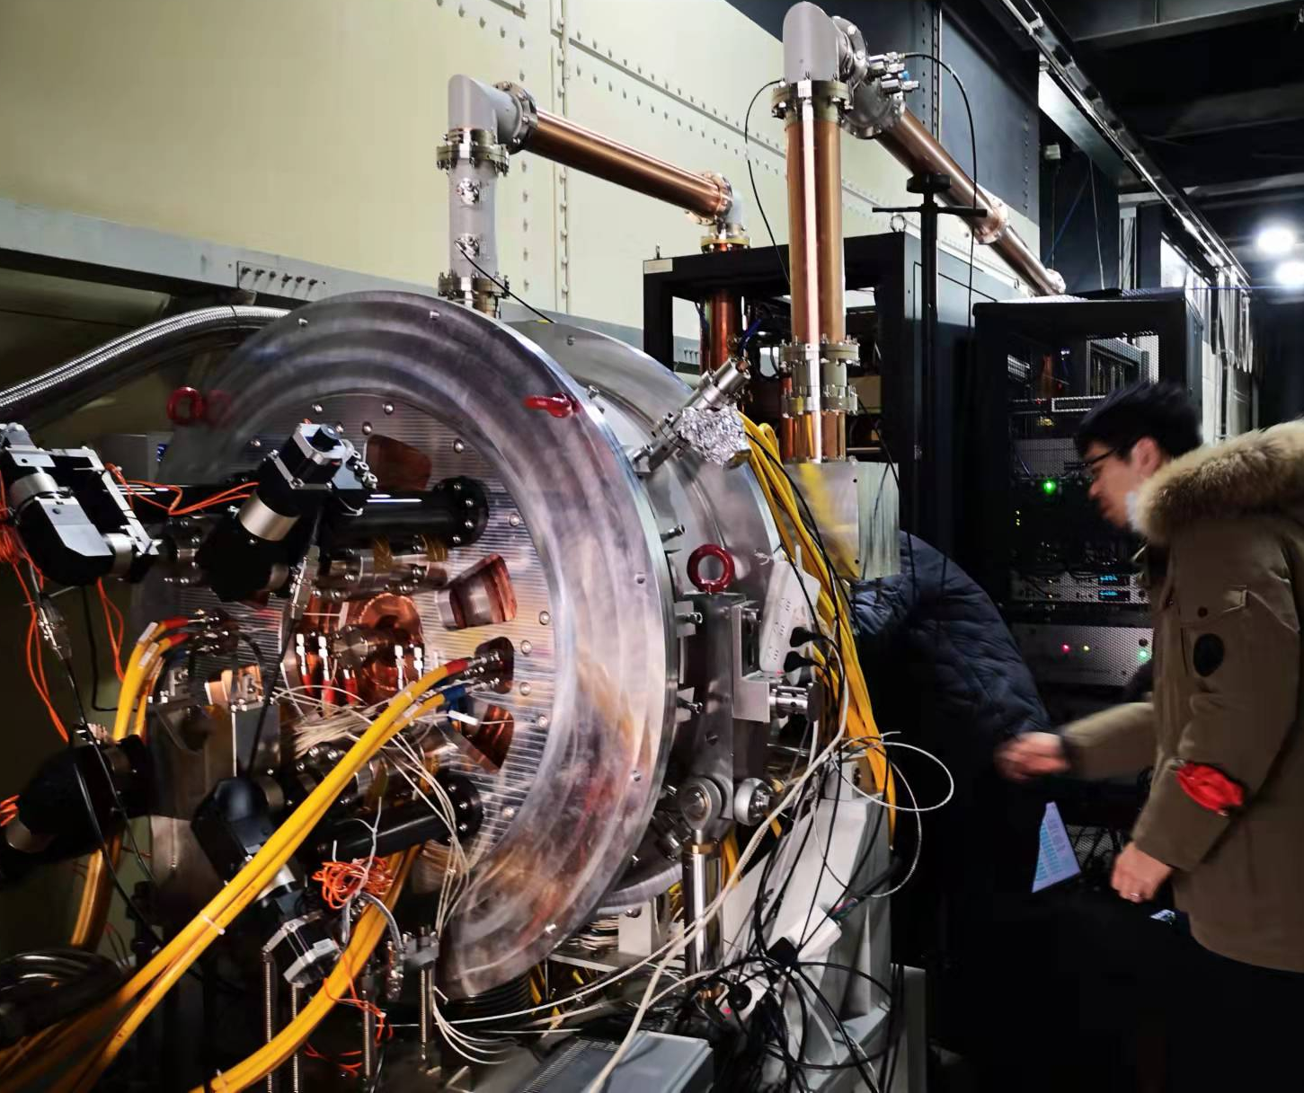
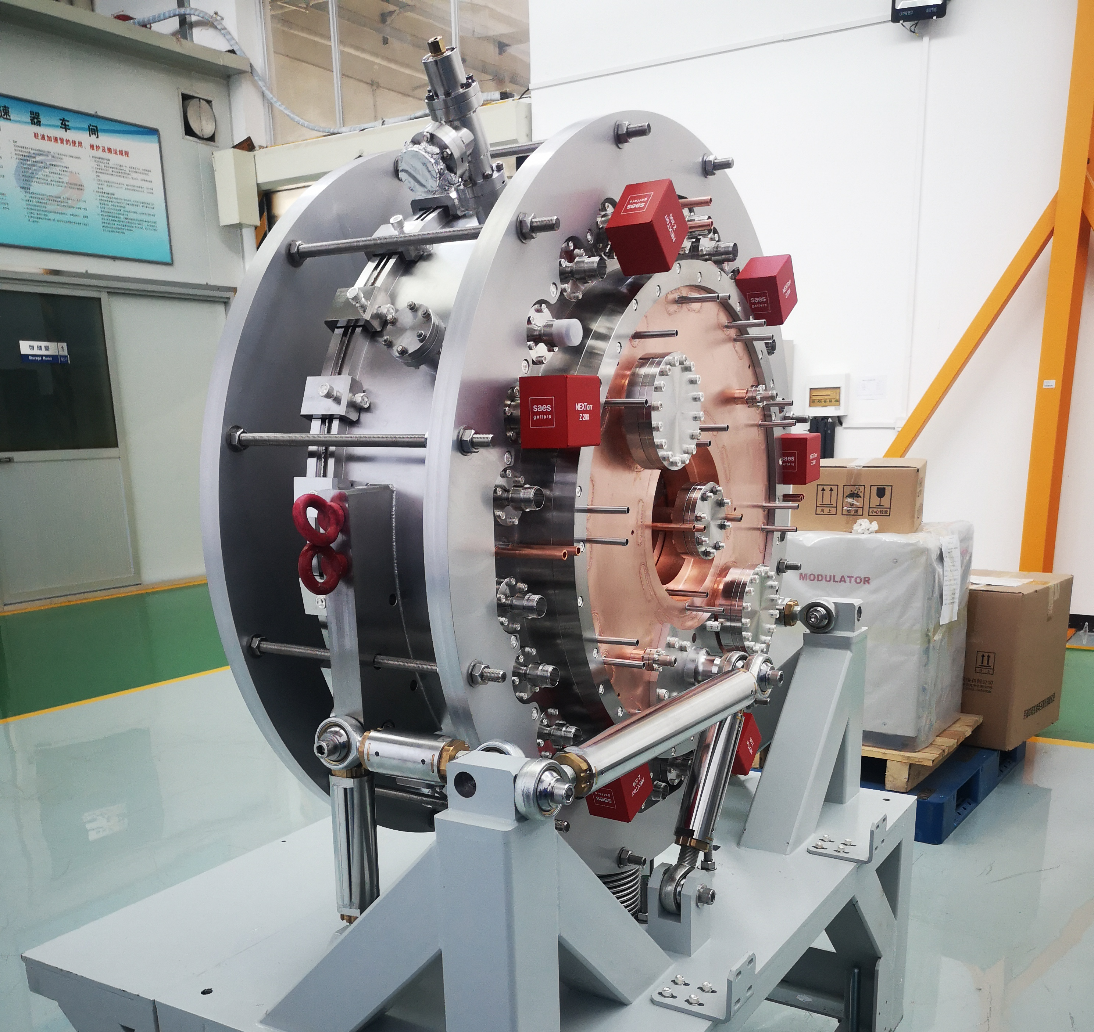
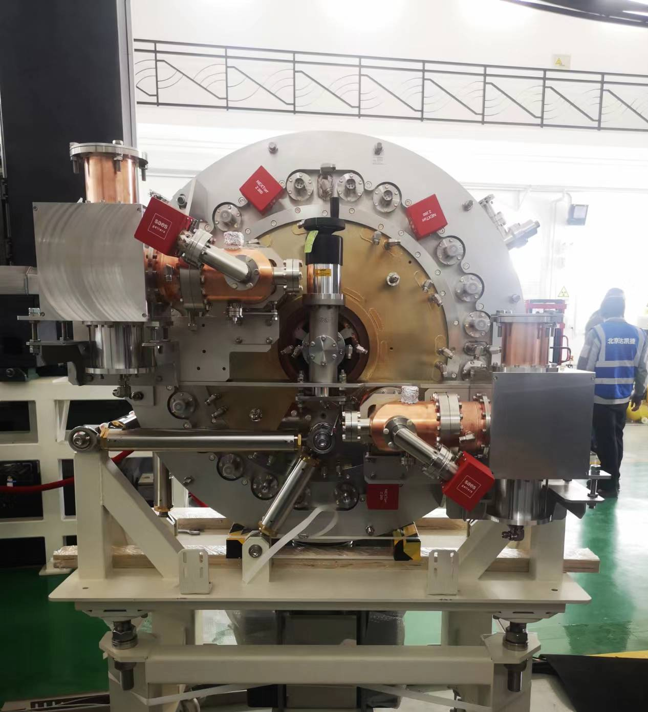
Machining of the VHF gun
3 guns have been made for process testing and beam commissioning
Prototype gun for machining process testing
Gun 2 and 3，>75kW CW stable operation(limited by AC power supply system)，low dark current and good beam performance

Slide 17
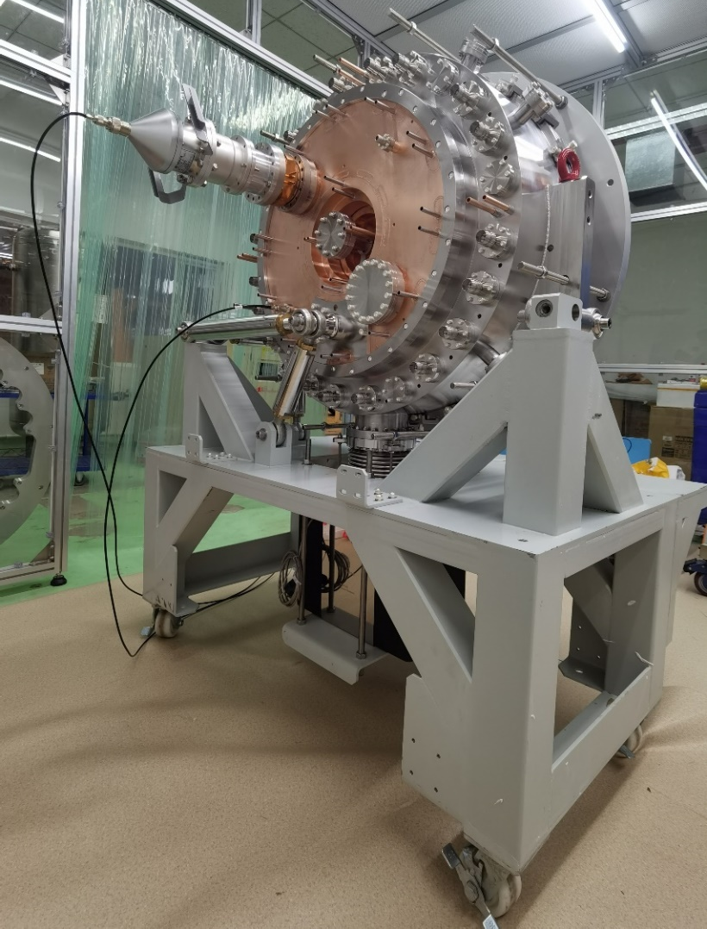
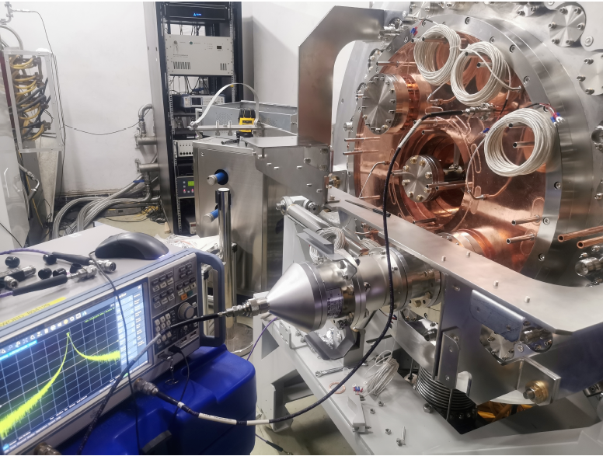
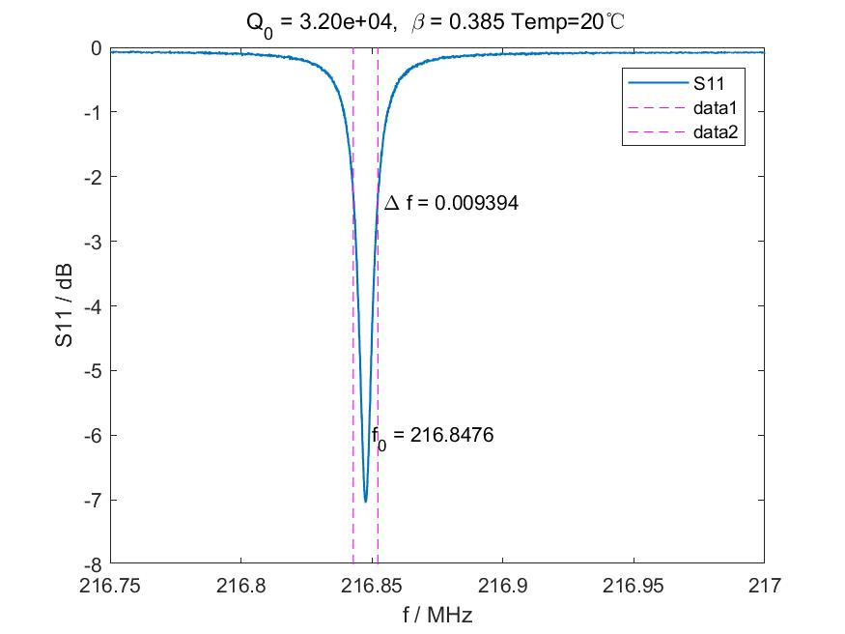
Cold test of the VHF gun
The measured frequency is in consistent with the design.
The quality factor is 5% less than the design.
Quality factor in design：33717
Quality factor measured：32000

Slide 18
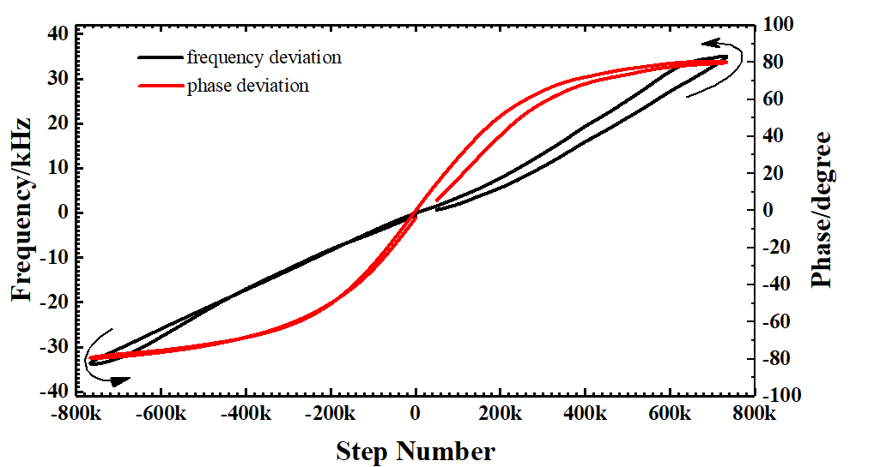
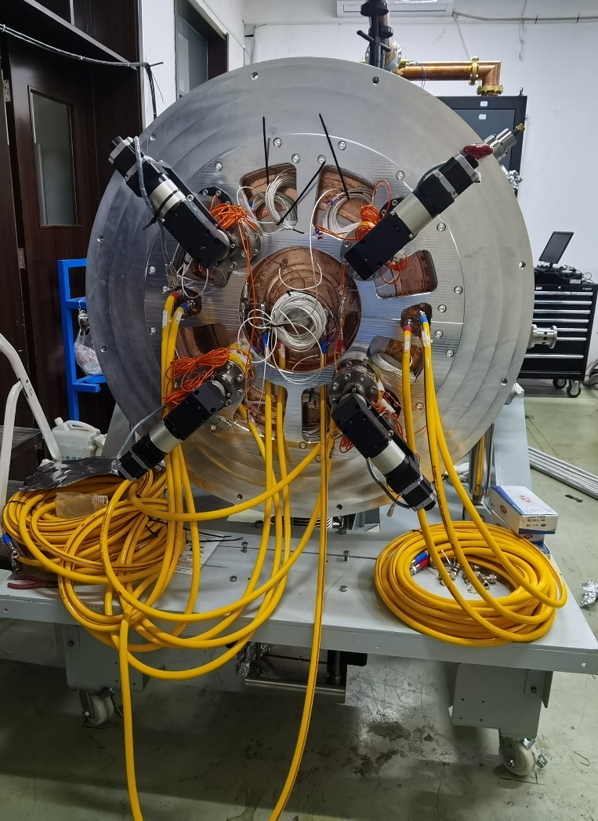
Cold test of the VHF gun
Tuner test
push
pull
Four tuners driven by step motors(no piezo), ~0.04Hz/step
The maximum total force with four tuner is about 40kN
The gun frequency response factor is about 2.5 kHz/kN.
Frequency shift range: (-100 kHz, 100 kHz)

Slide 19
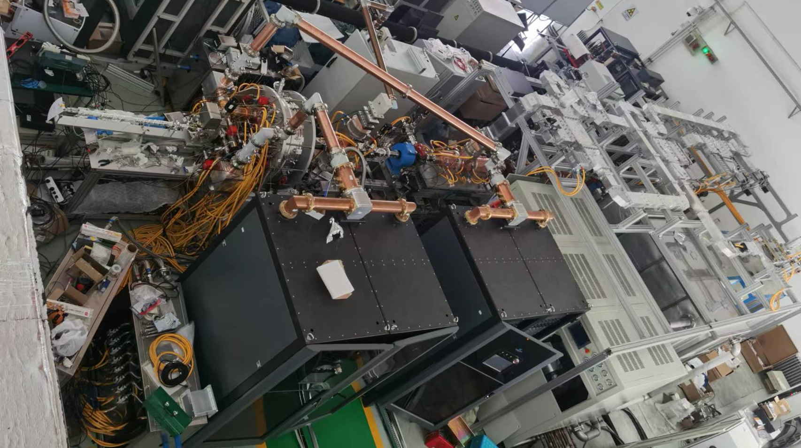
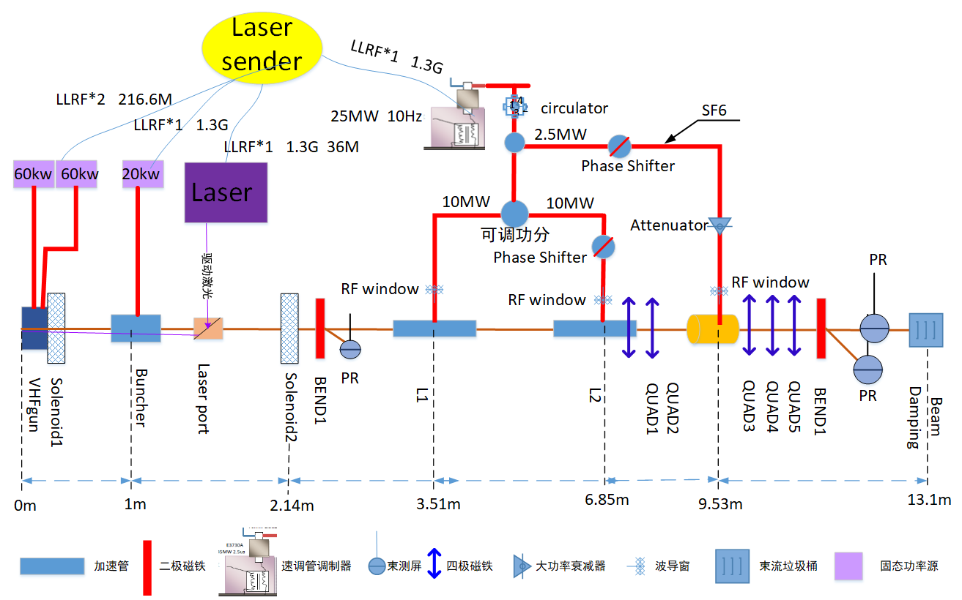
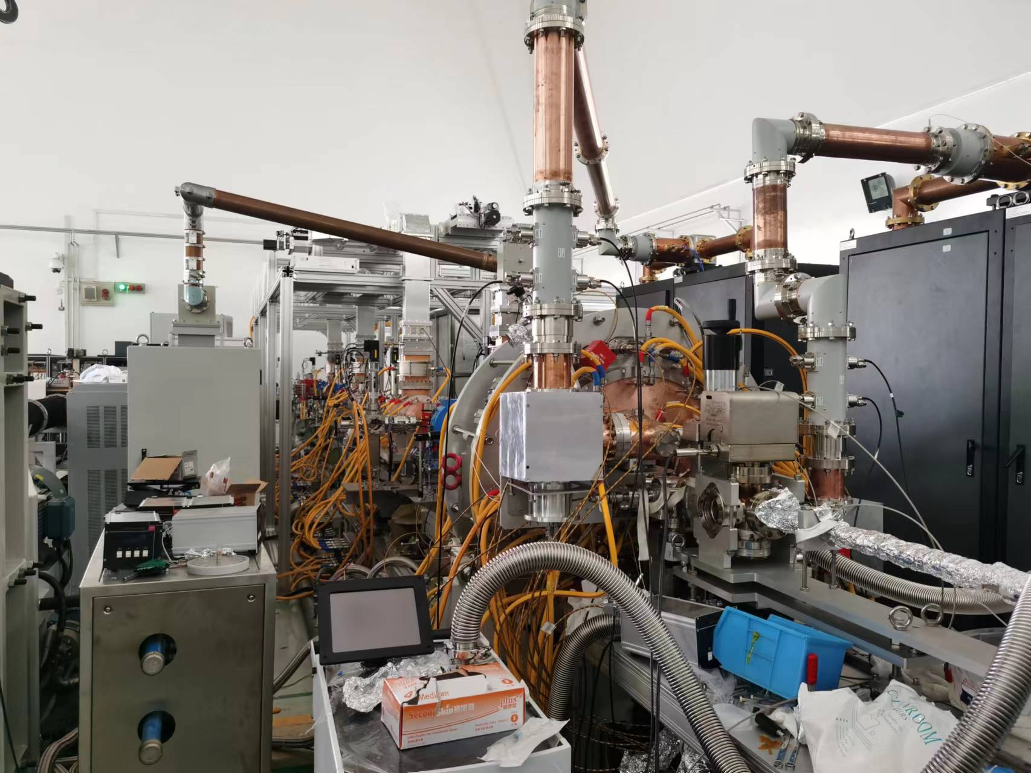
High power testing
30MeV beamline for gun beam testing
One 400kV Buncher powered by 20kW SSA
Two tubes and one deflecting cavity powered by a 20MW klystron operated in pulse mode.

Slide 20
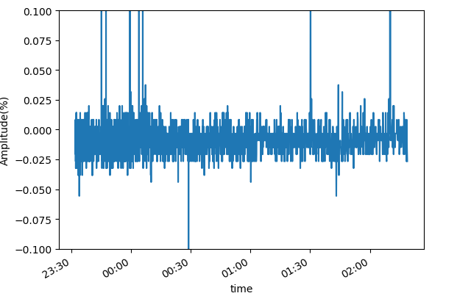
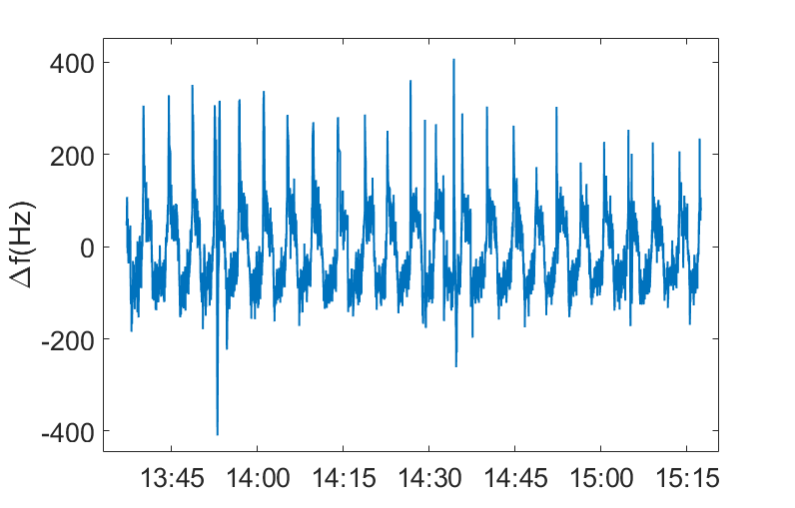
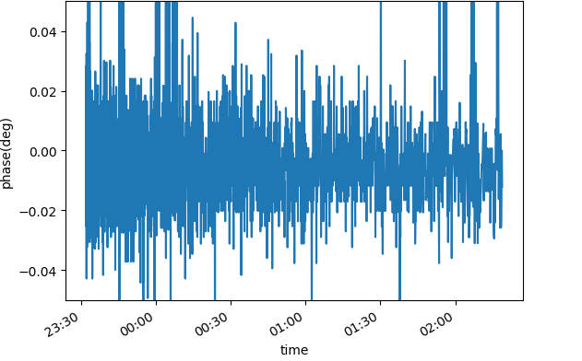


High power testing
After ~20hours RF commissioning, successfully operated with CW mode at 216.667 MHz with ~80 kW input power(limited by power supply system), or ~800kV voltage
Amplitude jitter 1.1$\text{‱}$
$$∆f±300Hz$$
Phase jitter 0.0148 deg
Multipacting is observed at RF power lower than 25kW, which is in consistent with the simulation results.
Good vacuum achieved in testing: ～2.0x10⁻⁸ pa without RF, ~9x10⁻⁸pa with 75kW CW RF power.

Slide 21
High power testing
Dark current
  High dark current in 2nd gun during the first round running, 1-10uA
  Significantly reduced after re-cleaning, less than 10nA with plug in.
  Obvious dark current increasing from 10nA->~400nA during CW operation in about two months. And it also reduced to very low level with re-cleaning.
  Contamination (or dust) from cathode plug or downstream beam pipe?
dark current w/o plug
Epeak: ~43MV/m
~10uA
dark current with plug
Epeak: ~30MV/m
~1-4uA
dark current and photoelectron
Epeak: ~30MV/m
<10 - 100nA
Photoelectron
Beam (~100pC)
Dark current of the 2nd gun, without(left) or with plug in(mid), and after re-processed

Slide 22
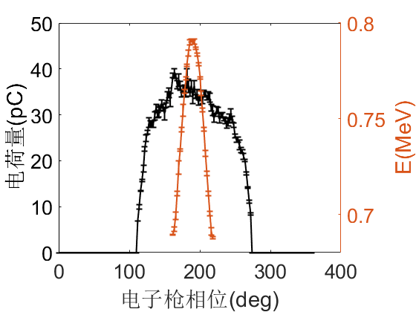
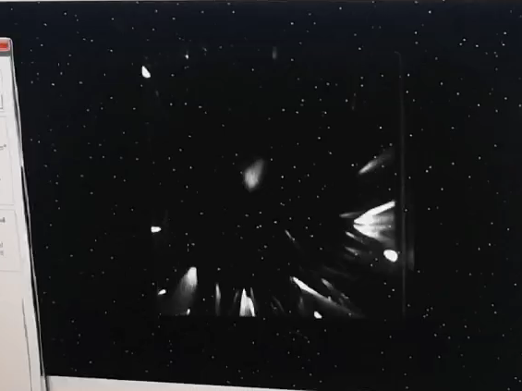
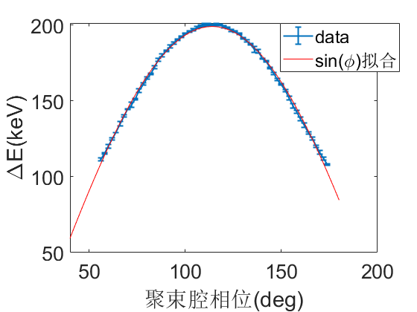
Beam testing
First photoelectron beam generated with Cs₂Te cathode on 23 August, 2022.
Bean profile after low energy bend magnet
Gun phase scan(75kW)
First photoelectron beam on 23 August, 2022 , QE: ~1%
Buncher on@~6kW
Deflecting cavity ON

Slide 23

Beam testing
100pC bunch charge with 10 kHz repetition rate can be stably produced

Slide 24




Beam testing
Emittance measurement and optimization(preliminary results )
Bunch charge | Projected emittance（95%）（$um∙rad$） | Slice emittance（95%）（$um∙rad$） | Bunch length (mm rms)
10 pC | 0.16 | 0.15 | 0.49
50 pC | 0.41 | 0.38 | 1.15
100 pC | 0.85 | 0.72 | 1.44
10pC
50pC
100pC

Slide 25





SHINE VHF gun Progress
04.2023 Tsinghua VHF gun delivered to SHINE project
08.2023 SHINE injector low energy beamline installed
09.2023 Vacuum ready for low energy beamline commissioning(~8x10⁻⁹pa w/o RF)

Slide 26
Summary and outlook
Further improve the gun performance and beam quality
  Increase cathode gradient to 30MV/m, MHz repetition operation .
  Beam emittance optimization.
  New cathode testing with higher performance (green cathode).
  In situ gun cleaning technologies.
New gun design and optimization
  higher voltage(>1MeV), lower emittance(<0.1um), low dark current, excellent gun vacuum with rf (green cathode)
Applications with high repetition rate and high quality beam
  High repetition MeV ultrafast electron diffraction and microscopy
Thanks

Slide 27
Acknowledgements
Collaboration and discussions with many colleagues;
Accelerator laboratory at Tsinghua University: Chuxiang Tang, Huaibi Chen, Wenhui Huang, Renkai Li, Lixin Yan, Lianmin Zheng, etc.
SHINE group: Houjun Qian, Guan Shu, etc.
DCLS group from DICP CAS: Weiqing Zhang, Jiayue Yang
S3FEL group from ISAF: Jiahang Shao
Peking University: Senlin Huang, Huamu Xie
IHEP: Xiaoping Li

