Slide 1
Theory of Photoemission from Cathodes with Disordered Surfaces
Presenter: Pallavi Saha
Date: 3rd October 2023
psaha3@bnl.gov

Slide 2
Acknowledgements
ASU
Siddharth Karkare
NIU
Oksana Chubenko
Cornell U.
Kevin Nangoi
Tomas A. Arias
Euclid Beamlabs
Eric Montgomery
Shashi Poddar
LBNL
Howard A. Padmore
NSF, DOE and CBB
for funding
psaha3@bnl.gov
2

Slide 3
What is the need to formulate a new model of photoemission from photocathodes?
Isn’t there already a well-defined model i.e. Dowell and Schmerge model?
And some more questions?....
3
psaha3@bnl.gov

Slide 4
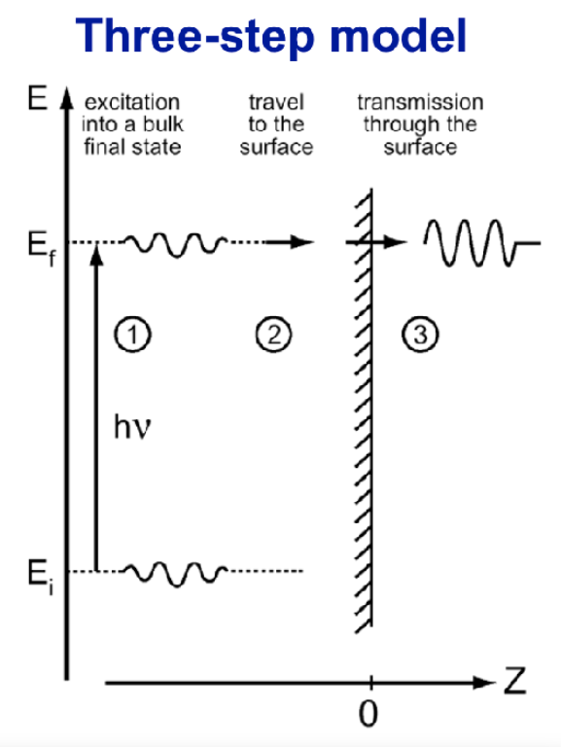
Spicer’s Three Step Model
Ref. W. Spicer, Phys. Rev. 112, 114 (1958).
psaha3@bnl.gov
4

Slide 5
Dowell-Schmerge Model
QE ~ ${(Excess energy)}^{2} ………………(1)$
MTE = $\frac{Excess energy}{3}……………………\left(2\right)$
Demonstrated by a large number of photocathodes.
Several assumptions are intrinsic to this model.
Assumptions
Difficulties
Conservation of transverse momentum.
Does not hold true for most cathodes in use today.
Single band parabolic dispersion relations.
Most band structures do not obey parabolic dispersion relations.
psaha3@bnl.gov
5

Slide 6
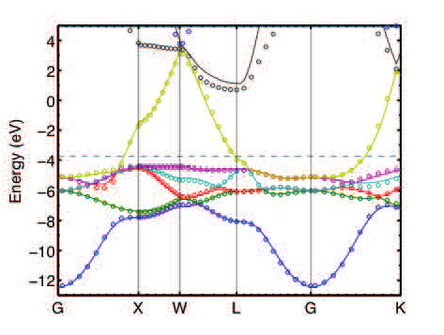
$$E_{f}$$
psaha3@bnl.gov
6

Slide 7
Dowell-Schmerge Model
QE ~ ${(Excess energy)}^{2} ………………(1)$
MTE = $\frac{Excess energy}{3}……………………\left(2\right)$
Demonstrated by a large number of photocathodes.
Several assumptions are intrinsic to this model.
Assumptions
Difficulties
Conservation of transverse momentum.
Does not hold true for most cathodes in use today.
Single band parabolic dispersion relations.
Most band structures do not obey parabolic dispersion relations.
psaha3@bnl.gov
7

Slide 8
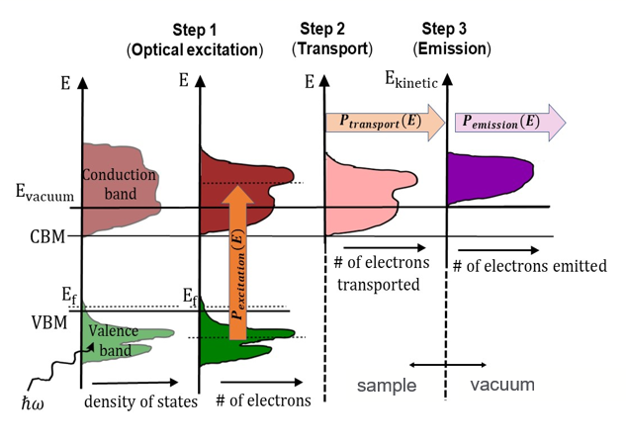
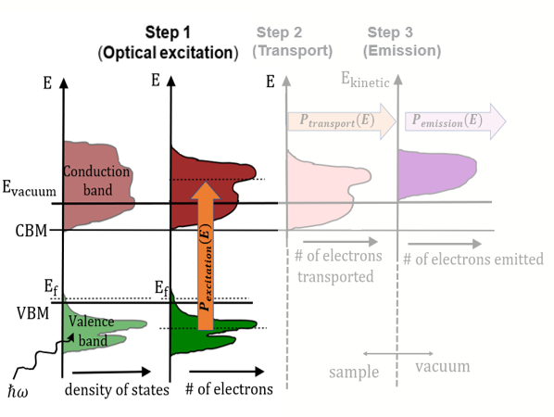
Step 1: Optical excitation
Excitation probability is proportional to the number of:
$ⅇ^{−}$in the valence band, and
vacant states in the conduction band.
It can be written as:
$$P_{excitation}\left(E\right)∝D\left(E\right)f\left(E\right)D\left(E+ℏ⍵\right)$$
$$[1−f\left(E+ℏω\right)]$$
Ref. P. Saha et al., J. Appl. Phys., 133, 5 (2023).
psaha3@bnl.gov
8

Slide 9
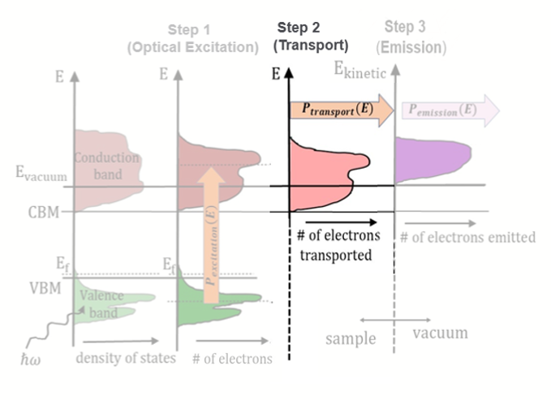
Step 2: Transport
The transport probability can be treated as a constant independent of electron energy and photon energy.
$$P_{transport}\left(E\right)∝C$$
psaha3@bnl.gov
9

Slide 10
Step 3: Emission
Disordered surfaces with a period ~ few nm
~few nm
Scattered electrons ($k_{⊥}$+ m$k_{surface}$)
1 nm
Sub-nm scale roughness can act as a diffraction grating to scatter electrons.
e⁻
Incoming electron ($k_{⊥}$)
Scattering of electrons will occur into only those wavevectors in the $k_{⊥}$ space which are energetically allowed.
$k_{⊥_{max}}$= $\sqrt{\frac{2mE_{kinetic}}{ℏ^{2}}}{, E}_{kinetic}$= $\left(E+ℏω−E_{vacuum}\right)$
1 meV–1 eV → $λ_{D}$ ~ 1 - 40 nm
Ref. S. Karkare, Phys. Rev. 4, 2 (2015).
Energy of electron before absorption of photon
psaha3@bnl.gov
10

Slide 11
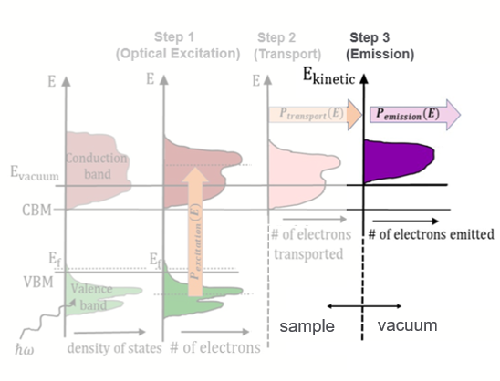
Step 3: Emission
Assumption: the scattering of electrons into all possible energetically allowed states in the $k_{⊥}$ space occurs with equal probability.
E($k_{⊥, emitted}$)
$$k_{⊥, emitted}$$
$P_{emission}\left(E\right)∝$ $\int_{0}^{k_{⊥_{max}}}{2πk_{⊥}dk_{⊥}}$
${ ∝E}_{kinetic}$ .
$$E_{vacuum}$$
$P_{emission}\left(E\right)$can be calculated as follows:
psaha3@bnl.gov
11

Slide 12
Schematic of photoemission model
Step 1: Optical excitation
$P_{excitation}\left(E\right)∝D\left(E\right)f\left(E\right)D(E+$ $ℏ⍵)\left[1−f\left(E+ℏω\right)\right]$
$$…………………..(1)$$
Step 2: Transport
$$P_{transport}\left(E\right)∝C$$
$$……………..(2)$$
Step 3: Emission
Schematic of photoemission
$$P_{emission}\left(E\right)∝\int_{0}^{k_{⊥_{max}}}{2πk_{⊥}dk_{⊥}=E_{kinetic}}$$
$$……………..(3)$$
psaha3@bnl.gov
12

Slide 13
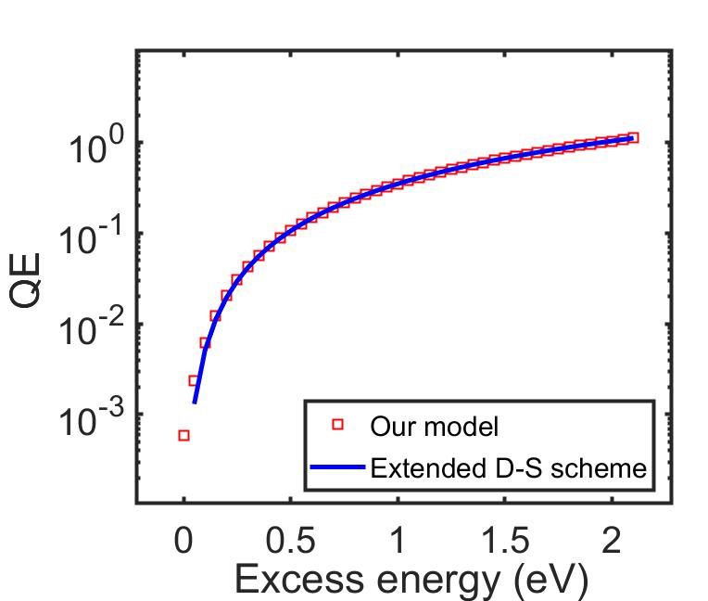
Expression for QE
$$\#ⅇ^{−} emitted= \int_{−∞}^{∞}{P_{excitation}\left(E\right)P_{transport}\left(E\right)P_{emission}\left(E\right) dE}$$
$$\#ⅇ^{−} excited= \int_{−∞}^{∞}{P_{excitation}\left(E\right)dE}$$
$QE\left(ℏω\right)$= $\frac{\#ⅇ^{−} emitted }{\#ⅇ^{−} excited}$
Assumption:
constant DOS,
Combining Equations (1) through (3),
$$QE\left(ℏω\right)=C \frac{\int_{−∞}^{∞}{D\left(E\right)f\left(E\right)D\left(E+ℏω\right)[1−f\left(E+ℏω\right)]E_{kinetic}dE}}{\int_{−∞}^{∞}{D\left(E\right)f\left(E\right)D\left(E+ℏω\right)\left[1−f\left(E+ℏω\right)\right]dE }}$$
psaha3@bnl.gov
13

Slide 14
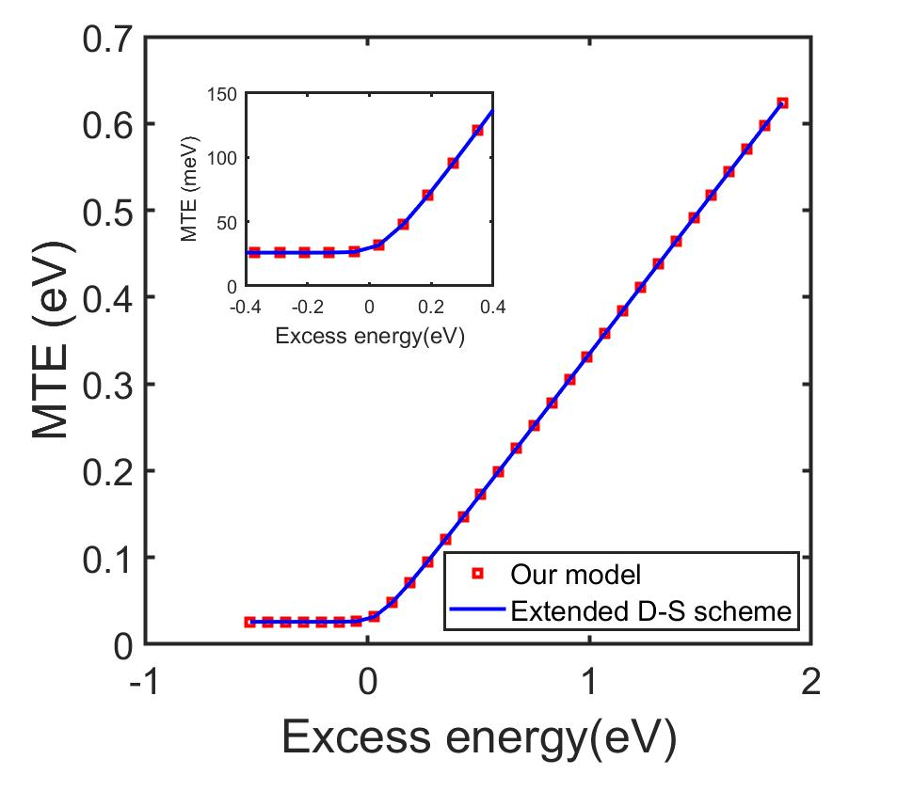
Expression for MTE
$$MTE\left(ℏω\right)=\frac{ℏ^{2}}{2m}\frac{\int_{−∞}^{∞}{D\left(E\right)f\left(E\right)D\left(E+ℏω\right)[1−f\left(E+ℏω\right)] dE\int_{0}^{k_{⊥_{max}}}{2πk_{⊥}{k^{2}}_{⊥}dk_{⊥}}}}{\int_{−∞}^{∞}{D\left(E\right)f\left(E\right)D\left(E+ℏω\right)\left[1−f\left(E+ℏω\right)\right]dE \int_{0}^{k_{⊥_{max}}}{2{πk}_{⊥}dk_{⊥}}}}$$
By substituting the value of $k_{⊥_{max}}, where k_{⊥_{max}}=\sqrt{\frac{2m}{ℏ^{2}} (E_{kinetic})}$
$$MTE\left(ℏω\right)=\frac{ℏ^{2}}{2m}\frac{\int_{−∞}^{∞}{D\left(E\right)f\left(E\right)D\left(E+ℏω\right)[1−f\left(E+ℏω\right)] E_{kinetic}^{2}dE}}{\int_{−∞}^{∞}{D\left(E\right)f\left(E\right)D\left(E+ℏω\right)\left[1−f\left(E+ℏω\right)\right]E_{kinetic}dE }}$$
Under the assumption of a constant DOS,
MTE = $\frac{E_{excess}}{3}$, $E_{excess}$ >> 0
MTE $→$ $k_{B}T$, $E_{excess}→$0
psaha3@bnl.gov
14

Slide 15
Takeaway
Our model applies to both semiconductor and metallic systems, and single crystalline and polycrystalline materials with disordered surfaces.
The model does not resort to any unphysical assumptions such as conservation of transverse momentum and single parabolic dispersion relation.
Addresses the challenges of a practical realistic photocathode.
Able to derive expressions for QE and MTE.
psaha3@bnl.gov
15

Slide 16
Thank you for listening!! Questions?
psaha3@bnl.gov
16

Slide 17
E($k_{⊥, emitted}$)
$$k_{⊥, emitted}$$
psaha3@bnl.gov
17

