Slide 1
Photocathode Physics for Photoinjectors (P3) Workshop
Brookhaven National Laboratory, NY, October 3-5, 2023.
UIC
Electron Scattering Processes in Photoemission:
The Franck-Condon Effect
W. Andreas Schroeder
Louis Angeloni and Ir-Jene Shan
Physics Department, University of Illinois Chicago
Department of Energy
DE-SC0020387

Slide 2
Outline
UIC
Metallized diamond(001) photocathode
− Two electron emission signals:
(i) Inner (small MTE) signal due to direct NEA emission from upper CB
(ii) Outer (large MTE) and stronger signal from optical phonon assisted emission
via the Franck-Condon effect – a momentum resonance
Near threshold MTE from ‘good’ metal photocathodes at 300K
− Sub-threshold MTE > 25meV (25-130meV measured)
− Sub-threshold MTE material (but not strongly crystal orientation) dependent
− POSTULATE: Emission via Franck-Condon effect after electron-electron scattering

Slide 3
Photocathode characterization system
UIC
− Laser / NLO based sub-picosecond tunable UV radiation source: 3.0 – 5.3eV (235-410nm)
20 W Yb:fiber laser
400 fs, 16.7 MHz, 1030 nm
15 W
0.5 W
THG
SHG
SHG
LBO
LBO
LBO
F
6 W 515 nm
Nonlinear fiber
(SC-3.7-975)
2ω
LBO
LBO
3ω
Continuum
(700-950 nm)
OPA 2
OPA 1
ω_{s,i}
BBO
Tunable UV (0.1-1mW)
Non-collinear
sum frequency
UV generation
Detector:
MCP & CCD camera;
Faraday cup
-10 kV
Δp_{T} measurement

Slide 4
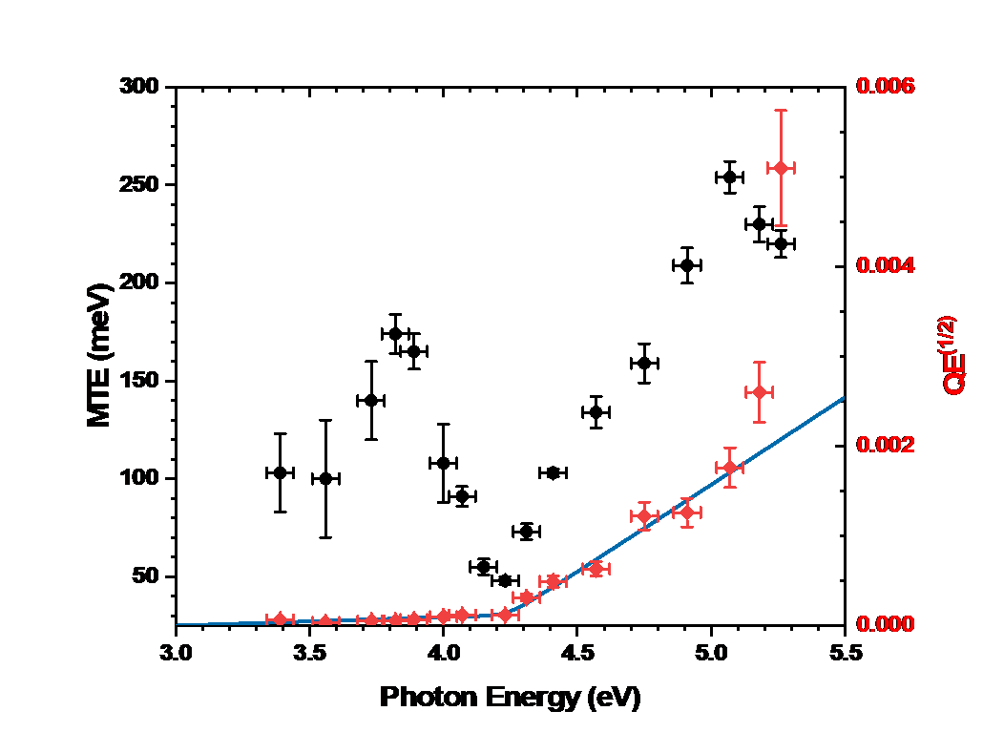
Prior work: N-doped diamond(001)
UIC
E
(eV)
MTE ≈ 50meV
7.05
Δ = 1.65eV
E_{vac.}
χ
5.4
B
A
C
2.4eV
ℇ_{F}
4.7eV
Nitrogen dopant states
0
p_{z}
Γ
X
L.A. Angeloni et al., Phys. Rev. B 107, 165105 (2023)

Slide 5
Metallized diamond(001)
UIC
Injection from ‘Ohmic’ metal contact
(constant metal DOS & parabolic band approximation):
$$\frac{3}{2}k_{B}T_{e}=\frac{3}{5}\left(ħω−ϕ_{int.}\right)$$
Boltzmann tail emission after energy equipartition with optical phonons under acceleration in E_{DC}/ε_{r} :
$$MTE≈\frac{1}{2}\left(\frac{m_{T}^{∗}}{m_{0}}\right)k_{B}T_{e}=\frac{1}{5}\left(\frac{m_{T}^{∗}}{m_{0}}\right)\left(ħω−ϕ_{int.}\right)$$
⇒ $MTE<\frac{1}{10}\left(ħω−φ_{int.}\right)$
... ${m_{T}^{∗}=0.45m}_{0}$ for
upper CB of diamond
CBs
E_{vac.}
e⁻
χ ≈ 0.5eV
ħω
φ_{int.}
E_{DC}
ℇ_{F}
N states
d = 0.5mm
Metal Diamond Vacuum
(Au/Pt/Ti)

Slide 6
Metallized diamond(001) emission
UIC
ħω = 4.54eV
Two emission signals:
Outer large MTE signal from strong optical phonon assisted Franck-Condon effect
$$p_{vac.}=p_{band}+nq_{phonon}$$
− Emission of Boltzmann tail of electron distribution
from NEA upper CB of diamond (χ ≈ −1eV)
− High emission efficiency over PE barrier due to
momentum resonance (T → 1)
Inner signal with MTE < 100meV from electrons
directly emitted from NEA upper CB of diamond
− Lower emission efficiency as $p_{vac.}≠p_{band}$;
less than ~5% of total signal
BOTH with Gaussian spatial beam profiles
J.D. Rameau et al., Phys. Rev. Lett. 106, 137602 (2011)

Slide 7
Boltzmann tail emission
UIC
− Parabolic band approximation
Direct band emission:
$$T=\frac{4p_{z}p_{z0}}{{\left(p_{z}+p_{z0}\right)}^{2}} →p_{z0}=p cosθ$$
$$N=\frac{A}{2}\int{cosθ dΩ \int_{0}^{∞}{dp{ p}^{3} exp\left[−\frac{p^{2}}{2m^{∗}k_{B}T_{e}}\right]}}$$
$$MTE=\frac{A}{2N}\int{cosθ \sin^{2}θ dΩ }$$
$$× \int_{0}^{∞}{dp \left(\frac{p^{2}}{2m_{0}}\right) p^{3} exp\left[−\frac{p^{2}}{2m^{∗}k_{B}T_{e}}\right]}$$
$$ MTE=\left(\frac{m^{∗}}{m_{0}}\right)k_{B}T_{e} ; m^{∗}< m_{0}$$
Franck-Condon effect:
$$T →1 ; p_{z}=p_{z0}$$
$$N=\frac{A}{2}\int{dΩ \int_{0}^{∞}{dp{ p}^{2} exp\left[−\frac{p^{2}}{2m^{∗}k_{B}T_{e}}\right]}}$$
$$MTE=\frac{A}{2N}\int{\sin^{2}θ dΩ }$$
$$× \int_{0}^{∞}{dp \left(\frac{p^{2}}{2m_{0}}\right) p^{2} exp\left[−\frac{p^{2}}{2m^{∗}k_{B}T_{e}}\right]}$$
$$ MTE=\left(\frac{m^{∗}}{m_{0}}\right)k_{B}T_{e} ; m^{∗}< m_{0}$$

Slide 8
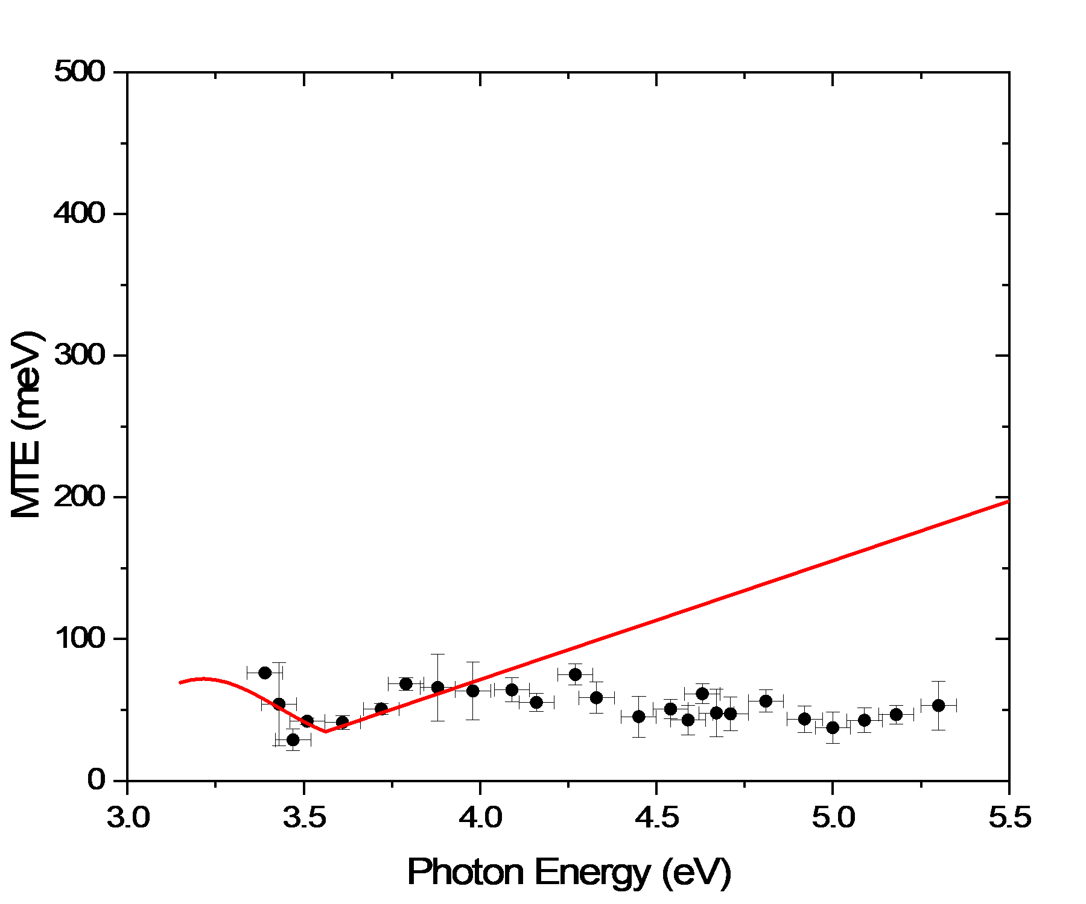
Inner signal MTE
UIC
Minimum MTE ≈ 35meV occurs when
$∆E≅\frac{5}{2}ħΩ_{LO}=0.41eV$
− Initial electron cooling (by LO phonon emission)
generates same number of phonons as photo-
injected electrons
⇒ Direct initial energy equipartition
For ΔE > 0.41eV, initial energy equipartition maintained
⇒ $MTE≈\frac{1}{5}\left(\frac{m_{T}^{∗}}{m_{0}}\right)\left(ħω−ϕ_{int.}\right)$
... red line (ϕ_{int.}= 3.15eV, m* = 0.45m₀)
Parabolic band approximation breaks down for lower CB when ΔE > 0.8eV (ħω > 4.0eV)
MTE ≈ 35meV

Slide 9
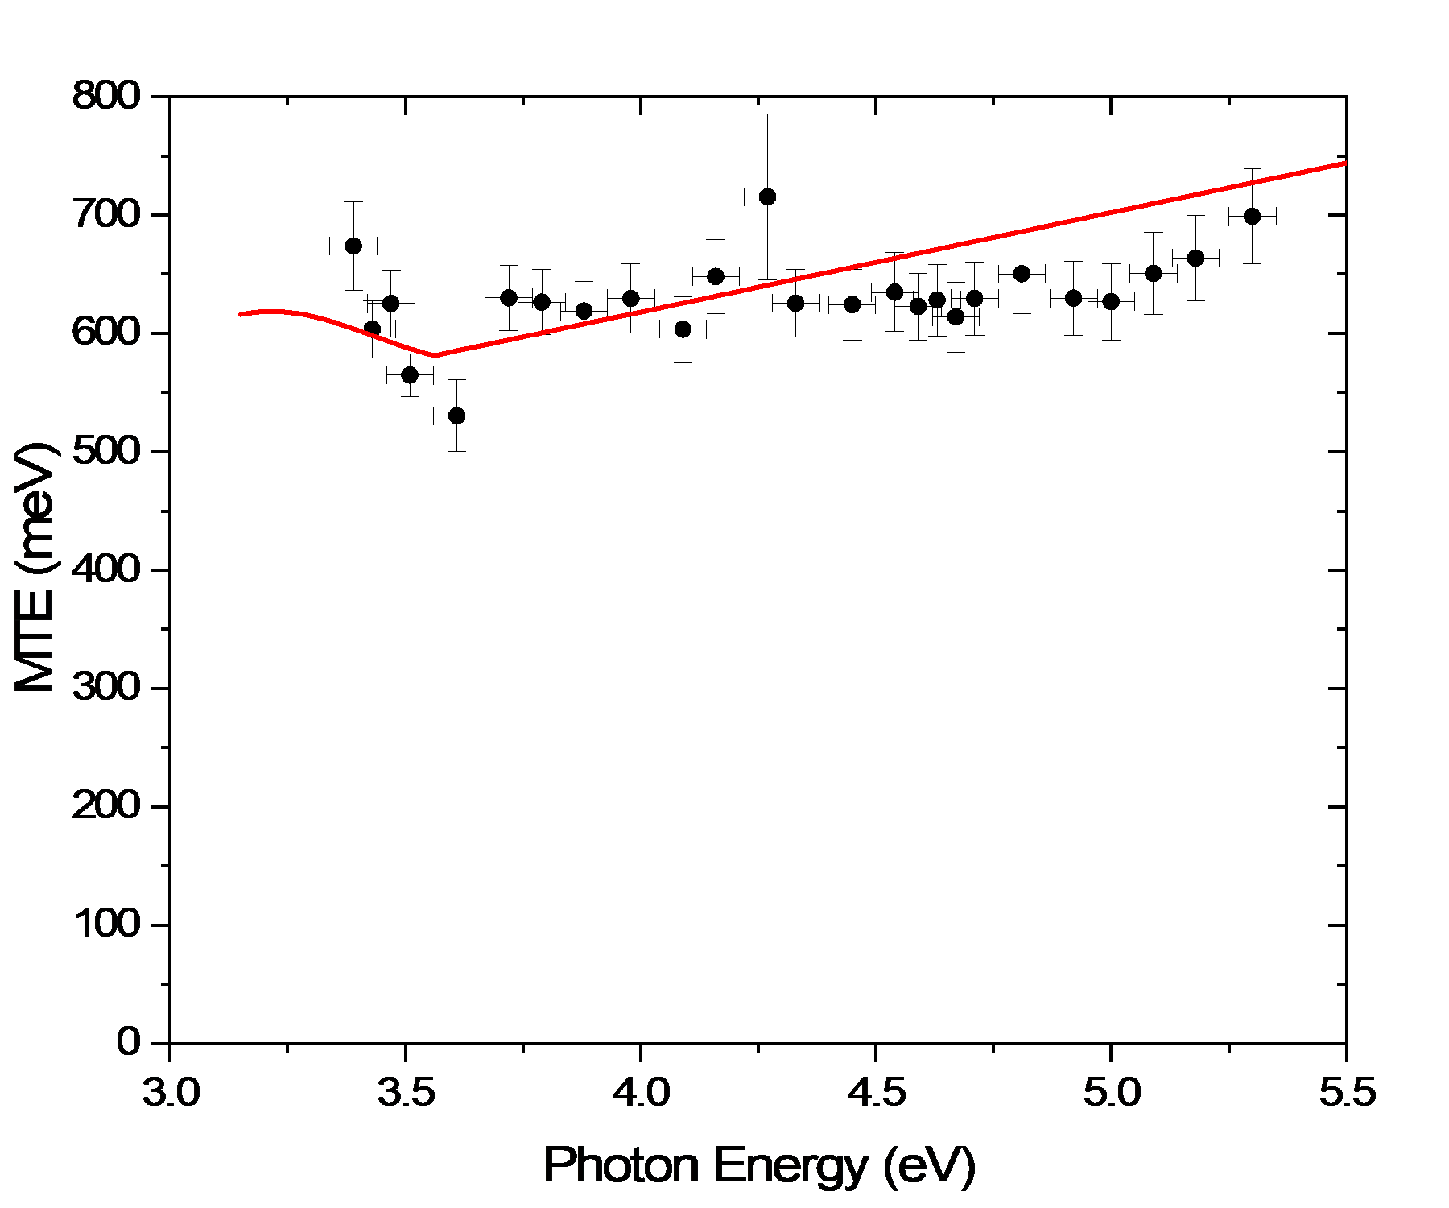
Outer signal MTE
UIC
Parabolic band analysis
$MTE≈\left(\frac{m^{∗}}{m_{0}}\right)k_{B}T_{e}+\frac{2}{3}∆^{/}$
... $∆^{/}=∆−−nħ_{LO}$
− Upper CB NEA = Δ − χ ≈ 1.15eV
− Strong electron-phonon coupling; n_{av.} ≈ 2
⇒ $\frac{2}{3}∆^{/}≈0.55eV$
... $ħ_{LO}$= 165meV
QE reaches 10⁻⁶ – 10⁻⁵ for ħω > 5eV
J.D. Rameau et al., Phys. Rev. Lett. 106, 137602 (2011)

Slide 10
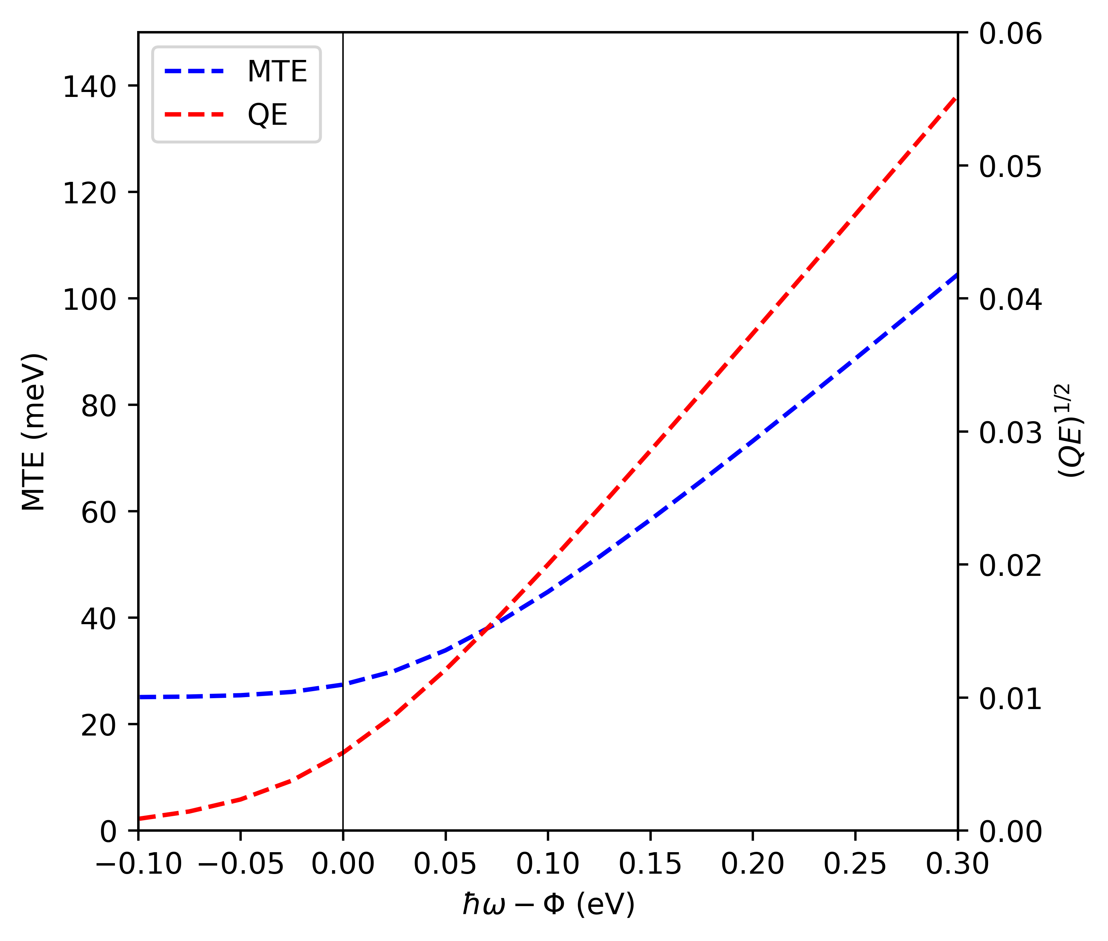
Near threshold MTE in metals
UIC
T = T_{e} = 300K
‘Accepted’ idea:
Low MTE (< 50meV) readily obtained by operating close to PE threshold
At the expense of lower QE
− Order of magnitude decrease from
ΔE = 0.15eV to 0.05eV
NOTE:
${\left(QE\right)}^{1/2}$ vs. ħω plot allows
extraction of work function
25meV
T. Vecchione et al., 35th Intl. Free-Electron Laser Conf., New York, NY (2013), pp. 424-426

Slide 11
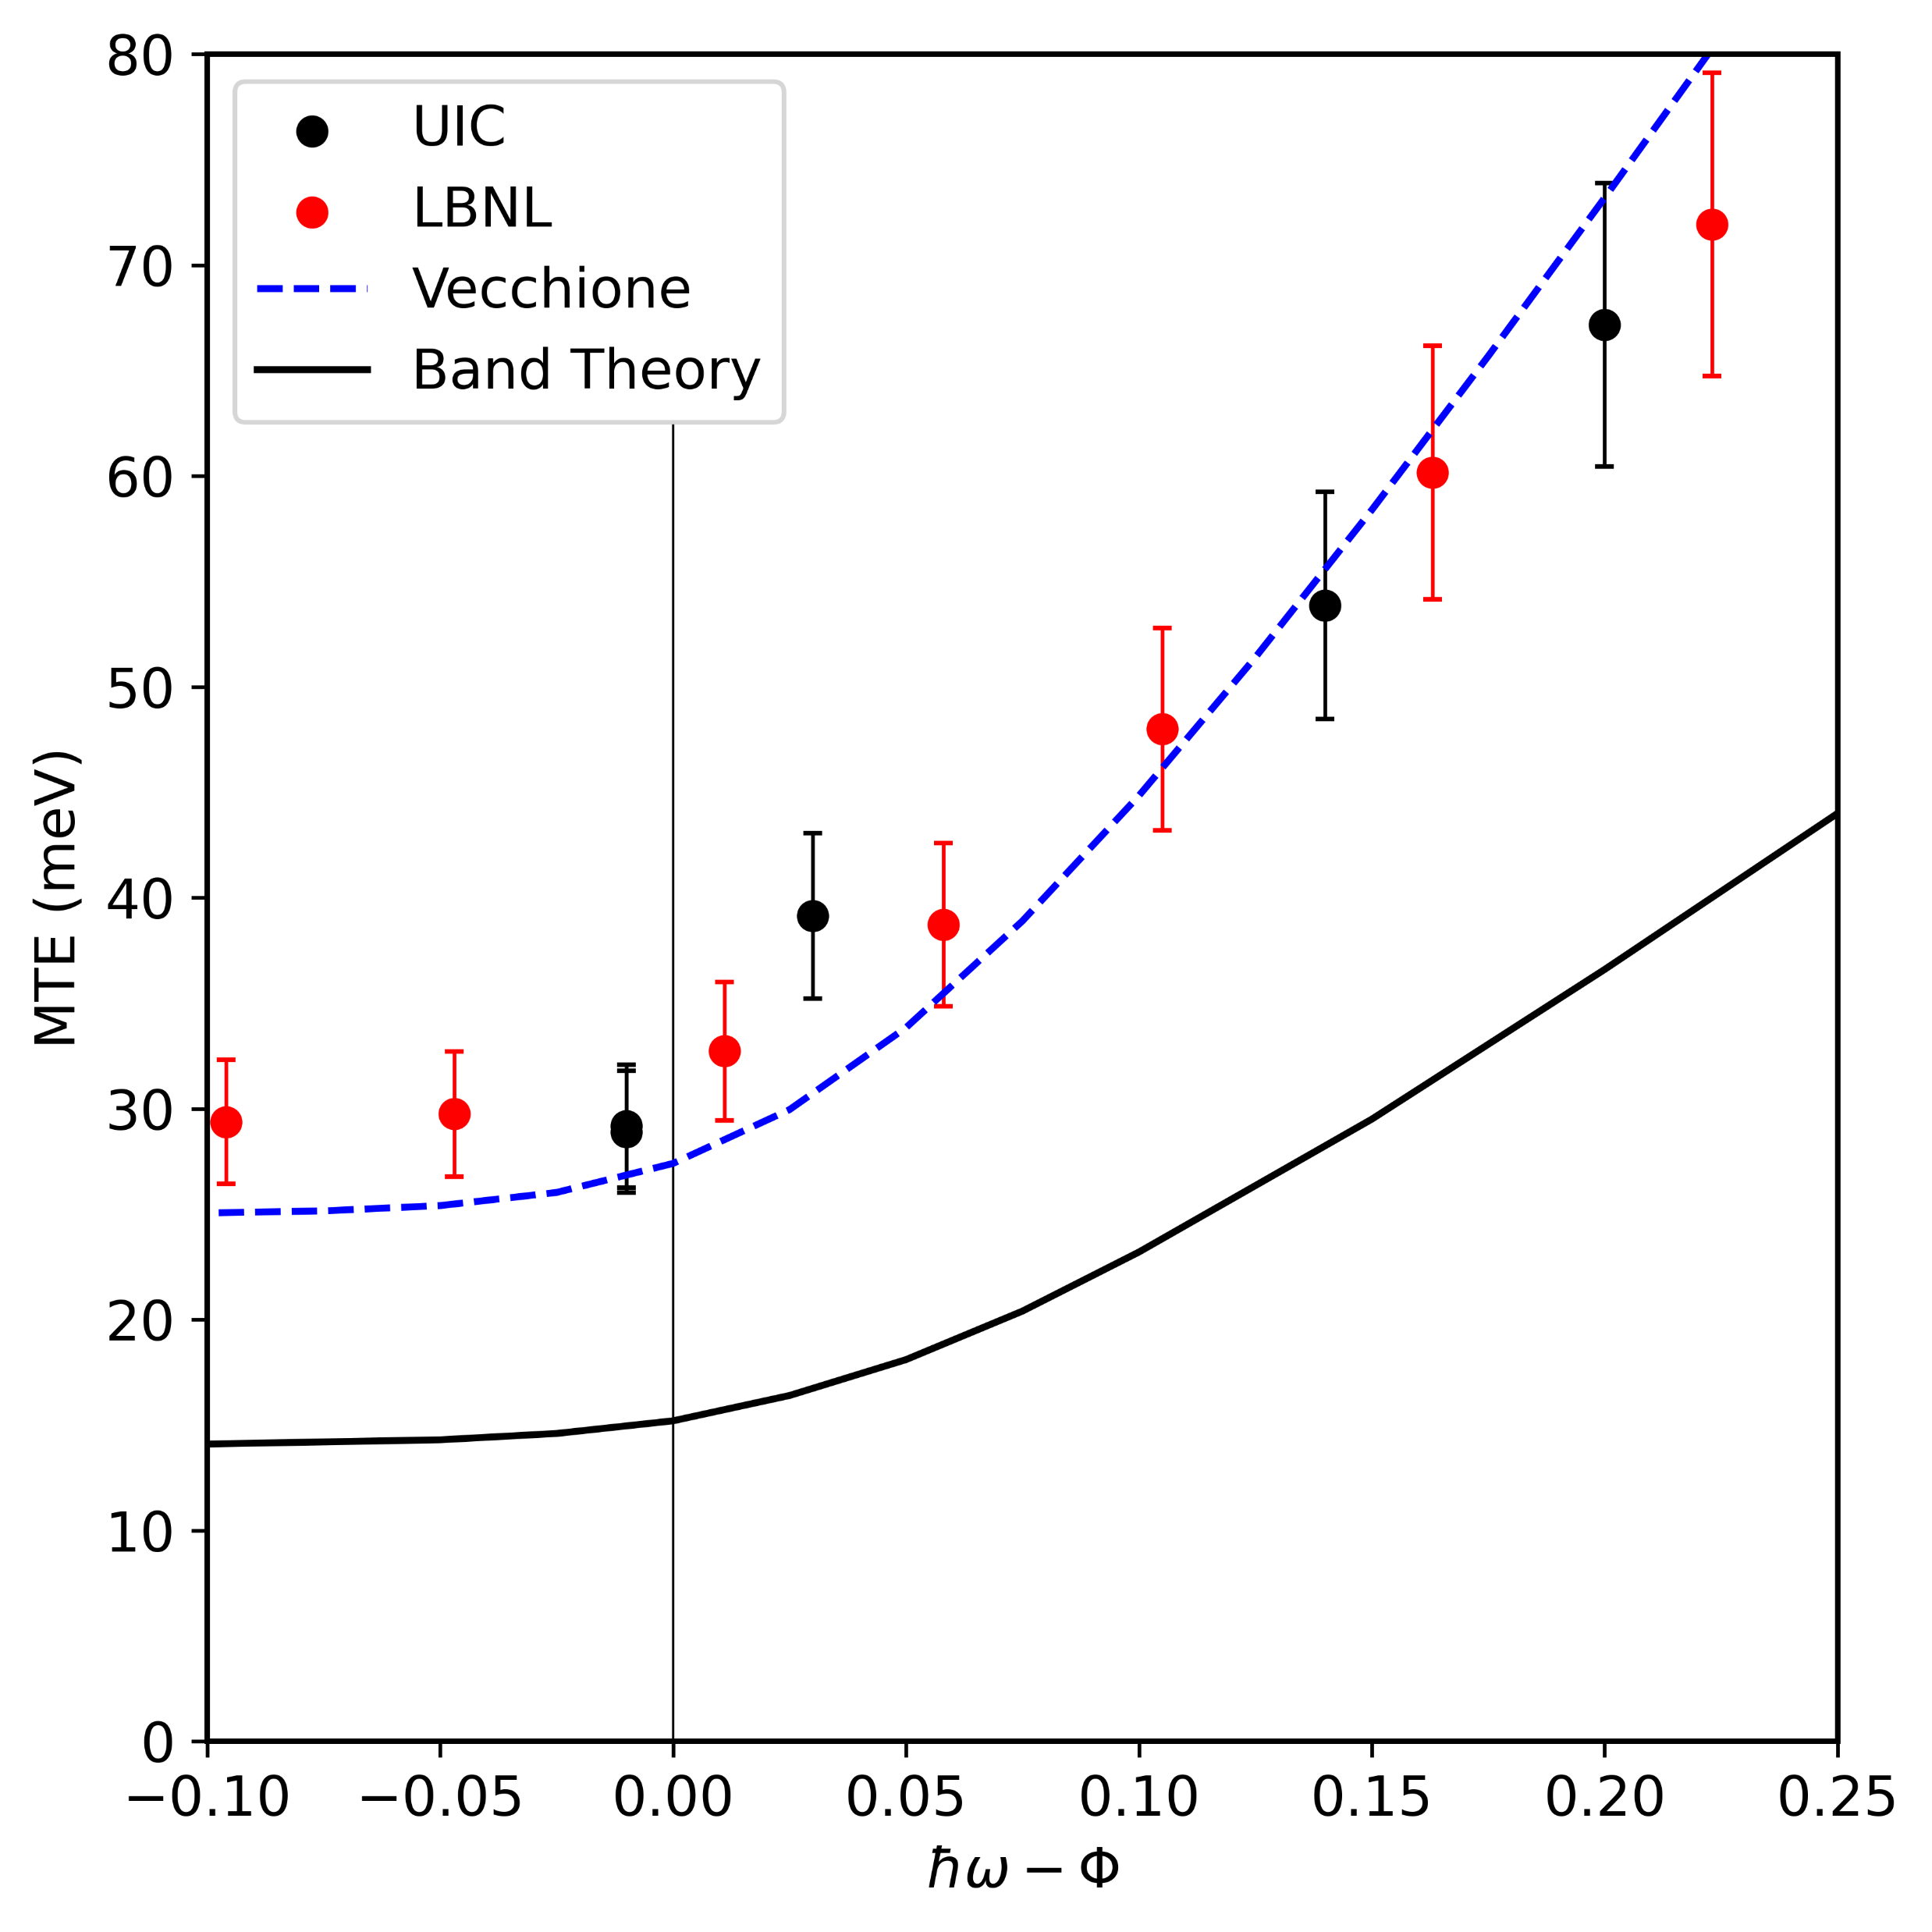
Cu(001): Near threshold MTE
UIC
MTE ≈ 30meV > k_{B}T_{e} measured below threshold (ΔE < 0) at 300K
Direct band emission simulation predicts MTE ≈ 14meV below threshold (ΔE < 0)
$$MTE≥\left(\frac{m_{T}^{∗}}{m_{0}}\right)k_{B}T_{e}$$
... $m_{T}^{∗}≈0.35$ – $0.4m_{0}$
T = 300K
(eV)
W.A. Schroeder & G. Adhikari, New J. Phys. 21, 033040 (2019) 033040

Slide 12
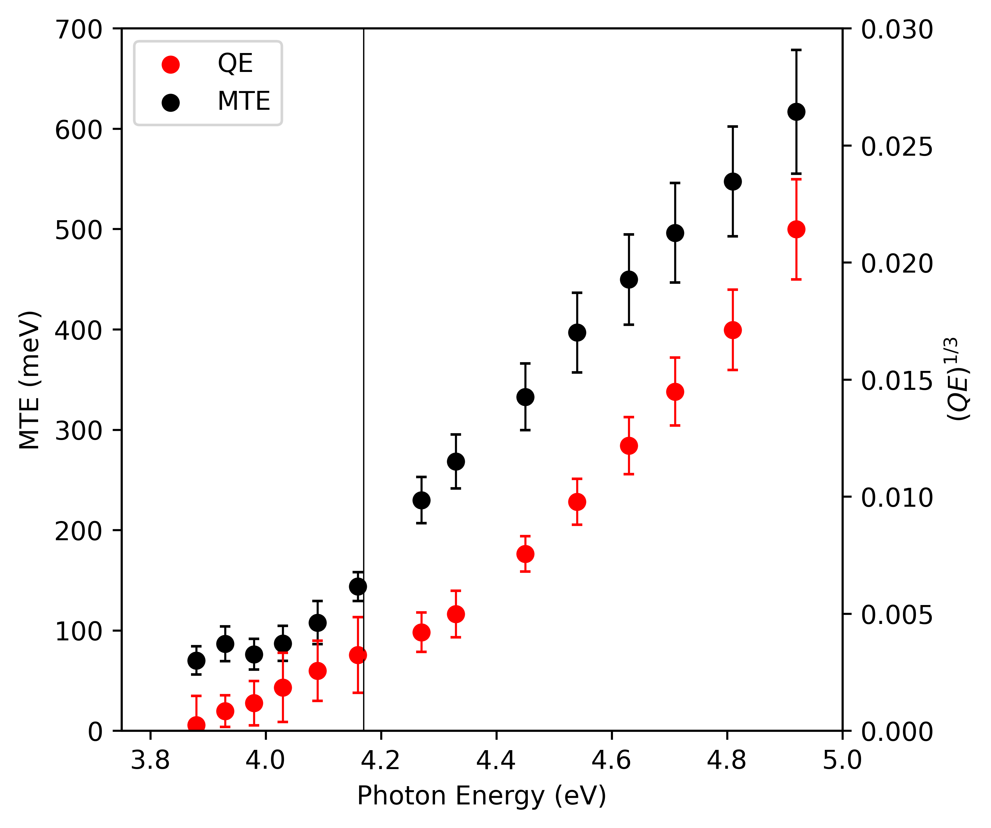
Other ‘good’ metals
UIC
Metal | MTE (meV) (ΔE < 0)
Ag(001) Cu(001) Rh(110) Nb(001) W(001) W(111) Ta(001) Ta(111) Mo(001) | 25±6† 29±3 70±6 130±12 83±9 91±11 82±16 100±13 80±9
W(001)
T = 300K
83(±9)meV
†Bulk plasmon effects

Slide 13
Electron-electron scattering I
UIC
− Sommerfeld free electron model; Near threshold emission
$$p_{1}^{∗}+p_{2}=p+p_{0}^{∗}$$
Small excess energy ΔE
⇒ Small $p_{0}^{∗}=\sqrt{2m_{0}∆E}$
Franck-Condon effect
⇒ PE barrier transmission T → 1
Two initial electrons from occupied states; One final electron into unoccupied states
⇒ Probability $∝f^{2}\left(1−f\right)$
... $f=\frac{1}{1+exp⁡\left(\frac{E−ε_{F}}{k_{B}T_{e}}\right)}$
p_{T}
$$p_{1}^{∗}$$
$$p$$
$$p_{2}$$
$$p_{0}^{∗}$$
p_{z}
p_{F}
~ k_{B}T_{e}

Slide 14
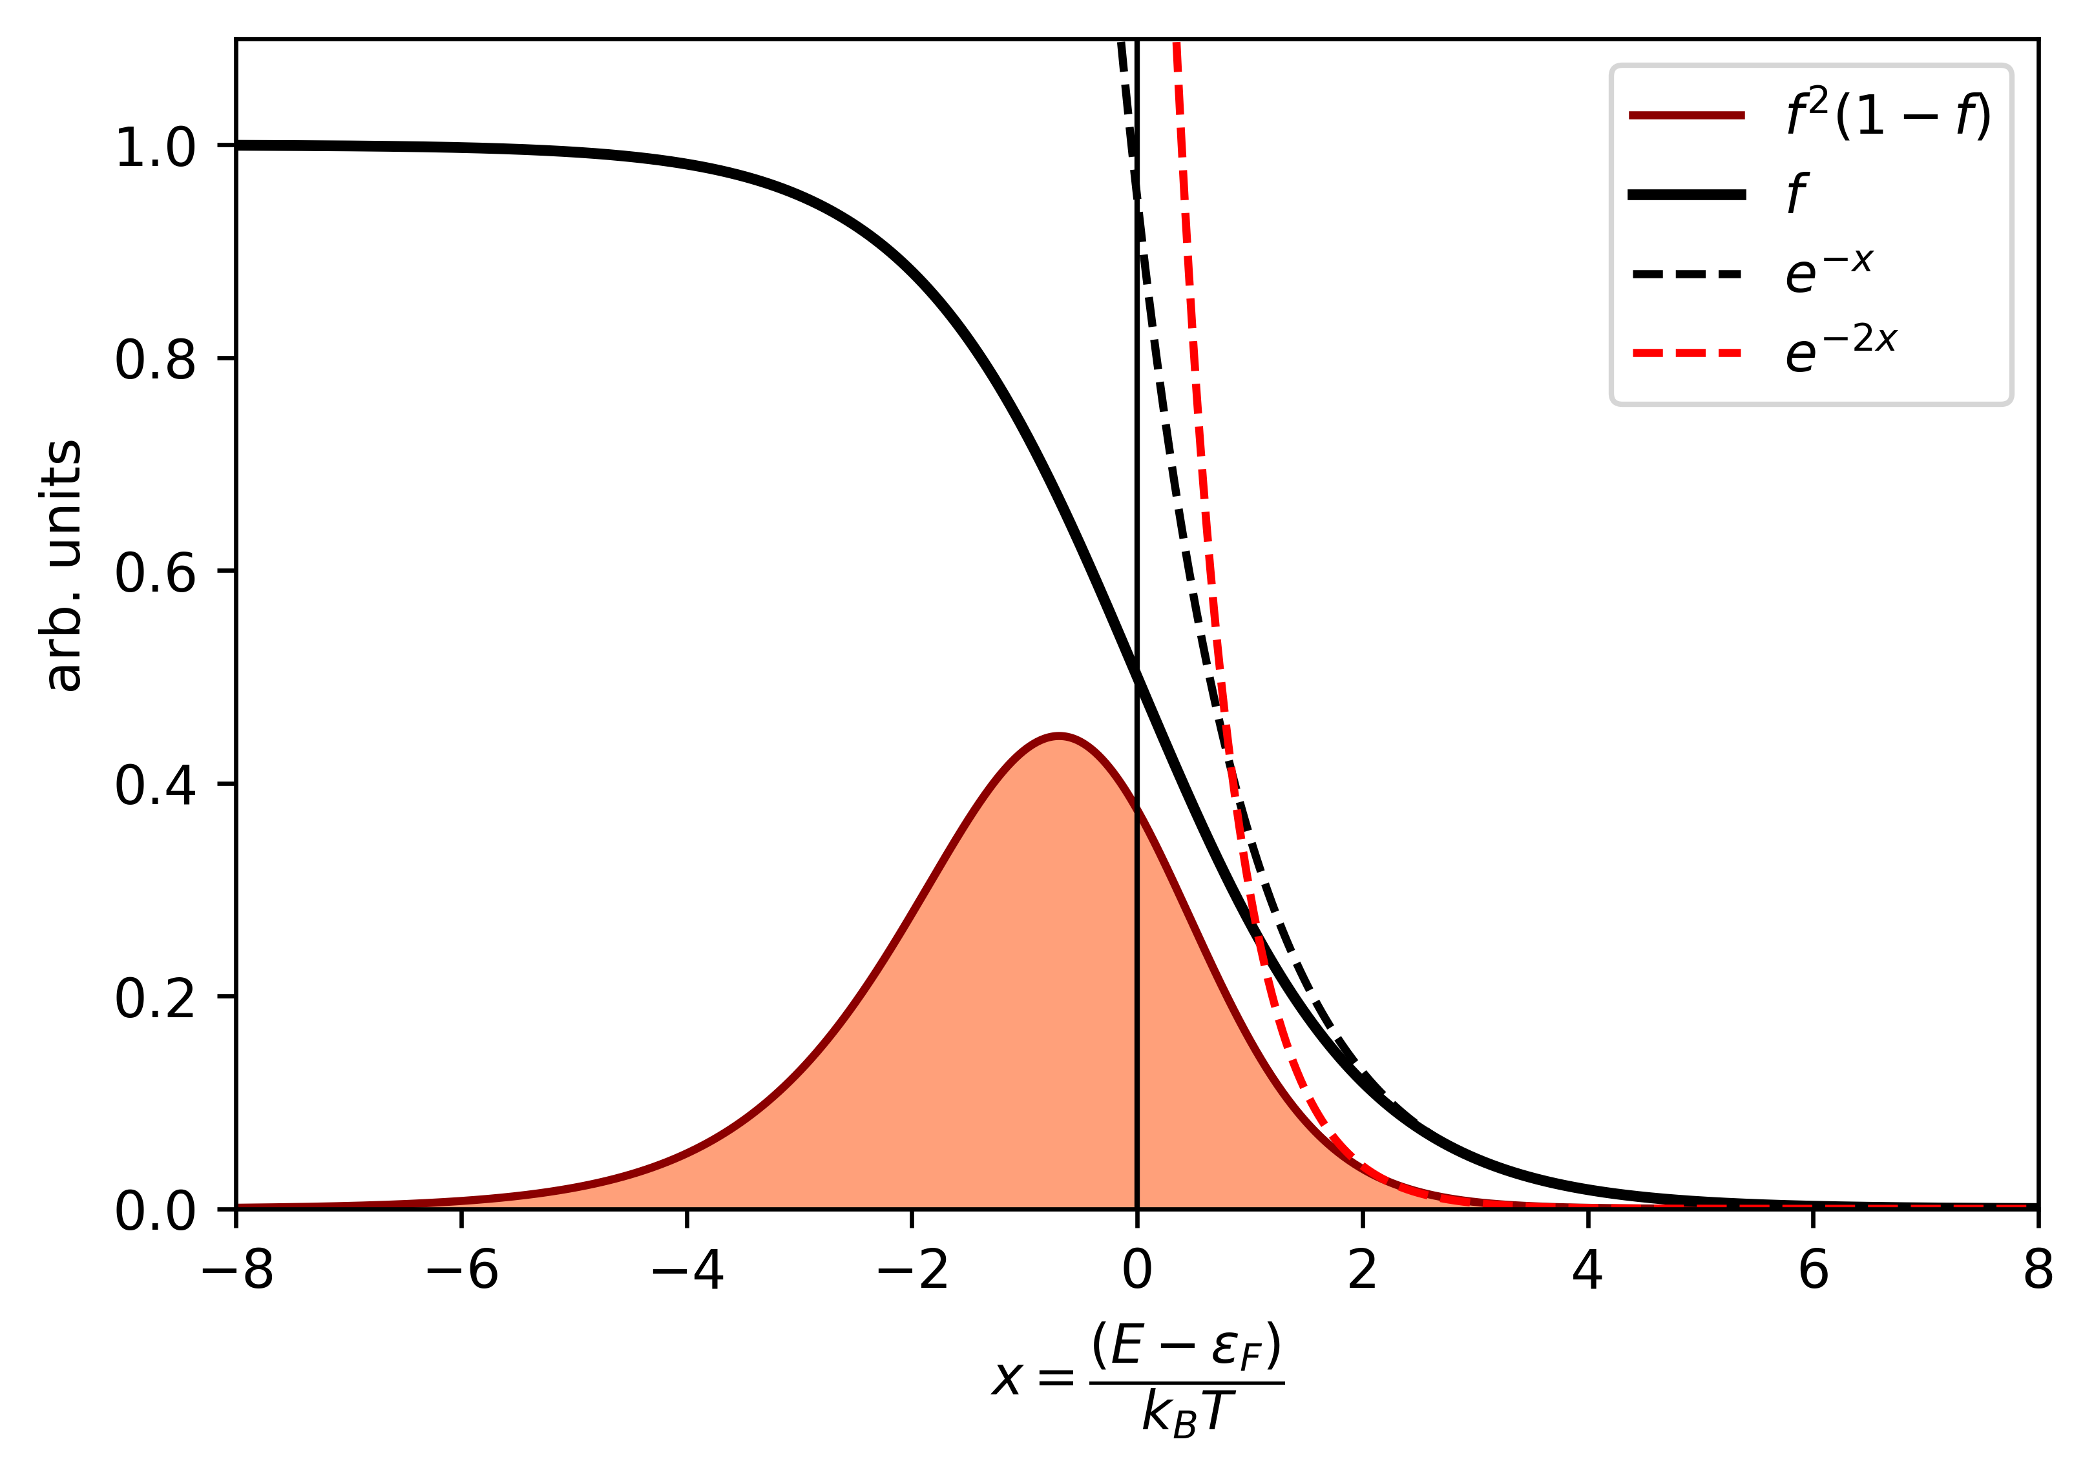
Electron-electron scattering II
UIC
− Energy dependence (neglecting DOS)
- - - $e^{−x}$
- - - $e^{−2x}$
Two below threshold emission processes:
(i) Direct band contribution
$MTE≥\left(\frac{m_{T}^{∗}}{m_{0}}\right)k_{B}T_{e}$
... $m_{T}^{∗}<m_{0}$
(ii) Electron scattering contribution
$MTE≈\frac{1}{2}\left(\frac{M}{m_{0}}\right)k_{B}T_{e}$
BUT: What is M ?
$$f$$
Above threshold
(ΔE > 0)
Below threshold
(ΔE < 0)
$$f^{2}(1−f)$$

Slide 15
Thermal electron mass
UIC
Specific heat of metals
$C_{V}=T+AT^{3}$
Electron specific heat:
Sommerfeld free electron model gives
$_{0}=\frac{π^{2}k_{B}^{2}}{2ε_{F}}$
Measured $=\left(\frac{M}{m_{0}}\right)γ_{0}$
... M is thermal electron mass
Metal | M/m₀ | N_{FS}
Ag Cu Rh Ta W Nb Mo | 1.006 1.366 6.09 6.69 7.56 14.25 14.95 | 1 1 4 2 2 2 3 or 4
POSTULATE: ${MTE}_{e−e}≈\frac{1}{N_{FS}}\left(\frac{M}{m_{0}}\right)\left(\frac{1}{2}k_{B}T_{e}\right)$
G.R. Stewart, Rev. Sci. Inst. 54, 1 (1983)

Slide 16
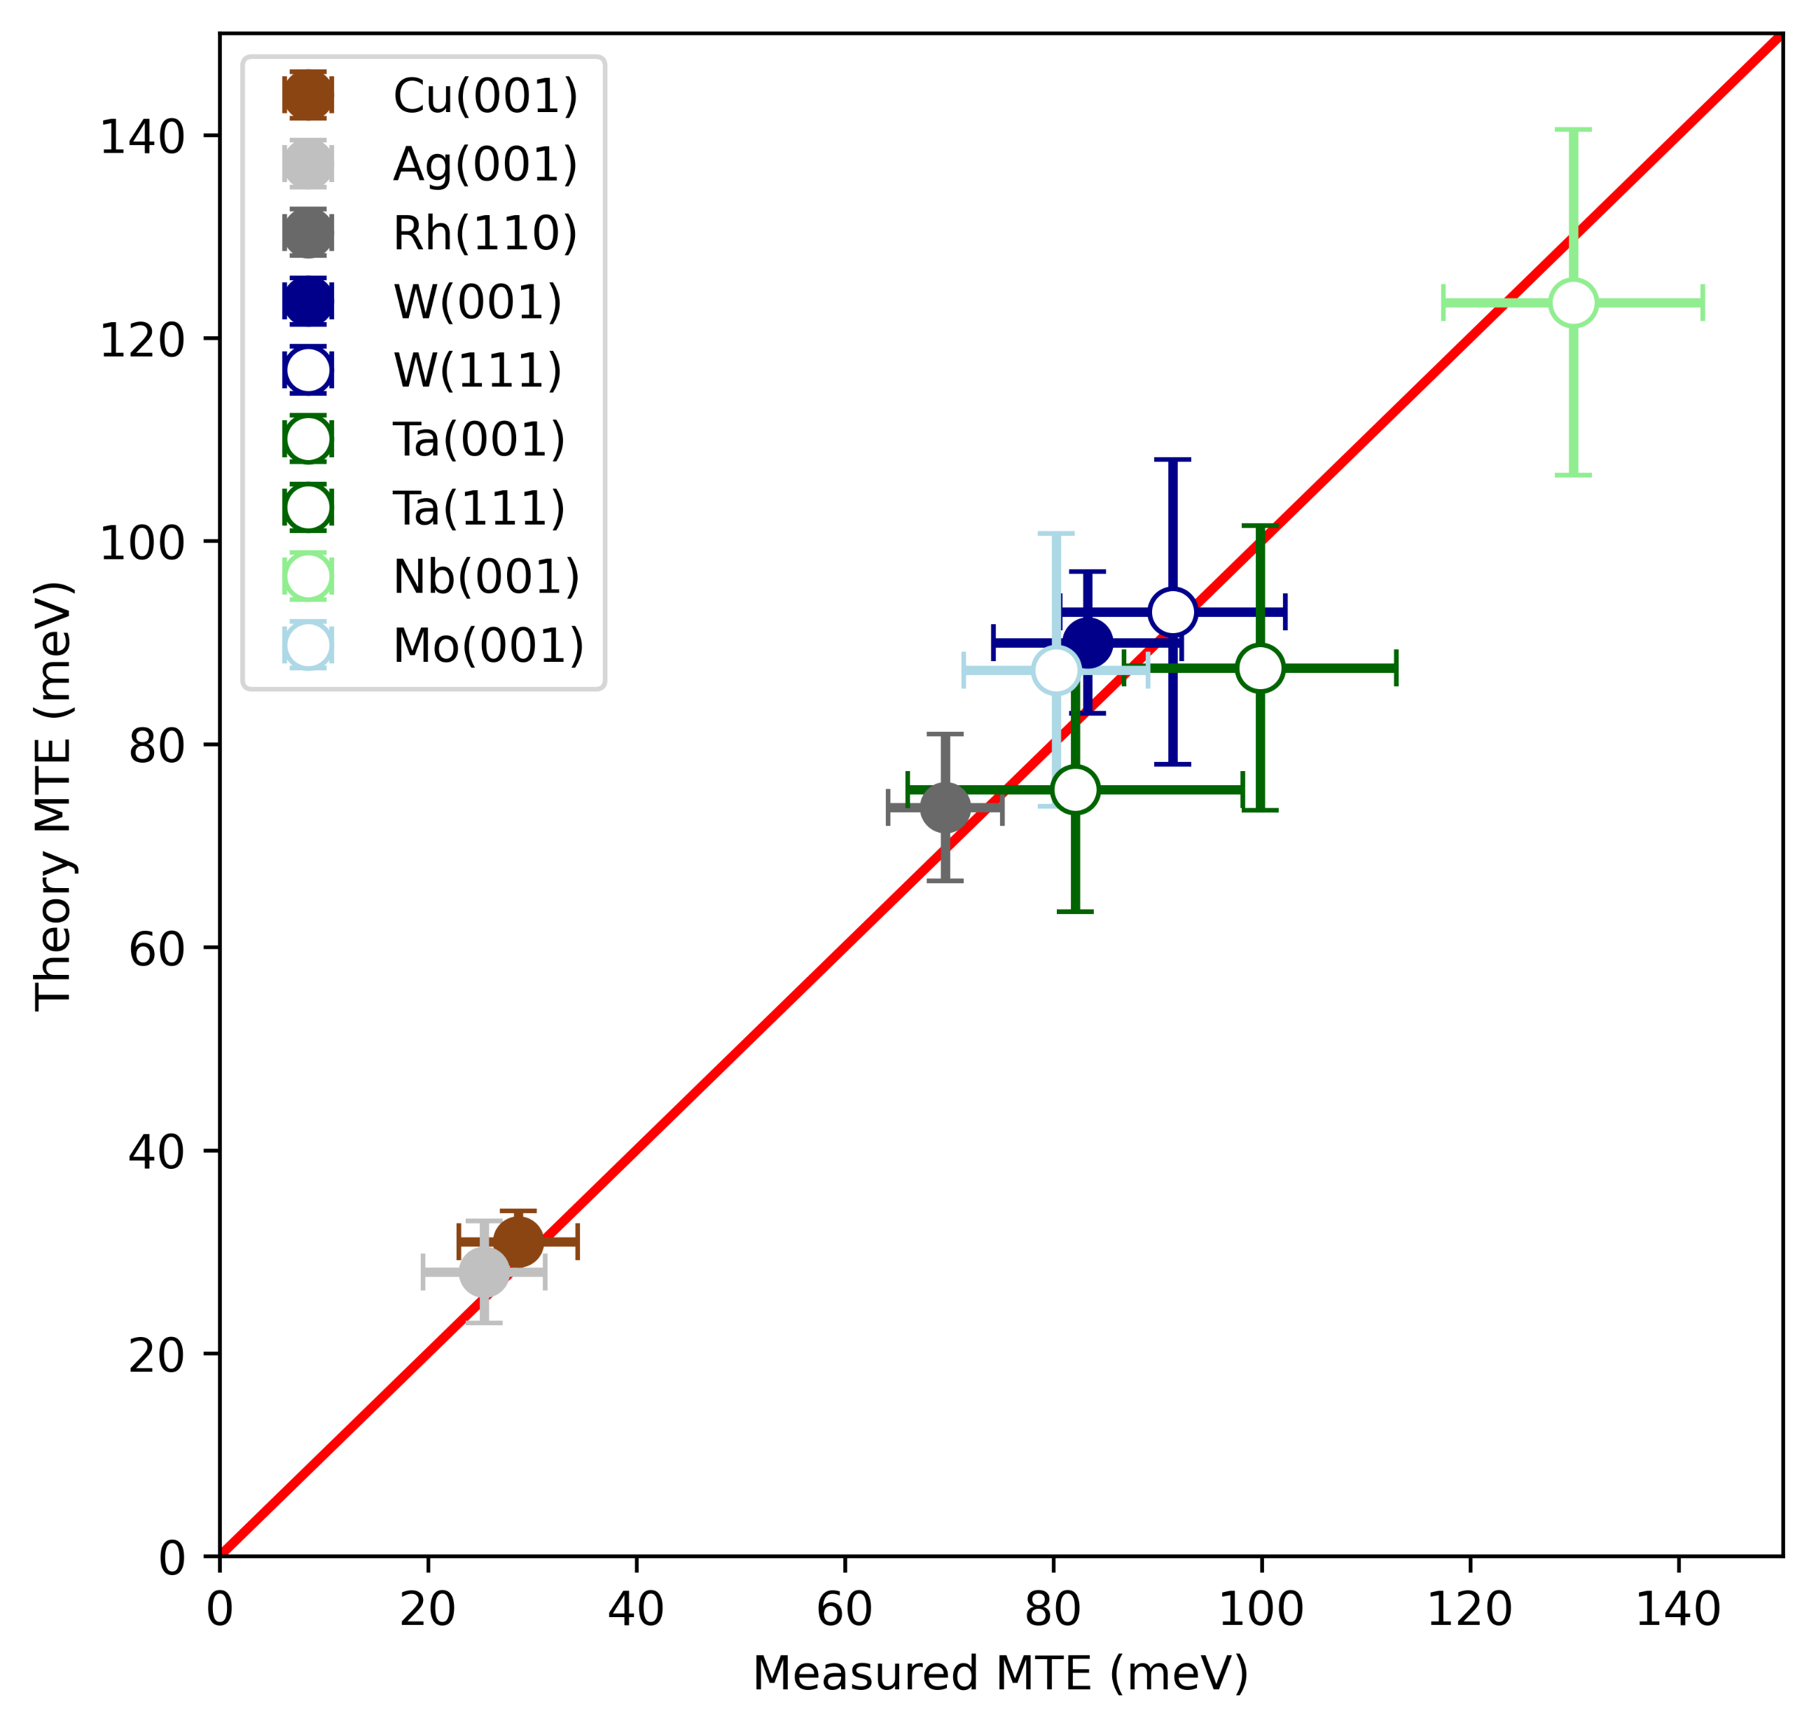
MTE: Theory vs. Experiment
UIC
Theoretical MTE:
${MTE}_{theory}={MTE}_{e−e}+{MTE}_{band}$
... ${MTE}_{band}≥\left(\frac{m_{T}^{∗}}{m_{0}}\right)k_{B}T_{e}$ ; $m_{T}^{∗}< m_{0}$
${MTE}_{band}≤1.5k_{B}T_{e}$ ; $m_{T}^{∗}> m_{0}$
Emission processes not independent:
BOTH emissions from virtual excited band states
⇒ Convolution in momentum space
∴ Addition of p_{T} variances (i.e., MTEs)
... Consistent with observation of a single
Gaussian electron beam profile
MTE_{theory} (meV)
MTE_{expt.} (meV)

Slide 17
Summary
UIC
Franck-Condon effect influences QE and MTE
(i) Metallized diamond(001): MTE > 500meV for outer signal with enhanced QE
p₀ = p_{band} + nq_{LO}
... optical phonon assisted emission
(ii) “Good” metals: MTE > k_{B}T_{e} for ΔE < 0
p₀ = p₁ + p₂ − p POSTULATE !
... electron-electron scattering near ΔE ≈ 0
NOTE: Other possible explanations; surface states (e.g., Tamm), upper CBs ...
Clear implications for discovery of (ultra)low intrinsic emittance photocathodes – especially for operation at 300K

Slide 18
A final note ...
UIC
− Need a better metal photocathode than copper?
Cu(001)
W(001)
Two-photon photoemission background
ħω = 4.27eV ⇒ ΔE ≈ − 0.1eV
ħω = 4.03eV ⇒ ΔE ≈ − 0.1eV
Significantly less two-photon PE in tungsten
Equivalent one-photon QE at same ΔE
Tungsten is less chemically reactive (almost no surface oxide)
Tungsten is harder (i.e., more robust) than copper

Slide 19
UIC
Thank You !

Slide 20
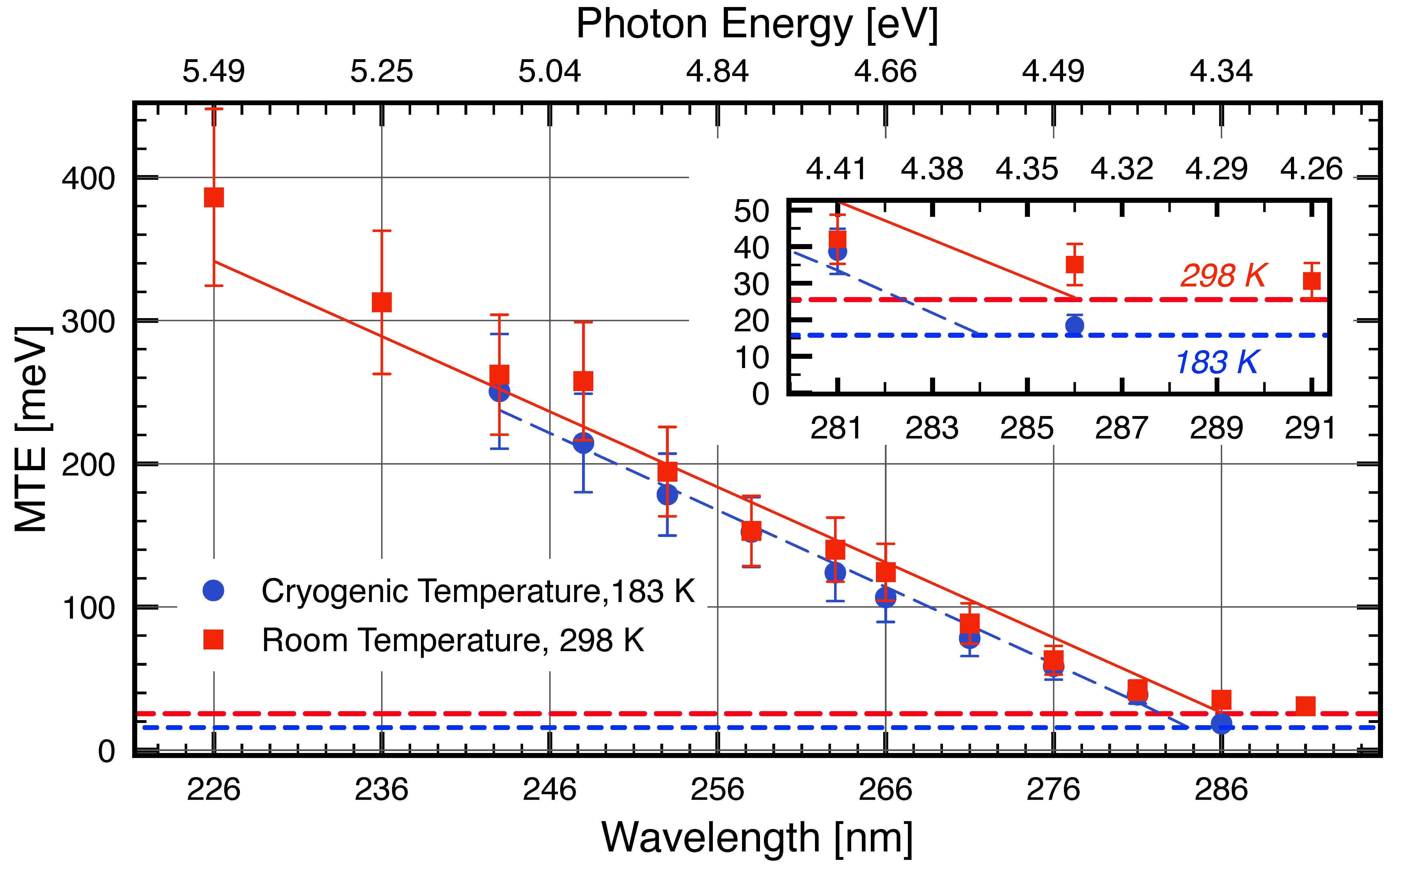
Other work: Cu(001)
UIC
PERFORMANCE CHARACTERISATION
OF A Cu (100) SINGLE–CRYSTAL PHOTOCATHODE
L. A. J. Soomary, D. P. Juarez–Lopez, C. P. Welsch, L. B. Jones, and T. C. Q. Noakes
12th Intl. Particle Acc. Conf. (IPAC 2021), Campinas, SP, Brazil, WEPAB112

Slide 21
Experiment: UV radiation delivery
UIC
− Laser / NLO based tunable UV radiation source: 3.0 – 5.3eV (235-410nm)
20 W Yb:fiber laser
400 fs, 16.7 MHz, 1030 nm
15 W
0.5 W
THG
SHG
SHG
Tunable UV (0.1-1mW)
LBO
LBO
LBO
F
6 W 515 nm
Nonlinear fiber
(SC-3.7-975)
2ω
LBO
LBO
f = 38cm
OAP
3ω
Continuum
(700-950 nm)
100μm aperture
OPA 2
OPA 1
ω_{s,i}
BBO
Tunable UV (0.1-1mW)
λ/2
f = 50cm
Non-collinear
sum frequency
UV generation
Detector:
MCP & CCD camera;
Faraday cup
Detector:
MCP & CCD camera;
Faraday cup
-10 kV
-10 kV
Δp_{T} measurement
Δp_{T} measurement

Slide 22
UIC

