Slide 1
Monte Carlo Modeling of Spin-Polarized Photoemission
Oksana Chubenko
Department of Physics, Northern Illinois University, DeKalb, IL 60115

Slide 2

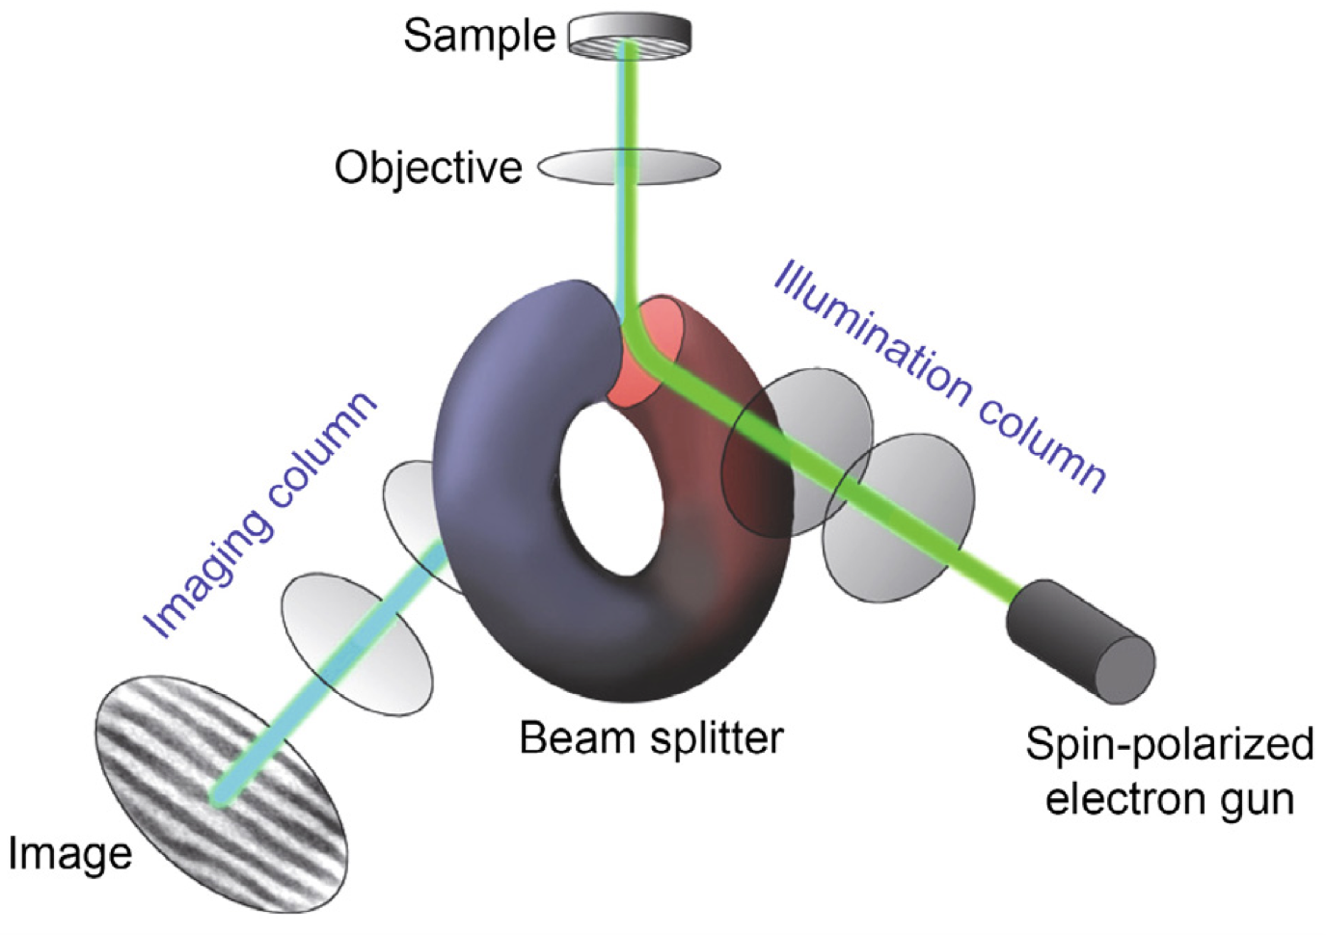
Spin-polarized electron beams and their applications
Particle Physics
probe the structure of subatomic particles
study fundamental forces
explore the properties of matter
https://www.bnl.gov/eic/
Spin-Polarized Scanning Tunneling Microscopy (SP-STM)
study the magnetic properties and electronic structure of nanostructures at the atomic and molecular level
Spin-Polarized Low-Energy Electron Microscopy (SP-LEEM)
imaging magnetic microstructures at surfaces and in thin films.
Ultrafast Spin-Polarized Low-Energy Electron Diffraction (LEED)
enable us to understand the correlation between structure and magnetism in ultrafast processes on surfaces at the nanoscale
Rougemaille and Schmid, Eur. Phys. J. Appl. Phys. 50, 20101 (2010)
Materials Sciences
investigate the electronic and magnetic properties of materials

Slide 3
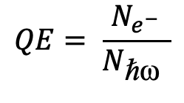

Requirements for efficient spin-polarized electron sources
$$QE= \frac{N_{e^{−}}}{N_{\text{ℏ}\text{ω} }}$$
$$\text{ℏ}\text{ω}$$
e⁻
High Quantum Efficiency (QE)
Intrinsic GaAs:
p-doped GaAs:
p-doped GaAs activated to NEA:

Slide 4
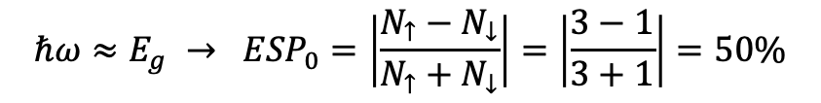

Requirements for efficient spin-polarized electron sources
High Electron Spin Polarization (ESP)
$${ESP}_{0}=\left|\frac{N_{↑}−N_{↓}}{N_{↑}+N_{↓}}\right|$$
Unstrained GaAs:
$$ℏω≈E_{g} → {ESP}_{0}=\left|\frac{N_{↑}−N_{↓}}{N_{↑}+N_{↓}}\right|=\left|\frac{3−1}{3+1}\right|=50\%$$
Chubenko et al. J. Appl. Phys. 130, 063101 (2021)
D’yakonov and Perel’, Sov. Phys. JETP 33, 1053 (1971)

Slide 5
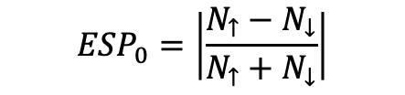

Requirements for efficient spin-polarized electron sources
High Electron Spin Polarization (ESP)
$${ESP}_{0}=\left|\frac{N_{↑}−N_{↓}}{N_{↑}+N_{↓}}\right|$$
Strained GaAs:
$${ℏω≈E_{g} → ESP}_{0}=\left|\frac{3−0}{3−0}\right|=100\%$$

Slide 6
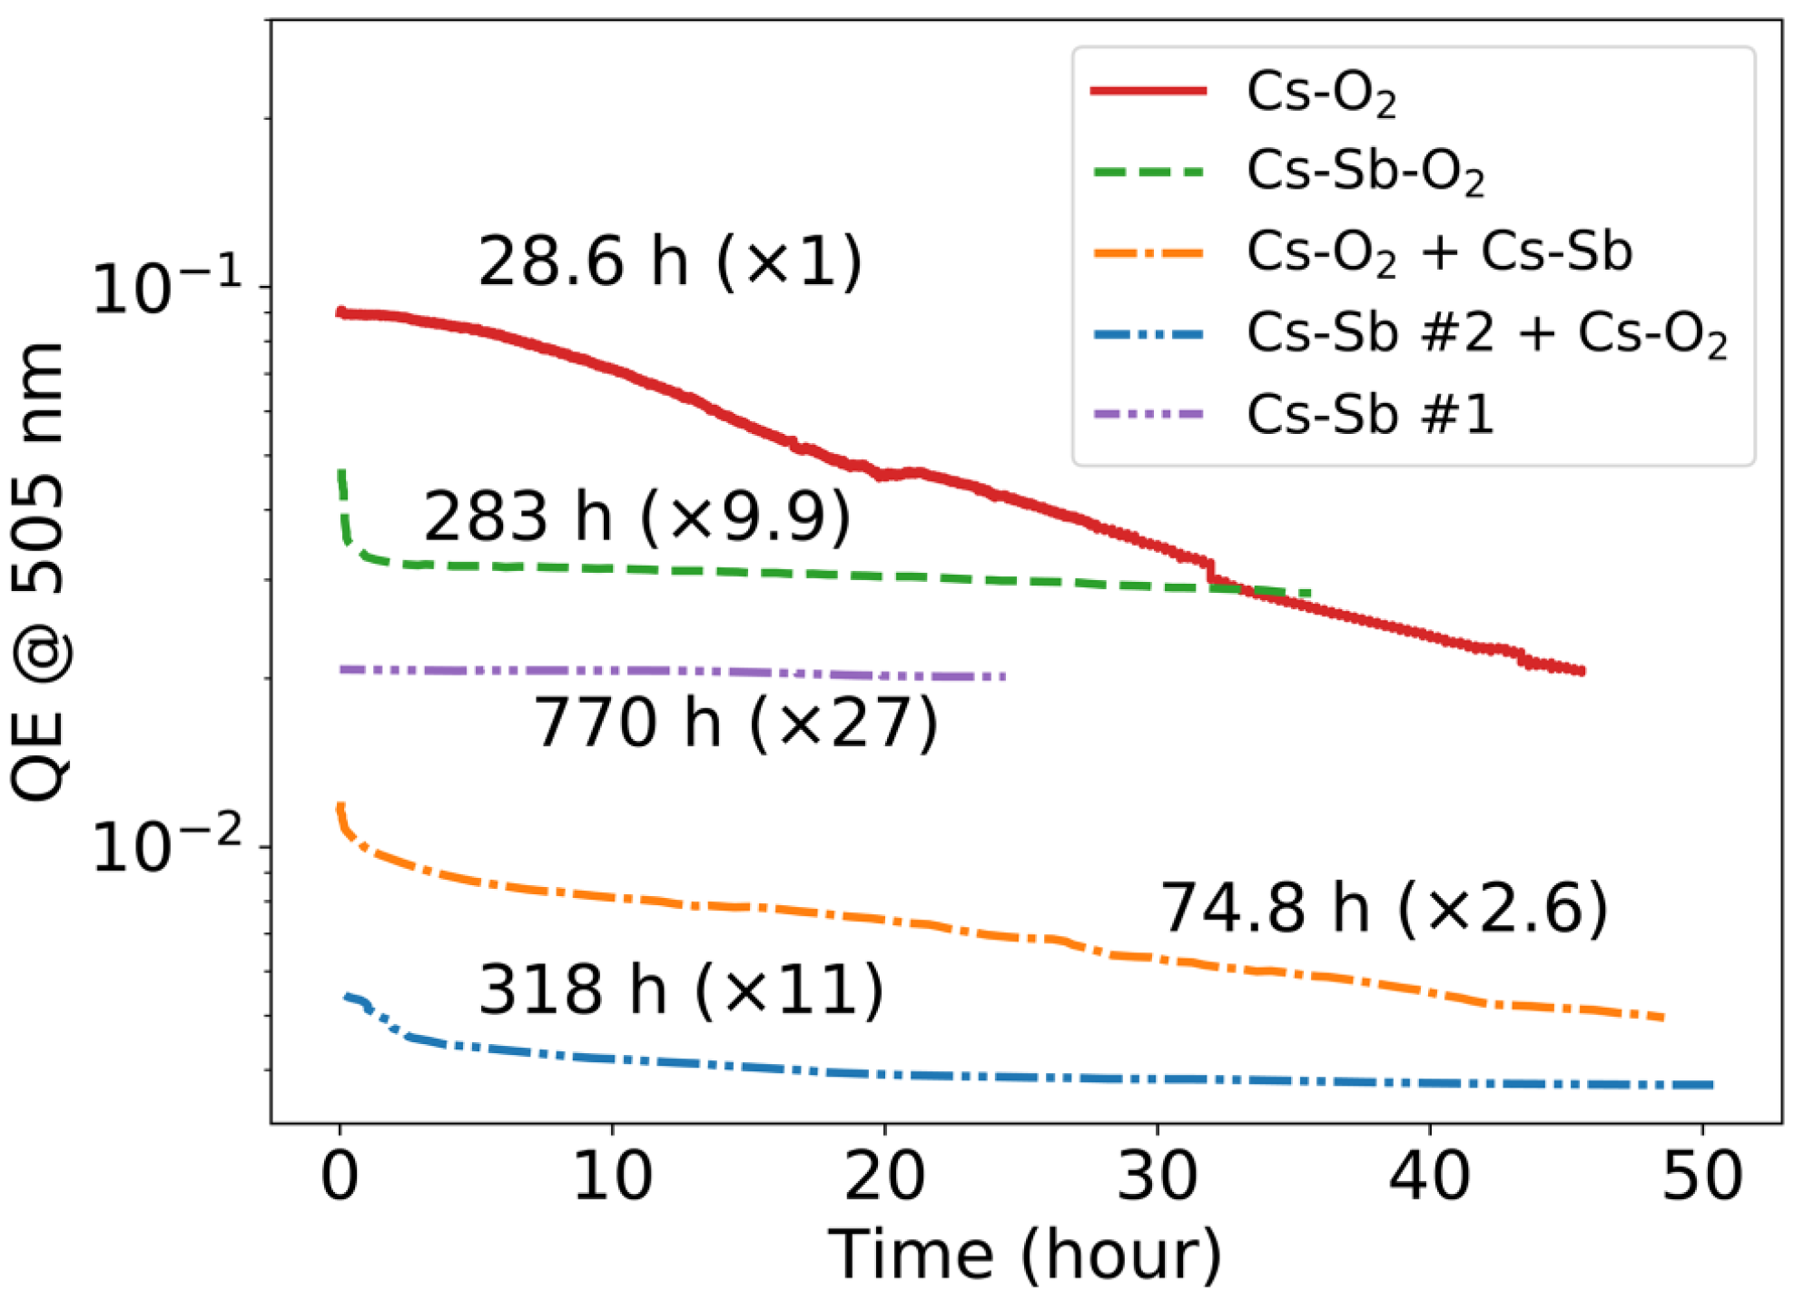
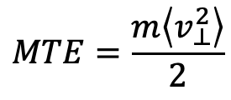

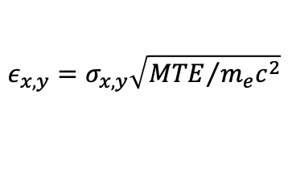
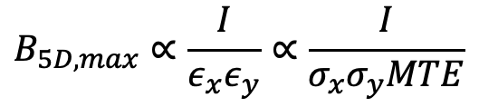

Requirements for efficient spin-polarized electron sources
ℏ𝑤
e⁻
High Brightness = high current + low Mean Transverse Energy (MTE)
$$σ_{x}$$
$$B_{5D, max}∝\frac{I}{ε_{x}ε_{y}}∝\frac{I}{σ_{x}σ_{y}MTE}$$
$$MTE=\frac{m\left\langle v_{⊥}^{2}\right\rangle }{2}$$
z
$$v_{⊥}$$
Bae et al. J. Appl. Phys. 124, 244903 (2018).
$$ε_{x,y}=σ_{x,y}\sqrt{{MTE}/{m_{e}c^{2}}}$$
Prompt response time
Robustness + long operational lifetime
Accessibility
Bae et al. J. Appl. Phys. 127, 124901 (2020).

Slide 7
Monte Carlo approach for modeling spin-polarized photoemission from semiconductors
Advantages of Monte Carlo approach:
QE, ESP, MTE, response time = f(ℏ𝜔, p, 𝜒, T).
Accounts for the subtleties of the material band structure.
Does not require a priori assumption about the particle distribution functions.
Can be easily modified to include different scattering mechanisms to model both steady-state and non-equilibrium conditions.
Accounts for the surface effects.
Can be applied to both bulk and thin layers.

Slide 8
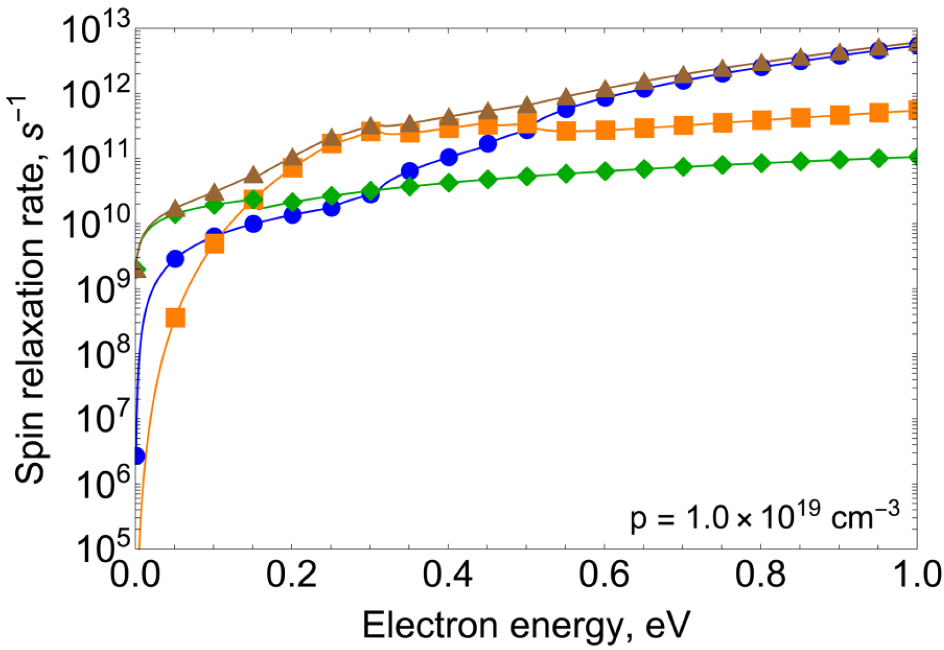

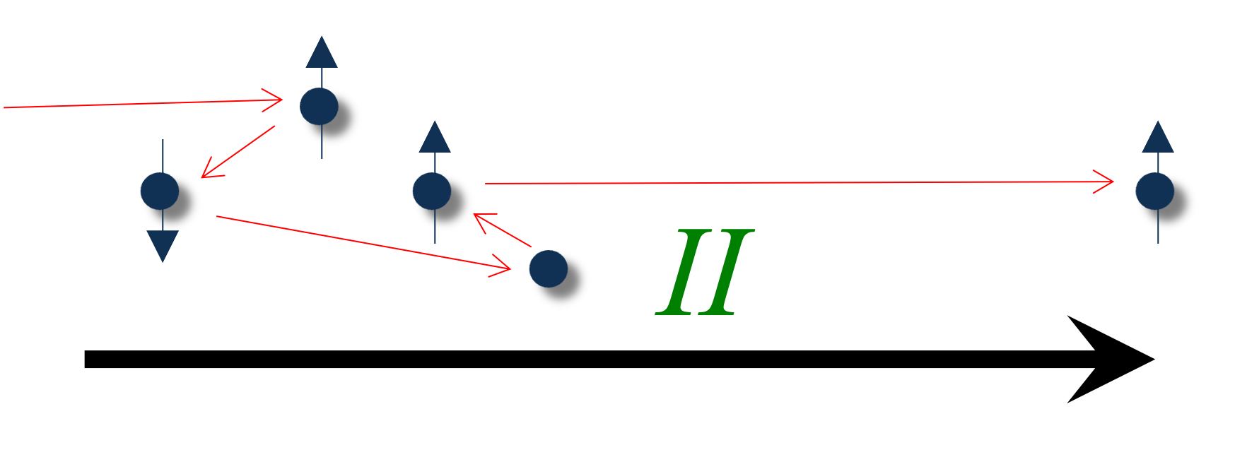
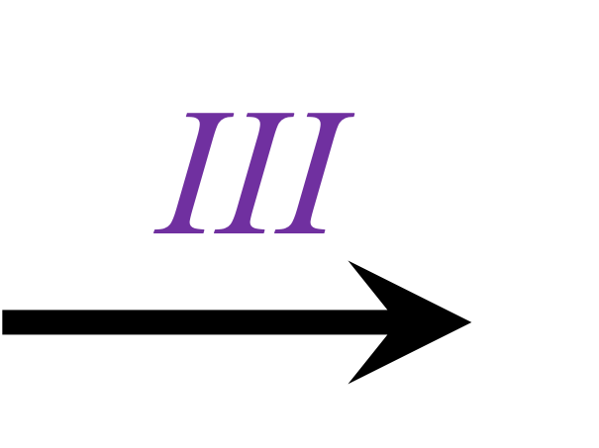
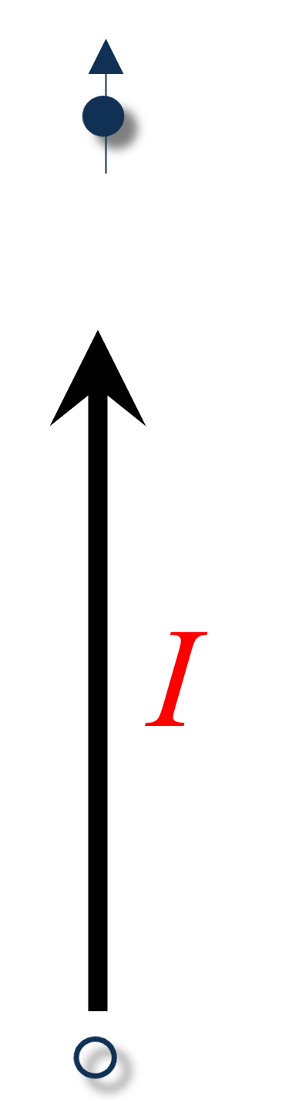

Monte Carlo approach for modeling spin-polarized photoemission from semiconductors
Transport
p = 10¹⁹ cm⁻³:
W_{b-b} = 8 nm
E_{b-b} = 0.47 eV
Elliott–Yafet (EY)
D’yakonov–Perel’ (DP)
Bir–Aronov–Pikus (BAP)
Total
Photoexcitation
Initial energy distribution of
photoexcited electrons
Initial electron distribution in
real space
Emission
Semiconductor
Vacuum
Initial spin orientation of
photoexcited electrons
$${ESP}_{0}=\left|\frac{N_{↑}−N_{↓}}{N_{↑}+N_{↓}}\right|$$
Spin-polarized photoemission from p-type NEA GaAs: I – photoexcitation, II – transport, III – emission.

Slide 9

Monte Carlo study of spin-polarized photoemission from GaAs
ESP, %
Characteristic behavior of experimental QE and ESP from NEA GaAs.

Slide 10
Monte Carlo study of spin-polarized photoemission from GaAs
Comparison with experiment: QE and ESP from p-type GaAs for different electron affinity levels
10
Chubenko et al. J. Appl. Phys. 130, 063101 (2021)

Slide 11
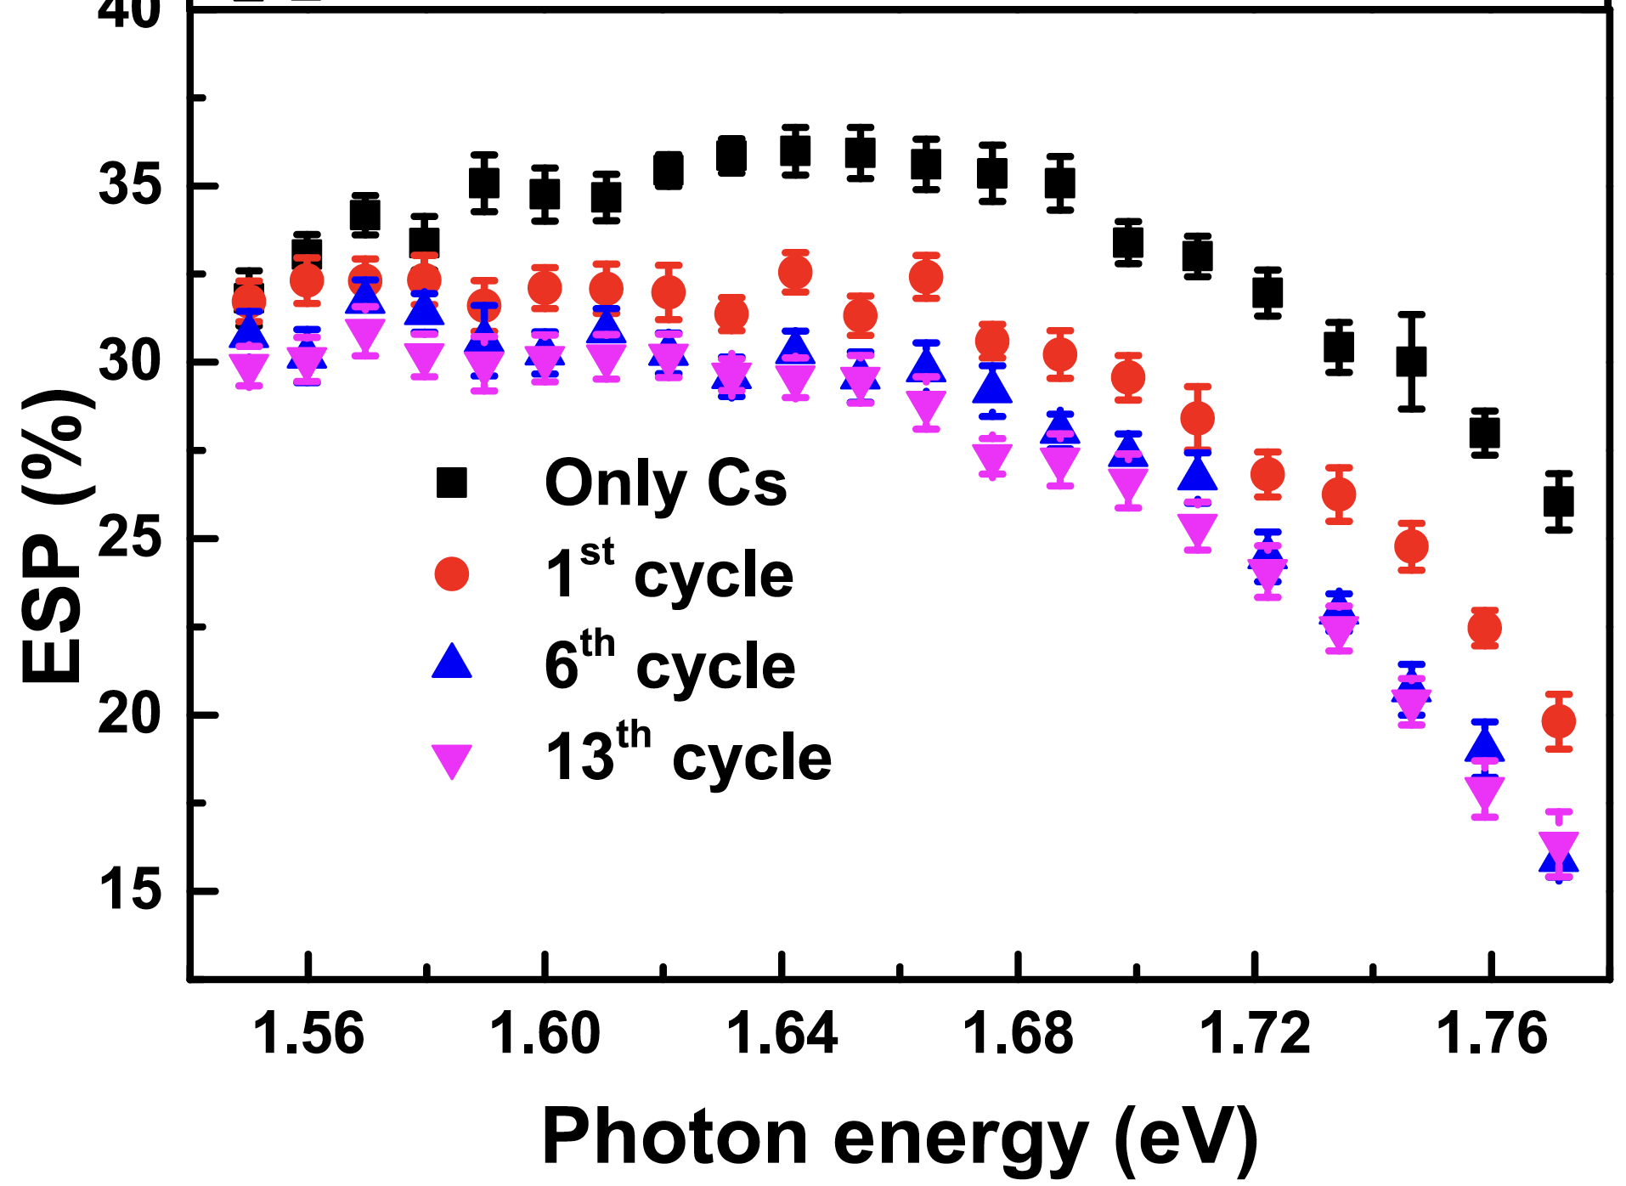
Monte Carlo study of spin-polarized photoemission from GaAs
Liu et al. Appl. Phys. 122, 035703 (2017).
11
Chubenko et al. J. Appl. Phys. 130, 063101 (2021)

Slide 12
Monte Carlo study of spin-polarized photoemission from GaAs
Comparison with experiment: QE and ESP from p-type GaAs for different doping densities
Chubenko et al. J. Appl. Phys. 130, 063101 (2021)
12

Slide 13
Future applications of spin-polarized Monte Carlo model
Effective/fast modeling of spin-polarized photoemission: C + MPI to run in parallel at HPC cluster.
Good agreement with available experimental data.
Required model parameters from Density Functional Theory (DFT) calculations.
The developed Monte Carlo model establishes a paradigm for future studies of spin-polarized photoemission.
13

Slide 14
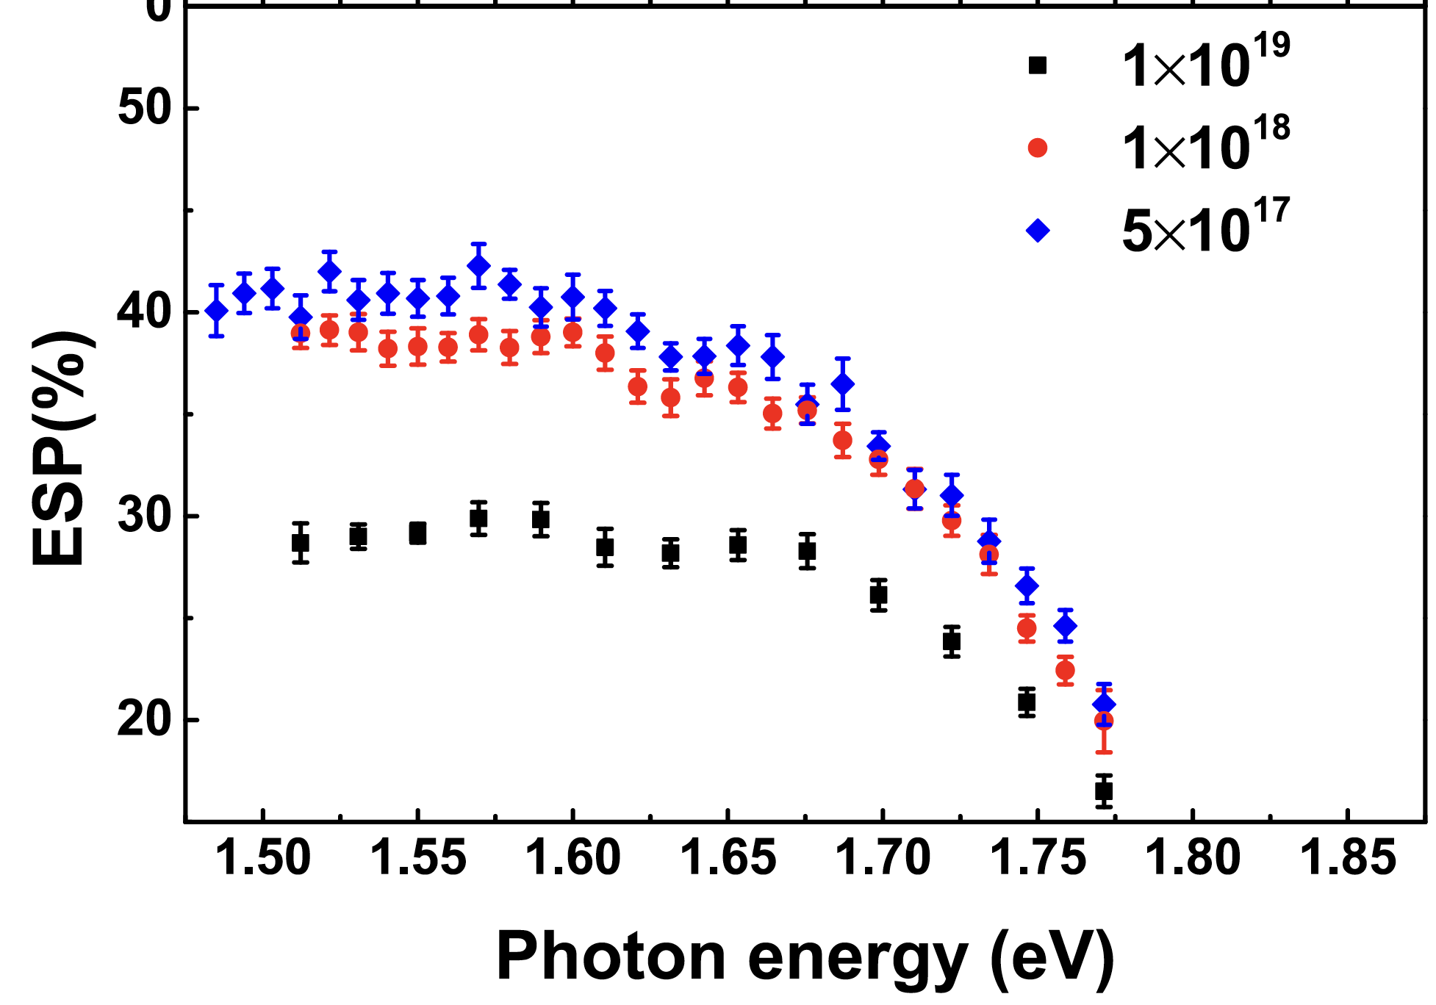
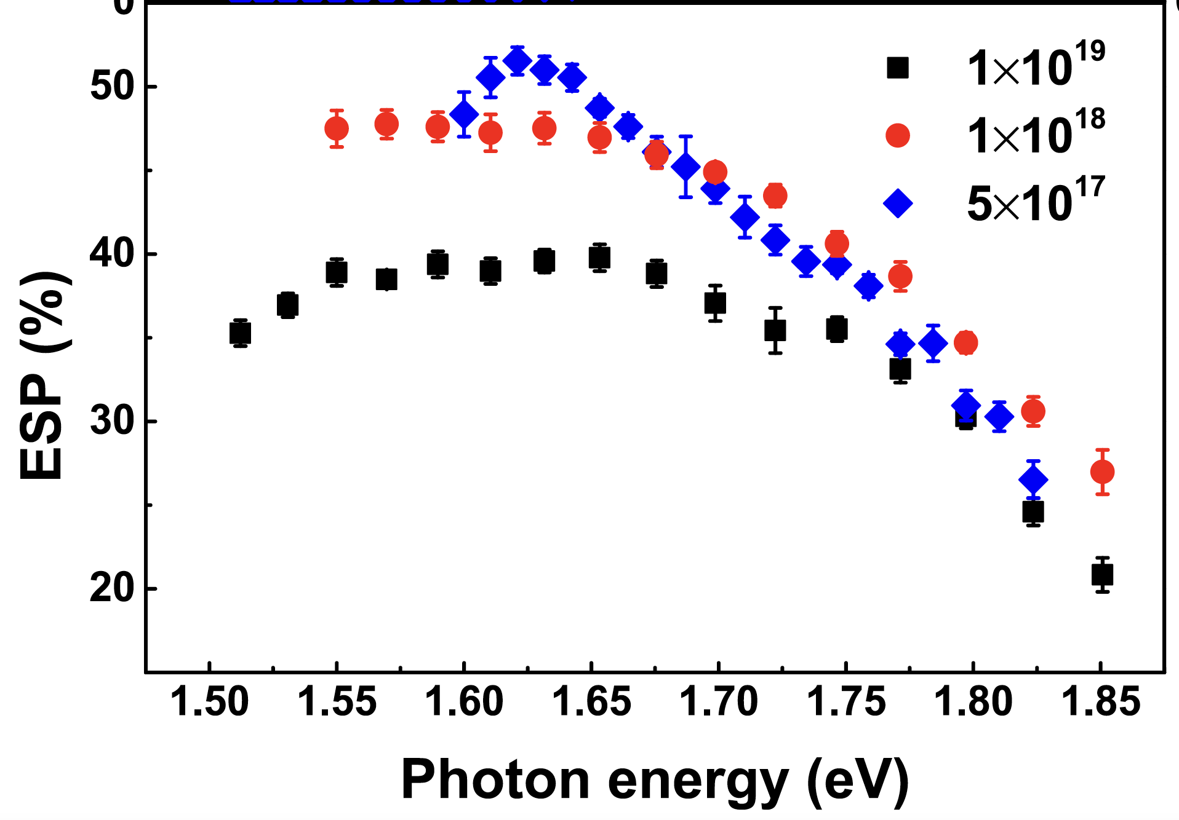
Future applications of spin-polarized Monte Carlo model
Temperature effects on spin-polarized photoemission from bulk GaAs.
$${ESP}_{0}=50\%$$
T = 300 K
T = 77 K
T = 2 K
?
?
Liu et al. Appl. Phys. 122, 035703 (2017).

Slide 15
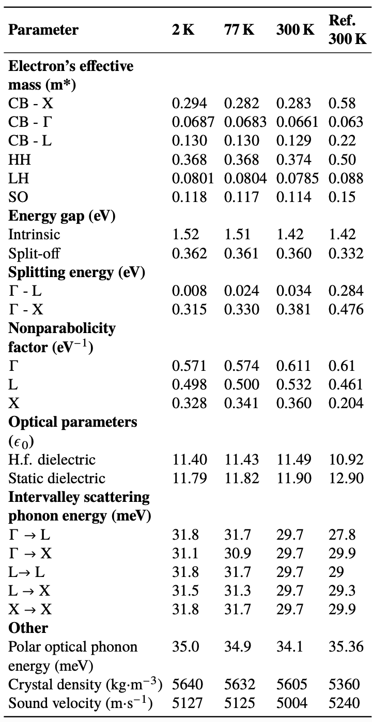
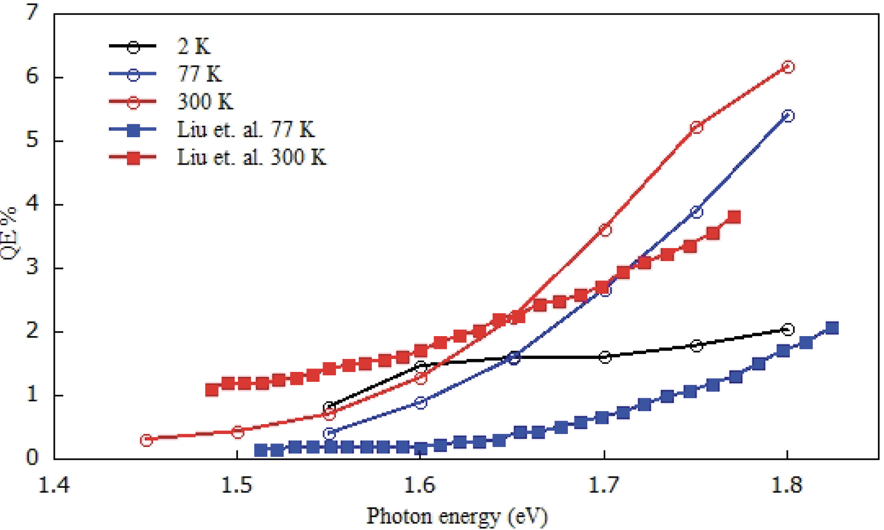
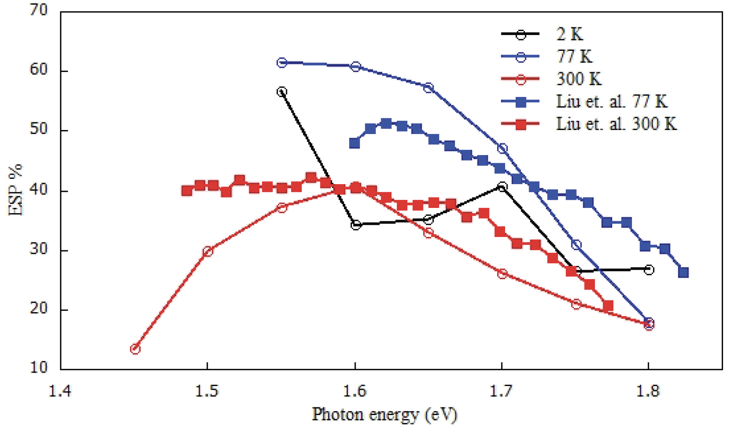
Future applications of spin-polarized Monte Carlo model
Preliminary results:
Rodriguez Alicea, Chubenko et al. NAPAC 2022

Slide 16
Future applications of spin-polarized Monte Carlo model
Spin-polarized photoemission from strained GaAs and Super-Lattice structures.
✅

Slide 17
Future applications of spin-polarized Monte Carlo model
Spin-polarized photoemission from CdTe and other II-VI semiconductors.
 | GaAs | CdTe
Direct bandgap | yes | yes
Cs-based activation | yes | yes
Surface quality | high | high
p-doped | yes | yes
Spin-orbit coupling | strong | moderate
Cost | MBE, expensive | ALD, cheap
Accessibility | limited | accessible
Thursday, October 5

Slide 18
Future applications of spin-polarized Monte Carlo model
Preliminary results for band model parameters available in literature, Boutaiba et al. Phys. REV. B 89, 245308 (2014):

Slide 19
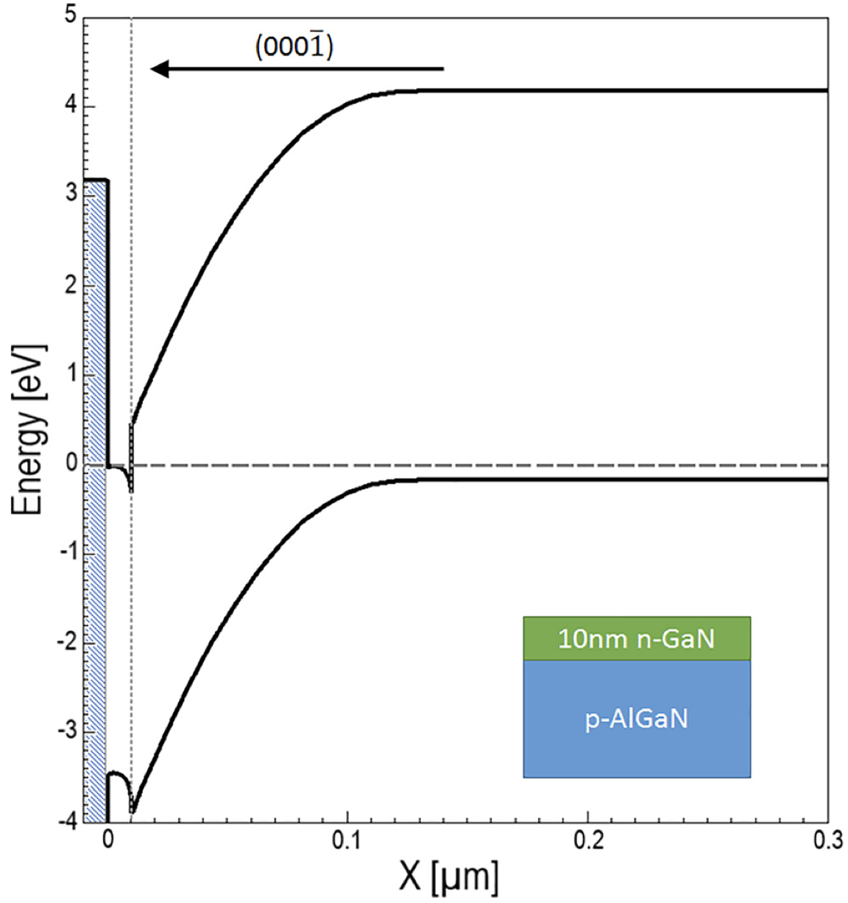
Future applications of spin-polarized Monte Carlo model
Spin-polarized photoemission from materials with inherently low/negative electron affinity levels.
Polarization band engineering to achieve an effective NEA condition without the use of Cs at the surface of GaN photocathode structures.
DFT + Monte Carlo approach to study spin-polarized photoemission from III-Nitride materials.
Marini et al. J. Appl. Phys. 124, 113101 (2018).

Slide 20
Summary and future directions
The detailed Monte Carlo model of photoemission has been developed to model main electron emission characteristics of semiconductor photocathodes. The model provides good agreement with experimental data for bulk NEA GaAs at room temperature.
The work in progress to implement both low temperature and lattice strained adjustments to the Monte Carlo Approach using DFT results.
The developed Monte Carlo model will be modified further to study spin-polarized photoemission from novel materials and layered structures.
✅

Slide 21


Acknowledgements
John Callahan (NIU)
A. Rodriguez Alicea (MSU)
Joniel O Mendez-Nieves (BNL)
Harish Bhandari (RMD Inc)
Siddharth Karkare (ASU)
Dimitre A. Dimitrov (LANL)
Jai Kwan Bae (BNL)
Luca Cultrera (BNL)
Ivan Bazarov (Cornell University)
Andrei Afanasev (GWU)
Thank you!

