Slide 1




On Chip Waveguide Integrated Photocathodes
Photocathode Physics
for Photoinjectors (P3)
Hyun Uk Chae, Alimohammed Kachwala (ASU), Ragib Ahsan (USC), Oksana Chubenko (NIU),
Siddharth Karkare (ASU), Rehan Kapadia (USC)
Department of Electrical and Computer Engineering
University of Southern California

Slide 2

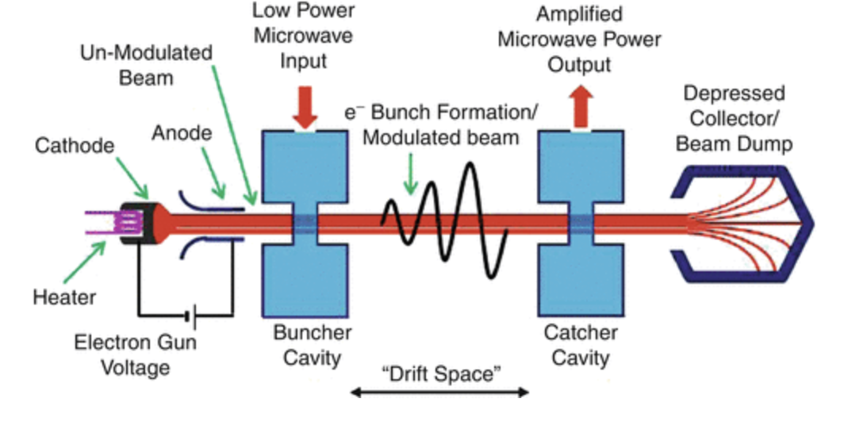
Why do we care about electron emitters?
Accelerators
Vacuum Electron Devices
Bright coherent source for scientific application
High power and high frequency wave generation and amplification

Slide 3
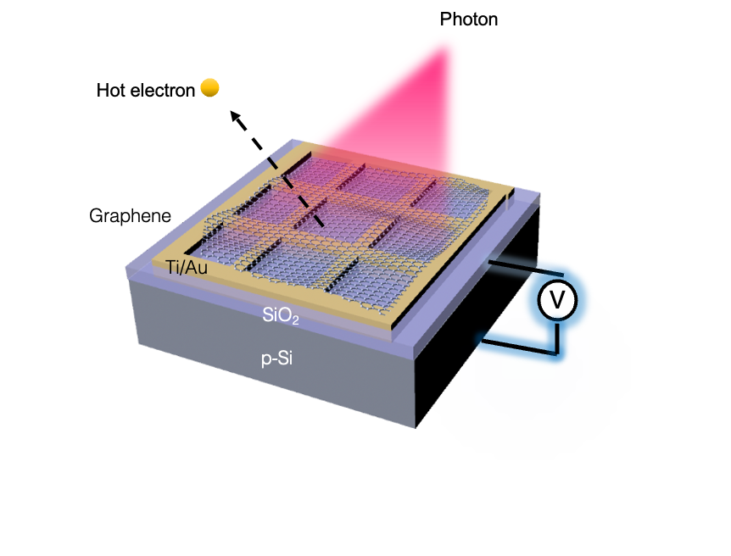
USC Semiconductor Photoemitters
Hot Electron Light Assisted Cathode (HELAC)

Slide 4
USC Semiconductor Photoemitters
Hot Electron Light Assisted Cathode (HELAC)
Waveguide Integrated Hot Electron Cathode

Slide 5
USC Semiconductor Photoemitters
Hot Electron Light Assisted Cathode (HELAC)
Waveguide Integrated Hot Electron Cathode

Slide 6
Can we couple light into a semiconductor device to maximize the light coupling into an absorber?

Slide 7
Key factors of good photoemitter
Rapid response Time

Slide 8
Key factors of good photoemitter
Rapid response Time
Low Mean transverse Energies (MTE)

Slide 9
Key factors of good photoemitter
Rapid response Time
Low Mean transverse Energies (MTE)
High Quantum Efficiency (QE)

Slide 10
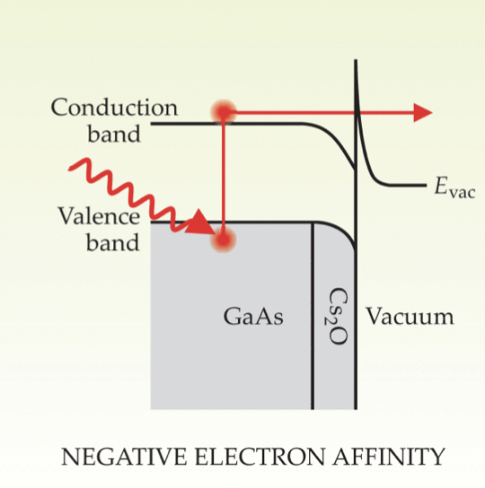
GaAs: Negative Electron Affinity
Hernandez-Garcia, Carlos, Patrick G. O Shea, and Marcy L. Stutzman. "Electron sources for accelerators." Physics today61.2 (2008): 44.

Slide 11
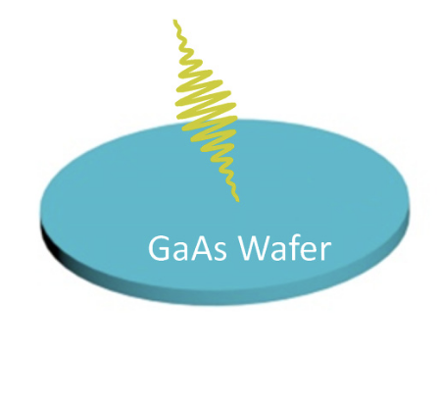
Limitations; GaAs: Negative Electron Affinity
Hernandez-Garcia, Carlos, Patrick G. O Shea, and Marcy L. Stutzman. "Electron sources for accelerators." Physics today61.2 (2008): 44.
Blankemeier, L., et al., 2019.

Slide 12
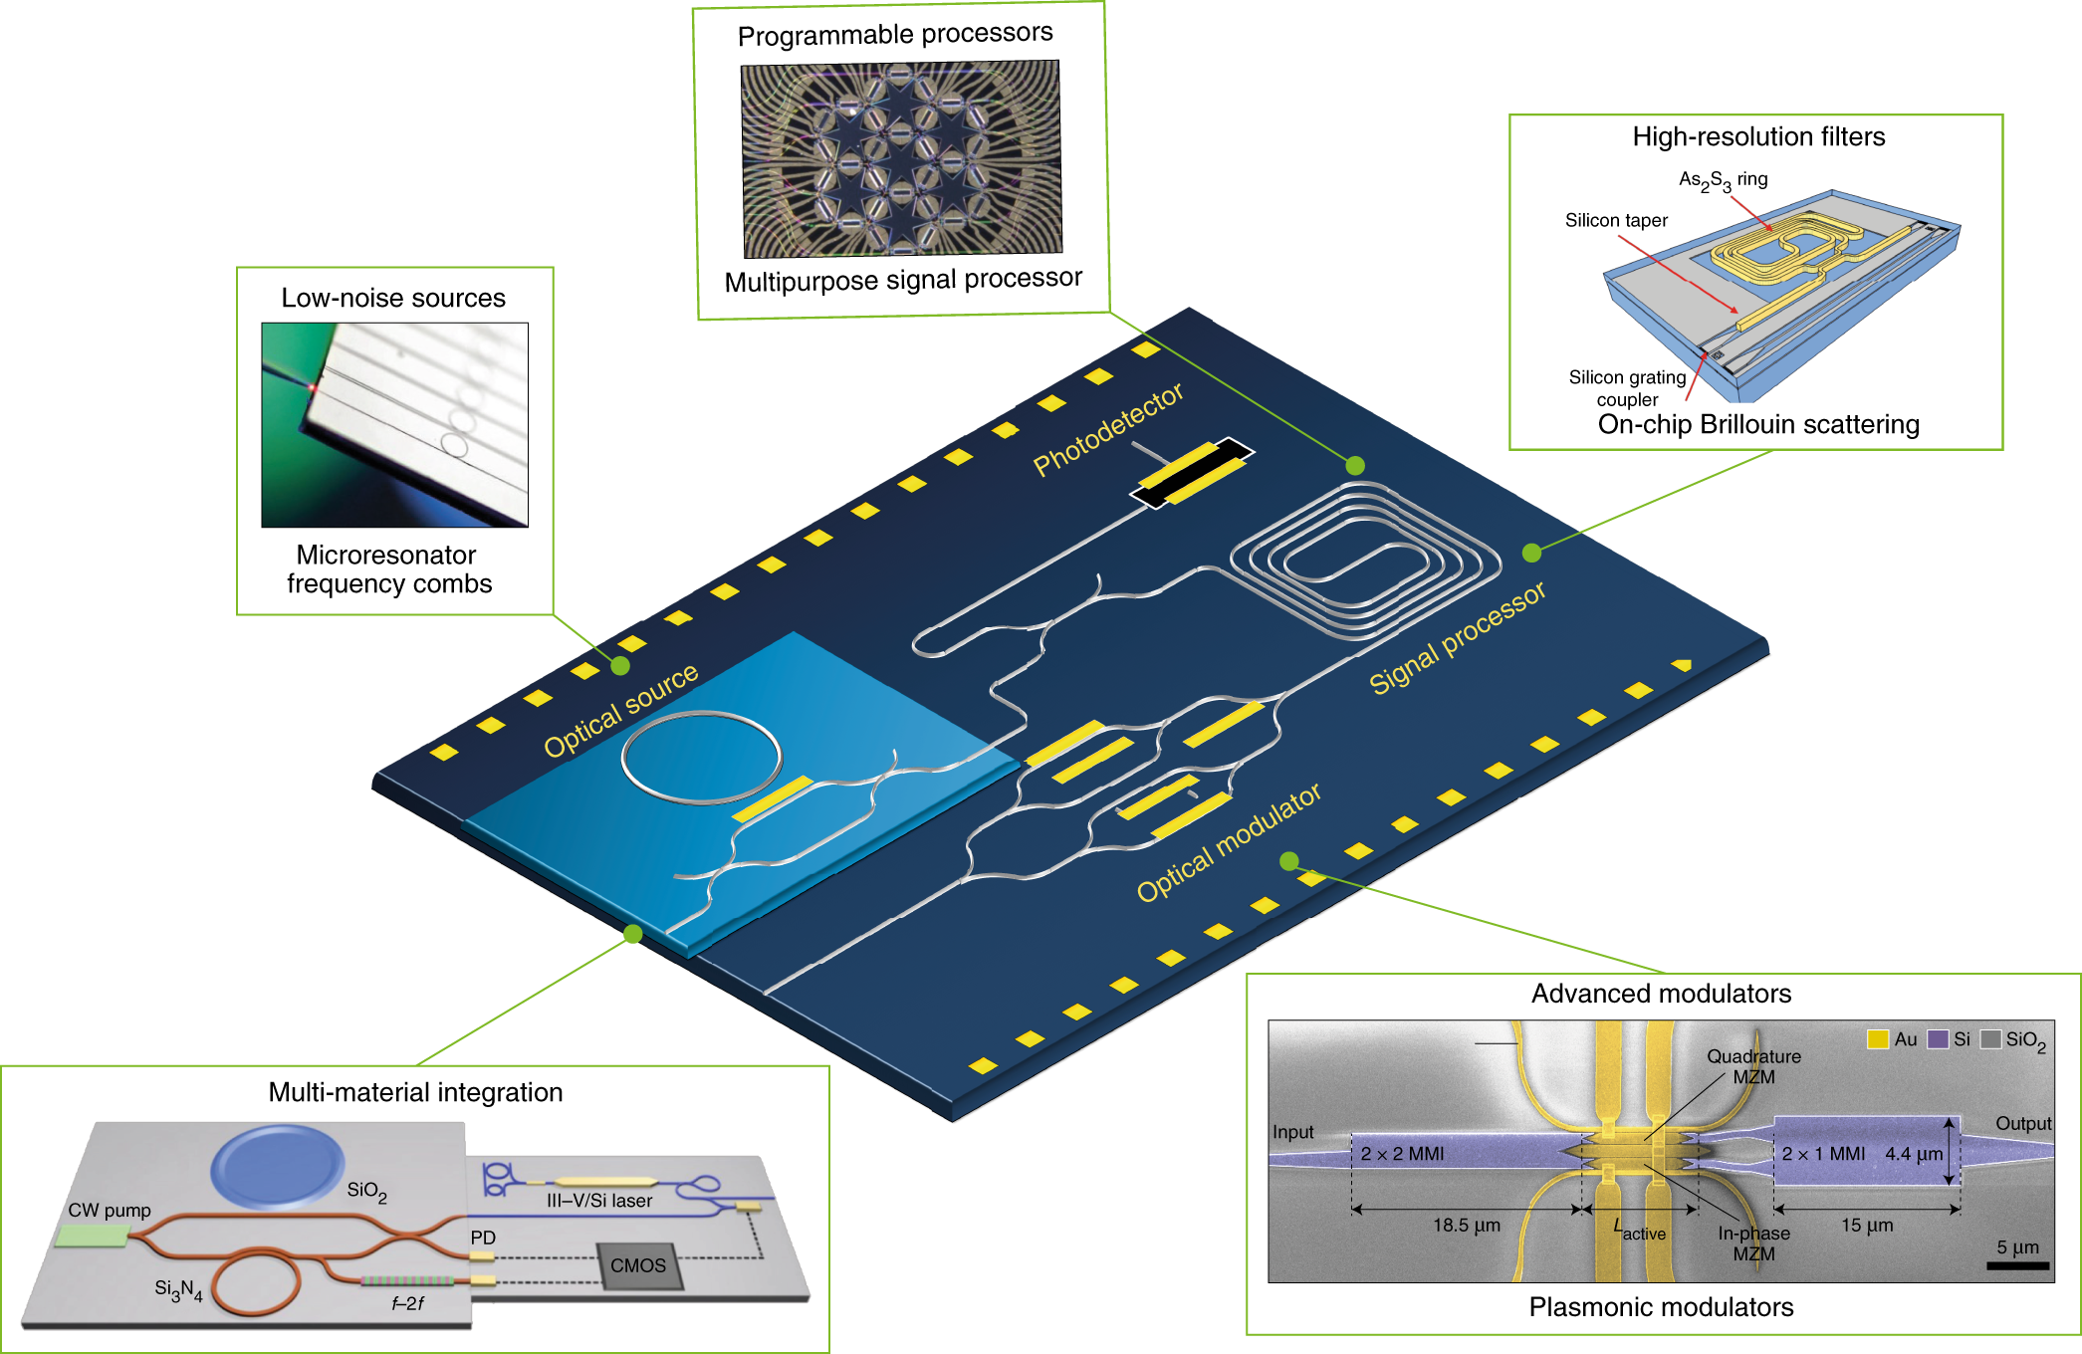
Background: Integrated Photonics
Integrated photonic circuits to manipulate, modulate and direct light on wafers are widely used in the telecommunication industry.

Slide 13
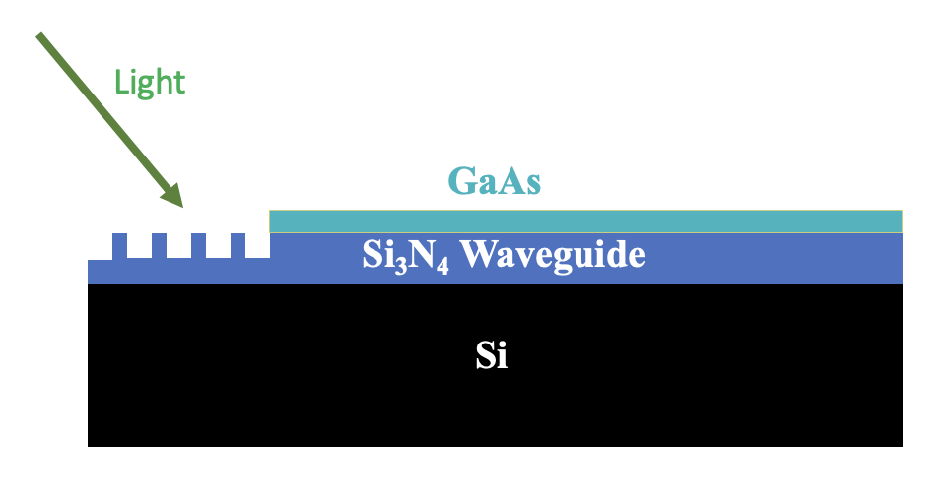
Limitations; GaAs: Negative Electron Affinity
Blankemeier, L., et al., 2019.

Slide 14
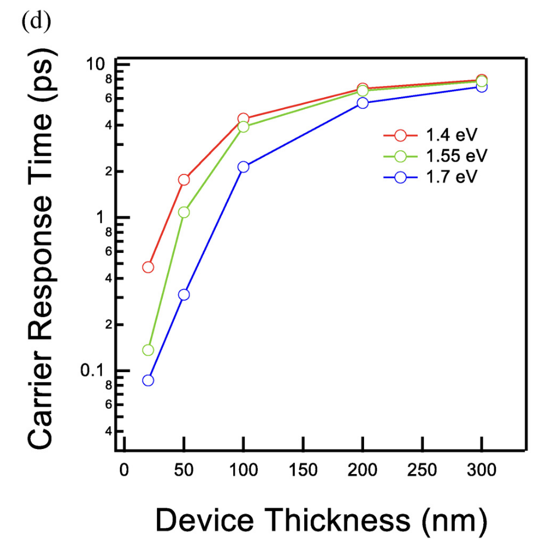
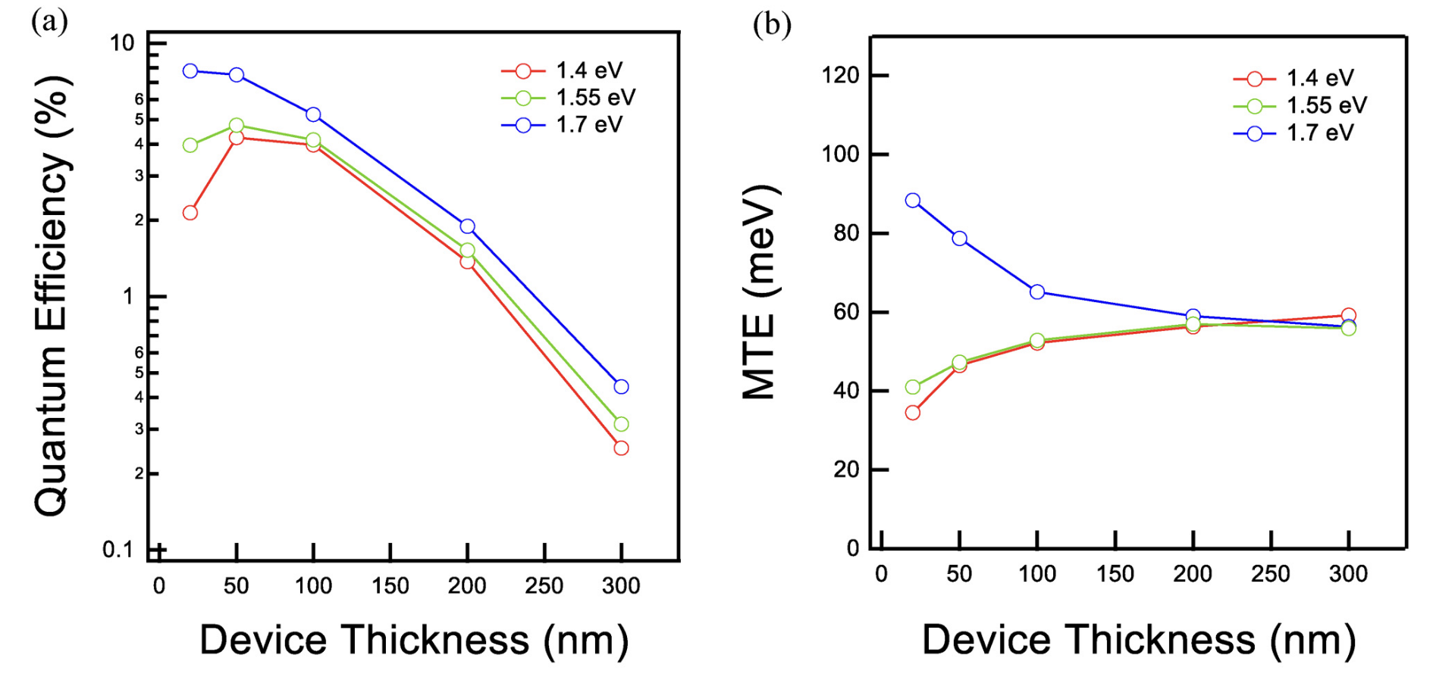
Integrated Photoemitter Simulation Result
High Quantum efficiency (QE)
Low MTE
Quick response time
Blankemeier, L., et al., 2019.

Slide 15
Key factors of designing good Photocathode
Absorber

Slide 16
Key factors of designing good Photocathode
Absorber
1. Efficient Light Coupling

Slide 17
Key factors of designing good Photocathode
2. Chose Proper Light Absorber
Absorber
1. Efficient Light Coupling

Slide 18
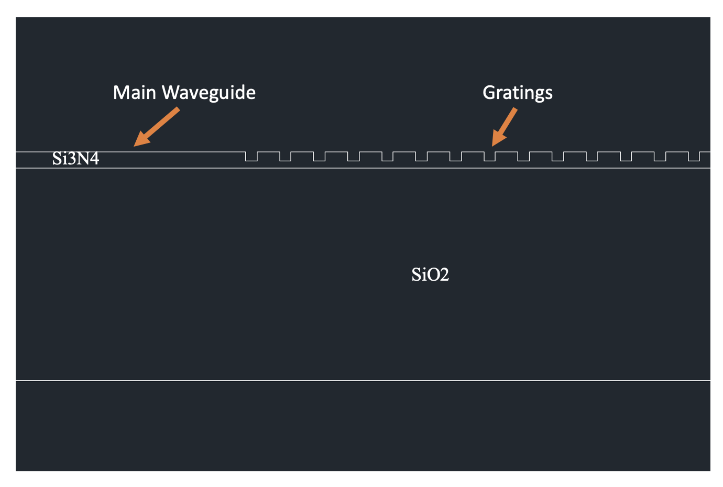
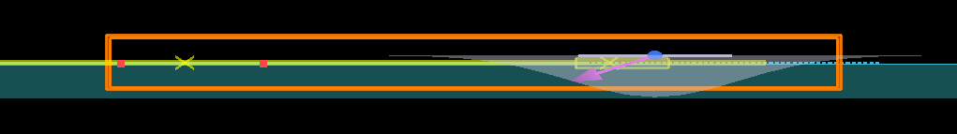
Design Grating Coupler
Lumerical FDTD simulation was used to track the transmission profile of designed grating coupler while traveling across the waveguide structure

Slide 19
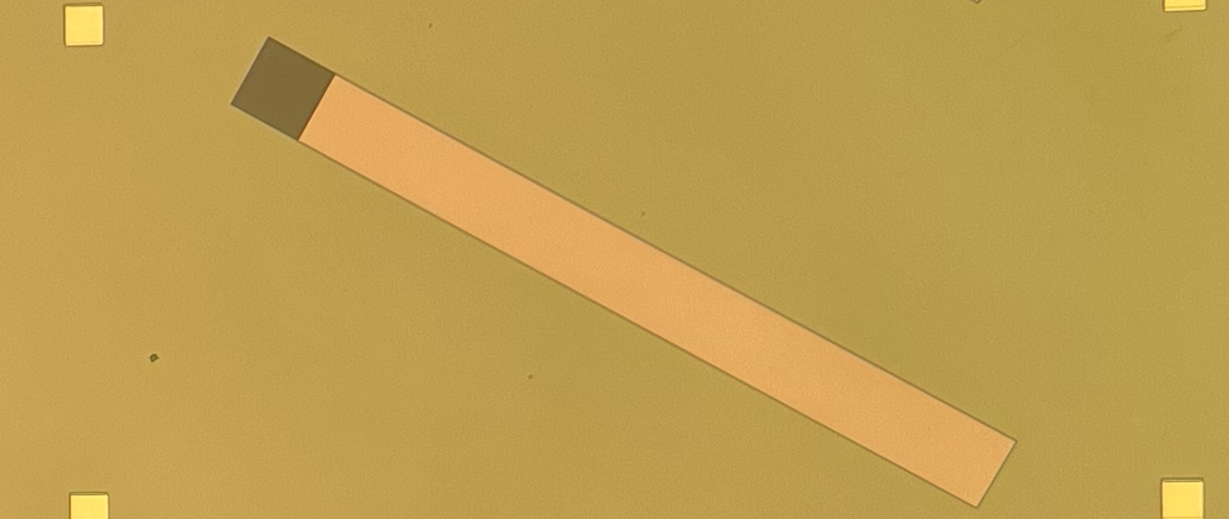

Design Grating Coupler
Grating Coupler
Waveguide
Optical Microscope image
5um
Scanning Electron Microscope image
Micro/Nano semiconductor fabrication technique used to build a Si₃N₄ grating coupler with waveguide structure
19

Slide 20
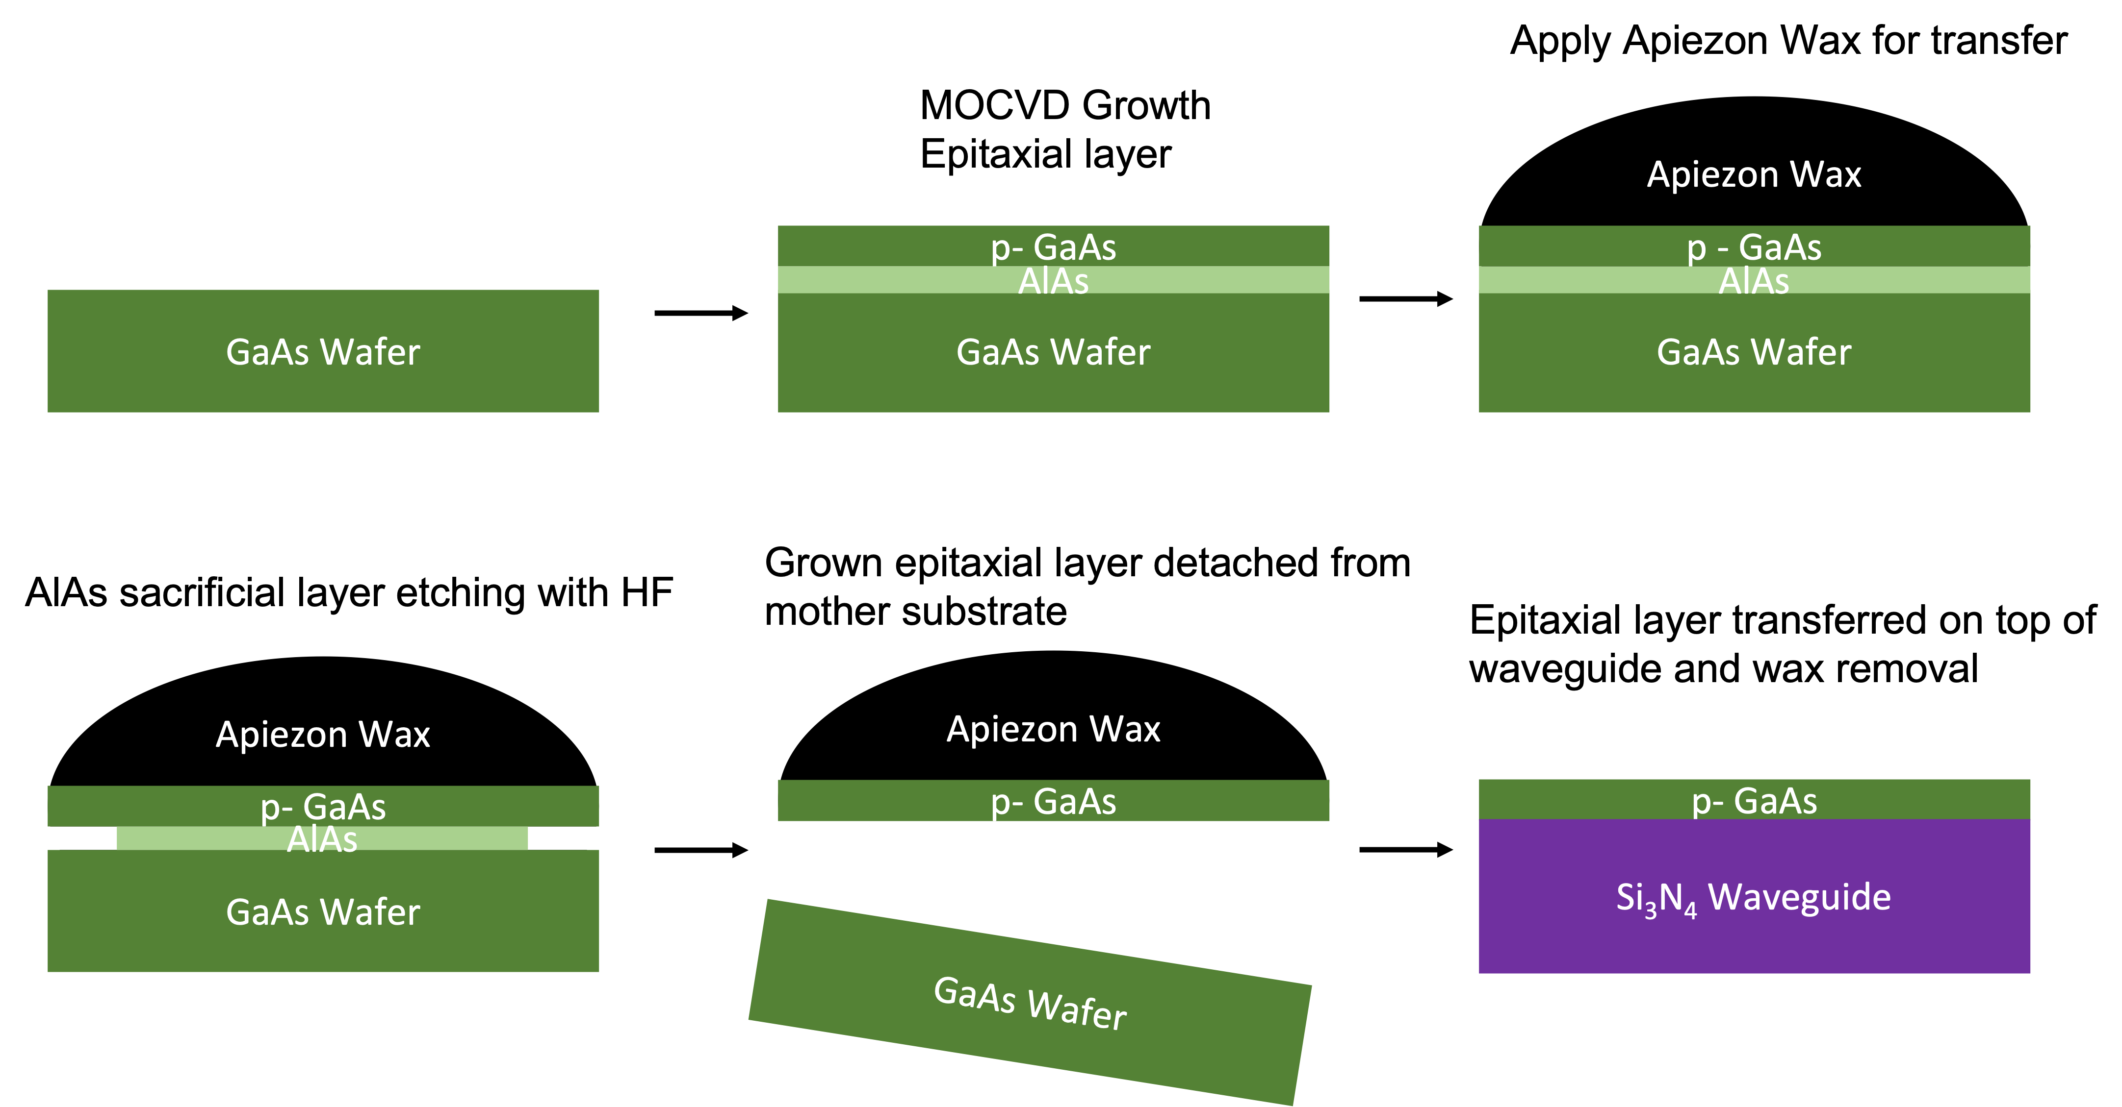
Transferring GaAs epitaxial layer on waveguide
Before Transfer
Waveguide
5um
Thin layer of p-GaAs was grown by Metal Organic Chemical Vapor Deposition (MOCVD).
Epitaxial lift-off process was processed to transfer GaAs on waveguide
After Transfer
20

Slide 21
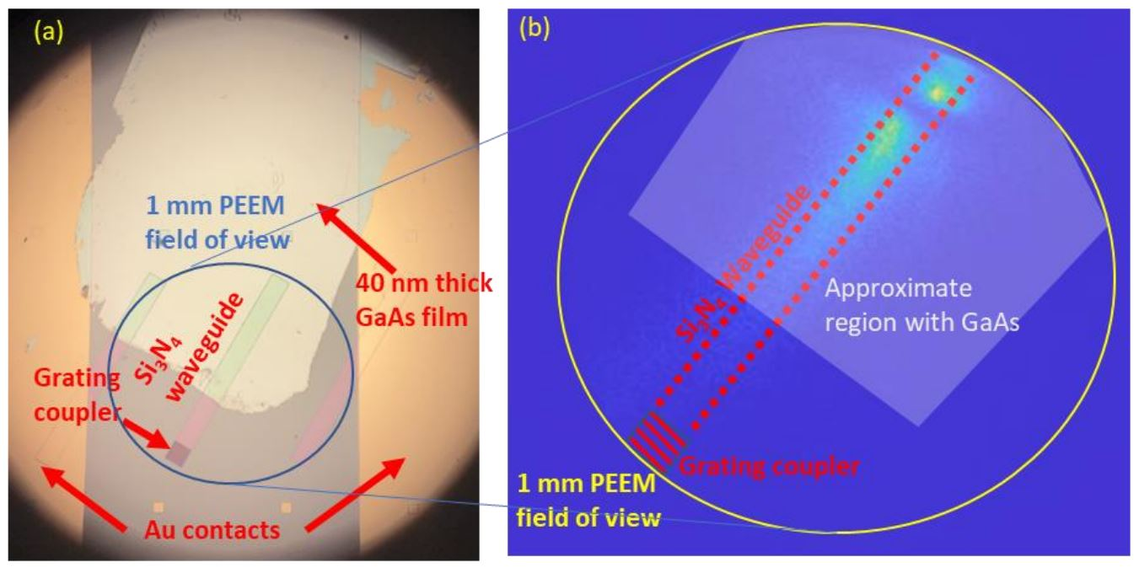

Confined Emission using PEEM
Measurement by
Photoemission Electron Microscopy was used to observed the photoemission profile
Photoemission confinement can be found at the waveguide region
21

Slide 22
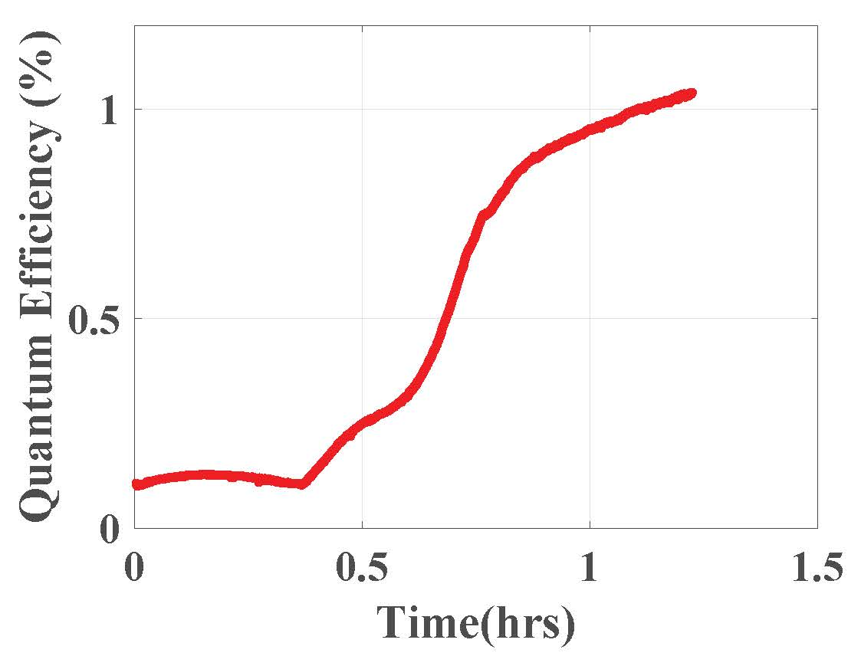
In-situ Cs₃Sb growth on top of waveguide
Instead of transferring thin epitaxial GaAs film, thin Cs3Sb was grown on top of waveguide structure in-situ.
Cs₃Sb thin films were grown via co-deposition of Cs and Sb onto the substrates.
20nm of thin film was grown having ~ 1% Quantum efficiency
Measurement by

Slide 23
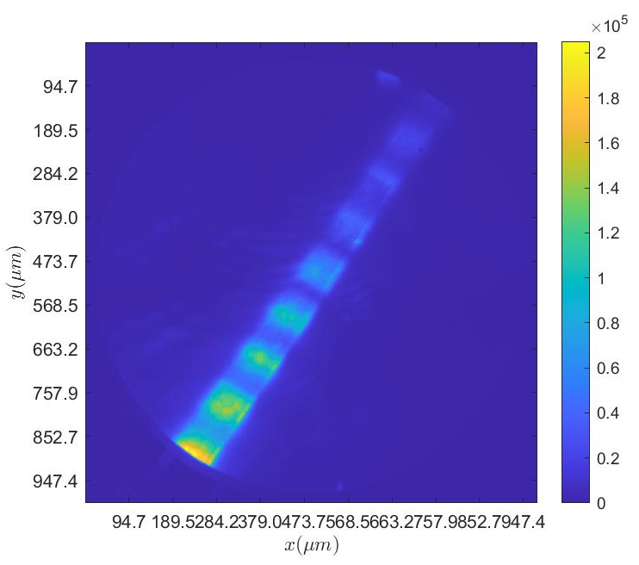
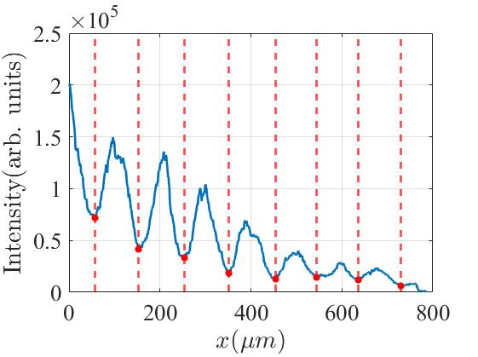
Confined Emission using PEEM
Patterned Emission Using PEEM
~100 μm
PEEM image showing confined emission from a ∼20 nm thick Cs₃Sb film at 𝜆 = 520 nm
The period of the beating pattern shows with ~100 um
Measurement by

Slide 24
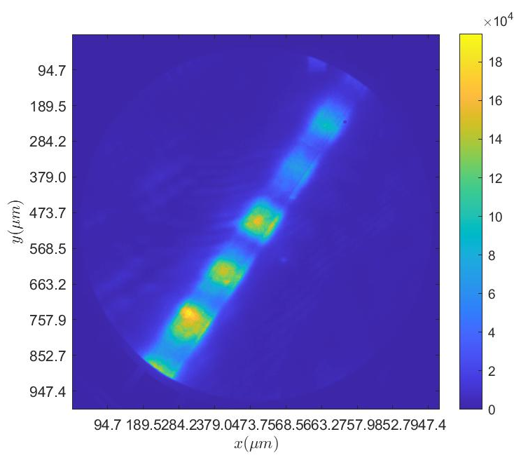
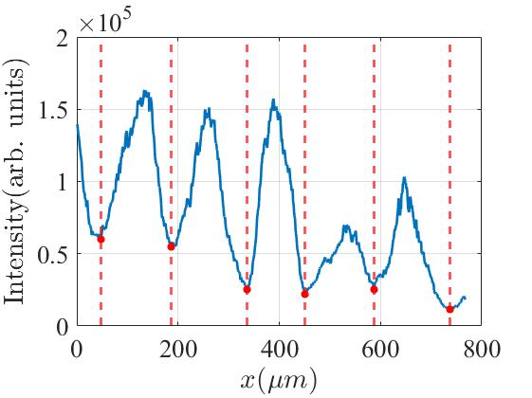
Confined Emission using PEEM
Patterned Emission Using PEEM
~150 μm
PEEM image showing confined emission from a ∼20 nm thick Cs₃Sb film at 𝜆 = 528 nm
The period of the beating pattern shows with ~150 um
Measurement by

Slide 25
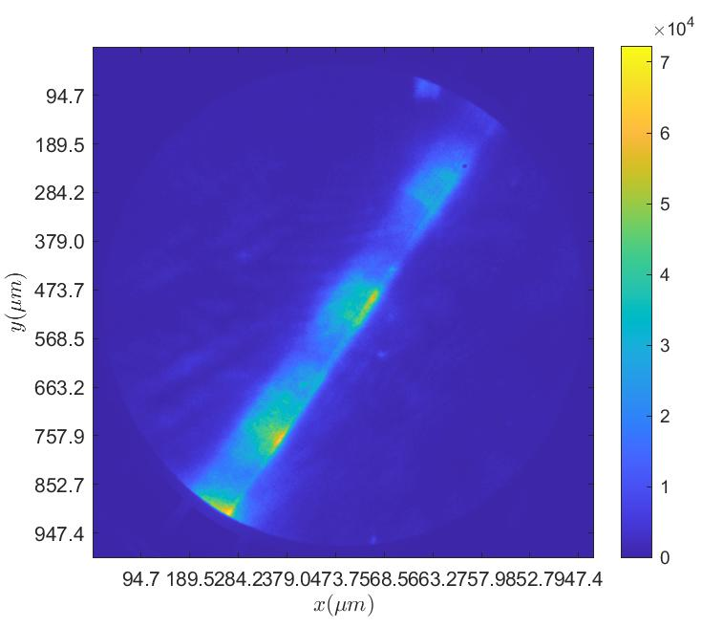
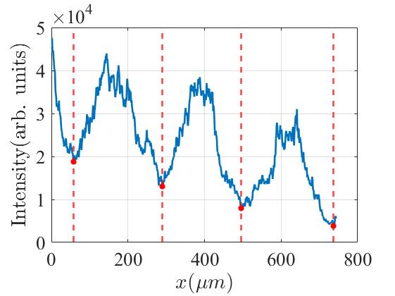
Confined Emission using PEEM
Patterned Emission Using PEEM
~250 μm
PEEM image showing confined emission from a ∼20 nm thick Cs₃Sb film at 𝜆 = 532 nm
The period of the beating pattern shows with ~250 um
Measurement by

Slide 26
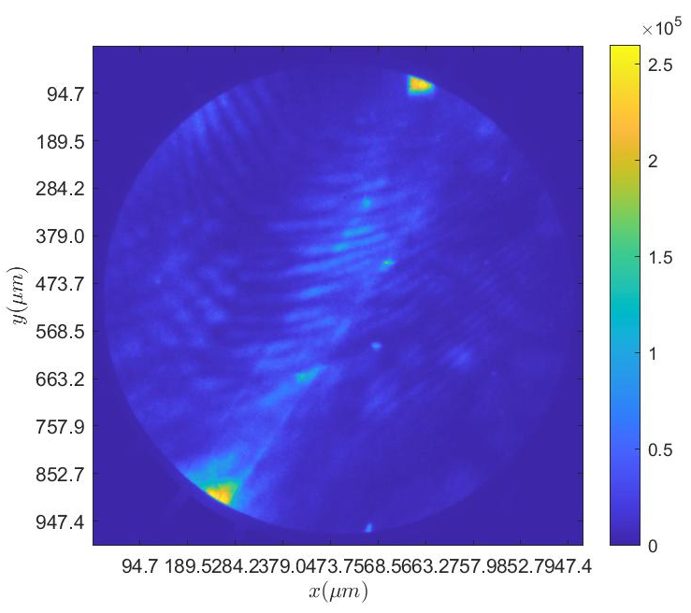
Confined Emission using PEEM
Patterned Emission Using PEEM
PEEM image showing no significant emission from a ∼20 nm thick Cs₃Sb film at 𝜆 = 538 nm
Wavelength out of range where the grating coupler cannot support does not support any modes in the waveguide.
Measurement by

Slide 27
Wavelength Dependent Photoemission
Patterned Emission Using PEEM
Wavelength
The period of the pattern increases as we go from 𝜆 = 520 nm to 𝜆 = 532 nm.
These transverse patterns are formed due to interference between these co-propagating modes thereby generating beating patterns with significant evanescent intensities that cause the electron emission.

Slide 28
Simulation study on beating pattern in waveguide
z
y
Si₃N₄
To calculate the modes, we assume that there is a symmetric SiO₂/Si₃N₄/SiO₂ waveguide where the cladding layers are infinitely thick. The asymmetry of upper and lower cladding layers in actual waveguide will modify the modes.
Then we assume that the mode profiles are not significantly altered when we have a 20 nm absorber on top of the waveguide
d
SiO₂
Cs₃Sb
Si₃N₄
SiO₂

Slide 29
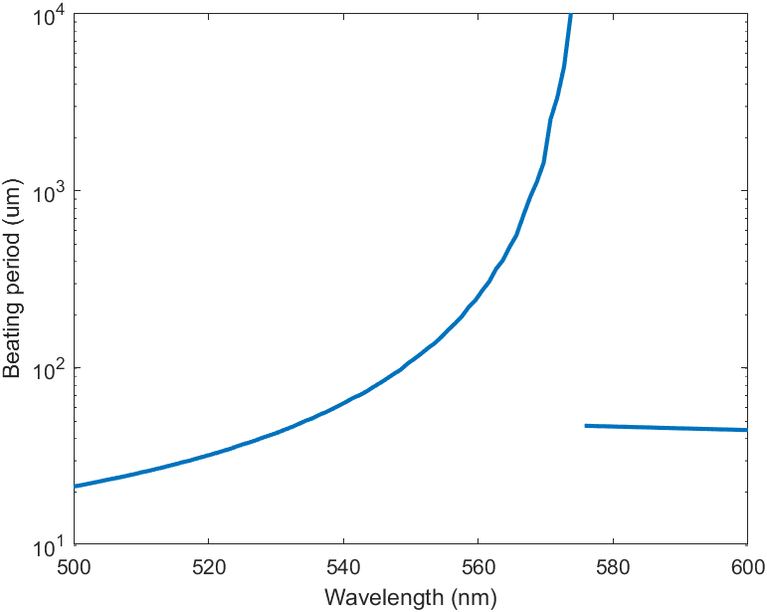
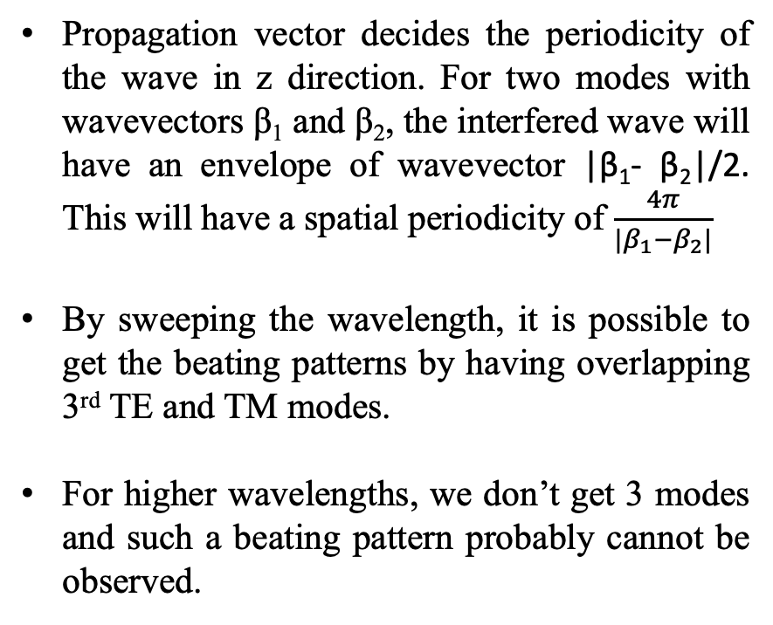
Simulation study on beating pattern in waveguide
Propagation vector decides the periodicity of the wave in z direction. For two modes with wavevectors β₁ and β₂, the interfered wave will have an envelope of wavevector |β₁- β₂|/2. This will have a spatial periodicity of $\frac{4π}{|β_{1}−β_{2}|}$
By sweeping the wavelength, it is possible to get the beating patterns by having overlapping 3rd TE and TM modes.
For higher wavelengths, we don’t get 3 modes and such a beating pattern probably cannot be observed.
3rd TE and TM mode
Fundamental TE and TM modes
(3rd mode doesn’t exist)

Slide 30
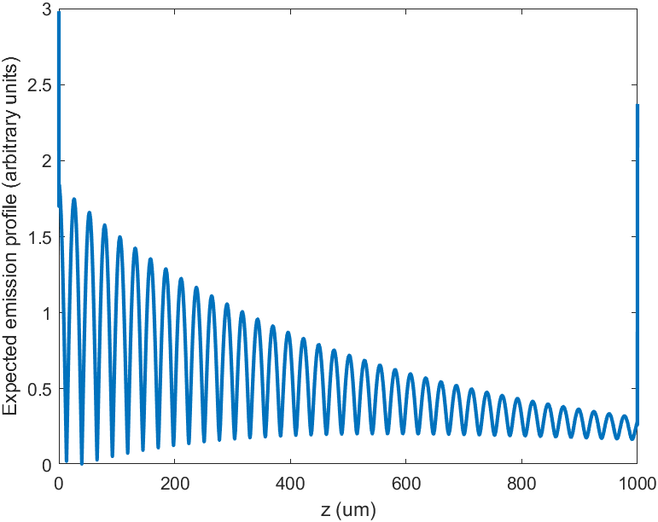
Reproducing the beating patterns
Simulation at 532 nm
Experiment at 532 nm
Beating pattern emission was reproduced by weighting each mode by the coupling and sum them to get the emission profile
We get a periodicity of ~30 um while having 250um for the experiement. The absorber may change the modes significantly so that the propagation constants have much smaller difference and leads to a longer (250 um in experiments) periodicity.

Slide 31
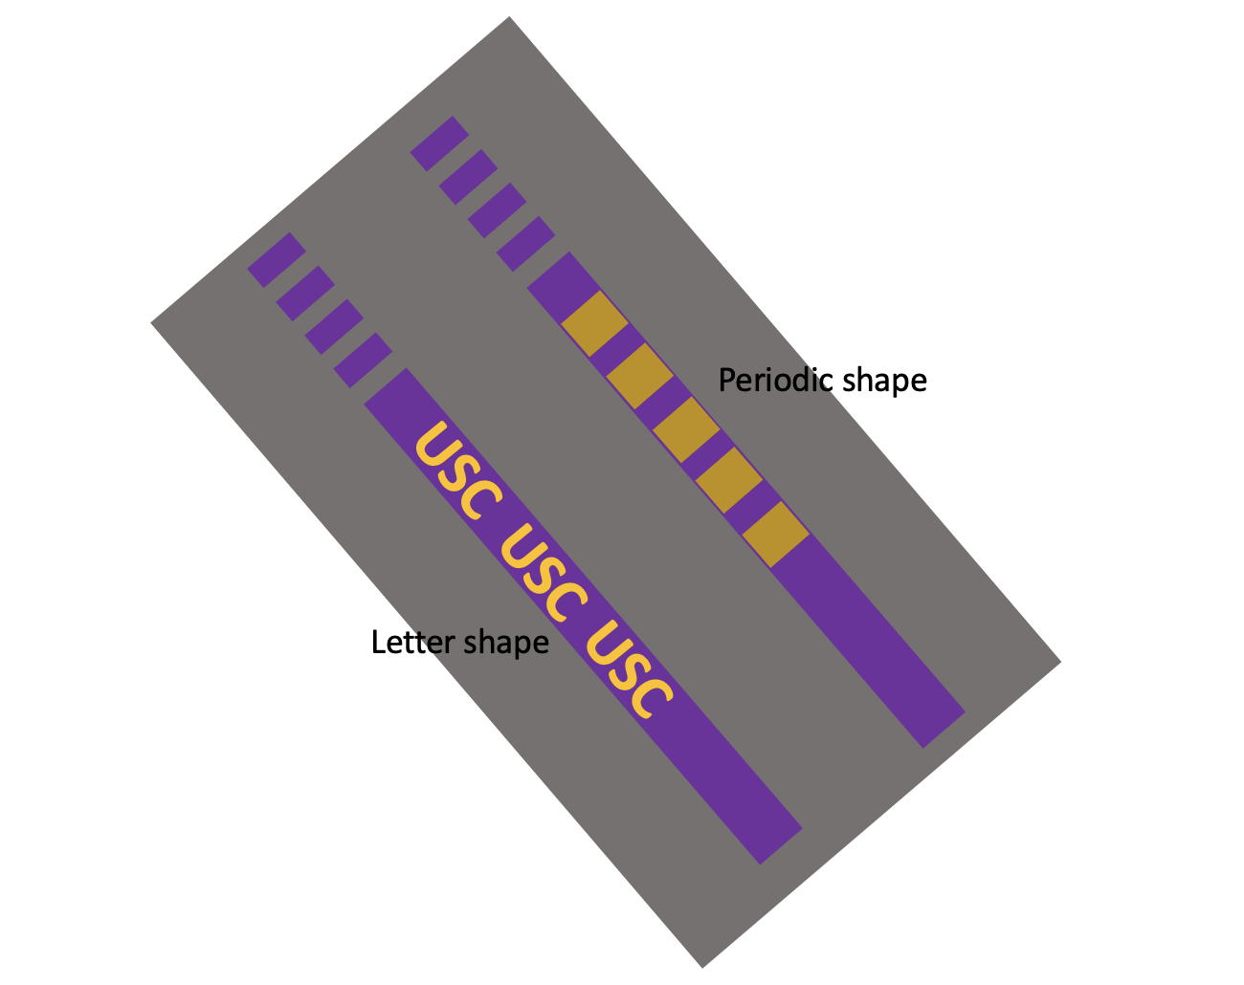
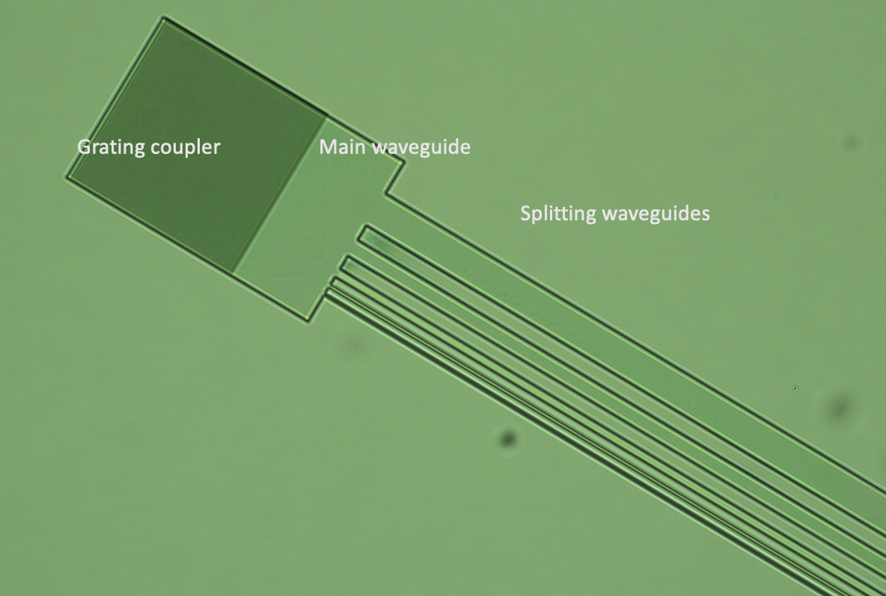
Future Work in experiments
Patternable Electron Emission Beam
Patterned /Split waveguide for beam shaping

Slide 32
Conclusion
On Chip Waveguide Integrated GaAs / CsSb Photocathode has been introduced as a new type of photoemitter

Slide 33
Conclusion
On Chip Waveguide Integrated GaAs / CsSb Photocathode has been introduced as a new type of photoemitter
This approach is general and proof of concept, can be improved by tuning each component of the device

Slide 34
Conclusion
On Chip Waveguide Integrated GaAs / CsSb Photocathode has been introduced as a new type of photoemitter
This approach is general and proof of concept, can be improved by tuning each component of the device
Can be extended to other works by using other emitting material or patterning the electron emission

Slide 35






Acknowledgements
Principal investigator: Prof. Rehan Kapadia
Graduate students: Hyun Uk Chae, Ragib Ahsan, Anika Tabassum Priyoti, Juan Sanchez Vazquez
ASU: Prof. Siddharth Karkare, Alimohammed Kachwala
NIU: Oksana Chubenko
Sponsors:

Slide 36
BACK UP SLIDES

Slide 37
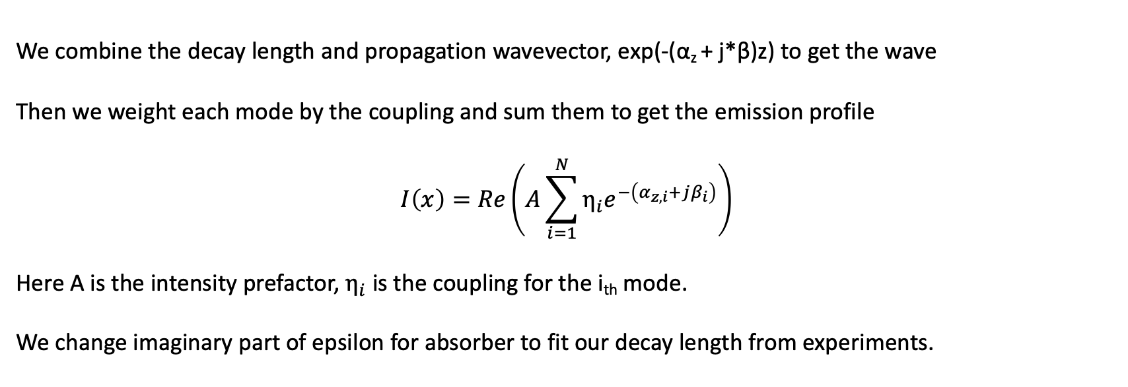
Reproducing the beating patterns
We combine the decay length and propagation wavevector, exp(-(α_{z} + j*β)z) to get the wave
Then we weight each mode by the coupling and sum them to get the emission profile
$$I\left(x\right)=Re\left(A\sum_{i=1}^{N}{η_{i}e^{−\left(α_{z,i}+jβ_{i}\right)}}\right)$$
Here A is the intensity prefactor, $η_{i}$ is the coupling for the i_{th} mode.
We change imaginary part of epsilon for absorber to fit our decay length from experiments.

