Slide 1
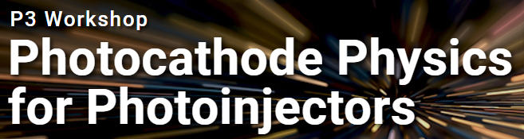

Development of Air Stable Silicon Photoemitter with Electronically Tunable Negative Electron Affinity
Ragib Ahsan, Hyun Uk Chae, Anika Tabassum Priyoti, Juan Sanchez Vazquez, Rehan Kapadia
Department of Electrical and Computer Engineering
University of Southern California

Slide 2
Can we operate a negative electron affinity photocathode without ultrahigh vacuum?

Slide 3
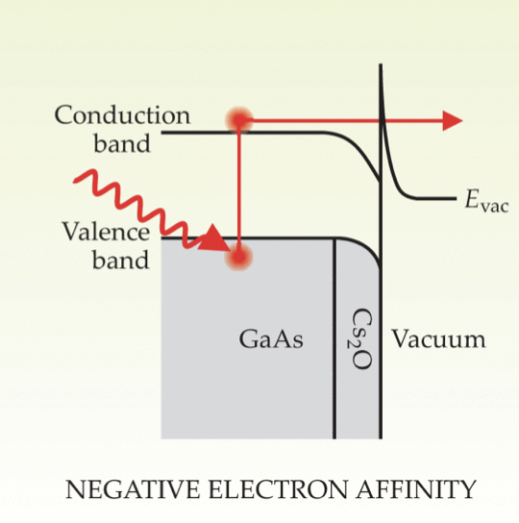
Traditional Negative Electron Affinity Photocathode
Pros:
High quantum efficiency
Visible photon excitation
Cons:
Requires ultrahigh vacuum
Hernandez-Garcia, Carlos, Patrick G. O Shea, and Marcy L. Stutzman. "Electron sources for accelerators." Physics today61.2 (2008): 44.

Slide 4
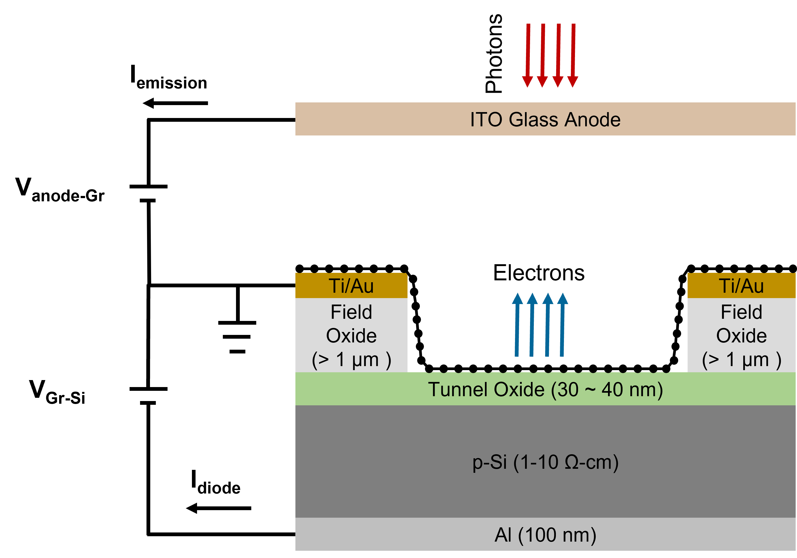
Electronically Tunable NEA Photocathode

Slide 5
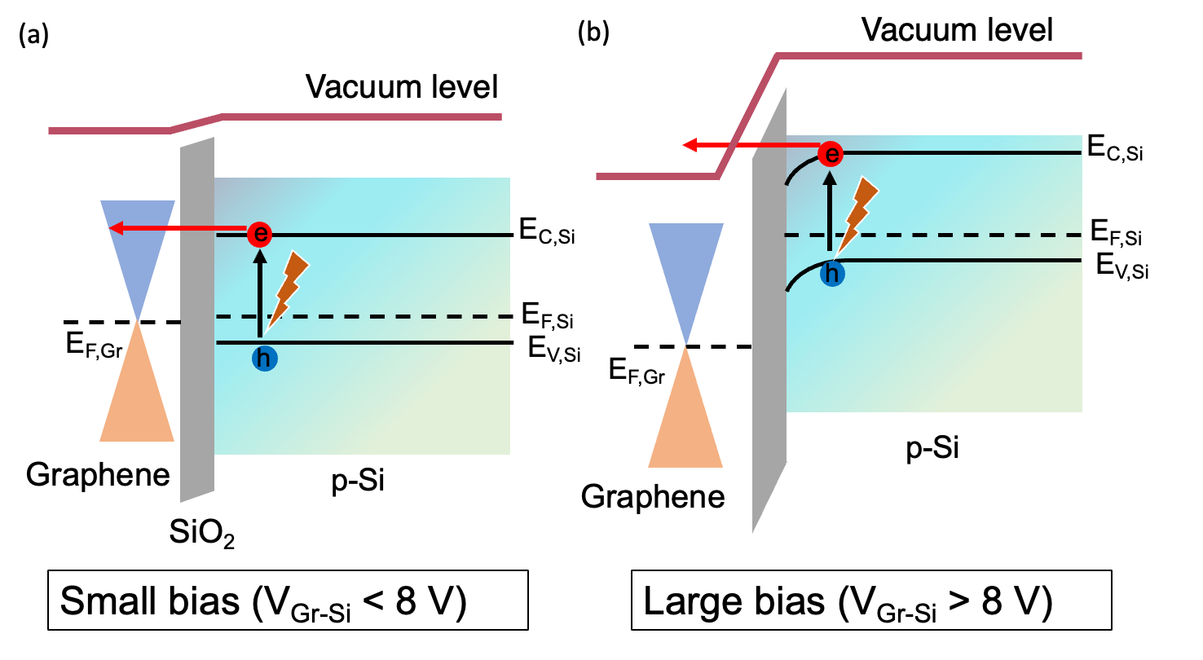
Working Principle
V_{FN} )
V_{FN} )
Voltage is applied between the semiconductor and graphene, generating an electric field which mimics the surface dipole field in an NEA photocathode.
Photo-excited electrons tunnel through the barrier and introduced into graphene with higher energy than E_{F,Gr}

Slide 6
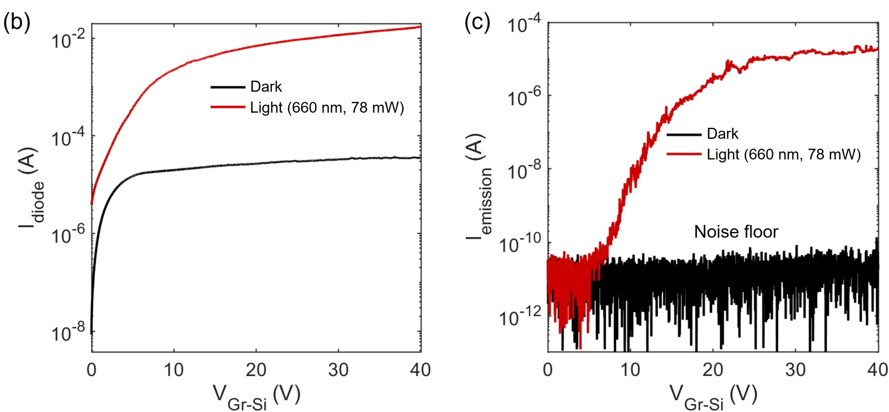
Experimental results: Emission current vs V_{Gr-Si}

Slide 7
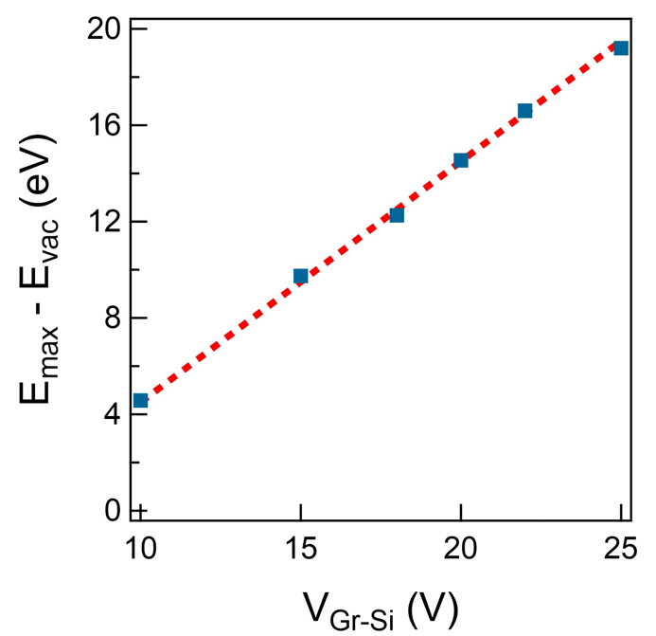
Experimental results: Emission current vs Anode voltage
Energy broadening by scattering
Carrier heating by electric field

Slide 8
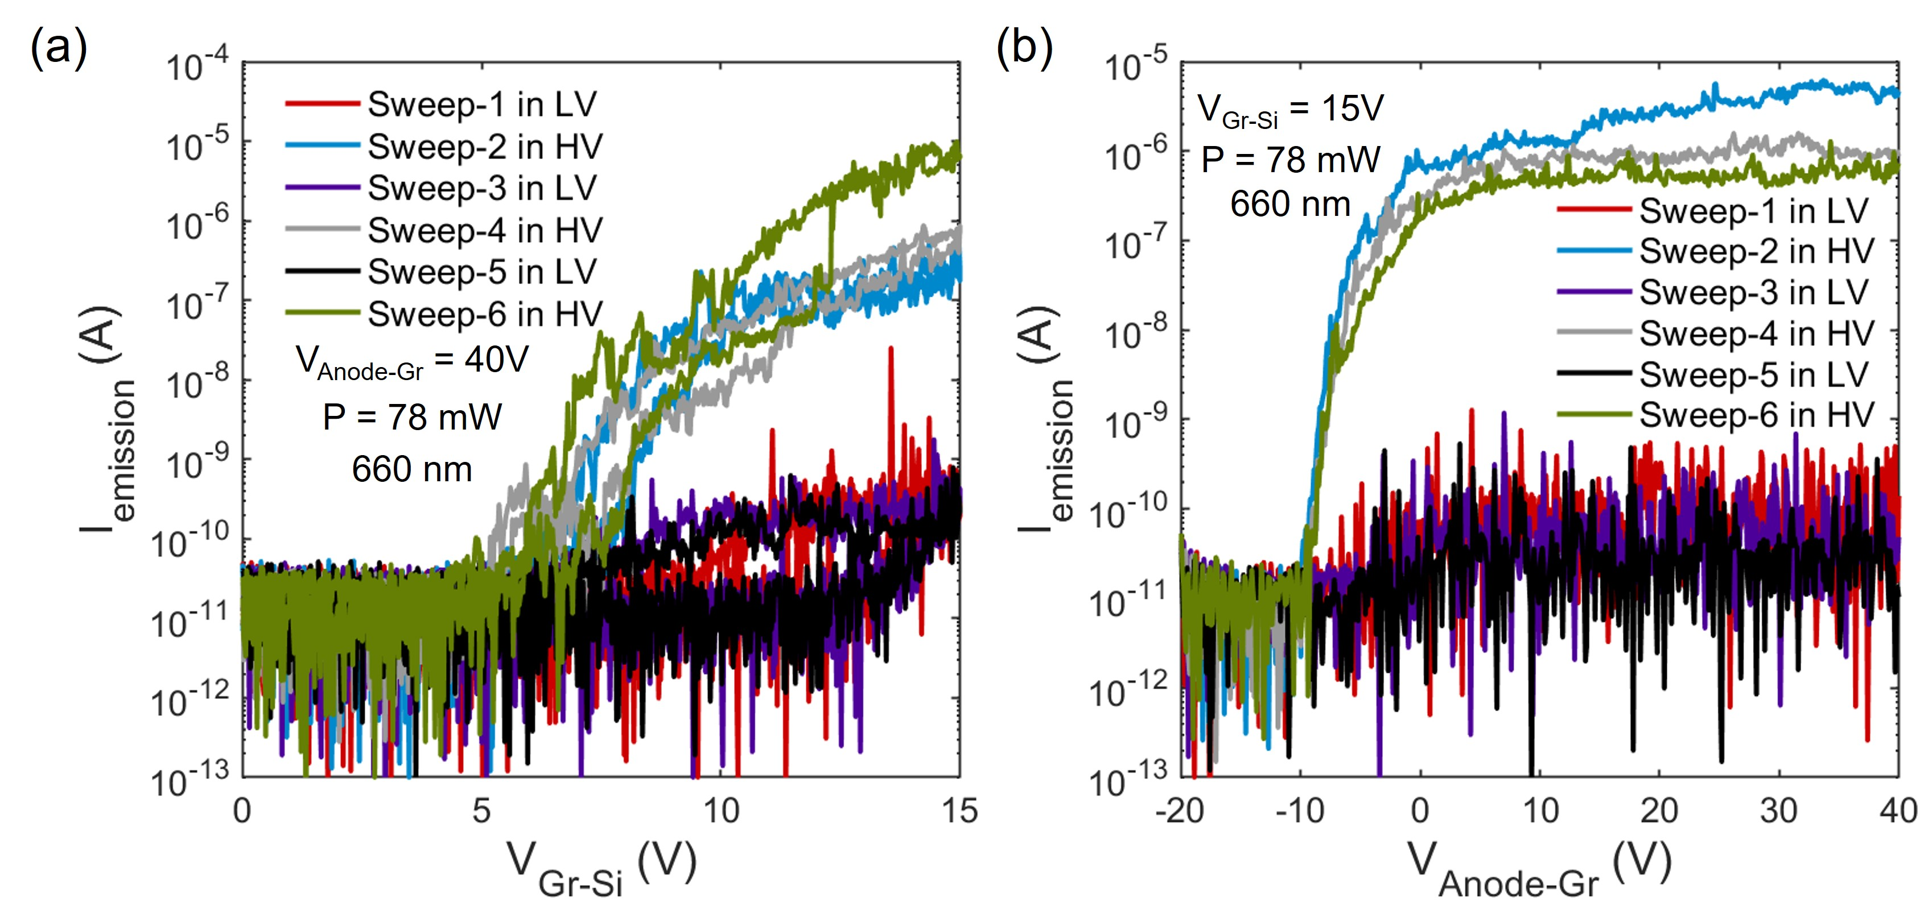
Stability at higher vacuum pressures

Slide 9
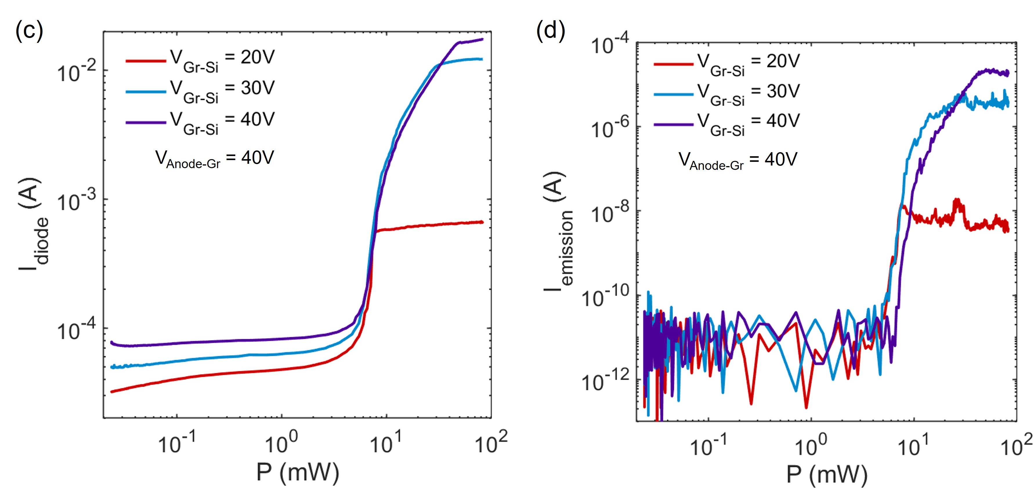


Experimental results: Emission current vs Optical power
$$I_{diode} \sim P^{2}$$
$$I_{emission} \sim P^{5}$$
Peak EQE = 0.1%

Slide 10
Key emission characteristics
Existence of a threshold V_{Gr-Si} to emit electrons
Energy distribution of emitted electrons is broad
Emission current shows a highly nonlinear dependence on optical power

Slide 11
Existence of a threshold V_{Gr-Si}
The electrons tunneling into/through SiO₂ must gain higher energy than the vacuum level (0.9 eV higher than SiO₂ conduction band minima)
Direct tunneling of electrons through SiO₂ will never allow this
Electrons must tunnel into SiO₂ conduction band (FN tunneling)
These electrons must gain at least 0.9 eV energy from electric field

Slide 12
Threshold for applied voltage
V_{FN} )
V_{FN} )

Slide 13
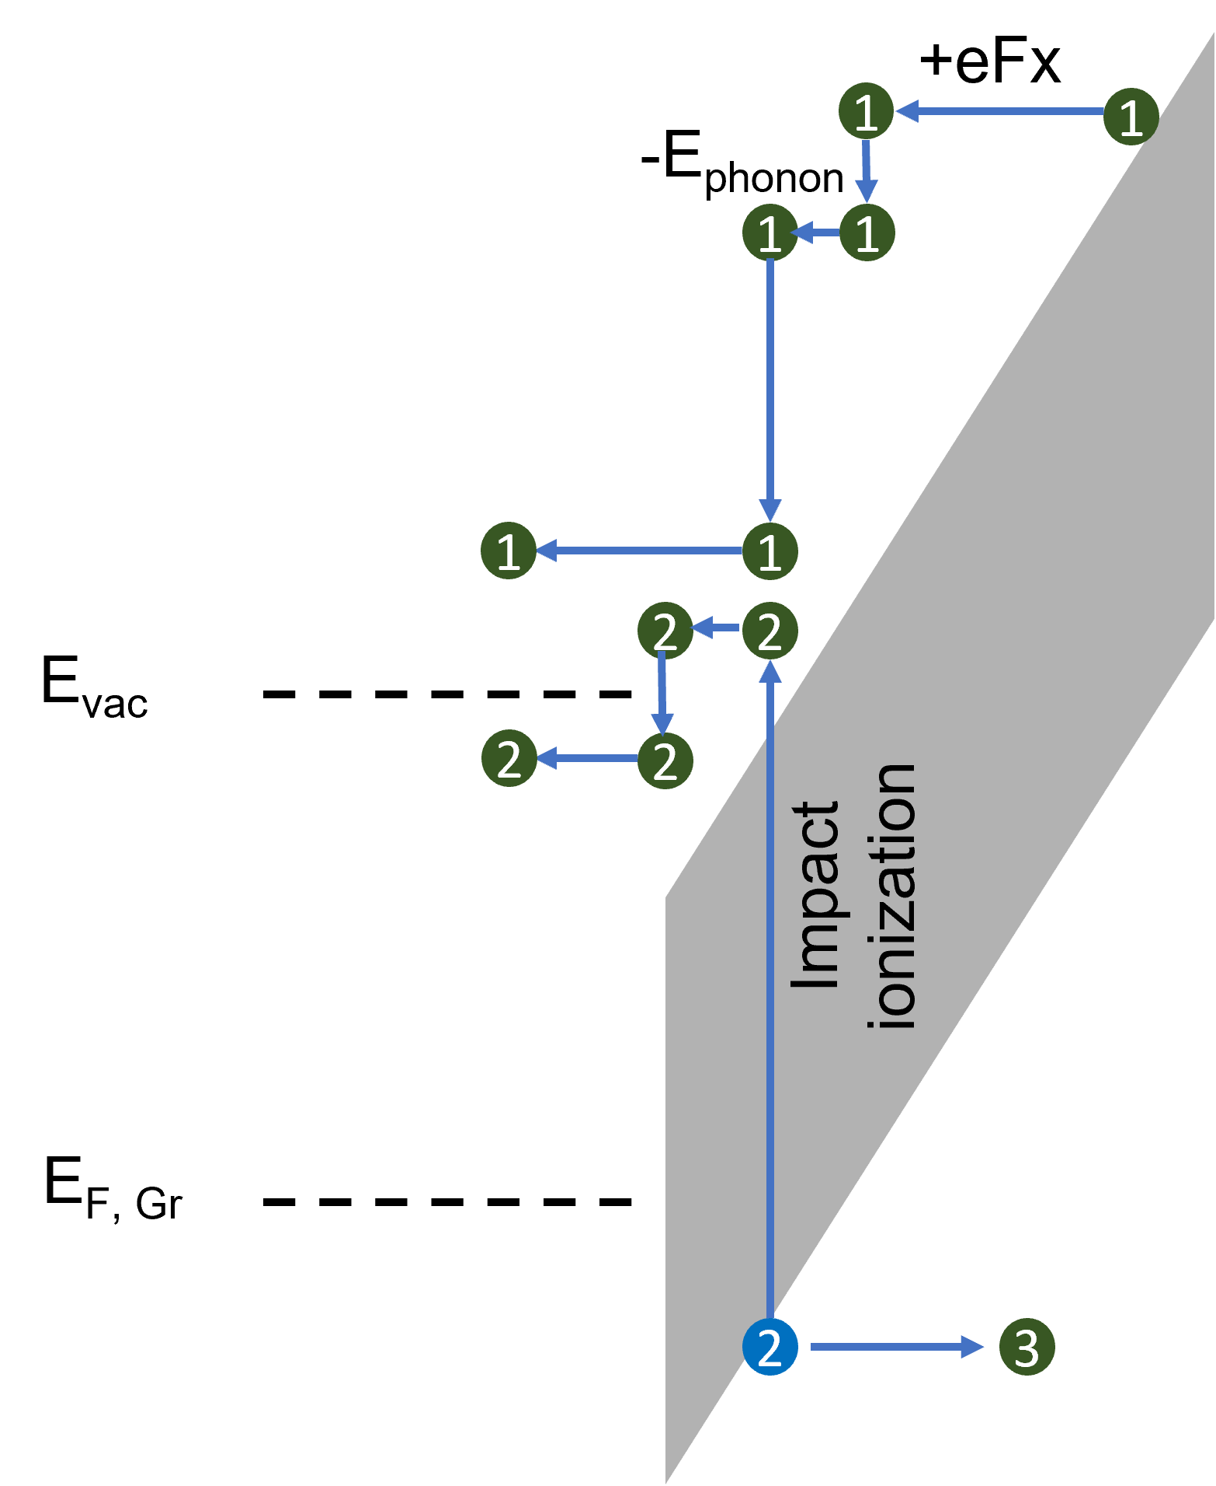
Broad energy distribution
To have a broad energy distribution, electrons must scatter at SiO₂ conduction band
Possible scattering mechanisms for SiO₂
  Longitudinal polar optical phonon scattering
  Acoustic phonon scattering
  Impact ionization scattering

Slide 14
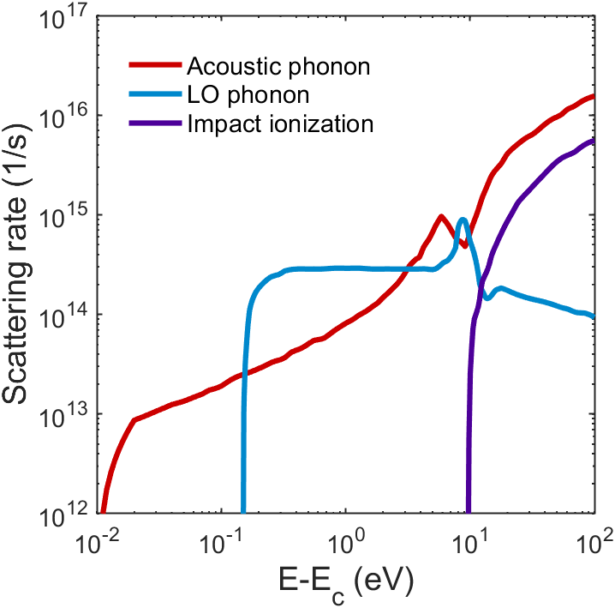
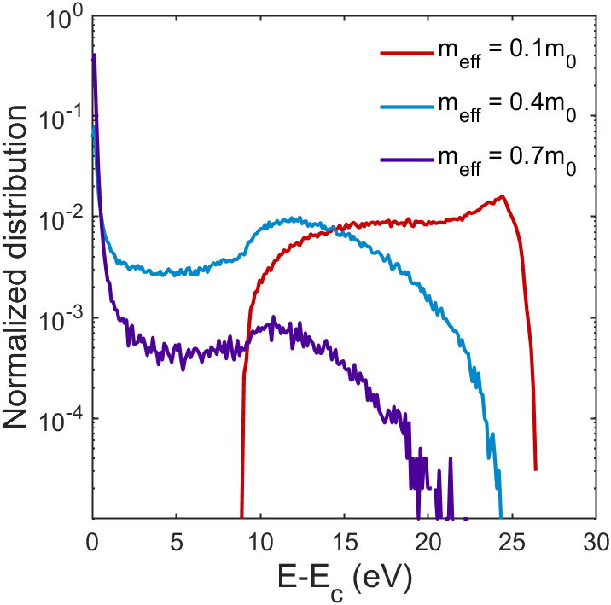
Monte Carlo simulation: Transport at SiO₂
E_{ox} = 1 V/nm
Parabolic band approximation

Slide 15
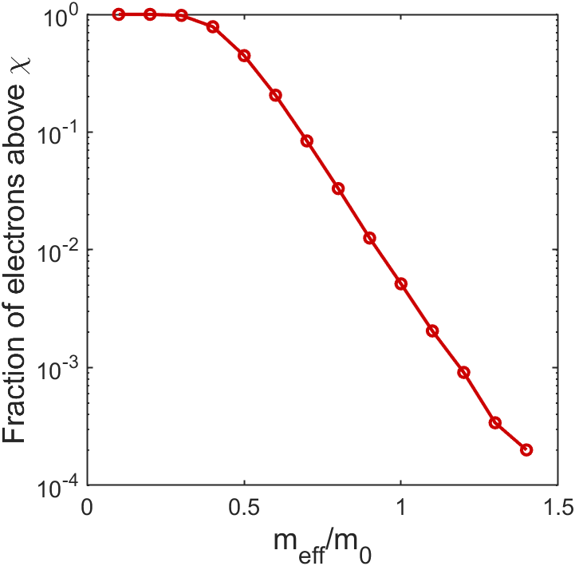
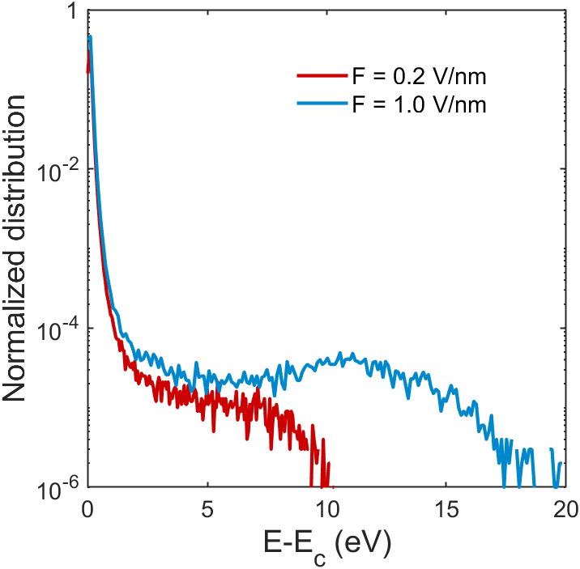
Monte Carlo simulation: Transport at SiO₂
E_{ox} = 1 V/nm
0.2 V/nm
1.0 V/nm
m_{eff} = m₀
High energy tail heating

Slide 16
Nonlinear emission current
Multiphoton absorption is highly unlikely in silicon for the optical power densities we have (10³-10⁴ W/m²)
There is no dominant scattering mechanism for SiO₂ that is nonlinear to electron injection rate/optical power
Optical power must modify the voltage distribution within the device
  Voltage dropped at depletion region at silicon
  Voltage dropped at oxide

Slide 17
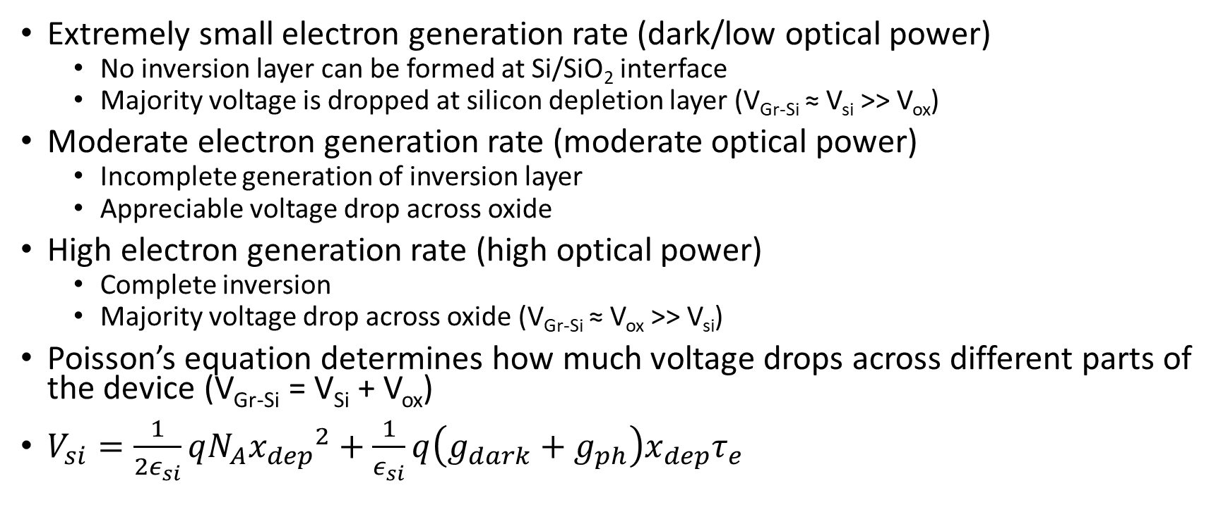
Voltage distribution between oxide and silicon
Extremely small electron generation rate (dark/low optical power)
  No inversion layer can be formed at Si/SiO₂ interface
  Majority voltage is dropped at silicon depletion layer (V_{Gr-Si} ≈ V_{si} >> V_{ox})
Moderate electron generation rate (moderate optical power)
  Incomplete generation of inversion layer
  Appreciable voltage drop across oxide
High electron generation rate (high optical power)
  Complete inversion
  Majority voltage drop across oxide (V_{Gr-Si} ≈ V_{ox} >> V_{si})
Poisson’s equation determines how much voltage drops across different parts of the device (V_{Gr-Si} = V_{Si} + V_{ox})
$V_{si}=\frac{1}{{2ε}_{si}}qN_{A}{x_{dep}}^{2}+\frac{1}{ε_{si}}q\left(g_{dark}+g_{ph}\right)x_{dep}τ_{e}$

Slide 18
Voltage redistribution by optical power
Higher optical power
Higher voltage/electric field at oxide
V_{Gr-Si} = 26V
P = P₁
P = P₂
Higher tunneling rates (Nonlinear)
Electron distribution heating (Nonlinear)
Nonlinear emission current
Generation current density is proportional to optical power density

Slide 19
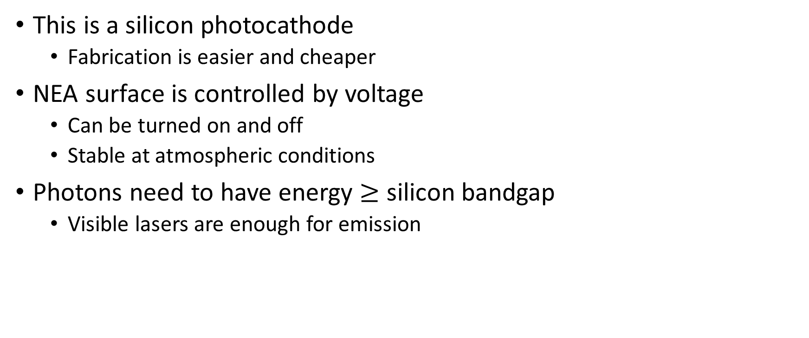
Summary
This is a silicon photocathode
  Fabrication is easier and cheaper
NEA surface is controlled by voltage
  Can be turned on and off
  Stable at atmospheric conditions
Photons need to have energy $≥$ silicon bandgap
  Visible lasers are enough for emission

Slide 20




Acknowledgements
Principal investigator: Prof. Rehan Kapadia
Graduate students: Hyun Uk Chae, Anika Tabassum Priyoti, Juan Sanchez Vazquez, Zezhi Wu
Sponsors:

