Slide 1




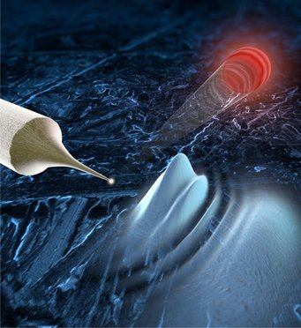

Ultrafast two-electron correlations from metal needle tips
Tomáš Chlouba, Jonas Heimerl, Stefan Meier, Peter Hommelhoff
Friedrich-Alexander-Universität Erlangen-Nürnberg (FAU)
Tomas.Chlouba@fau.de

Slide 2
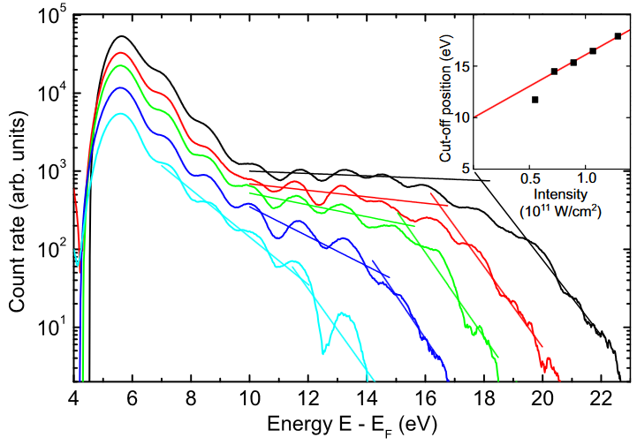
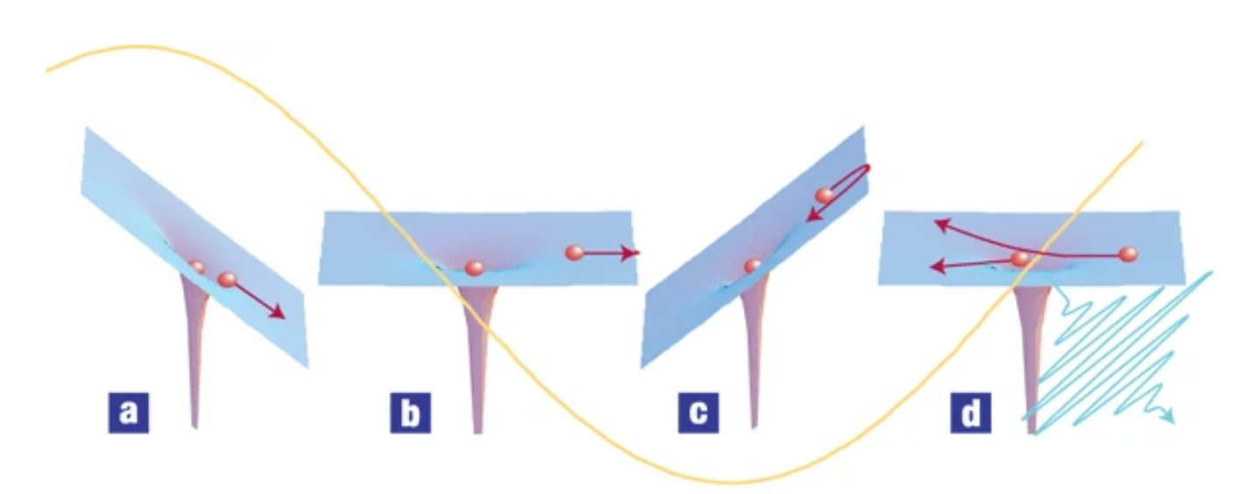
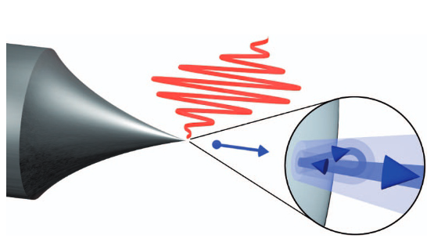
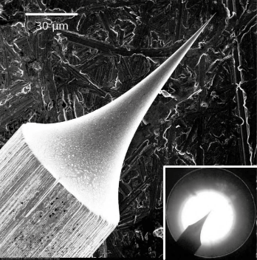
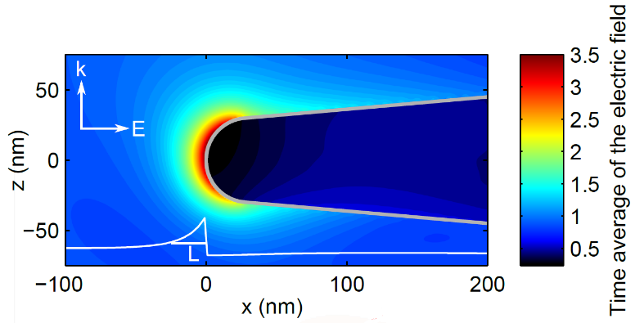
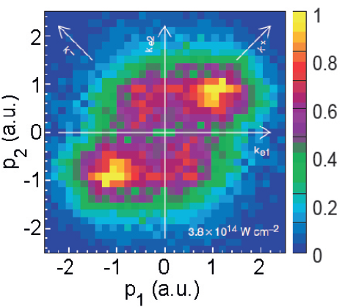
The evolution of photoemission experiments at gases and surfaces
High harmonic generation (HHG) in gases:
Three step model– electrons driven in strong laser fields
Electrons emitted from metal needle tips by femtosecond laser pulses
M. Krüger et al. 475, 78–81 (2011)
M. Krüger et al., NJP 14, 085019 (2012),
G. Herink et al., Nature 483, 190–193 (2012),
B. Piglosiewicz, Nat. Photon. 8, 37–42 (2014)
M. Krüger et al., J. Phys. B. 51, 172001 (2018)
A. L´Huillier & Ph. Balcou, Phys. Rev. Lett. 70 6 (1992)
P. B. Corkum, Phys. Rev. Lett. 71, 1994 (1993)
K. J. Schafer et al., Phys. Rev. Lett. 70 1599 (1993)
P. Corkum & F. Krausz, Nat. Phys. 3, 381 (2007.
Near-field enhancement
Correlations in Argon
What about solid state systems?
M. Krüger et al., NJP 14, 085019 (2012).
S. Thomas et al., Nano Lett. 13, 4790-4794 (2013).
Weber et al., Nature 405, 658 (2000)

Slide 3
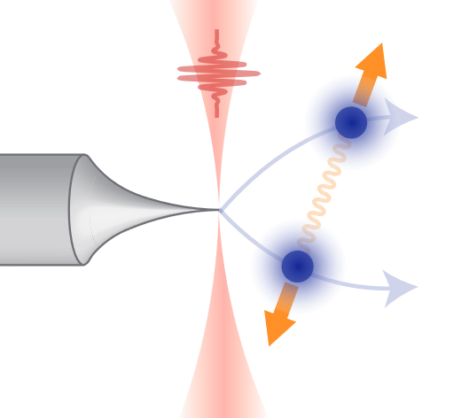
At the verge of multi-electron dynamics
Experimentally
Physics
Can we measure more than one electron from the same laser pulse?
Is there any correlation between these two electrons?
Few-electron correlations after ultrafast photoemission from nanometric needle tips, S. Meier, J. Heimerl and P. Hommelhoff, Nature Physics (2023). https://doi.org/10.1038/s41567-023-02059-7
Similar works:
S. Keramati et al., Phys. Rev. Lett. 127, 180602 (2021): two pixel coincidence detection
R. Haindl et al., arXiv:2209.12300 (2022): ultrafast TEM environment

Slide 4
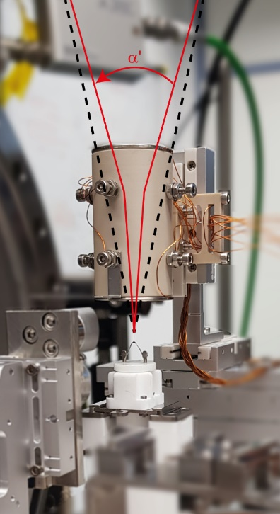
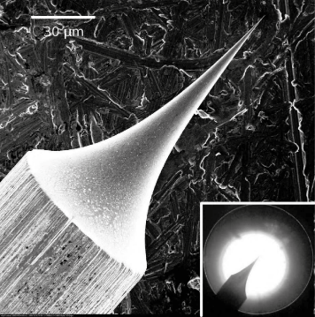
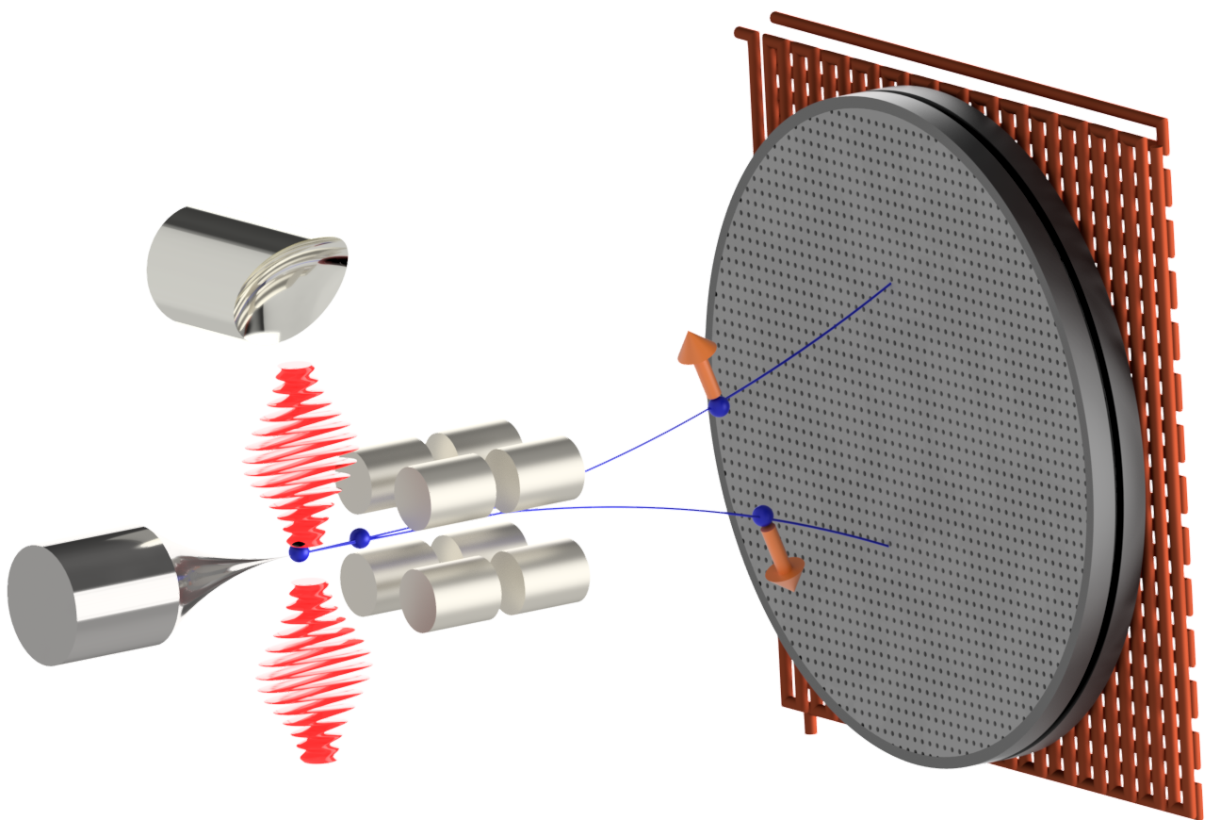
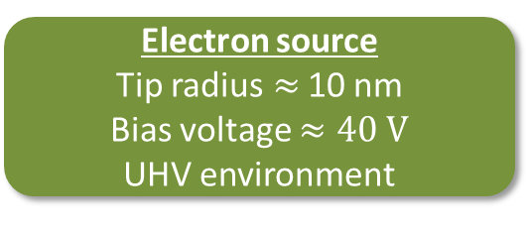
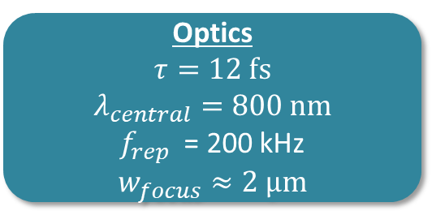
Experiment
Electron source
Tip radius$≈$ 10 nm
Bias voltage $≈40 V$
UHV environment
Optics
$$τ=12 fs$$
$$λ_{central}=800 nm$$
$f_{rep}$ = 200 kHz
$$w_{focus}≈2 μm$$
Detection system
Multi-hit capable delay-line detector
(Hexanode from Roentdek)
Electron optics
Two quadrupoles to zoom into inner part of electron beam

Slide 5
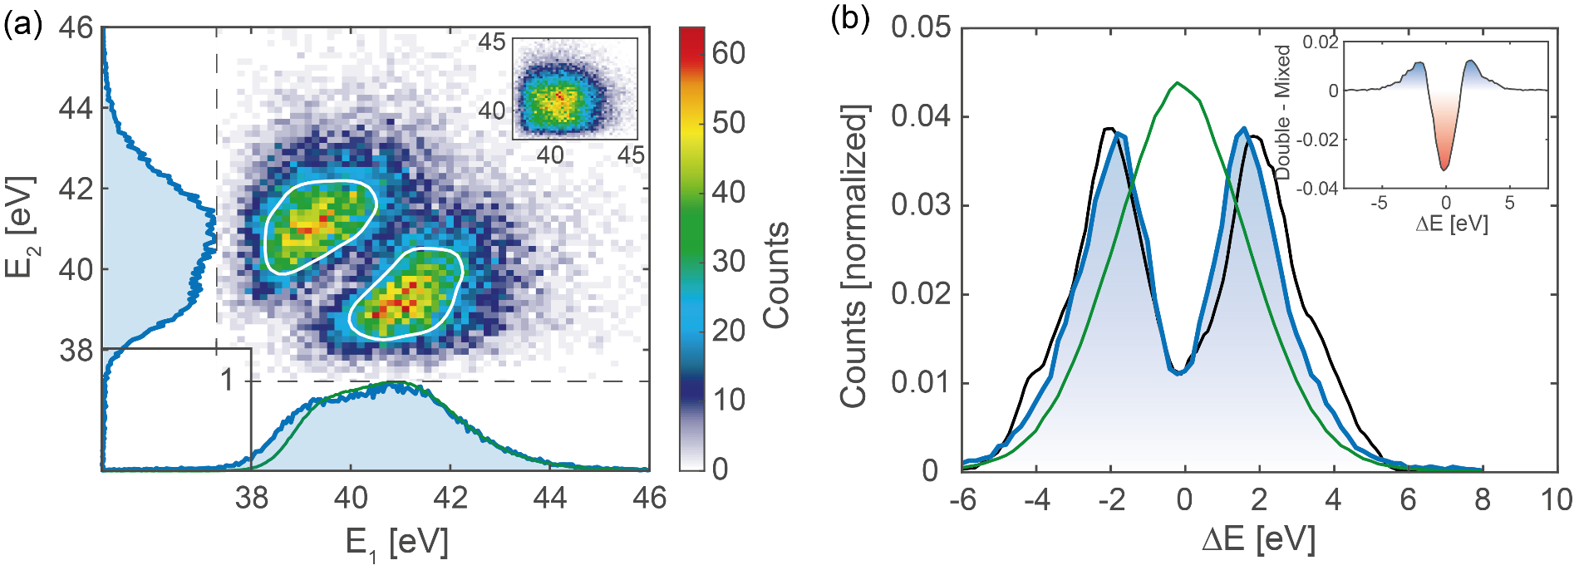
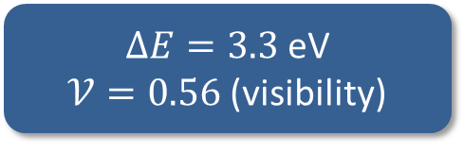
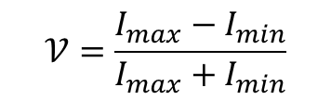
Energy anti-correlation
?
Uncorrelated case
Anticorrelation gap!
$ΔE=3.3$ eV
$𝒱=0.56$ (visibility)
Anticorrelation based on Coulomb repulsion
$$𝒱=\frac{I_{max}−I_{min}}{I_{max}+I_{min}}$$
[1] Yudin, G.L., Ivanov, M.Y., Physical Review A 64(1) (2001)

Slide 6
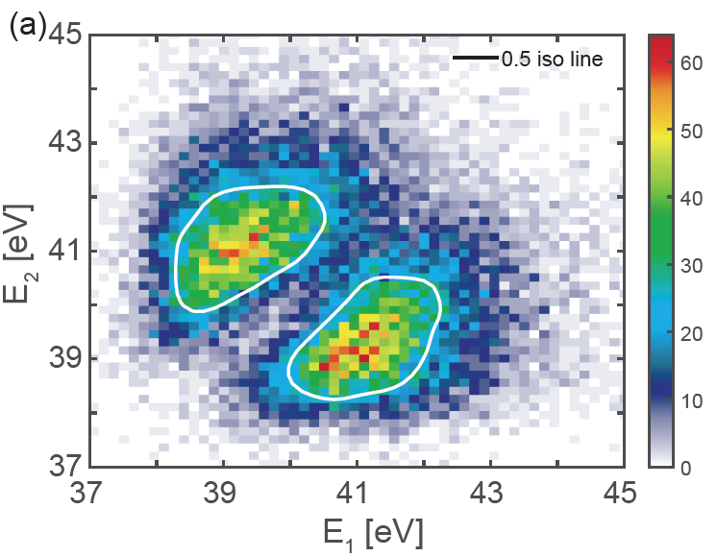
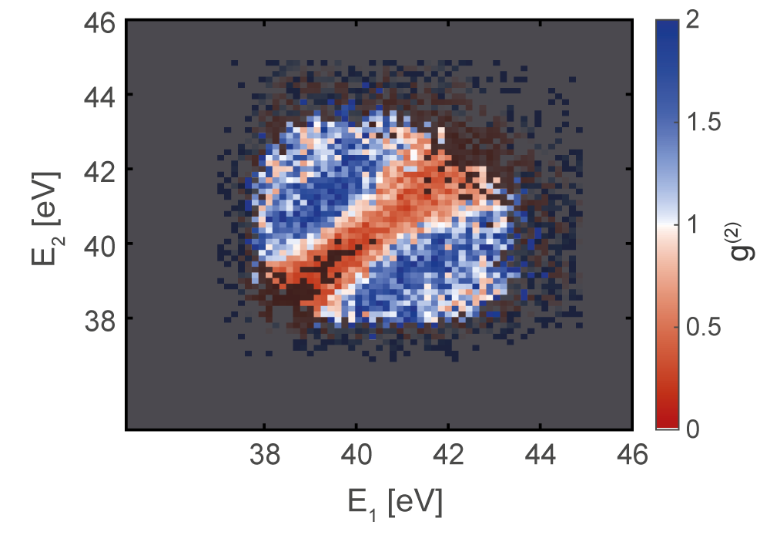
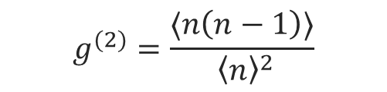
What can the anticorrelation be used for?
Filter window:
4 eV
1 eV
$$g^{(2)}=\frac{⟨n\left(n−1\right)⟩}{ {\left\langle n\right\rangle }^{2}}$$

Slide 7
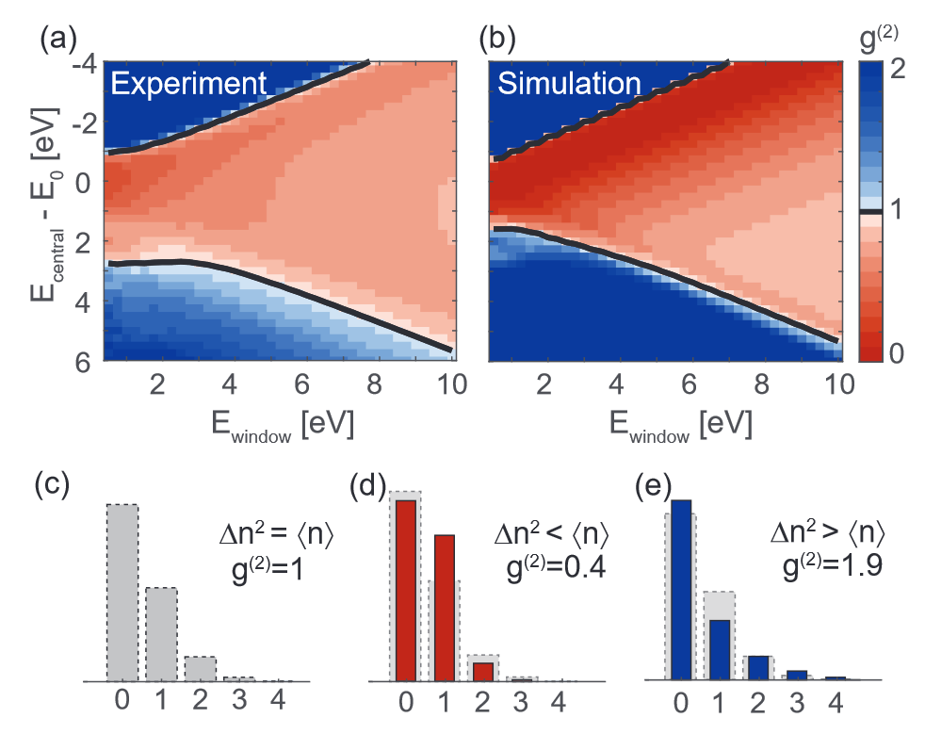

What can the anticorrelation used for?
$$g_{min}^{\left(2\right)}=0.34$$
Sub-Poissonian electron beams relevant for beating the shot noise limit in imaging
See e.g.
R. Berchera and P. Degiovanni, Quantum imaging with sub-Poissonian light: challenges and perspectives in optical metrology, Metrologia 56 024001 (2019)

Slide 8
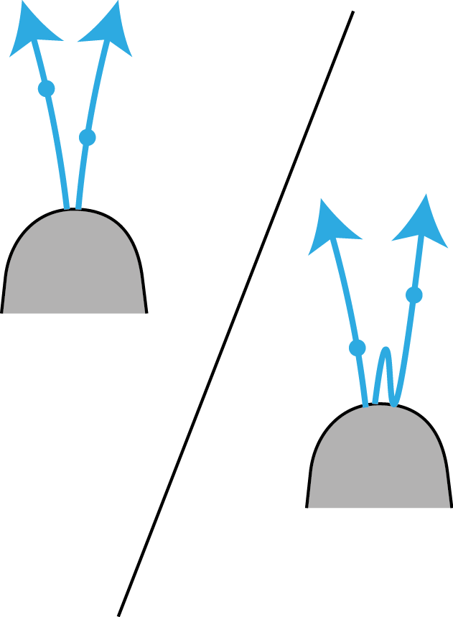
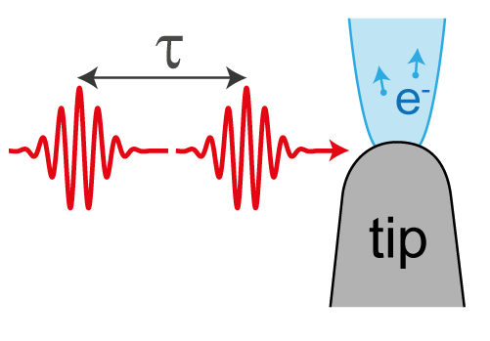
Which experimental parameters determine the energy gap?
Correlation decay time
Perturbative vs.
strong field

Slide 9
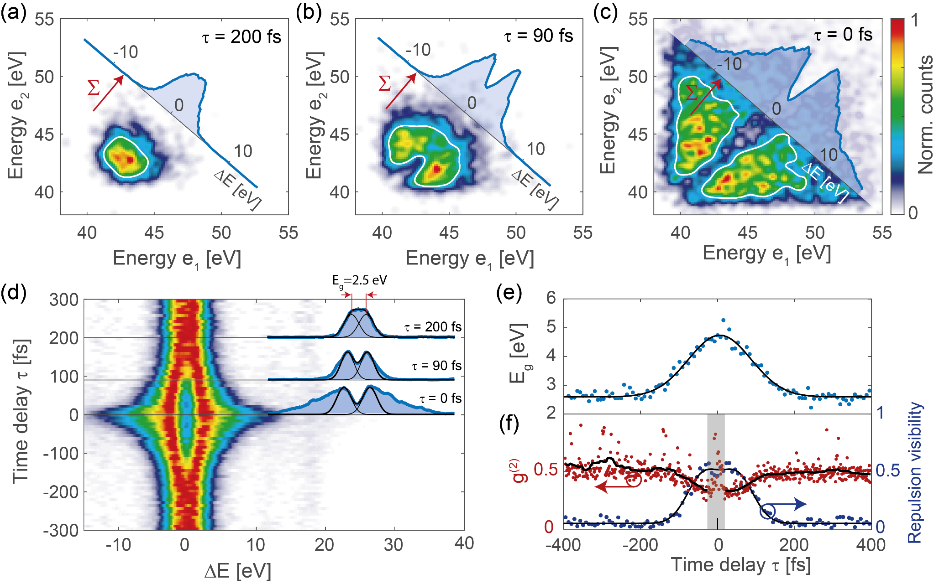
Anticorrelation gap as function of time
Two delayed pulse copies
Correlation decay time 82 fs!

Slide 10
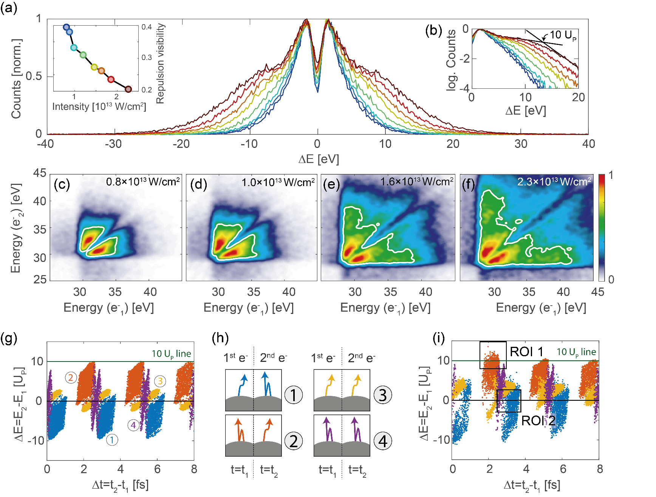
From the perturbative to the strong field regime
Visibility of the gap is reduced in the strong field regime
Visibility depends on four emitted two-electron classes (direct/ rescattered)
Coulomb off
Coulomb on
Emission time difference!

Slide 11
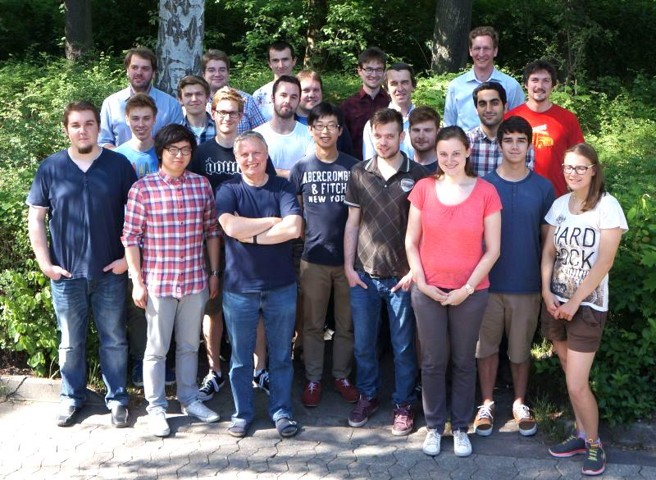
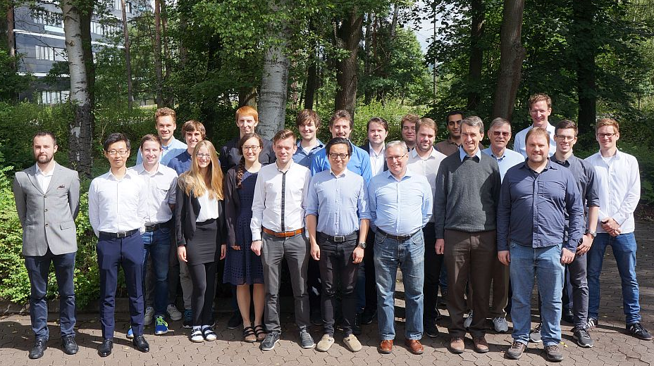
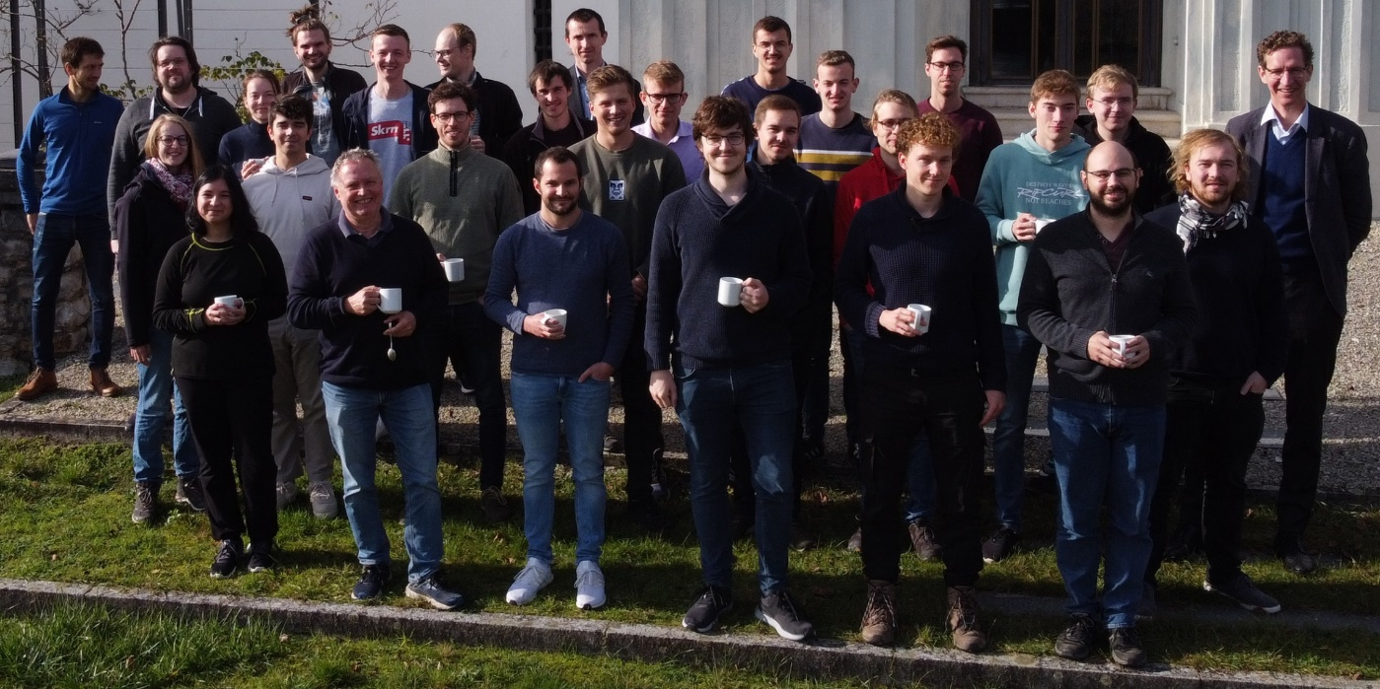
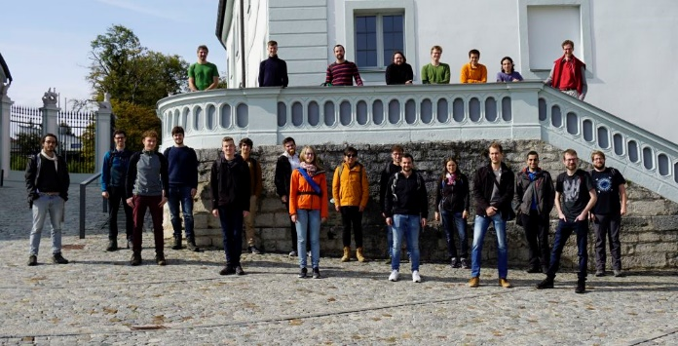













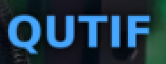
.
Tobias Boolakee
Leon Brückner
Tomás Chlouba
Julian Freier
Jonas Heimerl
Martin Hundhausen
Johannes Illmer
Manuel Konrad
Stefanie Kraus
Julian Litzel
Bastian Löhrl
Felix Lopéz Hoffmann
Matthias Meier
Stefan Meier
Annika Michalak
Jonathan Pölloth
Jürgen Ristein
Roy Shiloh
Franz Schmidt-Kaler
Timo Wirth
Simon Wittigschlager
Open
PhD student and postdoc positions! Pls. get in touch.
FAU’s Laser Physics
Partners/
collaborations:
ACHIP collaboration
iQCE collaboration
J. Rosenzweig, UCLA
I. Franco, Rochester
I. Kaminer, Technion
Ph. Russell, MPL
Th. Fennel, Rostock
A. Leitensdorfer, Konstanz
FAU Applied Physics: H. Weber
M. Kling, LMU/MPQ
R. L. Byer + coll., Stanford / SLAC
C. Lemell, J. Burgdörfer, TU Vienna
M. Stockman^{Ϯ}, Georgia State
G. G. Paulus, Jena
Former members:
PhDs: J. Breuer Ph. Dienstbier M. Förster C. Gerner J. Hammer C. Heide J. Hoffrogge M. Krüger Ang Li M. Schenk M. Seidling T. Paschen A. Tafel N. Schönenberger S. Thomas (Ph. Weber) P. Yousefi R. Zimmermann M. Sirotin
Postdocs: A. Aghajani-Talesh P. Dombi M. Kozák J. McNeur Y. Morimoto T. Higuchi
Master students: D. Ehberger T. Eckstein M. Eisele R. Fröhlich U. Häusler R. Heinreich S. Heinrich H. Kaupp A. Kirchner M. Knauft A. Liehl L. Maisenbacher J. Martinek A. Mittelbach F. Najafi C. Nauk H. Ramadas T. Sattler E. Schmidt J.-P. Stein H. Strzalka Y.-H. M. Tan Di Zhang
Former members (master thesis, PhDs; postdocs):
A. Aghajani-Talesh J. Breuer P. Dombi D. Ehberger M. Eisele M. Förster R. Fröhlich J. Hammer S. Heinrich J. Hoffrogge H. Kaupp M. Kozák M. Krüger A. Liehl J. McNeur
L. Maisenbacher F. Najafi H. Ramadas T. Sattler Ella Schmidt M. Schenk L. Seitz J.-P. Stein H. Strzalka Y.-H. M. Tan S. Thomas Di Zhang
achip.fau.de

