Slide 1

Bright Electron Beams from Plasmonic Spiral Photocathode
Alimohammed Kachwala
Arizona State University

Slide 2
Outline
Introduction
Reducing Emittance
Plasmonic Spiral Photocathode
FDTD Simulation
Fabrication and Characterization: Past and Present Attempts
Characterization Using Photoemission Electron Microscope
Electron Emission Spot Size
Mean Transverse Energy (MTE)
Emittance
4D-Brightness
Conclusion
Future Work

Slide 3
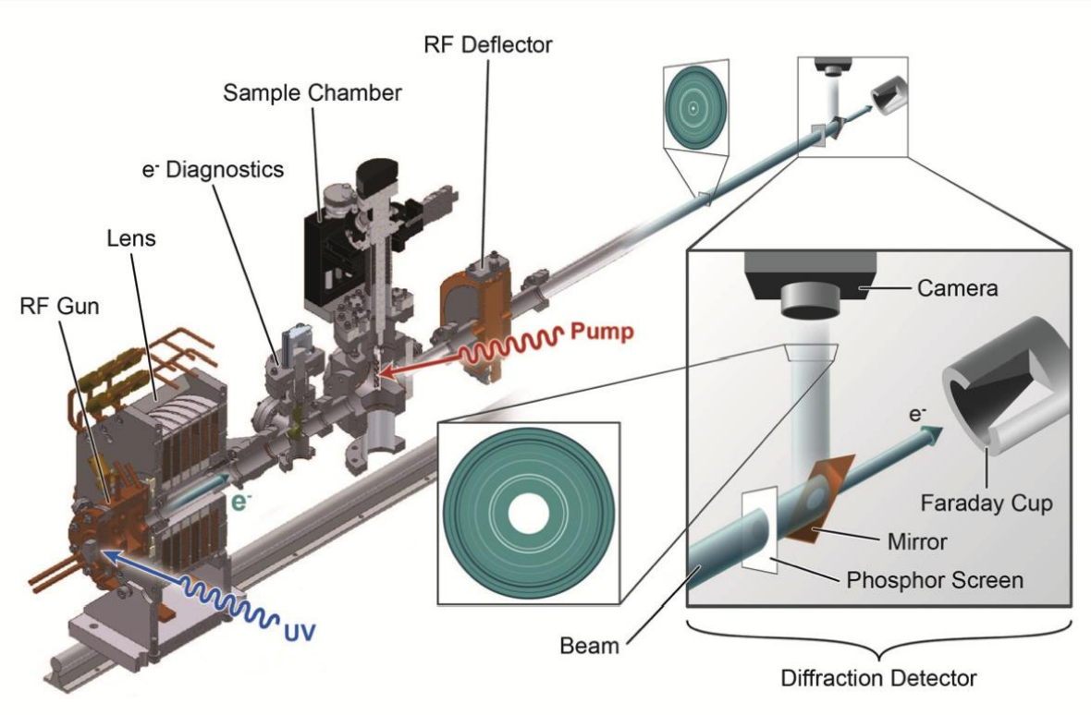
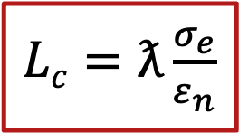
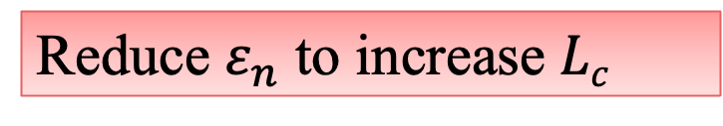
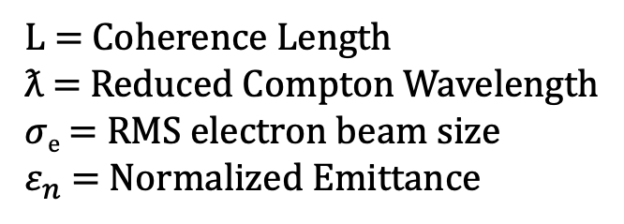
Introduction
UED
Coherence Length
$Lc=ƛ\frac{σ_{e}}{ε_{n}}$
L = Coherence Length
ƛ = Reduced Compton Wavelength
𝜎_{e} = RMS electron beam size
$ε_{n}$= Normalized Emittance
Reduce $ε_{n}$ to increase $Lc$
Physical Review Special Topics-Accelerators and Beams 17.12 (2014): 120701.

Slide 4
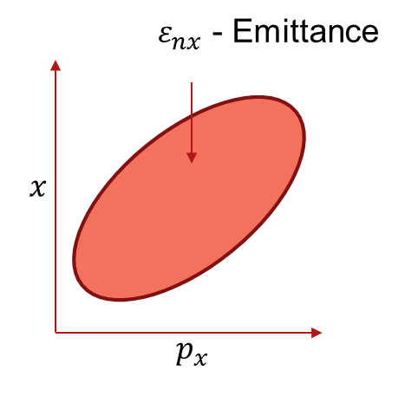
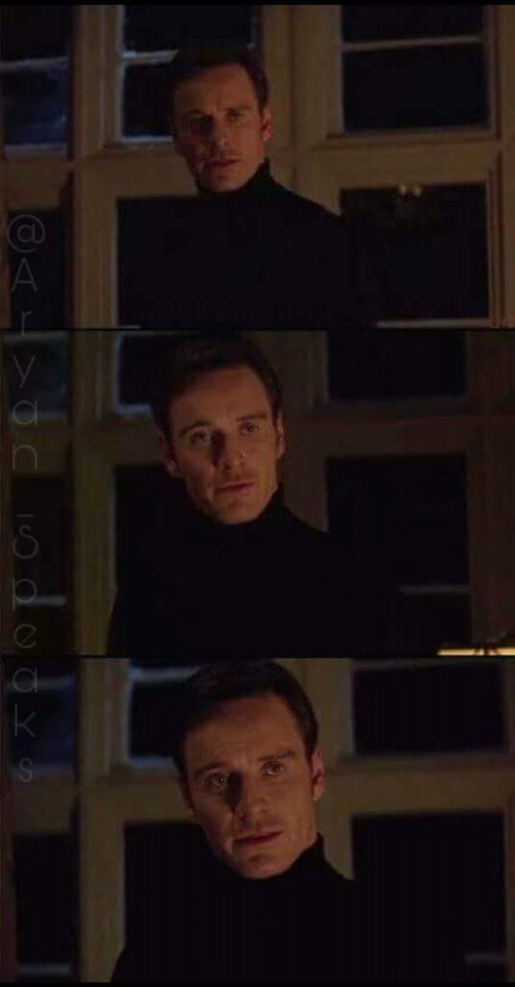
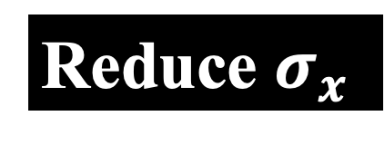
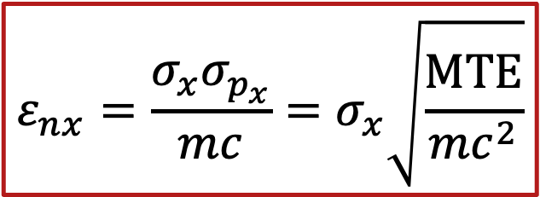
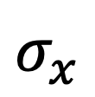
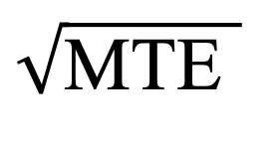
Emittance
Emittance
$$\sqrt{\text{MTE} }$$
Show me the better way to reduce emittance
$$σ_{x}$$
Reduce MTE
I said the better
$$ε_{nx}=\frac{σ_{x}σ_{p_{x}}}{mc}=σ_{x}\sqrt{\frac{MTE}{mc^{2}}}$$
Reduce $σ_{x}$
PERFECT!

Slide 5
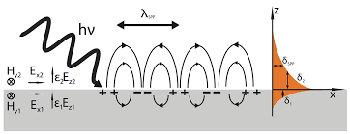
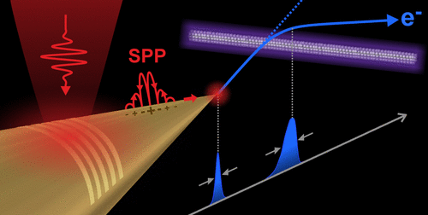
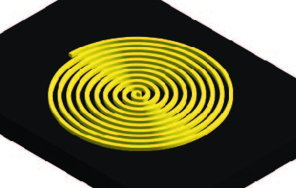
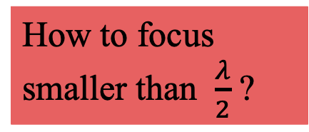
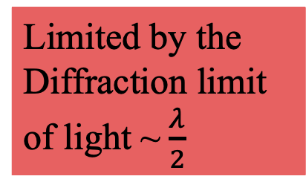
Reducing $σ_{x}$
Conventional way of focusing light
Surface Plasmon Polariton
Limited by the Diffraction limit of light ~$\frac{λ}{2}$
Gold Nanotip
Gold Spiral
How to focus smaller than $\frac{λ}{2}$ ?
https://en.wikipedia.org
Structural Dynamics 9.2 (2022)
Physical review letters 110.7 (2013): 074801
Physical Review Applied 19.3 (2023): 034034
Acs Photonics 3.4 (2016): 611-619

Slide 6
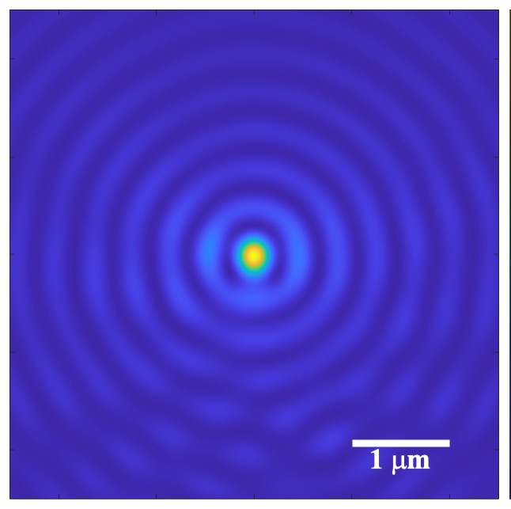
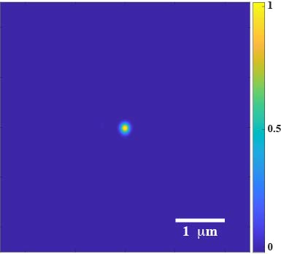

Plasmonic Spiral Photocathode: FDTD Simulation
Intensity(I) Map
I⁴ Map
Source: Circularly Polarized Gaussian; ℏω = 1.55 eV (𝜆 = 800 nm); Pulse Length = 150 fs
Non-Linear Photoemission:
electron source size ~140 nm
Fowler Dubridge:
$J_{n} α I^{n}$
Φ_{Au} ~5.4 eV; ℏω = 1.55 eV
n = 4, 𝐽₄ 𝛼 𝐼⁴
Physical review letters 104.8 (2010): 084801.
Nuclear Instruments and Methods in Physics Research Section A: Accelerators, Spectrometers, Detectors and Associated Equipment 601.1-2 (2009): 123-131.

Slide 7
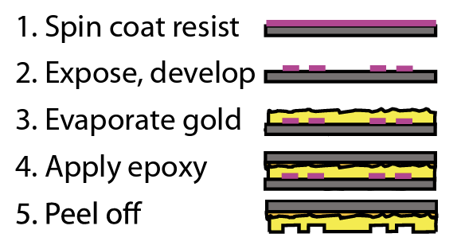
Past Attempts: Fabrication
Template Stripping Method
2 um
0.5 um
Physical Review Applied 12.5 (2019): 054057.

Slide 8
Past Attempts: PEEM Images
PEEM Hg Lamp
Before LASER cleaning
After LASER cleaning
LASER “cleaning” for 15 hours reduces hot spots
No Emission Spot at the Center
Change Fabrication Method
Large Start Radius

Slide 9
New Fabrication Technique
2R₀
200 nm PMMA 950 K
185 nm PMMA 495 K
Si Substrate
Si Substrate
Spiral Fabrication Process
Written with EBL
Developed in MIBK:IPA = 1:3
Lift off with Remover PG
Rinsed with IPA
Treated with O₂ Plasma
E beam evaporation of Cr (5 nm)/Au (120 nm)
Si Substrate
Si Substrate

Slide 10
New Fabrication: SEM Images

Slide 11
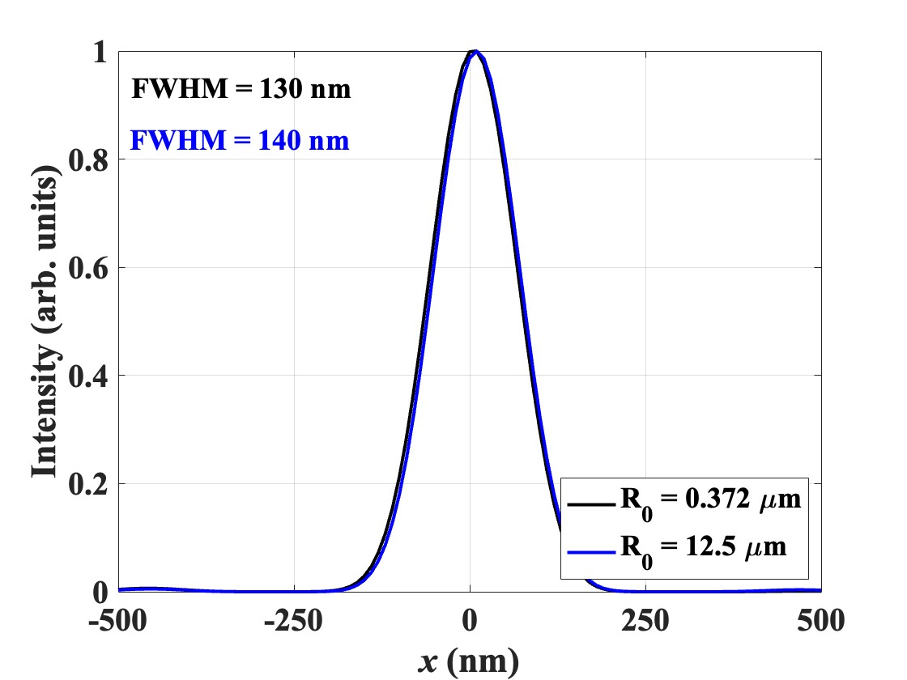
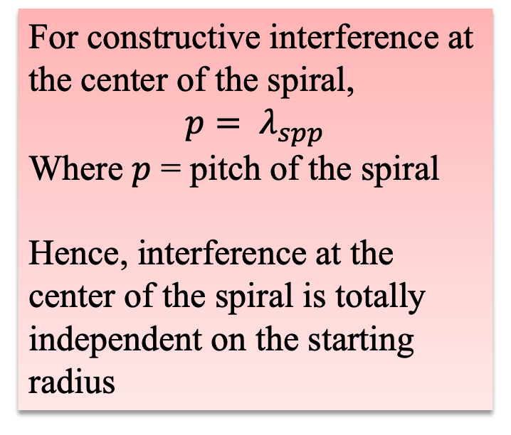
FDTD Simulation
For constructive interference at the center of the spiral,
$$p= λ_{spp}$$
Where $p$ = pitch of the spiral
Hence, interference at the center of the spiral is totally independent on the starting radius
4th order photoemission

Slide 12
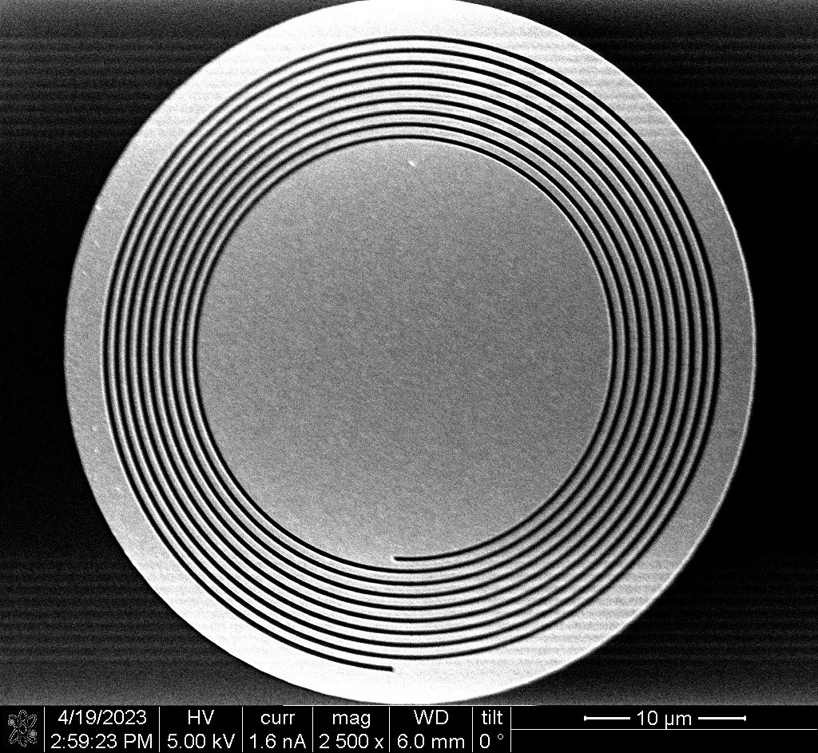
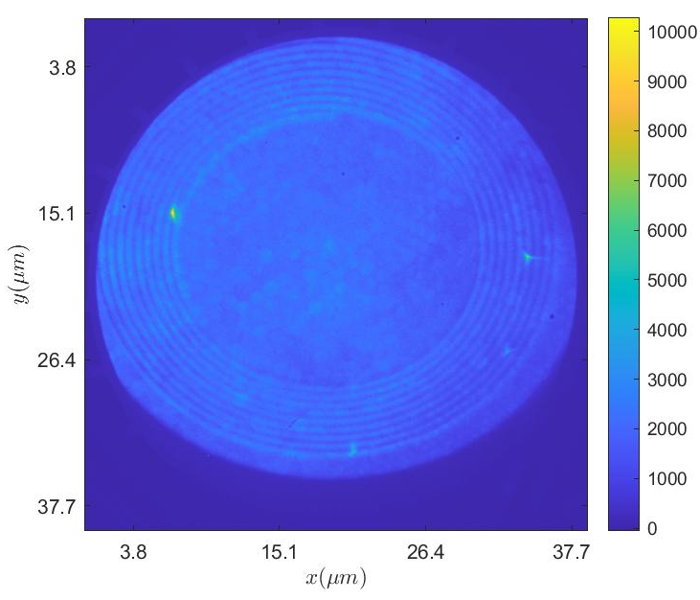
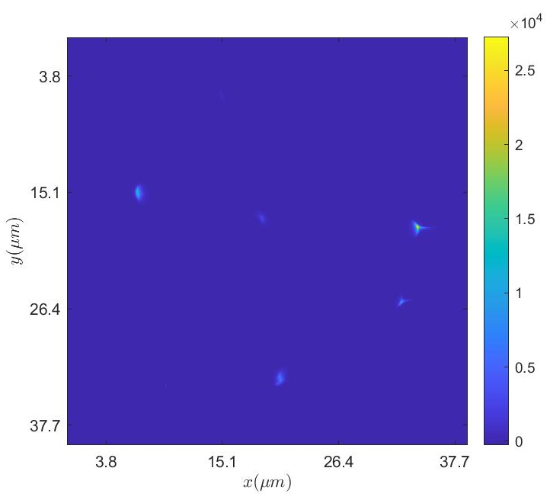
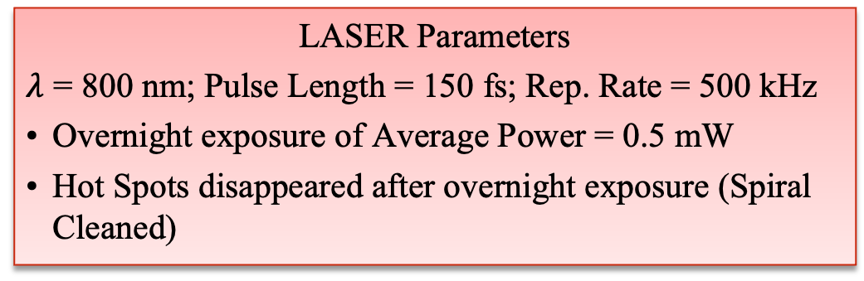
Spiral Photocathode: Study & Characterization
LASER cleaning of Hot-Spots
PEEM Hg Lamp + LASER
LASER
LASER Parameters
$λ$ = 800 nm; Pulse Length = 150 fs; Rep. Rate = 500 kHz
Overnight exposure of Average Power = 0.5 mW
Hot Spots disappeared after overnight exposure (Spiral Cleaned)
SEM

Slide 13
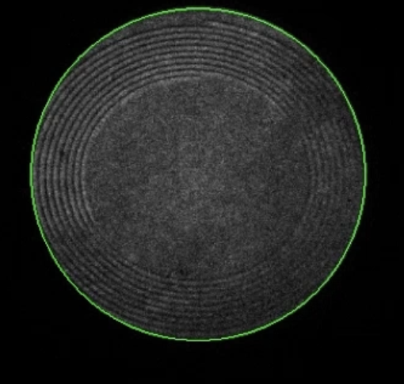
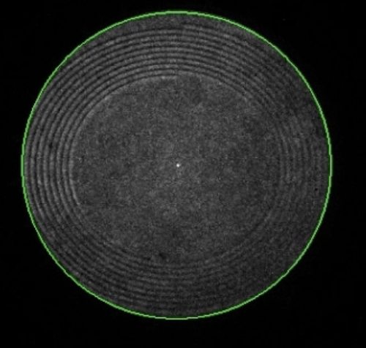
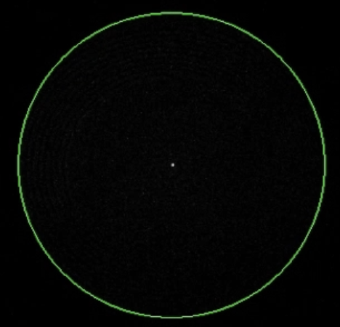
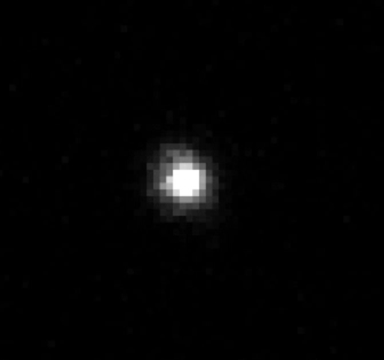
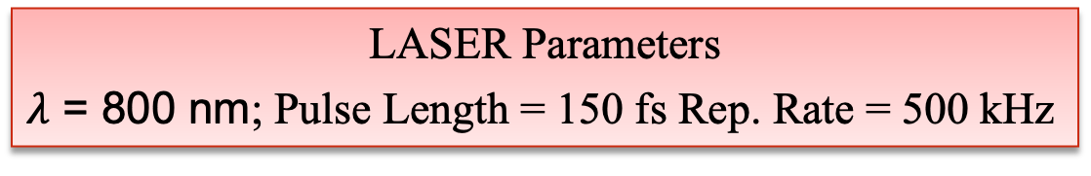
Spiral Photocathode: Study & Characterization
LASER Parameters
$λ$ = 800 nm; Pulse Length = 150 fs Rep. Rate = 500 kHz
Photoemission Measurement: Spiral Activation
10 μm
10 μm
PEEM Hg Lamp Image
PEEM Hg Lamp+ LASER
Extremely faint spot
Faint spot
Bright spot
Still bright
Brighter
~ 5 min
~ 5 min
Low LASER power
ND 1.0
~ 2 mW
ND 1.0
~ 2 mW
ND 1.5
~0.5 mW
ND 1.5
~0.5 mW
1st Activation
2nd Activation
10 μm
200 nm
LASER
LASER (Zoomed in)

Slide 14
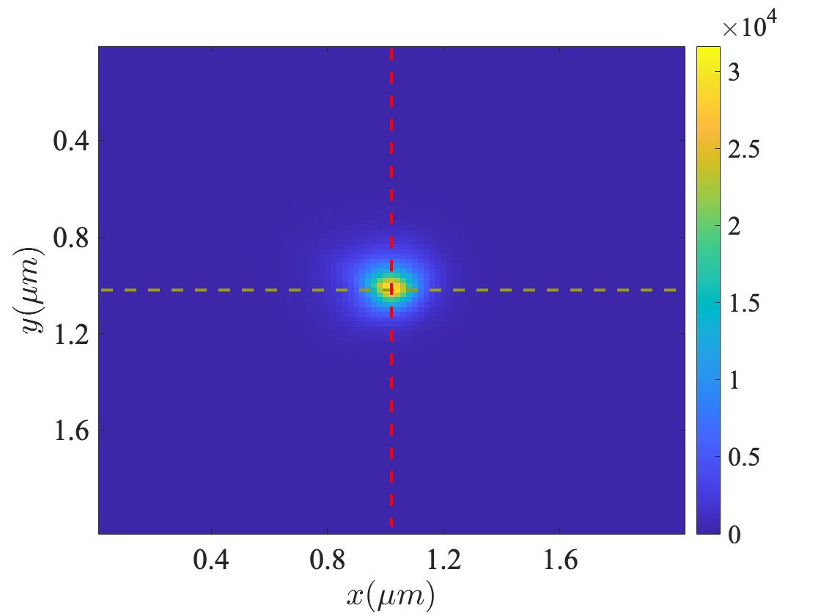
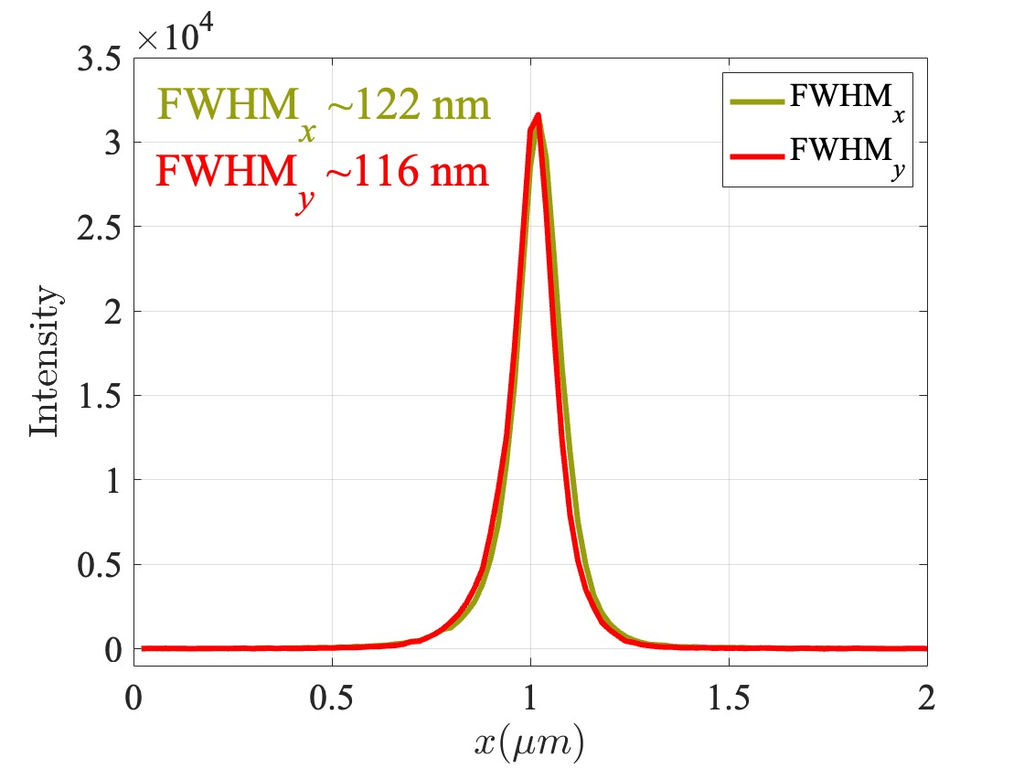
Spiral Photocathode: Study & Characterization
Electron Emission spot; Average incident LASER power = 136 μW

Slide 15
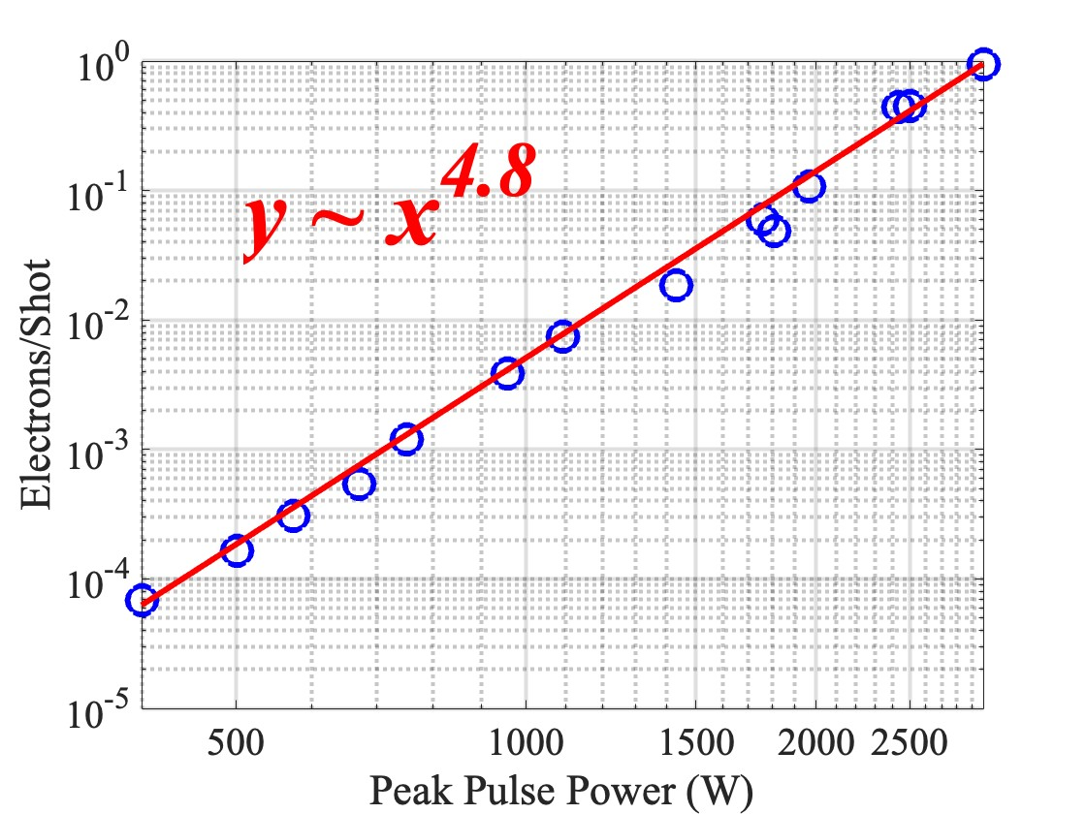
Spiral Photocathode: Order of Emission
~120 nm electron emission spot size makes sense as
Order of Emission ~5th

Slide 16
Spiral Photocathode: Order of Emission
1 electron/shot
~120 nm electron emission spot size makes sense as
Order of Emission ~5th
10⁻⁴ electrons/shot

Slide 17
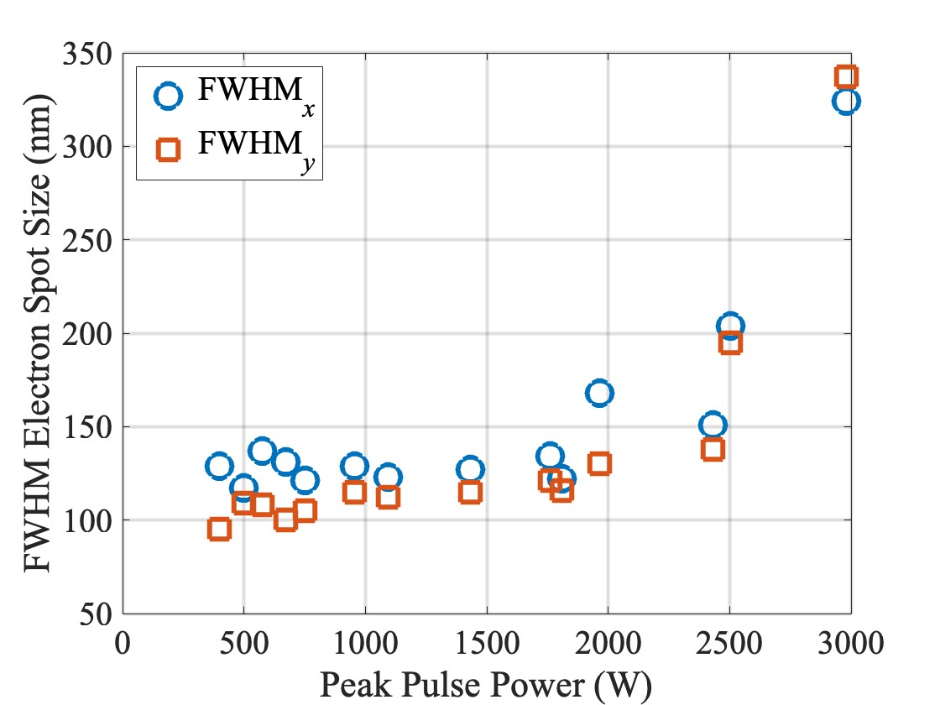
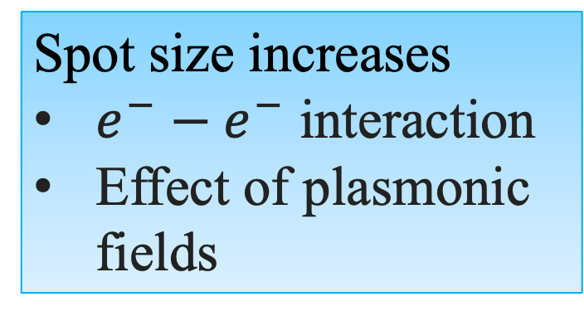
Spiral Photocathode: Spot Size
~120 nm electron emission spot size over wide range of LASER power
Spot size increases
$e^{−}−e^{−}$ interaction
Effect of plasmonic fields

Slide 18
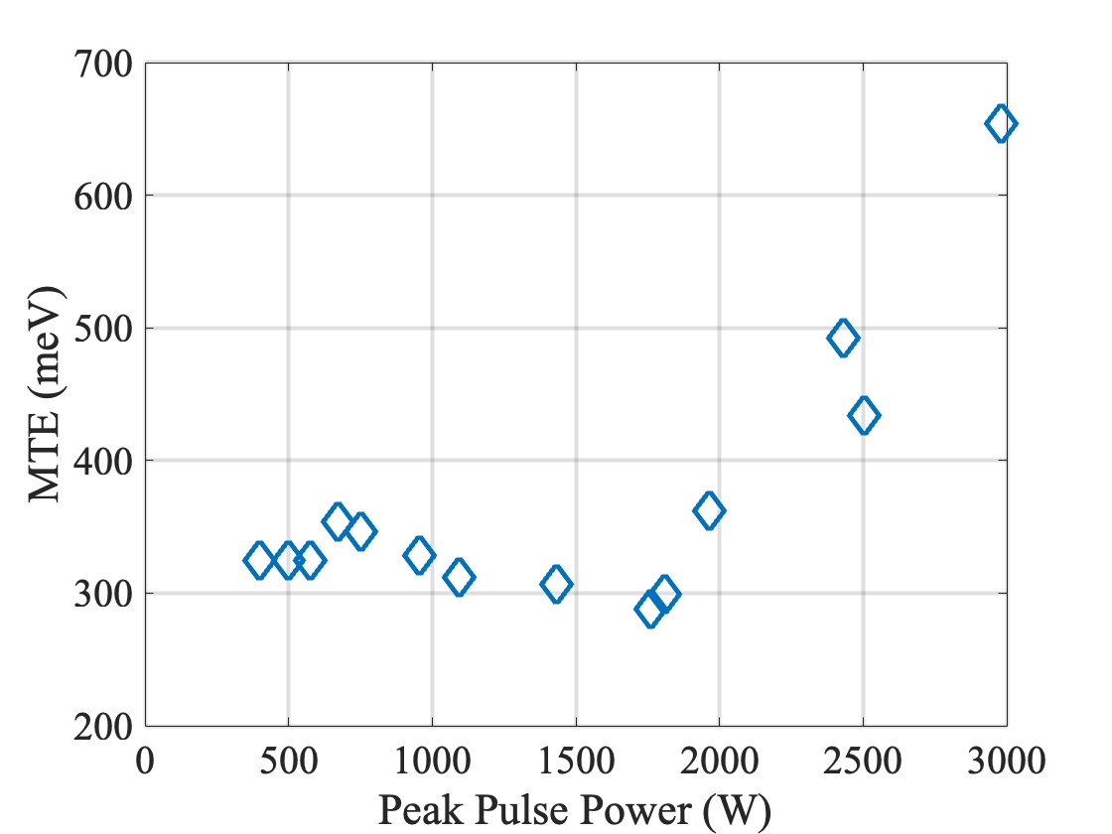
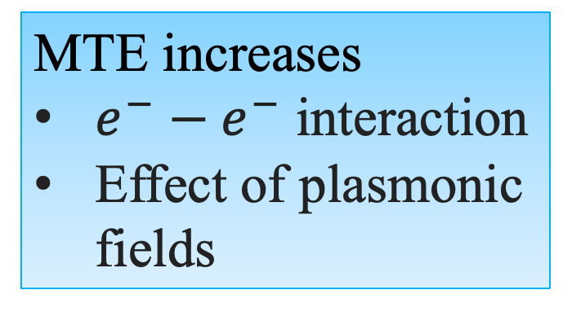
Spiral Photocathode: MTE
MTE increases
$e^{−}−e^{−}$ interaction
Effect of plasmonic fields
0.5 Å⁻¹

Slide 19
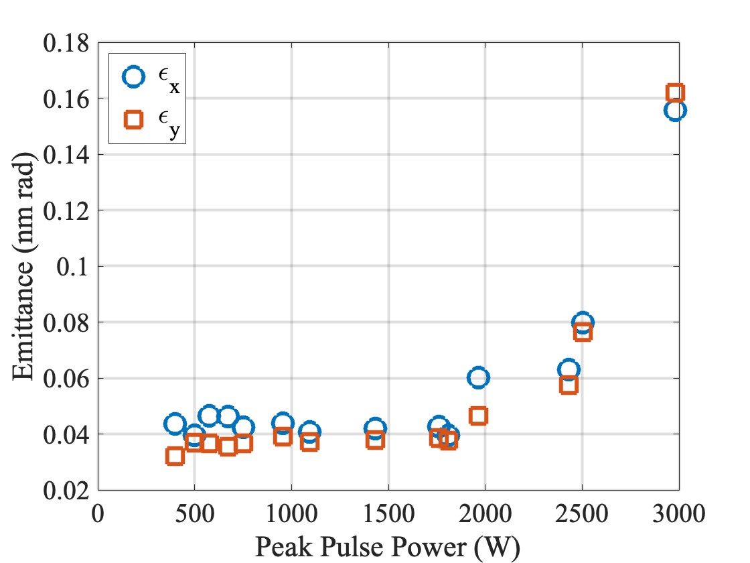

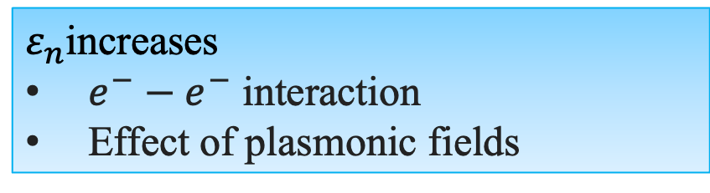
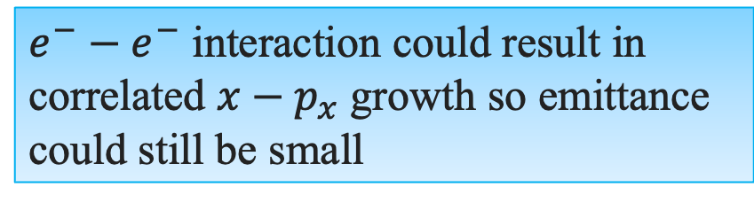
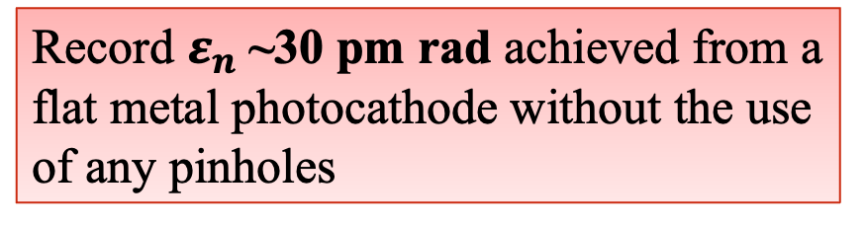
Spiral Photocathode: Emittance
Record $ε_{n}$~30 pm rad achieved from a flat metal photocathode without the use of any pinholes
2 pm rad from ZrO/W emitter tip in an Electron Microscope [Ultramicroscopy 176 (2017): 63-73]
700 pm rad from flat cathode in a photoinjector after the pinhole [Structural Dynamics 9.2 (2022)]
$$ε_{nx}=σ_{x}\sqrt{\frac{MTE}{mc^{2}}}$$
$ε_{n}$increases
$e^{−}−e^{−}$ interaction
Effect of plasmonic fields
$e^{−}−e^{−}$ interaction could result in correlated $x−p_{x}$ growth so emittance could still be small

Slide 20
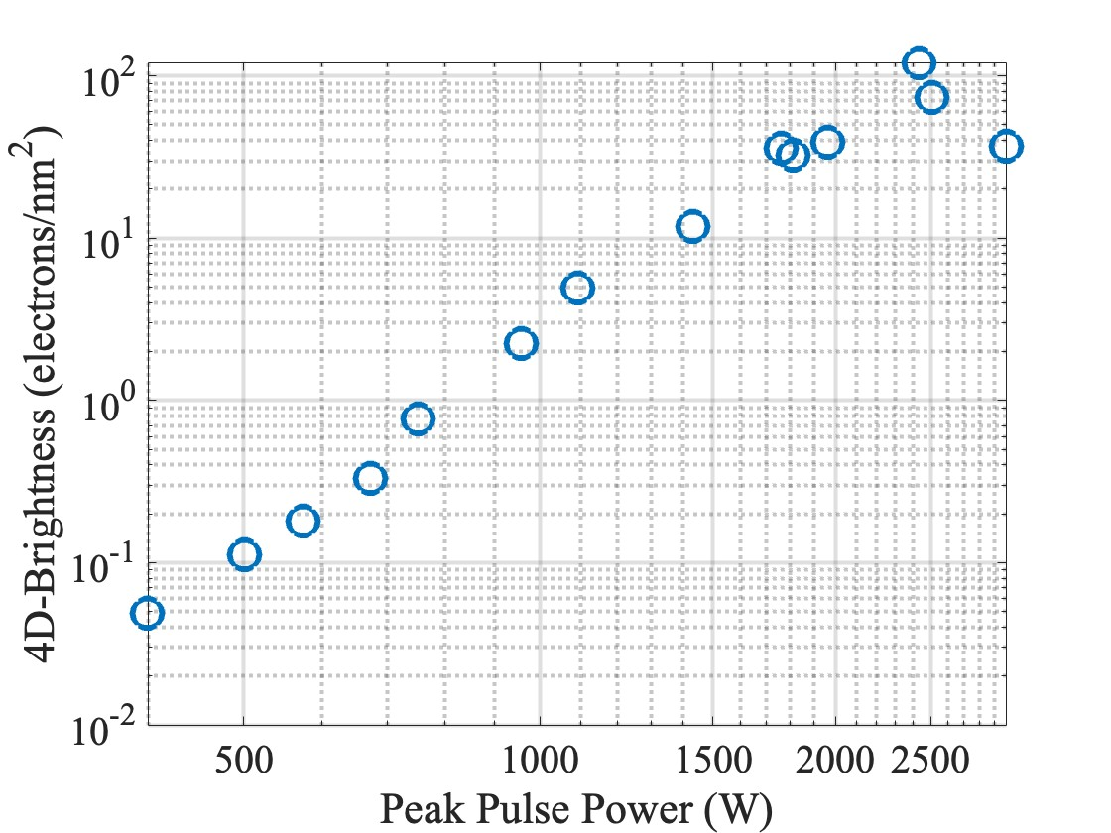
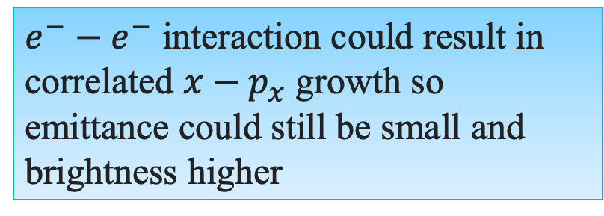
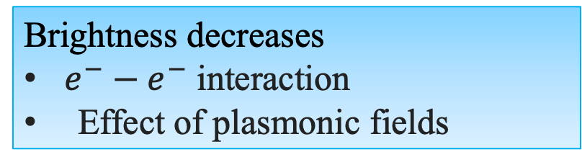
Spiral Photocathode: 4D-Brightness
Maximum 4-D Brightness achieved:
120 electrons/nm²
Brightness decreases
$e^{−}−e^{−}$ interaction
Effect of plasmonic fields
$e^{−}−e^{−}$ interaction could result in correlated $x−p_{x}$ growth so emittance could still be small and brightness higher

Slide 21
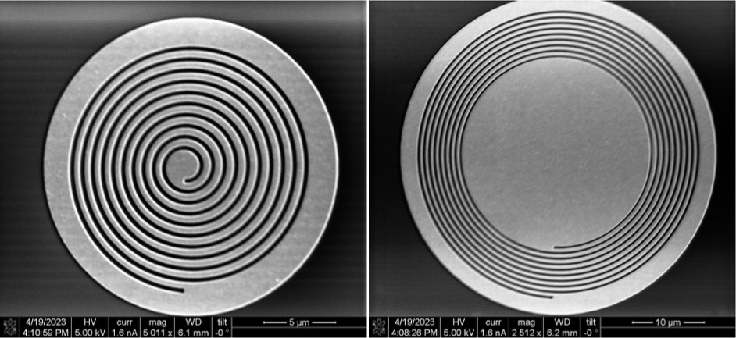
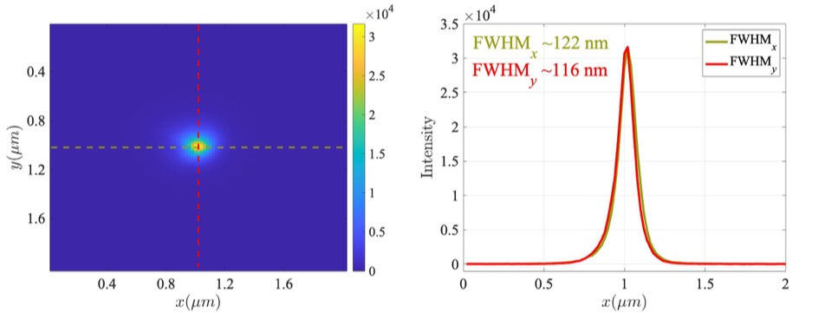
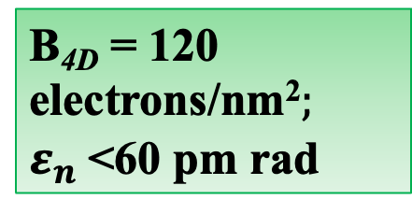
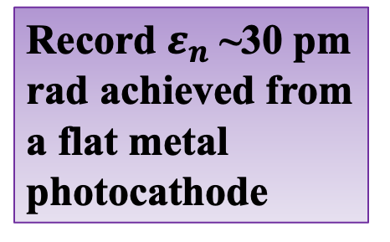
Conclusion
Fabrication
Record $ε_{n}$~30 pm rad achieved from a flat metal photocathode
Maximum 4-D Brightness achieved:
120 electrons/nm²
Electron Spot Size ~120 nm
B_{4D} = 120 electrons/nm²$;$
$ε_{n}$<60 pm rad

Slide 22
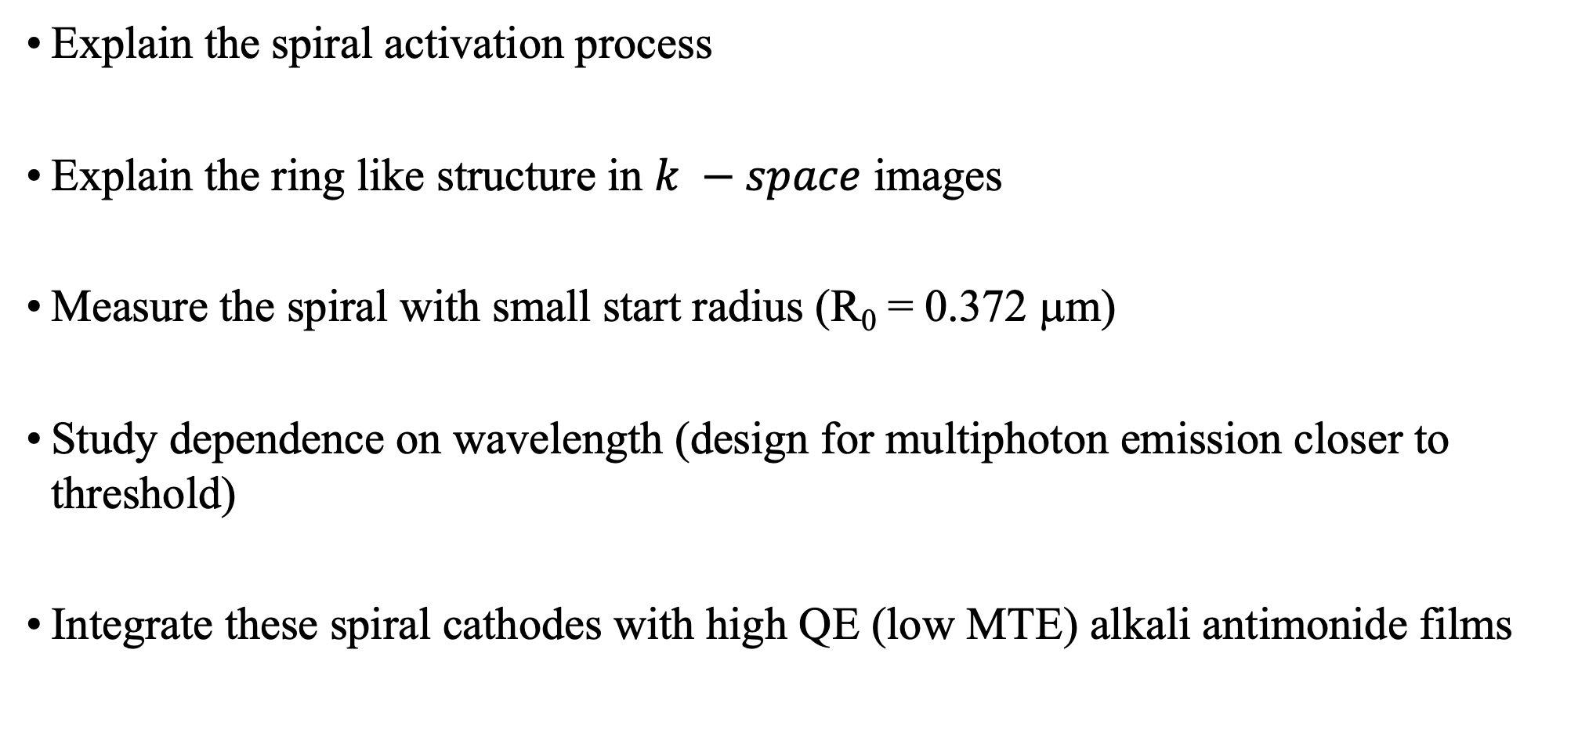
Future Work
Explain the spiral activation process
Explain the ring like structure in $k −space$ images
Measure the spiral with small start radius (R₀ = 0.372 μm)
Study dependence on wavelength (design for multiphoton emission closer to threshold)
Integrate these spiral cathodes with high QE (low MTE) alkali antimonide films

Slide 23



Acknowledgement
Arizona State University
Mansoure Rizi
Siddharth Karkare (PI)
Lawrence Berkeley National Lab
Daniele Filippetto
University of Chicago
Christopher Pierce
Cornell University
Jared Maxson

Slide 24
Thank You!
Questions? Comments?

Slide 25
Back Up Slides

Slide 26
SEM Images: After LASER Exposure

Slide 27
SEM Images: After LASER Exposure

Slide 28
SEM Images: After LASER Exposure

Slide 29
SEM Images: After LASER Exposure

Slide 30
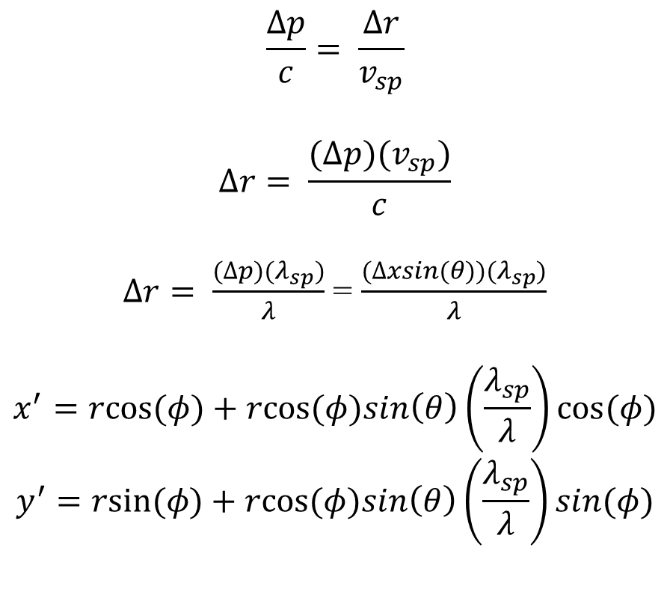
Spiral Tilt Compensation
y
$$\frac{∆p}{c}= \frac{∆r}{v_{sp}}$$
$$∆r= \frac{(∆p)(v_{sp})}{c}$$
$∆r= \frac{(∆p)(λ_{sp})}{λ}$ = $\frac{(∆xsin(θ))(λ_{sp})}{λ}$
$$x^{′}=rcos⁡(φ)+rcos⁡(φ)sin\left(θ\right)\left(\frac{λ_{sp}}{λ}\right)cos⁡(φ)$$
$$y^{′}=rsin⁡(φ)+rcos⁡(φ)sin\left(θ\right)\left(\frac{λ_{sp}}{λ}\right)sin(φ)$$
r+Δr
x
Φ = 180
r
Φ = 0
z
x
Δp
θ
Δx

Slide 31


Plasmonic Spiral: Tilt Compensation

Slide 32

Plasmonic Spiral: Tilt Compensation
FWHM ~ 140 nm

Slide 33

Plasmonic Spiral: Response Time
Response Time: FDTD Simulation
Incident Pulse Length: 150 fs
Polarization: Circular

Slide 34

Brief Description of PEEM
Sample
Objective
Contrast Aperture
1st Stigmator
Transfer Lens
2nd Stigmator
PEEM Column
Iris Aperture
1st Projective
2nd Projective
L1
IEF Column
L2
G1 and G2
Imaging Assembly

Slide 35

Density of States: Gold
Physical Chemistry Chemical Physics 17.39 (2015): 26036-26042

Slide 36








Electron Bunch Parameters
Brightness of Electron Bunch
Charge density in phase space
Coherence Length
The electron beam emitted from the photocathode is contained within a phase space volume, known as the emittance
$$Lc=ƛ\frac{σ_{e}}{ε_{n}}$$
L = Coherence Length
ƛ = Reduced Compton Wavelength
𝜎_{e} = RMS electron beam size
Ɛ_{n} = Normalized Emittance
$ε_{nx}$ - Emittance
B $α \frac{Q_{bunch}}{ε_{n}^{2}}$
$$x$$
B = Brightness of Electron Bunch
$Q_{bunch}$ = Bunch Charge
Ɛ_{n} = Normalized Emittance
Proteins: ~ 4 - 100 nm
$$p_{x}$$
$$ε_{nx}=\frac{σ_{x}σ_{p_{x}}}{mc}=σ_{x}\sqrt{\frac{MTE}{mc^{2}}}$$
$Lc$ ≥ 4 nm
$σ_{e}$ ≤ 200 μm
$ε_{n}\text{≤}$ 20 nm rad.
Increase Amount of Charge Extracted
Reduce Emittance/Mean Transverse Energy (MTE)
Reduce Emission Area
Reduce Mean Transverse Energy (MTE)

