Slide 1

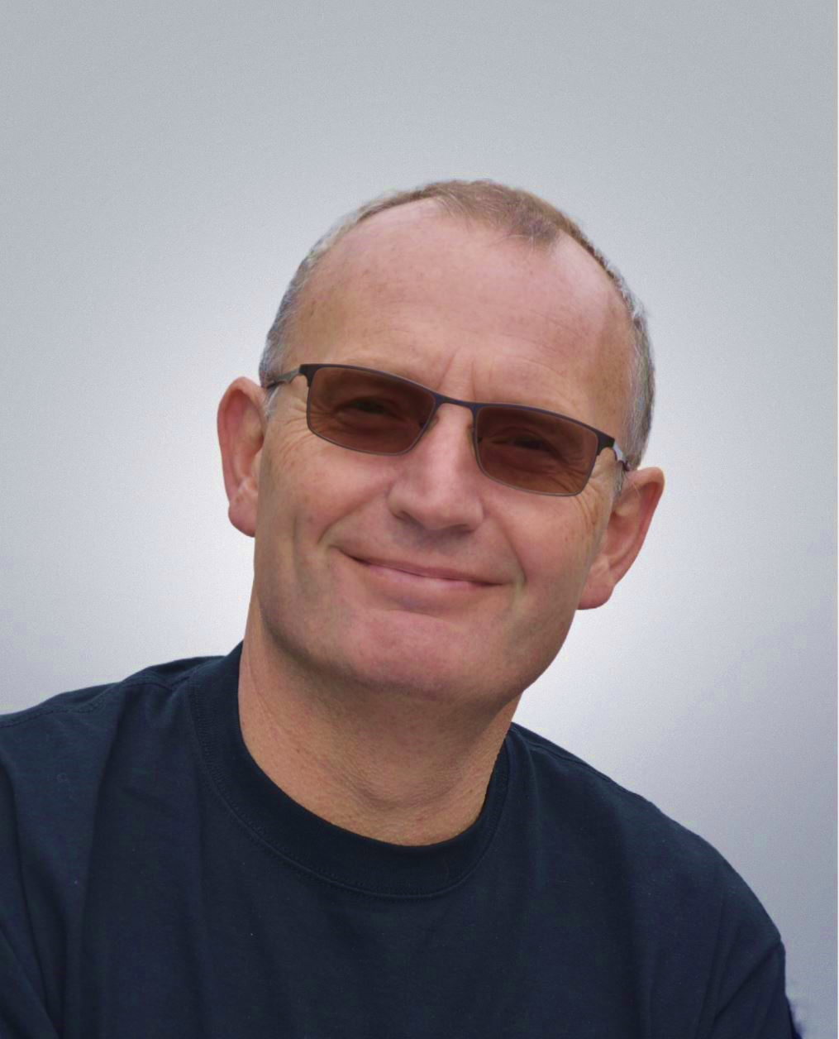
Dr. Lee Jones
Senior Accelerator Physicist
Accelerator Science and Technology Centre
STFC Daresbury Laboratory
TESS: The Transverse
Energy Spread Spectrometer
and Recent Experimental Results to
Characterise Photocathode Performance

Slide 2

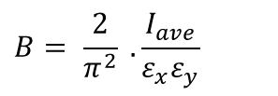


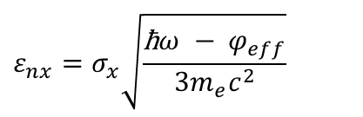

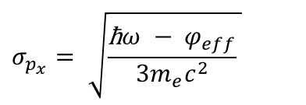

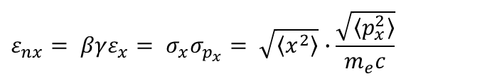

Transverse Energy Spread Spectrometer (TESS) - Motivation
UV Laser (266 nm)
$$B= \frac{2}{π^{2}} . \frac{I_{ave}}{ε_{x}ε_{y}}$$
Bright electron beams require low emittance sources
Recognise the important of the illumination wavelength
  Concept of ‘excess energy’:
2010: Aspiration to construct a device to measure MTE
Initial commissioning of ‘TESS’ presented at FEL 2013
  Used GaAs under illumination at 532 nm & 635 nm
  Later looked at GaAs & GaAsP subject to degradation
Broadband illumination → wavelength tunability
  Spectral response
Higher detector gain desirable (threshold emission)
Some way to monitor/assess Quantum Efficiency
…… the TESS evolved to meet these requirements
$$ε_{nx}= βγε_{x}= σ_{x}σ_{p_{x}}= \sqrt{\left\langle x^{2}\right\rangle }∙\frac{\sqrt{\left\langle p_{x}^{2}\right\rangle }}{m_{e}c}$$
$$E_{excess}=\text{ħ}ω − φ_{eff}$$
$$σ_{p_{x}}= \sqrt{\frac{\text{ħ}ω − φ_{eff}}{{3m_{e}c}^{2}} }$$
$$ε_{nx}=σ_{x}\sqrt{\frac{\text{ħ}ω − φ_{eff}}{{3m_{e}c}^{2}}}$$
D. Dowell & J. Schmerge, Phys. Rev. ST Accel. Beams 12, 074201 (2009)
$$\text{MTE}=k_{B}T\frac{{Li}_{3}\left[−\text{exp}\left(E_{excess}\right)\right]}{{Li}_{2}\left[−\text{exp}\left(E_{excess}\right)\right]}$$
$$\text{QE}={SLi}_{2}\left[−\text{exp}\left(E_{excess}\right)\right]$$
T. Vecchione et al., Proc. FEL 2013, 424-426 (TUPS083)
$$B∝\frac{E^{n}}{MTE}$$
$$\text{QE}∝E_{excess}^{2}$$
$$\text{MTE}=\frac{E_{excess}}{3}$$
P. Saha et al., J. Appl. Phys. 133, 053102 (2023)
2

Slide 3
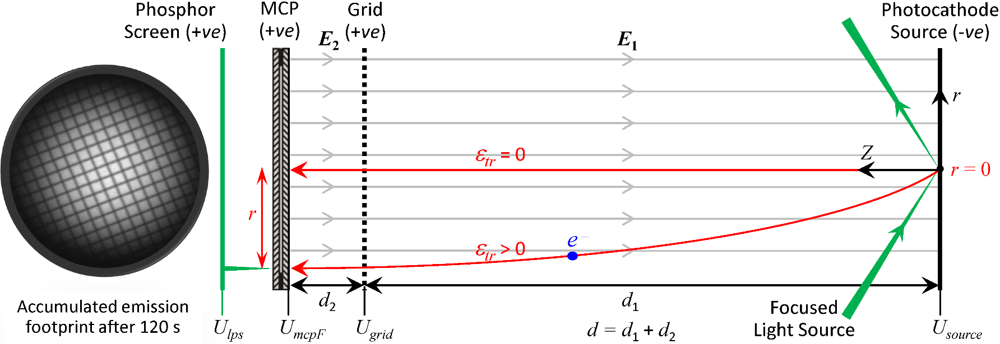
Transverse Energy Spread Spectrometer (TESS) - Concept
Photocurrent extremely low, typically 10s of fA
Voltages U_{source}, U_{grid} & U_{mcpF} determine electron flight time, typically 20 to 30 ns
  Statistically single electron emission ➔ No space charge affects
Each electron triggers cascade amplification in the MCP ➔ Spot on luminous phosphor screen
Long acquisition records all possible transverse energy components (ε_{tr})
Analysis of photoemission image yields the Transverse Energy Distribution Curve (TEDC)
L. Jones et al., Rev. Sci. Instrum. 93, 113314 (2022)
3

Slide 4
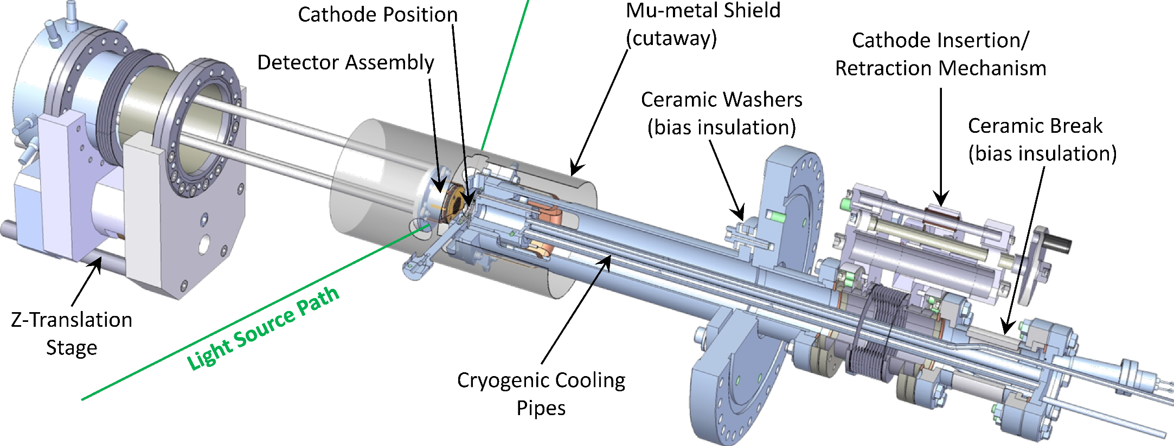
Transverse Energy Spread Spectrometer (TESS) - Schematic
L. Jones et al., Proc. FEL2013, TUPS033, 290-293
Credit: R. Cash
4
Notes:
Basic premise: We illuminate a photocathode with a vanishingly-small light spot and emit electrons into a known electric field. They travel a known distance before falling on an imaging detector with a known energy. The photoemission footprint is recorded and analysed to convert its physical distribution into a transverse energy spectrum based on the electron time of flight.
You can see the photoelectron detector and the photocathode holder.
The retraction stage on right for cathode loading/un-loading. The Z-stage on left adjusts the electron drift distance
Cathode illuminated a grazing incidence, and photo emitted electron allowed to propagate through a controlled electric field between the source and the detector

Slide 5
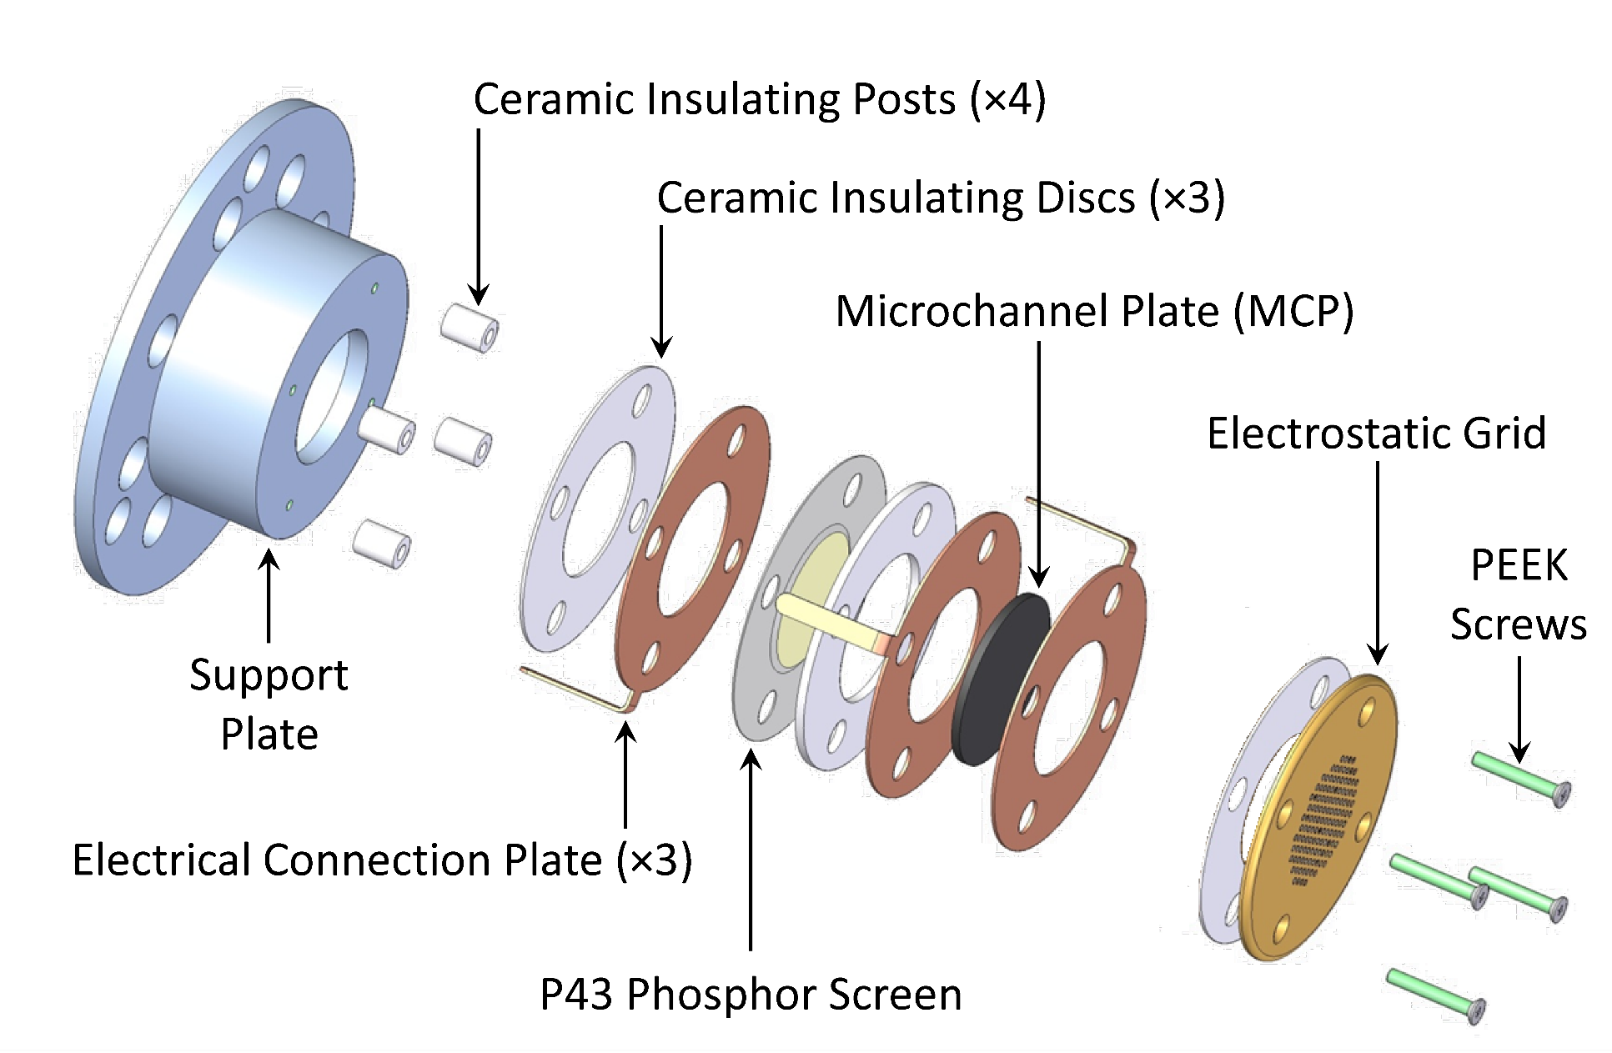
Transverse Energy Spread Spectrometer (TESS) - Schematic
L. Jones et al., Proc. FEL2013, TUPS033, 290-293
Credit: R. Cash
5
Notes:
Details of the photoelectron imaging detector. Combines the electrostatic grid required to setup the electric field between the detector and the photocathode source with a MCP and a phosphor screen.

Slide 6
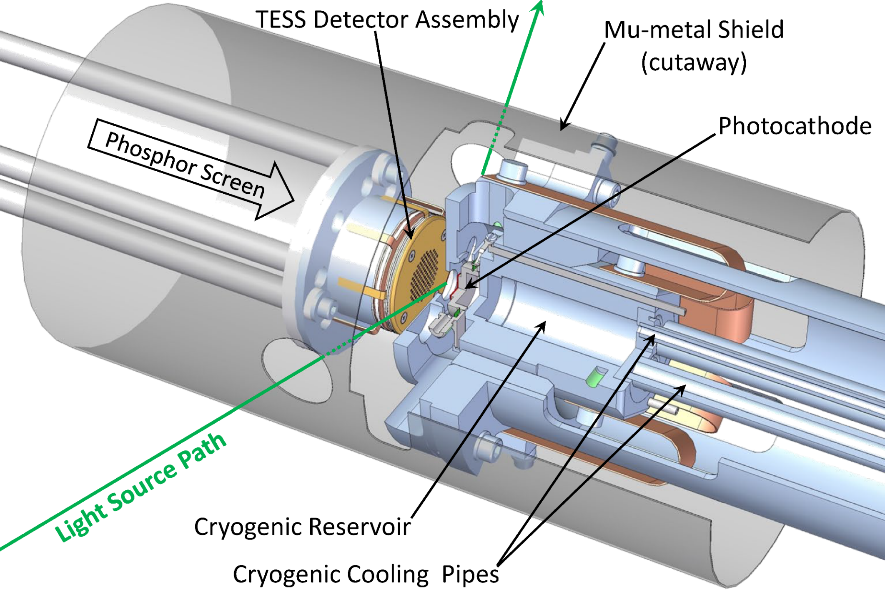
Transverse Energy Spread Spectrometer (TESS) - Schematic
L. Jones et al., Proc. FEL2013, TUPS033, 290-293
Credit: R. Cash
6
Notes:
Close-up of the TESS experient showing the mu-metal magnetic shield and the cryogenic cooling reservoir.
Data acquisition camera looks intot he vacuum system fro the left and records the photoemission footprint from the phosphor screen

Slide 7
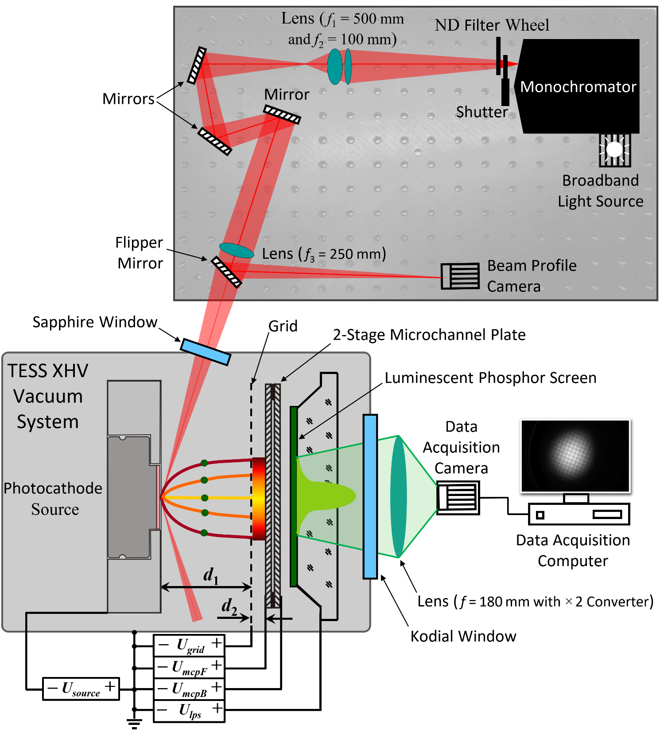
TESS Leading Particulars:
Laser-driven plasma broadband lightsource
Twin grating monochromator
  Usable flux from λ = 236 nm to > 800 nm
Filter wheel to avoid space charge
Beam profile camera at working distance
  Optimise source spot for each λ
Sapphire viewport window
  Maximise UV transmission
TESS base pressure typically 3 × 10⁻¹¹ mbar
LN₂ Cooling loop
Piezoelectric leak valve for
controlled degradation studies
TESS linked to GaAs PPF at 4 × 10⁻¹² mbar
  Storage carousel with up to 6 photocathodes
Vacuum suitcase for sample transfers between systems (< 1 × 10⁻¹⁰ mbar)
Credit: D.P. Juarez-Lopez
& H.E. Scheibler
L. Jones et al., Rev. Sci. Instrum. 93, 113314 (2022)
7
Notes:
Broadband laser-driven plasma lightsource coupled to monochromator. 230 to 850 nm range
Optics to focus light beam down to typically 100 micron FWHM at the photocathode. Beam profile camera to confirm this.

Slide 8
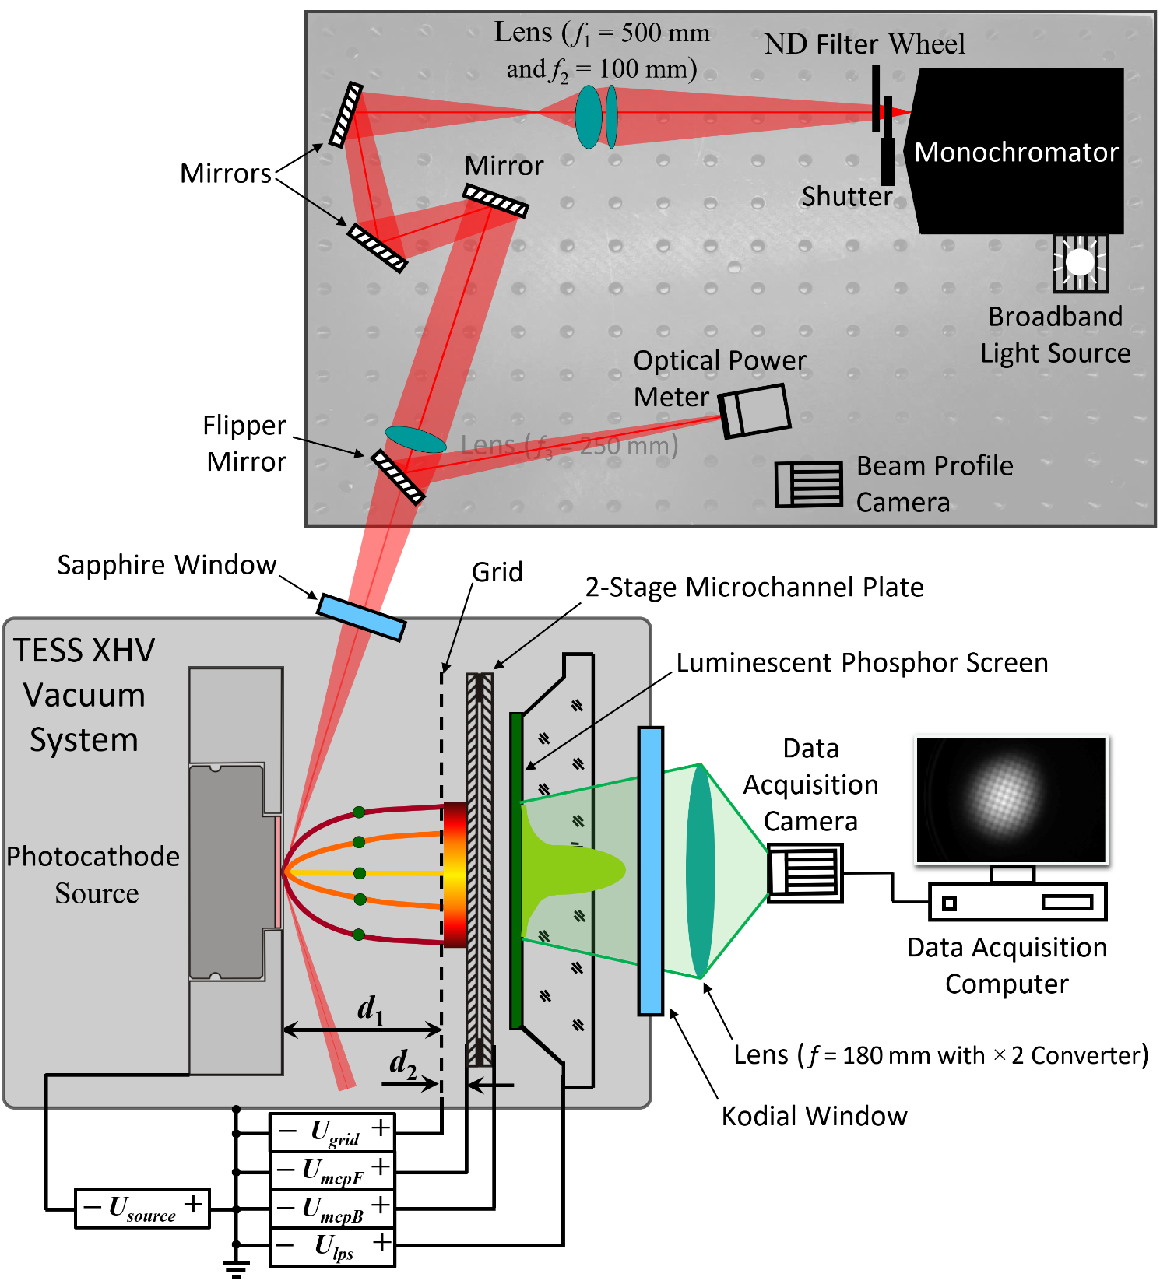
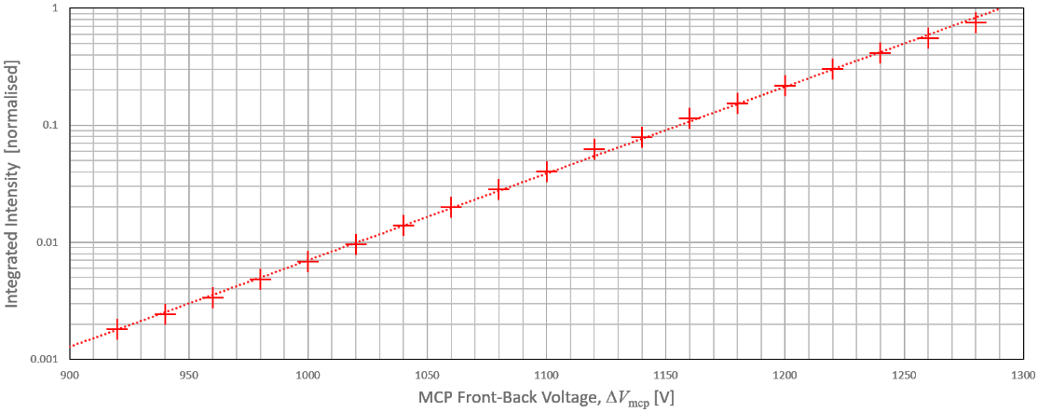


Relative QE Concept using:
Photoemission image intensity, I_{corrected}
Image acquisition time, t
Optical power measurement, P_{opt}
Illumination wavelength, λ
Viewport transmission correction, T_{viewport}
MCP front-back voltage difference, ΔV_{mcp}
And MCP gain, G_{mcp}
where
$${QE}_{relative}=\frac{I_{corrected}×hc}{t∙(P_{opt}×\text{l}×T_{viewport})∙G_{mcp}}$$
$$G_{mcp}=2^{\left(\frac{{∆V}_{mcp}}{41.0}\right)}=2^{\left(\frac{U_{mcpB}−U_{mcpF}}{41.0}\right)}$$
Credit: D.P. Juarez-Lopez
& H.E. Scheibler
8
Notes:
Broadband laser-driven plasma lightsource coupled to monochromator. 230 to 850 nm range
Optics to focus light beam down to typically 100 micron FWHM at the photocathode. Beam profile camera to confirm this.

Slide 9
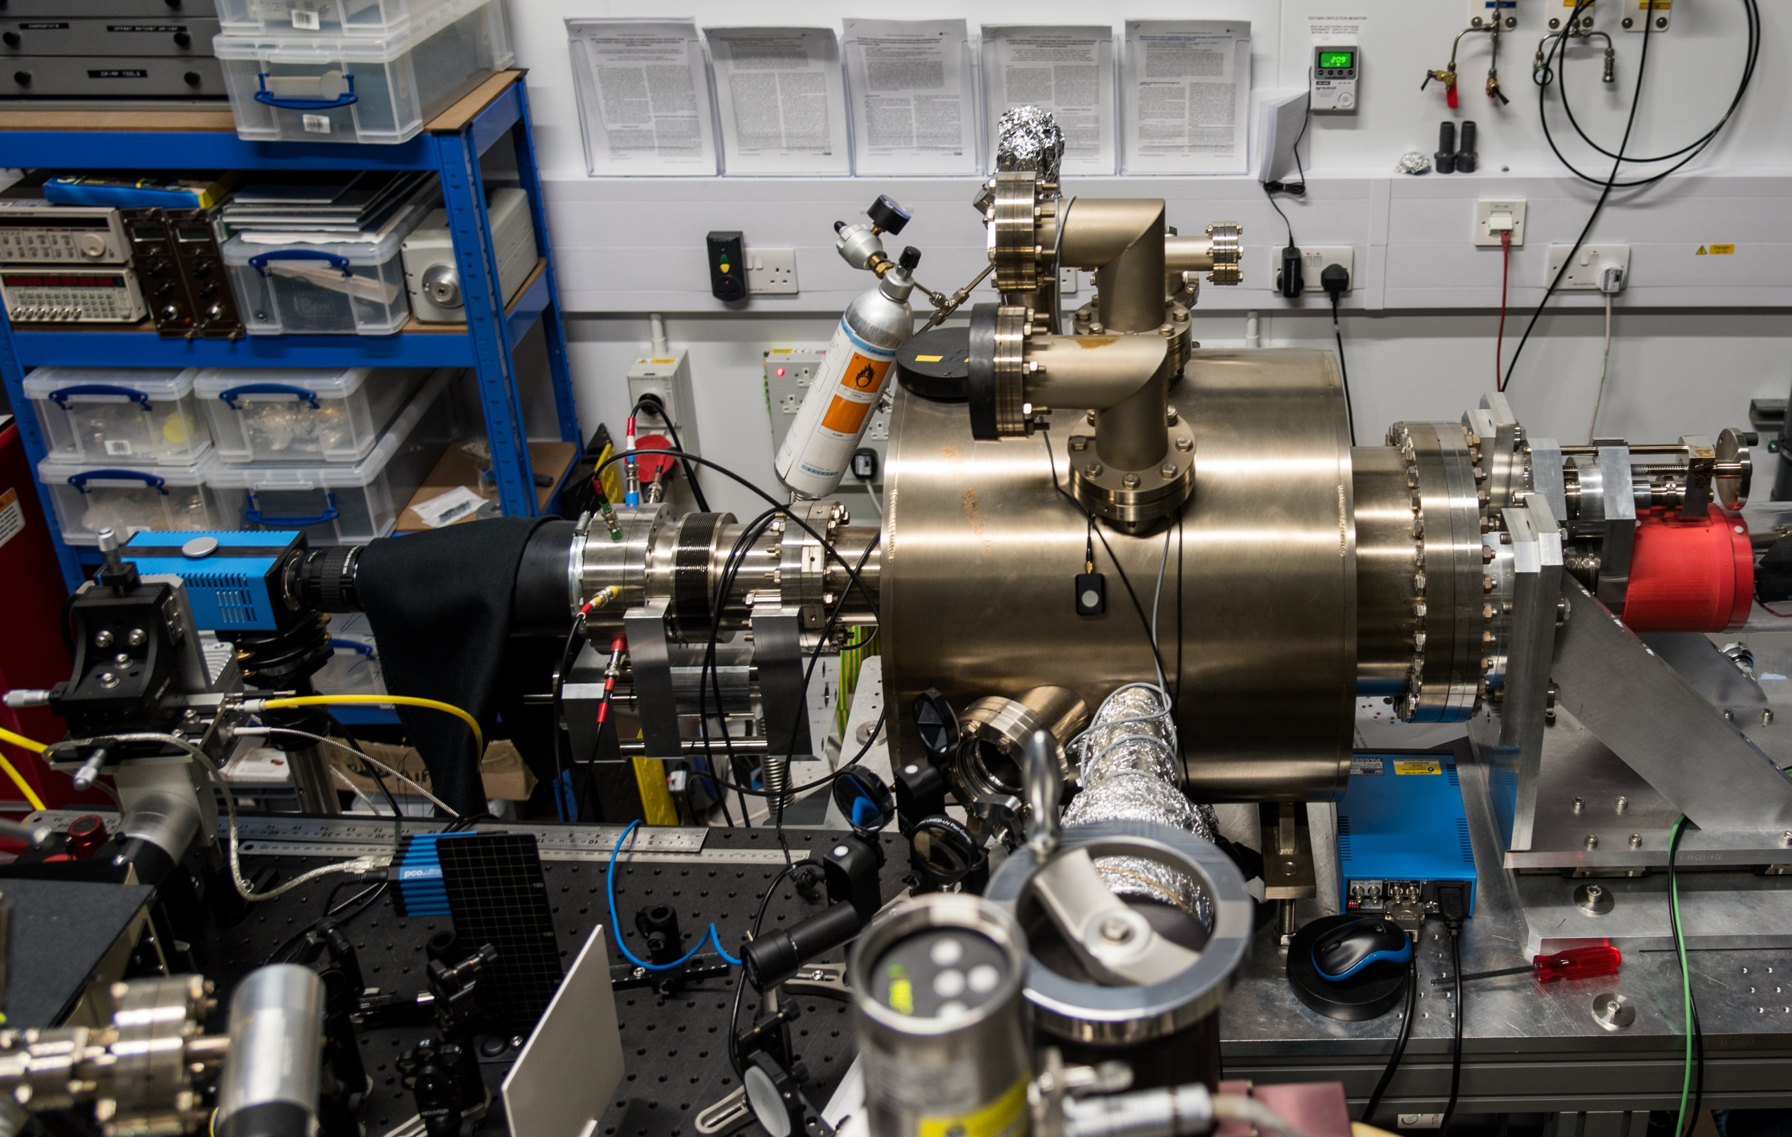
9
Notes:
And this is what we came up with ….. The TESS photocathode characterisation system in ASTeC’s VISTA laboratory

Slide 10
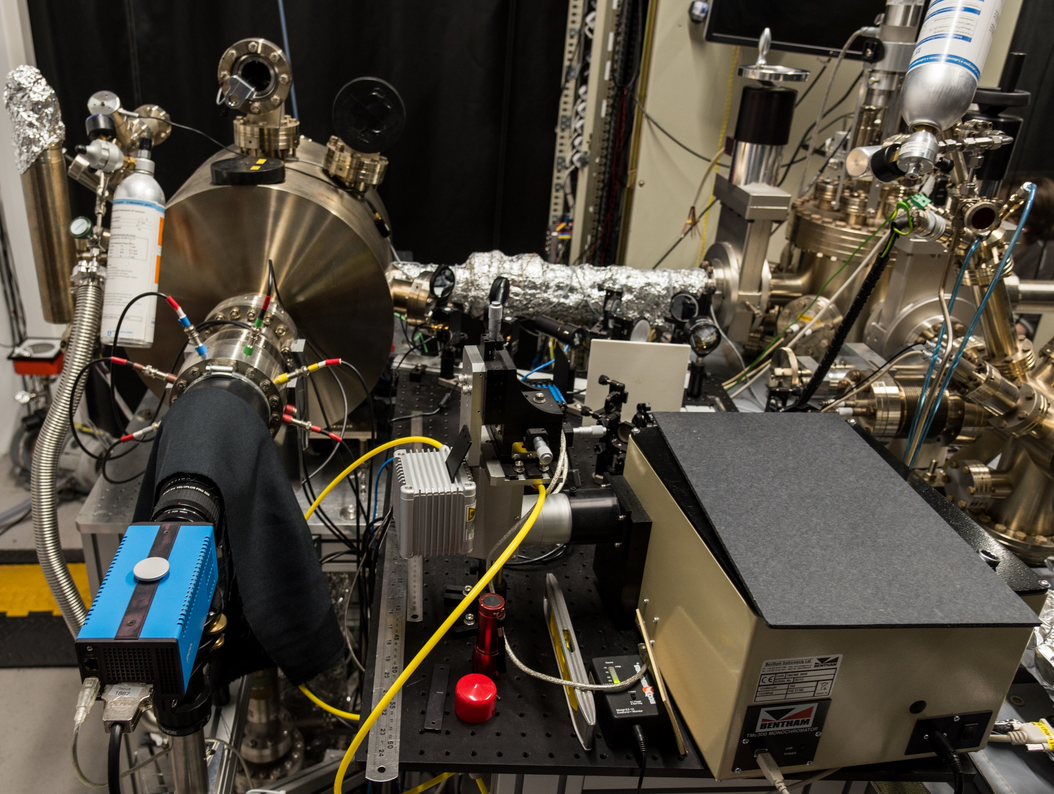
10
Notes:
DAQ camera in foreground looking towards the detector and phosphor screen.
LDPLS and monochromator to the right.

Slide 11
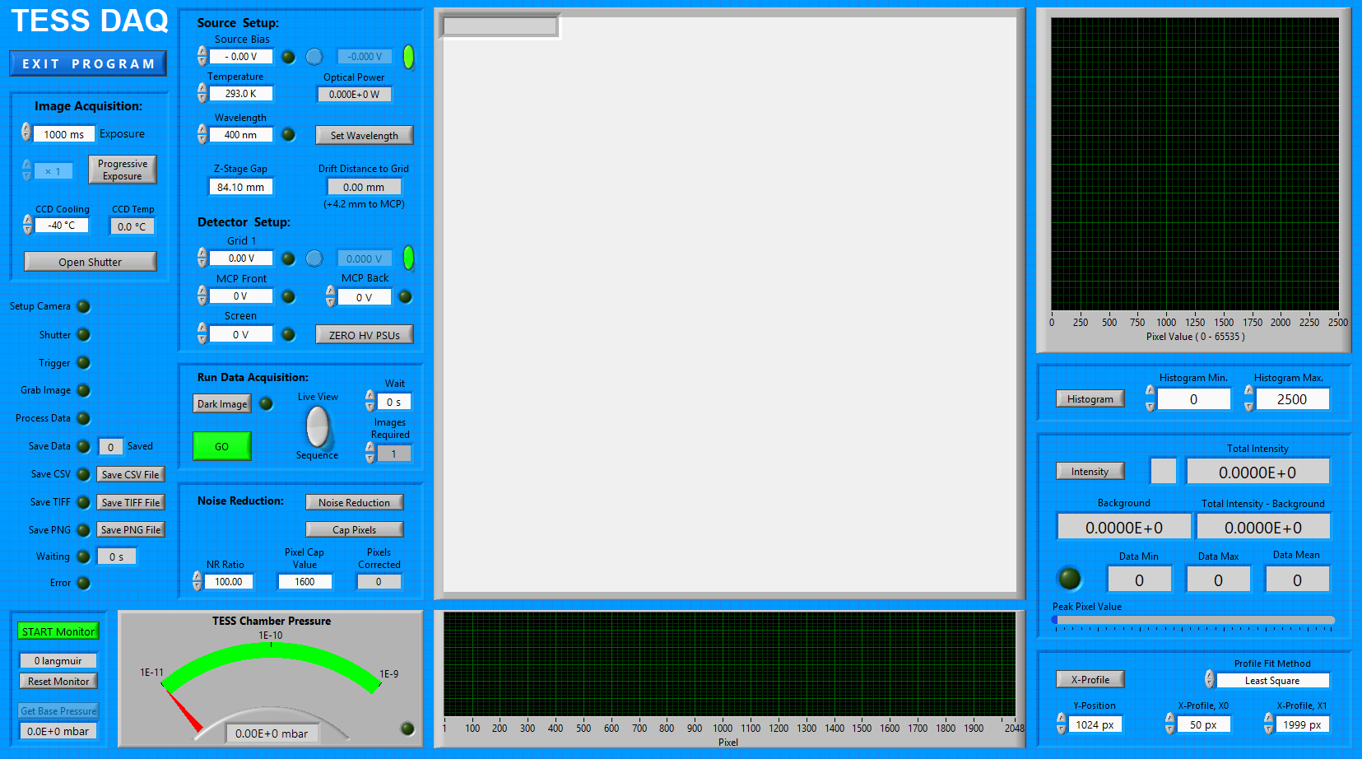
Transverse Energy Spread Spectrometer (TESS) – Data Acquisition
Photocathode Transverse Energy Spread Spectrometer: TESS Data Acquisition
11
Notes:
TESS DAQ program written in LabVIEW.
Integrates all power supplies and gauges, and allows control of photoemission image acquisition.
Record a data image and a dark image for each measurement, with a typical exposure time of 30 to 120 seconds.

Slide 12
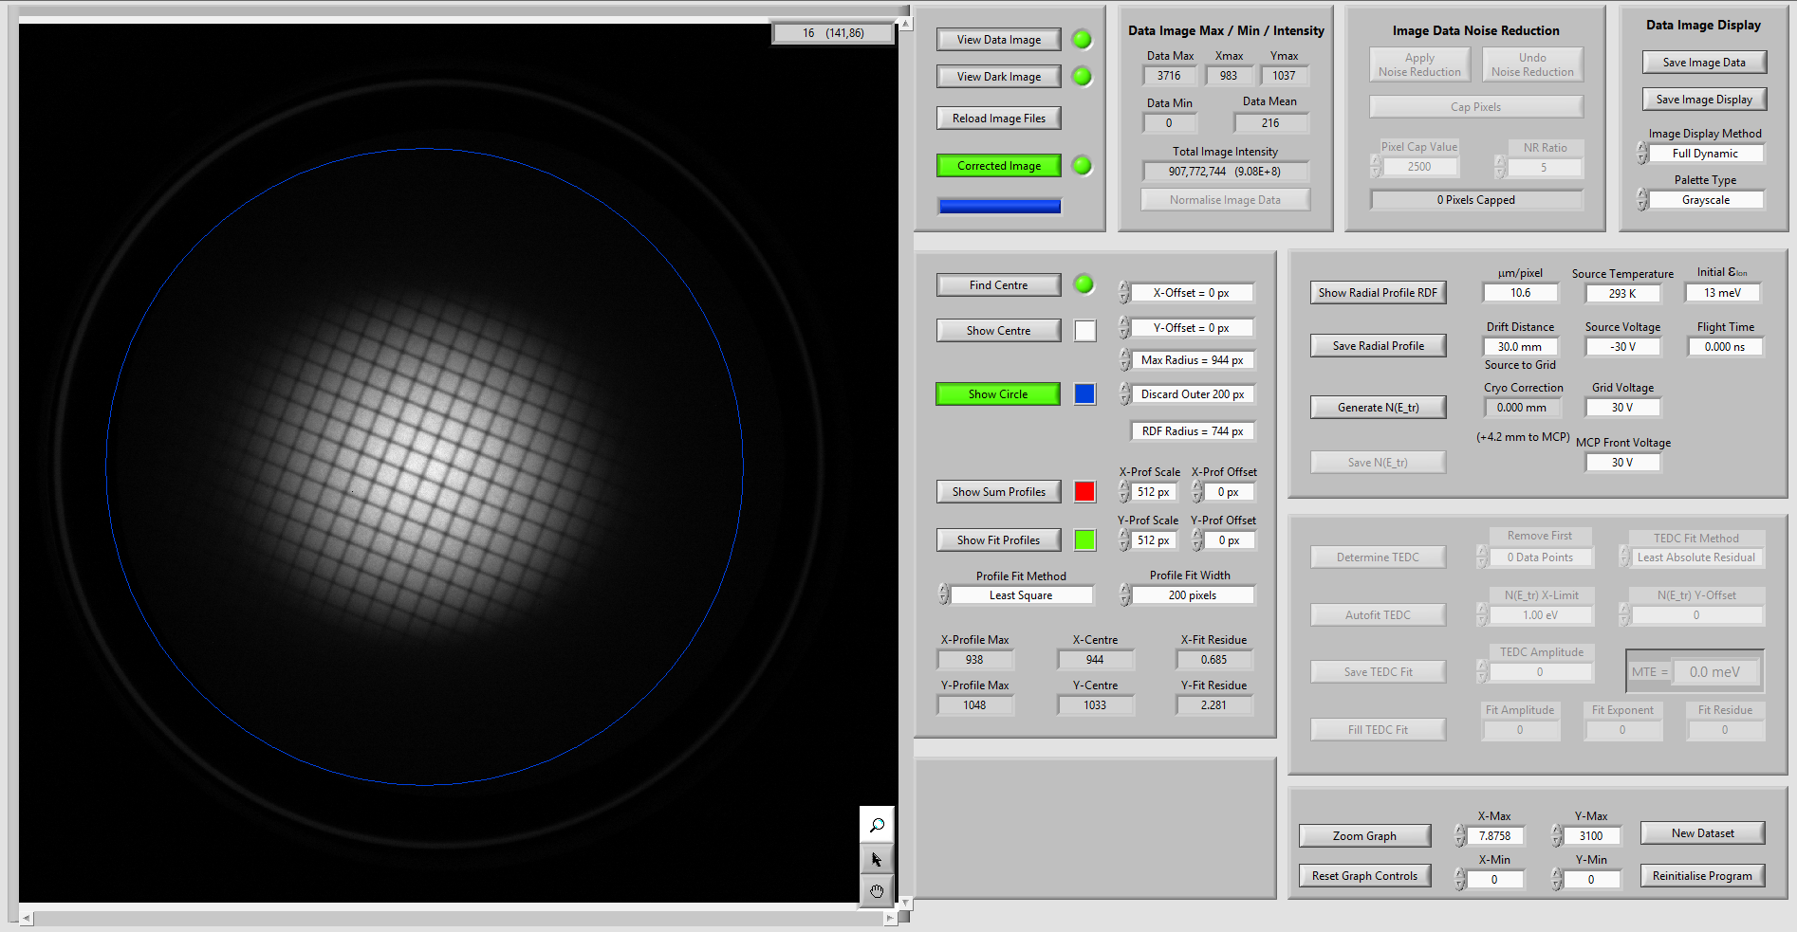
Transverse Energy Spread Spectrometer (TESS) – Quick Data Analysis
Photocathode Transverse Energy Spread Spectrometer: TESS Data Processing
Notes:
TESS Data analysis routine written in LabVIEW.
Carries out pixel-by-pixel subtraction to create a ‘corrected’ image.
Finds centroid of emission footprint and defines ROI for data analysis.
Generates a radial distribution function.
Calculates electron flight time based on drift distance and voltages applied to source and detector grid

Slide 13
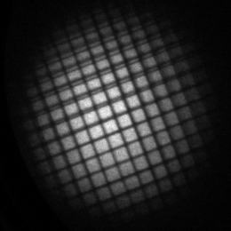
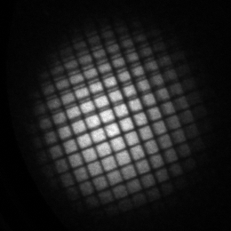
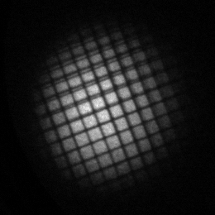
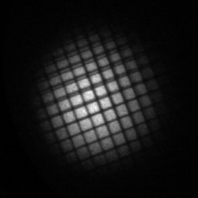
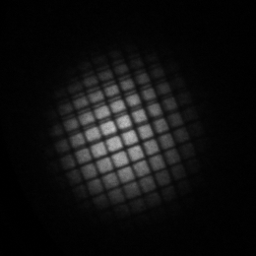
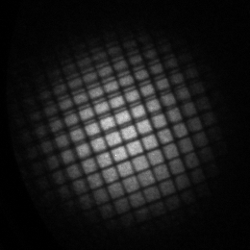
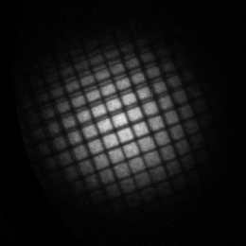
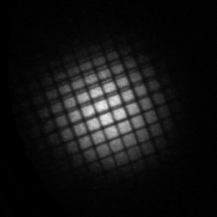
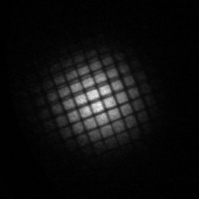
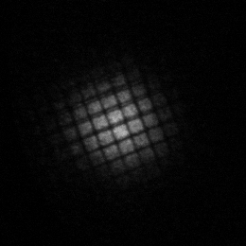
Examples of Measurements using the TESS with a Progressive Shift in Illumination Wavelength (λ)
Mo
λ = 266 nm
λ = 271 nm
λ = 276 nm
λ = 281 nm
λ = 286 nm
Cu
Electron emission images for a Mo photocathode (top) and a Cu photocathode (bottom), with the illumination wavelength
λ = 266 to 286 nm increasing in 5 nm steps from left to right. The difference in MTE between Cu and Mo is apparent,
as is the progressive reduction in MTE as the illumination wavelength is increased.
L. Jones et al., Proc. IPAC 2017, TUPAB111, 1580-1583
13
Notes:
Progressive shift in MTE evident for this data taken using the first multi-grid TESS detector which clearly shows how the MTE drops as the illumination wavelength is shifted towards the photoemission threshold.
As the wavelength is increased and the illumination photon energy approaches the workfunction of the material, so the excess energy identified earlier falls, as does the MTE.
Sadly the QE falls too …..

Slide 14
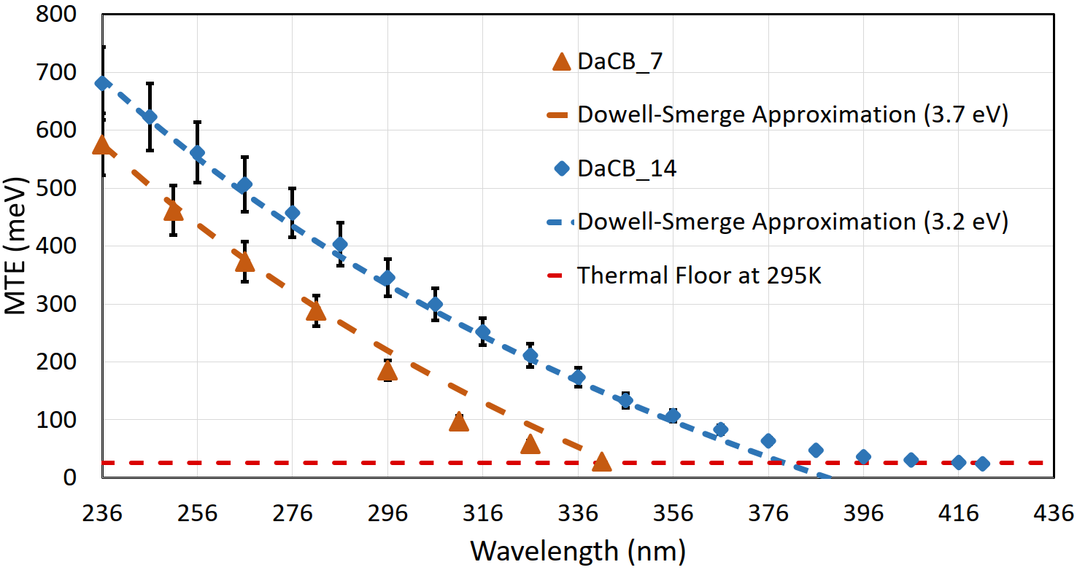
TESS Characterisation of Ultra-Thin MgO on Polycrystalline Cu
MTEs broadly agree with Dowell-Schmerge approximations using Work Functions of 3.2 and 3.7 eV
  WF reduction extends spectral response range, but MTEs at 266 nm are considerably higher than bare Cu
Differences most likely due to film thickness: DaCB_7 is ~ 0.24 nm while DaCB_14 is ~ 0.71 nm
Possibly accessible to Nd:YAG 3ω – Simpler laser. Further refinement needed
DESY considering the possible application of this technology
C. Benjamin et al., J. Phys. Conf. Ser. 2420 (2023) 012032
14

Slide 15
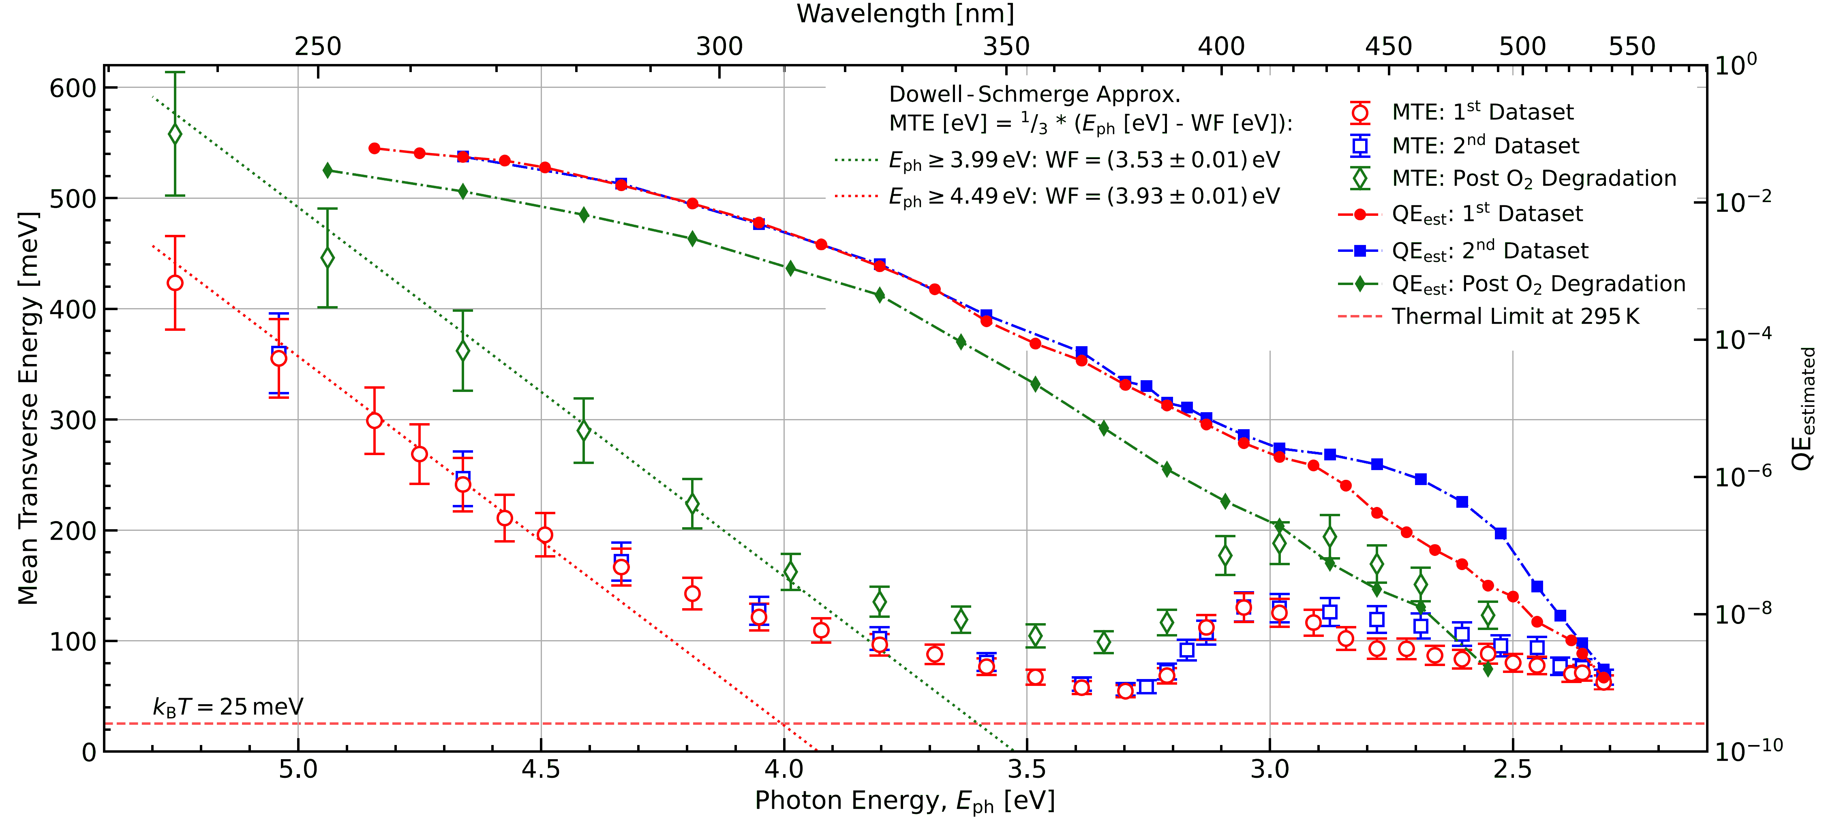
TESS Characterisation of DL CsTe Photocathode (~ 5% QE @ 266 nm)
λ = 266 nm
MTEs for both datasets broadly agree, and follow Dowell-Schmerge approximation (WF ~ 3.9 eV)
  O₂ degradation increases MTE (WF ~ 3.5 eV) and reduces estimated QE in comparison to ‘clean’ surface
Thermal floor not reached, either for the dominant Cs-Te emitters or the Cs/CsO emitters
Demonstrates the need for multi-wavelength QE monitor during deposition
H.M. Churn et al., Proc. IPAC 2023, TUPA030, 1404-1407
15

Slide 16
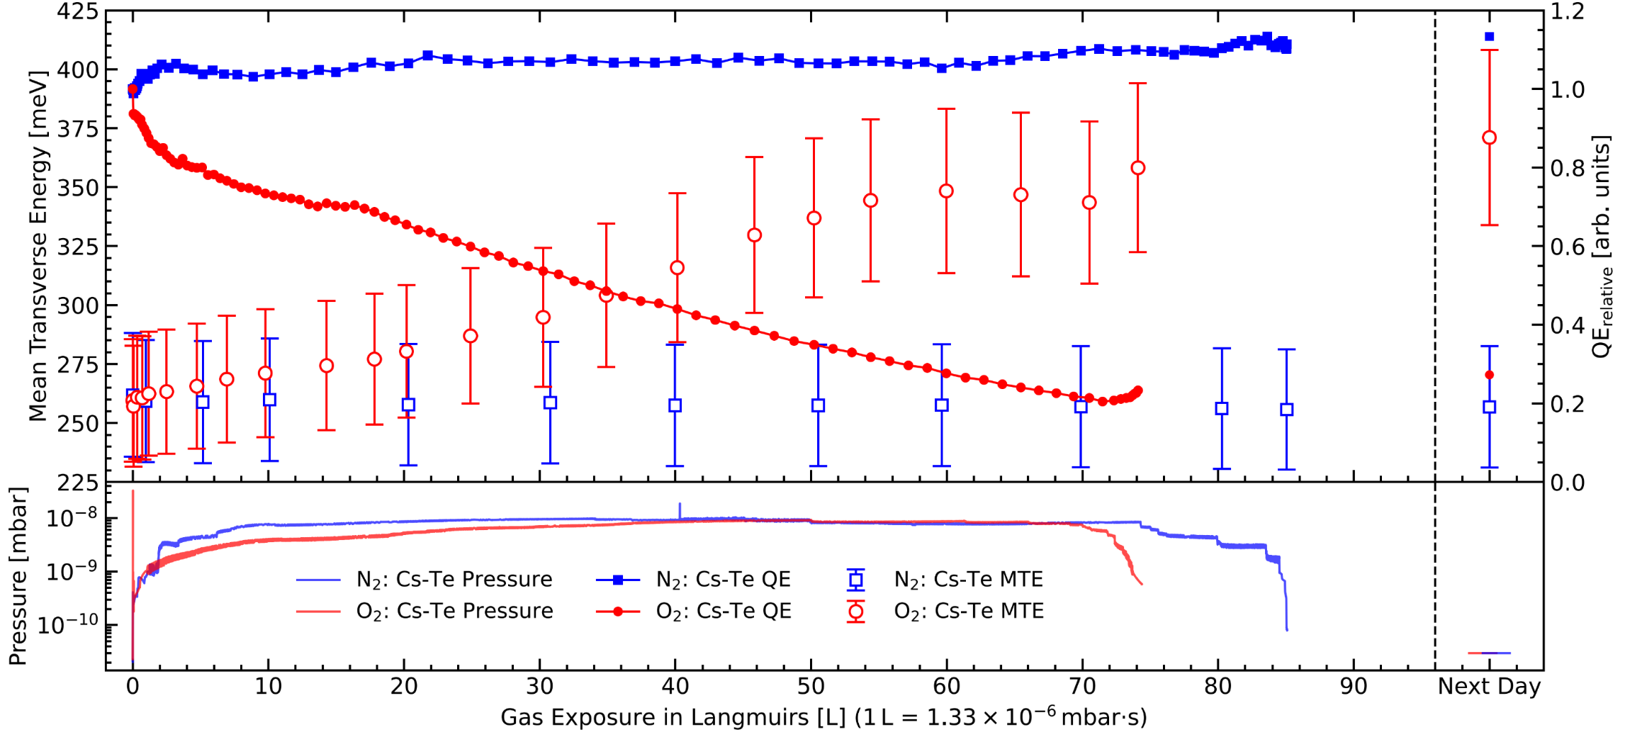
TESS Characterisation of DL CsTe Photocathode (~ 5% QE @ 266 nm)
Comparison of measured MTEs under illumination at 266 nm when subjected to O₂ and N₂ exposure
  N₂ has no apparent effect on photocathode performance (same result gained for bare Cu)
  O₂ drives an increase in MTE and a decrease in the QE (apparent degradation)
Operational cathodes will be ‘exposed’, so performance must change
H.M. Churn et al., Proc. IPAC 2023, TUPA030, 1404-1407
16

Slide 17
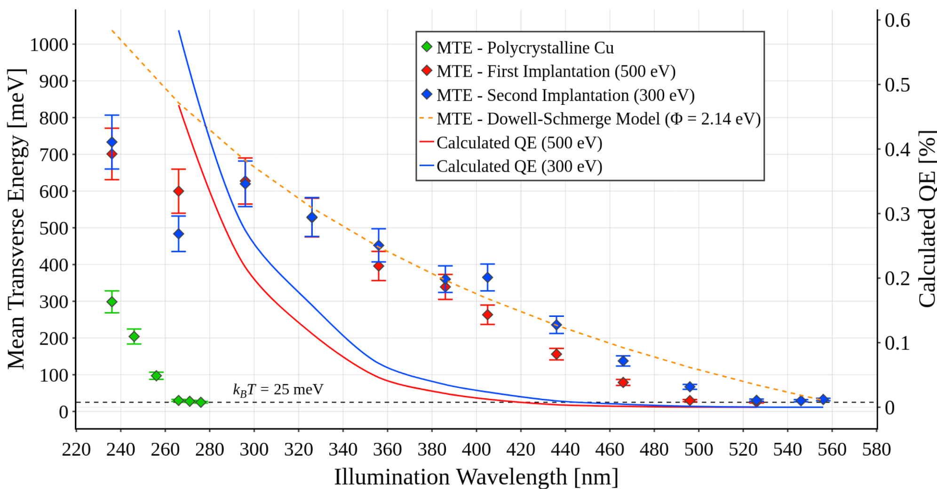
TESS Characterisation of Cs-Implanted Cu Photocathode
Substantial shift in WF on exposure to Cs ions, but energies too low for implantation
Inconsistent response following exposure to Cs ions at energies of 300 and 500 eV
MEIS data shows Cs confined to Cu surface – No chemical ‘protection’
Progressive heating to 500 °C shifted the WF from 2.1 eV to 4.8 eV
L.A.J. Soomary et al., Proc. IPAC 2023, TUPA138, 1611-1614
17

Slide 18
Future Work and
Collaborations:
Our collaboration with CERN highlighted an excess of Caesium in their Cs₂Te cathodes
Our own Cs₂Te cathodes exhibit similar behaviour
  Development of a multi-wavelength QE monitor is essential
  Monitor surface reflectivity and colour
Outcomes of CERN collaboration on Cs₂Te photocathode characterisation to be published
  CERN CsTe Work submitted to PRAB
  Discussions on further collaboration taking place
We have a lot of CLARA data relating to Cu cleaned by dry-ice and BPS172 solution
  Experimental project using the TESS to explore the effects of these cleaning processes
  Will include surface roughness and possibly SEY measurements
Consulting with HZB over use of vacuum suitcase to transport NaKSb cathodes to DL
HZB, DESY and INFN Developing their own TESS-like instruments
18

Slide 19
Conclusions:
TESS is one of a number of similar systems worldwide
  TEmeter, Momentatron, TOF
  Measurement of MTE, QE and spectral response crucial
Presence of low work function photoemitters:
  May be source of <significant> dark current
    High MTE so detrimental to gun vacuum and photocathode lifetime
    Source of X-ray emission
Techniques to modify surfaces (reduce WF) are of interest, but are immature:
  MgO results agree with theory but process needs refining
  Cs ‘implantation’ work needs higher energies
Quality control is essential to manufacture photocathodes with consistent levels of performance, maximum brightness and lifetime
19

Slide 20
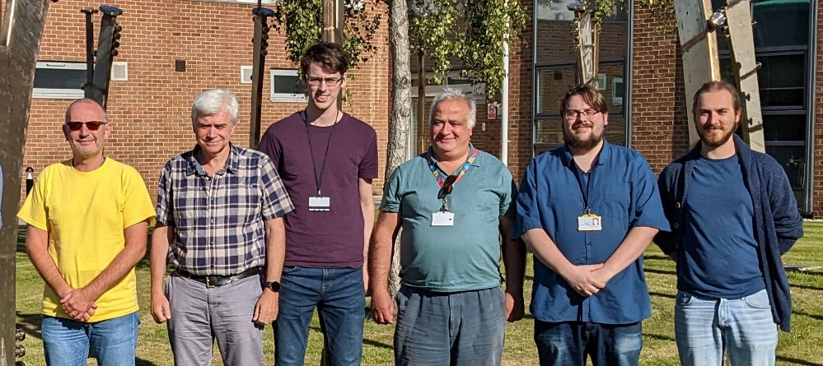
Thank you ☺
L.B. Jones, H.M. Churn, R. Valizadeh & T.C.Q. Noakes, (STFC ASTeC & Cockcroft Institute)
D.P. Juarez-Lopez ¹ , L.A.J. Soomary ² & C.P. Welsch
(The University of Liverpool & Cockcroft Institute)
C. Benjamin (The University of Warwick & STFC ASTeC)
H.E. Scheibler ³ (Institute of Semiconductor Physics)
¹ Now at DESY Hamburg, MVS Group ² Now at Kratos Anlaytical, Manchester ³ Collaboration suspended in 2021

Slide 21
-----------------------------
Additional Slides
-----------------------------

Slide 22
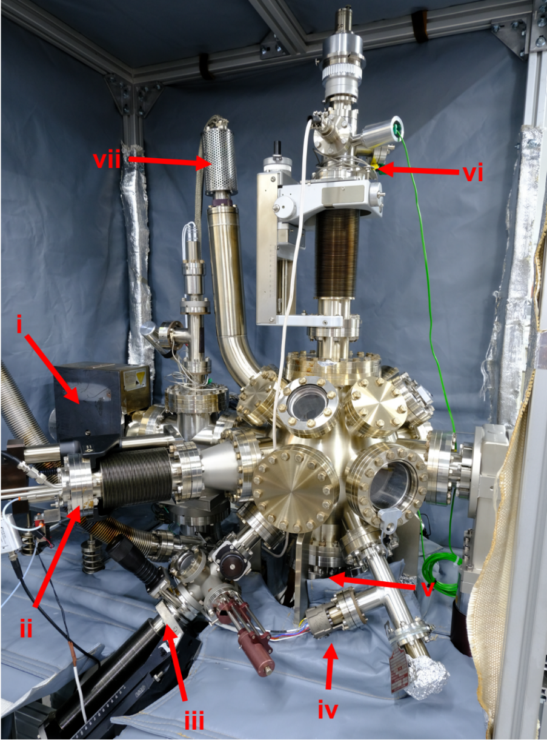
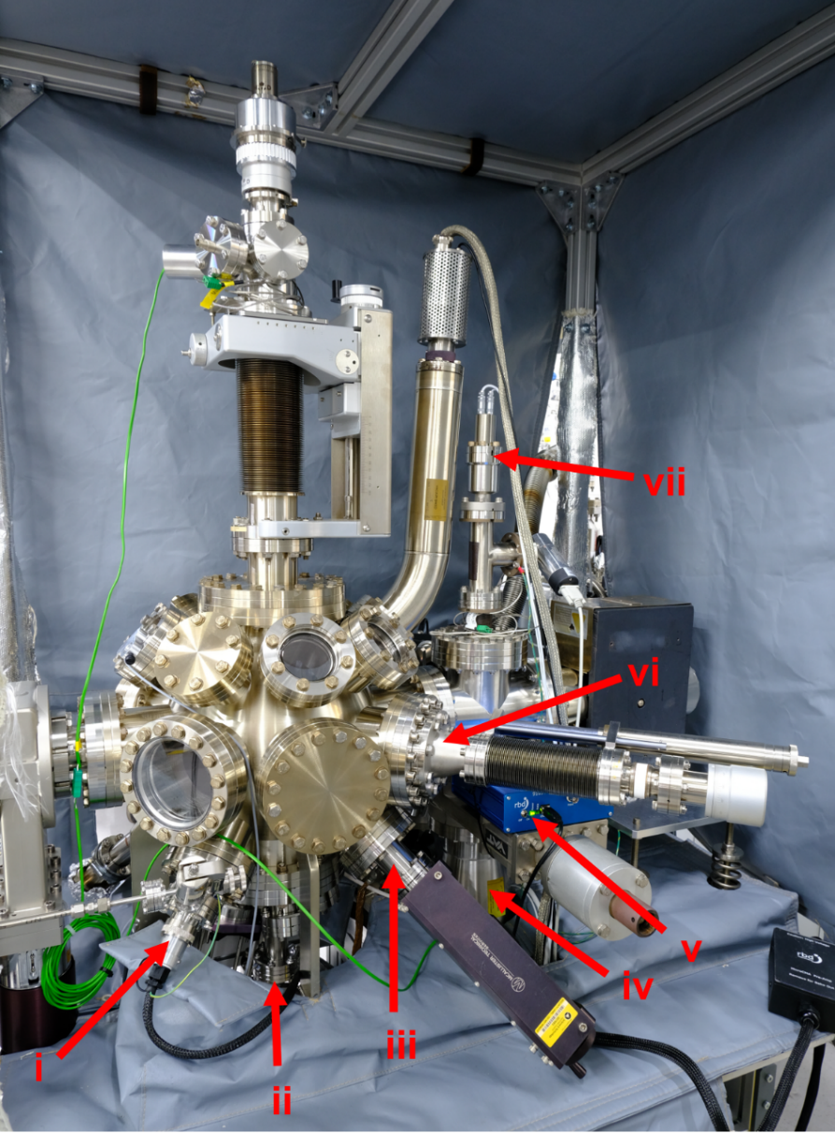
Alkali metal Photocathode Preparation Facility (APPF) for Cs-Te Photocathode Growth
Ion Pump
Quartz Micro Balance
Cs Source
XHV Gauge
Te Source
Manipulator
RGA
Ion Gun
Te Source
AES & CMA
Turbo Pump
Picoammeter
Mask Assembly
UHV Gauge
22

Slide 23
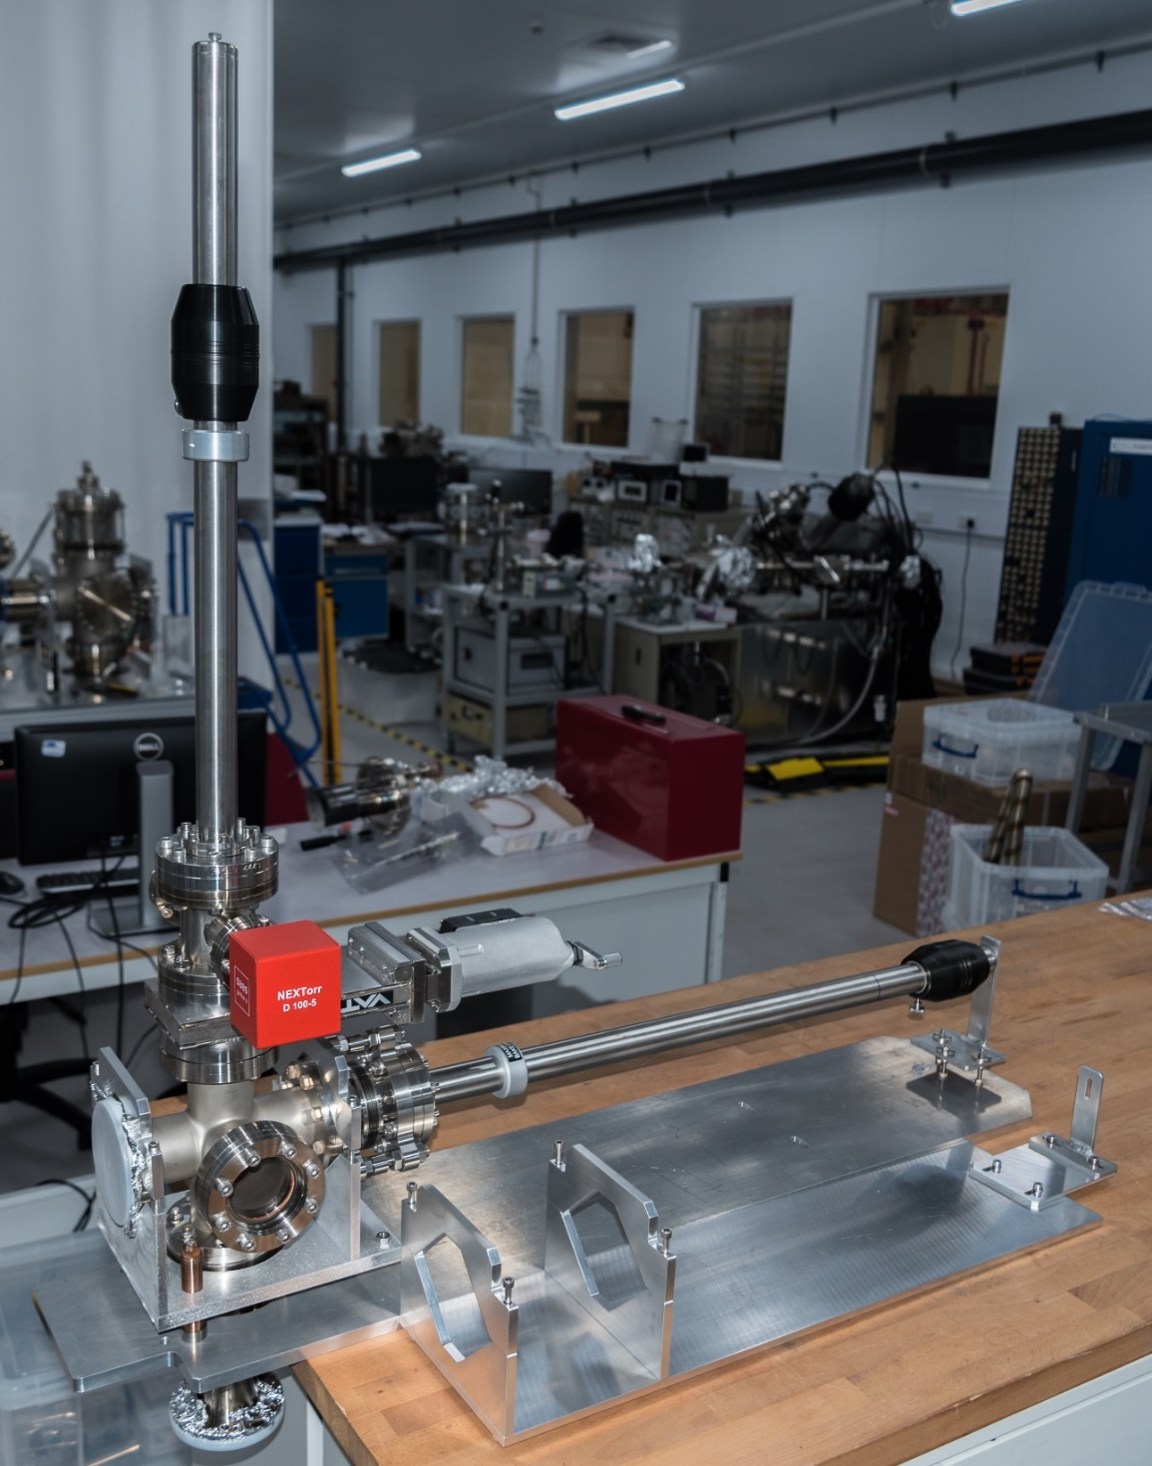
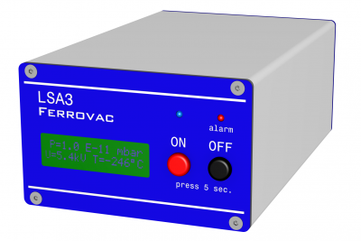

23

Slide 24
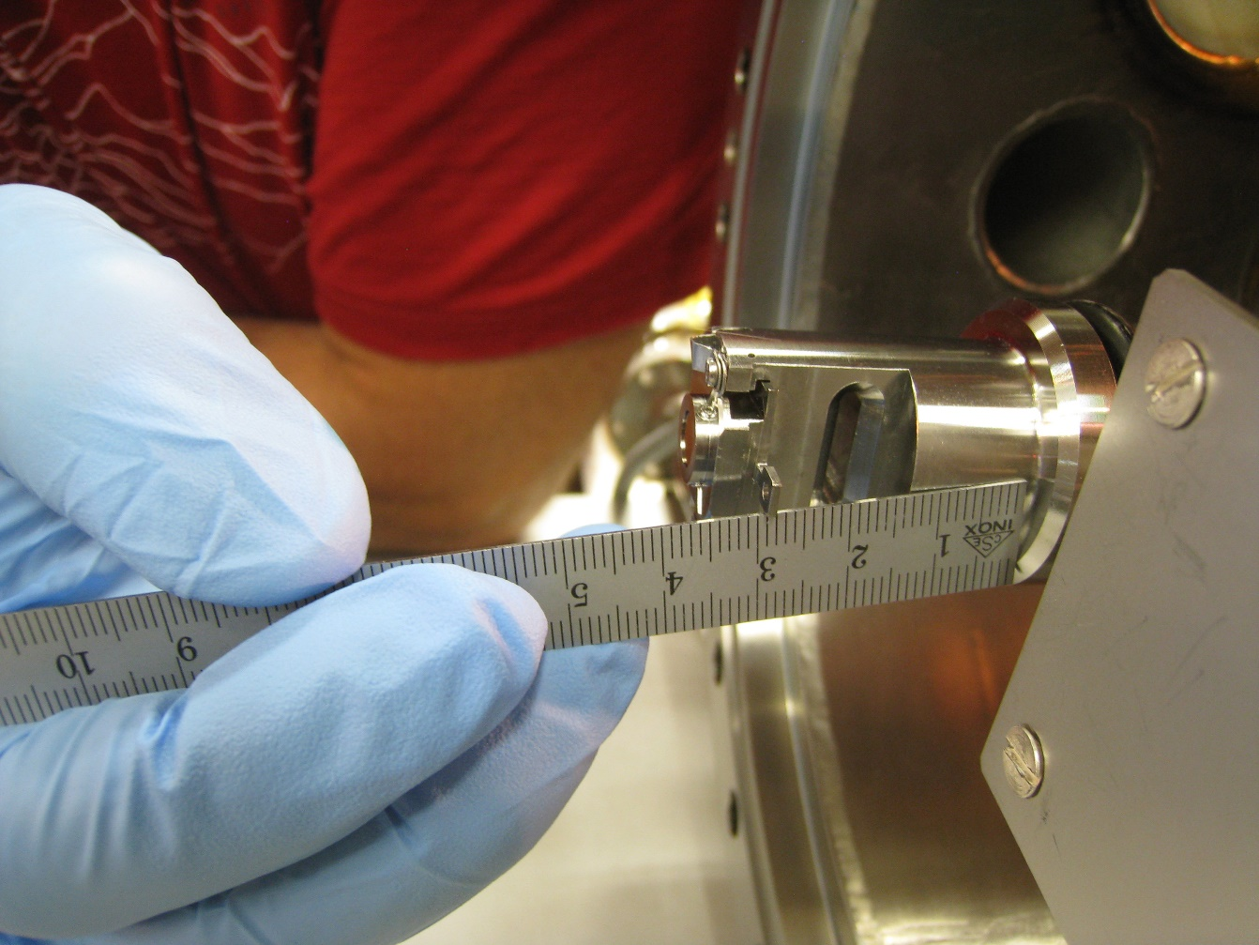
24

Slide 25
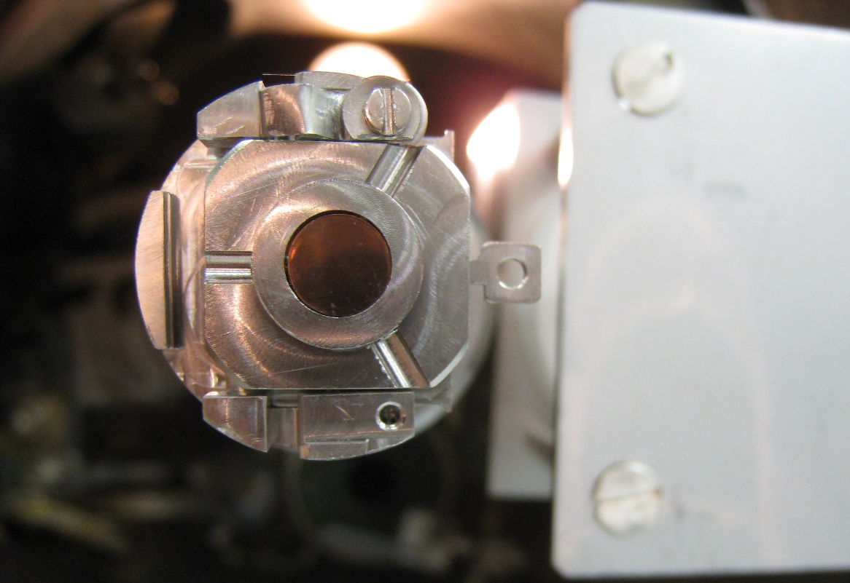
25

Slide 26
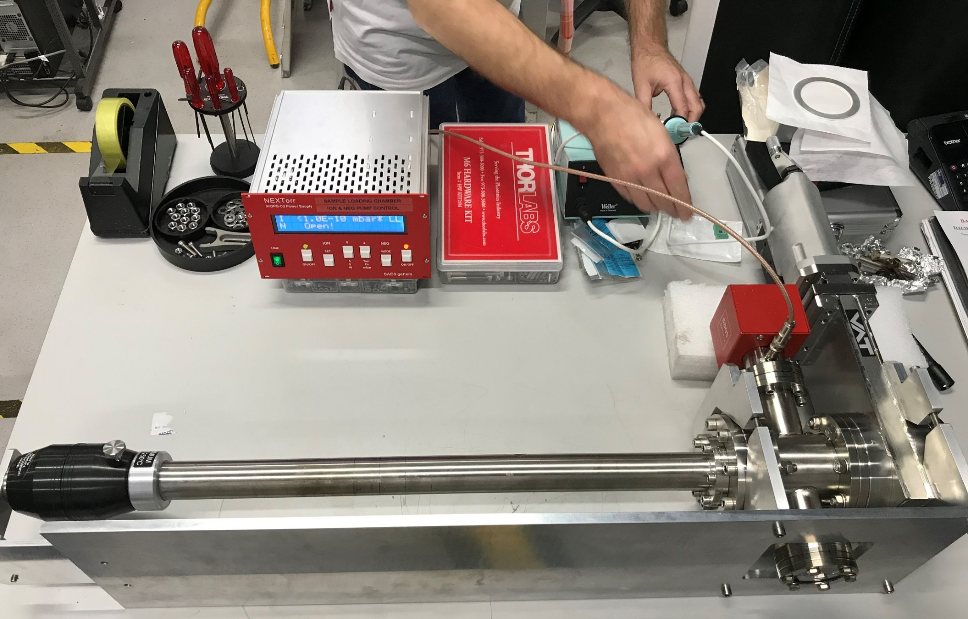
Suitcase arrives at DL less than 24 hours after leaving Prevessin, still under UHV ☺
4 Cs-Te Photocathodes made at CERN delivered to Daresbury’s VISTA Laboratory
26

Slide 27
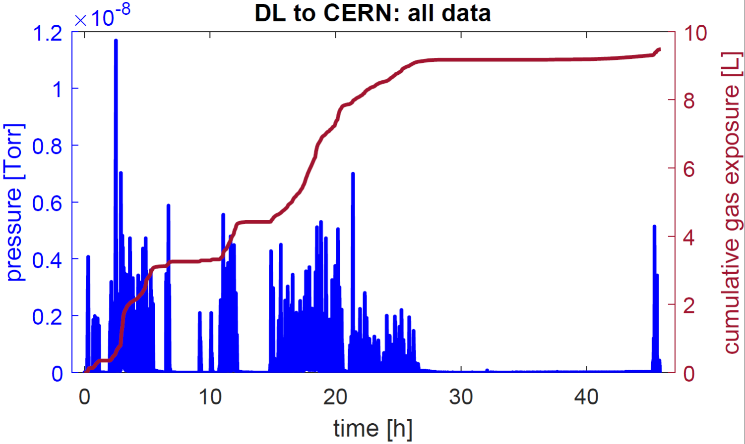

Slide 28
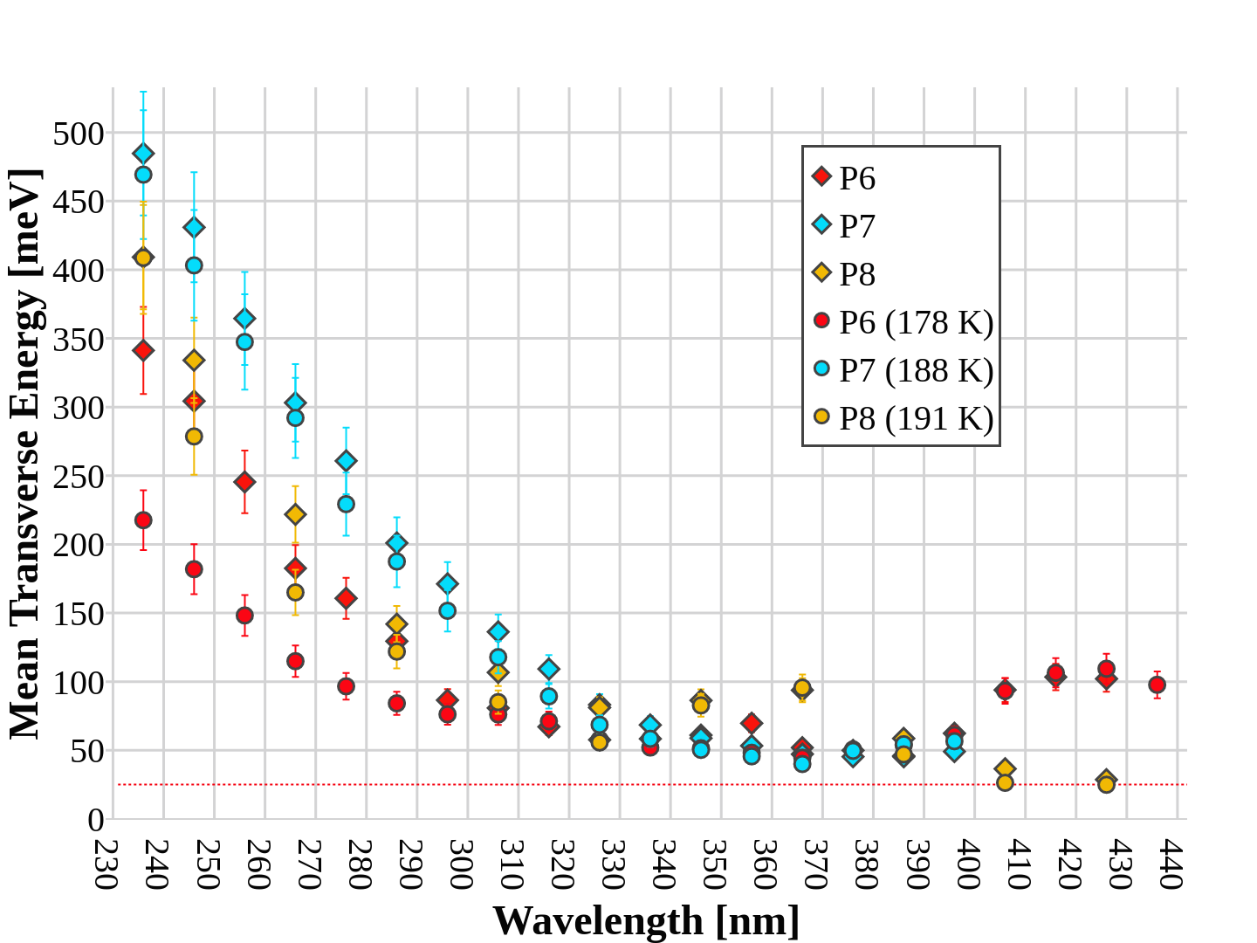

λ = 266 nm
$$k_{B}T=25 \text{meV}$$
Measured MTE values for the P6, P7 and P8 Cs-Te photocathodes at both room temperature
and cryogenic temperatures under illumination at wavelengths between 236 nm and 436 nm
28

Slide 29
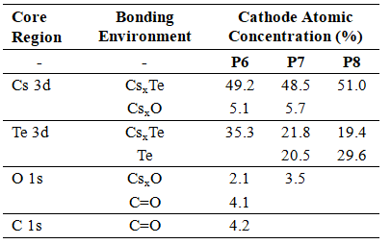
Cs-Te Photocathodes
Grown at CERN using CLIC PPF
Transported in UHV suitcase
Visible differences in film
XPS Surface characterisation
Differences in composition
Differences in QE
MTE and spectral response
QE (266 nm) 0.6 % 0.2 % 3.0 %
Measured MTE values for the P6, P7 and P8 Cs-Te photocathodes at both room temperature
and cryogenic temperatures under illumination at wavelengths between 236 nm and 436 nm
29

Slide 30
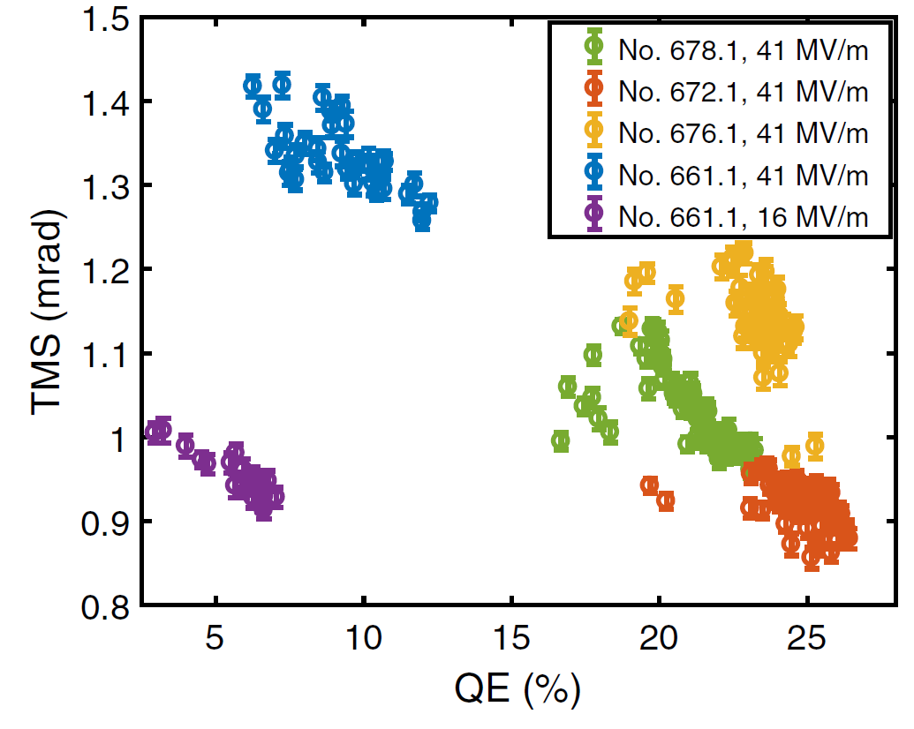
Recent Publication: Peng-Wei Huang et al.; Phys. Rev. Accel. Beams 25, 053401
Anomalous correlation between quantum efficiency and transverse momentum spread in semiconductor cathode photoemission
30

Slide 31
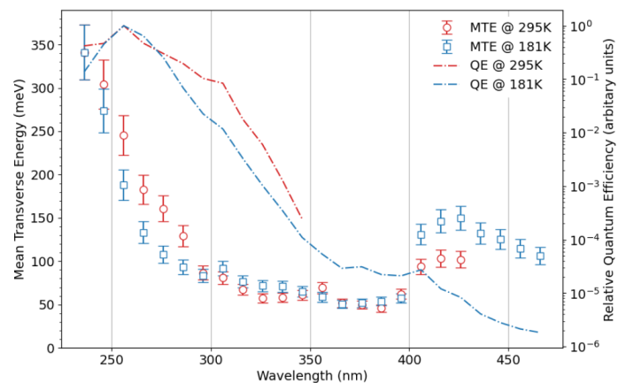
$$\text{Relative} \text{Quantum} \text{Efficiency}\text{, }{QE}_{rel} ∝ \frac{I_{corrected}}{t_{exp}∙P_{opt}∙G_{mcp}} \left[\text{arbitrary} \text{units}\right]$$
Measured MTE and QE_{rel} values for the P6 Cs-Te photocathode at both room temperature
and cryogenic temperatures under illumination at wavelengths between 236 nm and 436 nm

Slide 32
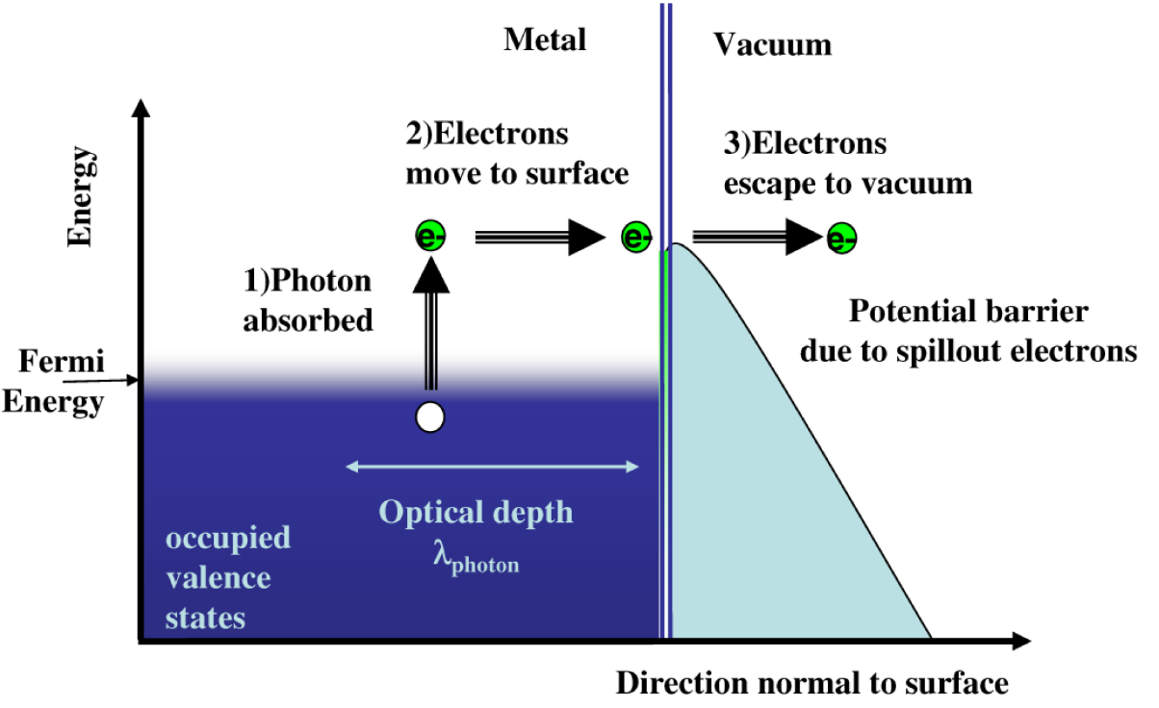
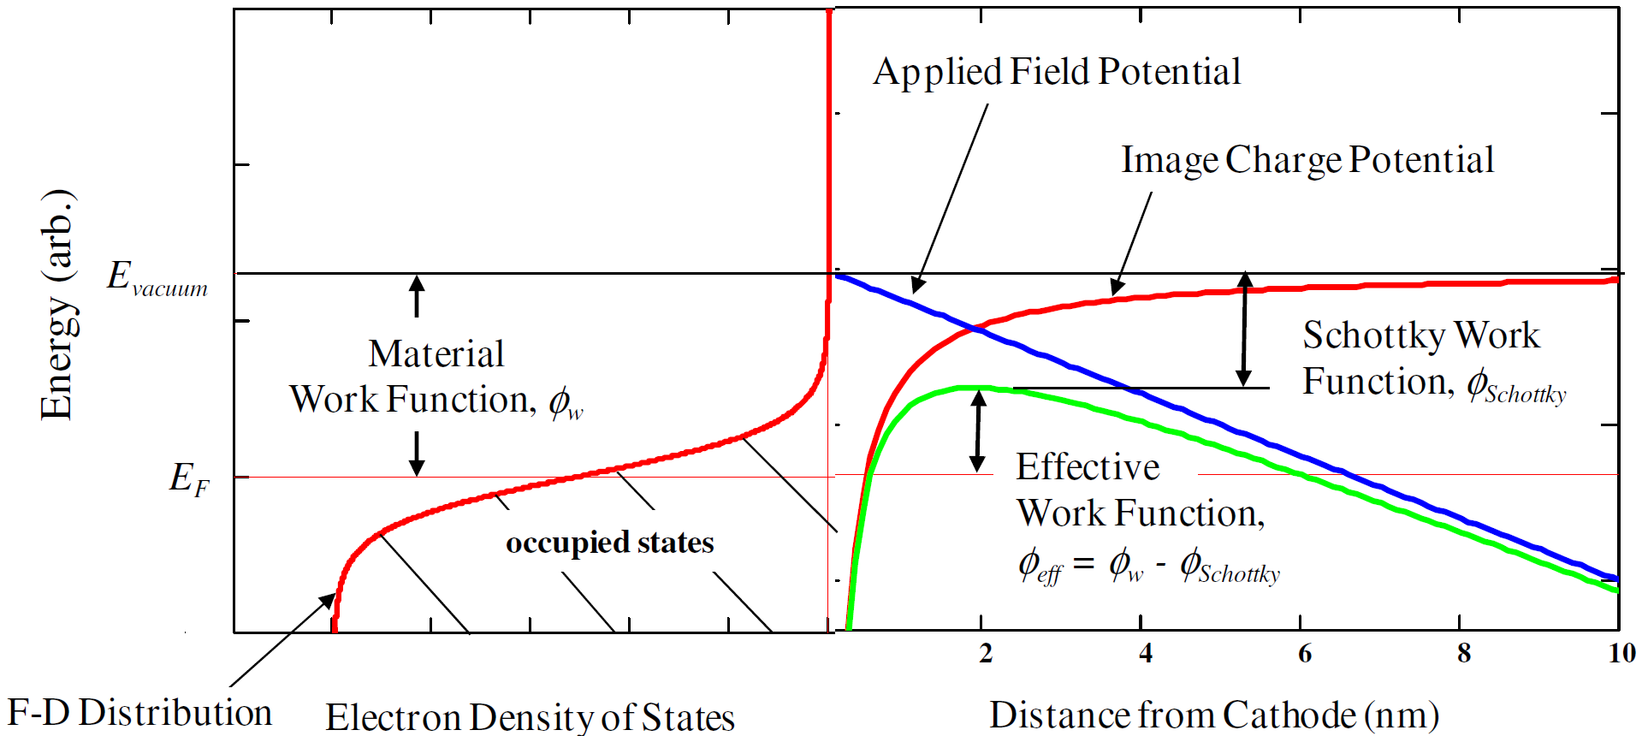

Slide 33
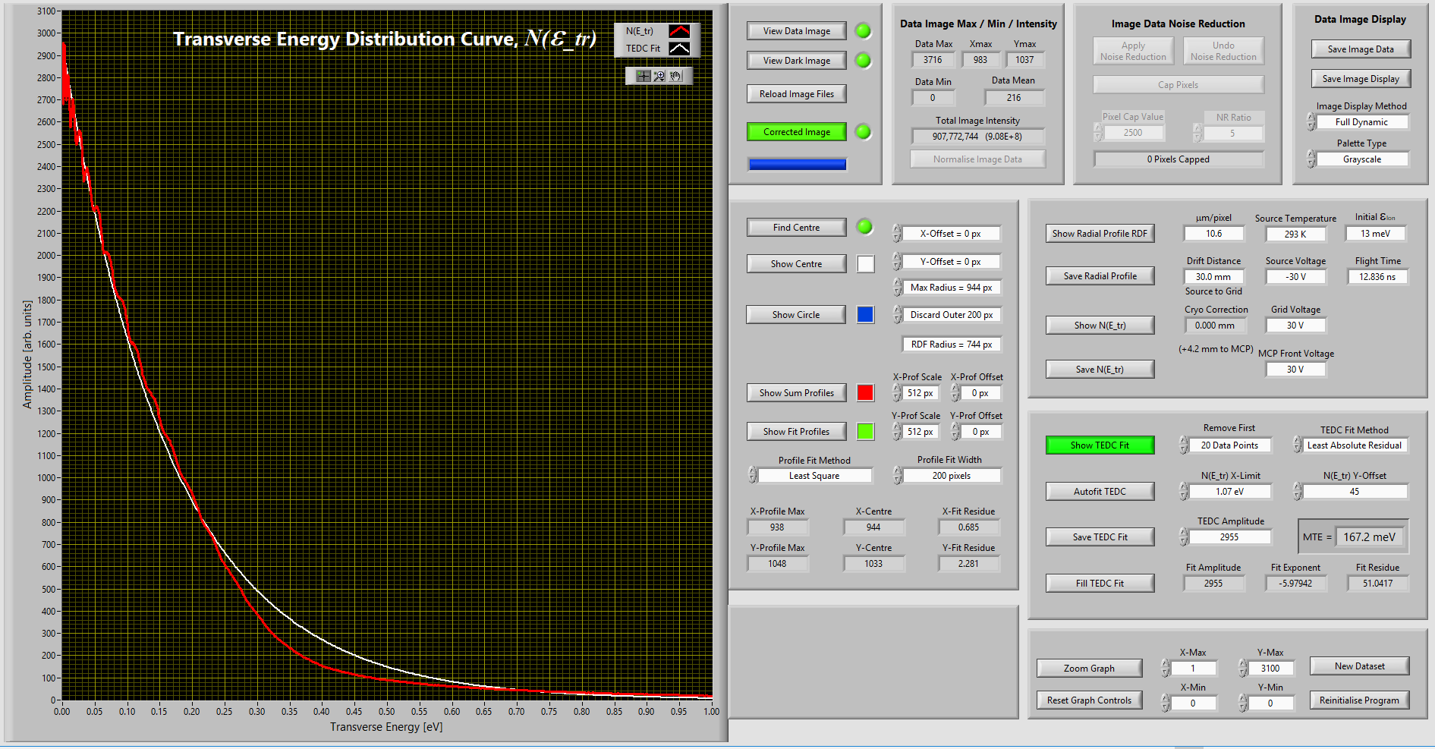
Transverse Energy Spread Spectrometer (TESS) – Quick Data Analysis
Photocathode Transverse Energy Spread Spectrometer: TESS Data Processing
Notes:
Converts the radial distribution to a transverse energy distribution curve.
Fits an exponential curve to the data and allows a value for MTE to be extracted.

Slide 34
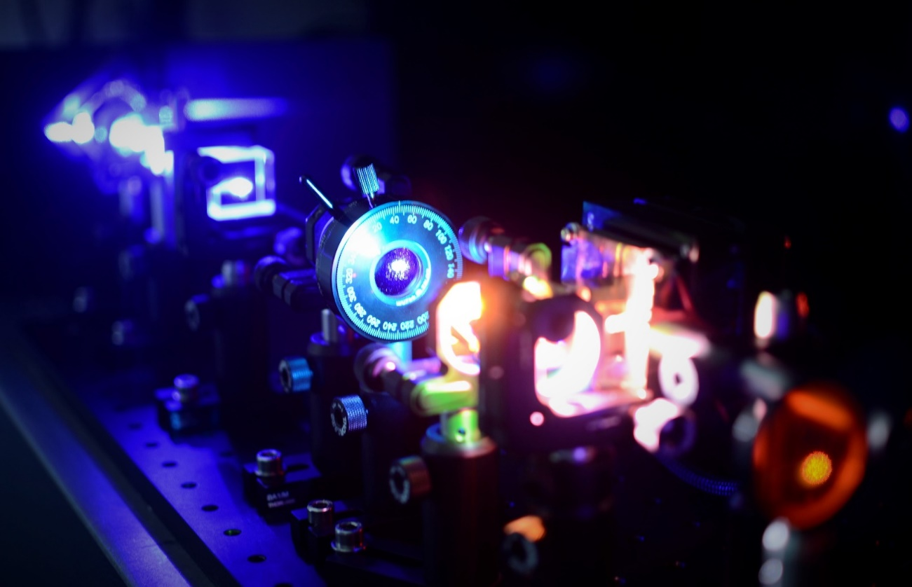
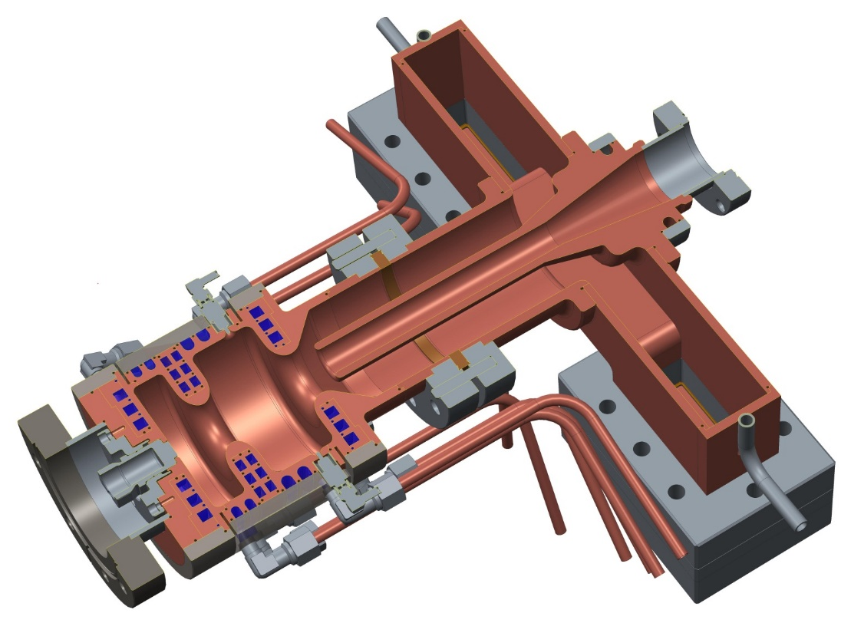
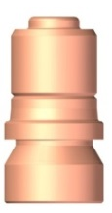
Possible UK X-FEL Injector
UV Laser (266 nm)
H-Shaped
RF Coupler
RF Probe
Cathode Plug
Gun Cavity
Cooling Channels
Radio Frequency Gun
Credit: B.L. Militsyn
Cathode Plug
34
Notes:
The Daresbury injector, also called Gun-400, is a further development of the coaxial coupled cavity design.
The basic design is a 1.5 cell S-band cavity with interchangeable photocathodes. Half wavelength length of the first cell was chosen for optimal generation of sub-ps low charge bunches for electron diffraction experiments.
The RF feed is via an innovative H-shaped coupler. This design allows for elimination of undesirable dipole mode in the cavity. Fine tuning of the coupler symmetry is provided with adjustment length of one shoulder.
Coupling coefficient of the gun is set to 1 to make optimal use of the RF power available. The expected RF pulse length is 2.5 - 3 microseconds.
The joint between the cavity and the coupler facilitates the fine tuning of the coupling.
The gun has an RF probe to measure field in the cavity.
The cavity is enclosed by a focusing solenoid and a bucking coil which zeros field in the cathode plane
The photocathode is compatible with the general INFN/DESY design with reduced to 10 mm photocathode tip.
For different operation modes different type photocathodes may be used
For gun conditioning a molybdenum plug is used
For FEL experiment we are planning to use Cs₂Te photocathode
For generation of short pulses – copper hybrid or thin film photocathodes may be used
The photocathode illuminated with laser light propagated inside coaxial.

Slide 35




Possible UK X-FEL Injector
UV Laser (266 nm)
H-Shaped
RF Coupler
RF Probe
$$B= \frac{2}{π^{2}} . \frac{I_{ave}}{ε_{x}ε_{y}}$$
$$ε_{nx}= βγε_{x}= σ_{x}σ_{p_{x}}= \sqrt{\left\langle x^{2}\right\rangle }∙\frac{\sqrt{\left\langle p_{x}^{2}\right\rangle }}{m_{e}c}$$
$$σ_{p_{x}}= \sqrt{\frac{\text{ħ}ω − φ_{eff}}{{3m_{e}c}^{2}} }$$
Cathode Plug
Gun Cavity
Cooling Channels
$$ε_{nx}=σ_{x}\sqrt{\frac{\text{ħ}ω − φ_{eff}}{{3m_{e}c}^{2}}}$$
Radio Frequency Gun
Credit: B.L. Militsyn
Cathode Plug
D. Dowell & J. Schmerge, Phys. Rev. ST Accel. Beams 12, 074201 (2009)

